Slide 1
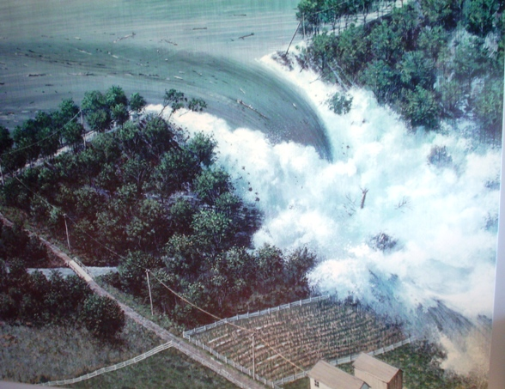
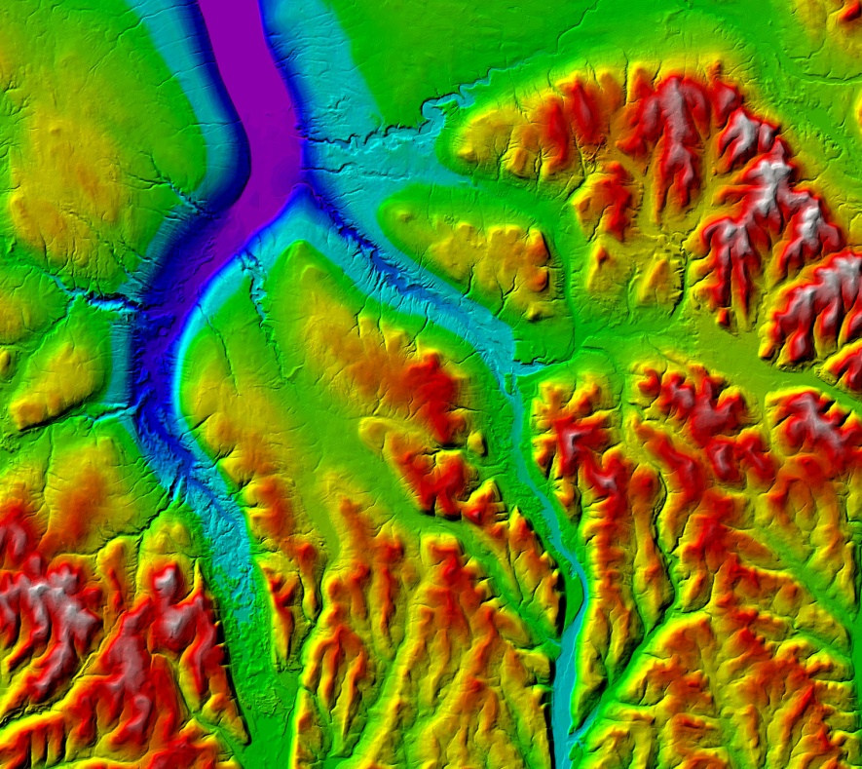
Automated “integrated Simplified Inundation Mapping (iSIM)” – CG3i Software Service
Johnstown, PA – May 31, 1889
CG3I UT Dallas Feb 2015

Slide 2
The Problem
Texas Administrative Code requires Emergency Action Plans (EAPs) to be filed for all dams in Texas of a certain size/hazard-level
Rule 61 of Chapter 299 of Texas Administrative Code Chapter 30
EAPs describe the hazard potential for each dam, but also provide a detailed analysis of potential floods, should the dam be breached
Full-scale analysis performed by a licensed engineering firm can cost $10,000-$100,000

Slide 3
The Problem
TCEQ has created a new class of analysis to help alleviate some of these costs:
Simplified Inundation Maps (SIMs)
Existing small/intermediate dams that meet certain requirements on hazard level qualify
SIMs reduce the complexity required of traditional analyses
Despite this, it may take days or weeks using obfuscated and disparate data and software packages to perform

Slide 4
The Goal
The Goal is to provide an automated method of integrated simplified inundation mapping that does not require extensive knowledge of dam engineering, programming or GIS.
The Objective is to make it simple enough that only three sources of information are required to run the analysis successfully with just the click of a button

Slide 5
Programs utilized
iSIM CG3i Service Bureau Software
ArcGIS 10.x with extensions:
3D Analyst
Spatial Analyst
HEC – RAS 4.1
Developed by US Army Corps of Engineers
Performs the actual hydrological analysis
Approved for use in SIMs by National Dam Safety Review Board & TCEQ
http://www.hec.usace.army.mil/software/hec-ras/downloads.aspx

Slide 6
Data Utilized
Three sources of information:
Dam Information (All provided by National Inventory of Dams)
Height
Width
Capacity
Normal maximum flow
Elevation
In our case, acquired via LiDAR @5m resolution
USGS data may be used, but is lower quality
Land Use
Used to estimate friction of water across land
Can be acquired from county sources
Federal data can also be used

Slide 7
Methodology
Data Preparation
A geodatabase is made using GIS, where multiple layers are created. The most important innovation iSIM offers is the algorithmic and thus standardized creation of cutlines for cross-sections.
Steady Flow Simulation
Using HEC-RAS, the characteristics of the deluge are defined by assigning values to cross-sections.
Presentation of Results
The processed data results are visualized using GIS.

Slide 8
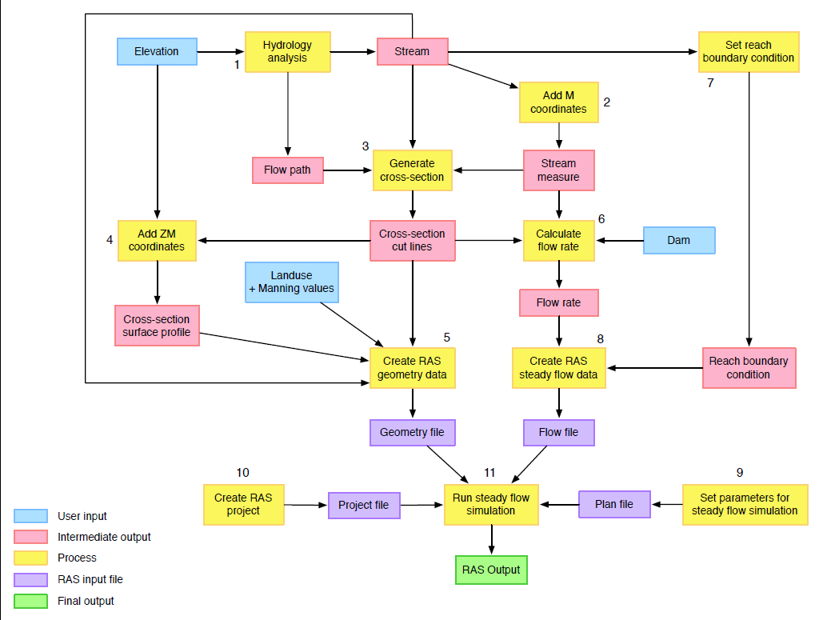
Copyright 2014, Proprietary, UTD/CG3I

Slide 9
Data Preparation
Geodatabase
Manning Values are assigned to land use type.
Manning Values are resistance values that determine both the velocity and the shape of the flow.
Define River
Define Cutlines
Convert to 3D Cross-sections
Export the Manning Table
Assign Manning Values to Cross-sections
Define Manning Values in Land Use

Slide 10
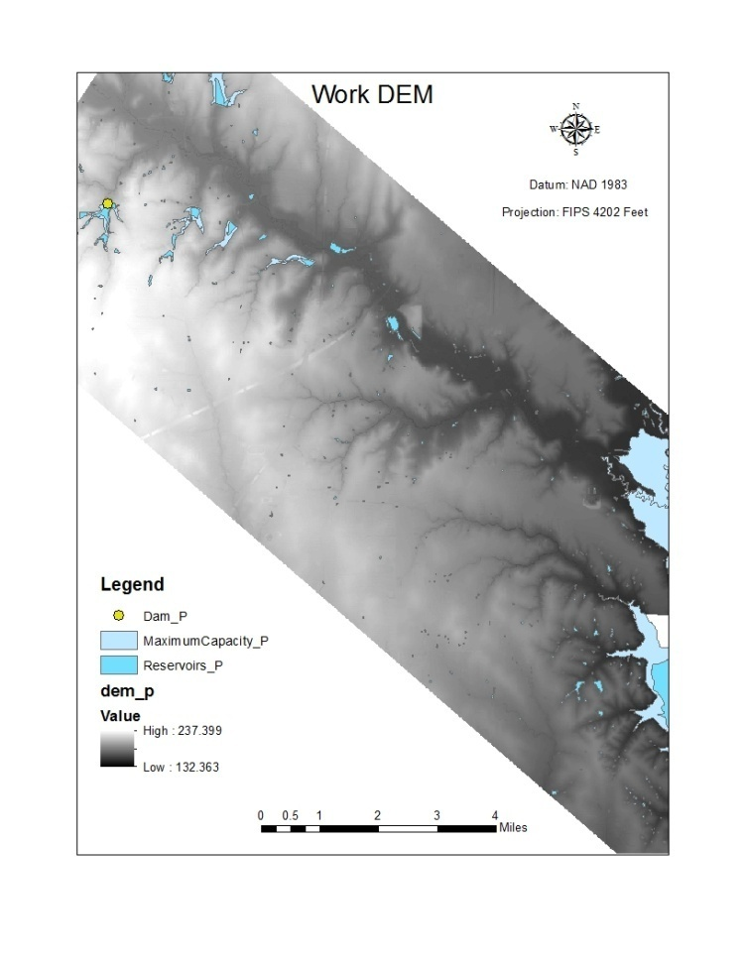
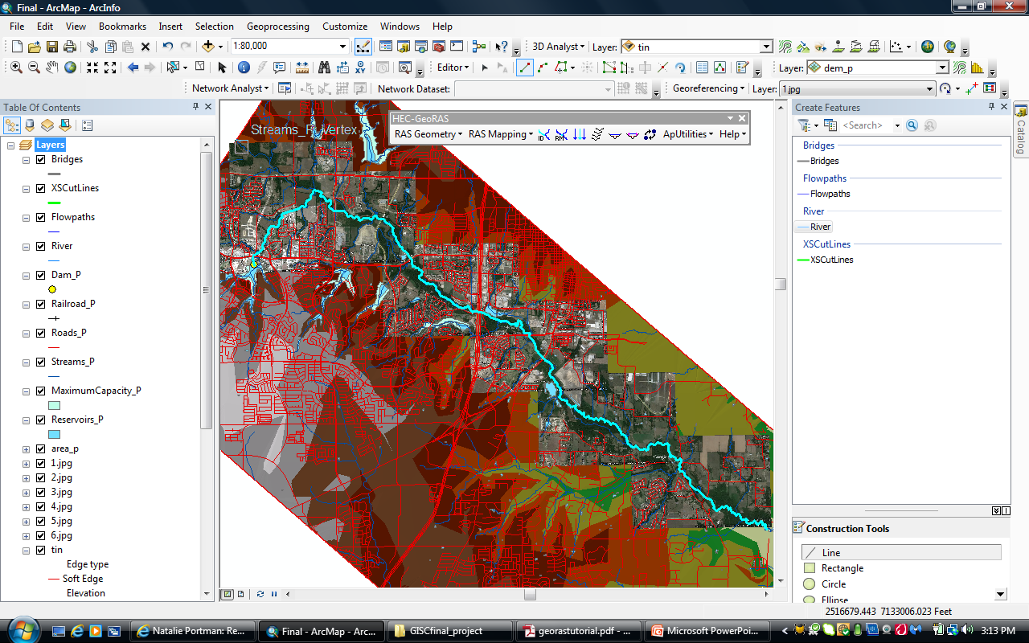
Step 1 – Hydrologic Calculations
Create River Centerline from DEM

Slide 11
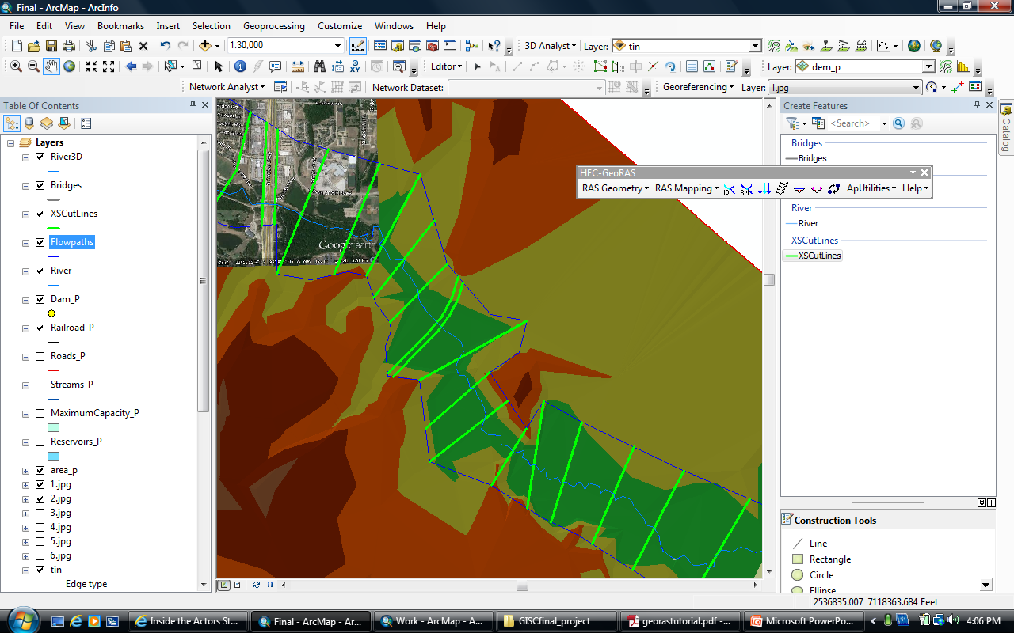
Step 2 & 3 – Create Cut-lines
The most important input for the RAS software is the cross sections, which are derived from the cut-lines
Innovative automation of cut-line placement
Placement regularly spaced at perpendicular angles to the river flow
Created in 2D first (cut-lines), then…

Slide 12
Cross-section Geometry Rules
A stream must be drawn from upstream to downstream.
A stream is composed of one or more reaches, and each reach must have unique combination of stream ID and reach ID.
All reaches must be connected at junctions.
A junction is an intersection of two or more streams.
A stream cannot contain parallel flow path. If three reaches connected at a junction, only two can have the same stream ID.
XS cut lines must be digitized from the left to the right side of a stream centerline.
XS cut lines cannot cross a stream centerline more than once.
XS cut lines cannot cross each other.
Moreover, HEC-­‐RAS itself also has limitations:
XS cut lines cannot have more than 500 stations (elevation points).
XS cut lines cannot have more than 20 variations in Manning’s N values.
There must be no vertical drop in elevation (two stations overlapping at the same location and having different elevation values), especially at the end of the line.

Slide 13
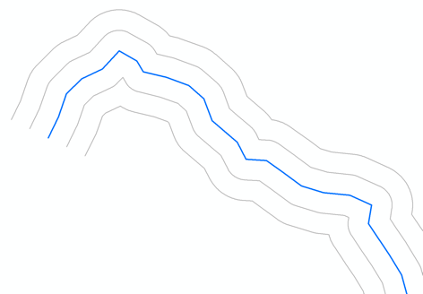
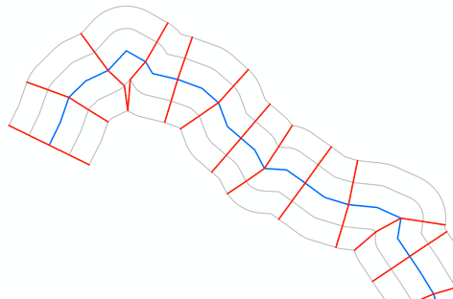
Our Solution
Offset lines are created along stream centerline
XS cut lines are generated with the aid of offset lines

Slide 14
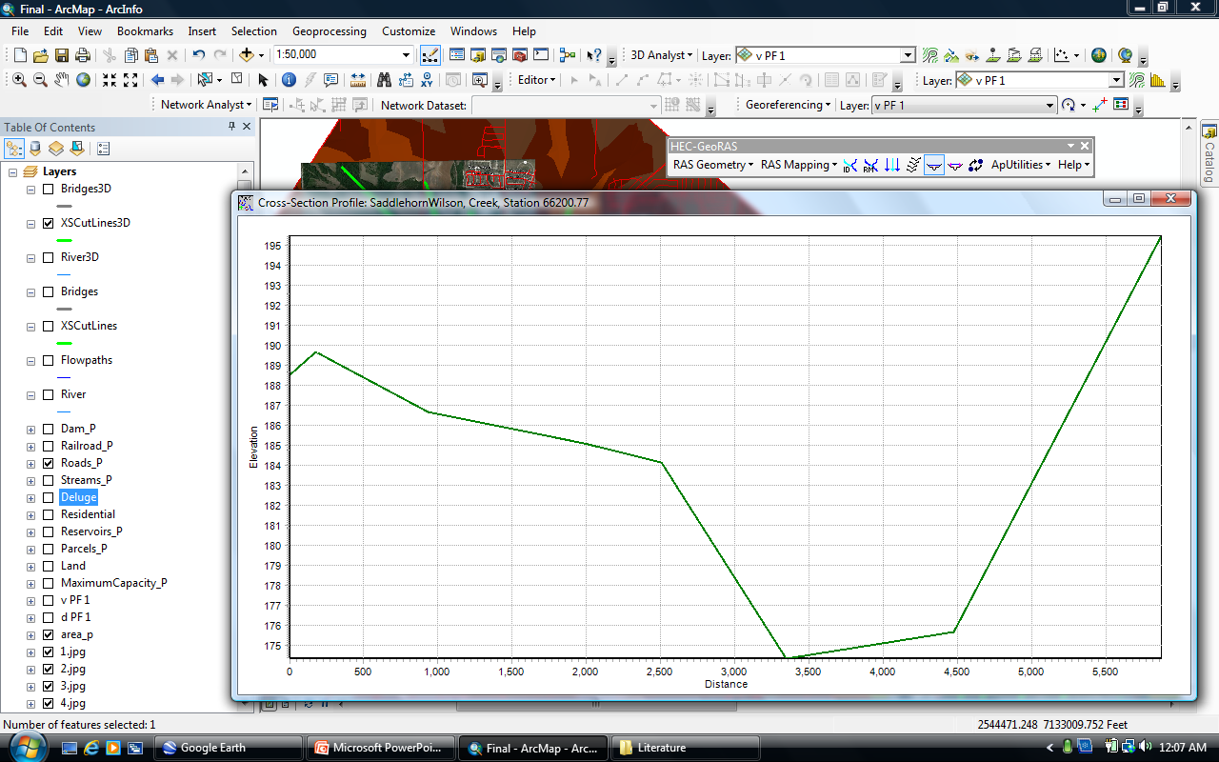
Step 4 – Transforming 2D to 3D

Slide 15
Step 5 – Creating RAS Geometry Data
In order to calculate the flood inundation, RAS needs to know the friction of the surface
Friction varies based on material
Concrete=low friction
Forest=high friction
Friction can be easily estimated from Land Use data
Can be sourced from county data
Friction data, called Manning Values, are intersected with the cross-sections to allow RAS to utilize friction in a 3D setting

Slide 16
Step 5 - Land Use
Example Parcel-level Land Use Data
Residential – A1 , A2, A3, A4, B1, B2, B3, B4, C1, C2, F4.
Commercial – C3, C4, F1, F3.
Industrial – C5,F2, J2, J4.
Farmland – D1, D2, D3, E1, E2, E3.
Forest – D4.
School – M7.
Golf Course – M4.
Flood Plain – M10.
Open Space – M5, M6, M8, M9, J1, J3, J5, J7.

Slide 17
Step 5 - Land Use Data in GIS

Slide 18
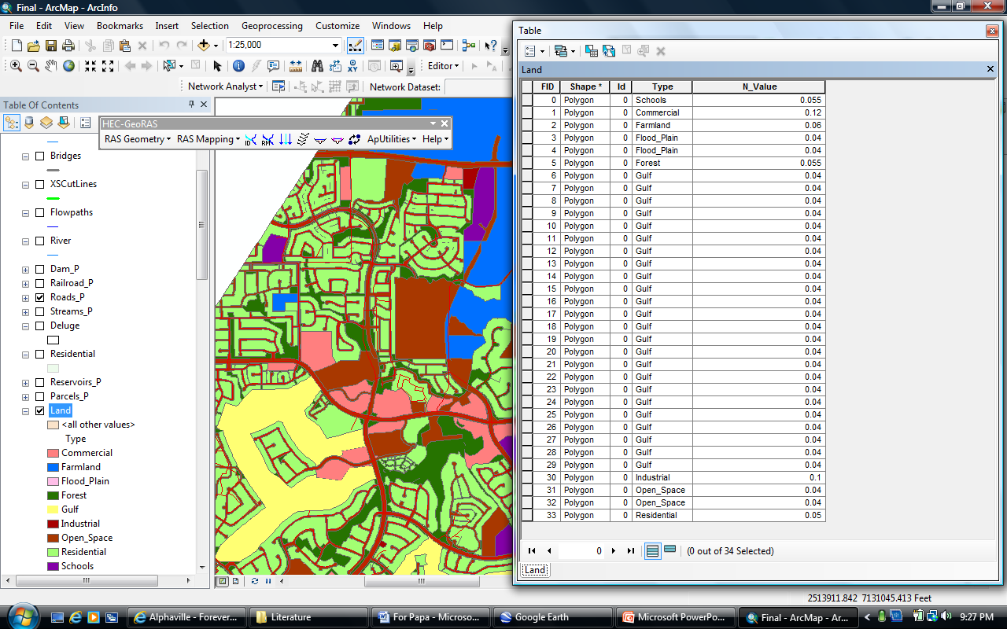
Step 5 – Manning Values
Notes:
Defining N – values are found in the HEC-GeoRAS users manual
Extracting n - creates a new table - Manning

Slide 19
Step 6 – Calculating the Flow Rate
Next, we need to determine the flow rate of the flood
Calculate flow rate under normal conditions plus an estimate of the rate after failure

Slide 20
Step 6a - Determining the Flood zone
Algorithms that will determine the extent of the flood zone are:
Qt = Total Release Discharge
Lu = Inundation Length

Slide 21
Step 6b - Determining the Flood zone
= Peak Total Discharge (in cfs)
= Breach Discharge from spillway
(emergency discharge) when the reservoir
water surface is at the top of the dam (in
cfs)
= Bottom width of the breach, assumed to be
3*H or ½ the width of a structural spillway.
= Maximum height of the Dam (in feet)
Source: TCEQ

Slide 22
Step 6c - Determining the Flood zone
Example:
Qt = Qb + 3,260
Qt = (3.1 * (40 * 3) * 40^(3/2)) + 3,260
Qt = 94,109 + 3,260
Qt = 97,369 CFS

Slide 23
Step 6d - Determining the Flood zone
= Correction factor for spillway size;
= Total capacity of the reservoir at the top of
the dam (acre-feet)
= Maximum height of the Dam (in feet)
Source: TCEQ

Slide 24
Step 6e - Determining the Flood zone
Example:
Lu = 0.012 * (94,109 / 3,260) * sqrt2 * 1,399 * 40
Lu = 0.012 * 28.87 * sqrt2 * 55960
Lu = 27,417 feet
Lu = 5.19 miles

Slide 25
Step 6f – Defining the Flood zone
There is a decreasing linear relationship where at “0” feet from the dam, the flow will equal Qb (94,109 cfs), while at 5.19 miles downstream (i.e. the inundation length), the flow will equal Qs (3,260 cfs)
Determine the slope of the extent:
3,260 = m? * 5.19 + 94,109
m? = (3,260 – 94,109) / 5.19
m = - 17,505
After 5.19 mi. the flow will be a constant 3,260 cfs

Slide 26
Step 6g – Defining the Flood zone
3,260 | = | Qs, cfs |  |  |  |  | 40ft = Dam Height
28.87 | = | Ks
1,399 | = | C, dam capacity @ top of reservoir, ac-ft
97,369 | = | Qt, total flow, cfs
 |  |  |  |  |  |  | Total Length
5.19 | = | Lu, inundation leght, miles |  |  |  |  | 75223.88
 |  | Elevation FT | River Name | HEC-RAS | From 0 FT | Qb-reduction | Miles |  | T Slope = | 0.002
 | 1 | 630 | S/W Creek | 75223.88 | 0 | 94109 | 0
 | 2 |  | S/W Creek | 74579.85 | 644.03 | 92008 | 0.12 |  | Qb-r = -17505 * miles + 94109
 | 3 |  | S/W Creek | 73891.2 | 1332.68 | 89733 | 0.25
 | 4 |  | S/W Creek | 73272.32 | 1951.56 | 87632 | 0.37 |  | 3258.05
 | 5 |  | S/W Creek | 73098.26 | 2125.62 | 87107 | 0.4
 | 6 |  | S/W Creek | 71932.19 | 3291.69 | 83256 | 0.62 |  | 5.19 | <<<
 | 7 |  | S/W Creek | 70763.11 | 4460.77 | 79230 | 0.85
 | 8 |  | S/W Creek | 69074.59 | 6149.29 | 73628 | 1.17
 | 9 |  | S/W Creek | 67400.41 | 7823.47 | 68202 | 1.48
 | 10 |  | S/W Creek | 66200.77 | 9023.11 | 64176 | 1.71
 | 11 |  | S/W Creek | 64678.95 | 10544.93 | 59099 | 2
 | 12 |  | S/W Creek | 61696.71 | 13527.17 | 49296 | 2.56
 | 13 |  | S/W Creek | 60424.17 | 14799.71 | 45095 | 2.8
 | 14 |  | S/W Creek | 58907.68 | 16316.2 | 40019 | 3.09
 | 15 |  | S/W Creek | 57854.23 | 17369.65 | 36518 | 3.29
 | 16 |  | S/W Creek | 56603.87 | 18620.01 | 32316 | 3.53
 | 17 |  | S/W Creek | 56406.83 | 18817.05 | 31791 | 3.56

Slide 27
Step 7 & 8 – Set Reach boundary condition & create steady flow data
After we have defined the slope of the landscape from the dam to the inundation point, we combine this with the flow rate from Step 6 to create a Steady Flow Data file

Slide 28
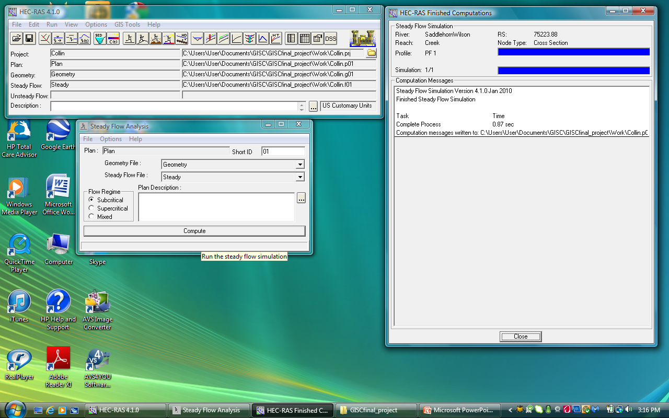
Steps 9-11 - Running HEC-RAS
A project file is created that points to all the required data (Step 10)
Includes Geometry data (step 5), Flow data (Step 8), as well as some additional parameters (Step 9)
Once everything is in place, HEC-RAS steady flow simulation is run (Step 11)

Slide 29
Step 11 - Steady Flow Analysis with HEC-RAS
Where:
= elevation of the main channel inverts
= depth of water at cross section
= velocity weighting coefficients
= gravitational acceleration
= energy head loss

Slide 30
Presentation of Results
The HEC-RAS output was a water surface TIN.
Using ArcGIS we can determine the depth and the velocity of the deluge.
Import the HEC-RAS Output
Visualize the Study Area using GIS
Subtract Water TIN from Land TIN
Using ArcGIS to continue the analysis
Export the Deluge Shapefile

Slide 31
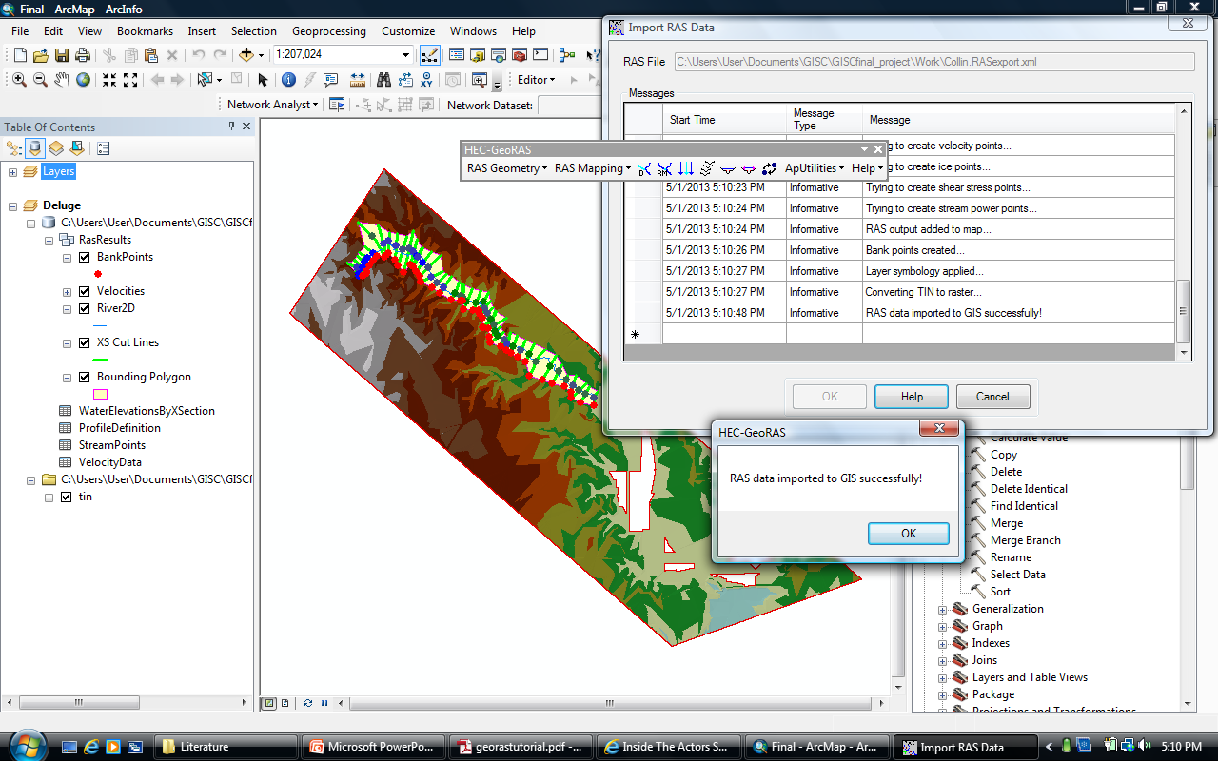
Step 1 – Visualizing Study Area
Notes:
Importing

Slide 32
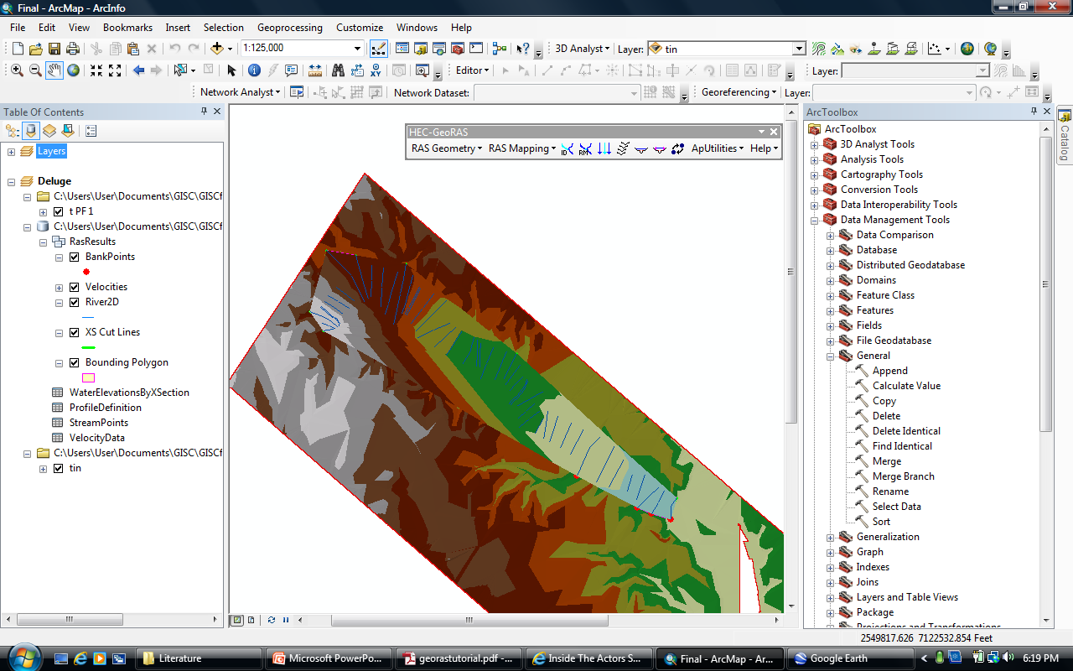
Step 2 – New water height TIN

Slide 33
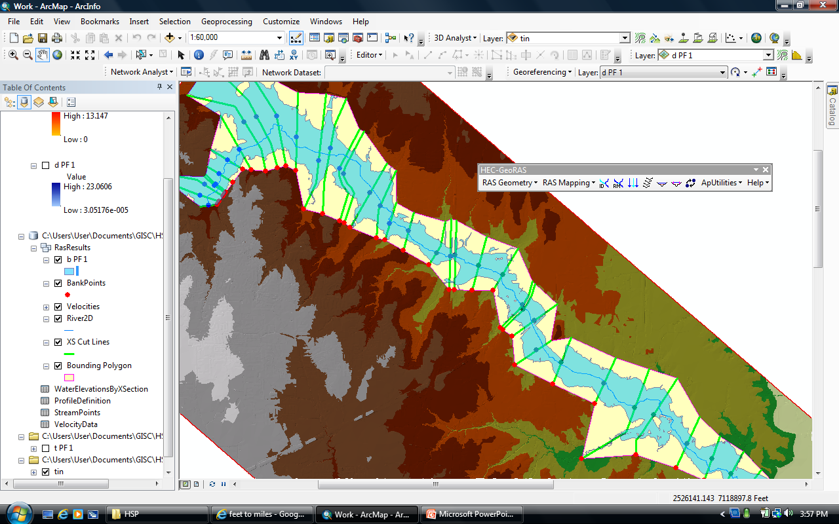
Step 3 – Final Inundation Shapefile
Notes:
Redo this slide

Slide 34
Results - Depth

Slide 35
Results - Strength

Slide 36
Results - Strength
Notes:
38 Homes

Slide 37
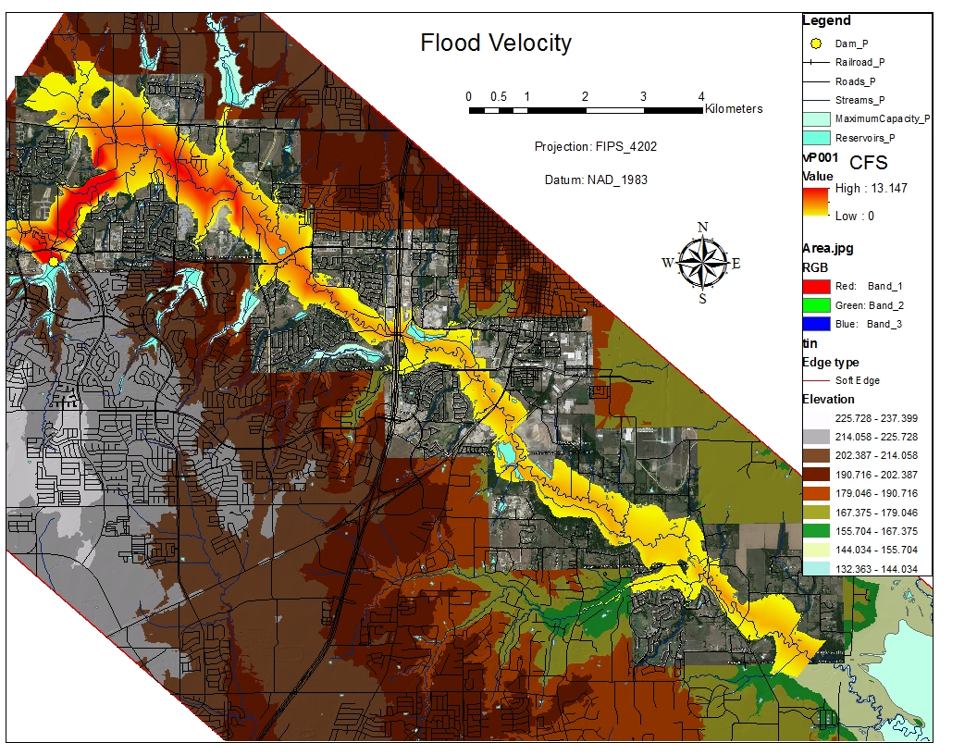
Results - Velocity
Notes:
Velocity = Distance / Time So Time = Distance / Velocity

Slide 38
Results - Timing
Notes:
Reasons for slowdown 1) Deluge is exhausted at 5.19 miles 2) Forests after Hardin Blvd

Slide 39
Conclusion
iSIM successfully automated HEC-RAS to function in an integrated environment
iSIM provides a dramatically lower cost solution than typical engineering analysis.
County governments can use this technique to obtain better flood zone visualization than traditional rule of thumb approaches.
Simplified Inundation Mapping provides a good worst case starting scenario for emergency action planning (EAPs)
Notes:
This simplified dam break provides good worst case scenarios for emergency management

Slide 40
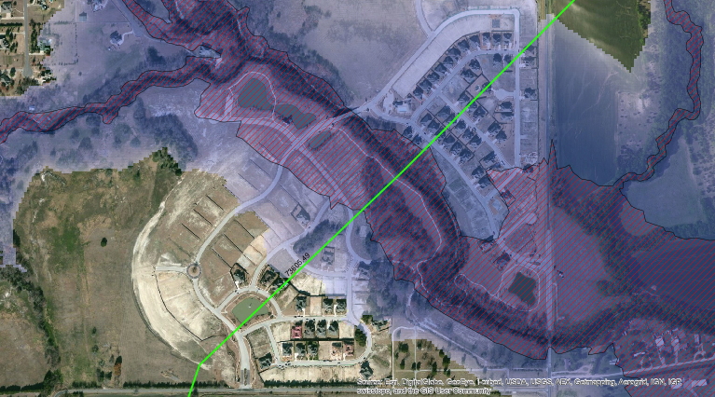
100 Year Flood Grid over Simplified Inundation Map

Slide 41
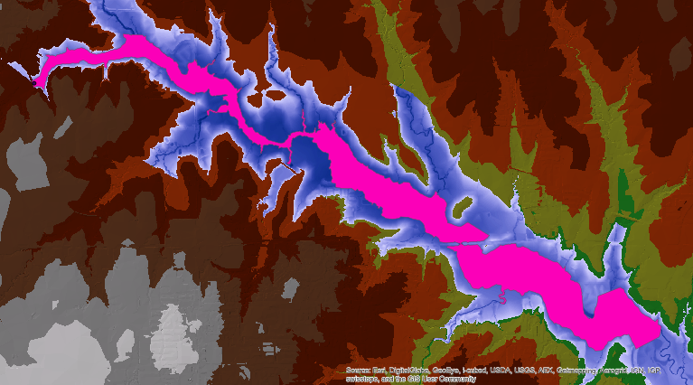
Engineering Breach Analysis (pink) over Integrated Simplified Inundation Map (blue)

Slide 42
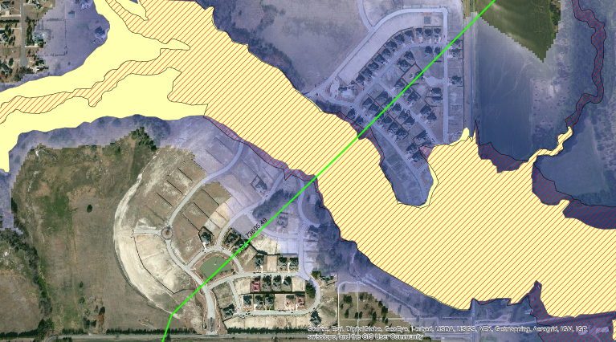
100 Year Flood Grid (red) over Engineering Breach Analysis (yellow)

Slide 43
NEXT STEPS? ”Real-time Spacial Temporal Modeling and Analysis”

Slide 44
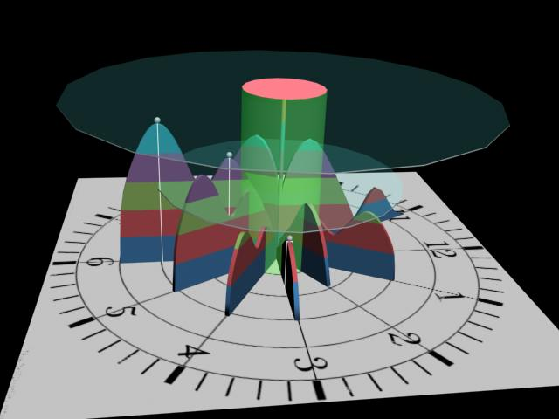
Experimental Space-Time Objects 3D Unbounded Information Avatars (UIA’s) i.e. “big data” visualizations

Slide 45
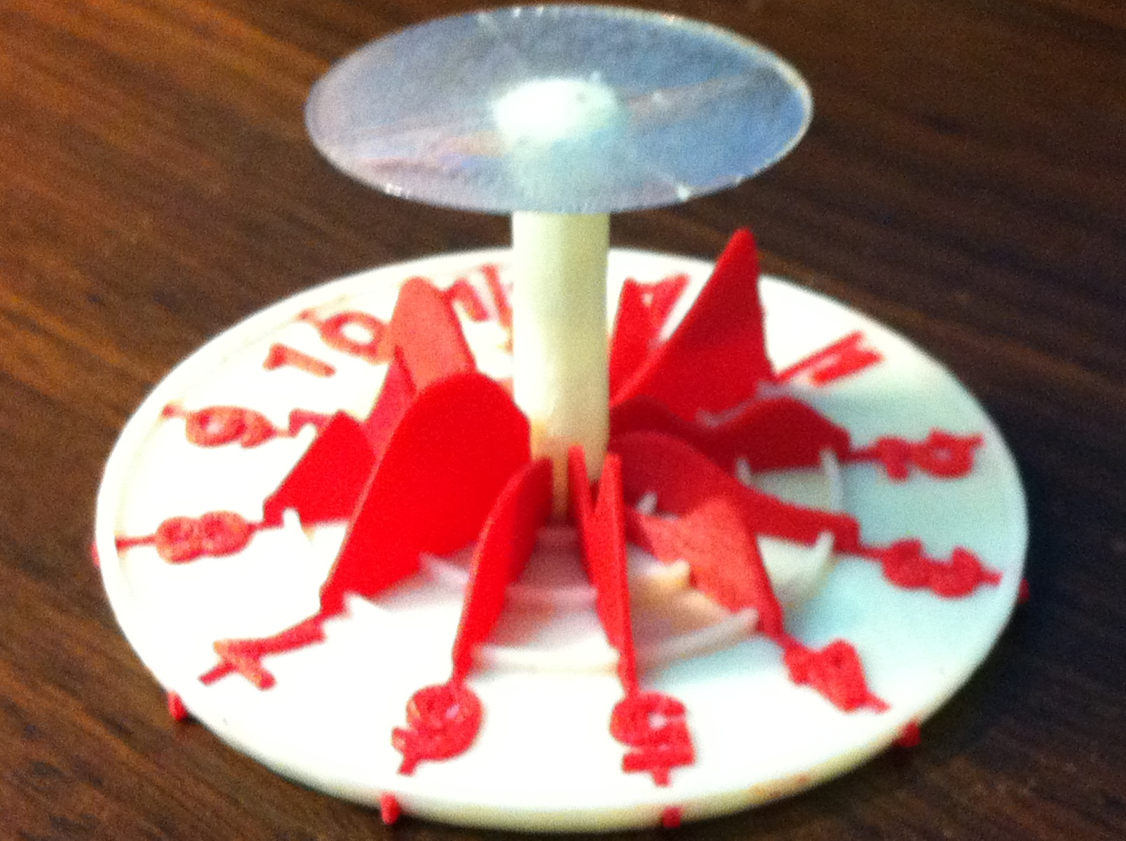
Experimental Space-Time Objects 3D-printed Avatar Object linked to Excel based software

Slide 46
Experimental Space-Time Objects Excel based software

Slide 47
Questions and Answers ?

Slide 48
The End

