Slide 1
National Flood Interoperability Experiment Alabama Case Studies
David R. Maidment Center for Research in Water Resources University of Texas at Austin
21 March 2015

Slide 2
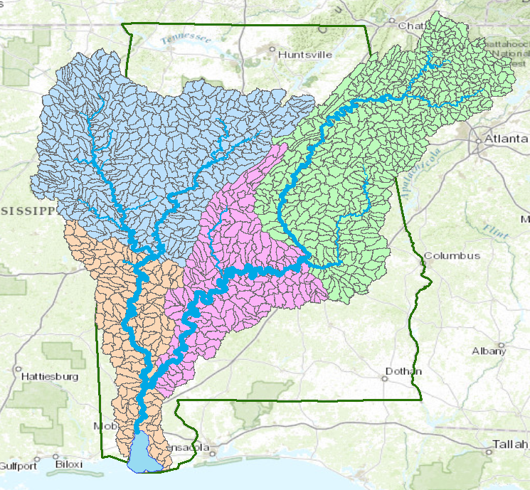
Mobile-Alabama River System
Black Warrior River
Coosa River
Cahaba River
TombigbeeRiver
Alabama River
Mobile River
Mobile Bay

Slide 3
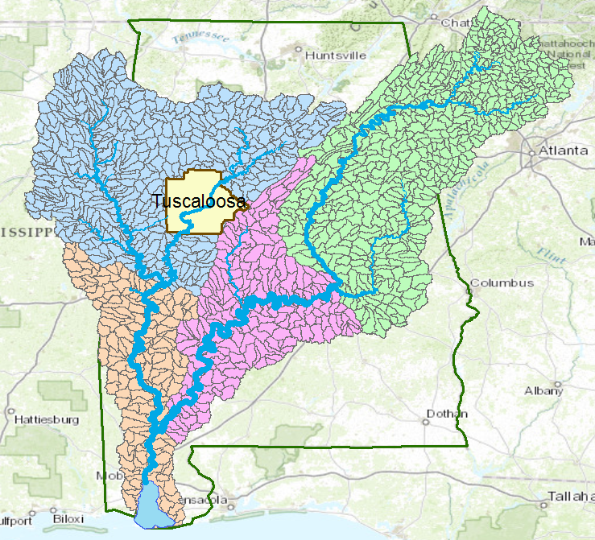
Tuscaloosa County
Black Warrior River

Slide 4
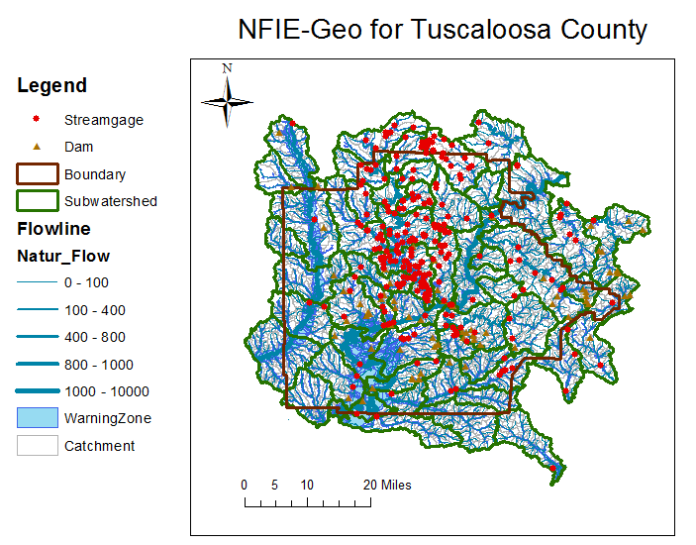
NFIE-Geo for a county….
County subset of national geospatial data layers
http://www.caee.utexas.edu/prof/maidment/CE397Flood/Assignment2/NFIEGeo.pdf

Slide 5
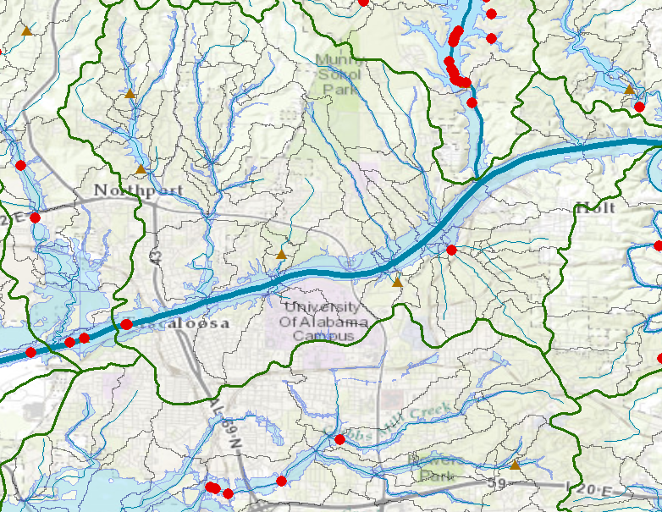
NFIE-Geo around University of Alabama Campus
Black Warrior River

Slide 6
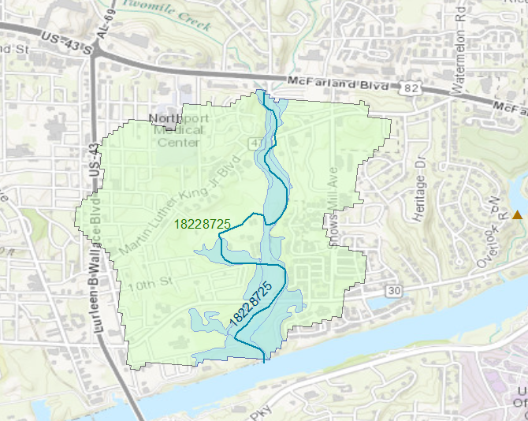
Catchment 18228725

Slide 7
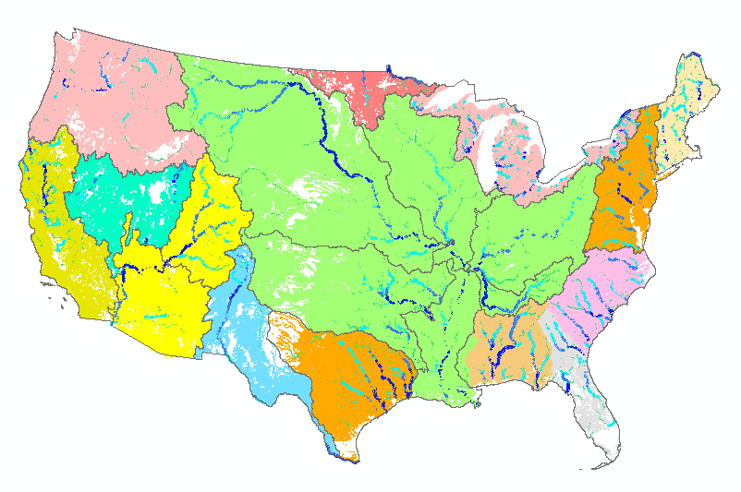
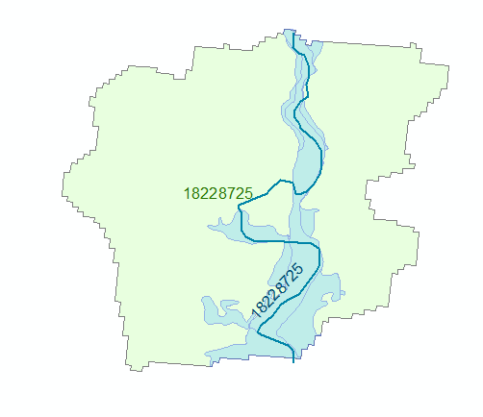
Geo to Hydro…
High spatial resolution hydrologic modeling at continental scale
Built upon NFIE-Geo: A national geospatial framework for hydrology
Continental landscape divided into 2.67 million local catchments, each containing a single stream reach
Stream reaches connect to form a national stream network
2.67 million catchments
Average area 3 km²
Average reach length 2 km

Slide 8
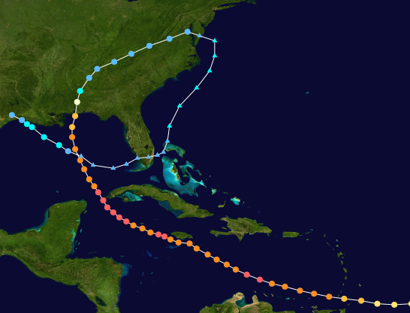
Hurricane Ivan, September 2004
The most expensive disaster in the history of Alabama

Slide 9
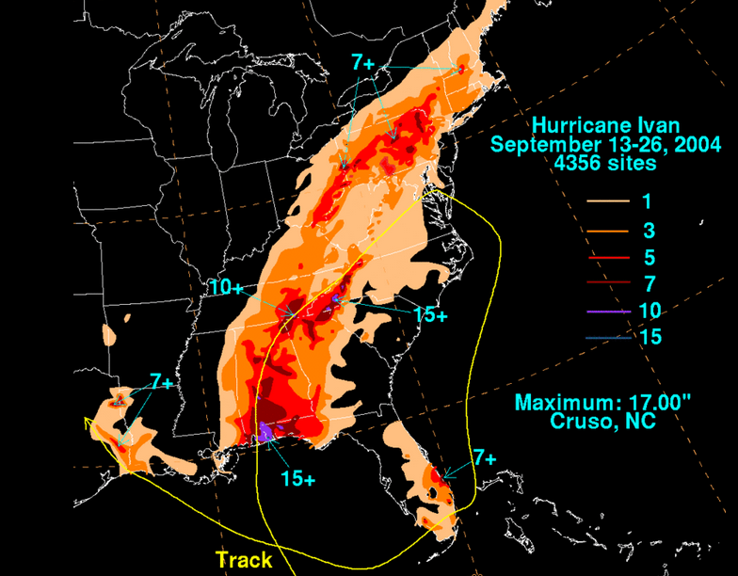
Hurricane Ivan as a case study
http://en.wikipedia.org/wiki/Hurricane_Ivan#Alabama

Slide 10
NWS River Forecast Centers
No River Forecast
Notes:
THERE’S A MAJOR GEOGRAPHIC GAP – WE DON’T FORECAST ALONG THE COAST

Slide 11
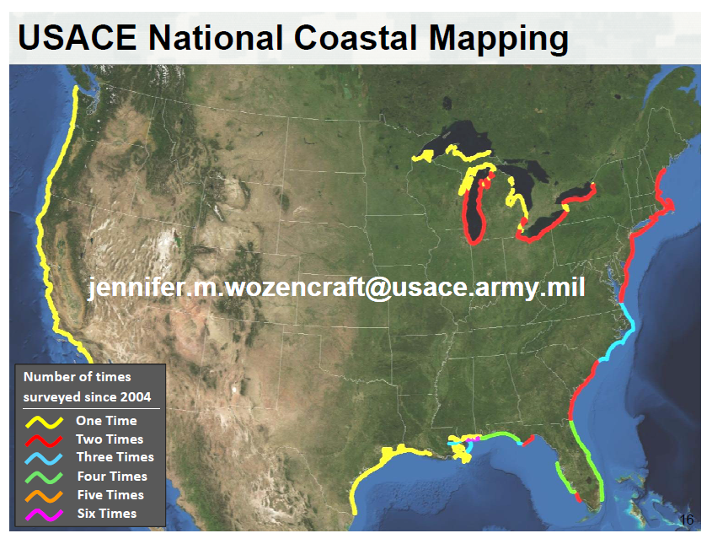

Slide 12
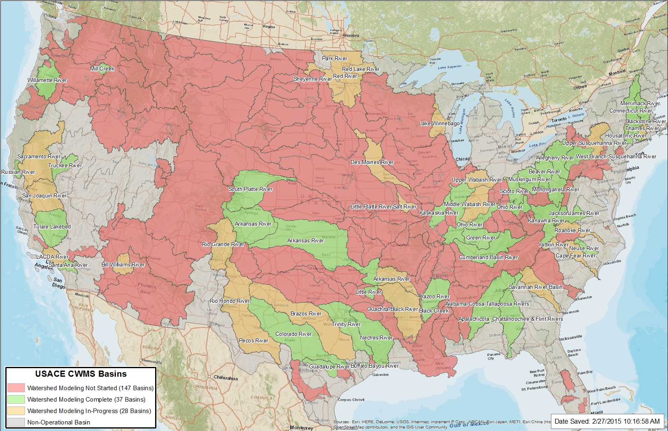
Corps of Engineers Modeling, Mapping and Consequences program
Source: R. Simrall, USACE

Slide 13
Severe Flooding in Mobile during Ivan
Black Warrior River
Case study for river-coastal interaction

