Slide 1
Automating NFIE-Hydro National Flood Interoperability Experiment (NFIE)
Fernando Salas, Marcelo Somos and David Maidment
Flood Forecasting Class
February 9, 2015

Slide 2
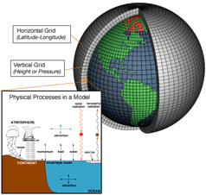
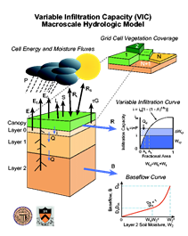
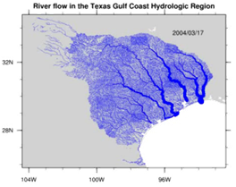
Modelling the terrestrial water cycle
Rivers
Lidar, surveys and river routing models
Streamflow, water level, fish etc.
Atmosphere
Observation datasets and numerical weather models
Precipitation, temperature, solar radiation etc.
Land Surface
Remote sensing and land surface models
Evaporation, soil moisture, surface runoff etc.

Slide 3
NFIE- Components
NFIE-Geo: National geospatial framework for hydrology
NFIE-Response: Wide area planning for flood emergency response
NFIE-Hydro: National high spatial resolution hydrologic forecasting
NFIE-River: River channel information and real-time flood inundation mapping
NFIE-Services: Web services for flood information

Slide 4
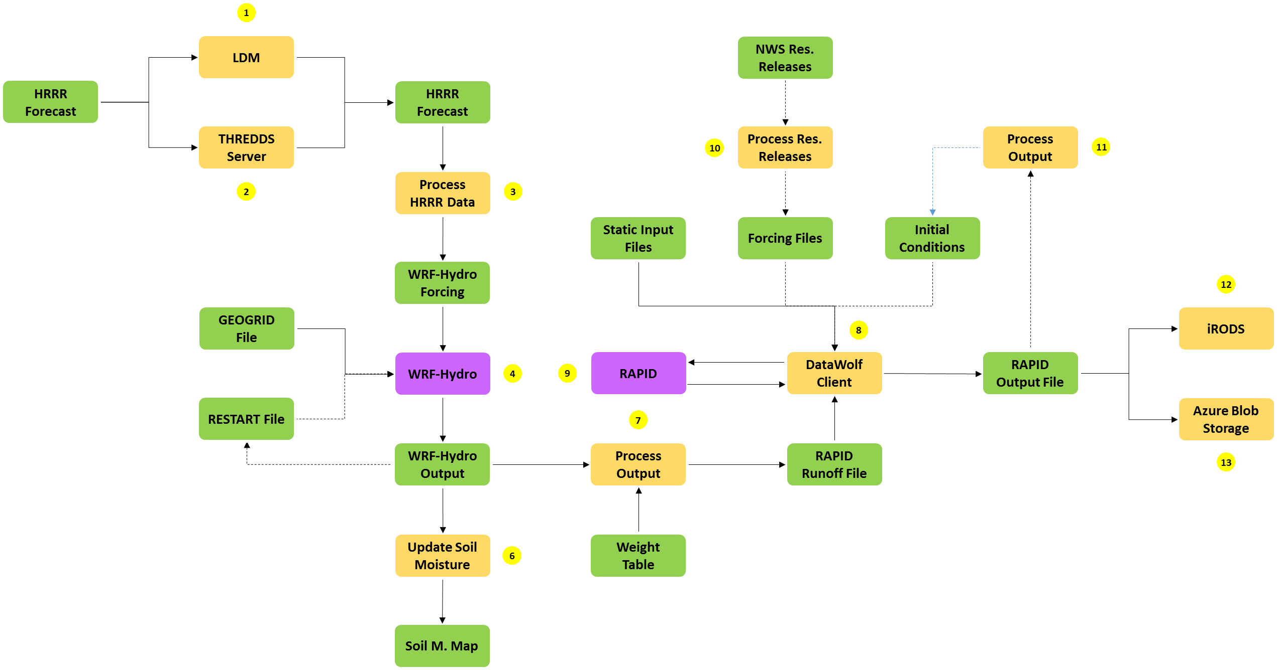
NFIE-Hydro Workflow
Implemented in Microsoft Azure

Slide 5
Flow in the Texas Gulf Coast RAPID Model, 3 hour time steps
Atmosphere
Land Surface
Rivers
GIS data describes 64k river reaches . . .
. . . simulate flow in each reach in each time step
David et al (2013)
DOI: 10.1016/j.envsoft.2012.12.011

Slide 6
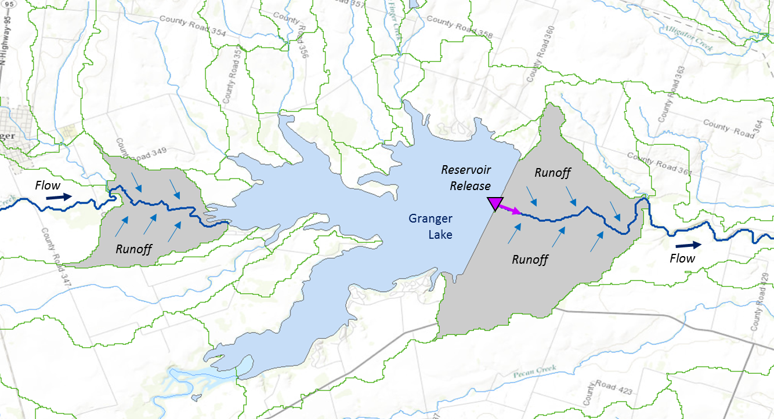
Muskingum
Method
RAPID River Routing Model
River Application for Parallel ComputatIon of Discharge
S_{prism} = KQ
S_{wedge} = KX (I – Q)
Computational Unit for Rivers
Forcing: Runoff and reservoir releases
NHDPlus Catchment
Flow
Legend
Dam
Junction
Catchment
http://rapid-hub.org/

Slide 7
RAPID Inputs
NFIE-Geo
Static inputs:
Network connectivity (csv file)
Muskingum k and x parameters (csv file)
Dynamic inputs:
Surface and sub-surface runoff (netCDF file)
Forcing (csv file)
reservoir release, spring flow, discharge etc.
Optional modules: reservoir model, diversion inputs/outputs

Slide 8
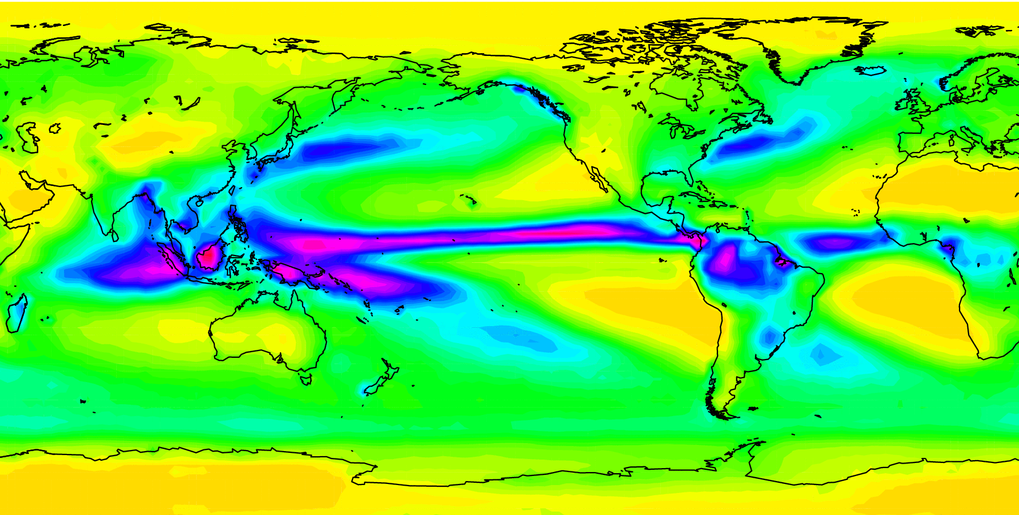
Network Common Data Form (netCDF)
Data:
Temperaure = 111,121,131,141,
211,221,231,241…
T(1,1,1), T(1,1,2), T(1,1,3), T(1,1,4)
T(1,2,1), T(1,2,2), T(1,2,3), T(1,2,4)

Slide 9
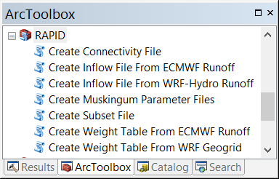
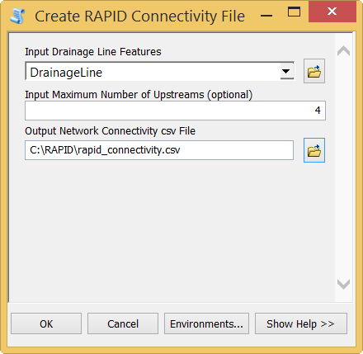
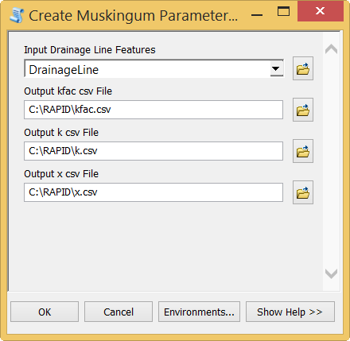
ArcGIS Tools for RAPID Model
13475951
13475949
13473525
Muskingum Parameters
K_{fac} = LENGTH_GEO x 3600
K = K_{fac} x λ_{k}
where λ_{k} = 0.35
X = λ_{x} x 0.1 (units:
where λ_{x} = 3
Flowline
Flowline

Slide 10
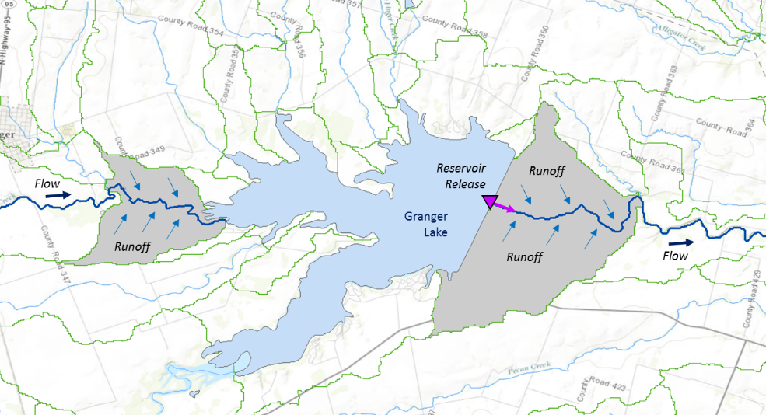
Surface and sub-surface runoff
Assumptions:
Simplified routing scheme
All runoff immediately goes into river channel
One river reach per catchment
No groundwater flow
No interaction between flow in channel and sub-surface flow
Runoff file
m3_riv ( Time, COMID )
m3_riv = X^{0,0}, X^{0,1}, X^{0,2}, X^{0,3}…
… X^{50,61816}, X^{50,61817}, X^{50,61818}

Slide 11
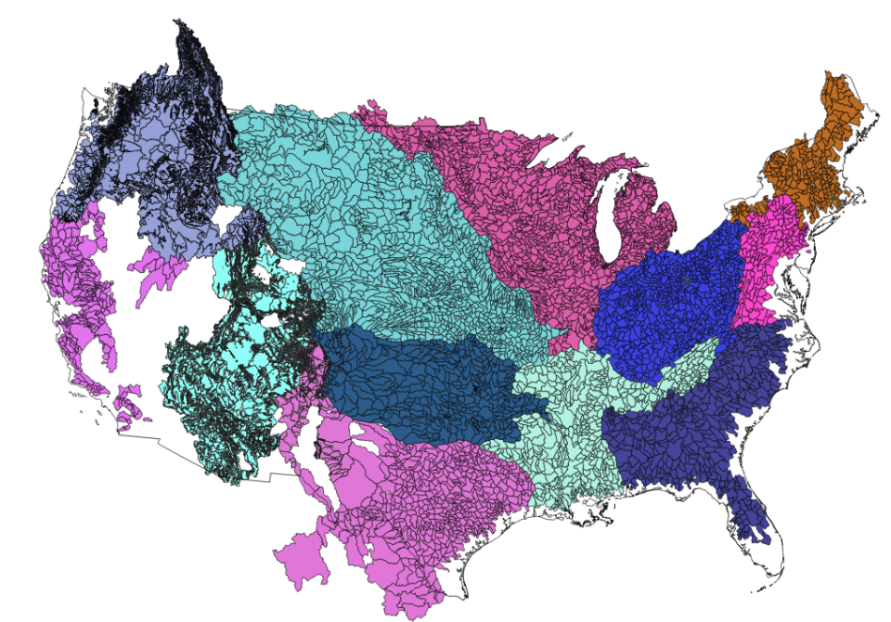
National Flood Interoperability Experiment
Two distinct land-surface approaches…
National Weather Service (NWS)
National Center for Atmospheric Research (NCAR)
Sacramento Soil Moisture Accounting Model (SAC-SMA)
Lumped model
4,000 Forecast basins
Weather Research and Forecasting-Hydro Model (WRF-Hydro)
Distributed model (1 – 4 km cells)
Connect runoff from basins to river reaches
Connect runoff from grid cells to river reaches
Web service
NWS Forecast Basins
Dynamic “downscaling”
“Weighted” average

Slide 12
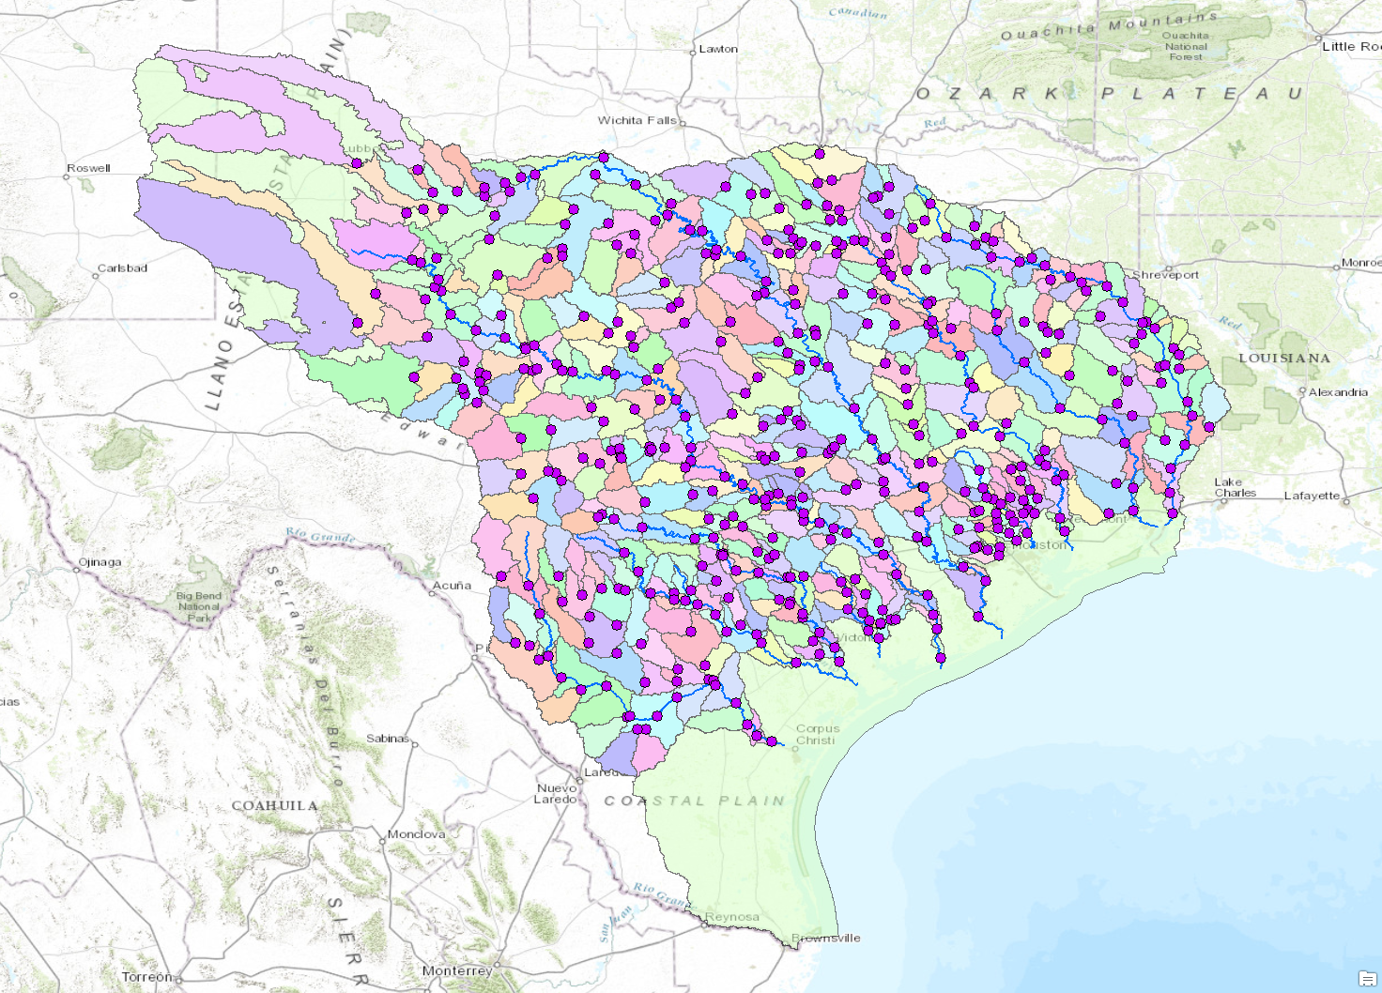
NWS West Gulf Region
74,000 river reaches
457 forecast points
92 reservoirs
NWS Forecast Point

Slide 13
NWS Forecast Basins in Austin Area

Slide 14
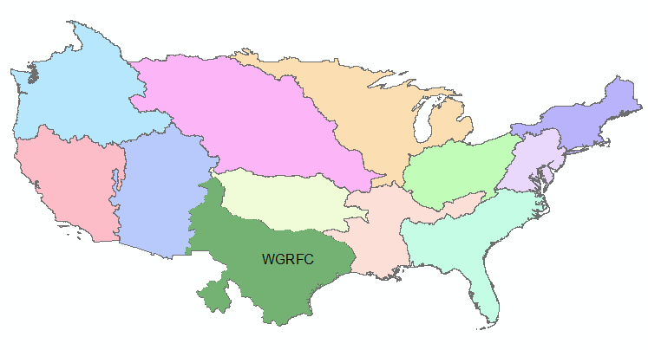
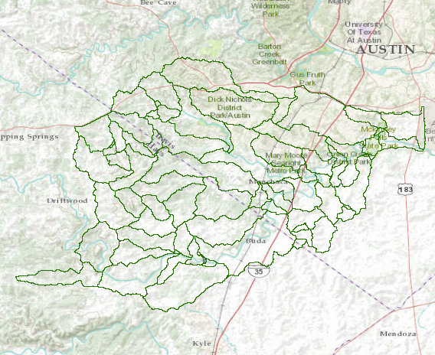
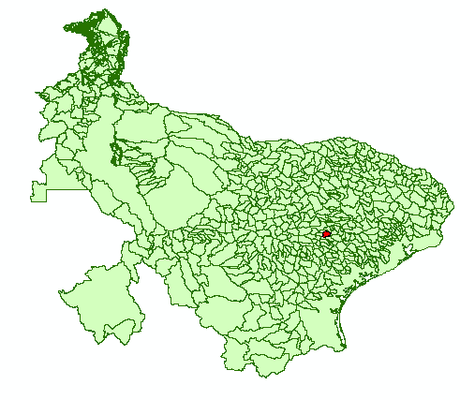
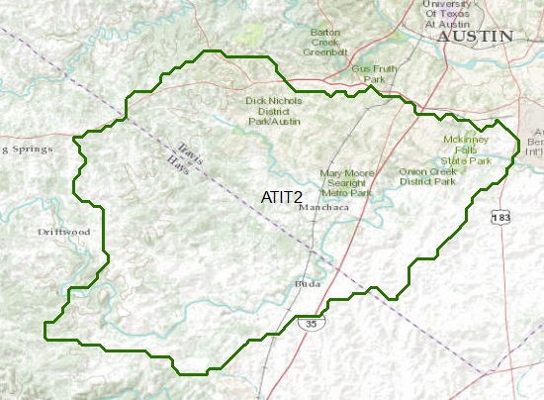
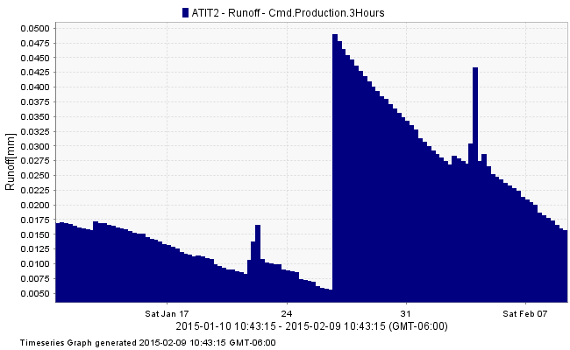
Dynamic Downscaling for NWS Basins NWS Forecast Basin to NHDPlus Catchment
NWS River Forecast Centers
NHDPlus
Catchments
Azure
Wiski
NWS Forecast
Subbasin ATIT2
Forecast Subbasins for
West Gulf River Forecast Center

Slide 15
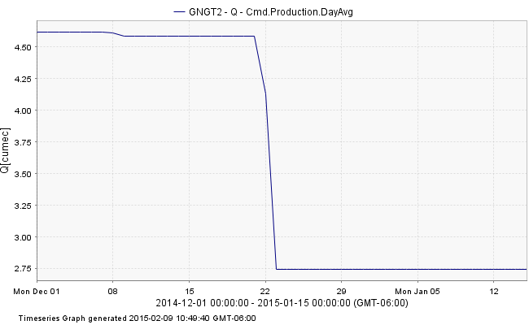
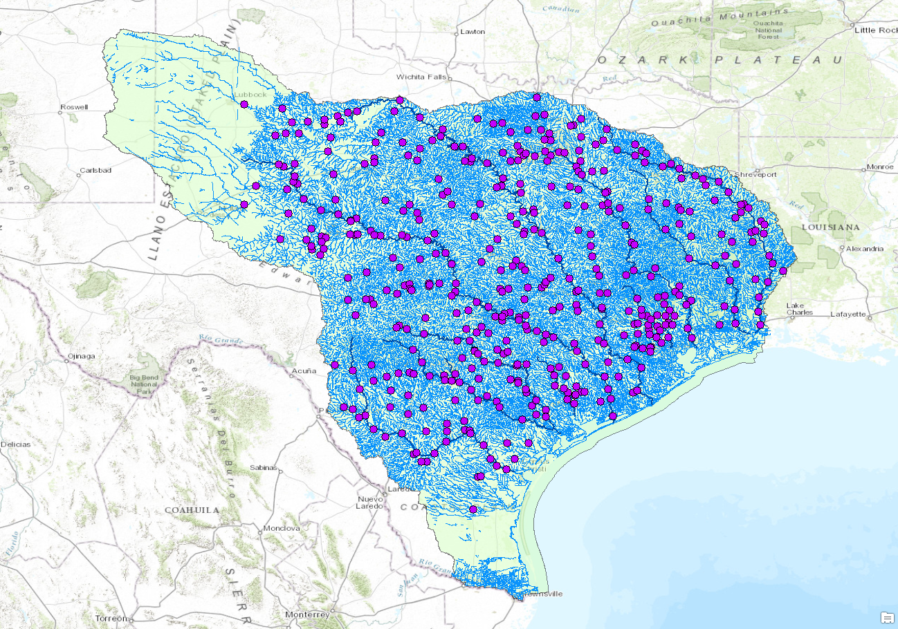
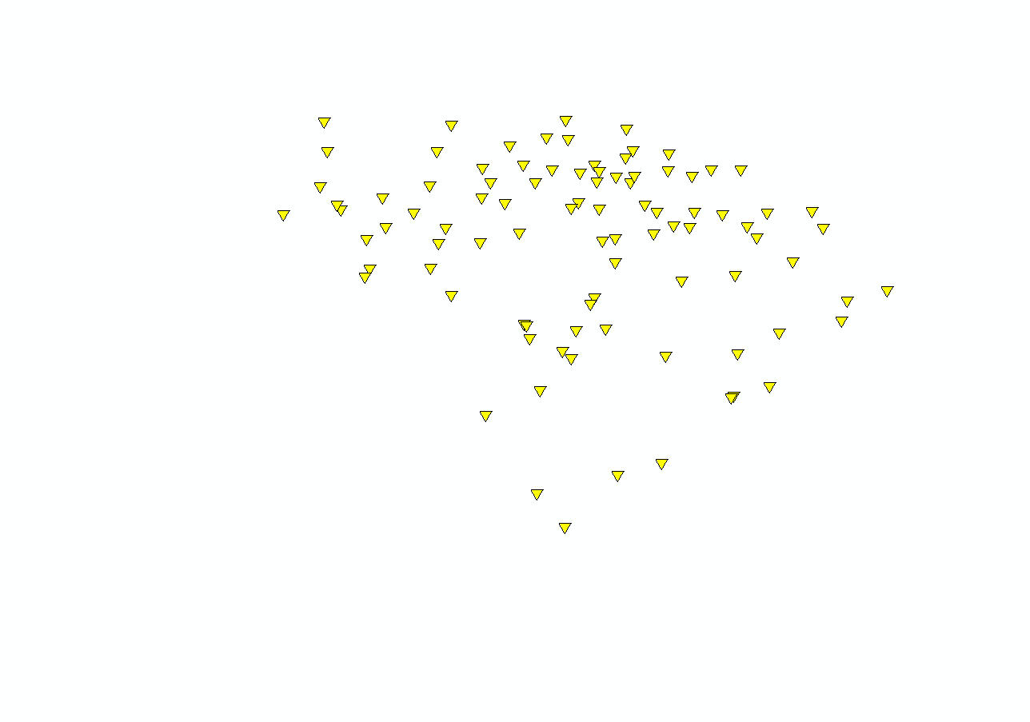
NWS West Gulf Region
http://wwokiweb01.cloudapp.net:8080/KiWIS/KiWIS?datasource=0&service=kisters&type=queryServices&request=getTimeseriesValues&format=wml2&ts_id=64561042&period=p30d
74,000 river reaches
457 forecast points
92 reservoirs
NWS Forecast Point
Major Reservoir

Slide 16
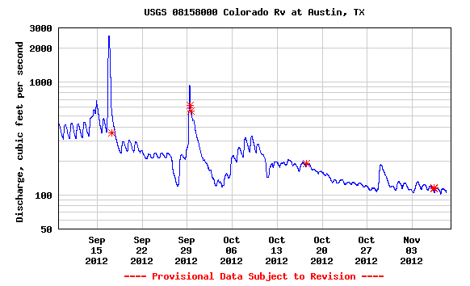
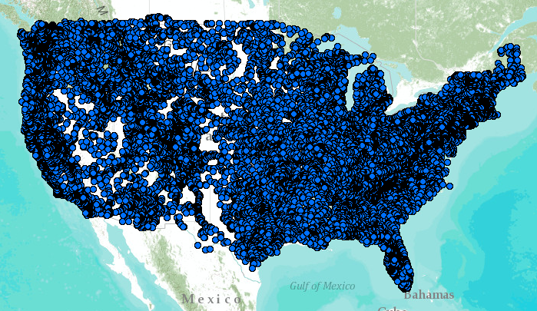
WaterML Web Services – USGS
Water time series data on the internet
http://waterservices.usgs.gov/nwis/dv/?format=waterml,2.0&
sites=08158000&parameterCd=00060&statCd=00003&period=p7d
24/7/365 service
For daily and real-time data
. . . Operational water web services system for the United States
http://waterservices.usgs.gov/nwis/iv?sites=08158000&period=P1D&parameterCd=00060

Slide 17
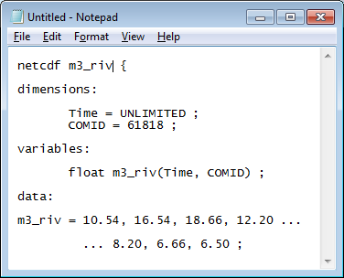
Creating the RAPID Runoff File
Runoff file
Web
Services
NWS
Runoff
NWS
Reservoir
Releases
Dynamic downscaling
Forecast basins to NHDPlus catchments
Forecast Basins (.csv)
NHDPlus Catchments (.csv)
NWS Reservoirs (.csv)
Python
Runoff file
m3_riv ( Time, COMID )
m3_riv = X^{0,0}, X^{0,1}, X^{0,2}, X^{0,3}…
… X^{50,61816}, X^{50,61817}, X^{50,61818}
RAPID Input Files
Runoff file (.nc)
Forcing file (.csv)
Note: Forcing file contains reservoir releases
Input
Files

Slide 18
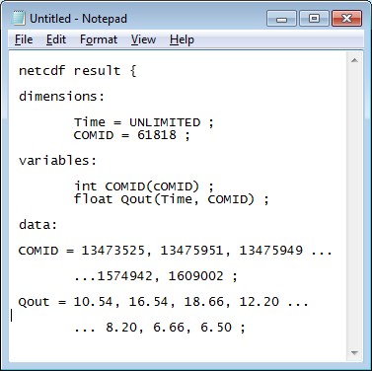
Executing RAPID Model
RAPID Model Service
Result
File
Input
Files
DataWolf - workflows
Result file
Qout ( Time, COMID )
Qout = Q^{0,13473525}, Q^{0,13475951}, Q^{0,13475949}…
… Q^{50,1574942}, Q^{50,1609002}
13475951
Unlike traditional netCDF files where variables have lat/long dimensions, RAPID result file has a COMID dimension where geospatial representation referenced externally (i.e. NHDPlus)
13475949
13473525

Slide 19
National Flood Interoperability Experiment
Two distinct land-surface approaches…
National Weather Service (NWS)
National Center for Atmospheric Research (NCAR)
Sacramento Soil Moisture Accounting Model (SAC-SMA)
Lumped model
4,000 Forecast basins
Weather Research and Forecasting-Hydro Model (WRF-Hydro)
Distributed model (1 – 4 km cells)
Connect runoff from basins to river reaches
Connect runoff from grid cells to river reaches
Web service
Dynamic “downscaling”
“Weighted” average

Slide 20
WRF-hydrO
The WRF-Hydro system was originally designed as a model coupling framework designed to facilitate easier coupling between the Weather Research and Forecasting model and components of terrestrial hydrological models
http://www.ral.ucar.edu/projects/wrf_hydro/

Slide 21
http://www.ral.ucar.edu/projects/wrf_hydro/images/User_Guide_v1.0.pdf

Slide 22
WRF-Hydro is both a stand-alone hydrological modeling architecture as well as a coupling architecture for coupling of hydrological models with atmospheric models. WRF-Hydro is fully-parallelized to enable its usage on clusters and high performance computing systems alike. Like the WRF model it does not attempt to prescribe a particular or singular suite of physics but, instead, is designed to be extensible to new hydrological parameterizations.

Slide 23
additional attributes
Multi-scale functionality to permit modeling of atmospheric, land surface and hydrological processes on different spatial grids
Modularized component model coupling interfaces for many typical terrestrial hydrological processes such as surface runoff, channel flow, lake/reservoir flow, sub-surface flow, land-atmosphere exchanges
Parallel code development for application on commodity cluster and higher performance computing systems
Stand-alone capabilities for hydrological prediction and research uncoupled to atmospheric models
Efficient coupling architecture so that it can be embedded within (or coupled to) other types of Earth system models such as the NCAR Community Earth System Model (CESM) or the NASA Land Information System (LIS)
Utilization of many standard data formats for efficient job construction and evaluation

Slide 24
WRF-Hydro architecture
http://www.ral.ucar.edu/projects/wrf_hydro/images/User_Guide_v1.0.pdf

Slide 25
Schematic illustrating the coupling and calling structure of WRF-Hydro from the WRF Model.
http://www.eco-hydrology.org/wrf-hydro2014/pdf/Gochis/Compiling_and_Executing_WRF_Hydro_Calabria_June_2014.pdf

Slide 26
HRLDAS and NOAHMP Land Surface Model
http://www.ral.ucar.edu/research/land/technology/noahmp_lsm.php

Slide 27
What is HRLDAS?
“The High Resolution Land Data Assimilation System (HRLDAS) runs the Noah and Noah MP Land Surface Models in an uncoupled mode (i.e.,not coupled with any atmospheric model) to evolve land surface and soil state variables over some time period”
http://www.ral.ucar.edu/research/land/technology/lsm/HRLDAS_USERS_GUIDE_34.pdf

Slide 28
Model physics options
1-dimensional (vertical) land surface parameterization
Surface overland flow
Saturated subsurface flow
Channel routing
Reservoir routing
Conceptual/empirical base flow

Slide 29
NoAh Multi physics (Mp)
Noah-MP is an uncoupled version to execute land-surface simulations. In this uncoupled mode, near-surface atmospheric forcing data are required as input forcing Noah-MP simulates soil moisture (both liquid water and ice content), soil temperature, skin temperature, snow depth (or snowpack density), snow water equivalent, canopy water content, and surface energy, water, and CO2 (if dynamic vegetation started) fluxes.

Slide 30
Some New Features in Noah-MP
1. Major components include a 1-layer canopy; 3-layer snow; 4-layer soil
2. Subgrid scheme: semi-tile vegetation and bare soil (Niu et al. 2010a)
3. Interactive energy balance method to predict skin temperature of the canopy and snow/soil surface
4. Modified two-stream radiation transfer scheme to consider the 3-D structure of the canopy (Niu and Yang, 2004)
5. More realistic snow physics: a thin surface layer, liquid water retention and refreezing, and snowpack densification (Yang and Niu, 2003)
6. A TOPMODEL- based runoff scheme (Niu et al., 2005)
7. An unconfined aquifer interacting with soil (Niu et al., 2007)
8. More permeable frozen soil (Niu and Yang, 2006)
9. Ball-Berry stomatal resistance related to photosynthesis
10. A short-term leaf dynamic model. (Dickinson et al., 1998)
http://www.jsg.utexas.edu/noah-mp/

Slide 31
NOAHMP land surface model

Slide 32
1)Acquire raw data for initialization and
forcing
2) Extract and organize raw data for initialization and forcing
3) Set up the model grid configuration
4) Perform spatial and temporal
interpolation of initialization and forcing data
5) Run the NoahMP LSM
http://www.ral.ucar.edu/research/land/technology/lsm/HRLDAS_USERS_GUIDE_34.pdf

Slide 33
Data preparation

Slide 34
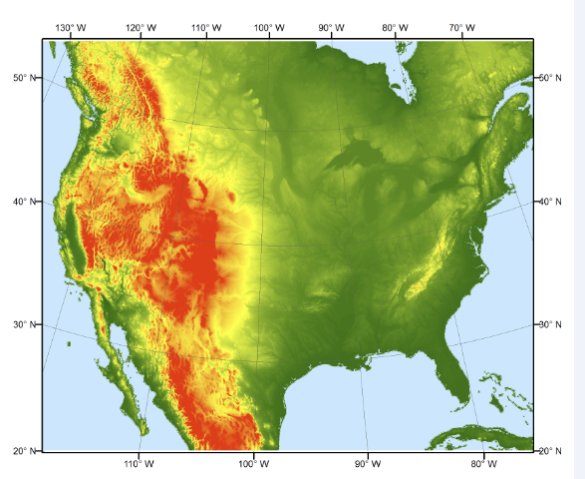
GEOGRID
HGT_M : Topographic elevation (units of meters) on the ‘mass grid’.
XLAT_M : Latitude coordinates, in decimal degrees, on the mass grid.
XLONG_M : Longitude coordinates, in decimal degrees, on the mass grid.
LANDUSEF : Land use fraction, in units of fraction.
SOILCTOP: Top layer soil texture category, in units of fraction
GREENFRAC : Monthly mean green vegetation fraction values (units of fraction).
ALBEDO12M : Monthly mean surface albedo values (units of %) not including snow effects.

Slide 35
Input forcing data for the Noah LSM, noahMP lsm
Incoming shortwave radiation (W/m2 )
Incoming longwave radiation (W/m2 )
Specific humidity (kg/kg)
Air temperature (K)
Surface pressure (Pa)
Near surface wind in the u- and v-components (m/s)
Liquid water precipitation rate (mm/s)

Slide 36
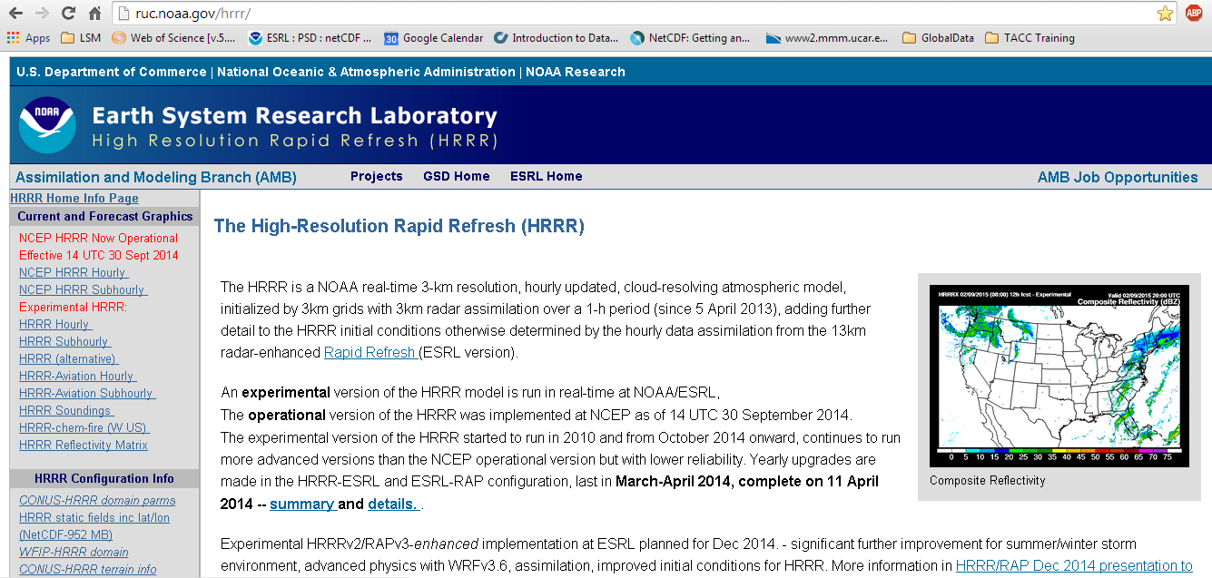
HRRR: high resolution rapid refresh

Slide 37
HRRR: high resolution rapid refresh

Slide 38
WRF-Hydro architecture (repeated)
HRLDAS NOAHMP -? RAPID -
http://www.ral.ucar.edu/projects/wrf_hydro/images/User_Guide_v1.0.pdf

Slide 39
Output data from WRF-Hydro:
Surface latent heat flux
Surface sensible heat flux
Ground heat flux
Ground surface and/or canopy skin temperature
Surface evaporation components (soil evaporation, transpiration, canopy water evaporation, snow sublimation and ponded water evaporation)
Soil moisture Soil temperature
Deep soil drainage
Surface runoff
Canopy moisture content Snow depth
Snow liquid water equivalent Stream channel inflow (optional with terrain routing)
Channel flow rate (optional with channel routing)
Channel flow depth (optional with channel routing)

Slide 40
https://ams.confex.com/ams/93Annual/flvgateway.cgi/id/23788?recordingid=23788

Slide 41
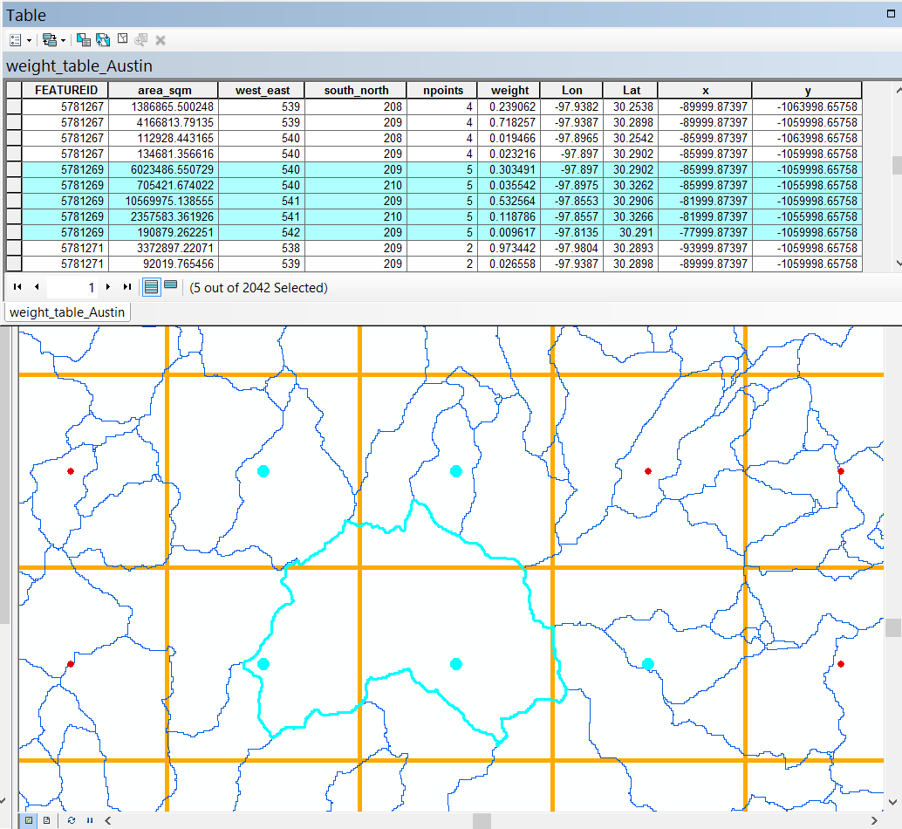
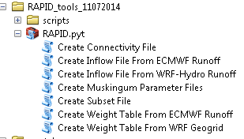
How to connect gridded input runoff data (WRFHydro) to NHDplus network
Runoff Downscaling Weight Table
540
541
542
210
209
From: Deng Ding/Nawajish Noman (ESRI)

Slide 42
Supercomputer support

Slide 43
WRF-hydro and RAPID benchmarking
WRF-hydro has been run (conus domain) using 16 nodes (one core) in each node. This can run in about 78 minutes for 24 hours forecast. (The test does not include the overhead for output).
But if I run 32 MPI tasks with 2 nodes or 64 MPI tasks with 4 nodes. It won't work due to the memory limitation.
Using 64 nodes (one core in each node), it takes 30 minutes to run one day.
RAPID takes 19.5 hours to run. The code needs to be modify since it gets really expensive as the domain gets larger (O)²

Slide 44
Timeline work at TACC (Testing and producing data for the summer institute)
Feb. 1: Final domains and mappings built. All data acquired processed and tested in a test case mode. 1 cycle per day (18z) scripting ready to activate
Mar. 1: Have all spin up data acquired and processed and initiate long term spin up starting from Oct 1 2014. Begin testing multiple cycles per day. Final cycles will be dictated by run time of each run and final cpu allocation. Estimate it will be very 3 or 4 hours.
Apr. 1: Complete method of distributing results to output centers (Unidata, RENCI, Alabama, NCSA)
May 1: All spin up complete. Initiate final operational cycles. Finalize default forecast products to be generated. Link results to visualization at National Water Center
June 1: Start of NFIE Summer Institute.

Slide 45
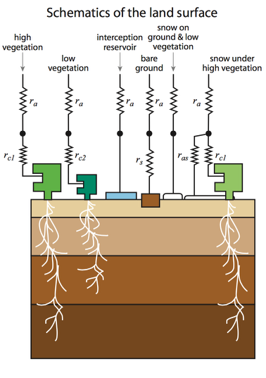
European Centre for Medium-Range Weather Forecasts (ECMWF)
Produce surface and subsurface runoff from the interaction of atmospheric and surface processes.
They produce NetCDF gridded datasets of weather forecasts for the entire world up to 15 days in advance.
Balsamo, G., Viterbo, P., Beljaars, A., van den Hurk, B., Hirschi, M., Betts, A. K. and Scipal, K. (2009), “A revised hydrology for the ecmwf model: Verification from field site to terrestrial water storage and impact in the integrated forecast system.” J. Hydrometeorol., 10, 623–643.

Slide 46
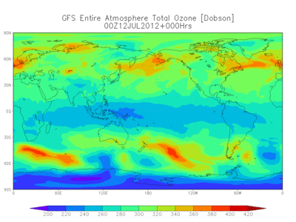
Atmospheric forcing
Several atmospheric models/datasets (some operational)
- Unique spatial domains, resolutions
- temporal resolutions
- AND data assimilation systems
Modeling groups: NCEP, NCAR, NASA, ECMWF etc.
Model outputs: Global Forecast System (GFS), Global Ensemble Forecasting System (GEFS), North American Mesoscale (NAM), Rapid Refresh (RAP), Rapid Update Cycle (RUC), High Resolution Rapid Refresh (HRRR)
Forcing Datasets : North American Land Data Assimilation System (NLDAS)/GLDAS, Global Data Assimilation System (GDAS), Climate Forecast System (CFS), North American Regional Reanalysis (NARR) etc.

Slide 47
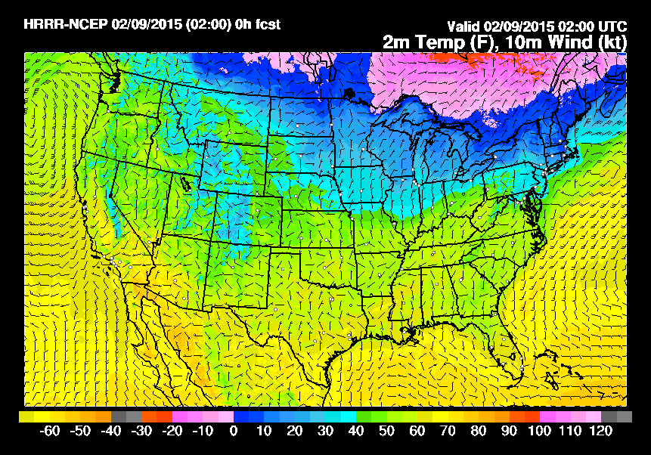
High Resolution Rapid Refresh (HRRR)
NOAA NCEP real-time 3 km resolution model
- Nested WRF model (cloud resolving atmospheric model)
Updated hourly
15 hour forecast
3 km radar assimilation
Initialized by RUC model
Variables of interest: Temp at 2 m, U and V wind at 2 m, relative humidity, specific humidity, precipitation rate, surface pressure

Slide 48
Accessing Real-time HRRR Forecasts
Time (Hours)
Forecast run at Hour 0
Forecast run at Hour 6
15
Time (Hours)
0
3
6
http://thredds-jumbo.unidata.ucar.edu/thredds/ncss/grib/HRRR/CONUS_3km/surface/Best?var=Temperature_height_above_ground&north=45&west=-134&east=-61&south=21&disableProjSubset=on&horizStride=1&time_start=2015-02-05T00:00:00Z&time_end=2015-02-09T17:00:00Z&timeStride=1&vertCoord=&accept=netcdf

Slide 49
NFIE-Hydro Workflow
Implemented in Microsoft Azure

Slide 50
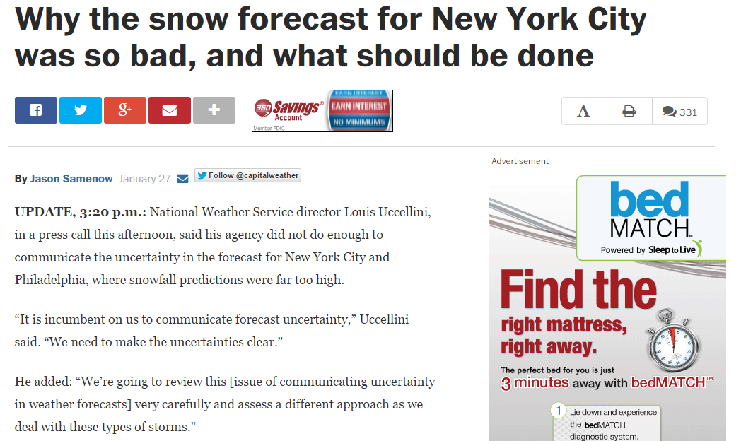
Winter Storm Warning – Jan. 27, 2015
http://www.washingtonpost.com/blogs/capital-weather-gang/wp/2015/01/27/why-the-snow-forecast-for-new-york-city-was-so-bad-and-what-should-be-done/

