Slide 1
NOAA National Weather Service
Hydrologic Forecast and Flood Warning Services
Edward Clark
Flash Flood Services Leader
Hydrologic Services Branch
NWS Office of Climate, Water and Weather Services

Slide 2
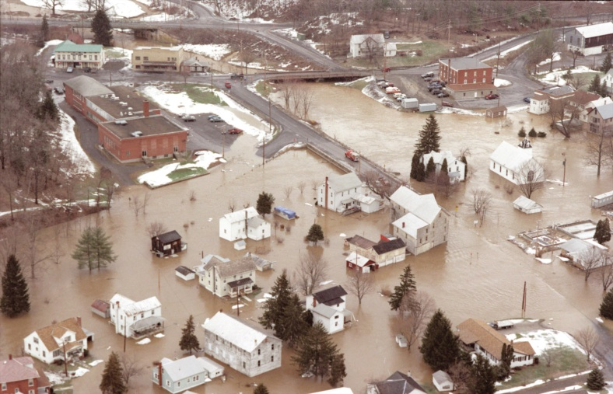
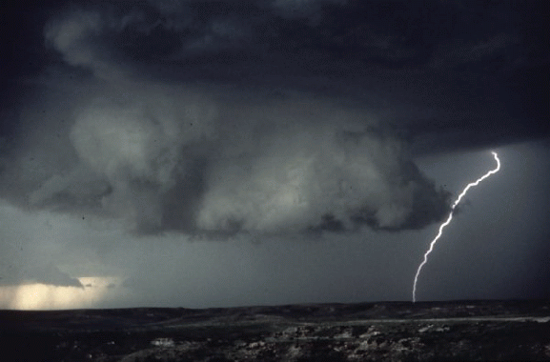
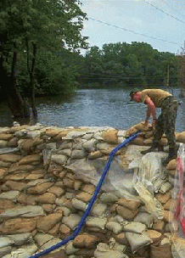
Socioeconomic Impacts
On average, over the past 30 years in the U.S., flooding has claimed over 95 lives and caused damages in excess of $8.2 billion annually
Floods occur in all 50 of the United States
Threat all months of the year
More fatalities than any other severe weather related phenomenon
More than half of all flood-related deaths result from motorists being
swept away in their vehicles
2
Notes:
Major events in Water year 2010
Atlanta, GA September 19-23, 2009
10-20 inches of rain in 24 hours
11 fatalities
$250 Million in damages
Record river flows
Nashville, TN May 1-3, 2010
10-16 inches of rain in 48 hours
31 fatalities
$2.3 billion in damages
Arkansas June 11, 2010
4-7 inches of rain in 24 hours most fell in about 6 hours
20 fatalities
$9 million in damages
River rose 20 feet in just a few hours

Slide 3
National Weather Service (NWS) Mission and Goals
Mission
“NOAA’s NWS provides weather, hydrologic, and climate forecasts and warnings for the United States, its territories, adjacent waters and ocean areas, for the protection of life and property and the enhancement of the national economy.”
NOAA Weather Ready Nation Objectives
Reduced loss of life, property, and disruption from high-impact events.
Improved freshwater resource management
Improved transportation efficiency and safety
Healthy people and communities due to improved air and water quality services
A more productive and efficient economy through environmental information relevant to key sectors of the U.S. economy services.

Slide 4
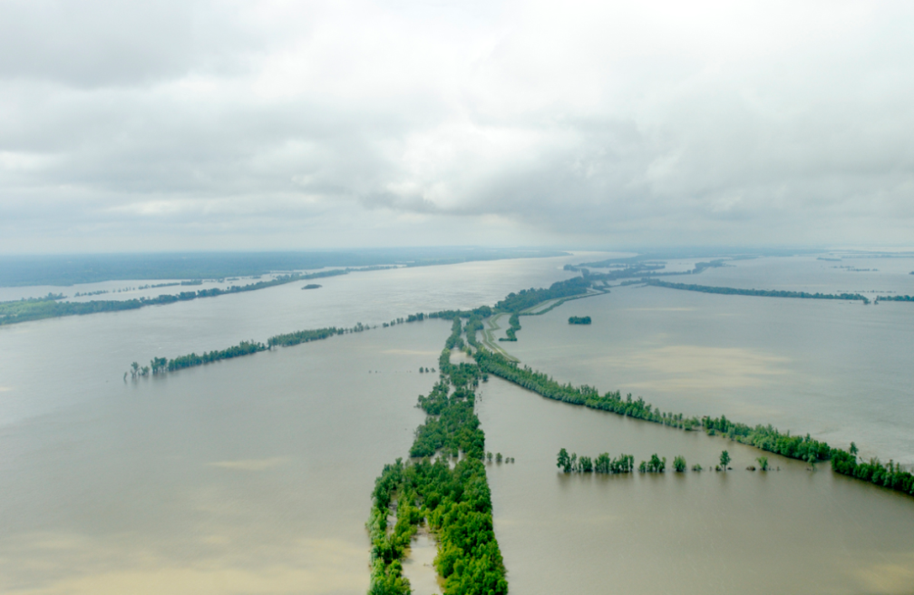
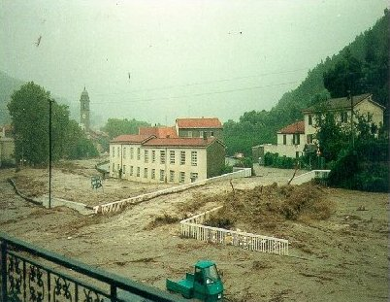
Floods versus Flash Floods
River Flood
  River rises to flood stage over many hours or days (> 6 hours from causative event)
  Longer lasting events
  Hydrometeorological event
Flash Flood
  Quick responding streams and rivers (impacts of flooding in < 6 hours after the causative event)
  Typically a meteorological event resulting from heavy rainfall, although can be the result of a dam break, levee failure, or ice jamming
4

Slide 5
NWS Operational Infrastructure
Notes:
Outline how The NWS produces hydrologic forecast products and services – for flash floods, river floods, water supply/drought.
National, Regional and Local expertise – adding value from the national centers, to the regional modelers and the local experts.

Slide 6
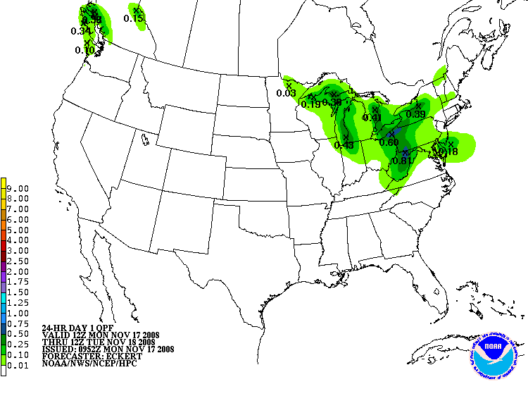
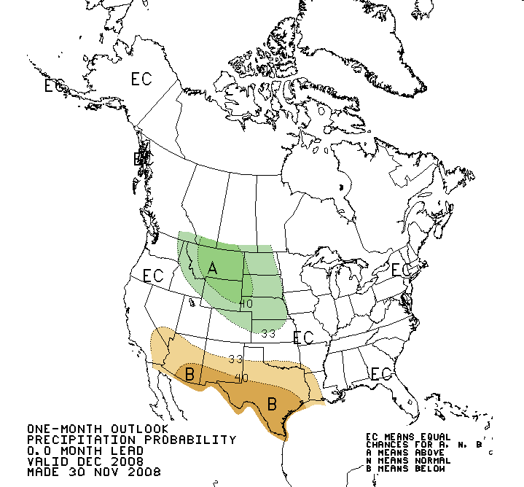
Hydrologic Services Roles and Responsibilities
NCEP Centers – Nation Guidance and Analysis
  Weather Prediction Center (WPC)
  Storm Prediction Center (SPC)
  Climate Prediction Center (CPC)
ACUS3 KMKC 041249
SWOMCD
MKC MCD 041249
OKZ000-041600-
SPC MESOSCALE DISCUSSION #0353 FOR SOUTHWEST TO NORTHEAST OKLAHOMA CONCERNING...HEAVY RAINFALL...
RAINFALL RATES UP TO 3 INCHES PER HOUR CAN BE EXPECTED TO CONTINUE FOR THE NEXT FEW HOURS IN A 50 MILE WIDE BAND FROM COMANCHE COUNTY NORTHEASTWARD ACROSS OKC TO OSAGE COUNTY.
TRAINING THUNDERSTORMS HAVE DEVELOPED RAPIDLY FROM JUST EAST OF LAWTON THROUGH OKC TO JUST WEST OF BARTLESVILLE. 12Z SURFACE ANALYSIS SHOWS ….

Slide 7
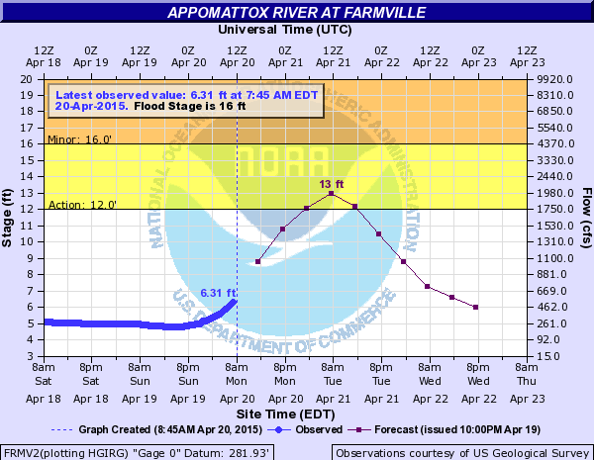
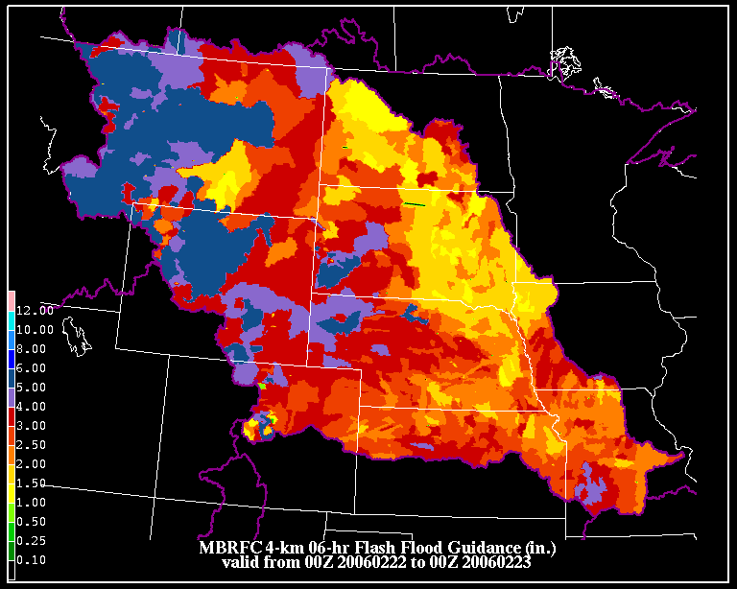
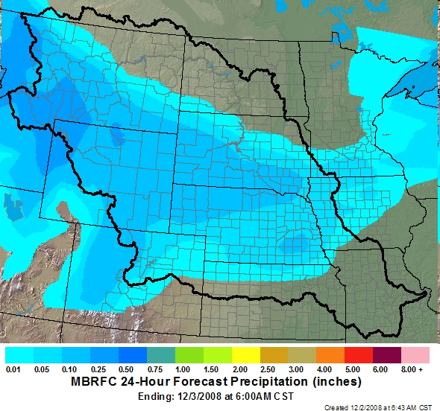
Hydrologic Services Roles and Responsibilities
River Forecast Centers (RFCs) – operate, and manage a regional hydrologic model
Activities
  Multi-sensor precipitation analyses
  Quantitative Precipitation Forecast (QPF)
  Hydrologic Modeling at Gauged Points
  Routine multi-agency collaboration
Outputs
  River forecast guidance (deterministic and probabilistic) with extended service/hours during flood events
  Flash flood guidance
  Water supply forecasts

Slide 8
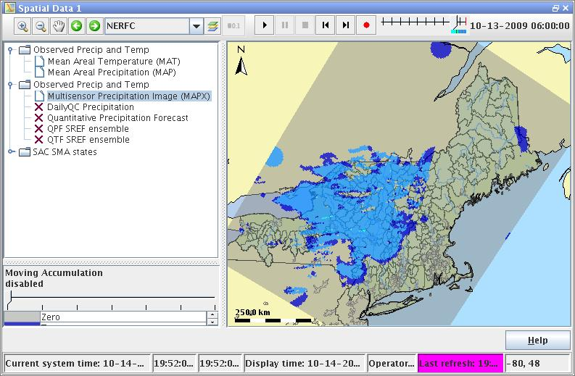
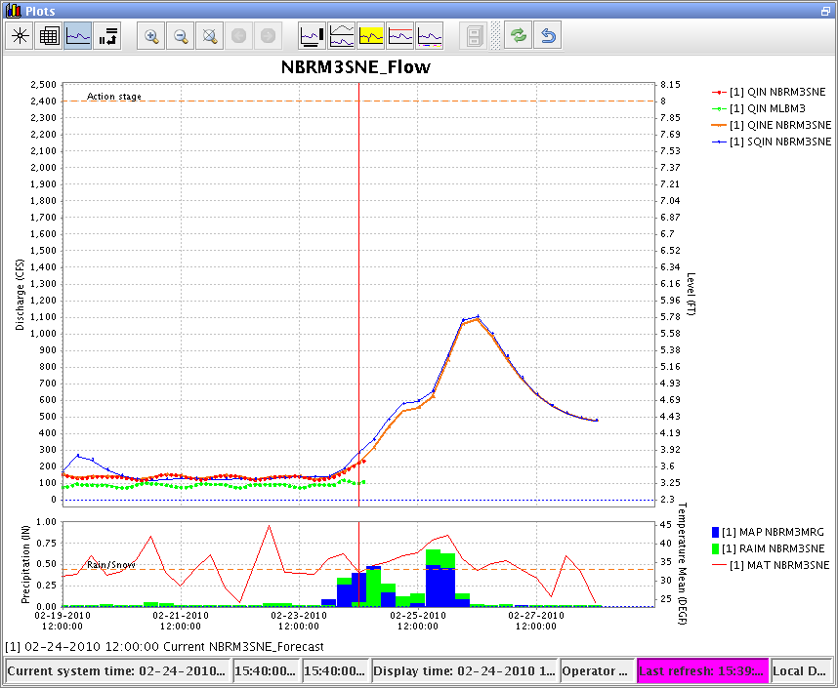
Community Hydrologic Prediction System (CHPS)
Flexible, open modeling architecture linking program elements
FC
Community Hydrologic Prediction System
FEWS Models
Models from Federal, State, Local, University and Partners
FEWS
Other Models
NWS Models
USACE Models
Implementation Status: Complete
CHPS prototype hardware & software at all 13 RFCs
Switched to Operational System on January 13, 2012
Retired legacy NWSRFS system
Notes:
8
The highest near-term priority of the hydrology program is to complete the implementation of the Community Hydrologic Prediction System (CHPS), which provides the foundation that will enable future S&T enhancements. FEWS is the software system through which Integrated Water Resource Science and Services will foster broader collaboration across multiple agencies. FEWS provides standard system infrastructure, data formats, and adapter mechanisms to allow modules to “talk to” one another.
For nearly three decades, the NWS has been using a very closed system for hydrologic forecasting, which has constrained incorporation of new science and technology developed by our federal partners and by universities. CHPS turns that around – it’s an open service-oriented architecture that facilitates the incorporation of new tools and information, and makes it possible for the first time to establish interoperability with our federal partners.
CHPS implementation is underway now and is scheduled to be completed by October 2010.

Slide 9
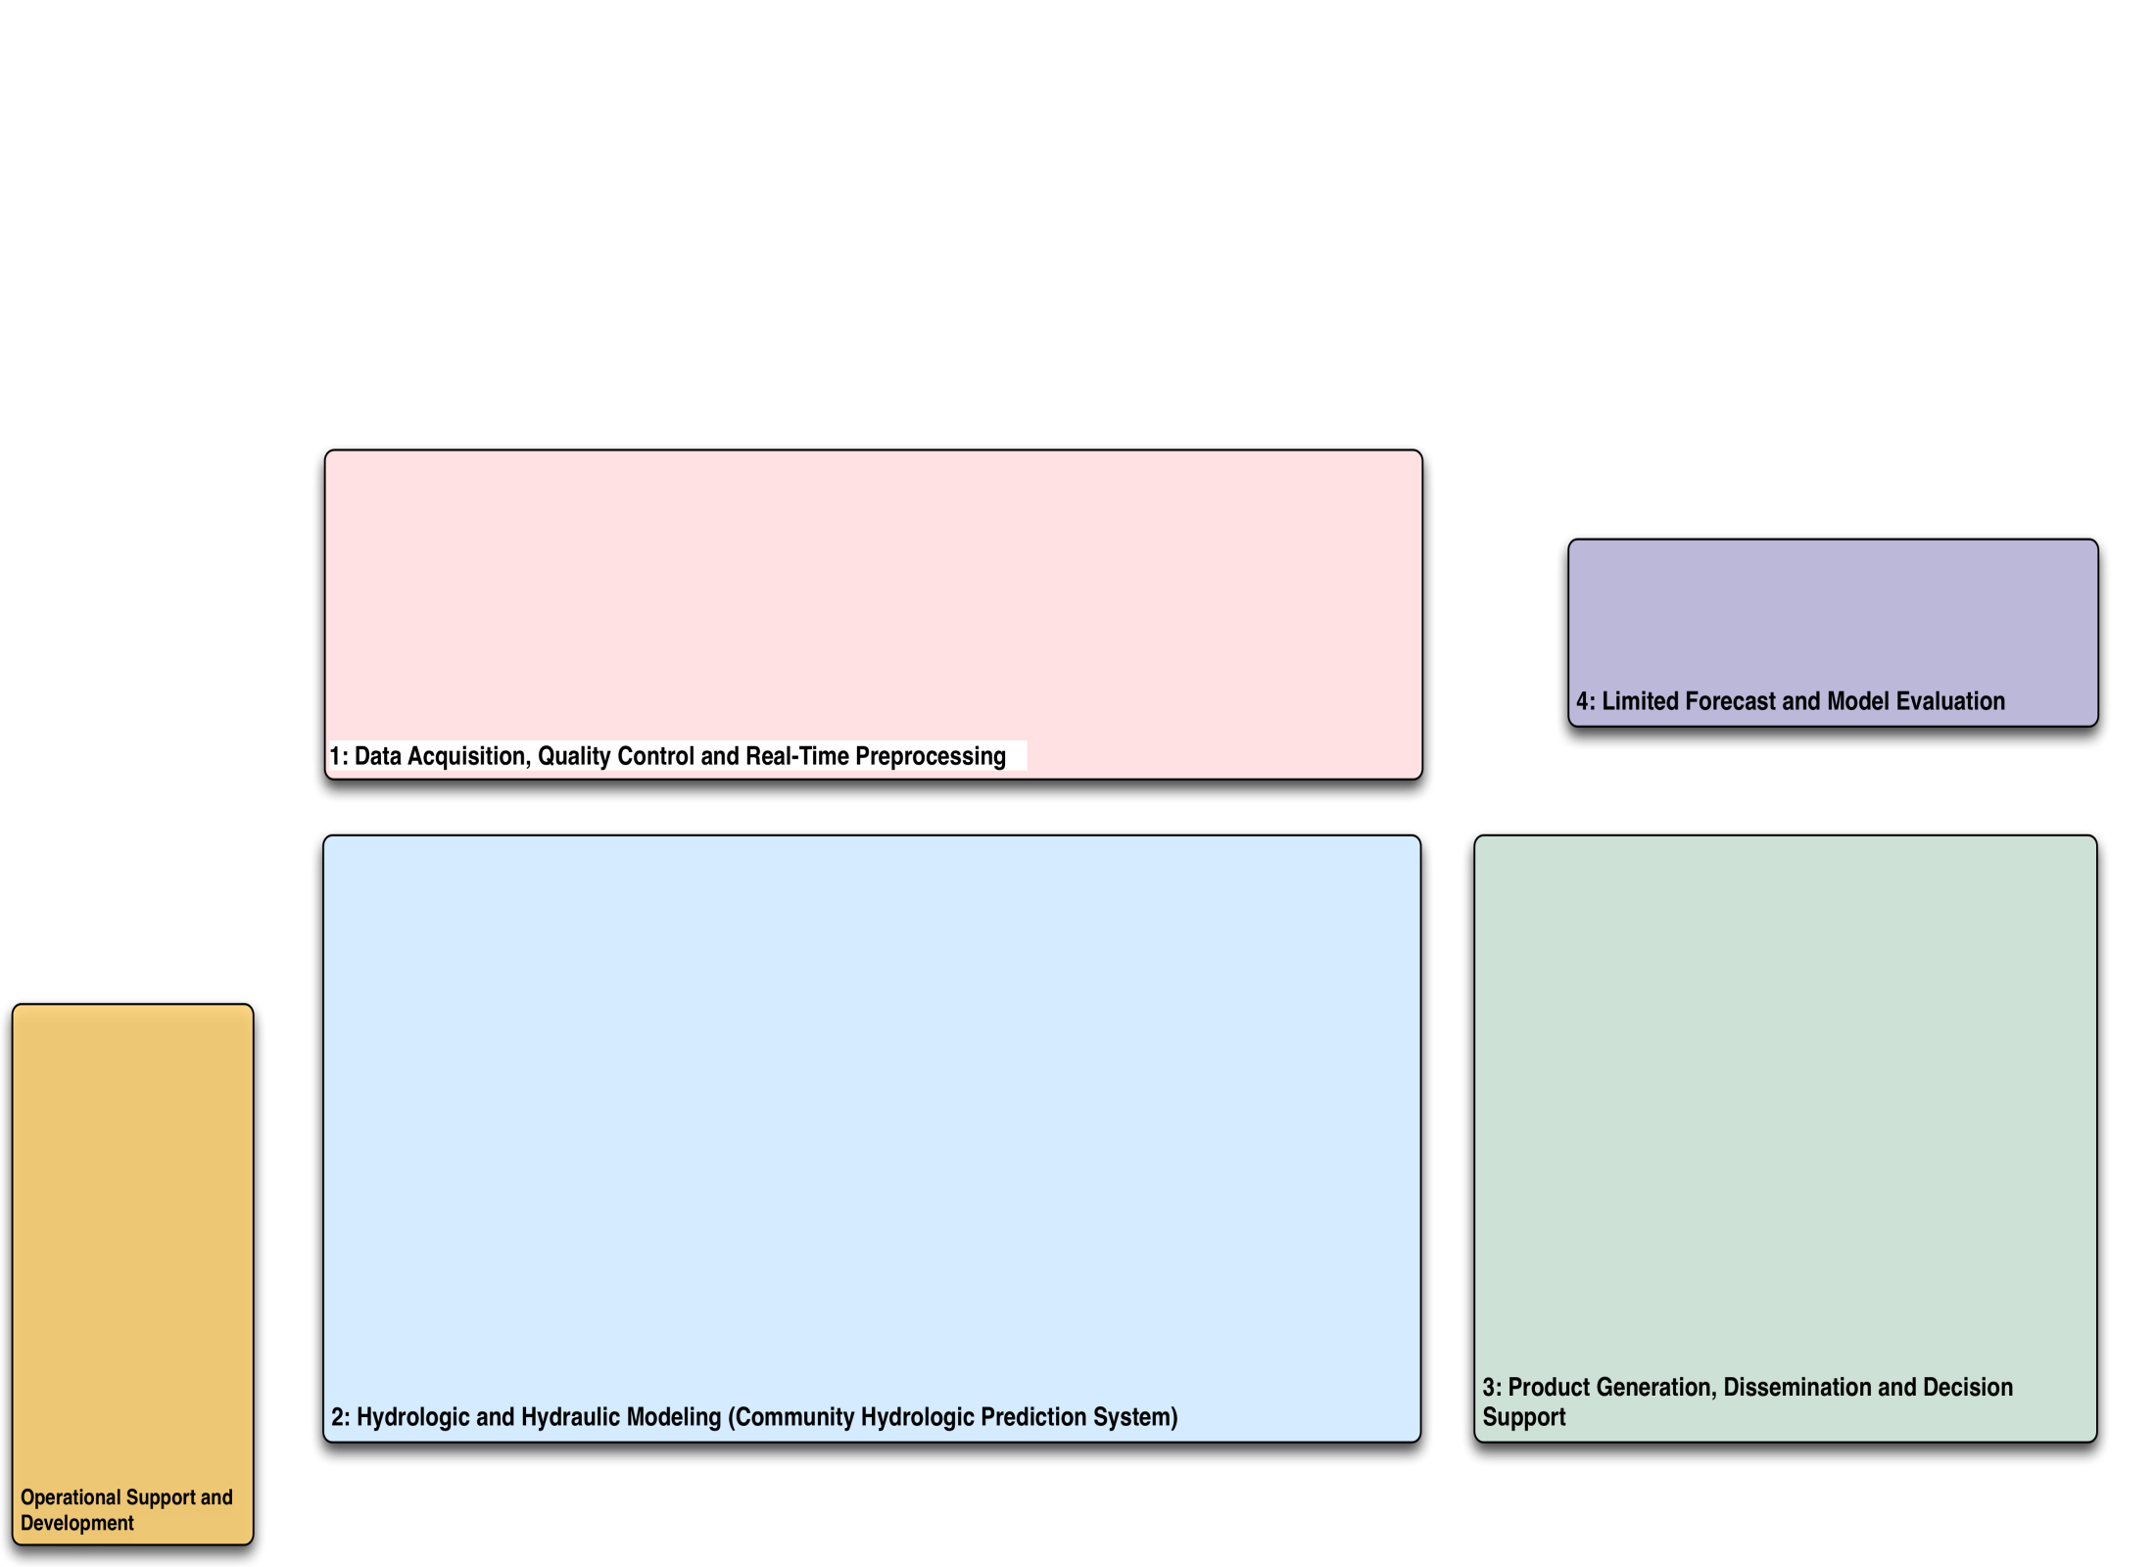
End-to-End River Forecast Process
1 - Data Acquisition, Quality Control and Real-time Processing
4 - Verification
3 – Product Generation, Dissemination, and Decision Support Services
2 - Hydrologic and Hydraulic Modeling within the Community Hydrologic Prediction System (CHPS)
Notes:
At a high level, the process is comprised of 4 components:
Data collection activities that include quality control and real-time pre-processing for model ingest
Execution of the Hydrological and Hydraulic models that simulate both the natural runoff and water management that occurs in a watershed
Processing of model output to generate products supporting WFO watch warning and advisory process, public dissemination and decision support service across all national, regional and local NWS offices.
And limited verification of components of the forecast process and warning products.

Slide 10
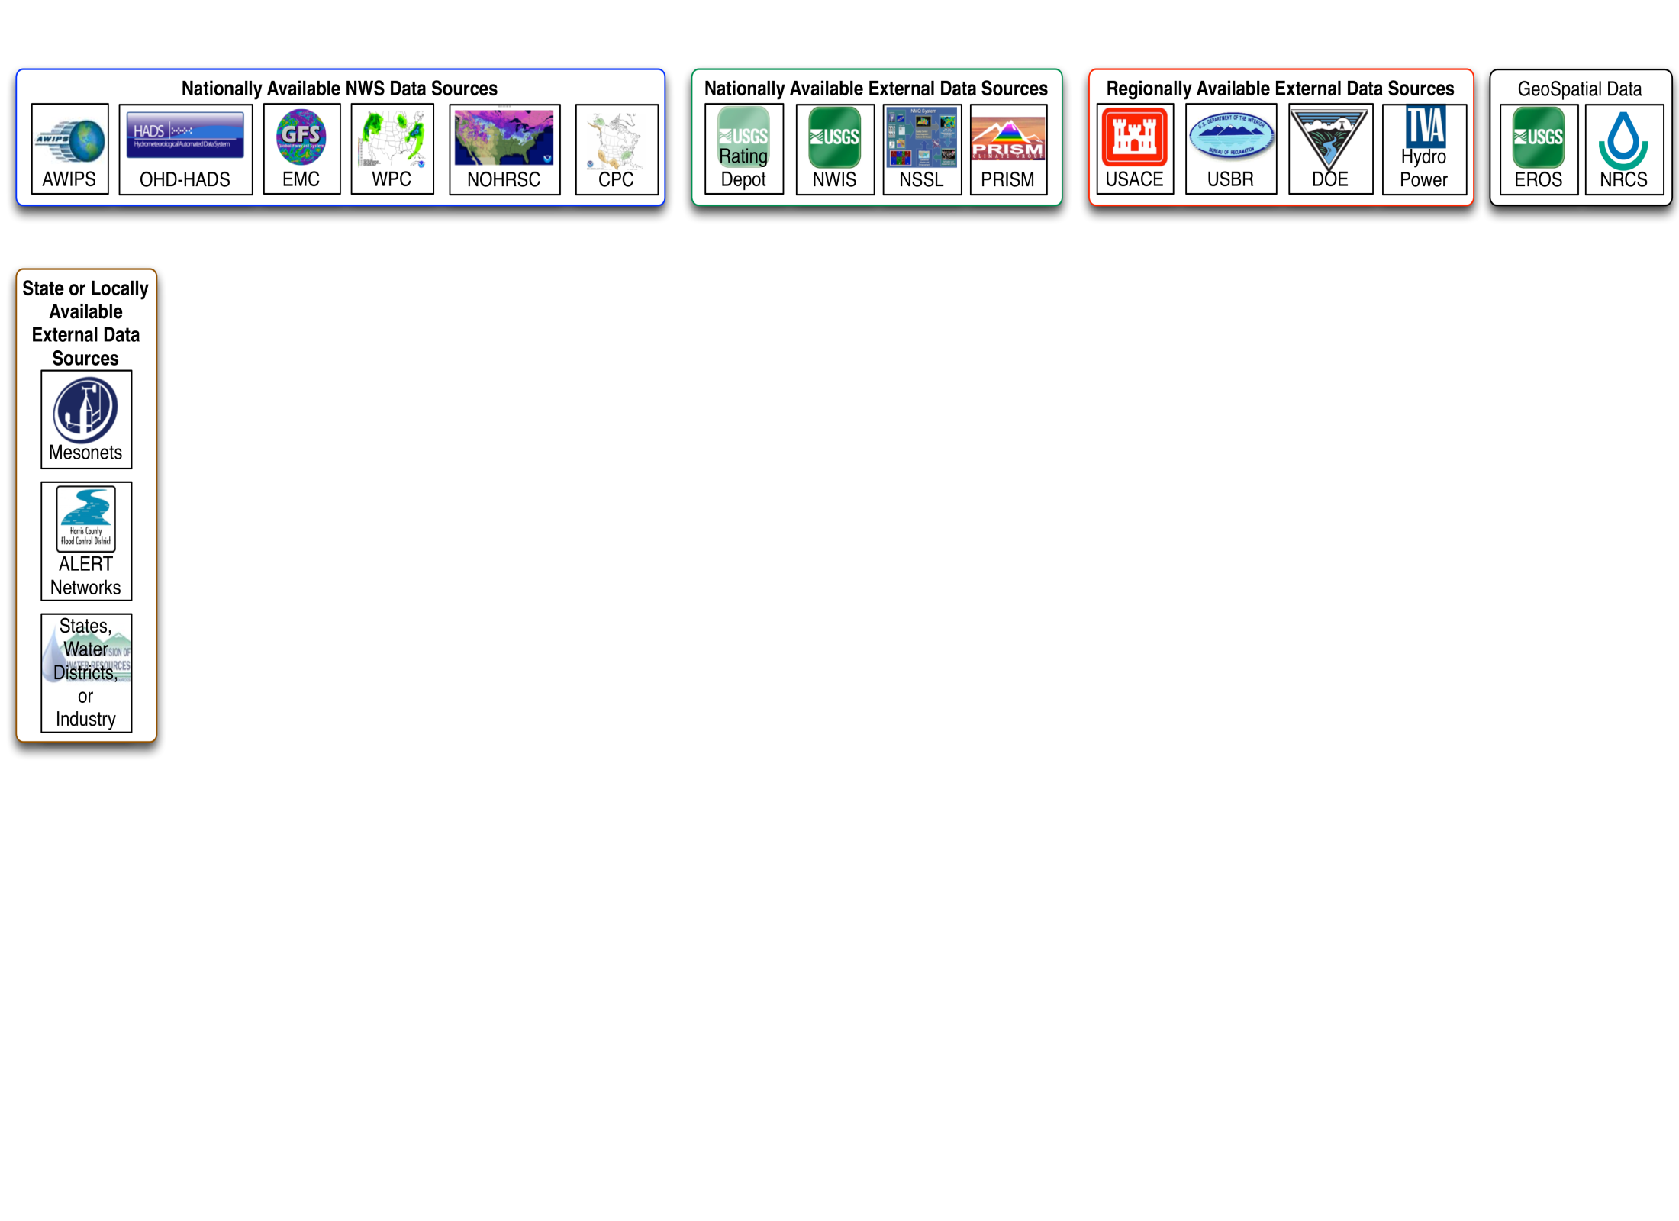
Relationships with federal, regional and local partners are essential for the initial discovery and routine acquisition of essential forcing data.
Notes:
Unlike atmospheric modeling, hydrologic processes and associated modeling is significantly impacted by human interaction with river systems.
Developing relationship with entities that control water is essential for the discovery of data needed to calibrate the models and to ensure access to the data for operational forecasting.
The presence of experts in regional water resources centers, such as the Service Coordination Hydrologist at the RFC and Service Hydrologist and the WFOs, ensures a connection with the stakeholder as both a data provider and user of NWS services.

Slide 11
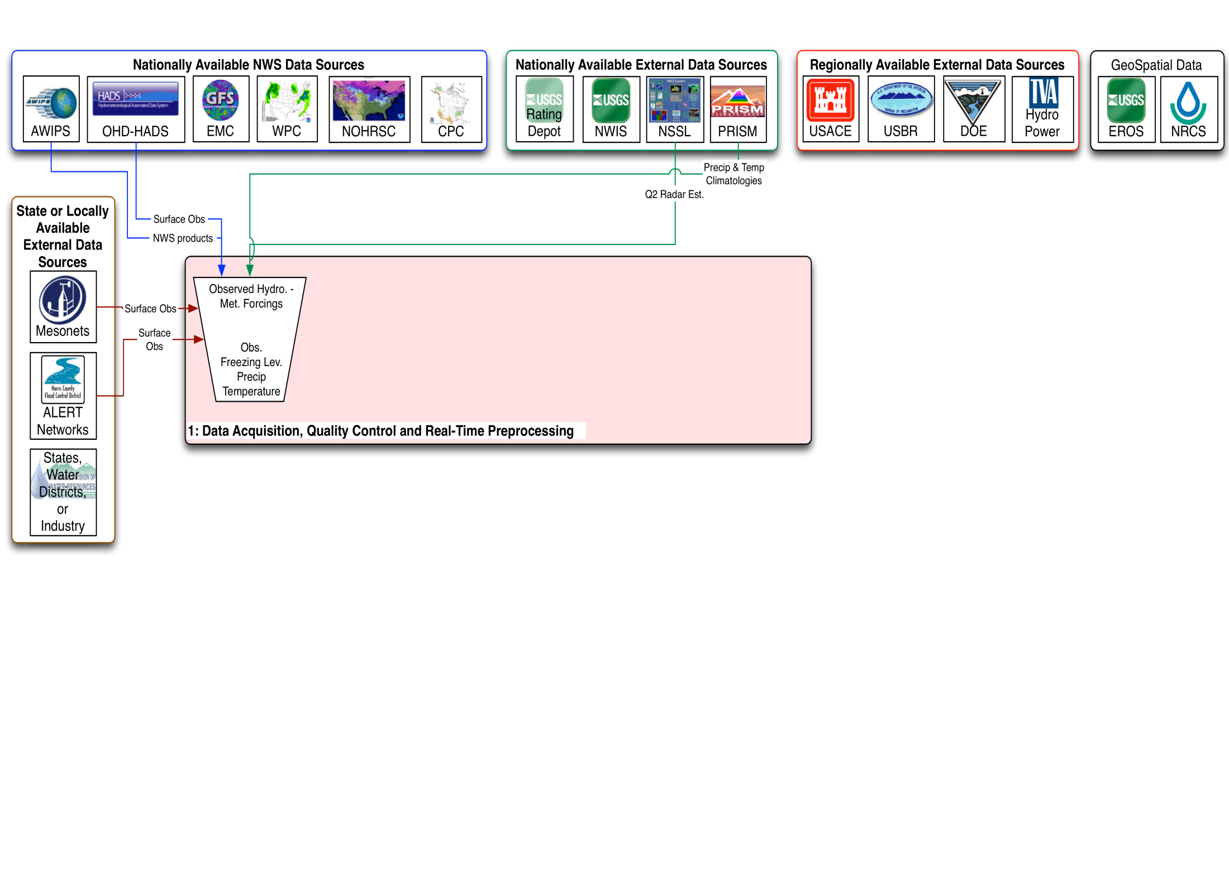
Notes:
Data ingest begins with observed and estimated atmospheric surface observations.
This process includes significant quality control of precipitation gage observations and radar rain-fall estimates to produce the best quantitative precipitation estimate data set.

Slide 12
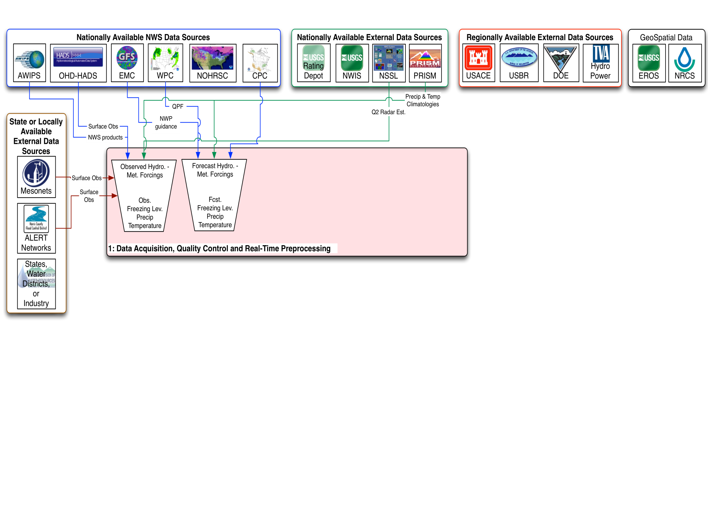
Notes:
Data projecting the future surface conditions is then generated, coordinated with WFO and neighboring RFCs, and processed into model input formats.
It is is important to note that all RFC QPF begins with the information generated by WPC.
QPF is required as both a deterministic and probabilistic input

Slide 13
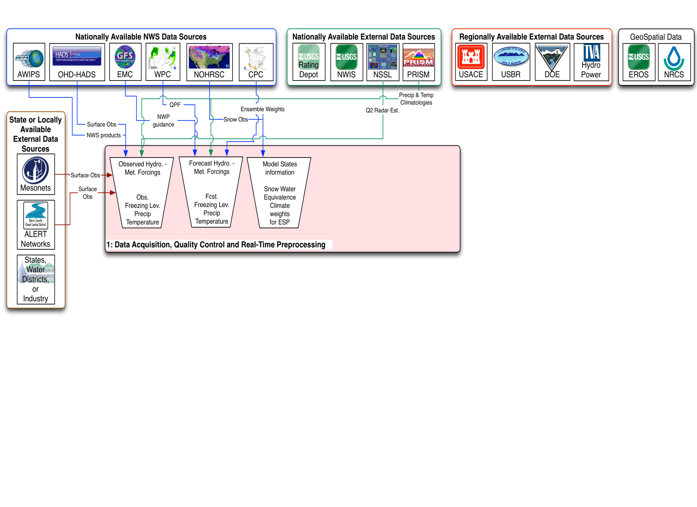
Notes:
Also included in the forecast process are routine updates to the model state parameters, in particular the snow water equivalence and areal extent of cover.
Products from CPC are used in both long range deterministic and ensemble forecasts.

Slide 14
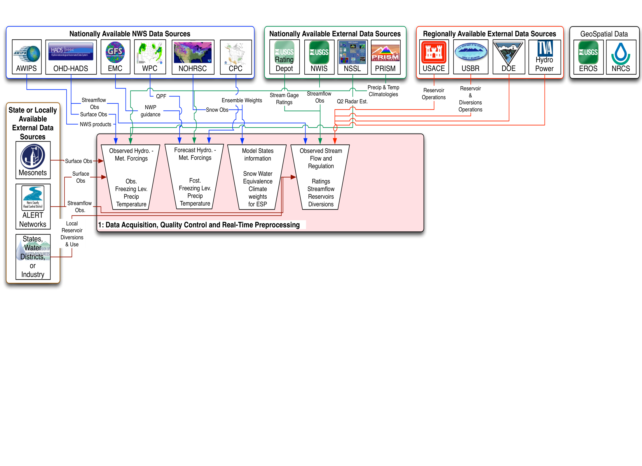
Notes:
A critical component of the process is the acquisition and quality control of observed streamflow conditions as well as the anthropogenic impacts through water management activities on the river flow conditions.
This includes the observations of reservoir operations, large scale diversions, consumptive use of water over a reach, and water returns to the channel such as those from trans-basin diversions.

Slide 15
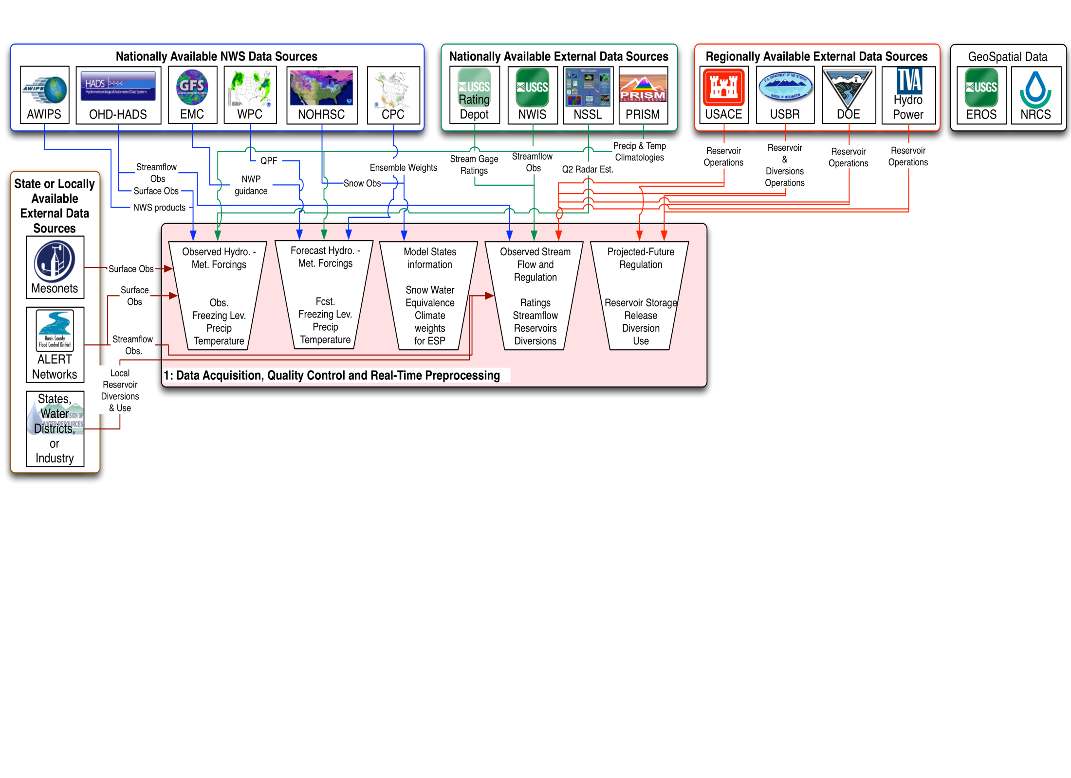
Notes:
Similar to the forecast atmospheric conditions, the modeling process requires estimates of future water management impacts on the watershed.
Again, this includes the observations of reservoir operations, large scale diversions, consumptive use of water over a reach, and water returns to the channel such as those from trans-basin diversions.
An unmet science requirement is development of water management projections as both single value and probabilistic input.

Slide 16
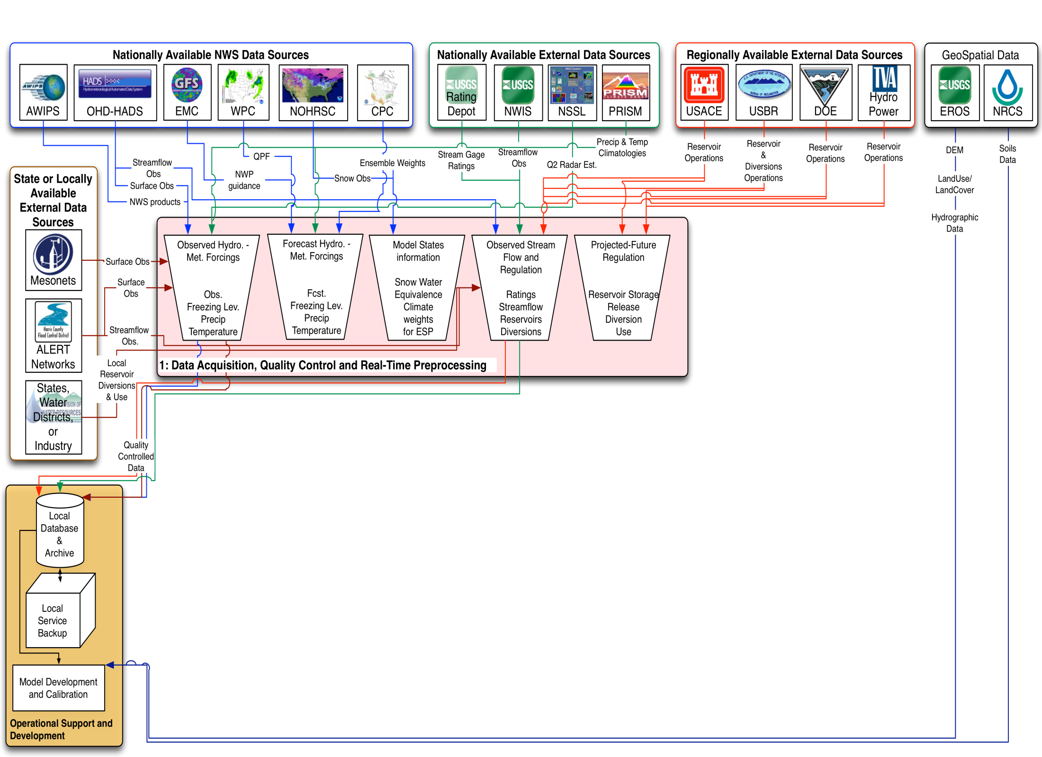
Notes:
In addition to preparing the forcing data for model execution, quality controlled data is retained in local databases and used for calibration or periodic recalibration of the operational hydrologic and hydraulic model.
Model development and calibration is also facilitated by geospatial data developed by the federal partners such as soils, elevation and hydrography data sets.

Slide 17
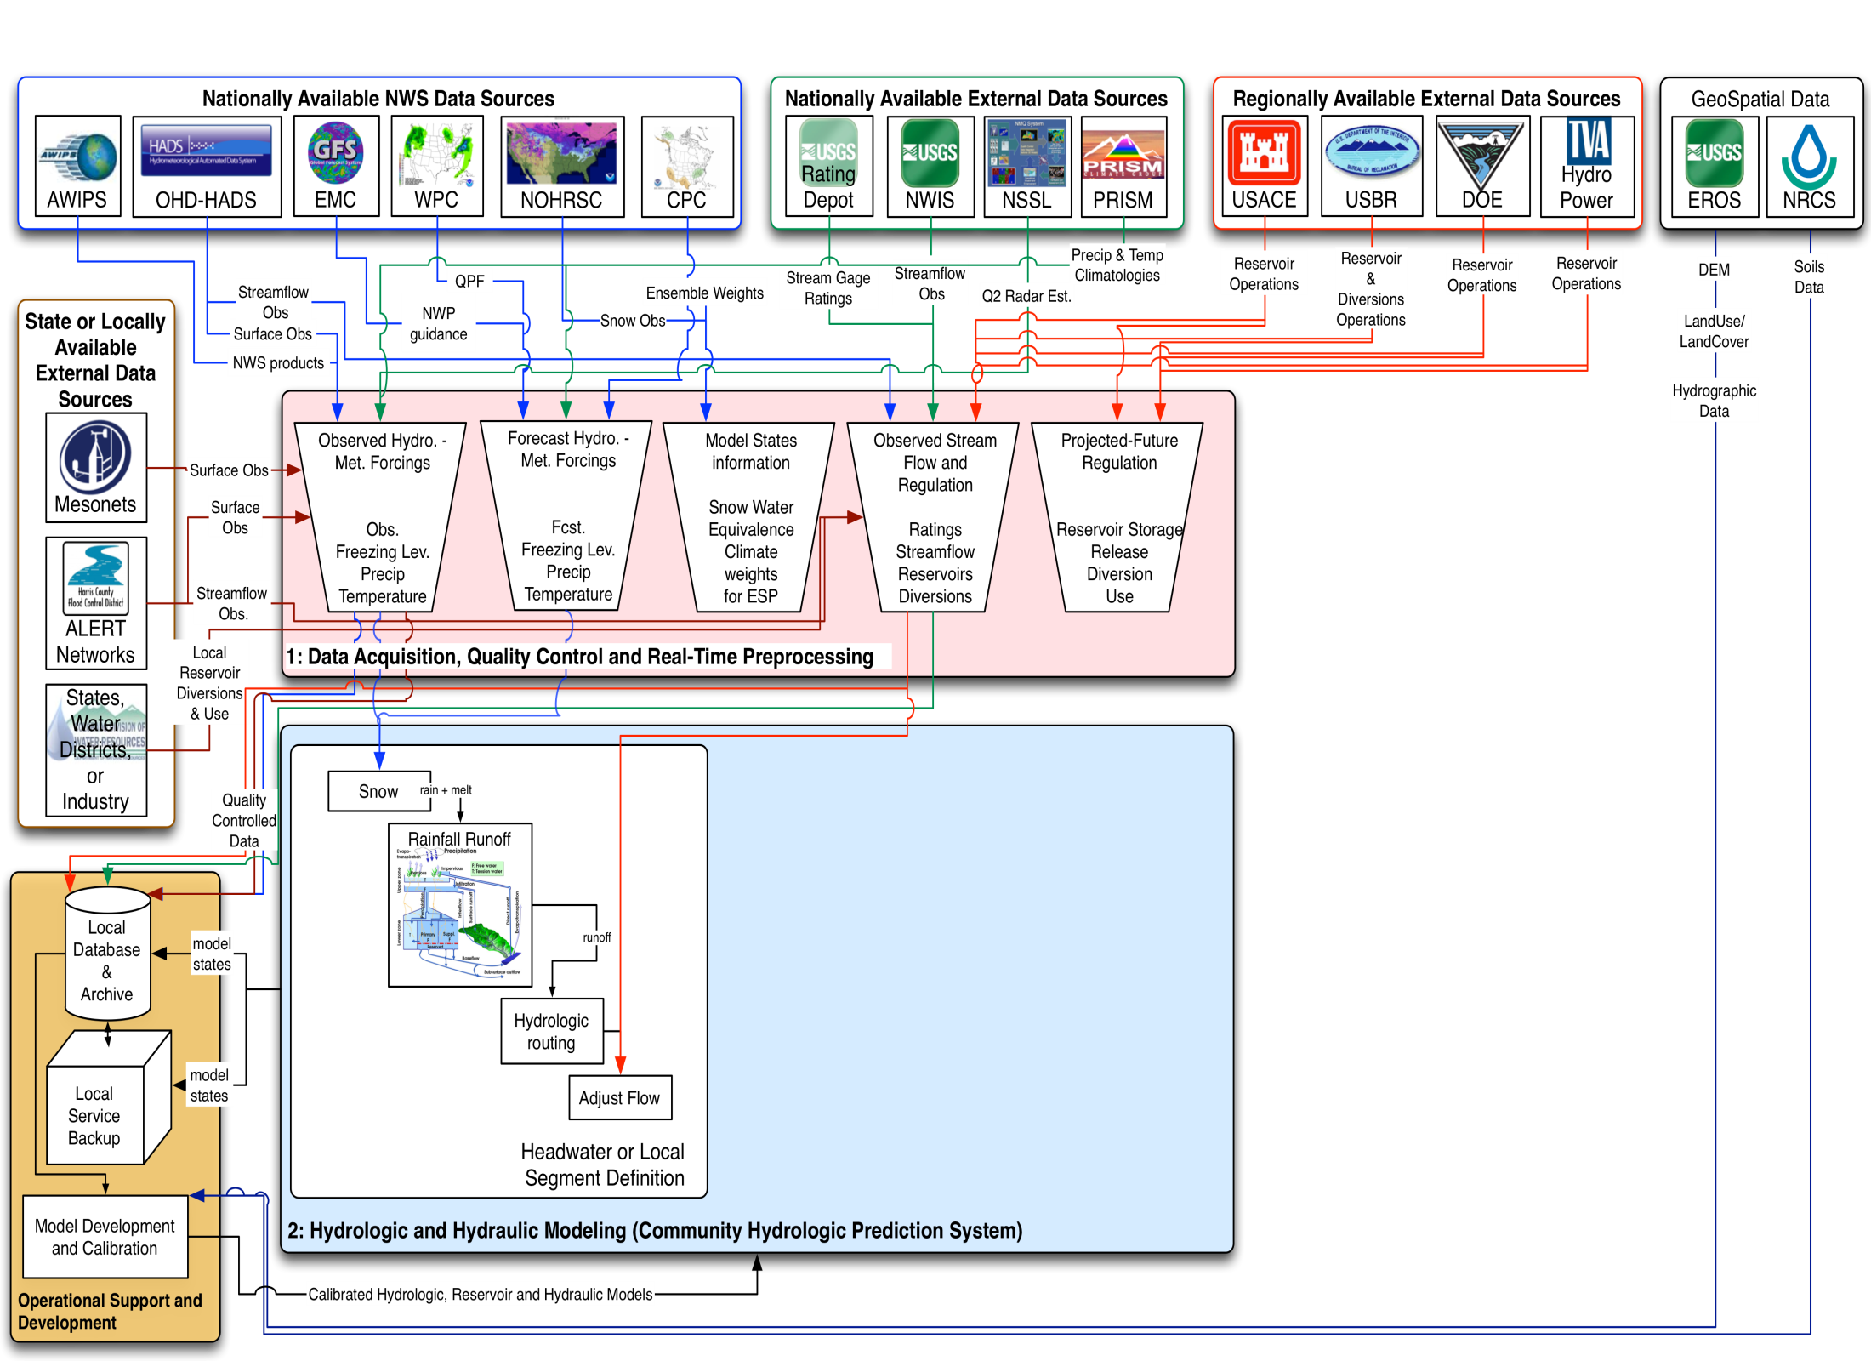
Notes:
Each RFC uses the Community Hydrologic Prediction System which is a collections models simulating the hydrologic, water management, and hydraulics process within a watershed.
Watershed are broken down into ‘segment’ that simulates these natural and regulated stream flow processes above a streamflow gage.
A typical headwater or local watershed model segment include the snow model, frozen ground, rainfall runoff model, hydrologic routing and flow adjustments to account for any anthropogenic alterations to the streamflow such as diversions or consumptive use.

Slide 18
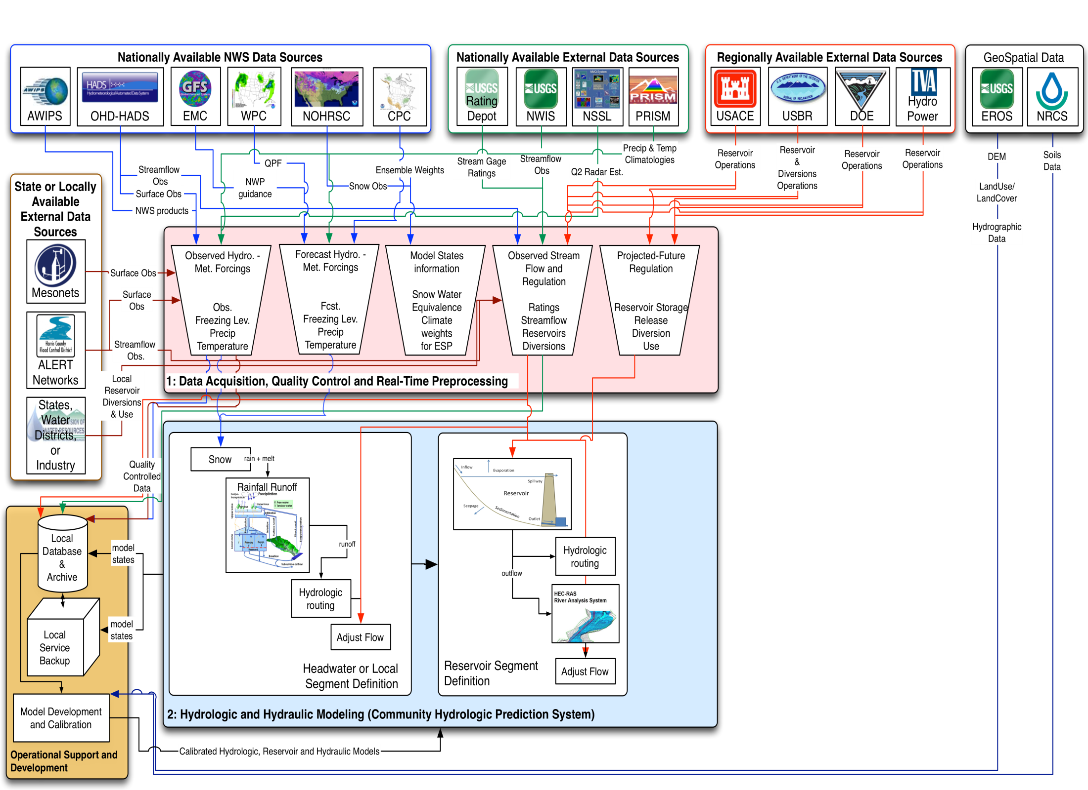
Notes:
As necessary, specific segments are developed to simulate reservoir operations.
Across the CONUS there are 402 USACE routinely* operated reservoirs, an over 3300 reservoirs with storage greater than 10K Acre-Feet
And, along many mainstem river systems or areas of tidal influence, the RFCs rely in a hydraulic routing model from the USACE to simulate the conveyance of water from upstream to downstream points.
*USACE assumes operations of all federally owned reservoirs when pool elevation Is in flood control levels

Slide 19
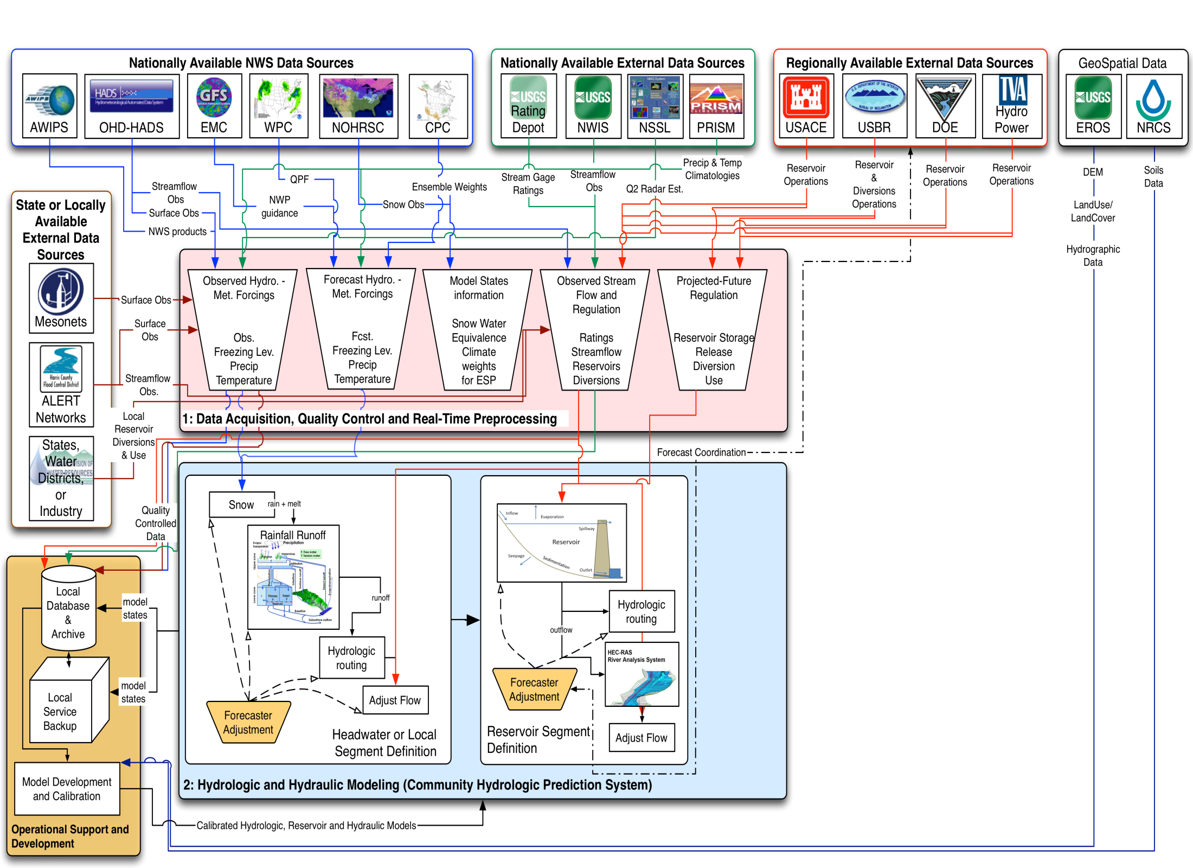
Notes:
During execution of the model, forecasters review each segment and make modifications to the model states or operations.
These “mods” are a means to account for uncertainty in the simulation process.
Essential “Mods” are used to incorporate forecaster knowledge of the basins, as well as coordinated information on future water management operations in the model. Currently, the later, is largely based on person-to-person communication.
BG: While data assimilation techniques are advancing, OHD testing suggest that Data Assimilation alone, due to the limited streamflow and soil moisture observations can not outperform the process that includes forecaster adjustment.

Slide 20
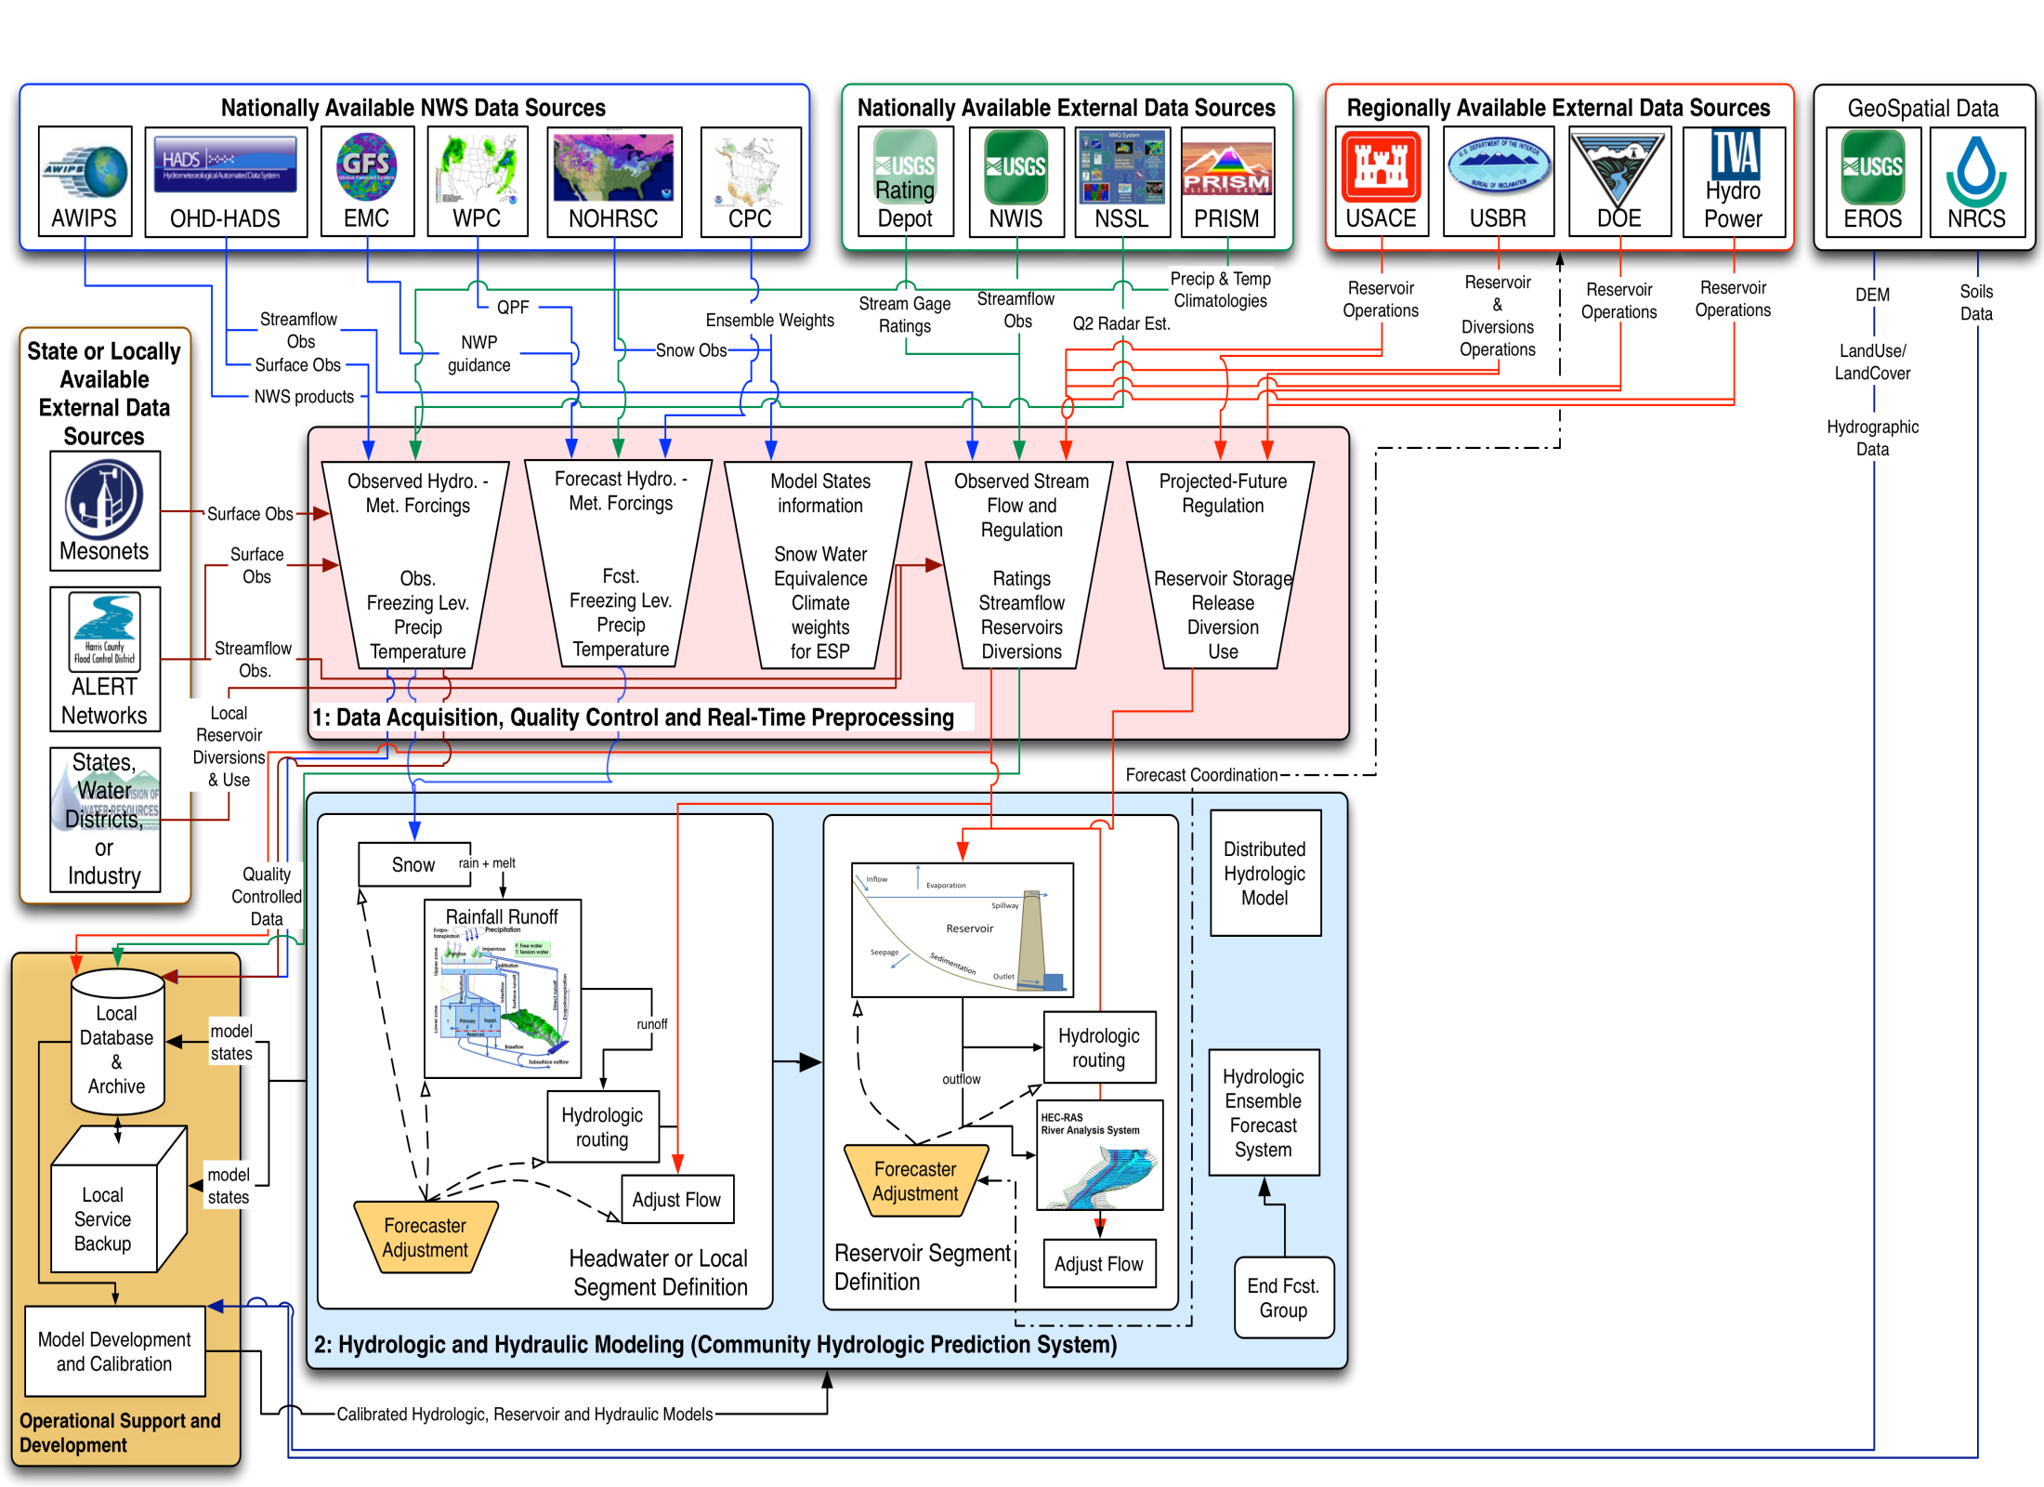
Notes:
This process is used for each segment within a watershed or forecast group and is iterated over the RFC’s area of responsibility.
There are approx 6700 total segments in the RFC’s defined workflows
Additional packages are executed within CHPS to leverage workflows and model states to produce ensemble stream flow estimates.
Distributed hydrologic models are executed with the same forcings data to provide flash flood guidance to the Weather Forecast Offices.

Slide 21
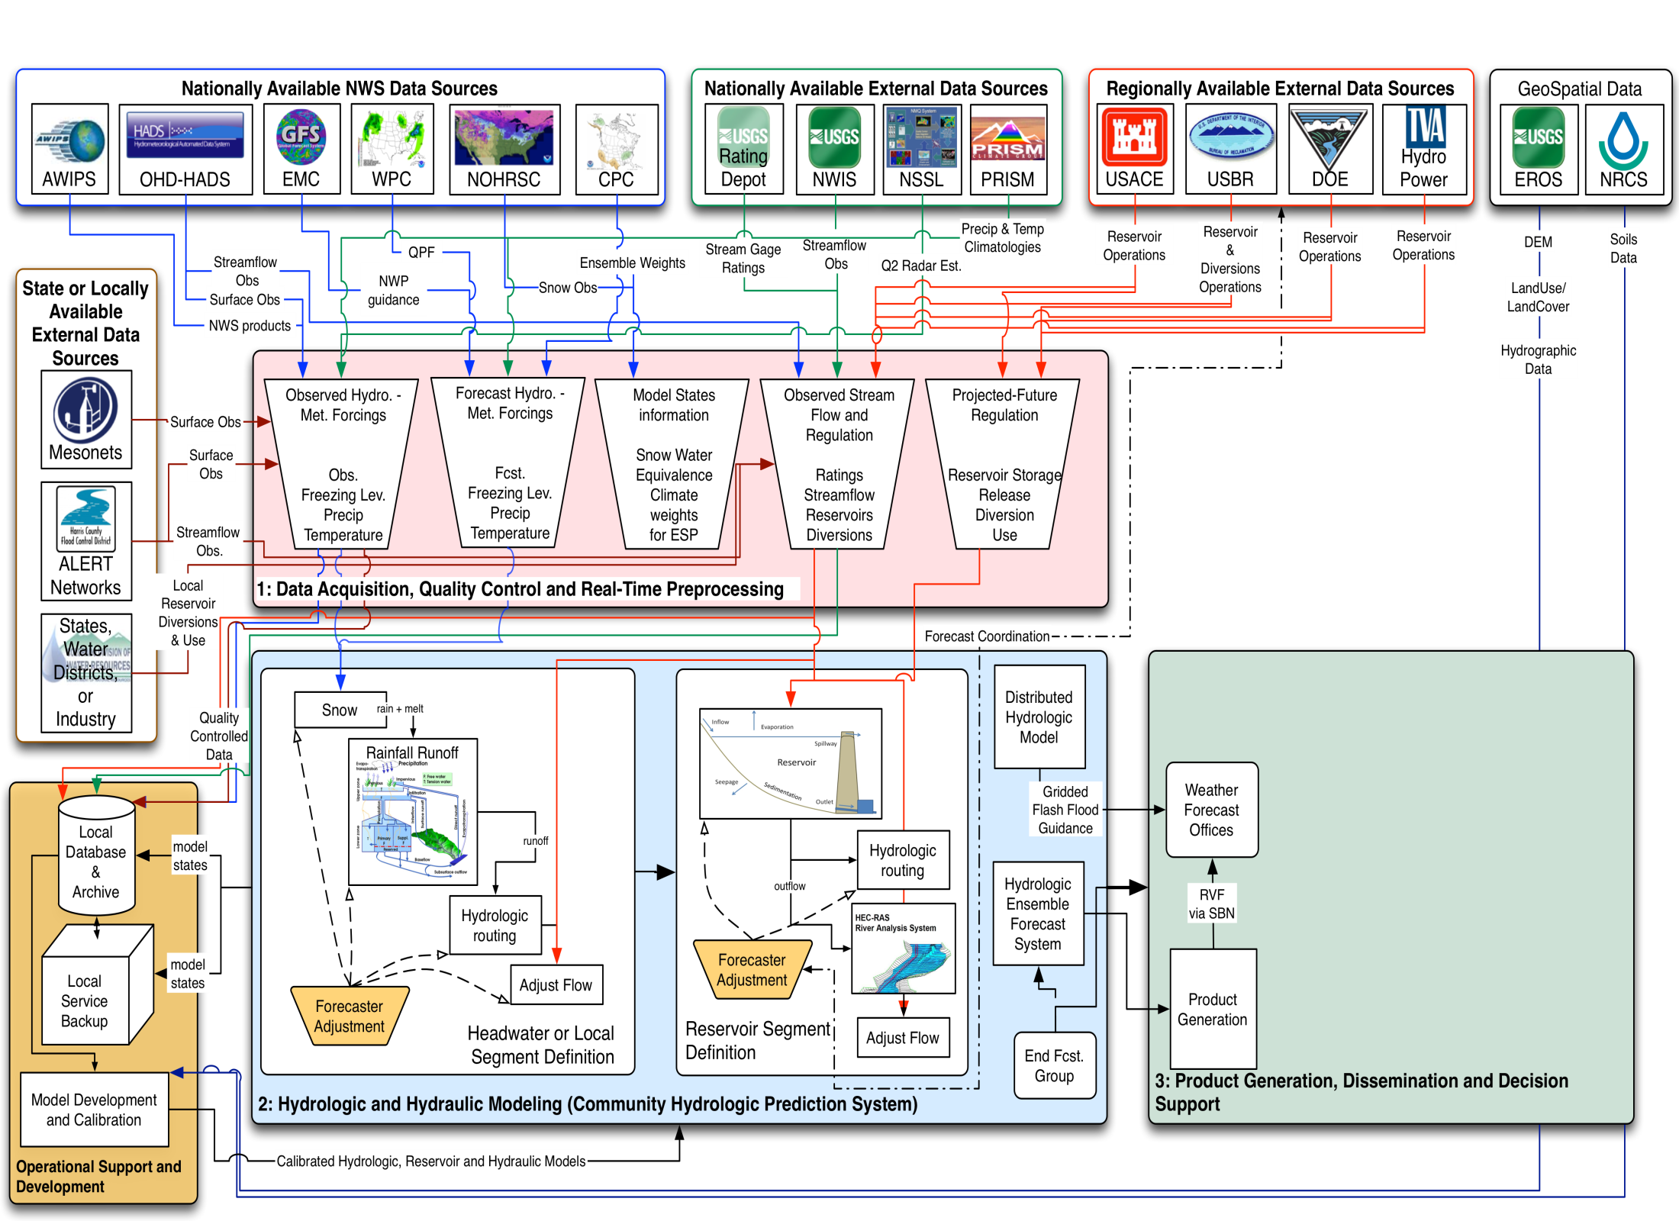
Notes:
Output from the model is post processed and combined with the quality controlled observations to produce river forecast products disseminated over the Satellite broadcast Network to the WFOs.

Slide 22
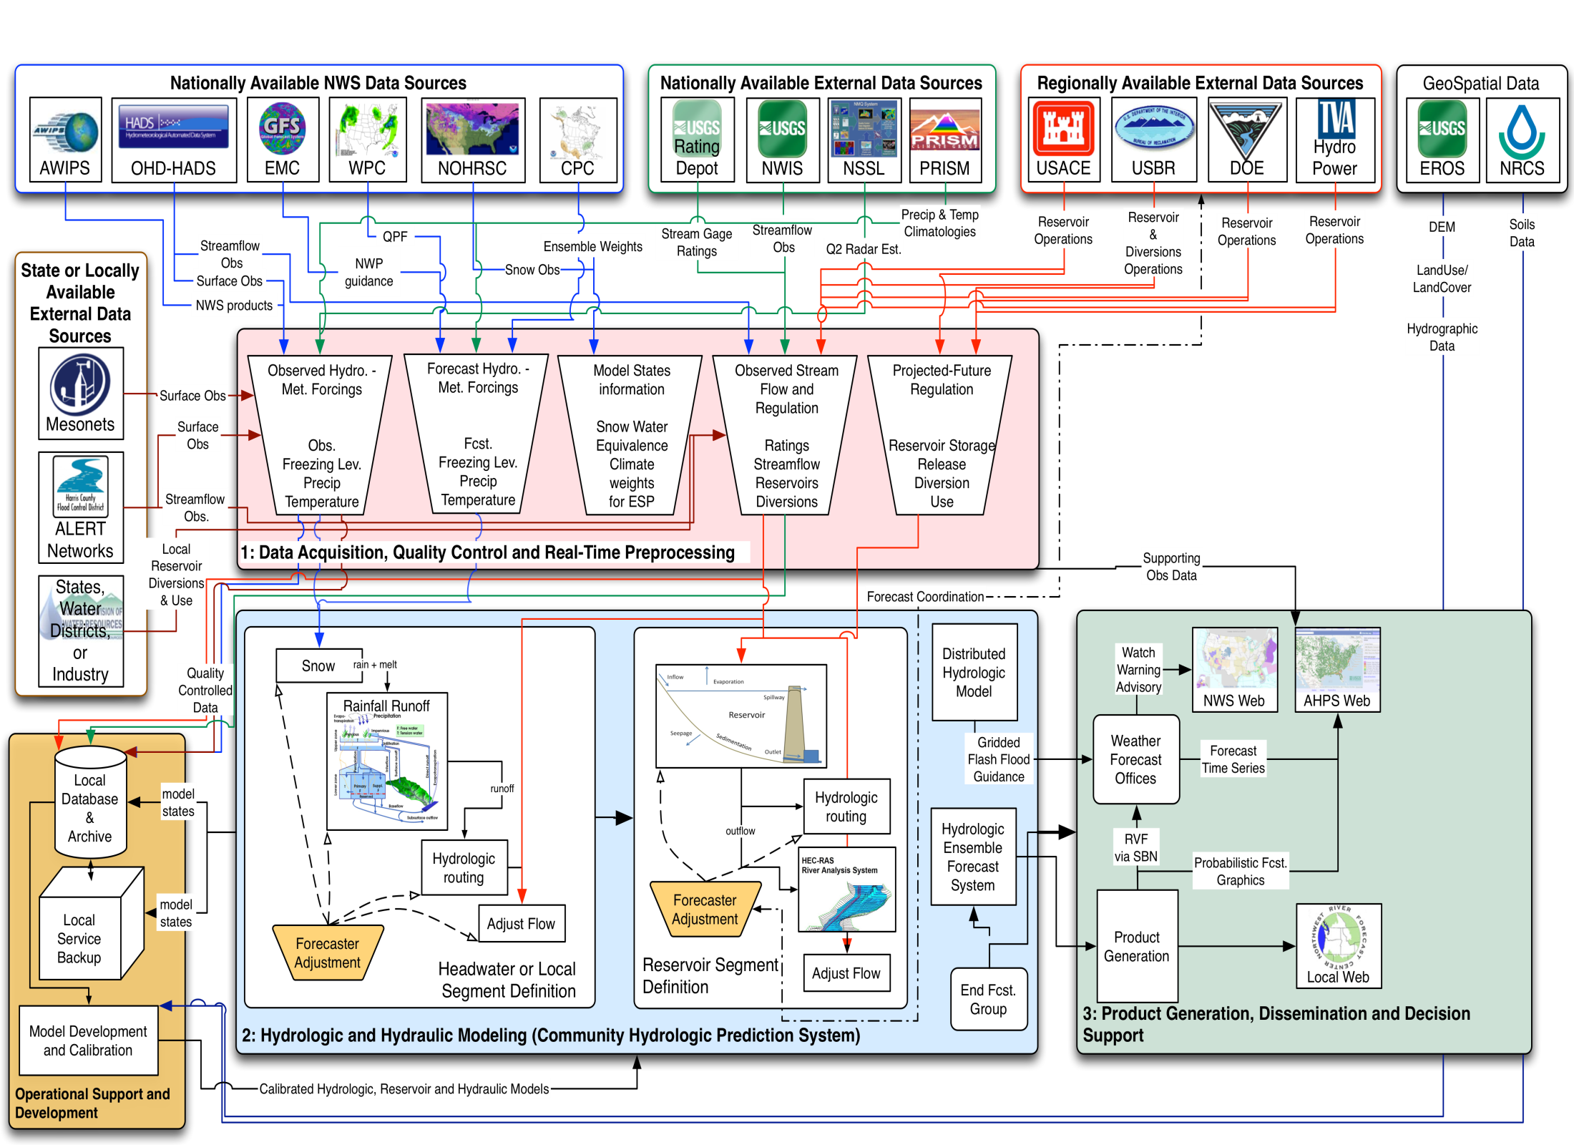
Notes:
These products as well as the aforementioned flash flood guidance form the basis for WFO river and flash flood watch warning advisories.
WFOs also help populate the hydrologic forecast information on the Advanced Hydrologic Prediction Service (AHPS) web pages.

Slide 23
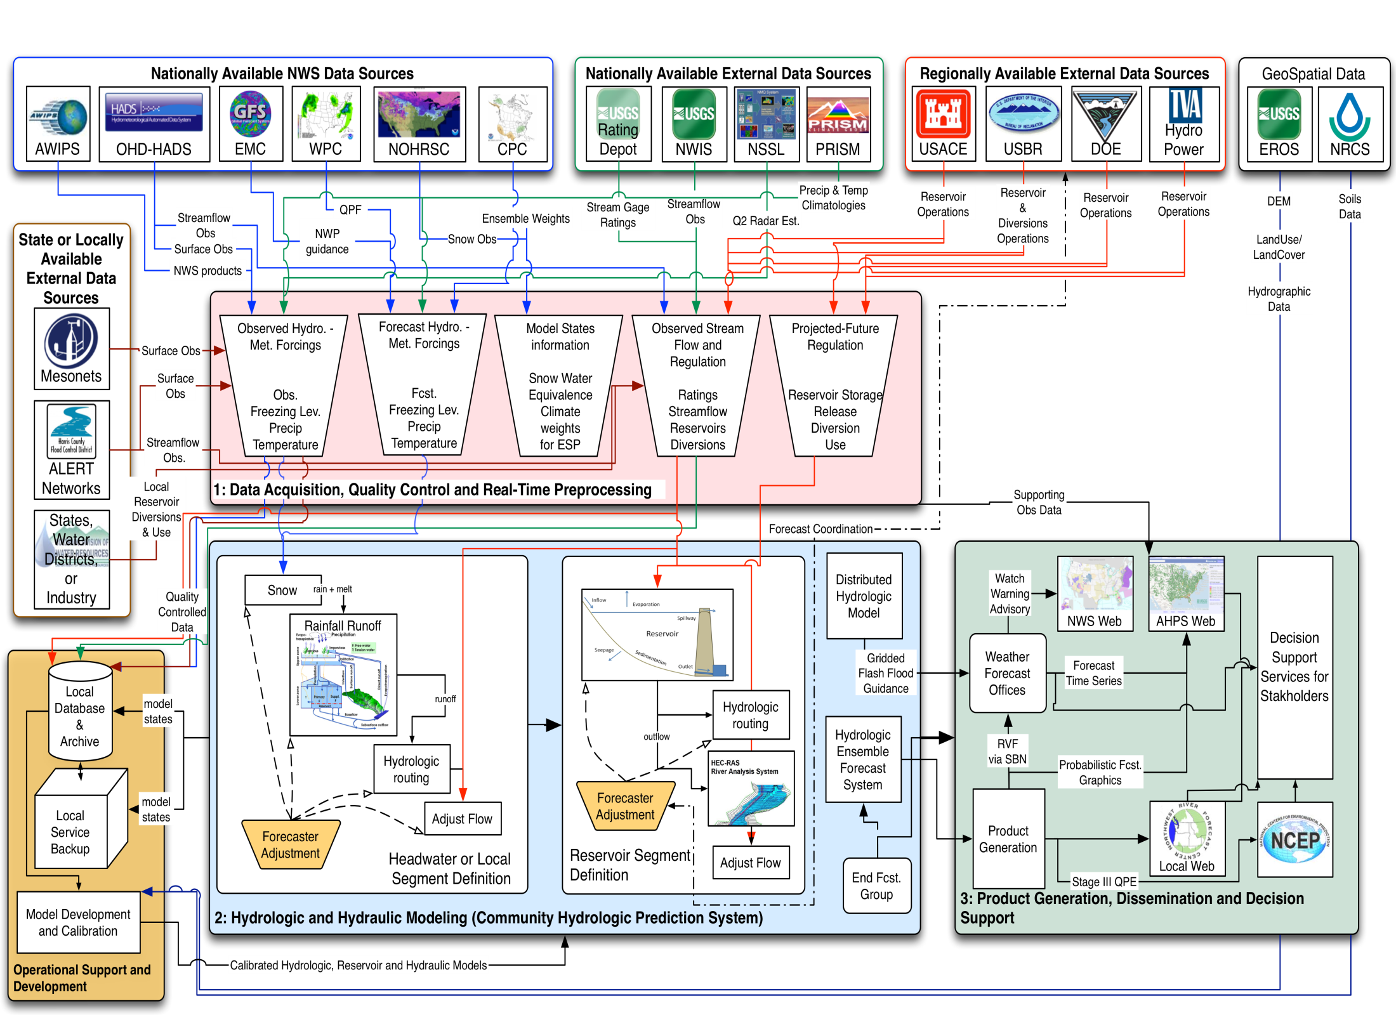
Notes:
The entire suite of information developed at the national, regional and local offices forms the basis for NWS hydrologic decision support services.

Slide 24
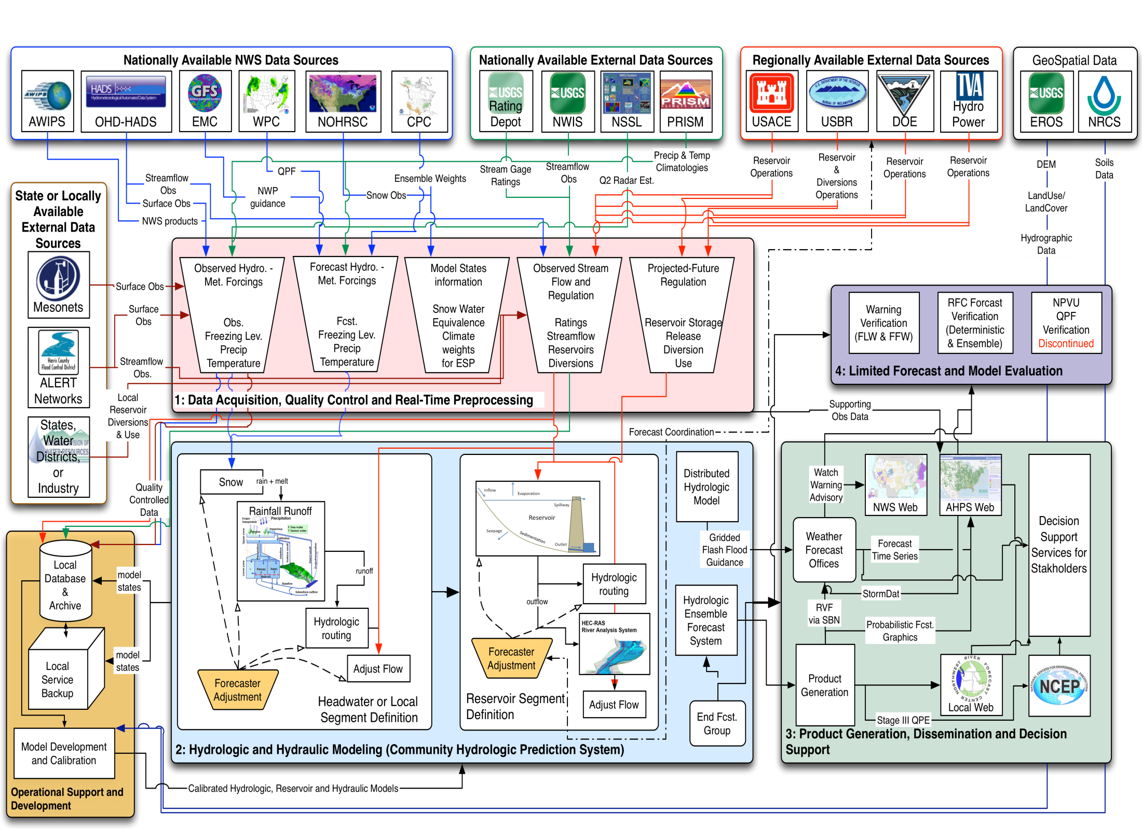
Notes:
Finally, limited verification activities facilitate the routine reporting of program performance. This include:
Warning verification for Flash Flood and Point-based River Warnings
Verification of the river forecast deterministic and probabilistic guidance.
While limited QPF verification continues at WPC as well as some regions and RFCs, the National Precipitation Verification program was terminated in FY2012.

Slide 25
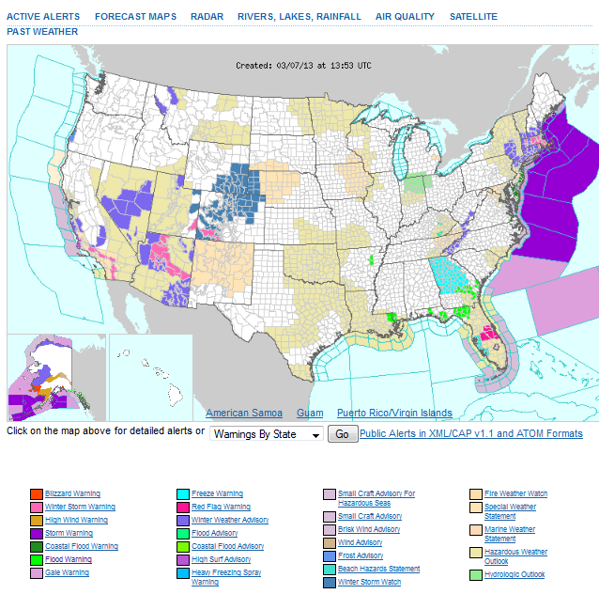
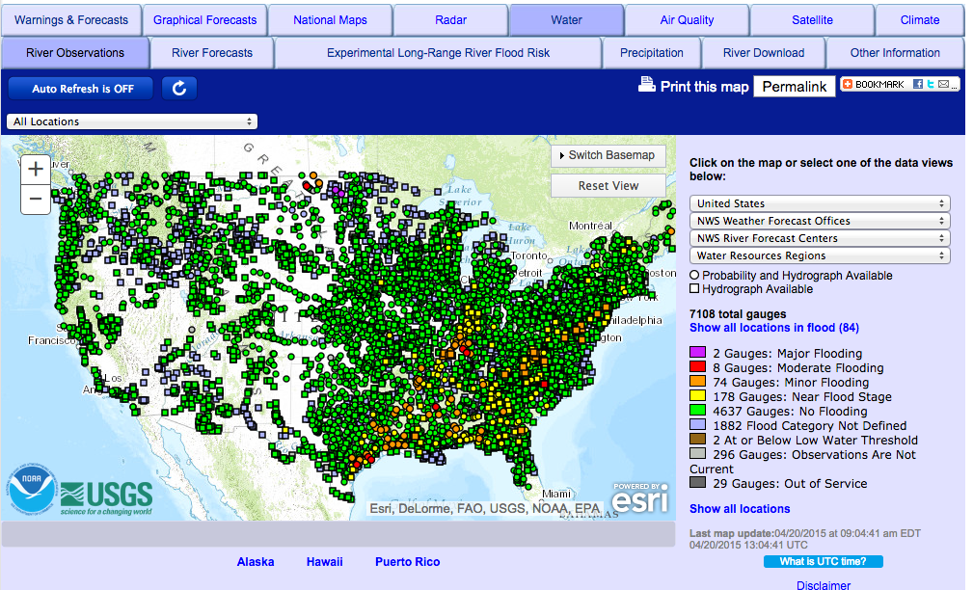
Accessing AHPS Information
“click on” the water tab for current river conditions
http://weather.gov/
25

Slide 26
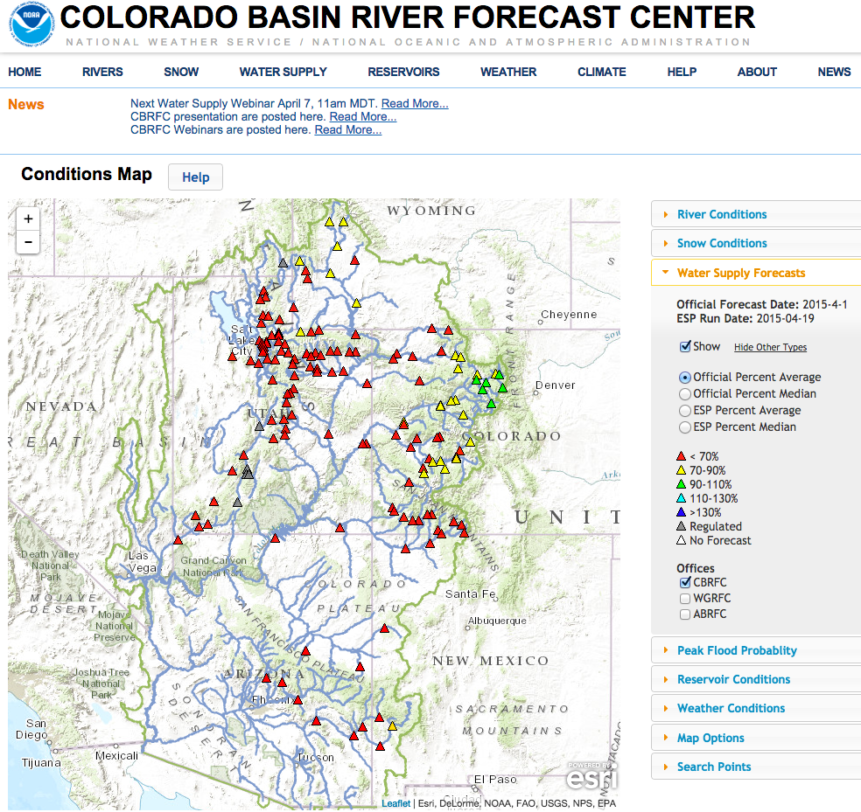
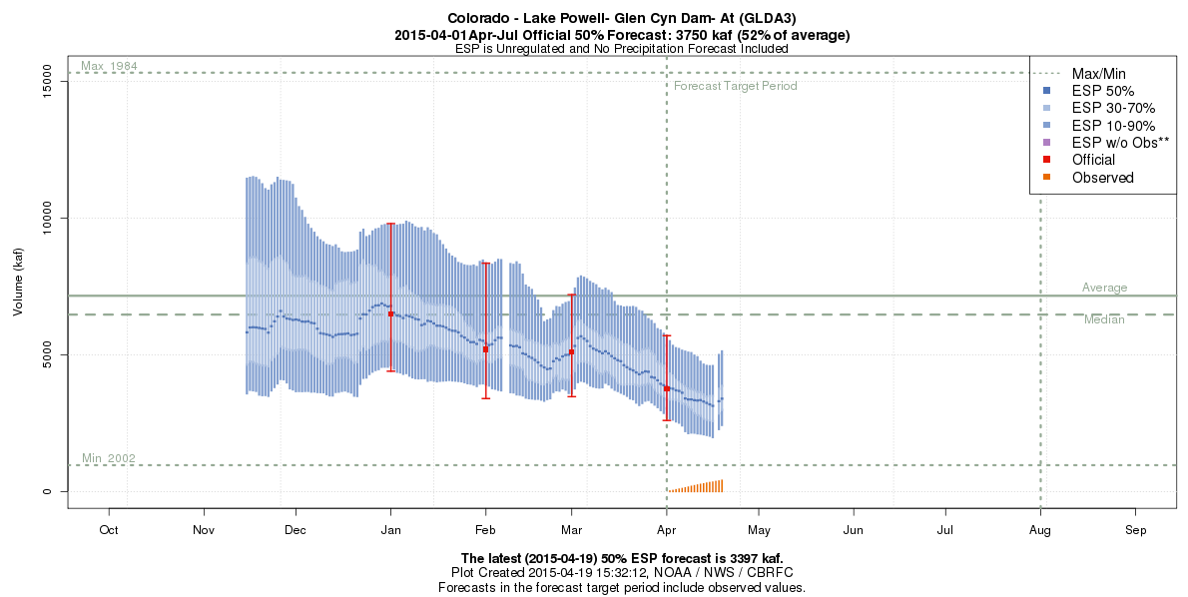
Snowmelt Water Supply Forecasts
Water Supply in the western US is from mountain snowpack.
Calculated April through July runoff period
Issued semi-monthly from January to June.
http://www.cbrfc.noaa.gov/lmap/lmap.php?interface=wsup
Notes:
RFC’s in the western portion of the country produce water supply forecasts from January through June for the April through July runoff periods. These river’s are highly dependent upon season snow accumulation and subsequent melt. They are a vital water supply source for irrigation, hydroelectric power and drinking water for many communities in the arid regions of the nation.

Slide 27
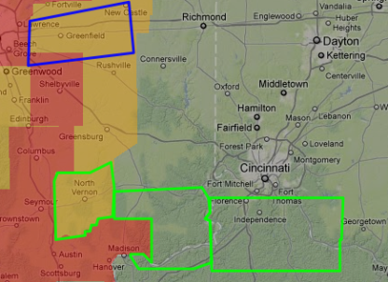

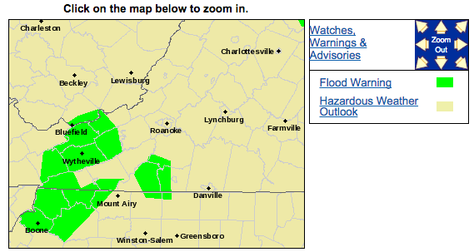
Hydrologic Services Roles and Responsibilities
Weather Forecast Offices (WFOs) – Local Monitoring and Warning
  Staffed 24 hours per day, 7 days per week
  Weather Forecast, and Hazard Warnings including:
    Flash flood watches and warnings
    River forecasts and warnings
  Local outreach and education (SH, hydro focal point, or WCM)
  Flash flood and River Flood verification (LSRs and Storm Data Reports)
  Event-based decision support services with Federal, Tribal, State and Local Agencies
  Web service delivery.
FLOOD WARNING
NATIONAL WEATHER SERVICE BLACKSBURG VA
855 AM EDT MON APR 20 2015
VAC021-071-077-155-173-197-750-WVC055-201900-
/O.EXT.KRNK.FA.W.0012.000000T0000Z-150420T1900Z/
/00000.0.ER.000000T0000Z.000000T0000Z.000000T0000Z.OO/
PULASKI VA-GRAYSON VA-GILES VA-CITY OF RADFORD VA-SMYTH VA-WYTHE VA-
BLAND VA-MERCER WV-
855 AM EDT MON APR 20 2015
THE NATIONAL WEATHER SERVICE IN BLACKSBURG HAS EXTENDED THE
* FLOOD WARNING FOR...
PULASKI COUNTY IN SOUTHWESTERN VIRGINIA...
CENTRAL GRAYSON COUNTY IN SOUTHWESTERN VIRGINIA...
WESTERN GILES COUNTY IN SOUTHWESTERN VIRGINIA...
THE SOUTHWESTERN CITY OF RADFORD IN SOUTHWESTERN VIRGINIA...
SMYTH COUNTY IN SOUTHWESTERN VIRGINIA...
WYTHE COUNTY IN SOUTHWESTERN VIRGINIA...
BLAND COUNTY IN SOUTHWESTERN VIRGINIA...
SOUTHEASTERN MERCER COUNTY IN SOUTHEASTERN WEST VIRGINIA...
* UNTIL 300 PM EDT MONDAY
* AT 852 AM EDT...LOCAL LAW ENFORCEMENT AND AUTOMATED RIVER
AND STREAM GAGES REPORTED OR SHOWED FLOODING OVER THE WARNED AREAS.
SPECIFICALLY...FLOODING OF WALKER AND WOLF CREEK

Slide 28

The Warning Process
Observe, monitor, detect, forecast and generate warning
3
Respond
1
2
Disseminate warning
28
Notes:
All 3 components essential to effective warning process

Slide 29
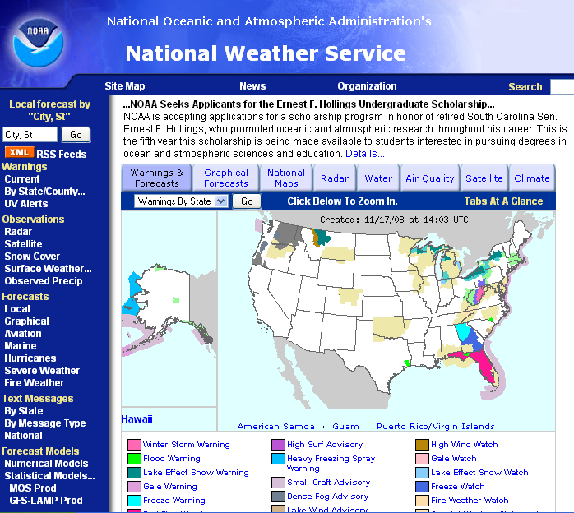
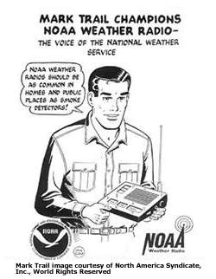
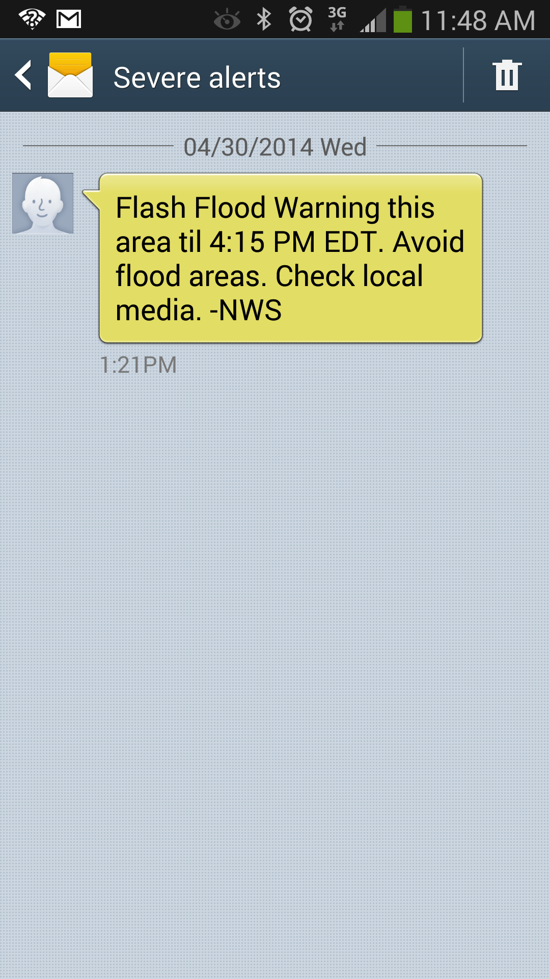
Product Dissemination
  Internet (http://www.weather.gov/)
  NOAA Weather Radio All Hazards
  Emergency Managers Weather Information Network
  NOAA Weather Wire Service
  NOAAPORT
  Emergency Alert System (EAS) and Wireless Emergency Alert (WEA)
  Broadcast by local Media Partners
Wireless Emergency Alerts (WEA)
29
Notes:
NOAA Weather Wire Service (NWWS) is a satellite data collection and dissemination system operated by the National Weather Service (NWS). Its purpose is to provide state and federal government, commercial users, media, and private citizens with timely delivery of meteorological, hydrological, climatological, and geophysical information. The vast majority of NWWS products are weather and hydrologic forecasts and warnings issued around the clock from 141 NWS offices nationwide
NOAA Weather Radio All Hazards (NWR) is a nationwide network of radio stations broadcasting continuous weather information directly from the nearest National Weather Service office. NWR broadcasts official Weather Service warnings, watches, forecasts and other hazard information 24 hours a day, 7 days a week.
The NOAAPORT broadcast system provides a one-way broadcast communication of NOAA environmental data and information in near-real time to NOAA and external users. This broadcast is implemented by a commercial provider of satellite communications utilizing the C-band. It's primary purpose is for providing internal communications within the National Weather Service and for providing forecasts, warnings and other products to the mass media (newspapers, radio stations, TV, etc.), emergency management agencies, and private weather services.
The NOAAPORT satellite communications system is operated by GTE Corp., under contract to the NWS. The system uses satellite transmitting (i.e. "uplink") equipment at NWS forecast offices throughout the continental U.S., Alaska, Hawaii and Puerto Rico. Each uplink site transmits NWS-generated weather information products which are then re-broadcasted via satellite to users.
The EAS is a national public warning system that requires broadcasters, cable television systems, wireless cable systems, satellite digital audio radio service (SDARS) providers, and direct broadcast satellite (DBS) providers to provide the communications capability to the President to address the American public during a national emergency. The system also may be used by state and local authorities to deliver important emergency information, such as AMBER alerts and weather information targeted to specific areas.

Slide 30
Building Decision Support Services
  Evolving Role of National Weather Service:
  Training NWS Forecasters in Incident Command System
  Embedding Emergency Response Specialists with Emergency Operation Centers
  Investing in social science research to support clear concise messaging
Federal Agencies
Research to Operations
Science and Modeling
DSS ICS
Research Community
Emergency Managers and First Responders
Social Science
30
Notes:
NOAA Weather Wire Service (NWWS) is a satellite data collection and dissemination system operated by the National Weather Service (NWS). Its purpose is to provide state and federal government, commercial users, media, and private citizens with timely delivery of meteorological, hydrological, climatological, and geophysical information. The vast majority of NWWS products are weather and hydrologic forecasts and warnings issued around the clock from 141 NWS offices nationwide
NOAA Weather Radio All Hazards (NWR) is a nationwide network of radio stations broadcasting continuous weather information directly from the nearest National Weather Service office. NWR broadcasts official Weather Service warnings, watches, forecasts and other hazard information 24 hours a day, 7 days a week.
The NOAAPORT broadcast system provides a one-way broadcast communication of NOAA environmental data and information in near-real time to NOAA and external users. This broadcast is implemented by a commercial provider of satellite communications utilizing the C-band. It's primary purpose is for providing internal communications within the National Weather Service and for providing forecasts, warnings and other products to the mass media (newspapers, radio stations, TV, etc.), emergency management agencies, and private weather services.
The NOAAPORT satellite communications system is operated by GTE Corp., under contract to the NWS. The system uses satellite transmitting (i.e. "uplink") equipment at NWS forecast offices throughout the continental U.S., Alaska, Hawaii and Puerto Rico. Each uplink site transmits NWS-generated weather information products which are then re-broadcasted via satellite to users.
The EAS is a national public warning system that requires broadcasters, cable television systems, wireless cable systems, satellite digital audio radio service (SDARS) providers, and direct broadcast satellite (DBS) providers to provide the communications capability to the President to address the American public during a national emergency. The system also may be used by state and local authorities to deliver important emergency information, such as AMBER alerts and weather information targeted to specific areas.

Slide 31
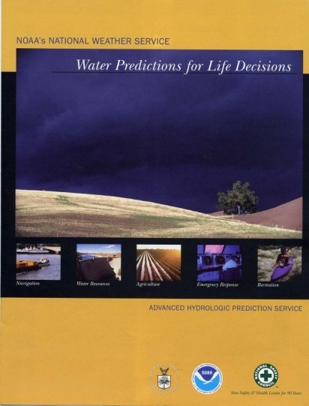
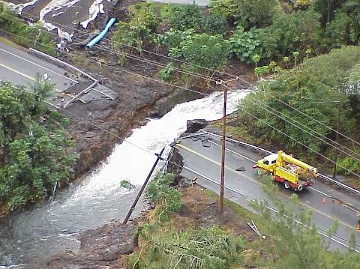
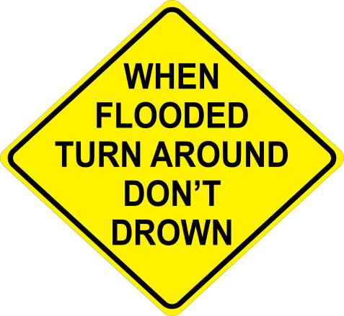
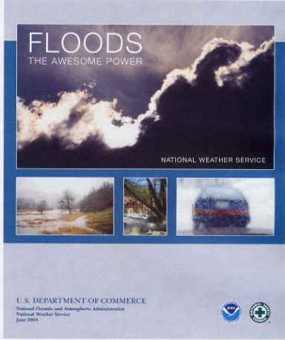
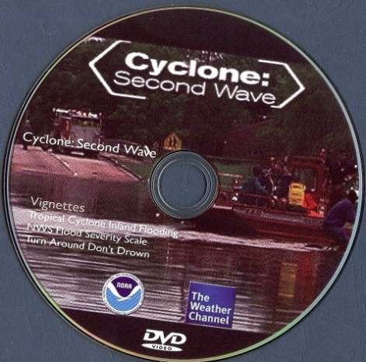
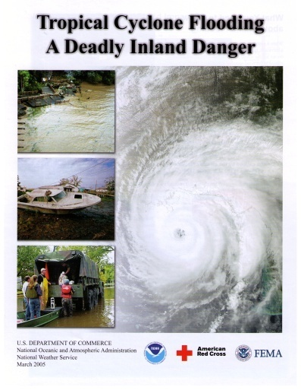
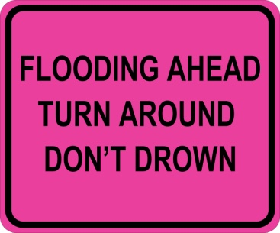

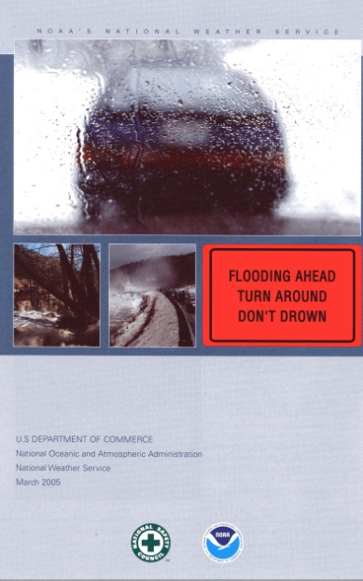
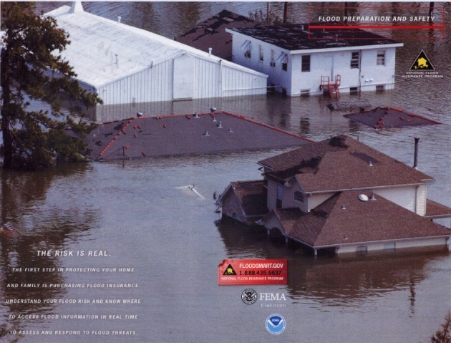
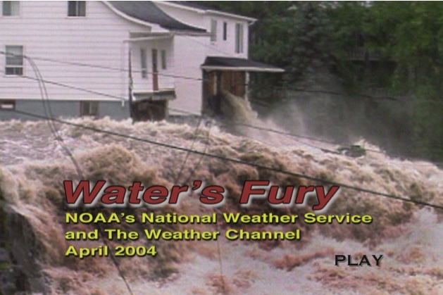
Partnerships Promoting Public Safety
31

Slide 32
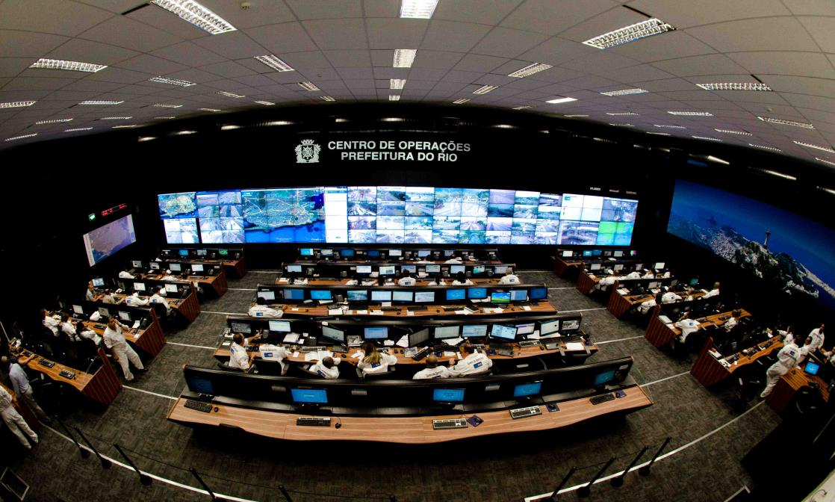
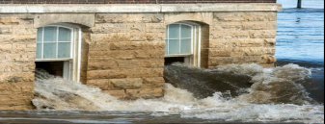
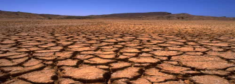

National Water Center
A foundation for developing a national “common operating picture” to improve situational awareness and enable critical decisions effecting the Nation’s most valuable resource
Fully integrated water resources program directed towards consistent products for impact-based decision support services
  Better inform event-driven high-impact events and routine high-value decisions
Catalyst for accelerating research to operations
Nerve center for optimization of data-flow among RFCs and IWRSS partners

Slide 33

NOAA’s National Weather Service
Forecasting Water from the Summit to the Sea

