Slide 1





Distributed Catchment Modeling
Topics
Essential Terrestrial Variables
Automating the Model Workflow
National Geospatial Data
Hydrologic Basis for Earth System Models
PIHM development
Climate Reanalysis & IPCC Projections
Detecting Decadal Ecosystem Change
Christopher Duffy, Penn State University
Notes:
1

Slide 2
  Why High Resolution Distributed Catchment Modeling?
  All flood, drought and water supply impacts are local
  Hydrologic Basis for Earth System Modeling (e.g. CZO’s)
  Cyberinfrastructure for Virtual Data-Model Sharing
  Climate reanalysis and future scenario reconstructions
  Scaling up from HUC-12 to River Basin Scales

Slide 3
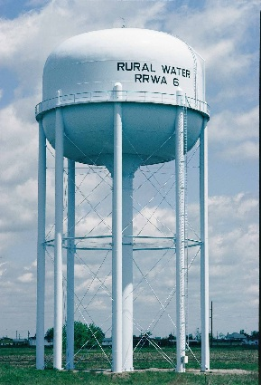
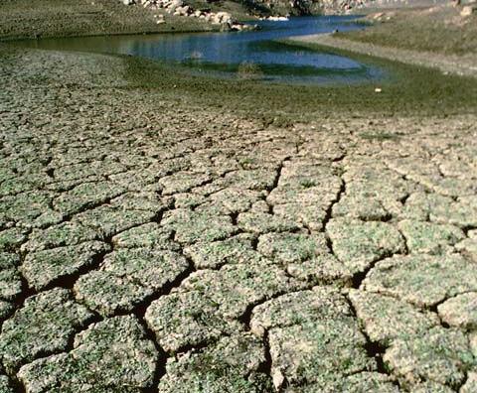
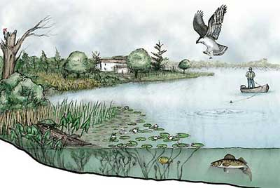
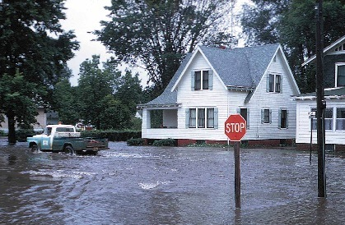
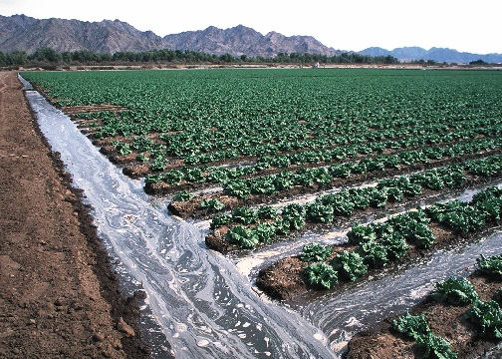
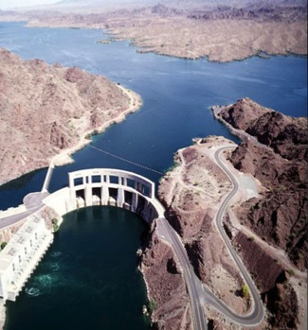
Motivating the Need for Water-Cycle Models
Ecosystem Services
Drinking Water
Energy
Agriculture
Floods
Drought
Notes:
* Water is key to sustainability. It is used for drinking, in power generation, for agriculture and support of the whole ecosystem. But too much of it can lead to floods and too little of it cause drought.

Slide 4
Essential Terrestrial Variables Necessary for Catchment Modeling Anywhere in CONUS
Atmospheric Forcing (precipitation, snow cover, wind, relative humidity, temperature, net radiation, albedo, photosynthestic atmospheric radiation)
Digital elevation models (30, 10, 3, 1m resolution)
River/Stream discharge, stage, cross-section
Soil (texture, C/N, organic, hydrologic & thermal properties)
Groundwater (levels, extent, hydrogeologic properties, 3D Architecture)
Land Cover (biomass/leaf area index, phenology,……. )
Land Use (human infrastructure, demography, ecosystem disturbance, property & political boundaries)
Environmental Tracers- stable isotopes
Water Use and Water Transfers
Lake/Reservoir/Diversion (levels, extent, discharge, operating rules)
…to be cont’d……..??

Slide 5
  ETV’s -> National Data Supporting Catchment Models
  National (continental) geospatial data for catchments is served by multiple nations/federal agencies/organizations
  Fast access to high resolution data is a requirement for model development at relevant scales
  Detection and attribution of change for climate, landuse and ecosystem impacts is critical for resource management and policy
  A community-driven exercise in developing a high resolution data and models

Slide 6
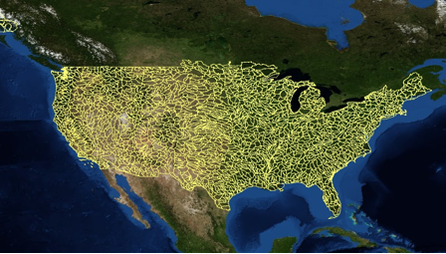
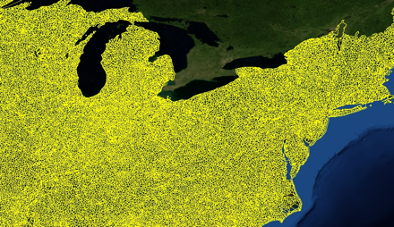
2,268 USGS
HUC 8
watersheds
The Hydrologic Unit Code (HUC)
A Basis For Catchment Model-Data Sharing
103,444 USGS
HUC 12
watersheds

Slide 7
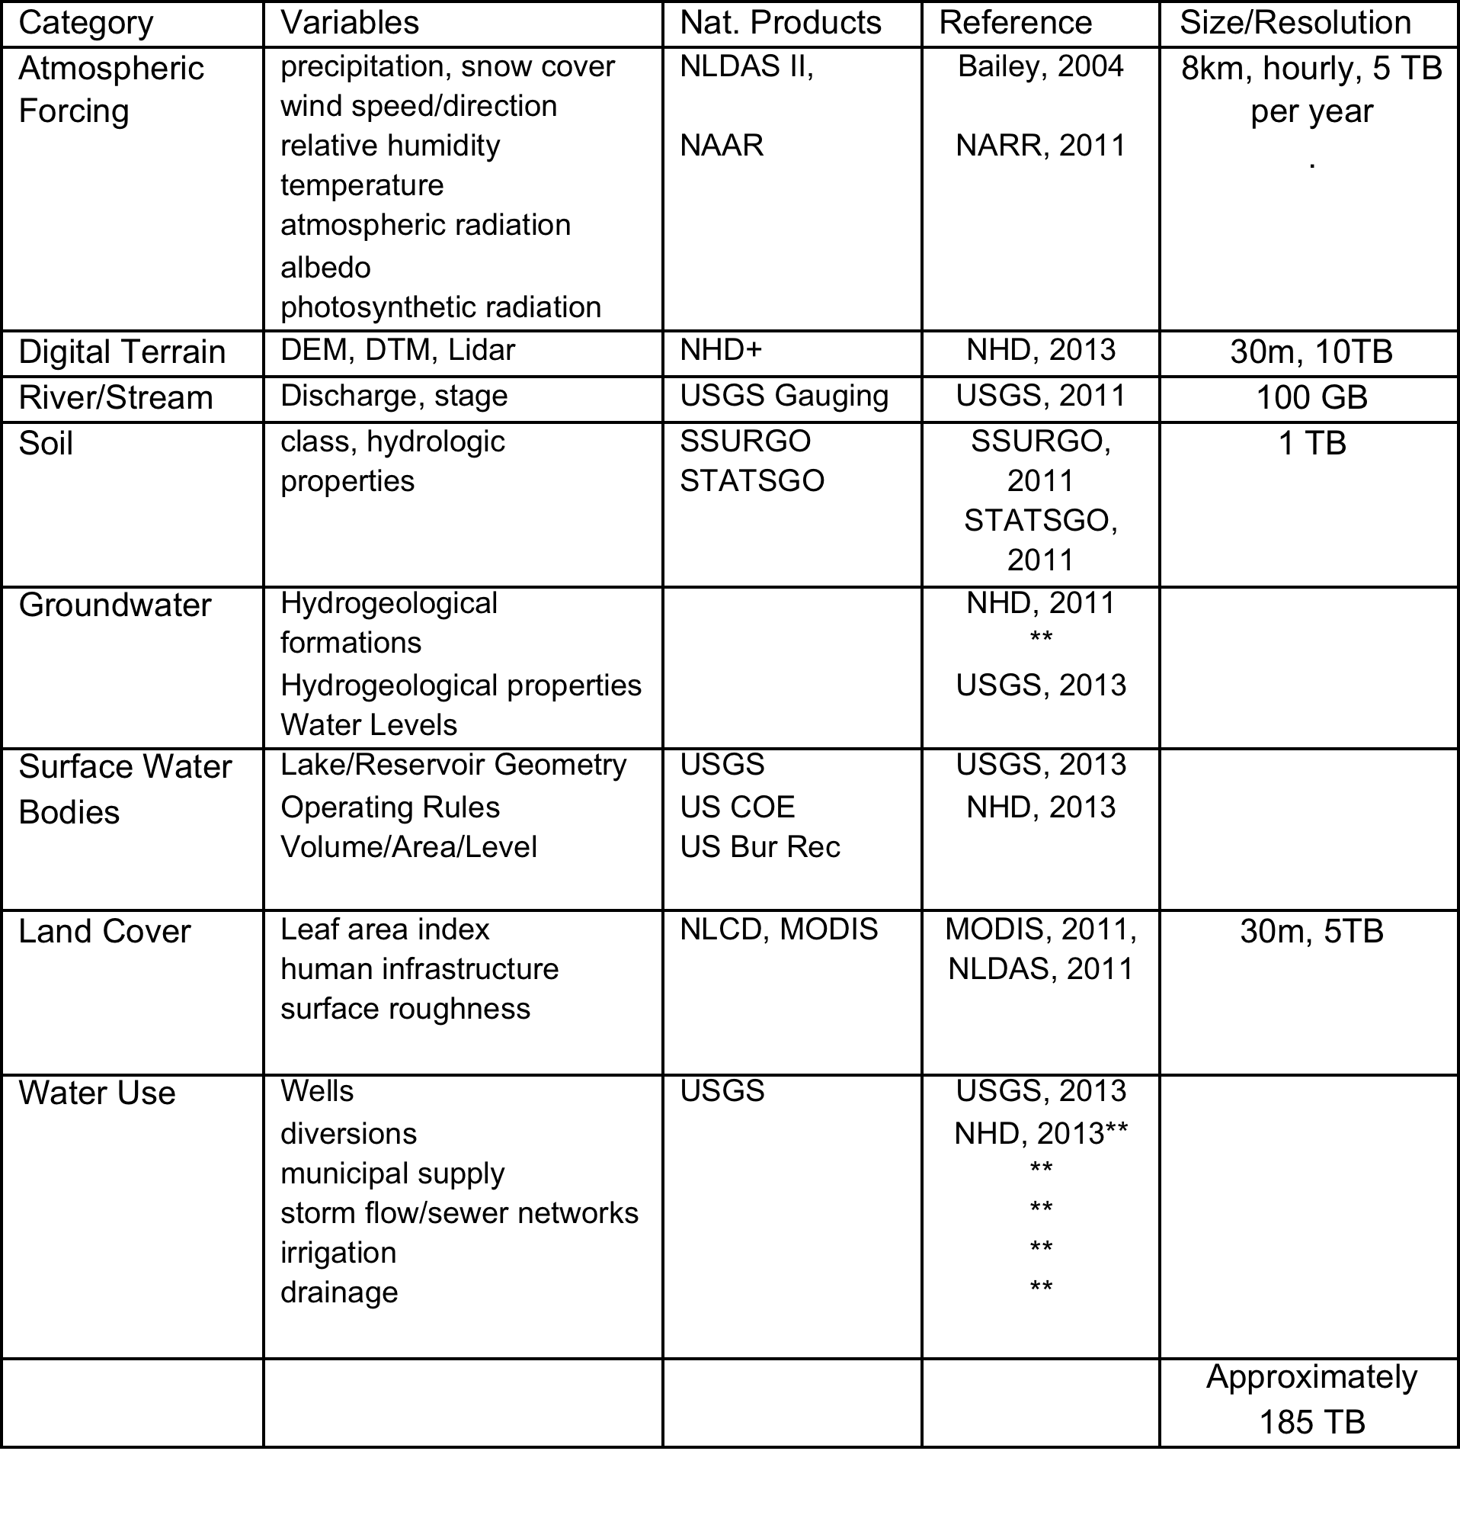
  An Initial ETV Bundle

Slide 8
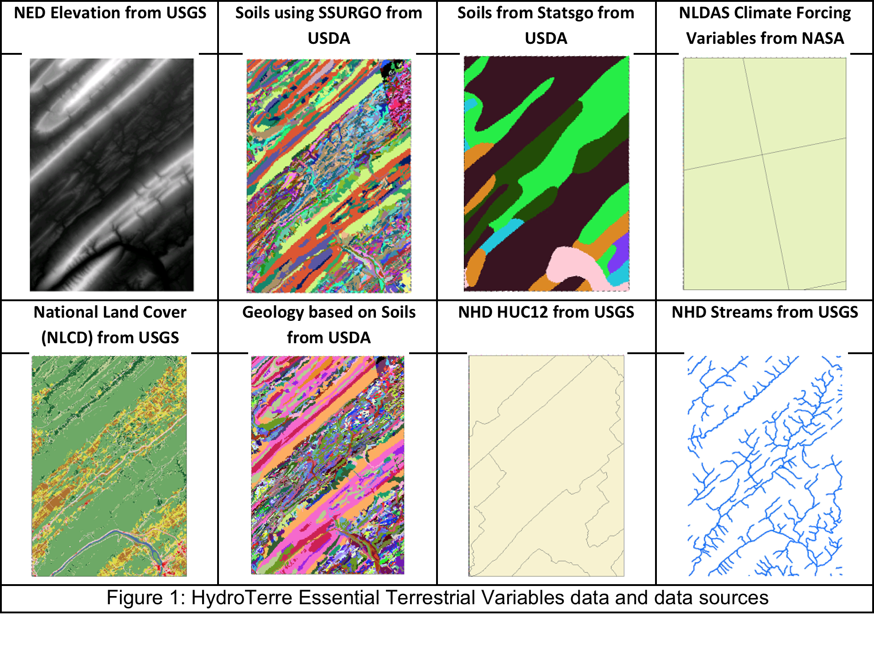
HydroTerre: High Resolution ETV
Need workflow here

Slide 9
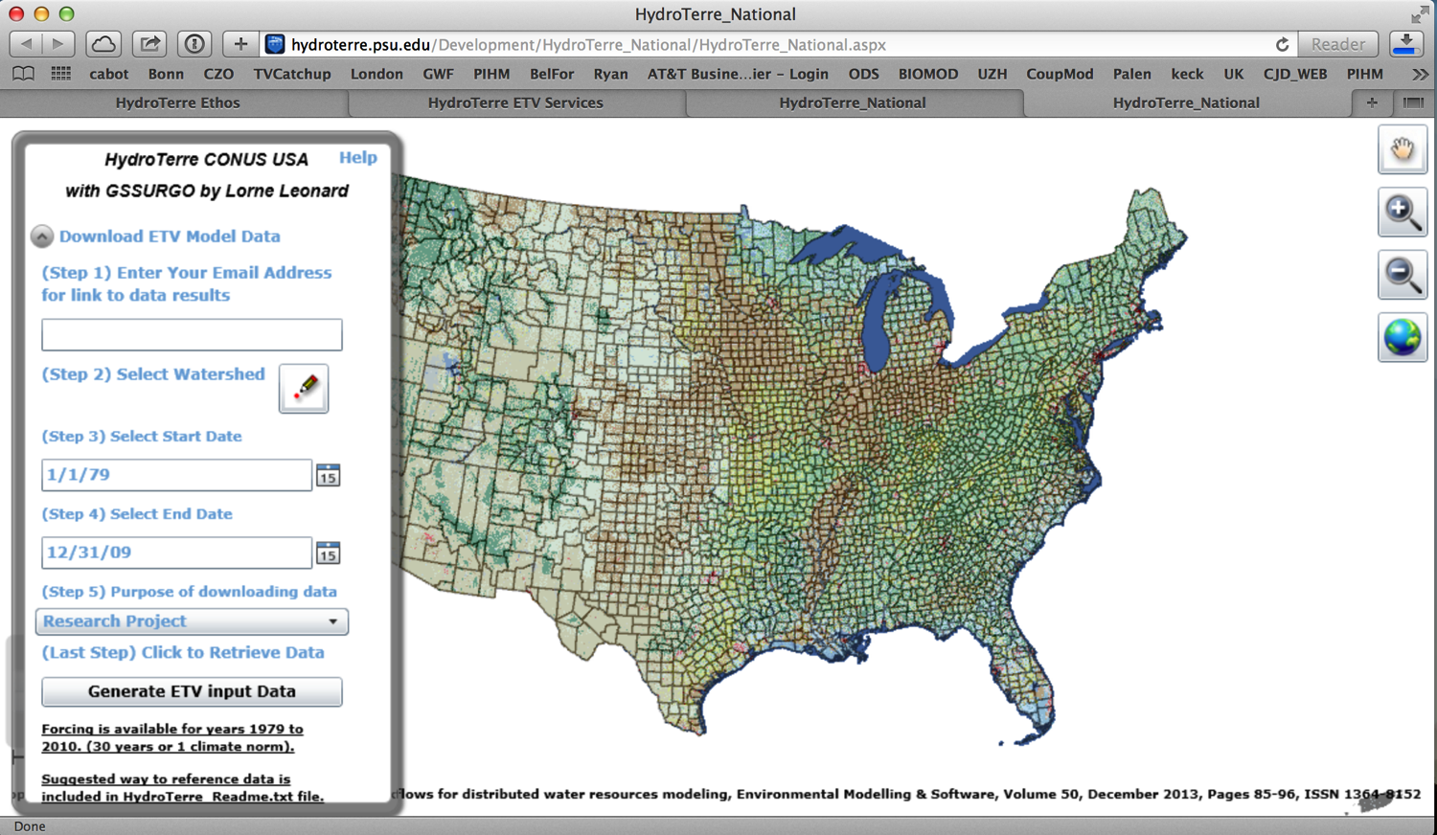

Slide 10
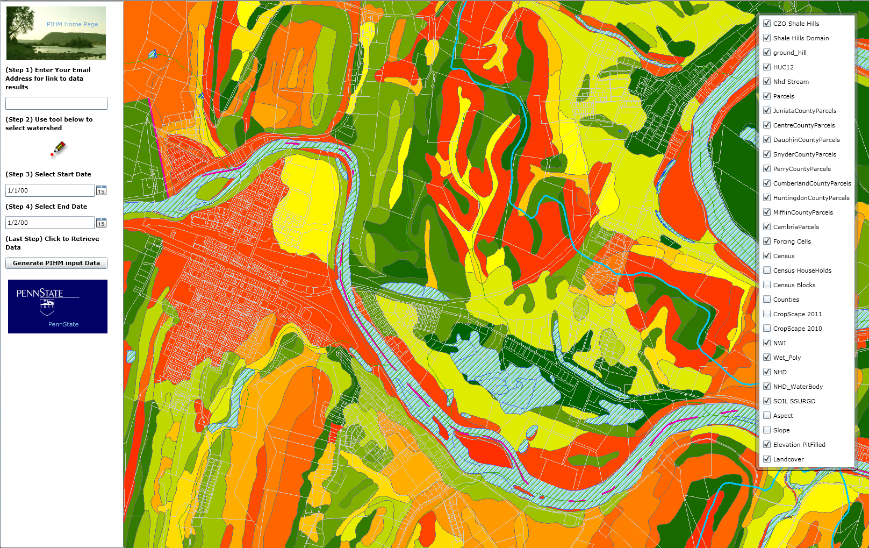
HydroTerre: A Prototype for Model-Data Access
Land Parcel Data; NHD: Stream, Lake, HUC’; USDA: Soils/Crops; NLCD: LU_LC;

Slide 11
HydroTerre: A Prototype Model-Data Workflow
Need workflow here

Slide 12
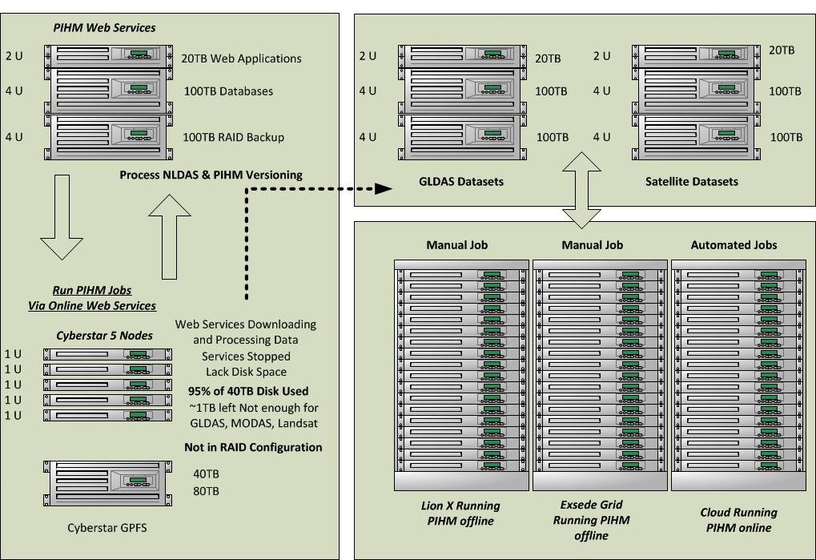
HydroTerre Prototype: Data and Modeling Hardware

Slide 13
  A Time Line for the Penn State Model PIHM
1998-04 SAHRA NSF Science & Technology Center
    Duffy sabbatical at Los Alamos
    Yizhong Qu first PhD & early architect
    Finite volume model first steps
2006-08 NSF Waters/CUAHSI Project
Duffy and Reed
Mukesh Kumar-redesign PIHM, Data-Model
Gopal Bhatt, PIHMgis
Shuangcai Li, PIHM_hydro
2008-13 NSF Critical Zone Observatory
Duffy, Brantley, and CZO teams
Kumar-PIHM_3D
Gopal Bhatt/Duffy- Solute, Age Modeling
Yuning Shi, Ken Davis Flux_PIHM
Lorne Leonard: Hydroterre
Soil TrEC European Community funding
2013-16 NSF EarthCube GeoSoft BB
NSF INSPIRE Project Lake-Catchment Age of Water

Slide 14
    Why & How of Integrated Models
  Multiphysics analysis is a unifying modeling strategy that allow scientists and engineers to explore
  fully-coupled effects of complex
  physical phenomena
  New sensors, communication networks, and characterization tools
  have made it possible to examine spatial and temporal
  phenomena over an unprecedented
  range of scales
  Goal: to develop an evolvable approach to hydrologic simulation,
  to advance predictive understanding &
  to develop the next generation
  of environmental forecasting tools

Slide 15
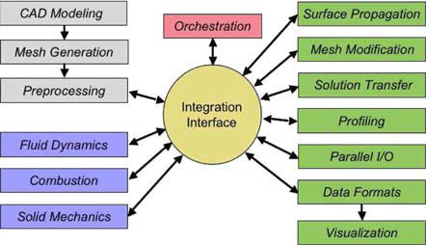
Architecture for Multiphysics Modeling
Sequential Coupling Approach one process or field is partially solved and then passed to the next physics field to form an initial solution. The iteration process continues until a final solution is achieved. The integration interface provides the services for subsystem interaction, data handling, mesh generation, parallel I/O, visualization, etc.
Mike Heath UIUC, 2008

Slide 16
Architecture for Multiphysics Modeling
Direct Coupling assembles all the physics equations in one matrix and solves all equations together. In this example an open-source GIS and Geodatabase is used for data management, mesh generation, space-time data analysis, and interface to the system solver and visualization.
User Interface
Data Management
PIHM
Data Analytics
Vector Processing
Kernel Physics
Spatial
Raster Processing
Numerical Solver
Temporal
Data Model Loader
Spatio-Temporal
Parameterization
Uncertainty
Field, Feature Objects, Non-Spatial Data
Domain Decomposition
Static: Conformed, constrained Delaunay & nested triangulation
Data Access Tool
Dynamic: Adaptive triangulations
ETV-Geodata
(Schema, Data, Relationships)
(Grid-Shp/ Dbf) Read, (Grid-Shp/ Dbf) Write
Kumar, Bhatt, Duffy, 2008; Bhatt, Kumar, Duffy, 2014; Leonard and Duffy, 2014

Slide 17
Open Source Programming Tools
QGIS
  an open source and free "Programmable Geographic Information System"
  a mapping tool, a GIS modeling system, and a GIS application programming interface (API) all in one
  a platform independent Open Source Geographic Information System that runs on Linux, Unix, Mac OSX, and Windows
  libraries for raster and vector geospatial formats
  Object relational database is handled using PostgreSQL
  GRASS compatible
Qt/C++
- tools for programming the interface and visualization

Slide 18
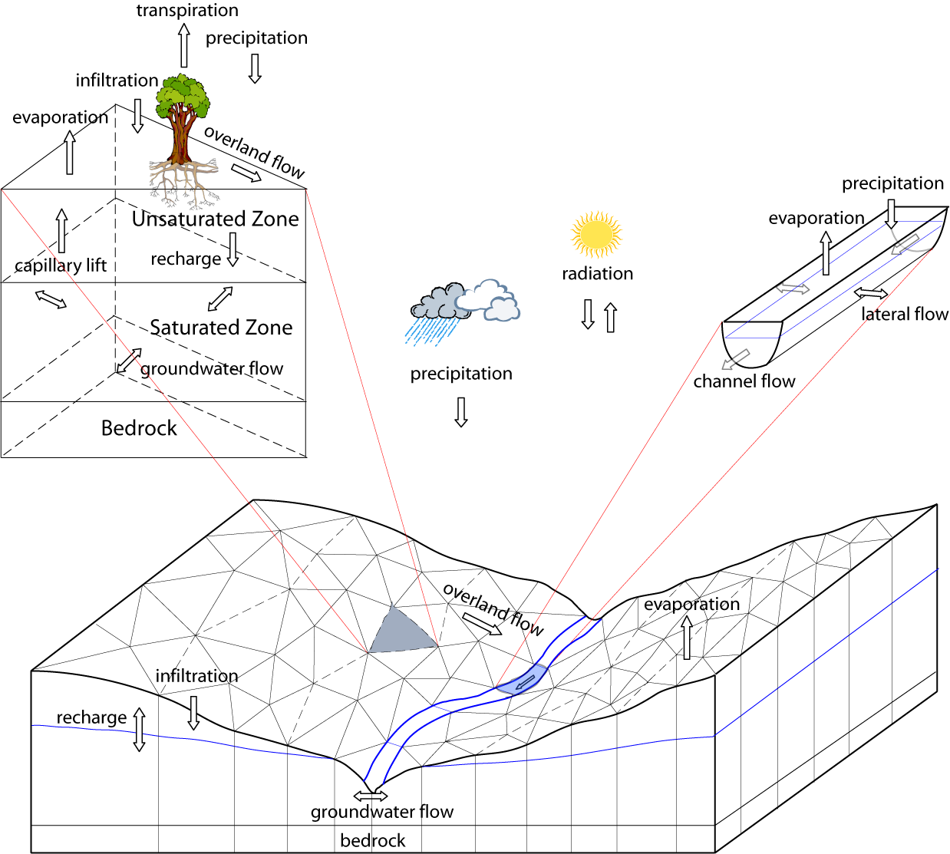
Fully coupled processes but with reduced physics (ASAP)
NOAH Land
Surface
Model
Qu and Duffy 2007. Kumar, Bhatt, Duffy 2009

Slide 19
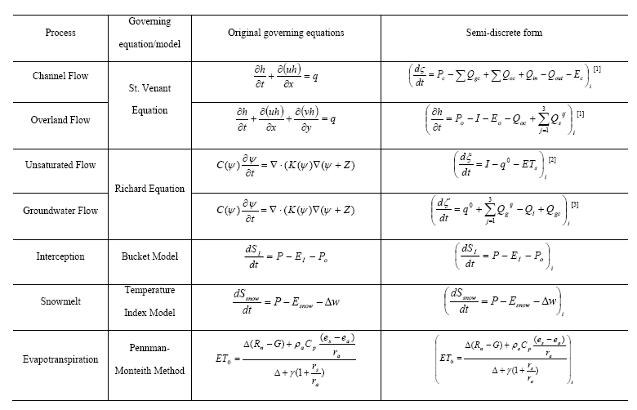
Semi-Discrete Finite Volume Formulation

Slide 20
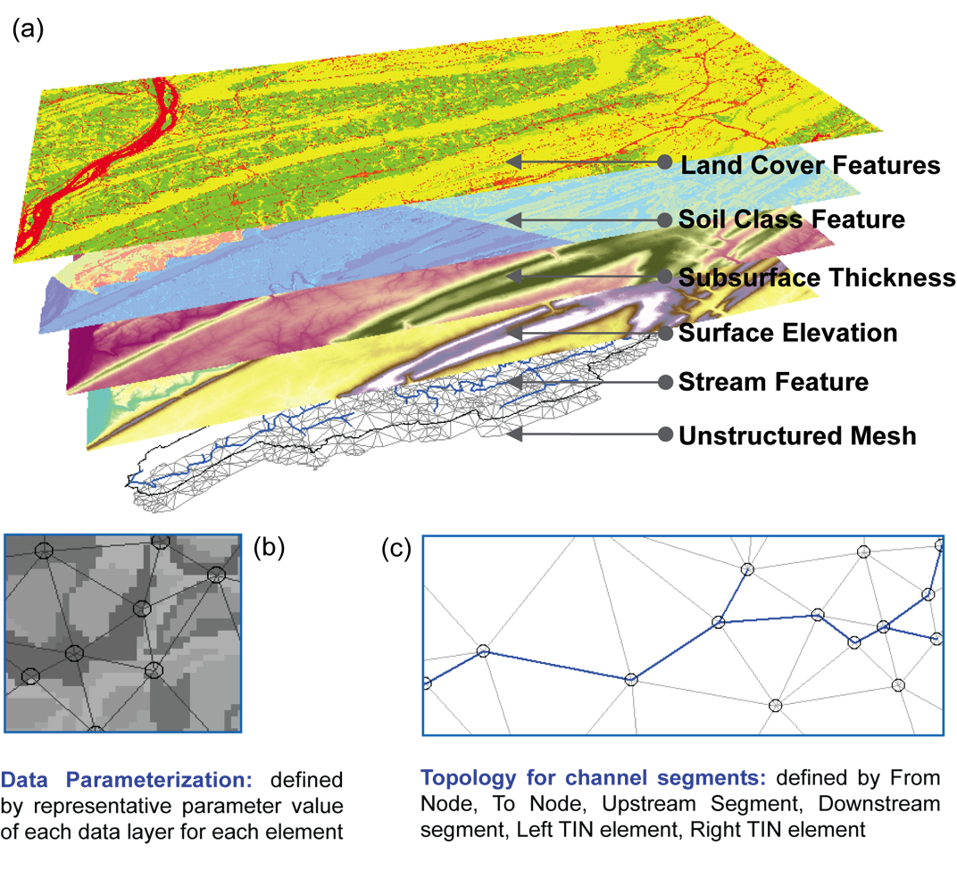
Desktop Data-Model Workflow
Gopal Bhatt author

Slide 21
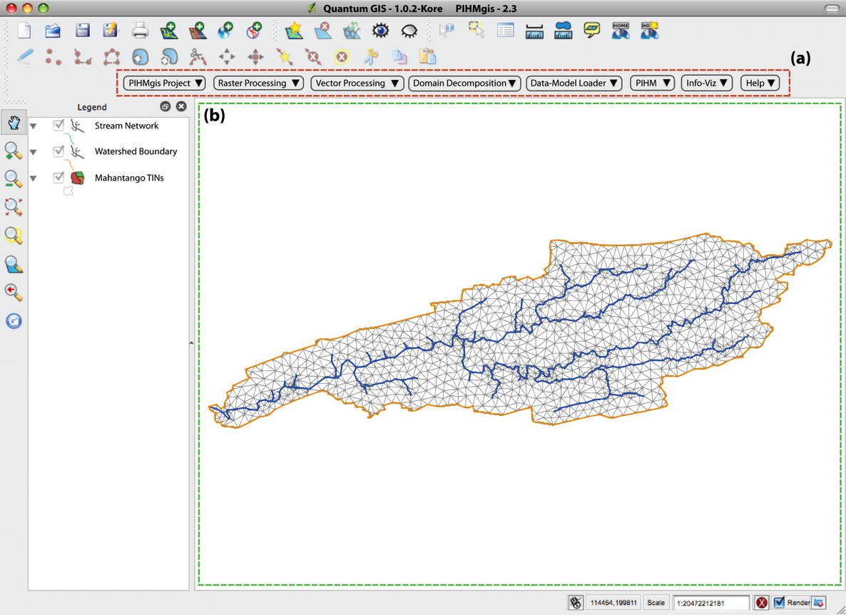
PIHM GIS: Open Source tool
for Desktop Model Setup with Tools for
A-Priori Parameters

Slide 22
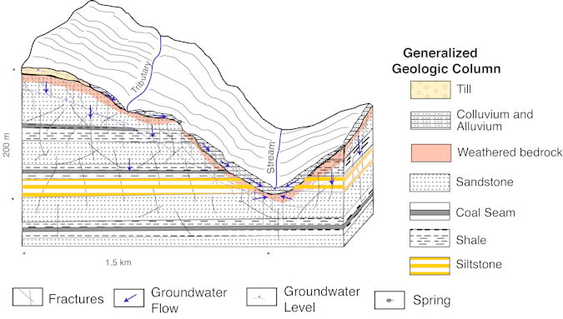
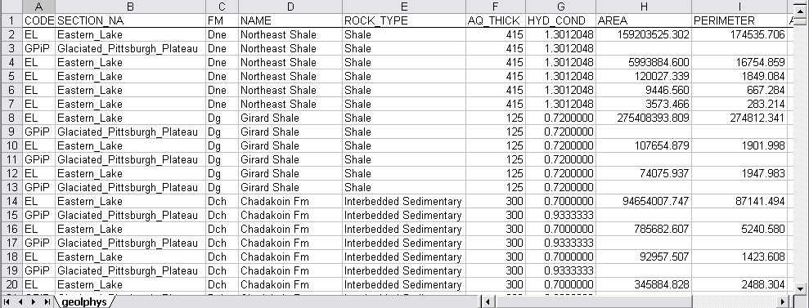
Conceptual Model + ETV data = A Priori Parameters
Conceptual Model Groundwater
flow in the Allegheny Plateau Section.
Example of the GIS for the surface geology coverage.

Slide 23
PIHM GIS Framework
User Interface
Data Management
PIHM
Data Analysis
Vector Processing
Kernel Definition
Spatial
Raster Processing
Numerical Solver
Temporal
Data Model Loader
Spatio-Temporal
Parameterization
Uncertainty
Field, Feature Objects, Non-Spatial Data
Domain Decomposition
Static: Conformed, constrained Delaunay & nested triangulation
Data Access Tool
Dynamic: Adaptive triangulations
Geodata
(Schema, Data, Relationships)
(Grid-Shp/ Dbf) Read, (Grid-Shp/ Dbf) Write

Slide 24
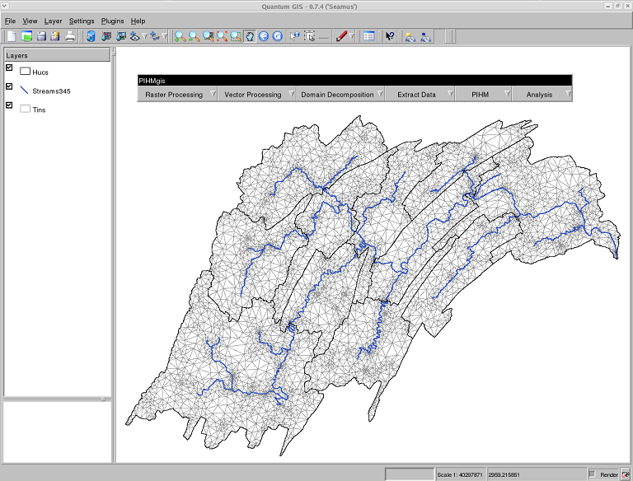
PIHM GIS Interface: Domain Decomposition

Slide 25
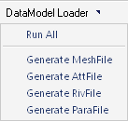
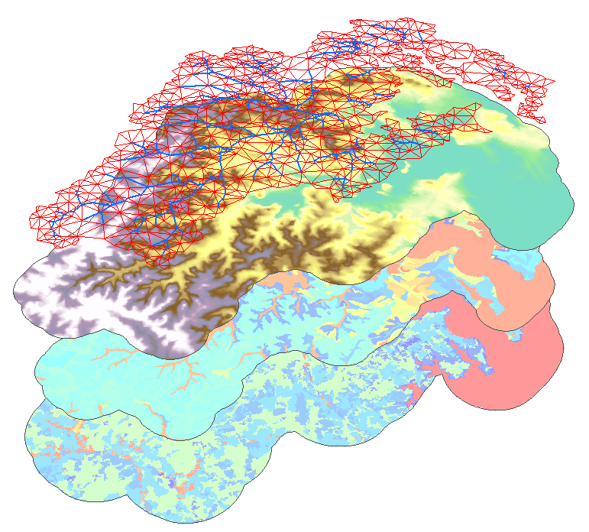
Irregular Mesh &
Stream Network
Elevations
Soil Classes
Land Cover

Slide 26
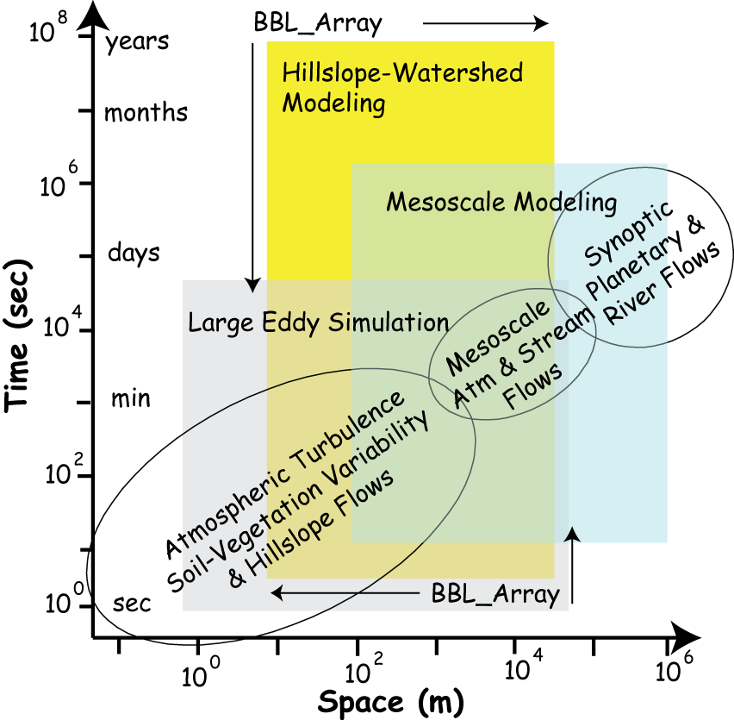
Hydroclimatic Process Scales
HUC-12 Scale

Slide 27
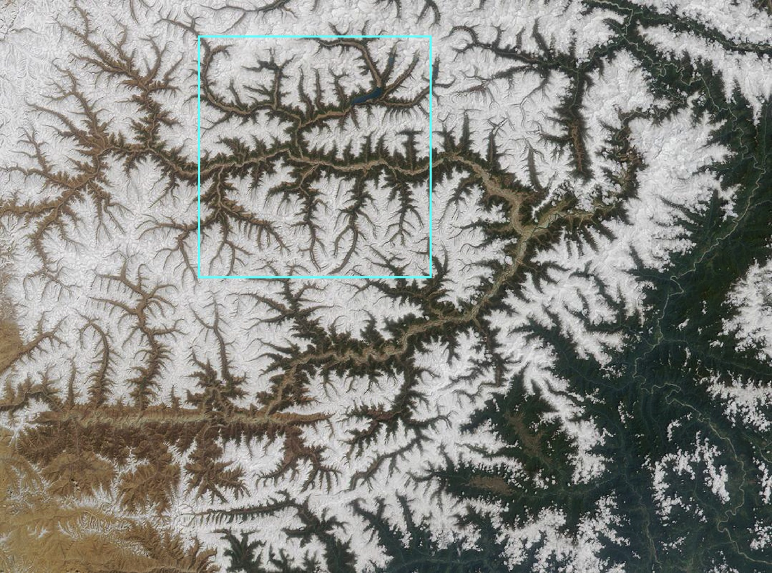
GCM Grid Box
Resolve Uplands In Large Scale Simulations

Slide 28
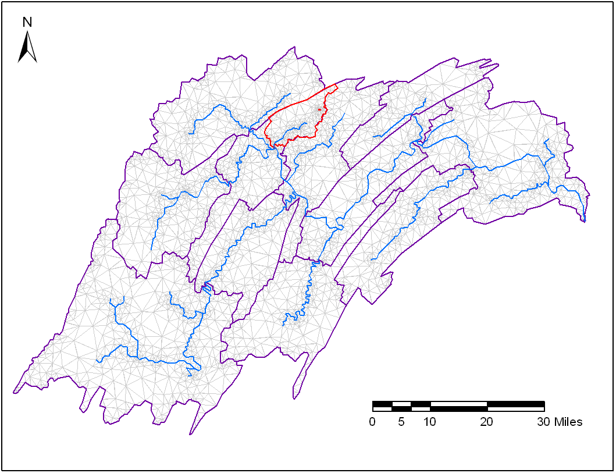
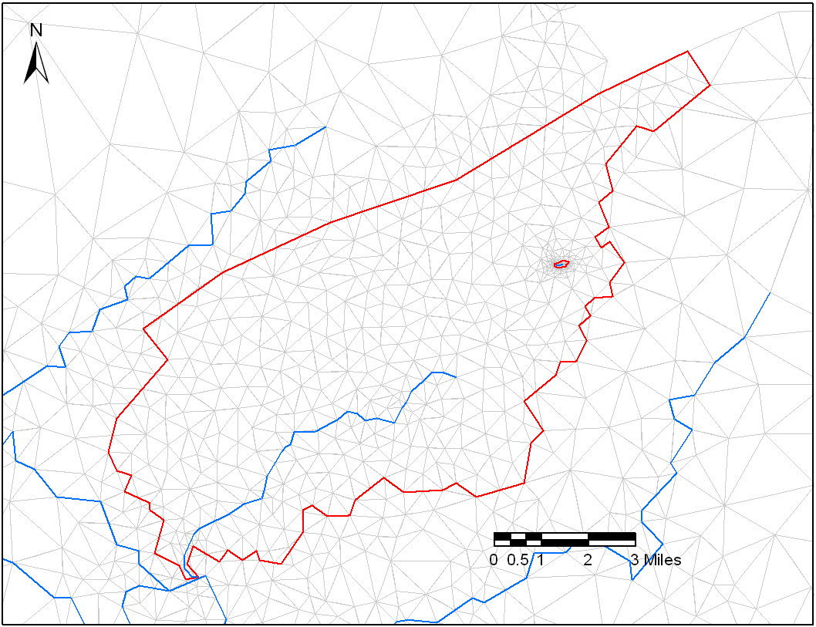
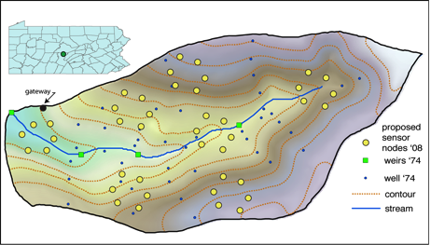
Unfolding A Multi-Scale
Experiment

Slide 29
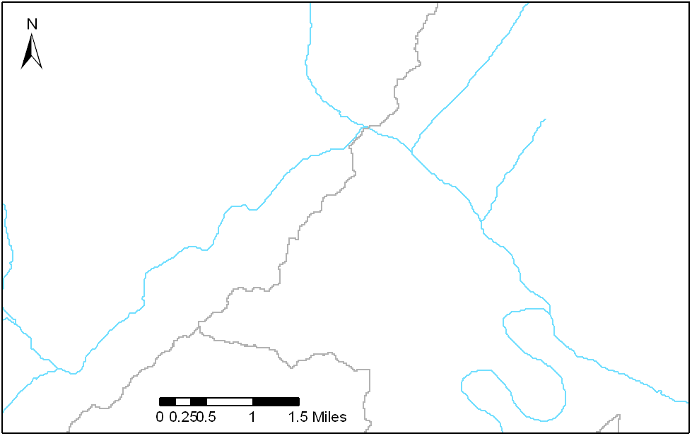
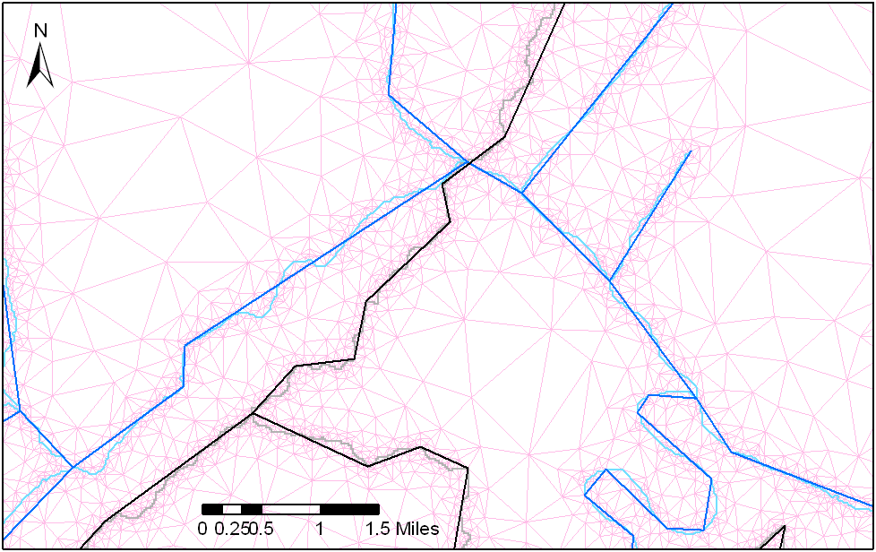
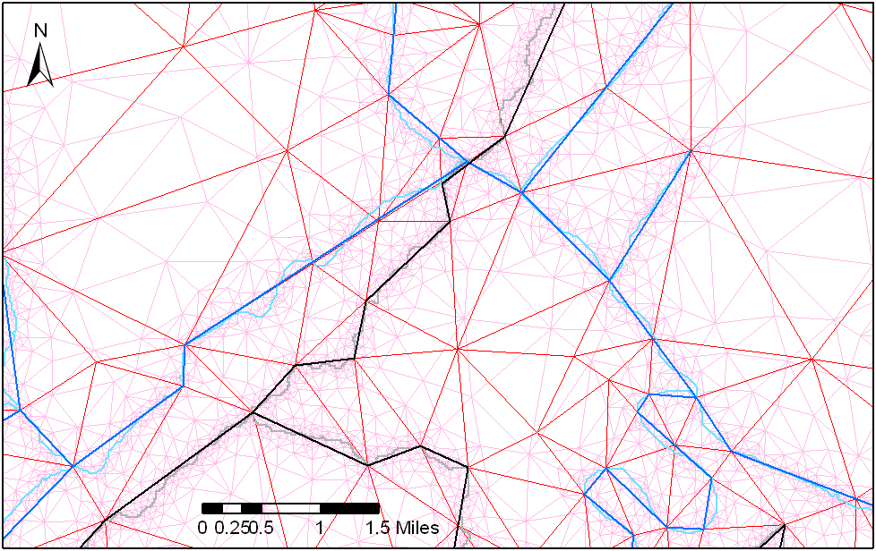
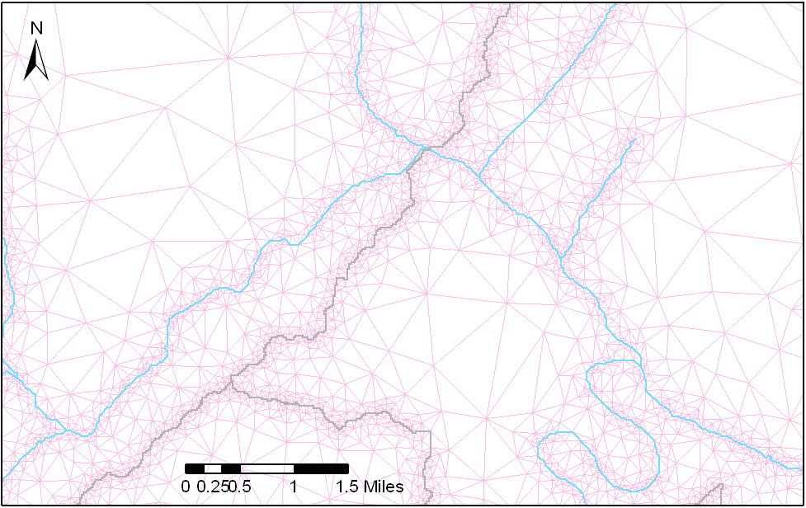
Generating Grids: resolution depends on purpose

Slide 30



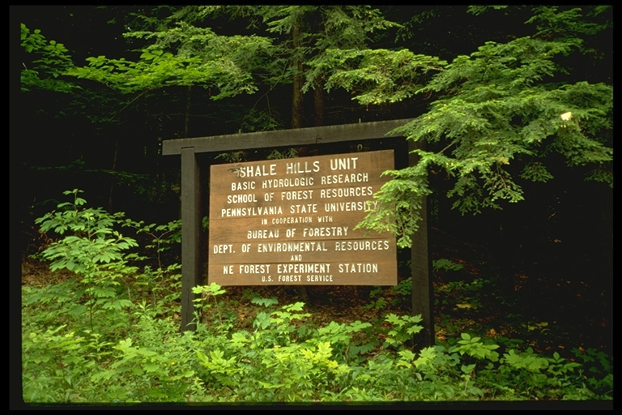


Model Development & Testing
The Shale Hills/Susquehanna
Critical Zone Observatory
Advancing interdisciplinary studies of earth surface processes
Chris Duffy, PI 07-13
Sue Brantley
Rudy Slingerland
David Eissenstat
Henry Lin
Ken Davis
Kamini Singha
Laura Toran
Pat Reed
Karen Salvage
Eric Kirby
Tim White
Kevin Dressler
Doug Miller
Brian Bills
Beth Boyer
Colin Duffy
Chris Graham
Jennifer Williams
Ray Fletcher
Michelle Tuttle
Paul Bierman
Peter Lichtner
Carl Steefel
Rich April
Ryan Mather
David Harbor
Larry McKay
Teferi Tsegaye
HernanSantos
Evan Thomas
Xuan Yu
Yu Zhang
Ryan Jones
Beth Boyer
CZEN

Slide 31
b) Shaver Creek catchment

Slide 32
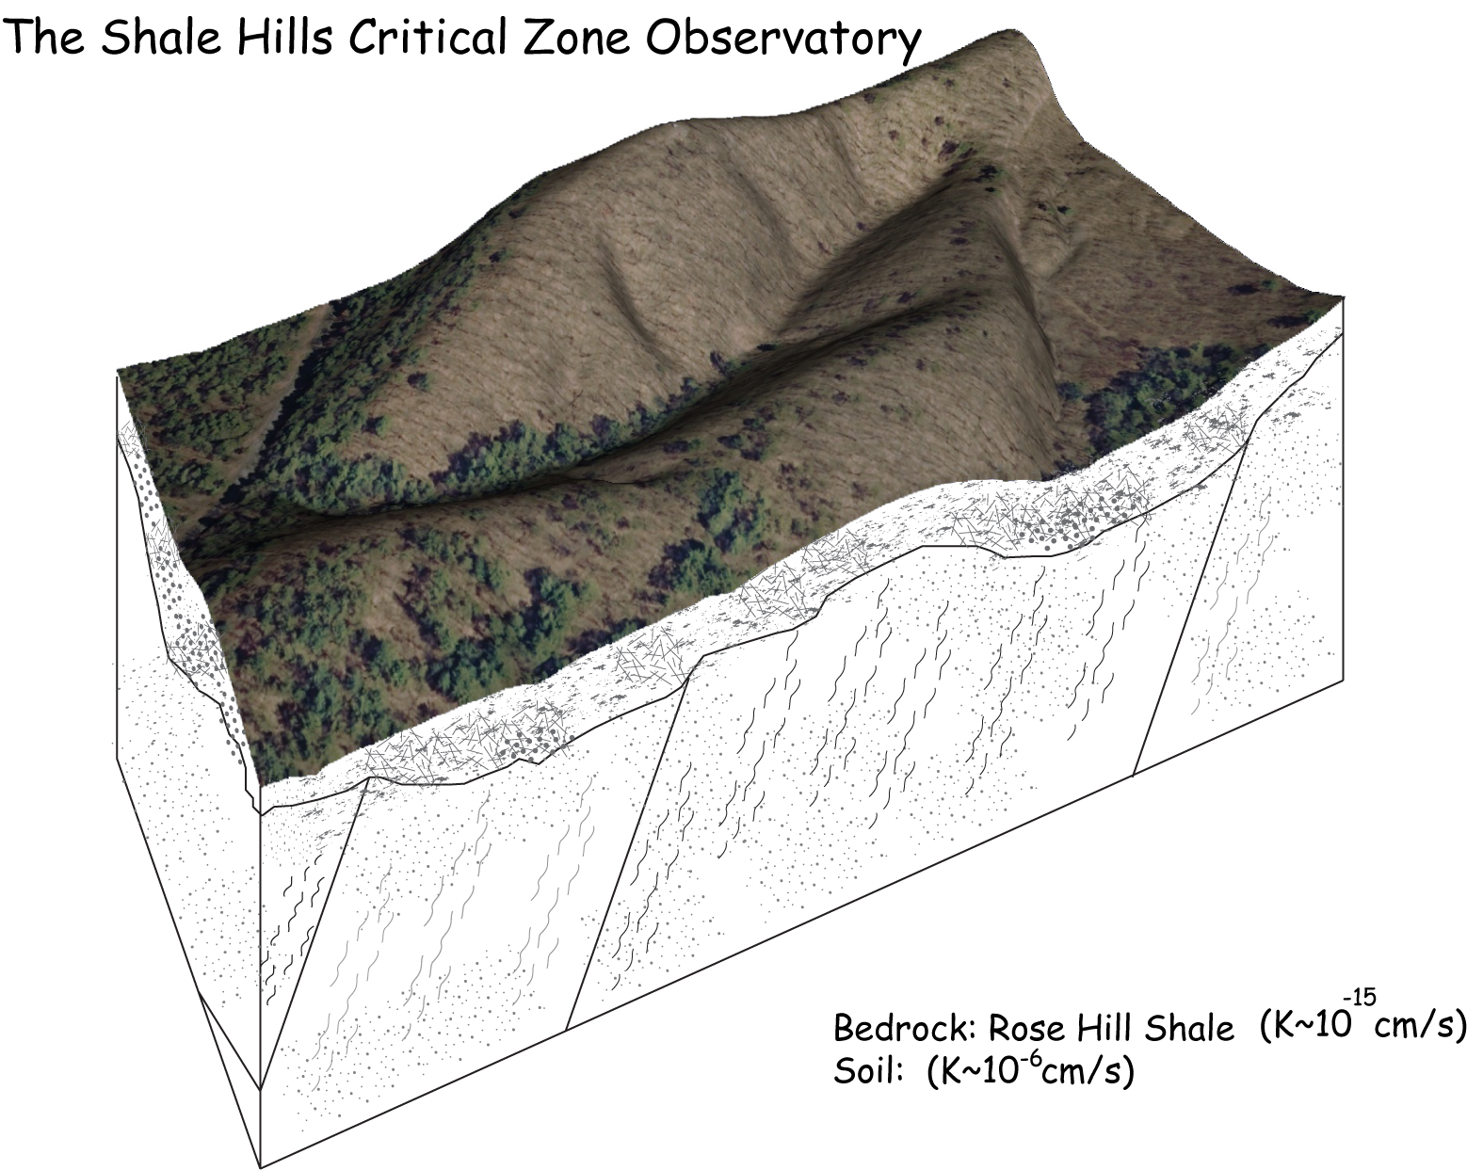

Slide 33
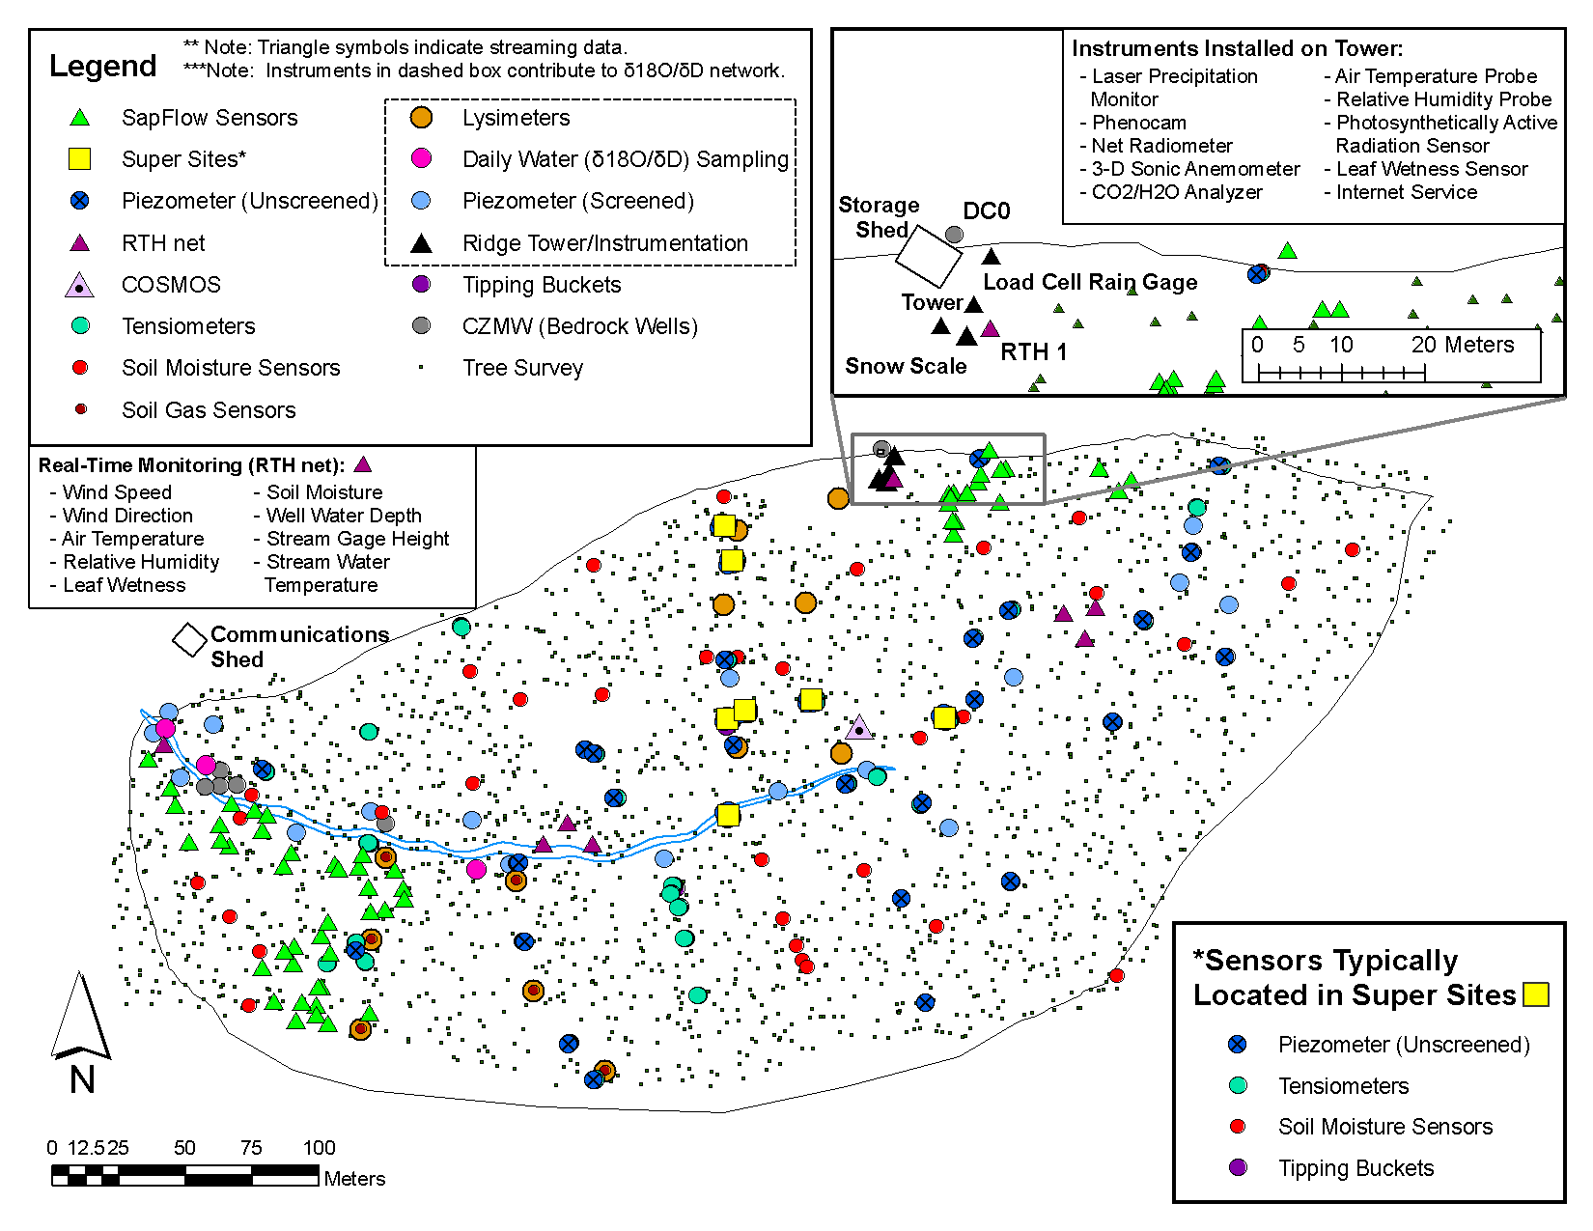

Slide 34
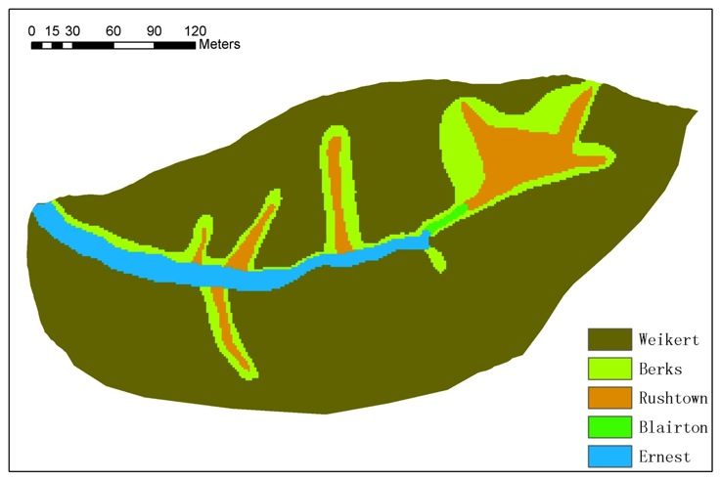
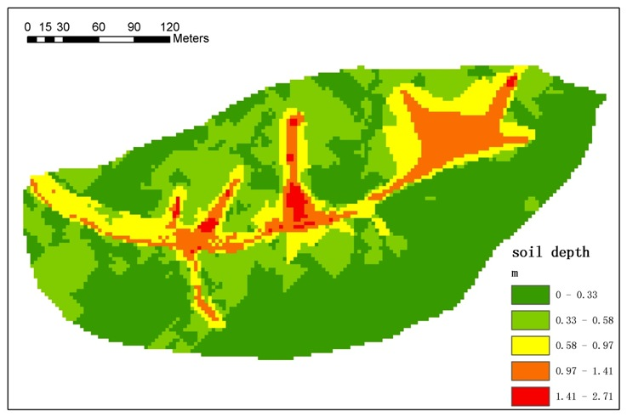
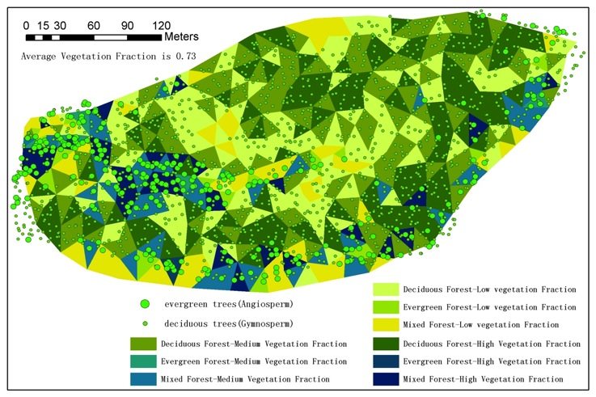
CZO Data ->lidar, Soil, Regolith,Veg

Slide 35
PIHM

Slide 36
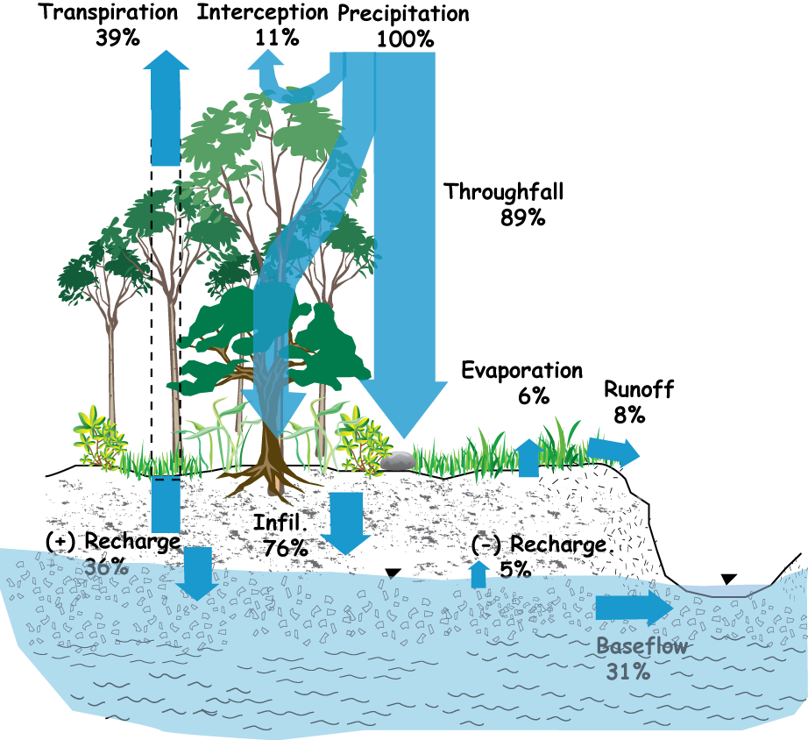
Basic Output: Water balance

Slide 37
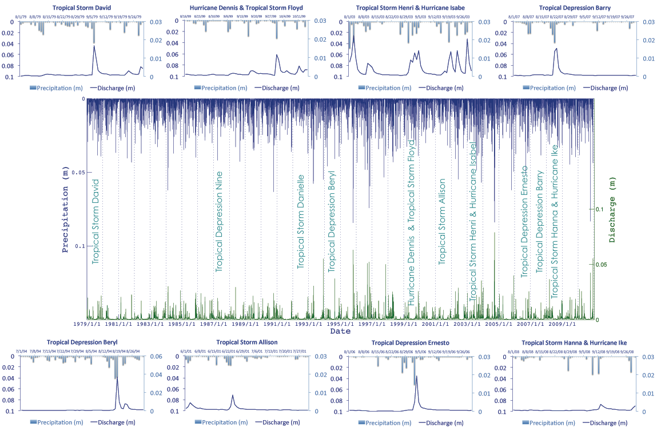
Shale Hills CZO: 1979-2010 Reanalysis Storm Library
CZO Reanalysis:
Shale Hills Storm Library
1979-2011

Slide 38
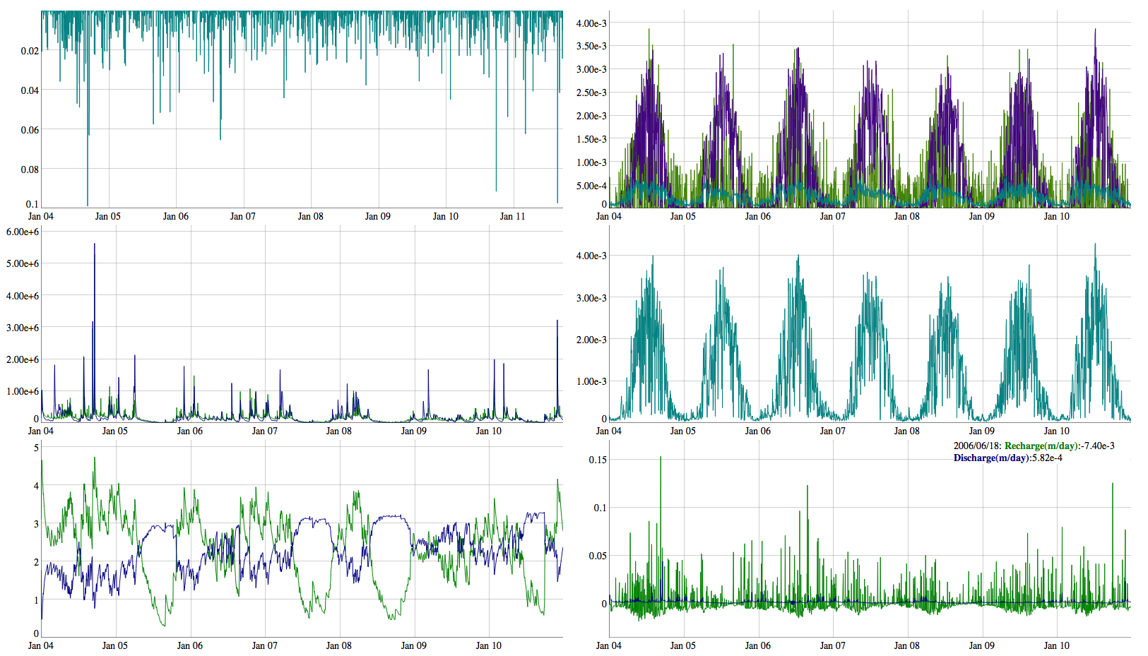
http://www.pihm.psu.edu/applications.html
CZO Catchment Reanalysis time series: 1979-Present

Slide 39
Stream-Groundwater Interaction

Slide 40
30 km^2 Meso-Scale Experiment
Integrated Modeling in a Coastal Watershed
Freshwater Discharge: Groundwater or Surface Water?
Gopal Bhatt
In cooperation with the Smithsonian
Environmental Research Center

Slide 41
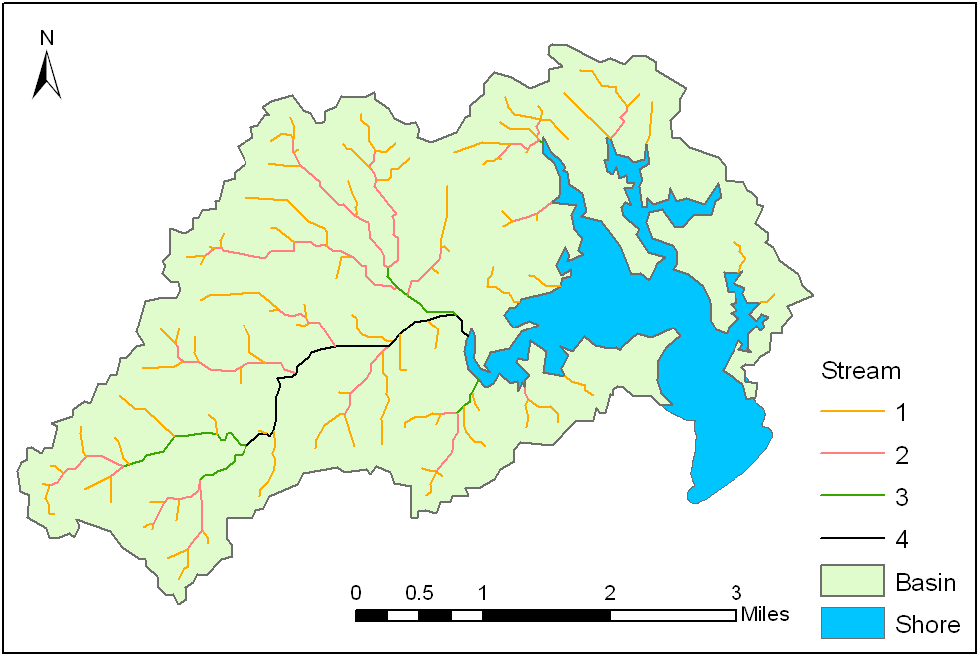
Domain used in decomposition

Slide 42
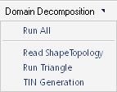
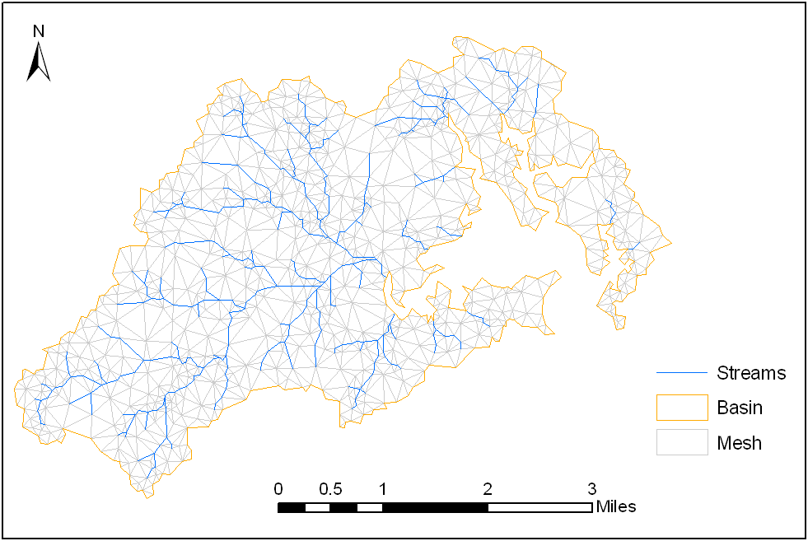
Triangular Irregular Mesh
(Number of Mesh = 1862)

Slide 43
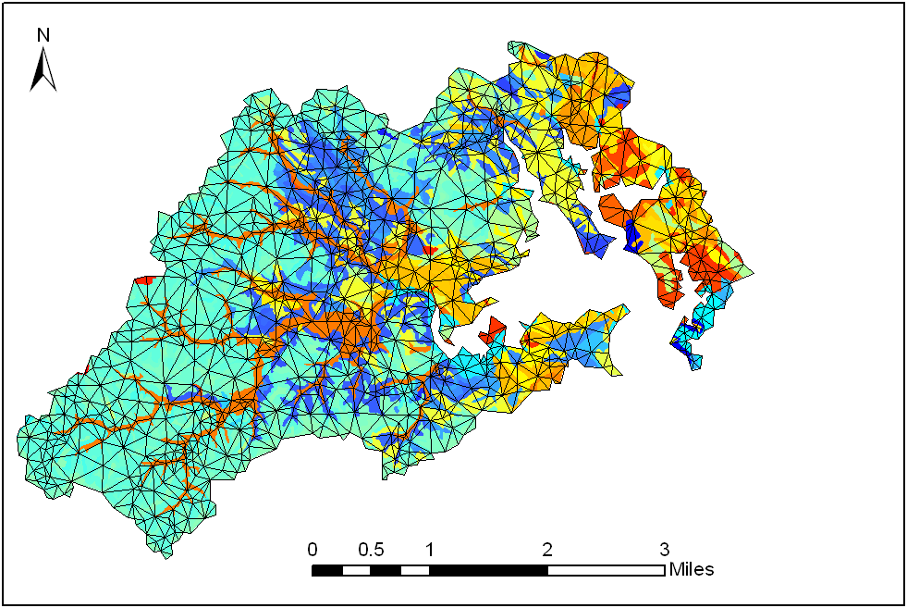
SSURGO Soil Classification

Slide 44
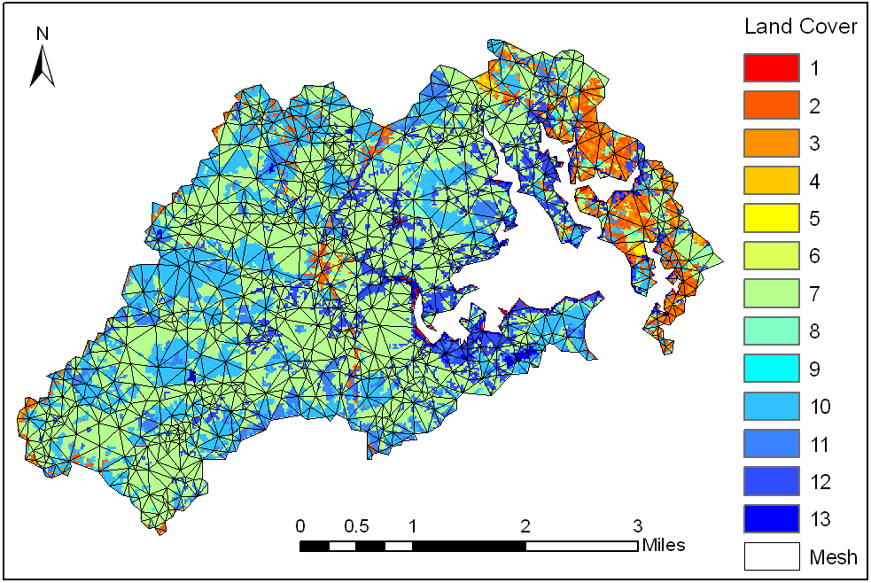
30m NLCD Data

Slide 45
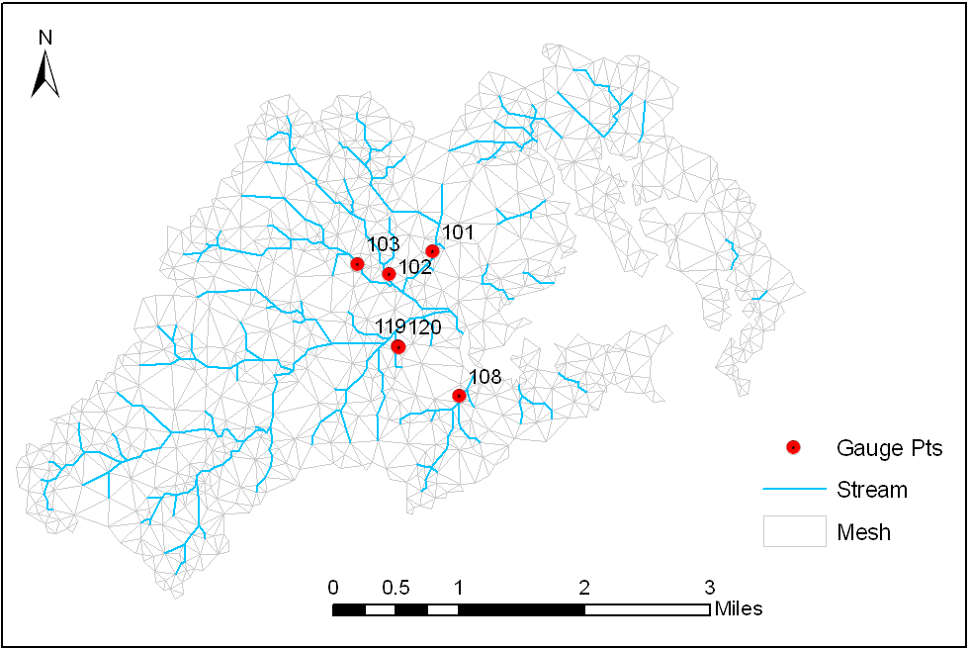
Stream Gauge Locations

Slide 47
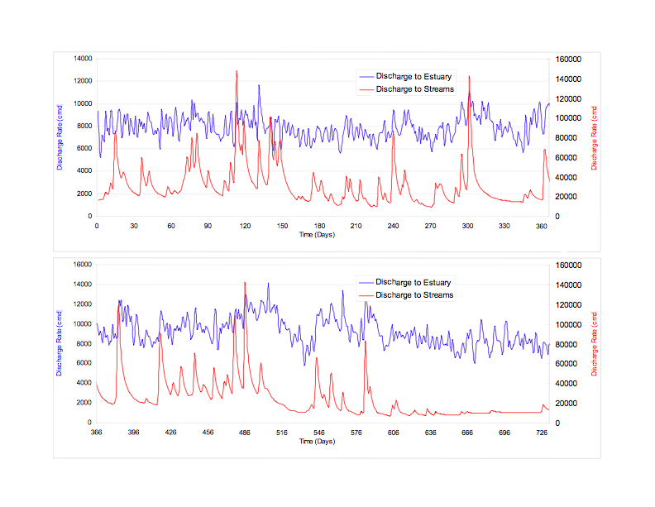
Freshwater Discharge to the Chesapeake

Slide 48
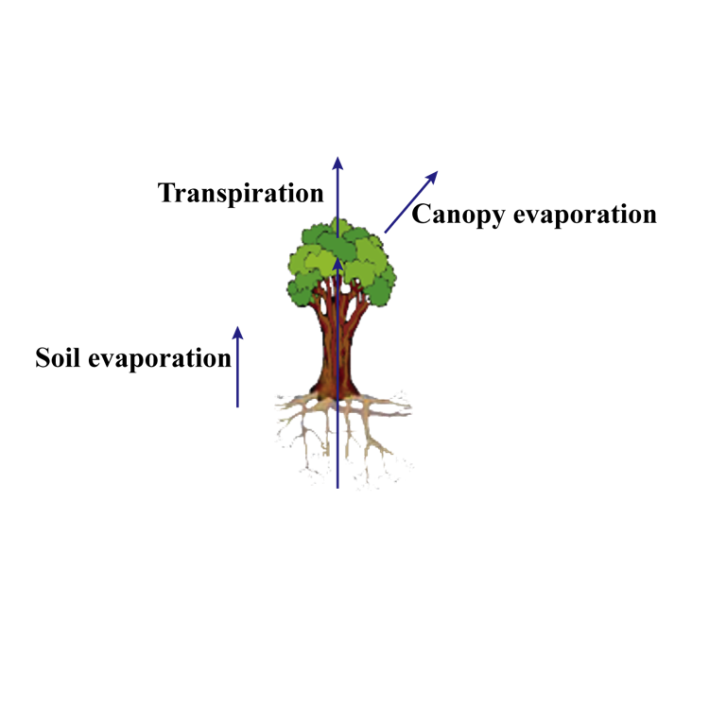
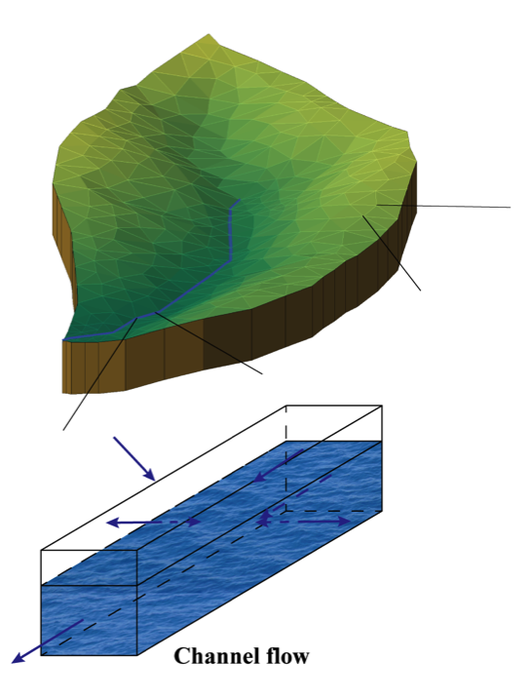


Physically-based land surface hydrologic model: Flux-PIHM
Penn State Integrated Hydrologic Model (PIHM)
Flux-PIHM

Slide 49
Flux-PIHM data assimilation system
Initial Conditions
Ensemble Members
Ensemble Members
Ensemble Members
Constrained Vrbls & Prmts
Perturbation
Ensemble Members
Ensemble Members
Ensemble Members
Ensemble Members
Ensemble Members
Ensemble Members
Forecast
Analysis
Ensemble Members
Ensemble Members
Ensemble Members
Ensemble Members
Observations
Flux-PIHM
EnKF
Quality Control
Notes:
Data assimilation system for parameter and state estimation

Slide 50




Flux-PIHM
Coupled land surface hydrologic model
Noah land surface + PIHM hydrology
Physically-based
Spatially-distributed
Notes:
Blue arrows are Noah processes, and red arrows are PIHM processes.

Slide 51


Slide 52


Slide 53

Spatial pattern of soil water content
Calibrated only using outlet discharge and SWC and WTD at one location, and driven by spatially uniform forcing data

Slide 54

Flux-PIHM DA system for parameter estimation
Notes:
Results from synthetic experiments. Solid lines represent estimated evolution of estimated parameter values when starting from different first guesses. Dashed lines are true parameter values. The DA system provide accurate estimates of parameter values.

Slide 55
Flux-PIHM
Flux-PIHM provides accurate predictions of water and energy fluxes both in time and space
It is now being coupled with different models to explore watershed processes:
  Weathering models (Flux-PIHM-WITCH)
  Reactive transport models (RT-Flux-PIHM)
  Biogeochemistry models (Flux-PIHM-BBGC)
  …

Slide 56

Wetland Vulnerability to Climate Change
Team
Chris Duffy
Xuan Yu
Gopal Bhatt
Ray Najaar
Michael Nassry
Denice Wardrop
Watersheds (7)
Muddy Creek
Kettle Creek
Shaver’s Creek
Young Womans Creek
East Mahantango Creek
Little Juniata River
Lackawanna River
Ecoregions (4)
Ridge and Valley
Piedmont
Unglaciated Plateau
Glaciated Plateau
20-Year Climate Scenarios (2)
Historical: 1979 - 1998
Future: 2046 - 2065

Slide 57



Slide 59


Slide 60
Workflow
Set up models using HydroTerre data
Calibrate catchments on historic data (1979-1998)
HydroGeoMorphic (HGM) classification of wetlands
        Riverine
        Slope
        Depression
Run IPCC future climate scenario (2046-2065)
Use relative gwl change to measure wetland vulnerability

Slide 61
Catchment-Wetland Response

Slide 62

Historical - IPCC Precip-Temp

Slide 63


Historical vs IPCC Simulations
Evapotranspiration
2046-2065
1979-1998
Recharge
2046-2065
1979-1998

Slide 64
“Constrain” Model on Streamflow & NWI Wetlands

Slide 65
FDC Young Woman’s Creek
Future:
peak flows - increase
low flows - lower

Slide 66
FDC Shaver Creek
Future:
peak flows - increase
low flows - increase slightly

Slide 67
FDC Lackawanna
Future:
peak flows increase
low flows increase

Slide 68
Simulated-Observed Wetlands
Working definition: wetland is defined as having a water table within 30 cm of the surface

Slide 69






Seasonal GW Change Anomaly Shavers Creek
Annual
Drier
Stable
Wetter
Fall
Winter
Spring
Summer

Slide 70





Seasonal GW Change Anomaly: Muddy Creek
Annual
Drier
Stable
Wetter
Fall
Winter
Spring
Summer

Slide 71
Catchment-Wide Results
 | NWI Wetlands |  | PIHM Depression
 | Drier | Wetter | Drier | Wetter | Ecoregion
Lackawanna River | 74% | 26% | 71% | 29% | Glaciated Plateau
Young Womans Creek | 62% | 38% | 63% | 37% | Unglaciated Plateau
Kettle Creek | 47% | 53% | 62% | 38% | Unglaciated Plateau
East Mahantango Creek | 40% | 60% | 50% | 50% | Ridge and Valley
Shaver’s Creek | 20% | 80% | 27% | 73% | Ridge and Valley
Little Juniata River | 71% | 29% | 64% | 36% | Ridge and Valley
Muddy Creek | 35% | 65% | 35% | 65% | Piedmont

Slide 72
Future Large Scale, High Resolution Model-Data Access & Scalability
Scaling Concepts and Models From HUC-12’S to Major River Basins

Slide 73

http://www.pihm.psu.edu/announcement_20141026.html
Topics
Essential Terrestrial Variables
Automating the Model Workflow
National Geospatial Data
Hydrologic Basis for Earth System Models
PIHM development
Climate Reanalysis & IPCC Projections
Detecting Decadal Ecosystem Change
Other examples
https://www.youtube.com/watch?v=1uRpMR6SpoI&feature=youtu.be

