Slide 1
Investigating the influence of land use/land cover change on flooding in the Upper Choctawhatchee
Monica Stone, Angela Pelle, & Lian Zhu

Slide 2
Recent Trends
Precipitation and streamflow have been increasing over the last century
S.E. is transitioning to be more urban/commercial
  60% forest
  25% agriculture (decreasing – being moved to the West in the last century)
(Cruise et al., 2010)

Slide 3
Increased Runoff from Urbanization
Urbanization creates areas that are impermeable to precipitation and leads to increased runoff
  Runoff occurs when precipitation rates > infiltration rates
  Vegetation promotes infiltration, so removal increases runoff
  Water drainage systems deliver precipitation to rivers much more quickly than the groundwater system
(Alexakis et al., 2014; Bronstert et al., 2002; Greenough et al., 2001; Ouellet et al., 2012; Wheater et al., 2009)

Slide 4
Consequences of Urbanization
Urbanization increases peak discharges and decreases lag times
  Increases the amount of people at risk to flooding
The larger the storm, the less effective vegetative cover is at attenuating runoff, and the larger the impact of urban surfaces
(Alexakis et al., 2014; Greenough et al., 2001; Wheater et al., 2009; Yan et al., 2013)

Slide 5
Floodplains
Have 2 main jobs:
  To store excess water during a flood event
  Serve as a source of water and nutrients for floodplain species
Floodplains are increasingly being used for anthropogenic activities
(Cruise et al., 2010; Wheater et al., 2009)

Slide 6
Anthropogenic Influence on Floodplains
Agriculture
  63% of pre-settlement floodplain forest converted for agricultural practices
  Grazing animals and heavy field machinery compact soil and reduce infiltration
Development
  Puts people directly in the way of floods
(Bronstert et al., 2002; Greenough et al., 2001; Shankman et al., 1996; Wheater et al., 2009; Yan et al., 2013)

Slide 7
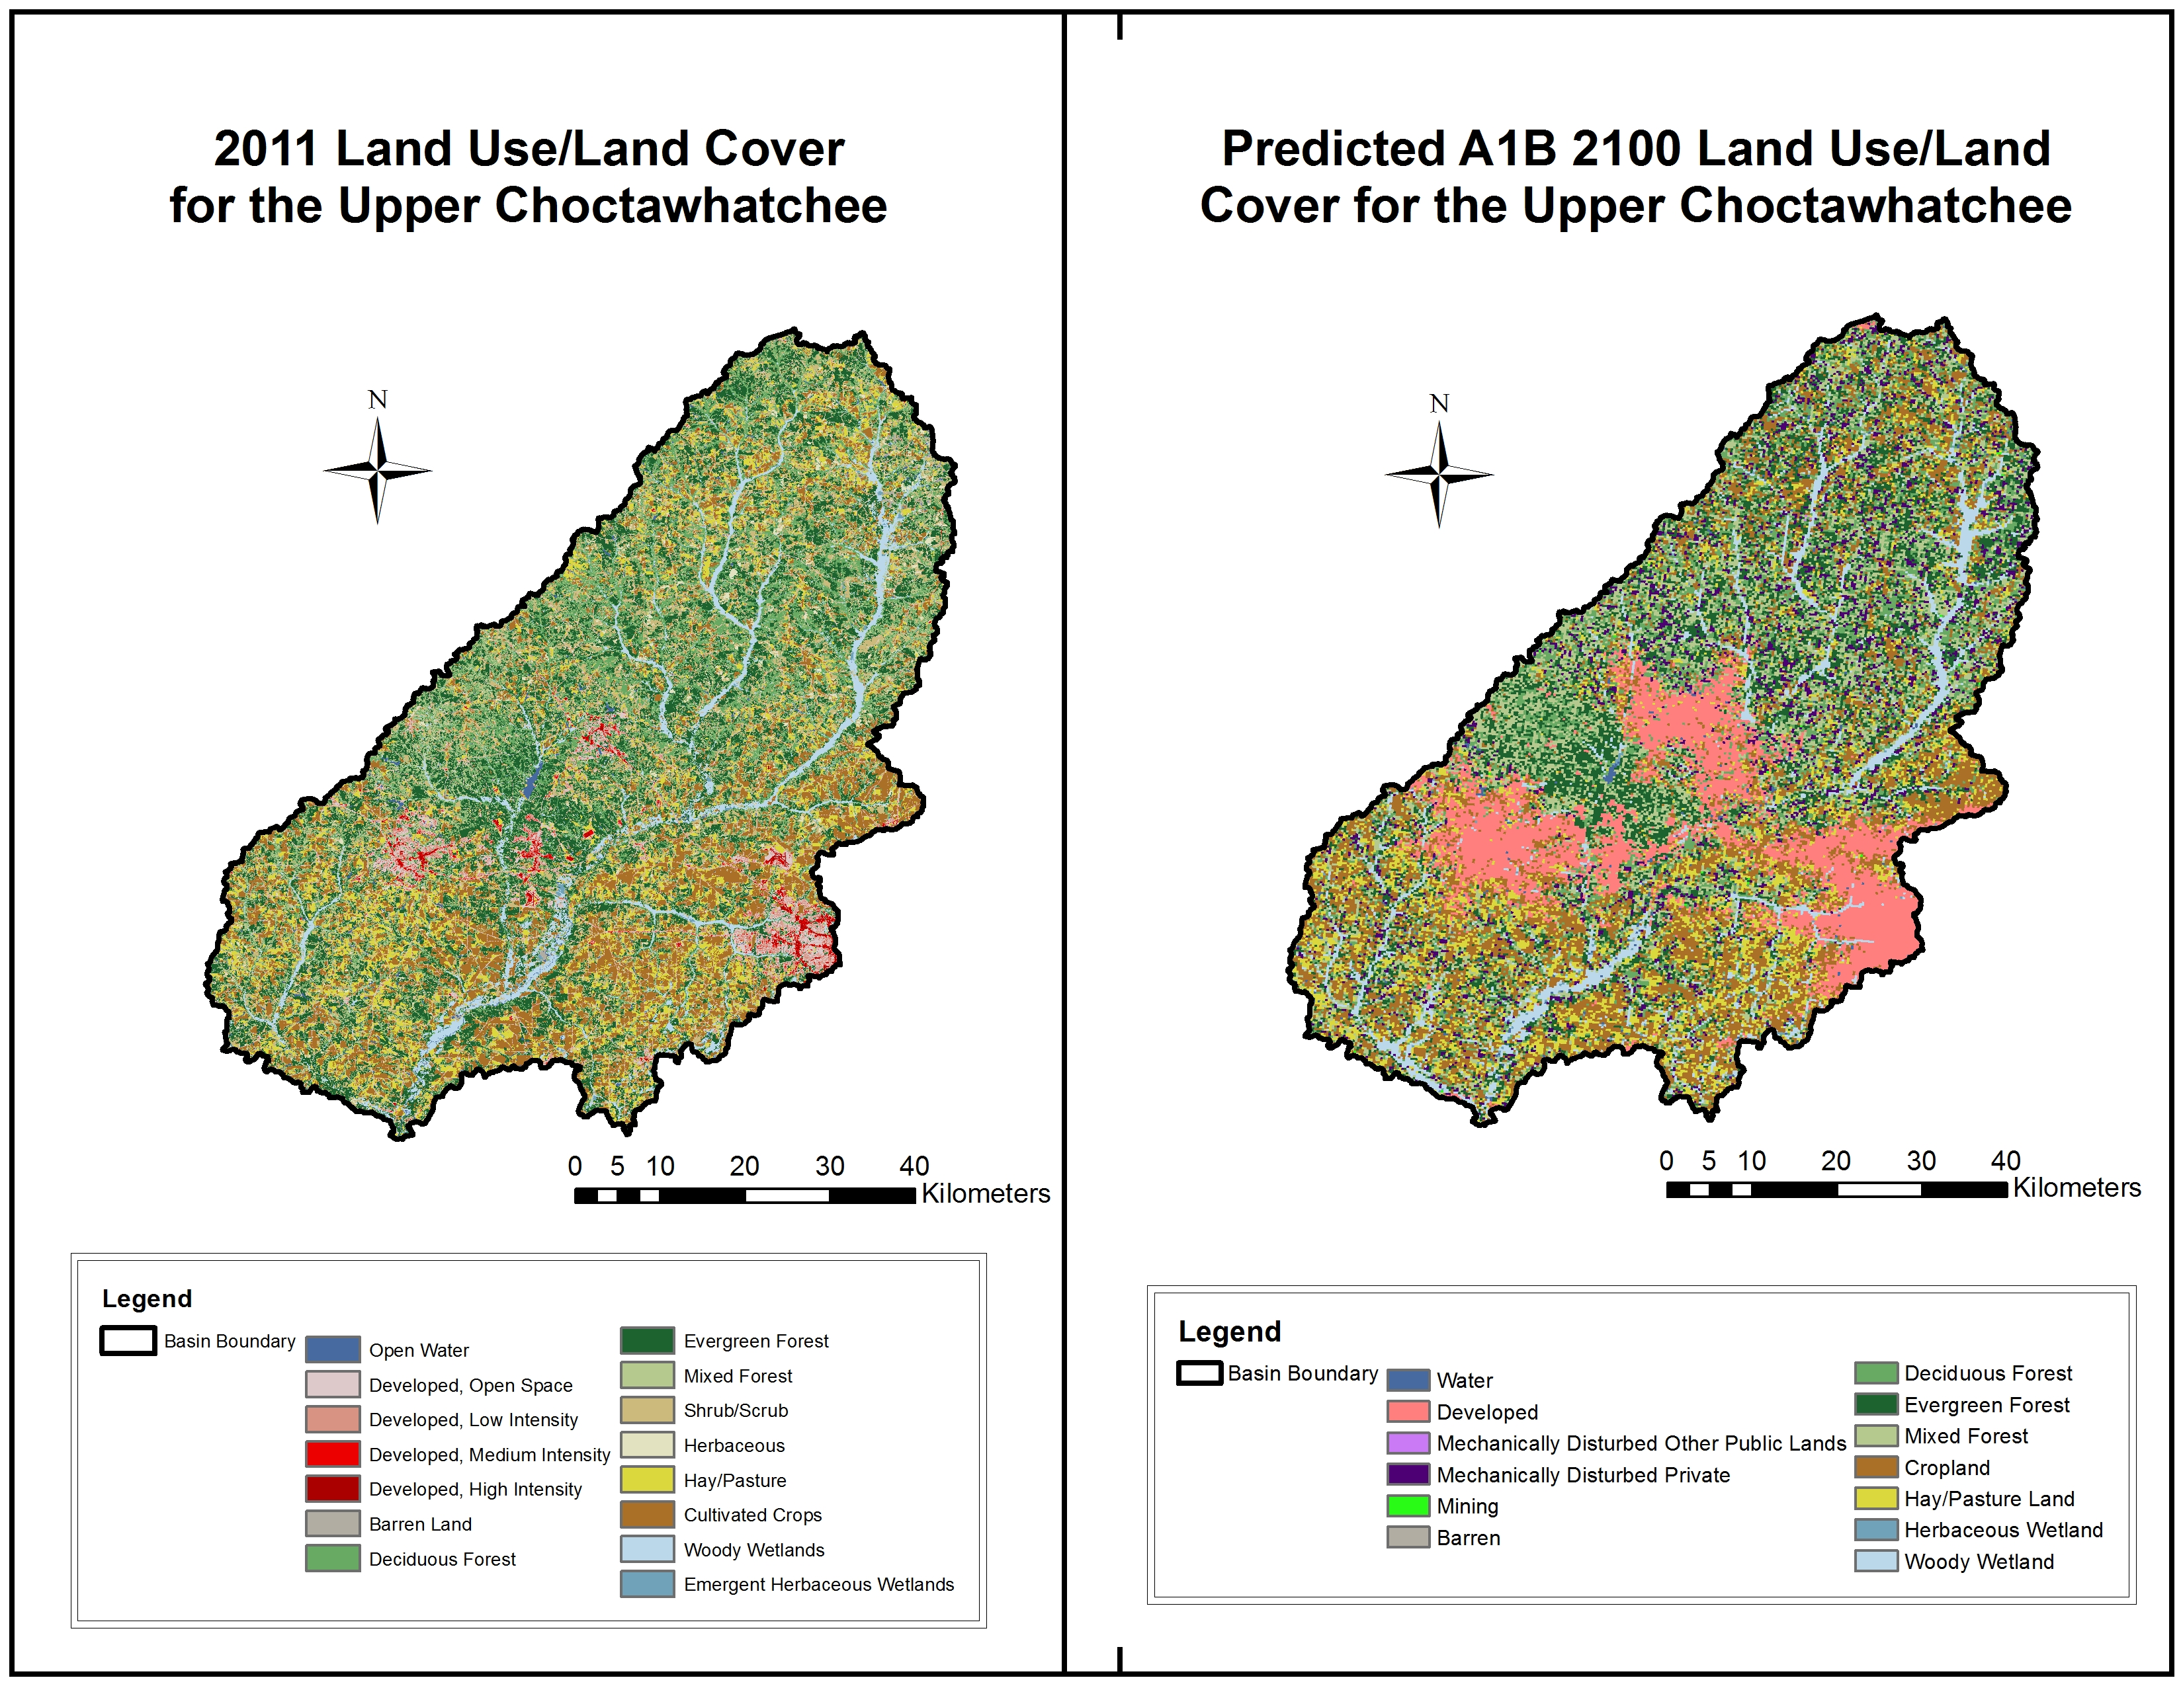
Study Area

Slide 8
Land Use/Land Cover Class | Today | Predicted for 2100
Water | 1.02% | 0.58%
Developed | 3.48% | 12.07%
Barren | 0.17% | 0.003%
Deciduous Forest | 16.85% | 12.10%
Evergreen Forest | 2.97% | 15.45%
Mixed Forest | 8.27% | 15.15%
Cropland | 19.71% | 21.19%
Hay/Pasture | 12.77% | 10.77%
Herbaceous Wetland | 0.31% | 0.21%
Woody Wetland | 6.47% | 6.04%

Slide 9
2100 A1B Climate Scenario
Rapid economic growth
A peak in global population mid-century
Development of new, efficient technologies
Balanced use of fossil and non-fossil energy sources
(IPCC, 2000)

Slide 10
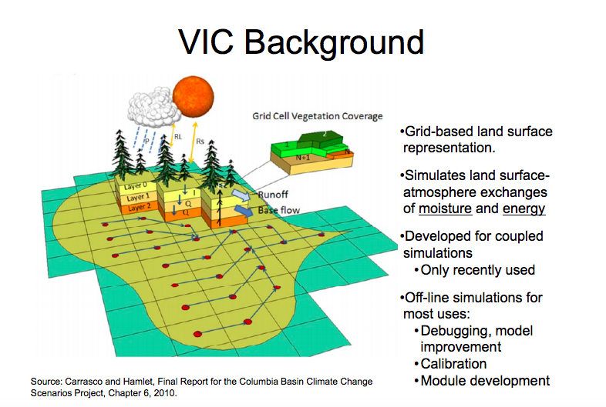

Slide 11
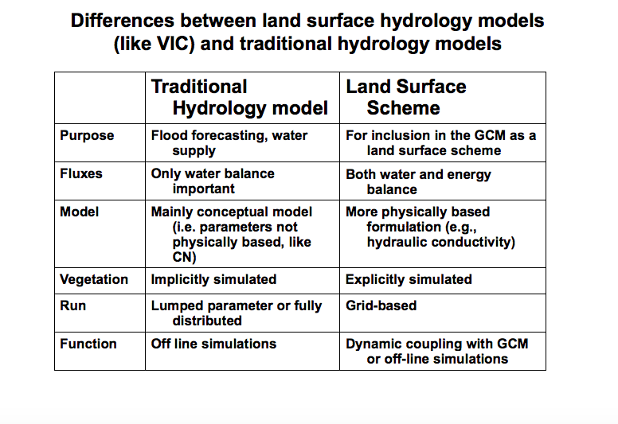

Slide 12
Frequency Threshold Method
Gridded results allow for estimation of severity of flooding at each un-gaged location within a watershed
USGS Regional Frequency Threshold Regression Equations (Flood Magnitudes for 5-100 year storms)
Hedgecock, T.S., and Feaster T.D., 2007, Maginutde and frequency of floods in Alabama, 2003: U.S. Geological Survey Scientific Investigations Report 2007-5204, 28 p., +app (available online at http://pubs.water.usgs.gov/sir2007-5204)

Slide 13
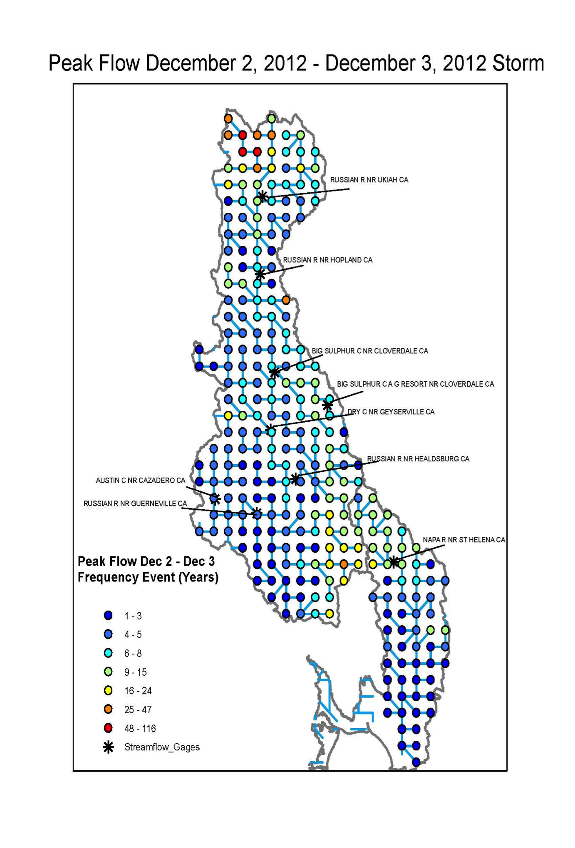
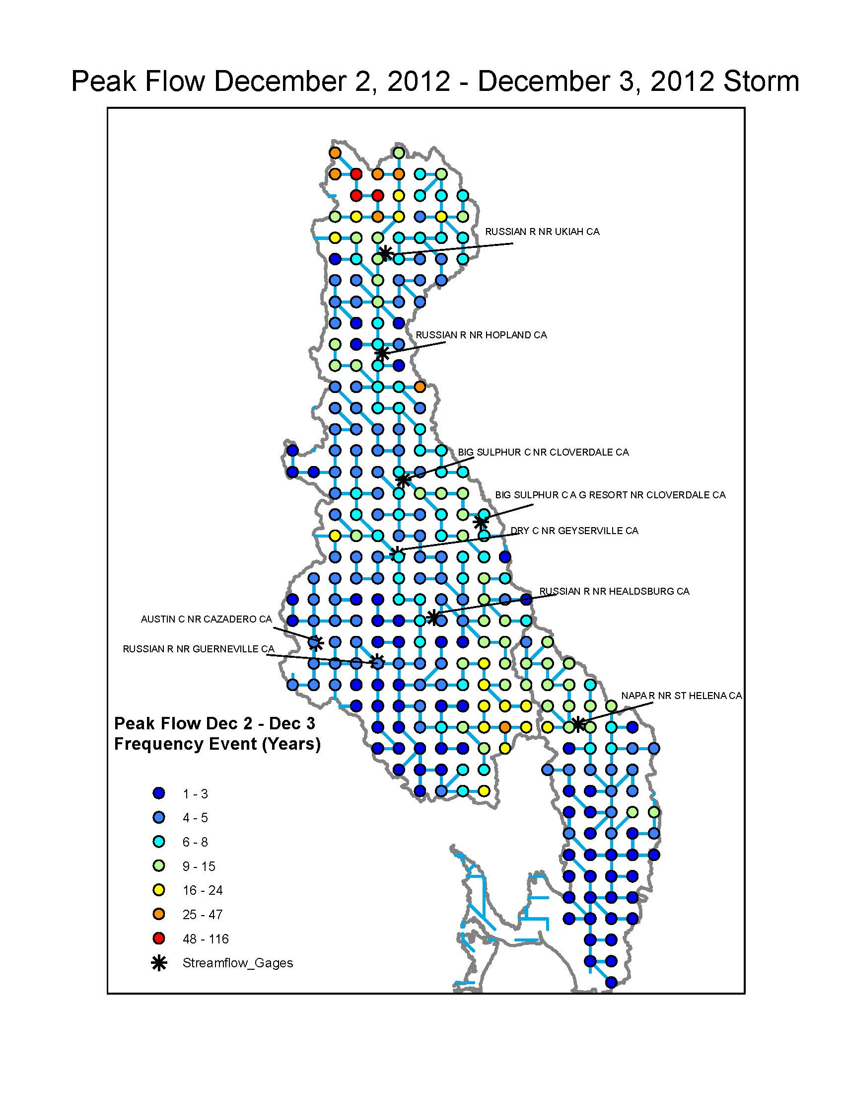
Example Product

Slide 14
Study Scenarios
Today’s land use/land cover
Forest area is predicted to increase from 28%
to 42% by 2100
  30, 35, 40, and 42% scenarios will be run, equally applied to all currently forested areas

Slide 15
03140201 Upper Choctawhatchee. Alabama.
Baseline run from 1980 – 2012

Slide 16
Flood Impacts
Loss of lives and property
Loss of livelihoods
Decreased purchasing and production power
Mass migration
Psychosocial effects
Hindering economic growth and development
Political implications

Slide 17
Flood Indirect Impacts Modeling
Water quality
Infrastructure
Boiling water alert
Bottle water

Slide 18
Flood Indirect Impacts Modeling
ECAT
Economic Consequences Assessment Tool (ECAT) is a dynamic, demand driven, supply constrained social accounting matrix based model.
ECAT models the behavior of water utility customers as they respond to water disruption events.
EACT is designed to provide information to water utility managers local policy makers

Slide 19
Flood Indirect Impacts Modeling
Meaning of Impacts Modeling
Knowing which sector will have the most serious economic impact will help manage the limited resources efficiently.

Slide 20
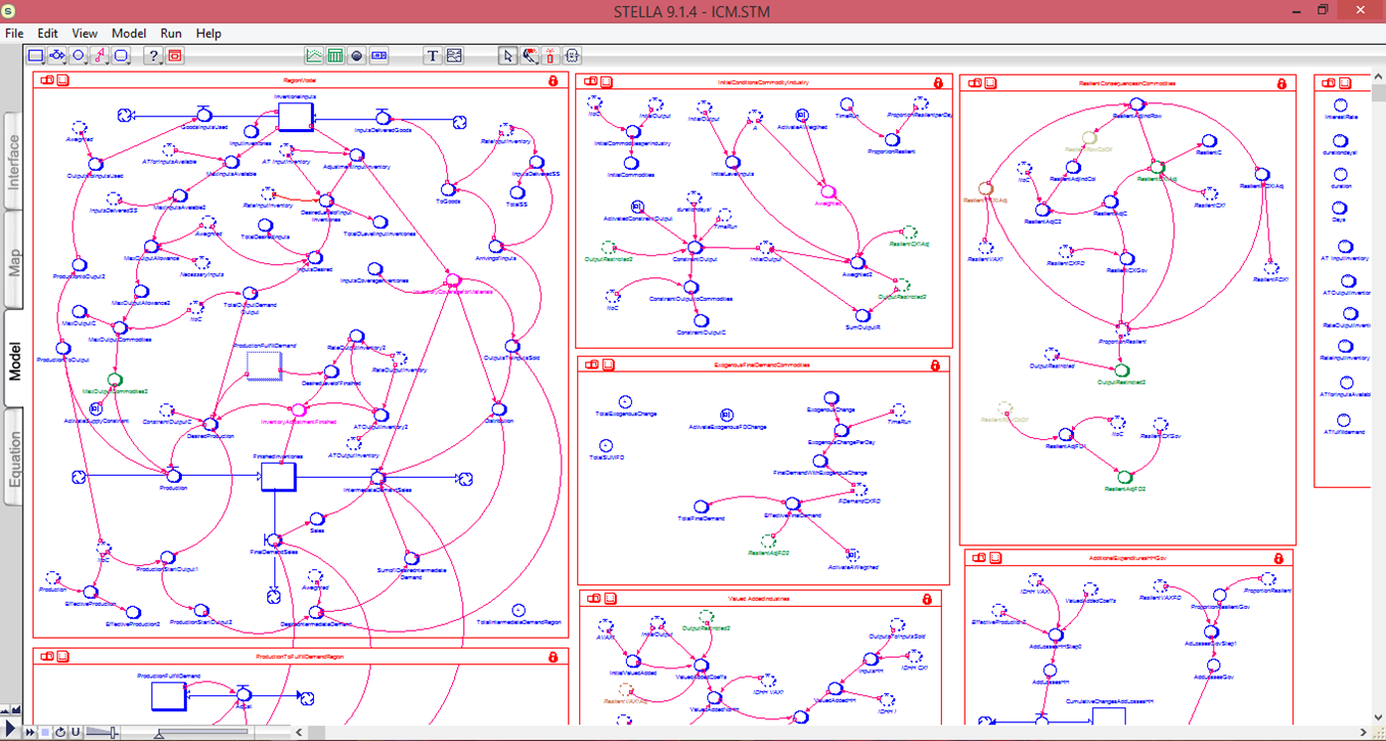
Drought Economic Impact Model

Slide 21
ArcGIS Tool
Automate the process to produce threshold frequencies for any gridded product input
VIC Model -> TF Values (per example) -> VIC Streamflow -> Economic model
Produce economic impact at each grid location

Slide 22
References
Alexakis, D.D., Grillakis, M.G., Koutroulis, A.G., Agapious, A., Themistocleous, K., Tsanis, I.K., Michaelides, S., Pashiardis, S., Demetriou, C., Aristeidou, K., Retalis, A., Tymvios, F., & Hadjimitsis, D.G. (2014). GIS and remote sensing techniques for the assessment of land use change impact on flood hydrology: The case study of Yialias basin in Cyprus. Natural Hazards and Earth System Sciences, 14, 413-426.
Bronstert, A., Niehoff, D., & Bürger, G. (2002). Effects of climate and land-use change on storm runoff generation: Present knowledge and modeling capabilities. Hydrological Processes, 16, 509-529.
Cruise, J.F., Laymon, C.A., & Al-Hamdan, O.Z. (2010). Impact of 20 years of land-cover change on the hydrology of streams in the Southeastern United States. Journal of the American Water Resources Association, 46(6), 1159-1170.
Greenough, G., McGeehin, M., Bernard, S.M., Trtanj, J., Riad, J., & Engelber, D. (2001). The potential impacts of climate variability and change on health impacts of extreme weather events in the United States. Environmental Health Perspectives, 109(2), 191-198.
Intergovernmental Panel on Climate Change (IPCC). (2000). Emissions scenarios: Summary for policymakers.
Ouellet, C., Saint-Laurent, D., & Normand, F. (2012). Flood events and flood risk assessment in relation to climate and land-use changes: Saint-François River, Southern Québec, Canada. Hydrological Sciences Journal, 57(2), 313-325.
Shankman, D. (1996). Stream channelization and changing vegetation patterns in the U.S. Coastal Plain. Geographical Review, 86(2), 216-232.
Sohl, T.L., Sayler, K.L., Bouchard, M.A., Reker, R.R., Friesz, A.M., Bennett, S.L., Sleeter, B.M., Sleeter, R.R., Wilson, T., Soular, C., Knuppe, M., & Van Hofwegen, T. (2014).
Spatially explicit modeling of 1992-2100 land cover and forest stand age for the conterminous United States. Ecological Applications, 24(5), 1015-1036.
Wheater, H., & Evans, E. (2009). Land use, water management, and future flood risk. Land Use Policy, 26S, S251-S264.
Yan, H., & Edwards, F.G. (2013). Effects of land use change on hydrologic response at a watershed scale, Arkansas. Journal of Hydrologic Engineering, 18, 1779-1785.

