Slide 1
CE 397 Flood Forecasting
Review Slides for the Midterm Exam
David Maidment
Spring 2015

Slide 2
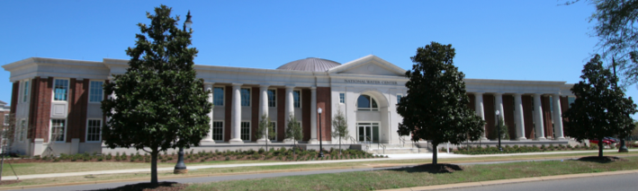
The Opportunity…
New National Water Center established on the Tuscaloosa campus of University of Alabama by the National Weather Service and federal agency partners
Has a mission to assess hydrology in a new way at the continental scale for the United State

Slide 3


Partnership with the academic community …
National Weather Service has joined with CUAHSI to conduct a one-year National Flood Interoperability Experiment (NFIE)
Includes a Summer Institute for students and faculty at the National Water Center, June 1 to July 17, 2015

Slide 4
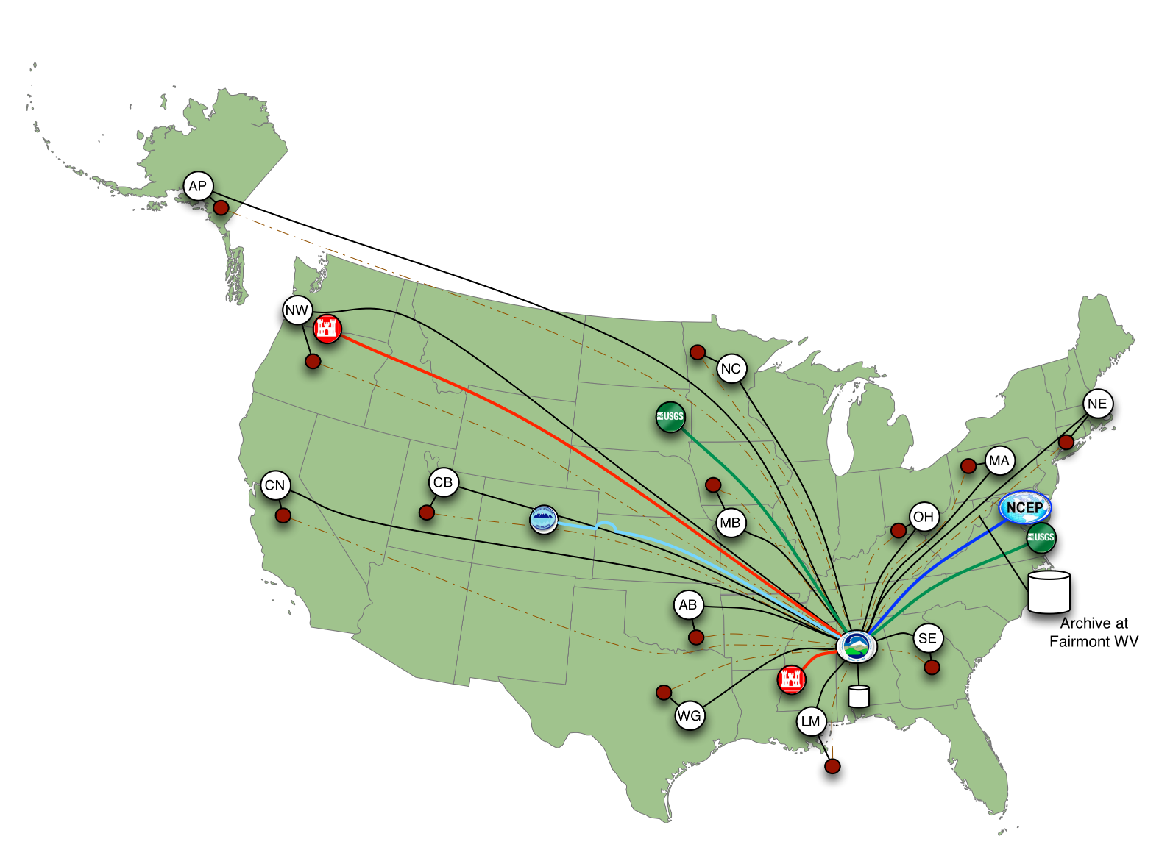
Nationally Synthesize Operations of Regional River Forecast Centers

Slide 5
Goal of the Experiment …
Close the gap between National Flood Forecasting and Local Emergency Response
Demonstrate forecasting of flood impacts at “stream and street level”
National
Weather and Hydrology
National Weather Service and federal agencies
National Water Center
River Flooding and Emergency Response
Local, State and Regional Agencies
Citizens
Local

Slide 6









NFIE Goal: Connect National Scale Flood Modeling with Local emergency planning and response
How can near-real-time hydrologic simulations at high spatial resolution, covering the nation, be carried out using the NHDPlus or next generation hydro-fabric (e.g. data structure for hillslope, watershed scales)?
How can this lead to improved emergency response and community resilience?
How can an improved interoperability framework support the first two goals and lead to sustained innovation in the research to operations process?
Slide: Ed Clark, NWS

Slide 7
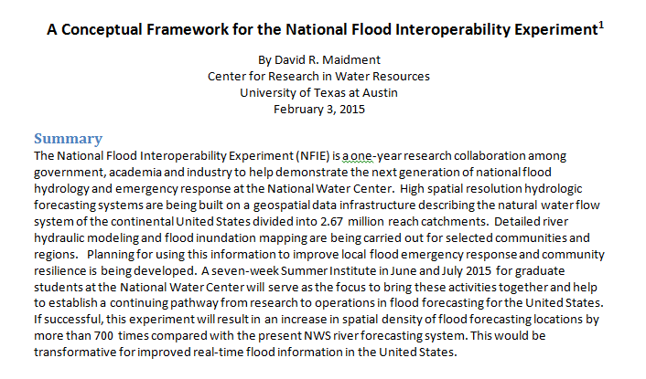
Conceptual Framework Paper…

Slide 8
National Flood Interoperability Experiment (NFIE):
Five Components
NFIE-Geo: National geospatial framework for hydrology
NFIE-Response: Wide area planning for flood emergency response
NFIE-Hydro: National high spatial resolution hydrologic forecasting
NFIE-River: River channel information and real-time flood inundation mapping
NFIE-Services: Web services for flood information

Slide 9
National Flood Interoperability Experiment (NFIE)
Component One: NFIE-Geo
NFIE-Geo: National geospatial framework for hydrology
NFIE-Response: Wide area planning for flood emergency response
NFIE-Hydro: National high spatial resolution hydrologic forecasting
NFIE-River: River channel information and real-time flood inundation mapping
NFIE-Services: Web services for flood information

Slide 10
Conceptual Framework Paper…

Slide 11
National Flood Interoperability Experiment (NFIE):
Five Components
NFIE-Geo: National geospatial framework for hydrology
NFIE-Response: Wide area planning for flood emergency response
NFIE-Hydro: National high spatial resolution hydrologic forecasting
NFIE-River: River channel information and real-time flood inundation mapping
NFIE-Services: Web services for flood information

Slide 12
National Flood Interoperability Experiment (NFIE)
Component One: NFIE-Geo
NFIE-Geo: National geospatial framework for hydrology
NFIE-Response: Wide area planning for flood emergency response
NFIE-Hydro: National high spatial resolution hydrologic forecasting
NFIE-River: River channel information and real-time flood inundation mapping
NFIE-Services: Web services for flood information

Slide 13
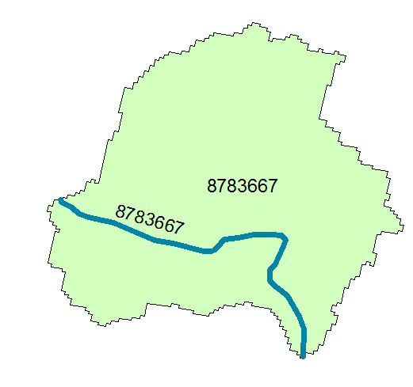
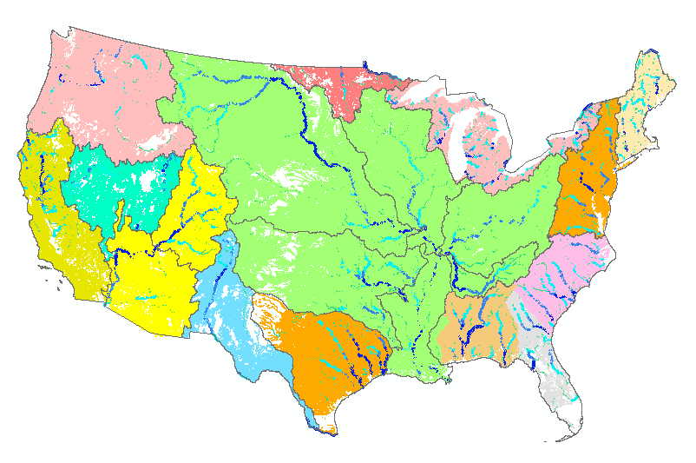
Assumptions…
High spatial resolution hydrologic modeling at continental scale
Built upon NFIE-Geo: A national geospatial framework for hydrology
  Continental landscape divided into 2.67 million local catchments, each containing a single stream reach
  Stream reaches connect to form a national stream network
2.67 million catchments
Average area 3 km²
Average reach length 2 km

Slide 14
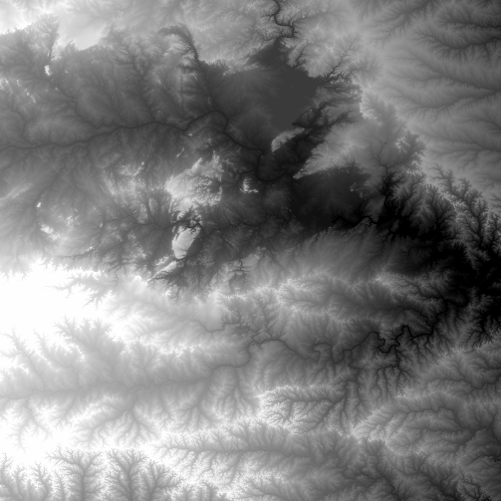
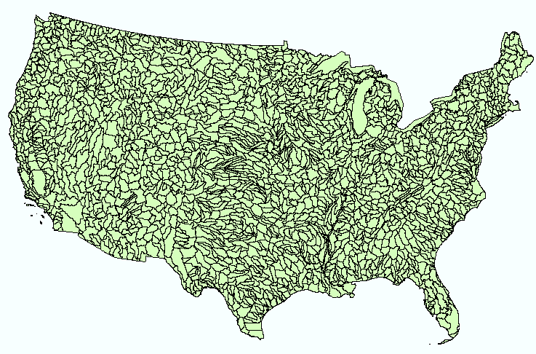
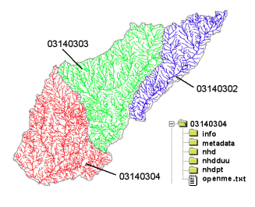
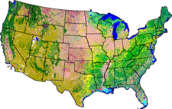
NHDPlus Version 2
Geospatial foundation for a national water data infrastructure
NHDPlus
2.67 million reach catchments in US
average area 3 km²
reach length 2 km
National Elevation Dataset
Watershed Boundary Dataset
National Hydrography Dataset
National Land Cover Dataset

Slide 15
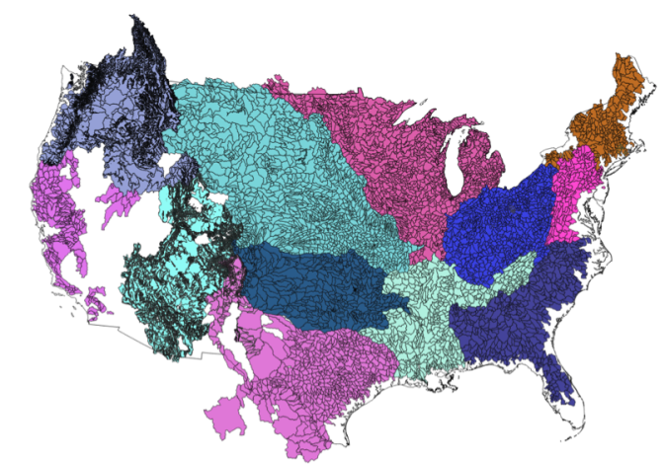


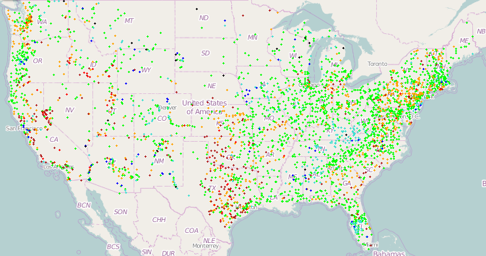
NFIE-Geo for National Flood Interoperability Experiment
Enhanced geospatial database for a national water data infrastructure
NWS Basins and
Forecast Points
USGS Water Watch
Points
National Flood
Hazard Layer
Feature classes:
Subwatershed (HUC12)
Catchment
Flowline
Waterbody
Dam
NFIE-Geo
9 feature classes
5 from NHDPlus
4 from IWRSS
NHDPlus

Slide 16
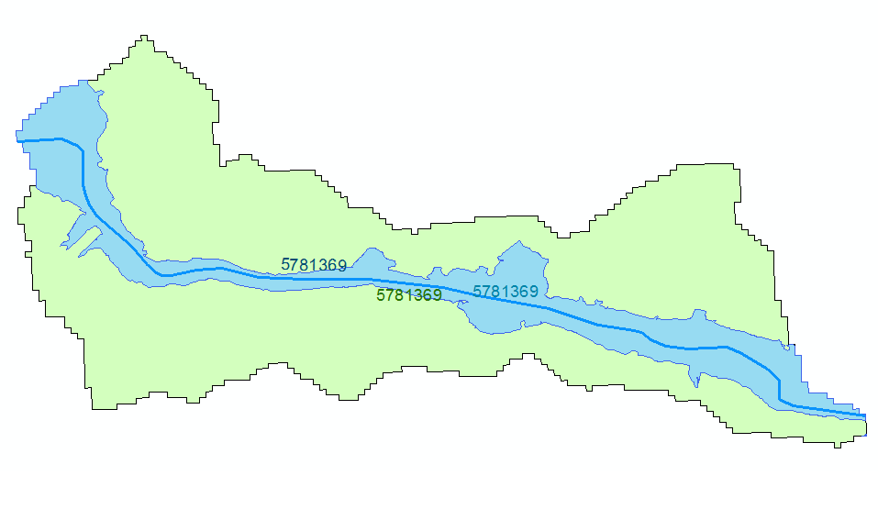
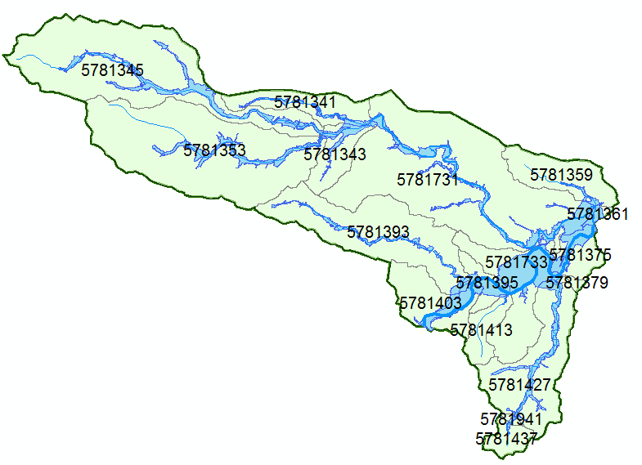
NHDPlus Reach Catchments and Subwatersheds
Reach Catchment
Subwatershed
Catchment 5781369
HUC12 Subwatershed
Contains reach catchments
Base for Hydrologic modeling
and flood emergency response planning
Each reach catchment has a single flow line
Uniquely labeled across the nation
Flood hazard zone defined by FEMA map

Slide 17
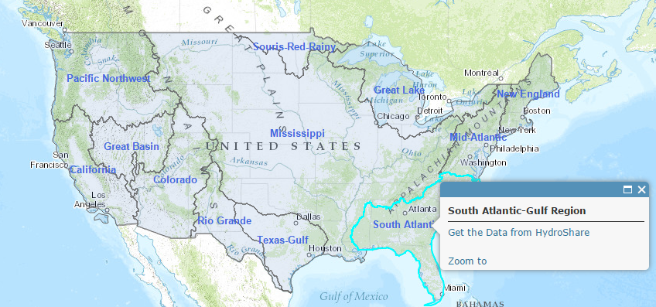
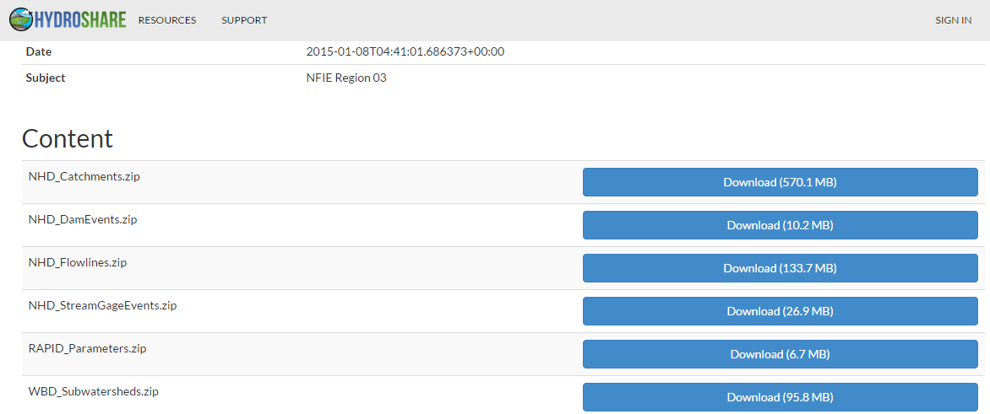
NFIE-Geo in HydroShare
https://www.arcgis.com/home/webmap/viewer.html?webmap=2c30160429984a59873f26b9d118dbfe
David Tarboton, Utah State Univ
and Ray Idaszak, RENCI

Slide 18
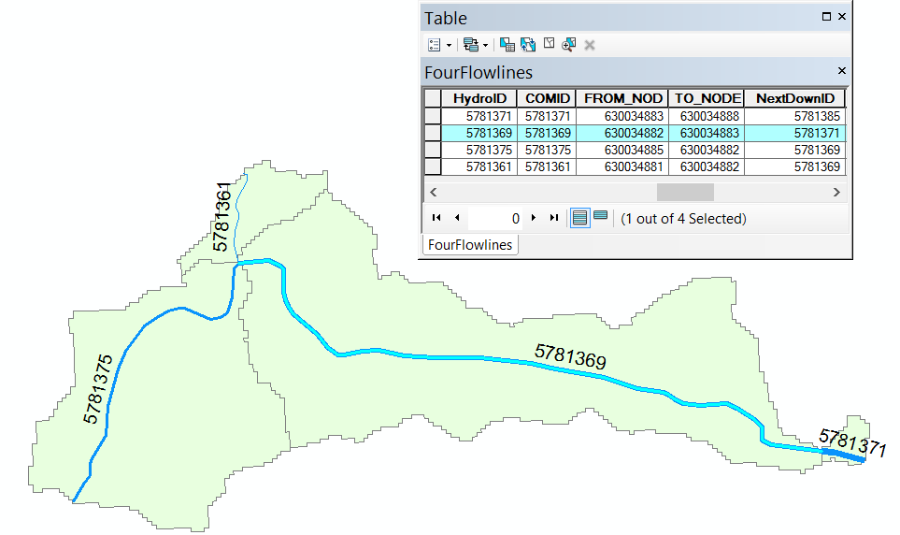
Reach Connectivity (100K NHD)
All flowlines have a From_Node and a To_Node in the downhill flow direction
These node numbers are attributes of the flowline and not actual points in the database
81
82
83
All node numbers are preceded by 6300348
So Node 81 is actually 630034881
88
85

Slide 19
Line-Node Topology
B
3
1
Converging reaches
D
A
Diverging reaches
2
4
C
Line | FromNode | ToNode
1 | A | B
2 | A | C
3 | B | D
4 | C | D
Flow Direction

Slide 20
Line-Node Topology for a loop
1
A
B
This means that there is a flow split
Each reach has its own local reach catchment
2
Line | FromNode | ToNode
1 | A | B
2 | A | B
Flow Direction

Slide 21
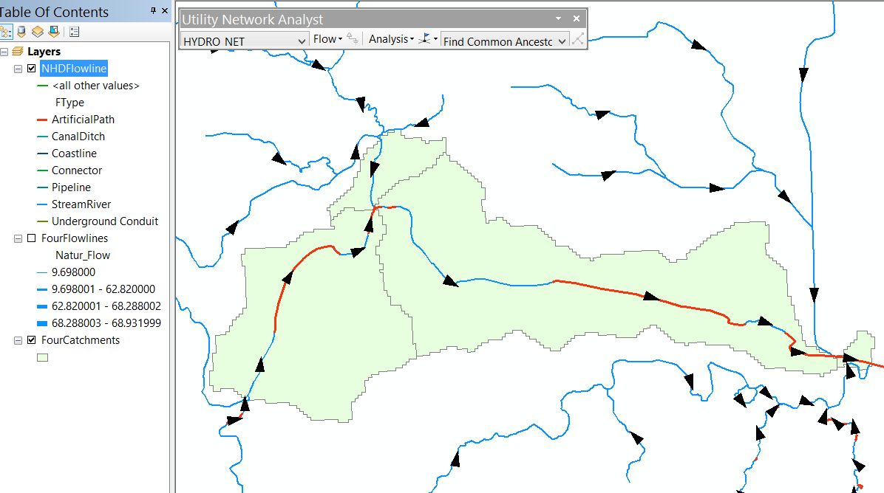
24K National Hydrography Dataset – Connectivity by geometric network
Feature Types
Geometric network
No FromNode and ToNode as attributes on the lines
No catchment associated with each individual line

Slide 22
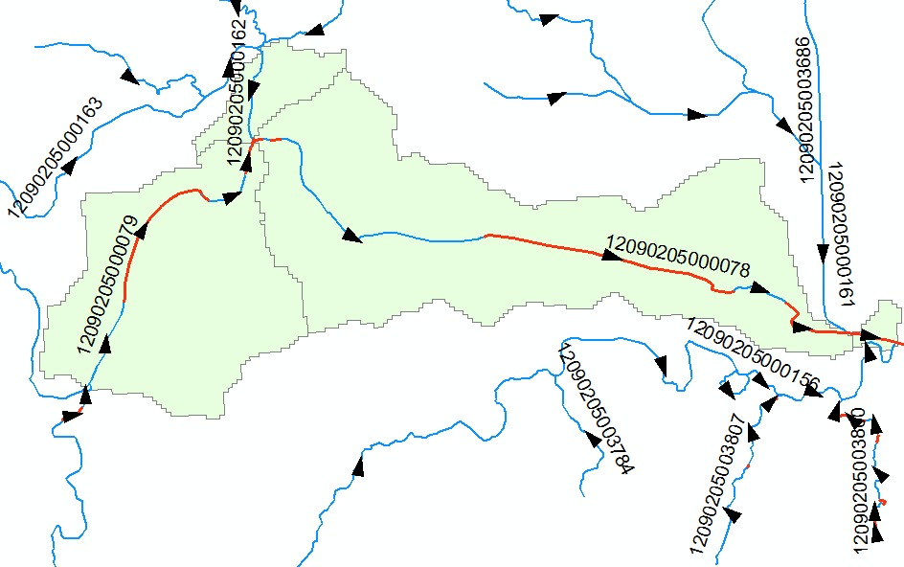
In 24K NHD, each reach is made up of “features” Indexed by a “ReachCode”
ReachCode 12090205000078 means that this is segment 78 in HUC8 Subbasin 12090205

Slide 23
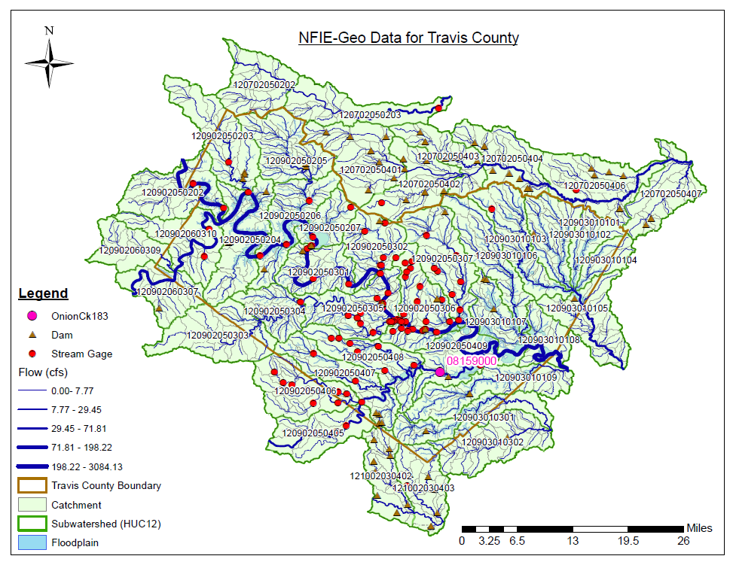
NFIE-Geo for a county….
County subset of national geospatial data layers
Map courtesy of Cyndi Castro
UT Austin
http://www.caee.utexas.edu/prof/maidment/CE397Flood/Assignment2/NFIEGeo.pdf

Slide 24
What have we learned?
NFIE-Geo is a solid information base for building a national flow forecasting system
National level data yields local data description that is detailed enough for “stream and street” level impacts
24K data is too detailed for a national model – better to stick to 100K flowline data

Slide 25
National Flood Interoperability Experiment (NFIE)
Component Two: NFIE-Hydro
NFIE-Geo: National geospatial framework for hydrology
NFIE-Response: Wide area planning for flood emergency response
NFIE-Hydro: National high spatial resolution hydrologic forecasting
NFIE-River: River channel information and real-time flood inundation mapping
NFIE-Services: Web services for flood information

Slide 26
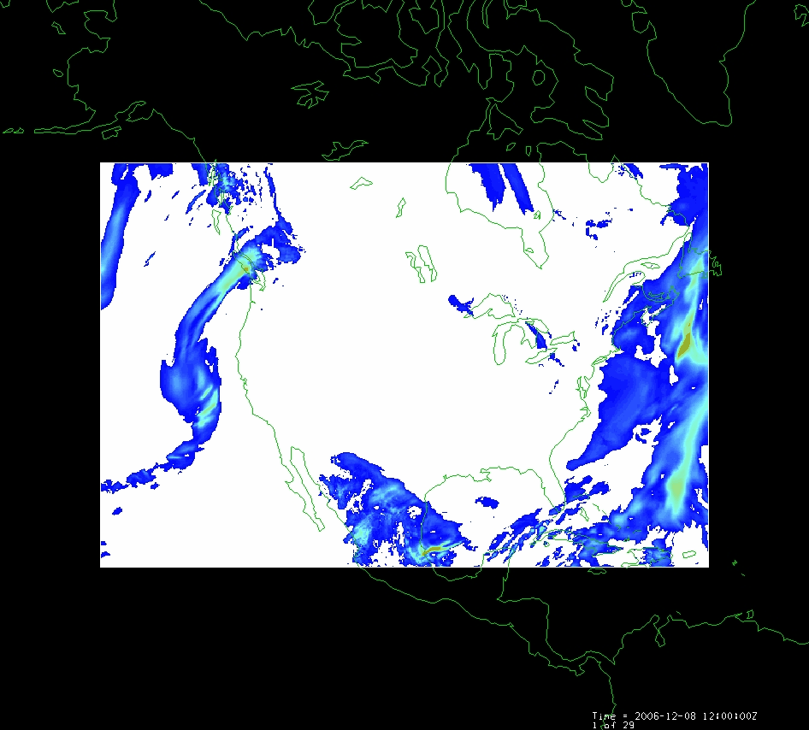
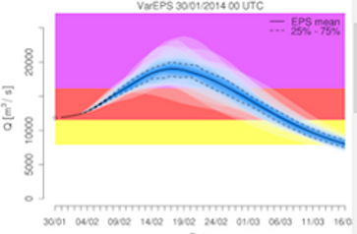
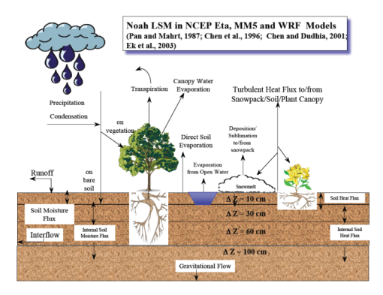
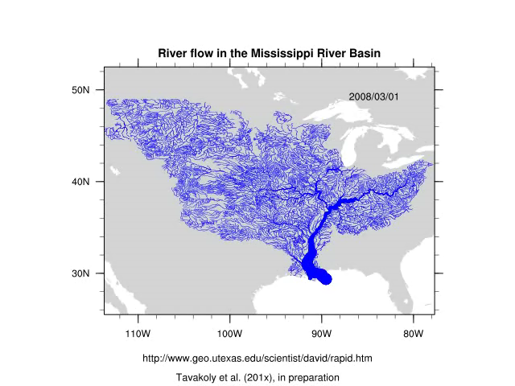
NFIE-Hydro Forecasting Model…
Weather model and forecasts
Probabilistic flood forecasts
Catchment-level forecasts
Weather
Precipitation
Streamflow
Runoff
Land-Atmosphere Model
Channel flow routing (for continental US)

Slide 27
Modeling of Weather, Hydrology, River Flow in WRF-Hydro
Forcing:
Radiation
Precipitation
Surface climate
Evaporation
Soil Moisture
Runoff
Recharge
Observations Datasets, Numerical Weather Model
Soil
Vegetation
Terrain
Network River Flow
Land Surface Model
RAPID: River Routing
on NHDPlus

Slide 28
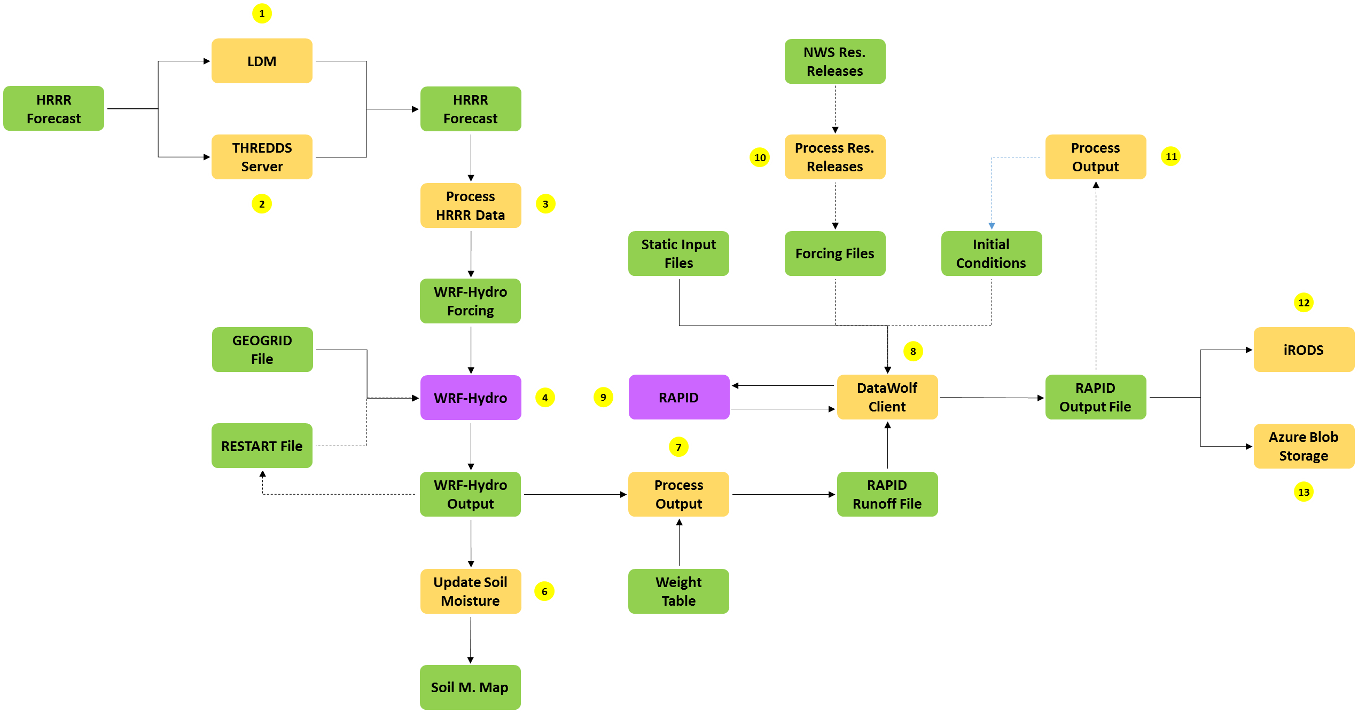
NFIE-Hydro Workflow
Implemented in Microsoft Azure

Slide 29
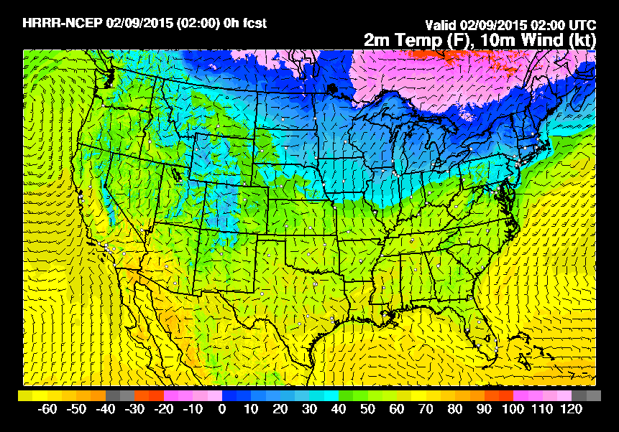
High Resolution Rapid Refresh (HRRR)
NOAA NCEP real-time 3 km resolution model
- Nested WRF model (cloud resolving atmospheric model)
Updated hourly
15 hour forecast
3 km radar assimilation
Initialized by RUC model
Variables of interest: Temp at 2 m, U and V wind at 2 m, relative humidity, specific humidity, precipitation rate, surface pressure

Slide 30
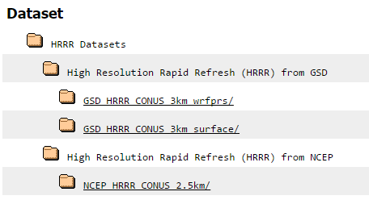
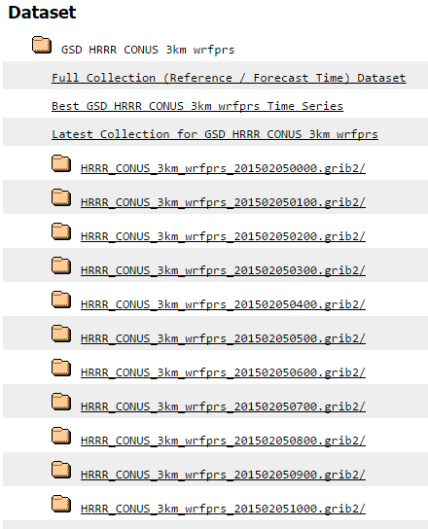
Accessing Real-time HRRR Forecasts
Time (Hours)
Forecast run at Hour 0
Forecast run at Hour 6
15
Time (Hours)
0
3
6
http://thredds-jumbo.unidata.ucar.edu/thredds/ncss/grib/HRRR/CONUS_3km/surface/Best?var=Temperature_height_above_ground&north=45&west=-134&east=-61&south=21&disableProjSubset=on&horizStride=1&time_start=2015-02-05T00:00:00Z&time_end=2015-02-09T17:00:00Z&timeStride=1&vertCoord=&accept=netcdf

Slide 31
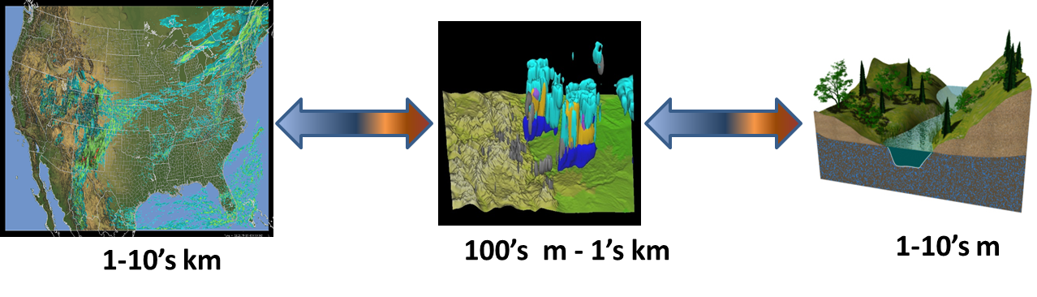
Overarching WRF-Hydro Scientific Objectives
(David Gochis, NCAR)
A community-based, supported coupling architecture designed to provide:
An extensible multi-scale & multi-physics land-atmosphere modeling capability for conservative, coupled and uncoupled assimilation & prediction of major water cycle components such as precipitation, soil moisture, snowpack, groundwater, streamflow, inundation
Streamflow prediction across scales (from 0-order headwater catchments to continental river basins & minutes to seasons)
A robust framework for land-atmosphere coupling studies

Slide 32
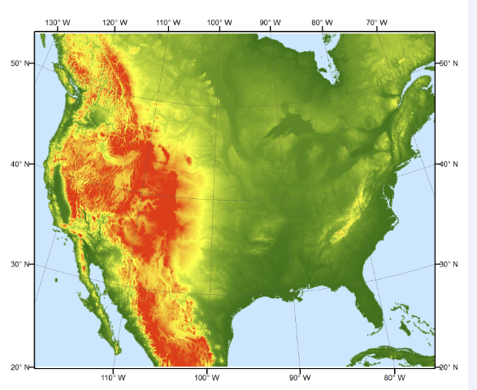
GEOGRID
HGT_M : Topographic elevation (units of meters) on the ‘mass grid’.
XLAT_M : Latitude coordinates, in decimal degrees, on the mass grid.
XLONG_M : Longitude coordinates, in decimal degrees, on the mass grid.
LANDUSEF : Land use fraction, in units of fraction.
SOILCTOP: Top layer soil texture category, in units of fraction
GREENFRAC : Monthly mean green vegetation fraction values (units of fraction).
ALBEDO12M : Monthly mean surface albedo values (units of %) not including snow effects.

Slide 33
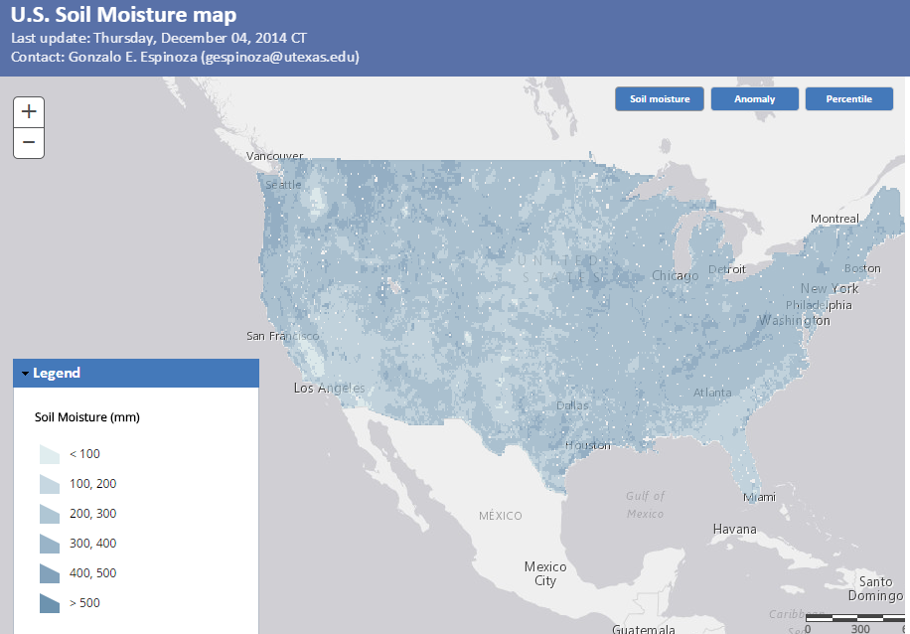
Soil Moisture Map (mm water in top 1 m of soil from NASA Land Data Assimilation System)
Map is created each day using NASA services
Include forecast soil moisture in NFIE
http://statsnldas.azurewebsites.net/

Slide 34
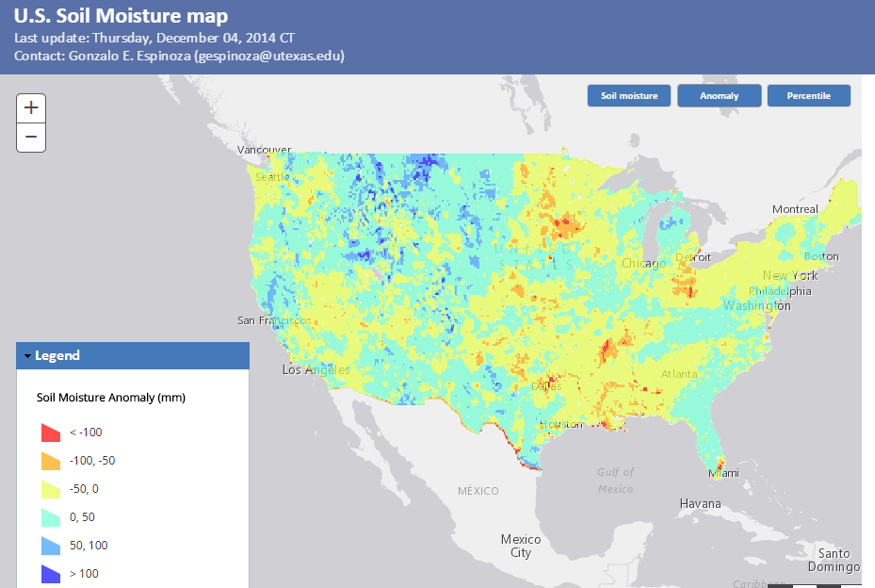
Soil Moisture Anomaly Map
(current value – mean for calendar day at each spatial point)
Map is created each day using NASA services
http://statsnldas.azurewebsites.net/

Slide 35
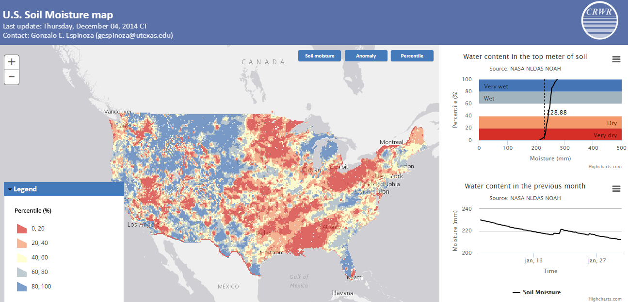
Soil Moisture Percentile Map
Current value expressed as a percentile based on historical data [1979 to present] on this calendar day at this spatial point
Compare present soil moisture with past conditions
http://statsnldas.azurewebsites.net/

Slide 36
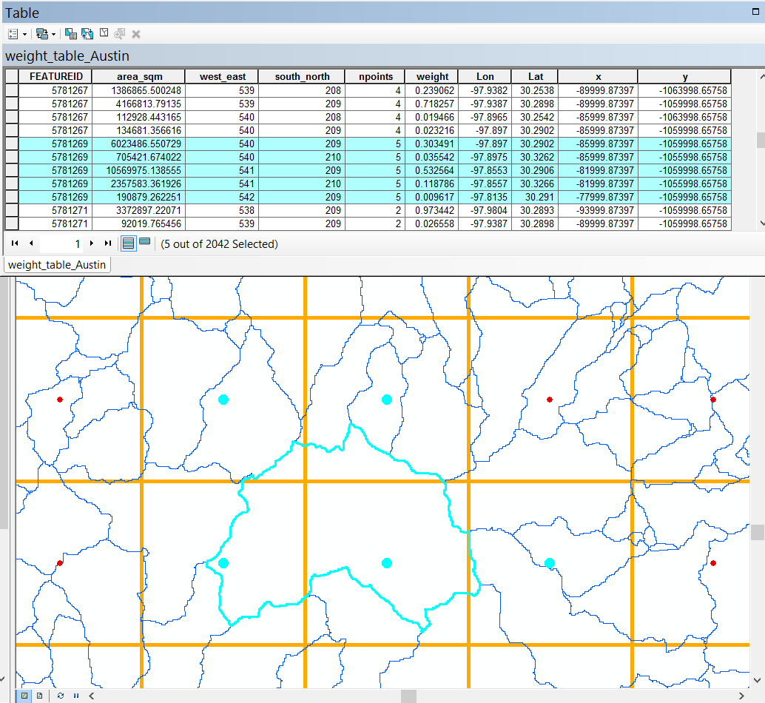
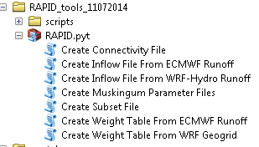
How to connect gridded input runoff data (WRFHydro) to NHDplus network
Runoff Downscaling Weight Table
540
541
542
210
209
From: Deng Ding/Nawajish Noman (ESRI)

Slide 37
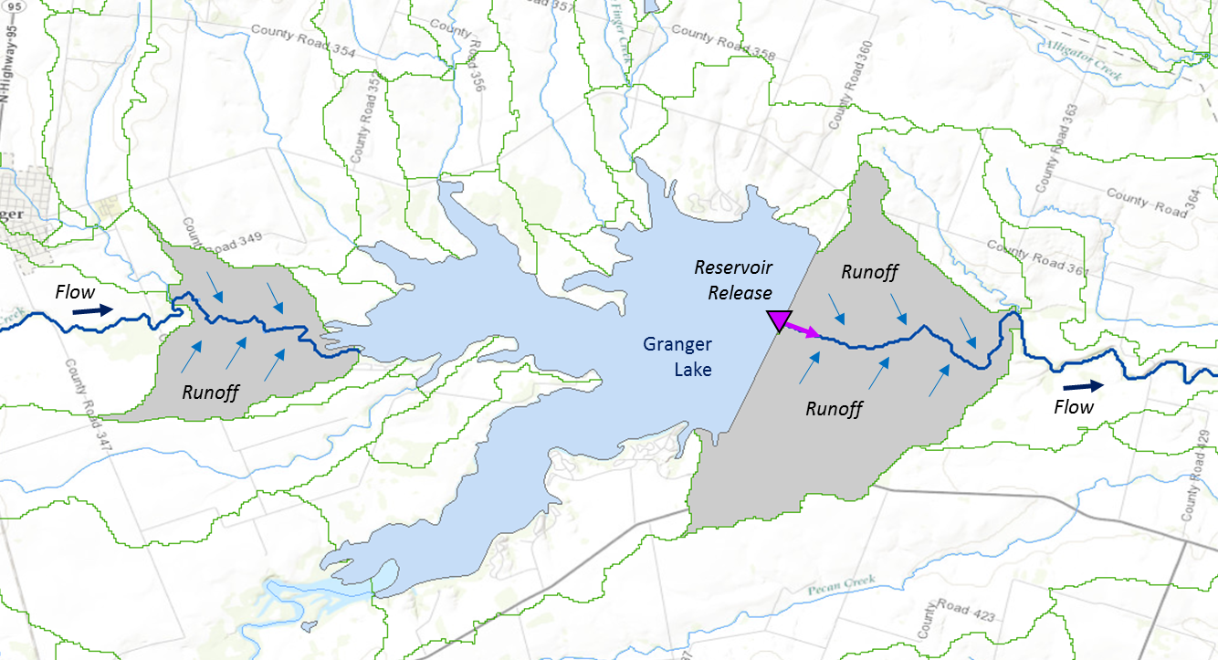
Muskingum
Method
RAPID River Routing Model
River Application for Parallel ComputatIon of Discharge
S_{prism} = KQ
S_{wedge} = KX (I – Q)
Computational Unit for Rivers
Forcing: Runoff and reservoir releases
NHDPlus Catchment
Flow
Legend
Dam
Junction
Catchment
http://rapid-hub.org/

Slide 38
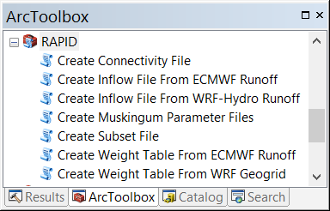
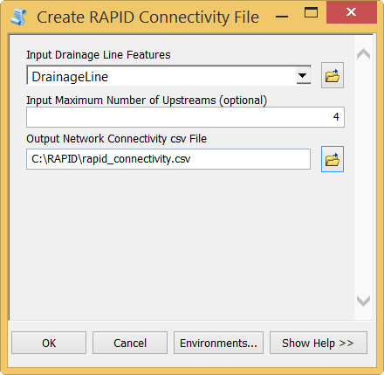
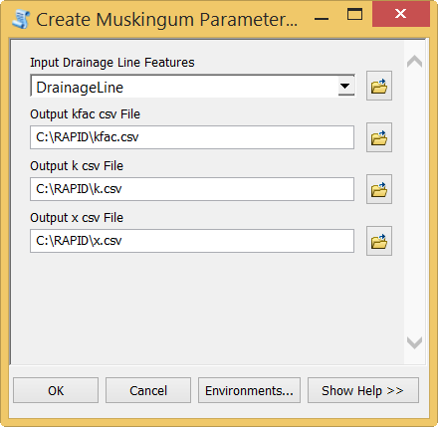
ArcGIS Tools for RAPID Model
13475951
13475949
13473525
Muskingum Parameters
K_{fac} = LENGTH_GEO x 3600
K = K_{fac} x λ_{k}
where λ_{k} = 0.35
X = λ_{x} x 0.1 (units:
where λ_{x} = 3
Flowline
Flowline

Slide 39
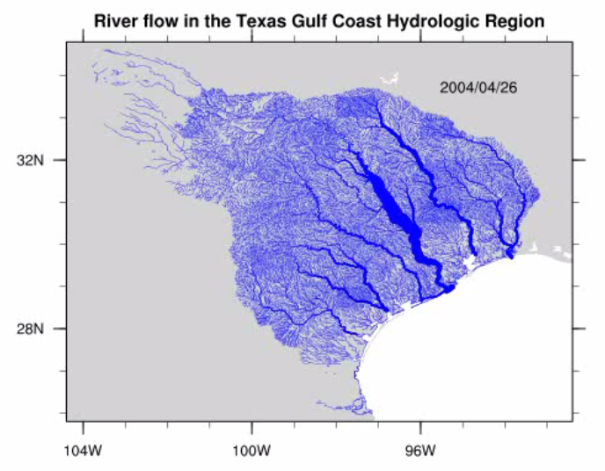
Flow in the Texas Gulf Coast
RAPID Model, 3 hour time steps
Atmosphere
Land Surface
Rivers
GIS data describes 64k river reaches . . .
. . . simulate flow in each reach in each time step
David et al (2013)
DOI: 10.1016/j.envsoft.2012.12.011

Slide 40
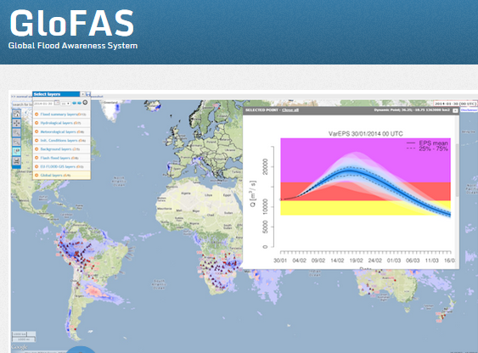
European Center for Medium Range Weather Forecasting and European Joint Research Commission
15 Day ahead forecast ensemble (50 hydrographs) at each location

Slide 41
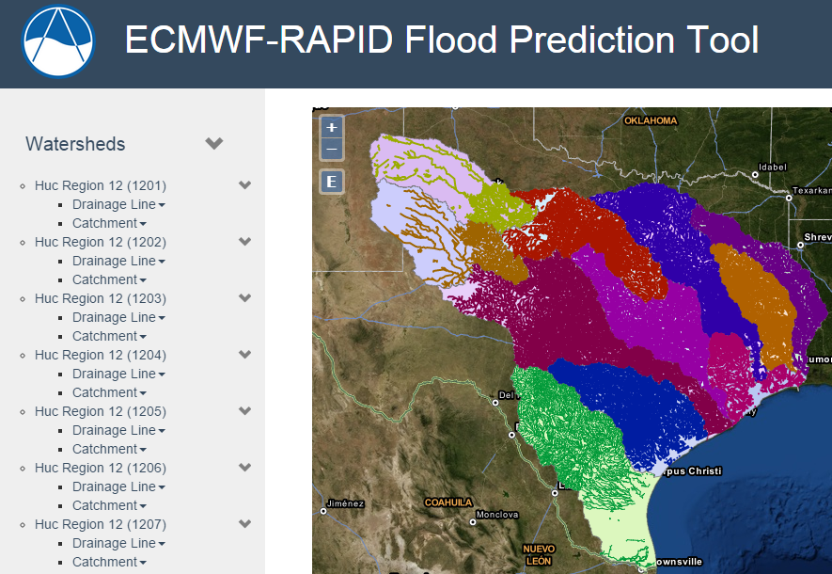
Hydrologic Forecasting for the Texas-Gulf Region
(from Brigham Young University)
(67,313 NHDPlus reaches)
Source: Jim Nelson, BYU
http://demo.tethys.ci-water.org/

Slide 42
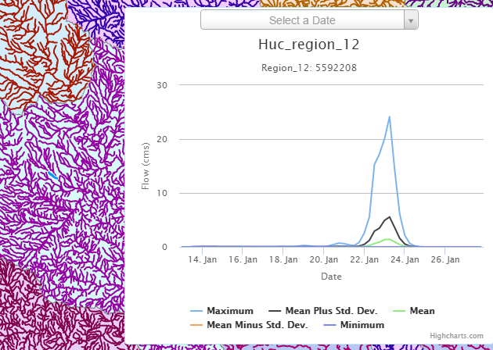
Ensemble Flow Forecast for Reach Catchment 5592208 made on Jan 13, 2015 (15 day horizon)
Weather information source: European Center for Medium Range Weather Forecasting (ECMWF). Summary statistics compiled from 50 forecast hydrographs
Source: Jim Nelson, BYU

Slide 43
What have we learned?
A high resolution flow forecasting model is feasible for the continental United States!
NFIE-Hydro is a work in progress that needs a complicated workflow system e.g. built in the Azure Data Factory to become operational
RAPID is a very useful flow model running over the NHD Flowlines
European GloFAS procedure is a more advanced than ours and easier to deploy locally

Slide 44
National Flood Interoperability Experiment (NFIE)
Component Three: NFIE-River
NFIE-Geo: National geospatial framework for hydrology
NFIE-Response: Wide area planning for flood emergency response
NFIE-Hydro: National high spatial resolution hydrologic forecasting
NFIE-River: River channel information and real-time flood inundation mapping
NFIE-Services: Web services for flood information

Slide 45
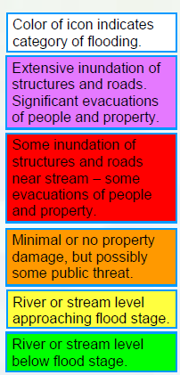
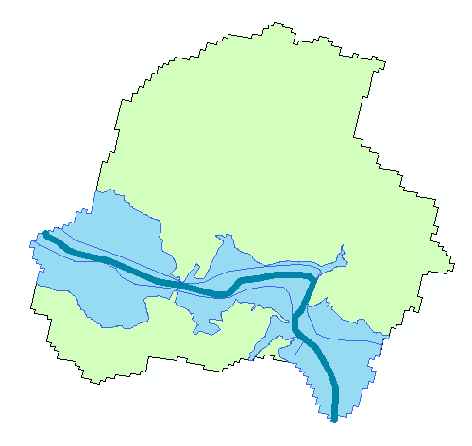
Flood risk zones…
Each catchment has a flood hazard zone defined from FEMA flood data
Probabilistic forecast from NFIE-Hydro defines flood risk
Color the zones according to risk

Slide 46
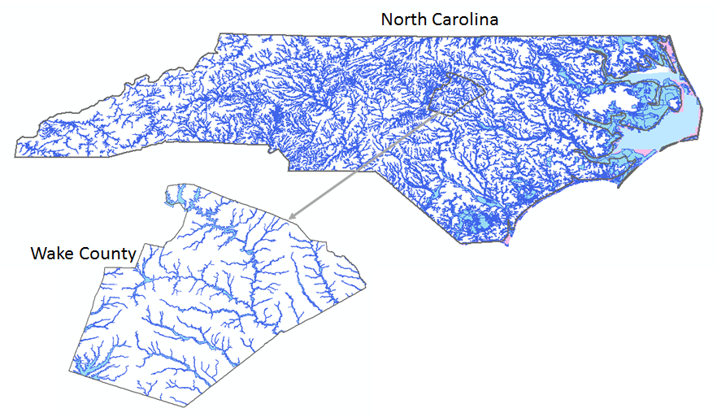
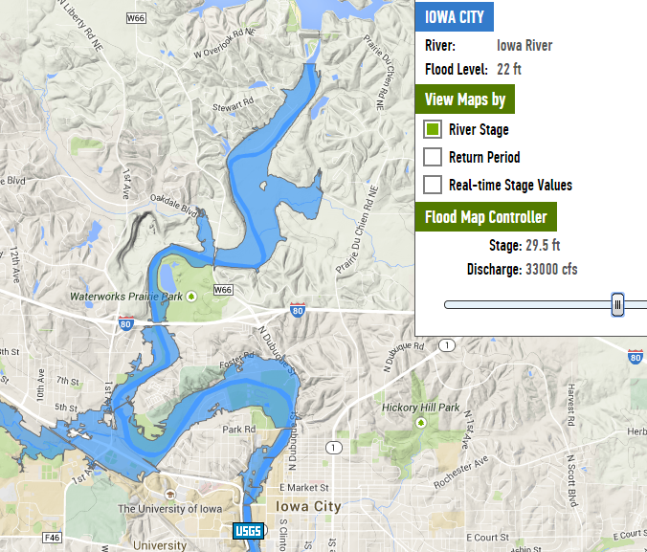

More comprehensive solution…
NFIE-River: Dynamic flood modeling, forecasting and inundation mapping in space and time
Requires LIDAR terrain data so can only be done for particular regions
North Carolina Floodplain Mapping Program
Iowa Flood Information System

Slide 47
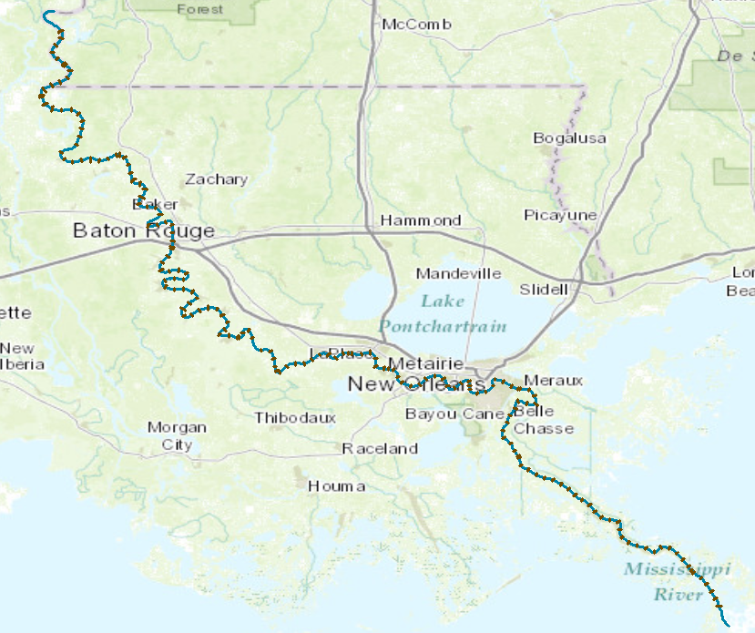
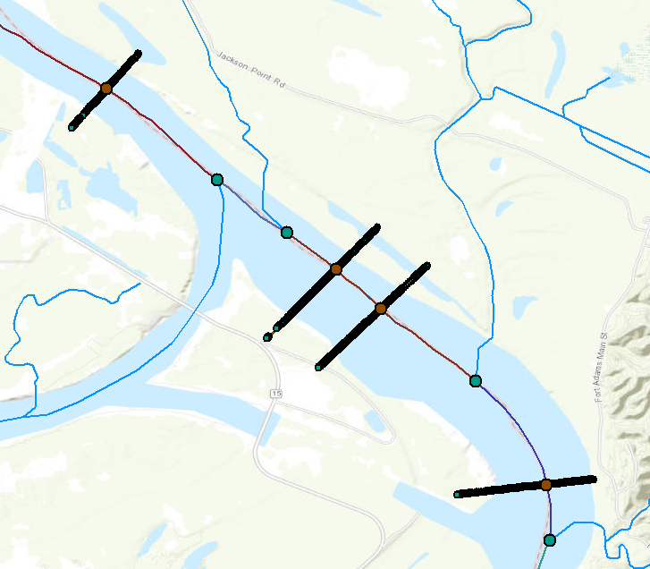
CrossSections on Lower Mississippi River
173 cross-sections over 543 km, or 3.1 km between cross-sections, on average
41,479 cross-section points (x,y,z) of bed elevation, or 240 points per cross-section, on average

Slide 48
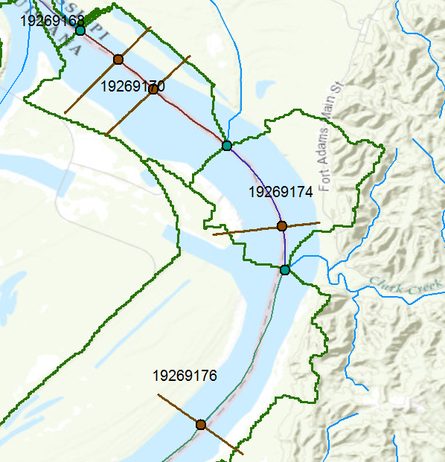
NFIE-Hydro and NFIE-River
Tributary inflow
Junction
XSIntersect
Catchment inflow

Slide 49
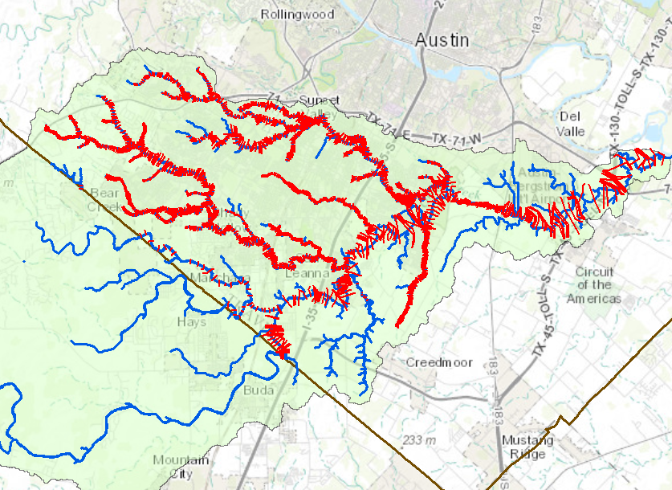
Cross-sections from HEC-RAS models
We need a national repository -- use HydroShare
Onion Creek watershed
Map: Xing Zheng
Data Source: City of Austin
Travis County
Hayes County

Slide 50

Real-Time Flood Inundation Mapping (USGS/NWS)
http://water.weather.gov/ahps2/inundation/inundation_google.php?gage=atit2

Slide 51
North Carolina Floodplain Mapping Program HEC- RAS Models
  5 Recurrence Intervals: 10, 25, 50, 100, 500
  300,000 cross-sections
  Each cross-section has a rating curve
Slide: Ken Ashe, NCFMP

Slide 52








Flood Alert and Mapping Network
How it works
Stream Gage
NWS SE River Forecast Center
FMIS
Output of Flood Forecast Model
Library of Flood Profiles
Rain Gage
Flood Forecast and Flood Inundation Maps available to Emergency Managers and Public
Now
3hr
6hr
9hr
12hr
24hr

Slide 53

Return Period – Discharge – Stage Height – Water Surface Elevation

Slide 54


Automated “integrated Simplified Inundation Mapping (iSIM)” – CG3i Software Service
Johnstown, PA – May 31, 1889
CG3I UT Dallas Feb 2015

Slide 55

Step 2 & 3 – Create Cut-lines
The most important input for the RAS software is the cross sections, which are derived from the cut-lines
  Innovative automation of cut-line placement
  Placement regularly spaced at perpendicular angles to the river flow
  Created in 2D first (cut-lines), then…

Slide 56
Cross-section Geometry Rules
A stream must be drawn from upstream to downstream.
A stream is composed of one or more reaches, and each reach must have unique combination of stream ID and reach ID.
All reaches must be connected at junctions.
A junction is an intersection of two or more streams.
A stream cannot contain parallel flow path. If three reaches connected at a junction, only two can have the same stream ID.
XS cut lines must be digitized from the left to the right side of a stream centerline.
XS cut lines cannot cross a stream centerline more than once.
XS cut lines cannot cross each other.
Moreover, HEC-­‐RAS itself also has limitations:
XS cut lines cannot have more than 500 stations (elevation points).
XS cut lines cannot have more than 20 variations in Manning’s N values.
There must be no vertical drop in elevation (two stations overlapping at the same location and having different elevation values), especially at the end of the line.

Slide 57


Our Solution
Offset lines are created along stream centerline
XS cut lines are generated with the aid of offset lines

Slide 58

Step 4 – Transforming 2D to 3D

Slide 59

Step 5 - Land Use Data in GIS

Slide 60

Step 3 – Final Inundation Shapefile
Notes:
Redo this slide

Slide 61

Workflow of GeoNet

Slide 62


Workflow of GeoNet: Non linear Filtering: a critical step when using lidar data
  Errors in the representation of the landscape can be introduced several ways:
    Acquisition
    Preprocessing
    Point cloud classification

Slide 63


Workflow of GeoNet: Filter Type Comparisons
Gaussian
Perona-Malik
Nonlinear diffusion equation:
Images: Passalacqua et al., 2010, DOI: 10.1029/2009JF001254 (top) Pelletier, 2013, DOI: 10.1029/2012WR012452 (bottom)

Slide 64


Workflow of GeoNet: Identification of likely channelized pixels
Channels
Diffusive portion of the landscape
Ridges
Geometric curvature
$$K=∇.\left(\frac{∇h}{\left|∇h\right|}\right)$$

Slide 65

Workflow of GeoNet: Identification of likely channelized pixels
Flow routing
D-infinity algorithm
Tells us the total number of cells which flow into a cell
Allows for flow divergence (flow can be directed into one or two neighboring cells depending on flow direction)
Image: Tarboton, 1997. http://www.neng.usu.edu/cee/faculty/dtarb/dinf.pdf

Slide 66

Workflow of GeoNet:
Geodesics and cost function
Fast Marching Algorithms are used to compute the geodesic distance by using the cost function for each of the outlets (identified as green dots).
The outlets are the starting point, and the draining basin is the region the fast marching can be done.
Big advantage: global operation using local information

Slide 67

Generalizing the method further for NHD incorporation
Postprocessing model creates feature of results
  Issues

Slide 68

Adapted methodology
For research purposes, GeoNet’s bank location feature was adapted for user input centerlines
Same general methodology used for channel bank identification
Banks locations output as a csv to facilitate GIS interface

Slide 69



The Texas NHDPlus network looks complicated...
...with 10⁵ river reaches.
Slide: Ben Hodges

Slide 70

But silicon microchips can have a billion (10⁹) or more transistors.
Electrical engineers routinely solve huge nonlinear circuit network problems during chip design.
Slide: Ben Hodges

Slide 71
We can solve the complete river network,
... but we need river geometry:
- cross-section area vs. depth
- cross-section perimeter vs. depth
- river bottom slope
- channel roughness
Slide: Ben Hodges

Slide 72
What have we learned?
We need hydraulic modeling on the main rivers and streams (SPRNT!)
Key connection is to add river cross-sections to NFIE-Geo dataset and derive flow properties from
Cross-sections can come from existing HEC-RAS models
Cross-sections can be derived from terrain data using GeoNet or ArcGIS

Slide 73
National Flood Interoperability Experiment (NFIE)
Component Four: NFIE-Response
NFIE-Geo: National geospatial framework for hydrology
NFIE-Response: Wide area planning for flood emergency response
NFIE-Hydro: National high spatial resolution hydrologic forecasting
NFIE-River: River channel information and real-time flood inundation mapping
NFIE-Services: Web services for flood information

Slide 74


Link with the First Response Community
Harry Evans, Chief of Staff Austin Fire Department
Responsible for flood emergency response in Austin
https://www.youtube.com/watch?v=ympaR6YUxiA&feature=youtube

Slide 75

Actual Rainfall Totals
Onion Creek watershed

Slide 76


Slide 77

11:30PM, Oct 30
Incident Command Locations
6.00AM, Oct 31
4.25AM, Oct 31
5.50AM, Oct 31

Slide 78



Address Points -- used for directing emergency response vehicles
All legal residences have an address point
Established when the lot is legally platted and registered with the county

Slide 79

Address Points and the Flood Hazard Zone
Williamson County
495,000 Address points in the two counties
How many points are in the flood hazard zone?
Where are the high flood risk areas in these counties?
Austin, Texas
Travis County

Slide 80


Address Points and the Floodplain

Slide 81



Address Points in the Floodplain
Address Points in Floodplain of Onion Creek
Floodpoints

Slide 82


Address Points in Floodplain of a Subwatershed
Number of Address Points in the Floodplain
A total of 12,052 address points are in the floodplain out of 495,468 in the study region (2.5%)

Slide 83


Address Points and Roads in Floodplain of Onion Creek

Slide 84


Length of Roads in Floodplain of a Subwatershed
Length of Roads in Floodplain (Km)
A total of 711 km of roads are in the floodplain out of 14,732 km in the study region (4.8%)

Slide 85



Intersection of Streams and Roads
5517 intersection points in Travis and Williamson Counties
Both datasets at 24K resolution
Data: Xing Zheng

Slide 86
Public Education
Community resilience
  Promoting self reliance
  Knowing areas of high risk
Public Awareness
  Timely notification of flood conditions
  Meaningful and actionable messaging
Public Notification
  Reverse Notification System (RNS)
  Social media
  News Media
  Subscription Services

Slide 87
Emergency Response
Pre-planning
  Flood Prone areas – type of flooding – access and egress – critical infrastructure
Training and Equipment
  Swift Water Rescue – Flat Water Evac… What’s the threat?
Predictive Services
  NWS, NOAA, USGS…How bad is bad?
  Real time flood updates
Evacuations
  Timely Evacuations vs Protect in Place

Slide 88
What have we learned?
Impact on people and on the transportation system are the two key factors linking flood forecasting with emergency response
Public education and awareness is critical
Hard to separate out all local flood issues from those related to improved flood forecasting
Communication of real-time information is key

Slide 89
National Flood Interoperability Experiment (NFIE)
Component Five: NFIE-Services
NFIE-Geo: National geospatial framework for hydrology
NFIE-Response: Wide area planning for flood emergency response
NFIE-Hydro: National high spatial resolution hydrologic forecasting
NFIE-River: River channel information and real-time flood inundation mapping
NFIE-Services: Web services for flood information

Slide 90

Introduction to
OGC & ISO Standards for Sharing Geographic Information
Focus on WaterML for Flood Forecasting
CE 397 Flood Forecasting, Feb 2015
by David K Arctur

Slide 91

Geographic Features:
Quick Overview
Feature: abstraction of a real-world phenomenon
Geographic Feature: a feature associated with a location relative to the Earth; digital representation of an aspect of the real world
Universe of discourse
Perceived in context of …
Geographic application
Digital Representation
Reality: phenomena
Classified as …
Feature Types
Defining [0..n]
Feature Instances
Data capture
Notes:
Notes:
Source: OGC Reference Model
URL:

Slide 92
Different phenomena call for different forms of exchange
Two broad categories of features: discrete and continuous
  Discrete: recognizable objects having distinct boundaries or spatial extent [vector]
    Buildings, streams, measurement stations, …
  Continuous: phenomena varying over space and time, with no specific extent [gridded, raster]
    Temperature, soil composition, land cover, elevation, …
    OGC “coverage”: defines a data model that associates spatio-temporal positions to data values or model outputs

Slide 93

What different things about coverage features do we need to exchange?
Earth imagery; gridded data (OGC AS Topic 7; ISO 19121, 19129)
Coverage schema (OGC AS Topic 6; ISO 19123)
AS = Abstract Spec
Notes:
Source: http://www.geo.cornell.edu/geology/classes/Geo101/graphics/ithaca_dem.jpg

Slide 94
What different things about observations do we need to exchange?
Observations and Measurements:
Related entities & their associations
(OGC AS Topic 20, ISO 19156)
But this is very abstract…
we need to create a profile for unambiguous use in hydrologic applications…
GFI_Feature
1
+featureOfInterest
0..*
OM_Observation
GF_PropertyType
+
phenomenonTime
1
+
resultTime
+observedProperty
+
validTime [0..1]
+
resultQuality [0..*]
+
parameter [0..*]
0..*
1
+procedure
+result
OM_Process
Any

Slide 95


Using OGC O&M model for water level …
(WaterML2 Part 1)
GFI_Feature
Stream Gage
1
+featureOfInterest
sampling feature
River is a
sampled feature
0..*
Stage Height
OM_Observation
GF_PropertyType
+
phenomenonTime
1
+
resultTime
+observedProperty
+
validTime [0..1]
+
resultQuality [0..*]
+
parameter [0..*]
0..*
1
+procedure
+result
Time series of values
OM_Process
Any
Water level measurement
Source: USGS
An Observation is an action whose result is an estimate of the value of
some property of the feature-of-interest, obtained using a specified procedure

Slide 96
Workflows
Flood
Maps
8
Measured with water level recorder
Extent of inundation modeled in GIS
1
Stage Height
Stage
Time Series
Measured with stream flow meter at a point in time
Apply rating curve to convert discharge to stage height time series
7
2
Discharge Value
Rating Curve
Derived from stage vs. discharge measurements over time at cross-section
Produced by hydraulic models & associated with cross-sections
6
3
Rating Curve
Discharge Time Series
Apply rating curve to convert stage height to discharge time series
Modeled by NFIE-Hydro for every NHDPlus Reach
5
4
Discharge Time Series
Typical Case
Flood Forecasting

Slide 97


Treating rating curves as a measurement …
(WaterML2 Part 2)
GFI_Feature
Gage Location
1
+featureOfInterest
sampling feature
(Stage, Discharge) pair
0..*
OM_Observation
GF_PropertyType
+
phenomenonTime
1
+
resultTime
+observedProperty
+
validTime [0..1]
+
resultQuality [0..*]
+
parameter [0..*]
0..*
1
+procedure
+result
OM_Process
Any
(Stage, Discharge) tuples
Observation or Conversion Method
Source: USGS
An Observation is an action whose result is an estimate of the value of
some property of the feature-of-interest, obtained using a specified procedure
Notes:
Rating curves are developed on infrequent, as-needed basis, by taking direct measurements of depth and flow, and plotting the curve from this data. The curve is then used to convert real-time measurements of depth into real-time values of discharge.
The object of WaterML 2.0 Part 2 is to apply the OGC O&M conceptual model and WaterML XML schema to convey the set of (stage, discharge) values.
Source: http://water.usgs.gov/edu/measureflow.html
See also: OGC 13-021r3 WaterML 2.0 – Part 2.

Slide 98

The stream flow can then be determined from the rating curve
(WaterML2 Part 1)
GFI_Feature
Stream Gage
1
+featureOfInterest
sampling feature
River is a
sampled feature
0..*
Discharge
OM_Observation
GF_PropertyType
+
phenomenonTime
1
+
resultTime
+observedProperty
+
validTime [0..1]
+
resultQuality [0..*]
+
parameter [0..*]
0..*
1
+procedure
+result
Time series of values
OM_Process
Any
Flow rate conversion
Source: USGS
An Observation is an action whose result is an estimate of the value of
some property of the feature-of-interest, obtained using a specified procedure
Notes:
Graph source: http://waterdata.usgs.gov/nwis/uv?cb_00060=on&cb_00065=on&cb_00065=on&format=gif_default&site_no=08158000&period=&begin_date=2015-02-02&end_date=2015-02-16

Slide 99
Workflows
Flood
Maps
8
Measured with water level recorder
Extent of inundation modeled in GIS
1
Stage Height
Stage
Time Series
Measured with stream flow meter at a point in time
Apply rating curve to convert discharge to stage height time series
7
2
Discharge Value
Rating Curve
Derived from stage vs. discharge measurements over time at cross-section
Produced by hydraulic models & associated with cross-sections
6
3
Rating Curve
Discharge Time Series
Apply rating curve to convert stage height to discharge time series
Modeled by NFIE-Hydro for every NHDPlus Reach
5
4
Discharge Time Series
Typical Case
Flood Forecasting

Slide 100
Ensemble Flow Forecast for Reach Catchment 5592208 made on Jan 13, 2015 (15 day horizon)
Weather information source: European Center for Medium Range Weather Forecasting (ECMWF). Summary statistics compiled from 50 forecast hydrographs
Source: Jim Nelson, BYU

Slide 101
Going from discharge to stage height with simulated rating curves
Monitoring Point on x-section
GFI_Feature
1
+featureOfInterest
(Stage, Discharge) pair
sampling feature
0..*
OM_Observation
GF_PropertyType
+
phenomenonTime
1
+
resultTime
+observedProperty
+
validTime [0..1]
+
resultQuality [0..*]
+
parameter [0..*]
0..*
1
+procedure
+result
(Stage, Discharge) tuples
OM_Process
Any
Conversion Method
Source: USGS
An Observation is an action whose result is an estimate of the value
of some property of the feature-of-interest, obtained using a specified procedure
Notes:
We already have rating curves at gages, and we can determine rating curves for any cross-section developed for hydraulic models.
That still doesn’t give us rating curves for all the NHDPlus reaches.
We can work from NED 10m, or LIDAR where available, to extract cross-sections where needed. Accuracy may vary!
Can then take a large-scale hydraulic model (SPRNT) to develop rating curves for all known cross-sections.

Slide 102

Flood Stage and Inundation

Slide 103

OGC/WMO Hydrology Domain Working Group
7+ Year International Effort – WaterML
(draft pending)
A time series for one variable at one location
Stage-Discharge values for one cross-section
WML2 Part 2
Ratings-Gaugings
Hydrology Domain Working Group formed
OGC at WMO Commission for Hydrology
Sensor Observation Service 2.0
Hydrology Profile
Best Practice
Memorandum of Understanding
between the
World Meteorological
Organization
and the
Open Geospatial Consortium
Technical Meetings every 3 months
Five Interoperability Experiments
(Surface water, groundwater, ratings-gaugings)
Annual week-long workshops
Involvement by many countries
2008
2009
2010
2011
2012
2013
2014
Acknowledgements: OGC, WMO, GRDC, NWS, CUAHSI, BoM/CSIRO, USGS, GSC, Kisters, …….
Notes:
(1) A four-year international effort has been undertaken to reconcile WaterML with international standards;
(2) This effort was initiated with the establishment of an Hydrology Domain Working Group by the Open Geospatial Consortium in September 2008;
(3) An OGC representative attended the WMO Congress of the Commission for Hydrology in 2008
(4) A formal agreement between Secretary General of WMO and President of OGC in 2009 to jointly develop standards for hydrology, climatology, oceanography and climatology;
(5) The joint OGC/WMO Hydrology Domain Working Group was supported by a large work effort, annual week-long workshops, four interoperability experiments for surface and groundwater data exchange, and participation by many countries;
(6) In June 2012, the OGC voted to adopt the revised version, WaterML2 as an international standard for exchange of water resources time series (the first such public standard that has existed);
(7) This Congress to the WMO Commission for Hydrology to whom I am speaking is considering WaterML2 for adoption as an official standard by WMO
(8) WaterML 2.0 Part 2 – Ratings and Gagings is ready for public comment, pending OGC approval to post.

Slide 104
What is Time? … on the web?
ISO 8601:2004[E] – Data elements and interchange formats –
Information interchange – Representation of dates and times
  Date and time values are ordered from the largest to smallest unit of time: year, month (or week), day, hour, minute, second, and fraction of second. This ordering corresponds to chronological order. This allows dates to be naturally sorted by computer file systems.
  Each date and time value has a fixed number of digits that must be padded with leading zeros. (The “format template” in figure below will achieve this in Excel spreadsheets)
  Two main formats – (1) a basic format with a minimal number of separators, or (2) an extended format with separators: hyphen between date values (year, month, week, and day) and
  colon between time values (hours, minutes, and seconds).
  Local time zone begins with
  + or – hours from UTC.
  http://en.wikipedia.org/wiki/ISO_8601
Date and time expressed according to ISO 8601:
Format template: | yyyy-m-dTh:mm:ssZ
Date: | 2015-02-15
Date and time in UTC: … as Zulu: | 2015-02-15T19:39:11+00:00
 | 2015-02-15T19:39:11Z
Date & time in Austin: with Daylight Savings: | 2015-02-15T13:39:11-06:00 2015-02-15T14:39:11-05:00
Week: | 2015-W07
Ordinal date: | 2015-046

Slide 105

Time–Value Pairs:
Building a time series for web exchange
How do you represent time series in a database?
Only precise instants are allowed.
<wml2:time>2015-02-02T23:55:00-06:00</wml2:time>
<wml2:value>12.25</wml2:value>
Notes:
Table source: http://waterdata.usgs.gov/nwis/uv?cb_00065=on&cb_00065=on&format=html&site_no=08158000&period=&begin_date=2015-02-02&end_date=2015-02-16
Graph source: http://waterdata.usgs.gov/nwis/uv?cb_00060=on&cb_00065=on&cb_00065=on&format=gif_default&site_no=08158000&period=&begin_date=2015-02-02&end_date=2015-02-16

Slide 106




WaterML Web Services CUAHSI, USGS, OGC, WMO…
Water time series data on the internet
24/7/365 service
For daily and real-time data
. . . Operational water web services system for the United States
http://waterservices.usgs.gov/nwis/iv/?format=waterml,2.0&sites=08158000&period=P1D&parameterCd=00060
Notes:
Increasingly, national water data is being published using WaterML to describe time series of observations and model results. This is the current output from the US Geological Survey for one of their tens of thousands of river gauges (this one is on the Colorado River in Austin TX).

Slide 107







Example: Global map of stream gauges for getting data and hydrograph at one gauge
http://geoss.maps.arcgis.com/home/webmap/viewer.html?webmap=5efcdfb27d744e3ea65eaf58c06f9d0c
Esri ArcGIS Online web map viewer
Click to add layers
WMO GRDC (gauge descriptions only, no water data)
Kisters GRDC (WaterML 2 data for OGC Surface Water IE)
USGS NWIS (most have real-time data)
Mexico (some with historical data, hosted by Univ of Texas)
Dominican Republic (historical data hosted by BYU)
Italy & New Zealand (real-time data, developed for AIP-6)
http://bit.ly/1ERSyva
Notes:
Full link: http://geoss.maps.arcgis.com/home/webmap/viewer.html?webmap=5efcdfb27d744e3ea65eaf58c06f9d0c
Short link: http://bit.ly/1ERSyva
Here is a map of the world’s major rivers, and <click>
locations of about 20,000 stream gauges registered in WMO’s Global Runoff Data Center in Germany. While the yellow dots represent locations where data has been collected, that data is not available in a standardized format, nor is it necessarily available without restriction. <click>
The purple dots are mainly coastal sites where Kisters has developed a WaterML2 web service from the GRDC data. This was done for the OGC Surface Water Interoperability Experiment in 2011. <click>
The US <click> and Mexico maintain another 20,000 stream gauges, nearly all of which provide ongoing data services. <click>
The red dots are for Dominican Republic, which started publishing its water data in 2012. <click>
As a result of this project, we can now add regional agencies’ gauges and data in Italy and New Zealand. <click> (shows legends) <click> (next slide)

Slide 108







NASA Land Data Assimilation System:
Grid and time series globally
http://bit.ly/J2I43m
Notes:
Full link: http://ec2-54-225-249-9.compute-1.amazonaws.com/MultidimensionalTemplate/index.html?appid=d73011dceb0e41d0af334912355bddd5
Short link: http://bit.ly/J2I43m

Slide 109


Develop NWS Experimental Data Services
Experimental WRF-Hydro ¹
NWS CHPS Modeling Units: RFCs
Export Data elements from the simulation& forecast workflow including:
Inflow to the Channel (INFW)
Mean Areal Precipitation (MAP)
Streamflow (QINE) at ~3600 points
PI-XML to WaterML2²
netCDF
to
NHD+
Data Services – local runoff
Slide: Ed Clark, NWS
¹Responsibility of NCAR

Slide 110
What have we learned?
Existing water data exchange standards are sufficient to support the NFIE
Sensor Observation Service and WaterML2
Emerging work on a ratings and gagings standard
We need to connect the geospatial and temporal information frameworks

Slide 111
Transformative for the nation…
Forecasts produced by
  Current system – 3600 locations
  NFIE system – 2.67 million locations
New Information to help emergency managers save lives and keep people safe
700 times more
Current
Proposed

