Slide 1
River Channels
CE 397 Flood Forecasting
David R. Maidment
Center for Research in Water Resources
University of Texas at Austin
16 February 2015

Slide 2
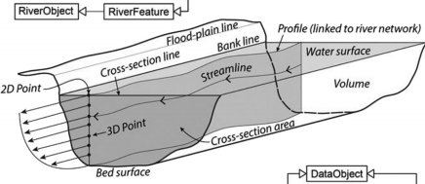
Arc River Data Model Framework
http://www.sciencedirect.com/science/article/pii/S1364815214003570

Slide 3
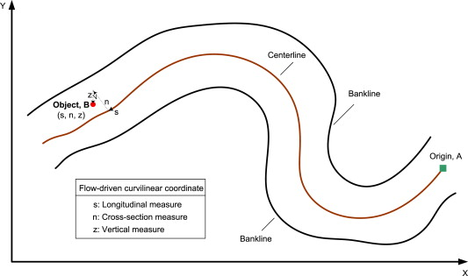
3D Curvilinear Flow Coordinate System
(x,y,z) = geographic location in space
(s,n) = distance (along, transverse) to flow centerline
Each point has (x,y,z,s,n) coordinates
Dongsu Kim , Marian Muste , Venkatesh Merwade
A GIS-based relational data model for multi-dimensional representation of river hydrodynamics and morphodynamics
Environmental Modelling &amp; Software, Volume 65, 2015, 79 - 93
http://dx.doi.org/10.1016/j.envsoft.2014.12.002
http://www.sciencedirect.com/science/article/pii/S1364815214003570

Slide 4
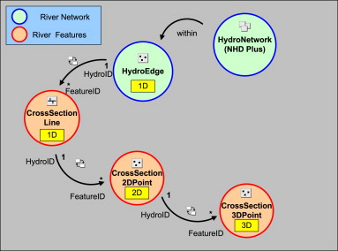
HydroID relationships to connect features
Fig. 3 Connectivity between the multidimensional cross-sectional river objects and the river network.
Dongsu Kim , Marian Muste , Venkatesh Merwade
A GIS-based relational data model for multi-dimensional representation of river hydrodynamics and morphodynamics
Environmental Modelling &amp; Software, Volume 65, 2015, 79 - 93
http://dx.doi.org/10.1016/j.envsoft.2014.12.002
http://www.sciencedirect.com/science/article/pii/S1364815214003570

Slide 5
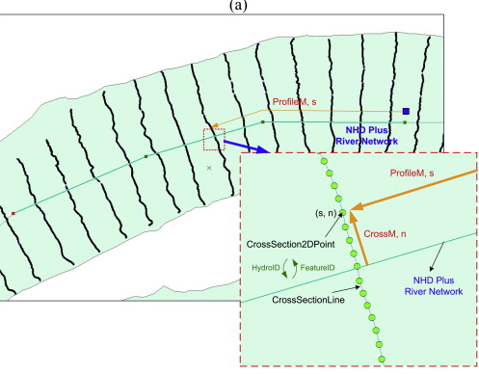
CrossSectionLine and Point
http://www.sciencedirect.com/science/article/pii/S1364815214003570

Slide 6
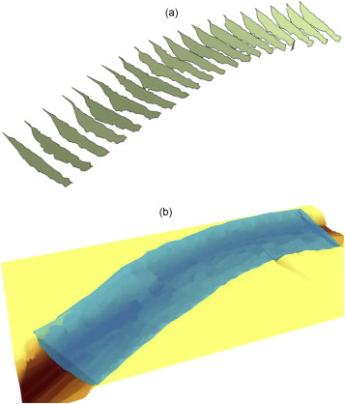
CrossSectionArea and RiverVolume
Fig. 5 Geometric features for representing river objects in addition to point features: a) 3D representation of the cross sections using the CrossSectionArea feature class; b) volumetric description of a river reach using RiverVolume feature class.
Dongsu Kim , Marian Muste , Venkatesh Merwade
A GIS-based relational data model for multi-dimensional representation of river hydrodynamics and morphodynamics
Environmental Modelling &amp; Software, Volume 65, 2015, 79 - 93
http://dx.doi.org/10.1016/j.envsoft.2014.12.002

Slide 7
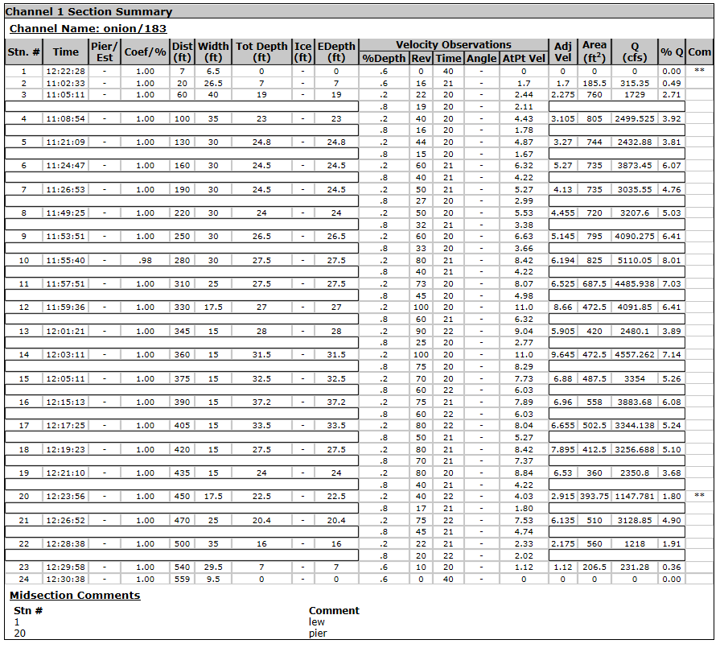
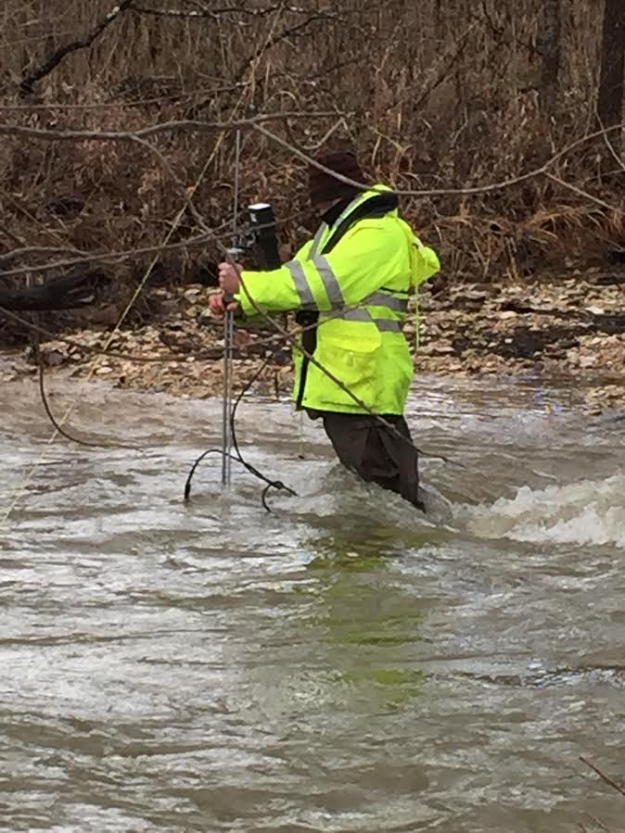
Stream Gaging, Onion Creek at Highway 183
Slide: Scott Gzyb, USGS
For method see: http://water.usgs.gov/edu/measureflow.html

Slide 8
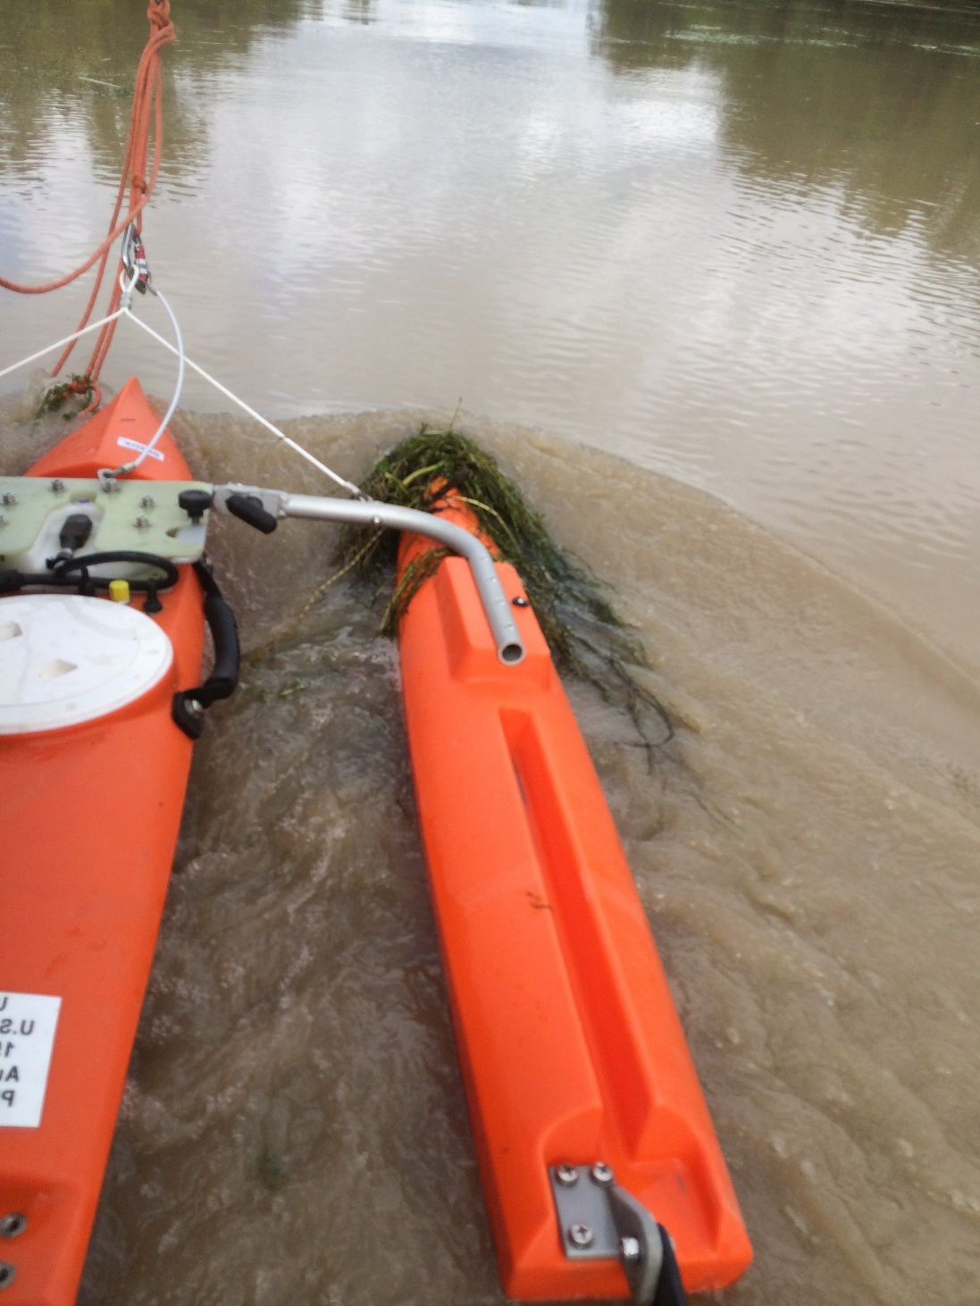
ADCP
Slide: Scott Gzyb, USGS
Acoustic Doppler Current Profiler

Slide 9
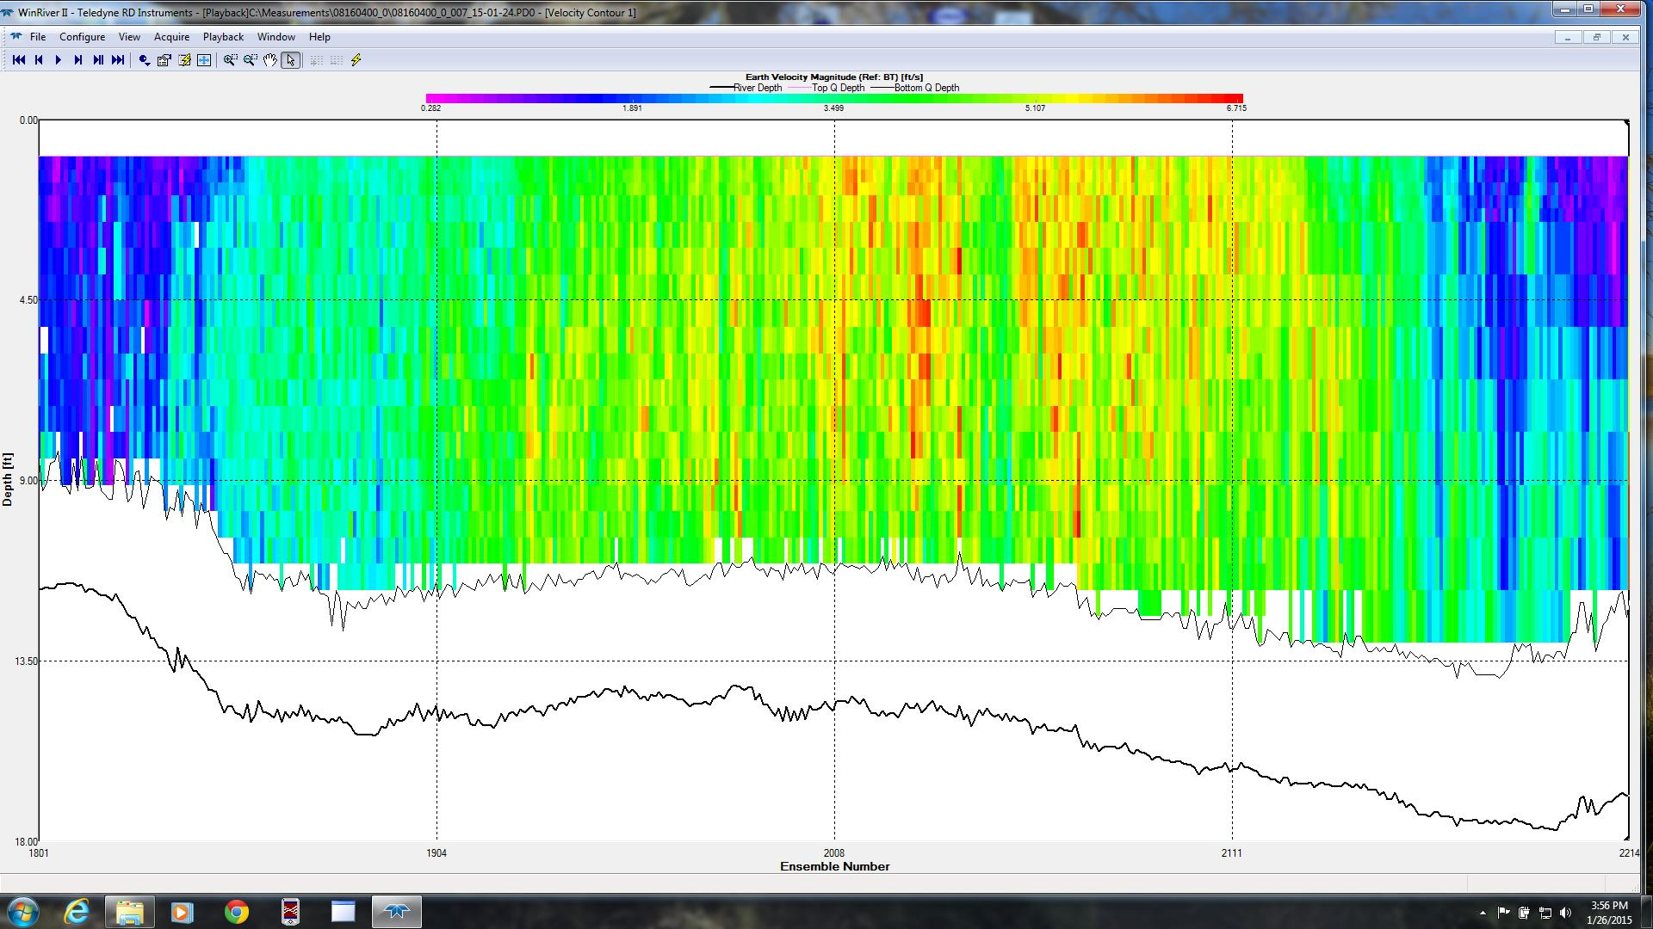
ADCP Velocity Profile – Colorado River at La Grange
Slide: Scott Gzyb, USGS

Slide 10
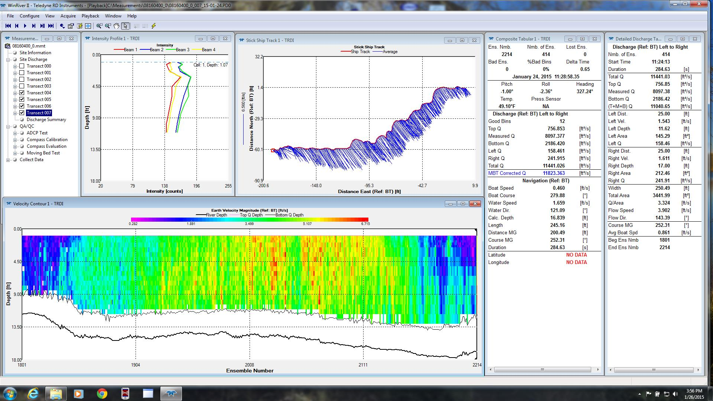
ADCP data collection information
Slide: Scott Gzyb, USGS

Slide 11
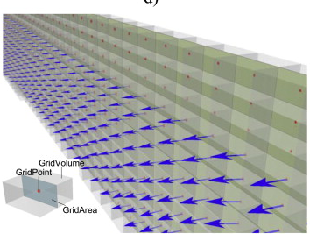
GridPoint, Area and Volume
http://www.sciencedirect.com/science/article/pii/S1364815214003570

Slide 12
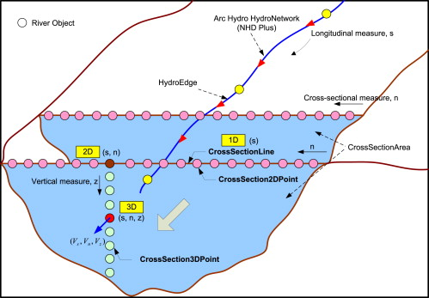
CrossSection and River Network
Fig. 13 Classes and their relationships in the Arc River data model framework.
Dongsu Kim , Marian Muste , Venkatesh Merwade
A GIS-based relational data model for multi-dimensional representation of river hydrodynamics and morphodynamics
Environmental Modelling &amp; Software, Volume 65, 2015, 79 - 93
http://dx.doi.org/10.1016/j.envsoft.2014.12.002
http://www.sciencedirect.com/science/article/pii/S1364815214003570

Slide 13
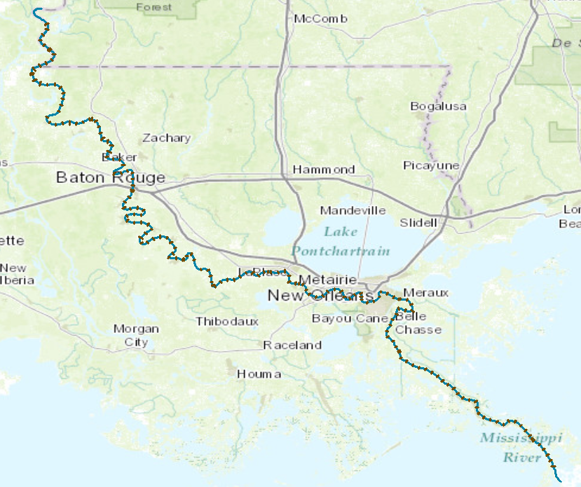
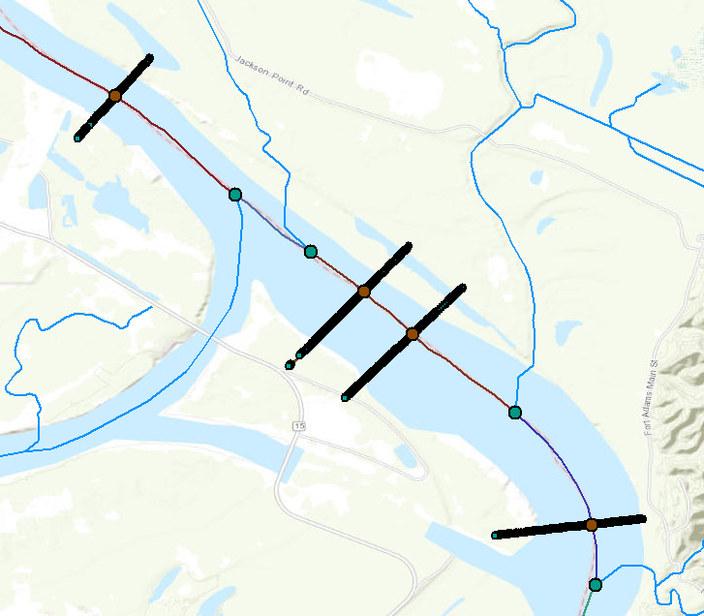
CrossSections on Lower Mississippi River
173 cross-sections over 543 km, or 3.1 km between cross-sections, on average
41,479 cross-section points (x,y,z) of bed elevation, or 240 points per cross-section, on average

Slide 14
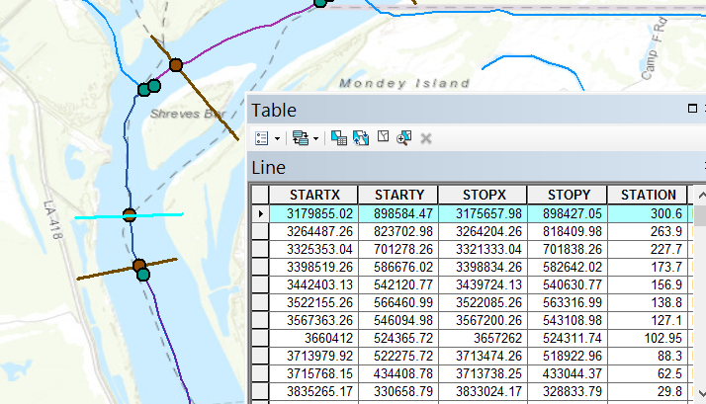
CrossSection Line
x,y in State-Plane coordinates in feet, Station is in river miles from lower end of River

Slide 15
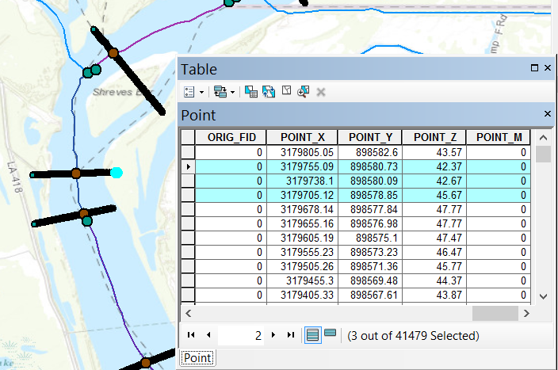
Mississippi CrossSection Points
Point_X, Point_Y in State-Plane coordinates in feet, Point_Z is elevation in feet above NAVD88

Slide 16
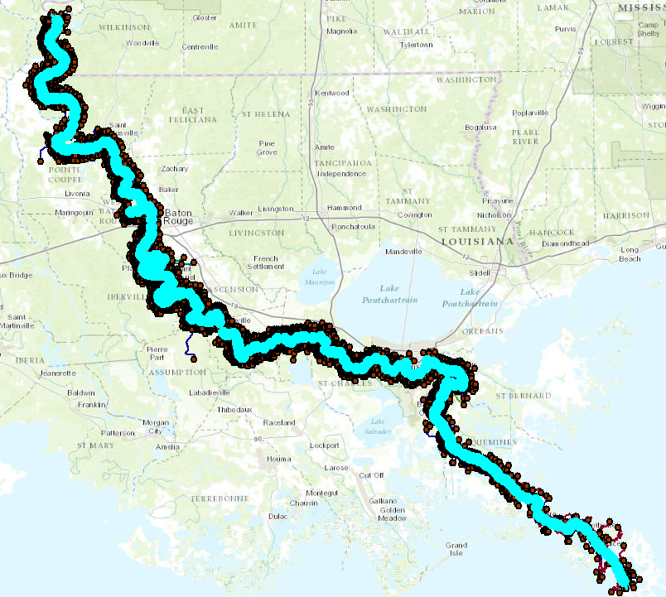
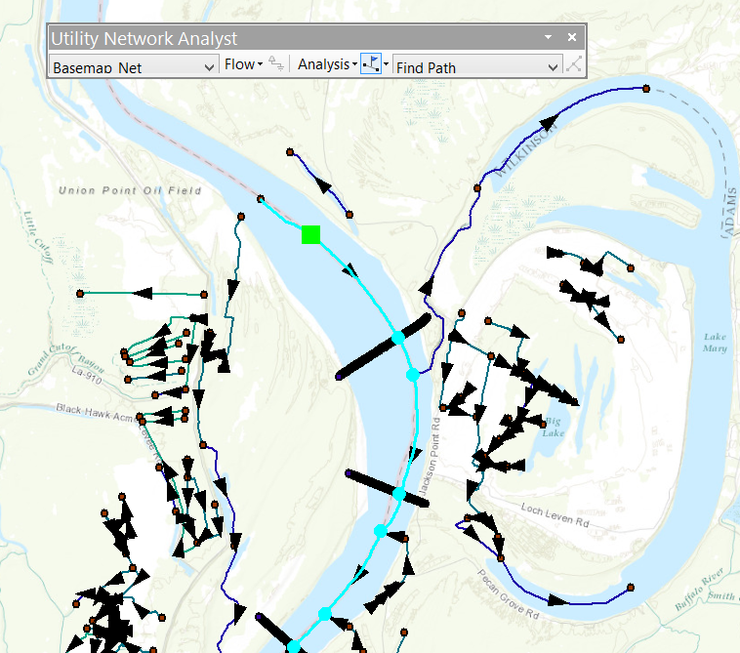
Network “Find Path” on 24K data
Conclusion: 24K data is too detailed for this river. Use 100K data

Slide 17
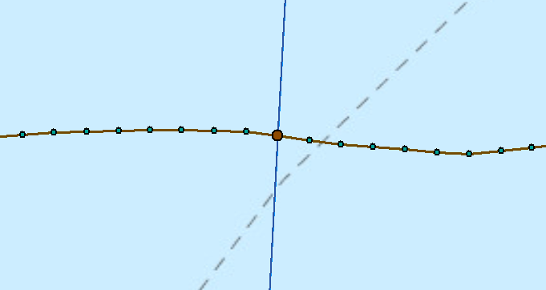
CrossSection Points along Line
Cross-Section Points and Line
XSIntersect Point
Centerline (Mflowline) (100K NHD)

Slide 18
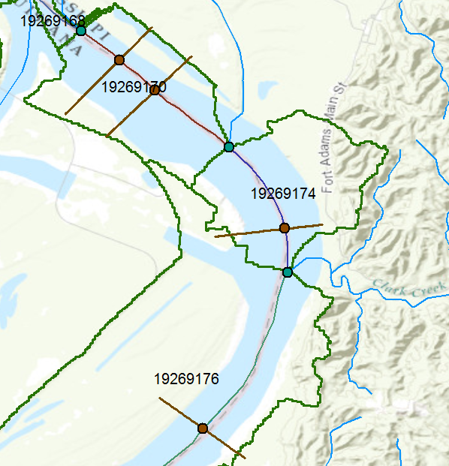
NFIE-Hydro and NFIE-River
Tributary inflow
Junction
XSIntersect
Catchment inflow

Slide 19
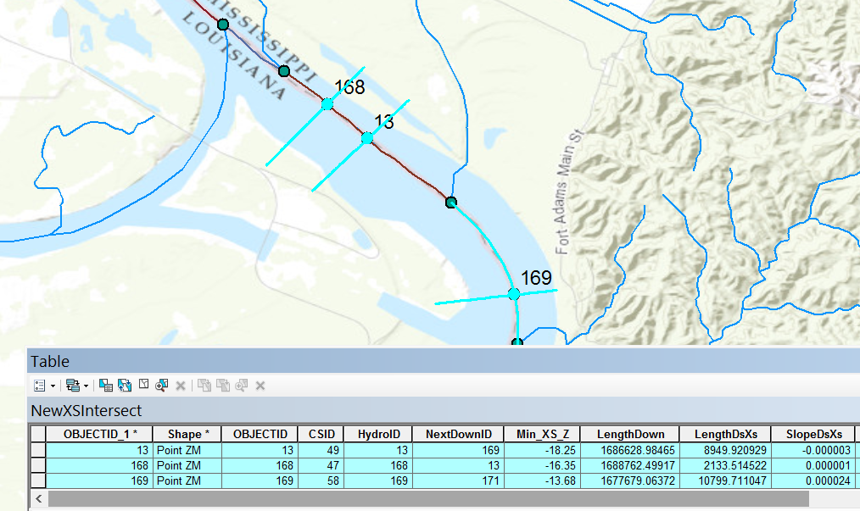
Longitudinal Profile Properties
Cross-section
168
13
169
LengthDown is distance to outlet (ft)
LengthDsXs is distance to next XS (ft)
Min_XS_Z is minimum Z on XS
SlopeDsXS is slope to next XS

