Slide 1
A Statistical Analysis and Geospatial Distribution of Soil Moisture in Texas
Gonzalo E. Espinoza
Center for Research in Water Resources
Flood Forecasting
February 11th, 2015

Slide 2
Outline
Land Assimilation System (LDAS)
  NLDAS NOAH and soil moisture
Statistical Analysis
  Cumulative Distribution Functions (CFDs)
  Applications
    Texas Drought 2011
    “Halloween Flood”. Onion Creek, 2013
Web Application Architecture
  Client
  Server
  Cloud
Work in progress

Slide 3

Land Assimilation System (LDAS)
Land-surface hydrologic model
Global (GLDAS ) National (NLDAS)
NOAH NLDAS-2
  Variables ~ 52
  Hourly and Monthly data
  1/8° cellsize ~14km
  Data since 1979
http://ldas.gsfc.nasa.gov/nldas/NLDASgoals.php

Slide 4
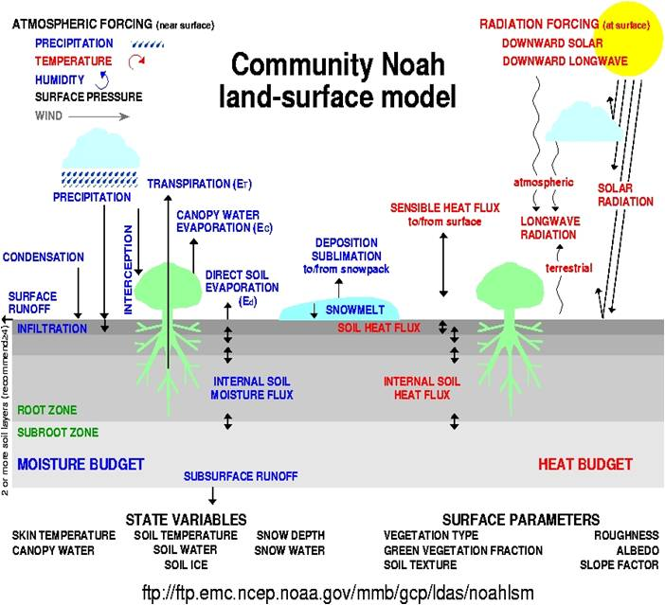
NLDAS NOAH & Soil moisture
Soil Moisture in the top meter
Top meter (4 layers)
  0-10cm
  10-40cm
  40-60cm
  60cm-100
Kg of water/m^2
Equivalent depth of water (mm)
http://ldas.gsfc.nasa.gov/nldas/NLDAS2model.php

Slide 5
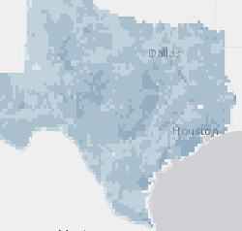
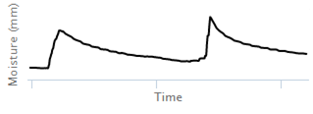
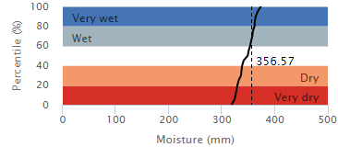
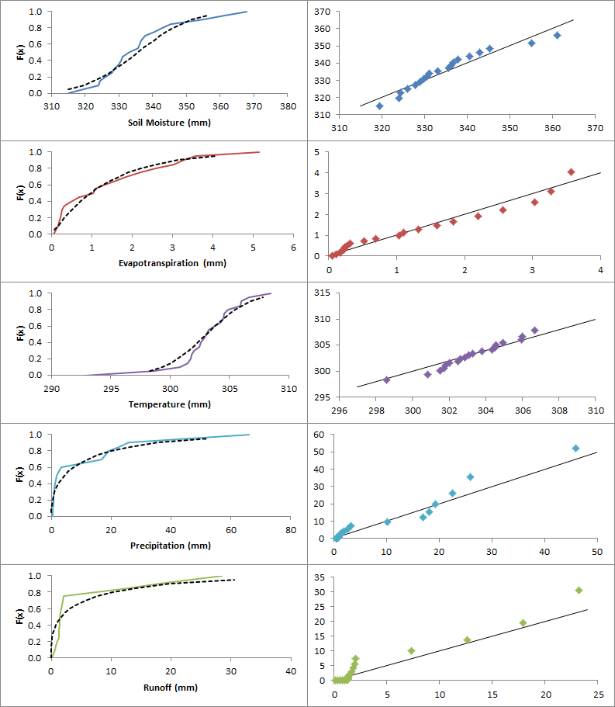
Statistical Analysis
Time Series
Implementation
  Python/R
  HPC
Results
  Cloud
  Web app
-Variable
-Time
-Space
NLDAS Data
Soil Moisture
Soil Moisture
Cell
CDFs construction
-Time step (day)
-Cell size (1/8°)
Empirical CFD calculation
Day
Quad: 30097-C6
Date: 12/04/2014
Validation
Variables
CDF modelling
-Soil Moisture
-Evapotranspiration
-Precipitation
-Runoff
-Temperature
Cloud Storage
Quad: 30097-C6
Date: June, 15th
http://texassoilmoisture.azurewebsites.net

Slide 6
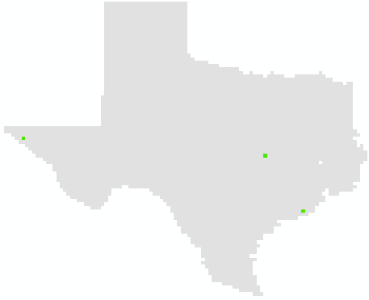
Cumulative Distribution Functions (CFDs)
Daily values for each cell
  4,136 cells
  1979 – 2013
Cumulative Distribution Functions (CDFs)
  For each cell and each day
  Statistical parameters (min, max, mean, standard deviation, etc.)
Comparing the latest soil moisture value
    Cell
    Day of the year
Examples:
West: El Paso
Central: North of Austin
Coast: South of Houston

Slide 7
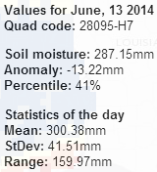
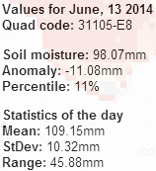
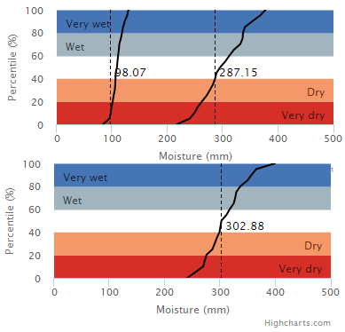
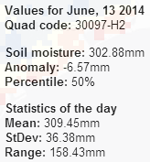
Cumulative Distribution Functions (CFDs)
Coast: South of Houston
West: El Paso
Central: North of Austin

Slide 8
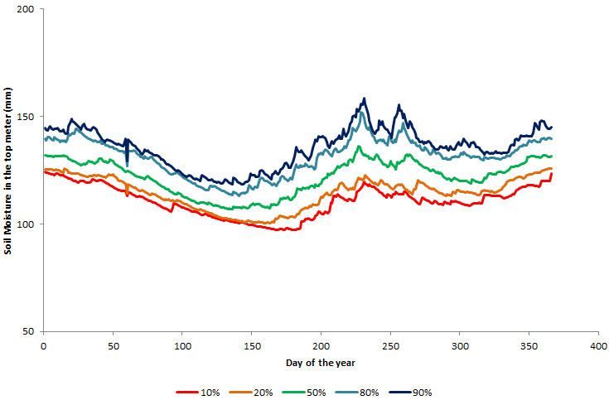
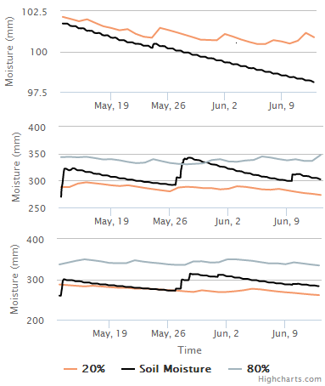
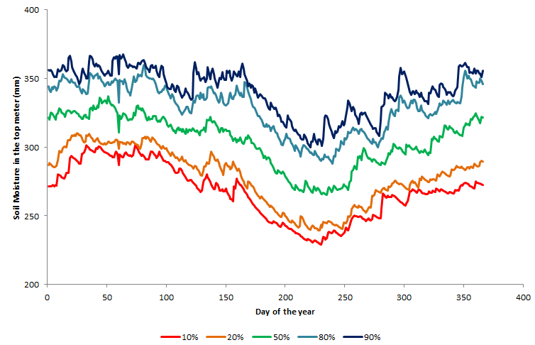
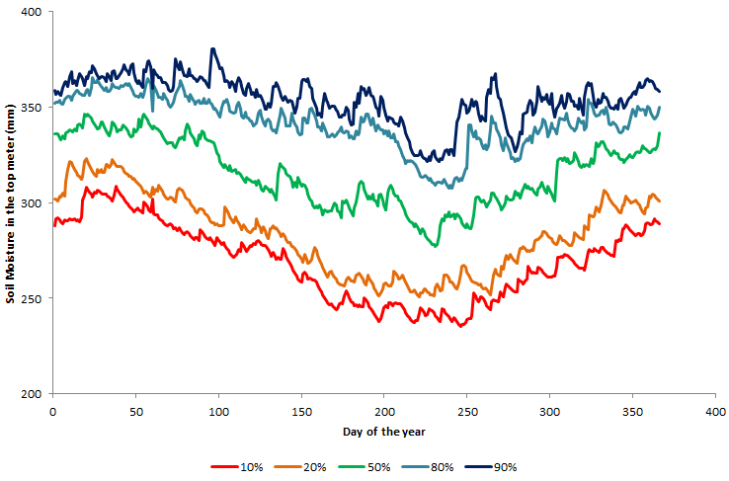
Cumulative Distribution Functions (CFDs)
West
Central
Coast

Slide 9
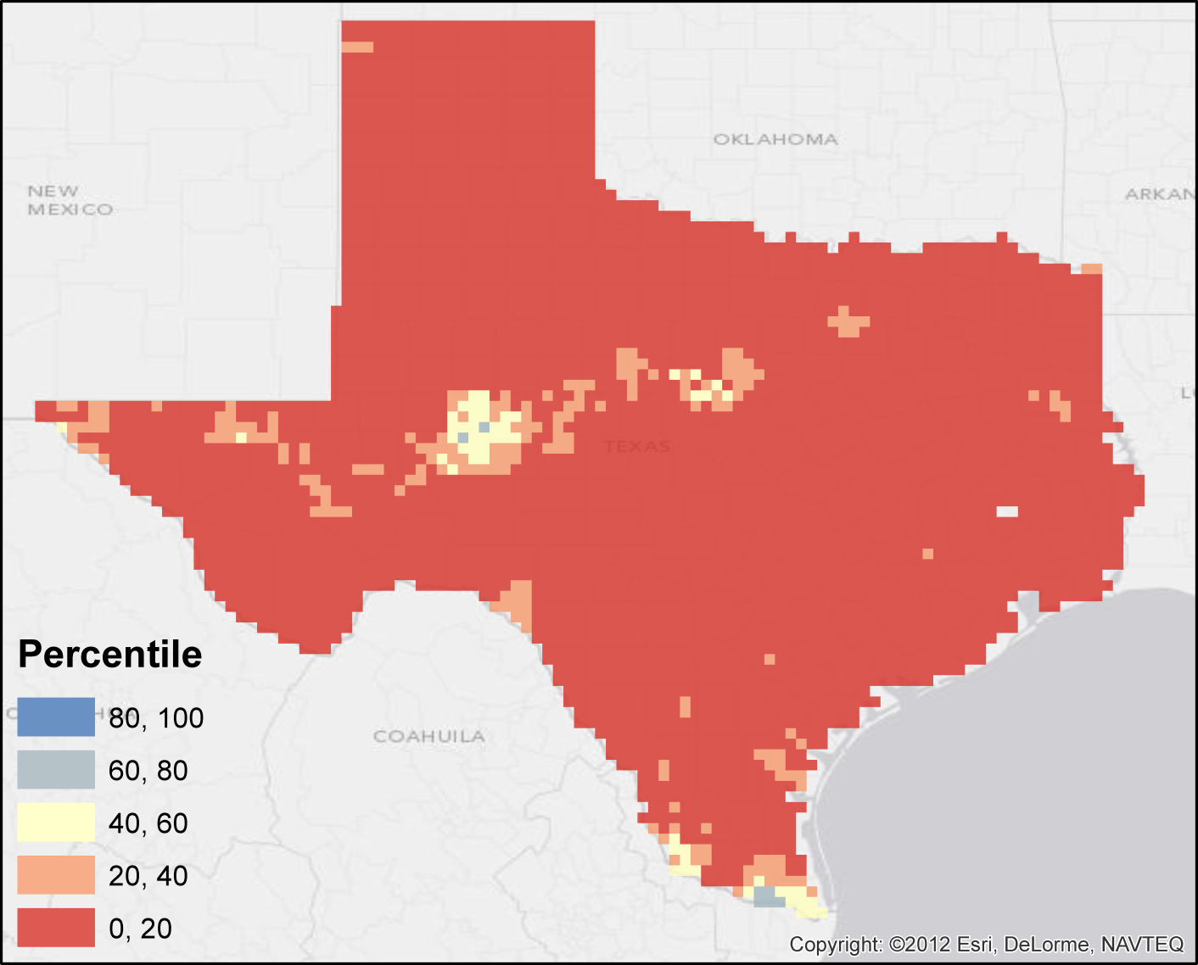
Applications: Texas Drought 2011
September 2011
5% percentile
Anomaly -55mm

Slide 10
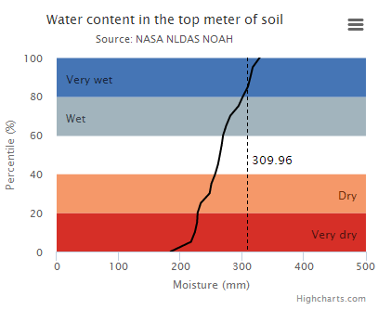
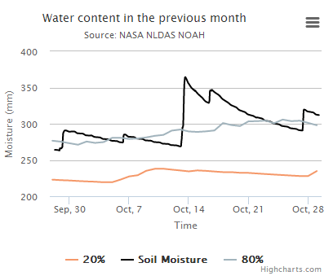
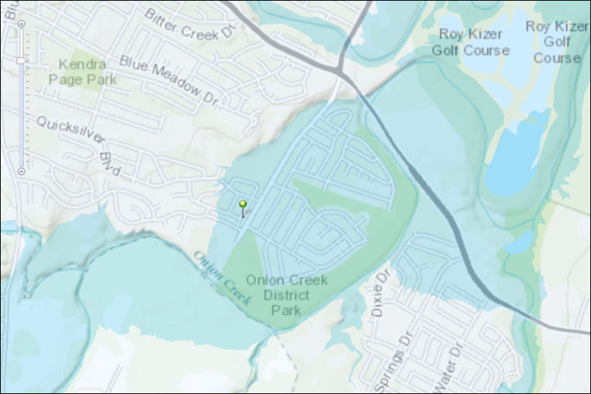
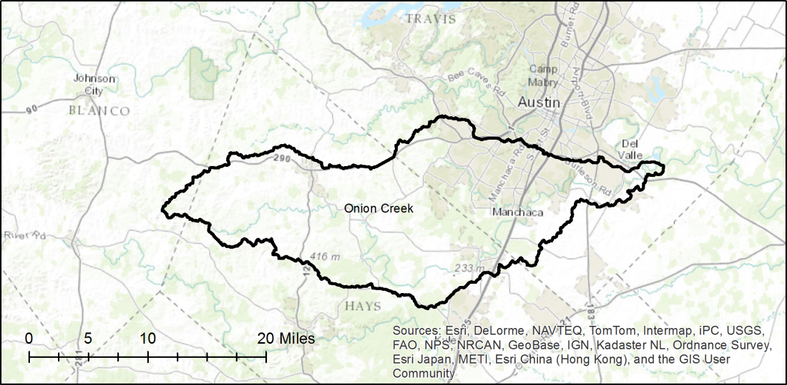
Applications: Onion Creek, 10/31/2013
Drainage Area: 730km2
Pre-storm soil moisture 87% percentile

Slide 11

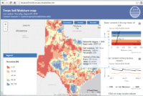
Web Application Architecture
Azure cloud
  Storage
  Django
ArcGIS
  Mapping
  Javascript
NASA
  Data rods
Cloud deployment
Storage Account
Client-Side
Microsoft Azure
Site & Date
stats
Web Deployment
Django (python)
Web app framework
User
Stats
ArcGIS API for JavaScript
Web App
ArcGIS server
Geographic data
NLDAS web services
Latest Values
Hydrologic Data
http://texassoilmoisture.azurewebsites.net
Server-Side

Slide 12
Work in progress
Process more variables
  Precipitation
  Runoff
  Evapotranspiration
  Temperature
Update the website design
  Layout
  Latest values
  Data storage communication
Improve the performance of the cloud storage
Risk scenarios
  Relationship between variables

