Slide 1
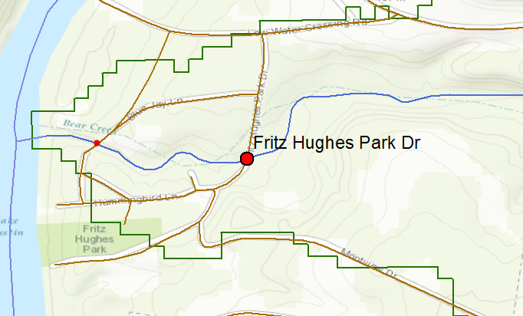
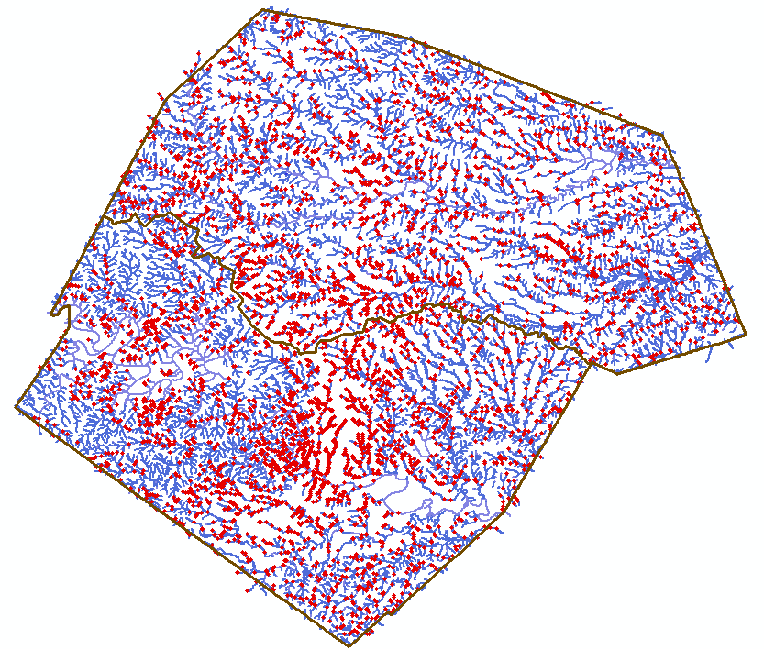
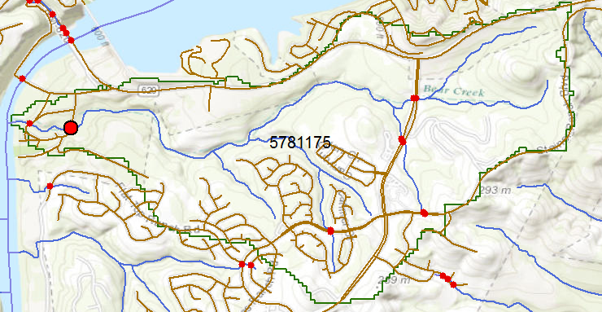
Intersection of Streams and Roads
5517 intersection points in Travis and Williamson Counties
Both datasets at 24K resolution
Data: Xing Zheng

