Slide 1



Tethys Platform: Build Web Apps for Water Resources Decision Support
Nathan R. Swain
Scott D. Christensen
Herman Dolder
Fidel Perez
Alan D. Snow
Jim Nelson
Norm Jones
Notes:
Introduce CI-Water

Slide 2
Everybody is Deploying their Apps to the Cloud

Slide 3
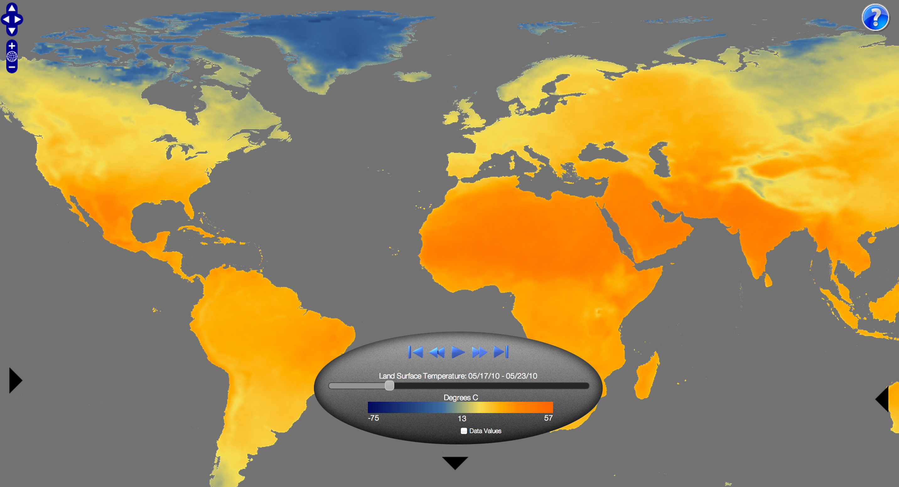
NOAA View
http://www.nnvl.noaa.gov/view/
Notes:
Environmental Data Viewer
Time series
Model and satellite
Education uses
Disclaimer: not for decision support or scientific purposes

Slide 4
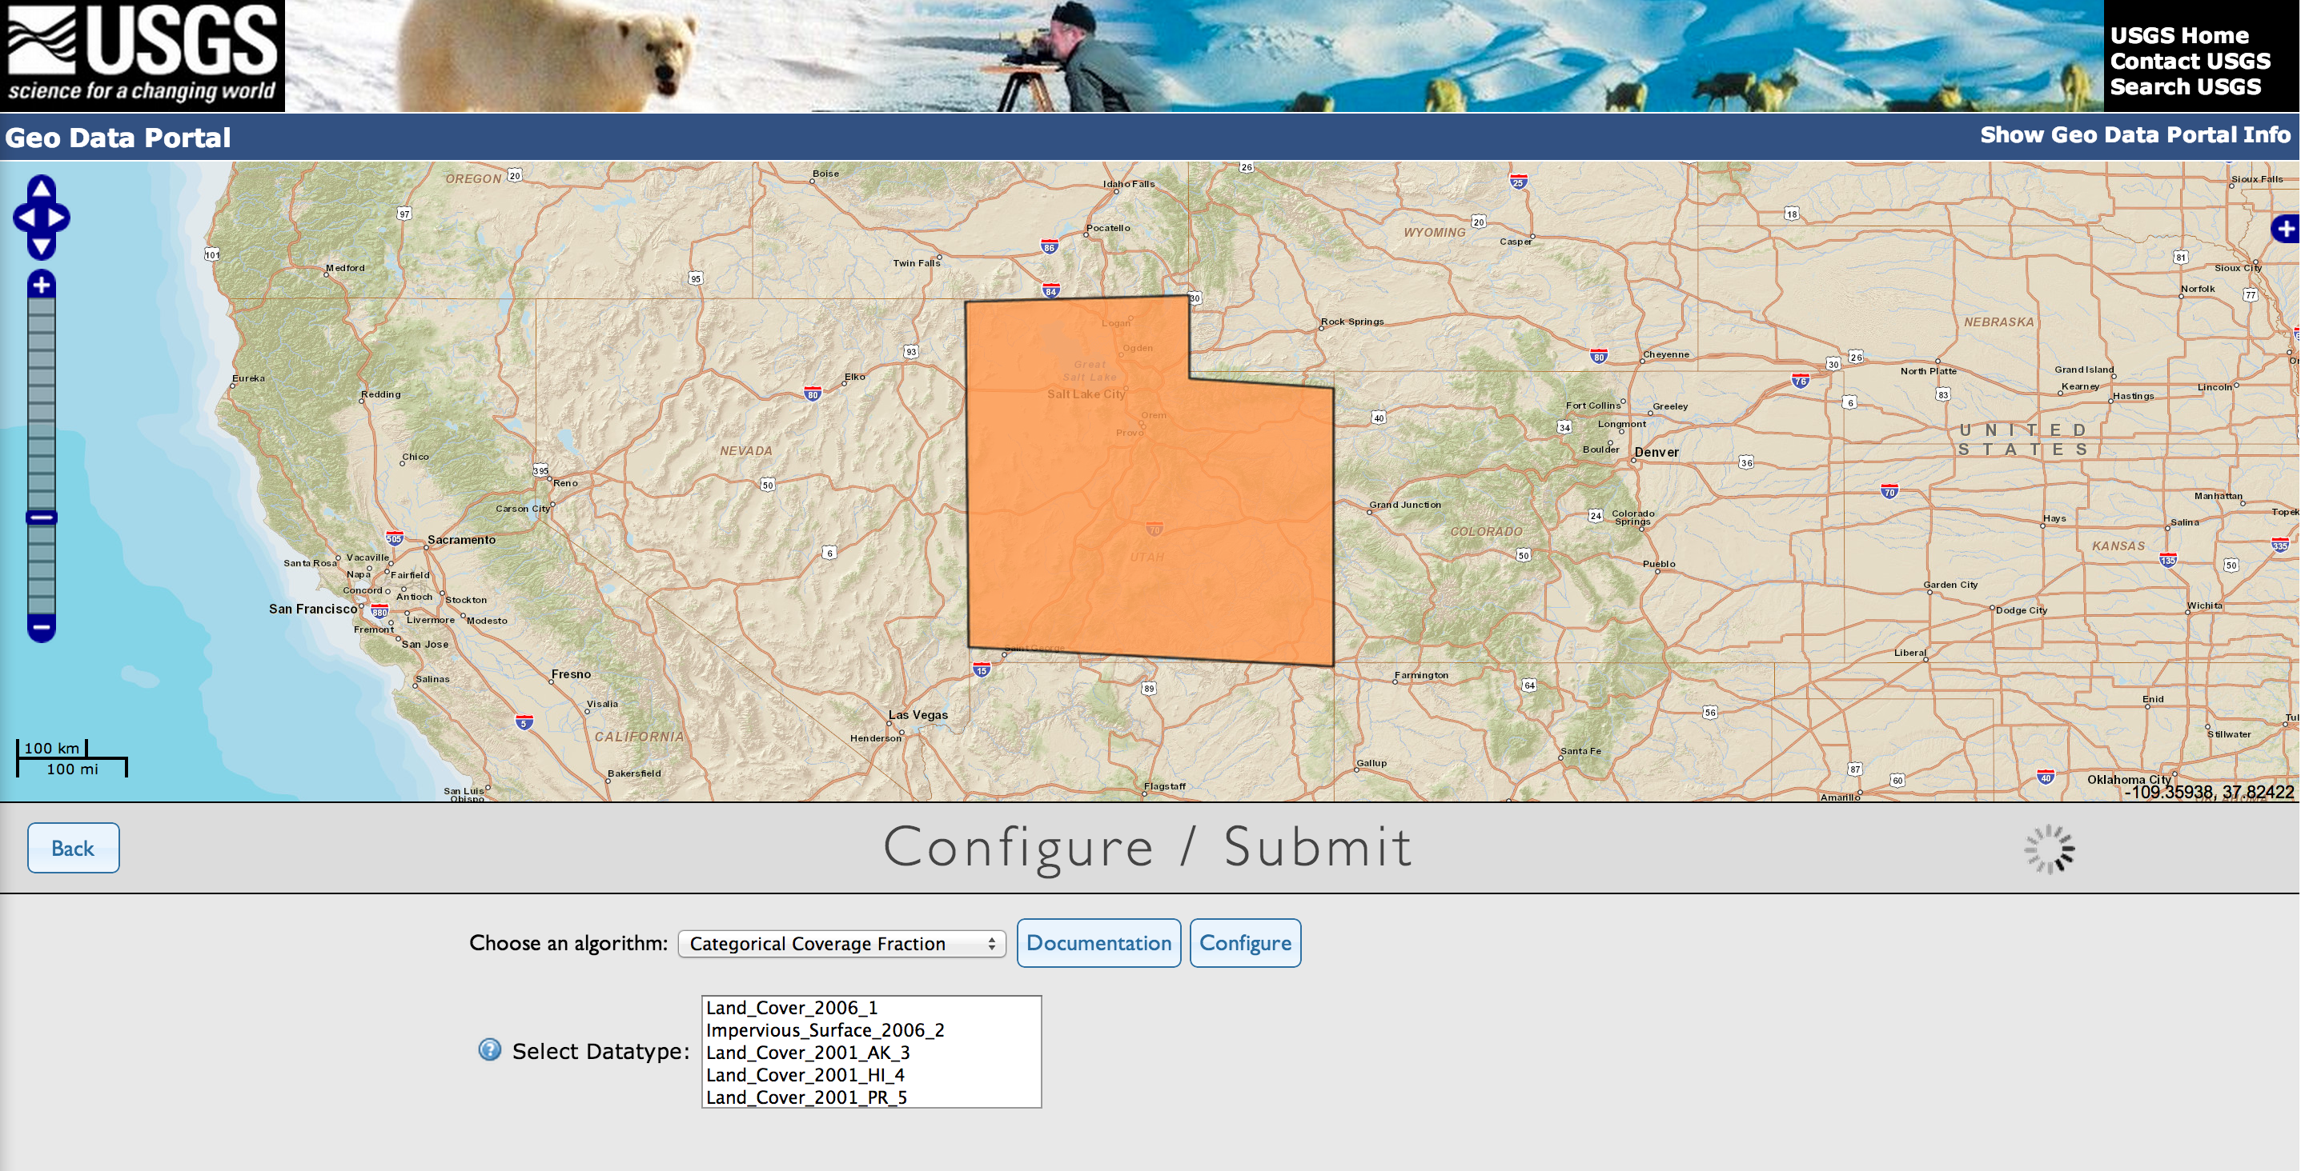
USGS Geo Data Portal
http://cida.usgs.gov/gdp/
Notes:
OGC Web Processing Service
Select dataset and calculate areal statistics
Subset datasets

Slide 5
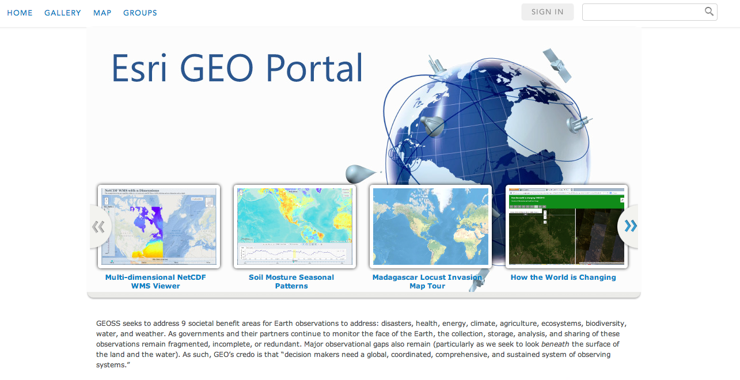
Esri GEO Portal
http://geoss.maps.arcgis.com/home/index.html

Slide 6
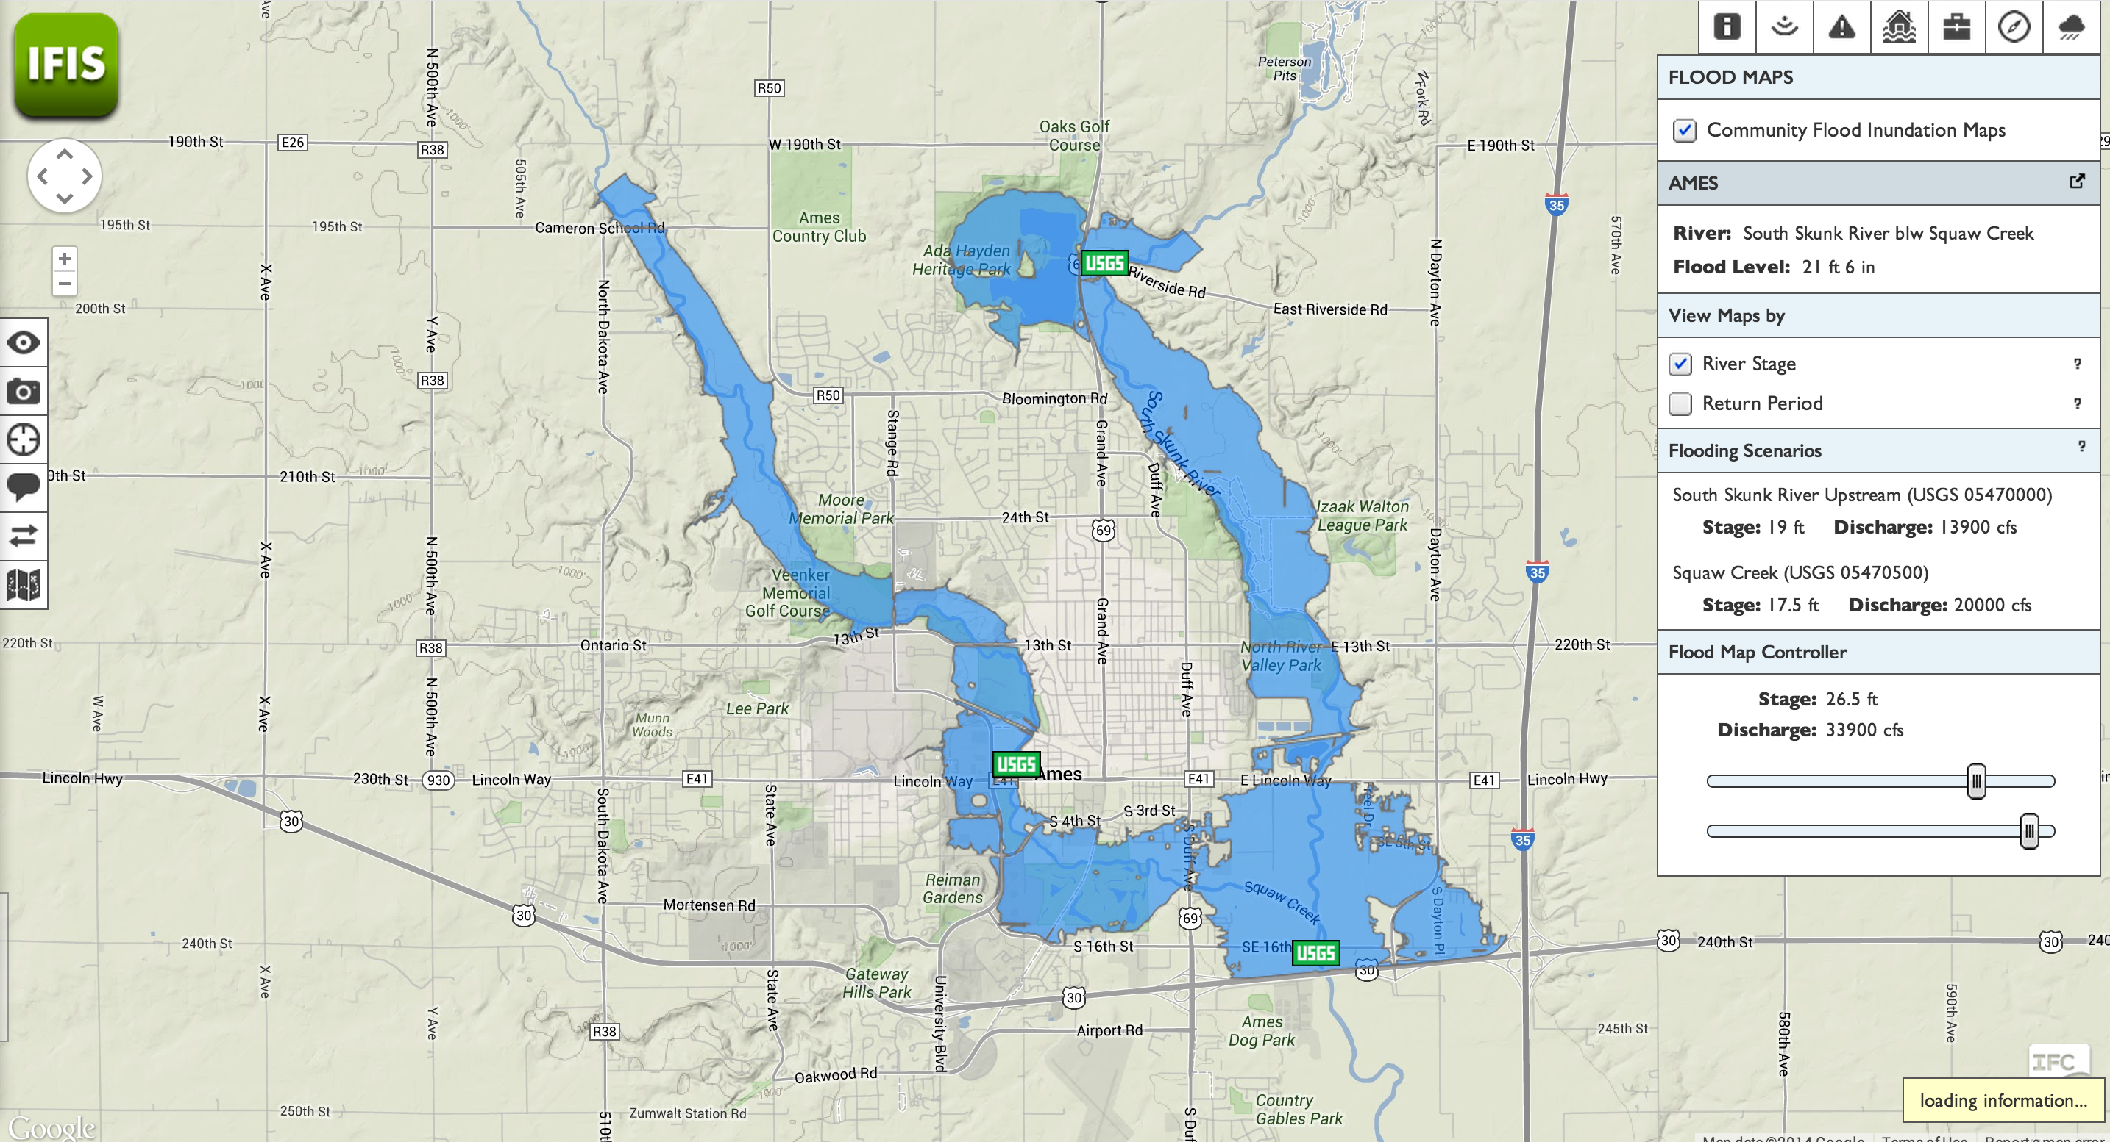
Iowa Flood Information System (IFIS)
http://ifis.iowafloodcenter.org/ifis/main/?v=b
Notes:
Flood conditions
flood forecasts
interactive flood inundation maps
real time weather and flood data

Slide 7
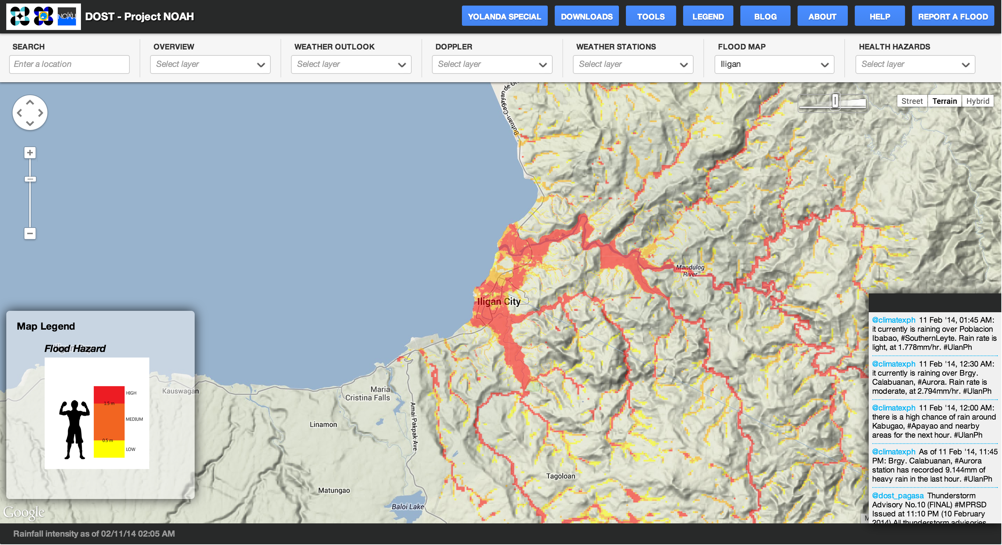
Nationwide Operational Assessment of Hazards (NOAH)
http://noah.dost.gov.ph/
Notes:
Philippines
Provide 6 hour lead time in emergencies
Web app & mobile apps (iOS and Android)
Live weather data streams & flood hazard maps
Used in 2 flooding events: 0 fatalities due to advanced warning

Slide 8
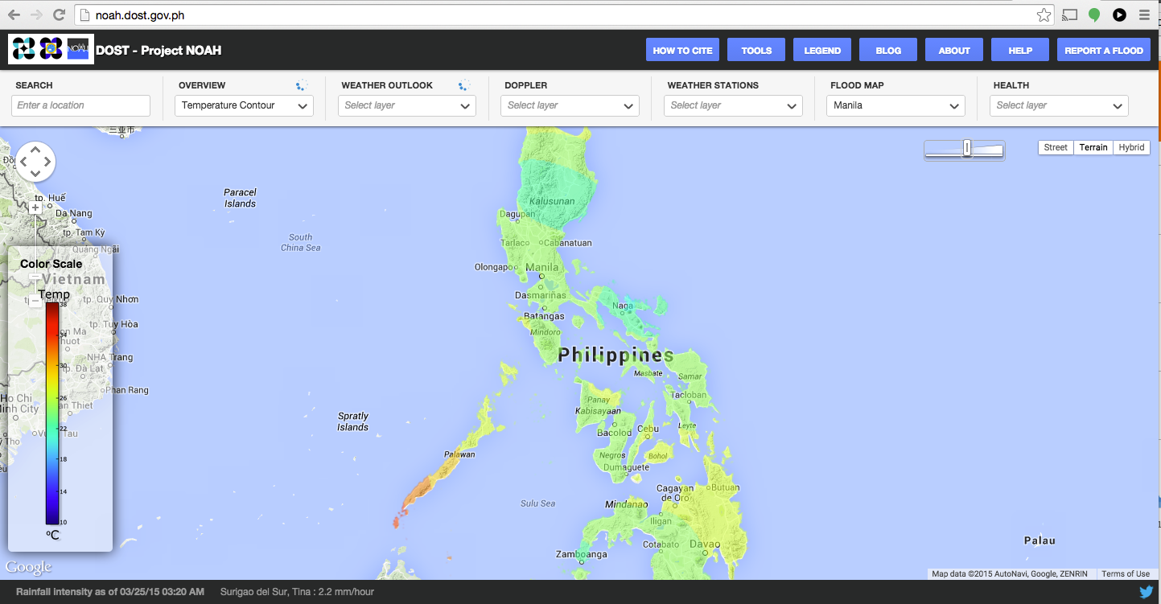
Project NOAH - Philippines
http://noah.dost.gov.ph/

Slide 9
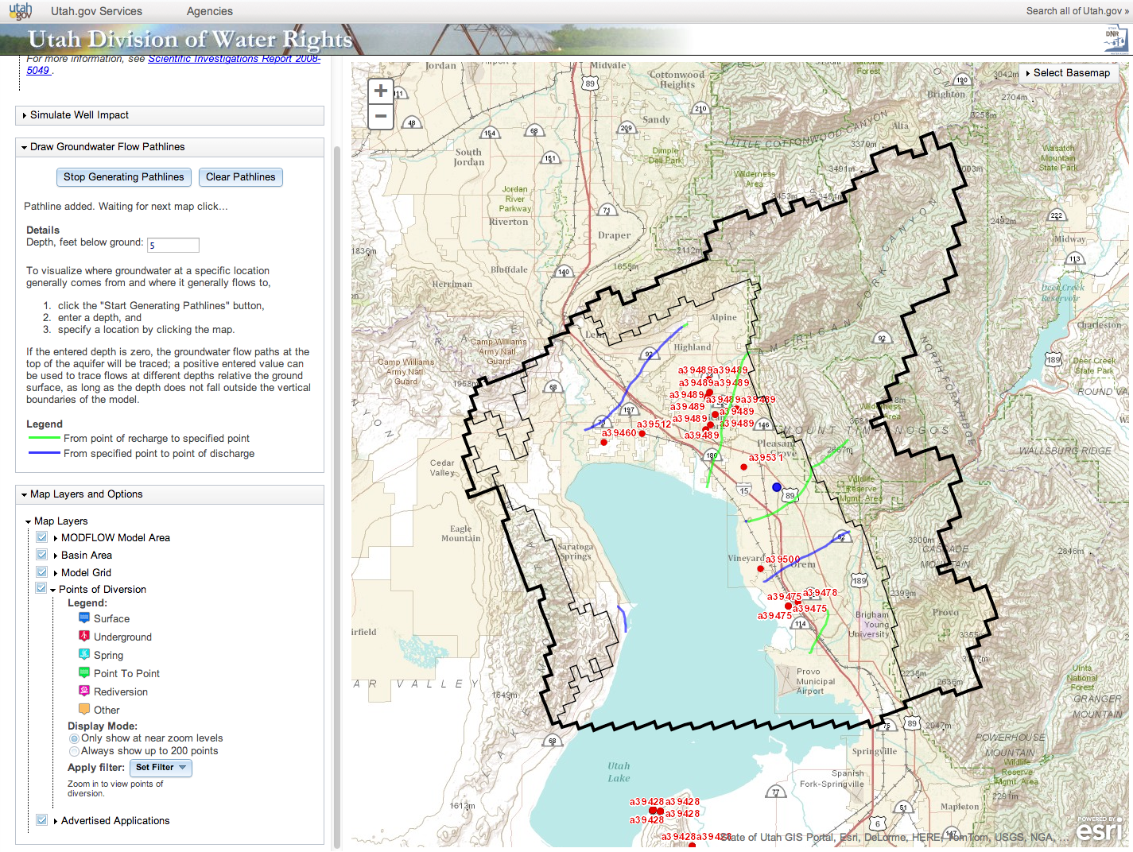
Utah Division of Water Rights
http://gis.waterrights.utah.gov/gwmodels/_new/RunModel2.asp
Notes:
Apps built with GISolve middleware
Executed on super computers (XSEDE & Open Science Grid)
Focus on geoprocessing on HPC resources

Slide 10



CI-WATER

Slide 11
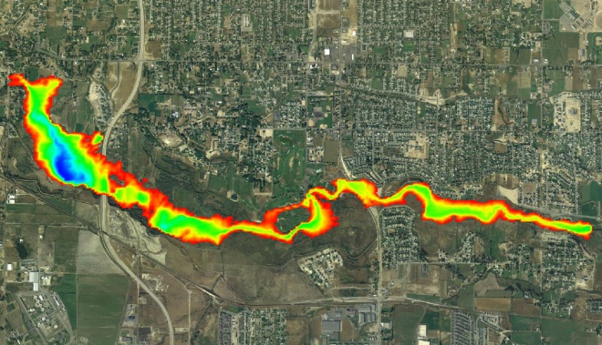
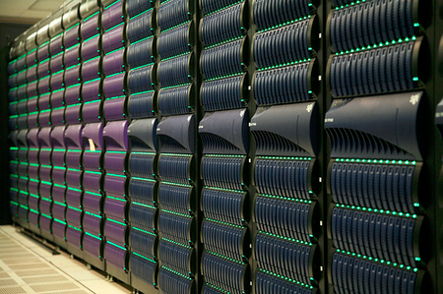
CI-WATER Objectives
Enhance cyberinfrastructure facilities
Enhance access to data- and computationally-intensive modeling
Advance high-resolution multi-physics watershed modeling
Promote STEM learning and water science engagement

Slide 12



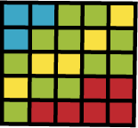





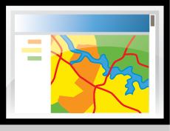
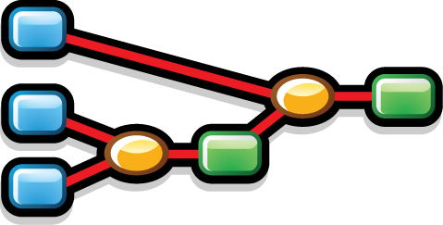

Cloud-Based Modeling for Decision Support
Spatial
Databases and Tools
Model Files
Custom Python Scripts
Simple Web Interfaces
Engineers, Decision Makers, Advocacy Groups, Public

Slide 13
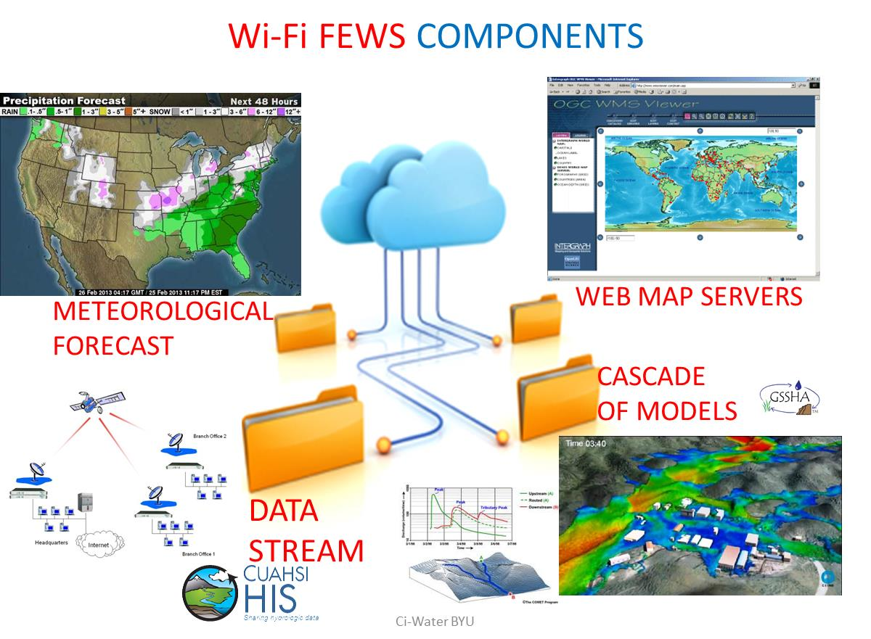
Flood Early Warning System
Web-based Interactive Fully Integrated
Flood Early Warning System

Slide 14
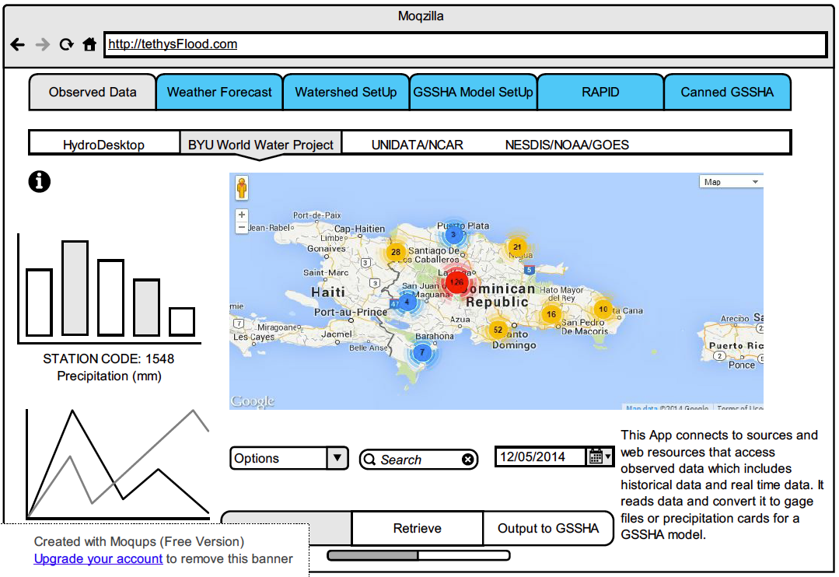
Observations through WaterML

Slide 15
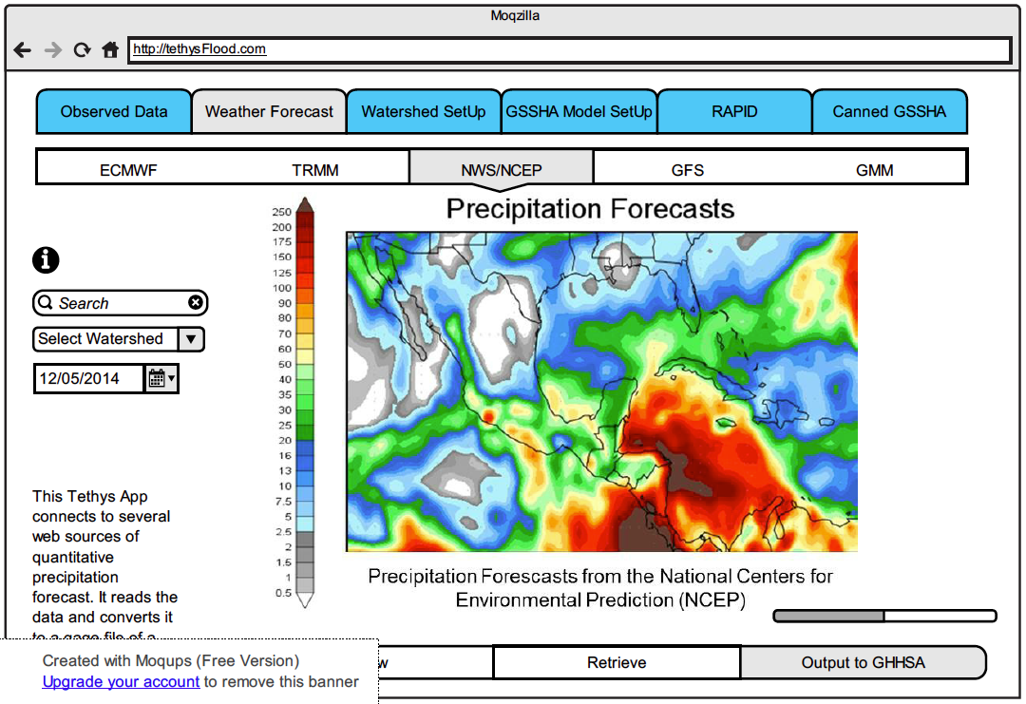
Precipitation

Slide 16
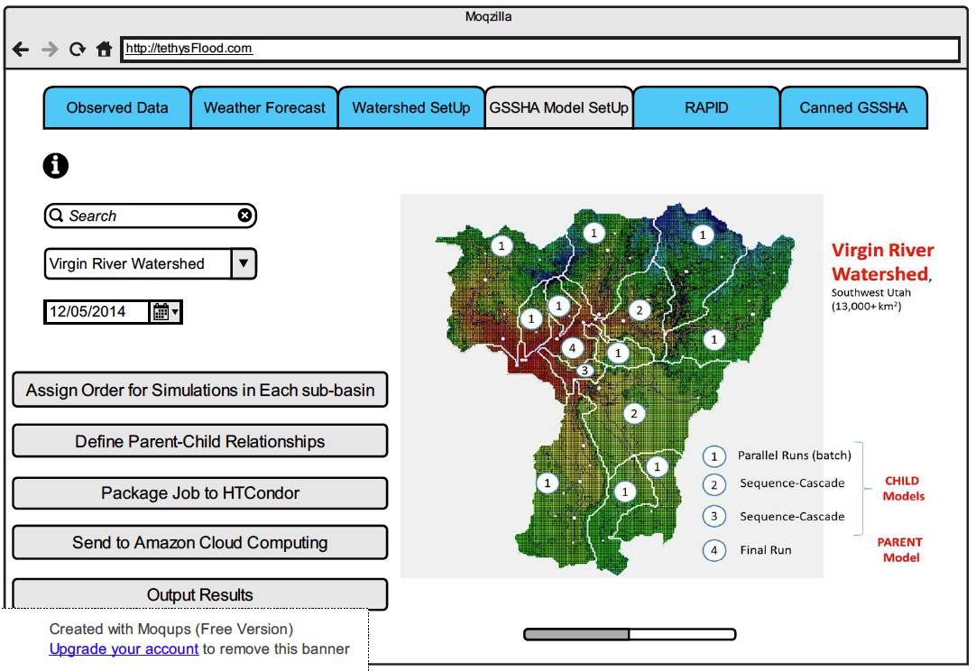
GSSHA Hydrologic Model

Slide 17
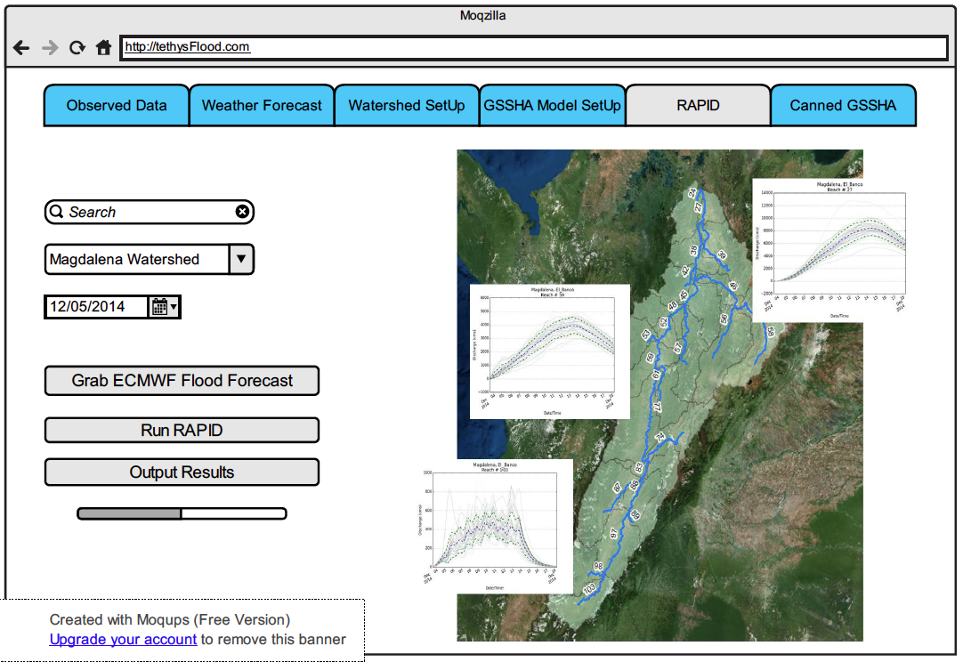
ECMWF-RAPID

Slide 18
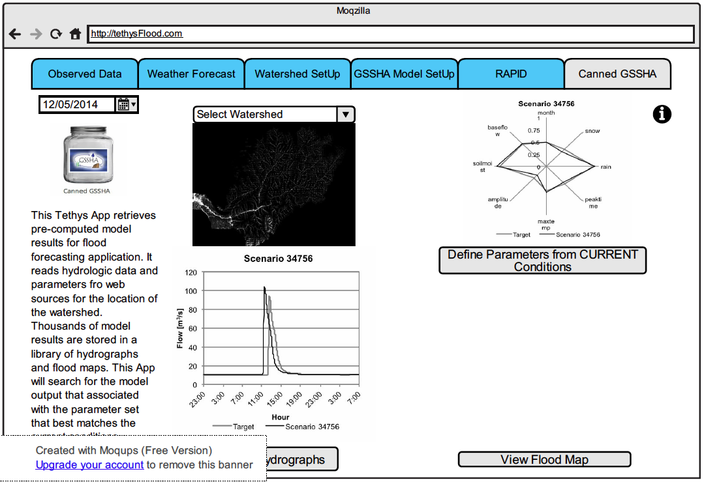
Canned GSSHA

Slide 19
Tethys Platform

Slide 20
An App Approach
Gather Data
Format Data
Build Model
Calibrate
Validate
Report
?
+
App
Notes:
One way to lower the barriers is illustrated in this slide.
Living Models
Life Cycle of Models
Have a question or problem
Build model to address question or problem
Issue report with final analysis
Problem
“One problem is that at the time a report is generated from the simulation model it is impossible to analyze all current or even conceive of future scenarios for which the model may be applicable. This limits the utility of the model in making good decisions (Jones et al., 2014).“
Add to this an app:
carefully crafted, narrowly focused
tailored to a specific scenario exploration activity
simple, structured workflow
Modify parameters, execute simulation, and visualize results

Slide 21
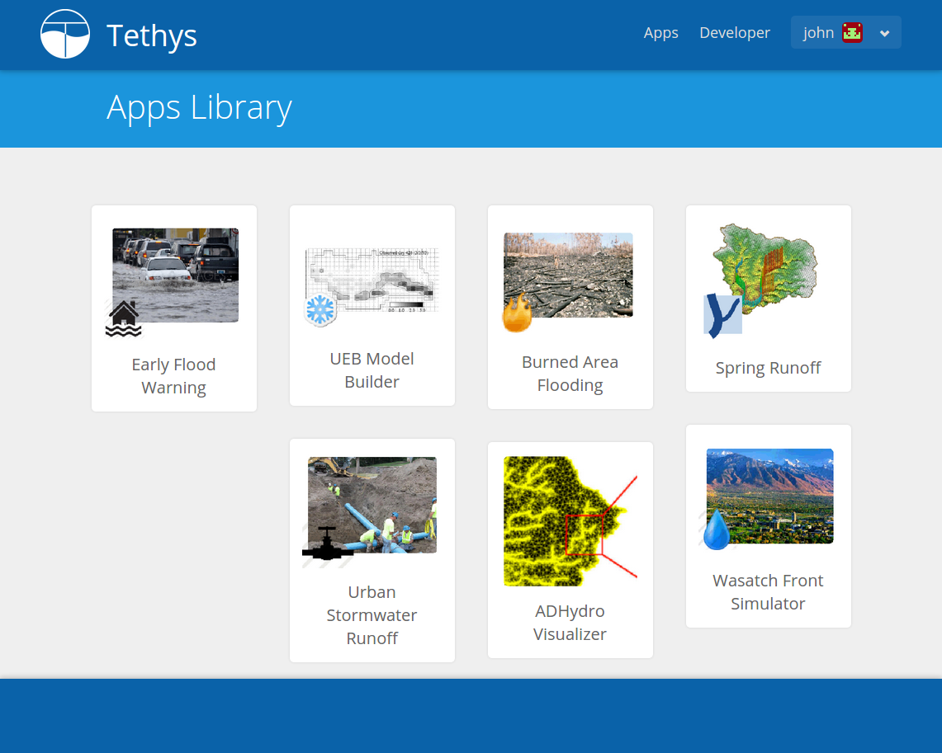
Apps for Water Resources
Notes:
------------------------------------------------------------------------------------------------------------------------------------------------------------
The CI-Water project has developed Tethys Platform to lower the barrier for creating water resources web apps
------------------------------------------------------------------------------------------------------------------------------------------------------------
What is a platform?
Computer operating system analogy:
Also called platform
Provides the minimum software for you to be able to use your computer
Create an environment where applications can run (like Word, Excel, or Google Chrome)
It also provides tools for developers to create applications
Tethys as a platform
Provides the foundational software for running hydrologic modeling web apps
Provides tools for web app developers
FOSS solutions (with a few exceptions)
The objective of my dissertation will be to develop the Tethys Platform
Both a development environment and a hosting platform for water resources web apps
Lower the barrier to create apps
Tethys will be hosted in a web environment
Only Internet connection and a modern web browser to run apps
Synthesize several FOSS projects
Python powered software development kit (SDK)
Tethys Apps
Standard web technologies (HTML, CSS, JavaScript, SQL)
Python powered on the backend (server)
Newer technologies for web (GIS and cloud computing)
Characteristics of apps:
carefully crafted, narrowly focused, simple workflow
tailored to a specific activities rather than being the “all-in-one” solution
emphasis on user experience and utility
Illustrate with an example of one of my favorite mobile app (Instagram)
-------------------------------------------------------------------------------------------------------------------------------------------------------------------------------------------------
We envision using web apps as a means of lowering the barrier to hydrologic modeling—making it more accessible to decision makers
-------------------------------------------------------------------------------------------------------------------------------------------------------------------------------------------------
WEB APPS vs. MOBILE APPS
We are building web apps
Web App Development
How they are developed.
Web apps are specialized web pages
Developed using HTML, JavaScript, PhP, Python, Framework, CMS
Client-Server, run in Browser
Mobile apps are developed as applications in their respective operating system
iOS: Objective-C
Android: Java
Windows Phone: .NET/C#
Why web apps?
Wider potential user base
Just need a modern web browser
Cross platform (Windows, Mac, Linux, Mobile)
Can run on mobile versions of browsers in theory (but performance can be an issue)
Many mobile apps are backed by web apps/versions
NOTE: To optimize app for mobile environment, need to develop versions for each mobile OS (Android and iOS)

Slide 22






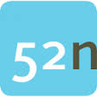










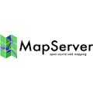

Software Selection
Spatial Data Storage
Spatial Analysis
Spatial Visualization
Web Framework
Spatial Publishing
Notes:
-----------------------------------------------------------------------------------------------------------------------
Tethys Platform provides (1) Software to support water resources app development
-----------------------------------------------------------------------------------------------------------------------
Whereas Esri provides all of the GIS functionality in a single package (i.e.: geodatabase, geoprocessing, and mapping), most
open source GIS software projects focus on only one piece of functionality. This necessitates the use of multiple open source
software projects to achieve all the GIS functionality.
Tethys Platform provides a suite of software to address the functionality needed by water resources web apps.
Tethys Software Suite:
Web GIS Support
52 North WPS
GeoServer
PostGIS SQL Database
Visualization
Google Earth & Google Maps mapping
OpenLayers mapping
Highcharts plotting
Computing
HTCondor
TethysCluster
Data
HydroShare
CKAN
Web Framework
Django

Slide 23
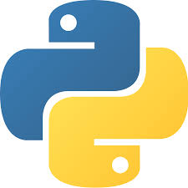






Python SDK
Notes:
------------------------------------------------------------------------------------------------------------------------------------------------------------------------------------------------------------------------------------
Tethys Platform provides (1) Software to support water resources app development and (2) a software development kit to simplify the development of web apps
------------------------------------------------------------------------------------------------------------------------------------------------------------------------------------------------------------------------------------
The use of an open source suite of software requires many software projects to be “stitched” together. The Tethys Python SDK fulfills this role by providing a framework for developing the web apps and APIs for interacting with each element of the software suite.
Tethys SDK:
Is a Python software development kit
Built on the Django Python web framework.
Provides a framework for developing apps.
Python modules/APIs for working with each component of the Tethys software stack

Slide 24
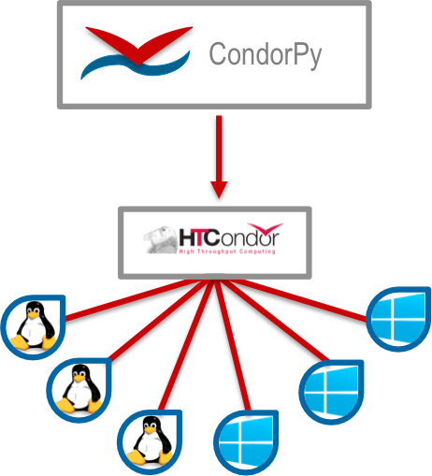
HTCondor

Slide 25
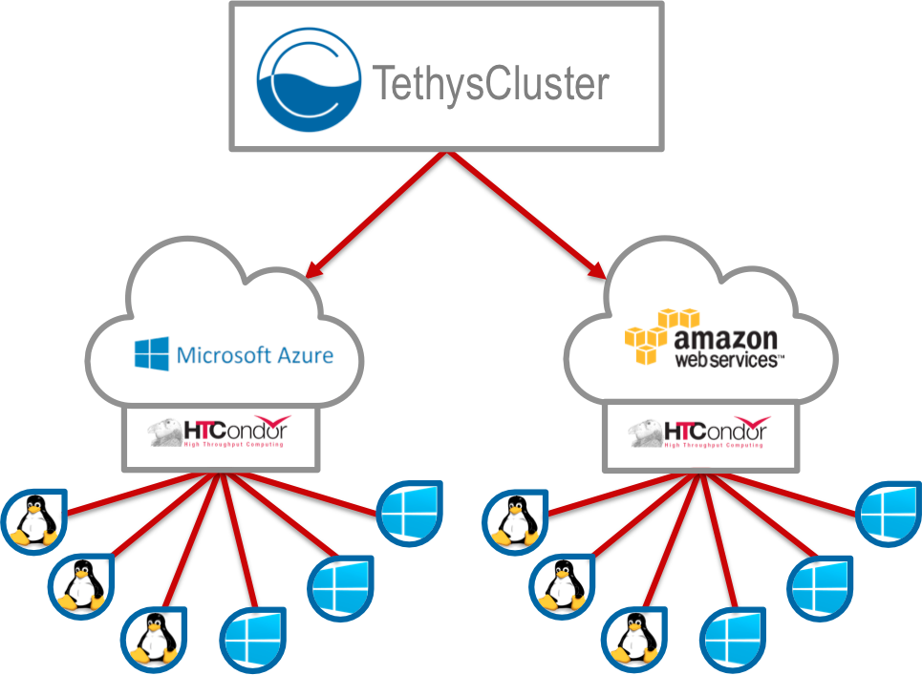
Tethys Cluster for the Cloud

Slide 26
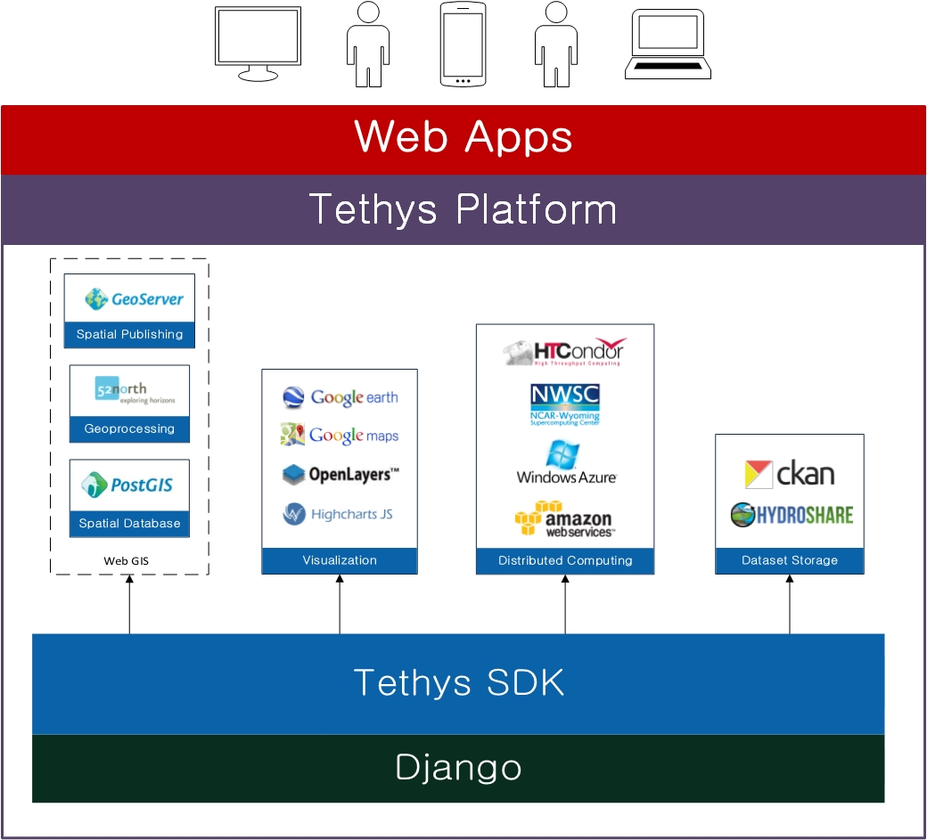
Software Suite
Notes:
------------------------------------------------------------------------------------------------------------------------------------------------------------------------------------------------------------------------------
Summary of Tethys Platform Architecture
------------------------------------------------------------------------------------------------------------------------------------------------------------------------------------------------------------------------------
Tethys Platform overcomes two barriers to web app development for water resources:
1. Software Selection Barrier
Water resources web apps have unique software needs beyond the normal web development “stack” (i.e.: GIS and computational needs).
There are a large number of Free and Open Source Software projects that can be used to address these needs
However, there are so many software projects, that it can be overwhelming to novice developers.
The software selection barrier is the problem of choosing which software to use to support water resources web app development.
2. Software Orchestration Barrier
Whereas proprietary software offer all functionality in a single convenient package, FOSS projects tend to focus on a single feature.
To provide all the necessary functionality that is needed for water resources web apps will require the synthesis of several FOSS projects.
The software orchestration barrier is the problem of synthesizing each of the FOSS projects included in the platform and making the functionality of each easy to incorporate in water resources web apps.

Slide 27
ECMWF-RAPID Flood Prediction
An Example Tethys App

Slide 28
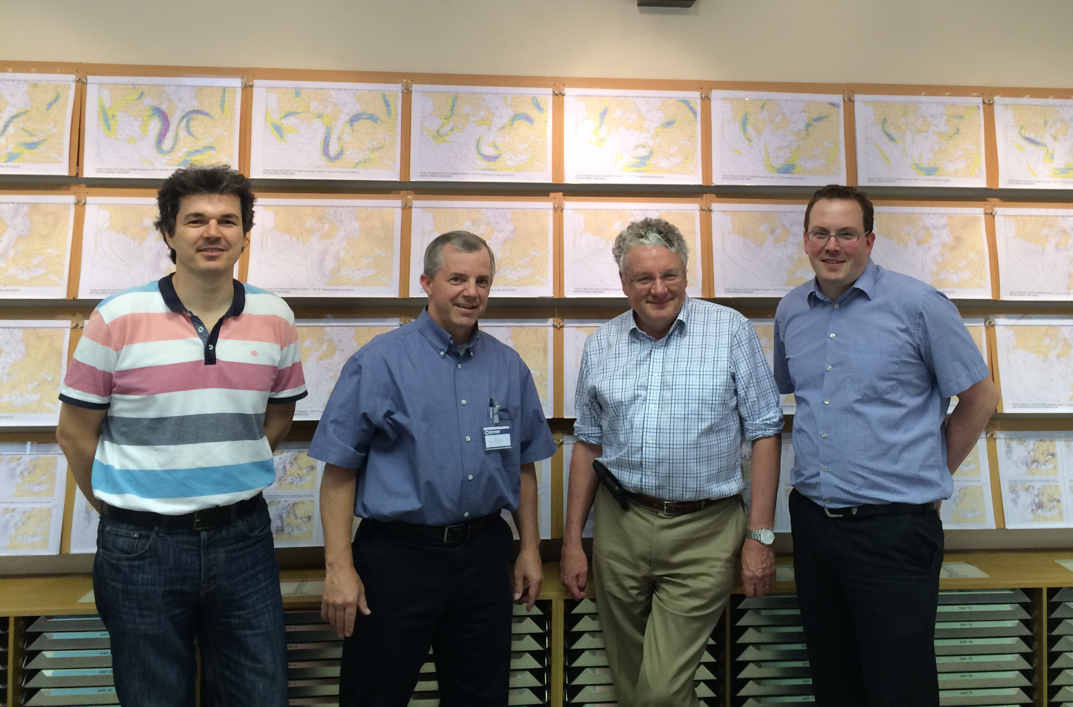
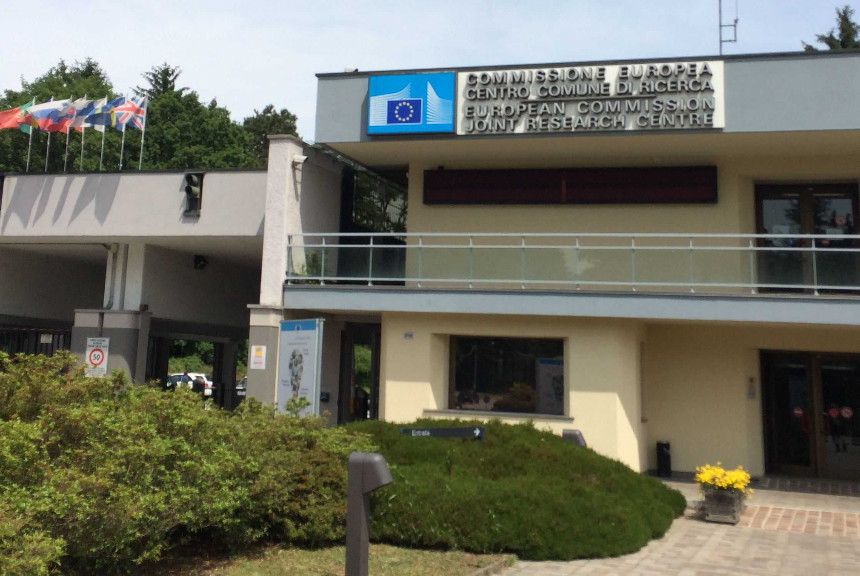
ECMWF and JRC Visit Spring 2014

Slide 29
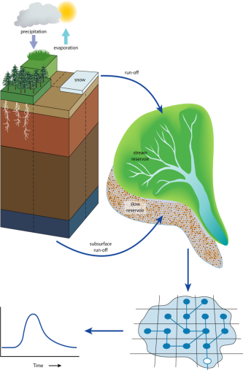
GloFAS: Modelling framework
Output from global NWP land-surface scheme forecast: HTESSEL (ECMWF)
(Hydrology Tiled ECMWF Scheme for Surface
Exchange over Land)
Surface heat & evaporation
Soil water budget
Output: surface flux & subsurface flux
Routing model: Simplified LISFLOOD (JRC)
Groundwater
Routing (kinematic wave)
Post-processing for end users

Slide 30
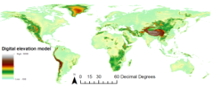
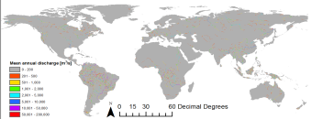
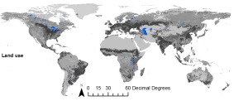
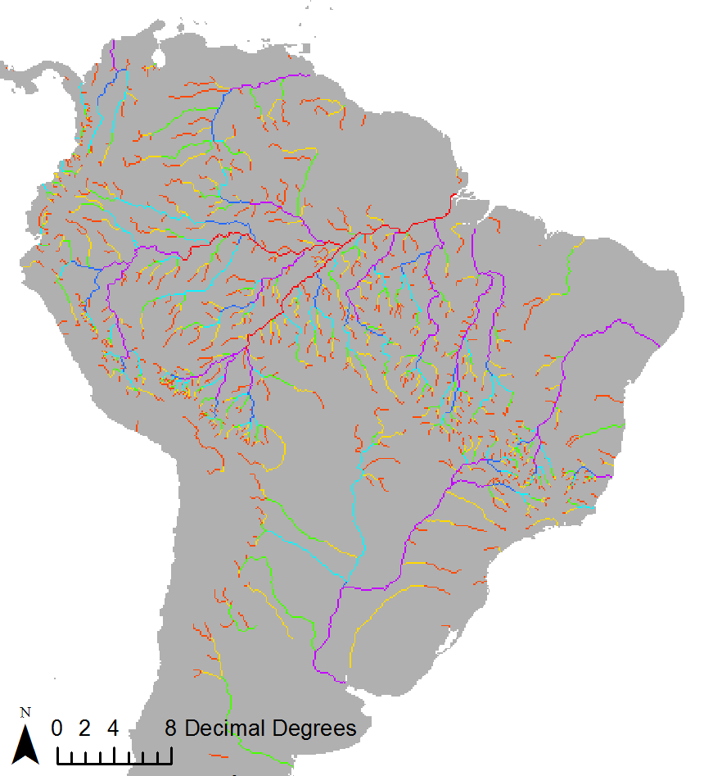
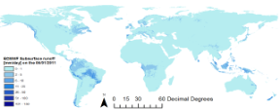
Global Flood Awareness System Set-up
Input: global spatial data
Hydro-Meteo model
Output: global daily discharge
ECMWF ERA-INTERIM Re-ANALYSIS
for discharge climatology (1979-2010)
ECMWF VAREPS for forecasts since
June 2011
Spatial resolution 0.1 degree

Slide 31
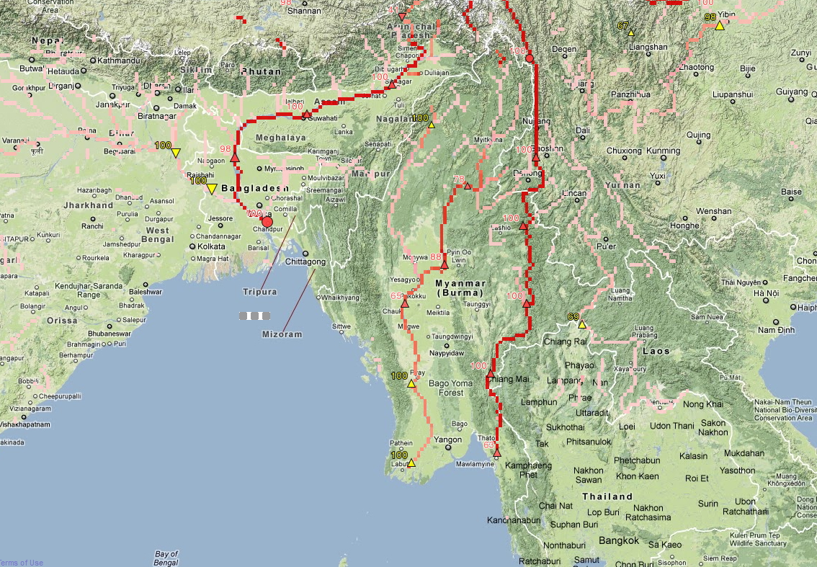
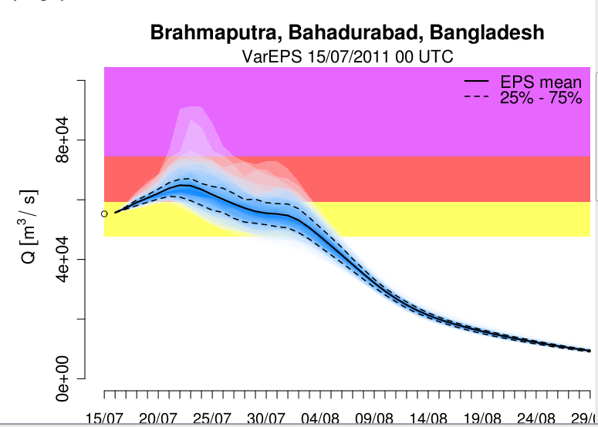
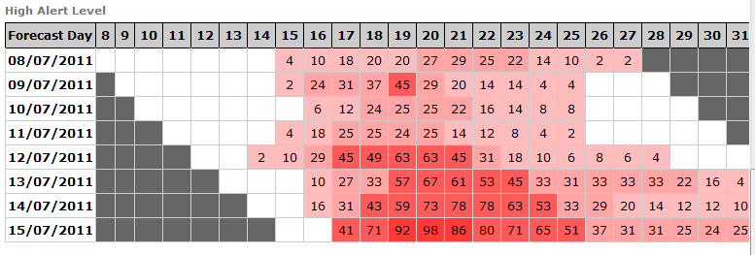
GloFAS forecast example 15 July 2011

Slide 32
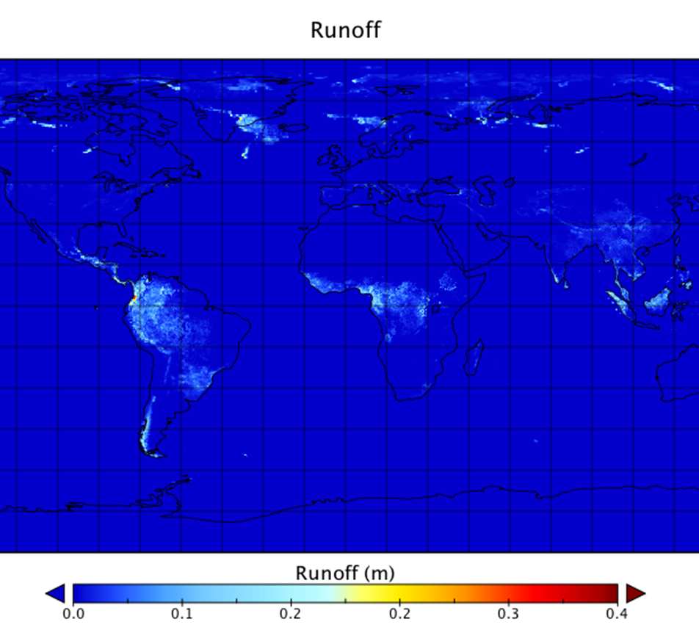
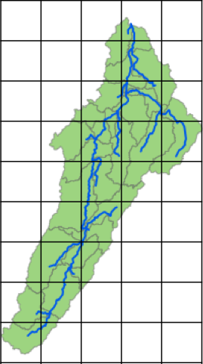
Downscale and route with RAPID

Slide 33
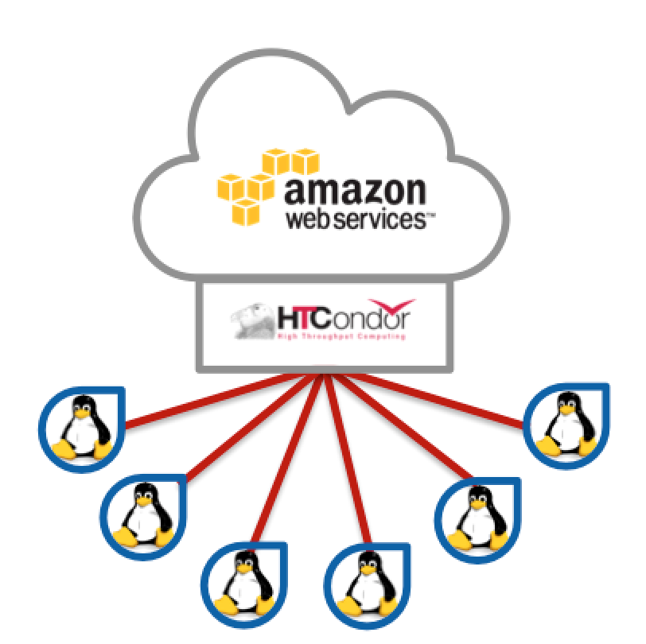
Processing Workflow
ECMWF Forecasts
1…52
In-stream Forecasts
1…52
15-Day Runoff Depth - Cumulative
(m)
15-Day Flow by Reach - Incremental
(cms)
Downscale ECMWF Forecast to Watershed
Run Forecast with RAPID
Downscaled Forecast
1…52
Weight Table
15-Day Runoff Volume by Reach -
Incremental (m³)
Other RAPID input Files for Watershed

Slide 34


Tethys for ECMWF-RAPID Data Storage and Computational Power

Slide 35
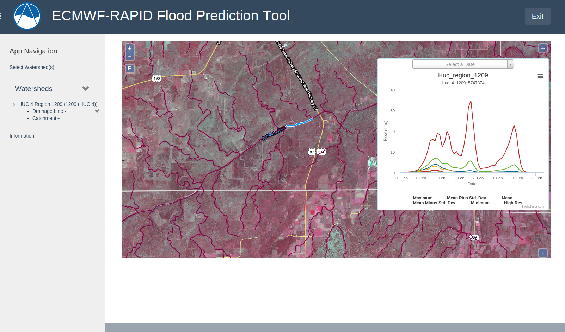
ECMWF-RAPID App in Tethys

Slide 36
Canned GSSHA
An Example Tethys App

Slide 37
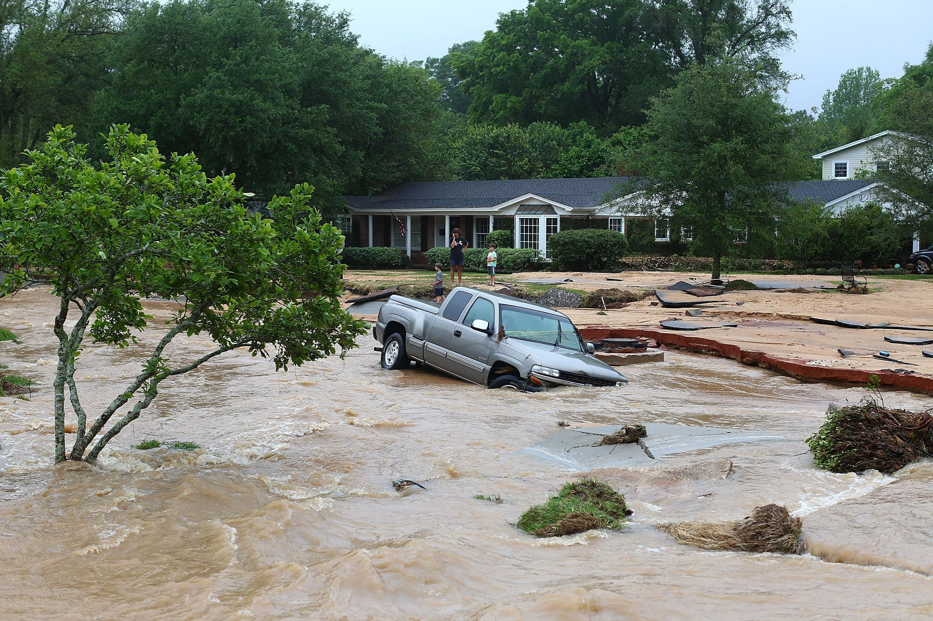
Flood Early Warning Systems

Slide 38
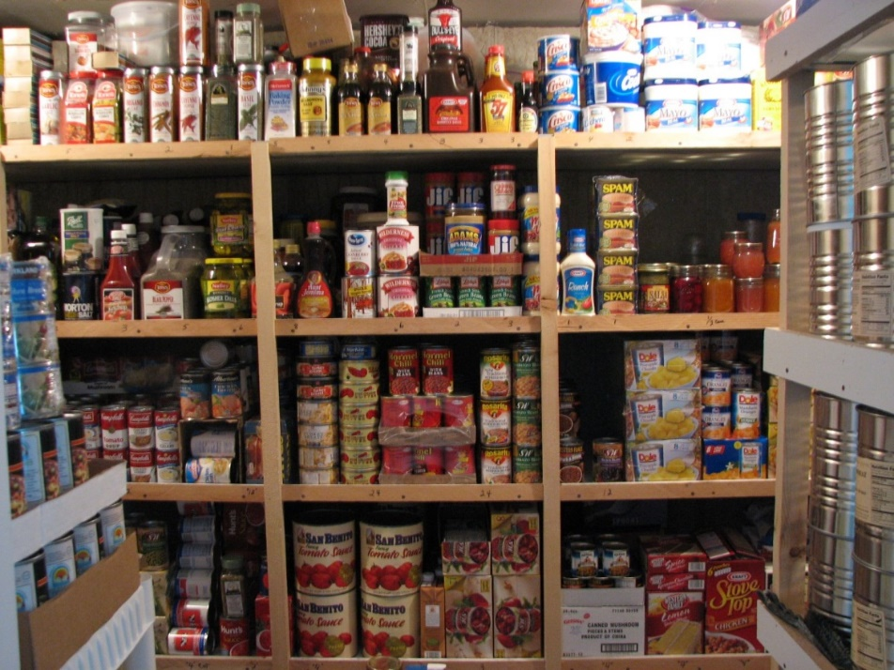
Preparedness
Food
Water
Fuel
Clothes
Computation Time
Assumption:
“Similar conditions produce similar results”
Our purpose will be to generate a large set of model runs to evenly cover the “variables space” and a technique to select the one that best fits the current conditions

Slide 39
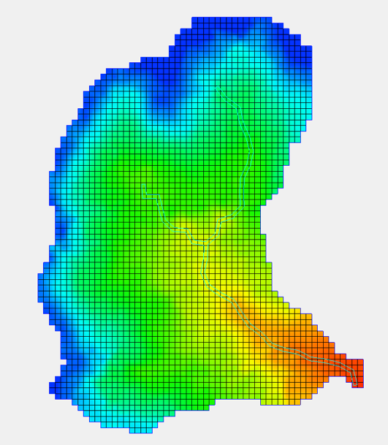
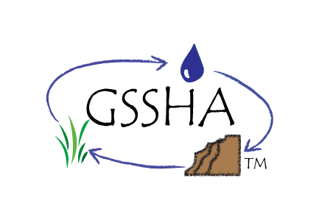
Generate

Slide 40
Generate

Slide 41
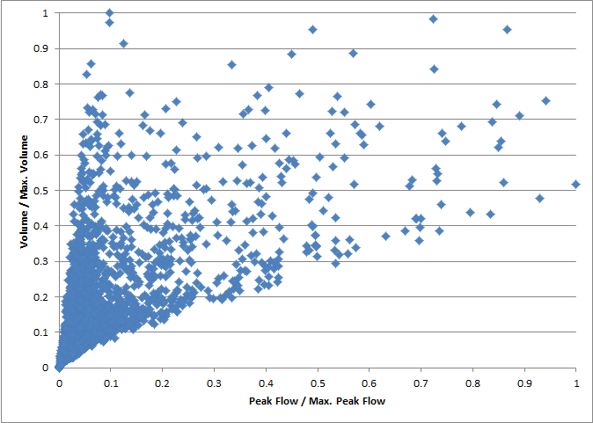
Generate

Slide 42
Select

Slide 43
Select
Similar conditions produced similar results?

Slide 44
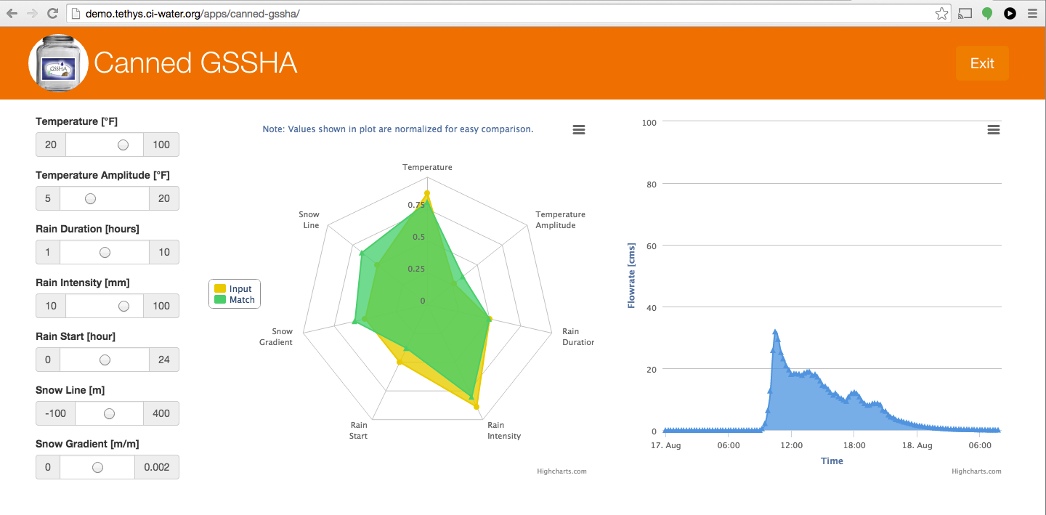
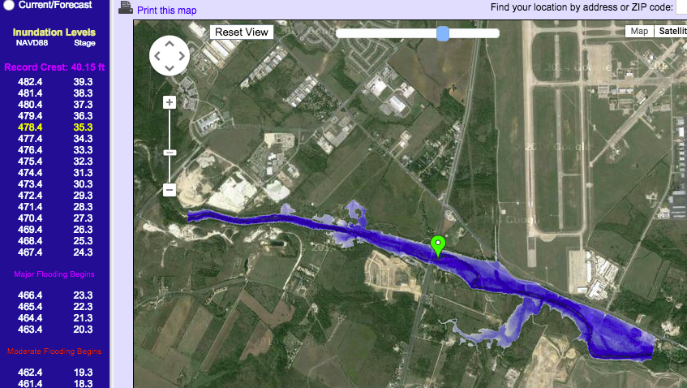
Canned GSSHA App in Tethys

Slide 45
National Flood Interoperability Experiment
An Example Tethys App

Slide 46
NFIE Continental Scale…
NFIE-Geo: National geospatial framework for hydrology
NFIE-Response: Wide area planning for flood emergency response
NFIE-Hydro: National high spatial resolution hydrologic forecasting
NFIE-River: River channel information and real-time flood inundation mapping
NFIE-Services: Web services for flood information

Slide 47
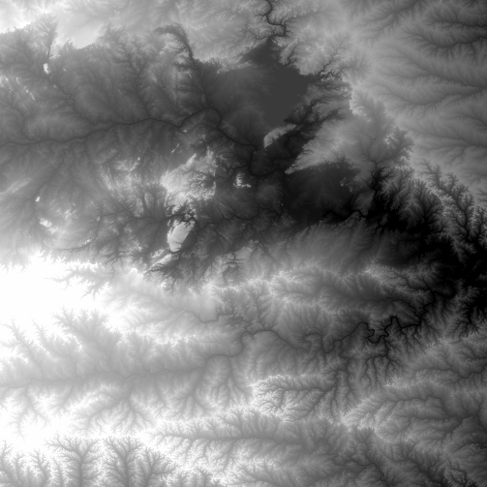
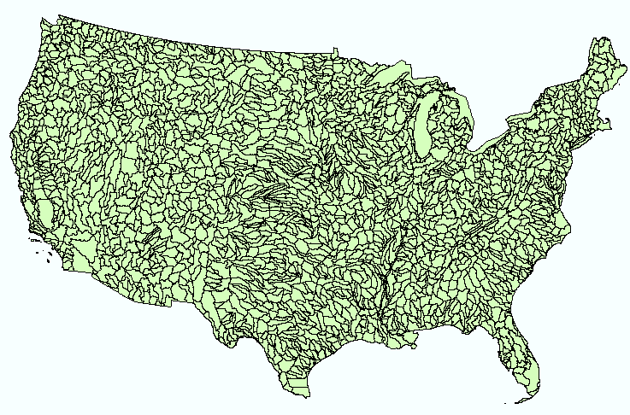
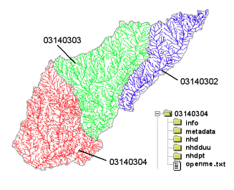

NHDPlus Version 2
NHDPlus
2.67 million reach catchments in US
average area 3 km²
reach length 2 km
National Elevation Dataset
Watershed Boundary Dataset
National Hydrography Dataset
National Land Cover Dataset

Slide 48




NFIE GEO
NWS Basins and
Forecast Points
USGS Water Watch
Points
National Flood
Hazard Layer
Feature classes:
Subwatershed (HUC12)
Catchment
Flowline
Waterbody
Dam
NFIE-Geo
9 feature classes
5 from NHDPlus
4 from IWRSS
NHDPlus

Slide 49
Tethys for NFIE
Your App Here
Notes:
-----------------------------------------------
Proposed Use of Tethys for NFIE
-----------------------------------------------
1. BYU Team will compose a suite of apps targeted at different aspects of a flood warning system:
Weather Forecast Visualization App
Ground Truth Visualization App
ECMWF Rapid Stream Flow Forecast App
2. Tethys Platform app development support and infrastructure (i.e.: Tethys servers for other teams) for hosting Tethys Apps developed by other interested teams

Slide 50

Thank You
ci-water.org
demo.tethys.ci-water.org
tethys.ci-water.org
This material is based upon work supported by the National Science Foundation under Grant No. 1135482

