Slide 1
Services-Oriented Architecture Updates David Maidment Part of a presentation made to the HIS Standing Committee, Washington DC, Nov 15, 2010

Slide 2
What have we learned?
We have custom-built a very large scale services-oriented architecture and a sophisticated user interface to it
A much simpler and more general pattern has emerged based on existing OGC information exchange standards and extensions to them
We have exposed a very large volume of information
It needs to be carefully organized to be most useful

Slide 3
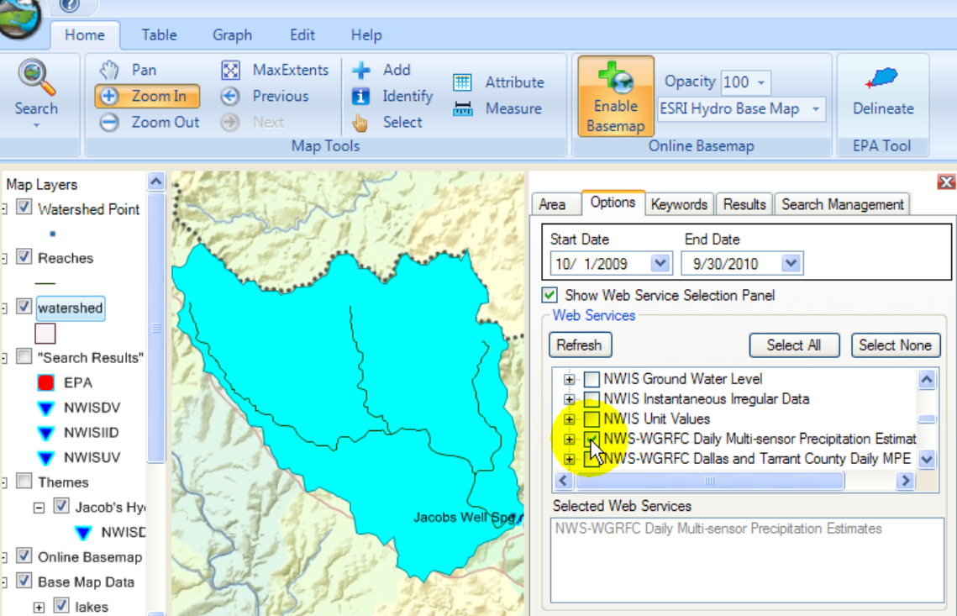
HydroDesktop
Metadata
Catalog
Data

Slide 4
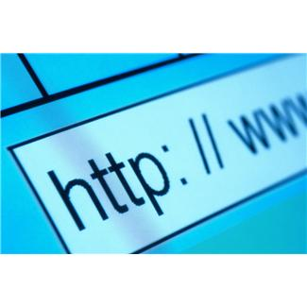
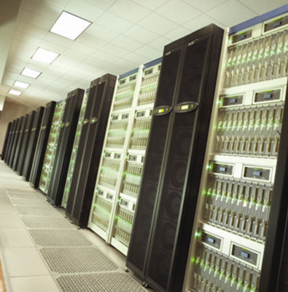
CUAHSI HIS: We are doing this now
We’ve built a very large scale prototype….
…….we’ve discovered that simple but general patterns exist
HIS Central
GetSites
GetSiteInfo
(WaterML)
GetSeriesCatalogForBox (XML)
GetWaterOneFlowServiceInfo (XML)
GetOntologyTree (XML)
HydroServer
(ODM)
HydroDesktop
GetValues
(WaterML)
All these services are custom-programmed …..
….. we can transition to using OGC web service standards

Slide 5
CUAHSI HIS in OGC Web Services
HydroCatalog
Register services and pass Metadata with OGC Web Feature Service
Search the catalog for services with
OGC Catalog Services for the Web
HydroServer
HydroDesktop
Get the data with
GetValues (WaterML 1.1)
or Sensor Observation Service (WaterML 2.0)

Slide 6
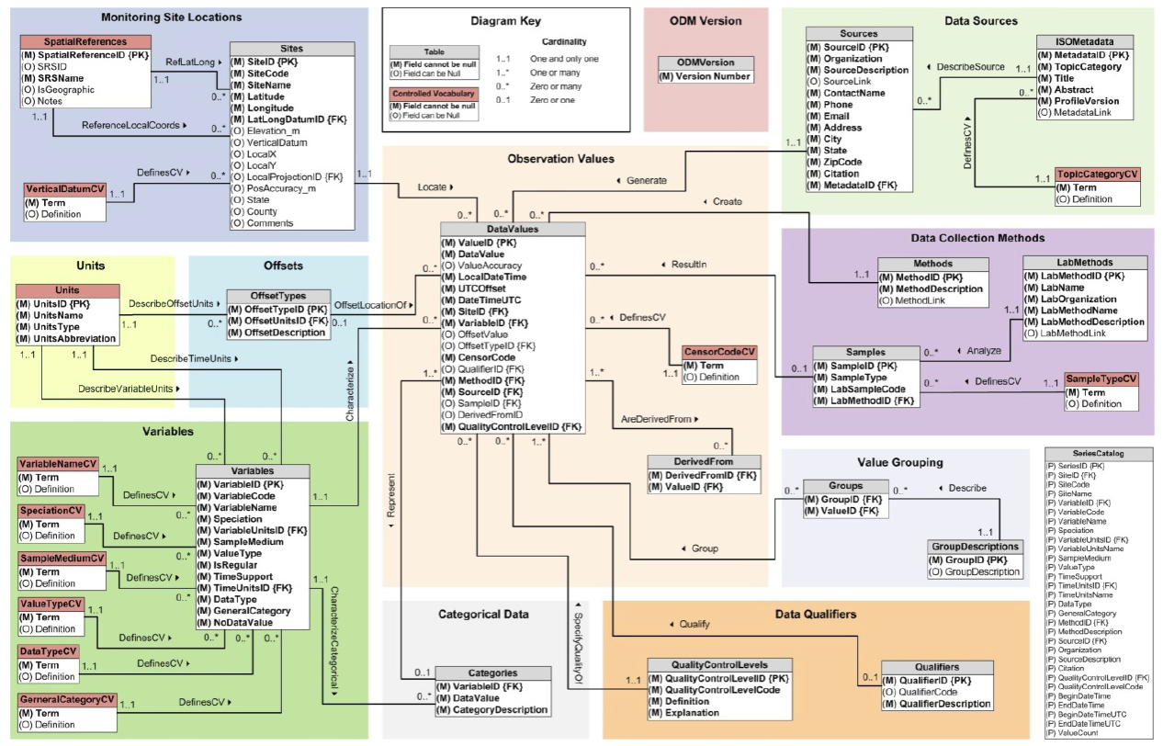
Building a Services Stack Using OGC Web Service Standards
Catalog Services – which list water web services
OGC Catalog Services for the Web
Metadata Services – which define a set of variables over a domain of space and time
OGC Web Feature Service
Data Services – which convey the data values
Currently WaterML 1.1
Future OGC Sensor Observation Service (WaterML2)
Catalog
Services
Metadata
Data
ODM Database
Notes:
There are three kinds of services: Catalogs that describe metadata services and define their domains in space; Metadata services whose records describe one variable from one source over a domain of space and time and provide a service call to access the data; Data services which enable downloading of the data. An ODM database can have a “stack” of these services mounted over it to provide tiered access to its information (and to allow public/private access to some time series if necessary).

Slide 7
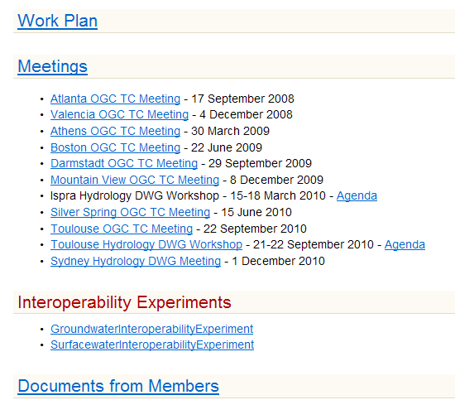
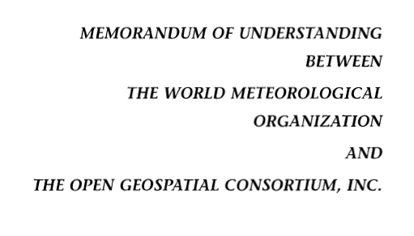
Jointly with World Meteorological Organization
Evolving WaterML into an International Standard
Meets every 3 months
Teleconferences most weeks
November 2009
WaterML Version 2 standard being proposed
Vote for adoption 3-6 months later
Notes:
The Hydrology Domain Working Group was initiated by the Open Geospatial Consortium in September 2008. The OGC has about 400 companies and agencies that have developed the most widely used standards for conveying geospatial information on the internet (Web Mapping Service, Web Feature Service, Web Coverage Service, Catalog Services for the Web, Sensor Observation Service). In November 2009, OGC and WMO agreed to collaborate to provide information data exchange standards in hydrology, climatology, oceanography and meteorology – there are now two working groups – the OGC/WMO Joint Hydrology Domain Working Group and a similar Met-Oceans Working Group. HDWG is proposing a new standard for WaterML in December 2010 that is a customization of the OGC Sensor Observation Services’ Get Observations function adapted for conveying time series through the internet (WaterML2). The technical specification for the “service stack” will be presented and peer-reviewed through the Hydrology Domain Working Group.

Slide 8
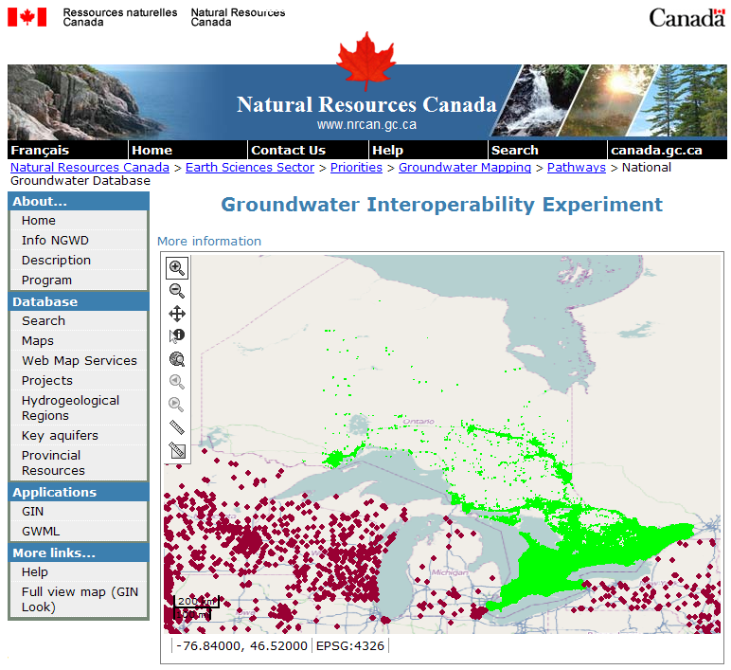
Groundwater Interoperability Experiment (US and Canada)
http://ngwd-bdnes.cits.nrcan.gc.ca/service/api_ngwds/en/wmc/gie.html

Slide 9
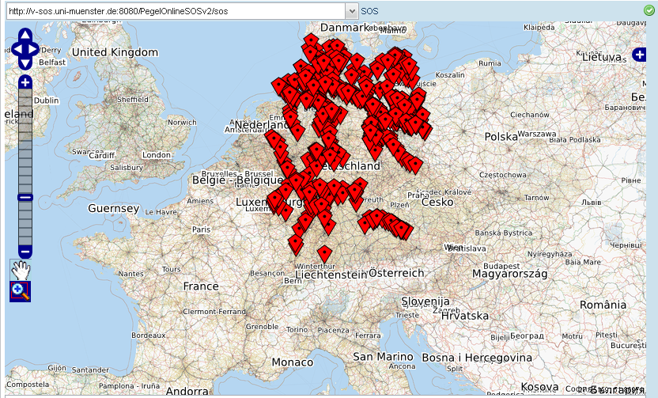
Surface Water Interoperabilty Experiment (France and Germany)
SOS DLZ-IT
SOS SANDRE
Slide from Arne Broering, 52North

Slide 10
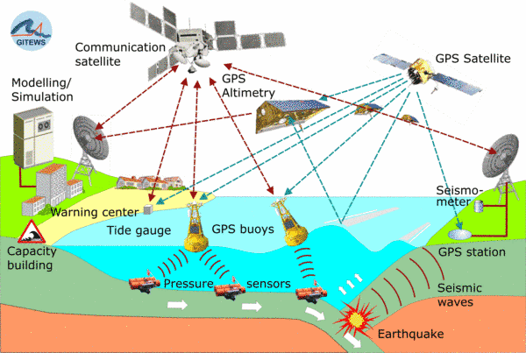
Detailed functional specification for standards based web services
OGC Sensor Web Enablement

Slide 11
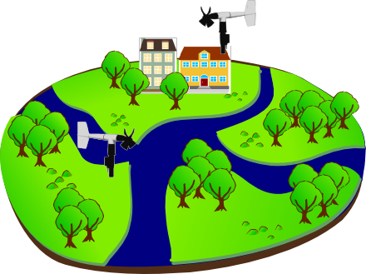
Sensor Observations Service: Get Observation
Observed Property := “Wind_Speed“
Sampling Time
Result
Feature of Interest
23 m/s 16.9.2010 13:45
uom
Procedure (ID := “DAVIS_123“)
Observation
Notes:
Basis for a standardized access to sensor data is the observation model defined in the Observations & Measurements standard. Let me briefly describe the main concepts / terms used in this model…

Slide 12
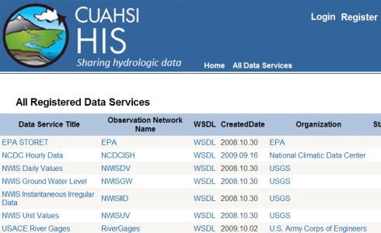
Federation of Catalog Services A MetaCatalog at CUAHSI Program Office, Boston
CS/W
HIS
Central
CS/W
CS/W
CS/W
UTexas
USU
Notes:
Using OGC Catalog Services for the web a “Metacatalog” can be built at the CUAHSI Program Office by installing the ESRI Geoportal Software (now an open source software program) and registering CS/W endpoints in it from individual CUAHSI data collections, including HIS Central. The CUAHSI Metacatalog provides a single URL address that allows search across all CUAHSI collections. The metadata and data for those collections stay at the individual universities or are ingested into HIS Central and accessed from there.

Slide 13
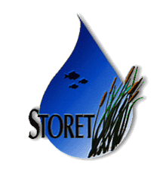
Water Agency Service Stacks
Federal
Geodata.gov, Data.gov, Geoplatform
NWIS
(Uses Catalog Services for Web in Geoportal)
Storet
State
NCDC
TWDB
Notes:
The Federal Government already supports Catalog Services for the Web through Geodata.gov and is moving to Data.Gov and a new initiative called the Geoplatform (requested by OMB in 2011). Cataloging water observations data under this system is a straightforward extension of what is already being done to federate the federal government’s geospatial data layers. State water observations data systems like that coming from the Texas Water Development Board can be federated and searched along with the federal water observations data services

Slide 14
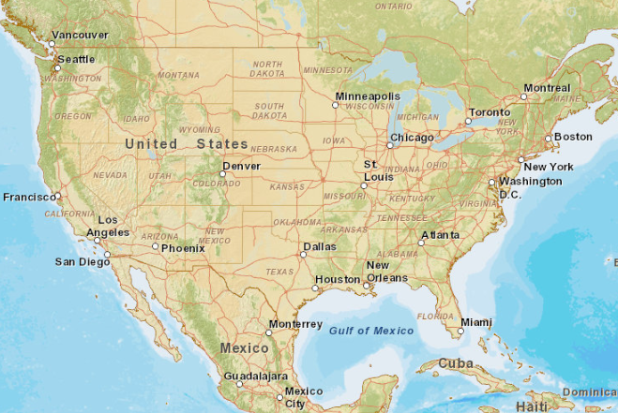
Service Stack Deployment
CUAHSI
USU
NWIS
HIS
Storet
TWDB
CZO
UTexas
NCDC
Phase 1
Phase 2
Phase 3
Notes:
During 2011, CUAHSI HIS will propose a phased implementation plan, beginning in Phase 1 with implementing the service stack at CUAHSI institutions, and the MetaCatalog at the CUAHSI Program Office. Phase 2 will involve deployment of public agency service stacks and we hope that these would be online at the end of 2011 for USGS, EPA, NCDC, and TWDB. Phase 3 would involve additional service stack deployment at other CUAHSI universities and other data collections (some already in HIS Central).

Slide 15
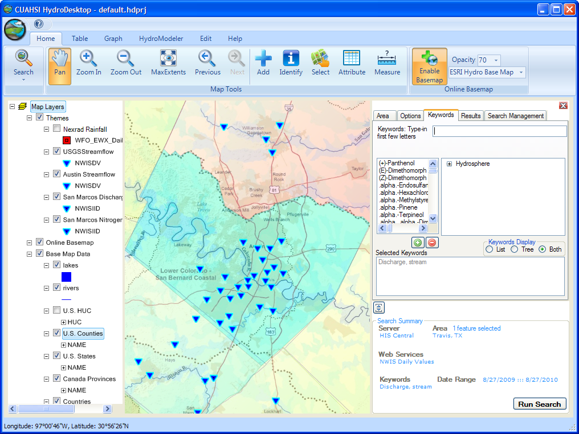
HydroDesktop Accesses MetaCatalog
HydroDesktop
MetaCatalog
CS/W
HIS
Central
Catalog
UTexas
Catalog
NWIS
Catalog
UTexas
Services
NWIS
Services
HIS
Central
Metadata
Metadata
Metadata
Data
Data
Data
University of Texas
US Geological Survey
San Diego Supercomputer Center
Notes:
A user of HydroDesktop just needs to know the CS/W endpoint address for a set of services. A collection of these can be downloaded automatically from the CUAHSI Program Office when HydroDesktop is opened up.

Slide 16
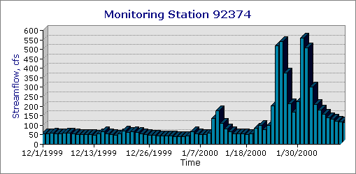
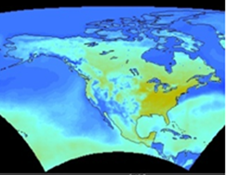
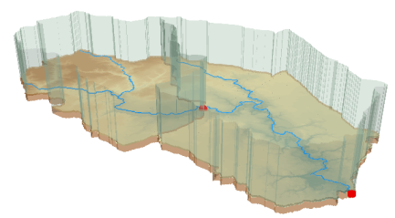
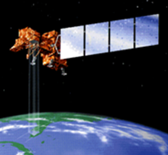
Crossing the Digital Divide
Discrete spatial objects with time series
Continuous space-time arrays
Weather and Climate
Observations
Remote Sensing
GIS
These are two very different data worlds
Notes:
Discrete spatial objects (GIS) and associated time series are two different data worlds that CUAHSI HIS has connected. We still need to connect with continuous space-time arrays of weather and climate and remote sensing information. That is complicated by that information being in binary files of various formats. Unidata’s THREDDS server is providing a common way of accessing such information

Slide 17
Catalog Services Searched Using a Common CUAHSI Ontology
Discrete spatial objects with time series
Continuous space-time arrays
Weather and Climate
Observations
Remote Sensing
GIS
CUAHSI HydroServer
Unidata THREDDS server
Notes:
The CUAHSI HydroServer publishes GIS and time series data, all of which can be accessed through a Catalog Services for the Web as OGC web services. Unidata THREDDS server performs a similar function for continuous space-time arrays. Over the past several months, an experiment between CUAHSI and Unidata has shown that these service stacks can be made interoperable (paper on this at AGU by Maidment et al). This means that in HydroDesktop of the future, a user will be able to search for all kinds of data and download them. This requires a common ontology so that the search is meaningful over multiple subject domains. NSF has recently funded a project to Hooper, Zaslavsky and Piasecki to build a stronger ontology for this purpose.

Slide 18
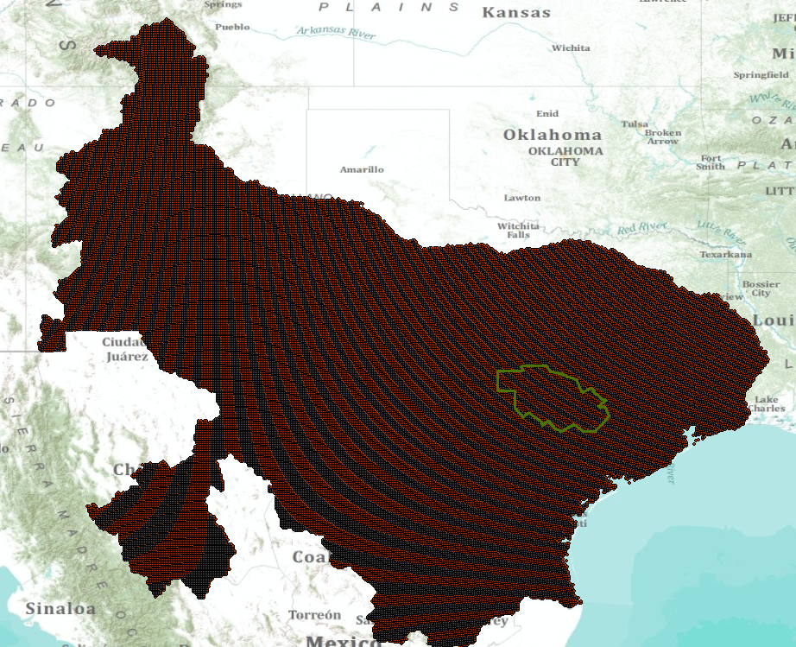
Multisensor Precipitation Estimate (MPE) West Gulf River Forecast Center

Slide 19
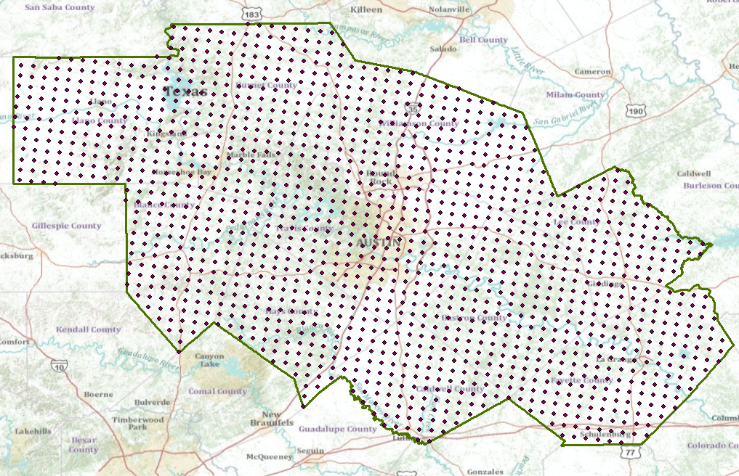
MPE Rainfall Points in CAPCOG

Slide 20
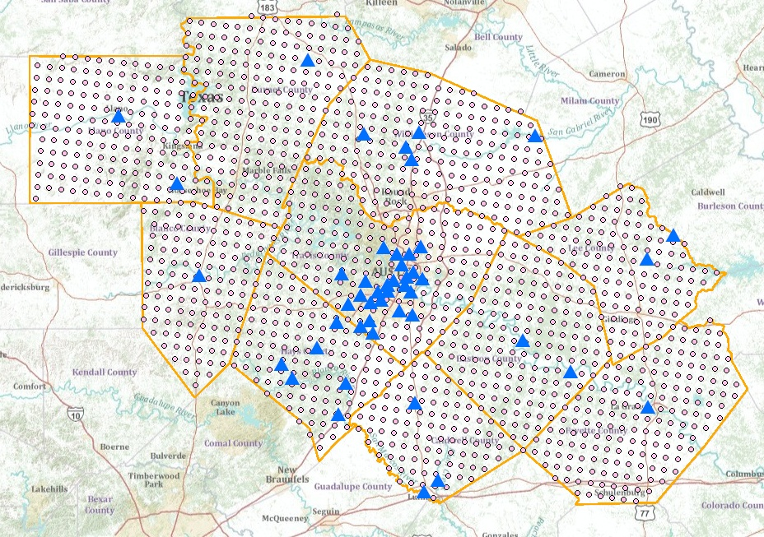
Observations Metadata Web Feature Service in ArcGIS.com USGS Streamflow and Nexrad Rainfall in CAPCOG region
A Web Feature Service in space
Notes:
Web feature services can be used to create maps of observations points federated across several water observation networks. This one shows Nexrad precipitation points and USGS streamflow points within the Capital Area Council of Governments (CAPCOG) in the Central Texas area, displayed over a base map in ArcGIS.com. This is all public information with no cost for access.

Slide 21
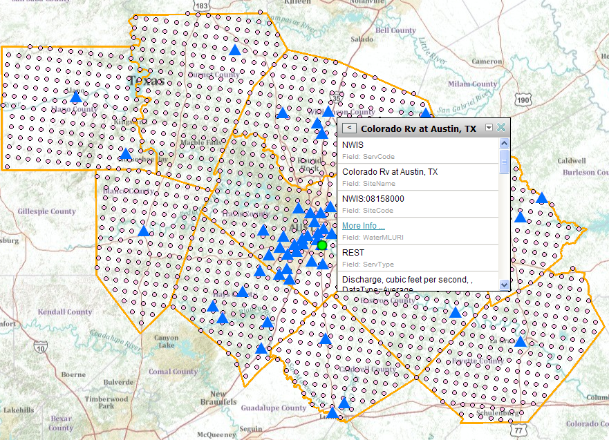
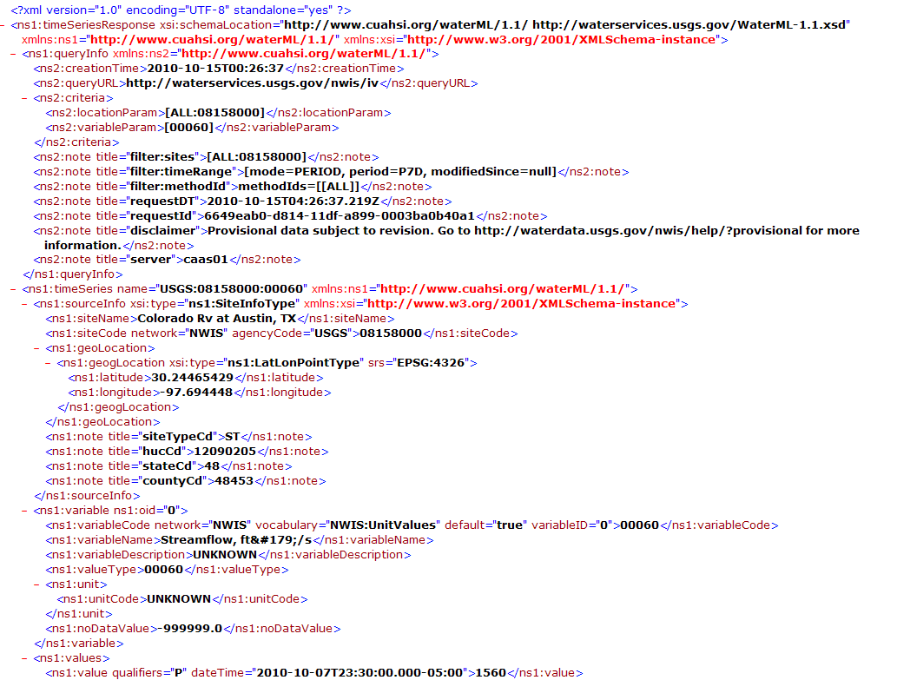
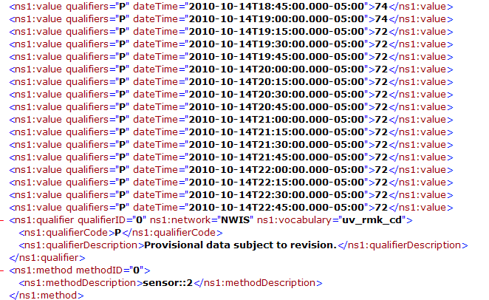
USGS REST service
http://waterservices.usgs.gov/nwis/iv?sites=08158000&period=P7D&parameterCd=00060
A WaterML observations service in time
Notes:
At each point in space there is a WaterML service in time. This one shows real-time WaterML services from the USGS for the Colorado River at Austin and it is current up to about 1 hour ago.

Slide 22
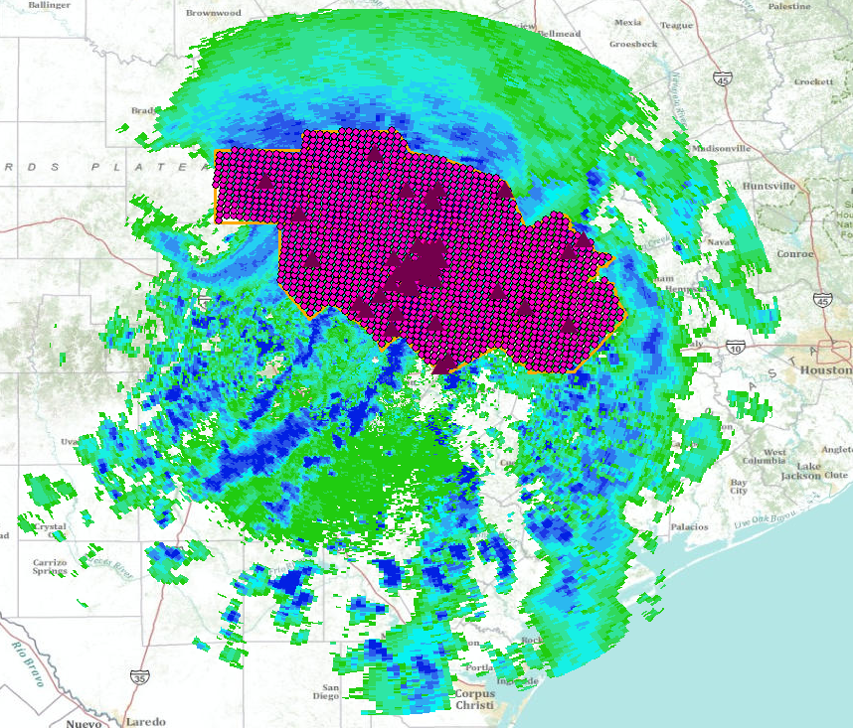
Tropical Storm Hermine, 8 Sept 2010
An archive of streamflow and rainfall information from an historical storm published as a water observations web service to support future study
Tropical Storm Hermine CRWR Map service
Tropical Storm Hermine CRWR Layer Package
Notes:
On 8 September 2010, a severe storm, Tropical Storm Hermine, struck Central Texas. This “Tropical Storm Hermine” service indexes both rainfall and streamflow services from Hermine. The streamflow data have been downloaded from the USGS instantaneous data service and republished as a CUAHSI water data service through the ODM so that they can be continuously access for research purposes in the future (presently the USGS stops access to its instantaneous data after 120 days).

