Slide 1
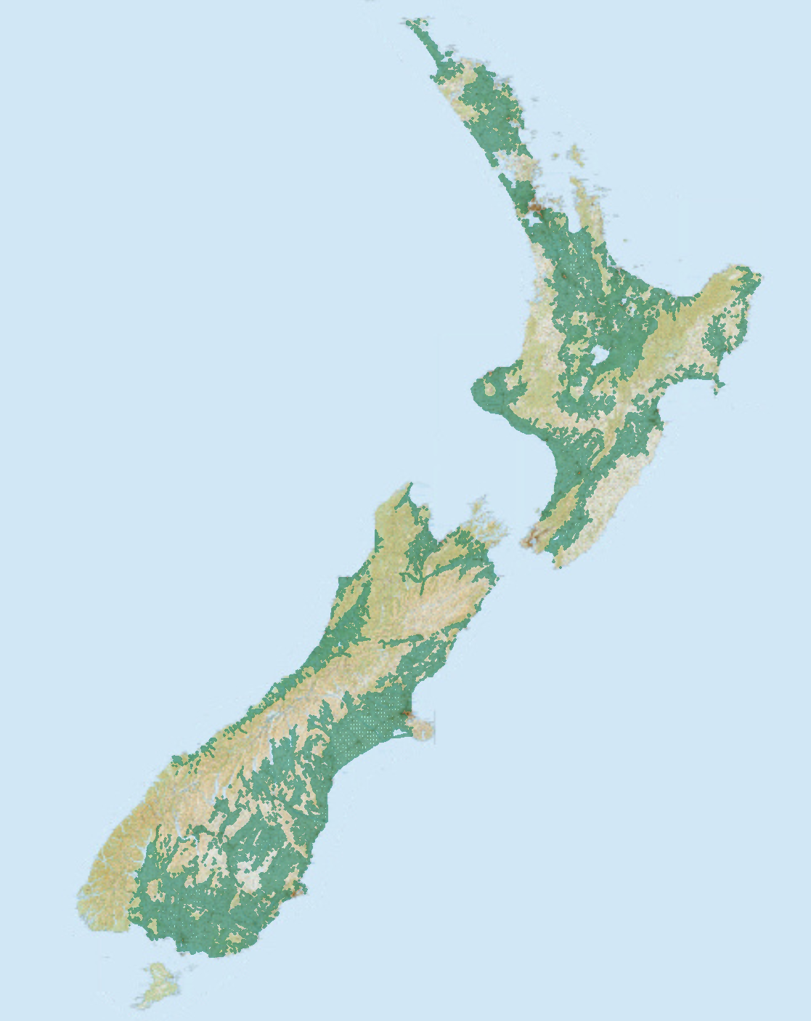
Groundwater of New Zealand
Source of Data: Andrew Dark, Aqualinc

Slide 2
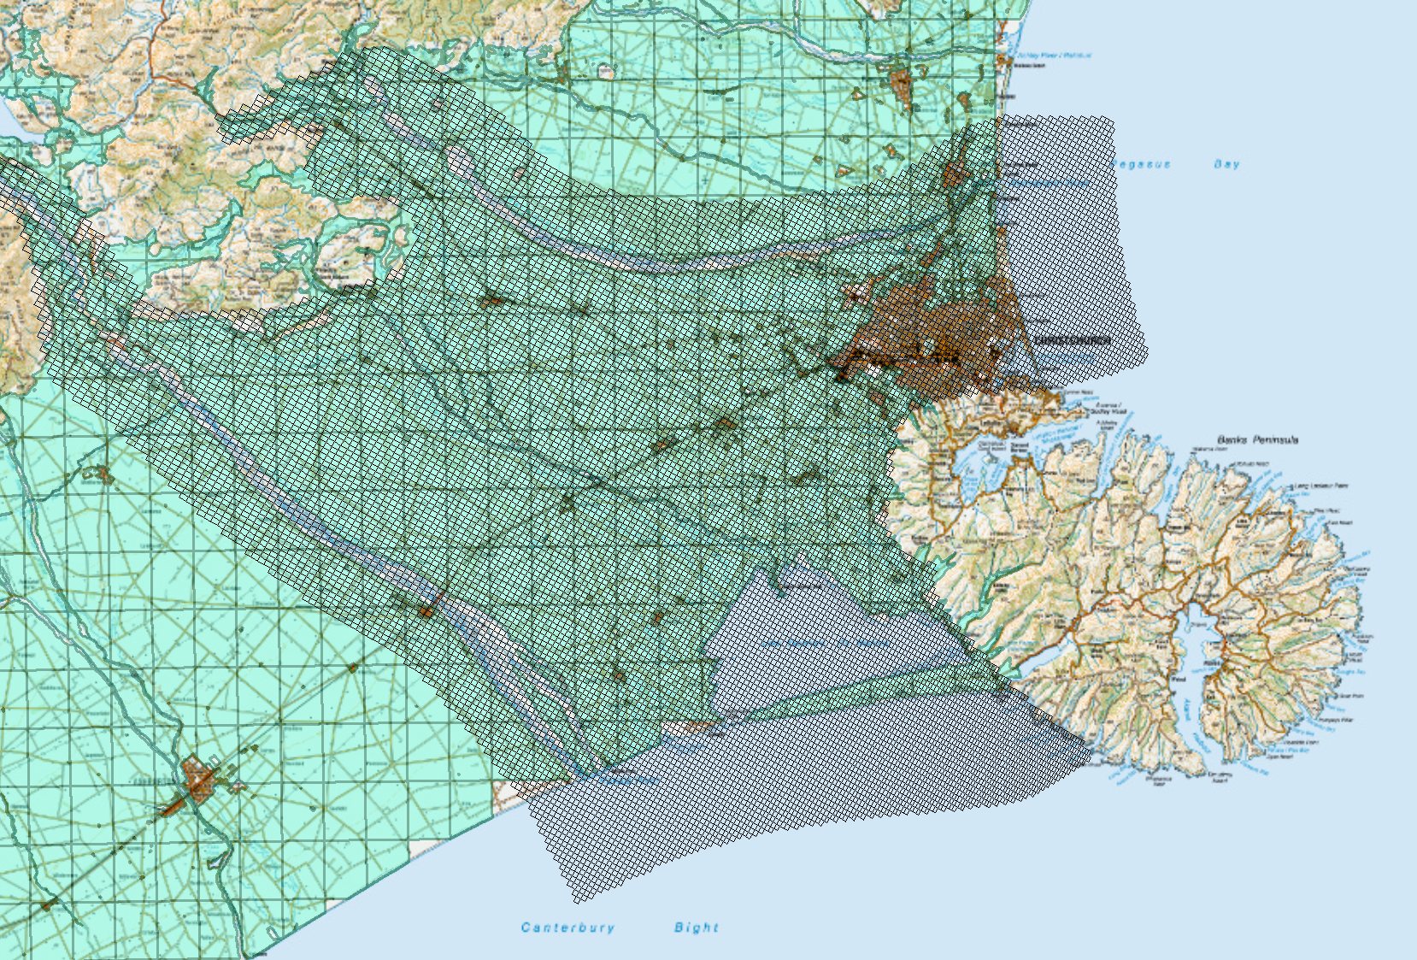
Selwyn Groundwater Model
Source of Data: Julian Weir, Aqualinc

Slide 3
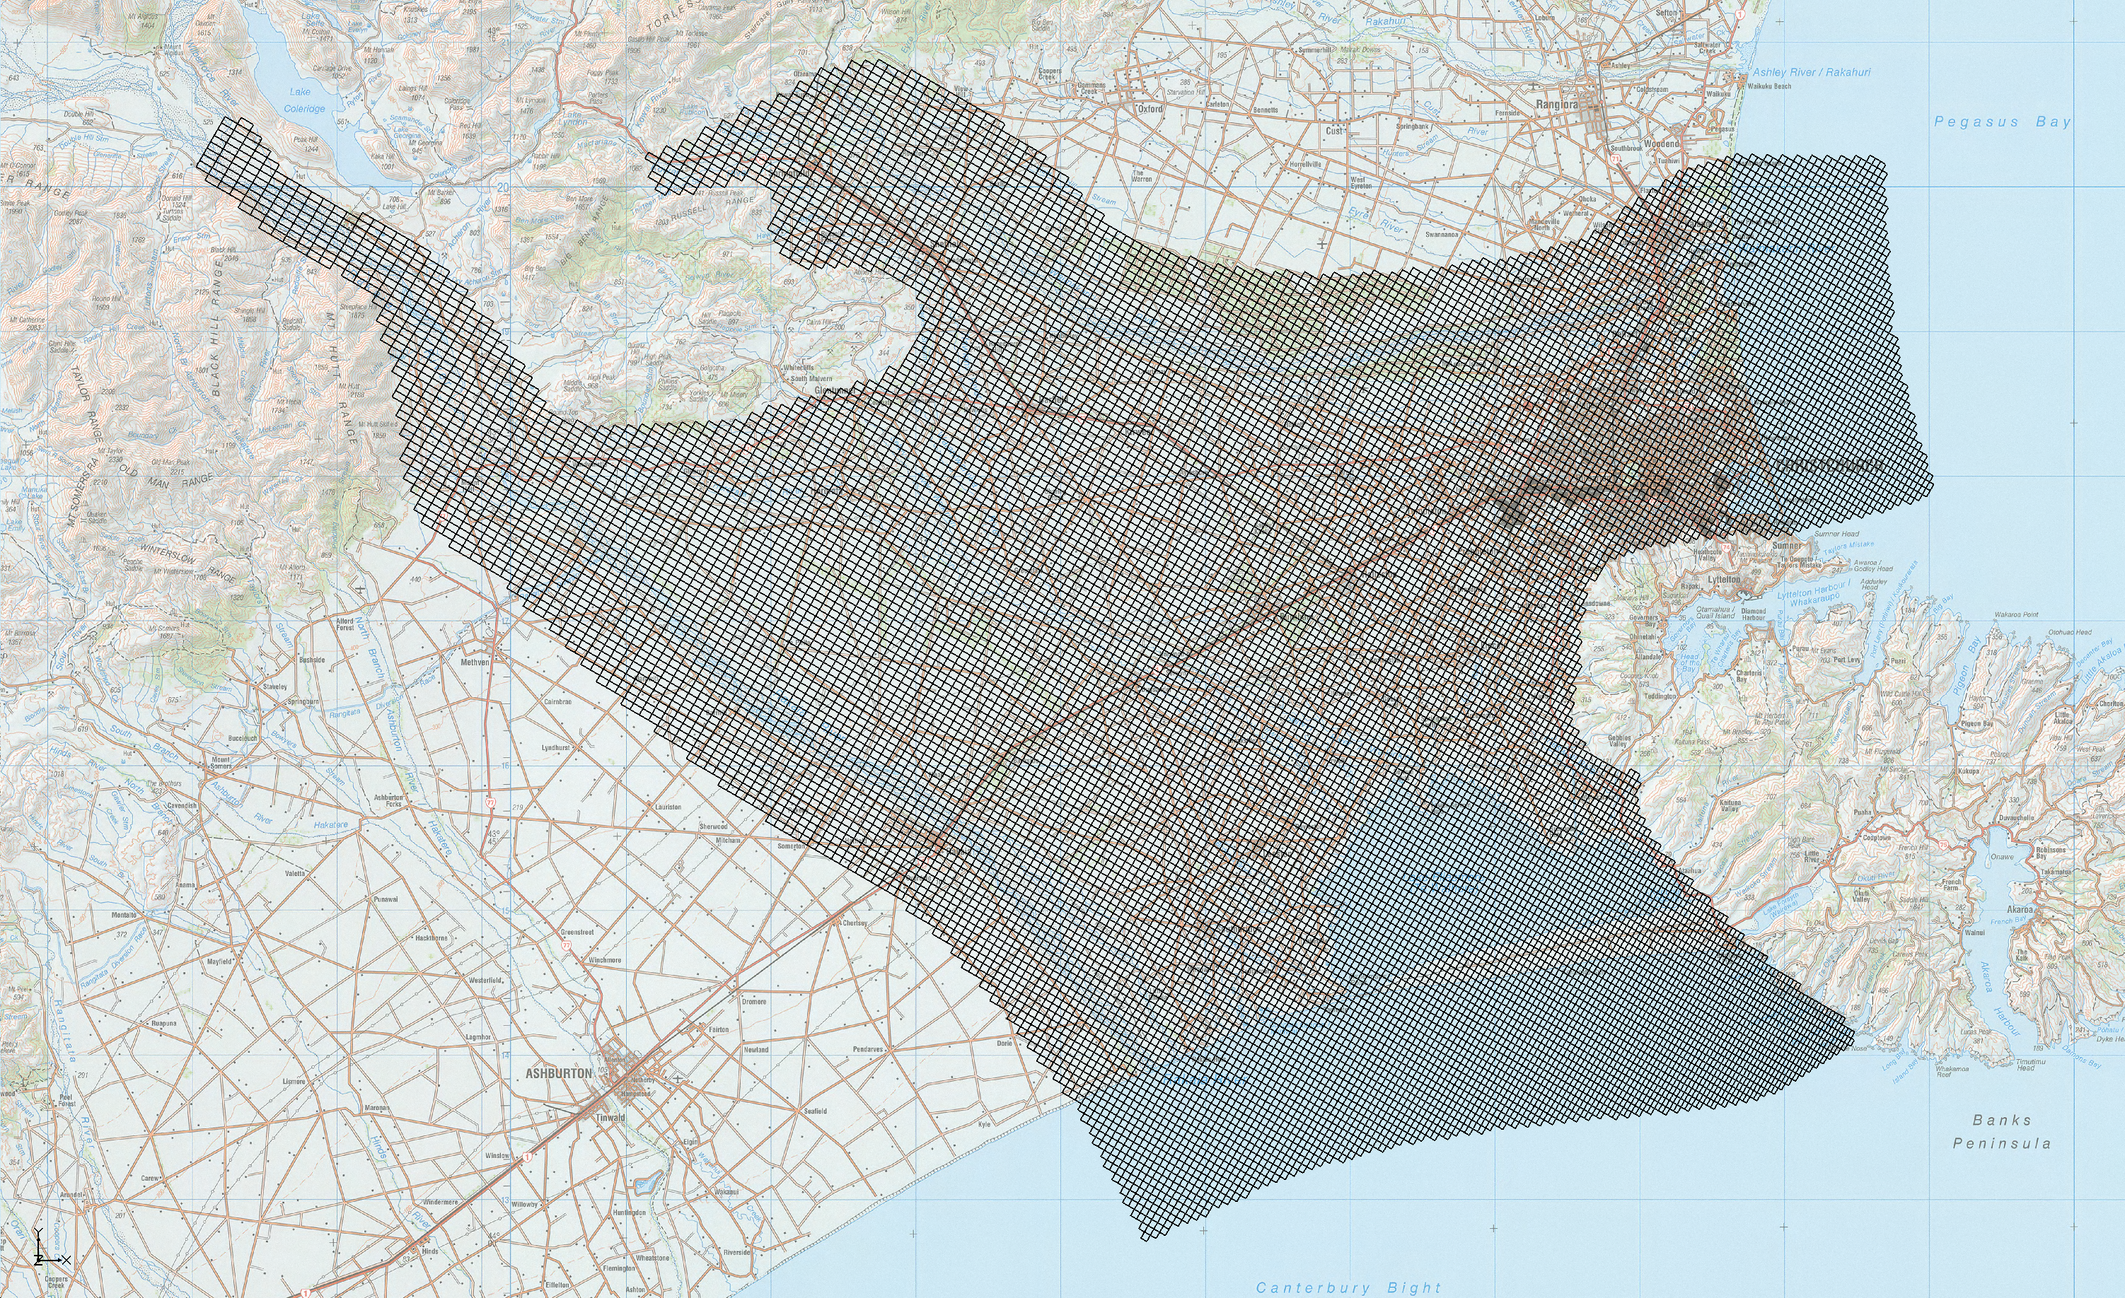
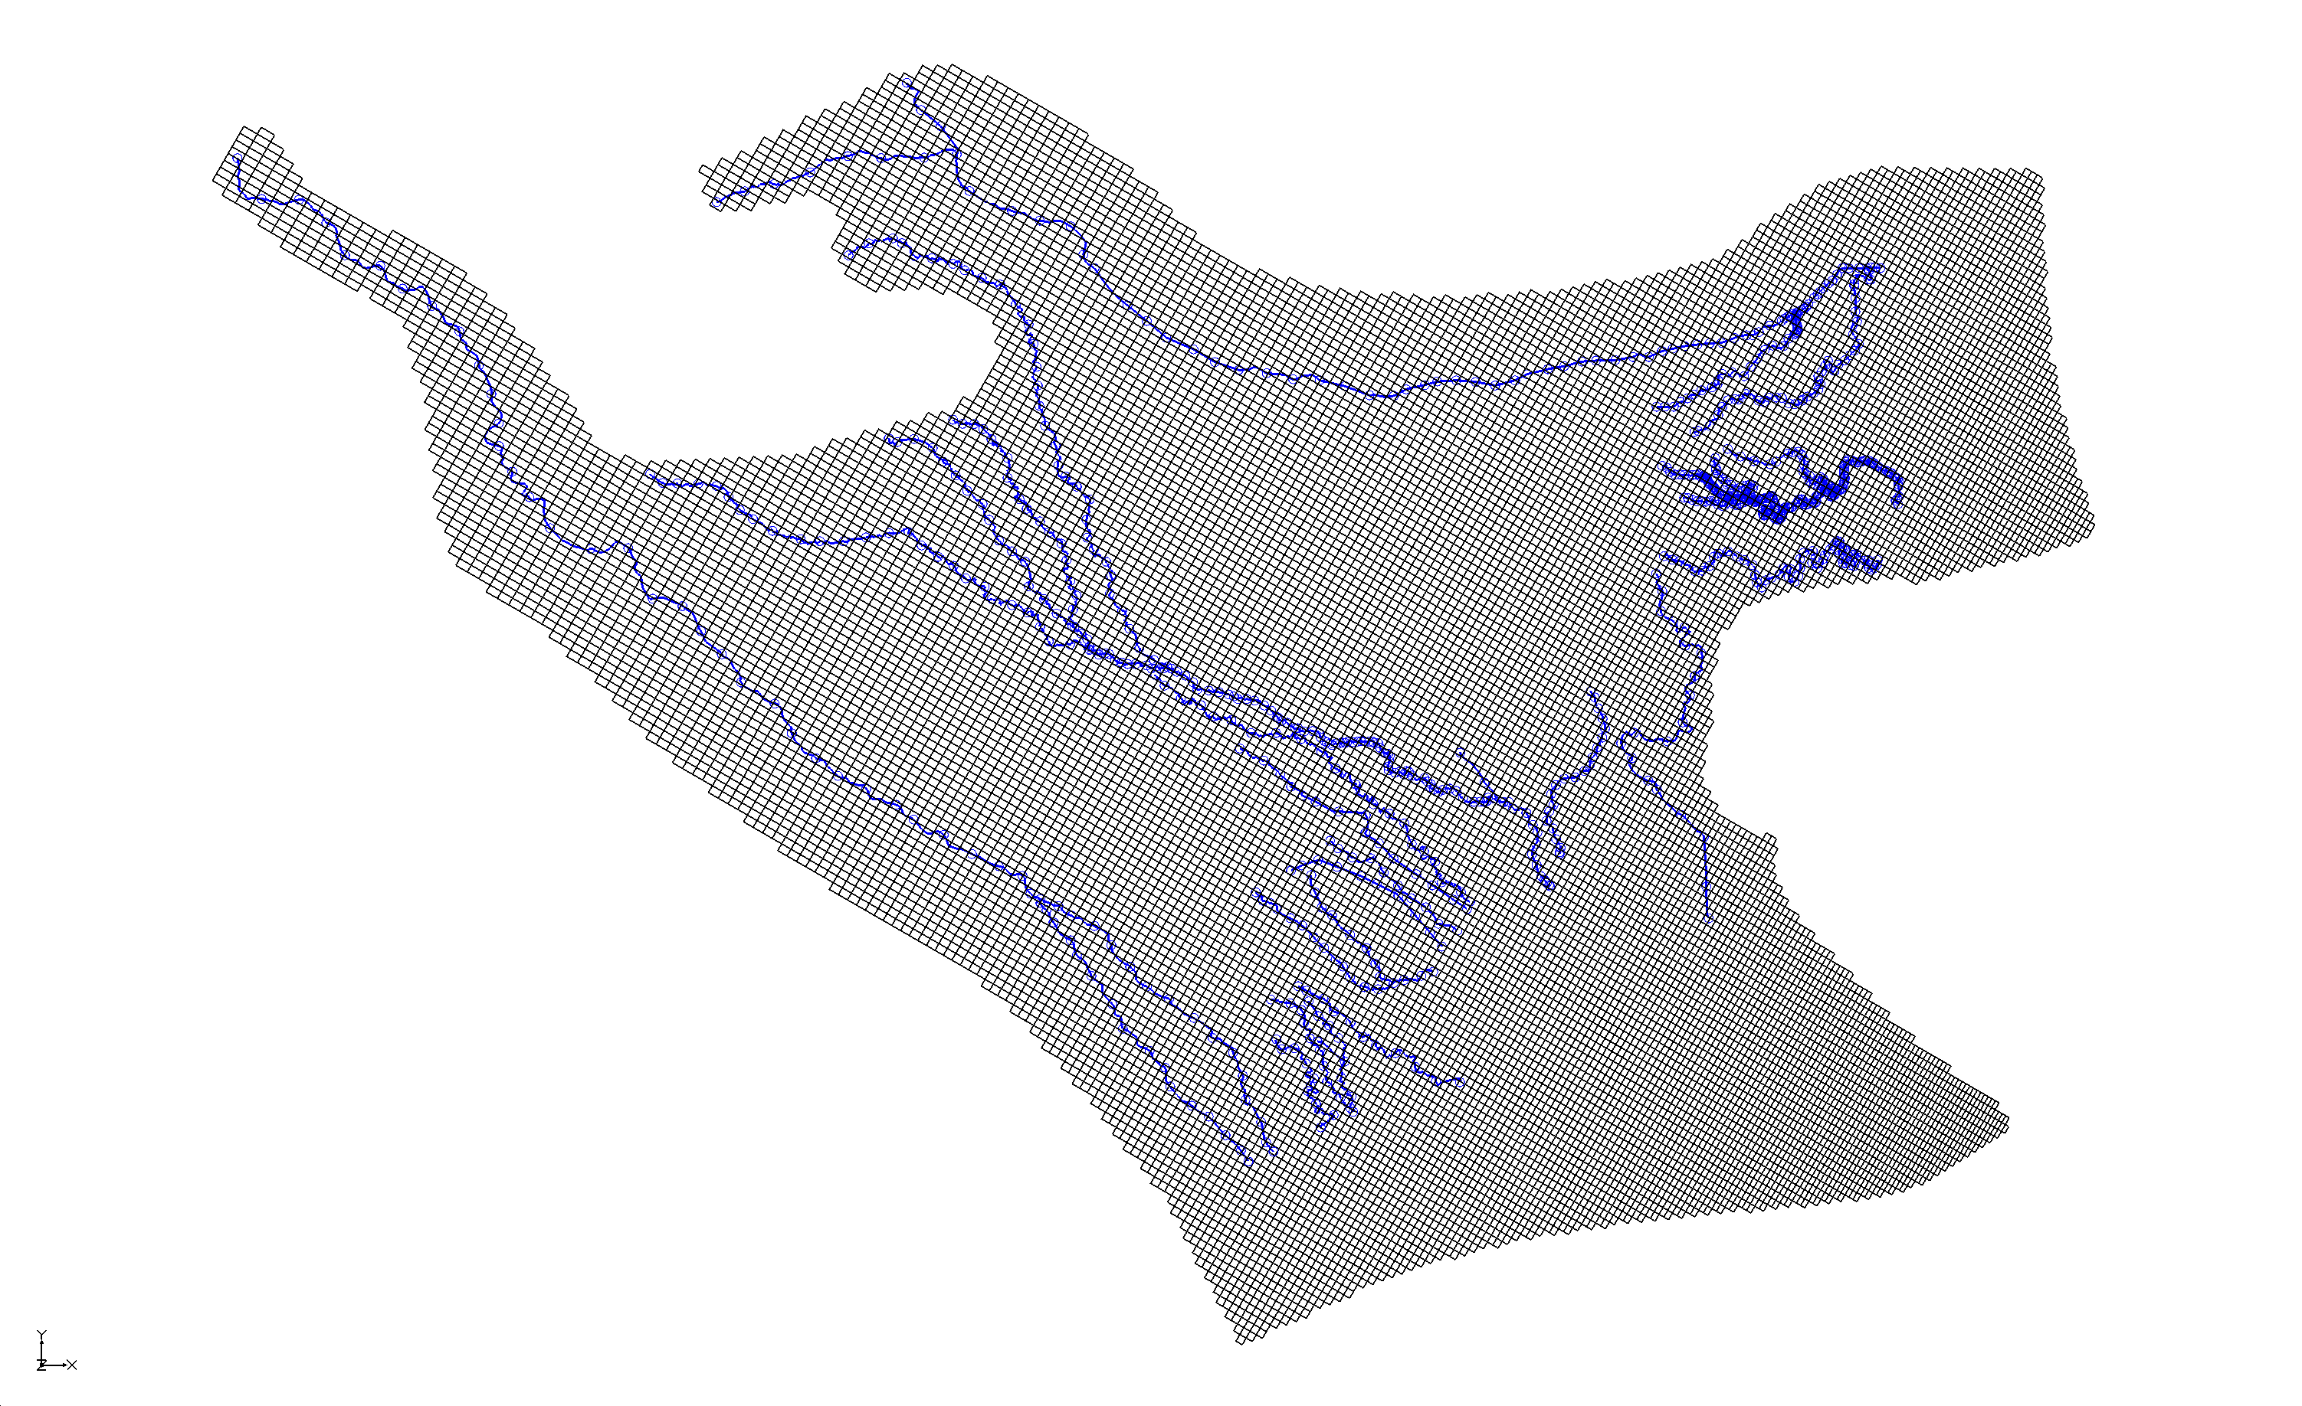
Rivers in Selwyn Groundwater Model
Source: Julian Weir, Aqualinc

Slide 4
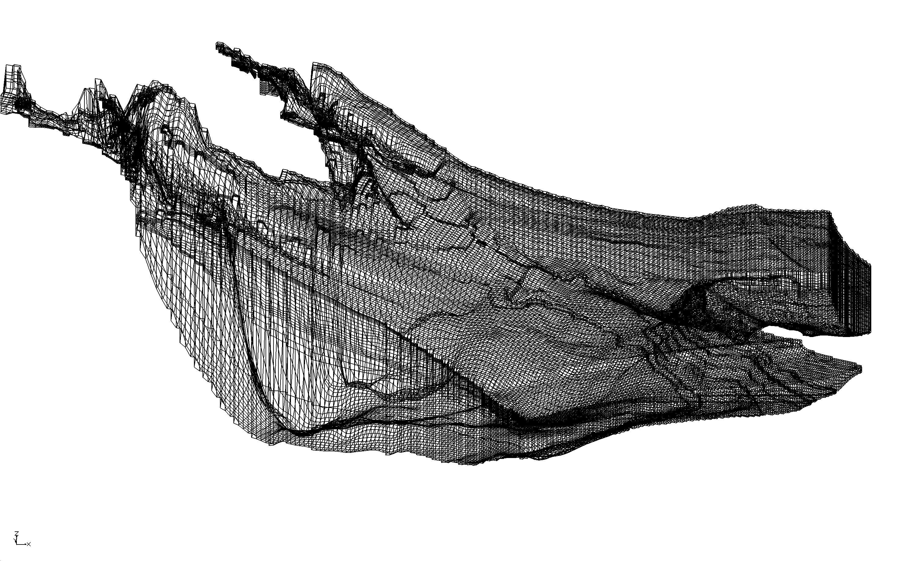
3D Model of Selwyn Groundwater
Source: Julian Weir, Aqualinc

Slide 5
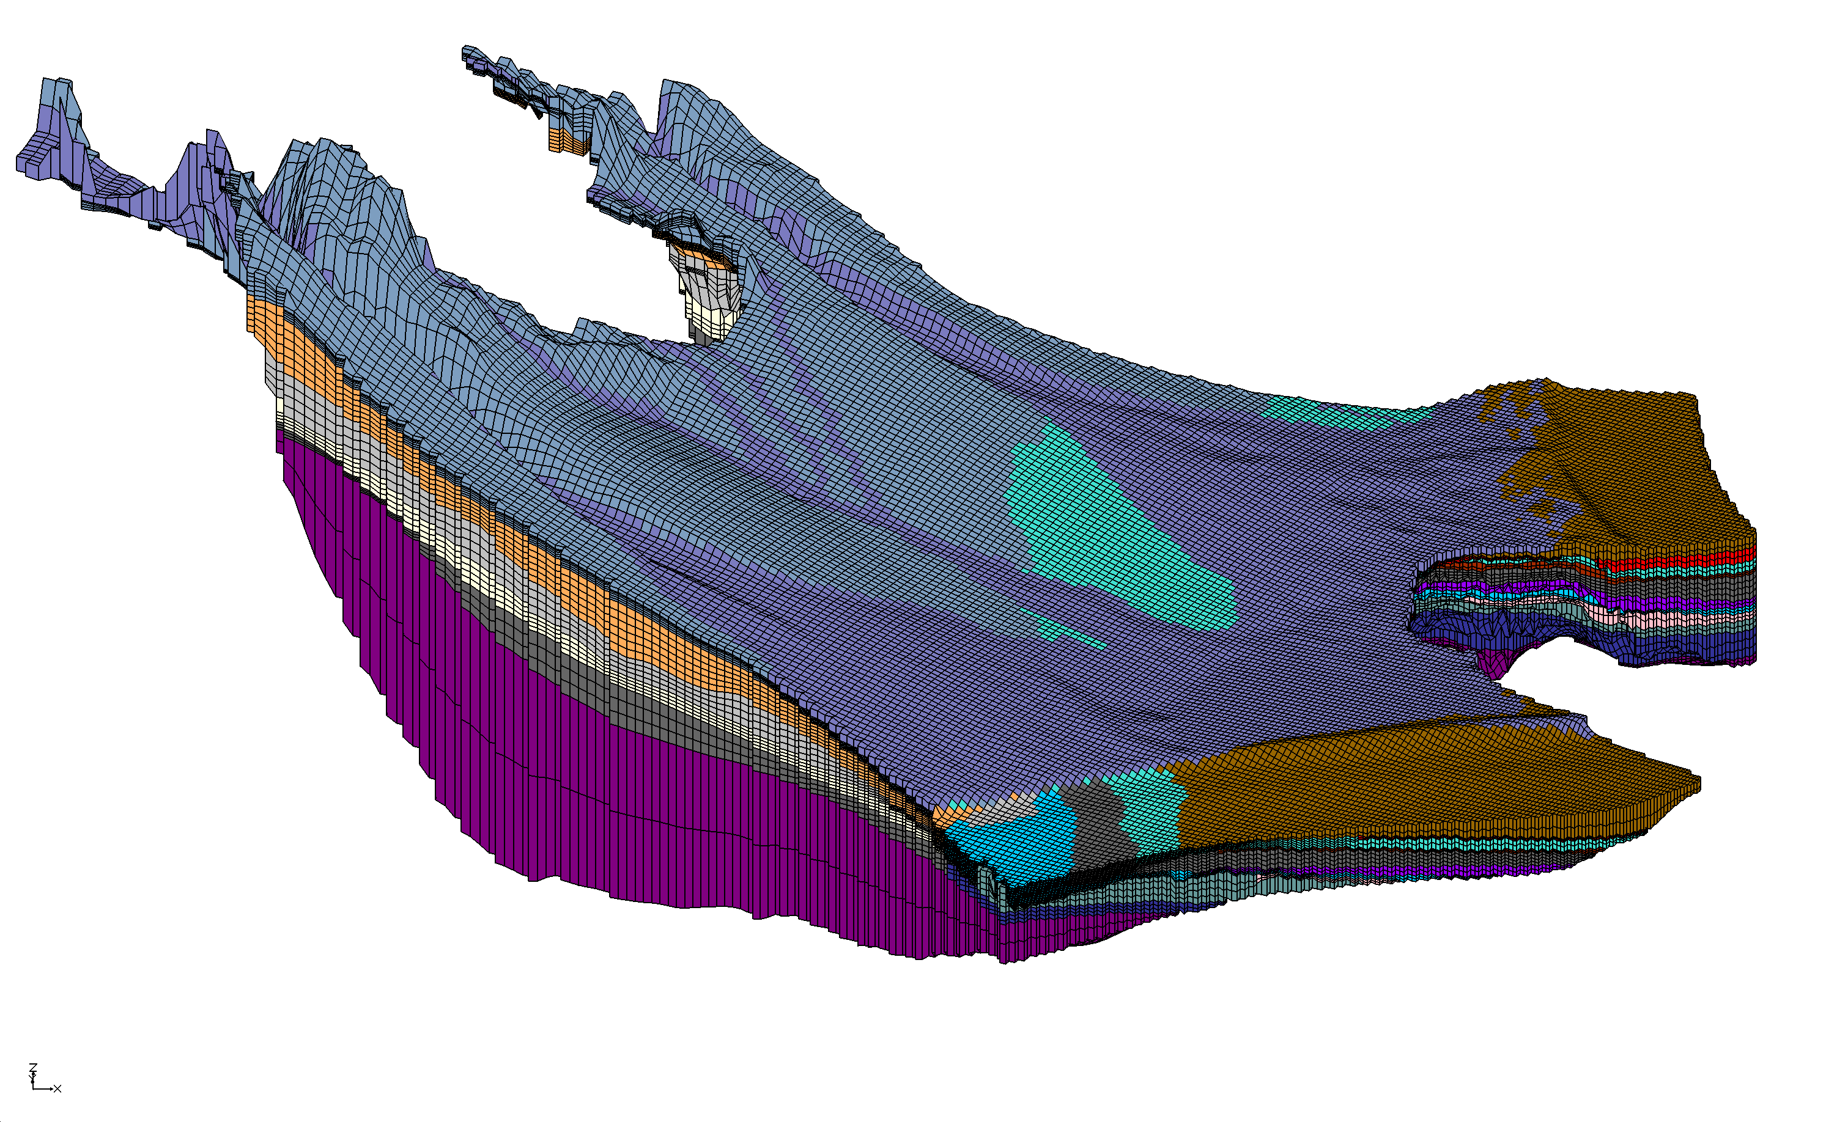
Selwyn Hydrogeological Strata
Waimakariri River
Selwyn River
Rakaia River
Source: Julian Weir, Aqualinc

Slide 6
Groundwater Level Calibration
Source: Julian Weir, Aqualinc

Slide 7
Surface Water Calibration
Source: Julian Weir, Aqualinc

Slide 8
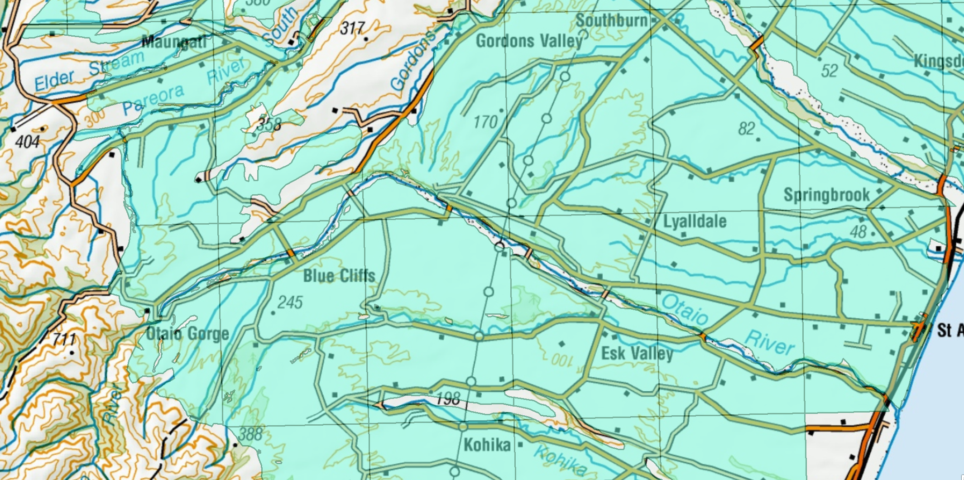
Groundwater at Blue Cliffs
Source of Data: Andrew Dark, Aqualinc

