Slide 1
Texas Drought Planning
David R. Maidment Center for Research in Water Resources University of Texas at Austin
Updated from a presentation made at the TAMEST 2012 Texas Water Summit, May 20, 2012
Revised version: 30 July 2012

Slide 2
Water Availability during the Drought
Drought Technology Steering Committee
Water balance of Texas
Drought in West Texas
Texas water and climate model

Slide 3
Water Availability during the Drought
Drought Technology Steering Committee
Water balance of Texas
Drought in West Texas
Texas water and climate model

Slide 4
Drought Forum, Feb 13, 2012
State water agencies and academic speakers
Formed a Drought Technology Steering Committee to continue dialog
TWDB, TCEQ, TPWD, TDEM
UT Austin, TAMU – College Station, Texas Tech
Acknowledgements: Brenner Brown, Kathy Alexander, David Bradsby, Mike Bewley, Byron Tapley, Himanshu Save, Gordon Wells, Teresa Howard, Johnnie Sullivan, Zong-Liang Yang, Xitian Cai, Jay Banner, Eric James, Charlie Kreitler, Cedric David, Dharhas Pothina
http://www.texasdroughtinfo.org

Slide 5
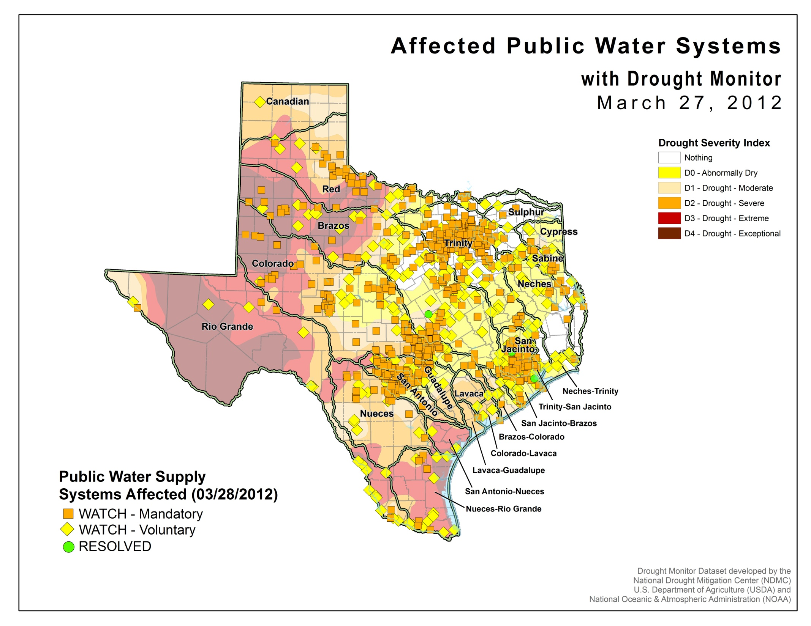
About 1000 water systems
600 Groundwater
400 Surface water

Slide 6
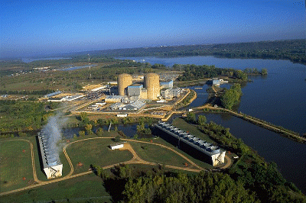
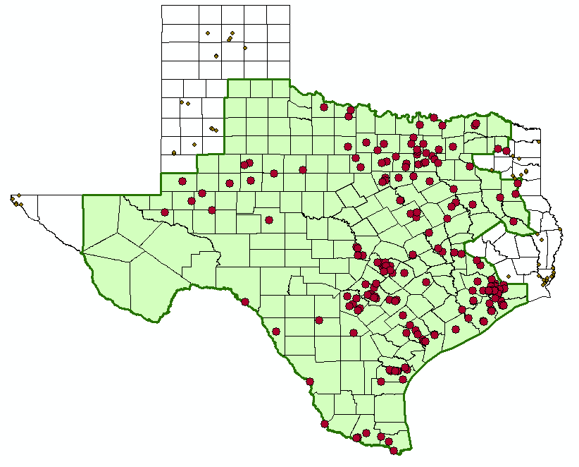
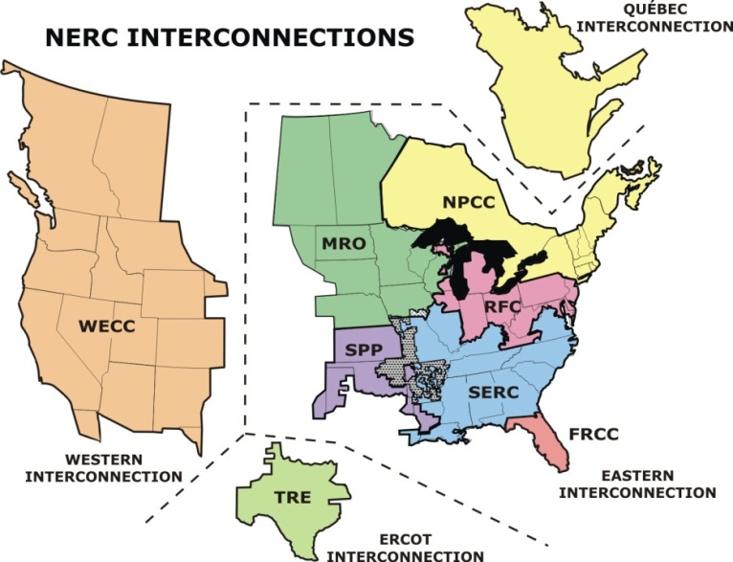
Water and Electric Power Generation
Water flow, level and temperature issues
ERCOT Power Pool

Slide 7
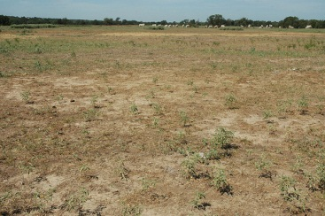
Impact on Agriculture
Pasture in Burleson County
Source: Texas Agrilife

Slide 8
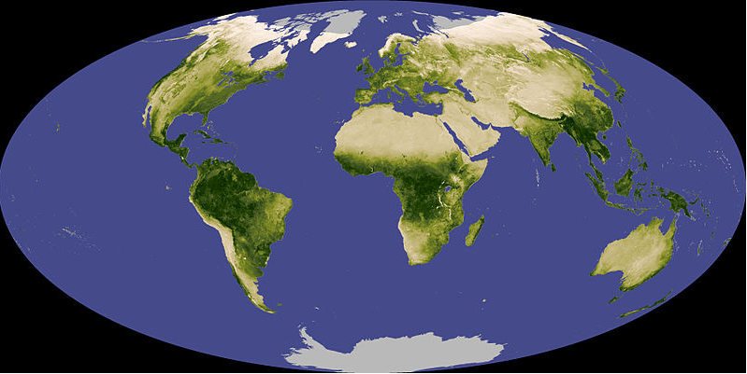
Normalized Difference Vegetation Index (NDVI)
A measure (0-1) of the greenness of the land surface derived from remote sensing
Vegetative vigor is limited by soil moisture

Slide 9
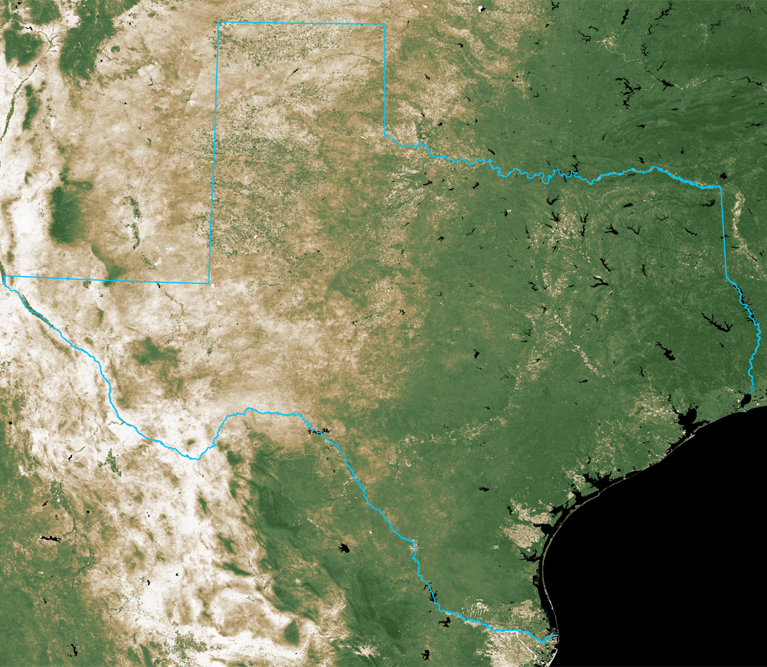
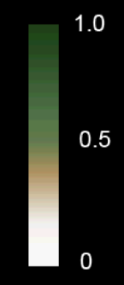
NDVI on September 30, 2010
Normalized Difference
Vegetation Index
September 30, 2010
Source: 16-day cycle MODIS
UT Center for Space Research

Slide 10
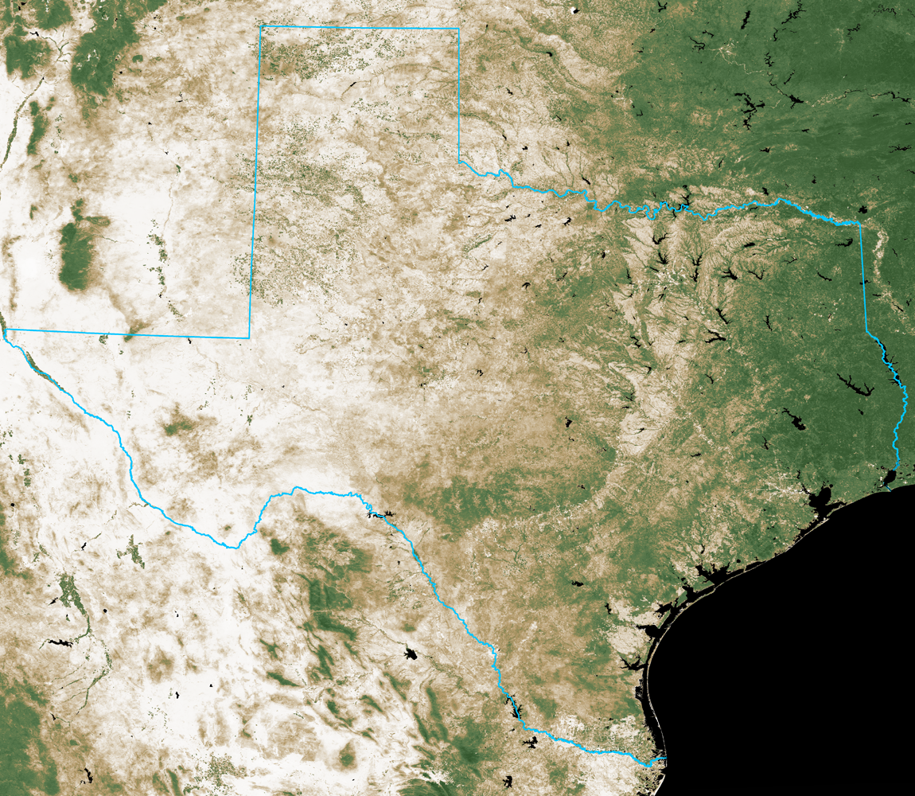
NDVI on September 30, 2011
Normalized Difference
Vegetation Index
September 30, 2011
Source: 16-day cycle MODIS
UT Center for Space Research

Slide 11
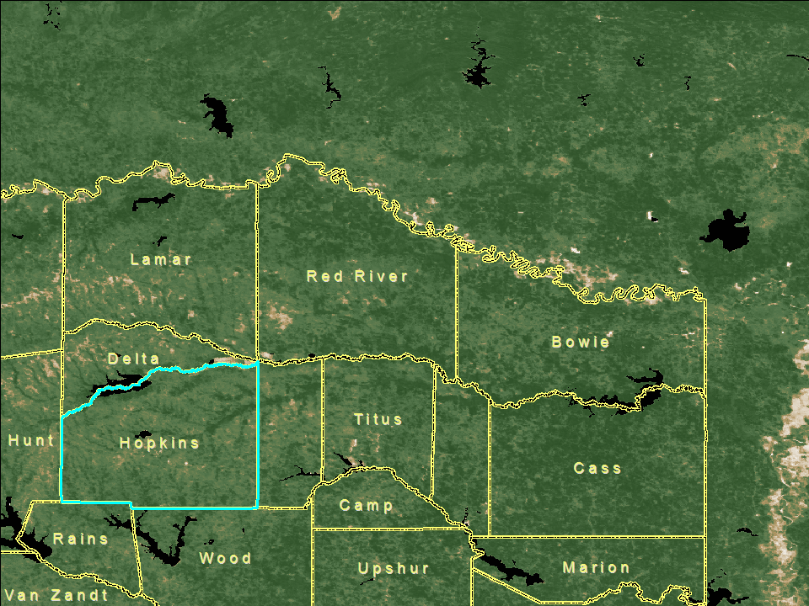
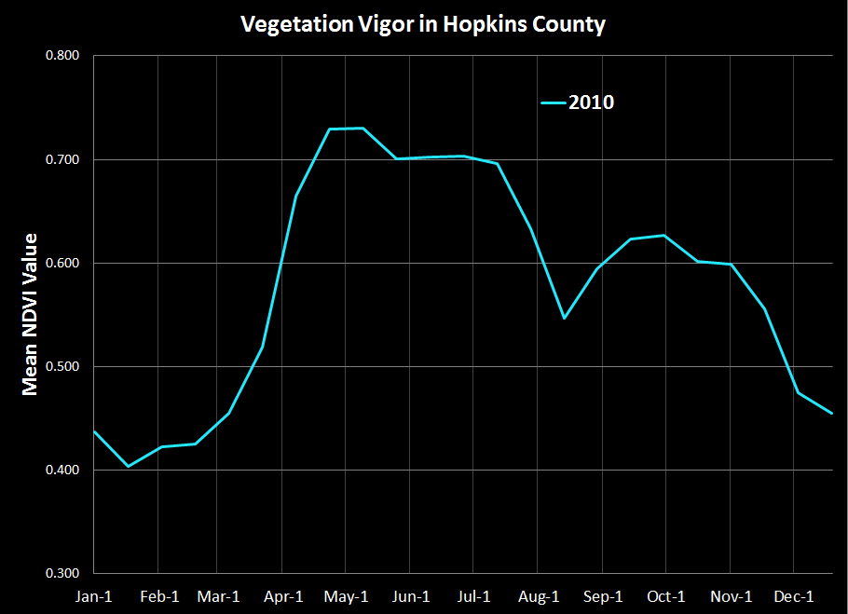
September 30
2010
September 30
2010

Slide 12
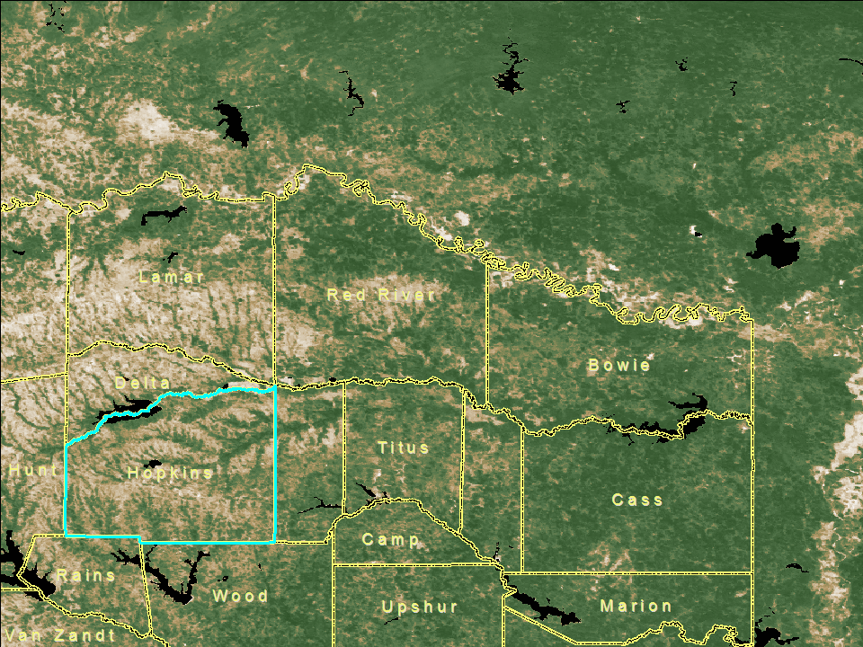
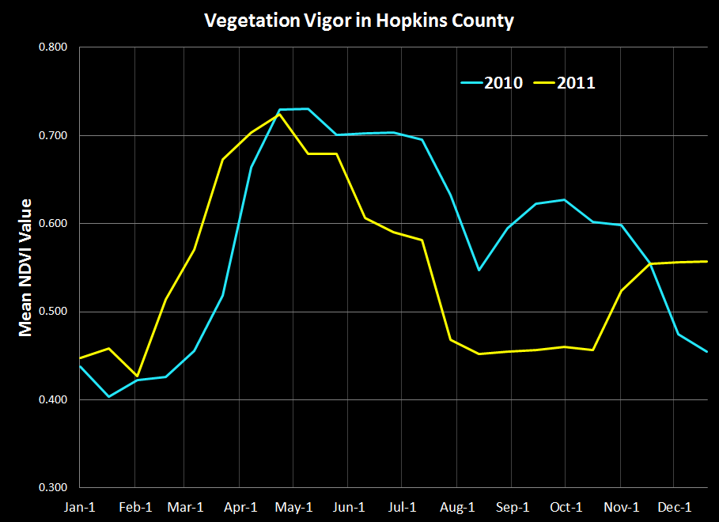
September 30
2011
September 30
2011

Slide 13
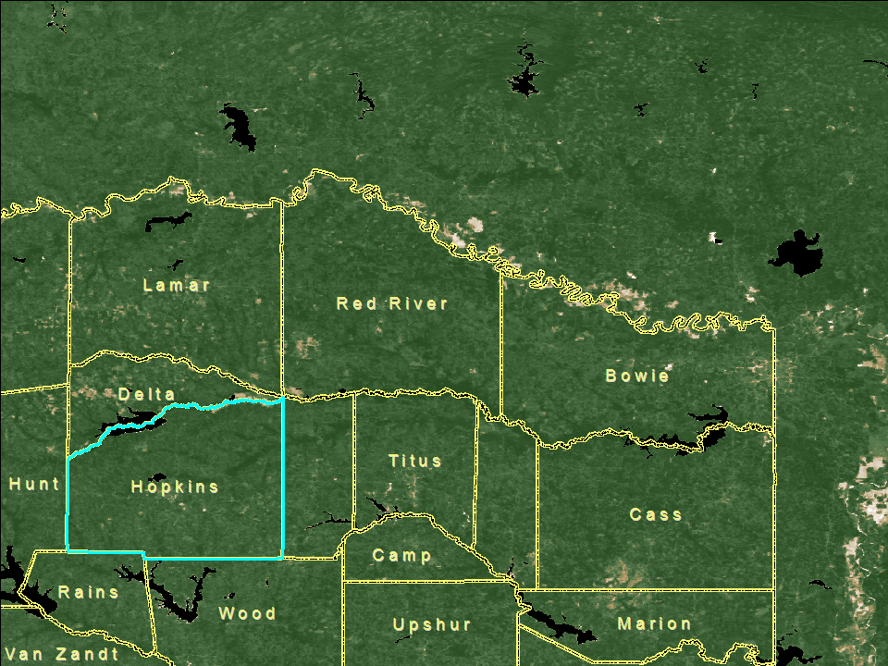
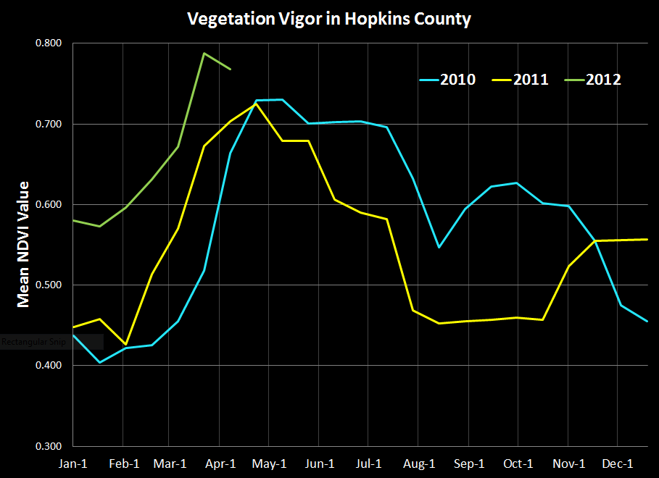
April 6
2012
April 6
2012

Slide 14
Water Availability during the Drought
Drought Technology Steering Committee
Water balance of Texas
Drought in West Texas
Texas water and climate model

Slide 15
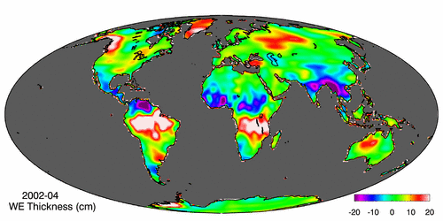
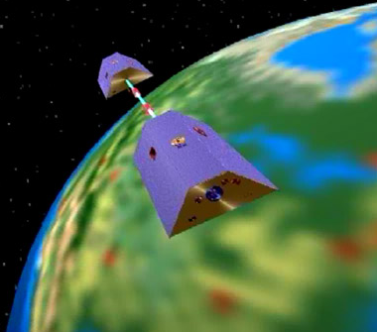
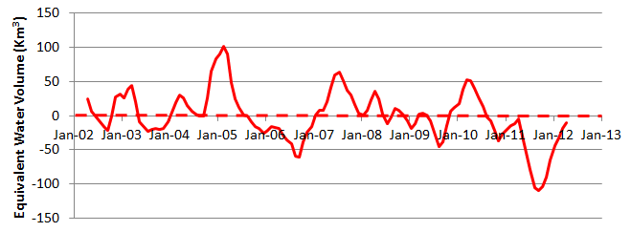
Measuring Gravity Anomaly from Space (GRACE) Force of gravity responds to changes in water volume Water is really heavy!
Gravity Anomaly of Texas, 2002 – 2012
Normal
In 2011, we lost 100 Km³ of water or 70 Lake Travis’s

Slide 16
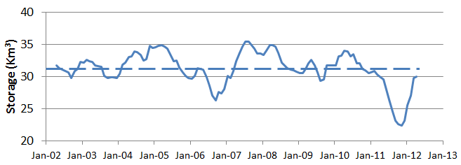
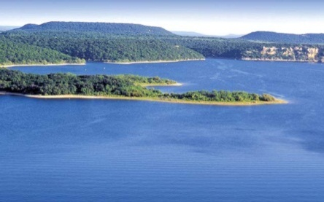
GRACE and Texas Reservoir Water Storage
Surface water reservoir storage is closely correlated with the GRACE data
Grace Satellites
Normal
In 2011 we lost 100 Km³ of water overall
Surface Water Reservoirs
Normal
In 2011 we lost 9 Km³ of water from reservoirs

Slide 17
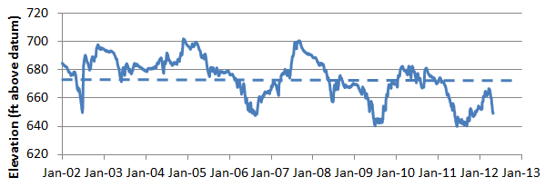
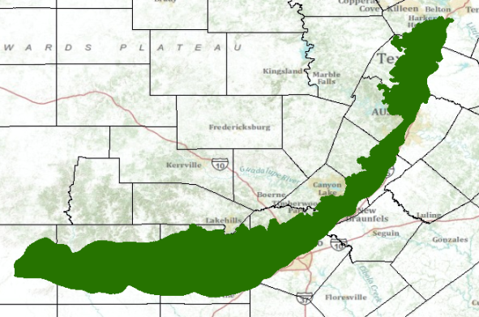
GRACE and Edwards Aquifer Levels
Edwards aquifer levels are also correlated with the GRACE data
Grace Satellites
Normal
Texas Drought
2005-2006
Texas Drought
2011
Normal
J-17 well
Edwards Aquifer

Slide 18
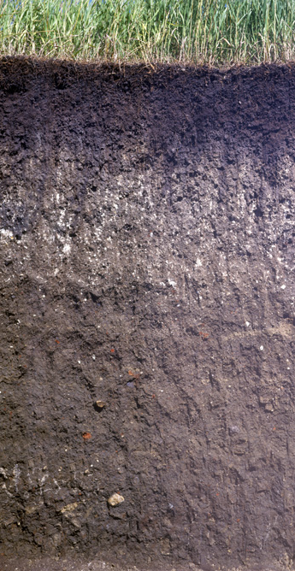
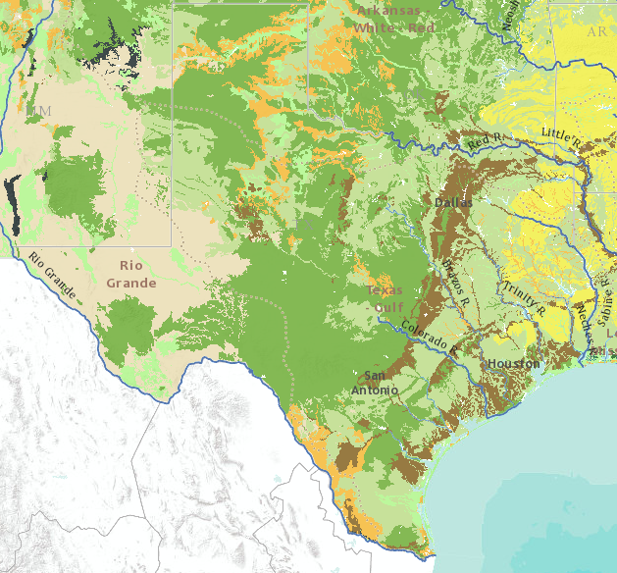
Soil Water In Texas
Soil water system has 78 Km³ of water storage capacity in top 1m of soil
Soil Wetness Index
Saturated
100
Soil Air
Oven Dry
Soil Water
0
Solid Particles
Soil Texture Map
First meter of Texas soil contains 11 cm of soil water and soil air

Slide 19
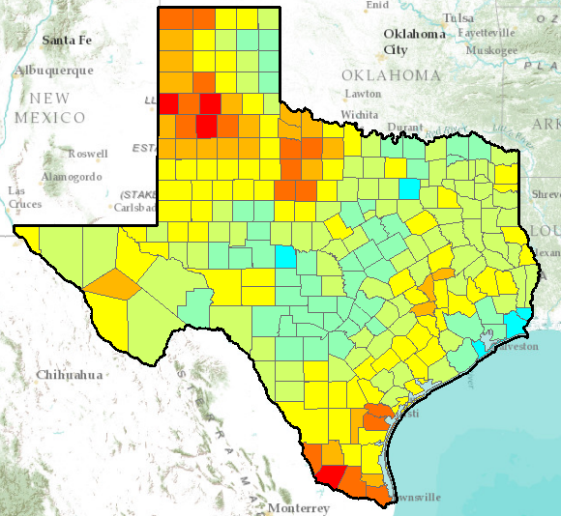
Texas Soil Wetness Index
1 June 2012
% soil water capacity
Average = 40%
Soil water storage in first meter of soil = 4 cm, or 31Km³ of water

Slide 20
Soil Wetness Index, Travis County, January 2011 - May 2012
Effect of Spring Rains

Slide 21
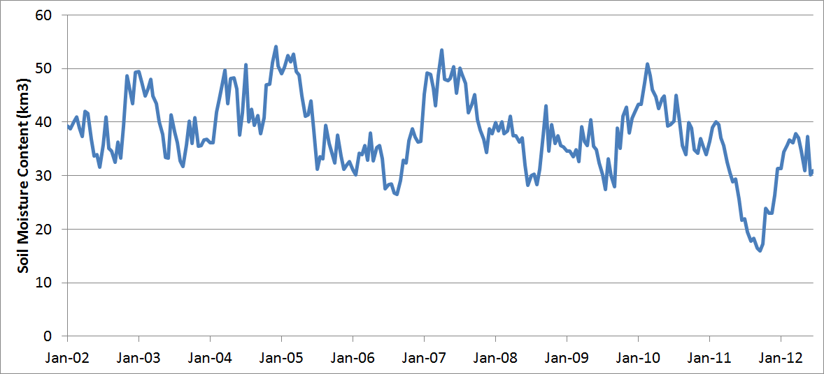
GRACE and Texas Soil Water Storage
Grace Satellites
Normal
In 2011 we lost 100 Km³ of water overall
Texas Soil Water Storage
Normal
We lost 25 Km³ of water from top 1m of soil

Slide 22
Summary Water Balance of Texas
Overall changes in Texas water storage can be measured from space by the GRACE satellites
In 2011 drought we lost 100 Km³ of water (70 Lake Travis’s)
About 9 Km³ from surface water reservoirs
Approximately 25 Km³ from the soil water system
About two thirds from shallow groundwater
We have regained most of this lost water
We need county level metrics of water availability for better drought management

Slide 23
Water Availability during the Drought
Drought Technology Steering Committee
Water balance of Texas
Drought in West Texas
Texas water and climate model

Slide 24
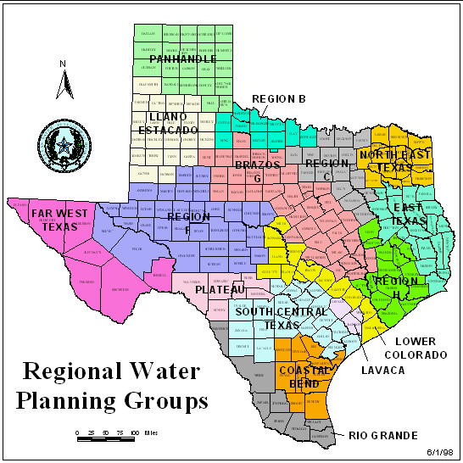
Drought in West Texas

Slide 25
Reservoirs
Odessa
Midland
San Angelo

Slide 26
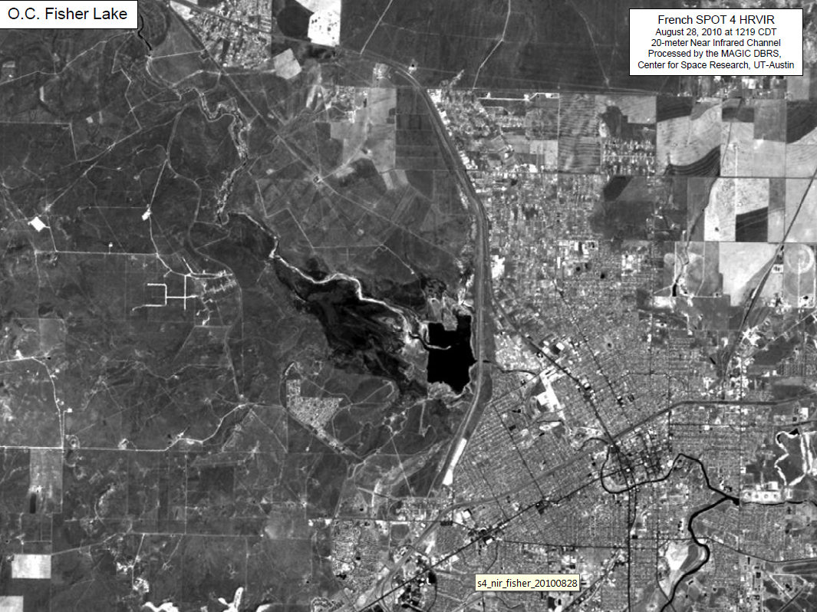
Lake O.C. Fisher, August 2010

Slide 27
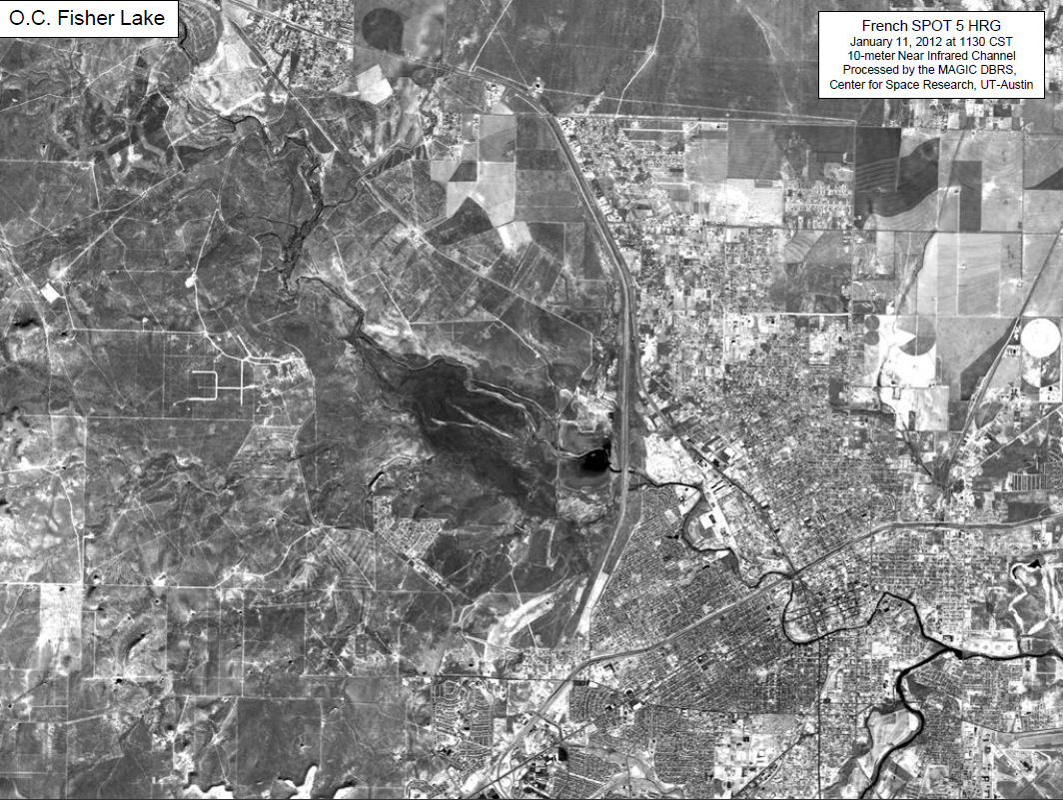
Lake O.C. Fisher, Jan 2012

Slide 28
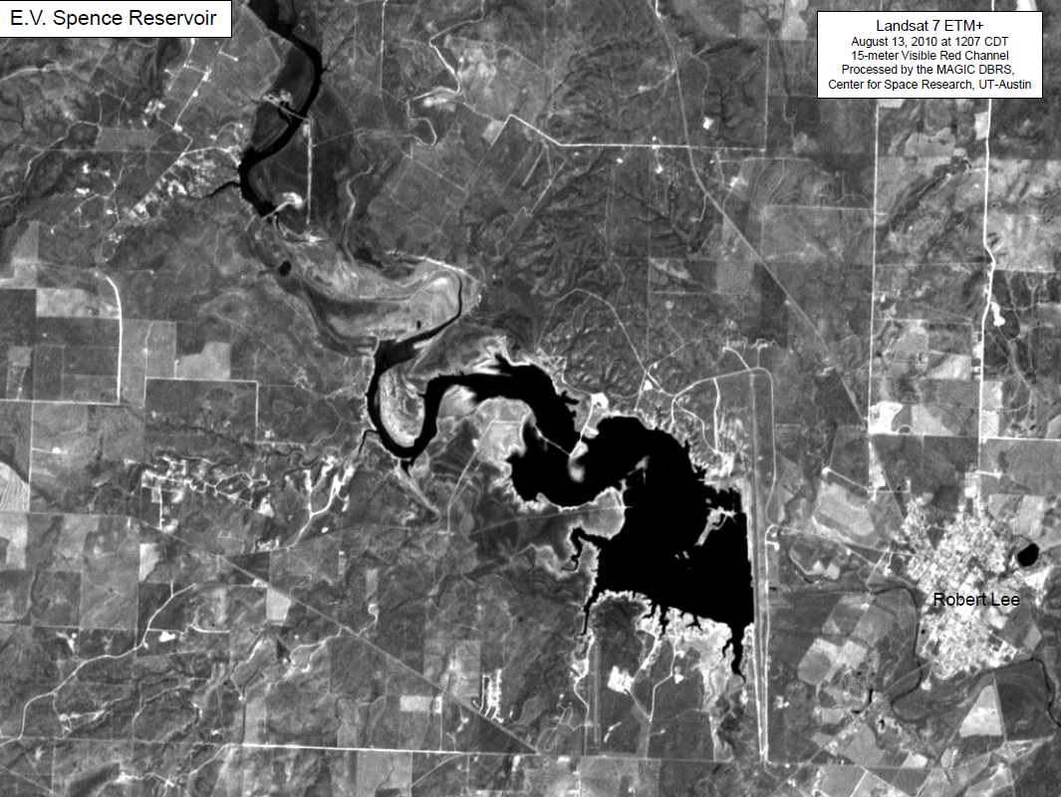
Lake E.V. Spence, August 2010

Slide 29
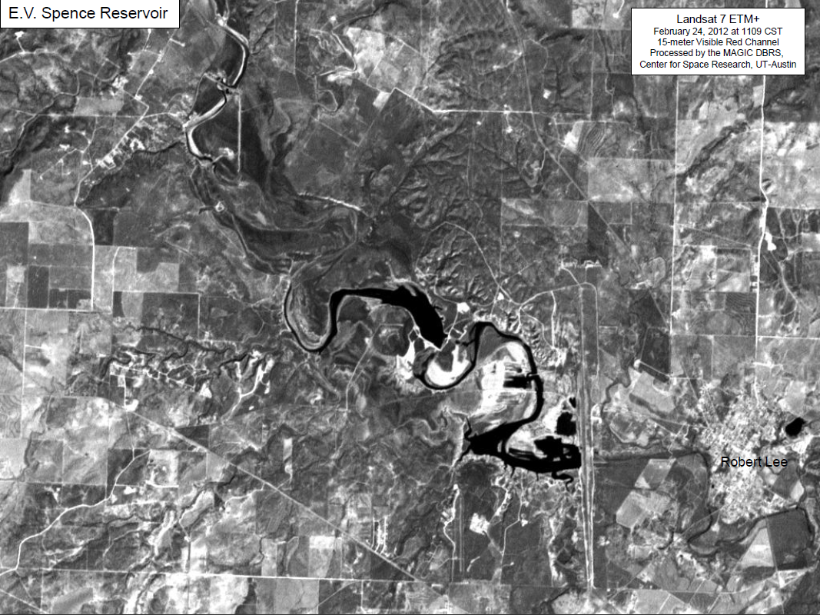
Lake E.V. Spence, Jan 2012

Slide 30
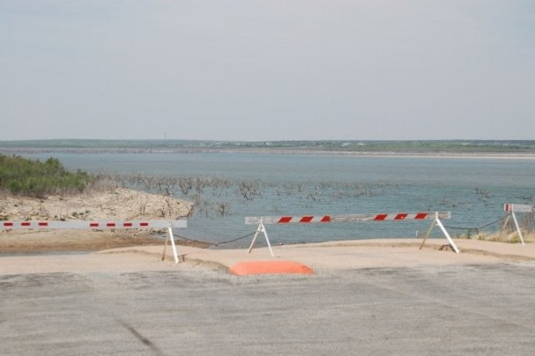
O.H. Ivie Reservoir
Owned and operated by the Colorado River Municipal Water District
Purpose: Water Supply
Supplies: Odessa, Big Spring, Snyder, Midland, Abilene, San Angelo, Ballinger
Storage Capacity: 554,339 acre-feet
Current Storage: 98,400 acre-feet
2011 Change in Storage: -81,820 acre-feet
M. Bewley

Slide 31
Drought in West Texas is chronic

Slide 32
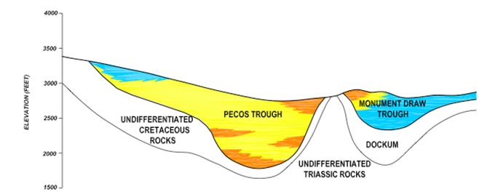
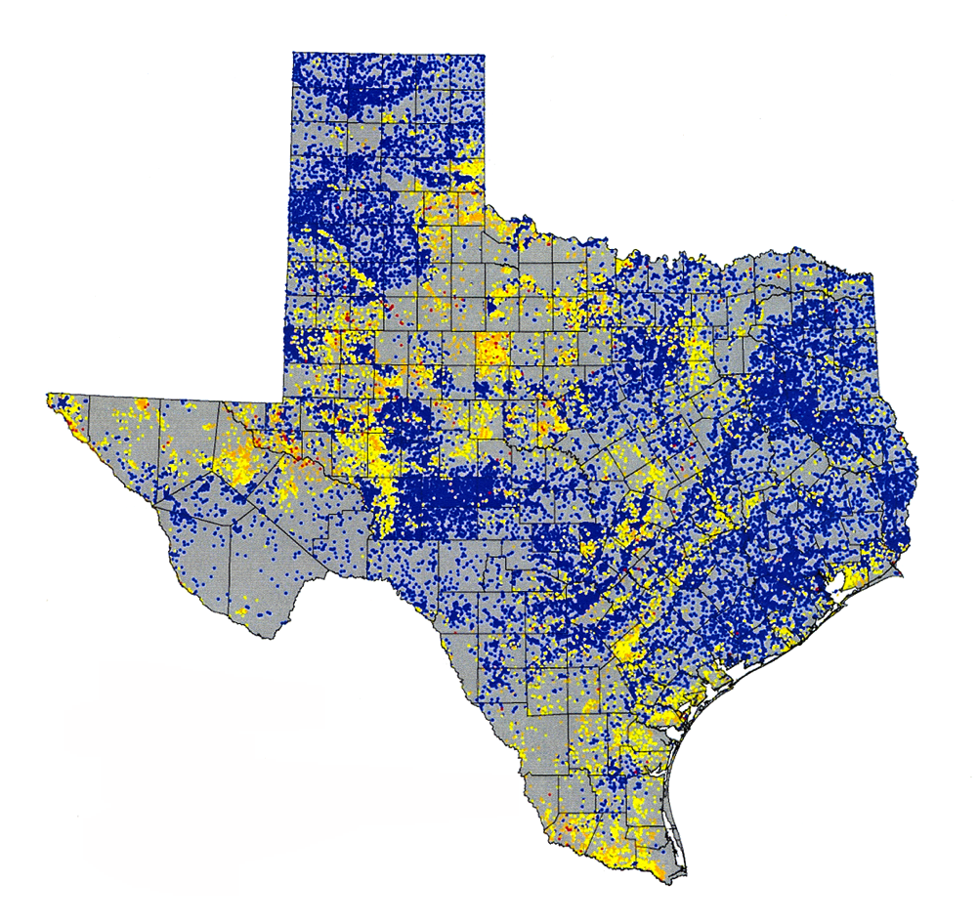
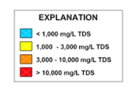
Saline Groundwaters of Texas
Pecos Alluvium

Slide 33
Water Availability during the Drought
Drought Technology Steering Committee
Water balance of Texas
Drought in West Texas
Texas water and climate model

Slide 34
Facing Drought in Texas
Texas population increased by 4.3 million in the last 10 years
430,000 people per year
1180 people per day
We have a Texas Water Plan but little money to implement it
The clock is ticking …..

Slide 35
Texas Water and Climate Model
Last severe drought in 1996 led to Senate Bill 1 in 1997 and SB2, SB3 later
Great improvement in long term water planning (10 to 50 years in future)
The 2011 drought exposed
We don’t have synthesized situational awareness of current condition of our water system state-wide
We need to be able to see ahead 6-18 months for rational water decision making

Slide 36
Drought Technology
Water Cycle
Atmosphere
Impacts
Economic Development
Public Water Supply
Agricultural Production
Electric Power Generation
Ecological Integrity
Soil Water
Surface Water
Groundwater
Observations – Modeling – Assessment – Prediction
Notes:
The intent of the Drought Technology Steering Committee is to bring the best available science and technology to bear on quantifying the storage and flow of water in Texas, and the impacts of water shortage on key water functions in the state.

Slide 37
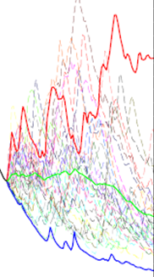
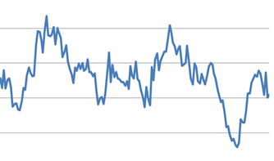
Texas Water and Climate Model
Improve our state-wide, real-time situational awareness of water conditions
Statistics from past
Current situation
Short-term predictions

Slide 38
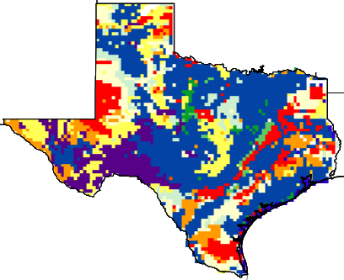
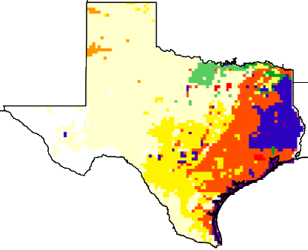
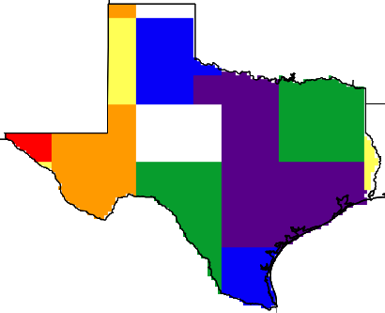
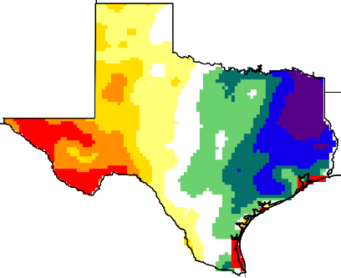
Calculate the Soil Water Balance of Texas
Land surface features
NLDAS atmospheric forcing
Soil
type
Temperature
Precipitation
Wind speed
Specific humidity
Surface pressure
Downward SW radiation
Downward LW radiation
Noah-MP land surface model
Land
cover
Soil
color
Green
vegetation fraction
Surface runoff
Sub-surface runoff
Soil moisture
Evapotranspiration
Water table ……
Model output

Slide 39
RAPID River Flow Model

Slide 40
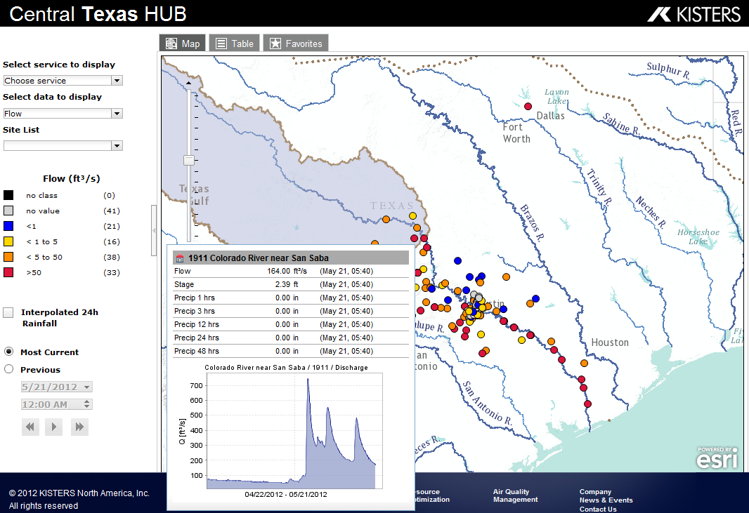
Synthesized Real-Time Water Models, Observations, Maps and Graphs
http://www.CentralTexasHub.org

Slide 41
Conclusions
GRACE Satellites can directly measure overall change in water storage in Texas
In 2011, we lost 100 Km³ of water, but conditions have returned to nearly normal
County-based metrics are needed to quantify drought severity and its spatial patterns
Surface water storage is almost gone in West Texas – switching to groundwater supply
We need a Texas Water and Climate Model

