Slide 1
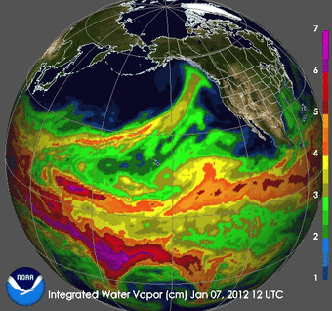
The Last 10 Years and the Next 10 Years
Presented by
David R. Maidment
Center for Water and the Environment
University of Texas at Austin
Presented to:
National Center for Atmospheric Research
13 September 2024
Acknowledgments: NOAA National Weather Service, US Geological Survey, Texas Department of Transportation, ESRI, KISTERS, colleagues and students at University of Texas at Austin

Slide 2
The Last 10 Years and the Next 10 Years
“Most people overestimate what they can do in one year and underestimate what they can do in ten years.” ― Bill Gates
Where were we 10 years ago?
Where are we now?
Where could we be 10 years from now?

Slide 3
Transformative Research
Transformative research challenges current understanding or provides pathways to new frontiers in science and engineering. It involves ideas, discoveries or tools that do one or both of the following:
Radically change understanding of an important existing concept in science, engineering or education.
Lead to the creation of a new paradigm or field of science, engineering or education.
https://new.nsf.gov/funding/learn/research-types/transformative-research#definition
Can we move from evolutionary change to transformative change?

Slide 4
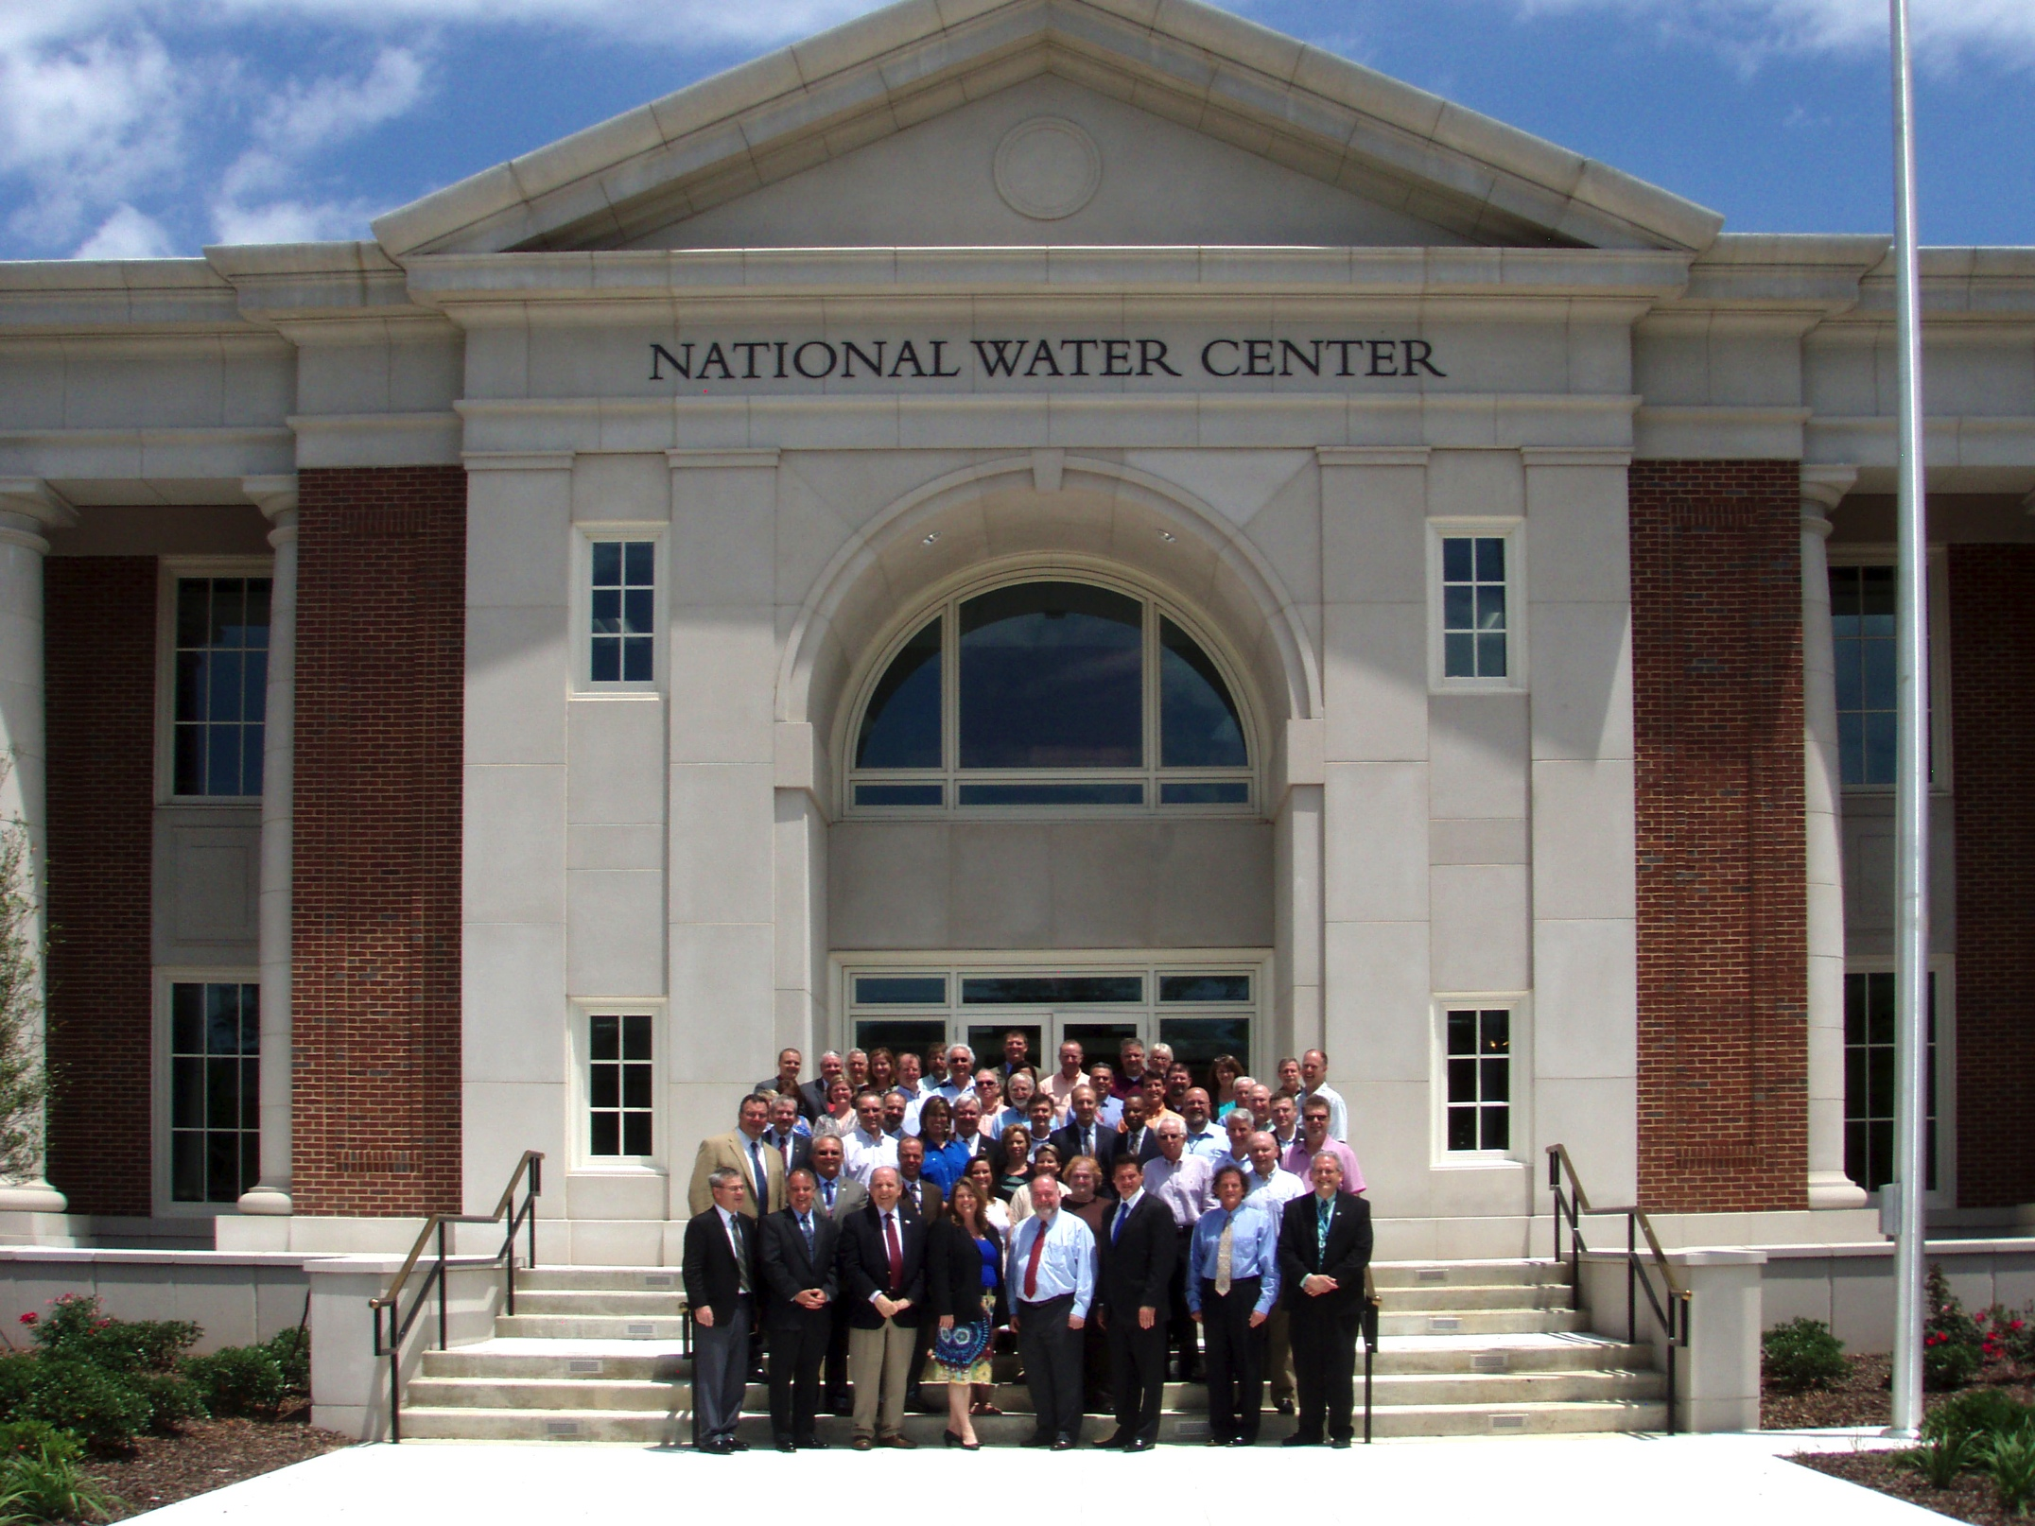
I proposed: Bring in the academic community and rapidly prototype
a new national flood forecasting system in one year … this has led to annual Summer Institutes for graduate student research
Inaugural Meeting – May, 2014

Slide 5
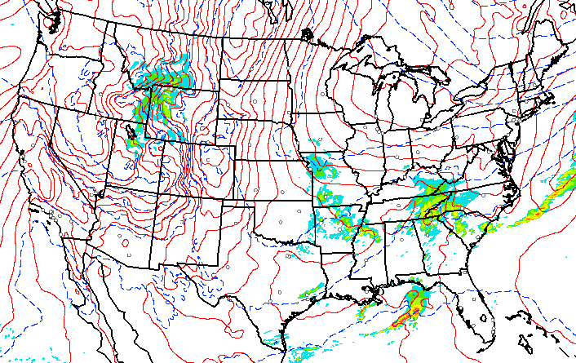
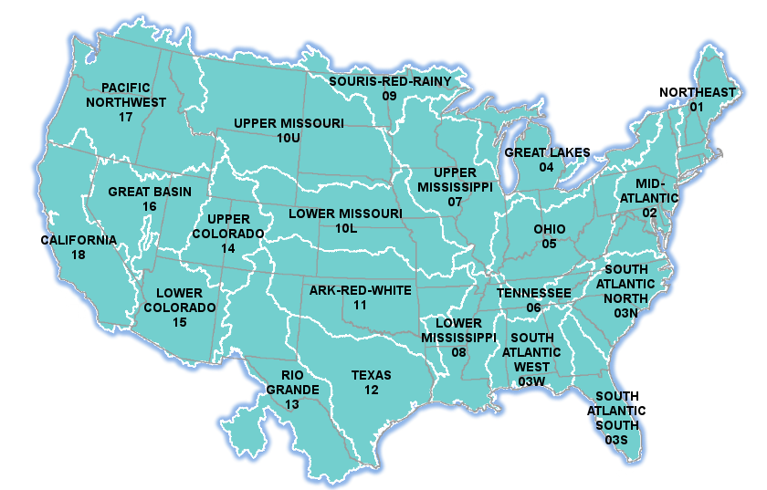
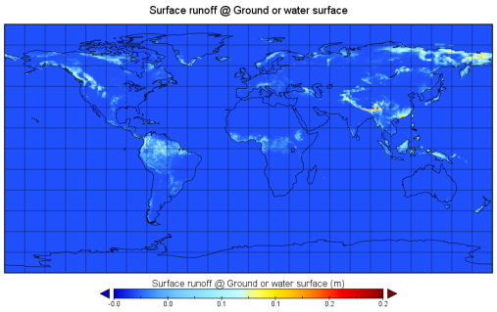
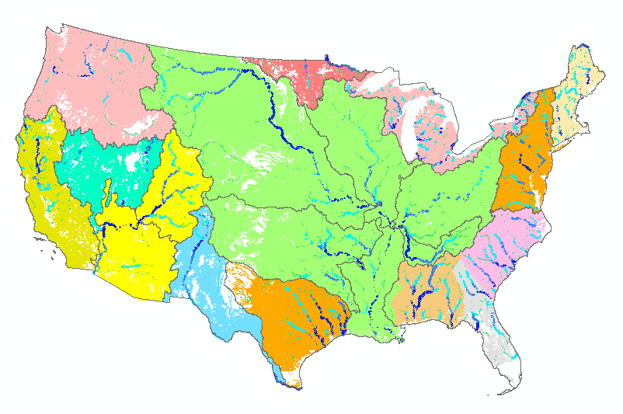
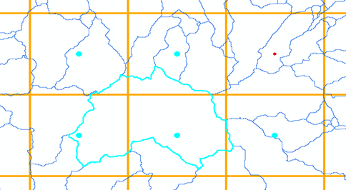
Leveraging US and European Weather Forecasting
2015 Summer Institute at National Water Center
HRRR
United
States
Europe
Forcing
NHDPlus
to RAPID
David
Gochis
WRF-Hydro
ECMWF
TACC
Grid to
catchment

Slide 6
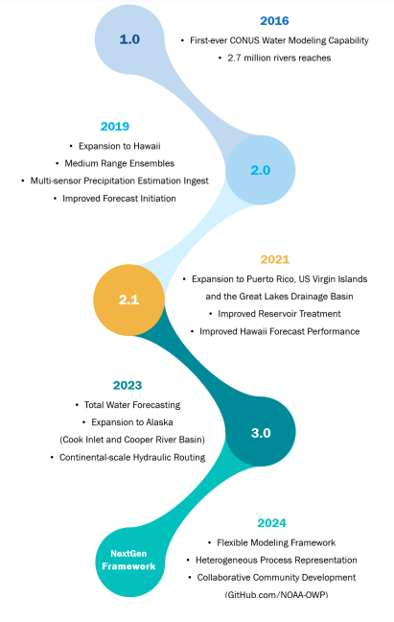
National Water Model – 2024
Water forecast like weather 24/7/365
2016
Initial CONUS Water Model
Four model outputs for forecast discharge:
Assimilation (Current conditions)
Short Range Forecast (18 hours ahead)
Medium Range (10 days ahead)
Long Range Forecast (30 days ahead)
Versions
2019
Includes Hawaii
Medium Range Forecast
2021
Includes Puerto Rico …
Improved performance
2023
Includes part of Alaska
Combines riverine and coastal
Future
Next Generation
Modeling Framework
Water flow forecasts on 5.2 million km
of streams and rivers in US

Slide 7
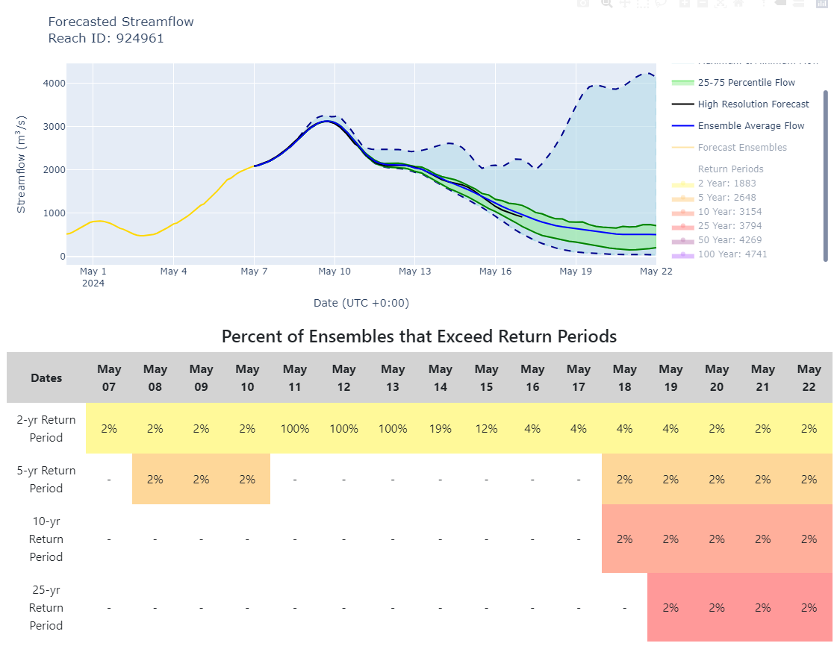
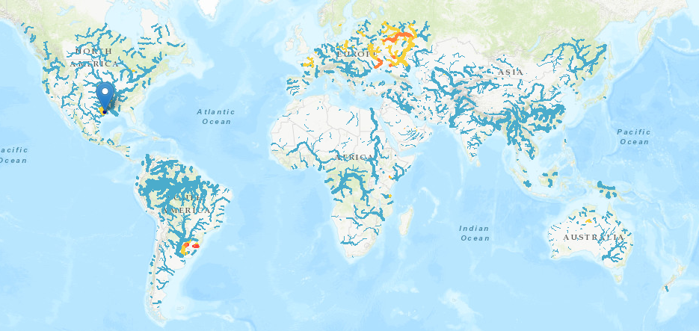
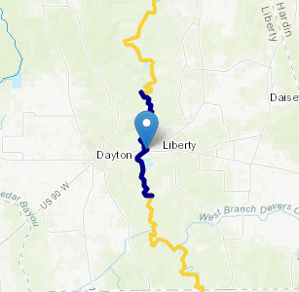
Global Streamflow and Flood Forecasting System (GEOGLOWS) Trinity River at Liberty, Texas
https://www.geoglows.org
Rendered as an ESRI Map Application

Slide 8
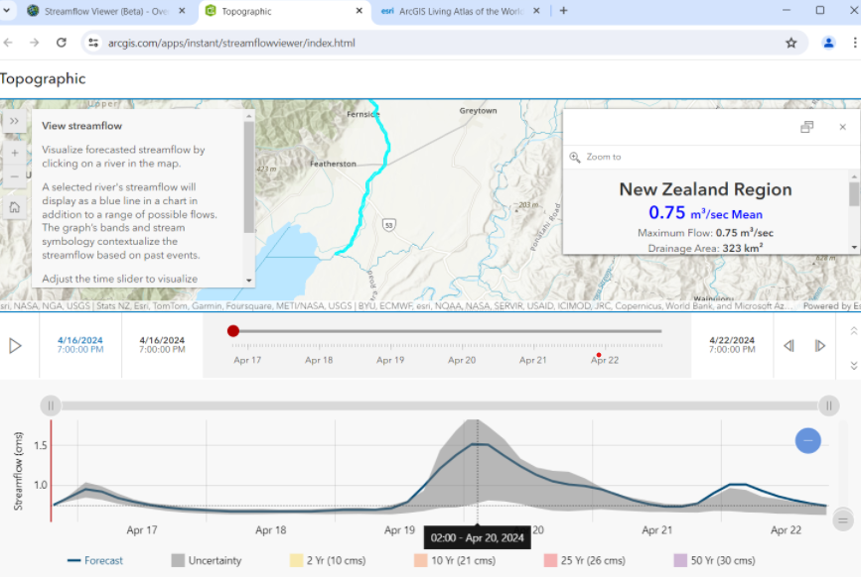
Global Streamflow and Flood Forecasting System (GEOGLOWS) Tauherenikau River at Featherston, New Zealand

Slide 9
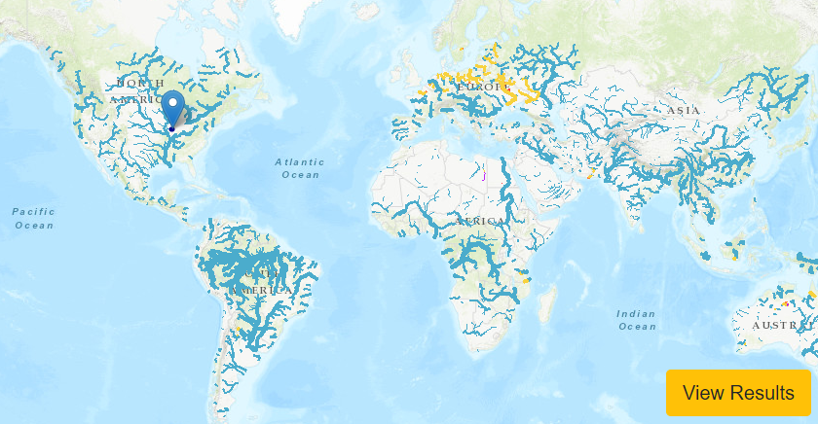
Development of Hydrology
in the Last 10 Years
Real-Time
Hydrology
Weather
Water flow is now like weather: forecast everywhere at local spatial scale all the time
Historical
Hydrology
Climate
Can we move from evolutionary change to transformative change? Yes!

Slide 10
Why does the
map look like this?
https://droughtmonitor.unl.edu/

Slide 11
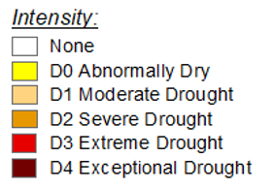
Time Series of US Drought Monitor
CONUS
2010
2015
2020
2025
2000
2005
Severe Drought
Texas

Slide 12
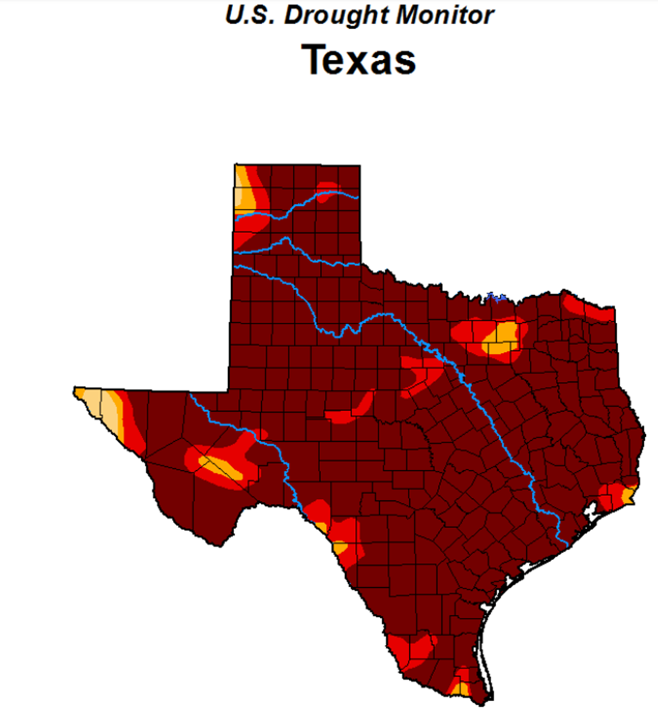
A Severe Drought in Texas
88% of Texas in D4
Exceptional Drought
October 2011
Because of losing cooling water at some power plants, drought threatened the power supply as well as the water supply.
This was really scary!
Texas population in 2011 = 25.6 million Texas population in 2024 = 30.5 million
Adding more than 1000 people per day
What happens if this severe drought recurs and is sustained?

Slide 13
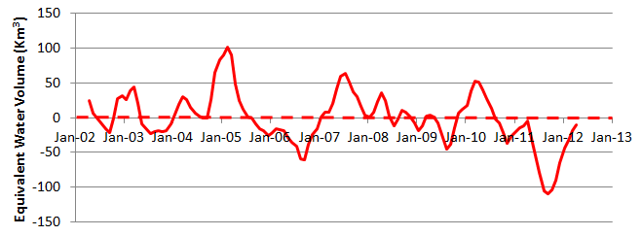
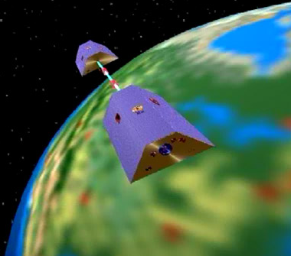
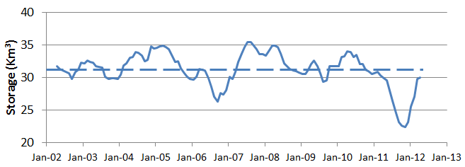
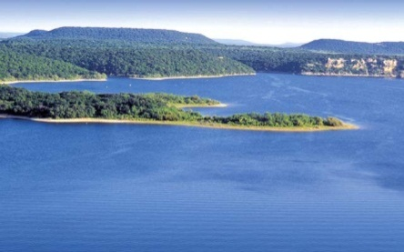
GRACE and Texas Reservoir Water Storage
Surface water reservoir storage is closely correlated with the GRACE data
Grace Satellites
Normal
In 2011 we lost 100 Km³ of water overall
Surface Water Reservoirs
Normal
In 2011 we lost 9 Km³ of water from reservoirs

Slide 14
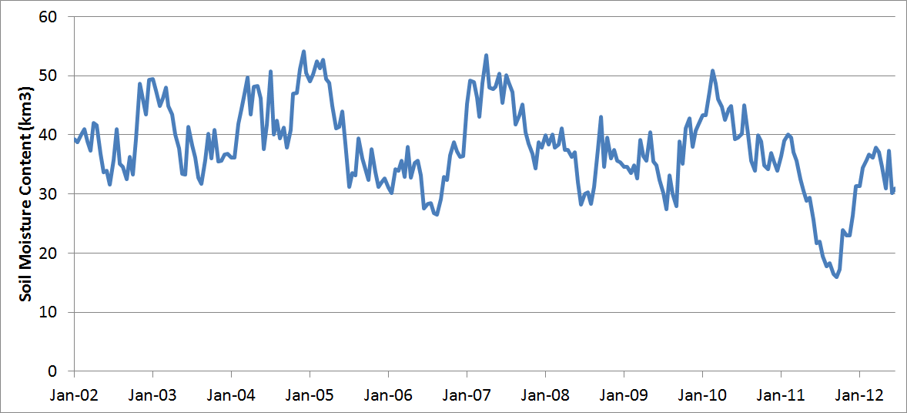
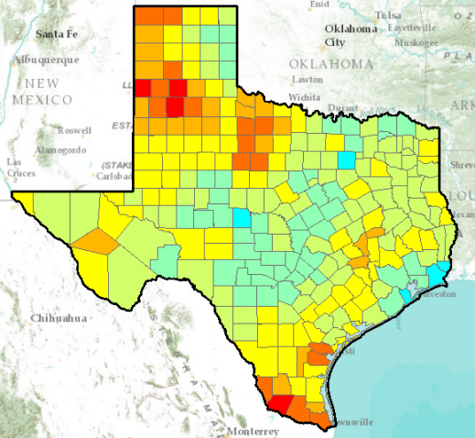
GRACE and Texas Soil Water Storage
Grace Satellites
Normal
In 2011 we lost 100 Km³ of water overall
Texas Soil Water Storage
Normal
We lost 25 Km³ of water from top 1m of soil

Slide 15
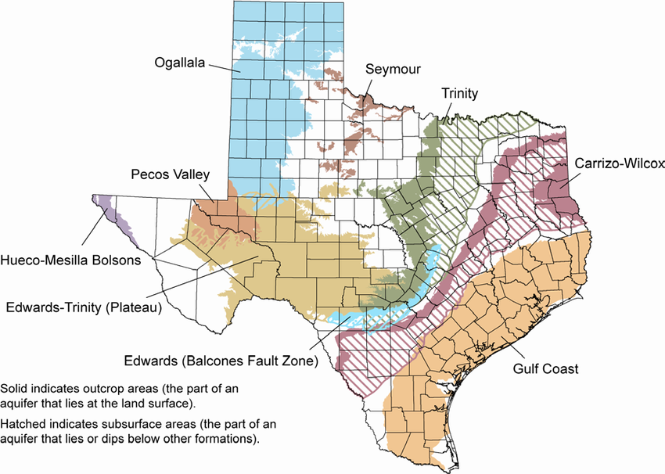
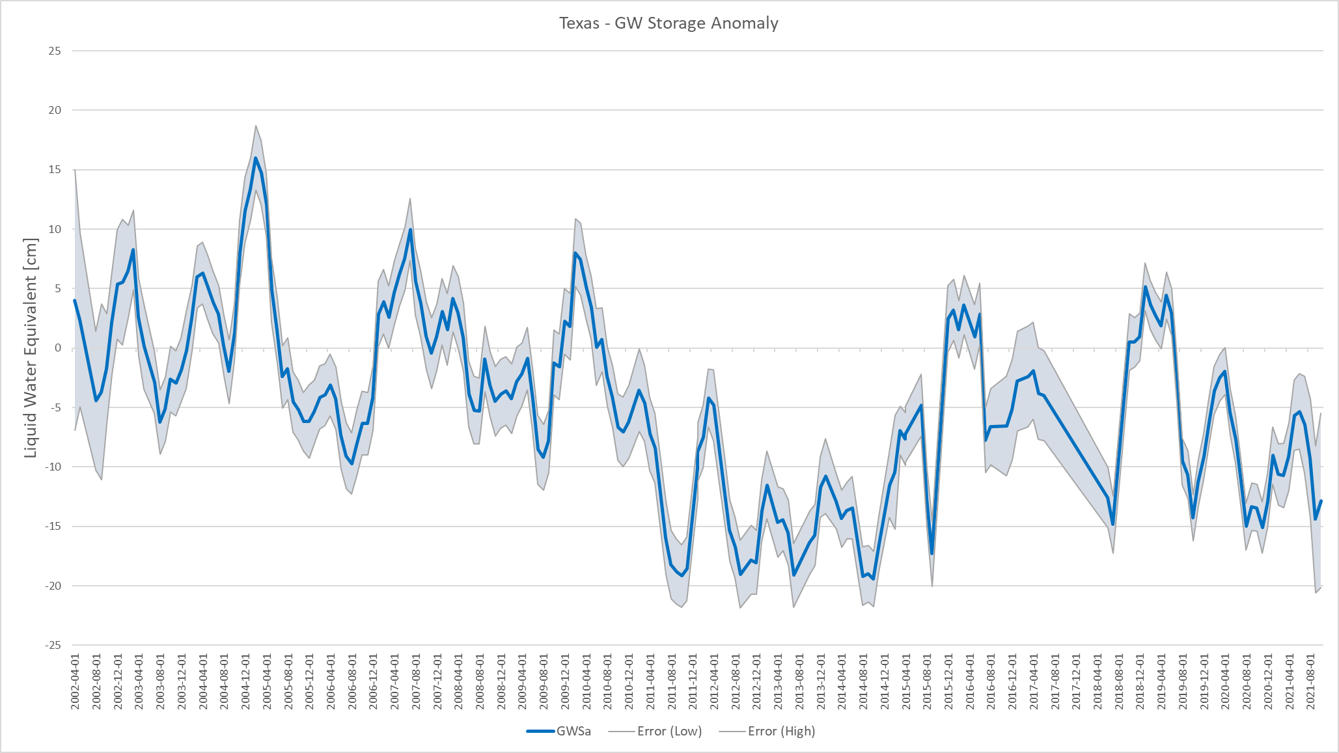
Groundwater Storage Anomaly in Texas Inferred from GRACE, 2002 –2021
20
2005
2010
2015
2020
Aquifers of Texas
10
Severe Drought
0
Data: Norman Jones
Brigham Young University
Liquid Water Equivalent (cm)
-10
-20

Slide 16
The Where of Water
Jack Dangermond
President, ESRI

Slide 17
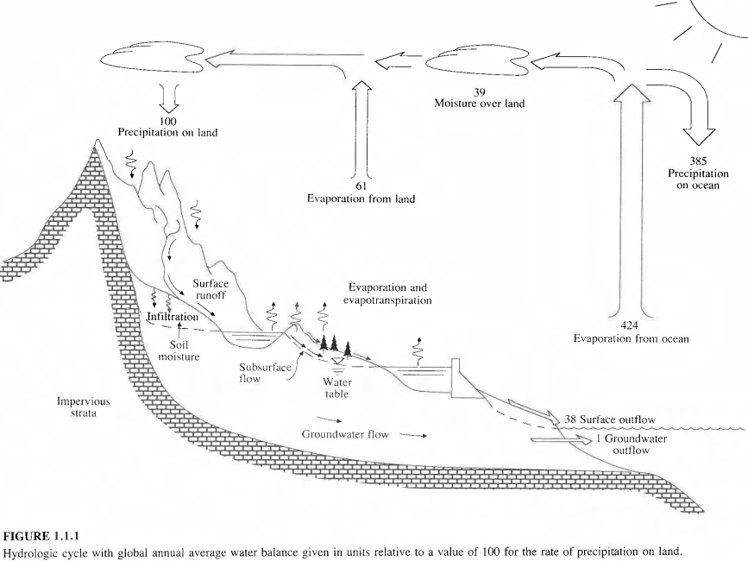
Hydrologic Cycle with annual precipitation on land = 100 units

Slide 18
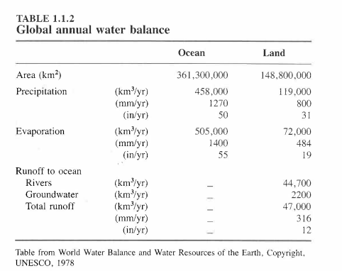
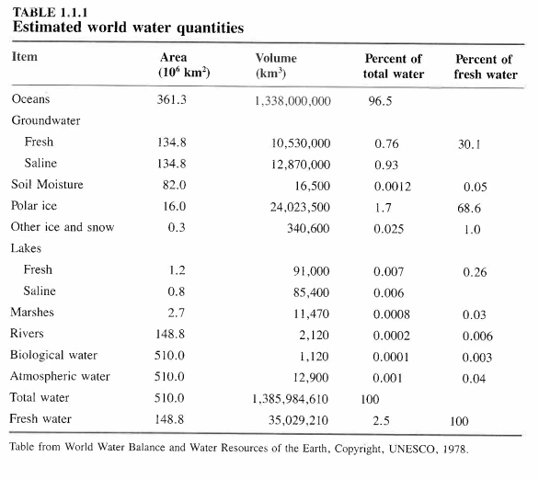
World Water Balance

Slide 19
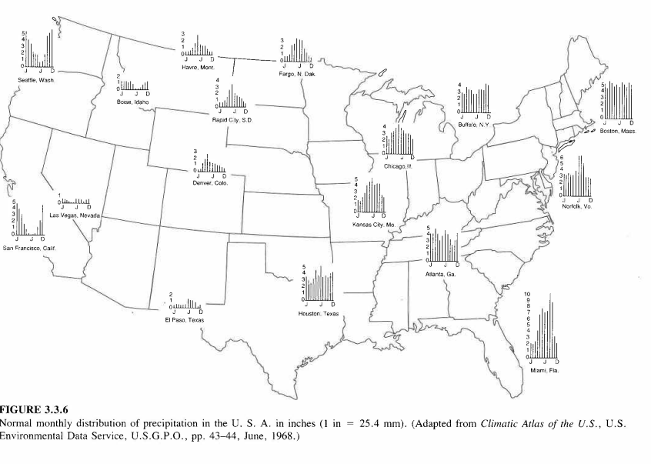
Monthly Distribution of Precipitation

Slide 20
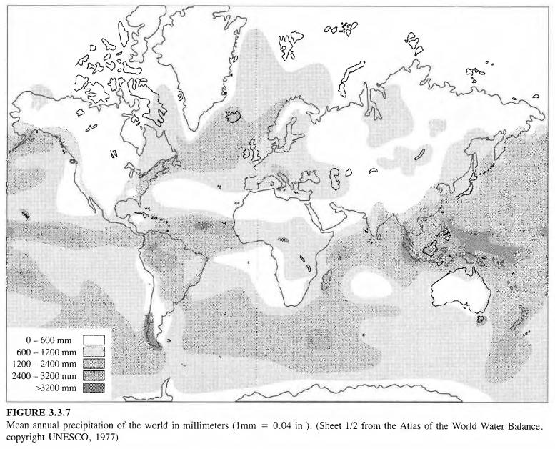
Global Distribution of Annual Precipition

Slide 21
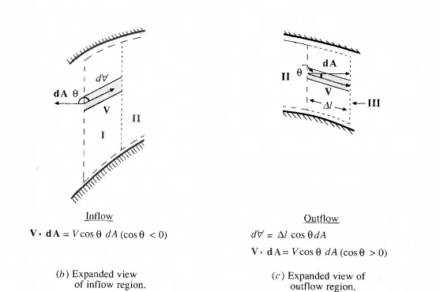
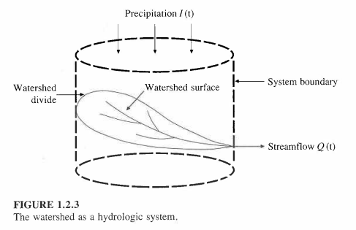
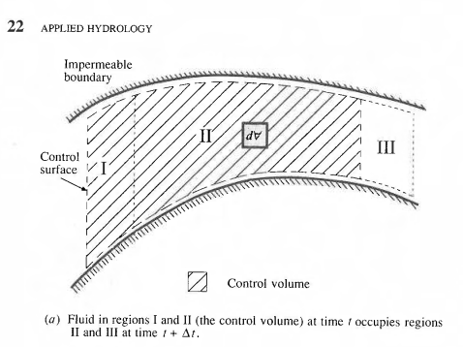
Watershed as a Control Volume

Slide 22
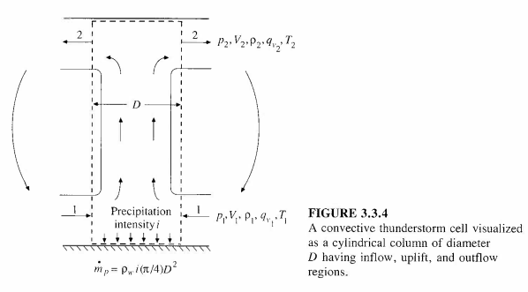
Water Vapor Transport
Specific humidity
Precipitable water

Slide 23
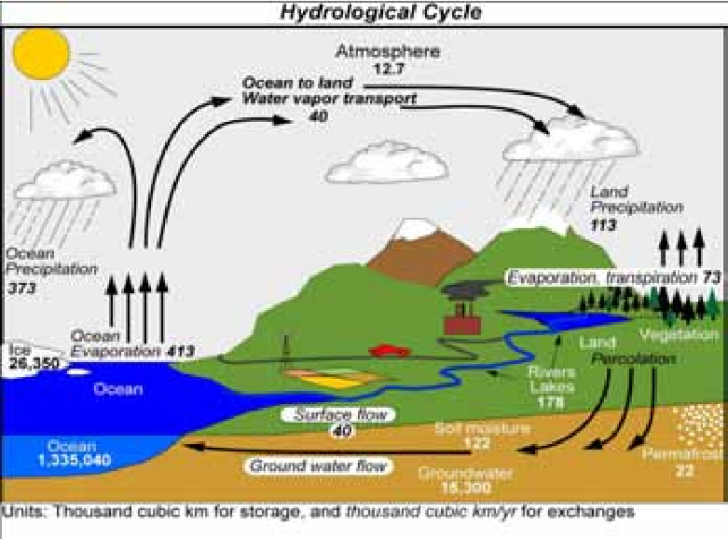
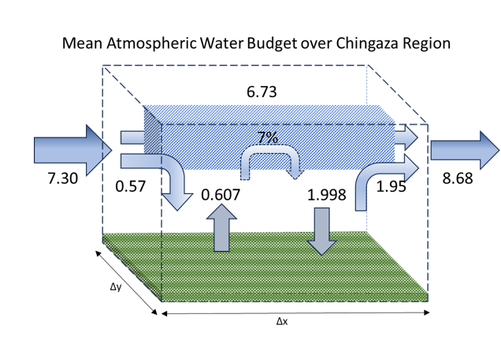
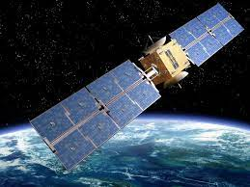
Goal for the Next Decade: Close the Global Hydrological Cycle Quantify the time-varying world water balance
Atmospheric water balance
Water storage
Soil
Groundwater
Oceans
Surface water balance
Image: Paolo Ceci

Slide 24
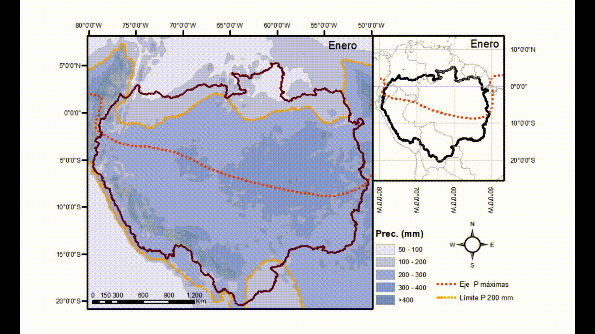
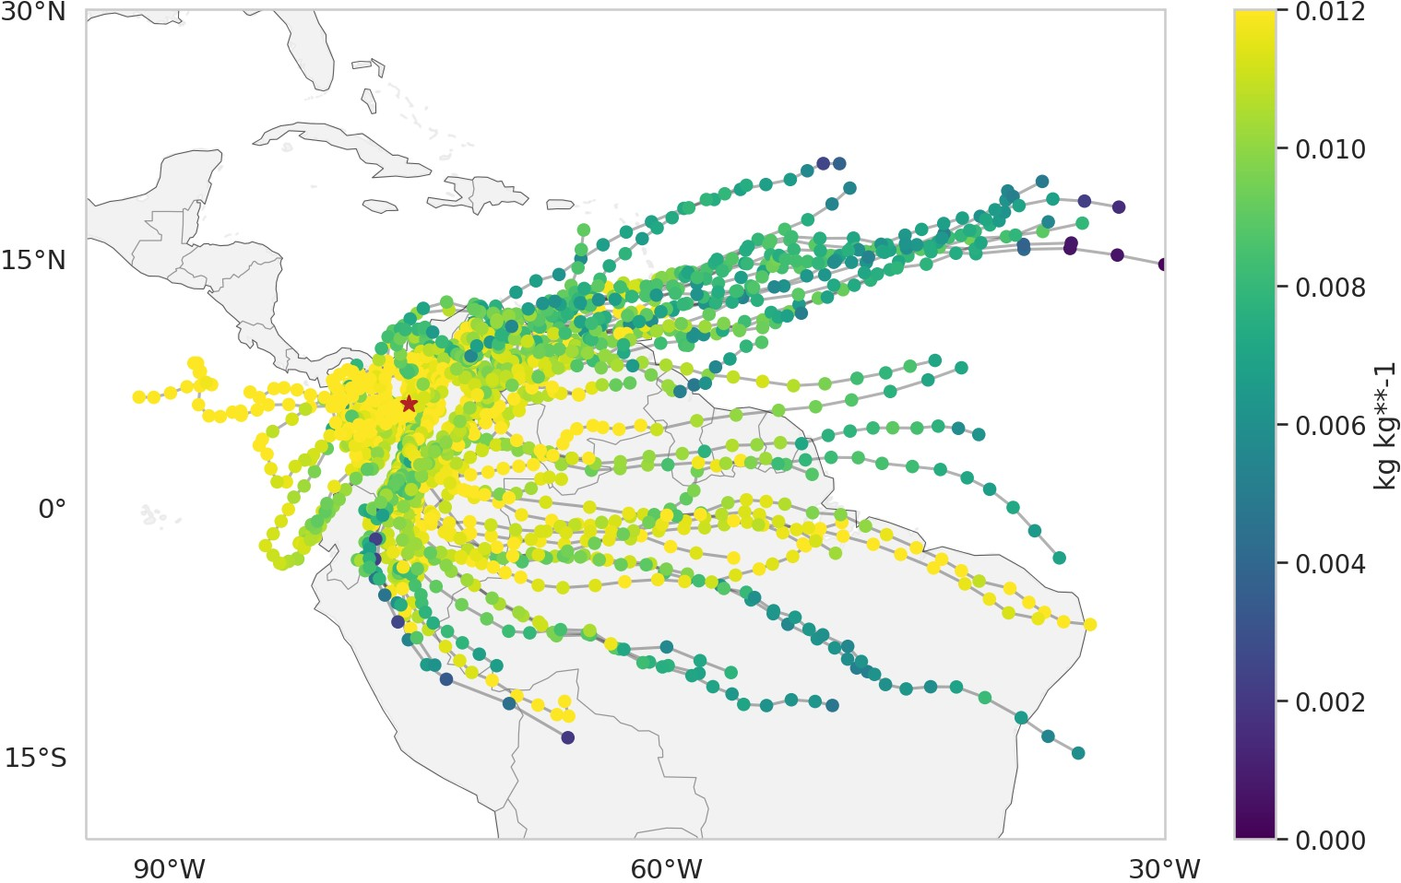
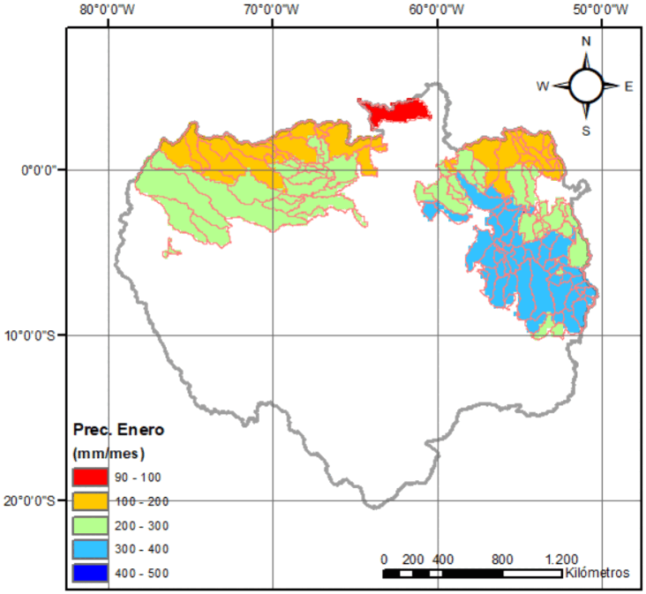
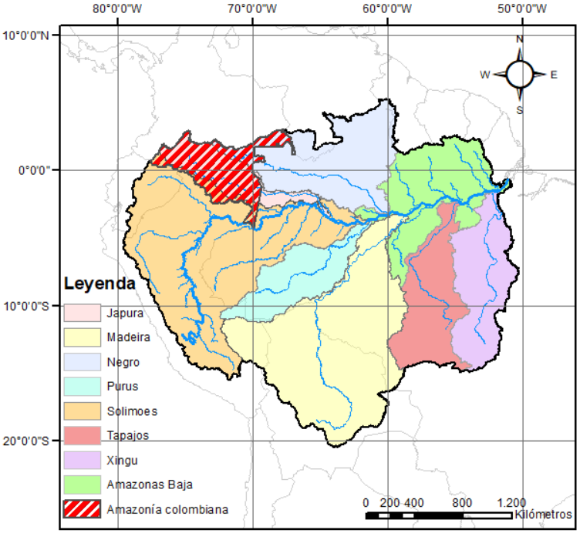
Water vapor transport and its importance in the local hydrological seasonality

Slide 25
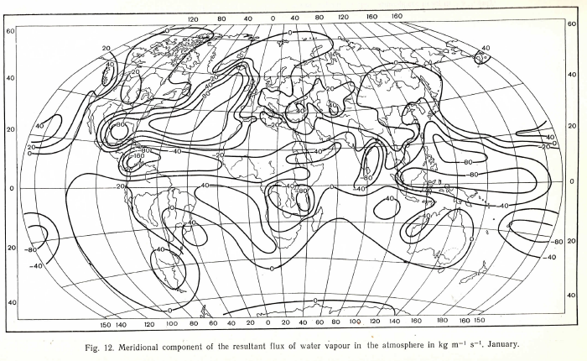
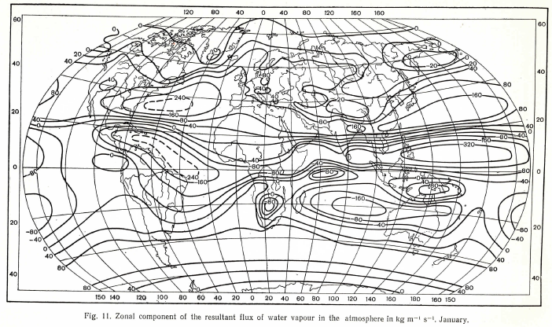
World Water Balance Study done for the International Hydrological Decade (1965-1974)
Meridional atmospheric
water flux
Quantified the time-averaged World Water Balance
1978
Zonal atmospheric
water flux

Slide 26
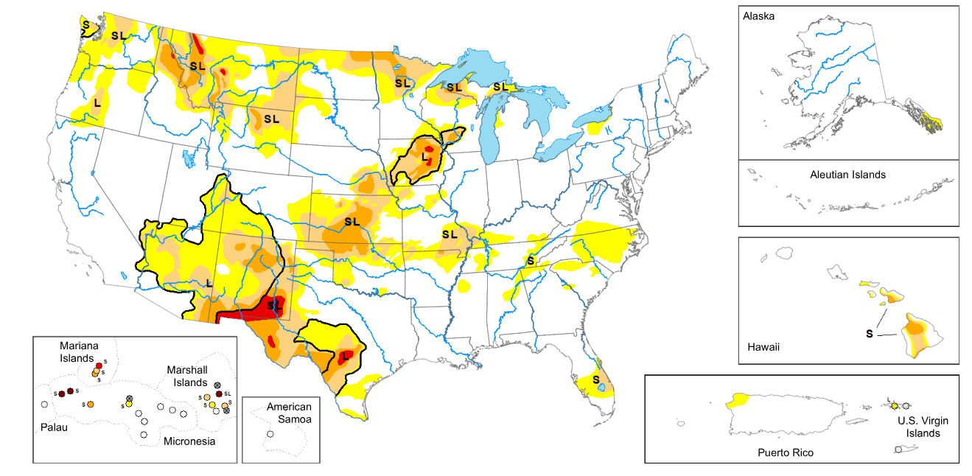
Global Teleconnections of Water Movement
Prediction of Drought:
A Task for the Next 10 Years

Slide 27
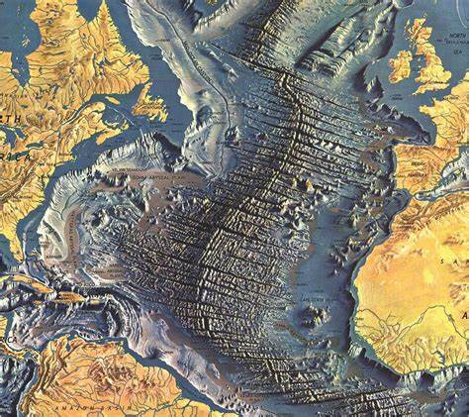
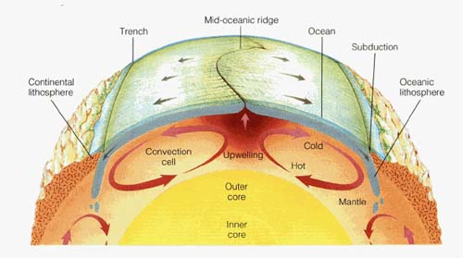
Development of Plate Tectonics
A magic period in Geology: 1962-1967
Discovered by mapping
the topography and
magnetism of the
ocean floor
“While conceptual innovation was an important part of the development of plate tectonics, the stories told here strongly suggest that the most powerful driving force was data.”
Image: National Geographic Maps
Image: City University of New York
Four scientific teams
Cambridge, Lamont Doherty, Scripps, Princeton

