Slide 1
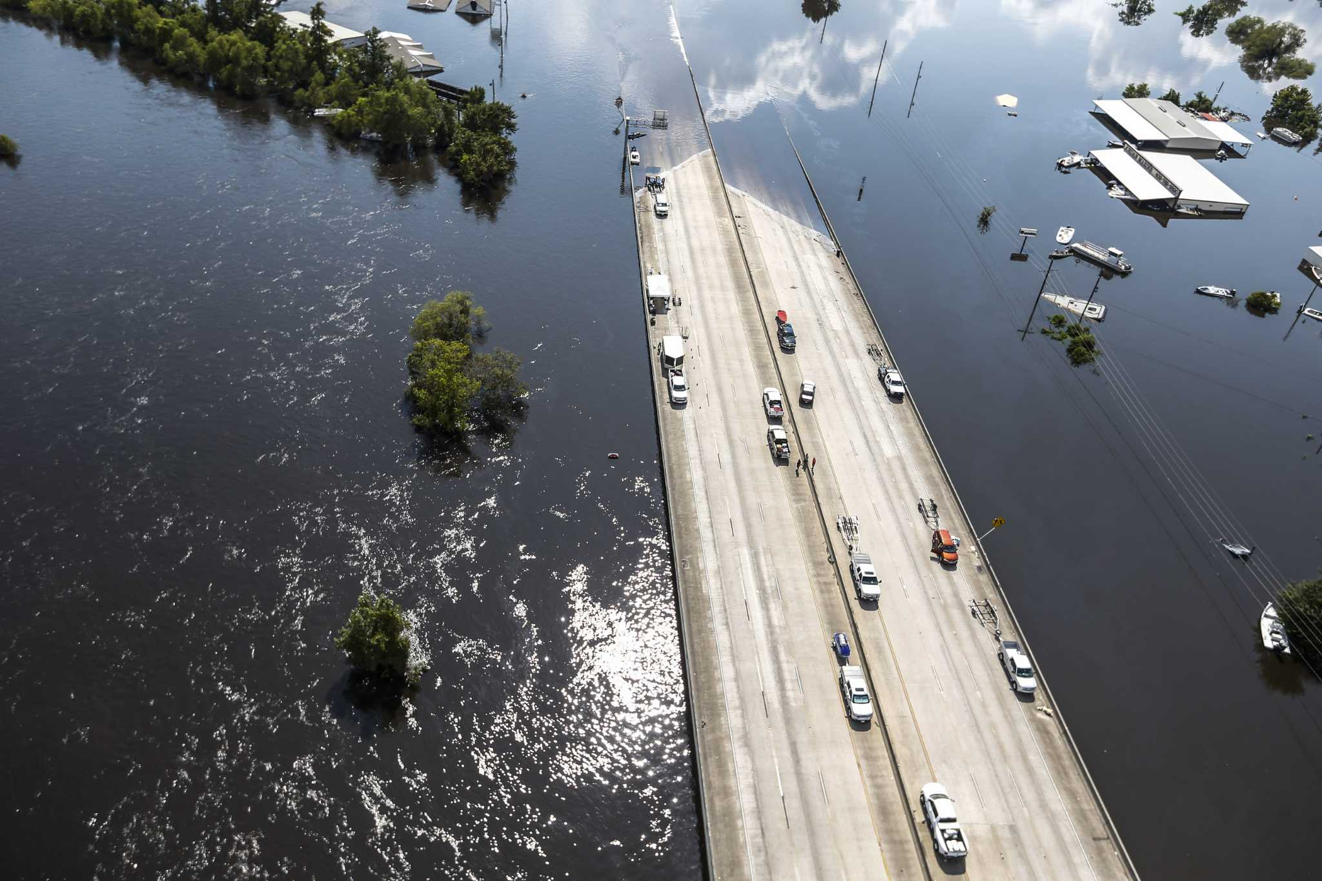
TxDOT Project 0-7095-01
Flood Assessment System for TxDOT (FAST)
Quarterly
Review 1
August 1, 2024
The University of Texas at Austin
US Geological Survey
KISTERS
ESRI

Slide 2
Every project is a safety project.
Texas has lost at least one person every day on Texas roads since Nov. 7, 2000.
Notes:
Texas has the highest number of roadway fatalities of any state in the country.

Slide 3
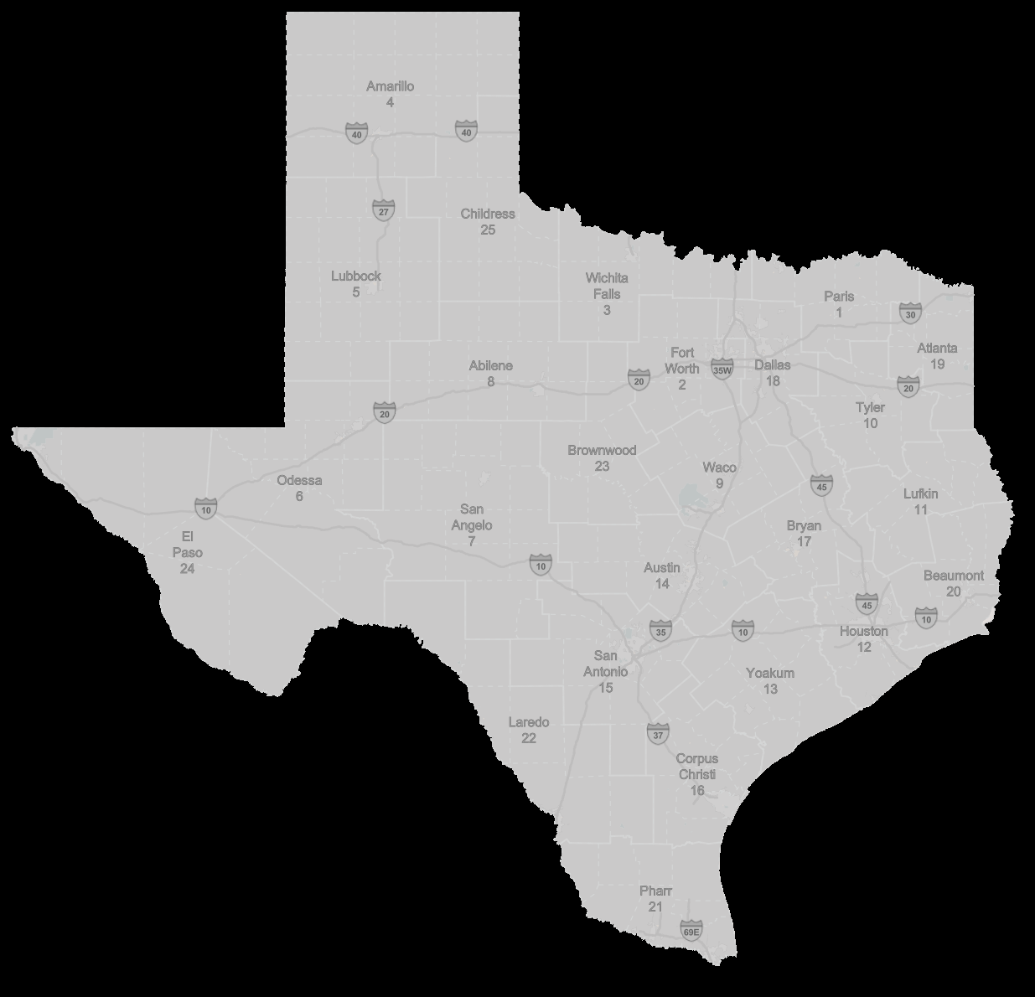
FEMA Press Release NR209 (May 8, 2018) – All Texans are at risk for floods
No place is safe from flooding. If it can rain, it can flood. And nowhere is that truer than Texas.
Nearly every major city in Texas is vulnerable to Gulf Coast hurricanes or sits in “Flash Flood Alley,” one of the most flash flood-prone areas in the nation. More than 200,000 single-family homes in disaster-declared Texas counties were flooded by Hurricane Harvey last year, and many of them were in areas not considered high-risk for floods.
Don’t assume your area won’t flood because it hasn’t in the past: Risk of flooding can change considerably as factors like drought and urban development affect the ground’s surface. Nationwide, 26 percent of flood insurance claims come from properties outside high-risk zones.
Notes:
We are especially vulnerable to flooding in Texas.

Slide 4
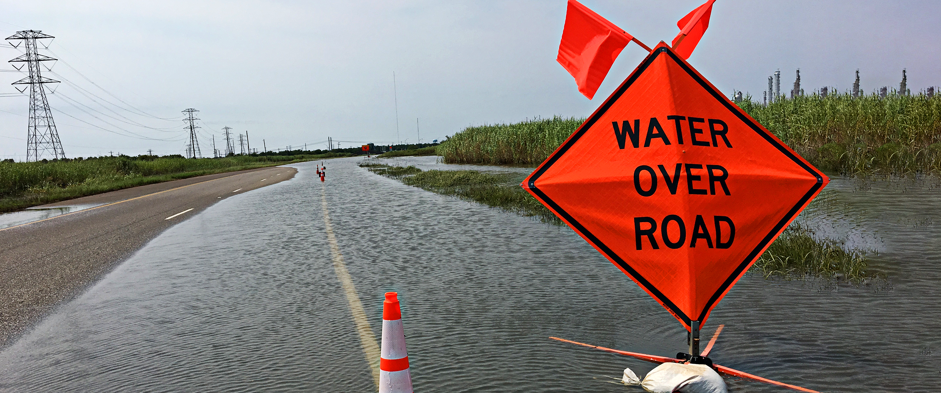
Turn Around, Don’t Drown.
On average, over 50% of flood fatalities occur in cars.
Notes:
TxDOT has a role to play in solving this problem. And we all do better, when we all do better.

Slide 5
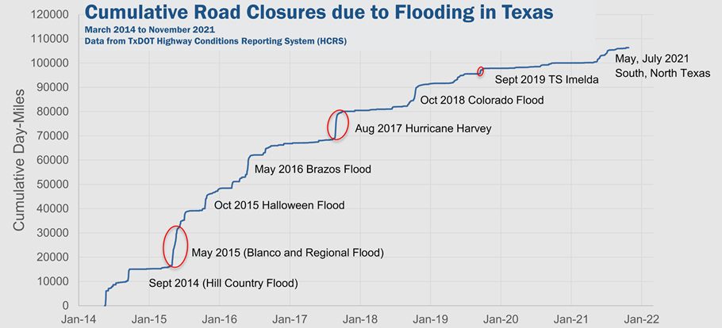
Reactive Proactive
Notes:
Bird’s eye view of what we’re doing here

Slide 6
TxDOT Project Management Committee (PMC)
Rose Marie Klee – Lead Advisor TxDOT DES - H&H Section Director
Matthew Heinze – Lead Advisor
TxDOT MNT – Maintenance Support Section Manager
Jade Adediwura – Project Manager
TxDOT RTI – Research Project Manager
Chris Henry
TxDOT MNT – Deputy Director
Omar DeLeon
TxDOT MNT/AUS – Director of Maintenance
Allison Wood
TxDOT DES / Huitt-Zollars
Trenton Ellis
TxDOT H&H – H&H Engineer
Stephanie Marquez
TxDOT TTP-GIM - Statewide GIS Data Engineer
Ryan Granger
TxDOT STR – Strategic Mgmt Analyst
Jared Browder
TxDOT MNT – TxMAP Specialist
Mauricio Moreno
TxDOT ITD – Information Security Architect
ChunHo Lee
TxDOT BRG – Geotechnical Engineer
Valerie Taylor
TxDOT HOU – Transportation Engineer
Mark Wallace
TxDOT BRG – State Bridge Inspection Program MGR

Slide 7
TxDOT Technical Project Management Team (TPMT)
Rose Marie Klee – Lead Advisor TxDOT DES - H&H Section Director
Trenton Ellis
TxDOT DES - H&H Engineer
Allison Wood
TxDOT DES / Huitt-Zollars
Stephanie Marquez
TxDOT TTP-GIM - Statewide GIS Data Engineer

Slide 8
TxDOT Technical Stakeholders
Matthew Heinze – Lead Advisor
TxDOT MNT – Maintenance Support Section Manager
Missy Lowe
TxDOT MNT – Maintenance Field Support Manager
Mauricio Moreno
TxDOT ITD – Information Security Architect
Jared Browder
TxDOT MNT – TxMAP Specialist
Priscillo Campos
TxDOT ITD – Management Analyst
Mysti Tran
TxDOT ITD – IT Planning & Admin System Branch Manager
Alonzo Balderaz
TxDOT ITD – GIS Development & Maintenance Lead
Joy Morales
TxDOT ITD – IT Applications Delivery Lead
Aiko Neill
TxDOT ITD – IT Contract Management Branch Manager
Bijal Patel
TxDOT ITD – Management Analyst
Lisa Ramirez
TxDOT ITD – Contract Administrator
Jason Henderson
TxDOT ITD – GIS Systems Architect
Carolyn Brooks
TxDOT PRO – Special Projects Coordinator

Slide 9
Project Advisory Committee
NOAA National Weather Service
NOAA Weather Forecast Office
Jason Johnson
West Gulf River Forecast Center
Jonathan Brazzell
West Gulf River Forecast Center, Lake Charles Office
Paul McKee
Southern Region HQ
Katie Landry-Guyton
West Gulf River Forecast Center, Houston/Galveston Office
Fernando Salas
Geo-Intelligence Division
Amanda Schroeder
West Gulf River Forecast Center, Dallas/Fort Worth Office
Paul Yura
Austin/San Antonio WFO
US Corps of Engineers
Matthew Lepinski
Lead Hydraulics Engineer, Water Resources Branch FTW
TxDOT H&H Section
State and Local Agencies
Ab Maamar-Tayeb
Davis Magenheimer
Edra Brashear
Harrison Smith
Maria Thomas
Shu Gao
Zenia De Leon
Jeff Linder
HCFCD
Jorge Urquidi
City of Austin, FEWS Team
Peter Smith
former TxDOT Director TPP
Christina Bryant
City of Austin, FEWS Team
+ TxDOT Project Management Committee
Sam Marie Hermitte
TWDB, Water Science Conservations

Slide 10
Project Tasks and Subtasks
Task 1
Project Management
Organization, Coordination,
Reporting, and Communication
Dr. David Maidment
Kristine Blickenstaff
Task 2
Task 3
Task 4
Task 5
Task 6
Flood
Map Services
Flood Decision Support Gauges
Flood Transportation Geodatabase
Flood
Data Services
Forecast Data Analytics
Flood Map
Development
Flood Map Delivery
Field Mapping
Flood Emergency
Response Exercises
Gauge Operation and Maintenance
Gauge Calibration
RQ30 Flood Decision Support Toolbox Sites
Velocity – Stage Height Interaction
Synthetic Rating Curves
Road Elevation Model
Stream Hydrography
Road Inundation
Span Bridges
Bridge Class Culverts
Low Water Crossings
Bridge Warnings
Flooded Road Inundation
Flood Impact Assessment
Data Assimilation Implementation
Transportation Flood Impact Simulation
Probability of Road Overtopping
Assimilation in Space and Time
Regional Error Assessment

Slide 11
Task 6
Forecast Data Analytics
Dr. Paola
Passalacqua
Dr. Matt Bartos
Task Components
Subtask 6.1 Probability of Road Overtopping
Subtask 6.2 Assimilation in Space and Time
Subtask 6.3 Regional Error Assessment

Slide 12
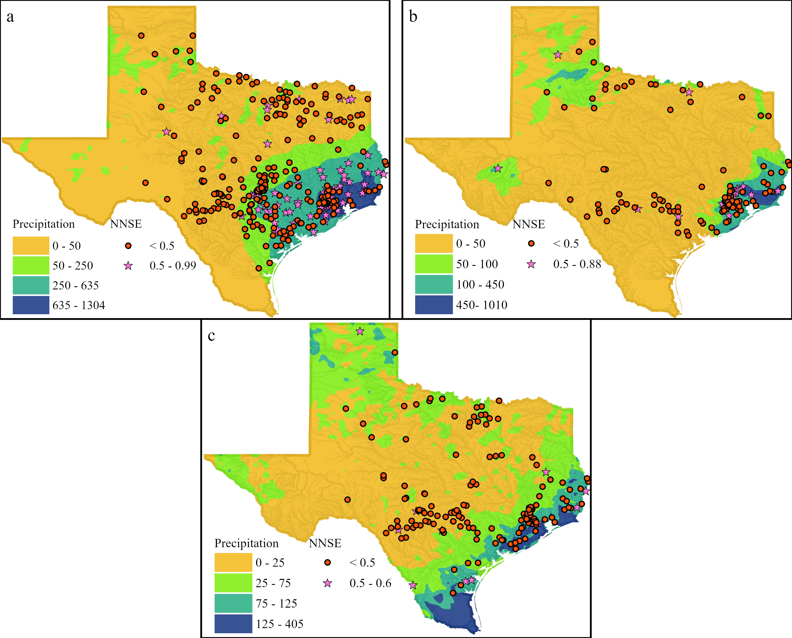
Task 6: Quantifying Forecast Error
Regional Error Assessment:
NWM 3.0 struggles to predict streamflow
accurately especially during major storm events.
Dr. Paola
Passalacqua
Draft of paper for the regional error assessment for NWM 2.1 and 3.0 is ready, undergoing revisions for final submission for publishing.
NWM 3.0 struggles to predict streamflow accurately especially during major storm events.
Fig: Spatial Distribution of NNSE for NWM 3.0 during (a) Hurricane Harvey, (b) TS Imelda, and (c) Hurricane Hanna. NNSE<0.5 in most locations.

Slide 13
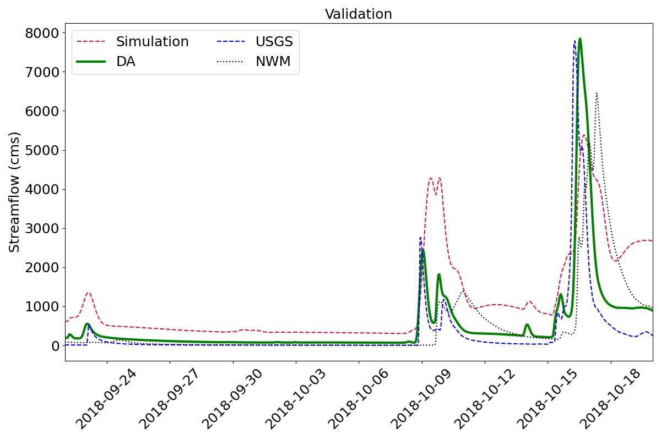
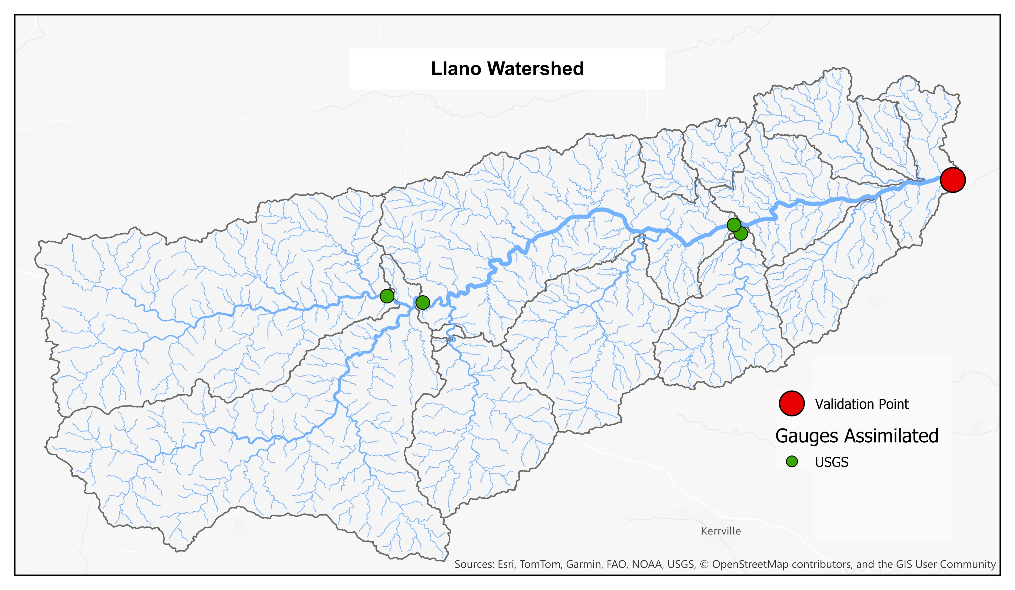
Task 6: Data Assimilation with the CFE Model
Streamflow prediction improves with Data Assimilation
CFE (Conceptual Functional Equivalent) Model:
One of the hydrological models considered for the
NextGen Framework.
A simplified conceptual model designed to be functionally
equivalent to the NWM.
DA improves the streamflow prediction at the validation site for 2018 Llano flood

Slide 14
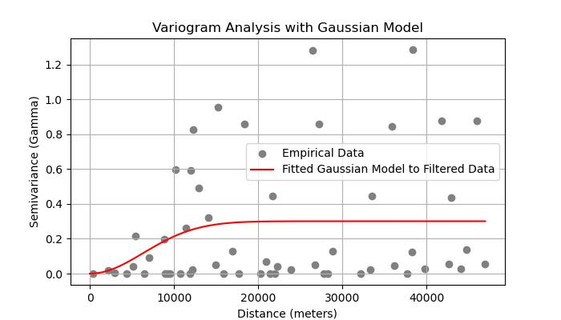
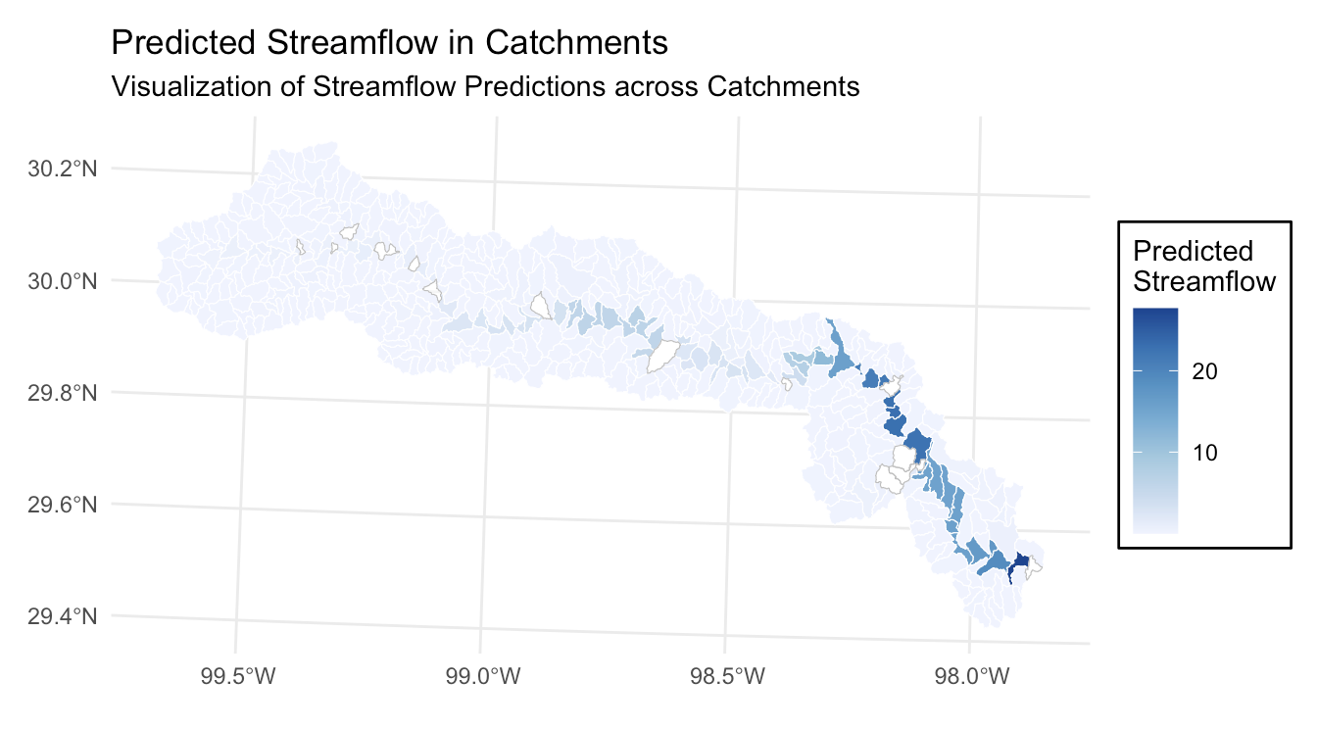
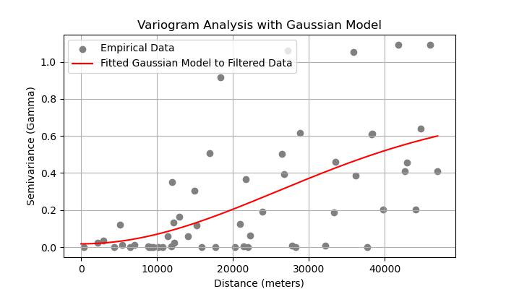
Further Improvement of Data Assimilation in Space with Spatial Correlation
Task 6: Further Improvement of Data Assimilation
Topological Kriging: A geostatistical method used for predicting spatial variables along river networks where the flow path significantly influences spatial relationships.
Quantifying the Spatial Correlation In Guadalupe Basin
2018-10-16 05:00:00
Initial Results for Spatial Correlation in Guadalupe Basin for 2018 storm
Current study focuses on spatial correlation within
the Llano, Guadalupe, and San Antonio Basins.
2018-10-16 10:00:00 (peak flow)

Slide 15
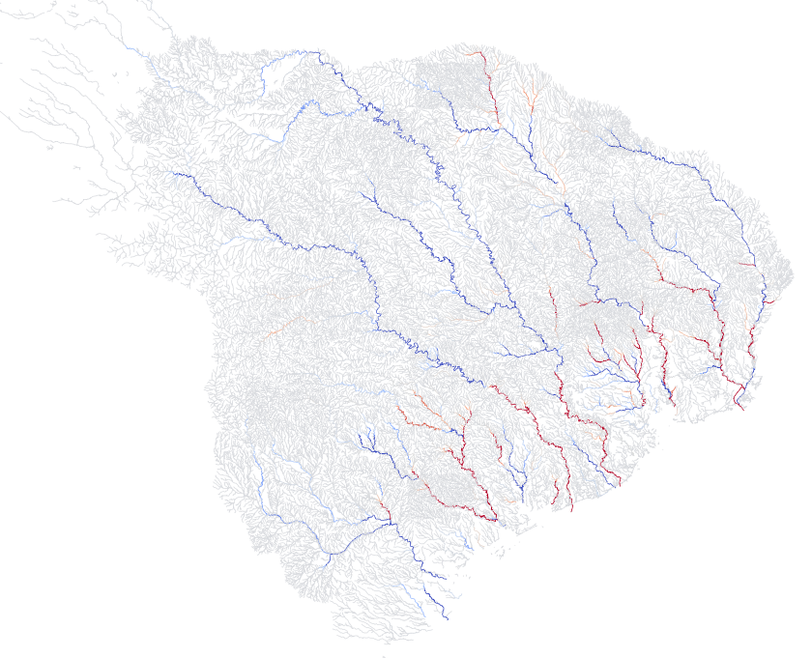
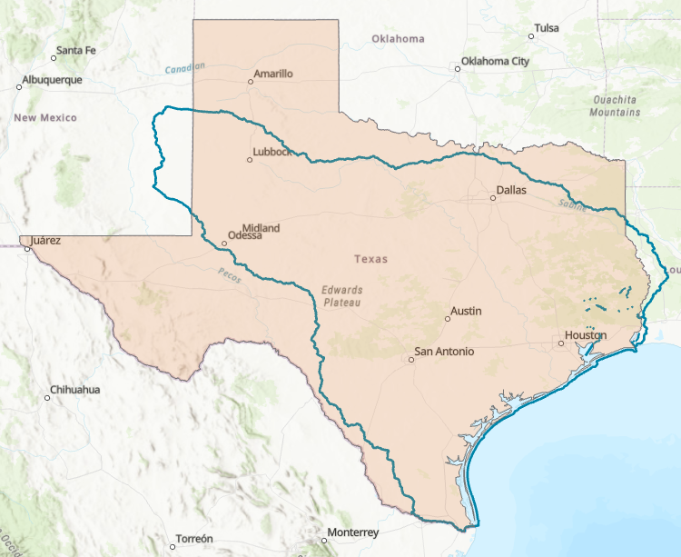
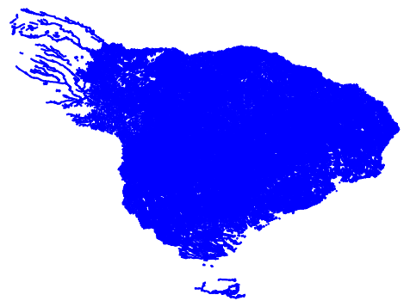
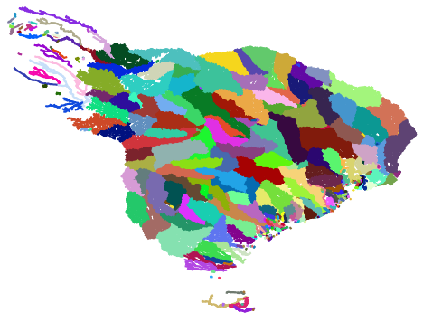
Task 6: Data assimilation with Kalman Filter
Data assimilation based on
Kalman Filtering extended to entire
USGS water resource region 12
(70,000 stream reaches)
Dr. Matt Bartos
Positive correction
Scaling to entire state facilitated by new parallelization scheme.
USGS water resource region 12
Negative correction

Slide 16
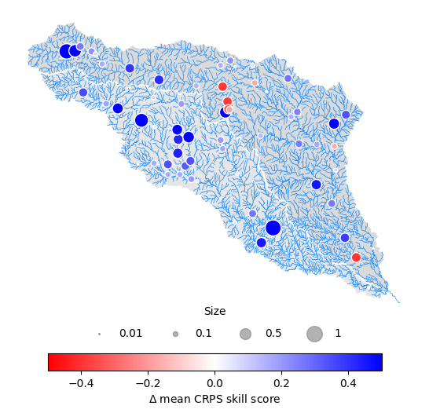
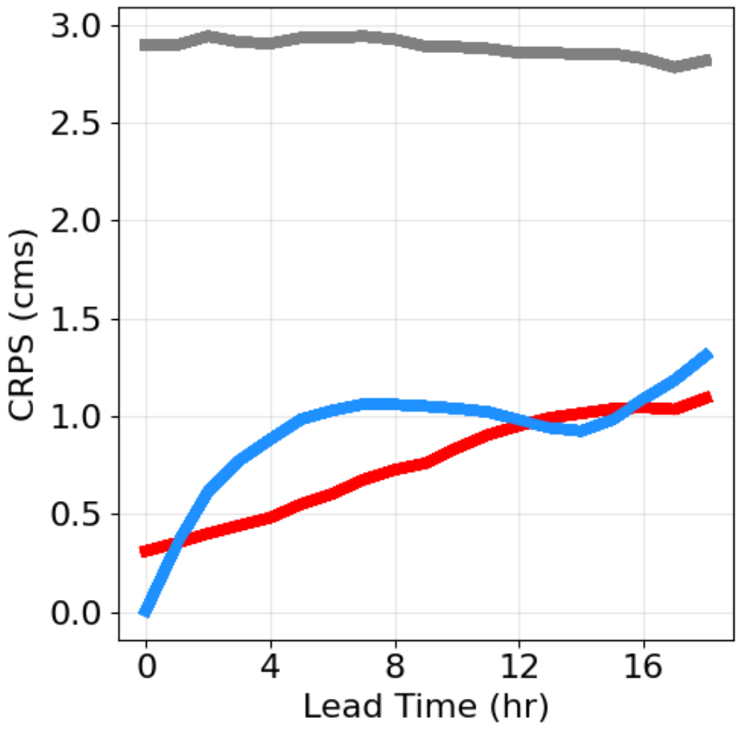
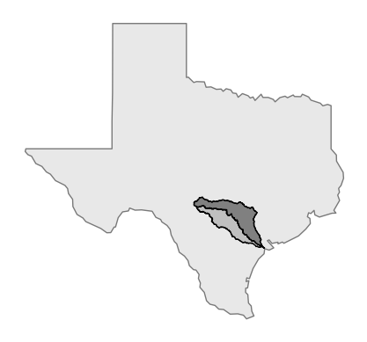
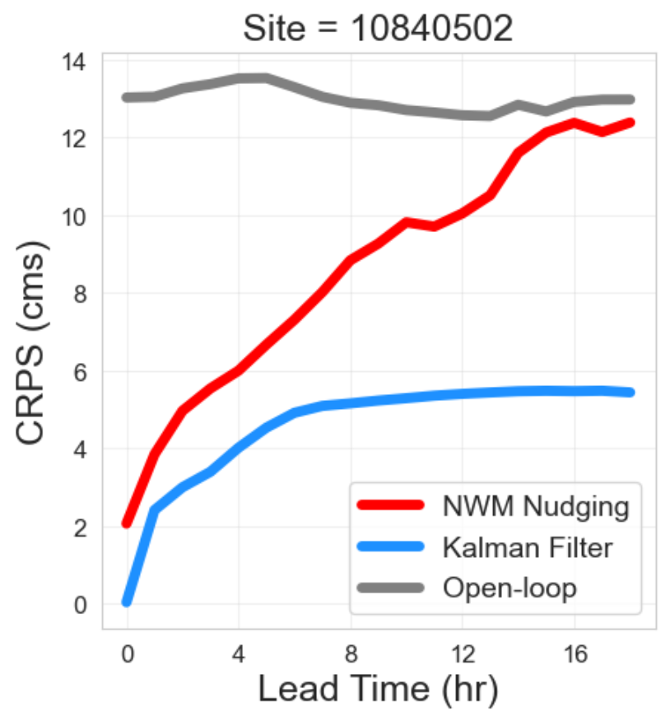
Task 6: Data assimilation
Tests on large river basins (San Antonio and Guadalupe) show that Kalman Filter greatly improves forecast accuracy
Nudging
outperforms
Kalman Filter
outperforms

Slide 17
Task 6: Data assimilation and False Flood Alarms
Kalman Filter significantly reduces false flood alarms compared to raw National Water Model outputs
Reduce false alarms

Slide 18
Task 6: Key Points: Knowledge Added and Operational Capabilities
We have quantified the performance of the current version of the NWM, providing a baseline for assessing improvements (Knowledge added)
We have developed an approach for scaling up the Data Assimilation approach over Texas (Operational capability achieved)
We are improving the DA approach temporal (forecasting) and spatial (spatial correlation) capabilities, which we will integrated in the scaled up approach (developing Knowledge and improving Operational capability)
Error assessment (baseline)
Quantified forecasting improvements
National Water Model
Data Assimilation over Texas
Spatial correlation
Observations
Improved forecasting

Slide 19
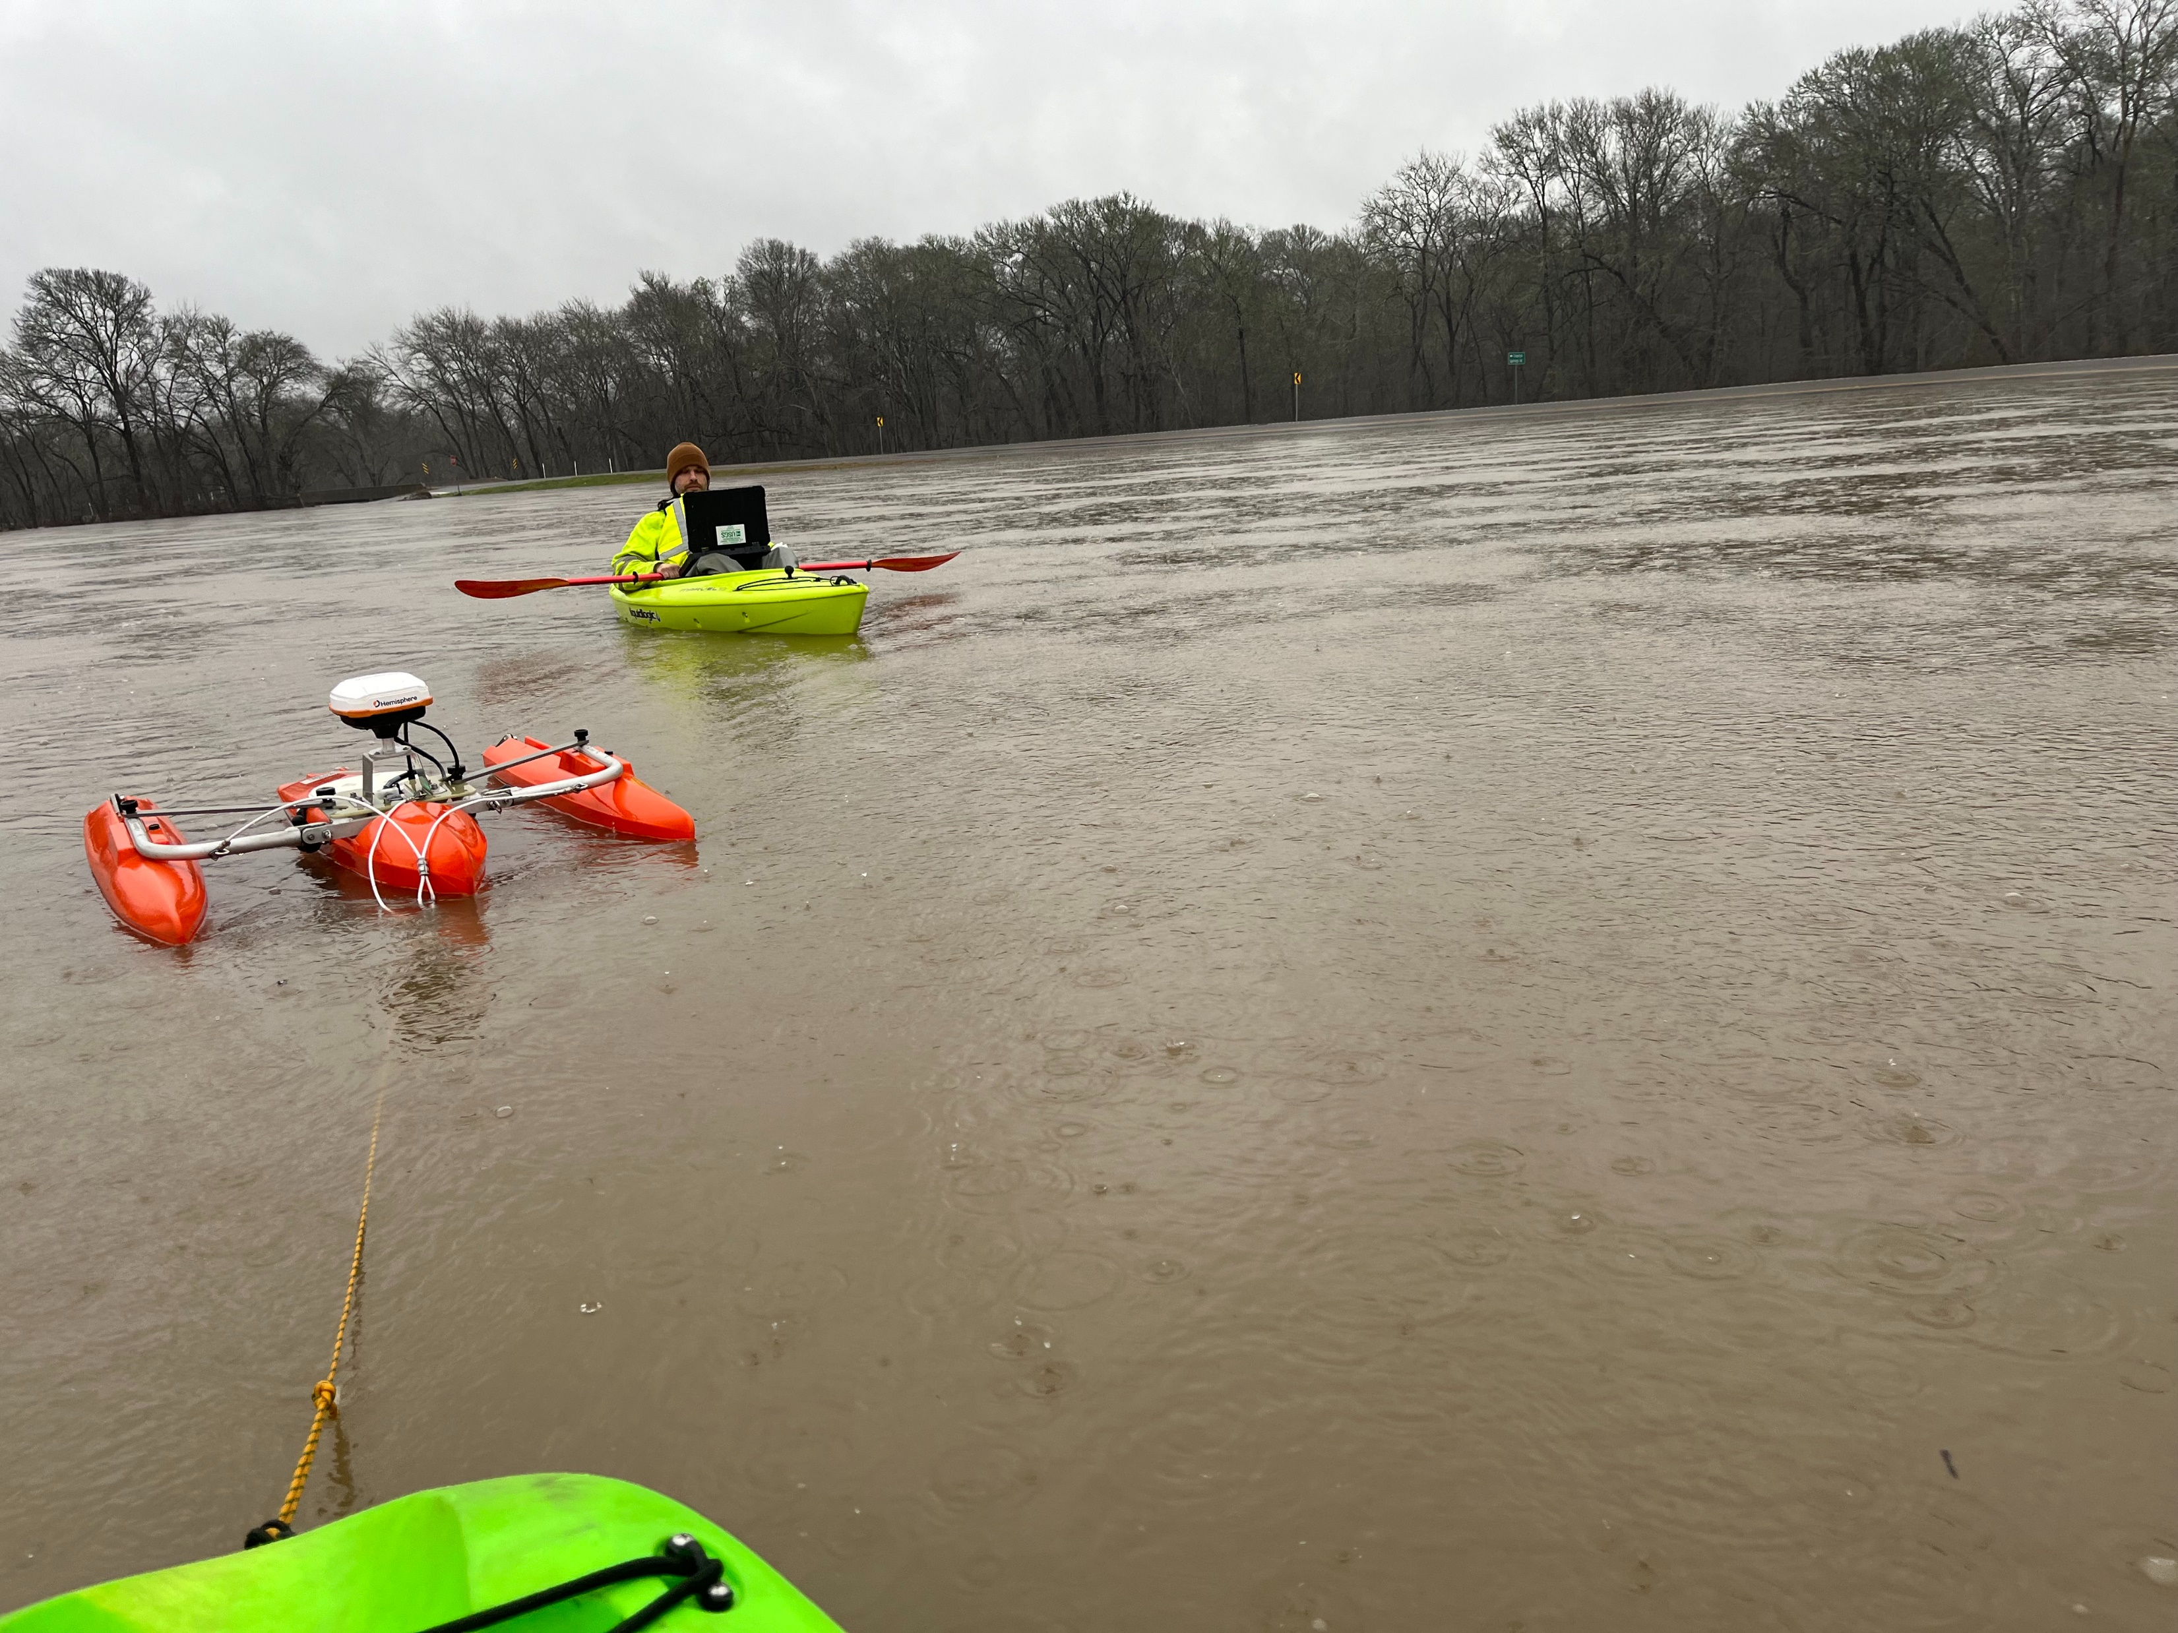
Task 1: USGS Gauge Network
What will we know about the gauge network that we do not know now?
Building a lower cost gauging network
Externalizing the black box of the RQ-30 gauge
Number of site visits needed for O&M/calibration
Updated USGS standards
Data improvements
Velocity
Scour
Backwater
Early warning
Velocity – stage – discharge relationships
Synthetic rating curve standardization
Flood inundation mapping libraries
Who will benefit? – “We all do better, when we all do better.” – RMK
Kristine
Blickenstaff

Slide 20
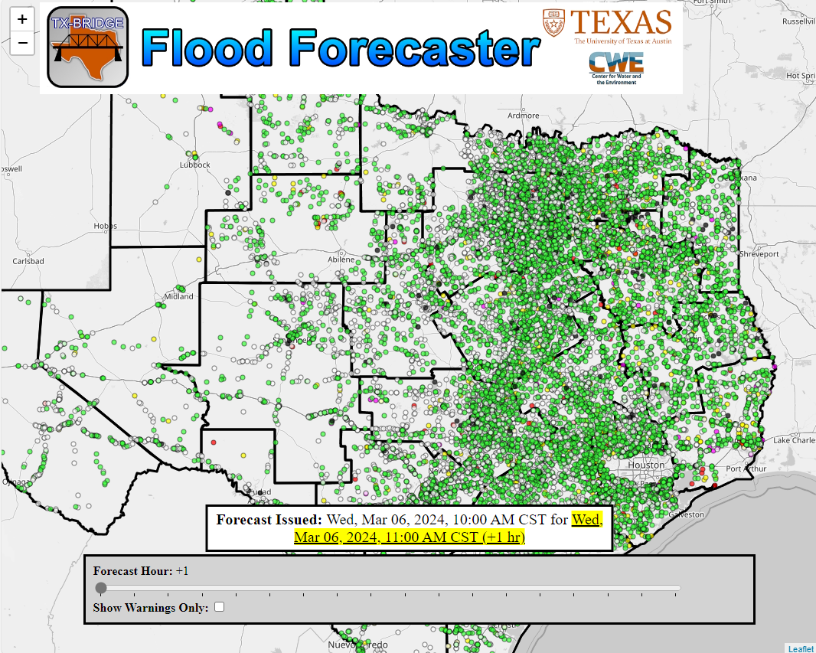
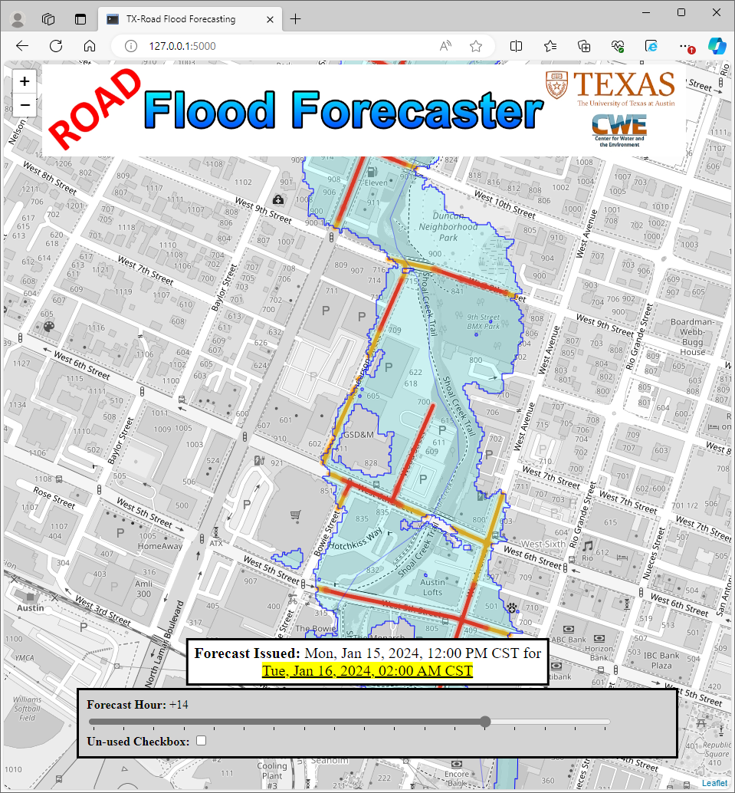
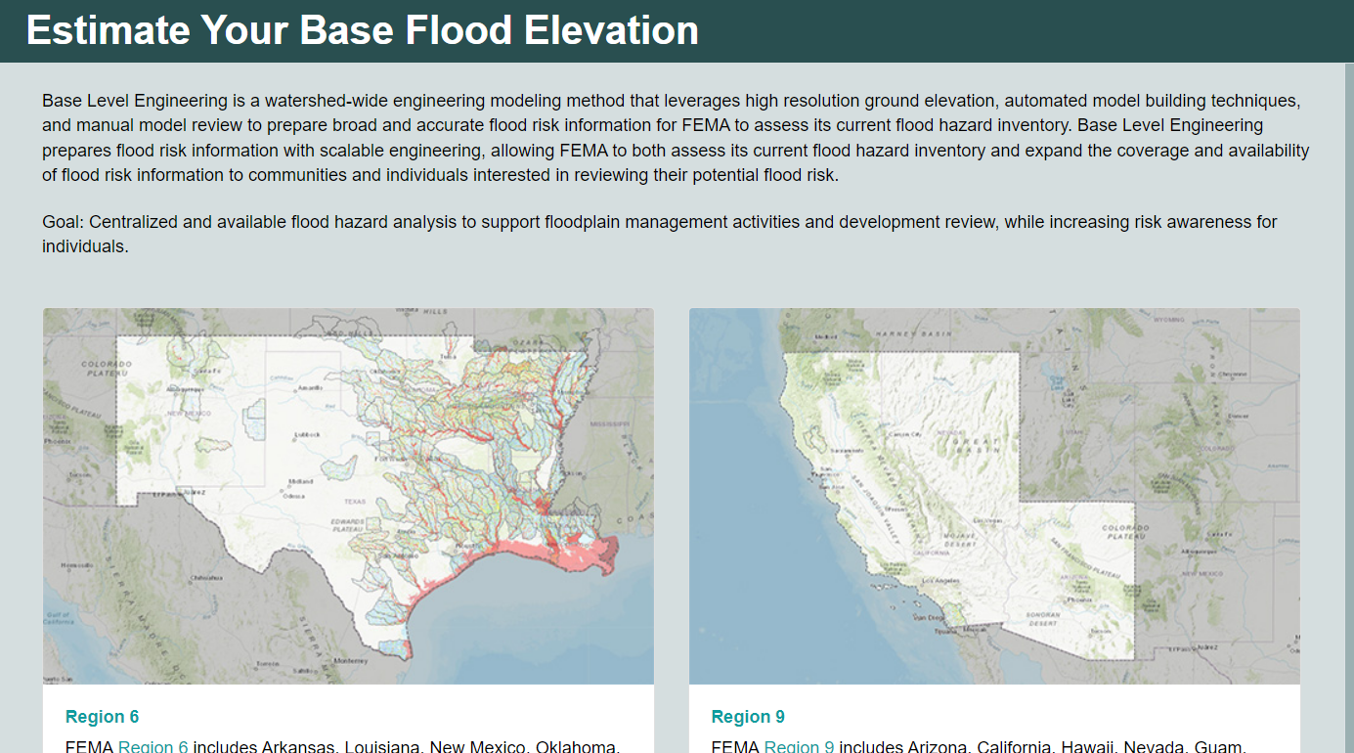
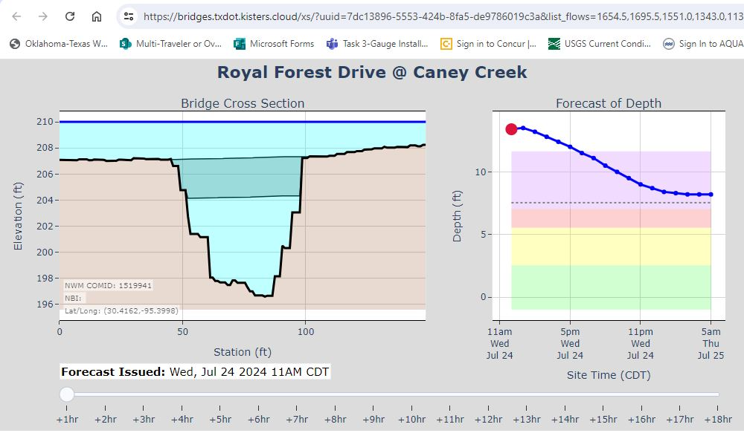
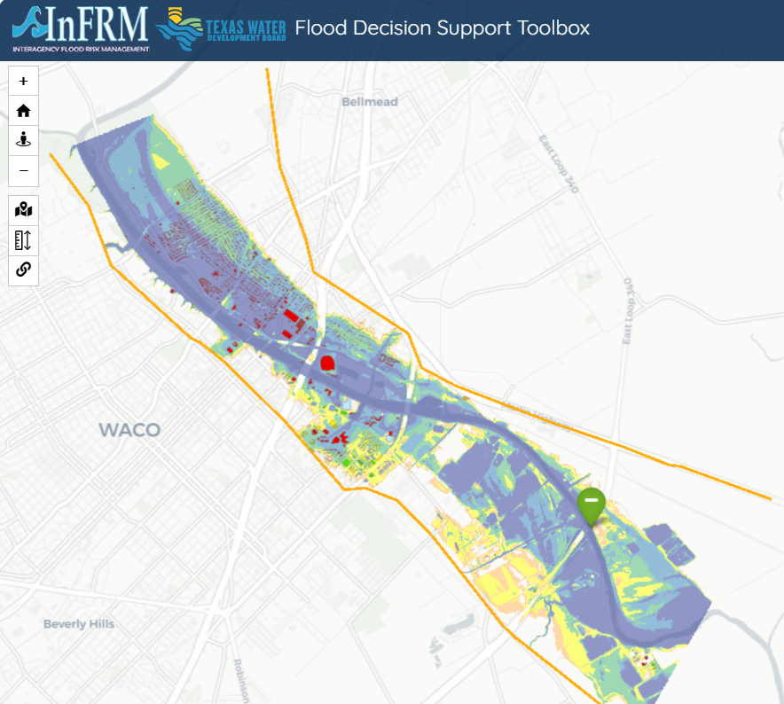
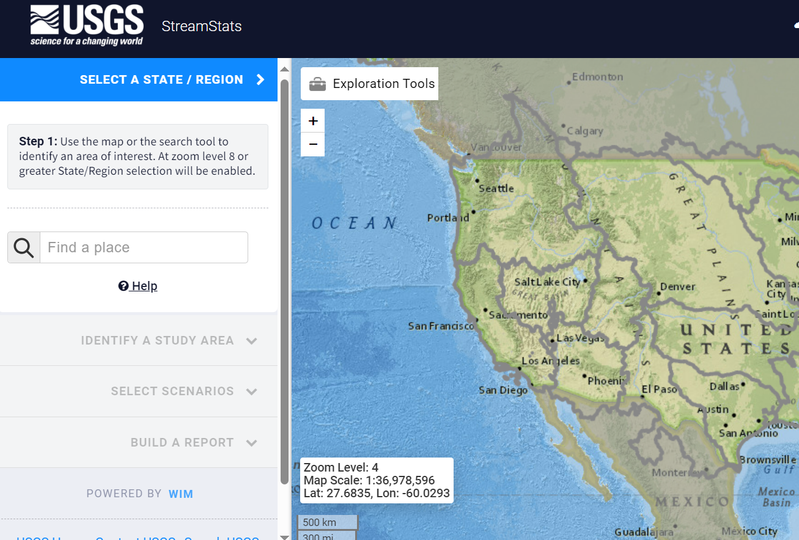
Task 1: All Roads Lead to Texas
Base Level Engineering
RQ-30 Gauges
Flood Assessment System
for TxDOT (FAST)
Flood Decision
Support Toolbox
Integrated Water
Science Basins
StreamStats

Slide 21
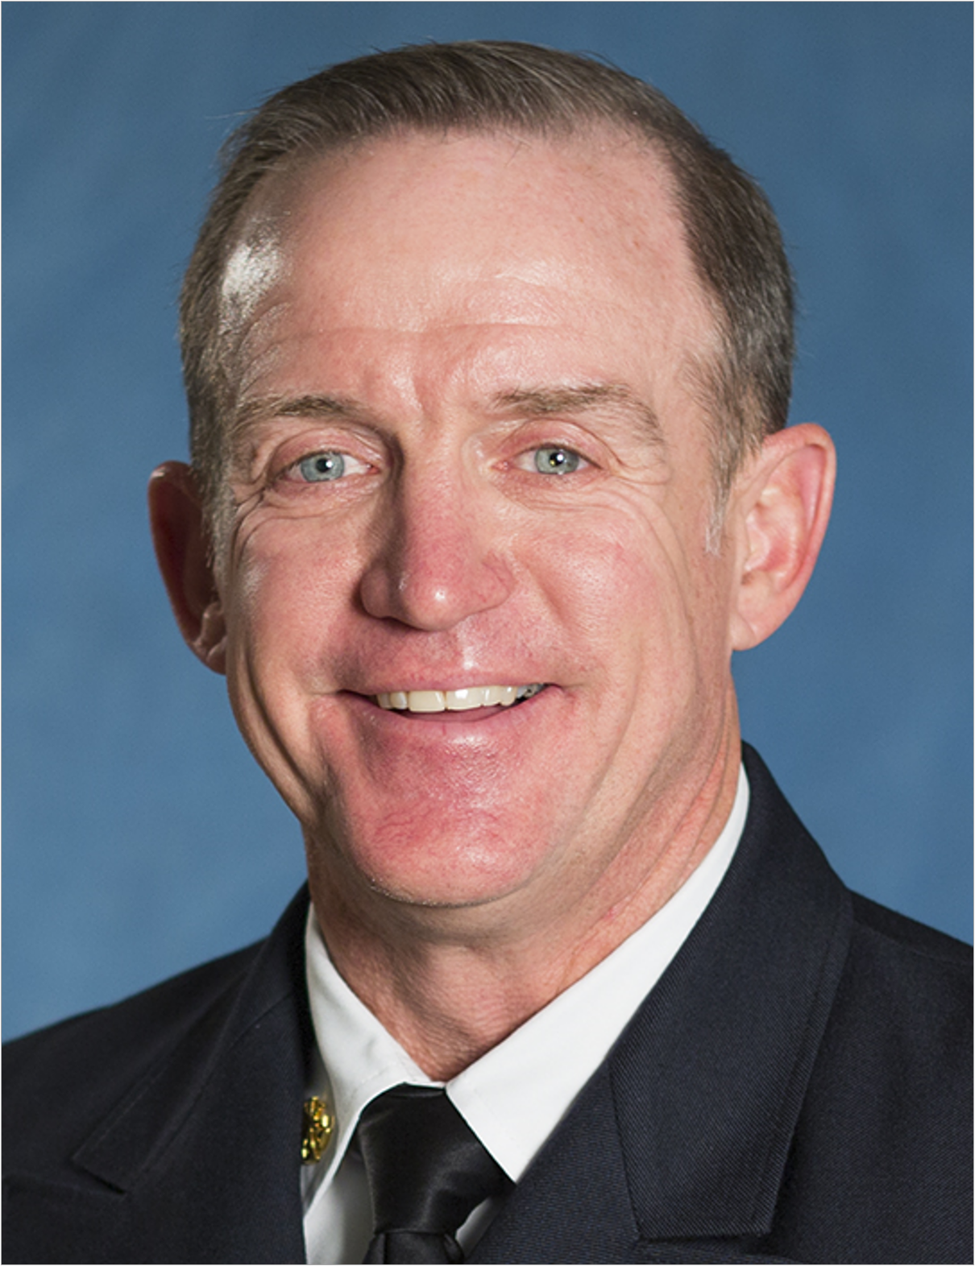
TASK 1: DEVELOPMENT of FAST
Harry Evans
FAST Project Agreement
UT’s Project
Management
USGS Project Management
UT Project Management Plan
USGS Project Management Plan
Technical Project Management Team (TxDOT IT, UT Dev, USGS)
Development & TACH
Feedback
Flood Decision Support Gauges
Research
Reports
TxDOT’s Project Management
TACH Team
Weekly Status Reports
Tim Whiteaker
Andy Carter
Christine Thies
Harry Evans
Monthly Progress Reports
Quarterly Review

Slide 22
Project Vision - Next Three Years
What is TxDOT receiving?
Flood Gauges
Flood Forecasting
Bridge Warning & Flooded Road data
Real-time flood maps
Who will use it?
TxDOT State EOC
TxDOT District EOC’s
TxDOT Maintenance Offices
TxDOT Field Staff during flood operations
Where will it be housed?
Flood Gauge data – USGS National Water Information System
Flood Forecasting – NWS National Water Prediction System
Flood Data Services – KISTERS cloud system (Amazon East cloud services)
Flood Map Services – TxDOT Information Technology Division (temporarily located at UT Austin)

Slide 23
Task 2
FLOOD MAP SERVICES
Harry Evans
Christine Thies
Task Components
Subtask 2.1 Flood Map Development
Subtask 2.2 Flood Map Delivery
Subtask 2.3 Field Mapping
Subtask 2.4 Flood Emergency Response Exercises

Slide 24
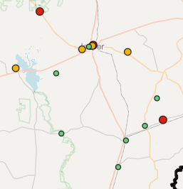
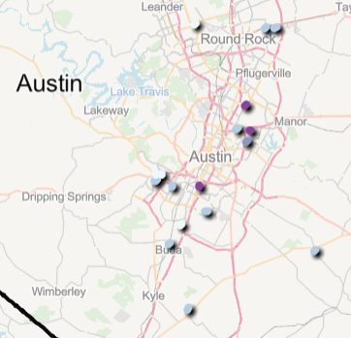
Task 2: Progress since last Quarterly Review (Dec 2023)
Gave TxDOT Access to Initial Datasets
Harry Evans
Draft prototype of
Bridge Warnings & Flooded Roads
Incorporated changes to
draft layers based on TPMT input
Flooded Roads
Bridge
Warnings

Slide 25
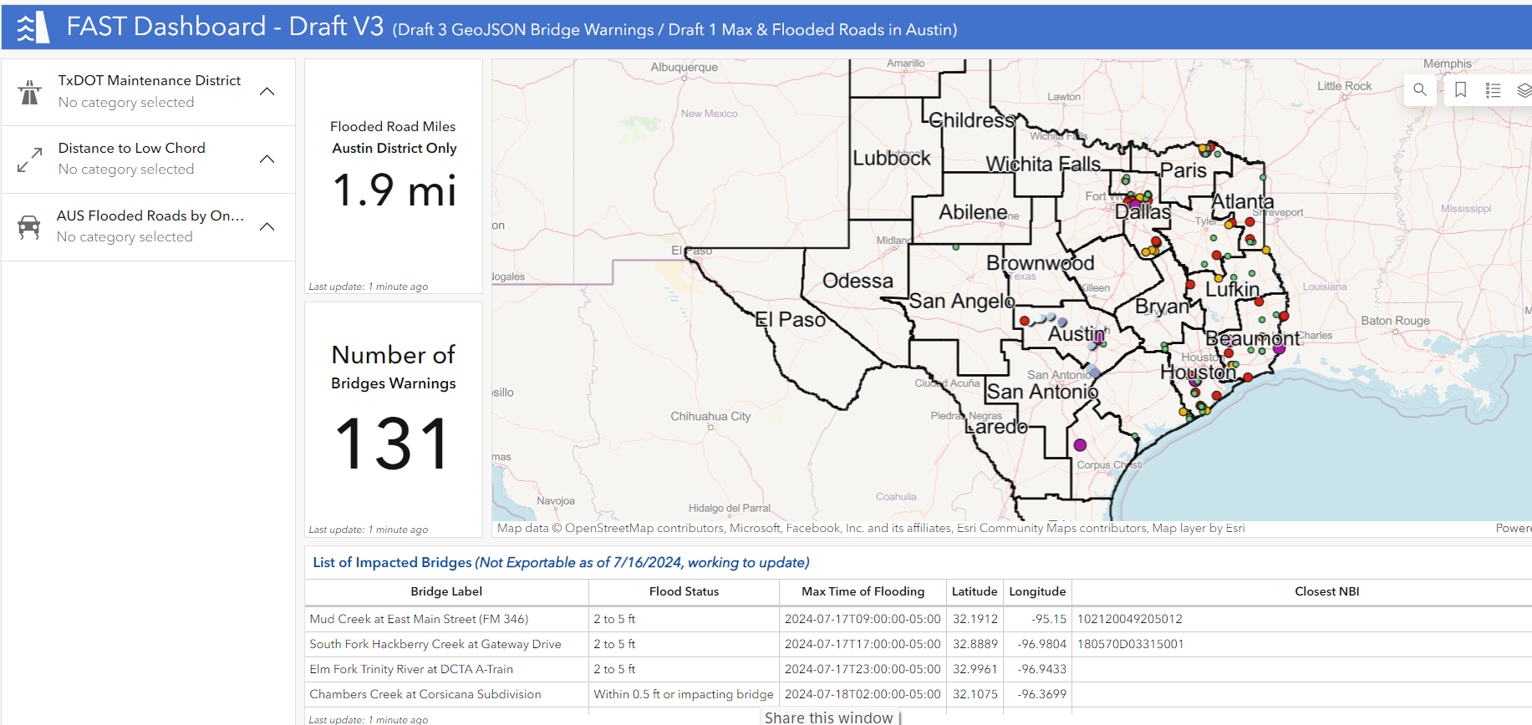
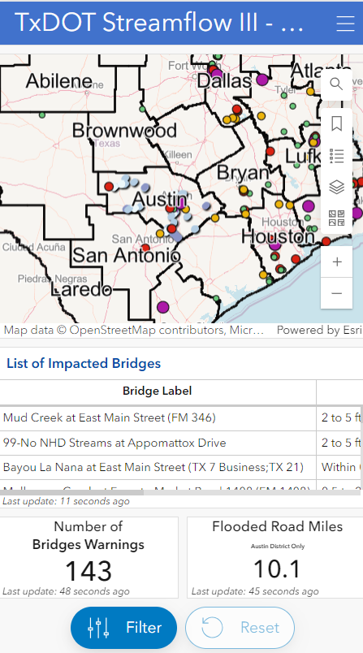
Task 2: Progress since last Quarterly Review (Dec 2023)
Created a ‘Sandbox’ for TxDOT & UT Interactions
Developed draft mobile and desktop applications
Provided to TPMT for internal review
TPMT provided feedback which has guided production
Try it out!
https://bit.ly/4d0I7KI

Slide 26
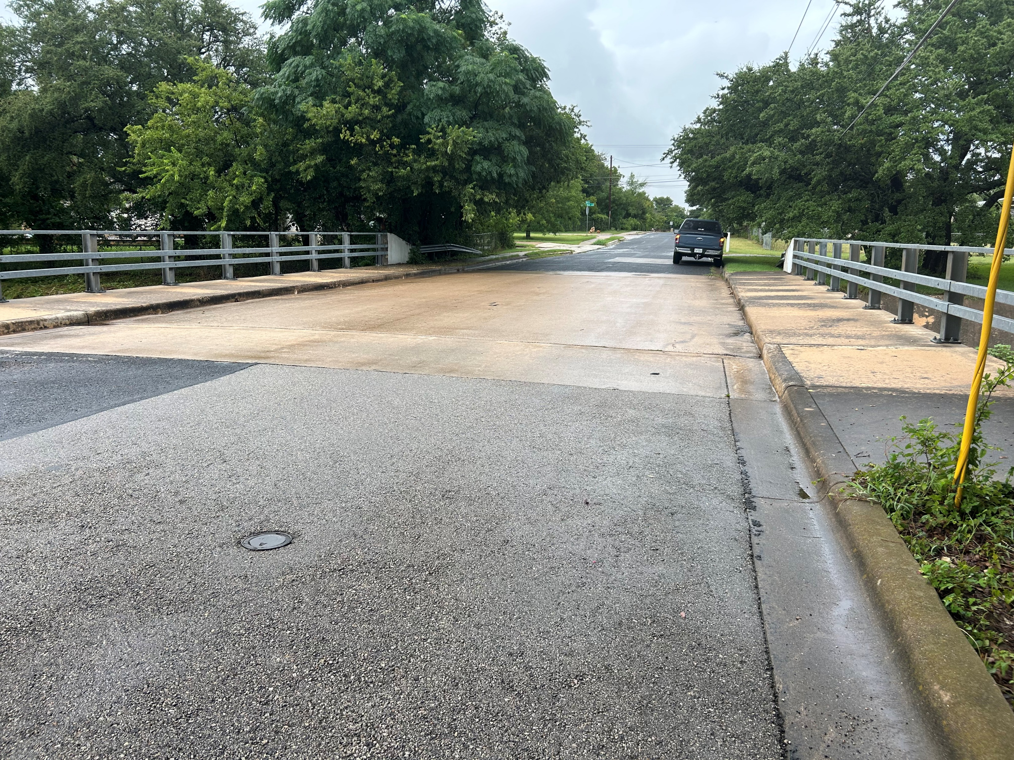
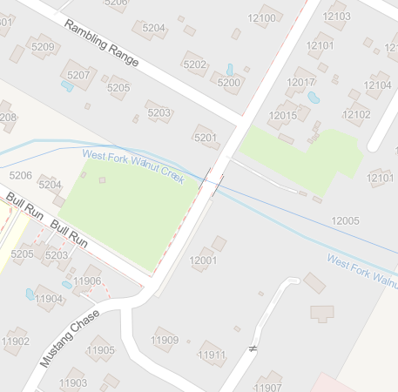
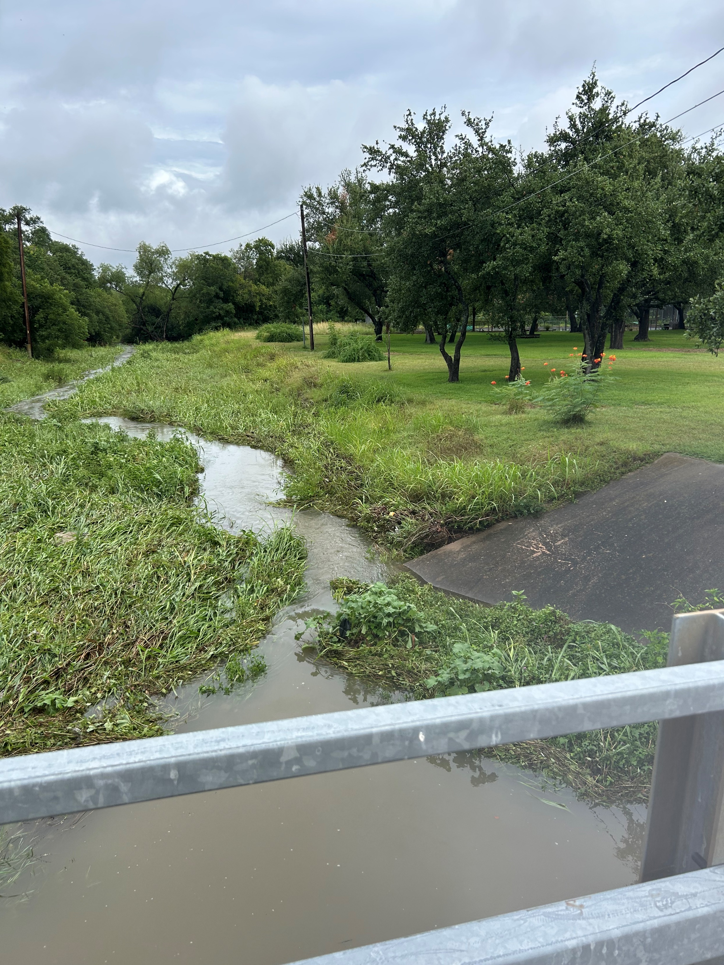
Task 2: Mustang Chase at Walnut Creek
UT Field Reconnaissance
Mustang Chase @
West Branch of Walnut Creek
FLOODED ROAD
in Dashboard
Field check
contradicts Bridge Warning Layer

Slide 27
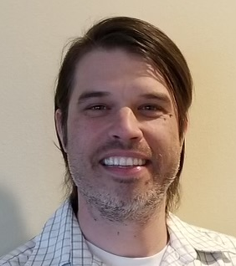
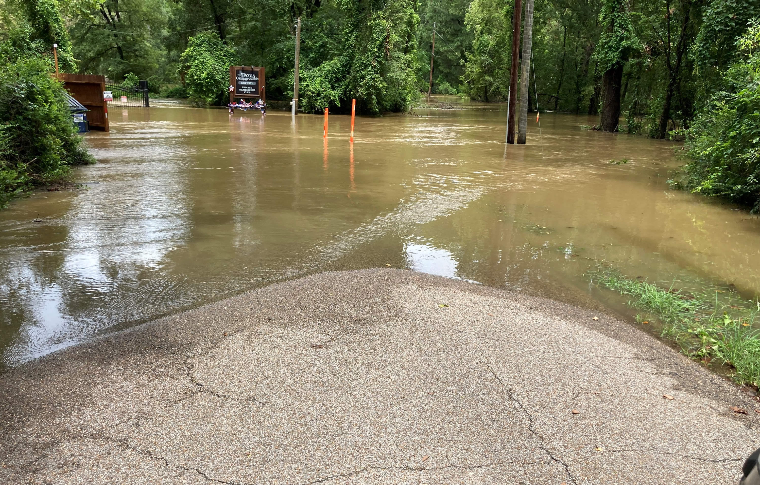
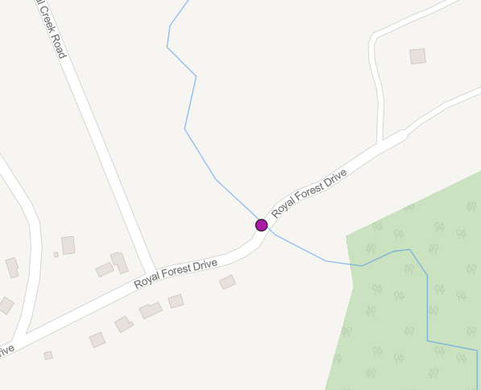
Task 2: Royal Forest Dr at Caney Creek
Jody Avant
USGS Field Reconnaissance
Royal Forest Dr @
Caney Creek
FLOODED BRIDGE
in Dashboard
Field check validates Bridge Warning Layer

Slide 28
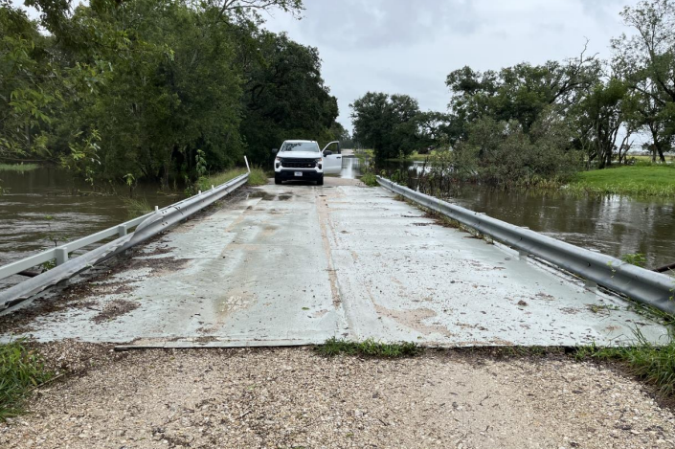
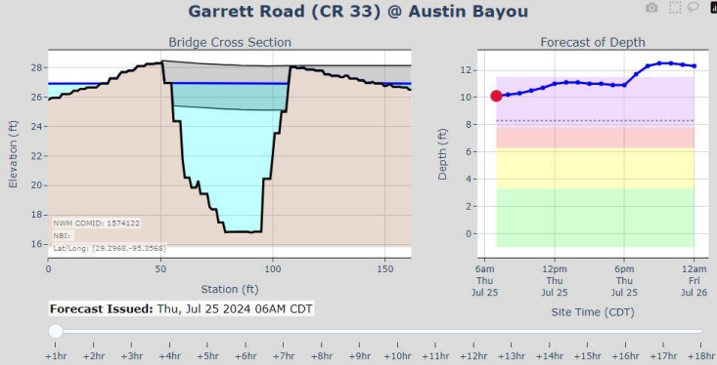
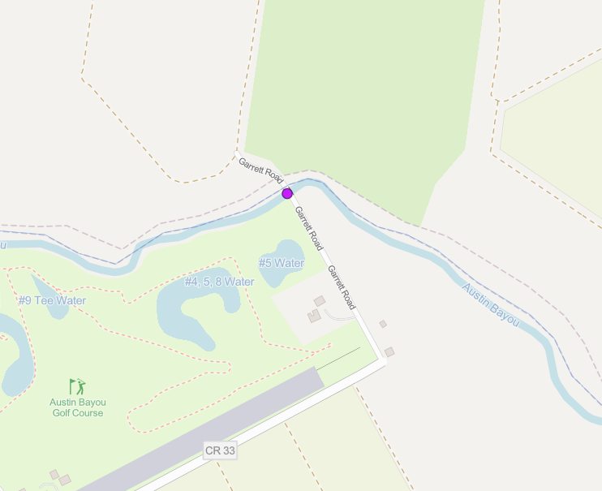
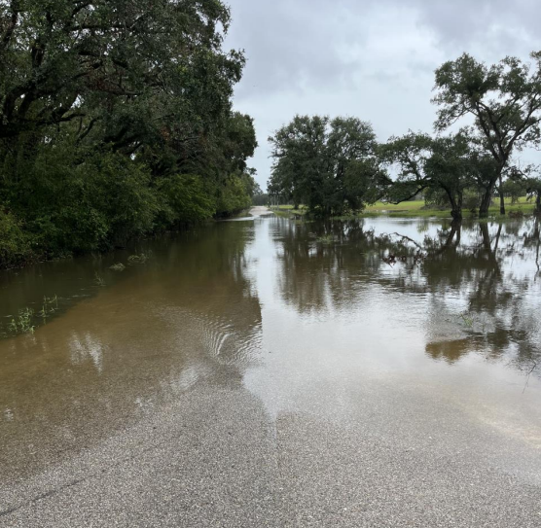
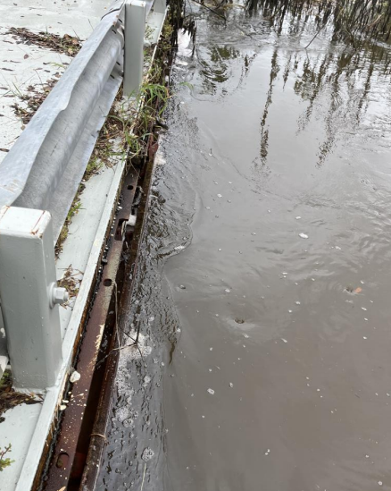
Task 2: Garrett Road at Austin Bayou
USGS Field Reconnaissance
Garrett Rd @
Austin Bayou
FLOODED BRIDGE
in Dashboard
Field check validates Bridge Warning Layer

Slide 29
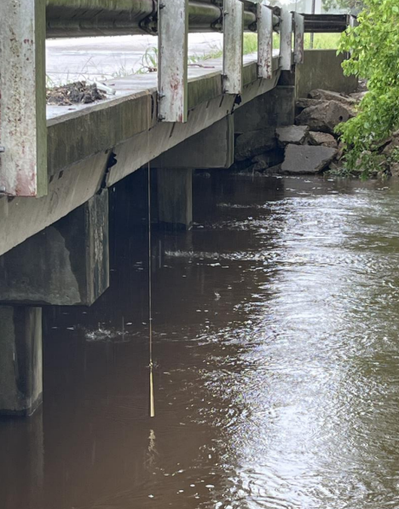
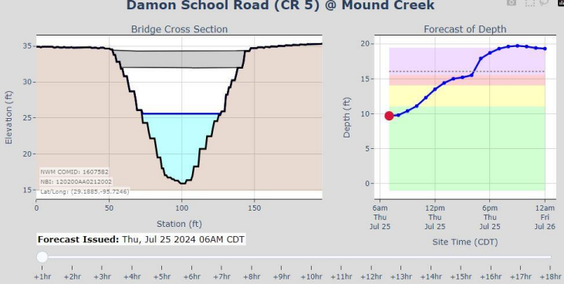
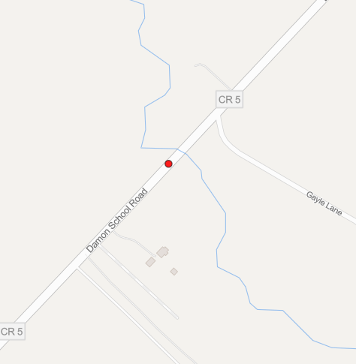
Task 2: Damon School Rd at Mound Creek
USGS Field Reconnaissance
Damon School Rd @
Mound Creek
2-5FT to BRIDGE
in Dashboard
Field check validates Bridge Warning Layer
3.9ft to deck

Slide 30
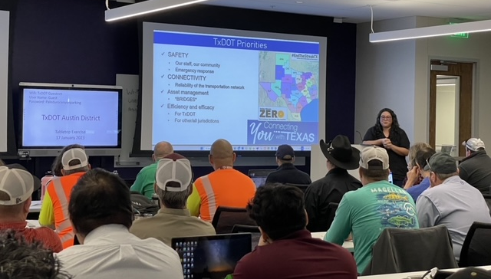
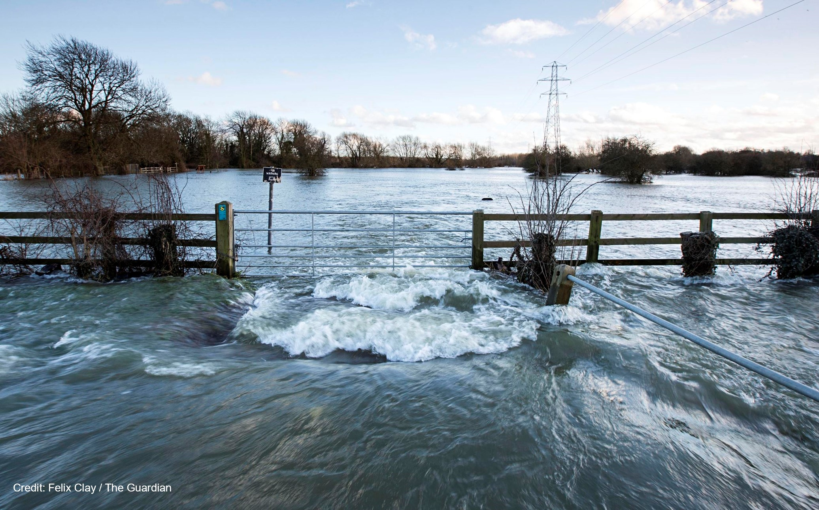
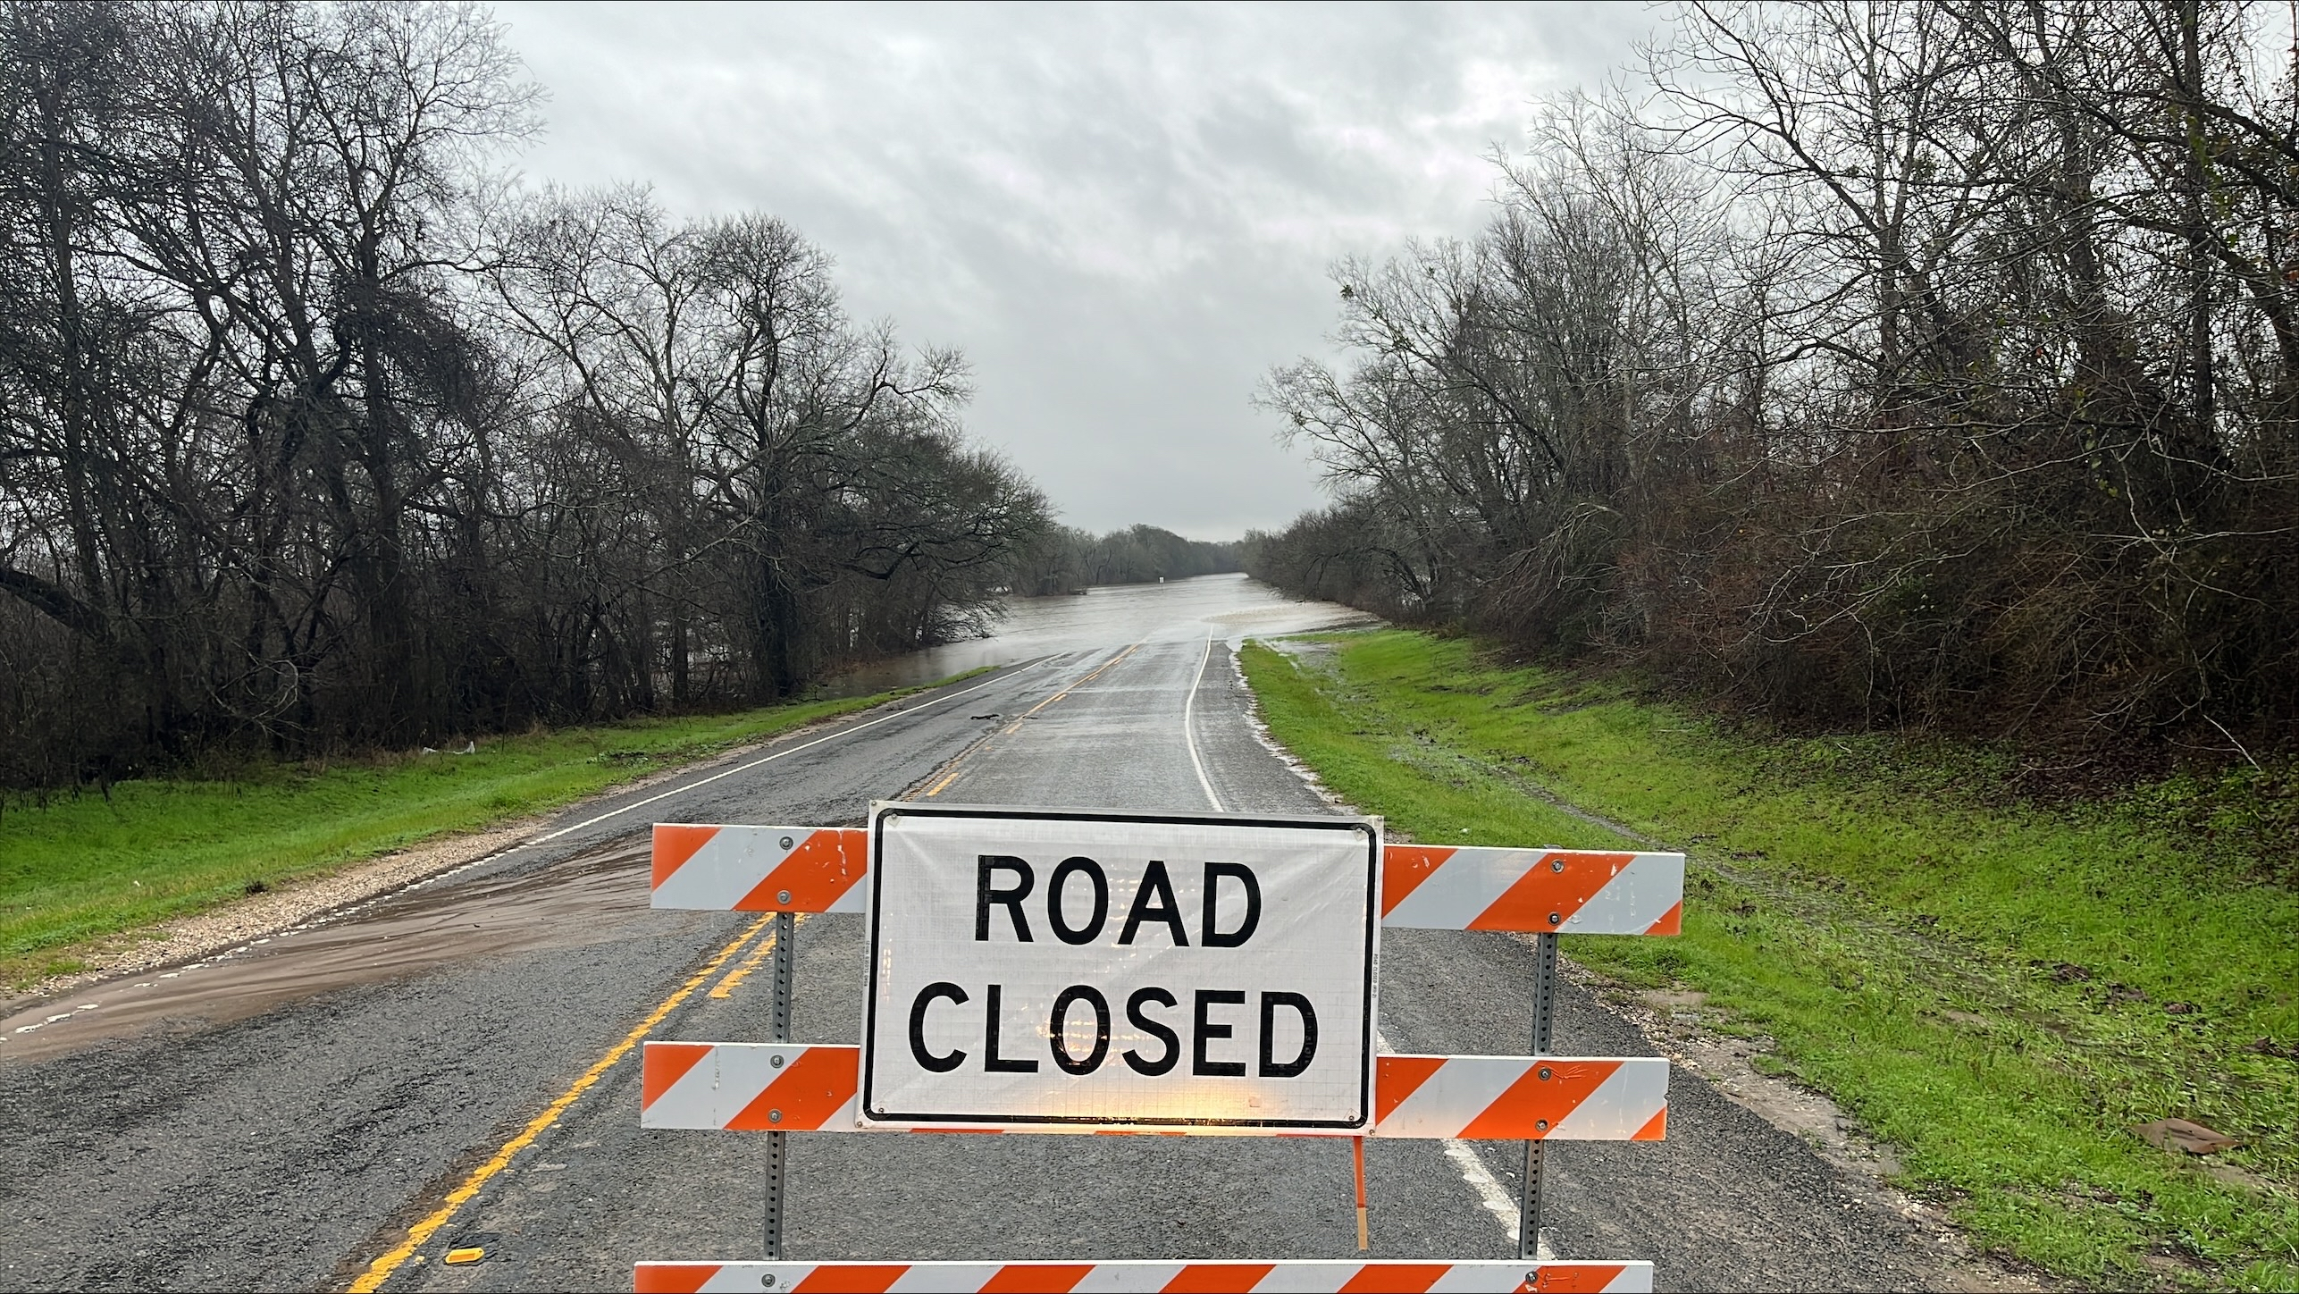
Task 2: Plans for Next Quarter
Flood Emergency Response Exercises
Exercise Work Group
Emergency Response Priorities
Create overall Exercise Plan

Slide 31
First Discussion

Slide 32
Task 3
FLOOD DECISION
SUPPORT GAUGES
Kristine
Blickenstaff
Scott Grzyb
Jon Thomas
Task Components
Subtask 3.1 Gauge Operation and Maintenance
Subtask 3.2 Gauge Calibration
Subtask 3.3 RQ30 Flood Decision Support Toolbox Sites
Subtask 3.4 Velocity – Stage Height Interaction
Subtask 3.5 Synthetic Rating Curves

Slide 33
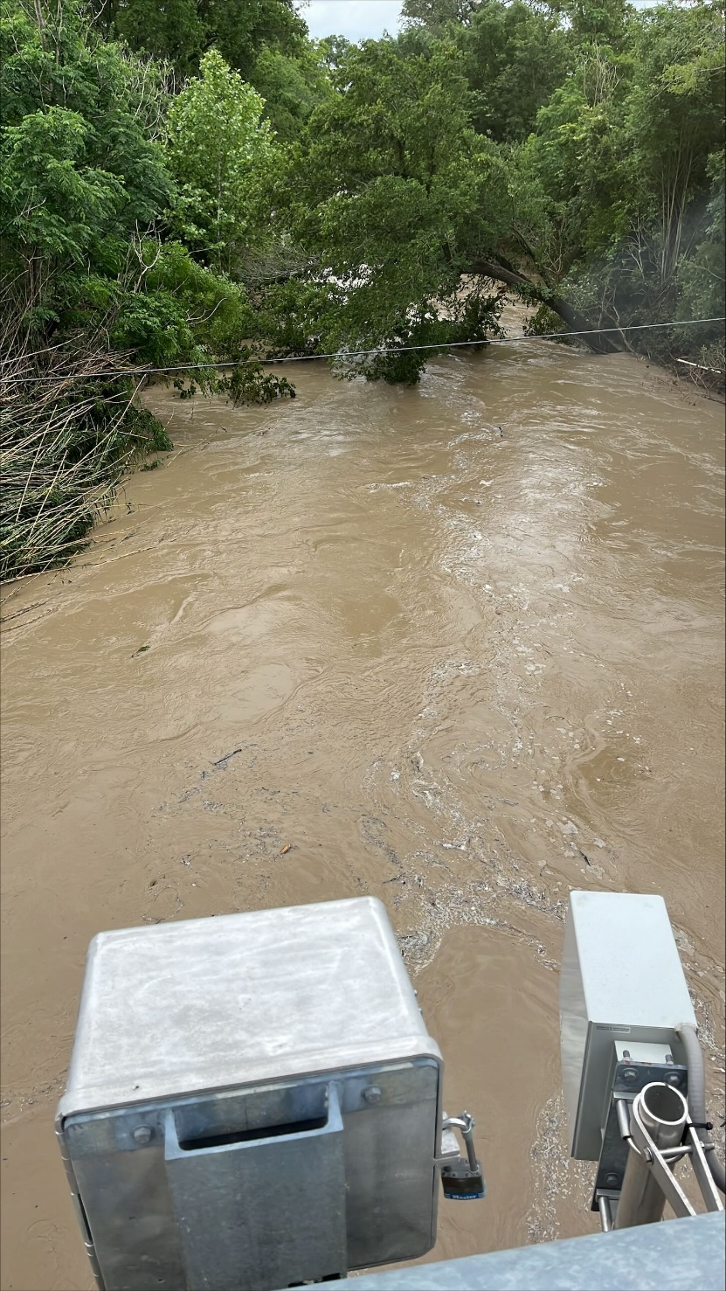
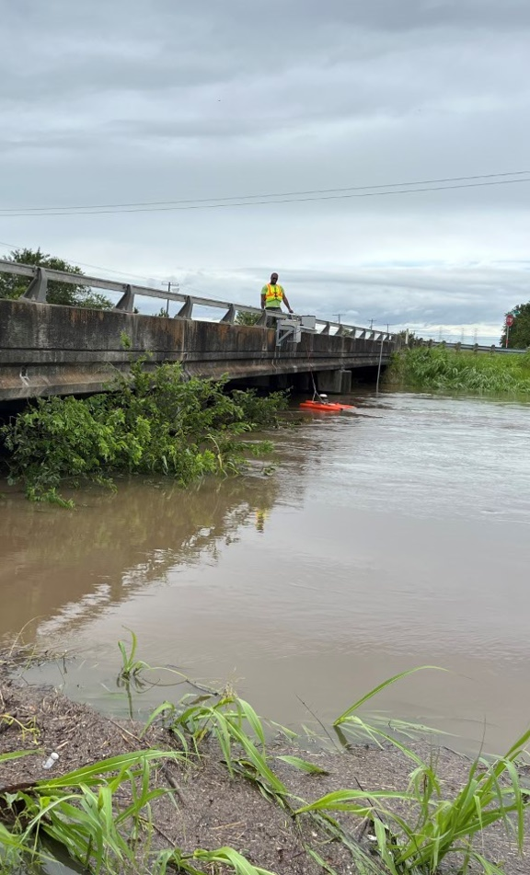
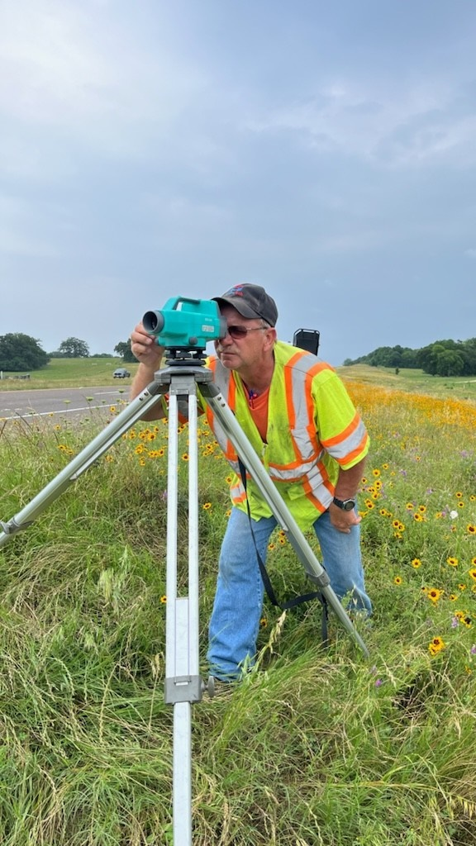
Task 3: Field Visits
179 gage visits
67 measurements
31 verification surveys

Slide 34
Task 3: Hurricane Beryl
6-hour response time
15 flood measurements over a 3- day campaign
Stress test on the network
Data collection during windy conditions
Telemetry issues identified

Slide 35
Task 3: Calibrations
20 gages calibrated
Continue verification measurements at calibrated gages

Slide 36
Task 3: Bathymetric Surveys
Jon Nelson is starting
hydrodynamic modeling
2 surveys completed
Data processing with iRIC
Determine what level of accuracy is needed for model derived discharge rating curves
Notes:
Add a headshot of jon

Slide 37
Task 3: Observed Limitations
Average velocity issues once water reaches the low chord
Road overflow
Power issues = Connectivity issues

Slide 38
Task 3: RQ-30 Flood Decisions Support Toolbox (FDST) Sites
1D modeling for FDST flood maps (On-going): 25* sites completed, yet to be validated
2D modeling for FDST flood maps (started)
Jon Thomas

Slide 39
Task 3: Synthetic Rating Curves and the FDST
FDST validated by comparing the modeled stage-discharge relationship (rating curve) to the USGS measured rating curve
RQ30 gages do not have the measurements to validate the FDST models in flood stage
We are developing a regionalized stage-discharge relationship using a GAM model based on 17,000+ discharge measurements in TX to provide an estimated rating curve for new gages based on stream:
Cross-section area (A)
Top width (B)
Other regional parameters
Method can provide a synthetic rating curve for any* stream location in Texas
*Estimates may be less accurate in certain scenarios, such as mountainous terrain or highly urbanized channels
Method is based on William Asquith's 2013 paper http://dx.doi.org/10.1061/(ASCE)HE.1943-5584.0000635

Slide 40
Task 3: Plans for Next Quarter
Continue flood measurements and calibrations
Continue bathymetric surveys
Experiment with increased transmission frequency for flood events
2D (14 locations) and 1D (8 locations) remain for FDST to be modeled and evaluated in FY24
Finalize regional regression equation for synthetic rating curve effort
Start assessment uncertainty across FEMA Region 6

Slide 41
Task 4
Flood
Transportation Geodatabase
Andy Carter, P.E.
Dr. David
Maidment
Dr. Tim
Whiteaker
Task Components
Subtask 4.1 Road Elevation Model
Subtask 4.2 Stream Hydrography
Subtask 4.3 Road Inundation
Subtask 4.4 Span Bridges
Subtask 4.5 Bridge Class Culverts
Subtask 4.6 Low Water Crossings

Slide 42
Flood Assessment System for TxDOT (FAST)
Conceptual Framework
FY24 Austin District On-System
FY25 State-wide On-System
FY26 State-wide public roads
Adjusted Forecast
Dynamic
Flood Map Service
Streamflow Measurement
Impact
Assessment
Flood Forecast
3D Roads
and bridges
Static
Flood Transportation
Geodatabase
Lidar terrain measurement
Quality Control and Checking
2D Roads
and bridges

Slide 43
Task 4: Flood Transportation Geodatabase
Develop a geodatabase schema that relates the built world
(roads, culverts, bridges)
with the flood inundation modeling
Flood Transportation Geodatabase

Slide 44
Task 4: Flood Inundation Mapping
Methods to extract flood inundation layers and rating curves
We have begun with HAND and will include HEC-RAS mapping later
Flood Transportation Database
Flood Inundation Layers

Slide 45
Task 4: Flood Transportation Geodatabase Components
Pavement Limit Polygons
Streamline / Road Intersections
Road Elevation Model
(from LiDAR)
Road Lines
Streamlines
Culverts
Low Water Crossings
Bridges
A 3D geographically integrated database of roads, streams, bridges, culverts and low water crossings

Slide 46
Task 4: ESRI Team for Geodatabase Design and Quality Control Checking
Dean Djokic
Principal Technical Consultant
Water Resources Practice
Arc Hydro Lead
Michelle Johnson
Principal Technical Consultant
Geodata Engineering; QA/QC
Flood Transportation Database design
Flood Transportation
QA/QC design

Slide 47
Task 4: Flood Transportation Geodatabase Design
Translating concepts into integrated data system
Raster
Vector
Tables
Key elements:
Topography
Hydrography
Hydrology/hydraulics/forecasting
Critical infrastructure
Reporting units

Slide 48
Task 4: Flood Transportation Geodatabase Design
Key elements:
Topography
Hydrography
Hydrology/hydraulics/forecasting
Critical infrastructure
Reporting units

Slide 49
Task 4: Geodatabase Design and Quality Control Checking

Slide 50
Task 4: Example: Road Crossing a Stream

Slide 51
Task 4: Composite Check being Configured in Data Reviewer

Slide 52
Task 4: Error Inspector used to Identify Issues

Slide 53
Task 5
Flood DATA SERVICES
Dr. Tim
Whiteaker
Andy Carter, P.E.
Dr. Attila Bibok
Task Components
Subtask 5.1 Road Elevation Model
Subtask 5.2 Stream Hydrography
Subtask 5.3 Road Inundation
Subtask 5.4 Span Bridges
Subtask 5.5 Bridge Class Culverts
Subtask 5.6 Low Water Crossings

Slide 54
Computed 1-meter Road Digital Elevation Model
Task 5: Flooded Road and Bridge Services
Dr. Tim
Whiteaker
For Austin District
Built from lidar
Supports flooded road computation

Slide 55
Published flooded road feature service in ArcGIS Online (AUS only)
Task 5: Flooded Road Service

Slide 56
Published bridge warnings service in ArcGIS Online and as GeoJSON (TX)
Task 5: Bridge Warning Service

Slide 57
Task 5: Progress since last Quarterly Review (Dec 2023)
Andy Carter, P.E.
OLD - Bridge Warning Prototype
NEW – Draft bridge warning Dashboard
Stand-up an [DRAFT] operational web service, using Kisters backend servers, that deploys a flooded bridge and flooded road system.
Agnostic data endpoints: GeoJSON, GIS Feature Layers, FAST API, etc…

Slide 58
Task 5: Bridge Cross Section Service
Bridge Cross Section Service: How it works
NWPS
Datasphere
0,0,1000,2000,2000,….
User defined flow list
Streamflow sources
Bridge Warning Service
(on AWS - Kisters)
Interactive Bridge Cross Section view (Web page)
Bridge definition
database
Example URL:
KISTERS AWS s3 bucket
https://bridges.txdot.kisters.cloud/xs/?uuid=00a1d8c7-2ead-4fc4-ae9c-928146a4460c&source=datasphere&product=short_range

Slide 59
Task 5: Bridge Warning API
Deploy an agnostic API for bridge warnings
Documented API – using SWAGGER
https://bridges.txdot.kisters.cloud/docs
https://bridges.txdot.kisters.cloud/xs/?
uuid=00a1d8c7-2ead-4fc4-ae9c-928146a4460c
list_flows=0,0,0,0,0,0,0,100,1000,5000,28000,42000,50000,45000,42000,35000,30000,25000
first_utc_time=2023-10-26T02:00:00
Click to see requested bridge (kisters.cloud)

Slide 60
Task 5: Current Web Architecture
Creating flooded road and bridge geospatial
layers hourly … Expose them in web maps
Bridge definition
database
Road Flooding Susceptibility
Static Assets
Datasphere
Realtime warning raw data
Realtime Streamflow sources
Flooded Road and bridge backend
Ingested to create Feature layers
What is predicted to flood?
Web Maps
Notes:
We have a solid base of services -> Now we have to upgrade them with DA
Make the first subcatchment operational with DA
Update the services to receive the DA adjusted forecasts
Gradually improve the lag of available forecasts and opbservations

Slide 61
Task 5: Plans for Next Quarter
Adding ‘Data Assimilation’ flow data to show
the difference in predicted impacts
Bridge definition
database
Road Flooding Susceptibility
Static Assets
Datasphere
Realtime warning raw data
Realtime Streamflow sources
Flooded Road and bridge backend
Ingested to create Feature layers
What is predicted to flood?
Web Maps
USGS Gages +
National Water Model +
Installed RQ-30 gages =
Improved flow estimates
Data Assimilation
Notes:
We have a solid base of services -> Now we have to upgrade them with DA
Make the first subcatchment operational with DA
Update the services to receive the DA adjusted forecasts
Gradually improve the lag of available forecasts and opbservations

Slide 62
Second Discussion

