Slide 1

Streamgaging using surface-velocity sensors
(RQ-30s)
Presented by Scott Grzyb, USGS to the TWDB FLOG/FIM Subcommittee
5 April 2024
U.S. Department of the Interior
U.S. Geological Survey

Slide 2
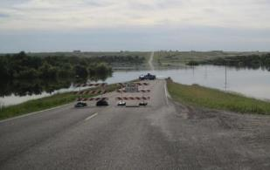
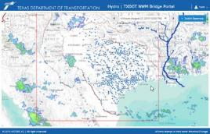
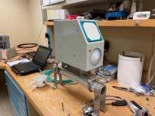
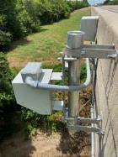
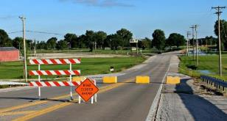

Objectives
Densified forecasting requires densification of stream gaging
Assess if newer technology can achieve comparable results with less effort

Slide 3
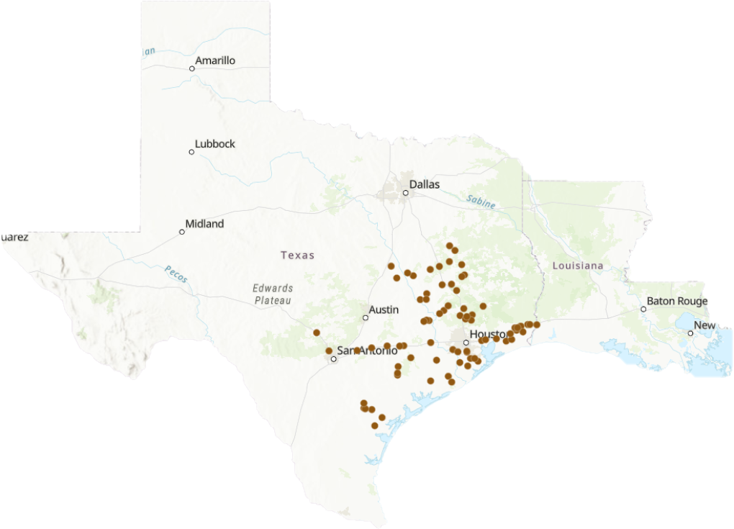
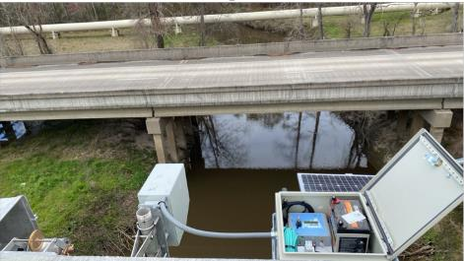
Study Area
80 TxDOT gages with
RQ-30 radar sensors

Slide 4
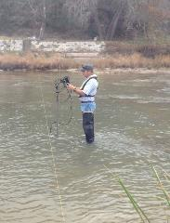
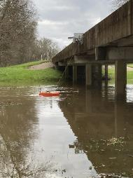
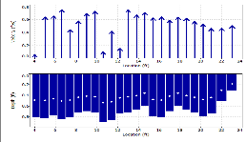
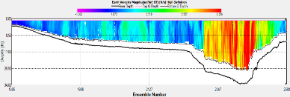
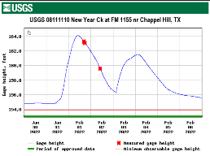
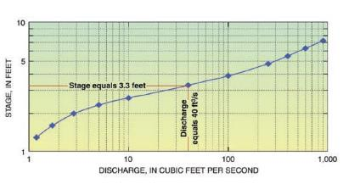
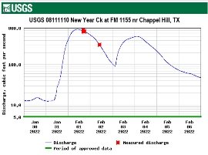
Traditional USGS Discharge Determination
Flowtracker Handheld ADCP
Acoustic Doppler Current Profiler
Measure Stage Height
Use Rating Curve to
get Discharge
USGS Stage-Discharge Rating

Slide 5
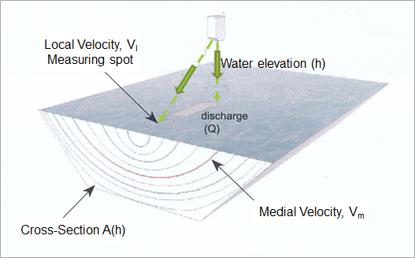
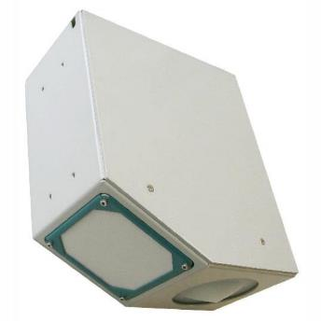
Measurement of Water Elevation and Velocity using RQ-30 Radar Gage
Discharge = Area * Mean Velocity

Slide 6
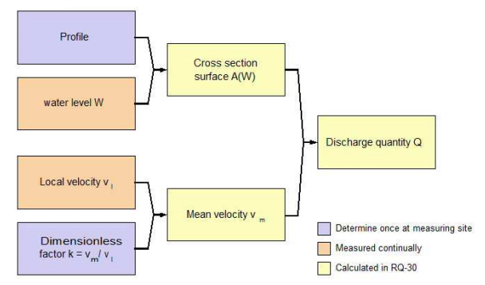
Computation of Discharge using RQ-30 Radar Gauge
A
Q
V

Slide 7

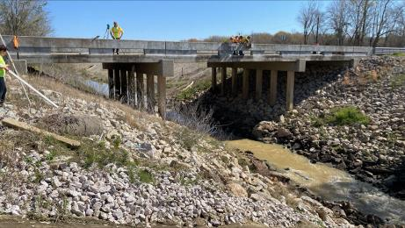
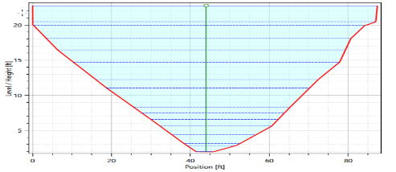
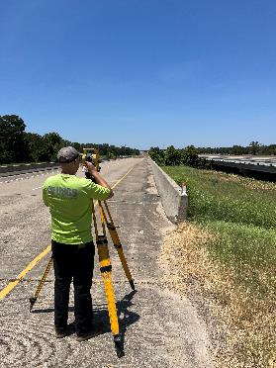
Cross Section Surveying
08041940-Green Pond Gully at FM 365 nr Fannett, TX
Channel geometry in-line with the velocity sensor
Low chord
Upper bridge deck / road elevation
Sensor elevation

Slide 8
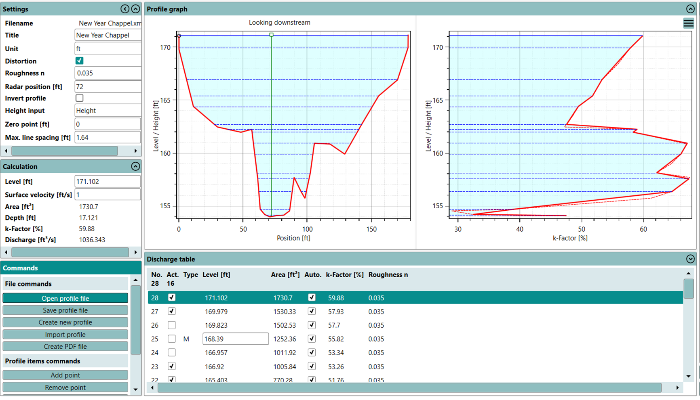

Slide 9
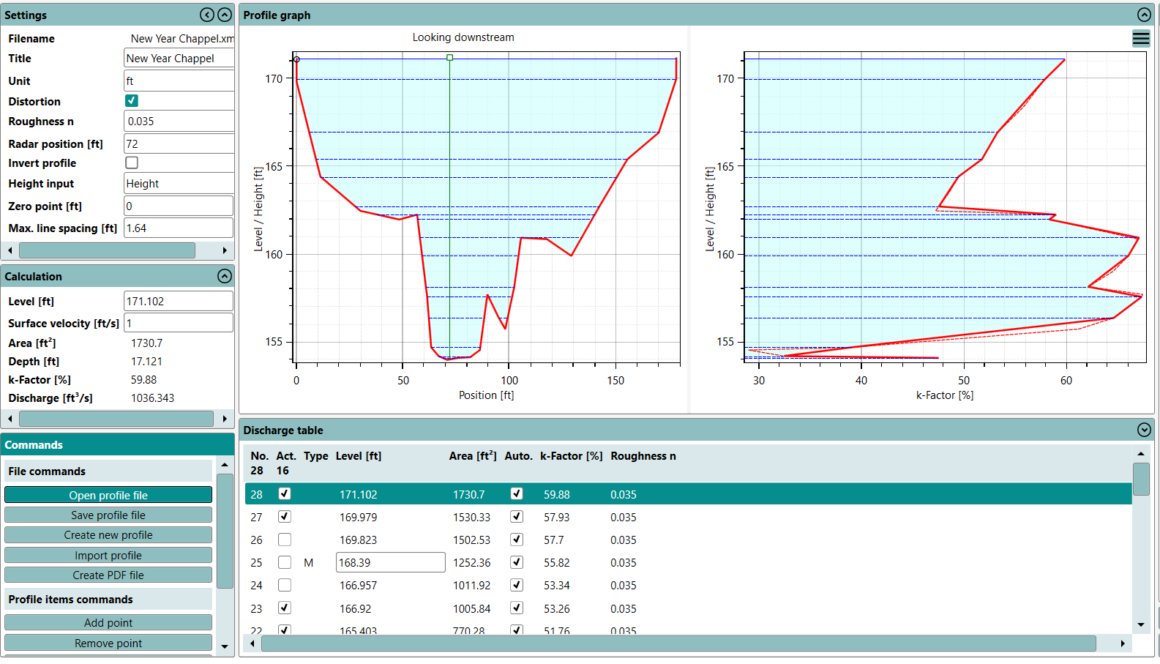
Cross-section
K-Factor Profile

Slide 10
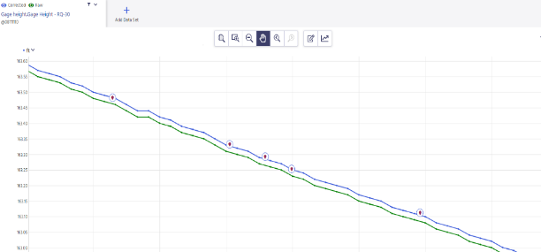
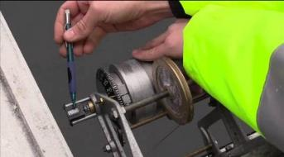
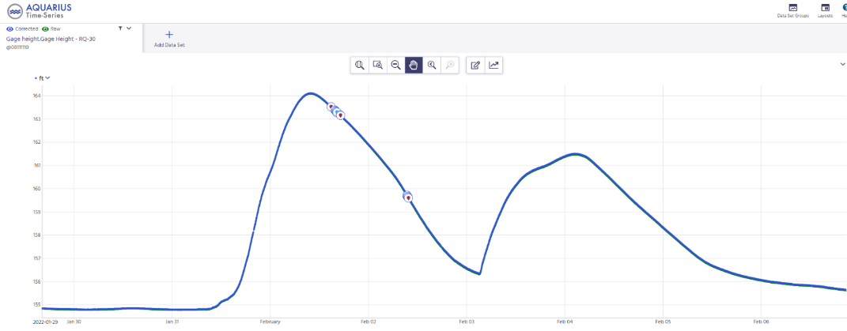
Gage Height Accuracy

Slide 11
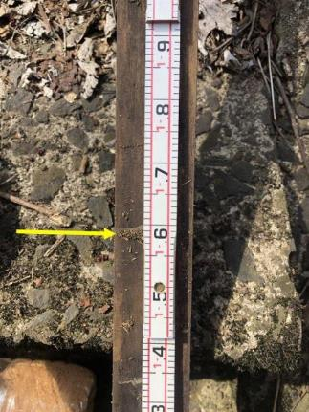
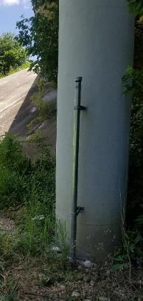
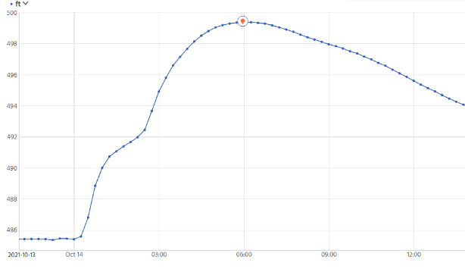
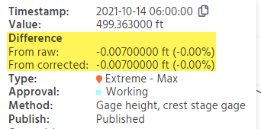
Gage Height Peak Verification

Slide 12

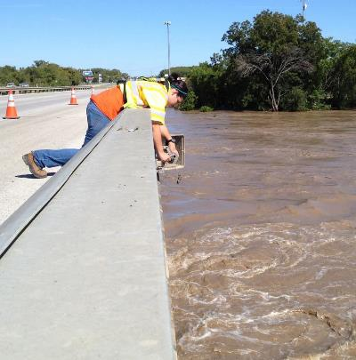
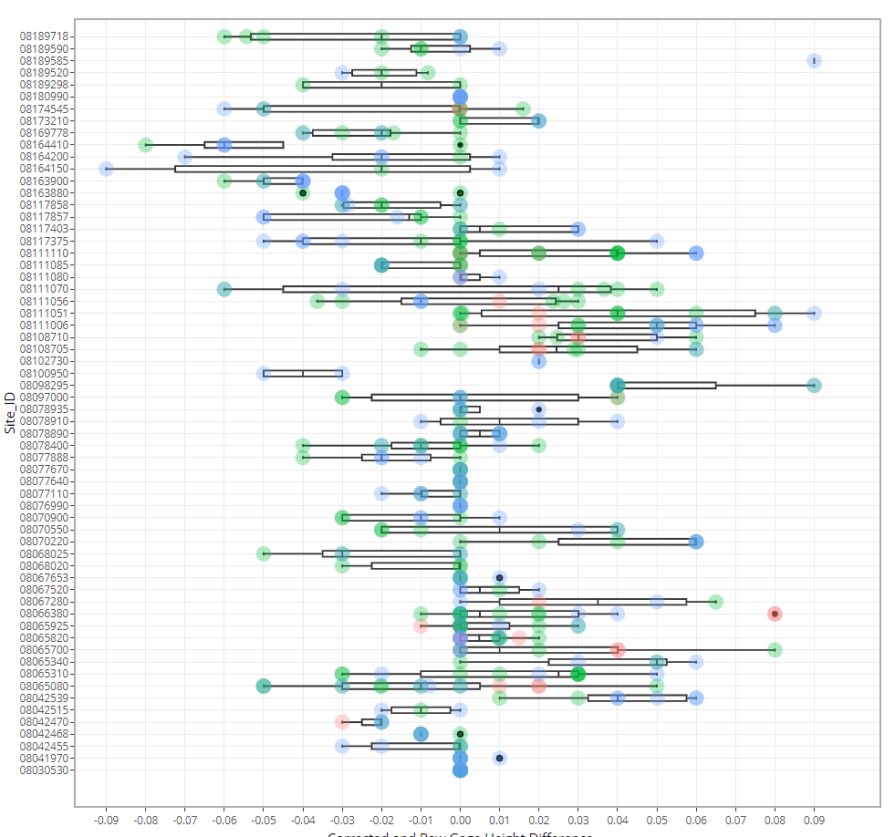

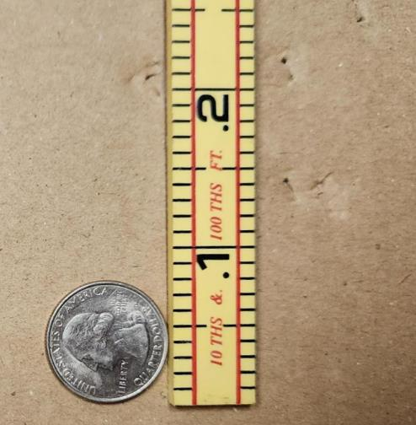
Gage Height Assessment
Gage Heights for 53 stations
No resets made for the life of the gage
+/- .05 ft accuracy
+/- 0.05 ft

Slide 13
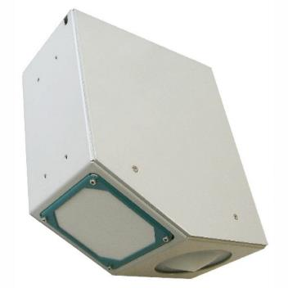
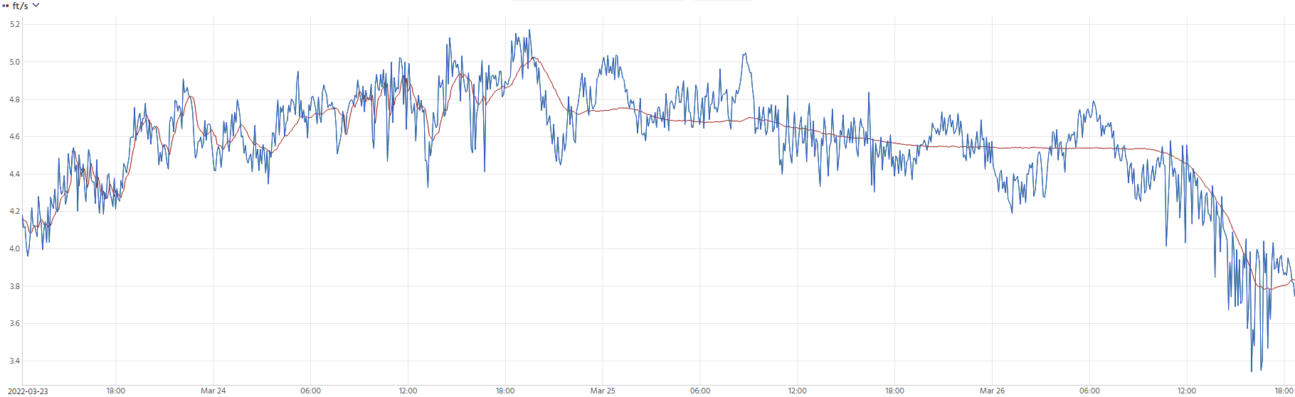

Velocity vs Learned Velocity
Velocity ( ft/s)
Date/time

Slide 14
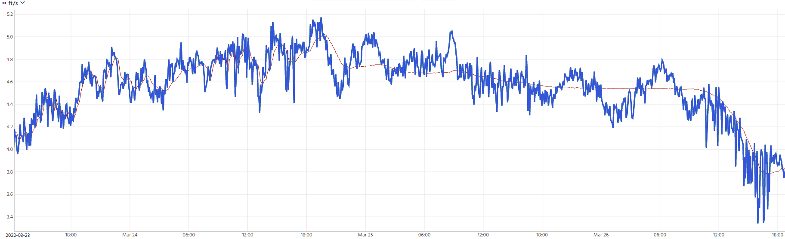
Point Velocity (surface)
Velocity ( ft/s)
Date/time

Slide 15
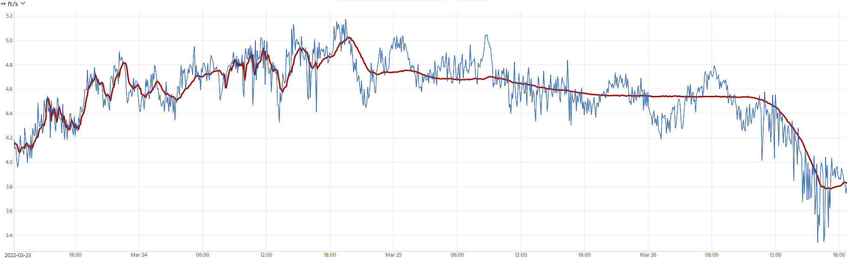
Learned Point Velocity (surface)
Velocity ( ft/s)
Date/time

Slide 16
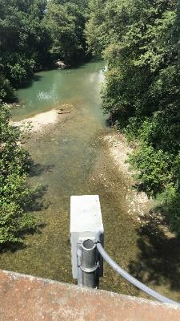
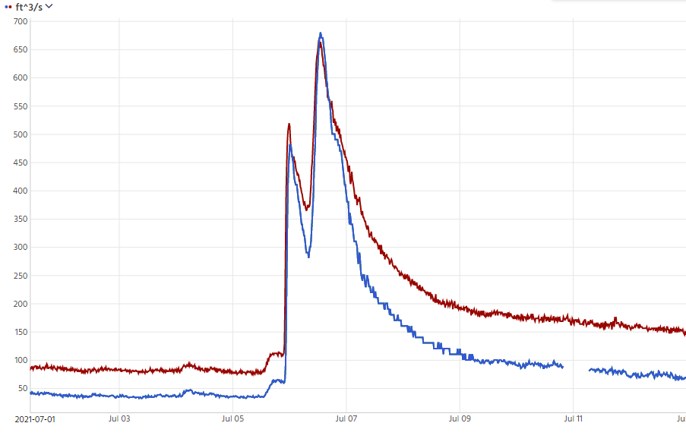
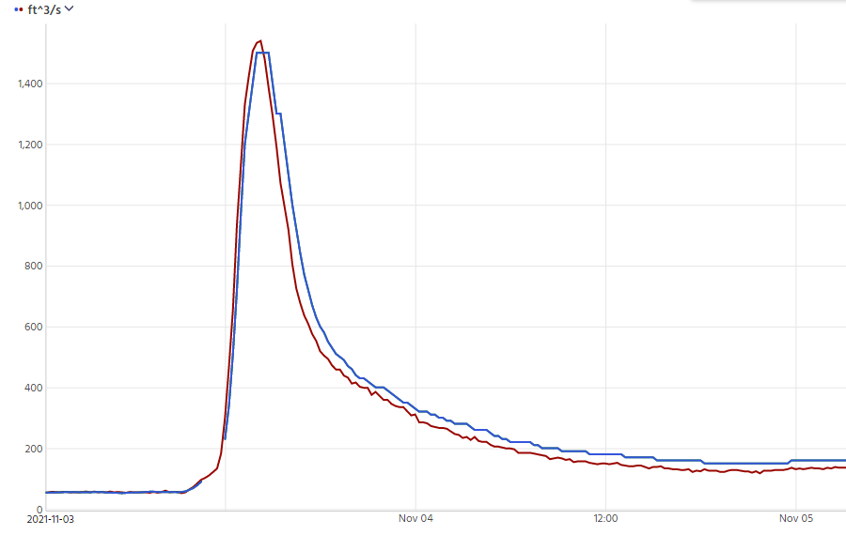
Early discharge observations
08167000 – Guadalupe Rv at Comfort, TX
July 2021
USGS Peak Discharge – 665 cfs
RQ-30 Peak Discharge – 680 cfs
November 2021
USGS Peak Discharge – 1,539 cfs
RQ-30 Peak Discharge – 1,500 cfs
Discharge ( cfs )
Date

Slide 17
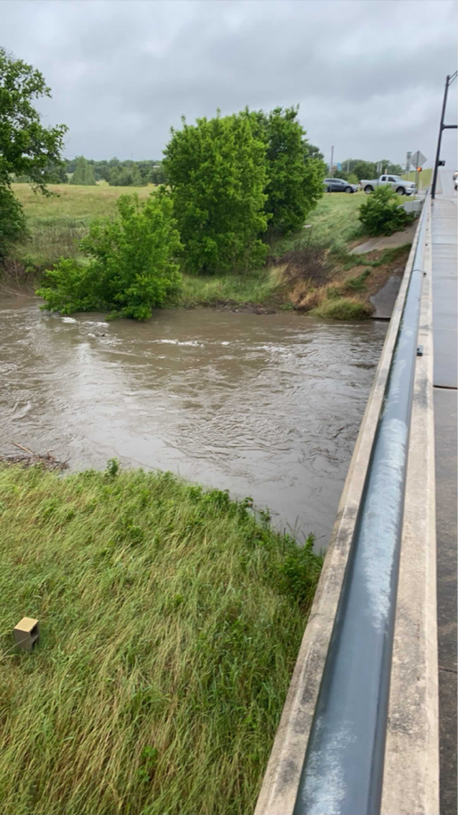
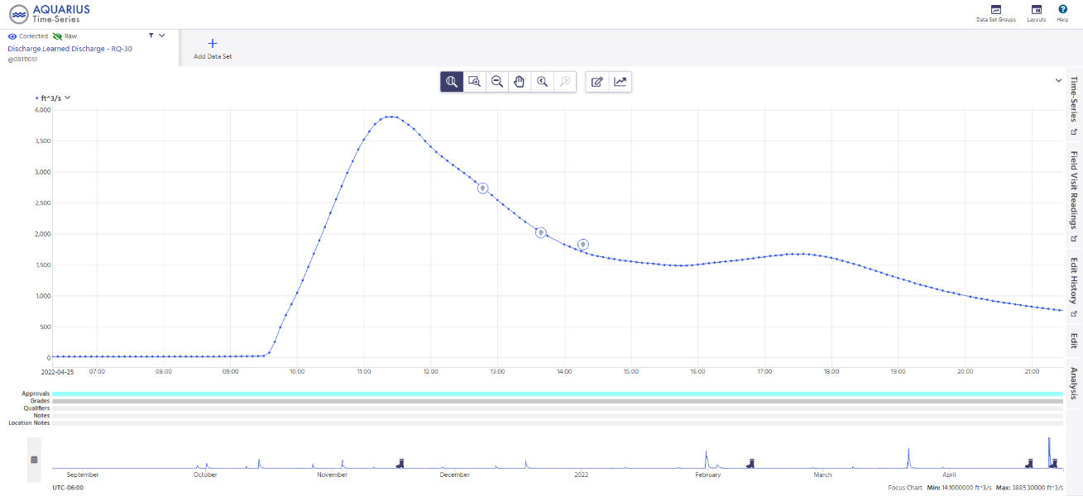
Discharge observations
Discharge ( cfs )
08111051 - Carters Ck nr College Station, TX
Measurements
RQ-30 Discharge
Date/time

Slide 18

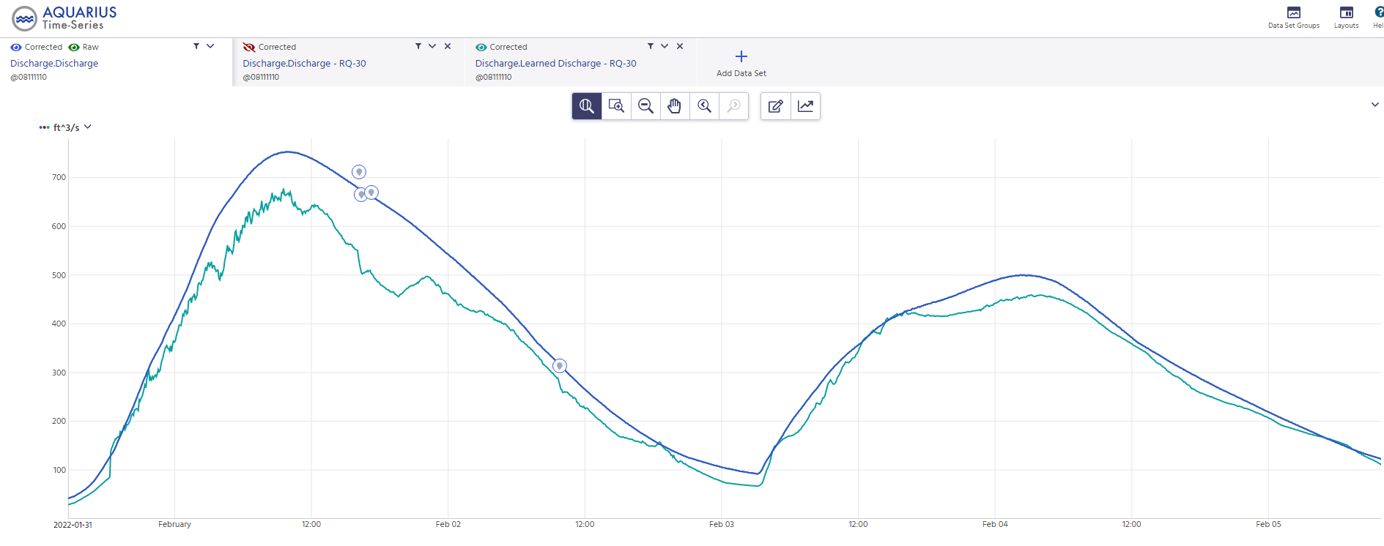
Discharge observations
Discharge ( cfs )
08111110 - New Year Ck at FM 1155 nr Chappell Hill, TX
Measurements
USGS Discharge
RQ-30 Discharge
Date/time

Slide 19
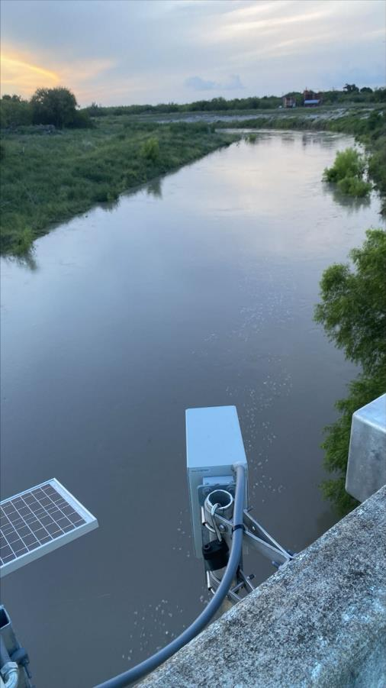
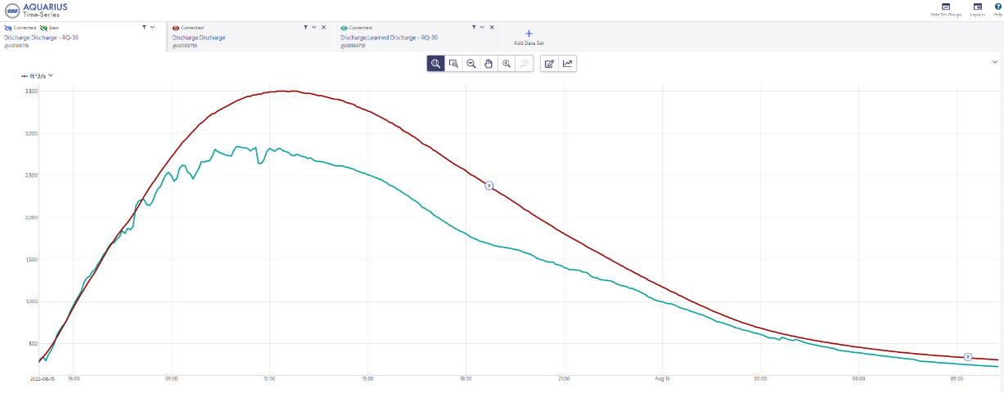
Discharge Measurement Comparisons
Discharge ( cfs )
08189718-Chiltipin ck at us 77 nr Sinton TX
Measurements
USGS Rated Discharge
RQ-30 Learned Discharge
Date/time
Measurements are 29% and 28% lower than USGS rated discharge.

Slide 20
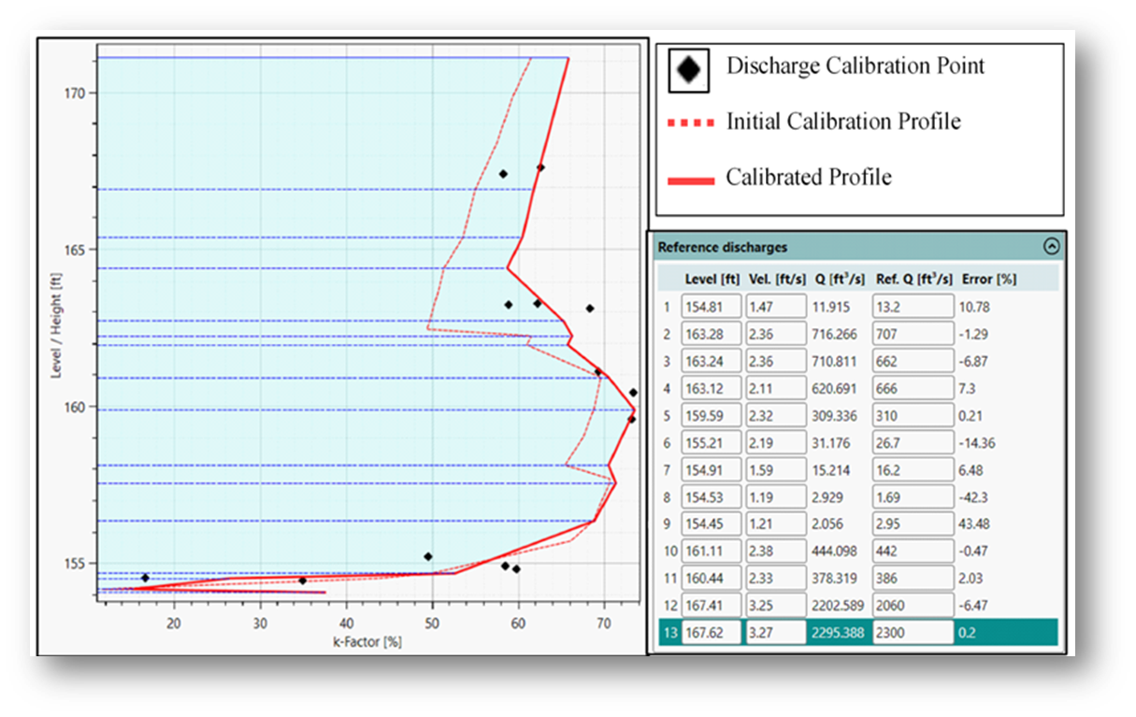
Q-Commander Calibration

Slide 21
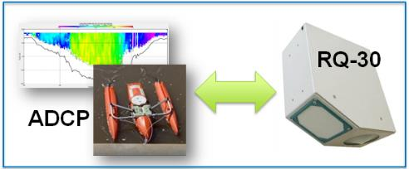
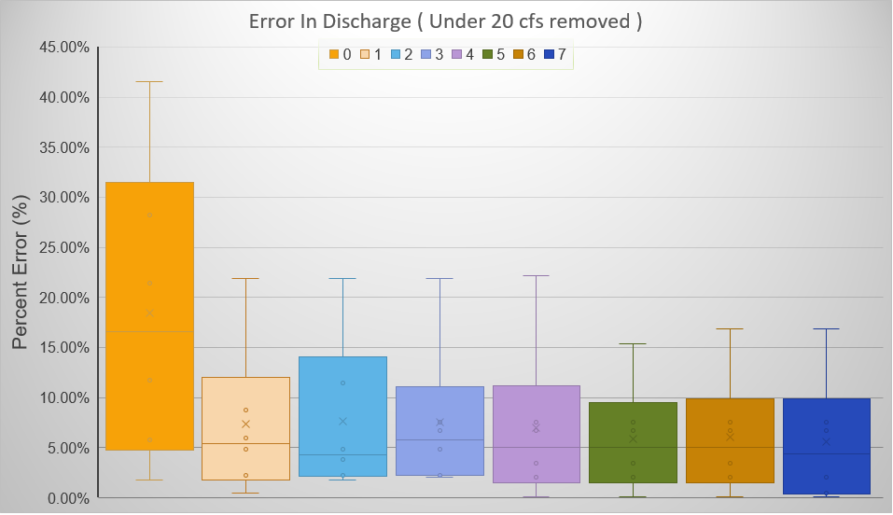
081111110 – New Year Ck at FM 1155 nr Chappel Hill, TX
Number of Calibration Points

Slide 22
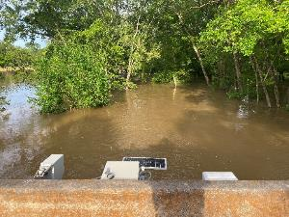
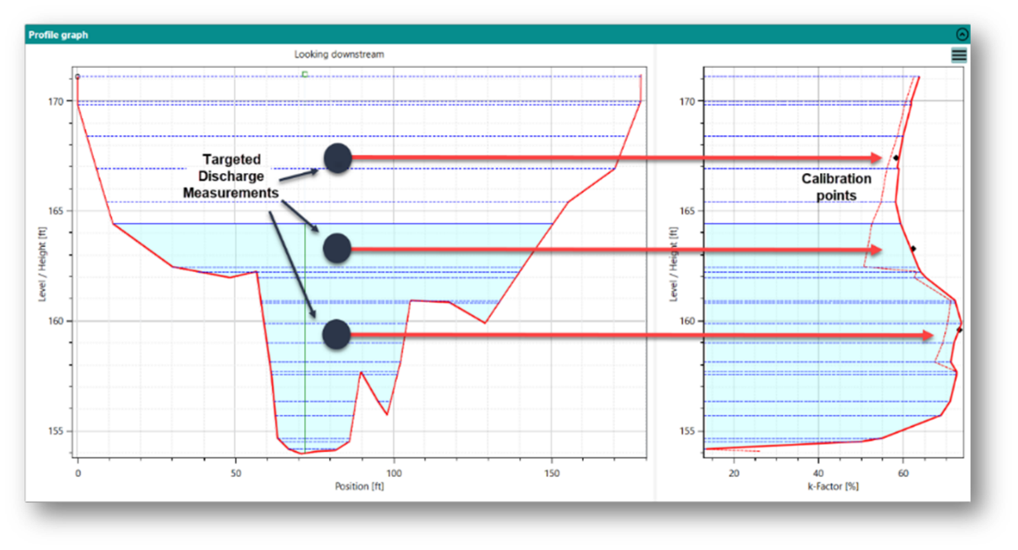
Targeted Approach
Measure a minimum of 2 discharges at different channel geometries.
Calibrate the RQ-30
Once calibrated, make minimal measurements to verify accuracy

Slide 23
Discharge observations – Pre-Calibration
Discharge ( cfs )
08111110 - New Year Ck at FM 1155 nr Chappell Hill, TX
Peak 700 cfs
Measurements
USGS Discharge
RQ-30 Discharge
Date/time

Slide 24
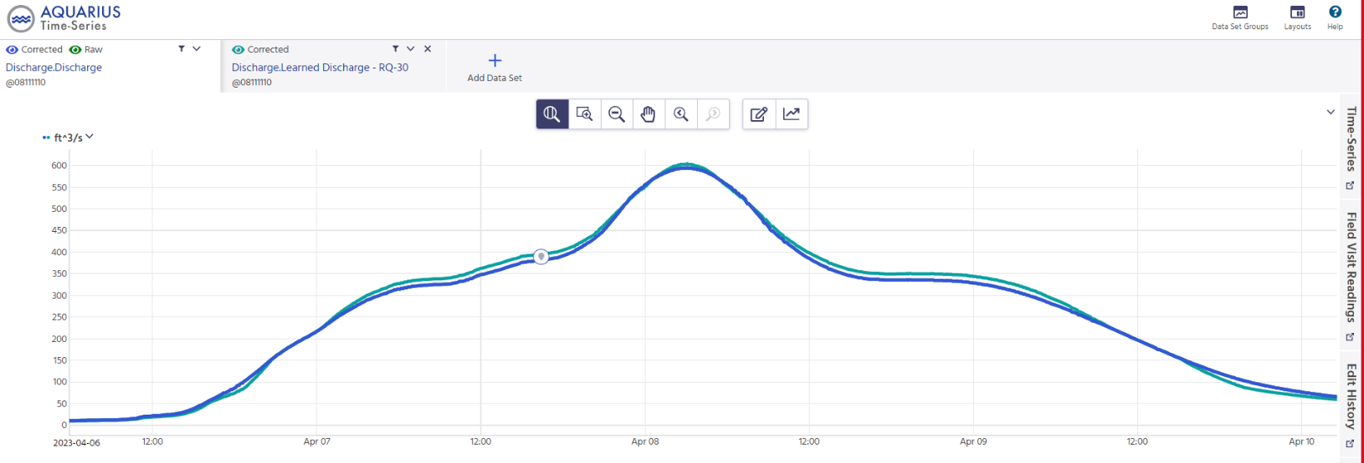
Discharge observations – Post Calibration
Discharge ( cfs )
08111110 - New Year Ck at FM 1155 nr Chappell Hill, TX
Peak 600 cfs
Measurement
USGS Discharge
RQ-30 Discharge
Date/time

Slide 25

081111110 – New Year Ck at FM 1155 nr Chappel Hill, TX
Measurement Number

Slide 26


Targeted Measurement Approach Exercise
(from USGS Velocimetry training class)
Students independently select 2 measurements they think represents channel geometry
Calibration is performed through Q-commander (RQ-30 software)
Results are compared with classmates

Slide 27





Externalizing K-Factor Calculation
Existing USGS app Area Comp 3 Is being modified to calculate K-factor - the coefficient to convert surface velocity to mean channel velocity

Slide 28


Externalizing Learned Velocity
Learned velocity is determined within the RQ-30
Currently no way to transfer learned velocity
Future learned velocity profile calculation being developed for integration into Area Comp 3

Slide 29


Relationship between averaged cells
Depth
Distance from Left Bank

Slide 30
Relationship between averaged cells
Depth
Distance from Left Bank

Slide 31




K-Factor Methods Compared
Q-Commander
ADCP Deconstruction

Slide 32


Q-Commander
ADCP Deconstruction
USGS Stage-Discharge Rating
Numerous Measurements
2 - 4 Measurements
(Using Targeted Approach)
1 - 2 Measurements
No need for roughness

Slide 33


Effectiveness in dynamic channel conditions
Seasonal changes
July 2021
February 2022

Slide 34


Effectiveness in dynamic channel conditions cont.

Slide 35



Cross Section Surveys
08111051-Carters Ck at FM 60 nr College Station
Main channel shows approximately 30% reduction in area at low flows following the application of riprap on the right bank.

Slide 36



Observations After Rectification

Slide 37



Tidally Affected Gages
08031020 – Cole Ck at I-10 nr Orange, TX
Stage
Velocity

Slide 38

Backwater Conditions Cont.
Relation between Stage Height and Velocity (Tehuacana Creek nr Waco)
Discharge
Stg/Q
Discharge
by velocity

Slide 39


Data Observations – Velocity
08164150 - W Navidad Rv at I-10 nr Schulenburg, TX
Stage ( ft )
Date/time

Slide 40


Data Observations – Velocity
08164150 - W Navidad Rv at I-10 nr Schulenburg, TX
Stage ( ft )
Date/time

Slide 41


Data Observations – Initial Velocity Wave
Stage (ft)
08111110 - New Year Ck at FM 1155 nr Chappell Hill, TX
Peak velocity of initial pulse

Slide 42



Data Observations – Initial Velocity Wave
08111110 - New Year Ck at FM 1155 nr Chappell Hill, TX
19 hours
6 hours
Subsequent rain events

Slide 43
 | Questions?

