Slide 1
Integrating Water Resource Information using GIS and the Web
David Maidment and Tim Whiteaker

Slide 2
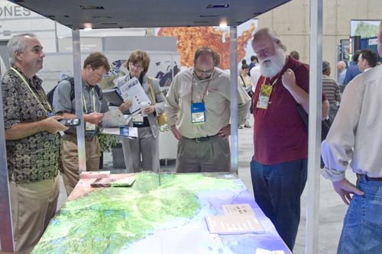
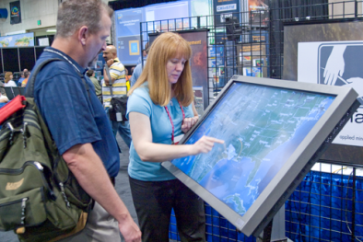
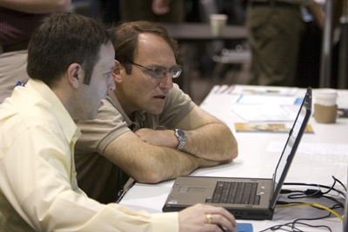
This PreConference Seminar Is Important
Creating and Sharing Ideas, Concepts and Experiences
GIS
Water
Resources
Contributing Valuable Content, Knowledge and Methods . . .
. . . Improving Water Resource Management

Slide 3
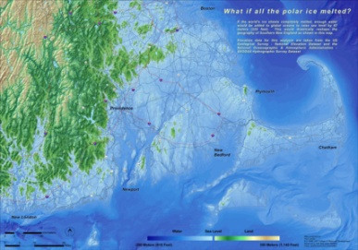
There is a Strong and Growing Demand for Integrated Water Information
Comprehensive Water Management
Emergency Management & Response
Long Term Water Assessment
Water Quality Management
Ecological Modeling
. . . .and Understanding Impacts of Climate Change
Sea Level Rise
Notes:
Flood, Drought, pollution, environmental flows-eco health pics

Slide 4
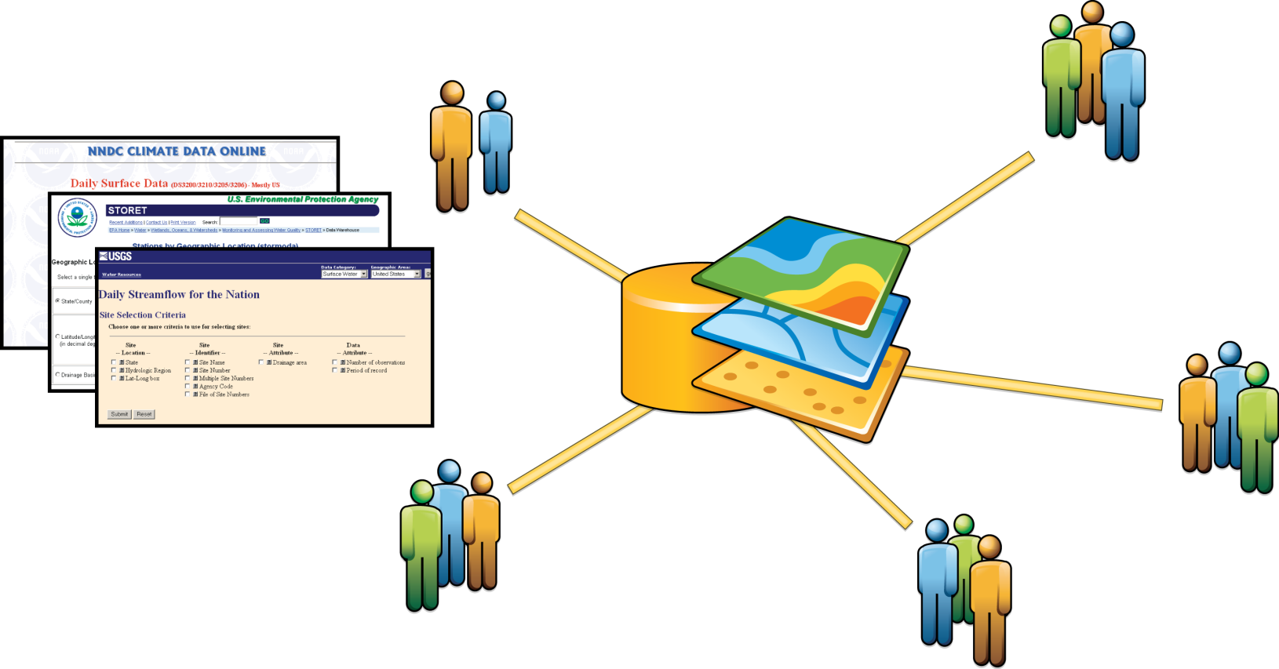
Data Sharing Has Been Crucial
Many Agencies Share Data as Part of Their Core Mission (USGS, EPA, NCDC, Water Districts)
(Geodata.gov/Data.gov)
Water Data Web Sites and Clearinghouses Have Improved Access . . .
. . . But These Efforts Haven’t Resulted In An Integrated System

Slide 5
The Current Water Data Situation is Complicated
Challenges
Many distributed tabular databases
Heterogeneous data models (Stove-piped / No Standard Data Formats)
Independently managed
Not spatially enabled
No over-arching community or sponsor . . .
Implications . . .
Data access and integration is laborious . . .
80% is about getting the data
Water Resource Information Is Not Leveraged
GIS and Web Services Can Help

Slide 6
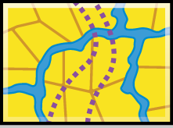
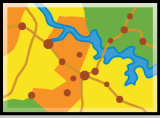
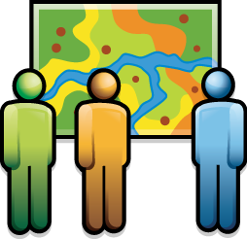
GIS Provides Integrative Technology
Bringing Together Geospatial Data and Knowledge
Providing New Methods For Analysis & Collaboration
GIS
And Making Them Accessible

Slide 7
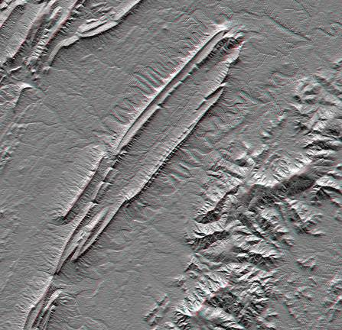
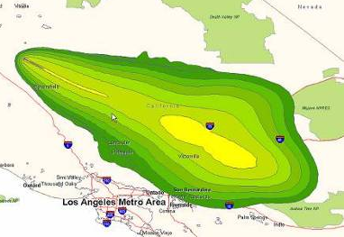
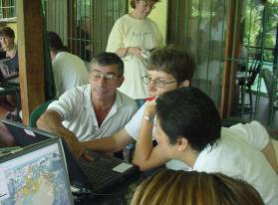
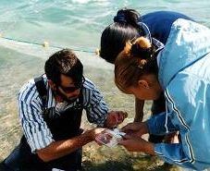
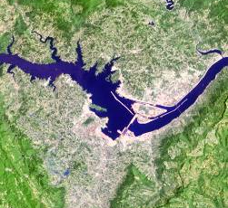
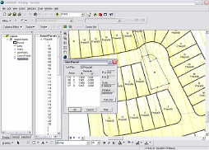
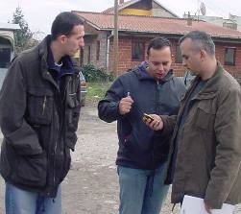
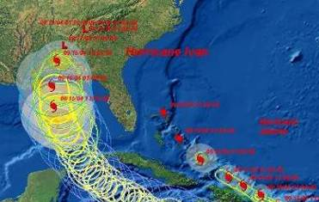
We are Moving to a Geodata Rich Society
More Geospatial Information, Applications and Access
Satellite Imagery (100x)
GPS / Location Data
Georeferenced Data
Real Time Change Monitoring
Locationally Aware Devices
Online GIS Services
Mapping
Visualization
Consumer Acccess
. . . Our Global Society is Increasingly Spatially Literate

Slide 8
Today GIS Implementations Follow Common Patterns
Supporting Enterprise and Pervasive Computing
Desktop
Server
Federated
Cloud/Web GIS
Desktop
Mobile
Web
Individuals
Ad Hoc Projects
Analysis/Modeling
Mapping
Workgroups
Shared Database
Fixed Applications
Transactions
Organizations
Shared Services
Integration
Collaboration
New

Slide 9
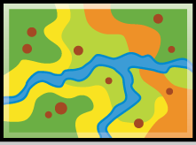
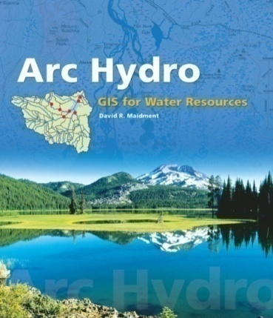
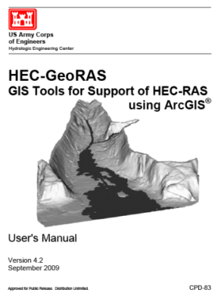
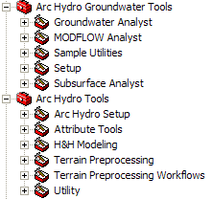
Desktop GIS Integrates Water Resource Knowledge
Widely Deployed Community Tools
Attributes
Data Model
Data Management
Analytic Tools
Terrain
Tracing & Accumulation
Groundwater
Model Integration
HEC-GeoRas, HEC-GeoHMS
Automated Hydrology and Hydraulics
Streamstats
ModFlow
Continuous
Time Series
Maps
A Large Community of Users. . . .
. . . Evolving, Improving

Slide 10
A New GIS Platform Is Emerging
Easier, Accessible and Collaborative
Enabled By
Cloud Architecture
Web Services
Information Integration
Crowd Sourcing
Open Data Sharing Policies
. . . And GIS Software
Empowering the GIS Professional . . .
And the Broader Community

Slide 11
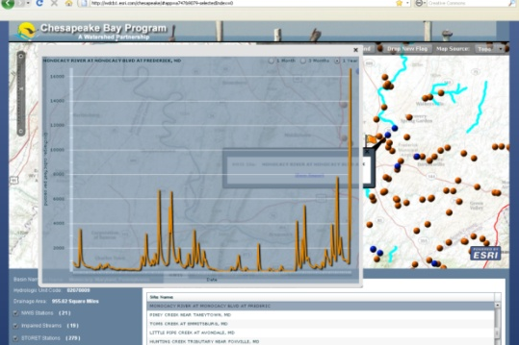
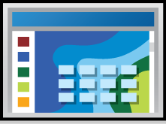
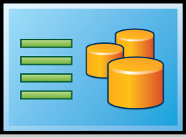
Web Centric GIS
A New Pattern……..Using the Internet as the Platform
Any Client
Ready to Use GIS Services (Data, Maps, Imagery, Models …)
Community Sharing
Search/Discovery Portal
Dynamic Integration of Information
GIS
Portal
GIS
Servers
GIS
Servers
GIS
Servers
Integrating Everything

Slide 12
WebGIS is A Simpler GIS Platform A Pervasive System for Using Maps & Geographic Information
Easier, More Powerful & Everywhere
Cloud
Web
Visualize
Create
Collaborate
Discover
Manage
Analyze
Enterprise
Mobile
Local
Desktop
Making GIS Available to Everyone
Notes:
12

Slide 13
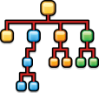
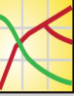
The Map Is The Focus
Simplifying Working With a GIS
GIS Maps
Interact
Query
Edit
Share
Analyze
Combine
Metadata
Data Model
Workflows
Symbology
Data
Tools and
Models
Tables/
Charts
Geographic Knowledge
Organized As Sharable Templates

Slide 14
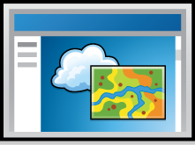
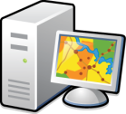
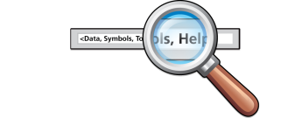
ESRI is Developing An Online GIS
A Complete GIS Implemented In the Cloud
Multiple
Clients
ArcGIS.com
Applications
Communities
Mashups
Maps, Data
and Analysis
Sharing
Discovery
Users Can Create, Share, Find and Use . . .
. . . Data, Maps and Applications

Slide 15
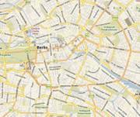
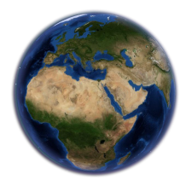
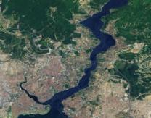
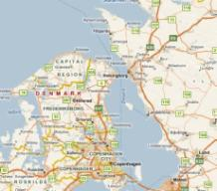
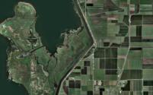
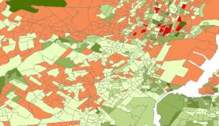
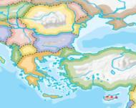
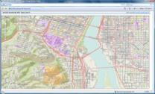
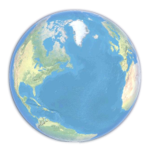
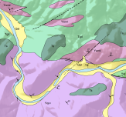
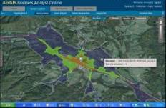
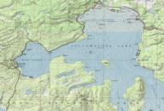
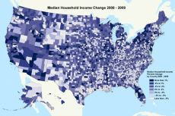
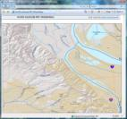
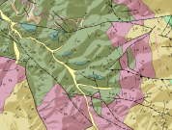
ArcGIS.com Provides Base Maps & GIS Content
Many Ready-to-Use Map and Image Services
Imagery
Streets
Demographic and Thematic
Topographic

Slide 16
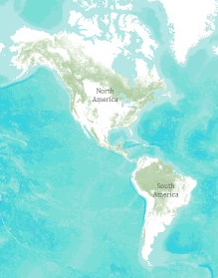
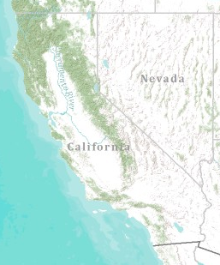
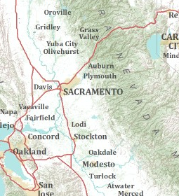
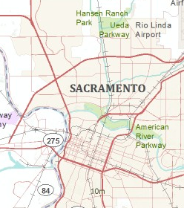
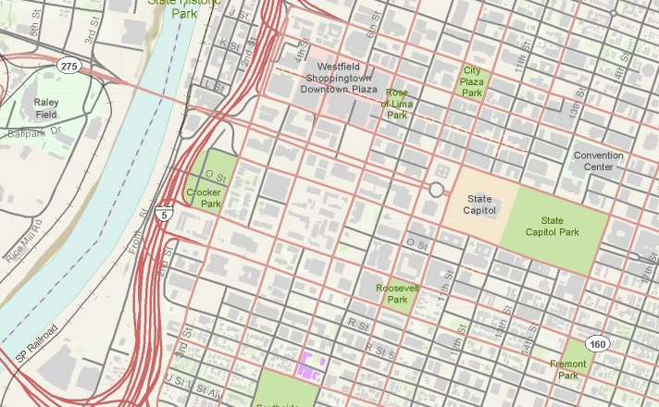
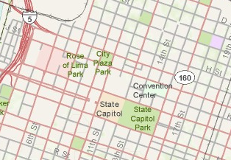
A Community Topographic Basemap
Developed Collaboratively With Our Users
Multi Scale
Authoritative Source
Template Based
A Free and Open Service

Slide 17
Getting to Know Online Hydro
Demo by Tim Whiteaker

Slide 18
Web Services are Interesting . . .
Users Can Interact with a Network of Services
……as a Collective Whole
Web Pages
Web Services
. . .Collaborative and Integrative Interaction

Slide 19
Water Information Can Be Easily Integrated With Web Services and GIS Many Organizations Are Already Collaborating
Agency 2
Implementing Web Services
(Using CUAHSI Standards)
Registering Services with HIS Central
Publishing Observation Maps
Agency 1
Agency 3
. . . Building an Online Water Information Community

Slide 20
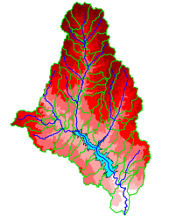
The Key Challenge
Integrating GIS and Water Resources Observations Data
Geography and GIS provide the Framework
Time Series Data
GIS
Water Environment
(Watersheds, streams, gages, sampling points)
The Water Itself
(Flow, water level concentraton)
. . . Relevant at all Scales

Slide 21
CUAHSI Has been Working on All These Challenges
Building a Hydrologic Information system
CUAHSI is a Consortium of more than 120 Universities . . .
. . .Supported by NSF

Slide 22
A Large Scale Prototype Has Been Constructed
Transforming Water Information Access
Providing a Web Enabled Observation Data Model
Establishing Data & Interoperability Standards
Maintaining a Central Data Catalog for Water Agencies
Collaborating with ESRI to host an Online Community Water Map
(Key for Integrating Water Observations w/ GIS)
A point in space
Time Series
Integrated Map View
. . . CUAHSI Provides Ongoing Innovation and Community Leadership

Slide 23
This System Integrates Many Types of Water Observations Data
Water quantity
Rainfall
Soil water
Water quality
Meteorology
Groundwater

Slide 24
This is Enabled by WaterML
a Web Language for Water Observations Data
GetValues Response in WaterML
. . .Adopted by USGS, and other agencies for Publishing Some of their Data

Slide 25
CUAHSI’s Portal Follows Internet Patterns Three Basic Components
Catalog
Server
User
Catalog
Server
User

Slide 26
CUAHSI
Provides a Common Language for Water Data
. . . Integrating Distributed Heterogeneous Data Sets

Slide 27
The CUAHSI Data Catalog Integrates
Multi Source Water Data Services
Map Integrating NWIS, STORET, & Climatic Sites
47 services
15,000 variables
1.8 million sites
9 million series
4.3 billion data Values
. . . The Worlds Largest Water Data Catalog

Slide 28
CUAHSI is Being Integrated With ArcGIS Online Creating a Web GIS for Water Resources
Clients
Mashups
Community
Desktop App
Basemaps
Browser
Share
Search/
Discover
Mobile
Water
Observation
Data
ArcGIS
Online
Models
Distributed
Services
GIS Services
Maps
. . . Map Enabling the CUAHSI Model

Slide 29
This System Organizes Water Information Using “Data Carts”
Metadata Records, for Each Time Series
Indexing water observations . . .
. . . including reference to its WaterML data service

Slide 30
Data Carts Organize Water Data Into “Themes”
Integrating Water Data Services From Multiple Agencies
. . . Across a Groups of Organizations

Slide 31
Data Carts are Published & Easily Discovered
Map and Data are encapsulated in a "Layer Package"
Information Shared within a Group . . .
. . . or Provided for Public Access

Slide 32
Water Data Themes in ArcGIS Online
Nutrients in Florida
Physical
Ontology of Concepts
Hydrosphere
Chemical
Biological

Slide 33
Watershed Delineation as a Geospatial Data Service

Slide 34
Time Series as Themes
A time series is like a feature
Theme – a collection of time series describing a subject and region
Streamflow data provided as WaterML data services by USGS

Slide 35
Bringing Water Into GIS Thematic Maps of Water Observations as GIS Layers
Groundwater
Streamflow
Salinity
Unified access to water data in Texas ….

Slide 36
Each Observations Map has a Data Cart An attribute table for time series metadata

Slide 37
Data Cart: A Record for Each Time Series One variable measured by one organization at one location over a period of time
A record describes each time series ….
…. and links to its WaterML web service

Slide 38
WaterML Web Service Delivers Data
Same format for all water observations data sources

Slide 39
Ingest Data into Arc Hydro Time Series
2005
Transform them into time-varying maps
2006
2007

Slide 40
Interpret Time-Varying Maps in a Geospatial Context
Arc Hydro Groundwater Tools ….

Slide 41
http://hydro_bm.esri.com/TxDischarge/TxDischargeLabels.html

Slide 42
Working with Temporal Data Carts in ArcGIS.com
Demo by Tim Whiteaker

Slide 43
Where are we going?
Data supplied by services
Temporal services for water observations
Geospatial services for watershed delineation ….
Centralized data cataloging and mapping
CUAHSI catalog at HIS Central
Base maps in ArcGIS Online
Thematic mapping of water observations
Water data layers in GIS

Slide 44
Making This System Successful Will Require
Leadership & Management
Adoption of Standards
Creating & Sharing Services
A Community Water Data Portal
Ongoing Participation
“It always seems impossible until it’s done”
Nelson Mandela
. . . A Community Based Approach

