Slide 1
Water Vision
David Maidment
University of Texas at Austin
Community Hydrobase map
Space-time observations layers
Arc Hydro River
ESRI User Conference Water Resources User Group, July 15, 2010

Slide 2
Is Global Geospatial Consciousness Possible?
How to make this work for Hydro
Billions
Society
Millions
Application
Users
100’s of Thousands
GIS Professionals
Thousands
Research
Slide from Jack Dangermond’s Plenary Presentation

Slide 3
Water Vision
David Maidment
University of Texas at Austin
Community Hydrobase map
Space-time observations layers
Arc Hydro River
ESRI User Conference Water Resources User Group, July 15, 2010

Slide 4
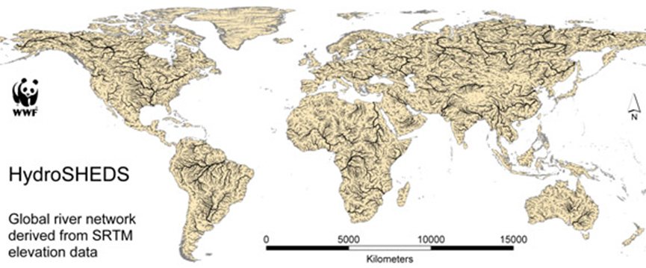
Global HydroBase Map
Build from HydroSheds
Global coverage from 60 ºS to 60 ºN

Slide 5
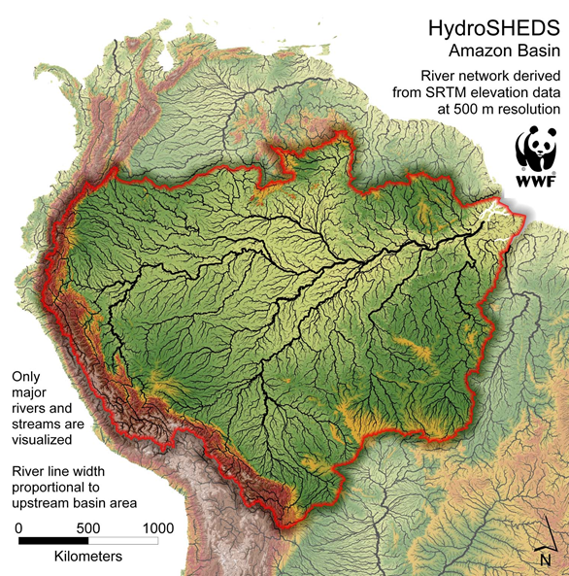

Slide 6
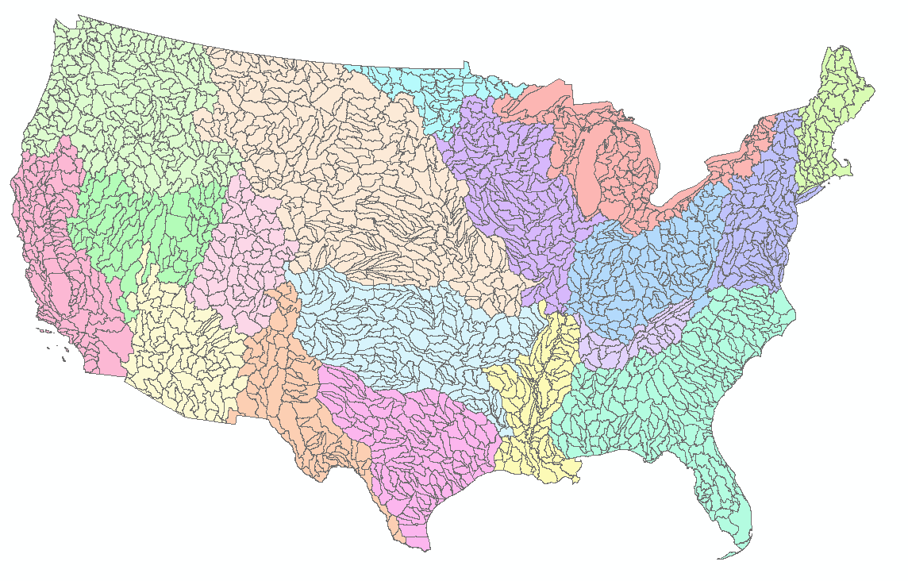
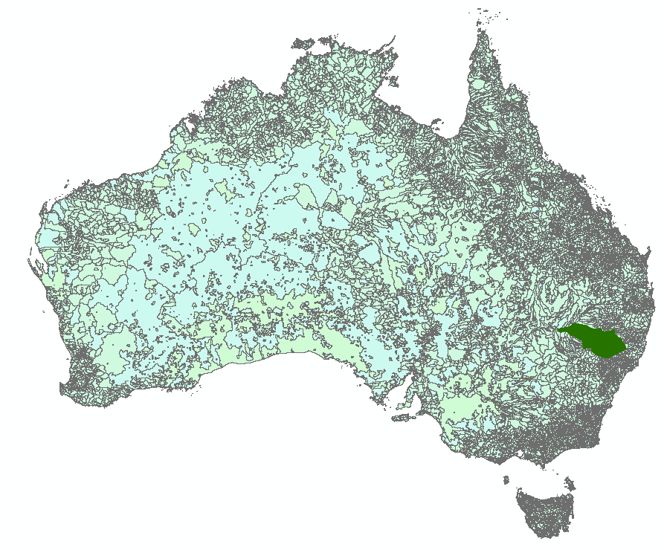
Add Detailed Content for Regions
NHDand NHDPlus – USGS and EPA
Geofabric - Bureau of Meteorology, Geoscience Australia, ANU and CSIRO'

Slide 7
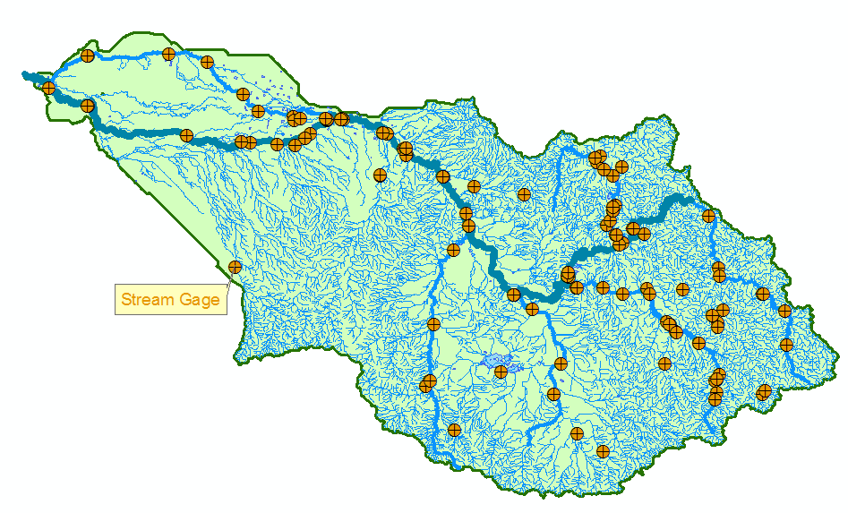
Namoi Basin

Slide 8
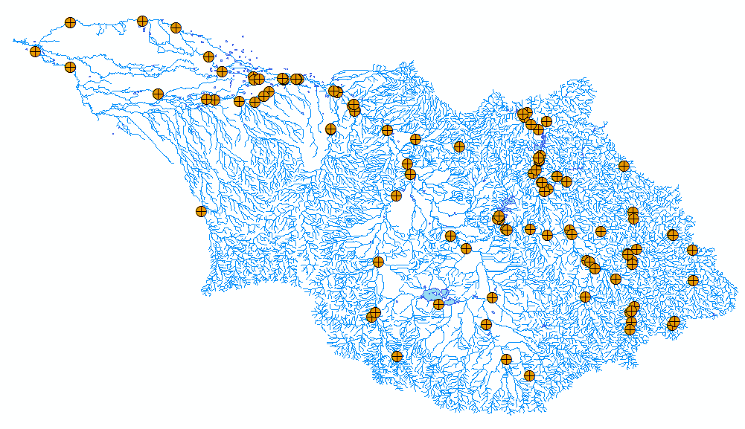
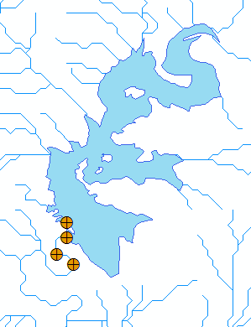
HydroBaseMap Display Layer
The Hydrography or “blue line” component of a topographic map
Arc Hydro Feature Classes

Slide 9
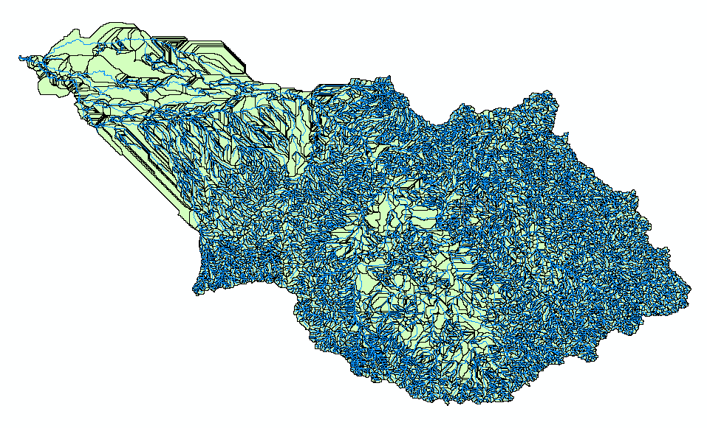
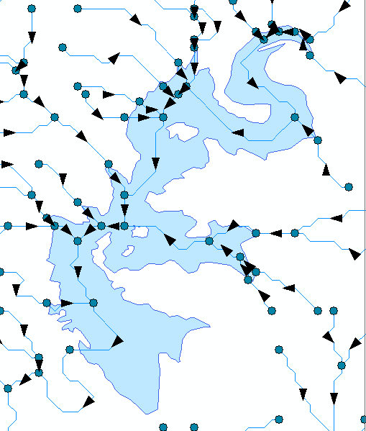
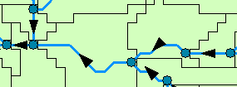
HydroBaseMap Analysis Layer
A geometric network with a local catchment for each network edge
Arc Hydro Feature Classes

Slide 10
Water Vision
David Maidment
University of Texas at Austin
Community Hydrobase map
Space-time observations layers
Arc Hydro River
ESRI User Conference Water Resources User Group, July 15, 2010

Slide 11
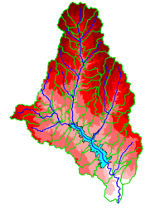
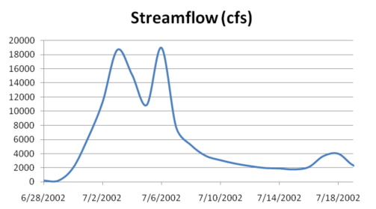
The Key Challenge
Integrating GIS and Water Resources Observations Data
Geography and GIS provide the Framework
Time Series Data
GIS
Water Environment
(Watersheds, streams, gages, sampling points)
The Water Itself
(Flow, water level concentraton)
. . . Relevant at all Scales

Slide 12
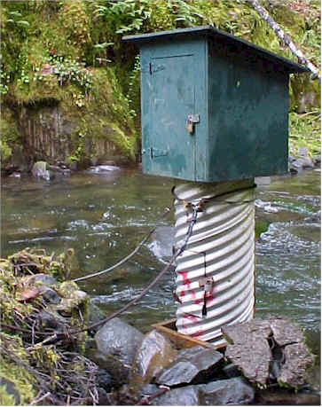
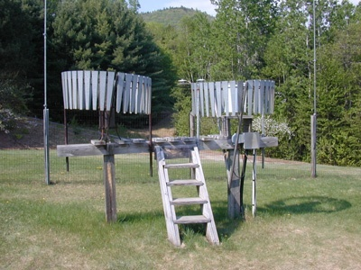
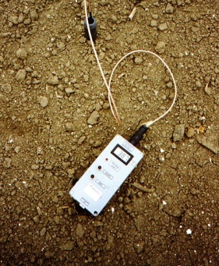
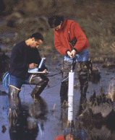
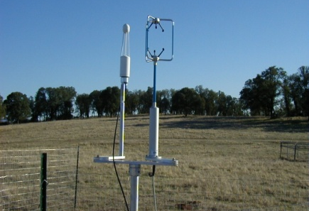
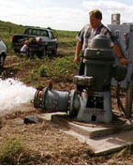
This System Integrates Many Types of Water Observations Data
Water quantity
Rainfall
Soil water
Water quality
Meteorology
Groundwater

Slide 13
This is Enabled by WaterML
a Web Language for Water Observations Data
GetValues Response in WaterML
. . .Adopted by USGS, and other agencies for Publishing Some of their Data

Slide 14
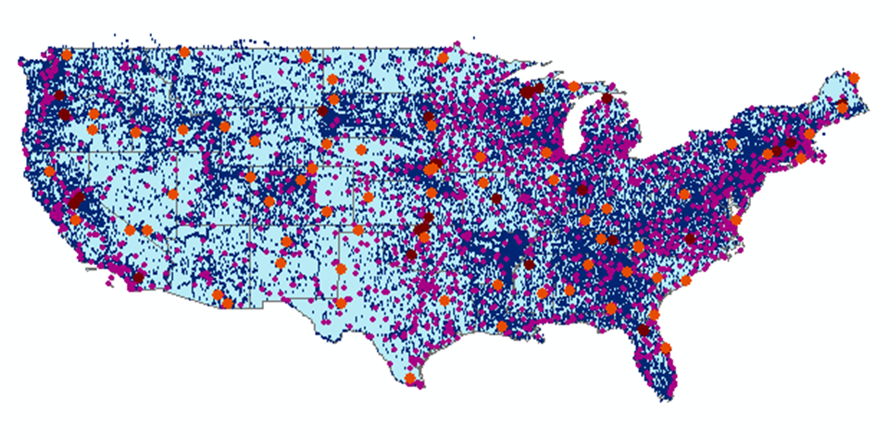
The CUAHSI Data Catalog Integrates
Multi Source Water Data Services
Map Integrating NWIS, STORET, & Climatic Sites
47 services
15,000 variables
1.8 million sites
9 million series
4.3 billion data Values
. . . The Worlds Largest Water Data Catalog

Slide 15
Working with WaterML Data Services
Demo by Tim Whiteaker

Slide 16
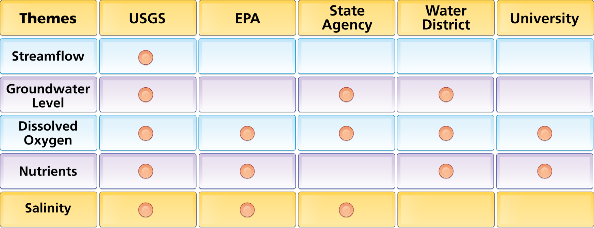
Data Carts Organize Water Data Into “Themes”
Integrating Water Data Services From Multiple Agencies
. . . Across a Groups of Organizations

Slide 17
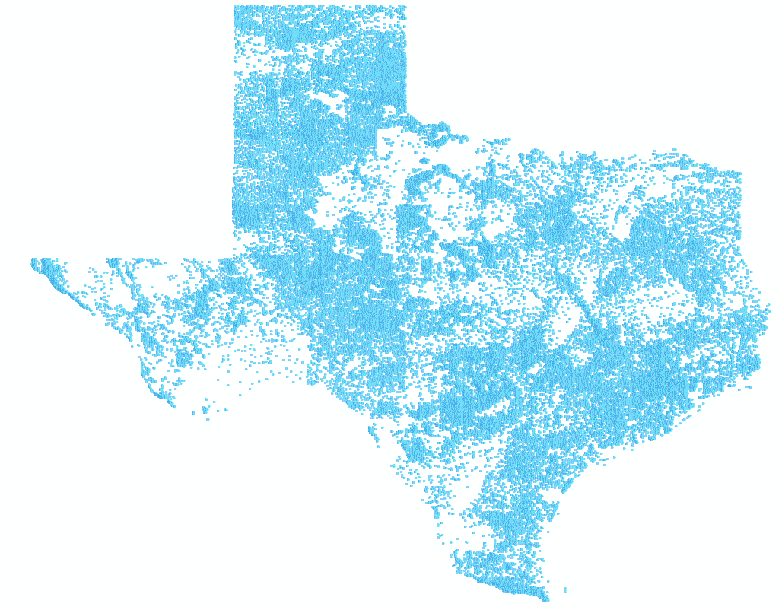
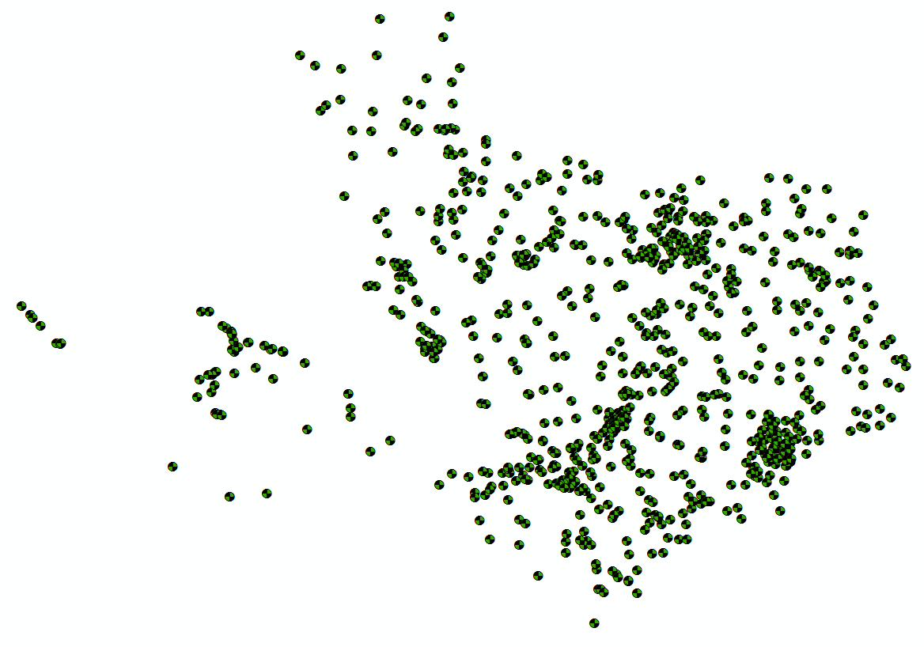
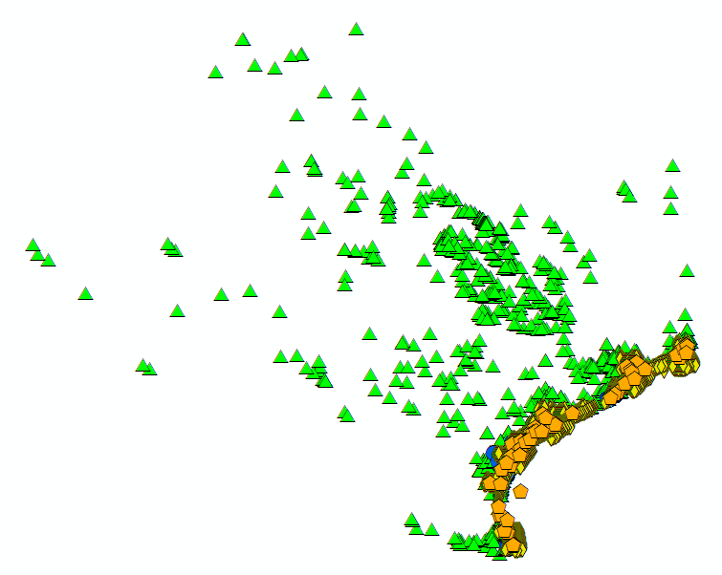
Bringing Water Into GIS Thematic Maps of Water Observations as GIS Layers
Groundwater
Streamflow
Salinity
Unified access to water data in Texas ….

Slide 18
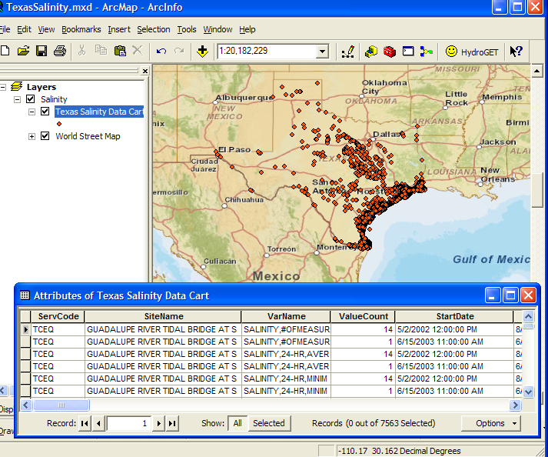
This System Organizes Water Information Using “Data Carts”
Metadata Records, for Each Time Series
Indexing water observations . . .
. . . including reference to its WaterML data service

Slide 19
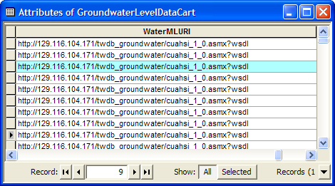
WaterML Web Service Delivers Data
Same format for all water observations data sources

Slide 20
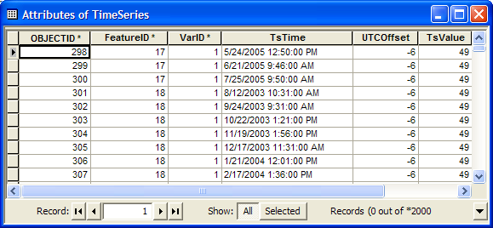
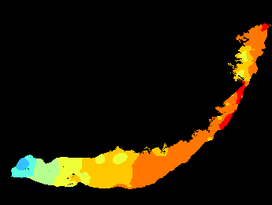
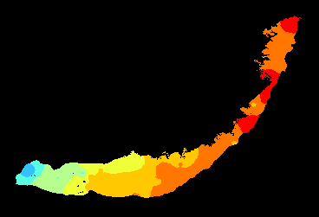
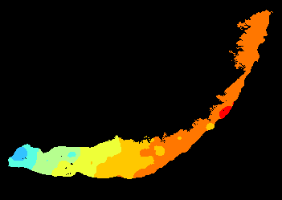
Ingest Data into Arc Hydro Time Series
2005
Transform them into time-varying maps
2006
2007

Slide 21
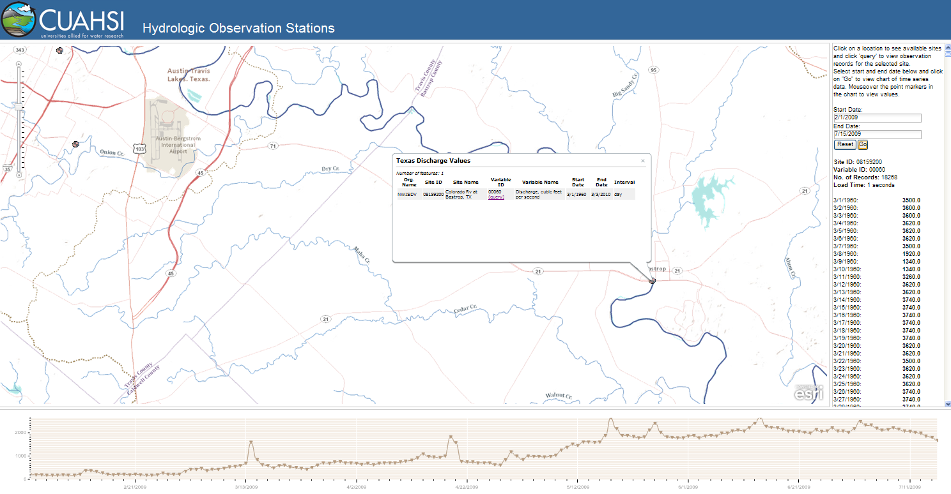
Publish space-time map services in ArcGIS 10
Query and visualize the data through the web

Slide 22
Viewing Observations Layers
Demo by Tim Whiteaker

Slide 23
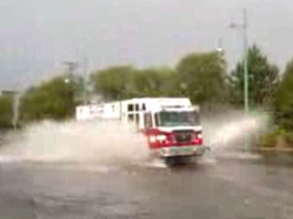
Real-Time Situational Awareness
Routing fire trucks during a flood
Requires a real-time flood water level map

Slide 24
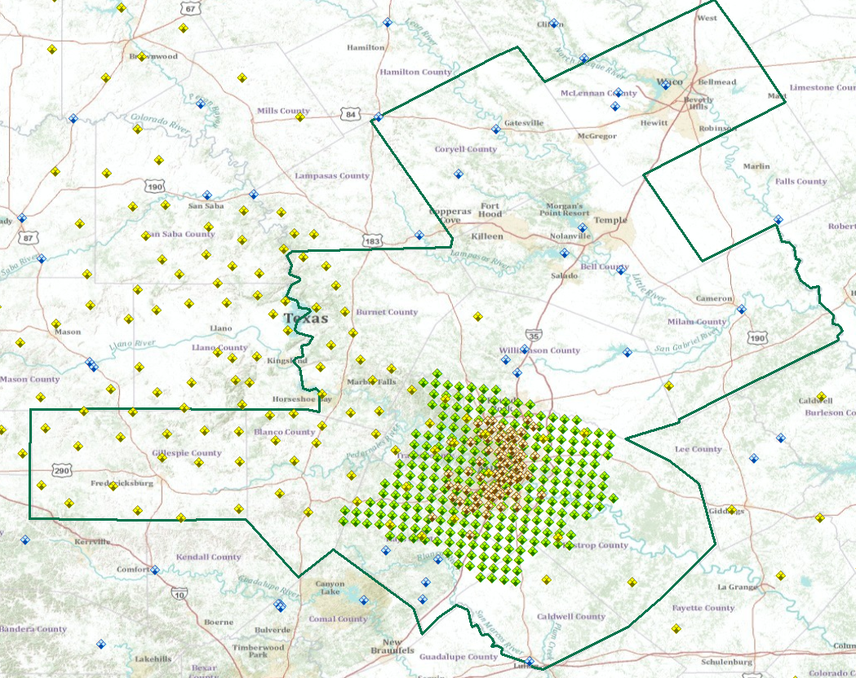
Real-time Observations Layer for Austin, Texas
WaterML web services for precipitation and water level
….provided by multiple agencies

Slide 26
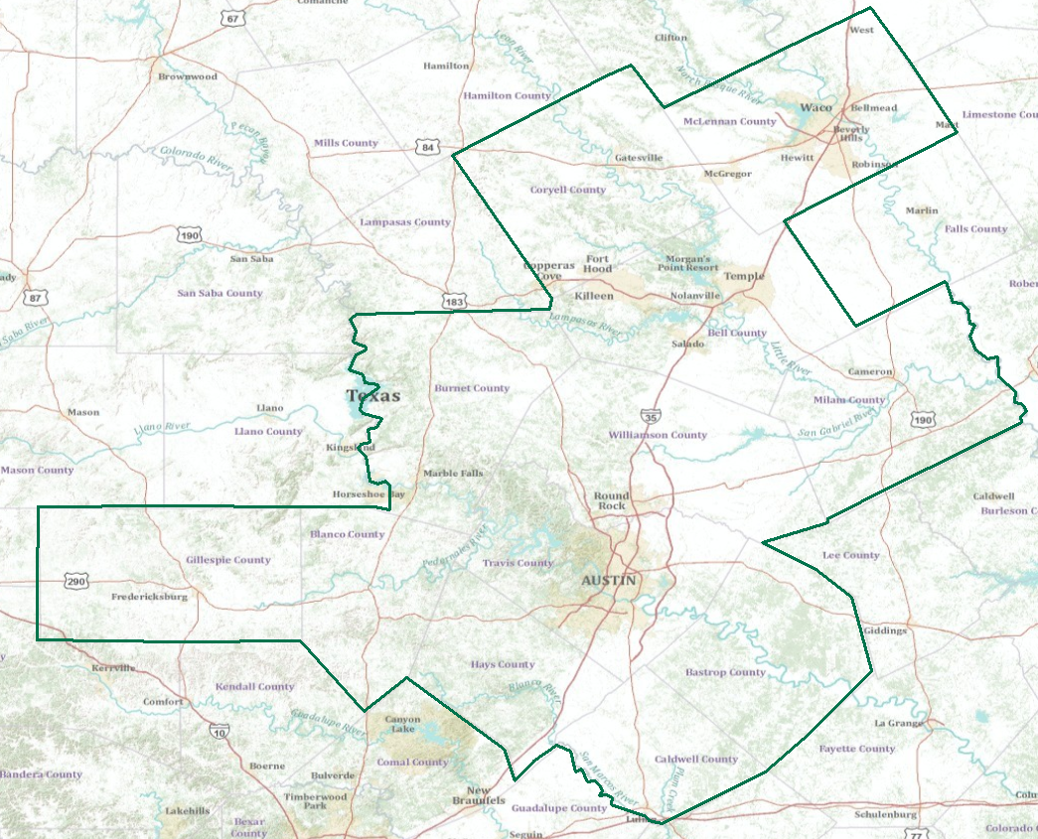
Real-Time Flood Information for Television
Maureen McCann, Meteorologist with News8 Austin
Develop a prototype of space-time mapping for television meteorologists

Slide 27
Water Vision
David Maidment
University of Texas at Austin
Community Hydrobase map
Space-time observations layers
Arc Hydro River
ESRI User Conference Water Resources User Group, July 15, 2010

Slide 28
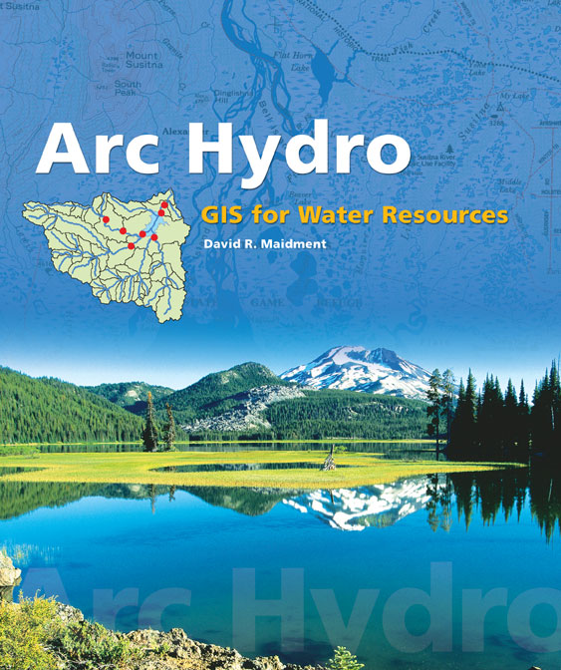
Arc Hydro: GIS for Water Resources
Published in 2002, now in revision for Arc Hydro II
Arc Hydro
An ArcGIS data model for water resources
Arc Hydro toolset for implementation
Framework for linking hydrologic simulation models
The Arc Hydro data model and
application tools are in the public
Domain.
Notes:
Notes:
Industrial partners: ESRI, Danish Hydraulic Institute, Camp,Dresser and McKee, Dodson and Associates
Government partners:
Federal: EPA, USGS, Corps of Engineers (Hydrologic Engineering Center)
State: Texas Natural Resource Conservation Commission, Texas Water Development Board
Local: Lower Colorado River Authority, City of Austin, Dept of Watershed Protection
Academic Partners: University of Texas, Brigham Young University, Utah State University

Slide 33
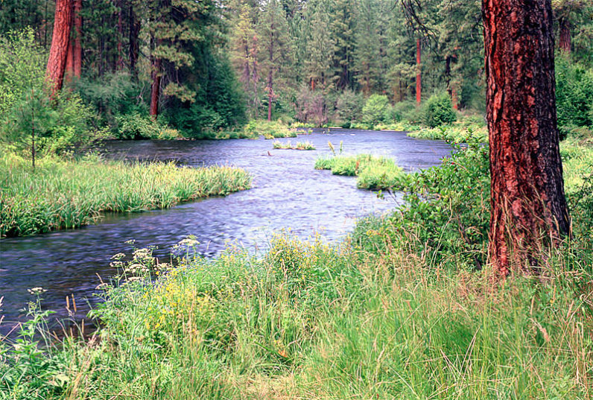
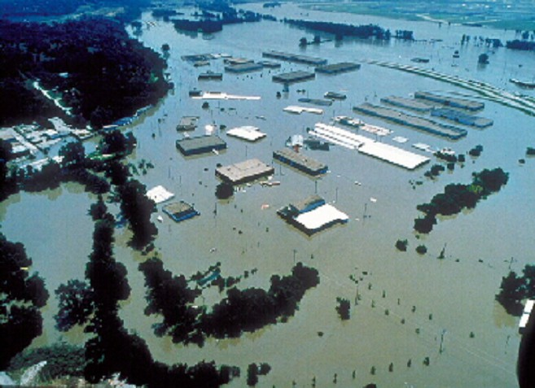
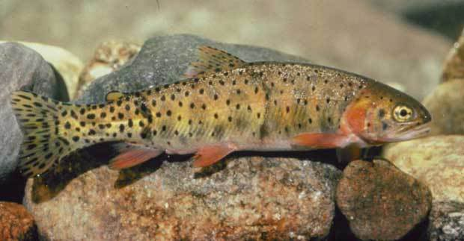
Arc Hydro River
GIS for River Morphology and Modeling
River Network
Channel Shape
Geography
Flooding
Aquatic Biology
Applications

Slide 34
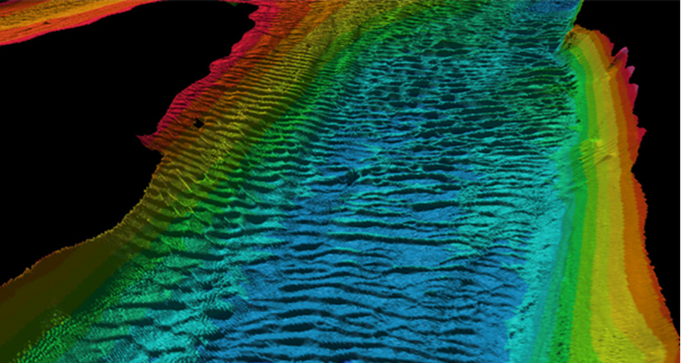
River Bottom Bathymetry
Sand waves on the bed of the Hudson River estuary up to 3 meters in height
Source: http://www.magazine.noaa.gov/stories/images/hudson_bathymetry.jpg

Slide 35
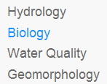
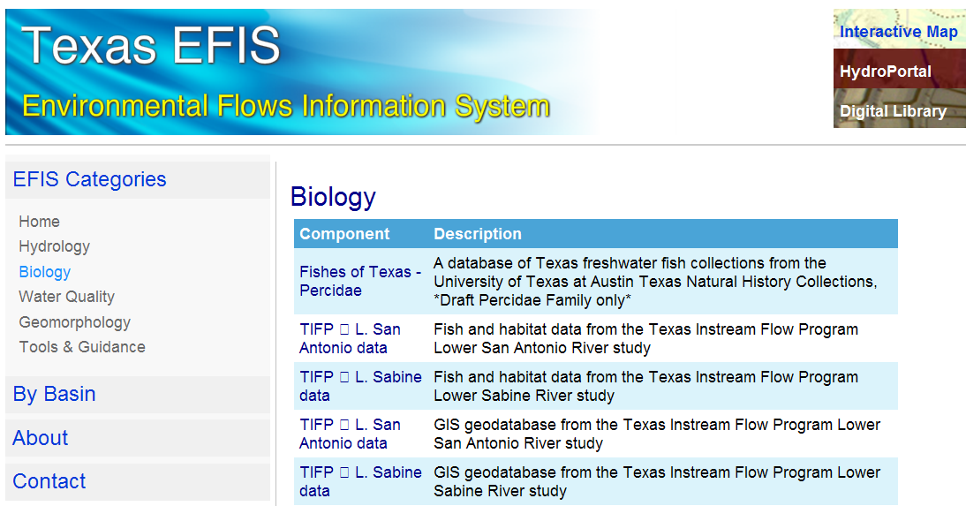
Environmental Flows
http://efis.crwr.utexas.edu

Slide 36
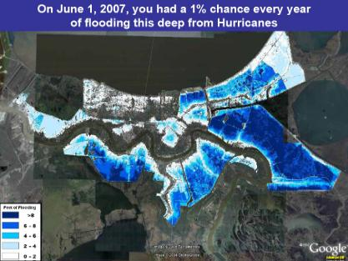
Mapping Differential Risk of Flooding
New Orleans

Slide 37
Arc Hydro River in ArcGIS Online
http://resources.esri.com/arcHydro/
Documentation of draft data model designs , discussion and meetings for Arc Hydro River

Slide 38
Arc Hydro River is a Proposal
We welcome your contribution and guidance
Questions?
Suggestions?
Who should be involved?
http://www.crwr.utexas.edu/gis/gishydro10/

