Slide 1
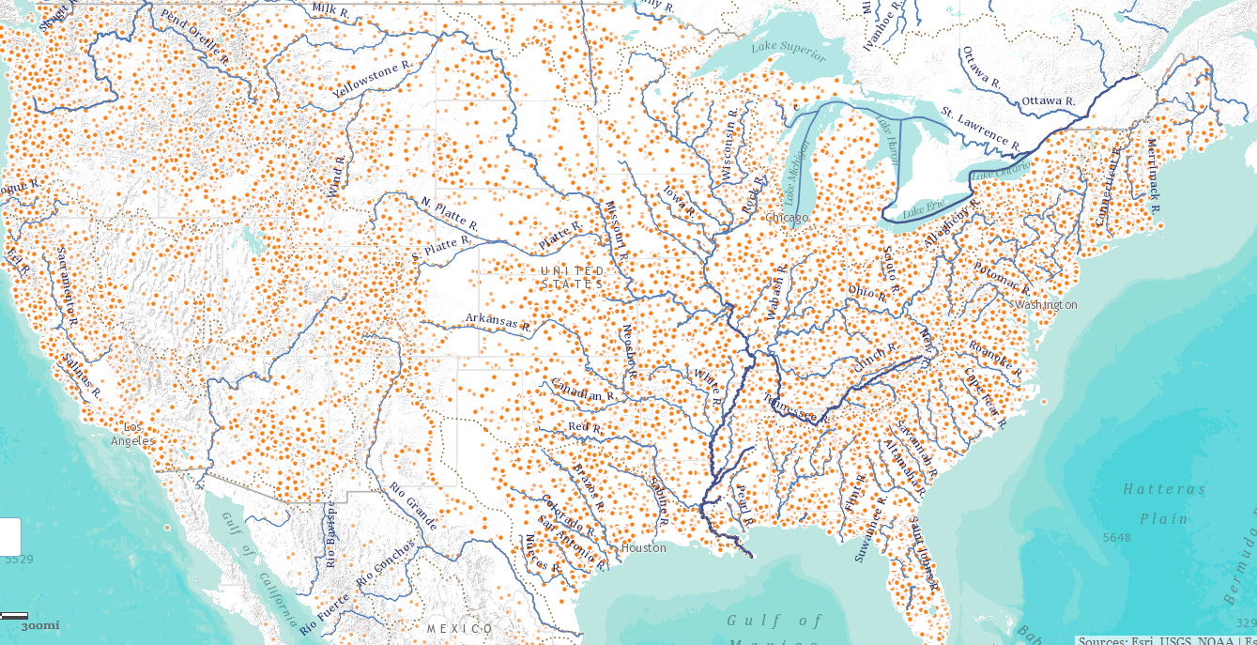
Open Water Data
GISHydro2014 Workshop
ESRI UserConference
San Diego, California
13 July 2014

Slide 2
Major Transitions in Geospatial Info
Paper maps to digital data
National Spatial Data Infrastructure development
Started in 1990’s
Took more than a decade to complete
Digital data to web services
Started several years ago
Will take years to complete
Maps
Data
Services

Slide 3
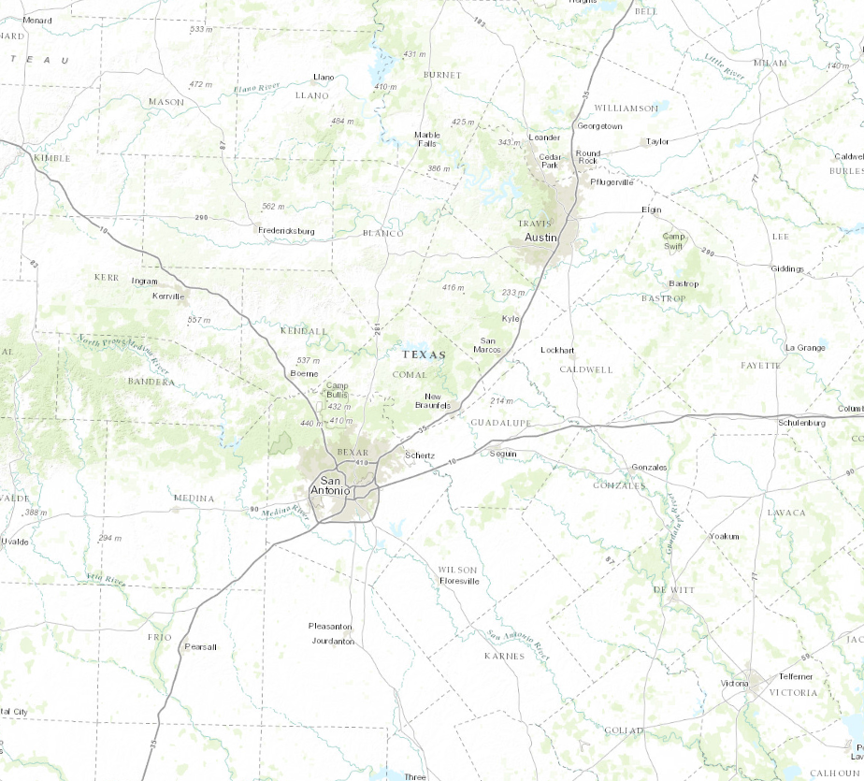
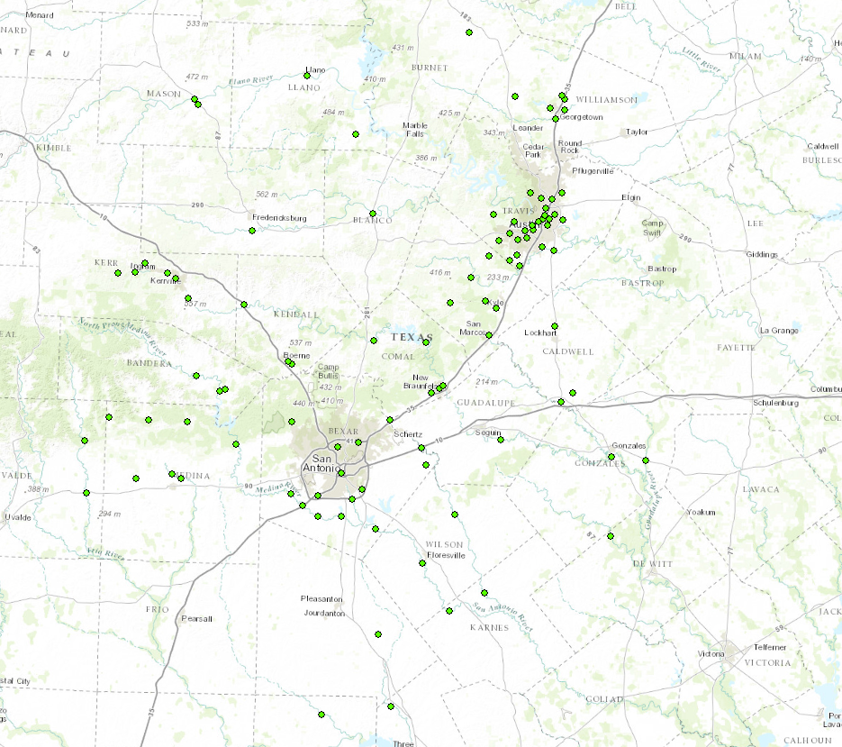
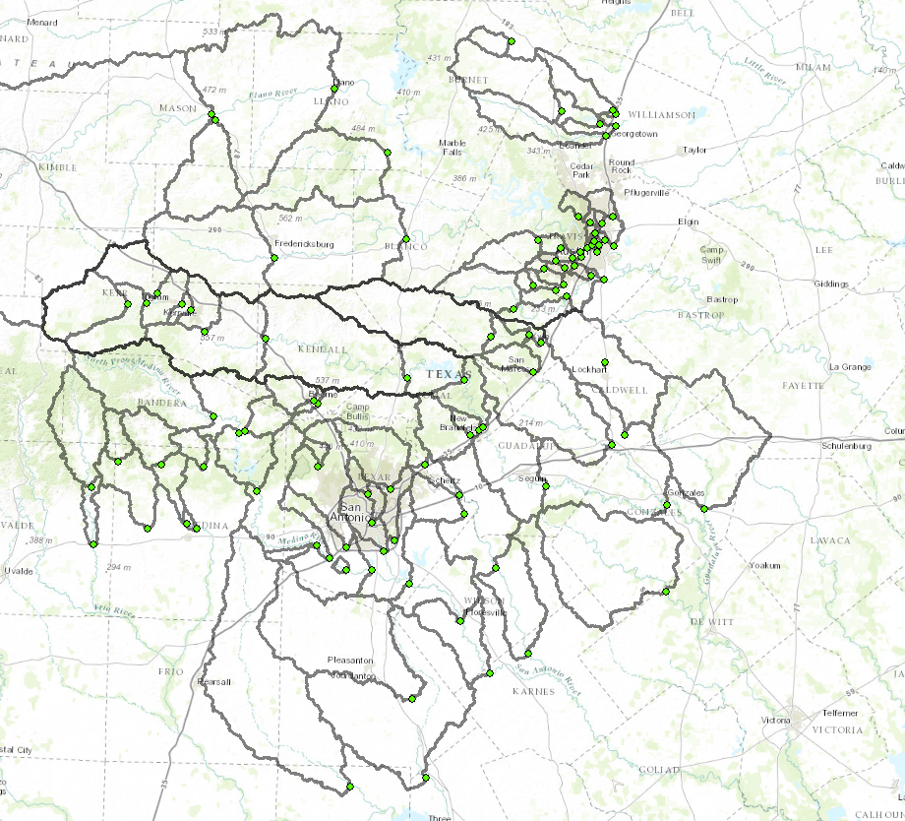
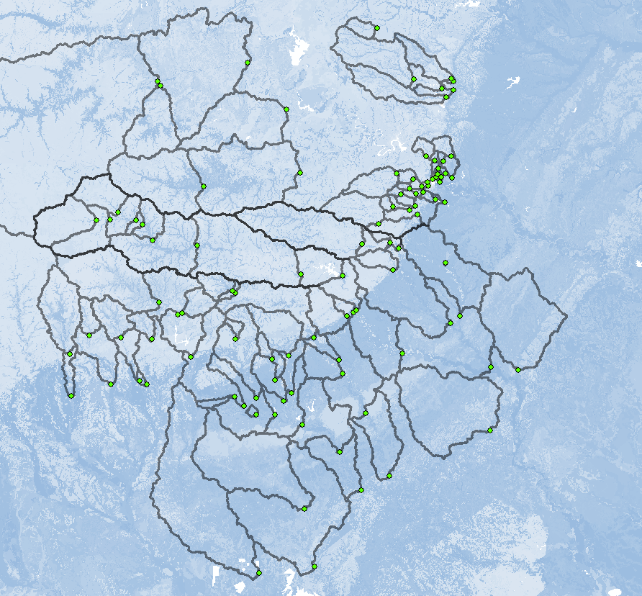
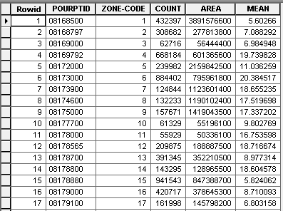
Geospatial Services
Goal:
Calculate average available water storage for a set of contributing areas
Key to Geospatial Services:
Standardized & Machine-Readable Formats
Remote Data & Tools:
Basemap
Stream Gages
Digital Elevation Model
Watershed Delineation Tool
Soil Available Moisture Map
Soil Statistics by Watershed

Slide 4
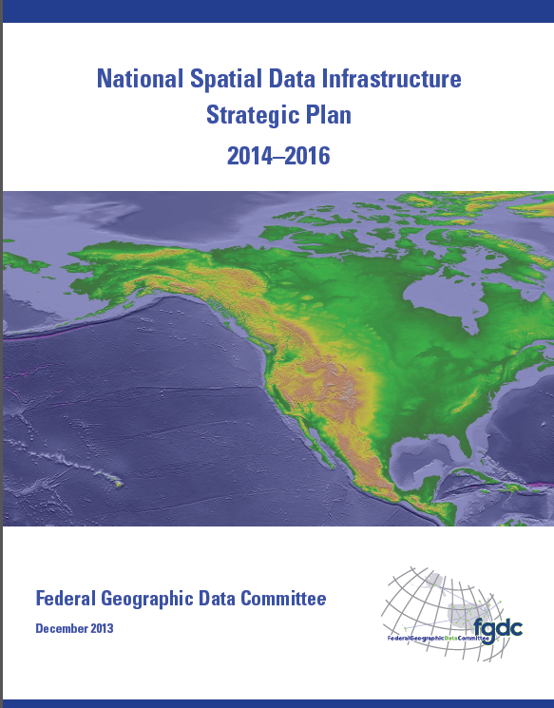
National Spatial Data Infrastructure (NSDI)
Desired Future State of NSDI
Create network of resources and services
Facilitate discovery, access and application of resources
Leverage shared standard-based services
Develop core set of information layers that interface with nonspatial data
Use real-time data feeds and sensor webs

Slide 5
National Water Data Infrastructure (NWDI)
A thematically organized set of water information data layers
Authoritative for the nation
Assembled from best available sources
Made freely available through water information services.

Slide 6
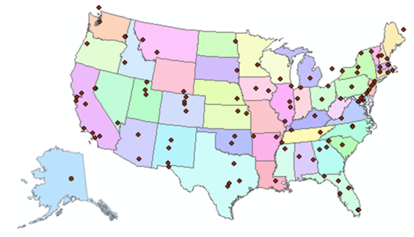
Consortium of Universities for the Advancement of Hydrologic Science, Inc.
www.cuahsi.org
CUAHSI
A consortium representing 125 US universities
Dr. Richard Hooper, President and CEO
Supported by the National Science Foundation Earth Science Division
Advances hydrologic science in nation’s universities
Includes a Hydrologic Information System project
Invented WaterML language for water resources time series
Building an academic prototype system

Slide 7
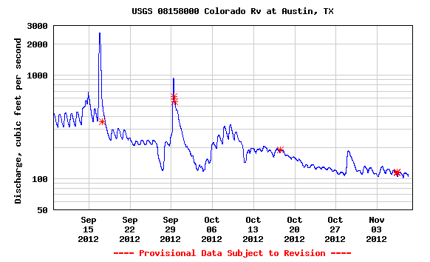
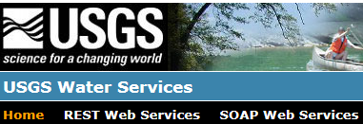
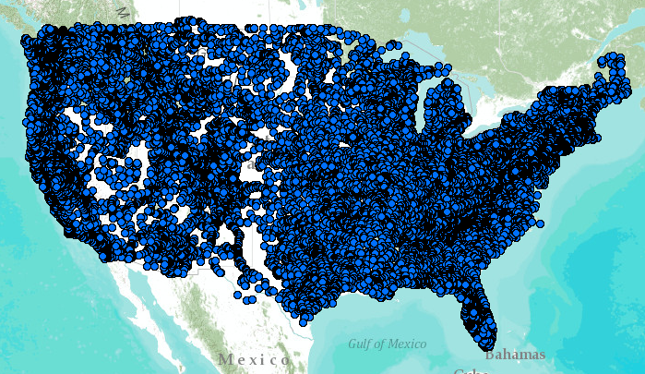
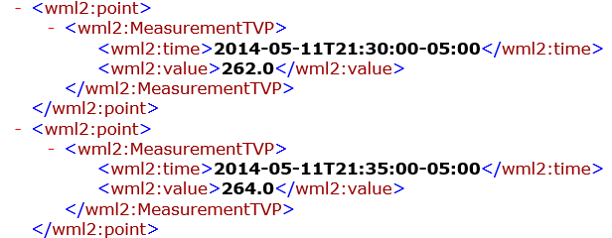
WaterML Web Services – CUAHSI, USGS, OGC, WMO …..
Water time series data on the internet
24/7/365 service
For daily and real-time data
. . . Operational water web services system for the United States
http://waterservices.usgs.gov/nwis/iv/?format=waterml,2.0&sites=08158000&period=P1D&parameterCd=00060

Slide 8
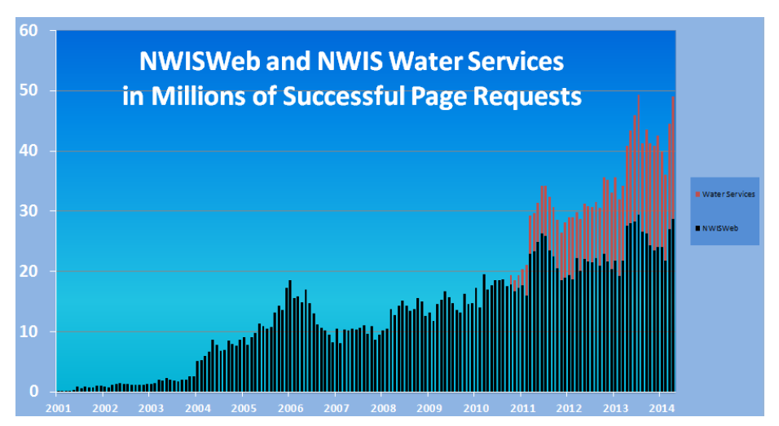

Slide 9
Open Geospatial Consortium
More than 400 companies and agencies globally
Internet standards for
Map services
Observation services
Catalog services
. . . Internet data standards for maps and observational data

Slide 10
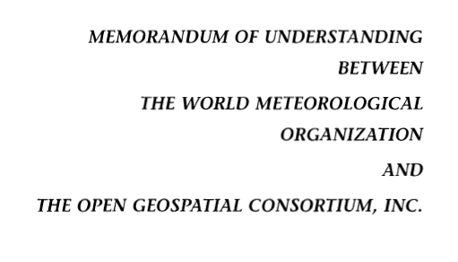
OGC/WMO Hydrology Domain Working Group
4-Year International Effort – WaterML
A time series for one variable at one location
Hydrology Domain Working Group formed
OGC at WMO Commission for Hydrology
Technical Meetings Each 3 Months Four Interoperability Experiments
(Surface water, groundwater, forecasting)
Annual week-long workshops
Involvement by many countries
November 2009
Acknowledgements: OGC, WMO, GRDC, NWS, CUAHSI, BoM/CSIRO, USGS, GSC, Kisters, …….
2008
2009
2010
2011
2012
Notes:
(1) A four-year international effort has been undertaken to reconcile WaterML with international standards;
(2) This effort was initiated with the establishment of an Hydrology Domain Working Group by the Open Geospatial Consortium in September 2008;
(3) An OGC representative attended the WMO Congress of the Commission for Hydrology in 2008
(4) A formal agreement between Secretary General of WMO and President of OGC in 2009 to jointly develop standards for hydrology, climatology, oceanography and climatology;
(5) The joint OGC/WMO Hydrology Domain Working Group was supported by a large work effort, annual week-long workshops, four interoperability experiments for surface and groundwater data exchange, and participation by many countries;
(6) In June 2012, the OGC voted to adopt the revised version, WaterML2 as an international standard for exchange of water resources time series (the first such public standard that has existed);
(7) This Congress to the WMO Commission for Hydrology to whom I am speaking is considering WaterML2 for adoption as an official standard by WMO

Slide 11
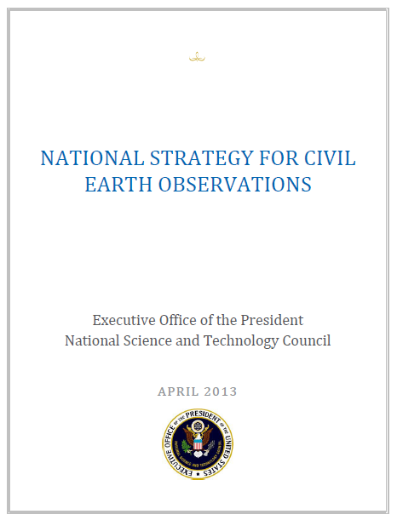
Committee on Environmental, Natural Resources, and Sustainability (CENRS)
“WaterML: Water Markup Language (ML) is an informatics initiative of the CENRS Subcommittee on Water Availability and Quality that provides a systematic way to access water information from point observation sites.” (p.21)
WaterML is the first OGC standard endorsed by the Executive Office of the President
http://www.whitehouse.gov/sites/default/files/microsites/ostp/nstc_2013_earthobsstrategy.pdf

Slide 12
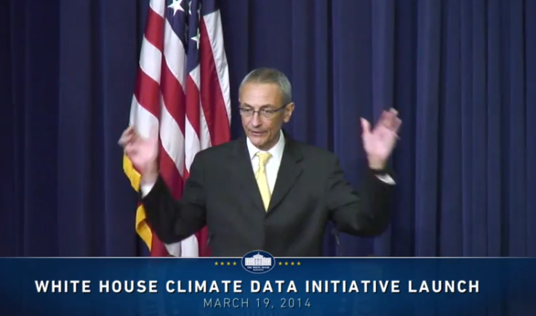
President’s Climate Data Initiative
John Podesta, Counsellor to the President, White House, March 19, 2014
https://www.youtube.com/watch?v=pfe5oRdsCp0&feature=youtu.be&t=7s

Slide 13
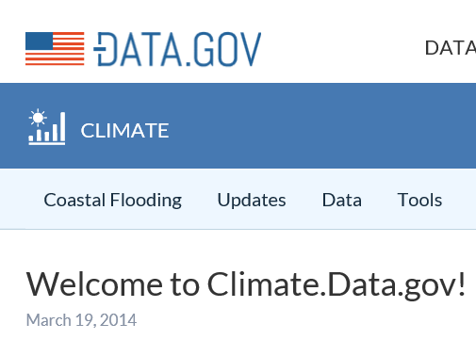
Goals of Climate Data Initiative
Prepare for climate change
Make government data accessible
Engage private sector
ESRI, Microsoft, Google, Intel ….
Engage communities
Chesapeake, New Orleans, World Bank, …
Why not Water.Data.gov?
Build an Open Water Data Initiative

Slide 14
Anne Castle, Asst Secretary for Water and Science, Dept of Interior
“Today we have unprecedented opportunities to use science and technology to create a better understanding of one of our most precious resources – water”
“I am committed to working with you to do that”
Chair

Slide 17
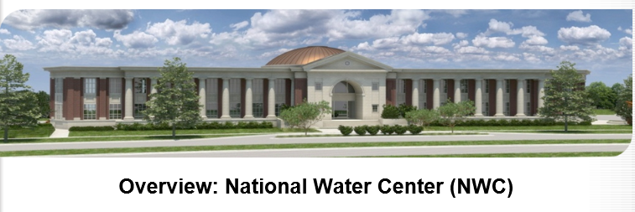
Common Operating Picture for Water Resources
Geo-Intelligence Laboratory
Science and software studio
Systems proving ground
Distance learning

Slide 18
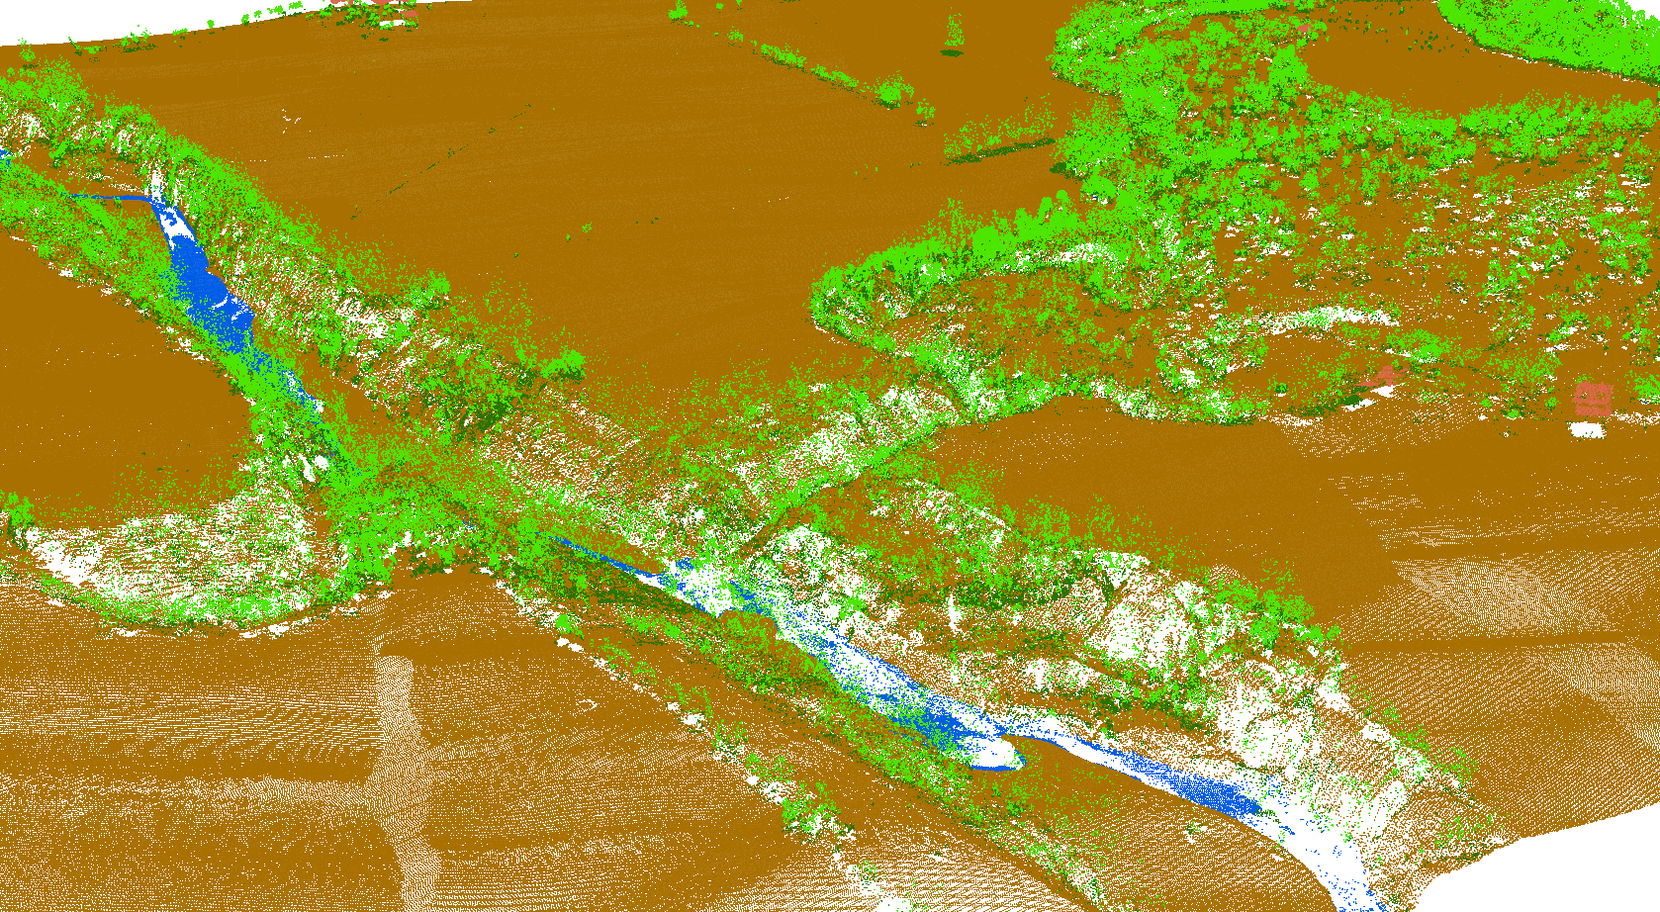
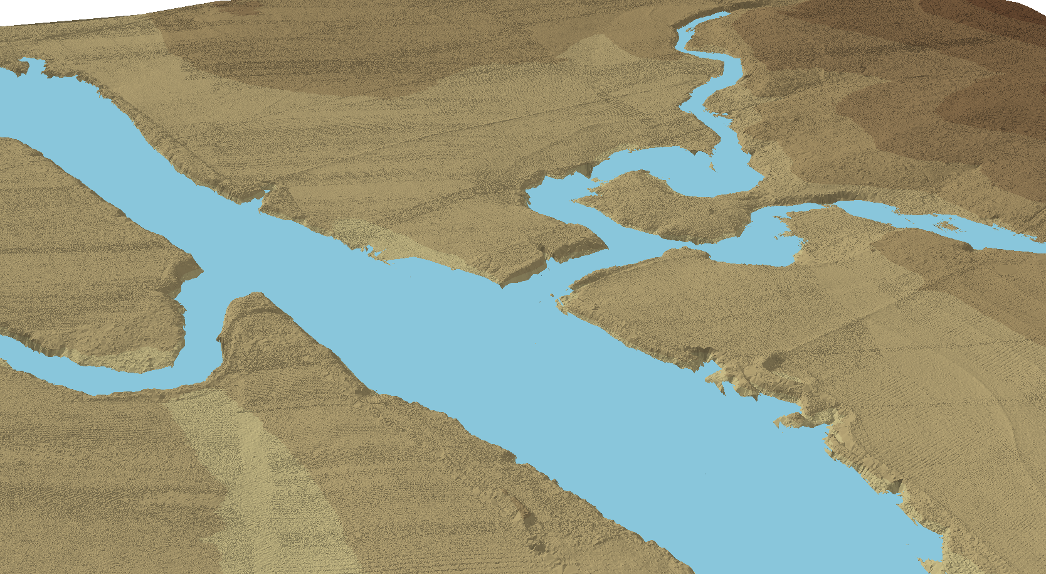
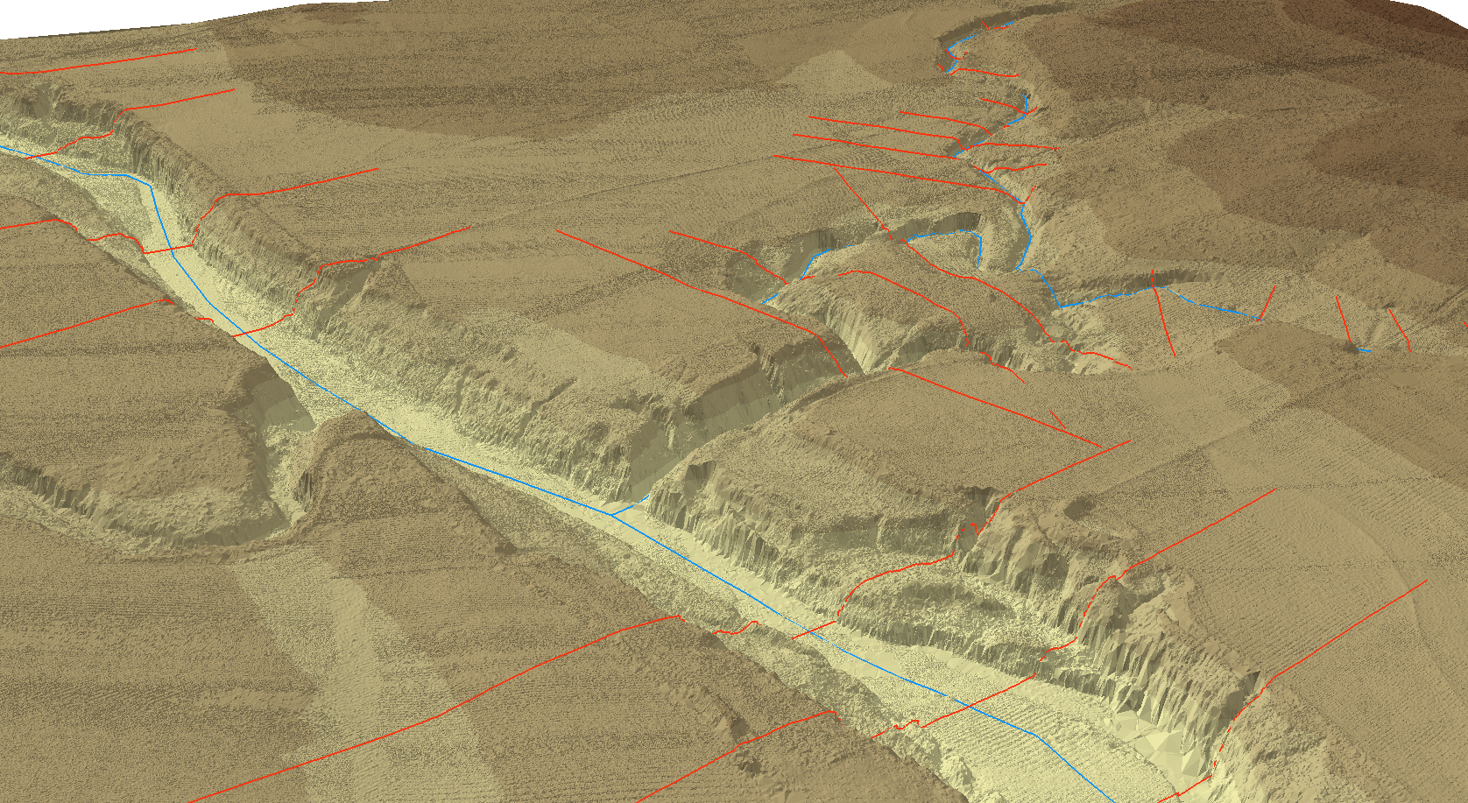
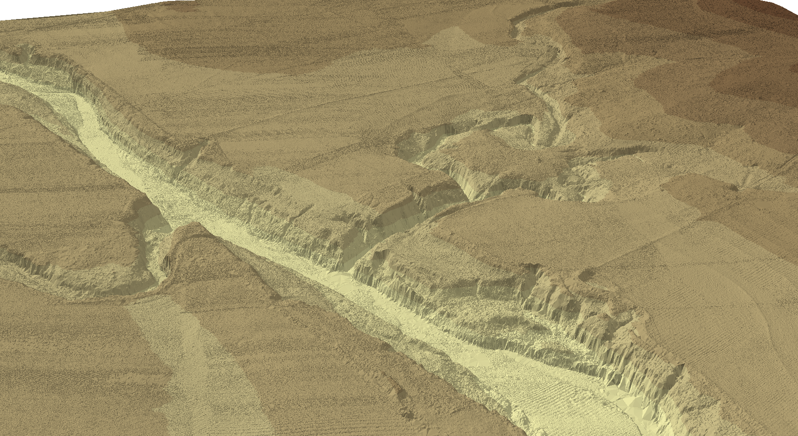
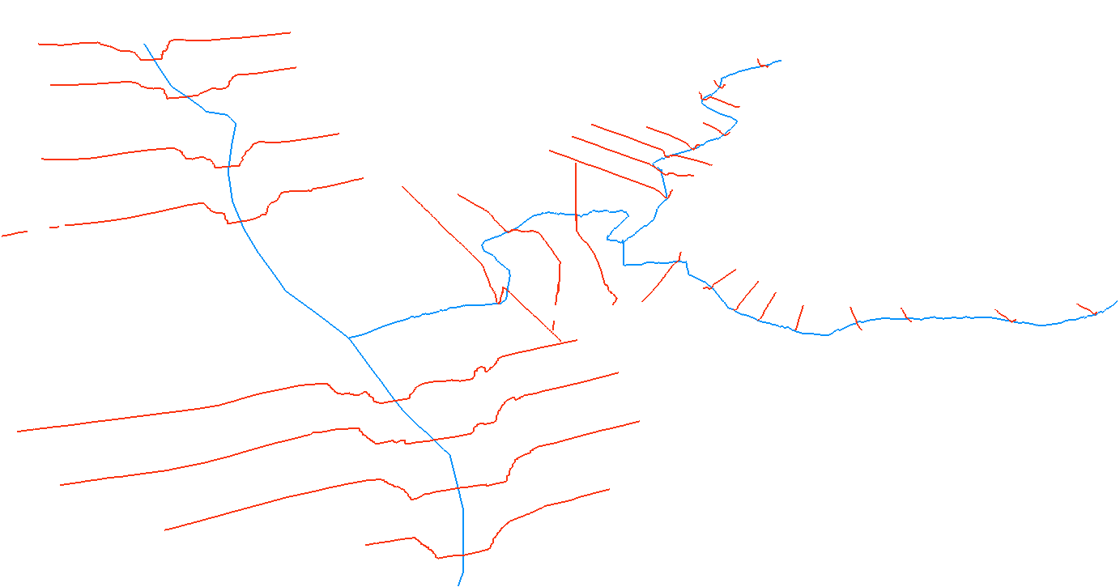
Flood Modeling: Geometry and Flow
RiverML – a language for communicating river channel and flood inundation map information

Slide 19
National Flood Interoperability Experiment: Connecting national flood forecasting with local flood emergency response
Will be led by the academic community in collaboration with the IWRSS partners through the National Water Center
Run from September 2014 to August 2015
Preparatory phase to May 2015
Summer Institute at the National Water Center to bring things together June to August 2015
Serves a use case in flooding for the Open Water Data Initiative
Open to all levels of government, commercial providers, academia

Slide 20
AWRA support for Open Water Data
Featured Collection of articles in JAWRA
New Technology Committee chaired by Jack Hampson and Sandra Fox
Special track at AWRA National meeting in Tysons Corner, VA, Nov 2014
GIS and Water Resources – data and modeling services in space and time
Your participation and suggestions are very welcome!!!

