Slide 1
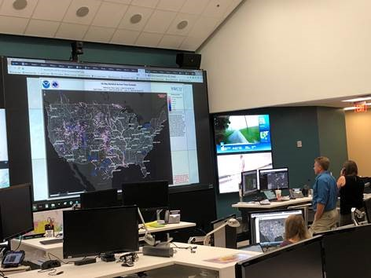
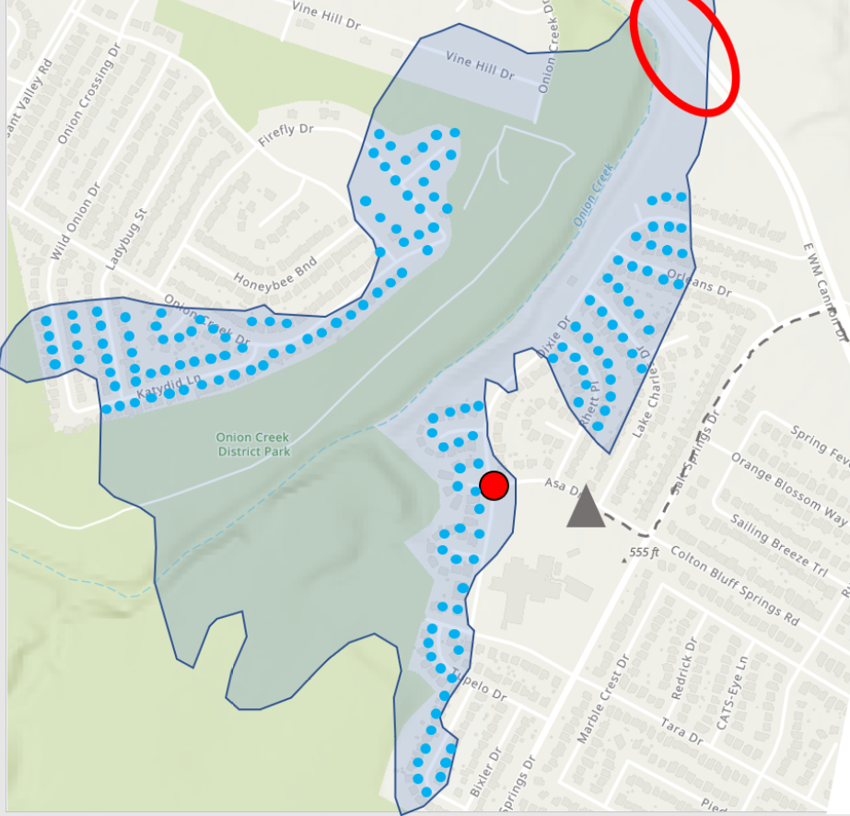
Mapping for Real-Time Flood Emergency Response From National … to … Local
Presented by David R. Maidment Center for Water and the Environment University of Texas at Austin
ESRI Water Resources and Hydro Meeting
San Diego, CA
10 July 2022
Acknowledgments: National Water Center, Texas Department of Transportation
Christine Thies, UT Austin

Slide 2
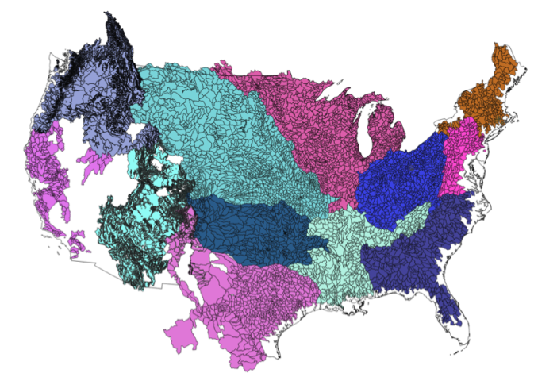
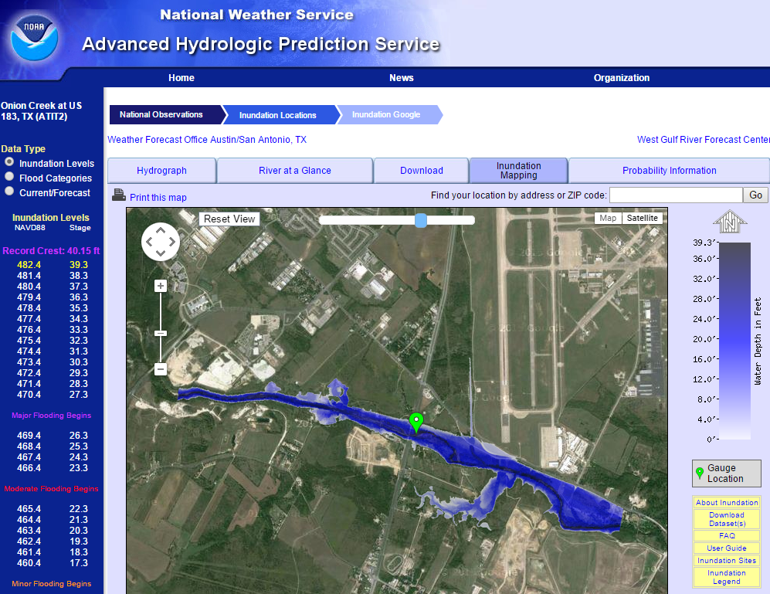
Conversations in 2013 ̶ 2014
Craig Fugate
FEMA
Administrator
“We need a national system for flood forecasting
and real-time inundation mapping”
Regional flood forecasting
for large watersheds
Jack Dangermond President, ESRI
“Can we
do better?”
“Yes, Jack,
but not yet”
Flood Inundation mapping
at some forecast points

Slide 3
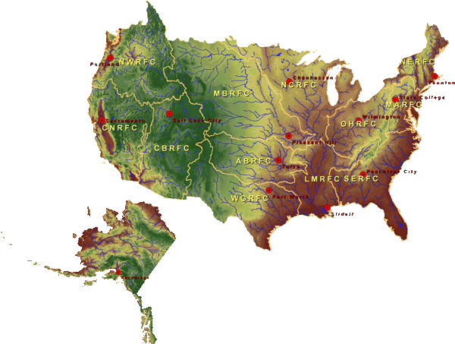
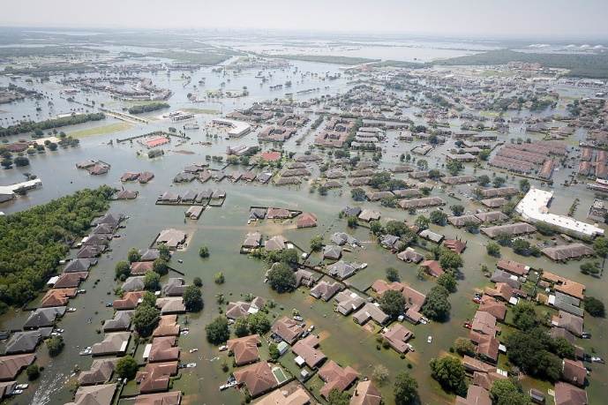
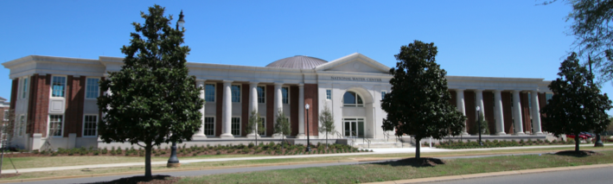
National Flood Forecasting
National Water Center
Established in 2014 in Tuscaloosa, AL

Slide 4
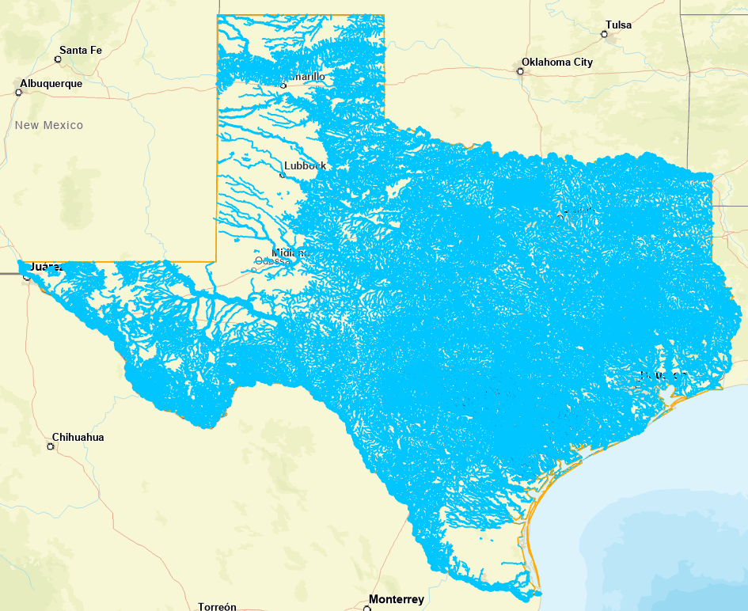
National Water Model
Water forecast like weather 24/7/365
Four model outputs:
Assimilation (Current conditions)
Short Range Forecast (18 hours ahead)
Medium Range (10 days ahead)
Long Range Forecast (30 days ahead)
Water flow forecasts on 190,000 miles
of streams and rivers in Texas

Slide 6
Operations Room at the National Water Center

Slide 7
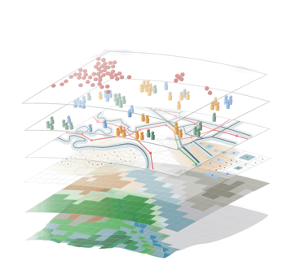
Geospatial Systems Are Helping Us Understand
Understanding
Sharing and Collaboration
Knowledge
Information
Integration
Mapping
Data
. . . Helping Us Make Better Decisions
Slide: Jack Dangermond

Slide 8
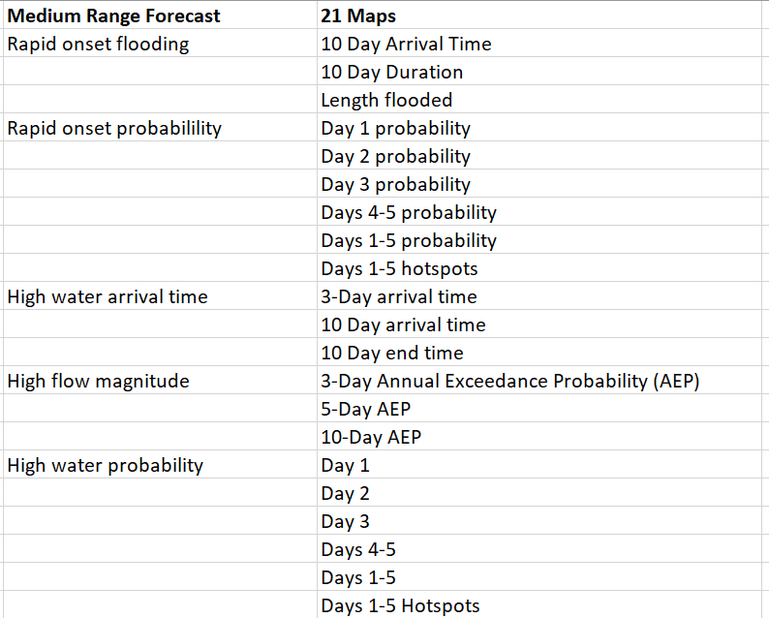
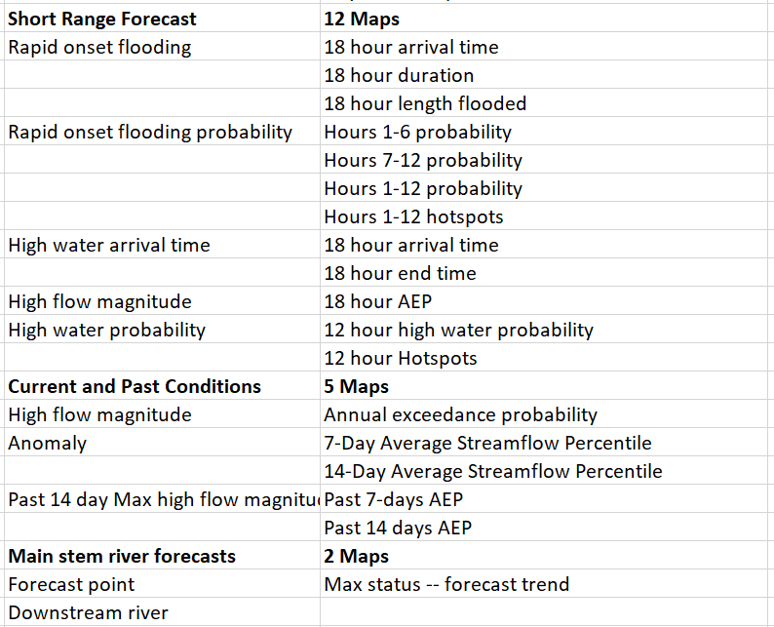
40 New Water Forecast Map Services
Free and publicly available
https://maps.water.noaa.gov/server/rest/services

Slide 9
Through open water services everyone can see …
https://www.weather.gov/owp/operations
… what is seen at the National Water Center

Slide 10
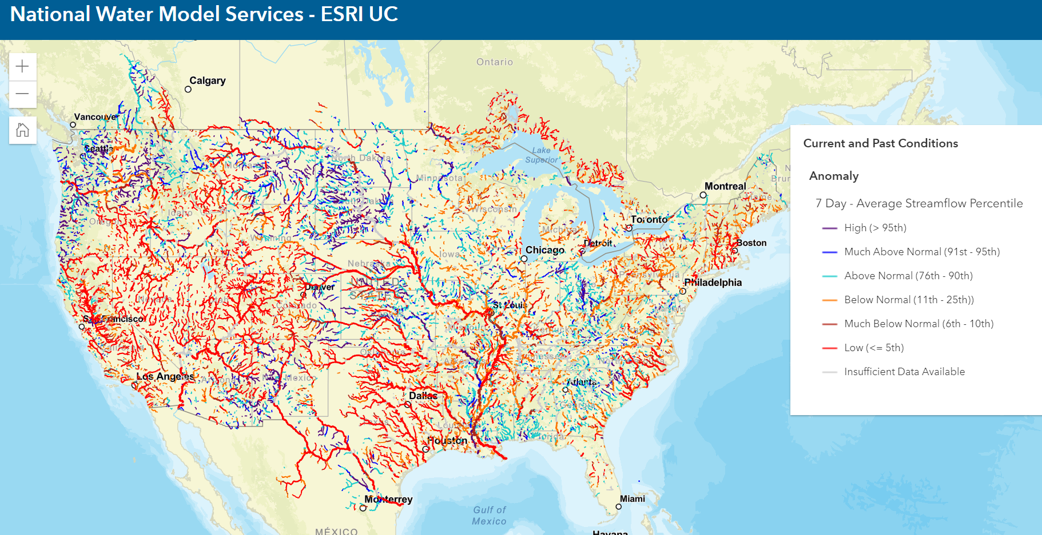
Water Flow Anomaly – Comparison with Average Flow Conditions Average for last 7 days
2.7 million stream reaches
covering United States

Slide 11
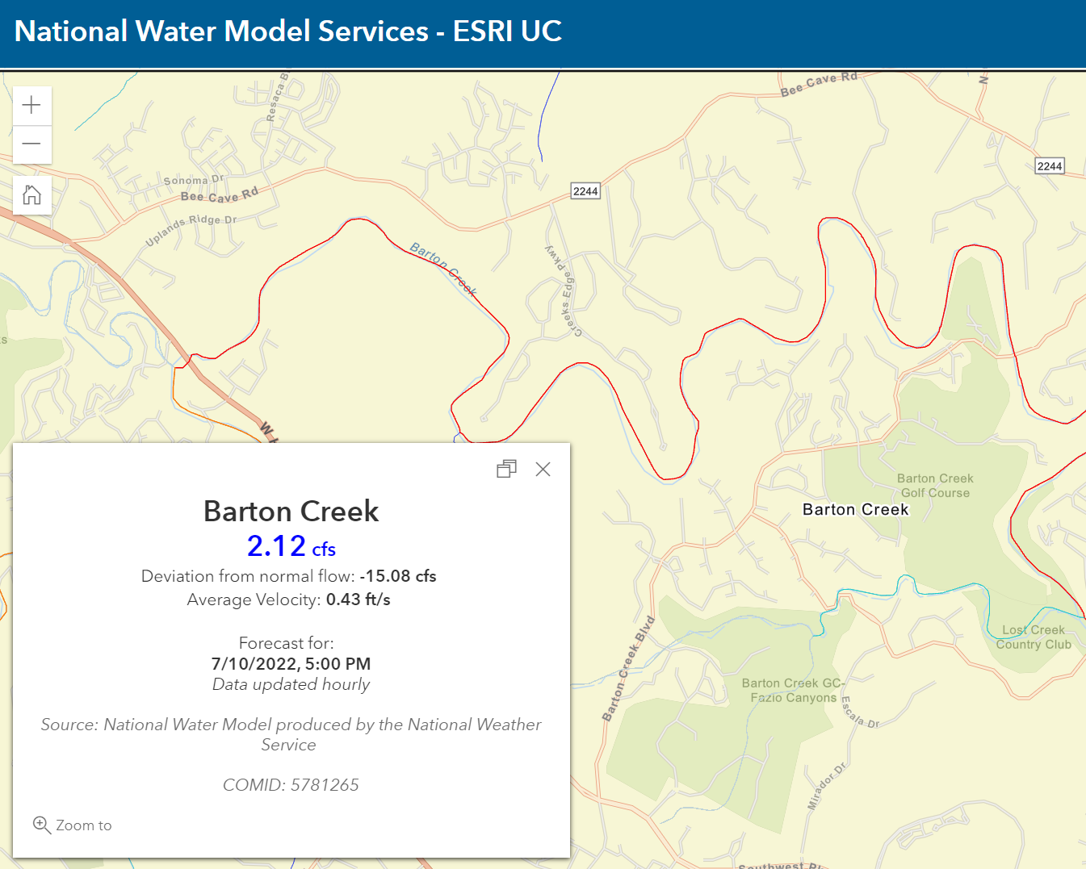
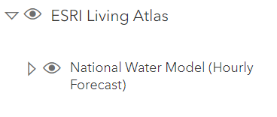
ESRI Living Atlas Water Flow Map -- Conditions at Local Scale
Barton Creek is near
my home in Austin, Texas
It is reach 5781265
in the national stream network

Slide 12
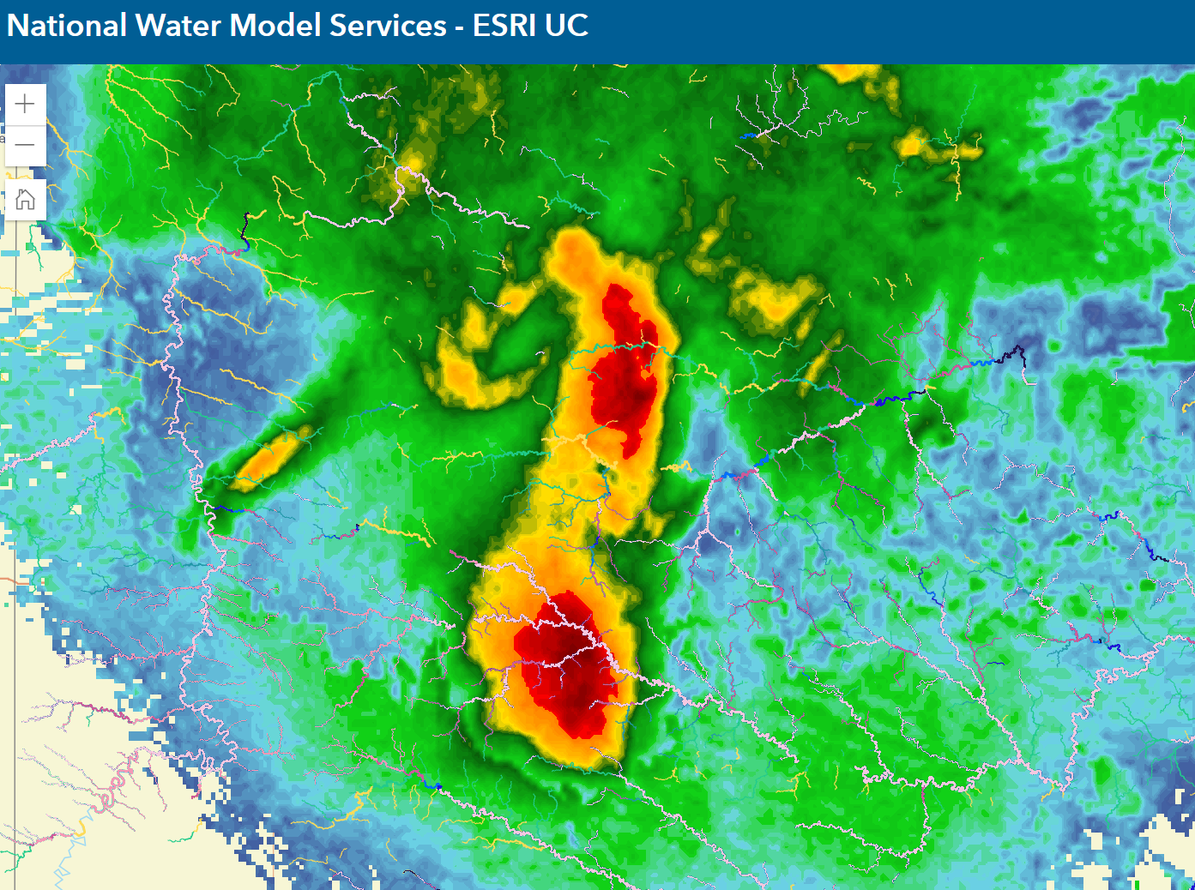
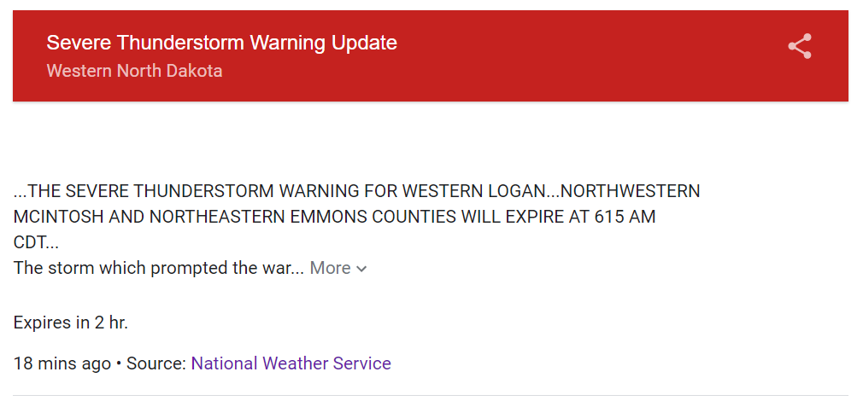
A Storm Occurring in North Dakota this Morning (10 July 2022)

Slide 13
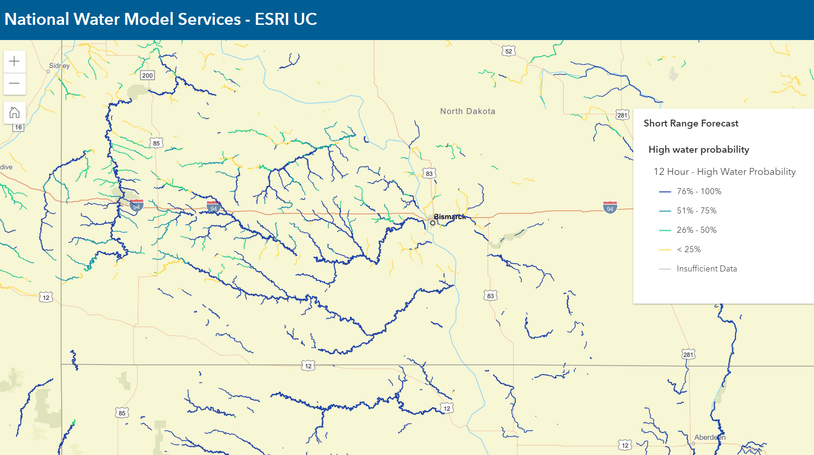
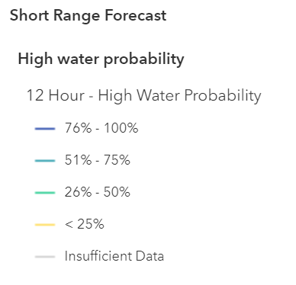
Probability of High Water in Next 12 Hours
Flooding is expected here

Slide 14
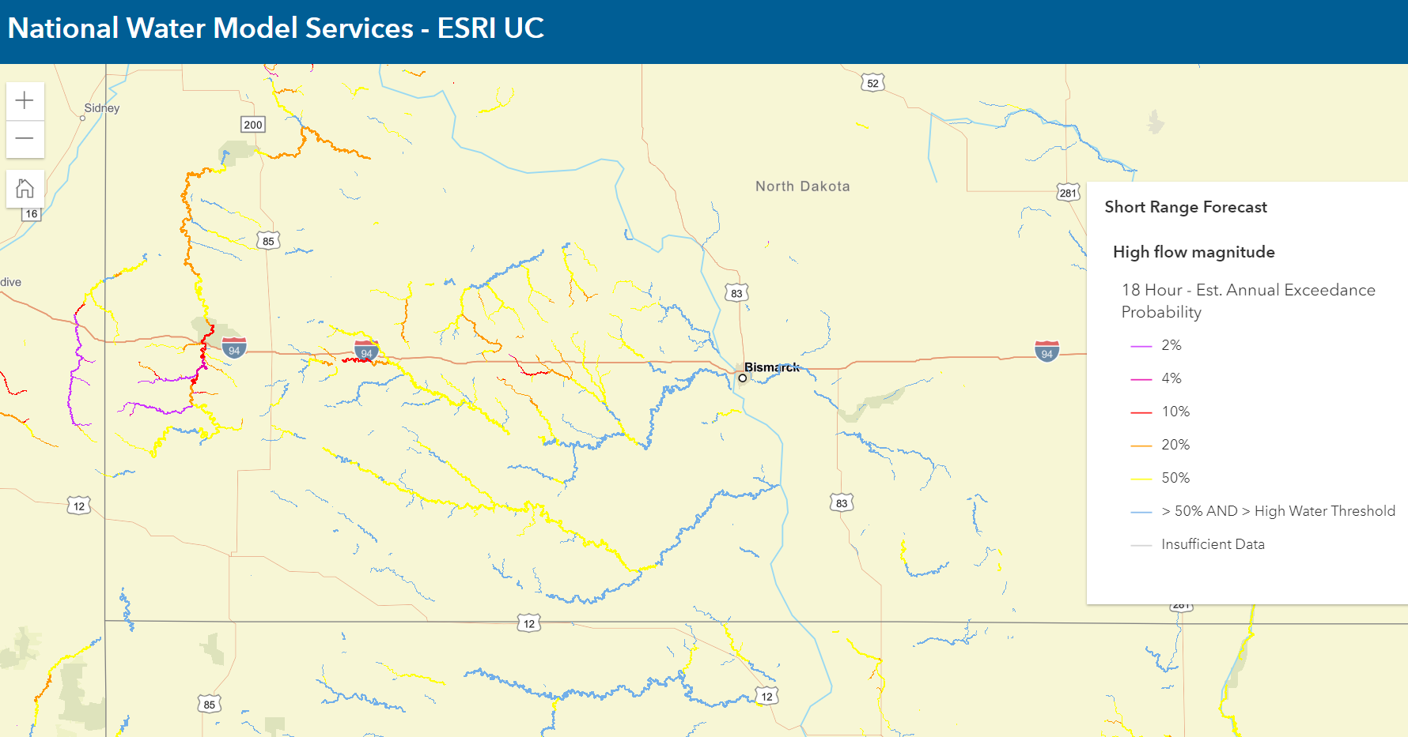
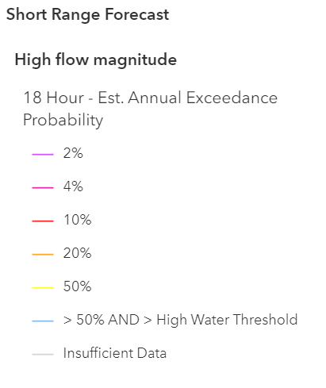
High Flow Magnitude Measured as Annual Exceedance Probability
High flood risk that threatens I-94

Slide 15
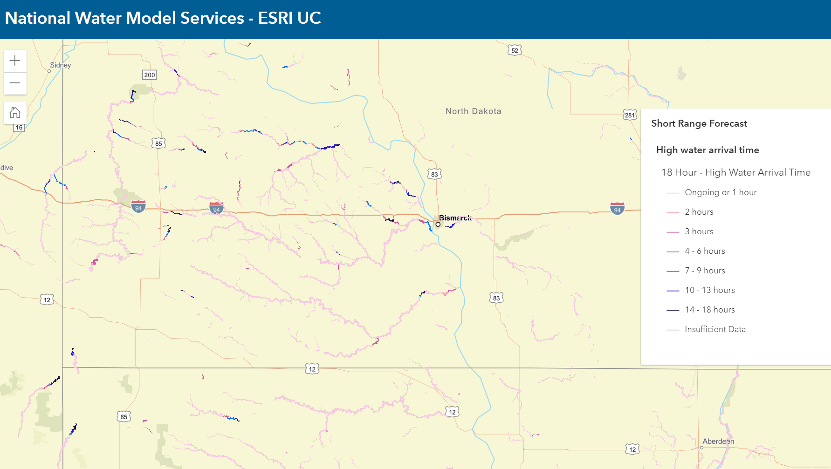
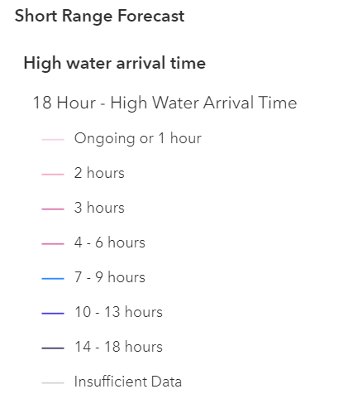
High Water Arrival Time
Flooding will occur soon

Slide 16
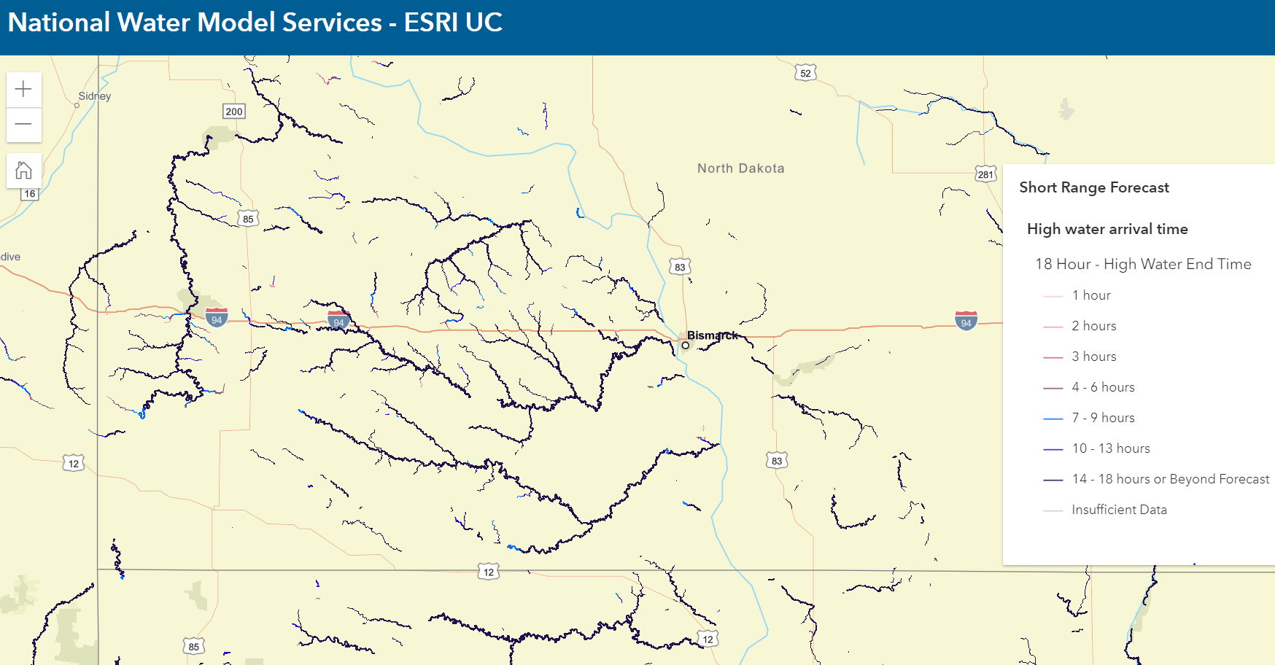
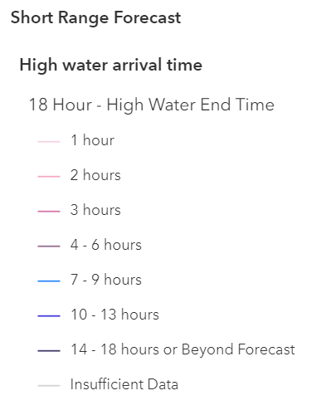
Ending Time of High Water (Short Range Forecast up to 18 hours ahead)
Flooding will continue for more than 18 hours

Slide 17
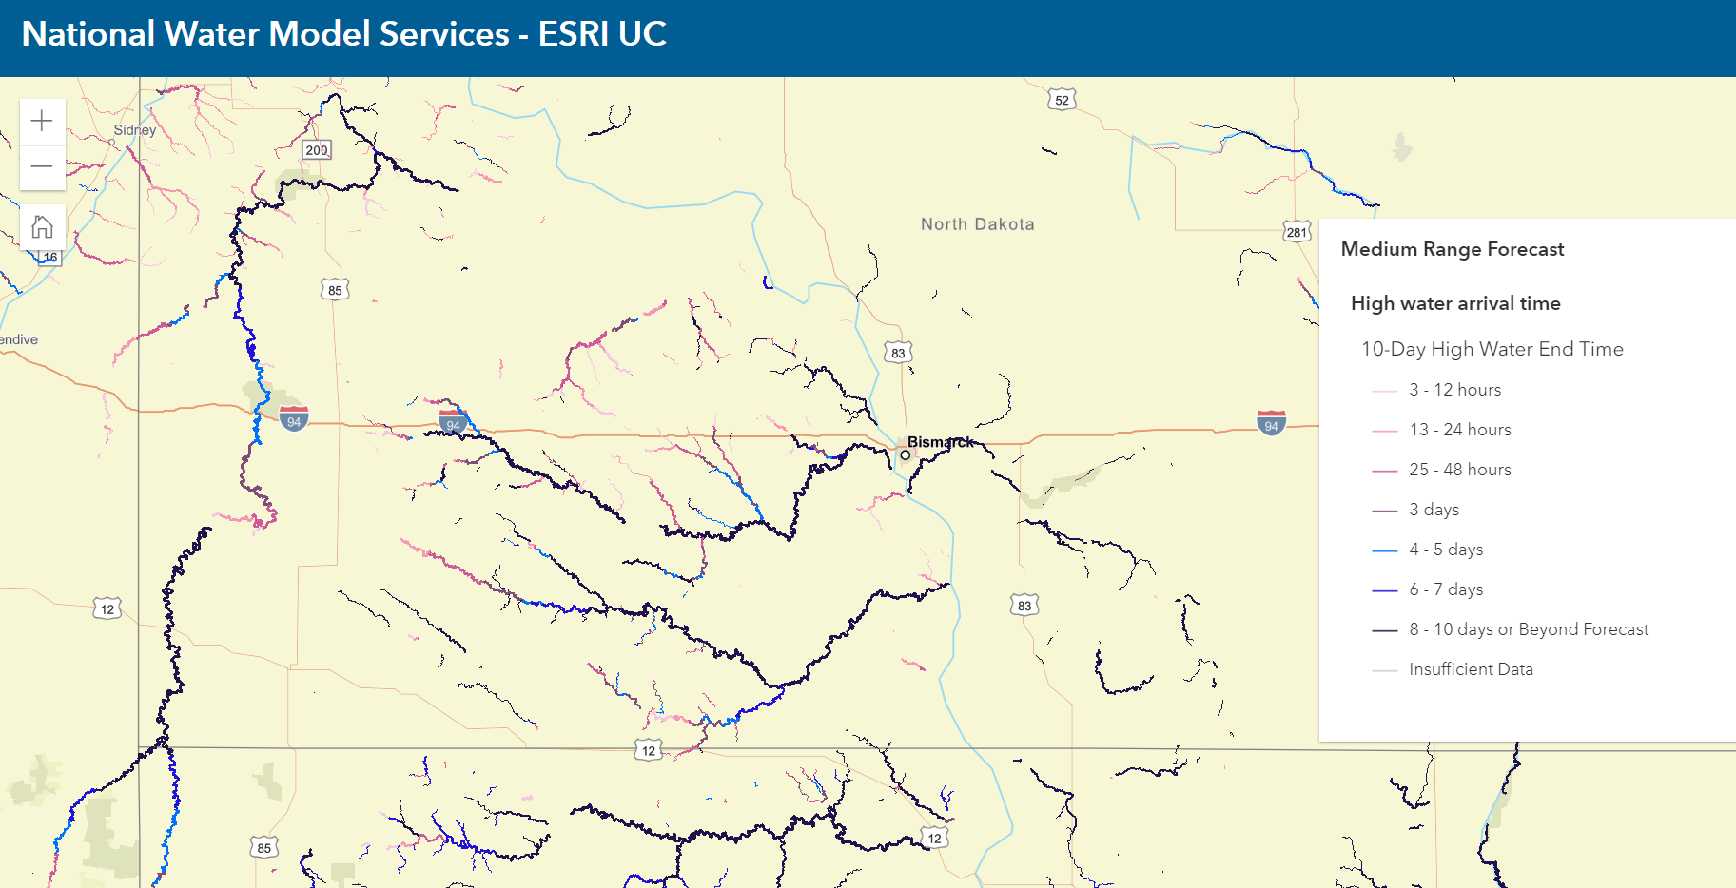
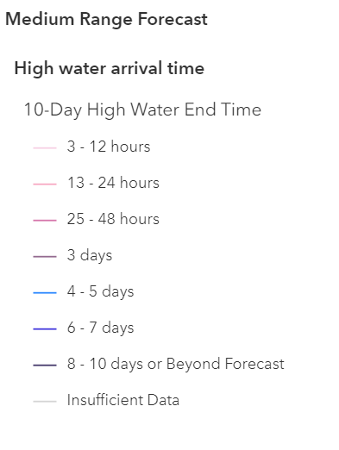
Ending Time of High Water (Medium Range Forecast up to 10 days ahead)
Flooding near I-94 will continue for 4-5 days

Slide 18
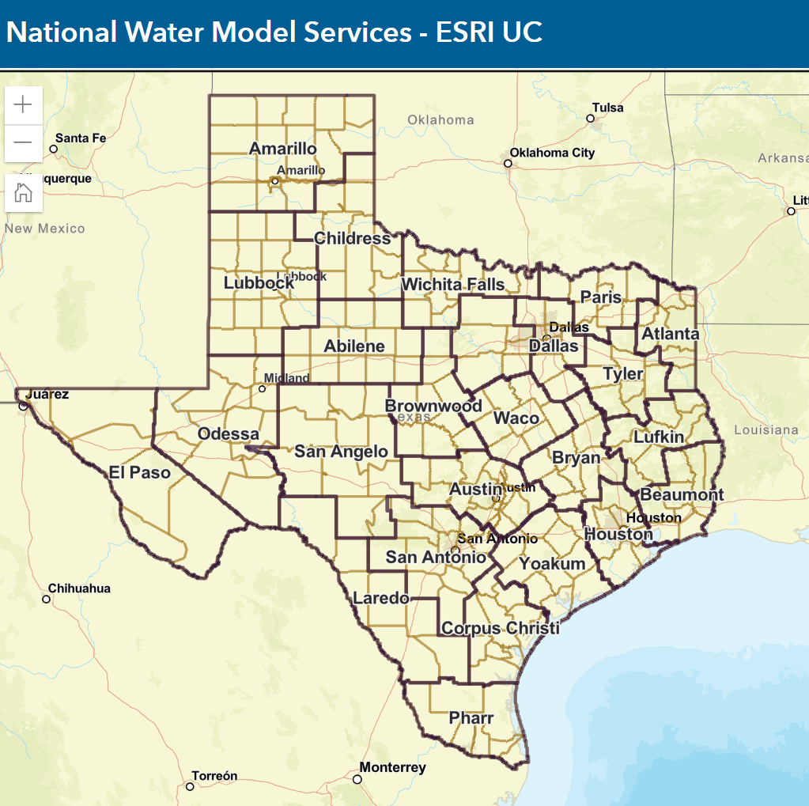
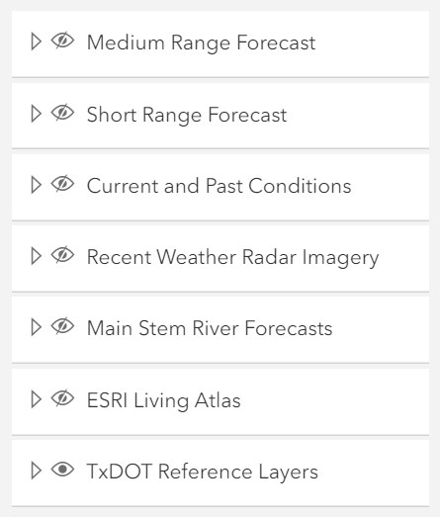
Flood Web Map Services for Texas Department of Transportation
https://www.arcgis.com/apps/instant/basic/index.html?appid=bb7cb731322d47f4bfee629ca148e053

Slide 19
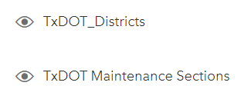
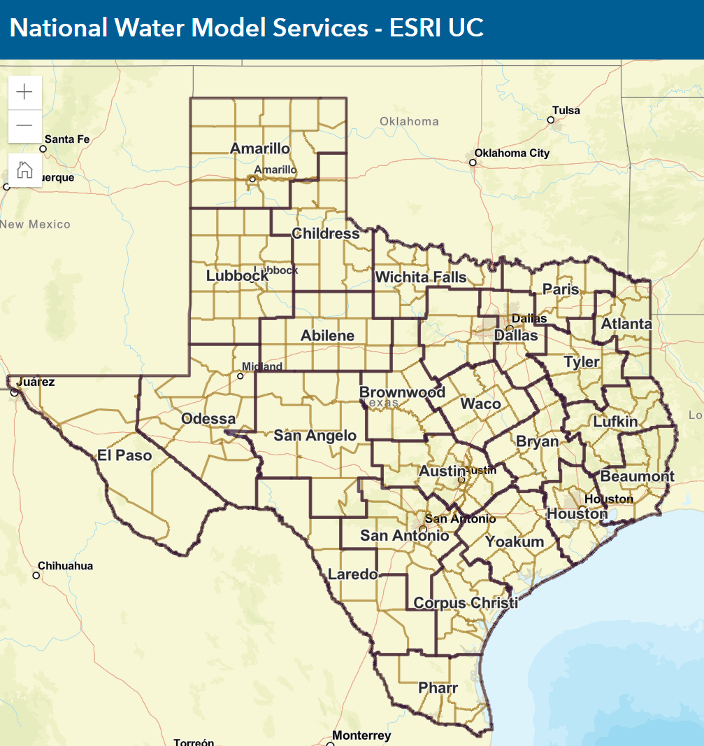
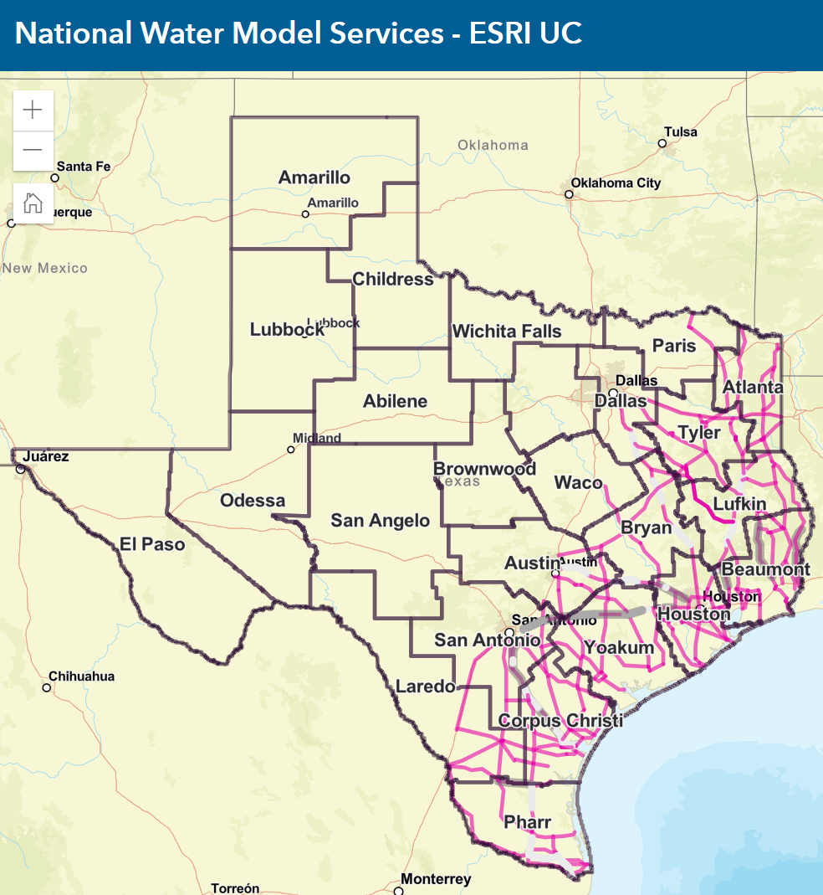
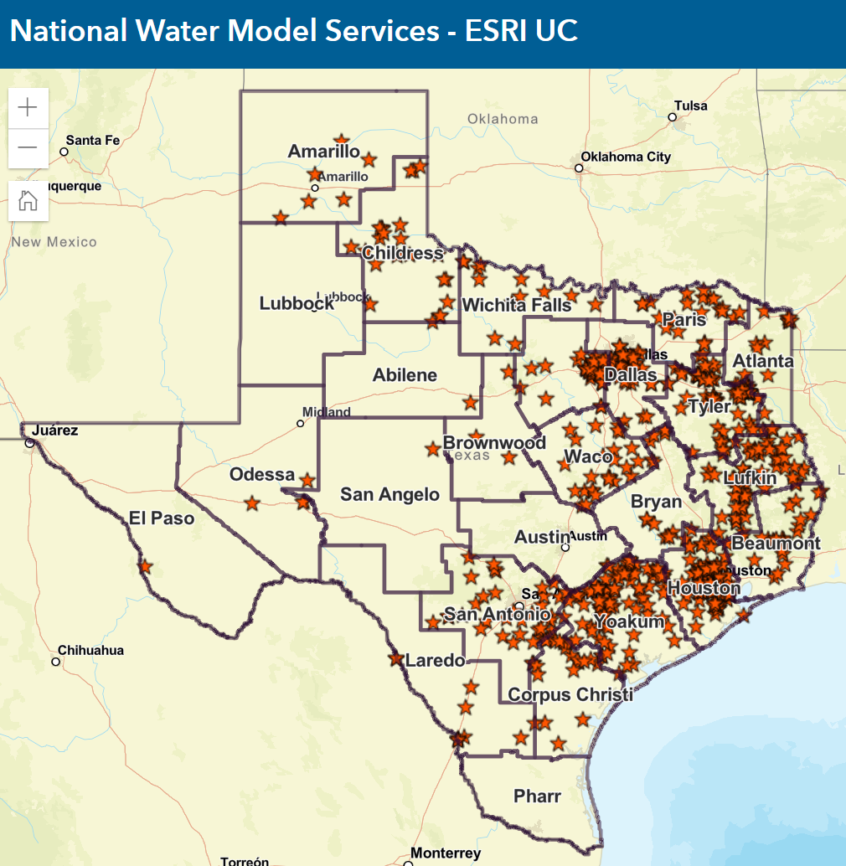
Texas Department of Transportation

Slide 20
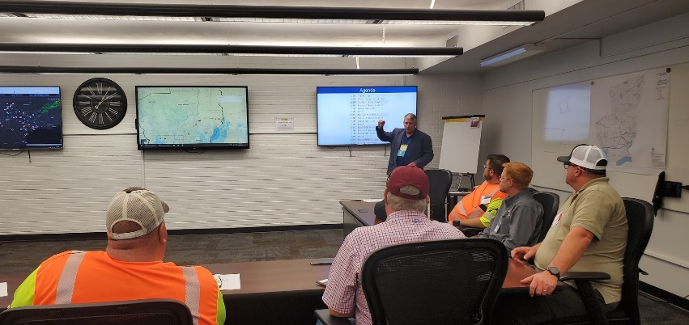
TxDOT wants to move from Reactive response to Proactive response
Reactive Response
Maintenance Staff
observing current
flood conditions
EOC staff
Decisions based on
current conditions

Slide 21
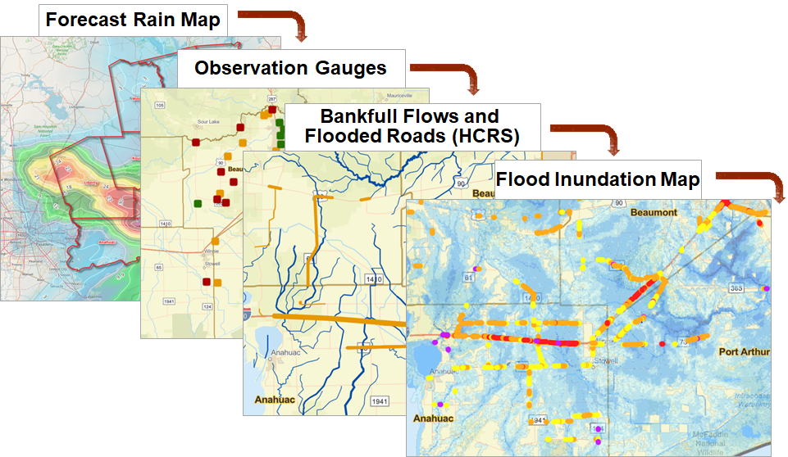
TxDOT wants to move from Reactive response to Proactive response
Proactive Response
Maintenance Staff
observing current
flood conditions
Predictive Storm and Flood Maps
EOC staff
Decisions based on
current and predicted conditions
Advance warning of location, extent
and severity of flooding

Slide 22
Some Thoughts I have Heard
“It’s the guys in the field who tell us what’s going on”
Keith Horn, Logistics Coordinator, BMT
“I want technology to be my eyes on the landscape”
Martin Gonzalez, District Engineer, BMT
“We want to move from being reactive to being proactive”
Chris Henry, Director of Maintenance, BMT
“We need all the data in one place”
Eliza Paul, District Engineer, HOU
“I want to know if there’s going be another Harvey”
Eliza Paul, District Engineer, HOU
“We could close IH-10 in 3-6 hours”
Chris Henry, Director of Maintenance, BMT
“At the SOC, we need warning 24-48 hours in advance”
Jared Browder, Maintenance Assessment Specialist, MNT

Slide 23
Flood Forecasting Project with Texas Department of Transportation
Largest research project ever supported by TxDOT ($6.38 million)

Slide 24
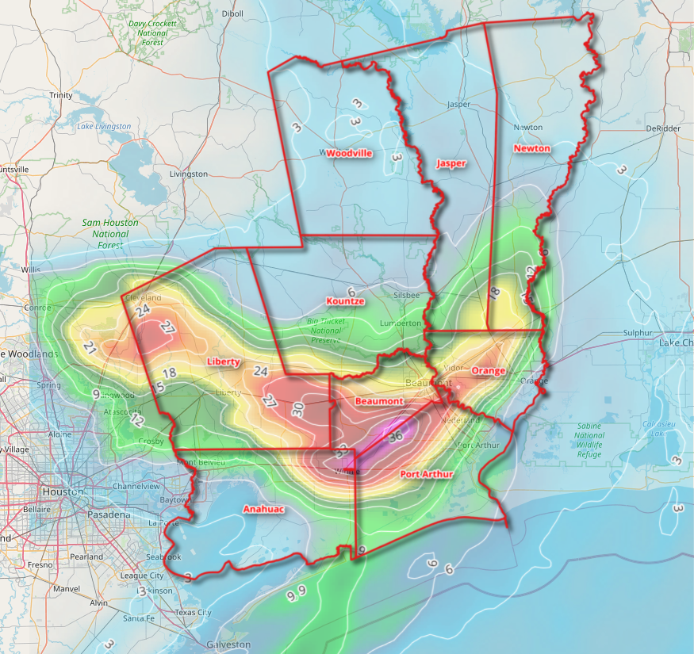
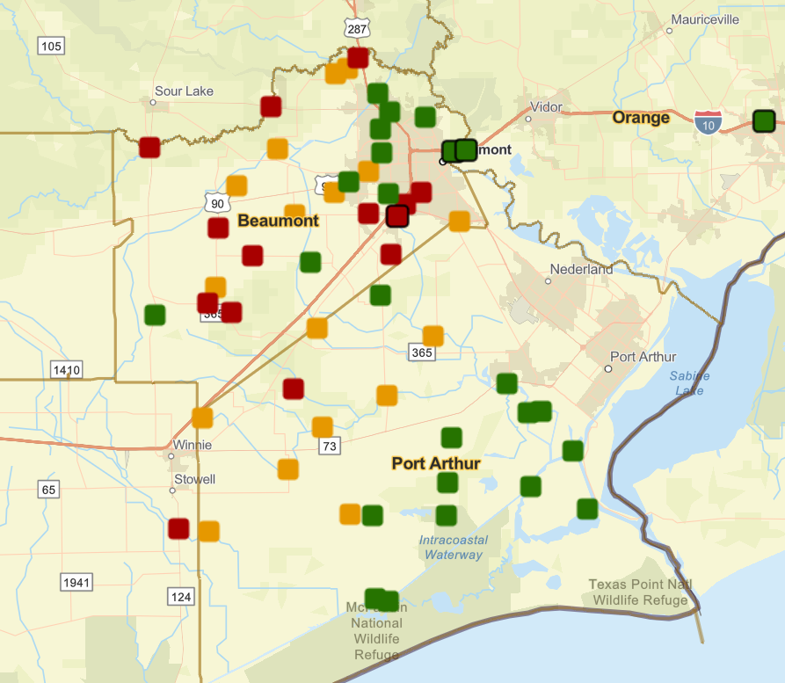
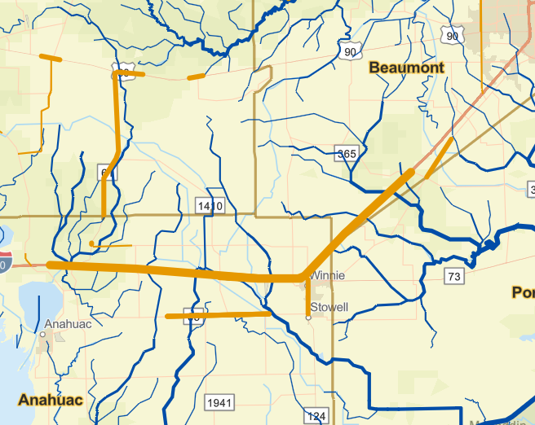
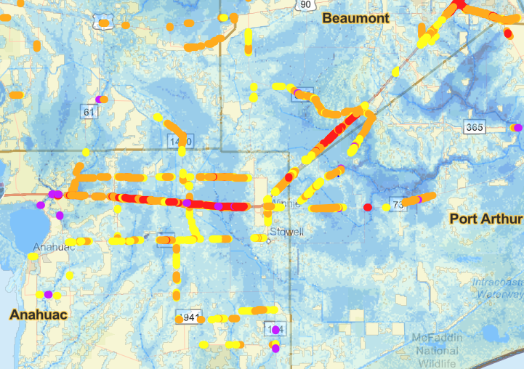
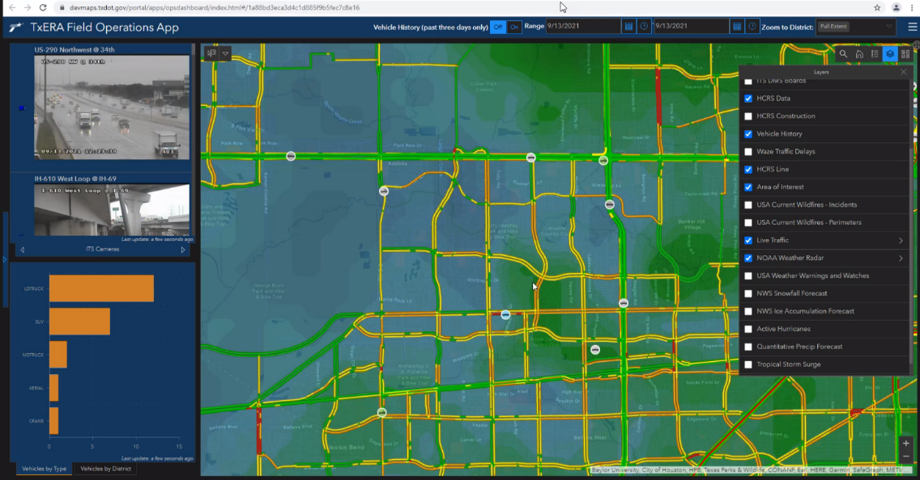
Rainmap in the Sky to Floodmap on the Ground
Forecast Rain Map
Maps accessible through ESRI StoryMap
Observation Gauges
https://arcg.is/0LLLXX
High Water Streams and
Flooded Roads (HCRS)
Flood Inundation Map
Web Communication
to TxDOT (TxERA)
Maps prepared for a
flood emergency response exercise
in Beaumont District of TxDOT
February 2022

Slide 25
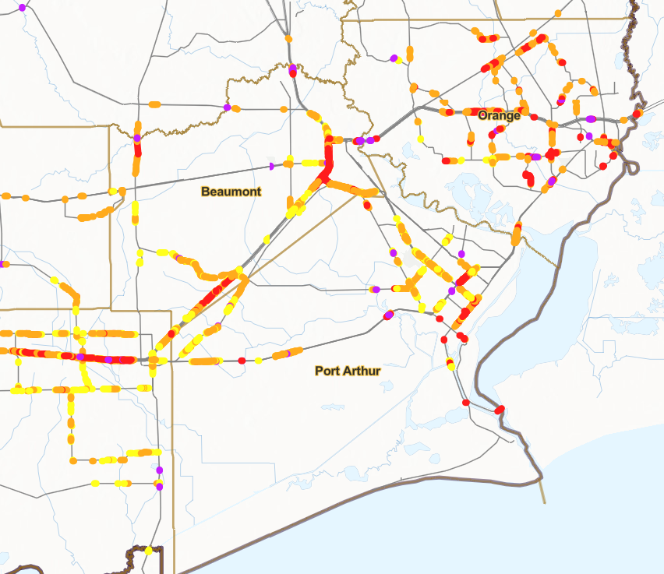
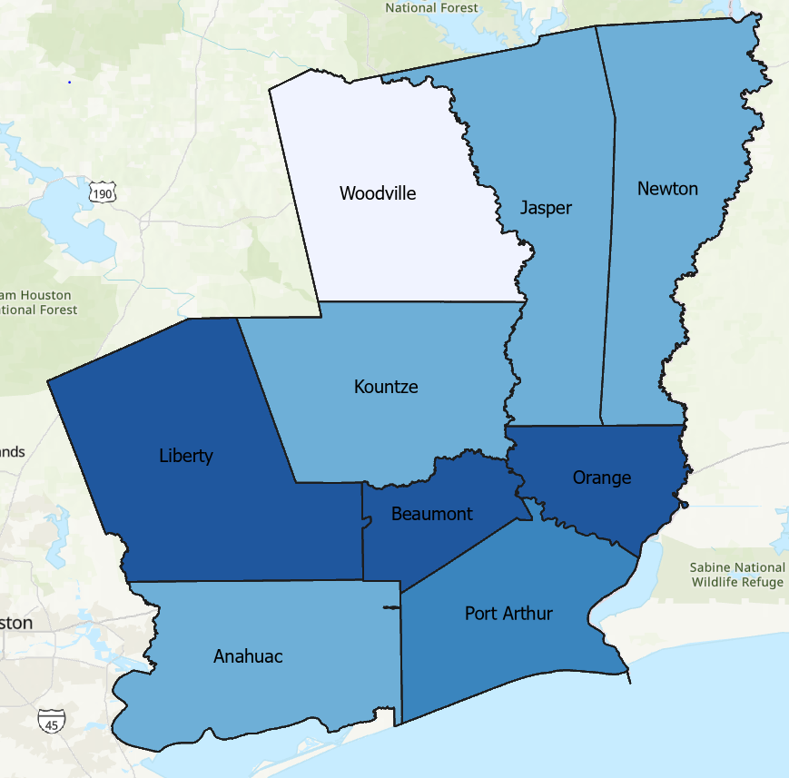
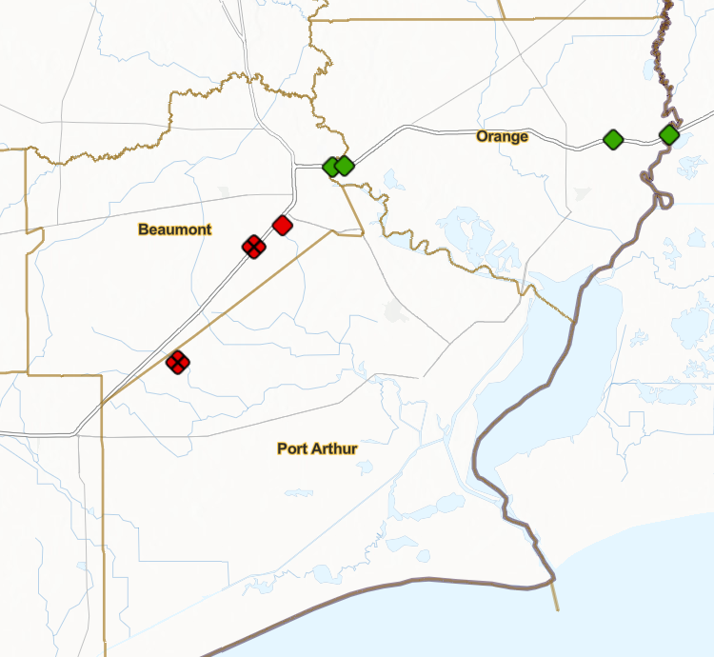
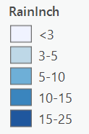
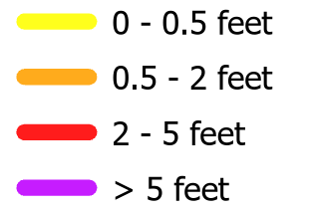
Top New Products
Flooded Road Estimates
Precipitation Forecast by Section
Bridge Warnings
Estimated Depth
Warning (< 5ft to bridge)
Concern (5 to 10ft to bridge)
Ok (>10ft to bridge)
X
Out of Service (gauge not working)
Notes:
Larry

Slide 26
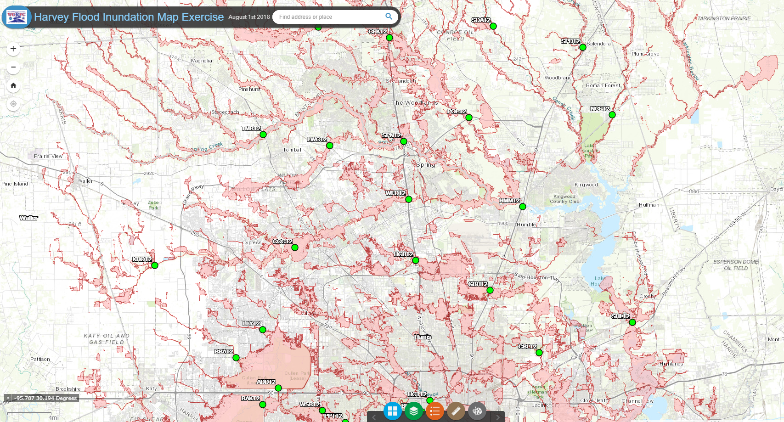
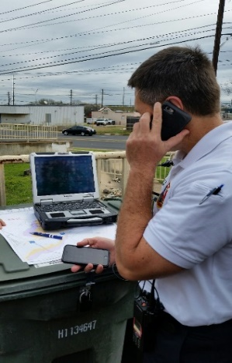
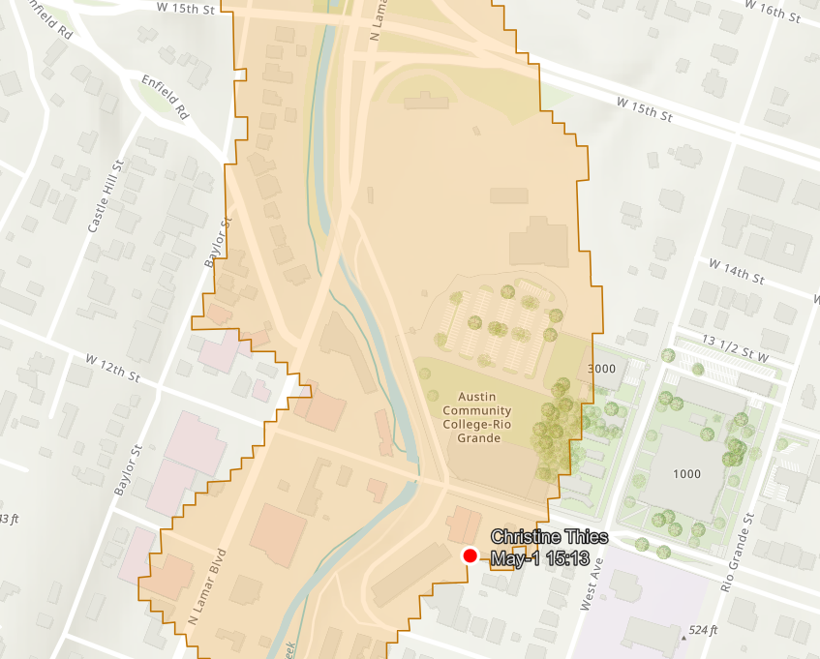
Predictive and Observational Flood Inundation Mapping
West Gulf River
Forecast Center
State Operations Center
Predictive Flood
Mapping
State Operations Center
Local EOC
First responders in field
Observational
Flood Mapping

Slide 27
NWC Flood Inundation Map Services are based on … Height Above Nearest Drainage (HAND)
Flooding occurs when Water Depth is greater than HAND
Flood
HAND
Normal

Slide 28
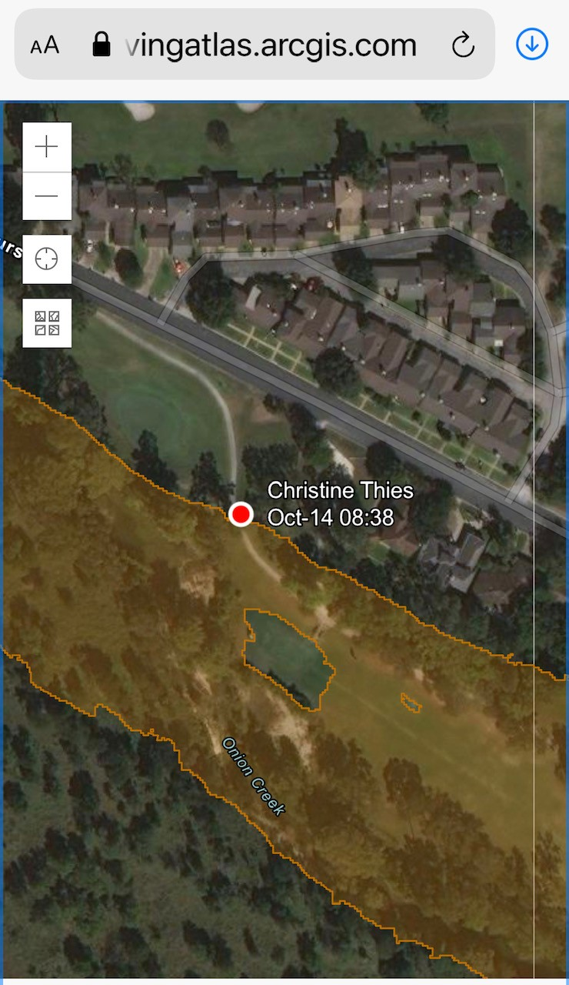
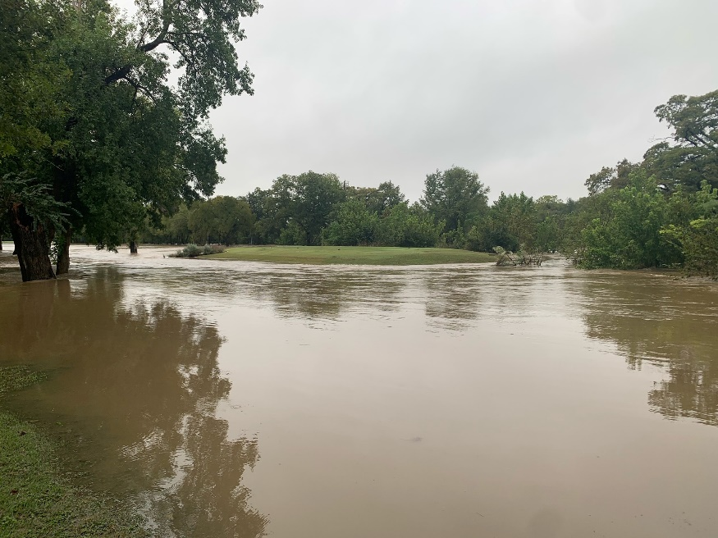
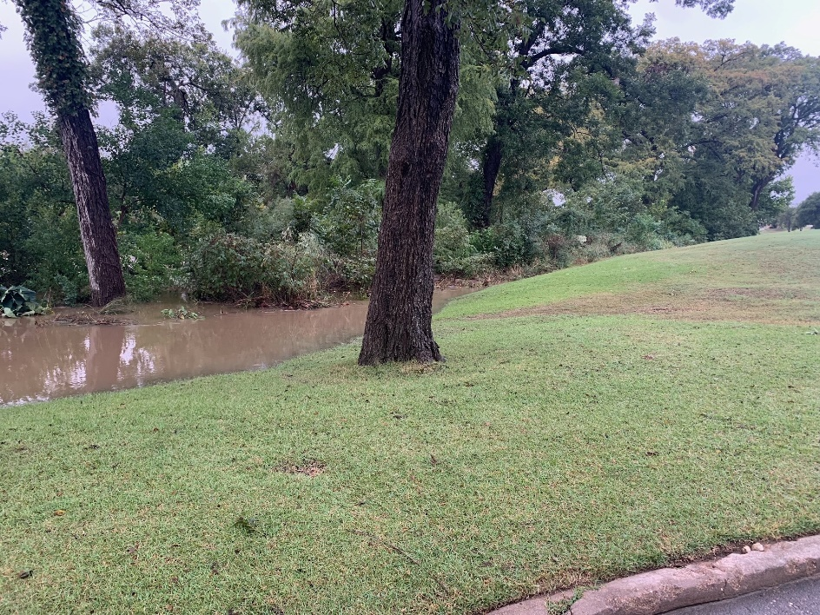
Pin2Flood on Onion Creek 14 October 2021
Tee Box
Tree
Tree
Tee Box
Based on Height Above
Nearest Drainage (HAND)
and 1m LIIDAR DEM

Slide 29
During Flood – Common Operating Picture
Emergency Management Flood Project – Pin2Flood
University of Texas Center for Water and the Environment

Slide 30
During Flood – Common Operating Picture
The first responder knows the scope and extent of the flood before them!
Emergency Managers can support and resource the response
Provides Common Operating Picture
https://gis.tdem.texas.gov/pin2flood/#
Emergency Management Flood Project – Pin2Flood
University of Texas Center for Water and the Environment

Slide 31
Adding Adjacent Flood Polygons
A function requested by first responders in field exercises

Slide 32
Pin2Flood Dashboard for Emergency Operations Center
https://gis.tdem.texas.gov/portal/apps/dashboards/4520d2fb7ceb41e180cdf29d97b0d2eb

Slide 33
Pin2Flood Vision
Arrival of Response Units
Emergency Management Flood Project – Pin2Flood
University of Texas Center for Water and the Environment

Slide 34
02:00
Flood calls start coming in..
Notes:
What if….
During a flood you were able to use your phone to drop a pin…

Slide 35
02:05
Flood calls start coming in..
Units Arrive on-scene
Notes:
What if….
During a flood you were able to use your phone to drop a pin…

Slide 36
02:07
Flood calls start coming in..
Units Arrive on-scene
Pin dropped at water’s edge
Notes:
What if….
During a flood you were able to use your phone to drop a pin…

Slide 37
02:09
Flood calls start coming in..
Units Arrive on-scene
Pin dropped at water’s edge
Flood inundation calculated
Notes:
What if….
During a flood you were able to use your phone to drop a pin…

Slide 38
02:10
Flood calls start coming in..
Units Arrive on-scene
Pin dropped at water’s edge
Flood inundation calculated
Able to identify….
Homes Impacted
Notes:
What if….
During a flood you were able to use your phone to drop a pin…

Slide 39
02:10
Flood calls start coming in..
Units Arrive on-scene
Pin dropped at water’s edge
Flood inundation calculated
Able to identify….
Homes Impacted
Population
Notes:
What if….
During a flood you were able to use your phone to drop a pin…

Slide 40
02:10
Flood calls start coming in..
Units Arrive on-scene
Pin dropped at water’s edge
Flood inundation calculated
Able to identify….
Homes Impacted
Population
Flooded Roads
Notes:
What if….
During a flood you were able to use your phone to drop a pin…

Slide 41
Progress in 9 years ….
National
Local
Jack Dangermond President, ESRI
“Can we
do better?”
“Ok, Jack
We’re doing
better now”

