Slide 1
Hypoxia in
Estuarine and Coastal Waters by
Y. Peter Sheng, Taeyun Kim, and Kijin Park
Civil & Coastal Engineering Department
University of Florida

Slide 2
Content
What Cause Hypoxia?
Hypoxia in Gulf of Mexico & Chesapeake Bay
Hypoxia in Florida
Simulation of Hypoxia in Florida
How do External Loading and Climate Change Affect Hypoxia?

Slide 3
What Cause Hypoxia?
External Loading
Wind Mixing
Tidal
Mixing
Nutrients
CBOD
Sediment Oxygen Demand
Notes:
Bottom-water hypoxia was strongly related to vertical stratification due to high or moderate river flow from the Peace River. Vertical stratification caused weak water mixing which prevented the surface water body from supplying DO to the bottom water body. Meanwhile, SOD continuously consumes DO at the bottom layer without sufficient sources from surface water. These successions created low DO events in Upper Charlotte Harbor.

Slide 4
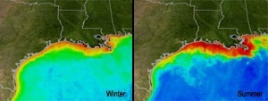
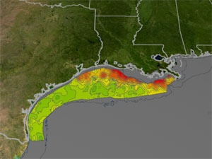
Mississippi Dead Zone
4500-7000 sq mi
NASA
Satellite
Imagery
NOAA Ship Survey
Notes:
MISSISSIPPI DEAD ZONE
Credit: Neuse River Estuary Modeling and Montoring (Above: Sediment filled water meets the blue ocean in this photo at the outflow of the Neuse River after Hurricane Floyd. )
Recent reports indicate that the large region of low oxygen water often referred to as the 'Dead Zone' has spread across nearly 5,800 square miles of the Gulf of Mexico again in what appears to be an annual event. NASA satellites monitor the health of the oceans and spots the conditions that lead to a dead zone. The above photo of the outflow of the Neuse River is an example of contrast seen in the Gulf of Mexico when sediment filled water meets the ocean.
MISSISSIPPI DEAD ZONE
Credit: NASA (Download High Resolution .tif: Summer / Winter)
These images show how ocean color changes from winter to summer in the Gulf of Mexico. Summertime satellite observations of ocean color from MODIS/Aqua show highly turbid waters which may include large blooms of phytoplankton extending from the mouth of the Mississippi River all the way to the Texas coast. When these blooms die and sink to the bottom, bacterial decomposition strips oxygen from the surrounding water, creating an environment very difficult for marine life to survive in. Reds and oranges represent high concentrations of phytoplankton and river sediment.
SHIPS AND SATELLITES MATCH MEASUREMENTS

Slide 5
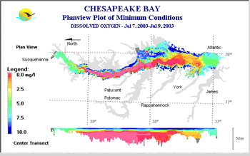
Chesapeake Bay Dead Zone
Notes:
Hundreds of sq. mi.

Slide 6
Bottom-water Hypoxia in Charlotte Harbor, FL
July 2000

Slide 7
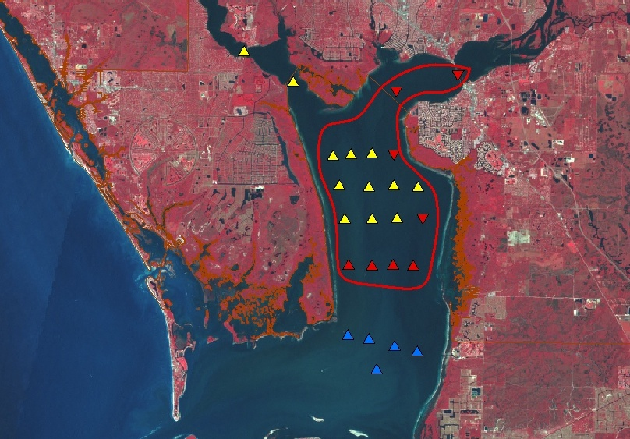
Hypoxia in Charlotte Harbor
After Charley (8/13/2004)
D. Tomasko
~38 sq mi on 8/27/04
Bottom hypoxia
Surface+Bottom hypoxia
Notes:
Stations with blue triangles were sampled and found not to have hypoxic conditions (D.O. < 2 mg / l) in either top or bottom waters. Stations with red triangles pointing up had hypoxic bottom waters, but surface waters were not hypoxic. Stations with red triangles pointing down had hypoxic conditions in both bottom and top layers. Stations in yellow were not sampled. The area delimited by the red line is my best estimate of the minimum size of the hypoxic bottom waters in Charlotte Harbor on August 27, 2004, based on these results and previous hypoxia delineation efforts. As a rough estimate, it would appear that ca. 38 square miles of the bottom waters of upper Charlotte Harbor are hypoxic, while an unknown (but smaller) area is hypoxic in both bottom and top waters.

Slide 8
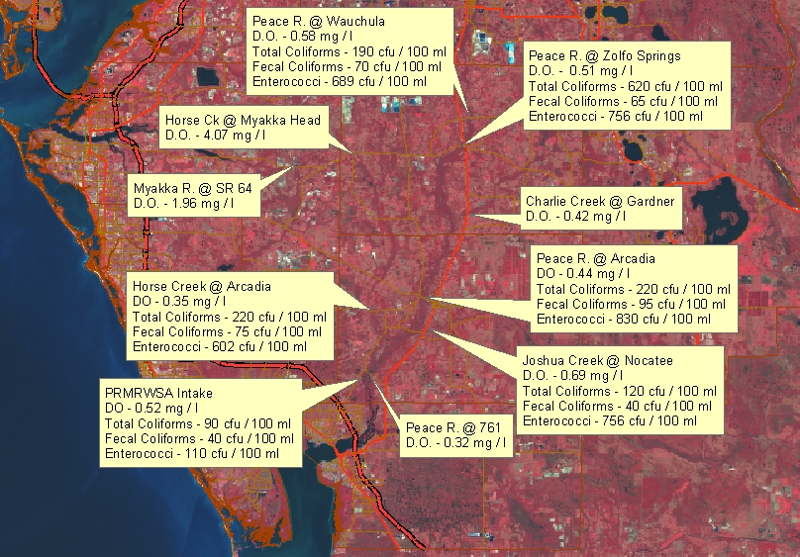
Hypoxia in Peace River Watershed
8/21/2004

Slide 9
Simulation of Hypoxia Using an Integrated Modeling System for Estuarine and Coastal Ecosystems
CH3D-IMS (Sheng et al. 2002)
Model Grid

Slide 10
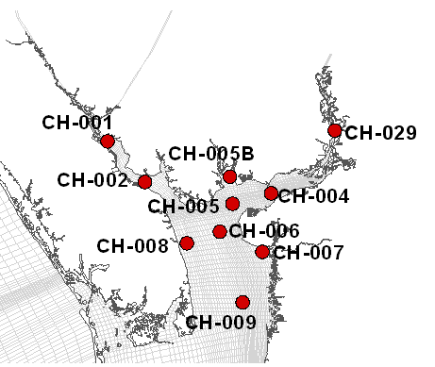
Hypoxia in Charlotte Harbor during 2000

Slide 11
Sediment Oxygen Demand
Station | Latitude | Longitude | Measured Value (March 1984) | Measured Value (Sep. 1984)
SOD #1 | 26º 55' 00" | 82º 06' 18" | 1.49 | 1.03
SOD #2 | 26º 48' 18" | 82º 06' 30" | N/A | 1.39

Slide 12
Volume of Bottom Hypoxic Water is Related to River Discharge, Ri, and Tide

Slide 13
Can we control Hypoxia?
Sediment Oxygen Demand (SOD) is due to the oxidation of organic matter in bottom sediments.
The main sources of organic matter in bottom sediments are from river loading, waste discharge, and dead algae following major bloom.
SOD can be a large fraction of oxygen consumption in surface water bodies.

Slide 14
DO and SOD with reduced nutrient/CBOD loading

Slide 15
SOD in the Upper Charlotte Harbor
(Increased air temperature of 3°)

Slide 16
DO in the Upper Charlotte Harbor
(Increased air temperature of 3°)

Slide 17
Phytoplankton in the Upper Charlotte Harbor
(Increased air temperature of 3°)

Slide 18
Conclusion
Hypoxia exists in Gulf of Mexico, Chesapeake Bay, and Florida.
Hypoxia in Charlotte Harbor is governed by river flow induced stratification and Sediment Oxygen Demand.
Bottom hypoxic water decreases when
  stratification decreases (low river flow, high wind, high tide)
  external loading (nutrients/CBOD) decreases
Peak hypoxic water volume is reduced by 5-10% with 50-100% load reduction
Climate change will lead to increase in SOD and decrease in DO, and changes in phytoplankton species

Slide 19
