Slide 1
Investigating Low Impact Development Opportunities for Kelly Field Building 171
Capt Josh R. Aldred, P.E.
The University of Texas at Austin

Slide 2
Overview
Purpose
Existing Site Conditions
Hydrology of Proposed Development
Low Impact Development (LID) Opportunities
Remaining Work
Questions

Slide 3
Purpose
AFCEE is moving to Bldg 171 on Kelly Field
Energy Independence & Security Act for Federal Projects
$500K allotted for site work and improvements
Educational tool for future large military projects
Notes:
AFCEE – Air Force Center for Engineering and the Environment
Federal projects over 5,000 square feet must meet runoff guidelines in the Energy Independence and Security Act (EISA), Section 438

Slide 4
Existing Site Conditions
Nearly 85% of watershed is impervious
Runoff is collected from roof/parking lot to storm sewer
2,200 parking spaces, 3,000+ future workers
More pavement is planned, so how do we reduce runoff?
Notes:
More pavement is planned, so how do we reduce runoff?
Low Impact Development offers the best solution

Slide 5
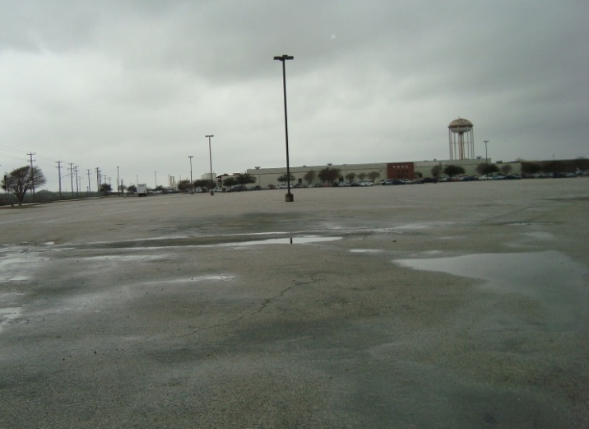
Kelly Field—Bldg 171: Looking to the southwest from the northeast corner

Slide 6
Calculating the 95th Percentile Storm
Used EPA technical guidance for EISA Section 438
Collected climate data for San Antonio (1893-2010)
Removed daily precipitation data < 0.1 inches
Sorted data and calculated the 95th percentile event
Notes:
Used three data sources from National Climactic Data Center
San Antonio Nursery (1893-1947)
Kelly Air Force Base (1948-1970)
San Antonio International Airport (1970-2010)

Slide 7
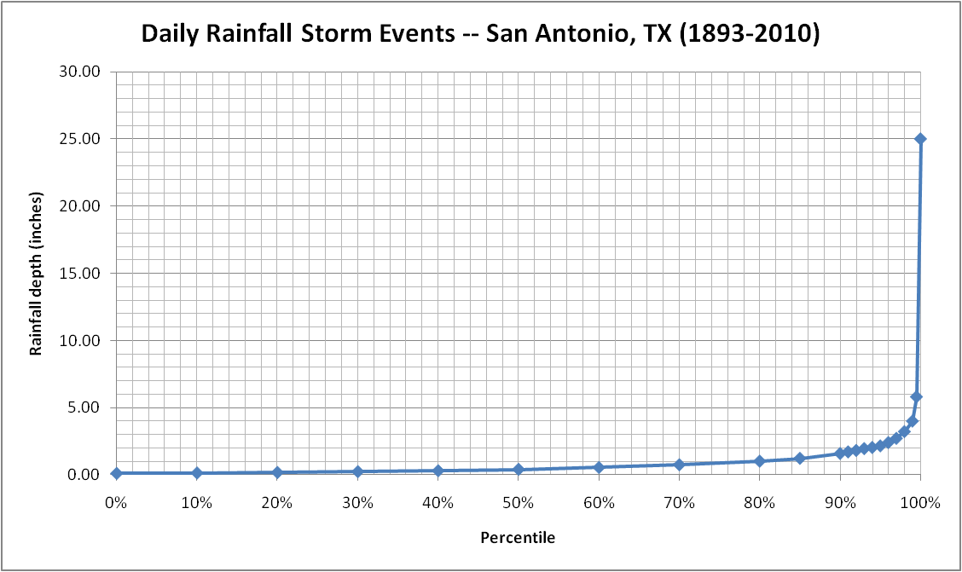
Calculating the 95th Percentile Storm
Percentile | Rainfall
0.0% | 0.11
10.0% | 0.14
20.0% | 0.18
30.0% | 0.24
40.0% | 0.31
50.0% | 0.41
60.0% | 0.55
70.0% | 0.75
80.0% | 1.02
85.0% | 1.23
90.0% | 1.59
91.0% | 1.71
92.0% | 1.82
93.0% | 1.96
94.0% | 2.04
95.0% | 2.16
96.0% | 2.41
97.0% | 2.72
98.0% | 3.22
99.0% | 4.00
99.5% | 5.81
100.0% | 25.00
Texas Department of Transportation (TXDOT) Drainage Manual
Return Intervals for Bexar County, Texas
Rainfall depth in inches for given Return Interval
1-year | 2-year | 5-year | 10-year | 25-year | 50-year | 100-year
 | 4.04 | 5.59 | 6.54 | 7.83 | 9.20 | 10.02

Slide 8
Determining the Watershed Area
Sources:
  San Antonio GIS Services (https://gis.sanantonio.gov)
    Hydrologic Services had Bexar County watershed map
    Downloaded 2-ft contour maps in AutoCAD & aerial imagery
    Entered contour map and imagery into ArcMap
    Measured Bldg 171 watershed area & features using ArcMap

Slide 9
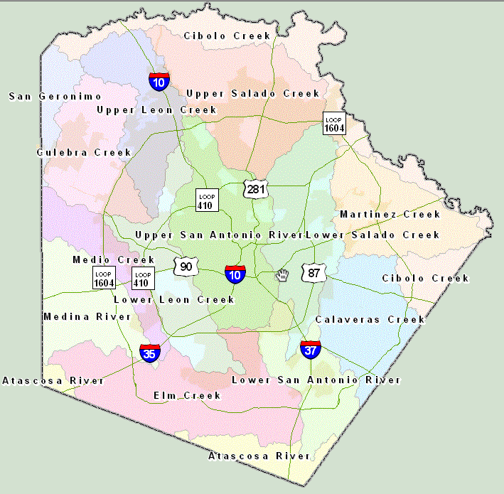
Kelly Field

Slide 10
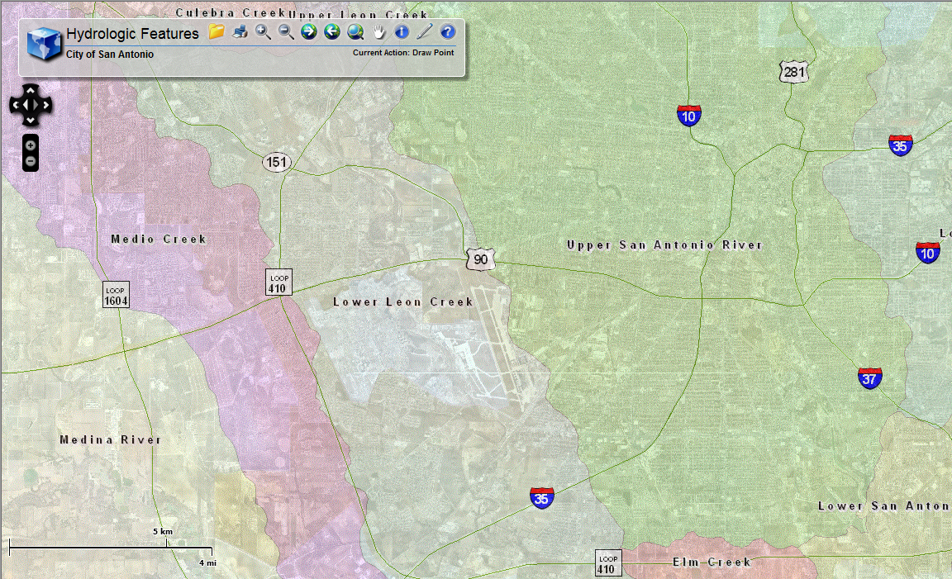
NORTH

Slide 11
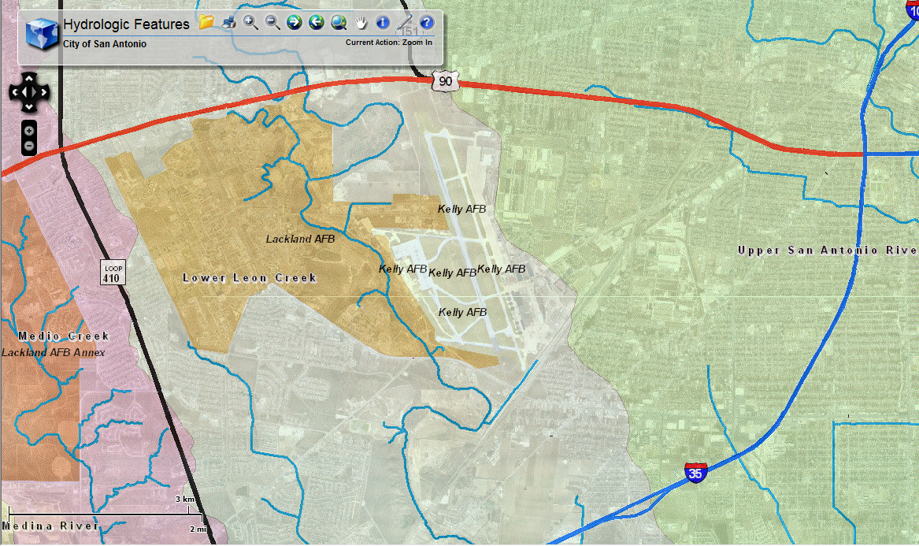
NORTH

Slide 12
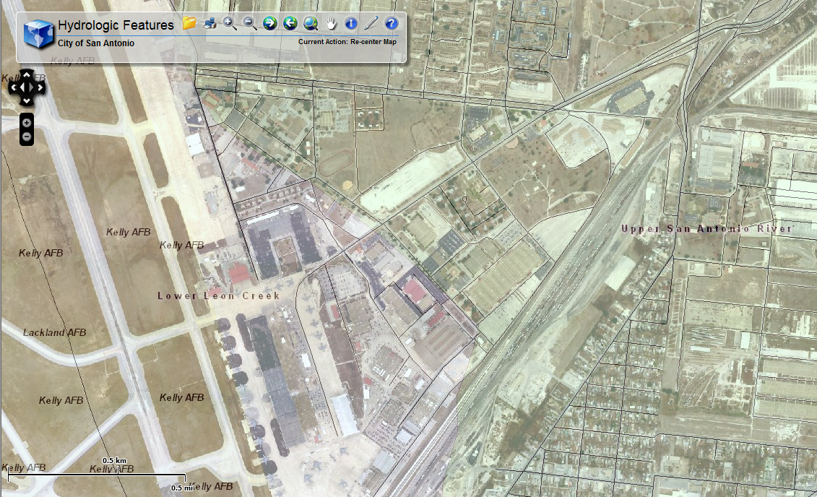
Bldg 171
NORTH

Slide 13
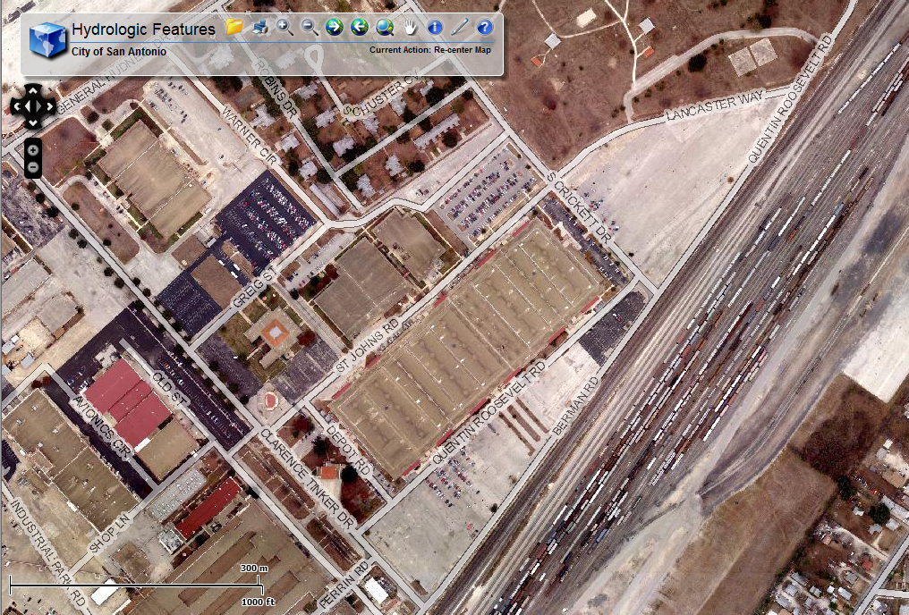
NORTH
Bldg 171

Slide 14
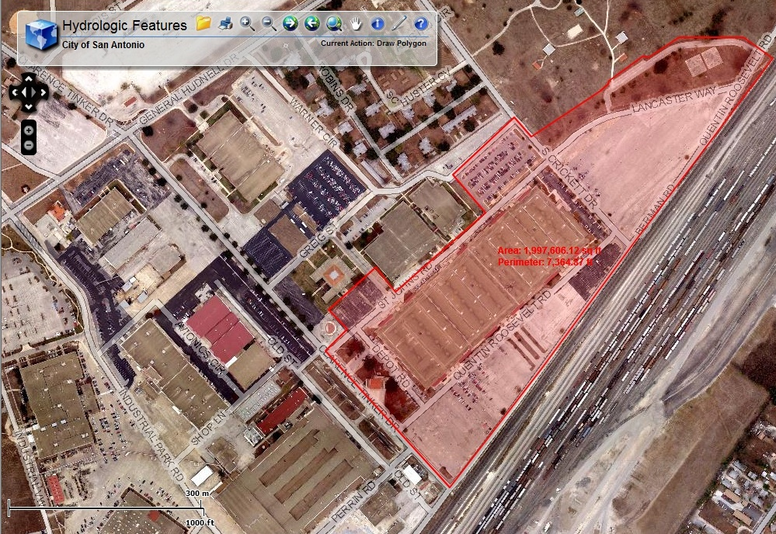
Area: 1,997,606 sq ft
NORTH

Slide 15
Measuring Watershed Features
Total Watershed Area (SF) | Square Feet | Acres
 | 1,997,606 | 45.86
Feature | Area (SF) | % of Watershed
Total Impervious Area | 1,690,257 | 84.61%
Impervious Area (parking lots) | 1,220,573 | 61.10%
Impervious Area (roof) | 463,842 | 23.22%
Impervious Area (mech equip) | 5,842 | 0.29%
Building Landscaping | 47,243 | 2.36%
Vegetated Areas | 239,145 | 11.97%
Parking Islands (vegetation) | 12,400 | 0.62%
Parking Islands (gravel) | 8,561 | 0.43%

Slide 16

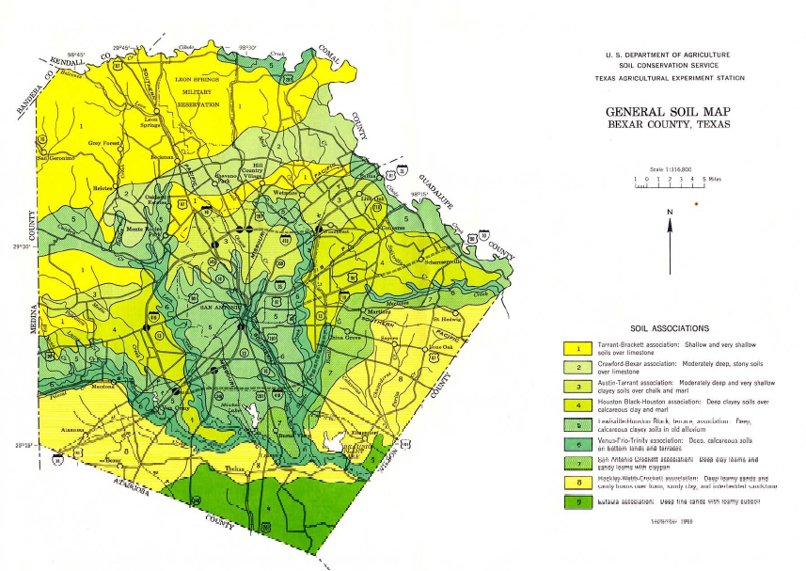
Soil Investigation
Need soil information for SCS runoff analysis
Essential for designing Low Impact Development (LID)
Key source → NRCS Soil Survey for Bexar County (1966)

Slide 17
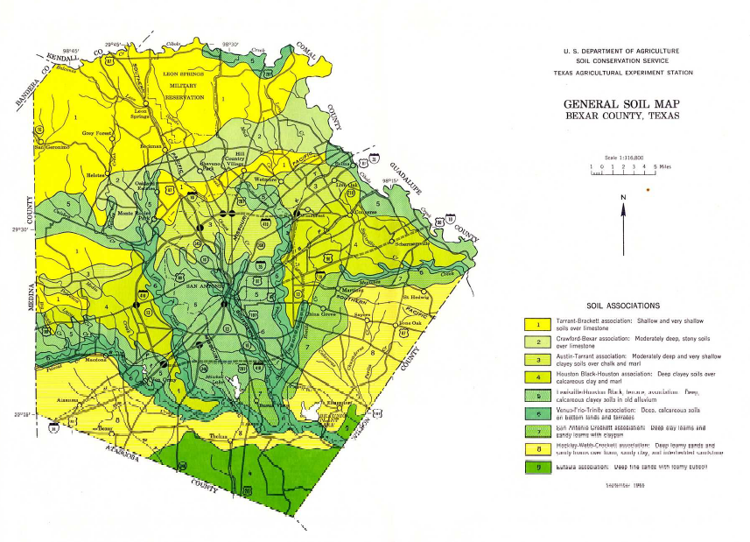
Kelly Field
Lewisville-Houston Black

Slide 18
Soil Investigation
Lewisville—Houston Black is the predominant soil
General characteristics
  Deep, siltly clays formed in calcareous alluvium
  Expansive soil – very prone to shrinkage and swelling
  Fine soil – clay content ranges from 30-60%
  Smectitic – clay is the dominant mineral in the soil
  Thermic – average soil temperature is between 59˚F and 72˚F
Sources:
Bexar County Texas Soil Survey, United States Department of Agriculture, 1966
NRCS Fact Sheet on Houston Black Soil (ftp://ftp-fc.sc.egov/TX/factsheets/fact_houstonsoil.pdf)

Slide 19
Soil Investigation
Lewisville soils (45%)
  Moderately permeable, dark-brown to dark grayish-brown
  Surface layer is about 25-inches thick
  Sub-surface is dark-brown to reddish-brown
  Fine, blocky structure
Houston Black soils (40%)
  Dark-gray to black, slowly permeable, 45-60 inches thick
  Sub-surface is reddish-yellow to light gray in color
  Some gravel below a depth of 6 feet
For SCS Runoff Calculations → Soil Type C
Sources:
Bexar County Texas Soil Survey, United States Department of Agriculture, 1966
NRCS Fact Sheet on Houston Black Soil (ftp://ftp-fc.sc.egov/TX/factsheets/fact_houstonsoil.pdf)

Slide 20
SCS Runoff Calculations
Assume Antecedent Moisture Condition II
Assume Type C soils – soils with high clay content
95th Percentile Storm for Precipitation (2.16”)
NRCS Type III Storm for San Antonio
Notes:
Assume Type C soils – soils usually high in clay
Good fit the for Lewisville-Black soils (30-60% clay)
NRCS Type III Storm for San Antonio
TXDOT Drainage Manual

Slide 21
SCS Runoff Calculations
Total Watershed Area (SF) | Square Feet | Acres
 | 1,997,606 | 45.86
Feature | Area (SF) | % of Watershed | Soil Type C SCS CN
Total Impervious Area | 1,690,257 | 84.61% | 98
Impervious Area (parking lots) | 1,220,573 | 61.10% | 98
Impervious Area (roof) | 463,842 | 23.22% | 98
Impervious Area (mech equip) | 5,842 | 0.29% | 98
Building Landscaping | 47,243 | 2.36% | 79
Vegetated Areas | 239,145 | 11.97% | 74
Parking Islands (vegetation) | 12,400 | 0.62% | 79
Parking Islands (gravel) | 8,561 | 0.43% | 89

Slide 22
SCS Runoff Calculations
Weighted CN for the watershed is 94.52
Initial Abstraction = 0.12 inches
Watershed storage = 0.58 inches

Slide 23
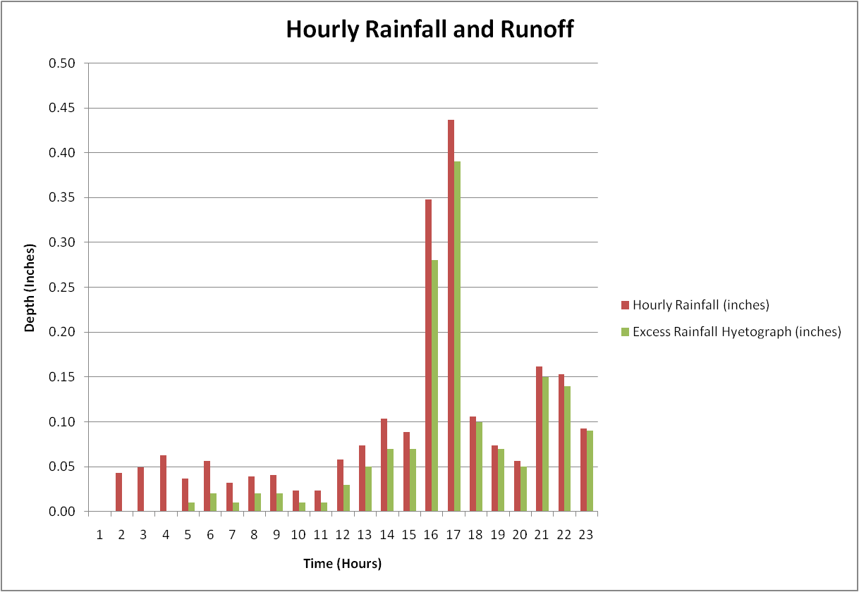

Slide 24
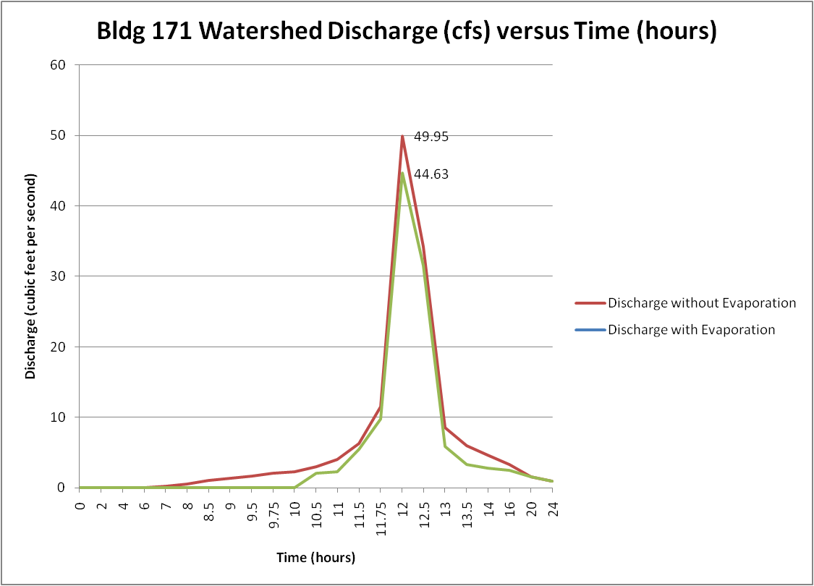
SCS Runoff Calculations
Runoff Hydrograph

Slide 25
EPA Storm Water Management Model
Four sub-catchments
SCS for infiltration
Estimated storm sewer locations and lengths
  PDF drawing from Port Authority of San Antonio
24-hour storm evaluated over 36 hours

Slide 26
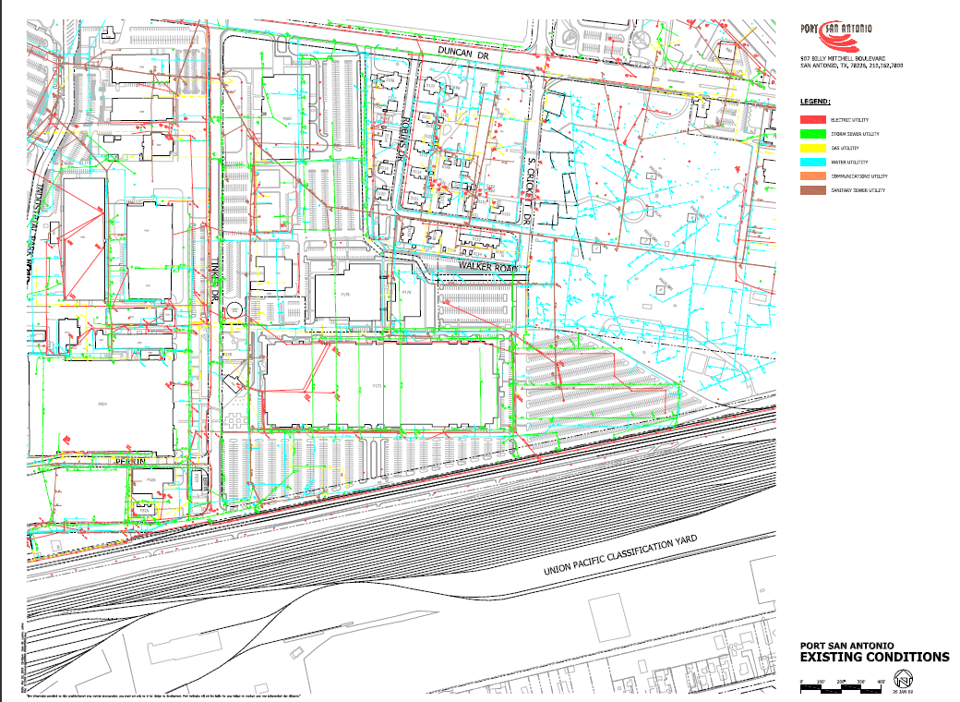
N

Slide 27
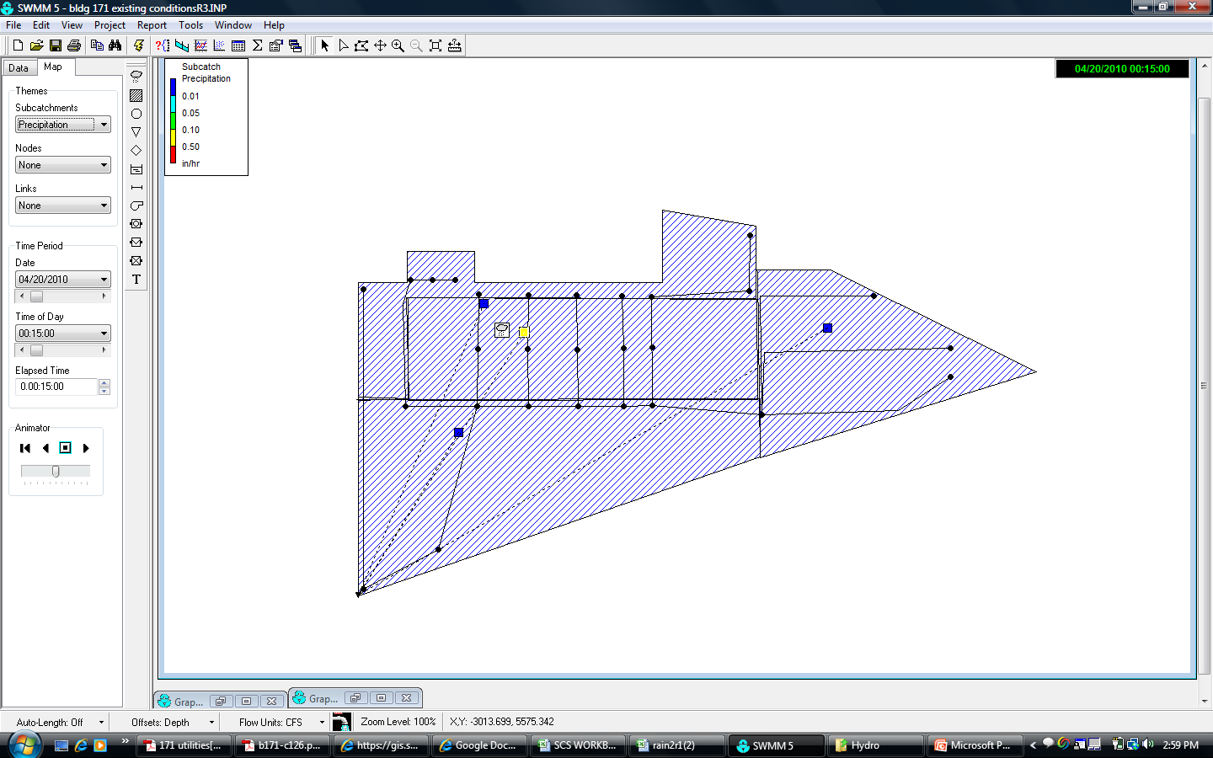
EPA Storm Water Management Model
N

Slide 28
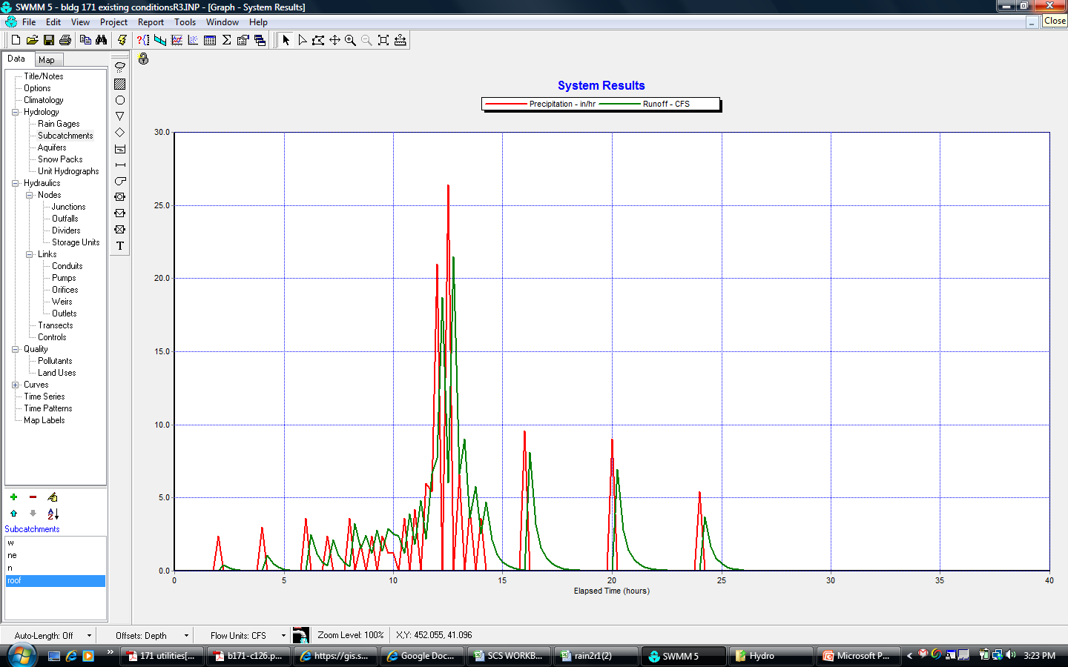
EPA Storm Water Management Model

Slide 29
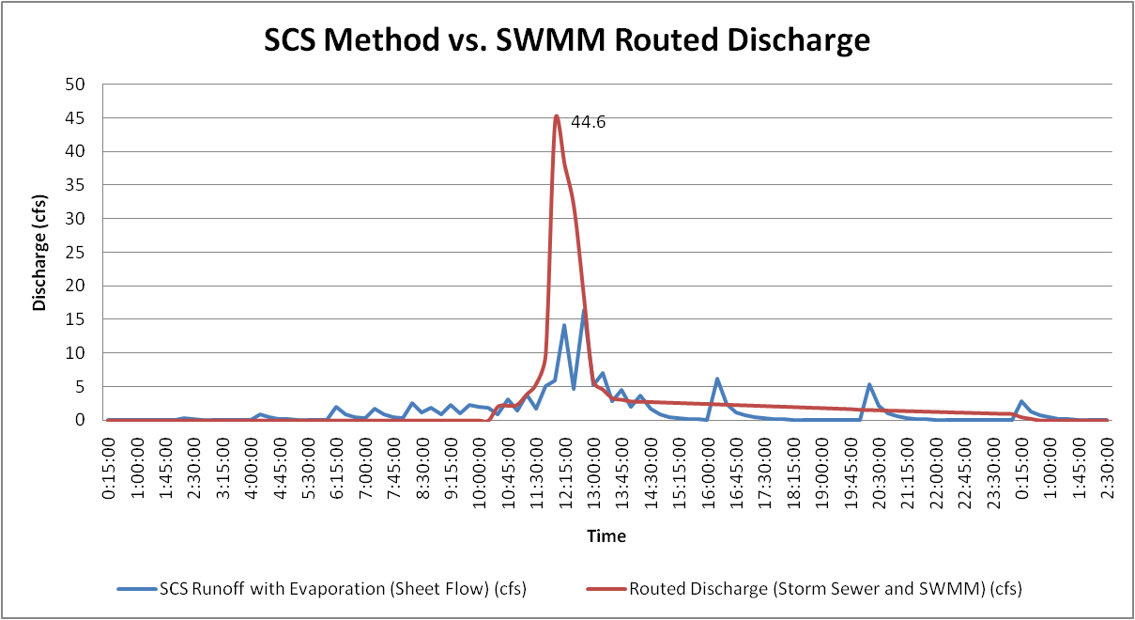
EPA Storm Water Management Model
44.6 cfs (SCS)
16.4 cfs (SWMM)

Slide 30
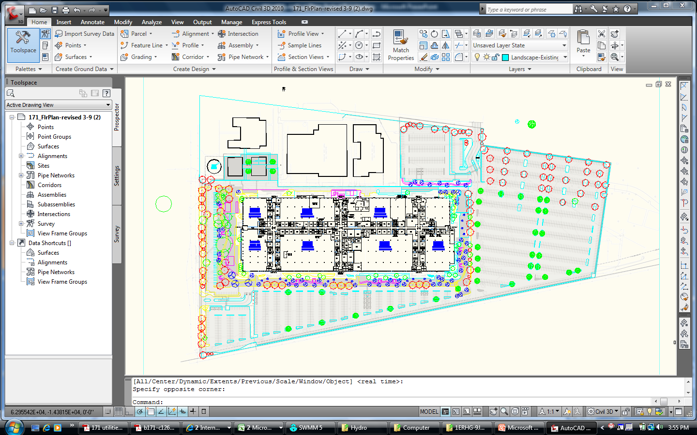
Hydrology of Proposed Development
Additional three acres of net impervious surface
More landscaping and parking islands
N

Slide 31
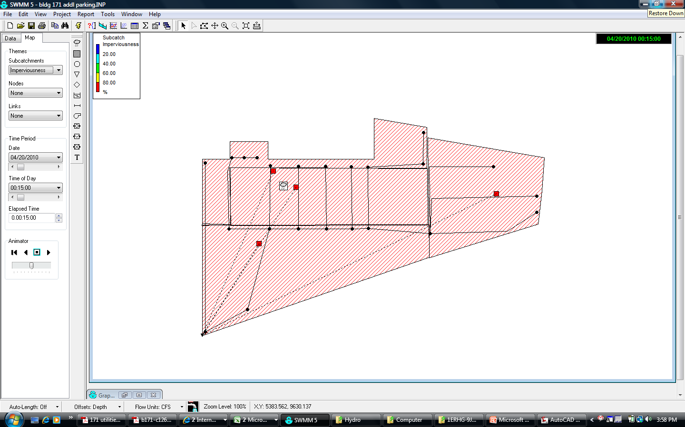
Hydrology of Proposed Development
N

Slide 32
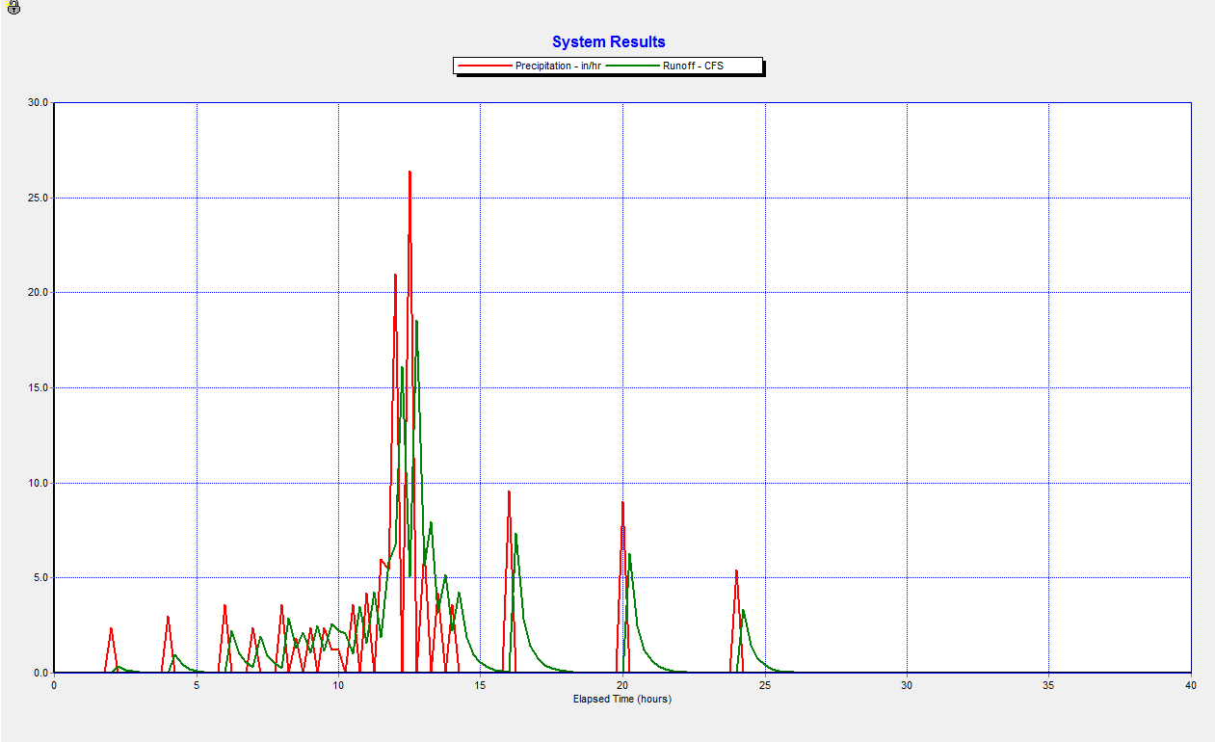
Hydrology of Proposed Development

Slide 33
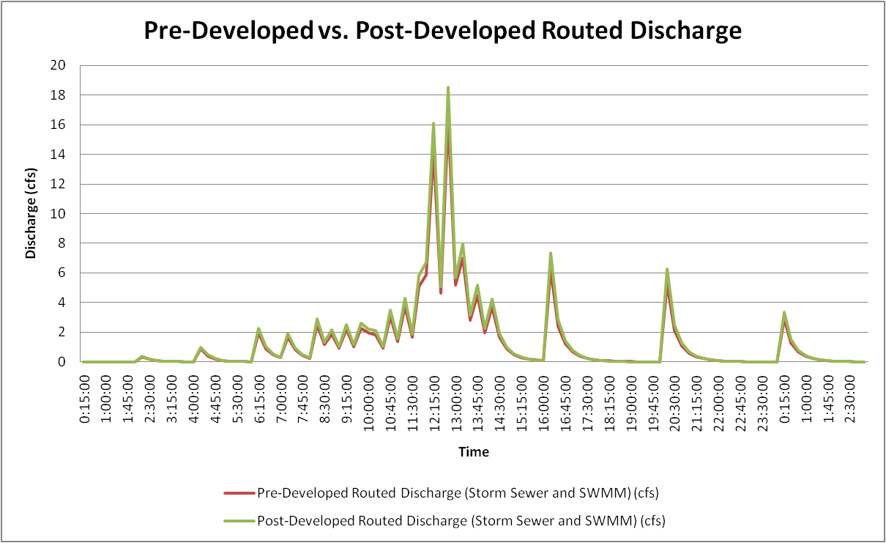
Hydrology of Proposed Development
18.6 cfs (Post-Development)
16.4 cfs (Pre-Development)
123,426 ft³ of runoff
140,778 ft³ of runoff

Slide 34
Low Impact Development Opportunities for Bldg 171
Treat and store water before it reaches drainage inlets
The goal is to reduce overall runoff by 18.6 cfs (EISA)
Challenges
  Roof—responsible for nearly 1/3 of peak runoff (5.5 cfs)
  Underground utilities
  Expansive soils
Notes:
The goal is to reduce overall runoff by 18.6 cfs
Not likely due to roof drainage to storm sewer
Maximum extent technically feasible (METF)

Slide 35
Low Impact Development Opportunities for Bldg 171
Vegetated strips and rain gardens
Bio-retention
Porous pavement and pavers
Infiltration trench
Sand filter
Notes:
Vegetated Strips/Rain Gardens
Low initial cost, relatively low maintenance costs
No storage capability, but removes sediments
Bioretention
Not recommended for soils with more than 25% clay
Porous Pavement/Pavers
High construction cost, could be damaged by expansive soils
Infiltration Trench
Higher construction cost, moderate maintenance costs
Great for storage and treatment
Can clog with sediments if runoff is not treated before it reaches the infiltration trench
Recommended for new development by the San Antonio River Authority
Sand Filter
High construction and maintenance costs
Can store and treat runoff
Can clog with sediments if runoff is not treated before it reaches the infiltration trench

Slide 36
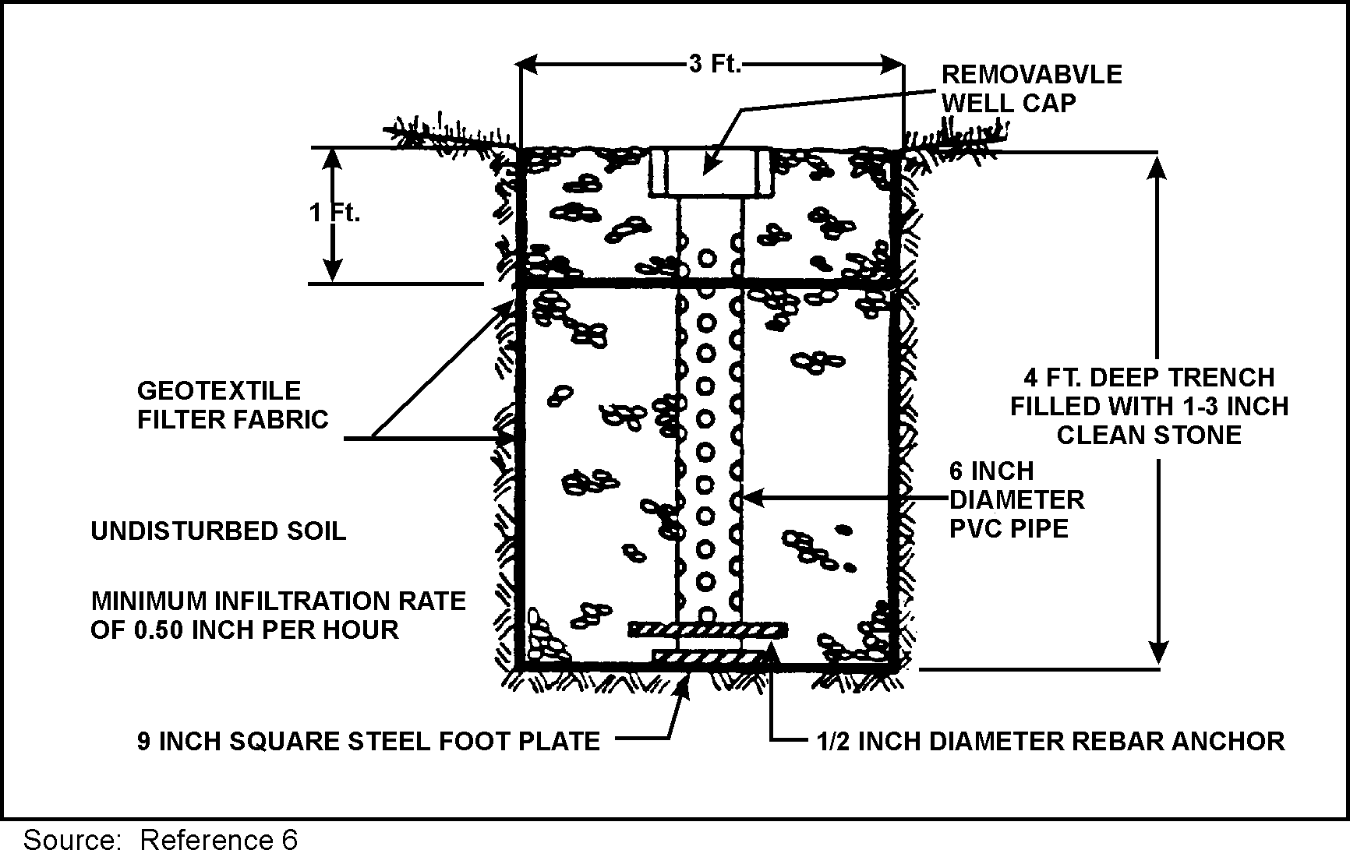
Low Impact Development Opportunities for Bldg 171
My recommendations
  Combination of vegetated strip and infiltration trench
  Utilize existing drainage patterns to capture runoff
  Collect post-treated runoff in an on-site cistern
Source: EPA

Slide 37
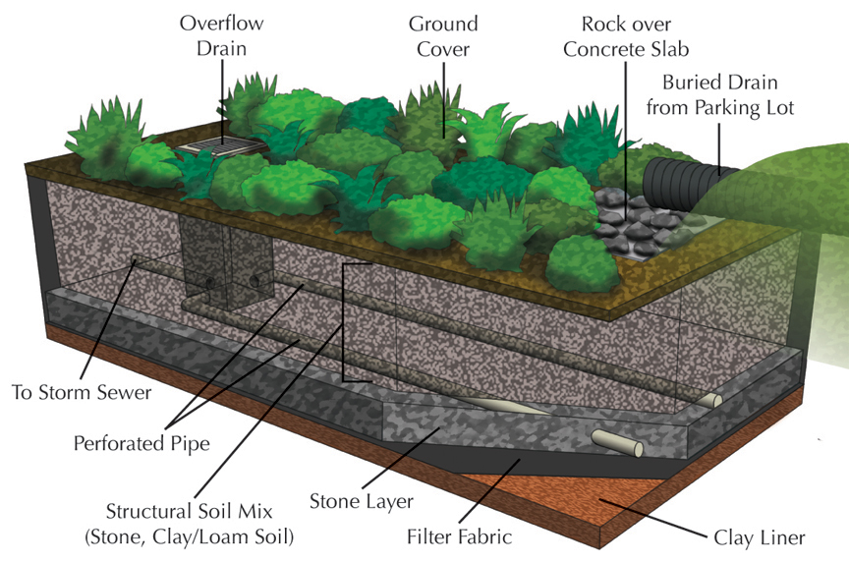
STORM WATER INLET AT HIGHER ELEVATION
OVERFLOW DRAIN
DRAINS TO STORM SEWER DRAINAGE INLET
CISTERN
Source: http://twosweet.bse.vt.edu/Tess/stormwater/images/infil_trench.jpg

Slide 38
Low Impact Development Opportunities for Bldg 171
Adding storage can decrease overall runoff by 50%
  Depression storage in each sub-catchment
  Overall runoff down from 140K cubic feet to 68K cubic feet
N

Slide 39
Remaining Work
Finish runoff calculations for LID techniques
Calculate LID cost and ROI
Evaluate runoff treatment
  TSS
  Heavy metals

Slide 40
Questions?

Slide 41
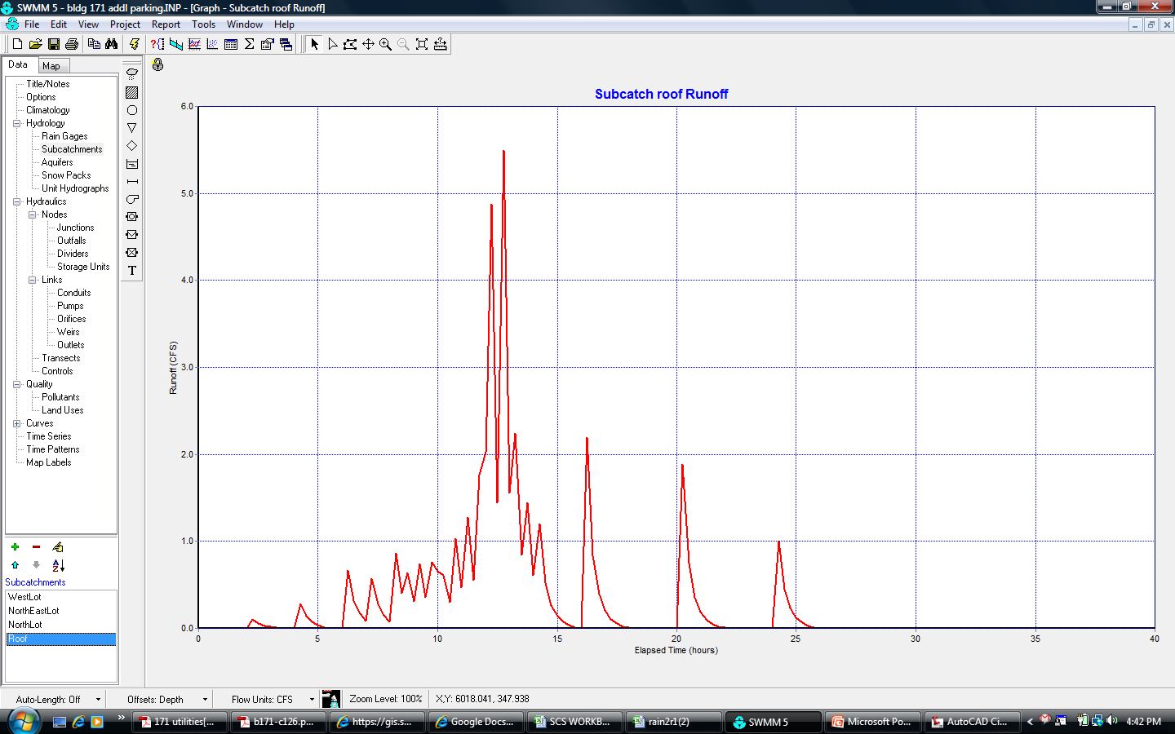
Roof – Post-Developed

Slide 42
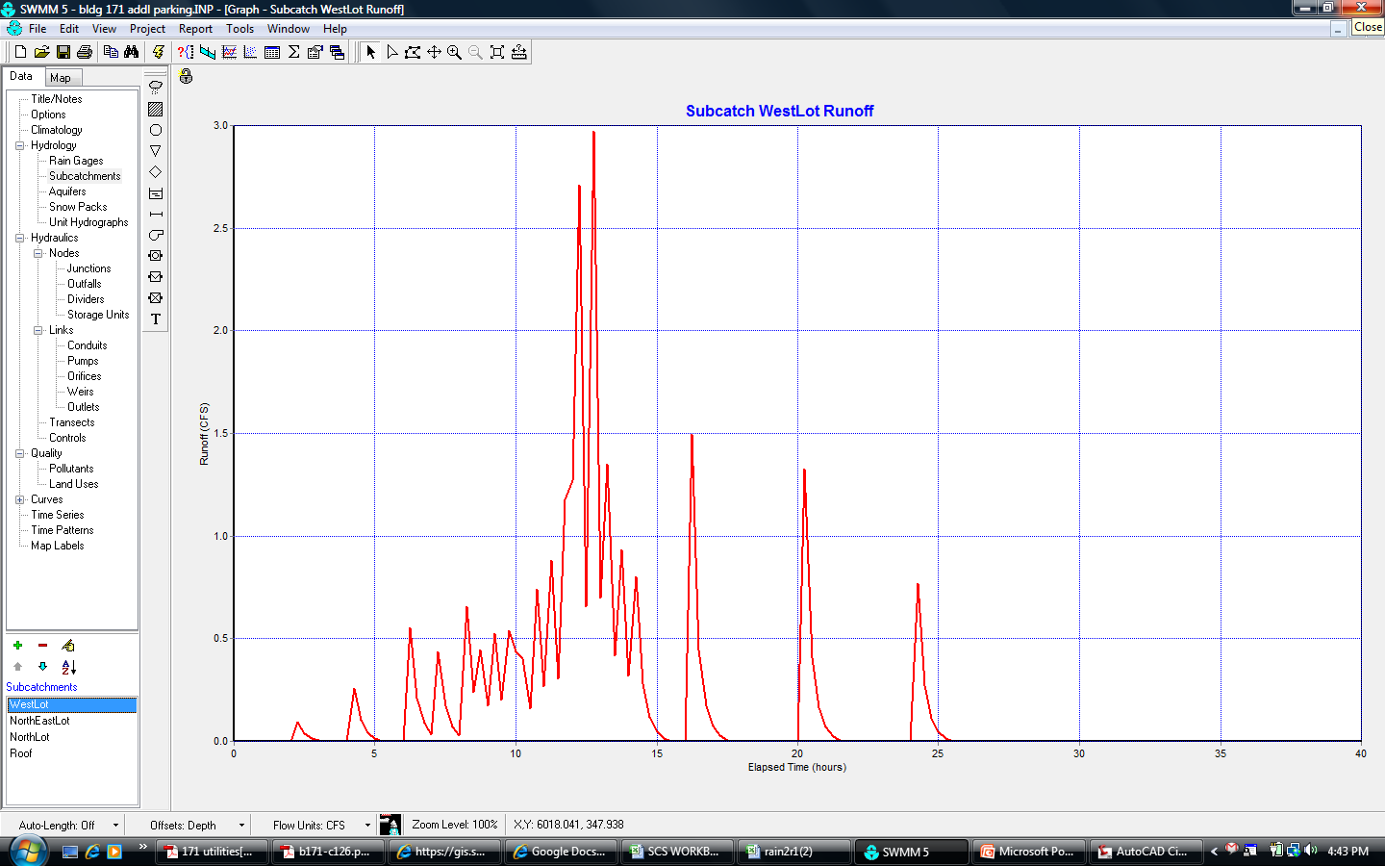
East Lot – Post-Developed

Slide 43
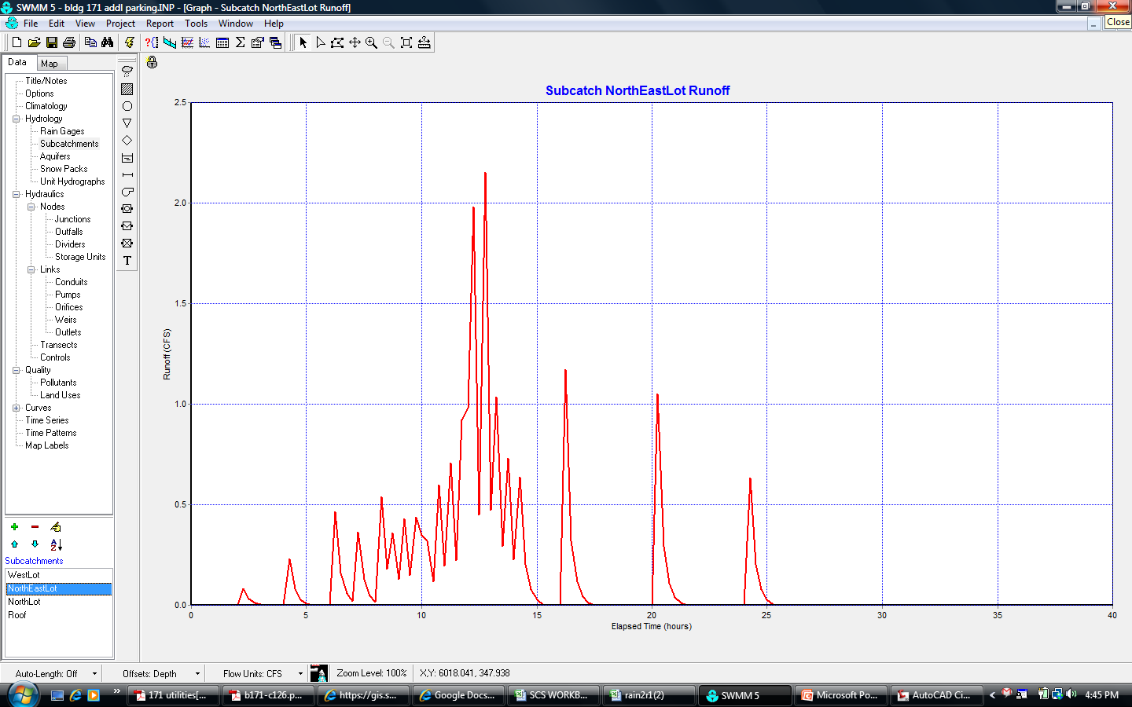
Northwest Lot – Post-Developed

Slide 44
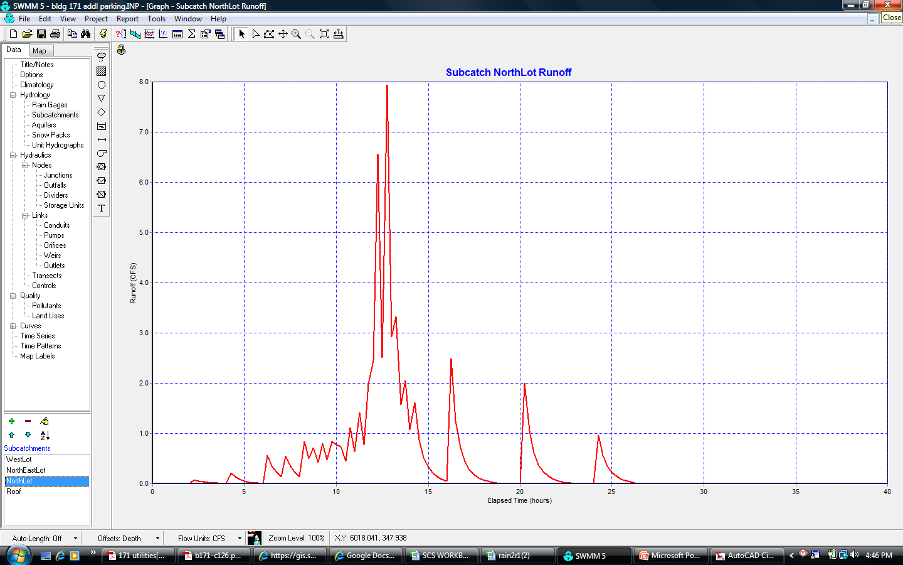
North Lot – Post-Developed

Slide 45
Time of Concentration Calculations
Assume slope is approximately 0.5%
Calculated peak rainfall intensity = 1.39 in/hr
Assume kinematic viscosity of asphalt = 1.2 x 10⁻⁵ ft²/sec
Manning’s number for asphalt = 0.015
Path from farthest point in watershed to outlet is 3,225 ft
Calculated unit discharge = 0.1038 ft²/sec
Calculated Reynolds number = 36,400 (Turbulent)
Velocity of overland flow = 1.30 ft/s
Time of Concentration = 41.3 minutes

Slide 46
