Slide 1
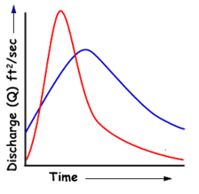
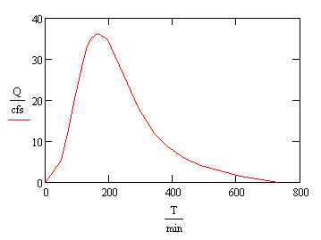
Unearthing the Unit Hydrograph
Rami Harfouch
Surface Water Hydrology
University of Texas at Austin, April 2010

Slide 2
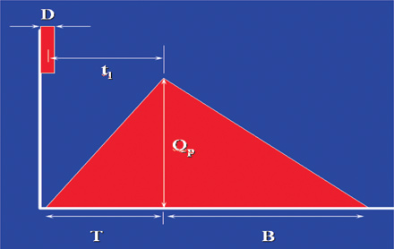
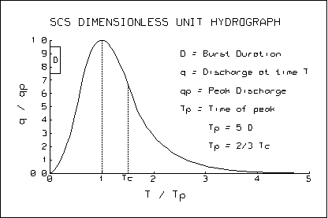
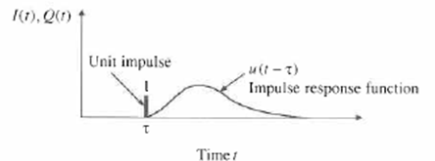
Flow methods
Peak flows (flood applications, channels design)
  Rationale method Q=C i A
Hydrograph (storage structures design)
  SCS triangular hydrograph
  SCS dimensionless hydrograph
  The Unit Hydrograph (UH)

Slide 3
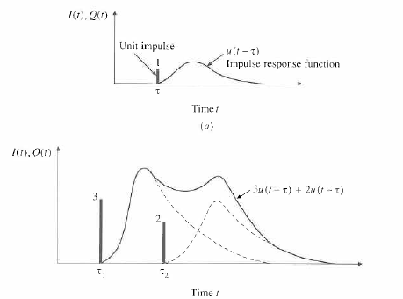
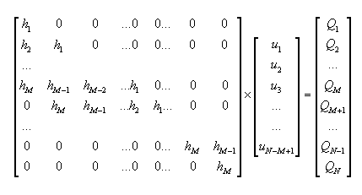
A UNIT HYDROGRAPH (UH) is
a direct runoff hydrograph resulting from 1 inch of excess rainfall generated uniformly over the drainage area at a constant rate for an effective duration

Slide 4
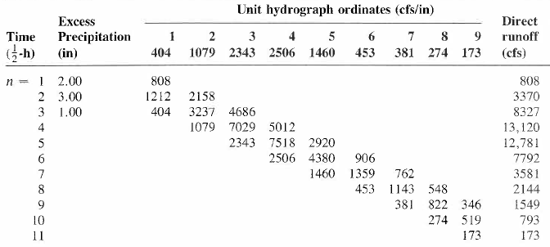
Simple application of the UH
Applied Hydrology, Maidment

Slide 5
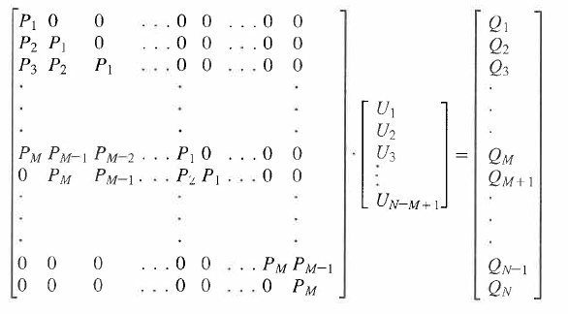
Matrix Calculation
[P][U] = [Q]
Precipitation
UH
Discharge
Applied Hydrology, Maidment

Slide 6
How to calculate the UH?
It is easy…
Solution by successive approximation (Collins 1939)
Solution by linear regression (Snyder 1955)
  [P] [U] = [Q]
  Transform [P] to a square matrix (because rectangular matrix don’t have an inverse)
  [P]^{T}[P][U] = [P]^{T} [Q]
  Let [Z] = [P]^{T}[P]
  [U] = [Z]⁻¹ [P]^{T} [Q]
=MMULT(MMULT(MINVERSE(MMULT(TRANSPOSE(L9:W25),L9:W25)),TRANSPOSE(L9:W25)),Y9:Y2)
In excel,
=MMULT(MMULT(MINVERSE(MMULT(TRANSPOSE(L9:W25),L9:W25)),TRANSPOSE(L9:W25)),Y9:Y2)

Slide 7
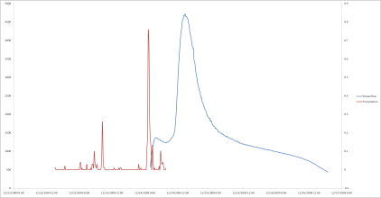
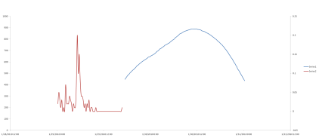
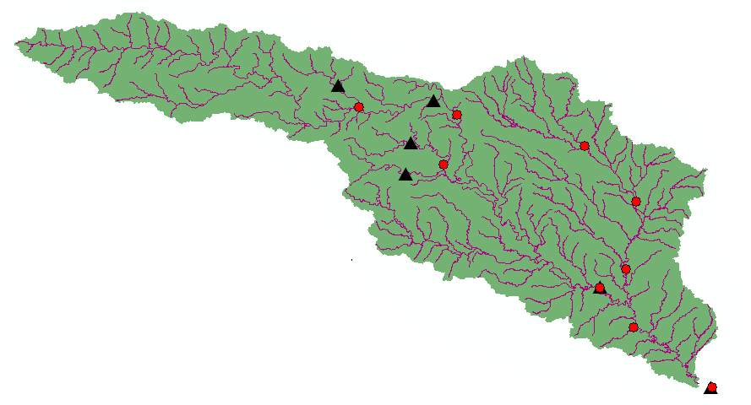
2
Selecting the storm events
Selecting a watershed and the Gauging stations
Modify the rainfall and flow events (excess rainfall, adequate time steps)
1
3
Plug the UH for other storm events, calculate streamflow and compare them to the measured
Computing the different Unit Hydrographs, and adapting them into one
5
4

Slide 8
Watershed selection criteria
Flow and precipitation gages with real time information
Unregulated with Hortonian flow and no snow = No storage
Small watershed (to have a uniform distribution of rain) VS big watershed (where UH is usually used)
In Texas!

Slide 9
Precipitation and streamflow gages with available real time data
Streamflow gagesRunoff coefficients
0- 0.15
0.15 – 1
4
1- 2.7
2.7 - 7.8
Kilometers
7.8 – 12.7
0
137.5
275
550
#
USGS precipitation gages

Slide 10
Someplace in Texas

Slide 11
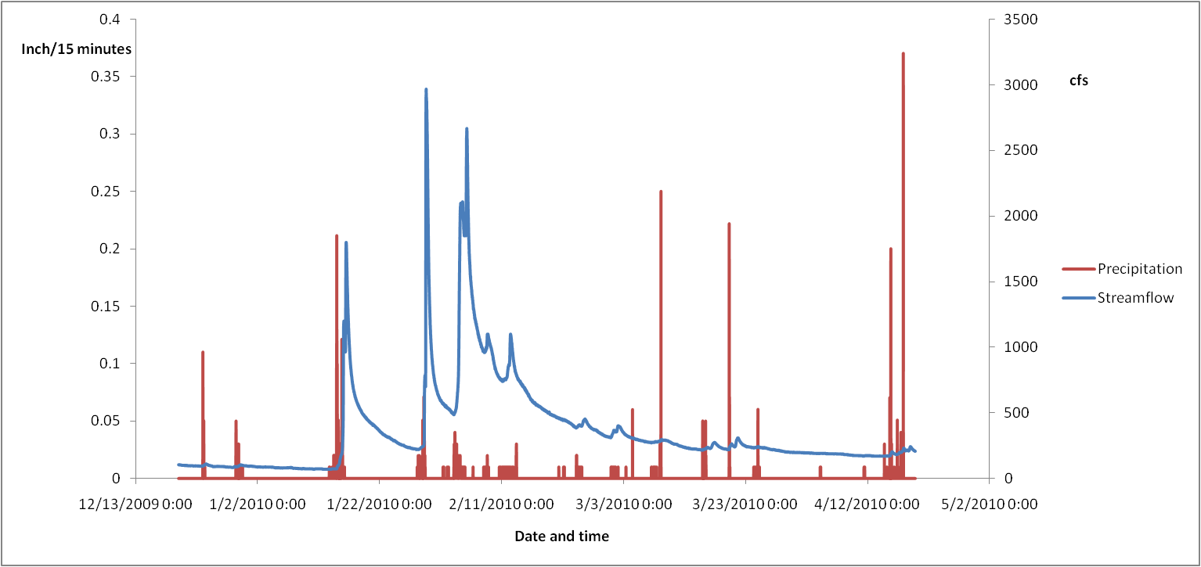
Selection of the watershed depends on the runoff information
No rain or no data?!
Edwards Aquifer = Non Hortonian Flow

Slide 12
Selection of the storms
Short and strong storms
Single-peaked hydrograph of short time base

Slide 13
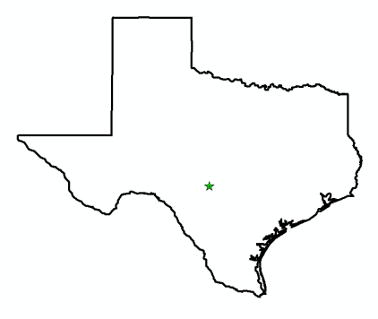
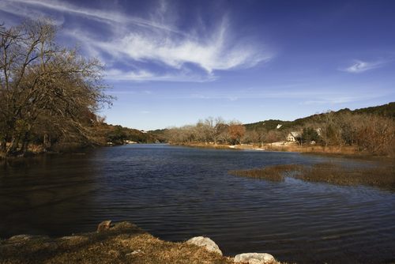
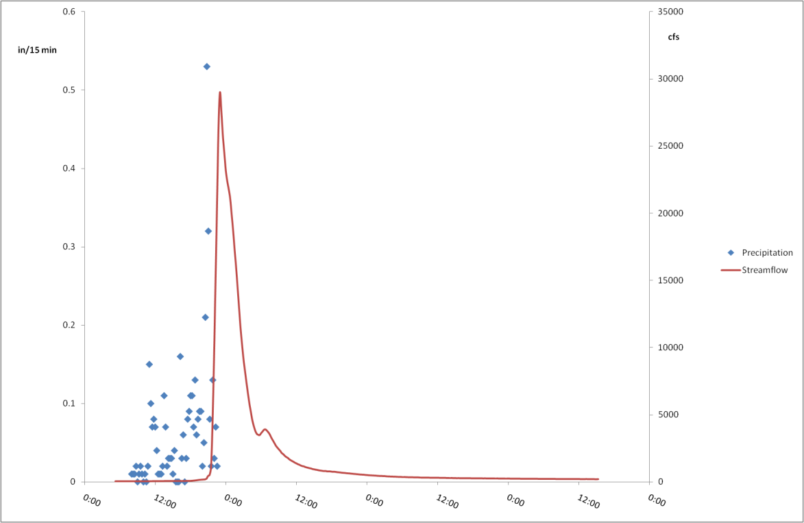
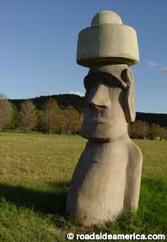
Case study: Guadalupe River at Hunt Texas

Slide 14
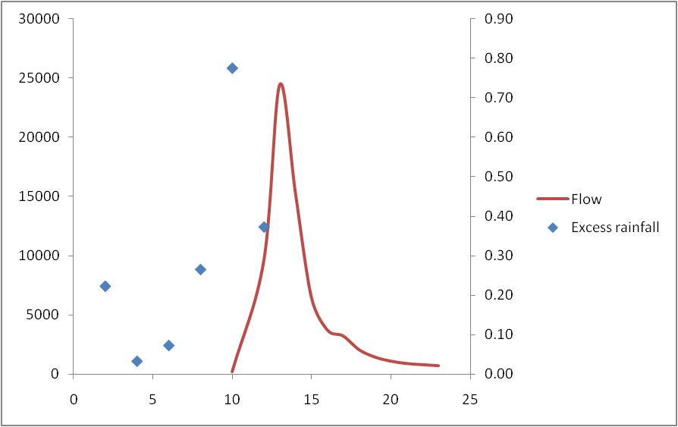
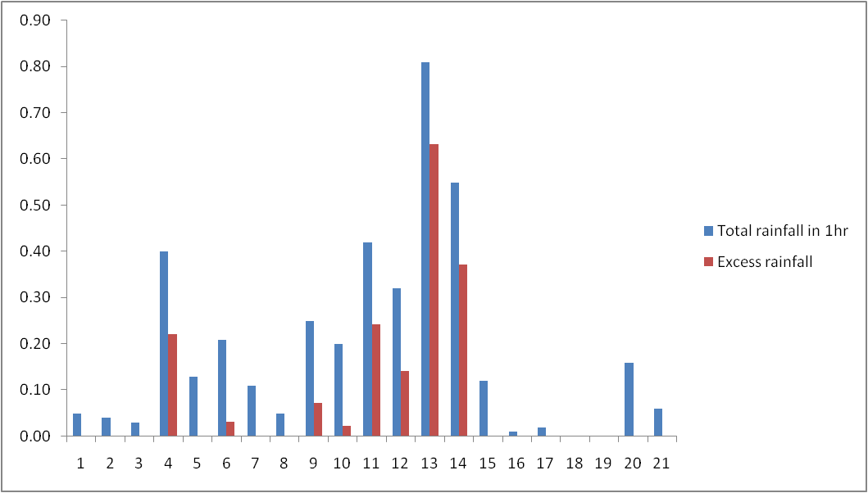
Raw data
Increasing the time step depending on the length of the event, and the response time
Calculating the excess rainfall Hyetograph using the Ф-index method
Modified Data
One more Increase of the time step from 1h to 2hrs to create a continuous event

Slide 15
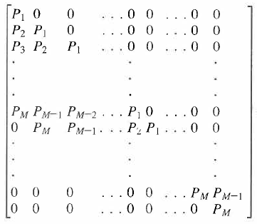

[P]
  [U] = [Z]⁻¹ [P]^{T} [Q]
t(h) | Excess Rainfall (in) | Q(cfs)
2 | 0.22 | 68.375
4 | 0.03 | 76
6 | 0.07 | 78.75
8 | 0.26 | 94
10 | 0.77 | 183.5
12 | 0.37 | 9595.12
13 | 0 | 24425
14 | 0 | 15150
15 | 0 | 6435
16 | 0 | 3708.75
17 | 0 | 3201.25
18 | 0 | 2043.75
19 | 0 | 1423.75
20 | 0 | 1079.75
21 | 0 | 876.875
22 | 0 | 781.75
23 | 0 | 692
[Q]

Slide 16
The result…
UH (τ=2hrs,bf=500cfs)
-6780.256
7333.716
21992
7301.544
4512.247
234.5135
4682.728
-486.1719
1222.673
1192.859
-279.9168
1356.144
“The resulting Unit Hydrograph may show erratic variatons and even have negative values”
Maidment, Applied Hydrology

Slide 18
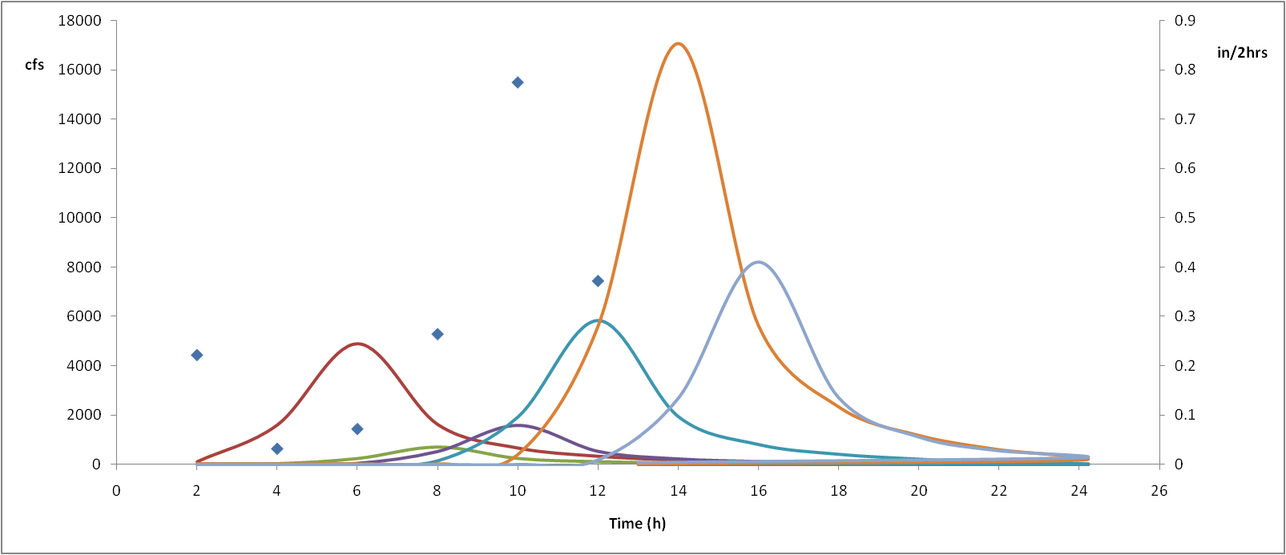
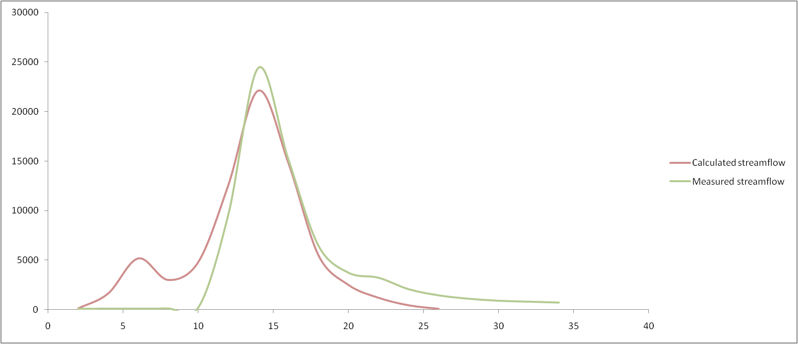
Impulse response functions
Measured VS calculated hydrograph

Slide 19
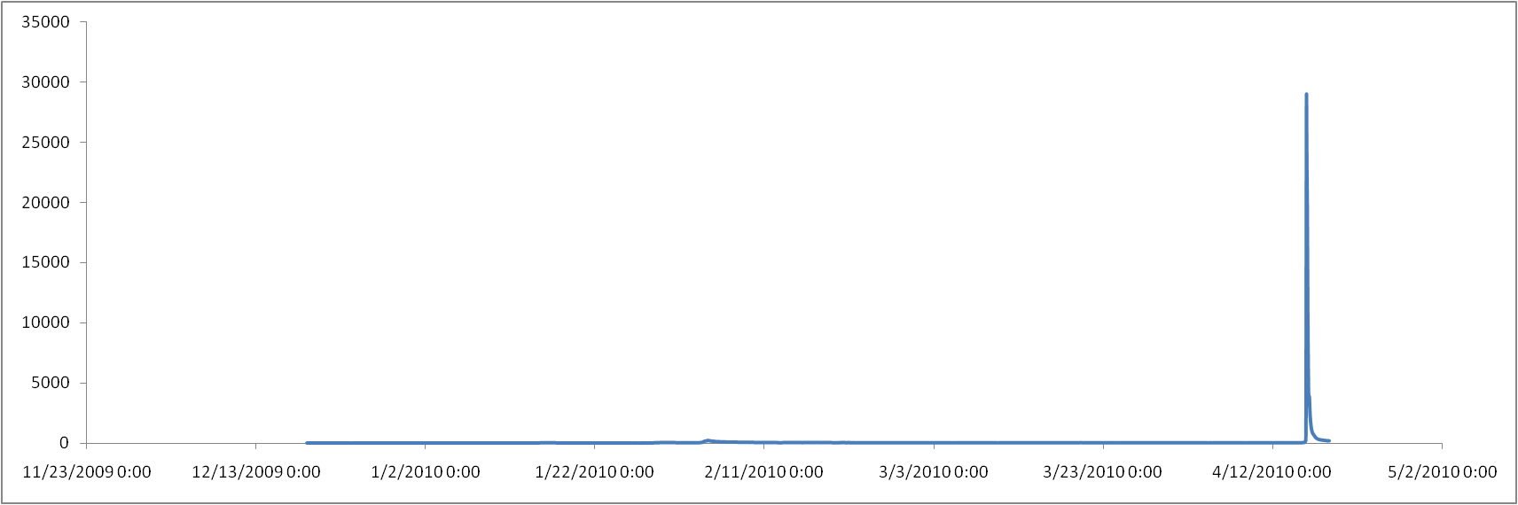
…No other storm event to test the UH
Only 1 event near Hunt in the last 120 days…

Slide 20
The UH is better calculated from strong and isolated storm events… Not many of them happened in the last 120 days
Next:
  Find THE watershed with the perfect storms and storm information
  Create a synthetic Hydrograph from the UH and test it for other stream gages in the watershed
  Compare the peak flows from the UH and the rationale method (C i A)

