Slide 1
HFR method For small storm events
Andrea Ryan
April 22,2010

Slide 2
Problem statement
Increased imperviousness on the Texas A&M West Campus is damaging the watershed.
Notes:
student population increasing from 7,500 in 1962 to 52,000 in 2004 The two sections of campus
Main Campus and West Campus (3.03 and 4.39 square kilometers, respectively) are located in two different watersheds
While West Campus is less developed than Main Campus, development that has taken place over the last 50 years on West Campus has greatly increased the impervious surface and volume of storm water draining into White Creek, subsequently degrading the structure of the creek and the ecosystem.

Slide 3
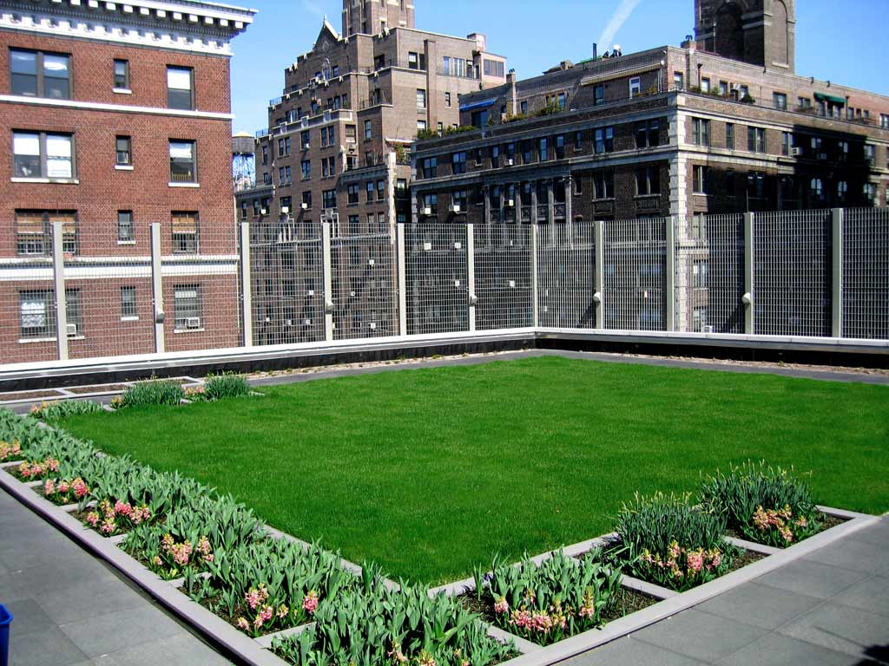
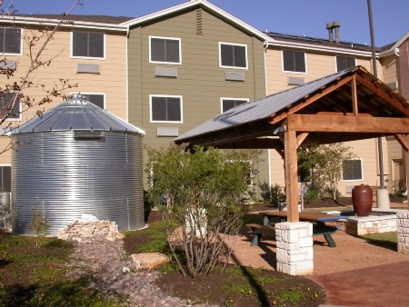
methodology
SCS Curve Number Method
http://www.tececo.com/images/photographs/porous_pavement/PorousPavement.JPG
http://www.designshare.com/portfolio/project/1/604/Green%20Roof.jpg
http://www.rosefellowship.org/images/projects/springterrace/gallery/05.jpg
Notes:
GR = 86 (3in of substrate)
PP = 71 (10.2cm of substrate – Ia-2.0cm)
RHS = 98 with Ia=10.2cm – since after the Ia for RHS, all other stormwater runs off.

Slide 4
MODELING
HFR Model
Storm Water Management Model (SWMM)
OUTPUT:
Hydrologic Footprint Residence
Peak Flow
Volume
Notes:
http://www.villanova.edu/studentlife/assets/images/specolympics/rain_cloud_000.gif
We both learned how to do both HEC & SWMM but I’m mainly doing HEC & Katie’s mostly doing SWMM

Slide 5
HEC-HMS Procedure
Notes:
Import the precipitation data from the prepared storm events.

Slide 6
Hec-hms procedure (continued)
Notes:
Import 6 LID combination scenarios for the Basins.
Use GIS shapefiles to get weighted curve numbers for subbasins.

Slide 7
Hec-hms procedure (continued)
Notes:
Include all subbasins in the meterologic model
Include all precipitation gages

Slide 8
Hec-hms procedure (continued)
Notes:
- Takes a while… 502 nodes to run. Can take anywhere from 10 minutes to 45 minutes for a single scenario to run depending on length of storm.

Slide 9
Hec-hms procedure (continued) HEC – Yeah!
This output is now the input to SWMM…

Slide 10
Hypothesis about final results
Katie – large storm events (>3.0in)
Andrea – small storm events (<3.0in)
Hypothesis: Low Impact Development will be more effective for small storms & a detention pond will be more effective for large storms.

Slide 11
struggles
24 Storms through HEC-HMS… with a hyphen in the name. BIG MISTAKE.
SWMM has an error
HFR? Problem from SWMM output or HFR code itself?

Slide 12
Preliminary results
 |  | Event 2 | Event 76 | Event 77
Precipitation (in) |  | 2.2 | 2.5 | 2.4
Present Conditions | Average Flow (cms) | 2.2 | 2.8 | 2.8
 | Max Flow (cms) | 11.7 | 17.0 | 16.4
 | Total Volume (m3) | 93.4 | 110.8 | 100.6
Green Roofs | Average Flow (cms) | 1.6 | 2.1 | 2.1
 | Max Flow (cms) | 7.7 | 13.2 | 14.0
 | Total Volume (m3) | 65.8 | 81.1 | 71.9
Green Roofs + Pervious Pavement | Average Flow (cms) | 1.6 | 2.1 | 2.1
 | Max Flow (cms) | 7.7 | 13.2 | 14.0
 | Total Volume (m3) | 65.8 | 81.1 | 71.9
Pervious Pavement | Average Flow (cms) | 1.7 | 2.3 | 2.2
 | Max Flow (cms) | 8.6 | 14.0 | 14.4
 | Total Volume (m3) | 72.8 | 88.4 | 79.0
Rainwater Harvesting | Average Flow (cms) | 1.4 | 2.0 | 1.9
 | Max Flow (cms) | 7.0 | 11.9 | 12.6
 | Total Volume (m3) | 60.3 | 74.2 | 65.8
Rainwater Harvesting + Pervious Pavement | Average Flow (cms) | 1.4 | 2.0 | 1.9
 | Max Flow (cms) | 7.0 | 11.9 | 12.6
 | Total Volume (m3) | 60.3 | 74.2 | 65.8
Detention Pond | Average Flow (cms) | 2.2 | 2.8 | 2.8
 | Max Flow (cms) | 9.1 | 12.2 | 11.9
 | Total Volume (m3) | 93.4 | 110.8 | 100.6

Slide 13
Preliminary results: Average of 3 storms

Slide 14
Future work
Run storm events to test hypothesis
A small lit review of the impacts of LID and BMPs on small vs large storms
Figure out what’s wrong with SWMM & HFR…

Slide 15
Questions?

