Slide 1
Floodwater Management in Dallas, TX
Stephen Swan
CE 394K 2
April 22, 2010

Slide 2
OUTLINE
Project Background
Dallas and the Trinity River
Flood of 1908
Current Flood Control Measures
Initial Modeling
Future Work

Slide 3
CITY OF DALLAS
Population: 1.2 million
8th largest city in the nation
Average annual precipitation
Rainfall: 33.7 in
Snow: 2.5 in
Located along the Trinity River in the Upper Trinity River Basin

Slide 4
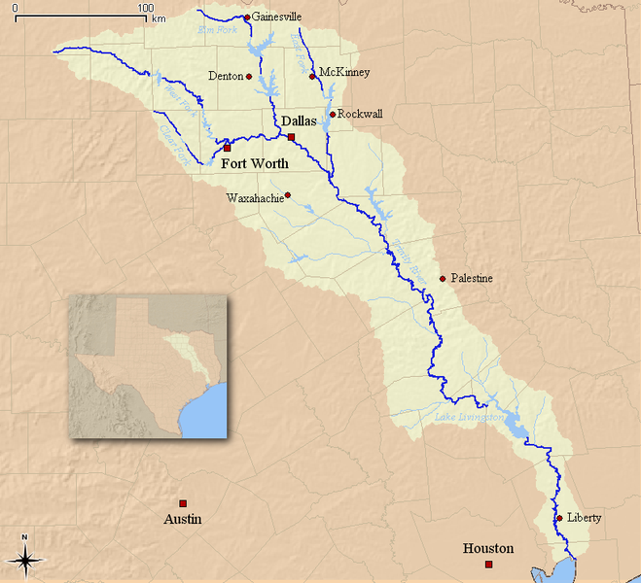
TRINITY RIVER AT DALLAS
Three forks meet before Dallas
Clear, West, and Elm Forks
East Fork meets southeast of Dallas
River course
710 mile length
Empties into the Gulf of Mexico
Average annual flow
Last ten years: 800 - 4000 cfs

Slide 5
FLOOD OF 1908
Worst recorded flood in Dallas’ history
Trinity River
52.6 feet deep
1.5 miles wide
Estimated damage : $2.5 million
4,000 people left homeless
Five were killed
Began the design and implementation of flood control systems in Dallas

Slide 6
DALLAS FLOOD CONTROL
Levees
East Levee: 11.5 mi
West Levee: 13.4 mi
Rochester Levee: 5.1 mi
Average height: 28 ft
Pumping Stations
Stations: 16
Pumps: 63
Flow rate: 4,399 cfs
Pressure Sewers
Sewers: 6
Flow rate: 19,868 cfs

Slide 7
LEVEE SYSTEM

Slide 8
USACE PERIODIC INPECTION 2007
USACE 5 year inspection
Dallas levee system → Unacceptable
East levee
47% below Standard Project Flood
West levee
42% below Standard Project Flood
Issues with other flood protection

Slide 9
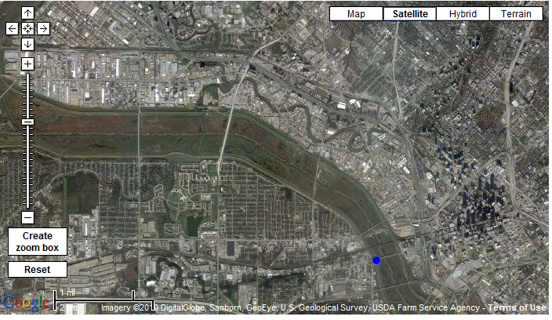
HEC-HMS MODELING
USGS Streamflow Gauge 08057000 at Downtown Dallas

Slide 10
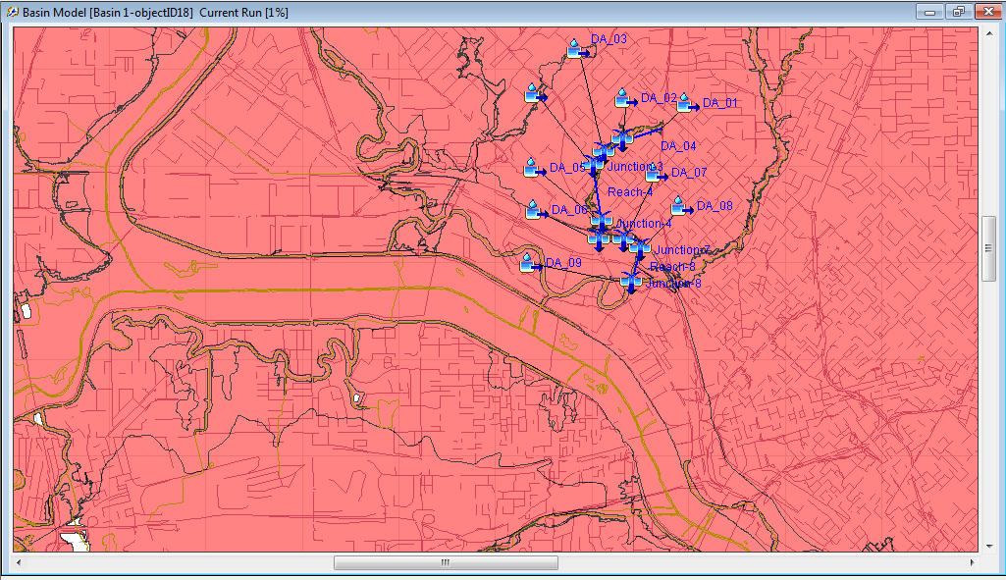
HEC-HMS MODELING
Cedar Springs Branch at Turtle Creek

Slide 11
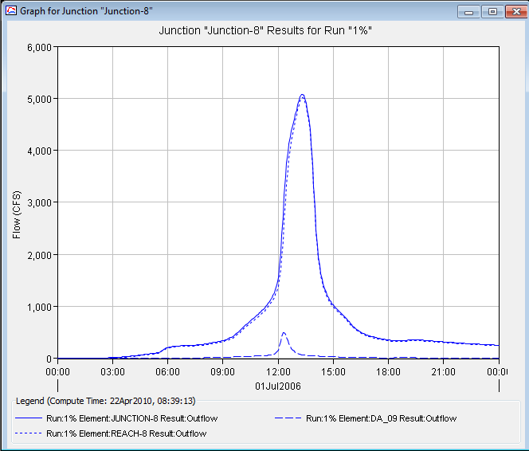
HEC-HMS MODELING
100-year conditions outflow at Cedar Springs Branch, Junction 8

Slide 12
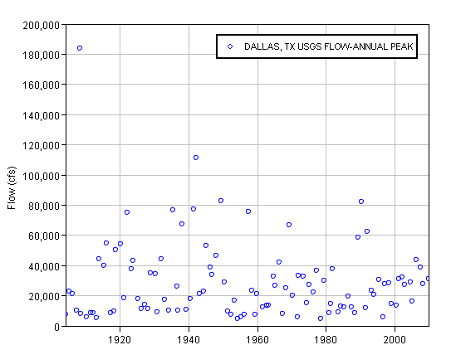
HEC-SSP MODELING
Annual peak flows for USGS 08057000 at Dallas, TX

Slide 13
HEC-SSP MODELING
Annual peak flows distribution

Slide 14
FUTURE WORK
HEC-RAS Modeling
Model the current levee system against 100-year flood conditions
Determine levee failures from the 100-year flood
Compare 100-year flood failures to Standard Project Flood failures

Slide 15
QUESTIONS?

