Slide 1

Flood flow prediction in a river system using artificial neural network: Case study Guadalupe Basin
Ahmad Tavakoly
April 2010

Slide 2
Importance of Flow Forecast
Optimize the Water Resources System
Warning system for approaching flood
Regulating reservoir outputs

Slide 3
Why ANNs?
Limit inputs vs. a large number of inputs for distributed models
Computationally fast and reliable
Not expensive
ANN solution is obtained through an optimization process...

Slide 4
How do ANNs work?
Random mapping between an input and an output.
The input layer neurons Transmit the values to the next layer
A typical ANN consists three layers namely, input, hidden, and output

Slide 5
How do ANNs work?
data passing through one neuron to another are multiplied by the weights
Weights control the strength of the passing signal
Optimized weight has a minimum MSE of the difference between results and observed data
Sum of the product transferred by a special functions

Slide 6
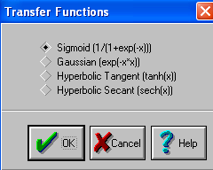
Transfer functions
w_{ji}= weight of the connection joining the j^{th} node in a layer with the i^{th} node in the previous layer; and x_{i}= value of the i^{th} node in the previous layer

Slide 7
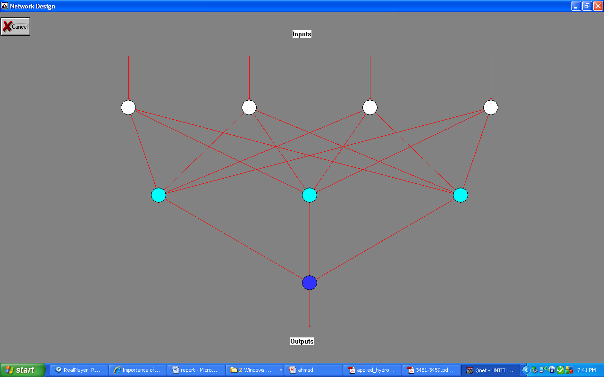
A typical feed-forward ANN
Input
Input
Output
Input
Input
Hidden Layer

Slide 8
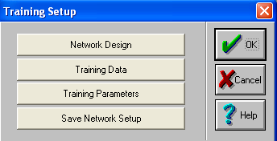
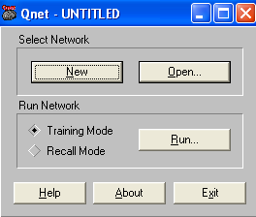
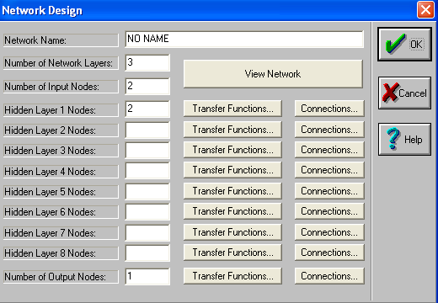
Qnet

Slide 9
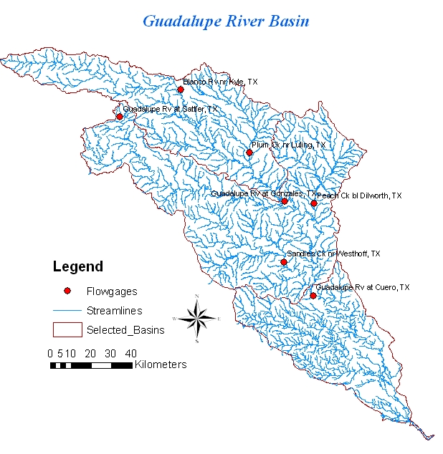
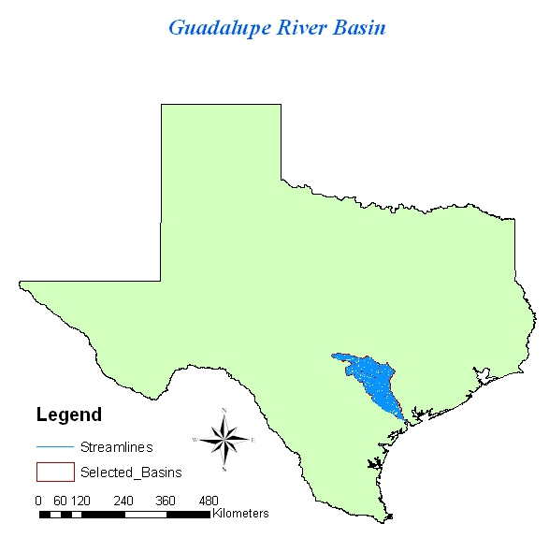
Case Study

Slide 10

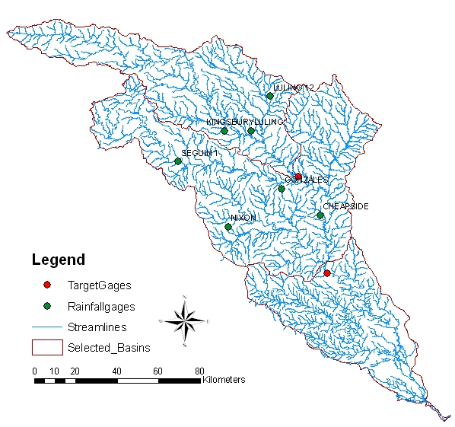
Precipitation Gages

Slide 11
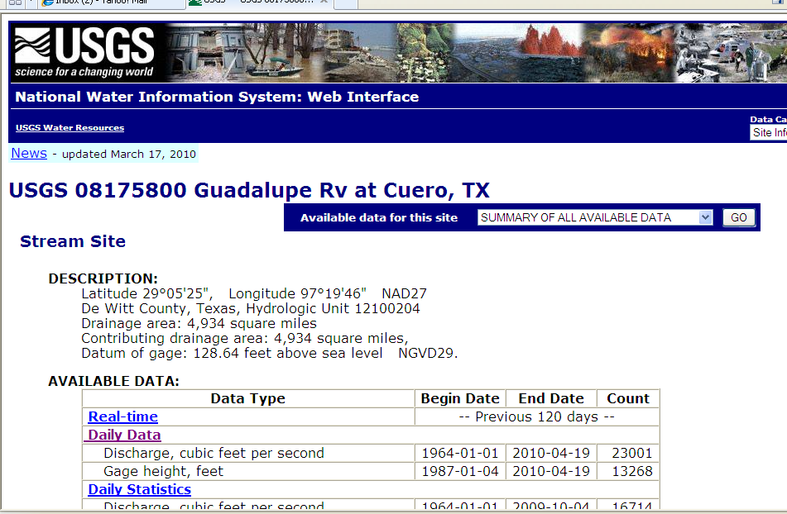
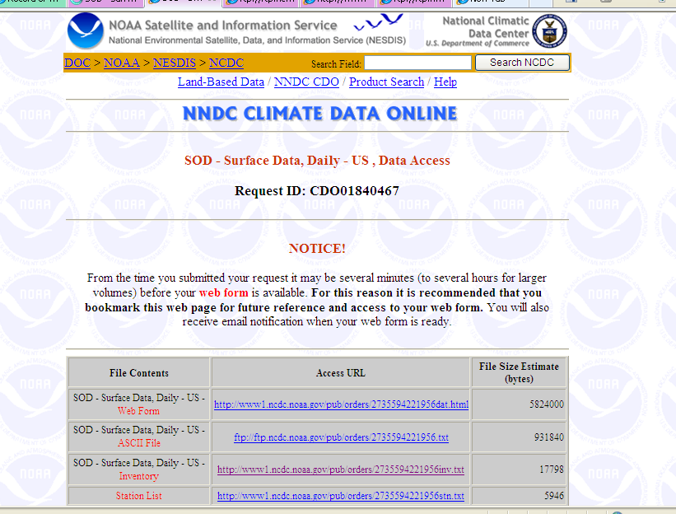
Data: Flow Rate and Precipitation
Daily Data: Time Period
01/01/2008-04/15/2010
http://waterdata.usgs.gov/nwis/nwisman/?site_no=08175800
http://www1.ncdc.noaa.gov/pub/orders/CDO2735594221956.html

Slide 12
Input Patter: Gonzales Station
pattern | Input data
1 | Q_{Kyle} (t-2), Q_{sattler} (t-2), Q_{luing} (t-2)
2 | Q_{Kyle} (t-1), Q_{sattle}(t-1), Q_{luing}(t-1)
3 | Q_{Kyle} (t-2), Q_{sattler} (t-2), Q_{luing} (t-2) , Q_{Kyle} (t-1), Q_{sattle}(t-1), Q_{luing}(t-1)
4 | Q_{Kyle} (t-2), Q_{sattler} (t-2), Q_{luing} (t-2) , Q_{Kyle} (t-1), Q_{sattle}(t-1), Q_{luing}(t-1), Q_{gonzales} (t-1)
5 | Q_{Kyle} (t-2), Q_{sattler} (t-2), Q_{luing} (t-2), P_{Seguin1} (t-1), P_{kingsbury} (t-1), P_{luling} (t-1),P_{Luling12} (t-1)
6 | Q_{Kyle} (t-2), Q_{sattler} (t-2), Q_{luing} (t-2), P_{Seguin1} (t-2), P_{kingsbury} (t-2), P_{luling} (t-2),P_{Luling12} (t-2)

Slide 13
Flow prediction: Gonzales Station, Training
pattern | R² | RMS Error | Transfer Function
1 | 0.8 | 0.051 | Sigmoid
1 | 0.8 | 0.048 | Hyperbolic Tangent
2 | 0.91 | 0.027 | Sigmoid
2 | 0.92 | 0.022 | Hyperbolic Tangent
3 | 0.93 | 0.015 | Sigmoid
3 | 0.945 | 0.0135 | Hyperbolic Tangent
4 | 0.95 | 0.014 | Sigmoid
4 | 0.96 | 0.013 | Hyperbolic Tangent
5 | 0.93 | 0.018 | Sigmoid
5 | 0.93 | 0.013 | Hyperbolic Tangent
6 | 0.845 | 0.044 | Sigmoid
6 | 0.862 | 0.042 | Hyperbolic Tangent

Slide 14
Flow prediction: Gonzales Station, Verifying
pattern | R² | RMS Error | Transfer Function
1 | 0.81 | 0.063 | Sigmoid
1 | 0.84 | 0.055 | Hyperbolic Tangent
2 | 0.84 | 0.070 | Sigmoid
2 | 0.85 | 0.075 | Hyperbolic Tangent
3 | 0.83 | 0.052 | Sigmoid
3 | 0.85 | 0.053 | Hyperbolic Tangent
4 | 0.89 | 0.03 | Sigmoid
4 | 0.91 | .028 | Hyperbolic Tangent
5 | 0.83 | 0.06 | Sigmoid
5 | 0.83 | 0.06 | Hyperbolic Tangent
6 | 0.85 | .053 | Sigmoid
6 | 0.86 | .053 | Hyperbolic Tangent

Slide 15
Calibration: Gonzales

Slide 16
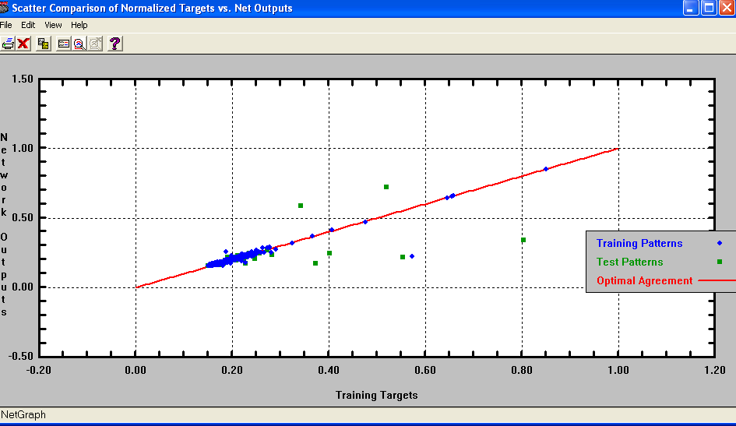
Gonzales: Comparison of predicted and measured data

Slide 17
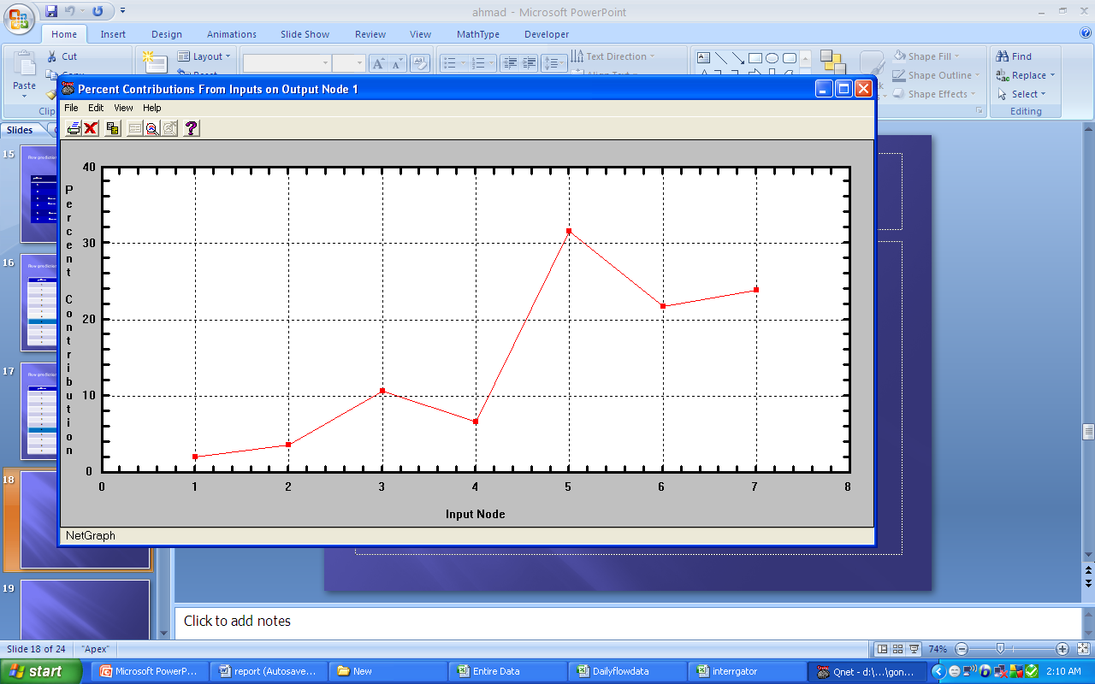
Sensitivity Analysis
Input Node |  | Percent Contribution
1 | Sattler(t-1) | 2.06
2 | Sattler(t-2) | 3.62
3 | Kyle(t-1) | 10.66
4 | Kyle(t-2) | 6.59
5 | Luling(t-1) | 31.52
6 | Luling(t-2) | 21.72
7 | Gonzales(t-1) | 23.83

Slide 18
Input Pattern: Cuero Station
pattern | Input data
1 | Q_{gonzales} (t-2), Q_{dilworth} (t-2), Q_{westhoff} (t-2)
2 | Q_{gonzales} (t-1), Q_{dilworth} (t-1), Q_{westhoff} (t-1)
3 | Q_{gonzales} (t-2), Q_{dilworth} (t-2), Q_{westhoff} (t-2), Q_{gonzales} (t-1), Q_{dilworth} (t-1), Q_{westhoff} (t-1)
4 | Q_{gonzales} (t-2), Q_{dilworth} (t-2), Q_{westhoff} (t-2), Q_{gonzales} (t-1), Q_{dilworth} (t-1), Q_{westhoff} (t-1) Q_{Cuero} (t-1)
5 | Q_{gonzales} (t-2), Q_{dilworth} (t-2), Q_{westhoff} (t-2), P_{cheapside} (t-1), P_{gonzales} (t-1), P_{nixon} (t-1),
6 | Q_{gonzales} (t-2), Q_{dilworth} (t-2), Q_{westhoff} (t-2), P_{cheapside} (t-2), P_{gonzales} (t-2), P_{nixon} (t-2),

Slide 19
Flow prediction: Cuero Station, Training
pattern | R² | RMS Error | Transfer Function
1 | 0.87 | 0.06 | Sigmoid
1 | 0.87 | 0.06 | Hyperbolic Tangent
2 | 0.90 | .037 | Sigmoid
2 | 0.90 | .035 | Hyperbolic Tangent
3 | 0.96 | 0.033 | Sigmoid
3 | 0.96 | 0.036 | Hyperbolic Tangent
4 | 0.98 | 0.03 | Sigmoid
4 | 0.98 | 0.025 | Hyperbolic Tangent
5 | 0.96 | 0.05 | Sigmoid
5 | 0.96 | 0.04 | Hyperbolic Tangent
6 | 0.90 | 0.05 | Sigmoid
6 | 0.90 | 0.048 | Hyperbolic Tangent

Slide 20
Flow prediction: Cuero Station, Verifying
pattern | R² | RMS Error | Transfer Function
1 | 0.81 | 0.07 | Sigmoid
1 | 0.81 | 0.07 | Hyperbolic Tangent
2 | 0.93 | 0.017 | Sigmoid
2 | 0.93 | 0.016 | Hyperbolic Tangent
3 | 0.93 | 0.016 | Sigmoid
3 | 0.93 | 0.016 | Hyperbolic Tangent
4 | 0.93 | 0.014 | Sigmoid
4 | 0.93 | 0.013 | Hyperbolic Tangent
5 | 0.91 | 0.031 | Sigmoid
5 | 0.91 | 0.033 | Hyperbolic Tangent
6 | 0.84 | 0.06 | Sigmoid
6 | 0.84 | 0.06 | Hyperbolic Tangent

Slide 21
Calibration: Cuero

Slide 22
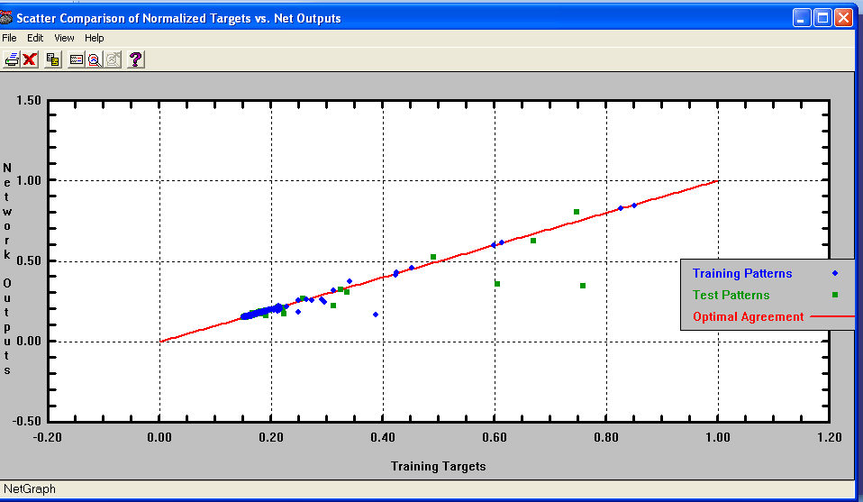
Cuero: Comparison of predicted and measured data

Slide 23
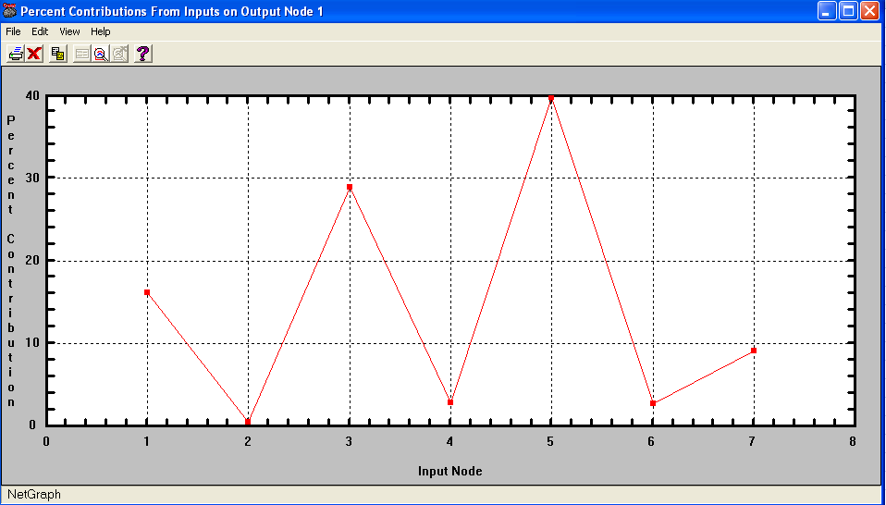
Sensitivity Analysis
Input Node |  | Percent Contribution
1 | Gonzales(t-1) | 16.17
2 | Gonzales(t-2) | 0.52
3 | Dilworth(t-1) | 28.93
4 | Dilworth(t-2) | 2.81
5 | Westhoff(t-1) | 39.74
6 | Westhoff(t-2) | 2.73
7 | Cuero(t-1) | 9.1

Slide 24
Results
The ANN model was able to predict flow accurately.
Only flow rate can be define as input variables.
The model for Gonzales gage shows the highest Sensitivity to Q_{luing}(t-1) and Q_{gonzales} (t-1).
Q_{dilworth} (t-1), Q_{westhoff} (t-1) have the begest effects on Flow rate at Cuero gage.

Slide 25
Future Work
Work with more data (bigger time period)
Test the model
Write repot

Slide 26
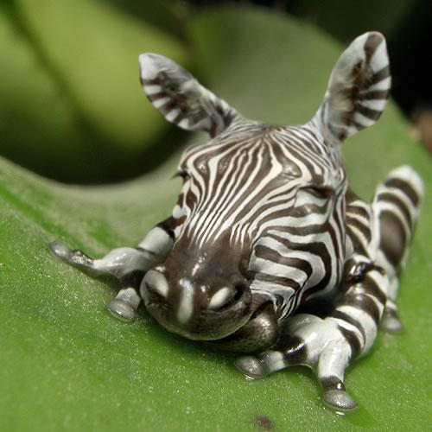
Thank you
Question?
Manipulation Art: Zebrafrog by Jerico Santander

