Slide 1
Hydrological Data Access and Simple Model Building
Jingqi Dong
April 27th, 2010

Slide 2
Contents
Theories
Methods to predict stream flow
Tools
HydroModeler in HydroDesktop
Work done
Calculated precipitable water - Warm-up…
Used HydroModeler
Future work

Slide 3
Theories
At one point
Atmospheric Method
Precipitable Water
Hydrologic Models
At a watershed
Hydrologic Methods
Streamflow
Excess Rainfall
SCS Method for Abstractions
Direct Runoff
Unit Hydrograph
River Routing
Muskingum Method

Slide 4
Tools
OpenMI
SCS Method for Abstractions
Unit Hydrograph
Muskingum Method
Components
HydroDesktop
HydroModeler
Rainfall
Input
Use
Link
Time Series Data
Link
Streamflow
Output

Slide 5
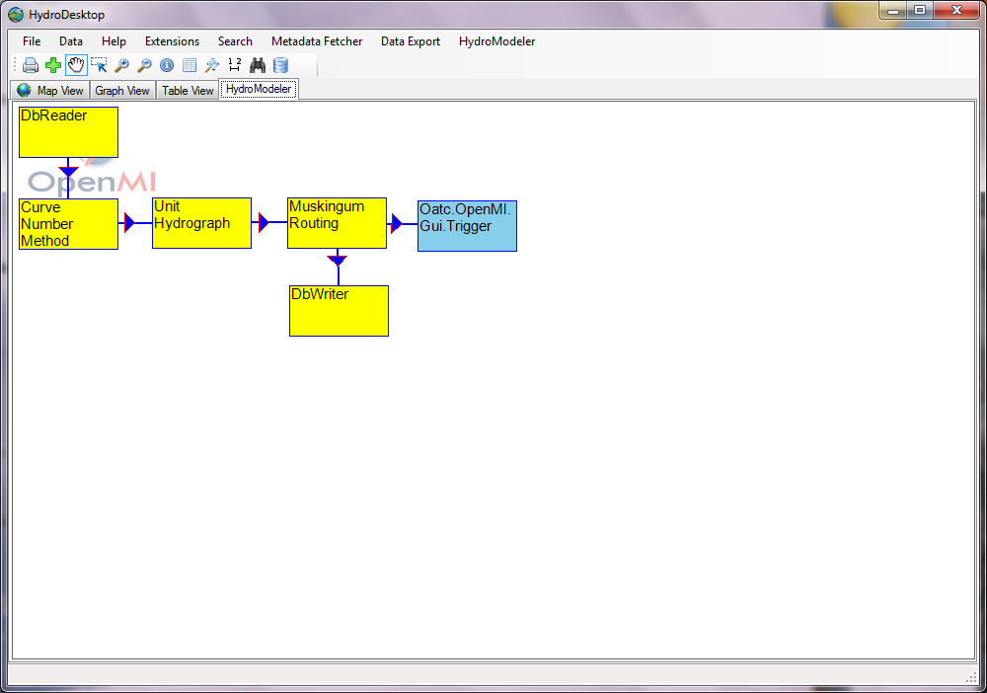

Slide 6
Precipitable water - Station
Upper Trinity River Basin
Precipitable Water at one location for March 1st.

Slide 7
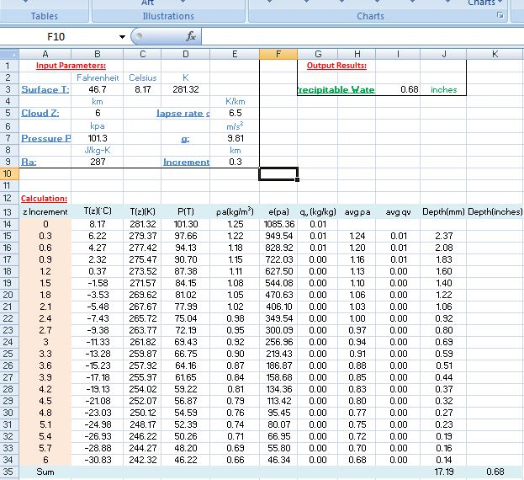
Precipitable water - Equations
Surface Temperature;
Cloud Height;
Lapse Rate α;
Pressure P;
Increment z

Slide 8
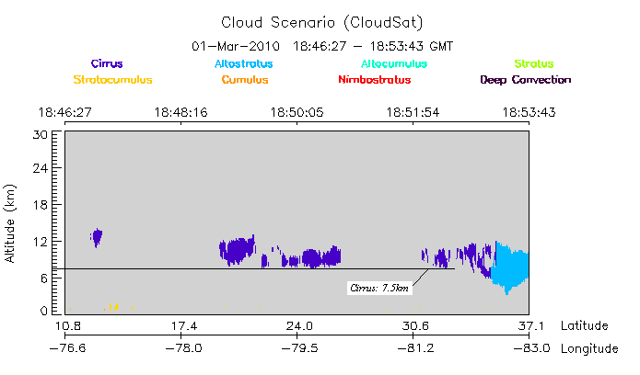
Precipitable water - Cloud Height
MODIS Online Visualization and Analysis System

Slide 9
HydroModeler
Download HydroModeler from IRODs
Preparation:
Created Shapefiles for the watershed;
Download precipitation in Database
Linking each component
in the model
to create the new composition in HydroModeler
Run!

Slide 10
Download HydroModeler
IRODs is a website for CUAHSI Online

Slide 11
Preparation – Spatial Shapefiles
Centroid
Point shapefile
SubWatersheds
Polygon shapefile
Unit Hydrograph
StreamNet
Polyline shapefile
Muskingum Method
SCS Method for Abstractions
Excess Rainfall
Direct Runoff
Stream flow

Slide 12
Spatial Shapefiles - Parameters
Equations:
SCS Dimensionless Hydrograph: Direct Runoff
Peak Discharge:
Muskingum Method:
River Routing
SCS Method for abstractions : Excess Rainfall

Slide 13
Spatial Shapefiles - Parameters
Centroid
Area (mi²)
SubWatershed
Area(mi²)
StreamNet
Length (feet)
To_Comid; From_Comid
Curve Number
The time of concentration
Curve Number
The time of concentration
K, X
GridID
GridID
GridID

Slide 14
Spatial Shapefiles - Parameters
Estimate Curve Number according to the Land Use;
T_{c} = T_{land} + T_{river} (min) = X_{land}/v_{land} + X_{river}/v_{river}
Use Table 5.7.1 in “Applied Hydrology”
Estimate X(Wedge storage weighting factor) according to river types: 0.0 <= X <= 0.5
X = 0 for reservoir-type storage
X = 0.5 for 'full' wedge storage
Estimate K (Proportionality Coefficient: The travel time of flood wave) :

Slide 15
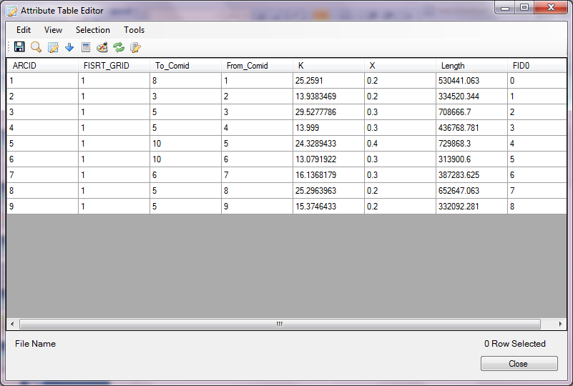
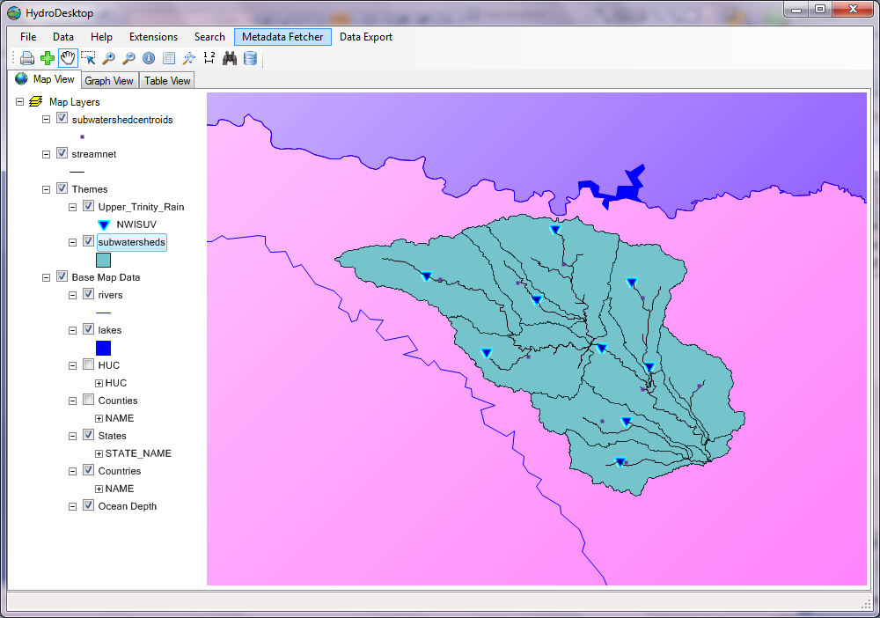
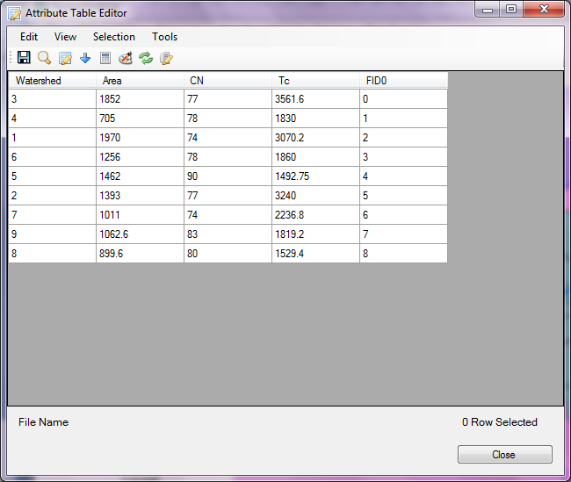
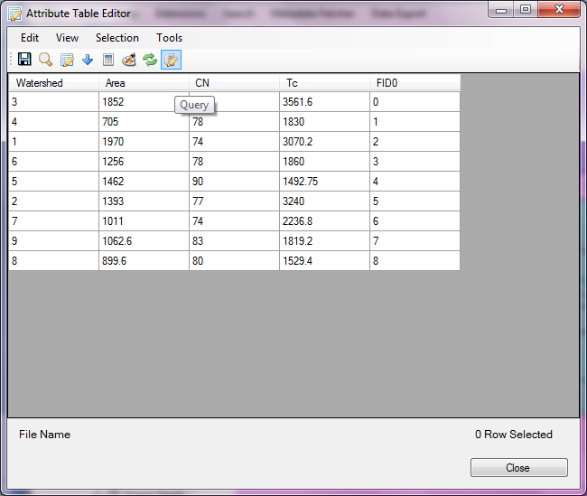

Slide 16
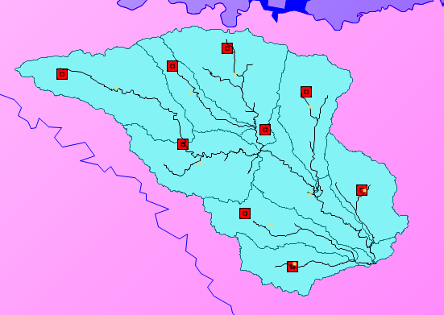
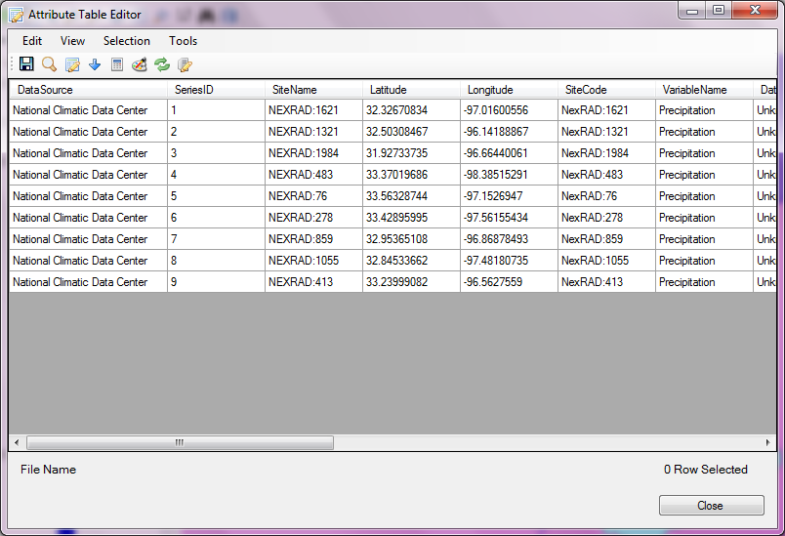
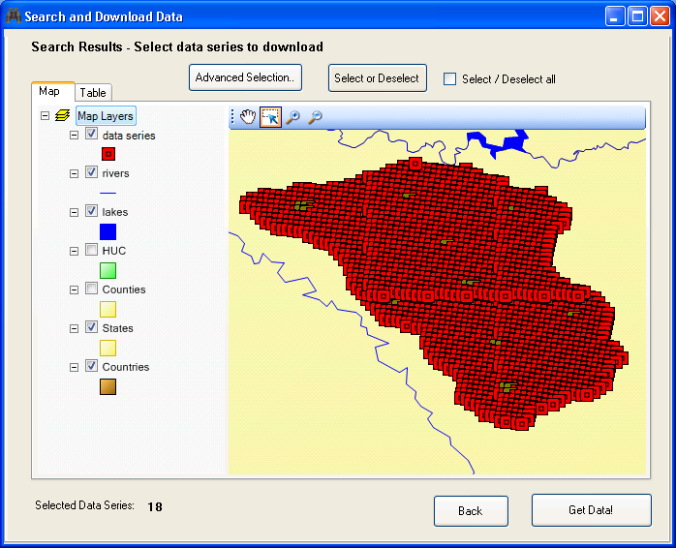
Realtime precipitation ← NEXRAD

Slide 17
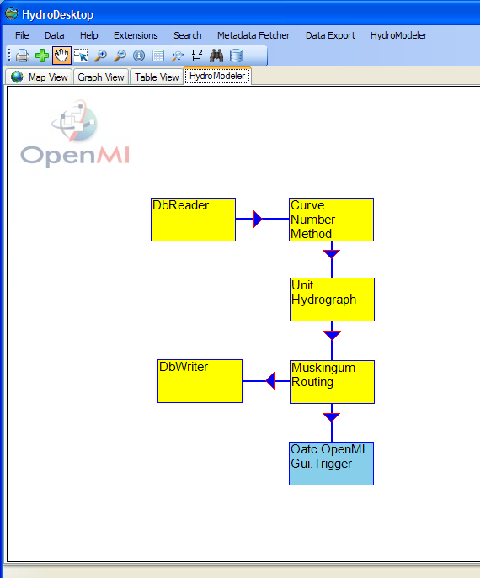
Model Linking

Slide 18
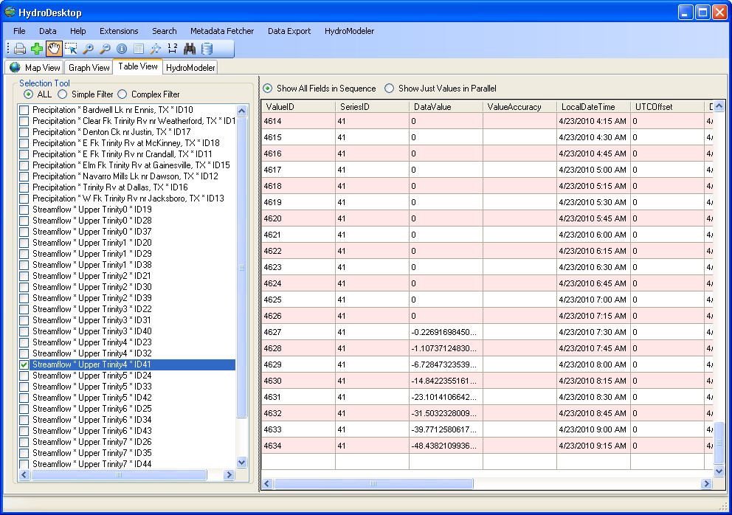
Run → Successful
→ Bad Result…

Slide 19
Possible Reasons…
Input precipitation ID is not correspond with the Shapefiles’ GridID!
Parameters’ estimation error

Slide 20
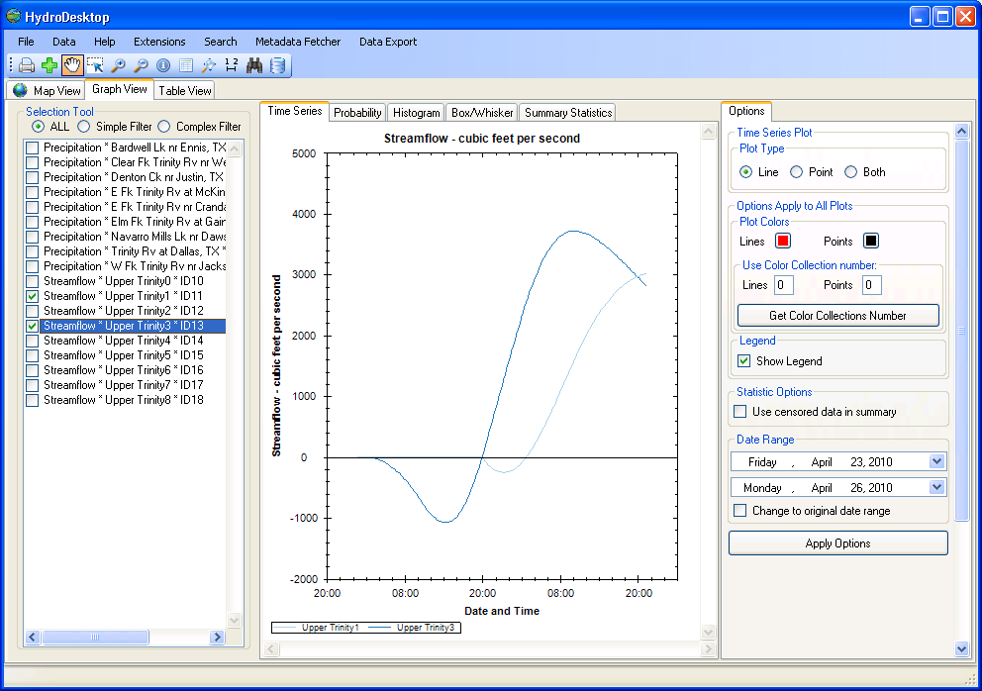
After corresponding…

Slide 21
Future work…
Improve the parameters
Write report

Slide 22
References
Ven Chow, David Maidment, Larry Mays. Applied Hydrology. [M] New York: McGraw-Hill, c1988.
Hartmann, Dennis L. Global Physical Climatology. [M] Burlington: Elsevier, 1994.
JASEM M. AL-HUMOUD and ISMAIL I. ESEN (2006), Approximate Methods for the Estimation of Muskingum Flood Routing Parameters.[J] Water Resources Management. 20: 979–990
USDA – Natural Resources Conservation Service (1995), Upper Trinity River Basin Study.

Slide 23
Many thanks to…
Dr. Maidment
Dr. Jonathan L Goodall & Tony Castronova in the University of South Carolina
Harish Sangireddy
Fernando R Salas
Eric Hersh
Stephen Swan
All co-workers in CRWR…

Slide 24
Thank you!
Questions?

