Slide 1
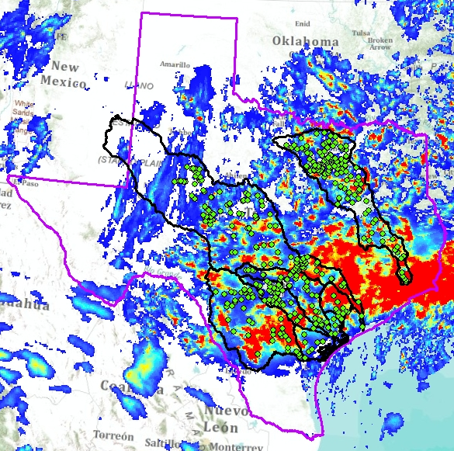
A Texas Water Balance Using GIS
Finding the ZERO…?

Slide 2
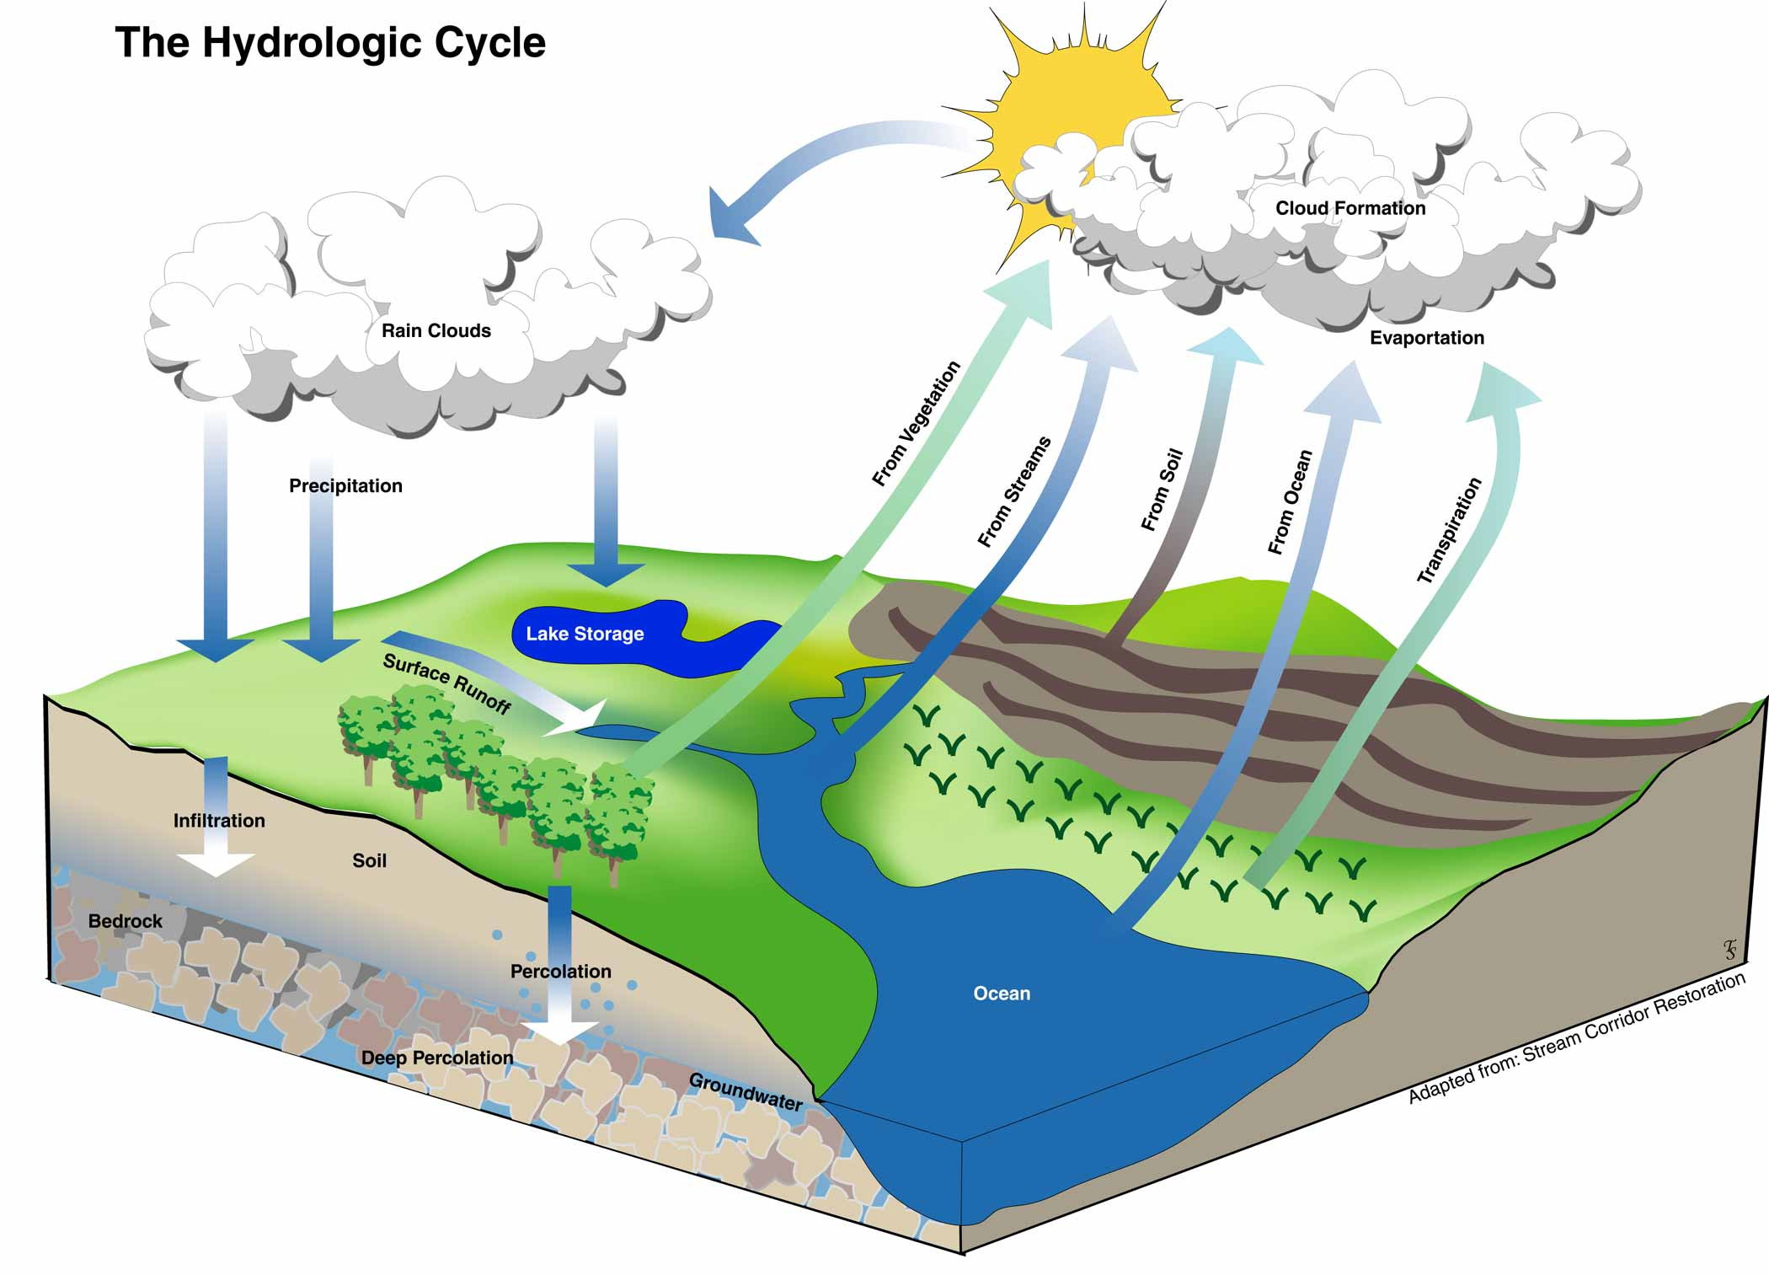
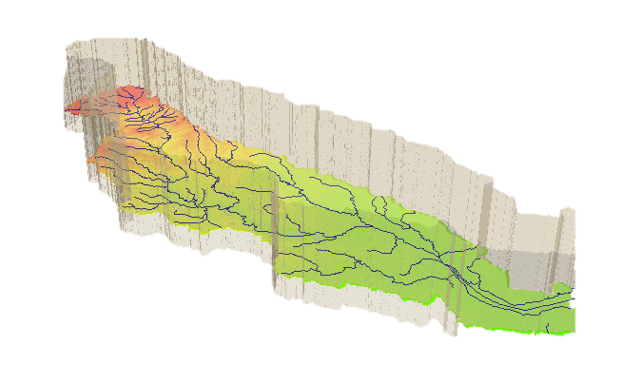

Hydrologic Cycle
I(t) Precipitation
E(t) Evaporation
Q(t) Streamflow
ΔS(t)$=I(t)−E(t)−Q(t)$

Slide 3
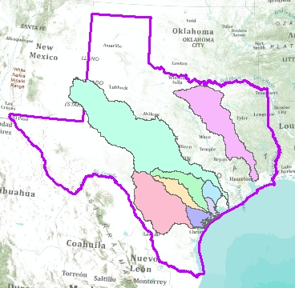
Texas River Basins
River Basin | Area (sq km)
Colorado | 98,318
Trinity | 41,562
Nueces | 39,626
Guadalupe | 14,078
San Antonio | 9,843
Trinity
Colorado
San Antonio
Nueces
Guadalupe

Slide 4
Water Balance Workflow
Identify basin of interest and locate stream gages within it
Delineate the watershed
Select time period and units
Acquire precipitation, evaporation and streamflow data
Compute watershed-averaged precipitation, evaporation and streamflow for gage and associated watershed

Slide 5
Data Collection
Precipitation - Next Generation Radar (NEXRAD)
  NCDC THREDDS Server
Evaporation - North American Regional Reanalysis (NARR)
  ESRL PSD THREDDS Server
Streamflow - United States Geological Survey (USGS)
  CUAHSI Web Services

Slide 6
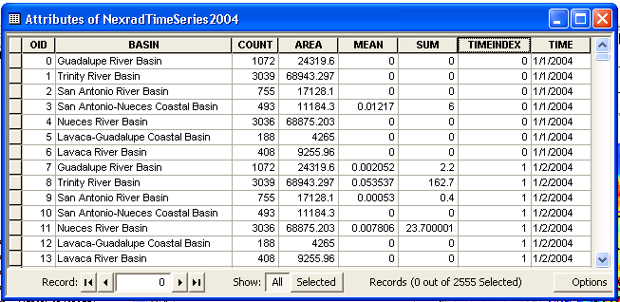
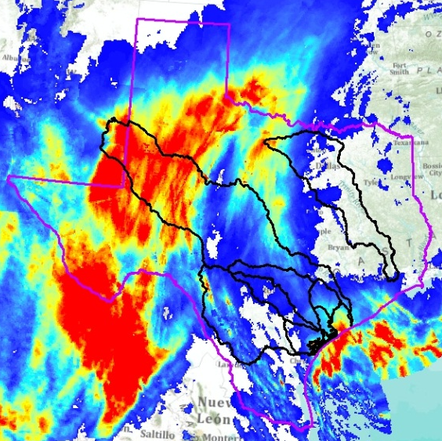
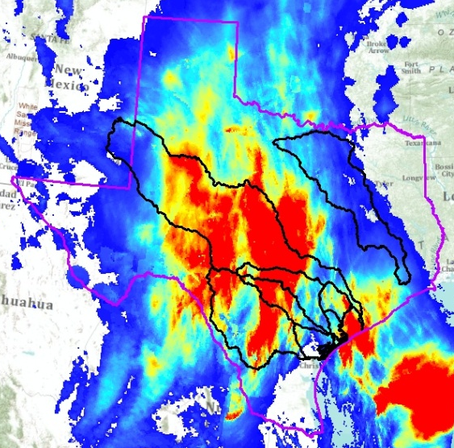
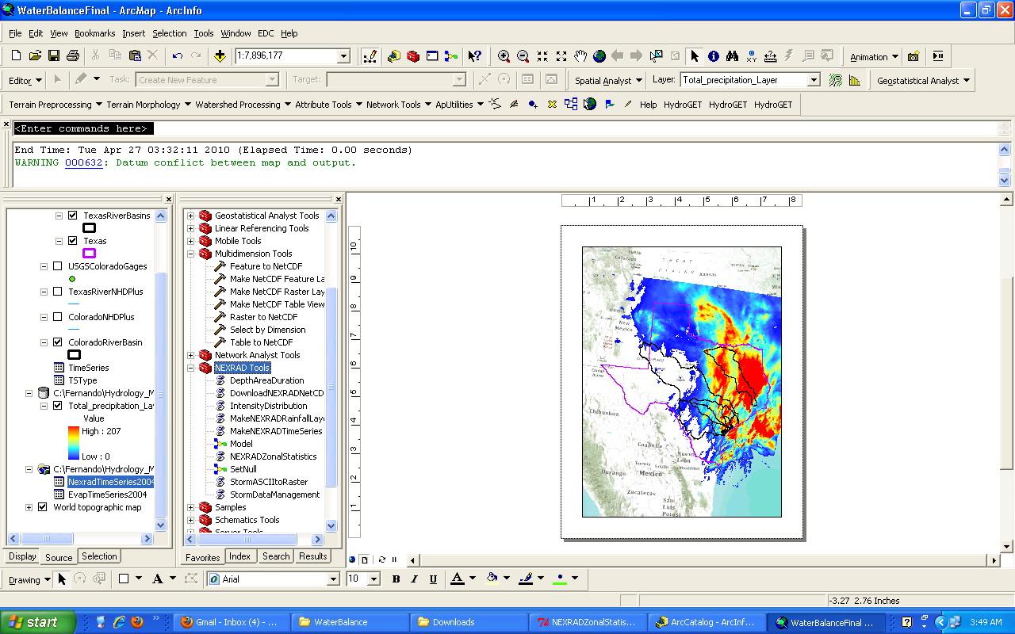
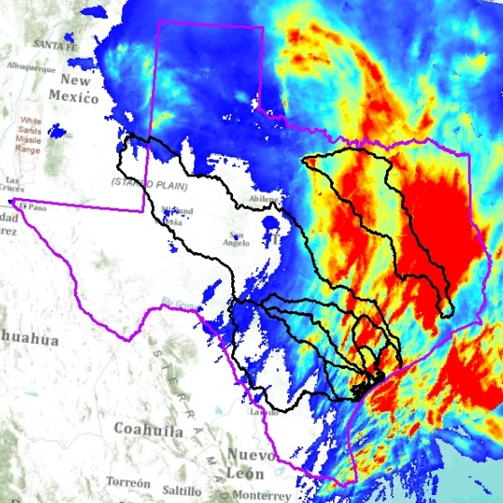
GIS Automated Tools - Grids

Slide 7
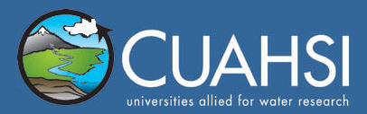
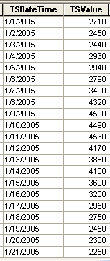
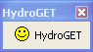
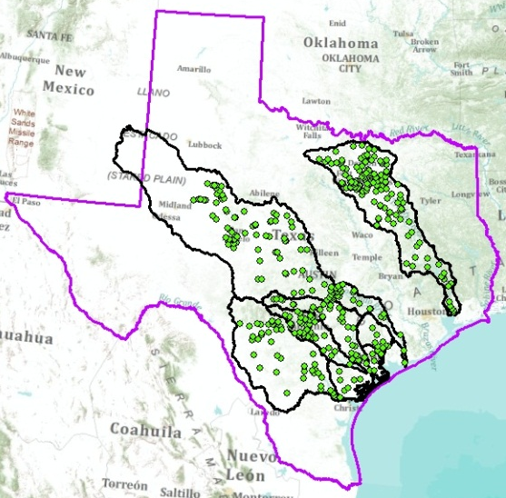
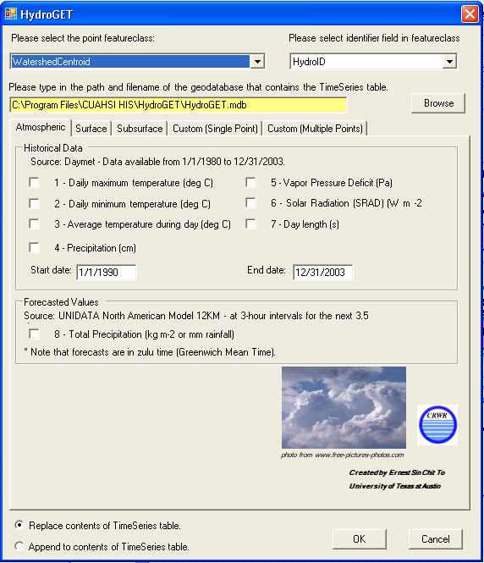
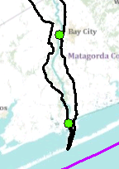
GIS Automated Tools – Time Series

Slide 8
Colorado River Basin

Slide 9
Colorado River Basin - 2004

Slide 10
Colorado River Basin - 2005

Slide 11
Trinity River Basin

Slide 12
Trinity River Basin - 2004

Slide 13
Trinity River Basin - 2005

Slide 14
Nueces River Basin

Slide 15
Nueces River Basin - 2004

Slide 16
Nueces River Basin – 2005

Slide 17
Guadalupe River Basin

Slide 18
Guadalupe River Basin - 2004

Slide 19
Guadalupe River Basin - 2005

Slide 20
San Antonio River Basin

Slide 21
San Antonio River Basin - 2004

Slide 22
San Antonio River Basin - 2005

Slide 23
Water Storage

Slide 25
Future Work…
Find the ZERO

Slide 26
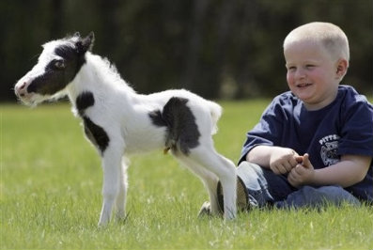
Questions…?

