Slide 1
Matlab and WaterOneFlow WebServices
James Seppi
CE394K Hydrology, Spring 2010
University of Texas

Slide 2
Contents
Introduction
Products
Example Analysis
Conclusions
To-Do

Slide 3
Background
WaterOneFlow web services
  GetSites
  GetSiteInfo
  GetVariables
  GetValues
WaterML
HIS Central
HydroServer
(WaterOneFlow)
WaterML Clients
Matlab Client

Slide 4
Background - Matlab
Sophisticated computational software
Supports scripting and object-oriented programming
  Can access Java libraries in new versions
Web Services
  createClassFromWsdl(wsdl_uri)
  Error?
GUIDE for making simple GUIs

Slide 5
Products – WaterML Parsers
Input
Parse
WaterML File
Matlab struct
Output
M-file Script
M-file Scripts
  parseSitesXML.m
  parseSiteInfoXML.m
  parseVariablesXML.m
  parseValuesXML.m
Work with both WaterML 1.0 and 1.1
Produce Matlab structs
Can be used independently or scripted together

Slide 6
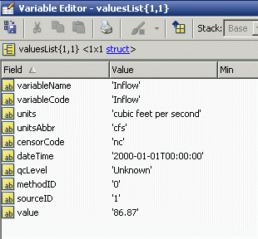
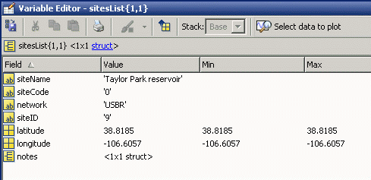
Products – HydroMatlab
Matlab GUI program
Utilizes WaterML parsers
Fetches data from WaterOneFlow services
Writes data to Matlab workspace and text files

Slide 7
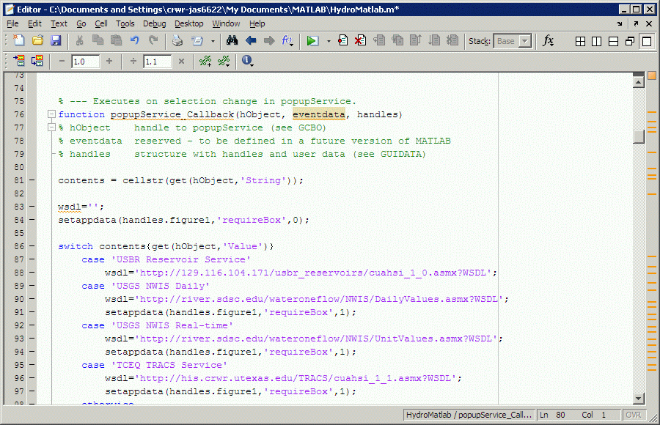
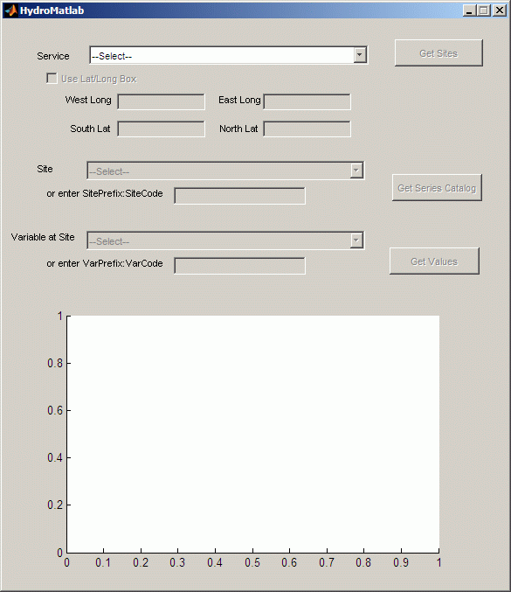
HydroMatlab

Slide 8
Execution Path
Select WaterOneFlow Service
Create Web Service Proxy Class
GetSites
(optional)
Select Site
(or enter code)
GetSiteInfo
Select Variable
(or enter code)
GetValues
Plot Values
Out: sitesList struct
Out: seriesList struct
Out: Values struct

Slide 9
HydroMatlab

Slide 10
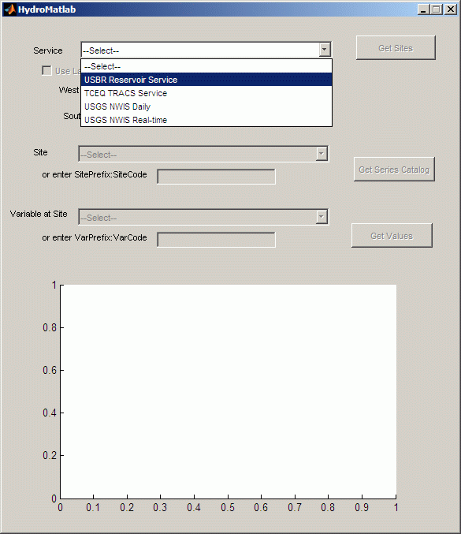
HydroMatlab

Slide 11
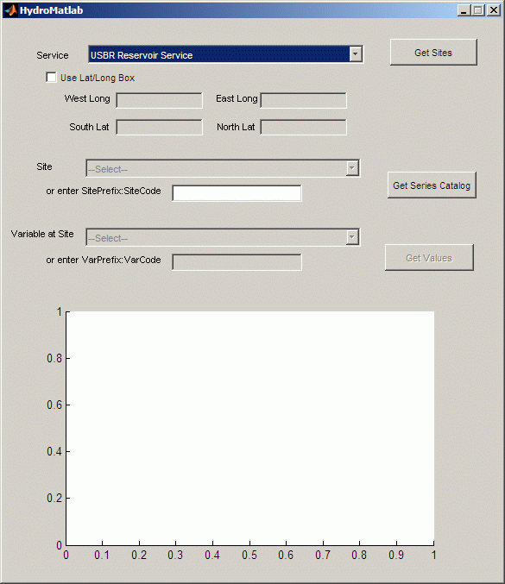
HydroMatlab

Slide 12
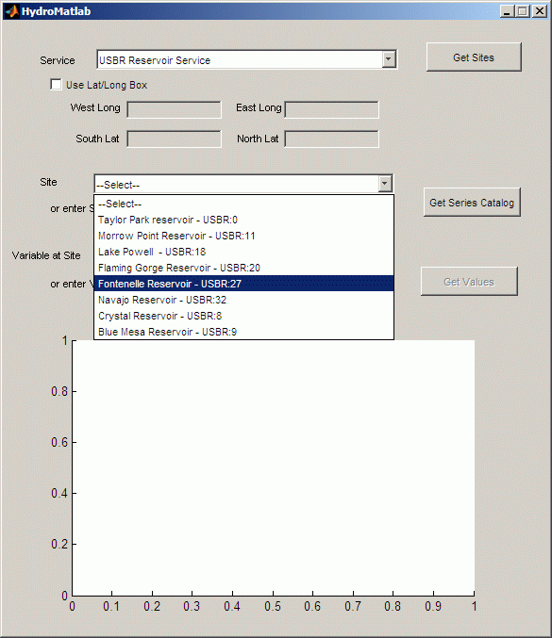
HydroMatlab

Slide 13
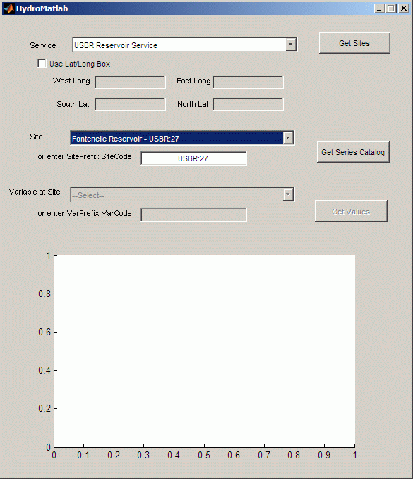
HydroMatlab

Slide 14
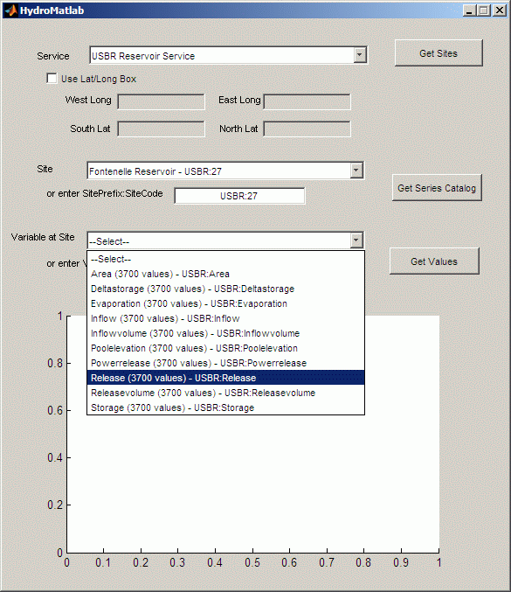
HydroMatlab

Slide 15
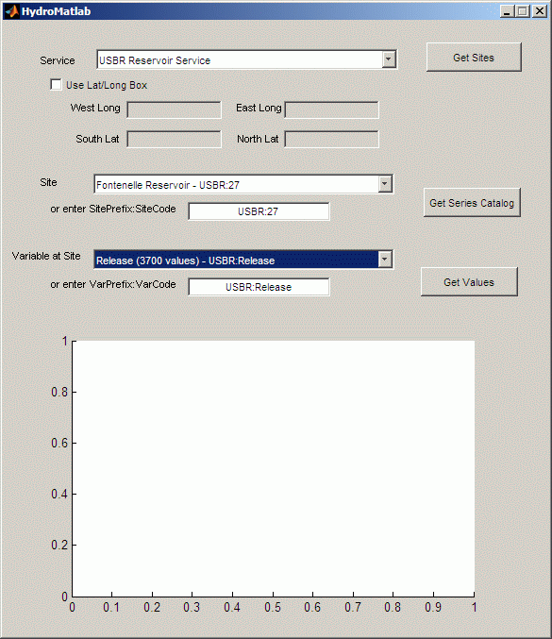
HydroMatlab

Slide 16
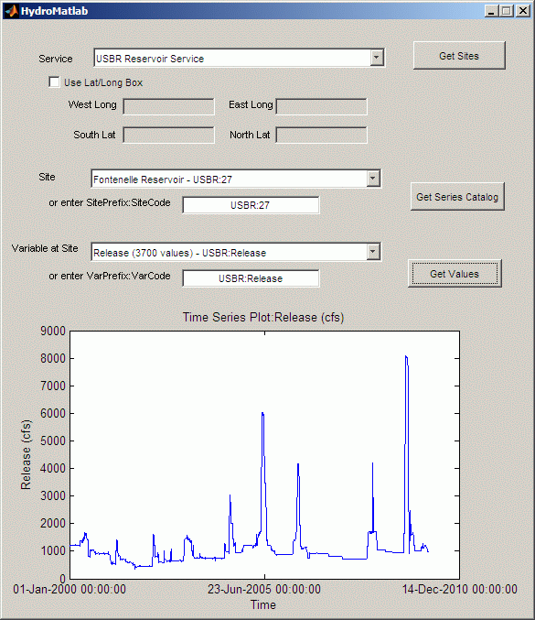
HydroMatlab

Slide 17
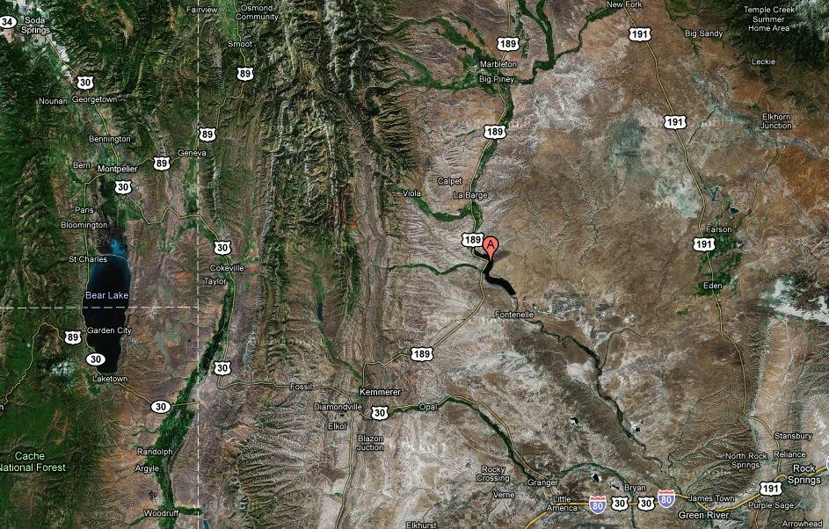
Example with HydroMatlab
USBR Service by Solaleh & Tim
Fontenelle Dam in Wyoming
Retrieved values with HydroMatlab
    Inflow, Release, Evaporation time series
    3,700 values each (10 years)
Simple Balance Calculation
  ΔStorage = Inflow – Evaporation – Release
  Storage_{i} = Storage_{i-1} + ΔStorage_{i}

Slide 18
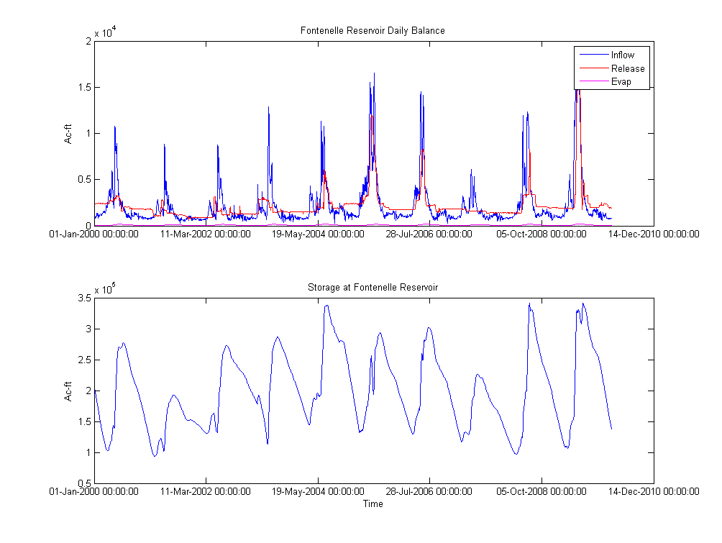
Example with HydroMatlab

Slide 19
Conclusions (so far)
Matlab is not so great for connecting natively to web services
    Built-in proxy class didn’t work out-of-the-box
    Luckily we have other products like HydroExcel and HydroDesktop
Matlab is good/fast at complex calculations and large data sets
HydroMatlab is a good example project

Slide 20
To Do
Add more services to the list
  Maybe change to use a configuration file
Clean up & comment code
  Document struct outputs
Enhance example with a more extensive analysis
  Flow routing
Report!

Slide 21
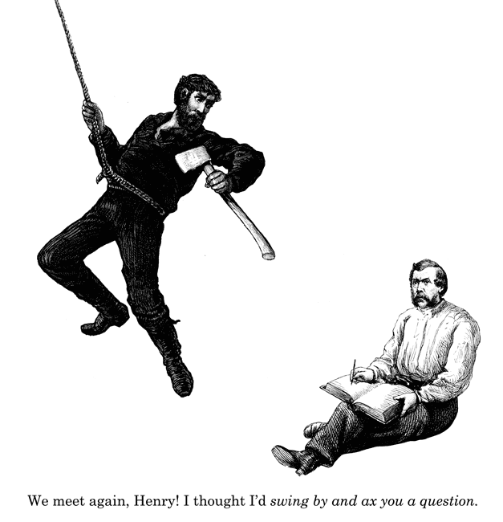
Questions?

