Slide 1
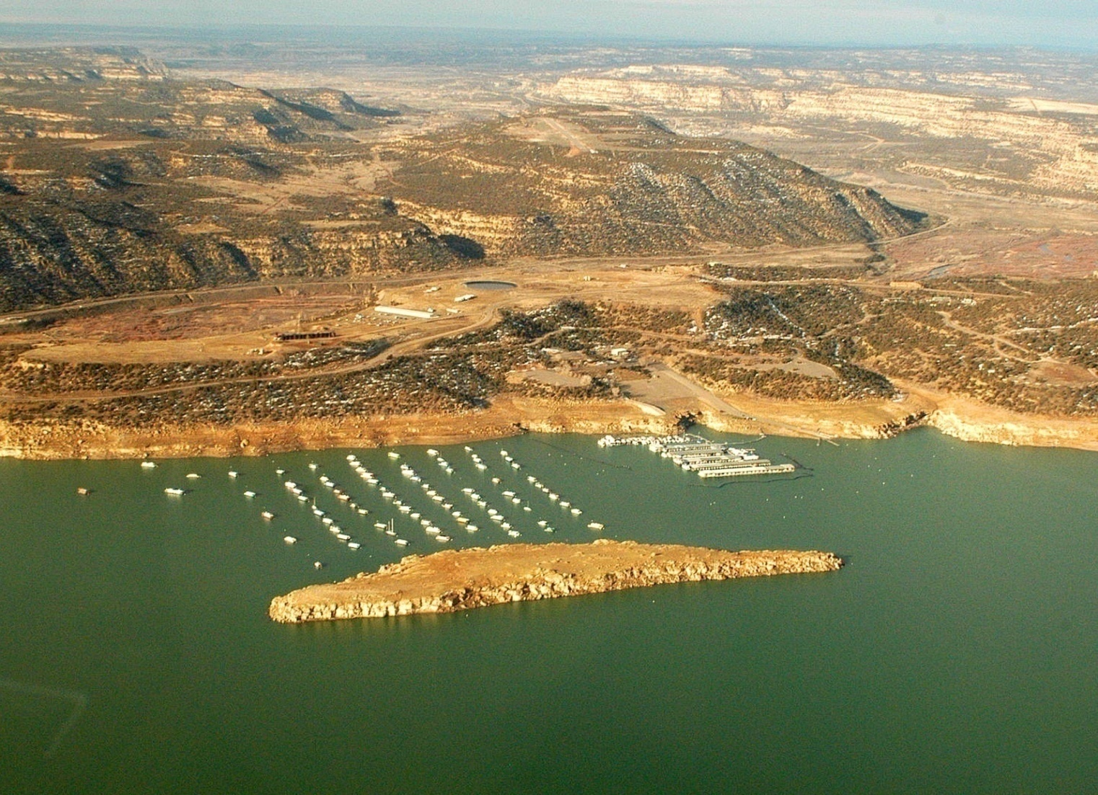
Surface Runoff Model for Navajo Reservoir
Solaleh Khezri
Spring 2010

Slide 2
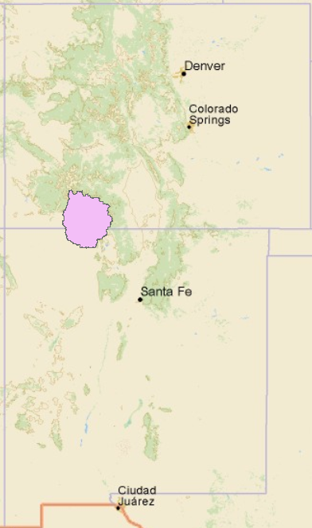
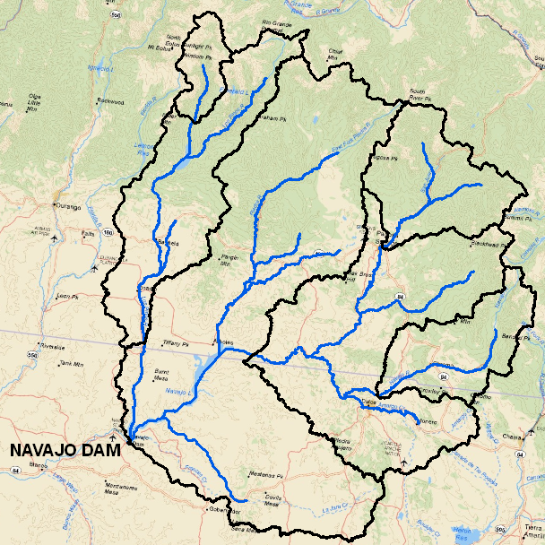
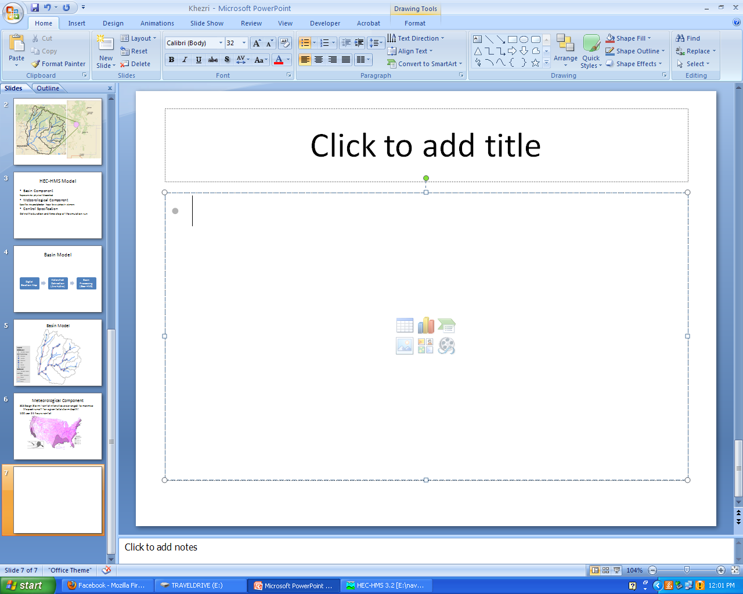
Navajo Reservoir
Drainage Area : 3190 Sq mi
Located on San Juan River
Dam Construction was completed in 1962.

Slide 3
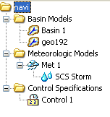
HEC-HMS Model
Basin Component
Represent the physical Watershed
Meteorological Component
Specifies the precipitation input for
a sub-basin element
Control Specification
Define the duration and time step of the simulation run

Slide 4
Basin Model
Digital Elevation Map
Watershed Delineation (Arc Hydro)
Basin Processing (Geo-HMS)
Import the Basin Model to HEC-HMS
Basin Centroid
Basin Slope
Basin Lag time
Centroidal Flow Path
Longest Flow Path
Add HMS Schematic/Legend

Slide 5
Some Tricks about Geo-HMS
Clean the local Temp directory, before using HEC-GeoHMS tool in ArcGIS.
The Subbasin Centroid may falls on the subbasin boundary.

Slide 6
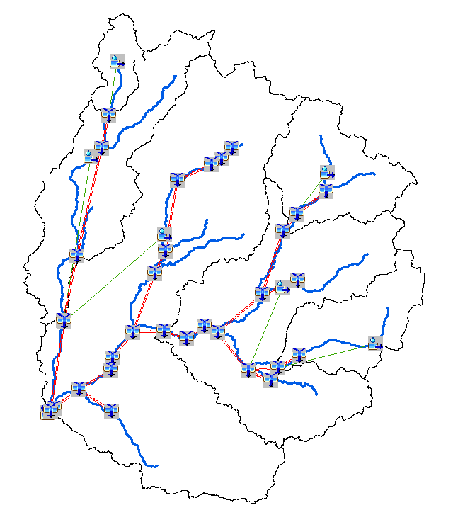
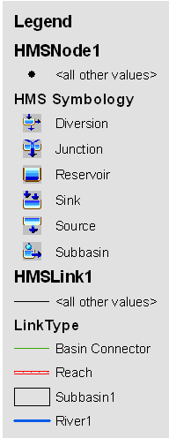
Basin Model

Slide 7
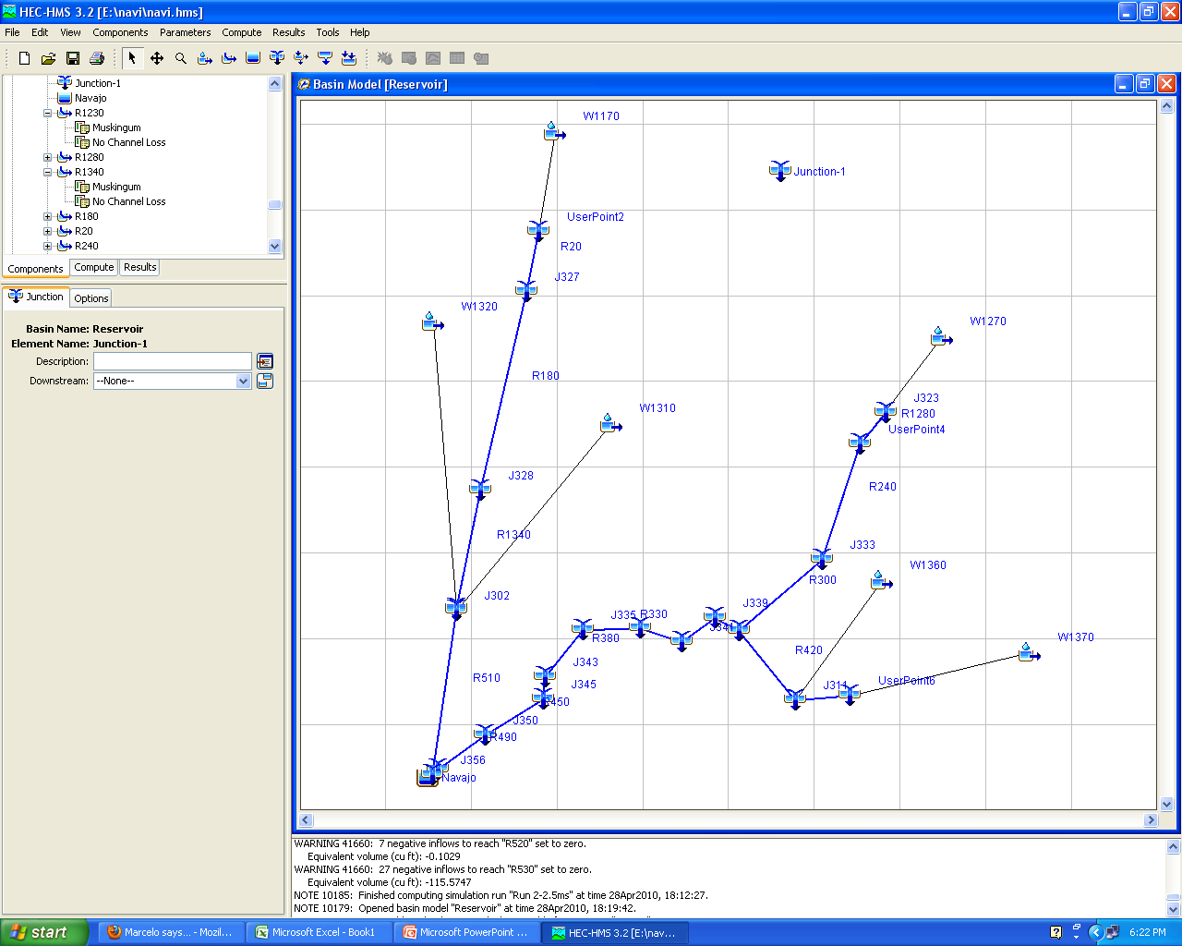
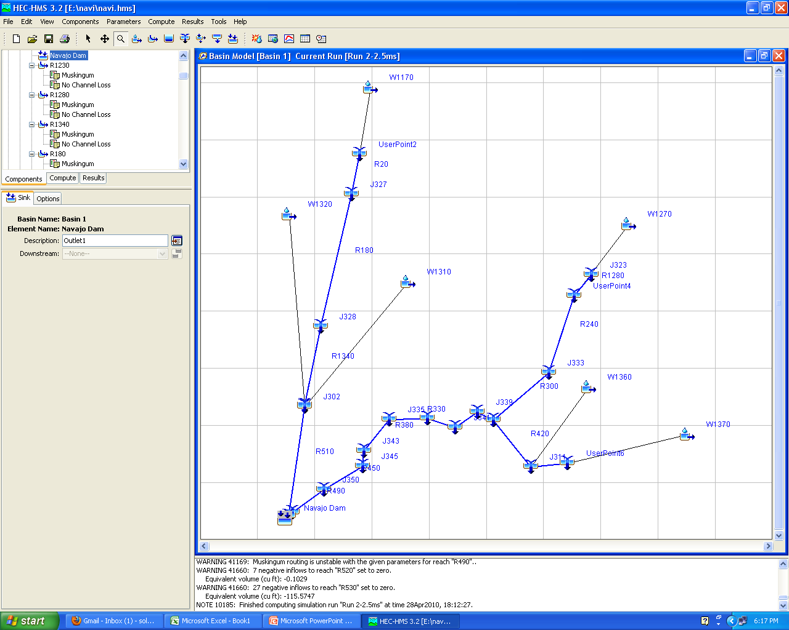

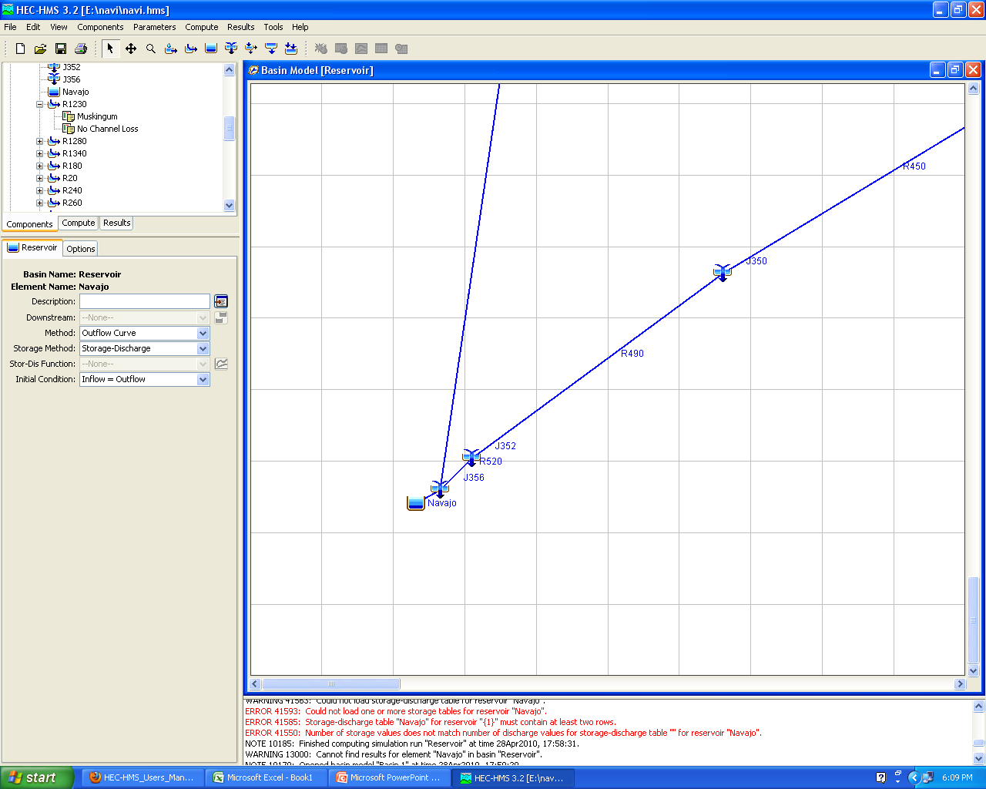
Basin Model Elements
Junction: Combines streamflow from elements located upstream of a junction.
Reach: Convey streamflow in the basin model.
Subbasin: Represent the physical Watershed.
Reservoir: Models the detention or attenuation of a hydrograph.

Slide 8
Calculation Methods and Parameters
Reach
Routing Method
Subbasin
Baseflow Method
X=.2
K=L/V (V=1 ft/s) Loss - Gain Method
Loss Method (CN=60)
Transform Method (lag time calculated by HEC-Geo HMS)
Notes:
Lag time= 60% of time of concentration

Slide 9
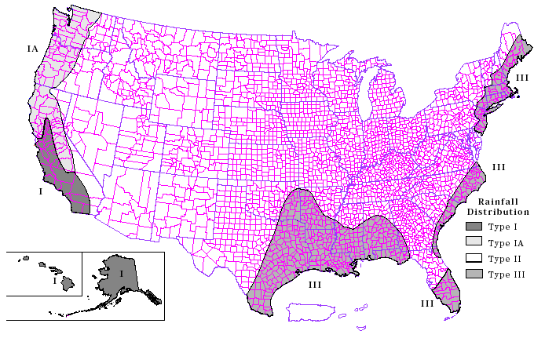
Meteorological Component
SCS Design Storm: rainfall intensities are arranged to maximize the peak runoff for a given total storm depth.
100 year 24 hours rainfall (4 in)
Notes:
The SCS hypothetical storm method implements the four synthetic rainfall distributions developed by the Natural Resources Conservation Service (NRCS) from observed precipitation events. The four distributions correspond to different geographic regions.

Slide 10
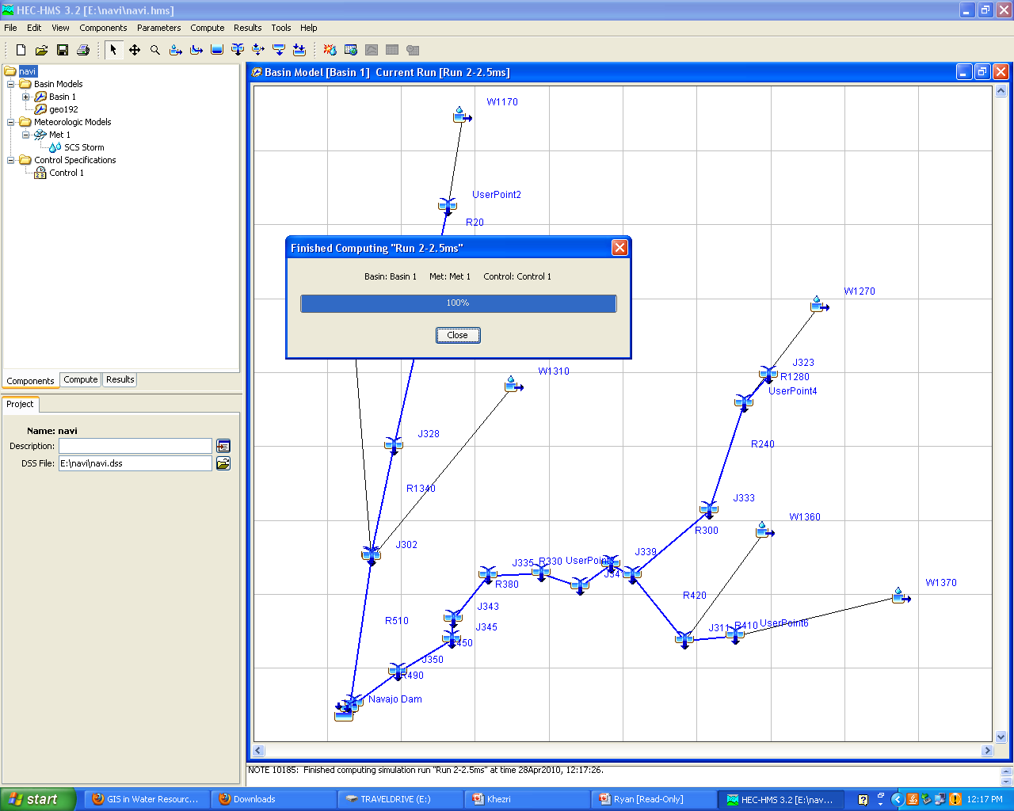
Running HEC-HMS

Slide 11
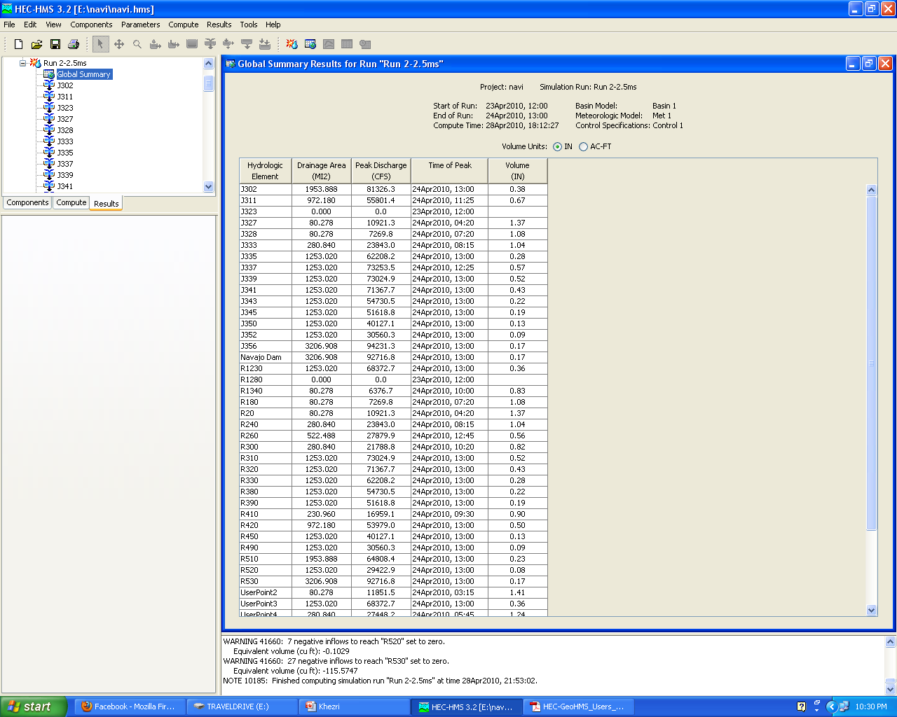
Global Summery Results

Slide 12
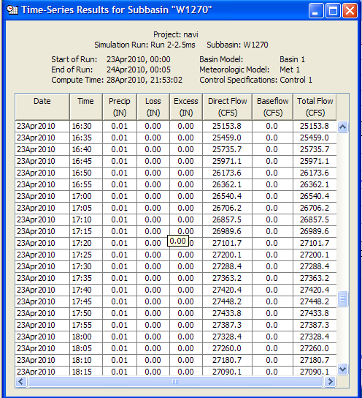
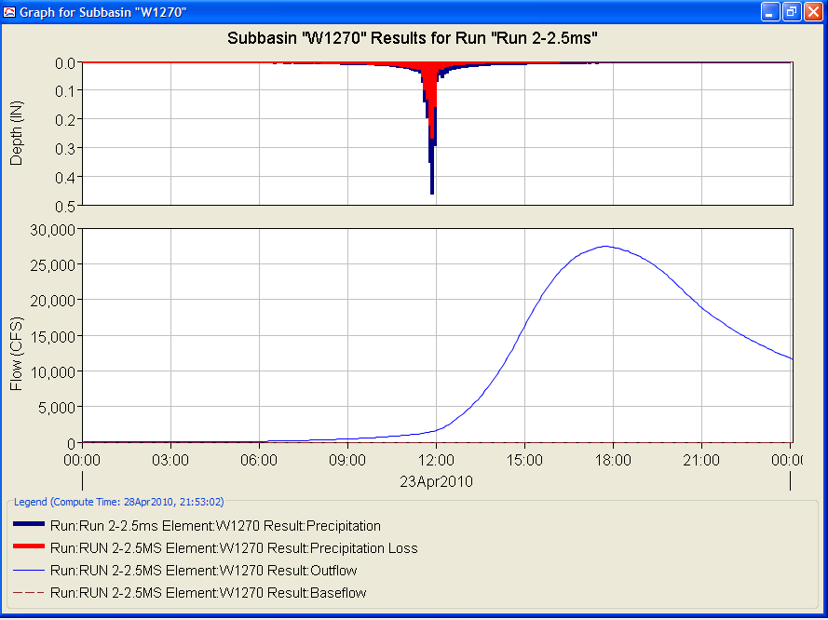
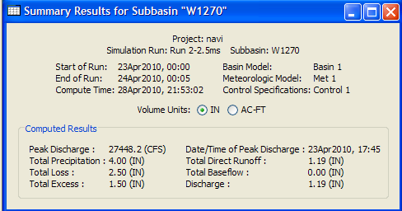
Result for an Element

Slide 13
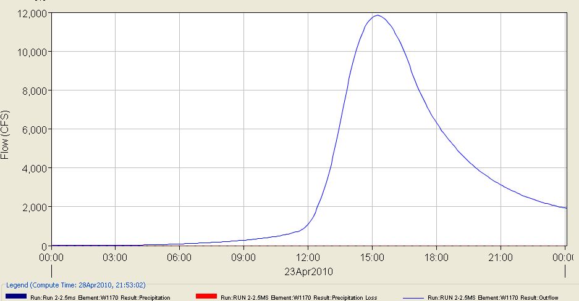
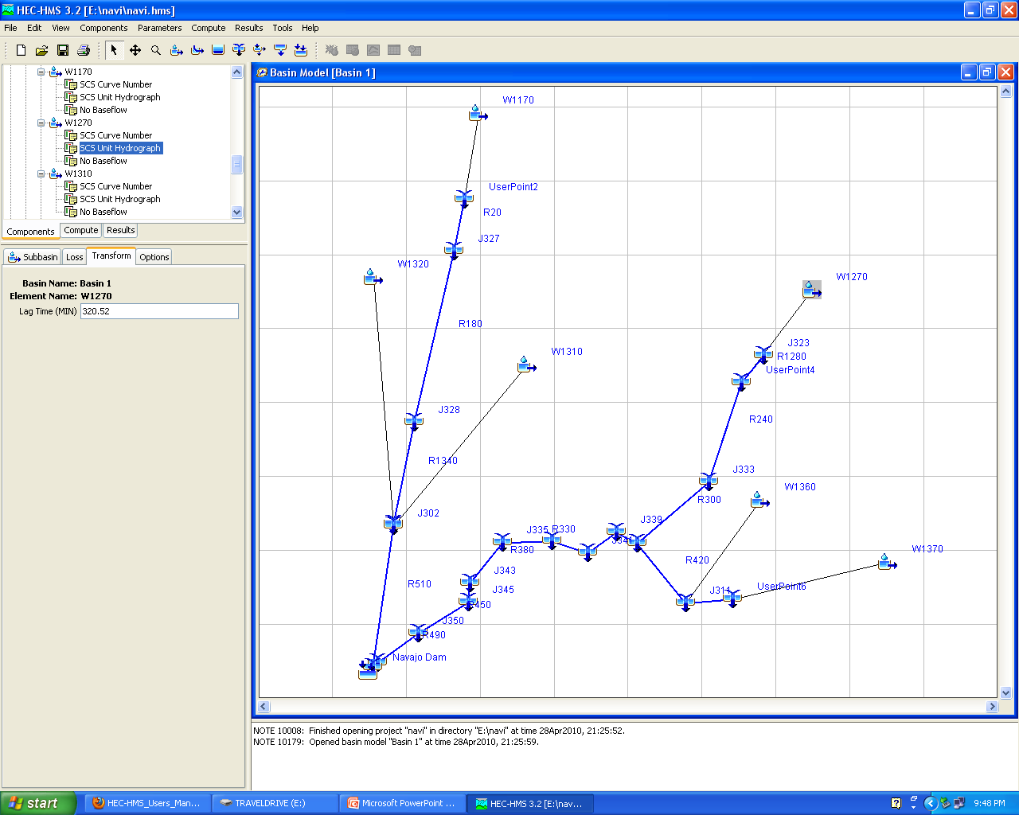
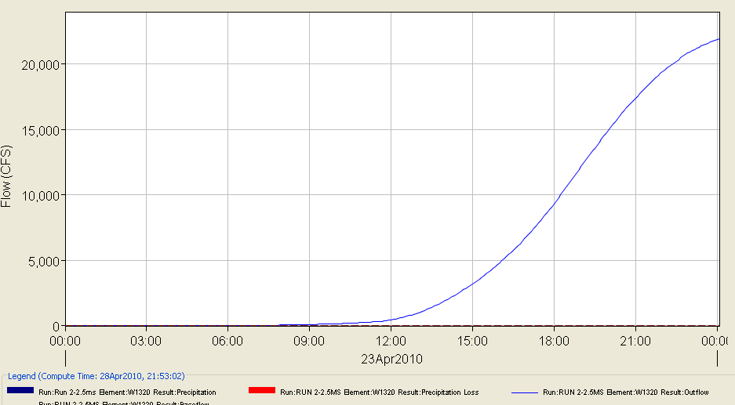
Subbasin Outflow
Lag Time: 442 min
Lag Time:
740 min

Slide 14
Future Work
Run the model for a specific precipitation event
Compare the outflow with the observed streamflow
Write a Report

