Slide 1
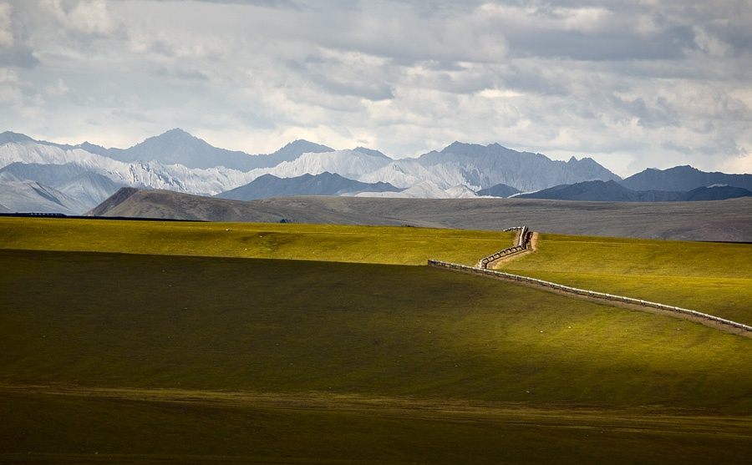
Watershed Delineation and Characteristics on Alaska’s North Slope
Matt Khosh
University of Texas at Austin
Department of Marne Science

Slide 2
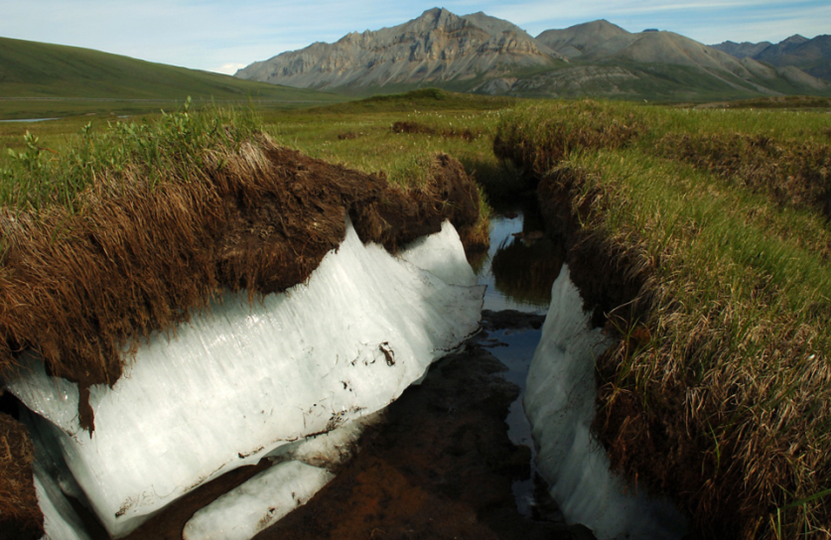
Arctic Ecosystems
Prevailing cold and wet climate promotes long-term storage of atmospheric CO₂
Large pools of stored organic matter
In the context of climate change…???
CH₄
CO₂
N₂o

Slide 3
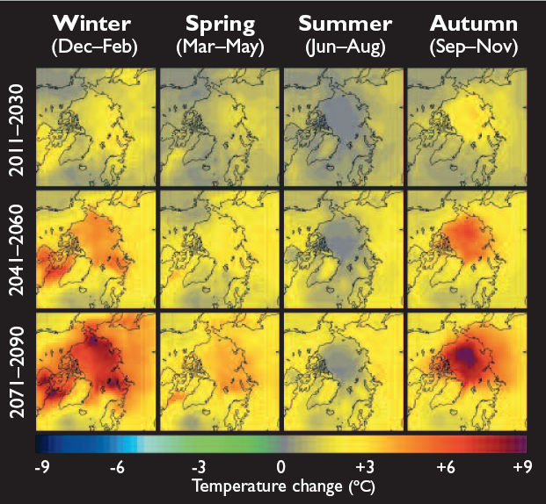
Climate Change

Slide 4
Climate Change

Slide 5
Arctic Rivers
High amounts of organic matter
DOM (dissolved organic matter)
Carbon and Nitrogen
Sites of Biogeochemical transformations
Organic matter conduits
System loss pathways
Organic matter dynamics and how it will be affected ???

Slide 6
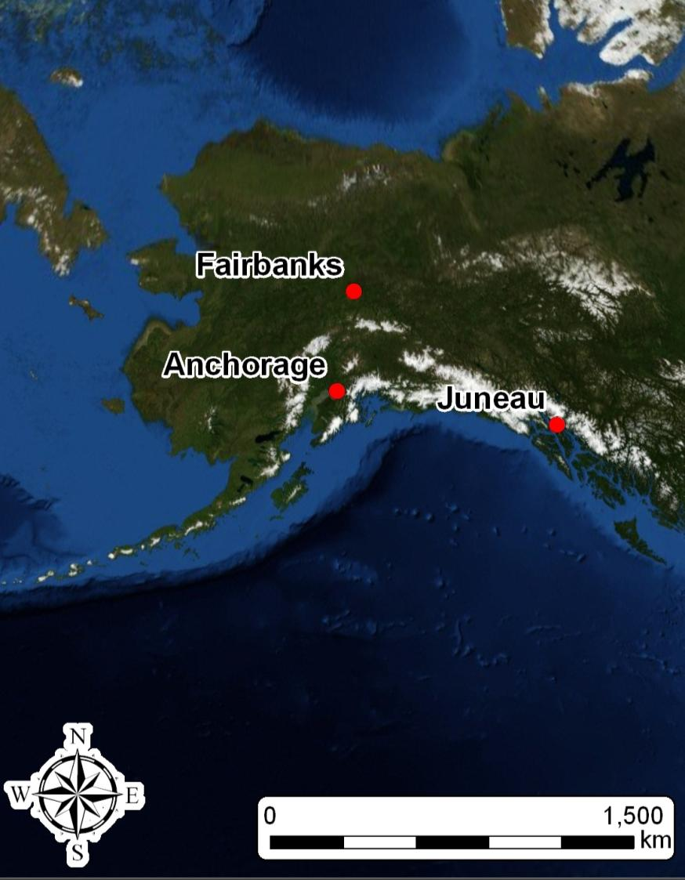
Study Area
“North Slope”
Above the Arctic Circle
Soil frozen most of the year
“active layer”

Slide 7
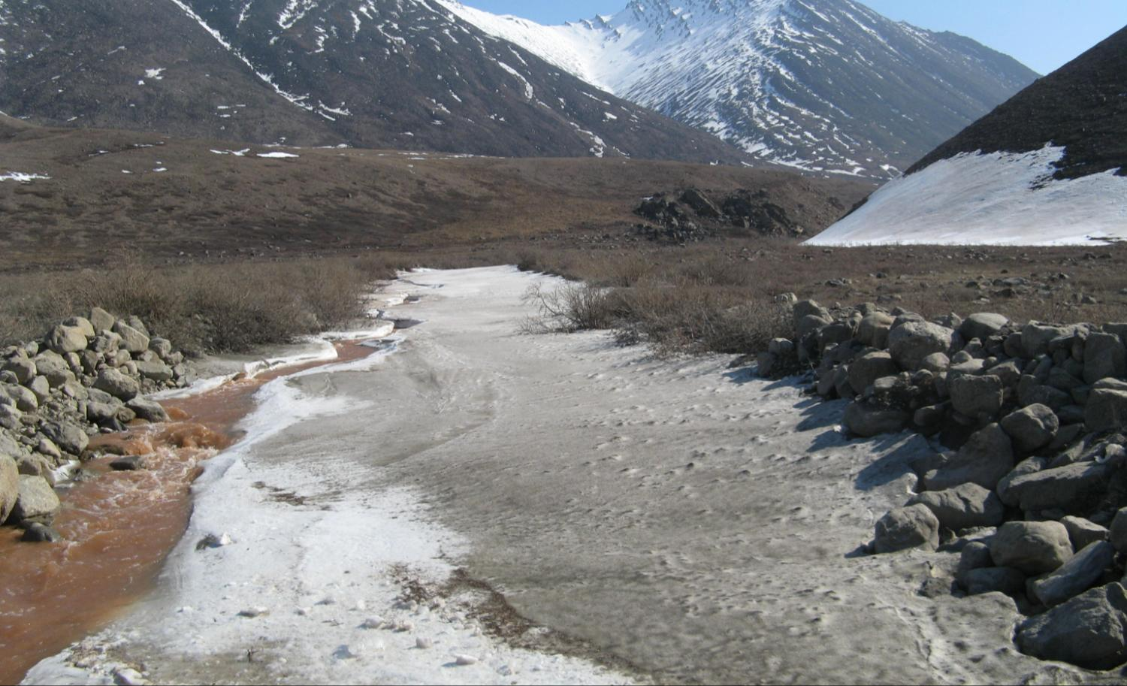
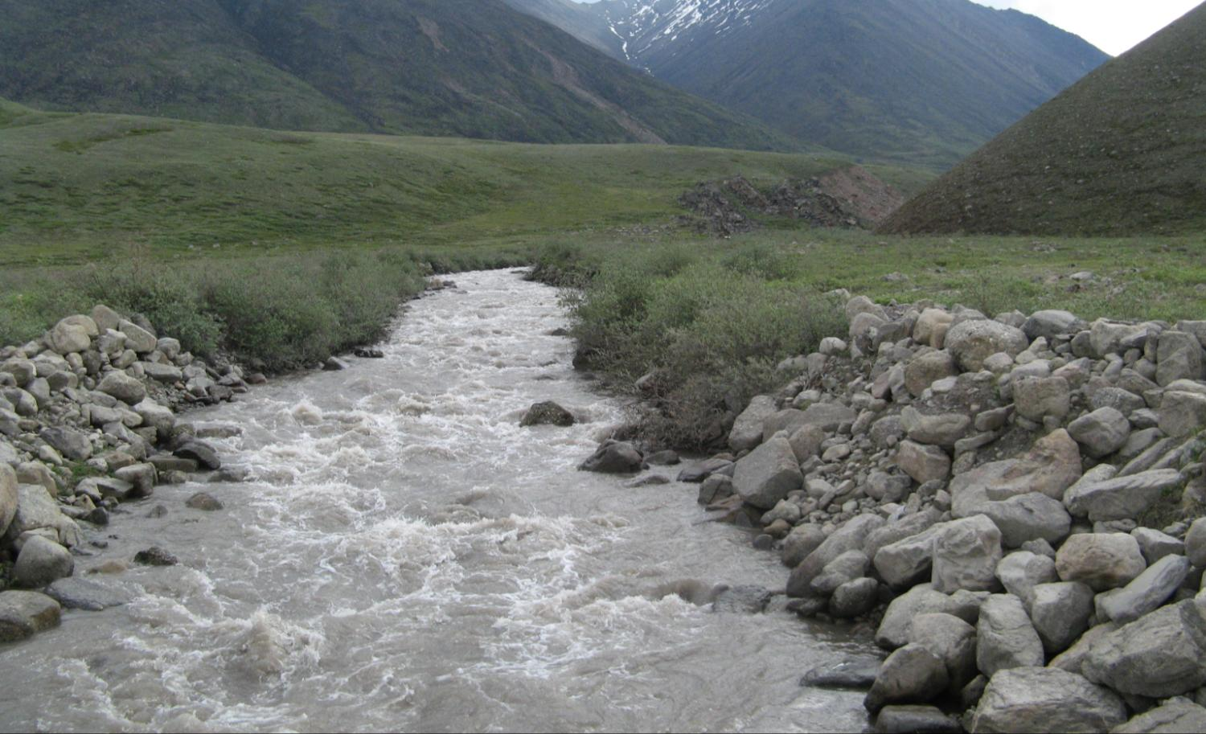
Arctic Rivers
5/21/2009
6/18/2009

Slide 8
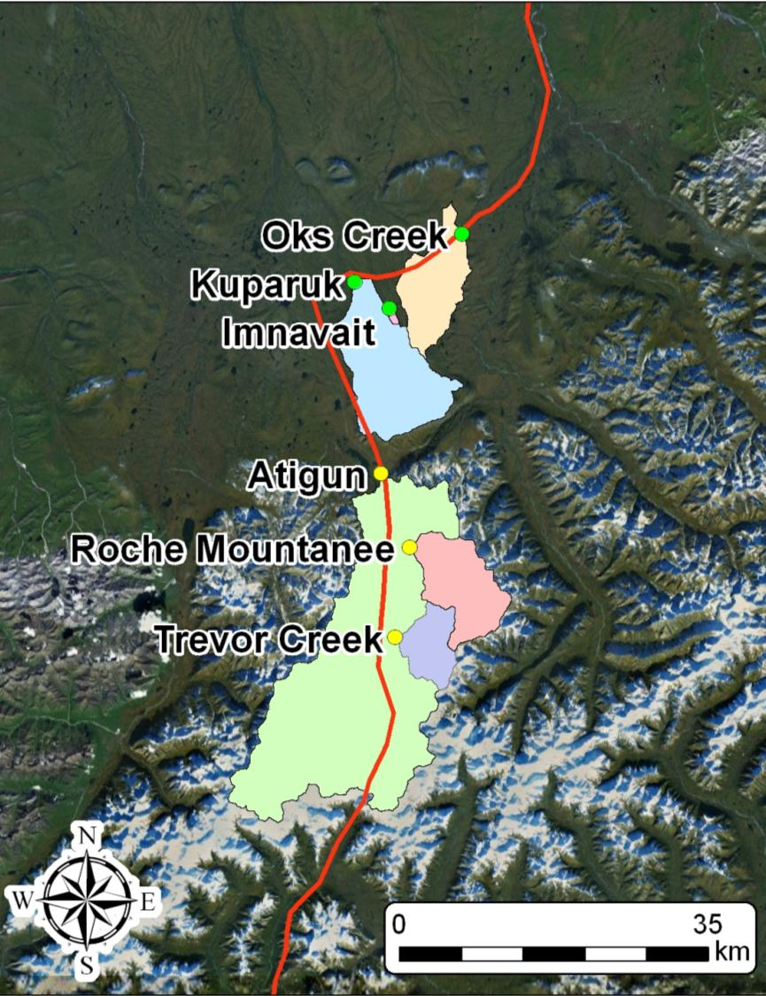
Study Area
Sampling Sites
3 Mountain
3 Tundra
Watershed area ?

Slide 9
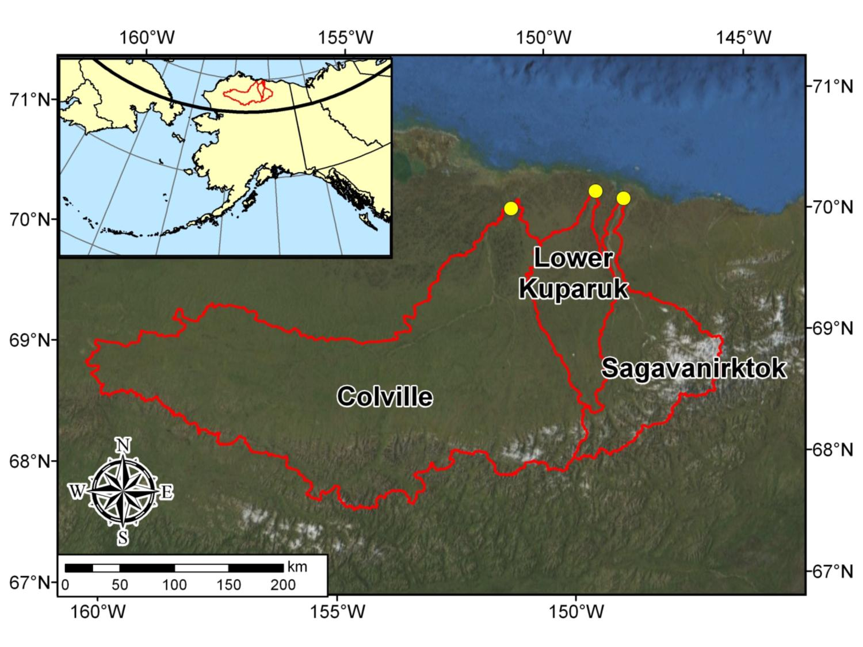
Study Sites

Slide 10
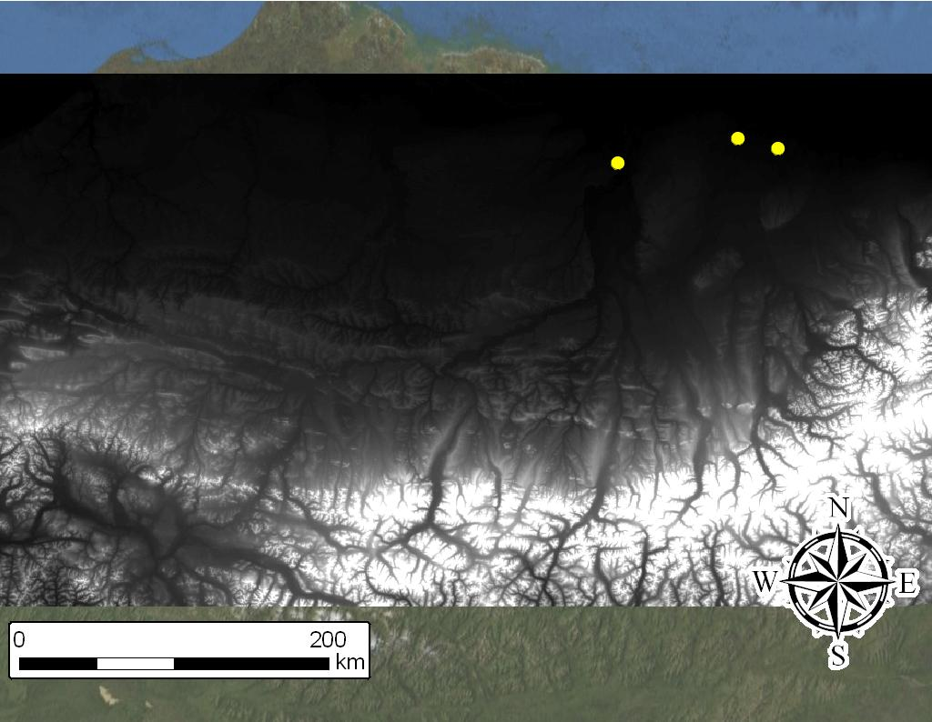
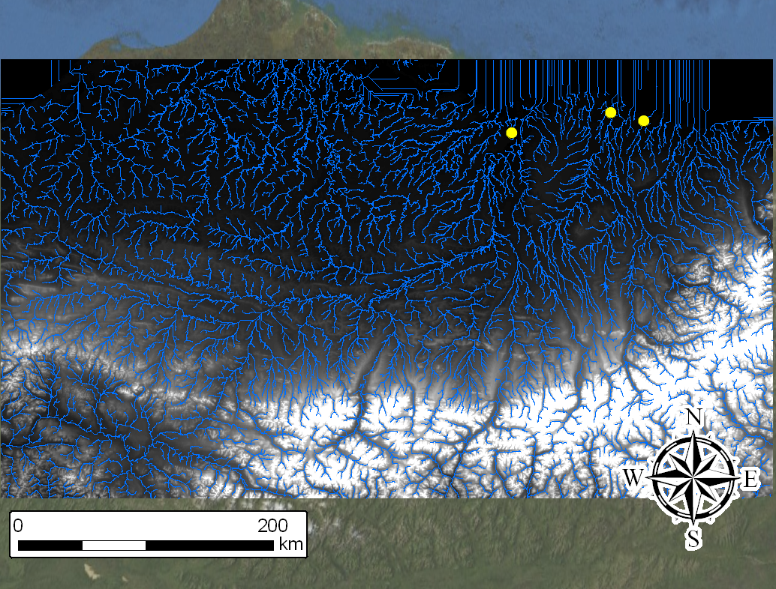
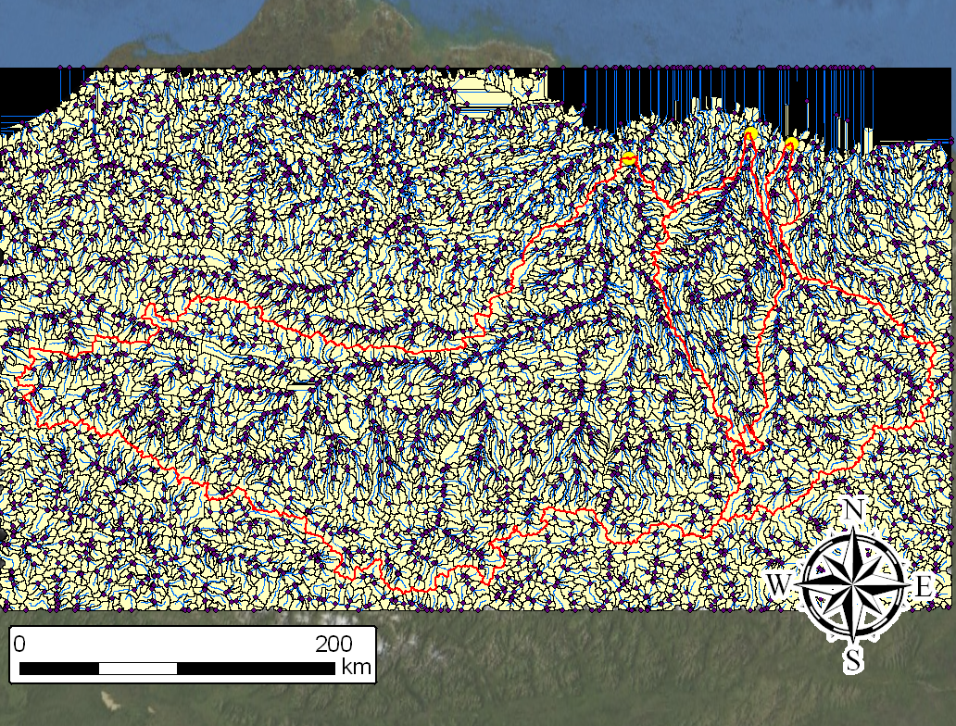
DEM approx. 40m x 40m
Stream delineation value = 5000 cells

Slide 11
100m DEM
Stream delineation = 1500

Slide 12
 | Area (km²)
Site | 40m 5000 FAC | 100m 1500 FAC | % difference
Colville | 58,587 | 58,728 | -0.24%
Kuparuk | 8,884 | 8,811 | 0.82%
Sagavanirktok | 12,679 | 12,592 | 0.69%

Slide 13
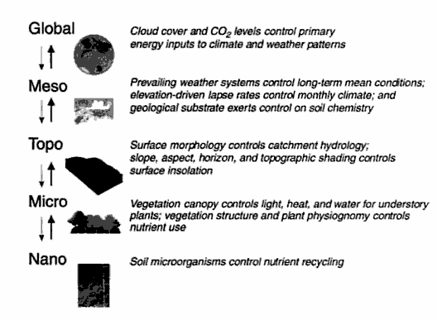
Mackey (1996)

Slide 14
Watershed Attributes
Topographic Primary Attributes
Computed directly from the DEM
Slope
Aspect
Plan and profile curvature
Flow path length
Upslope contributing area
Flow direction

Slide 16
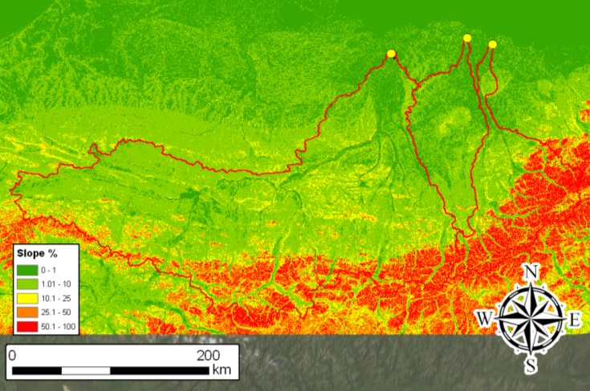

Slide 19
Watershed Attributes
Secondary/Compound Attributes
Computed from a combination of primary attributes
Physically based or empirically derived indices
Characterize landscape spatial variability of specific processes

Slide 20
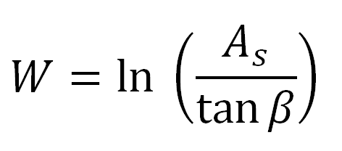
Topographic Wetness
Effects of topography on the location and size of saturated areas and areas of runoff generation
Surface saturation zones
Soil water content
Delineate vegetation
As = specific catchment area (m)
[Upslope contributing area/cell width]
Β = slope gradient

Slide 21
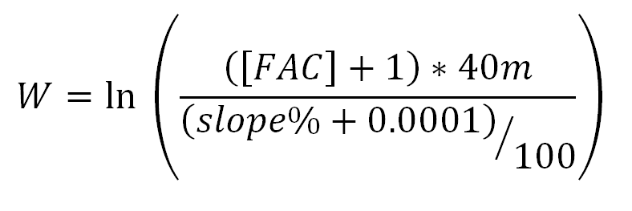
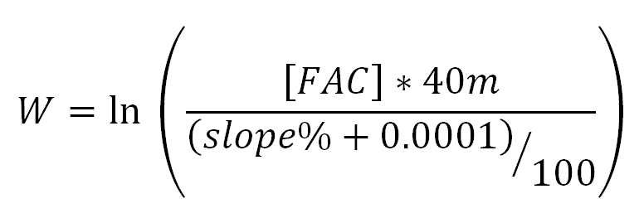
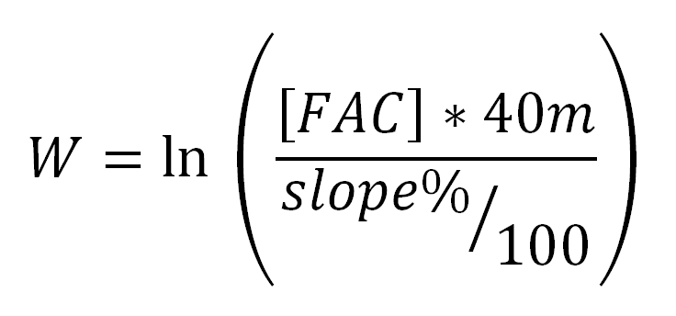

Slide 22
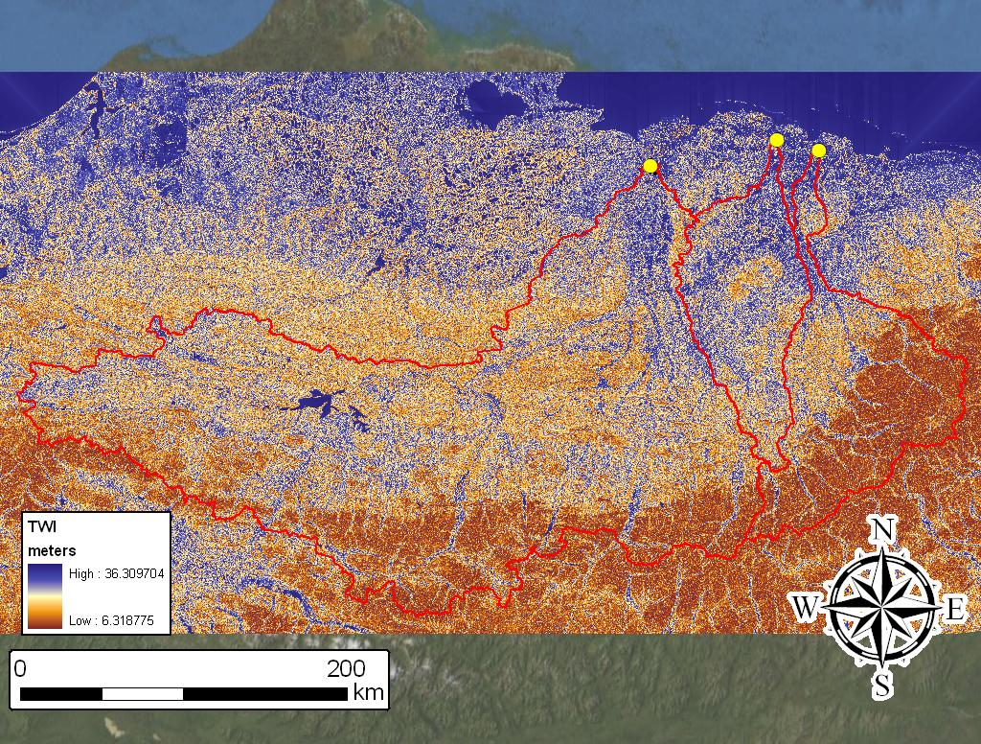

Slide 23
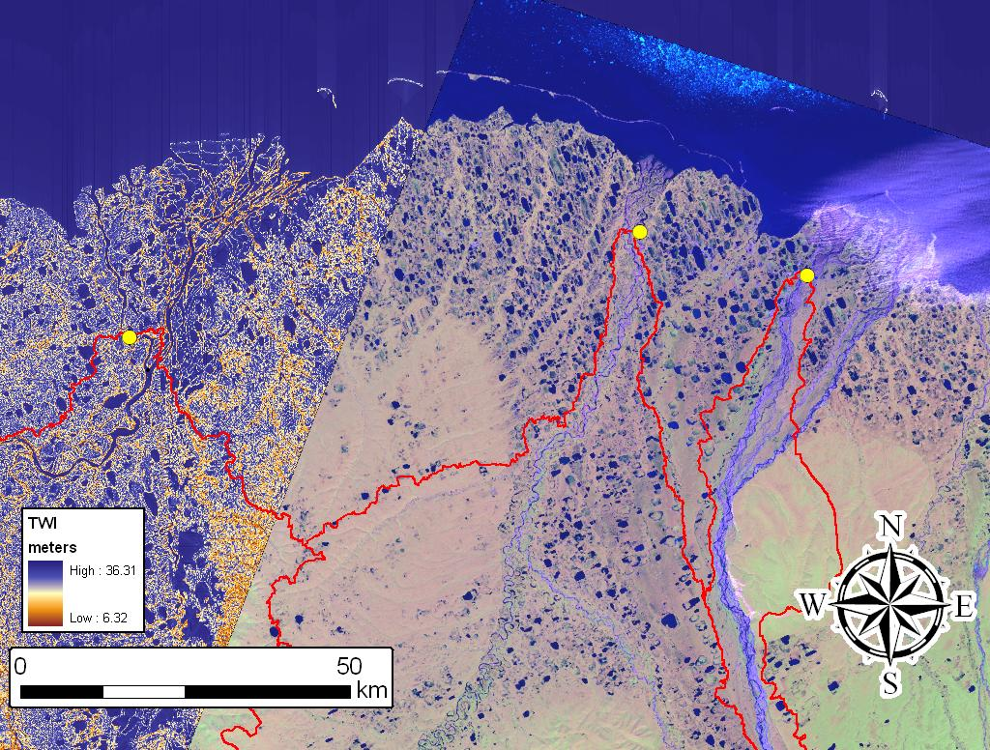

Slide 24
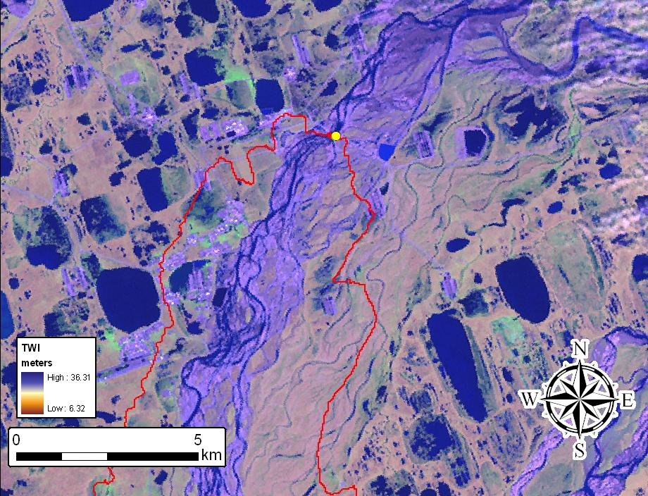

Slide 25
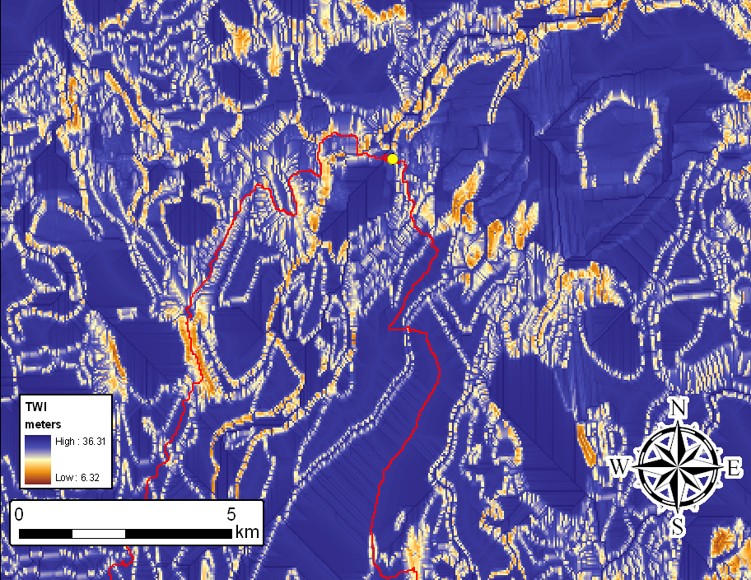

Slide 26
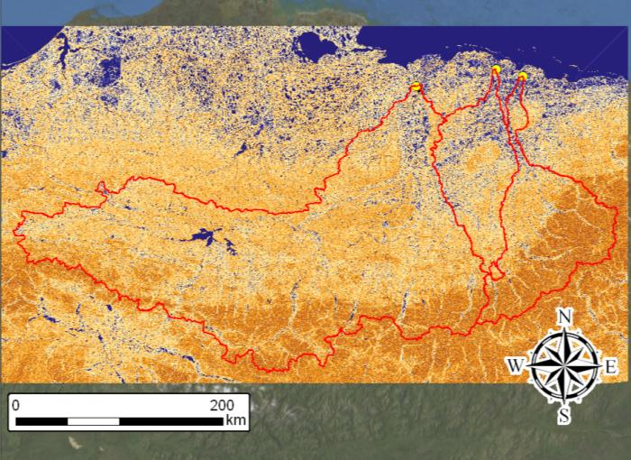

Slide 27
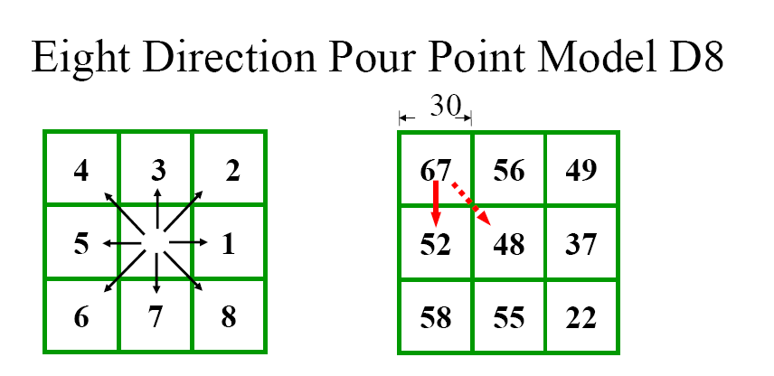
Upslope Contributing Area

Slide 28
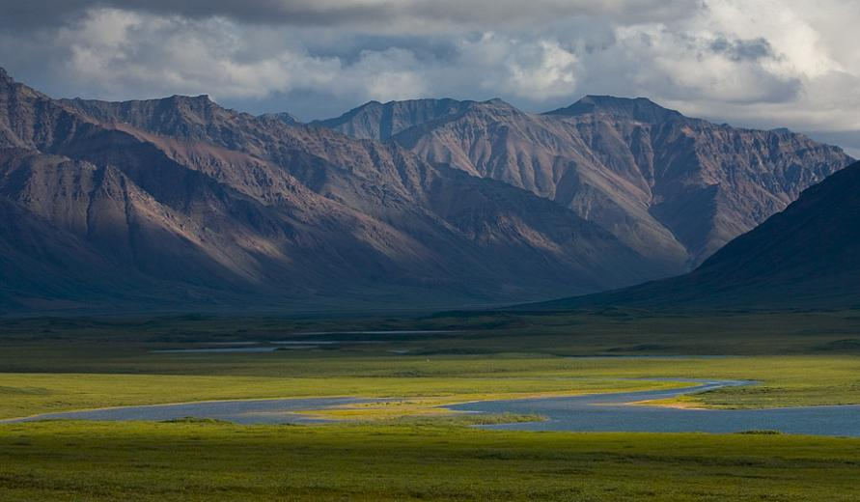
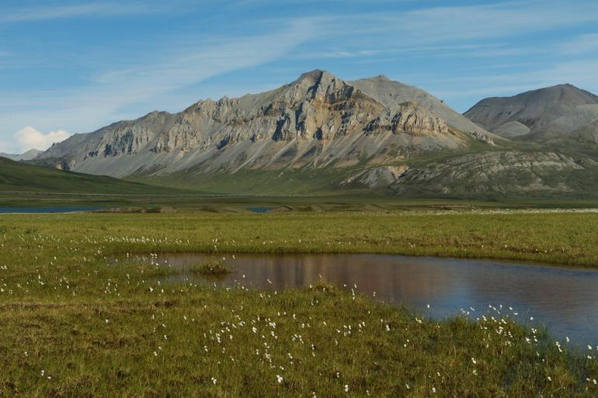
Future Work…
Calculate TWI using the D-infinity model
Land-cover type distribution
Permafrost extent and or active layer depth index

Slide 29
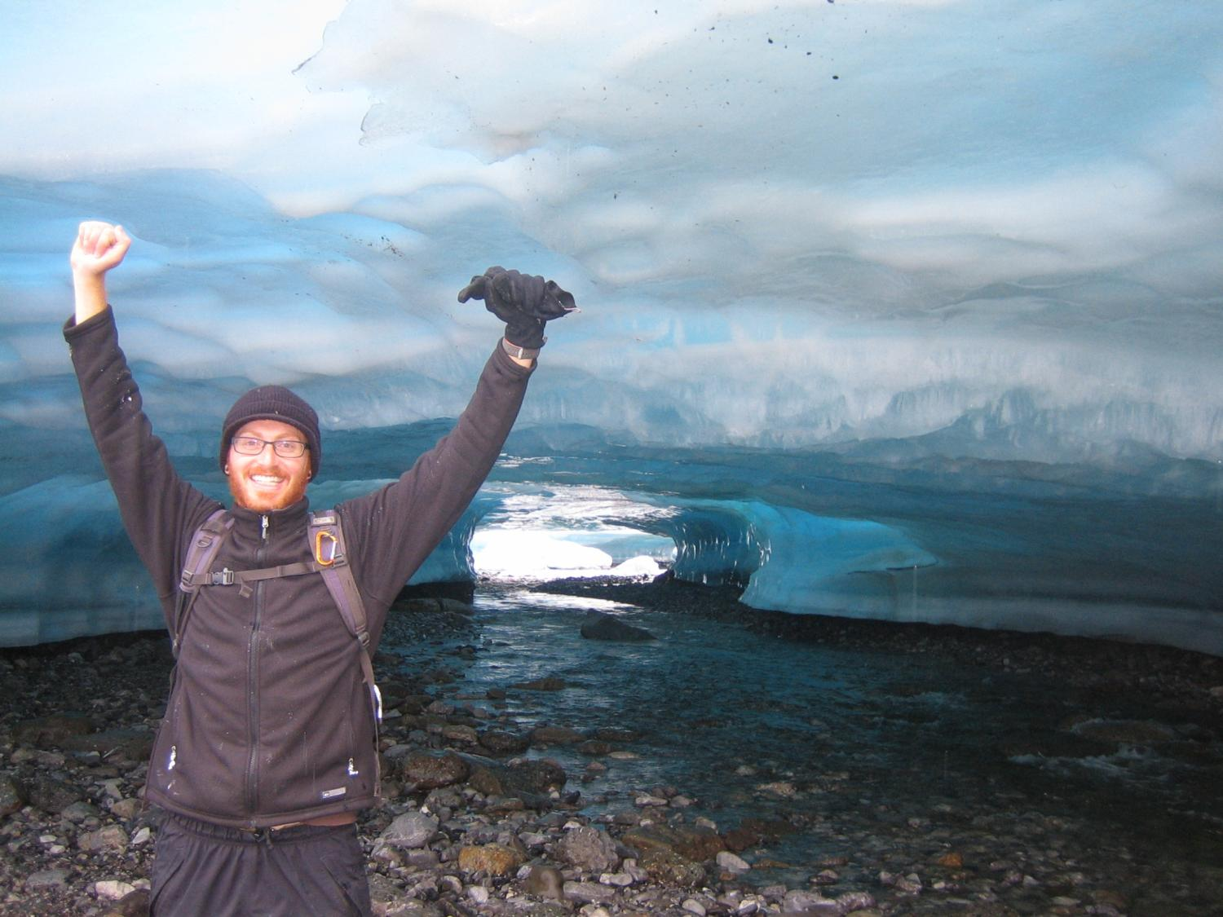
Questions ???

