Slide 1
Drought Frequency Analysis in Tlamacazapa, Guerrero, Mexico
Robin Lynch
Hydrology
April 29,2010

Slide 2
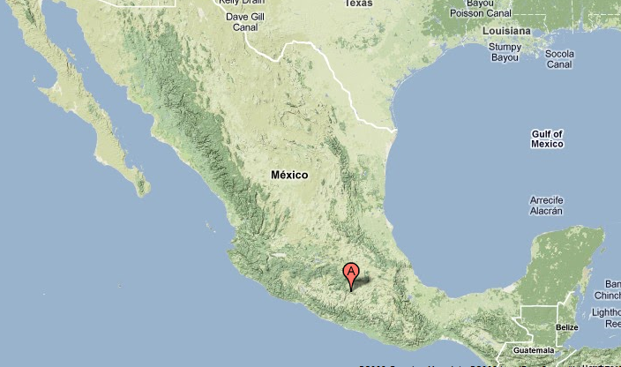
Tlamacazapa, Guerrero
Remote mountain village
Extreme poverty
Water scarcity
Reliant on wells contaminated with arsenic
Source: Google Maps

Slide 3
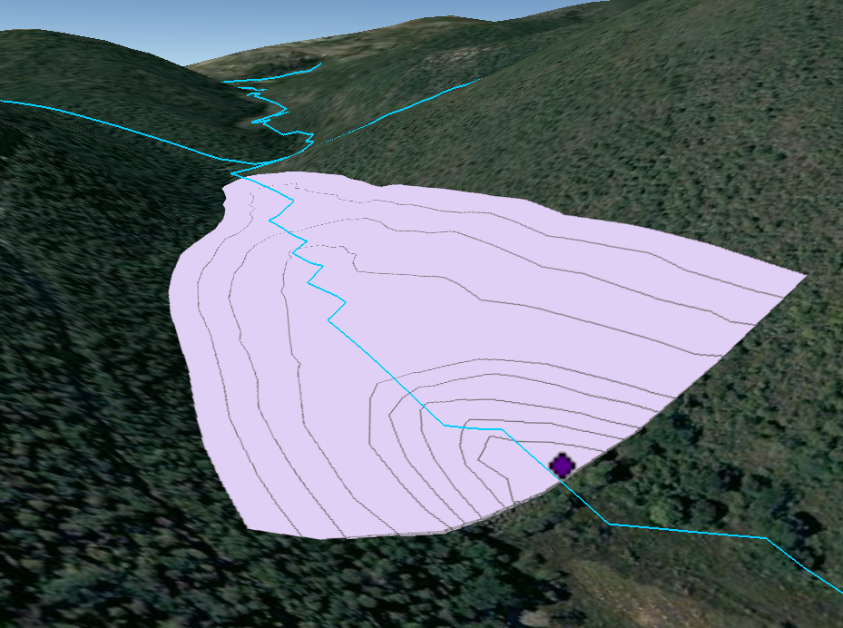
Previous Work
Concluded:
  Year round piped water possible…but
  Needs 10 meter high dam downstream
Source: Google Earth

Slide 4
Assumptions:
Only used average rainfall between 2003-2007
Doesn’t take into account long term variability!

Slide 5
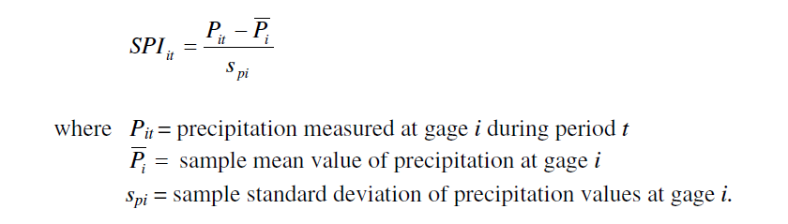
Drought Frequency Analysis
Determine how impacted Tlamcazapa is by droughts
Use SPI (Standardized Precipitation Index)
Assumes data is normally distributed
Source: (Hallack-Algeria 2005)

Slide 6
Instituto Mexicano de Technologia del Agua (IMTA)
16 gaging stations
Within 25 kilometer radius of Tlama
Rainfall data between 1940-1998
Inconsistent years in each station

Slide 7
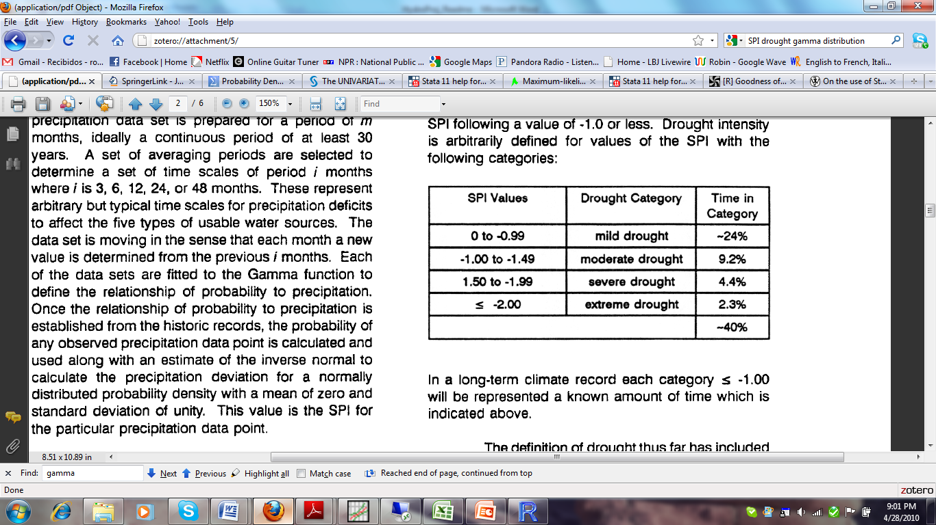
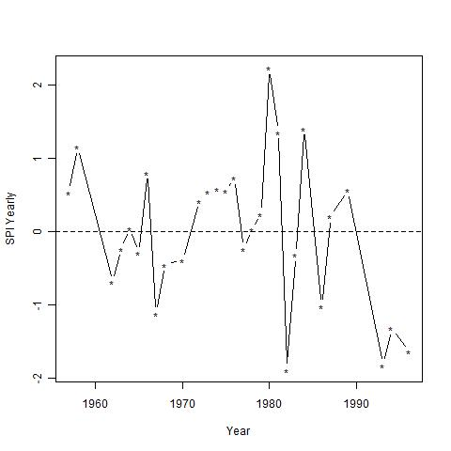
First station
Source:
(McKee et al. 1993)

Slide 8
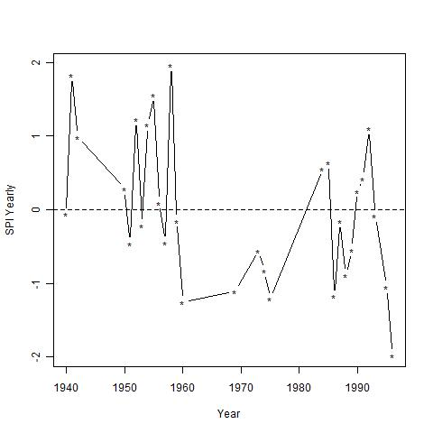
Second Station
Whoa!!!

Slide 9
Theissen Polygons
Cannot take average of SPI per year
Each gage’s SPI thrown off due to incomplete time span
Must use Theissen Polygons to choose Nearest Neighbor
For years when closest gage has no data, use nearest neighbor “hot decking” imputation procedure

Slide 10
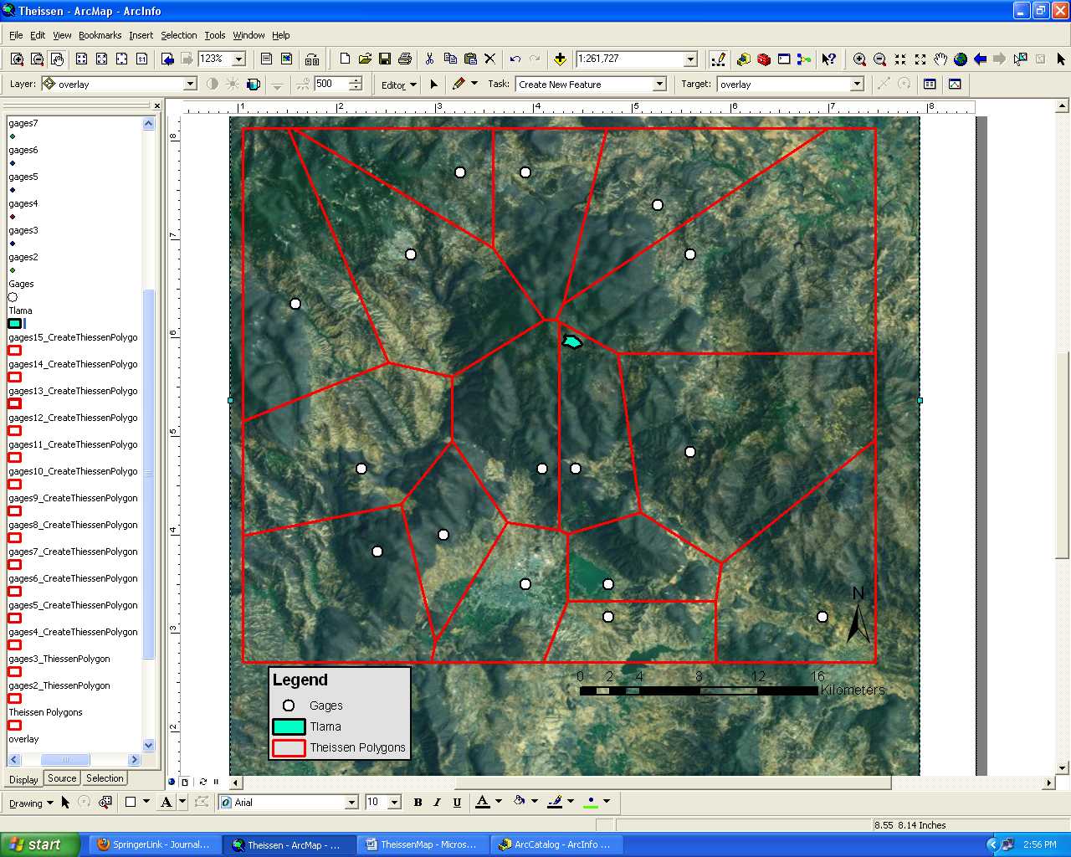

Slide 11
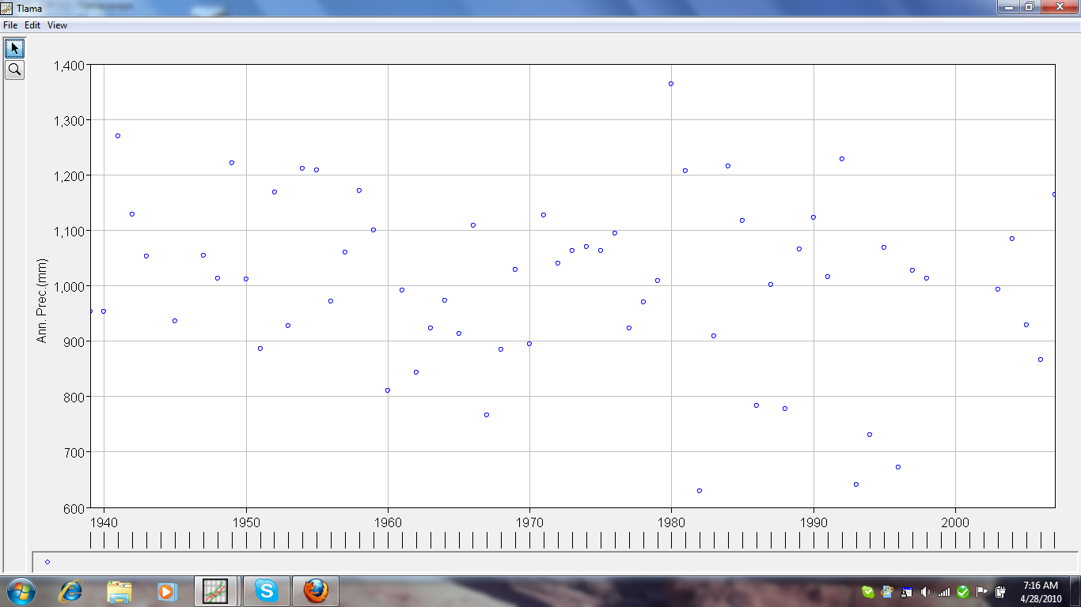
60+ years of Data!
Data from 1940-2007
(1944,1946,1999-2002 missing)

Slide 12
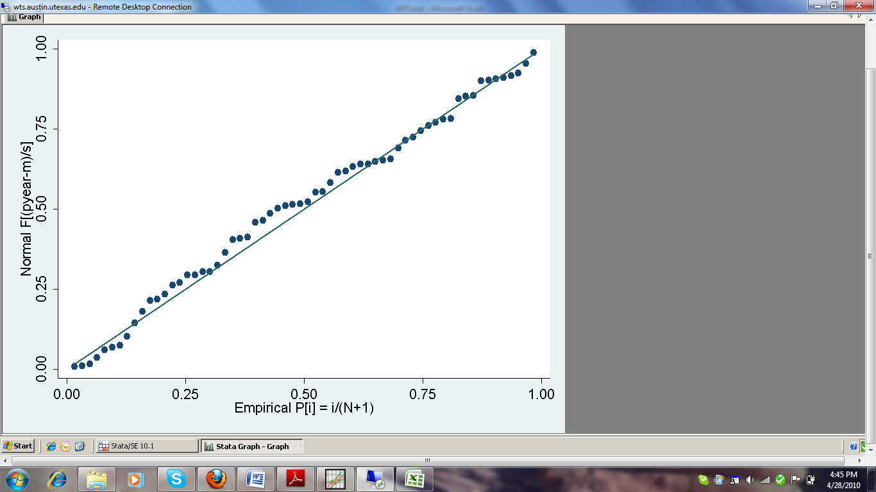
Check for Normality

Slide 13
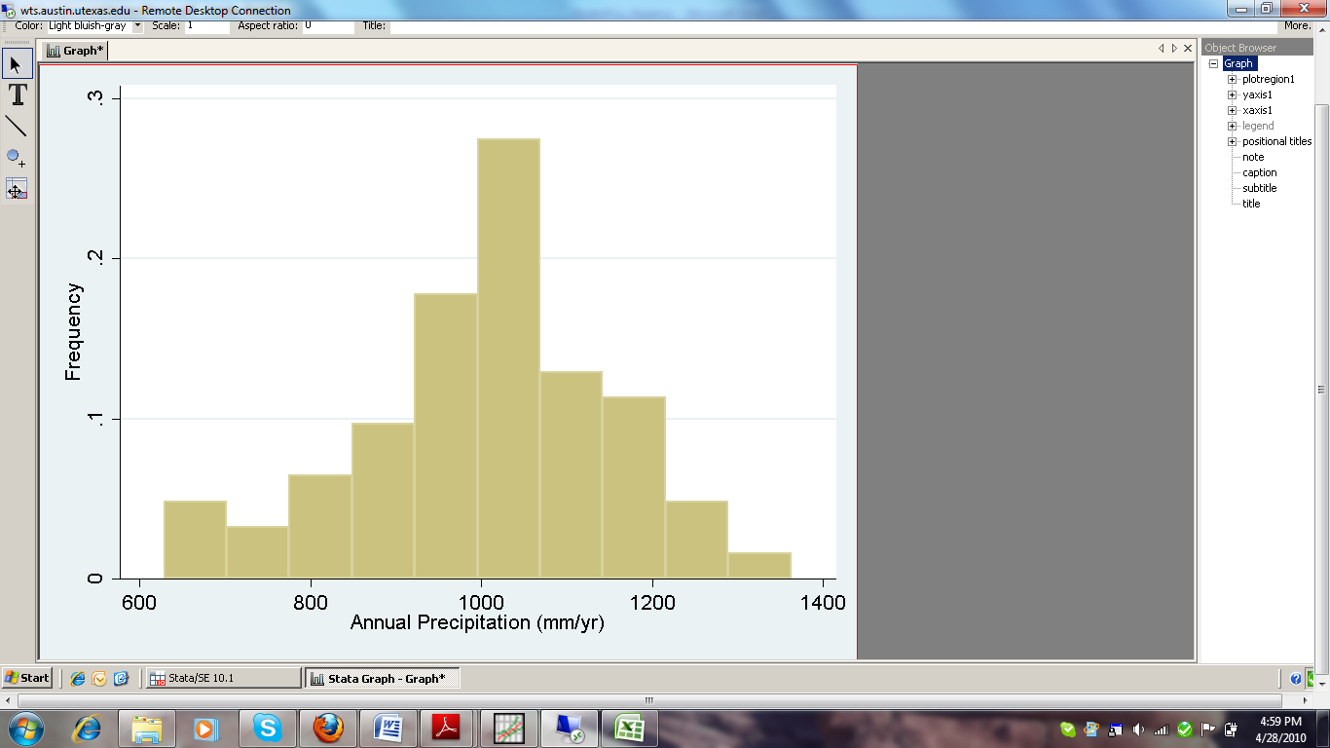
…It’s Kinda Normal

Slide 14
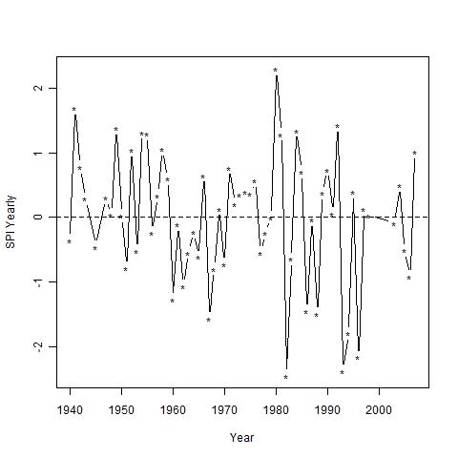
SPI Values for Tlama: 1940-2007

Slide 15
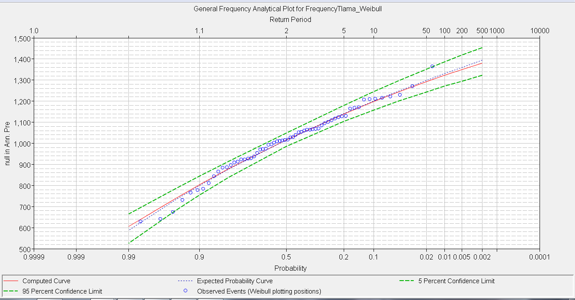
HEC-SSP
Only looks at probability of exceedence

Slide 16
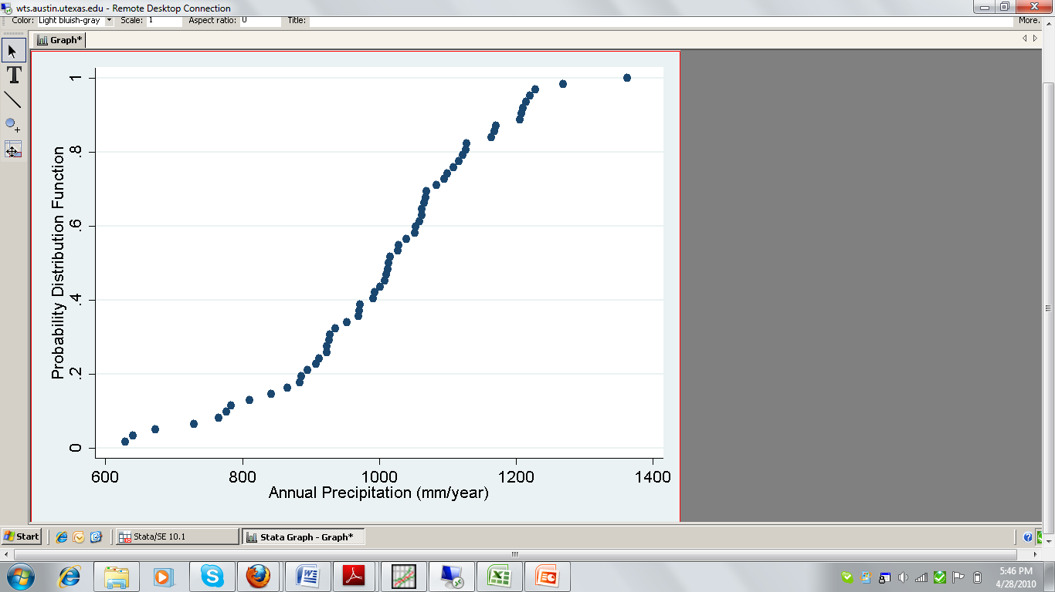
Probability Distribution Function

Slide 17
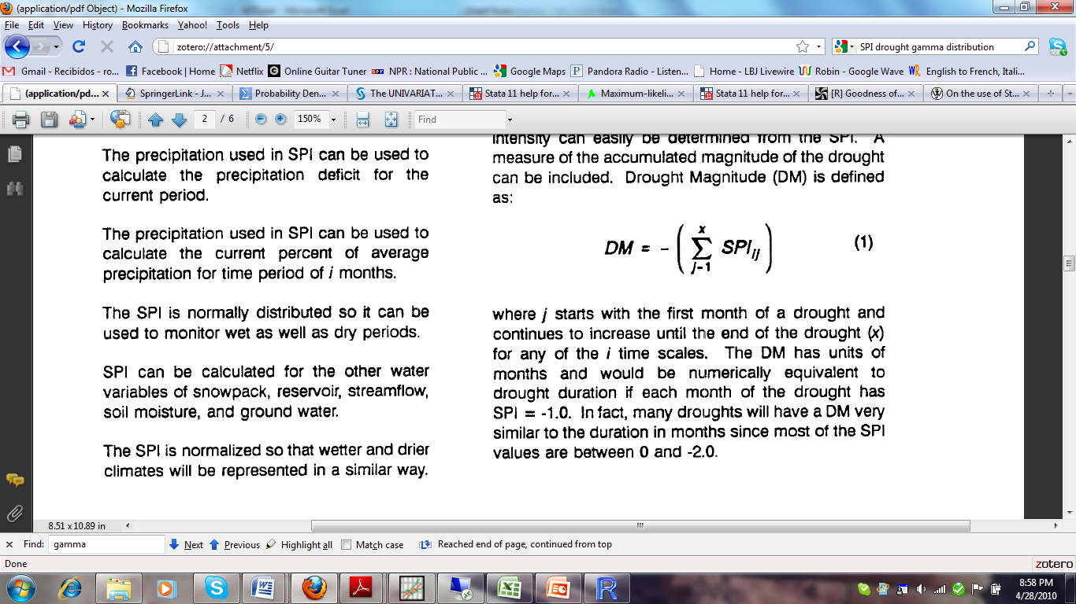
Drought Magnitude
Source: (McKee et al. 1993)

Slide 18
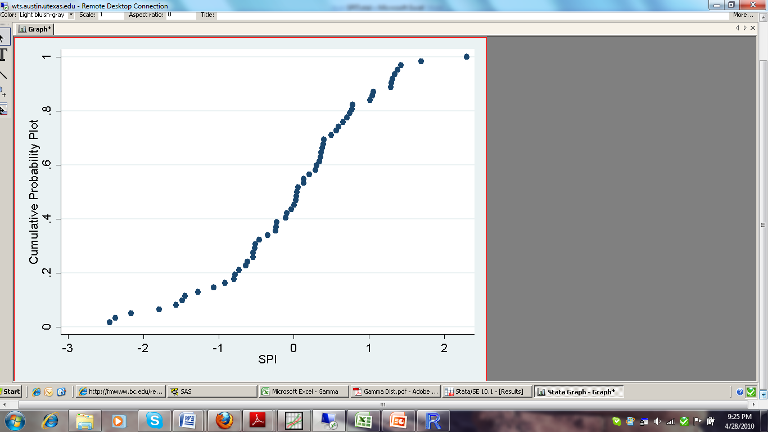
Recurrence Probability
P(SPI<0) = 0.5
P(SPI<-1)= 0.15
P(SPI<-1.5)= 0.1

Slide 19
Drought Frequency of Tlama

Slide 20
Future Work
Statistical regression to see the relationship between drought and arsenic levels
Make recommendations for reservoir planning using this drought frequency analysis

