Slide 1
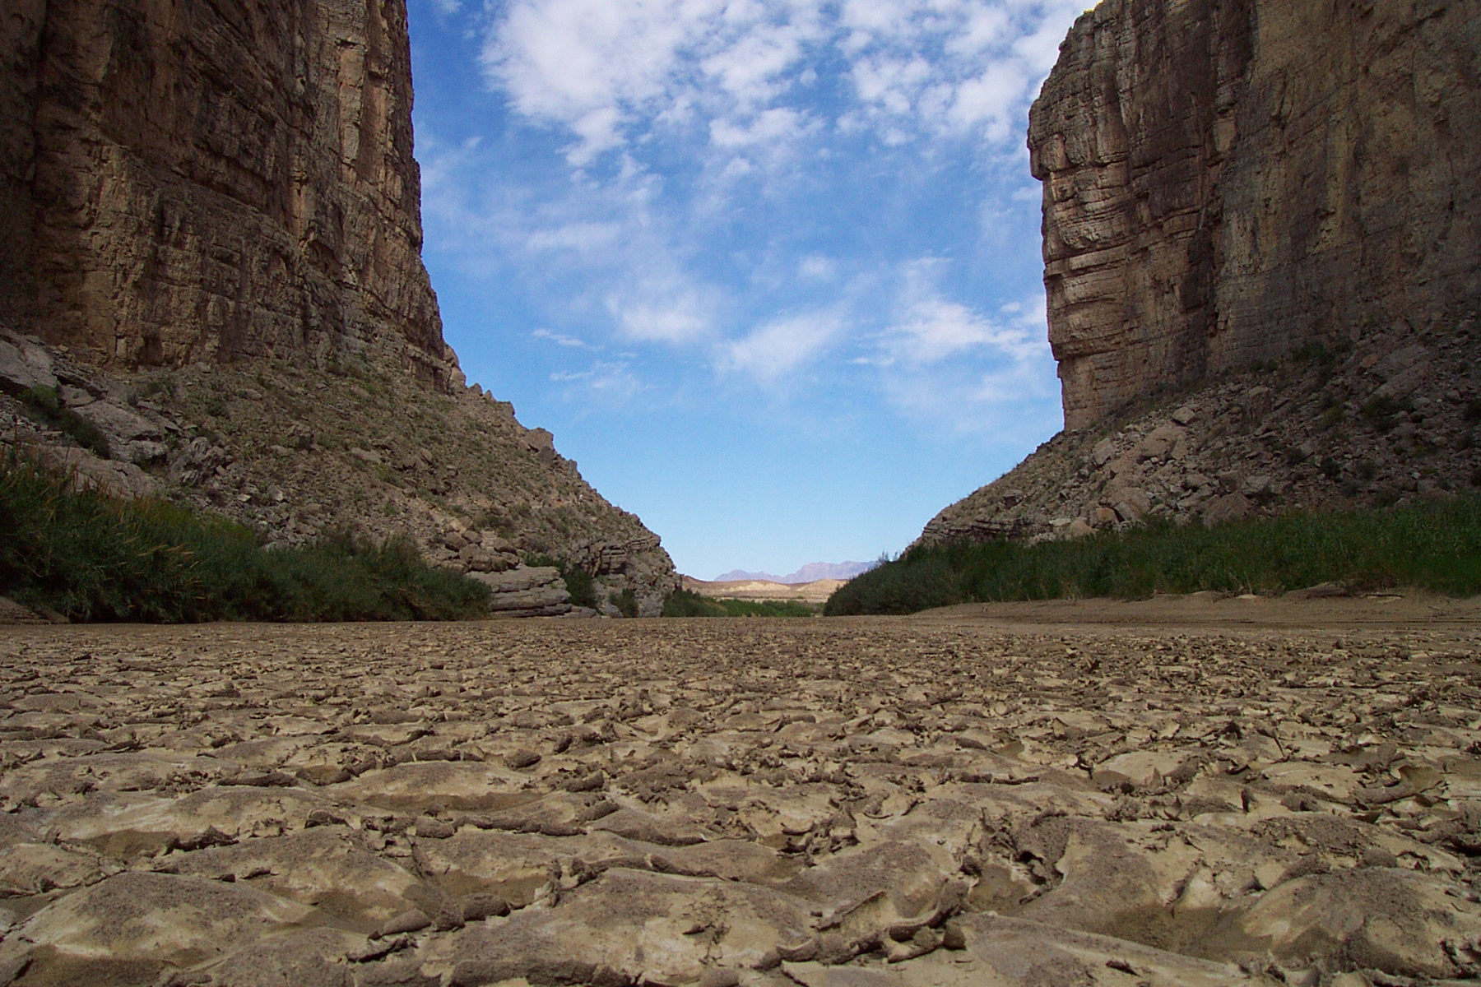
Forging into the Forgotten River
…and perhaps forgetting it once again
Laura Read
April 29, 2010
Dr. David Maidment

Slide 2
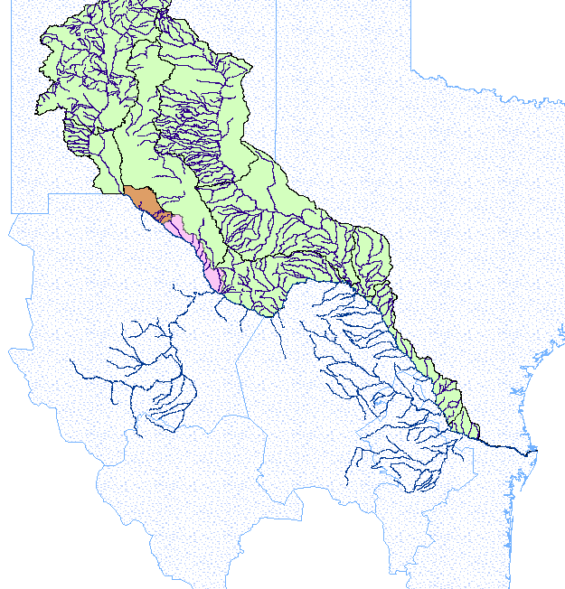
Basic Basin
Background
70 Catchments
Trans-boundary Waters
336,000 sq mile area

Slide 3
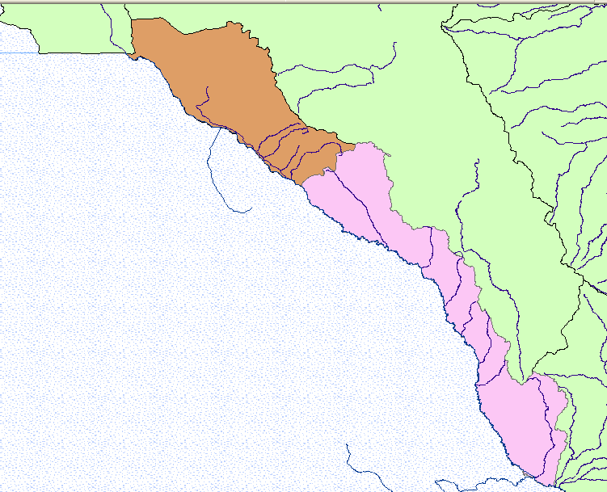
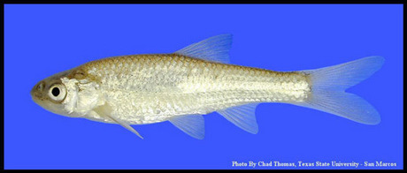
A Closer Look:
Big Bend will expand into an International Park
Population skyrocket
If we think this is dry…
Fishes find friends

Slide 4
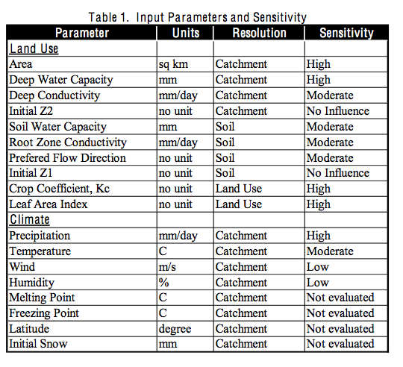
Scheming up a schemata
WEAP

Slide 5
Data Collection
Variables
Climate
Land/Soil
Climate Data
Land use and Soil Data
NARR Data (32 km) in netCDF files
Monthly averages for 30 years:
  Precipitation
  Temperature
  Relative humidity
  U-wind speed
Land Data Assimilation Systems (L-DAS) by NASA
Near real-time data of land surface model parameters
  Land use
  Land cover
  Soil type
  Also available: greenness factor and elevation data

Slide 6
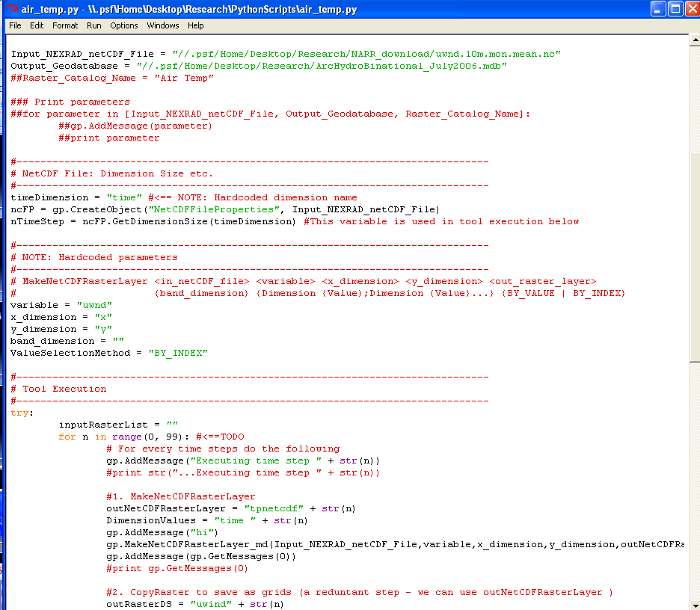
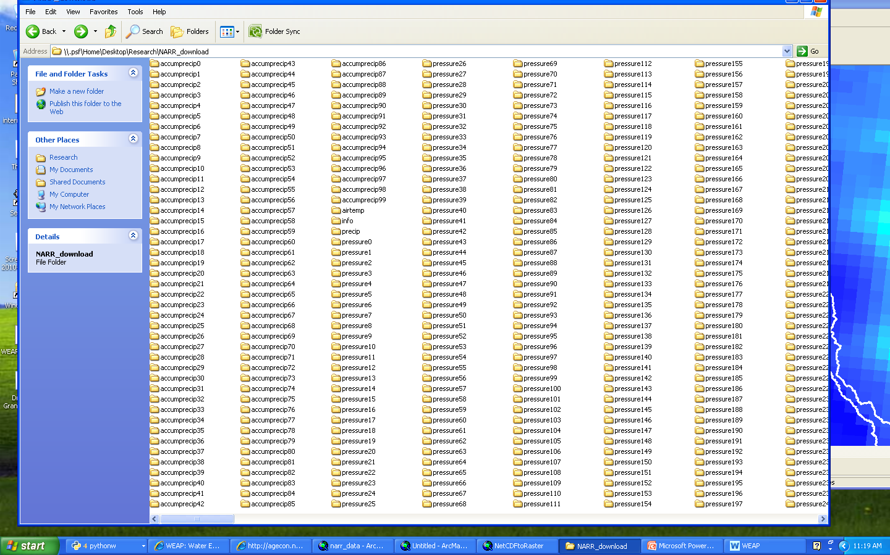
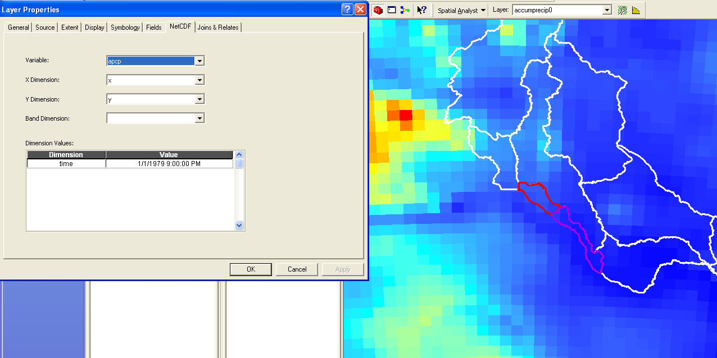
Decoding the data
Data Merge
netCDF to raster
Zonal statistics

Slide 7
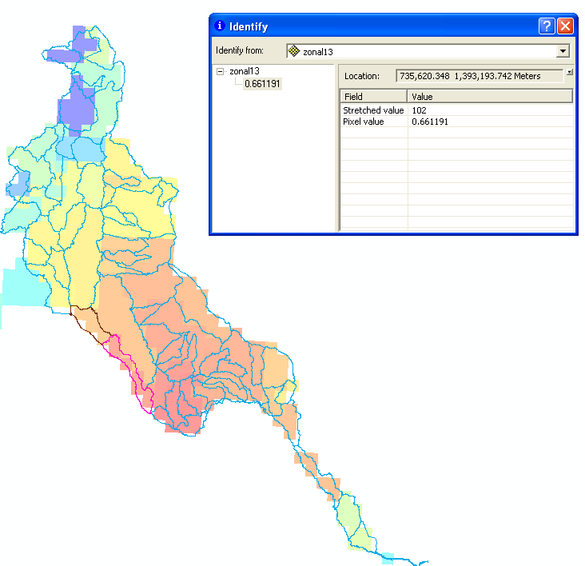
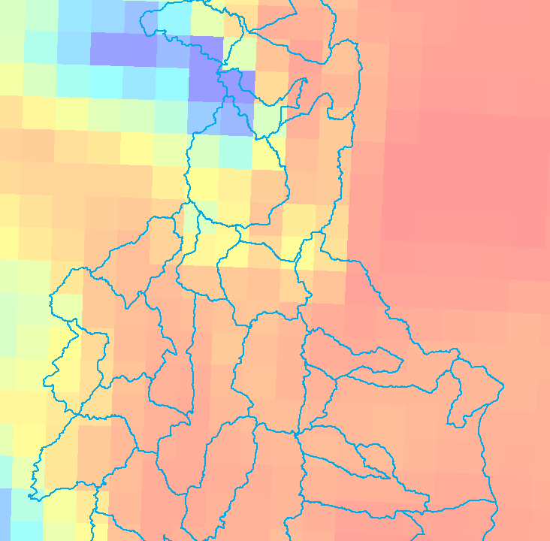
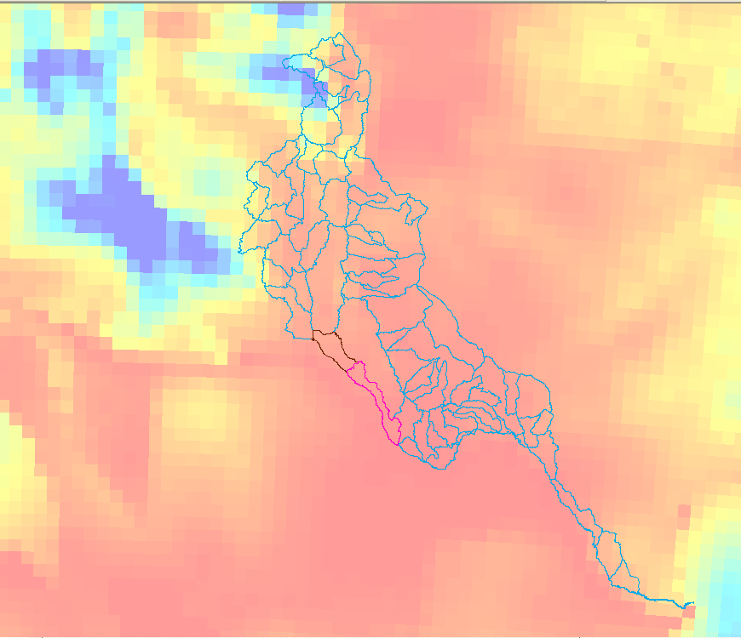
Decode part II
Data Merge
netCDF to raster
Zonal statistics
ASCII to raster
Notes:
January, 1980 precipitation

Slide 8
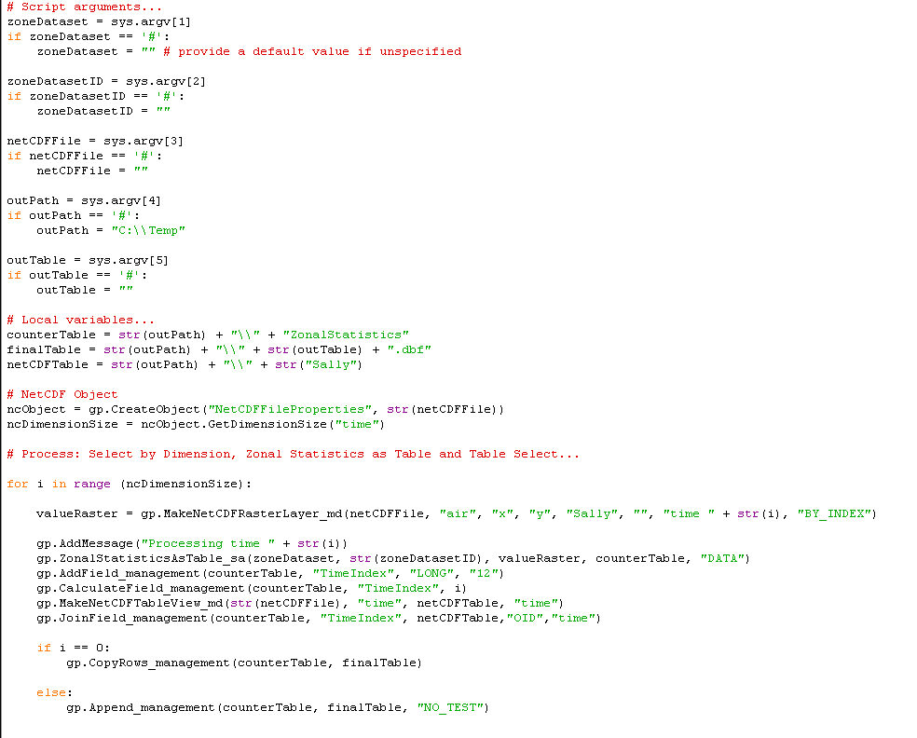
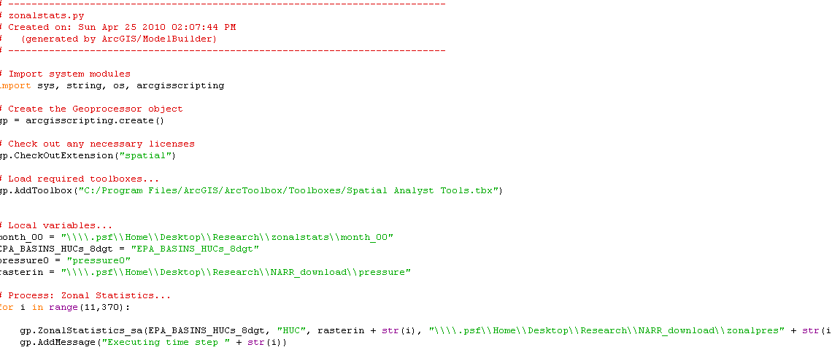
Zoning in
Data Merge
netCDF to raster
Zonal statistics
ASCII to raster

Slide 9
Results of Zonal Statistics: Climate

Slide 10
30 Years, Precipitation, Basin

Slide 11
Forgotten River, 30 Years, Rain

Slide 12
Upstream and Downstream

Slide 13
Data Collection
Variables
Climate
Land/Soil
Land use and Soil Data
Land Data Assimilation Systems (L-DAS) by NASA
Near real-time data of land surface model parameters
  Land use
  Land cover
  Soil type
  Also available: greenness factor and elevation data

Slide 14
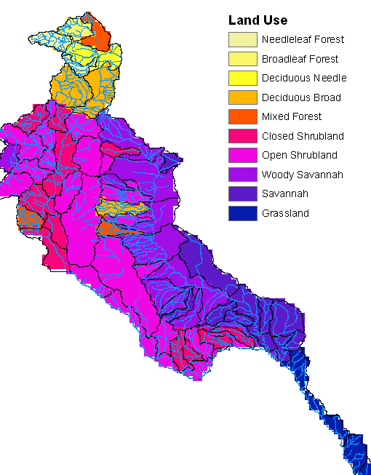
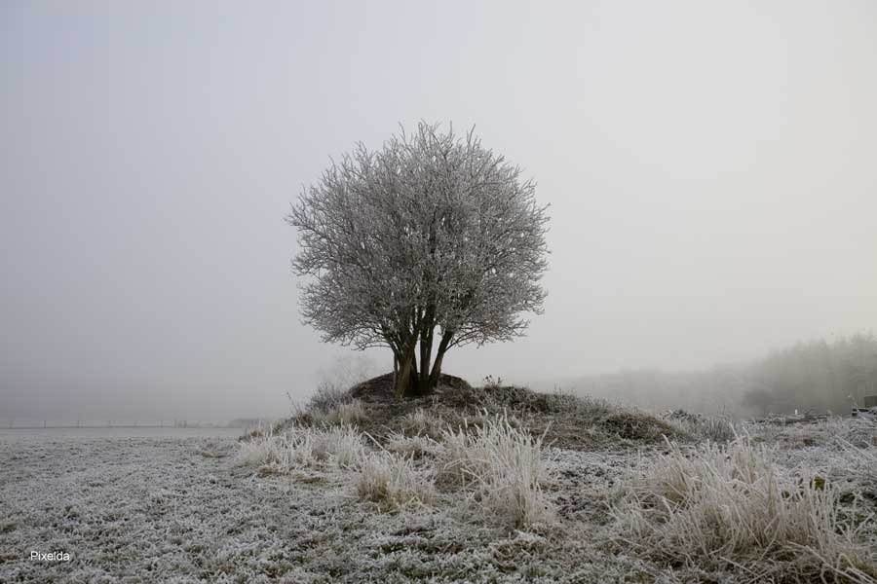
Land Use
Northern Basin is completely different
Open shrub land where water is absent

Slide 15
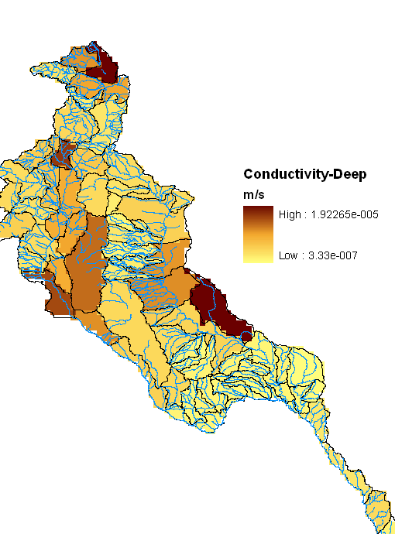
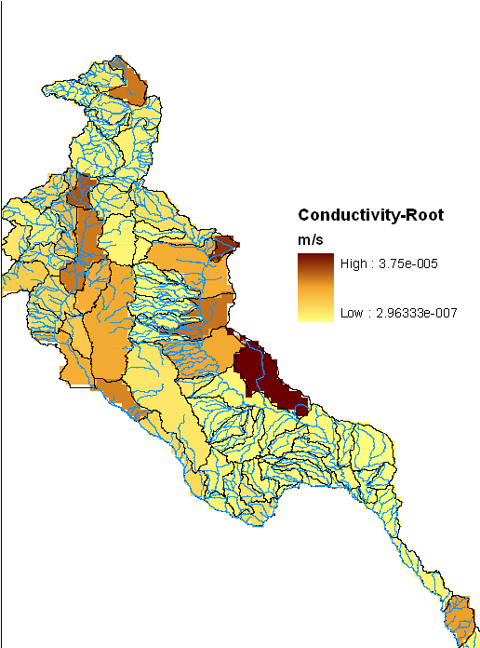
Soil Conductivity

Slide 16
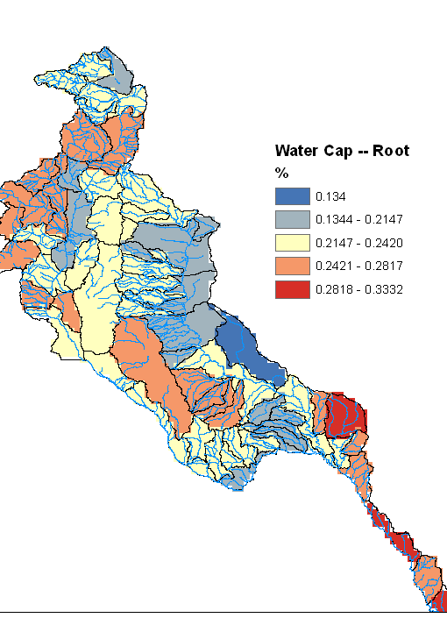

Soil Water Capacity
Very low available water for entire basin
Reflects loam and sandy soil types

Slide 17
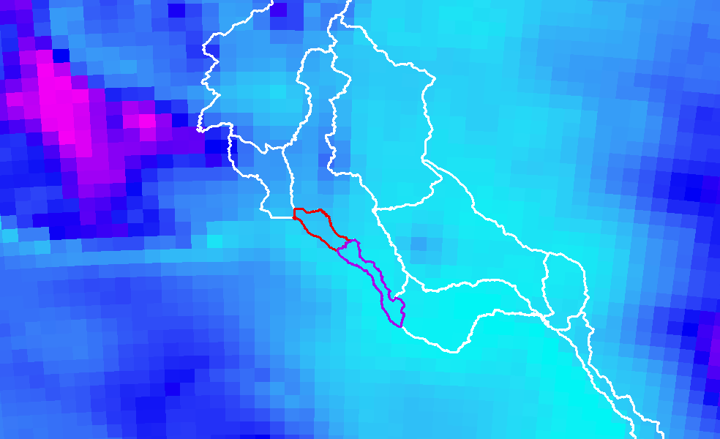
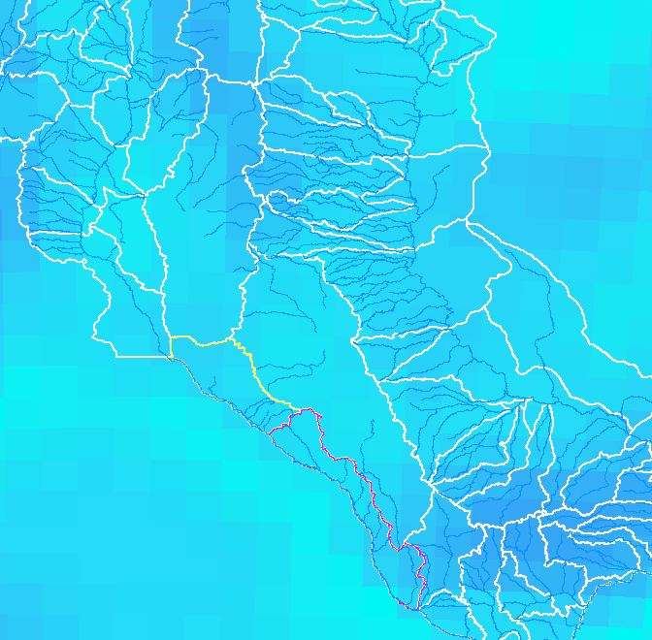
Conclusions and Future Work
Rio Grande Basin’s variability
New respect for super computers
Start WEAPing for a living
Make a raster time series video—Harish?

Slide 18
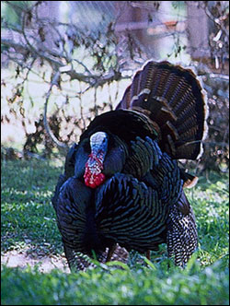
Questions…?
Rio Grande Wild Turkey

Slide 19
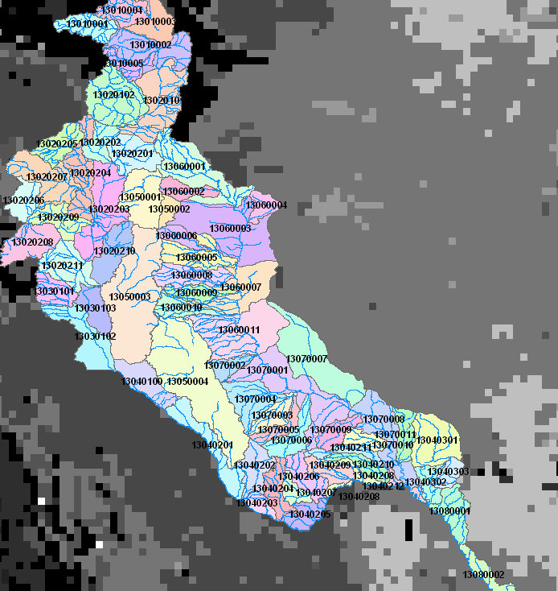
HUC Outlines
1
2
6
3
5
7
4
8
9

