Slide 1
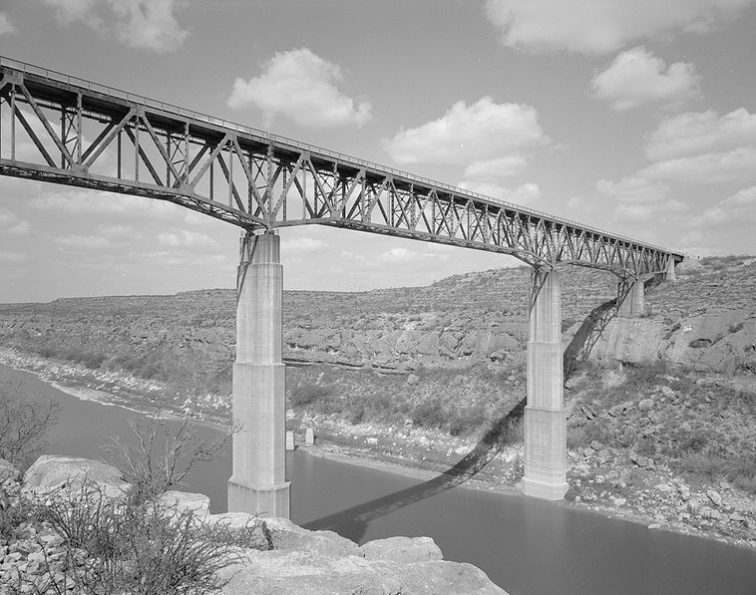
Surface Water Balance in the Pecos River Basin
Surface Water Balance in the Pecos River Basin
Sedat Yalcinkaya
April 28, 2010
Pecos River, near Langtry, Val Verde County, Texas

Slide 2
Too much water but not when and where it is needed!
IPCC report “Climate Change and Water”, 2008
UN Millennium Development Goals “Food and Water Security”
The EU Water Framework Directive - Integrated River Basin Management for Europe

Slide 3
Water Resources Planning and Management
Surface Water Balance in the Pecos River Basin with ArcGIS
Runoff Analysis in the study area
Application of WEAP
All the calculations were made for 1990 except runoff analysis

Slide 4
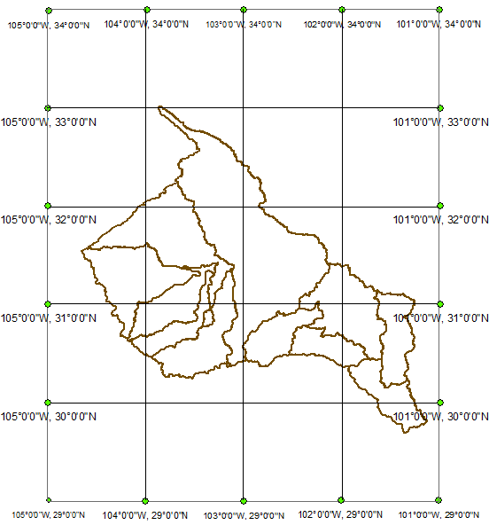
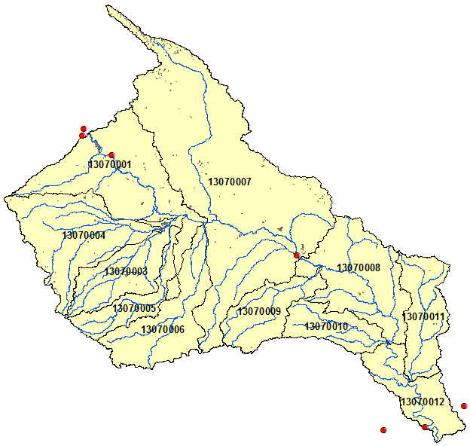
Study Area
WATERSHEDS (HUC_8) | AREA (KM2)
13070001 | 6454.582529
13070003 | 2913.223075
13070004 | 5074.004481
13070005 | 1831.660091
13070006 | 3833.113807
13070007 | 16414.37423
13070008 | 4962.616022
13070009 | 2505.34438
13070010 | 1997.452143
13070011 | 2828.999238
13070012 | 2573.636942
TOTAL BASIN AREA | 51389.006960
33.02 and 29.69 N Latitude
104.65 and 101.14 W Longitude

Slide 5
Data Sources
CRWR Database
NRCS, Geospatial Data Gateway
NHDPlus
NCDC
NASA, Land Data Assimilation System

Slide 6
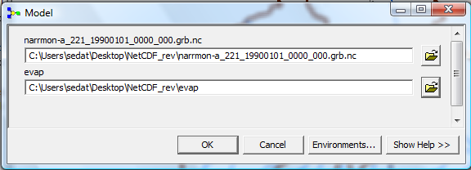
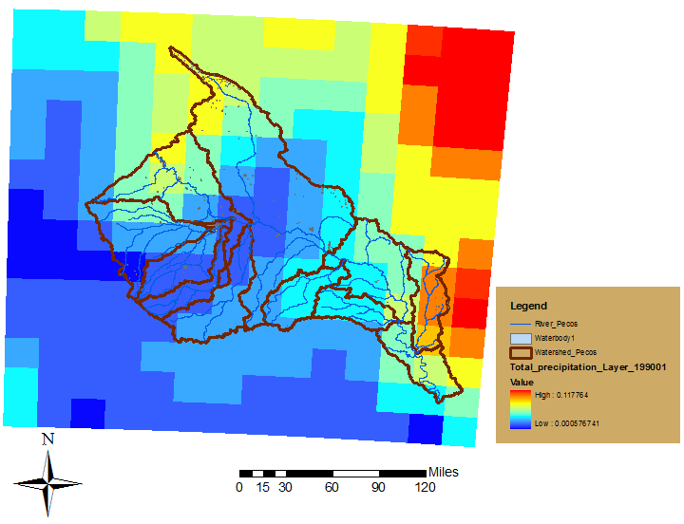
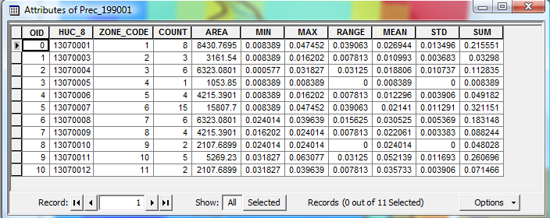
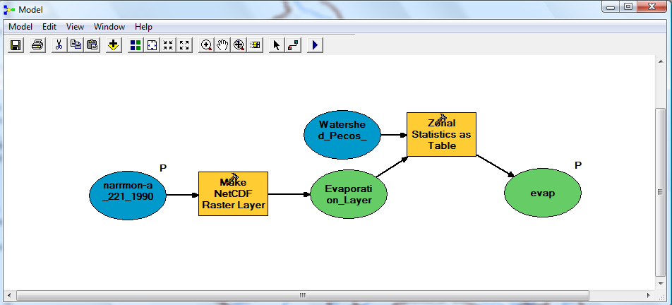
Processing the Climate Data
32 km cell size

Slide 7
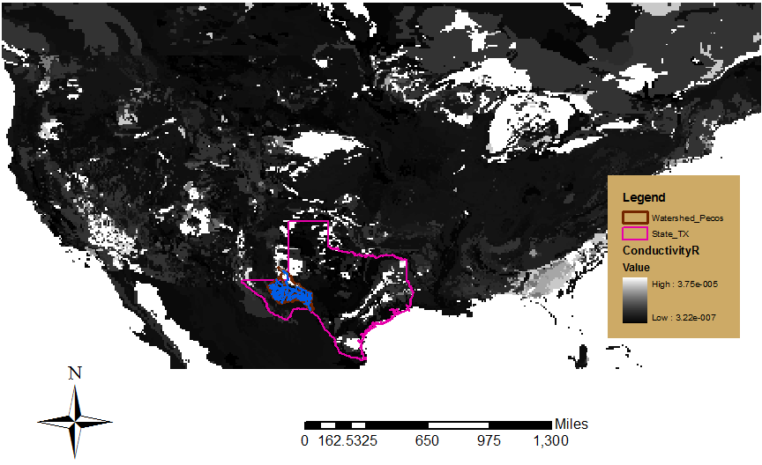
Processing the Soil Data
Layer | Thickness | Depth to Top | Depth to Bottom
1 | 5 cm (2 in) | 0 cm (0 in) | 5 cm (2 in)
2 | 5 cm (2 in) | 5 cm (2 in) | 10 cm (4 in)
3 | 10 cm (4 in) | 10 cm (4 in) | 20 cm (8 in)
4 | 10 cm (4 in) | 20 cm (8 in) | 30 cm (12 in)
5 | 10 cm (4 in) | 30 cm (12 in) | 40 cm (16 in)
6 | 20 cm (8 in) | 40 cm (16 in) | 60 cm (24 in)
7 | 20 cm (8 in) | 60 cm (24 in) | 80 cm (31 in)
8 | 20 cm (8 in) | 80 cm (31 in) | 100 cm (39 in)
9 | 50 cm (20 in) | 100 cm (39 in) | 150 cm (59 in)
10 | 50 cm (20 in) | 150 cm (59 in) | 200 cm (79 in)
11 | 50 cm (20 in) | 200 cm (79 in) | 250 cm (98 in)
First Bucket
Second Bucket
The resolution is 1/8 degree (~140 km² per grid cell)

Slide 8
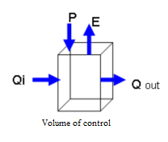
Simple Surface Water Balance with ArcGIS
P= Precipitation
E= Evaporation
Q= Naturalized Flows

Slide 9
Precipitation and Evaporation

Slide 10
Water Balance
It is likely that considerable amount of water was stored in the reservoirs exist along the basin.

Slide 11
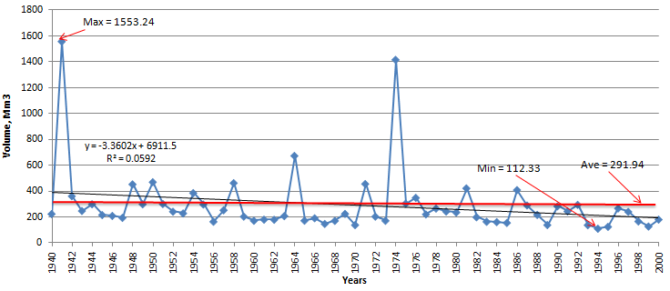
Runoff Analysis

Slide 12

Rainfall vs Runoff
For example; for a 40 mm rainfall can cause a 0.4 mm runoff

Slide 13
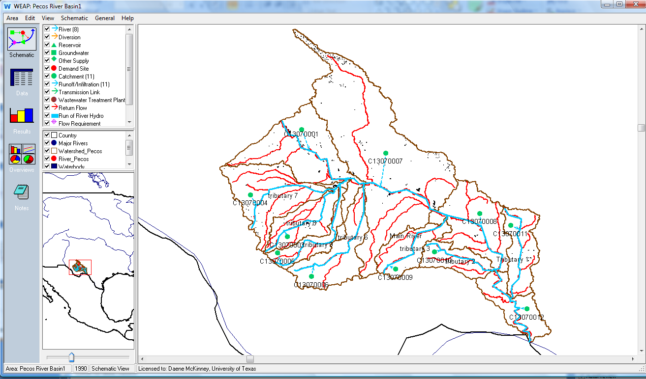
Hydrologic Modeling with WEAP

Slide 14
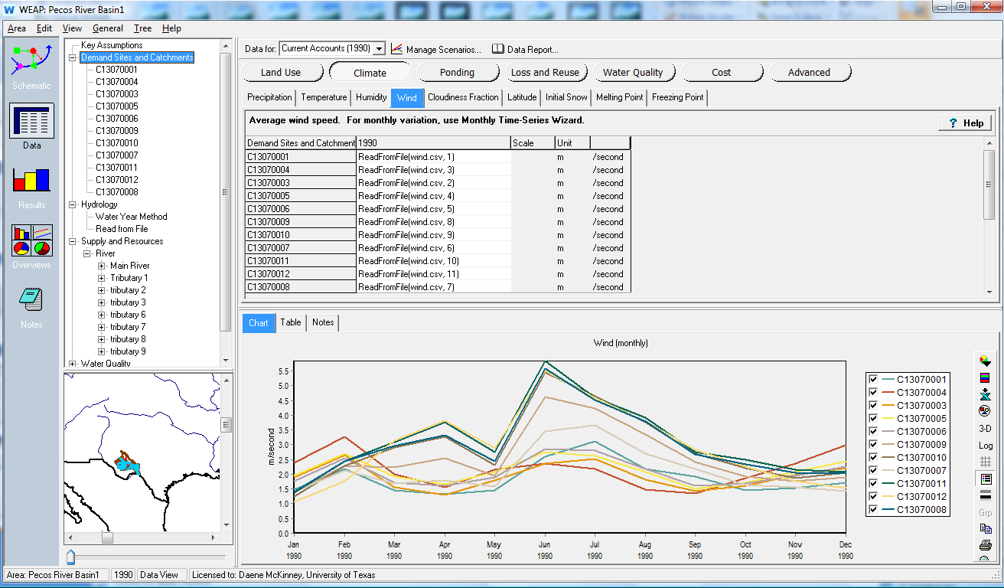
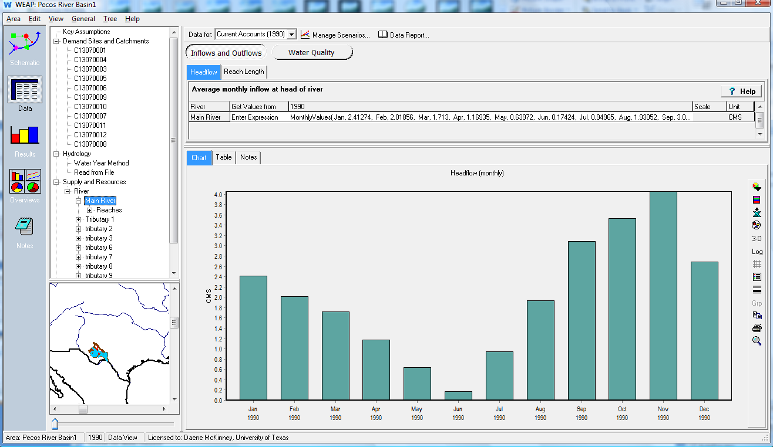
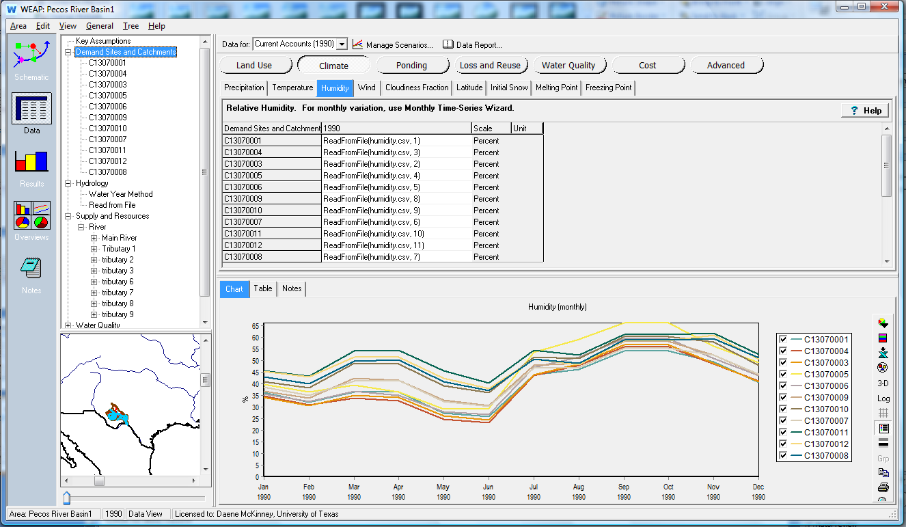
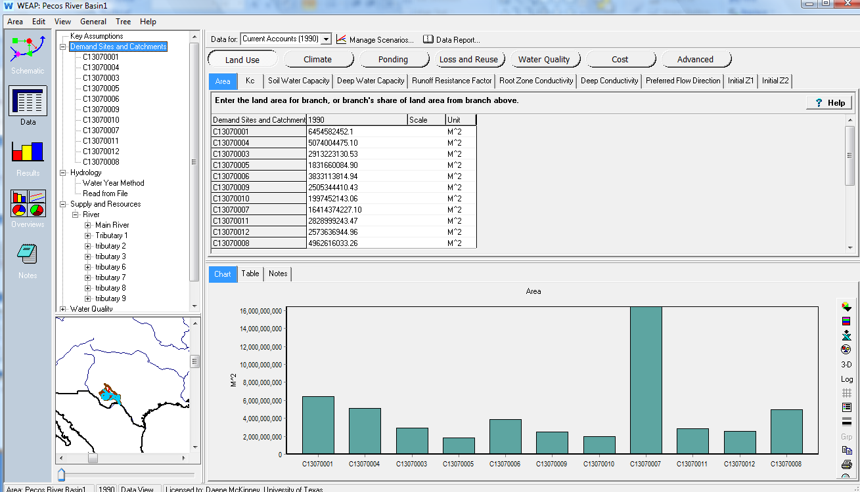
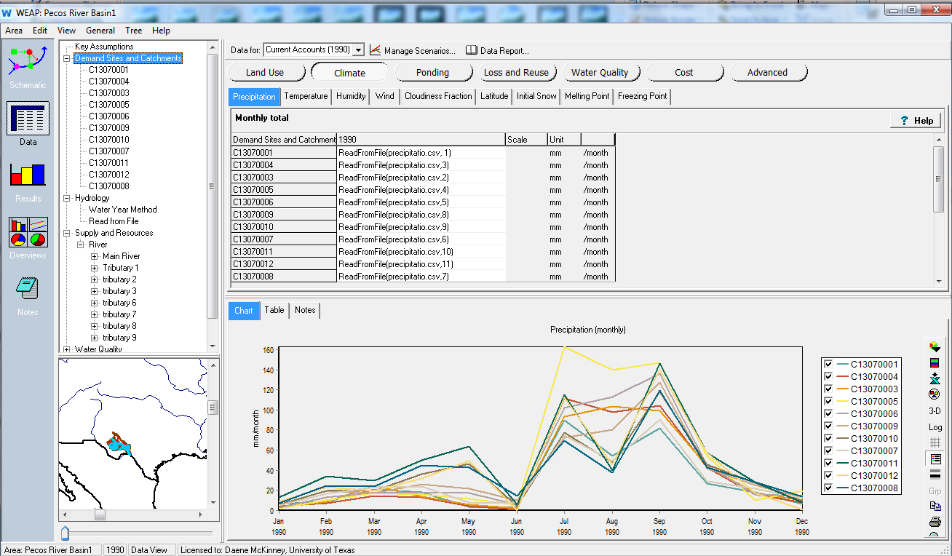
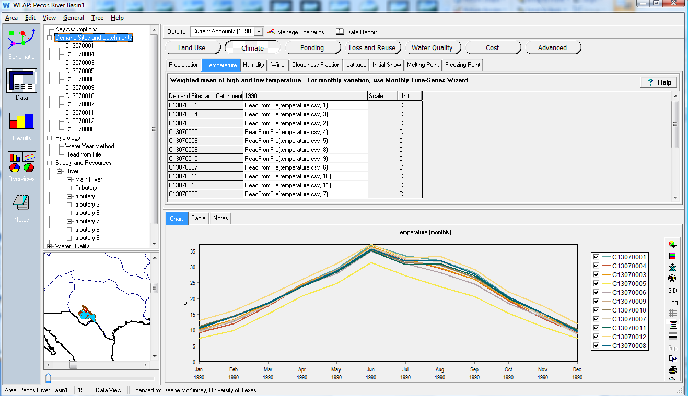
Adding Data to WEAP

Slide 15
WEAP Results

Slide 16
Conclusion
 | 1990 values in mm
 | Precipitation | Evaporation | Runoff
Mean | 35.4525 | 21.06 | 0.46
Max | 107.9 | 43.92 | 1.2
Min | 5.76 | 4.88 | 0.18
Most of the precipitation occurs in July, August and September
Precipitation gets the lowest level in winter
Maximum evaporation occurs in August, September and October
Maximum runoff occurs in September and October
The water balance for 1990 indicates shortage of water in May, June and December.

Slide 17
Questions??

