Slide 1
Effects of Urbanization on the Onion Creek Watershed
Laura Gundlach

Slide 2
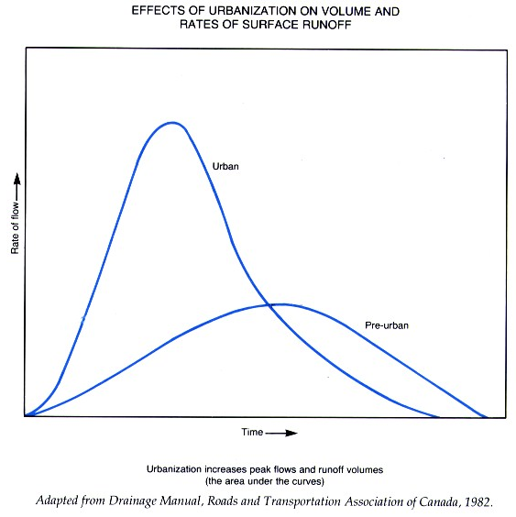
Effects of Urbanization on the Hydrograph
Increased Impervious Cover and Improved Drainage Systems cause:
  Higher Peak Flows
  Shorter Lag Times
  Higher Total Runoff Volumes

Slide 3
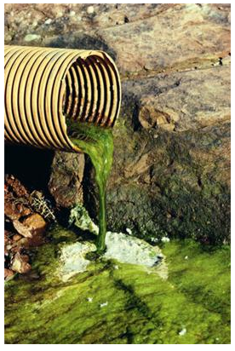
Other Effects of Urbanization…
Less Recharge of Aquifers
Water Quality Degrades
  Water running off of impervious areas, such as roads and parking lots, can contain a lot of contaminants, such as oil and garbage

Slide 4
Project Goals
Quantify the effects of urbanization on a real hydrograph
  Create a working basin model in HEC-HMS
  Find the hydrograph for a given storm
  Modify the land use data to include more development
  Compare the new hydrograph to the control
Learn how to find data, use ArcGIS, and use HEC-HMS

Slide 5
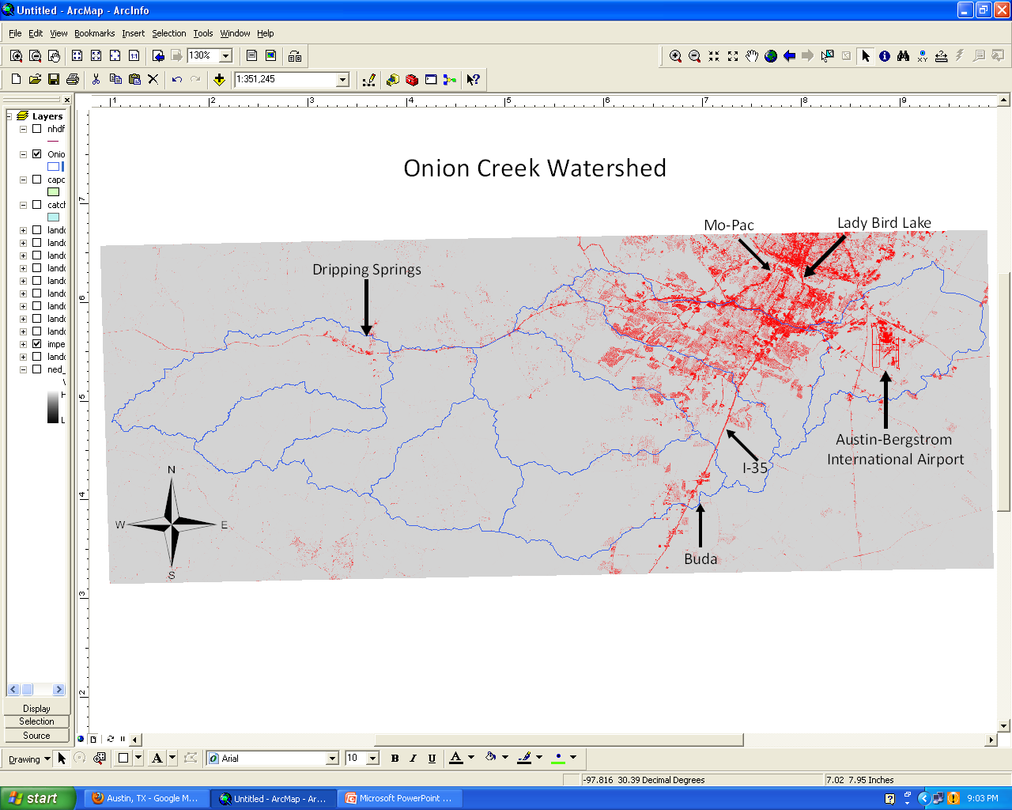
Onion Creek Watershed
Red indicates the intensity of impervious cover
From National Land Cover Database

Slide 6
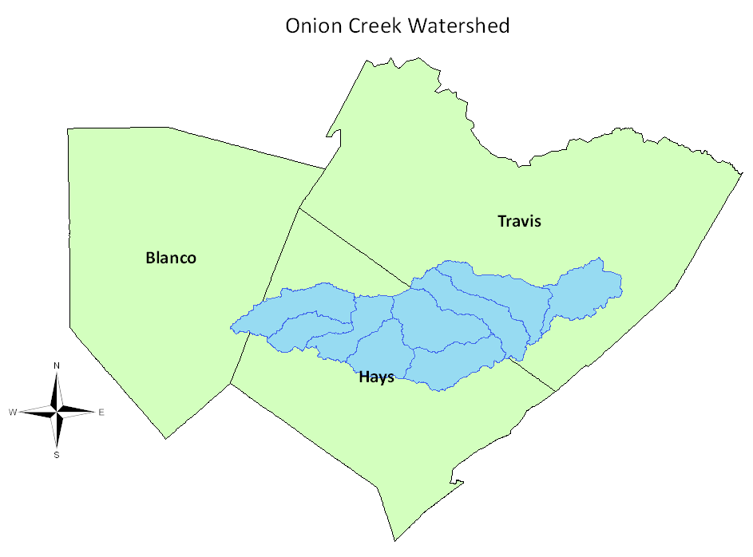
Why Onion Creek?
Readily Available Data
  CAPCOG
Coming Under Increasing Development Pressure
  Includes much of South Austin, Buda
  Lower end contains the Airport

Slide 7
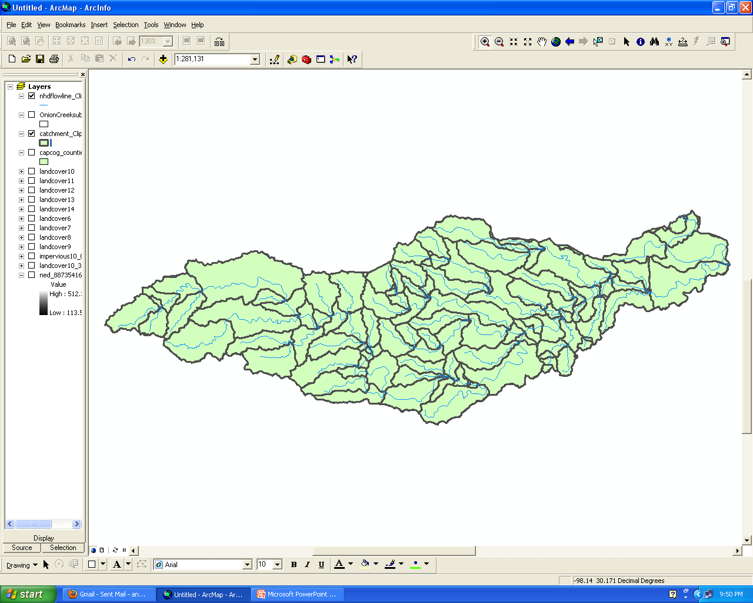
Defining the Level of Detail
Using data from NDHPlus – 187 catchments

Slide 8
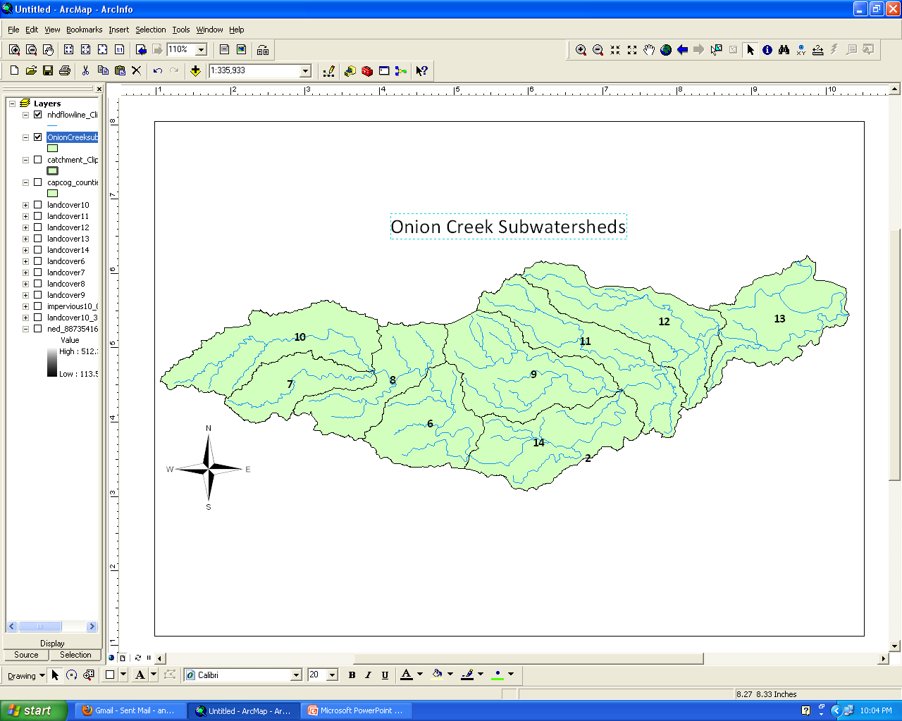
Defining the Level of Detail
Using 12 digit Hydrologic Unit Codes – 9 Subwatersheds containing Onion Creek

Slide 9
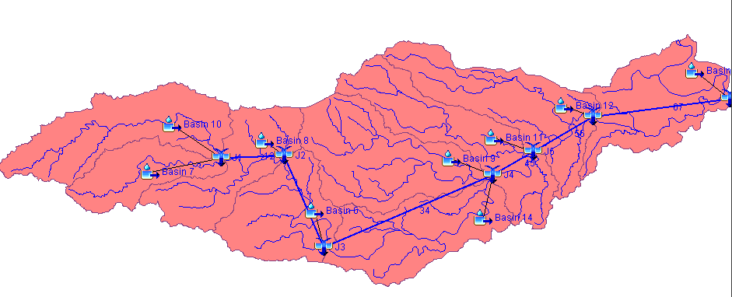
HEC-HMS Development
Meteorlogic Model
  SCS Storm
Control Specifications
Basin Model
  9 Subbasins
  6 Reaches
  7 Junctions

Slide 10
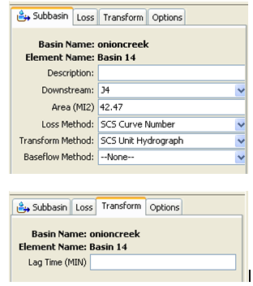
Subbasins
Baseflow
  Assumed none
    Limited Streamflow Gages in the Area
    Interested in the difference in the hydrographs
Transform Method
  SCS Unit Hydrograph
    Requires a Parameter of Lag Time = .8*Tc
?

Slide 11
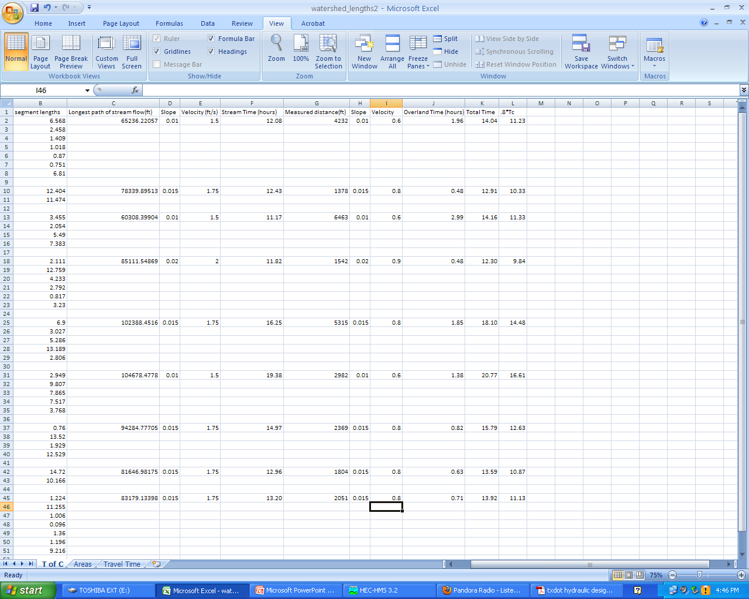
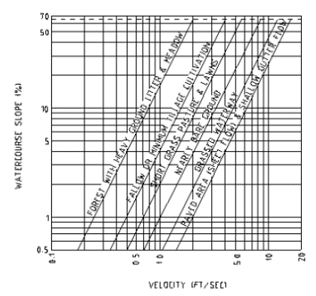
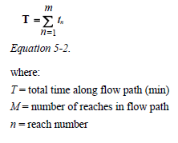
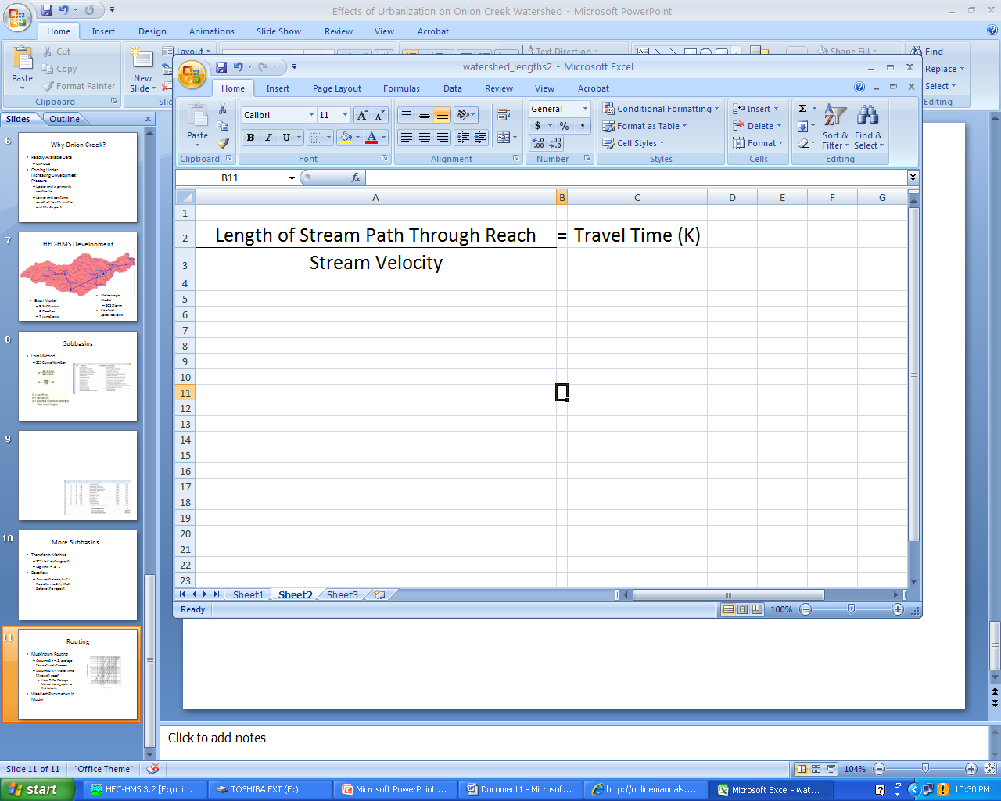
Time of Concentration
TxDot Hydraulic Design Manual Nomographs
  Overland Sheet Flow to Stream
  Stream Flow to Junction
Times are Additive

Slide 12
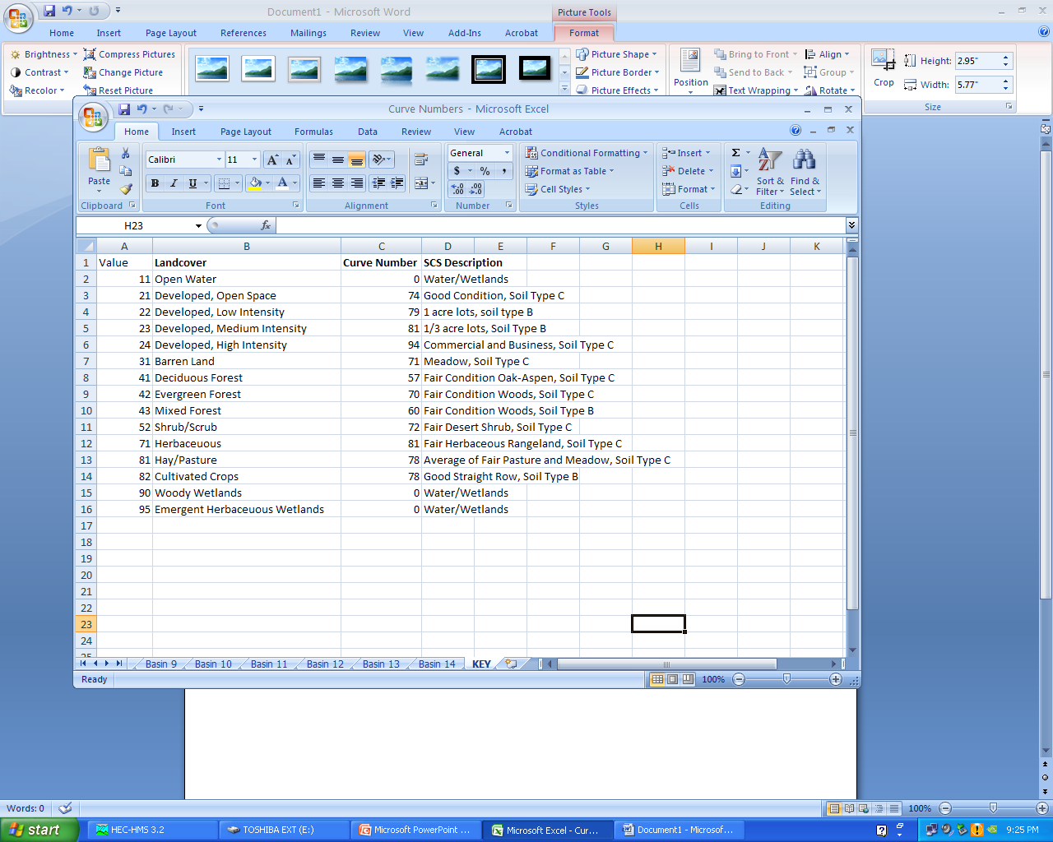
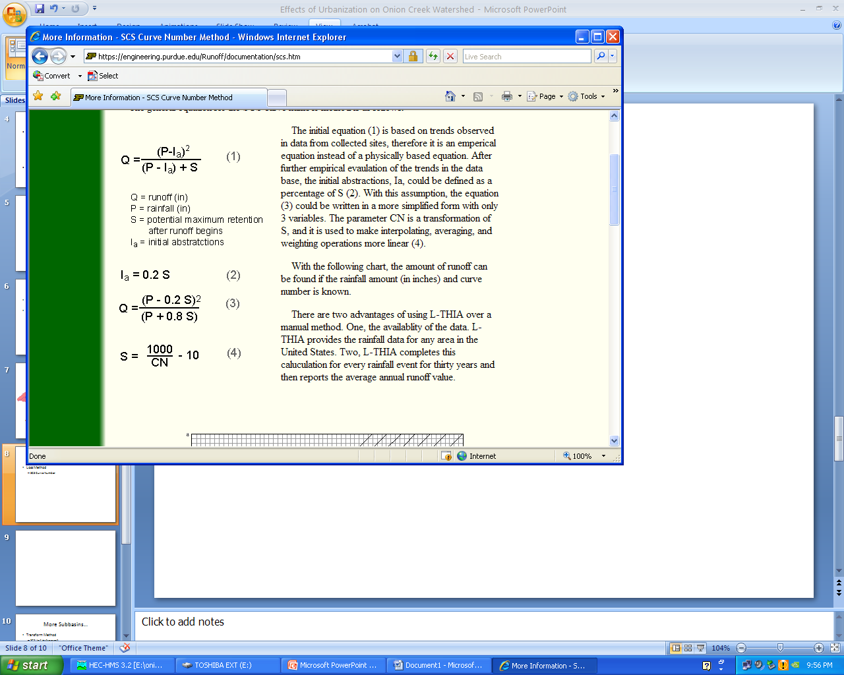
Subbasins
Loss Method
  SCS Curve Number

Slide 13
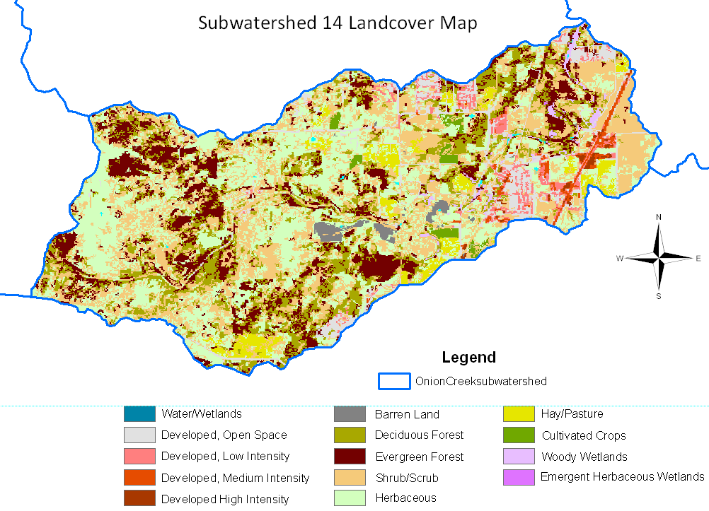
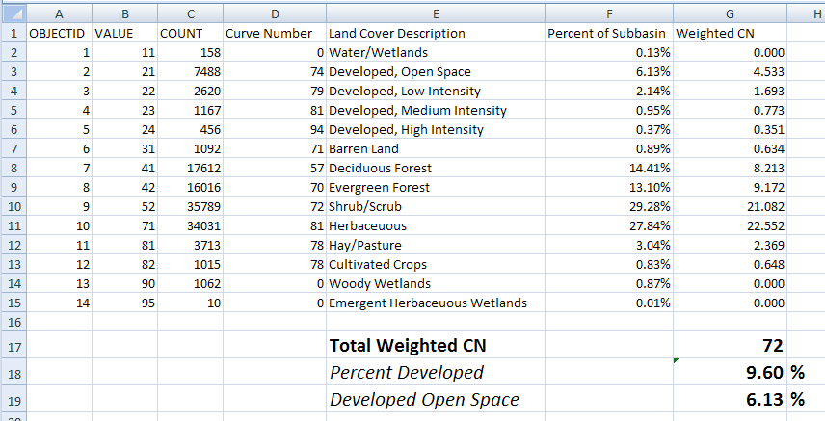

Slide 14
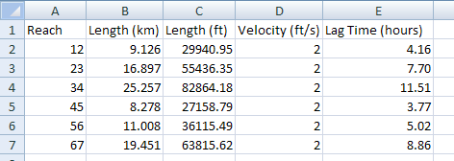
Routing
Muskingum Routing
  Assumed x = .2, average for natural streams
  Assumed K = Travel Time through reach
    Found each Reach Distance
    Assumed v = 2 ft/s
Easily Weakest Parameters in Model
  Could not back calculate parameters because gages do not exist at each outflow point

Slide 15
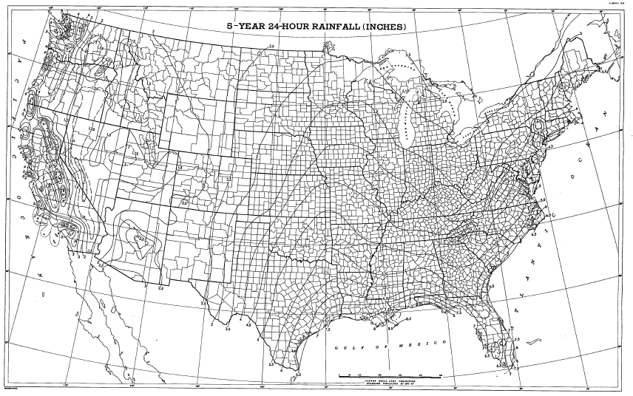
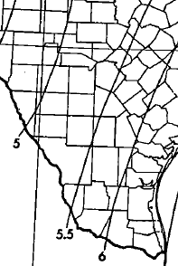
Precipitation Model
NWS TP-40 Rainfall Depth (5.5”) for an SCS Type 3 Storm

Slide 16

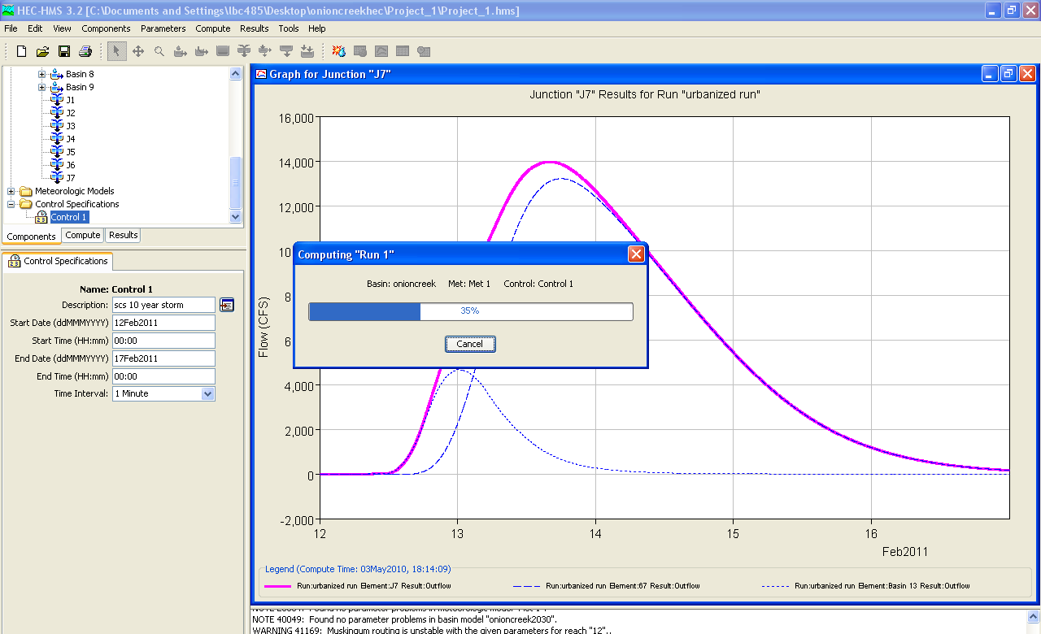
Control Specifications and… Go!
Impatiently Waiting…

Slide 17
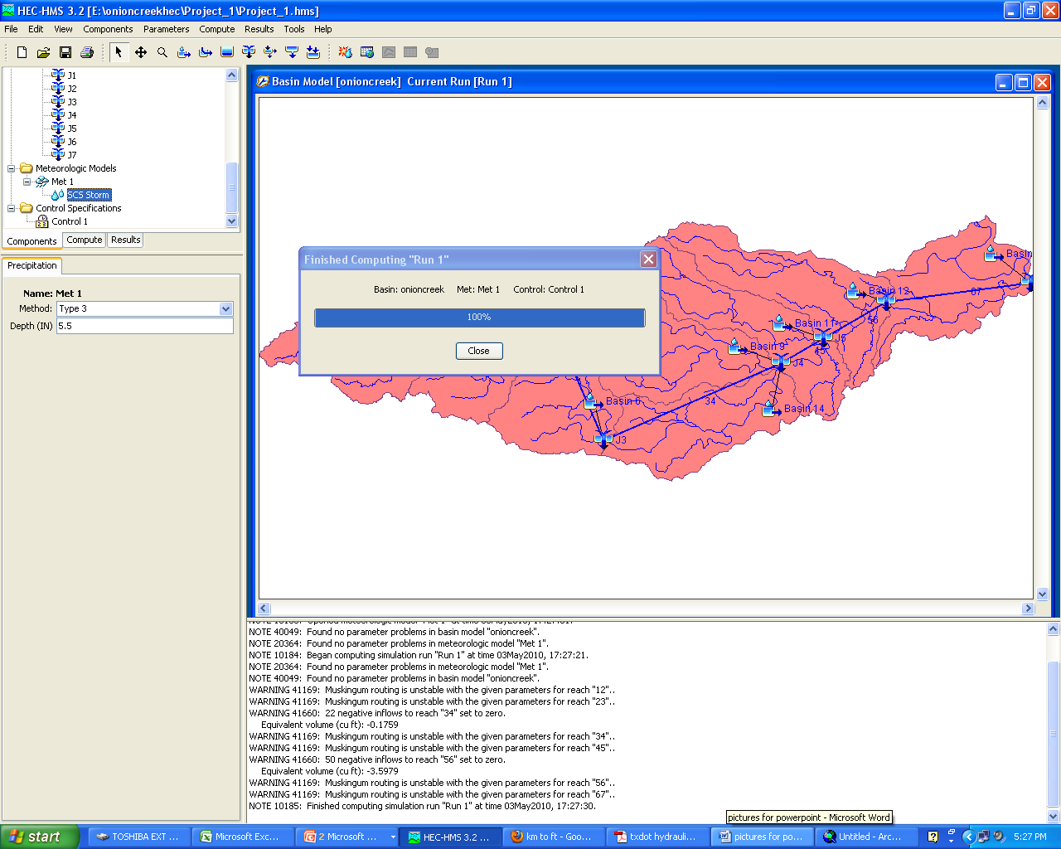
Worked!

Slide 18
“Urbanizing” the Watershed
Chose to make projections about growth in Buda (Subbasin 14), in South Austin (12), and around the Airport (13)

Slide 19
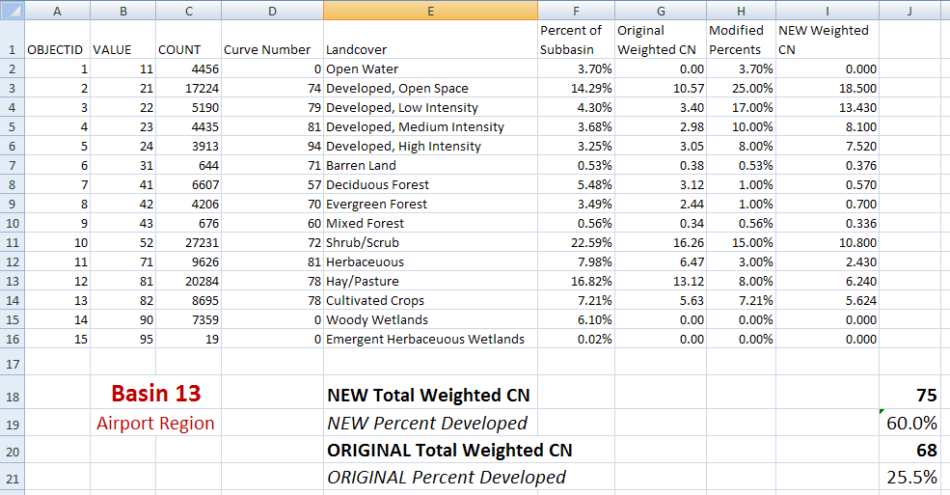
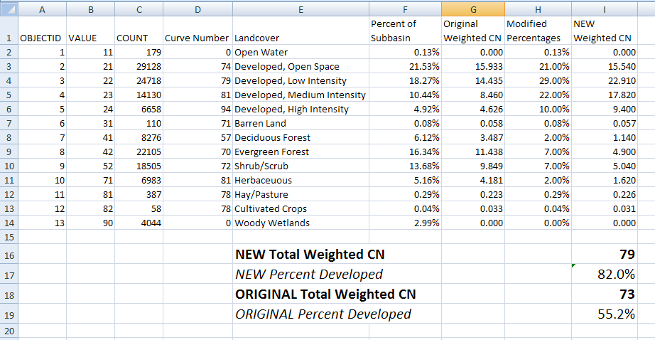
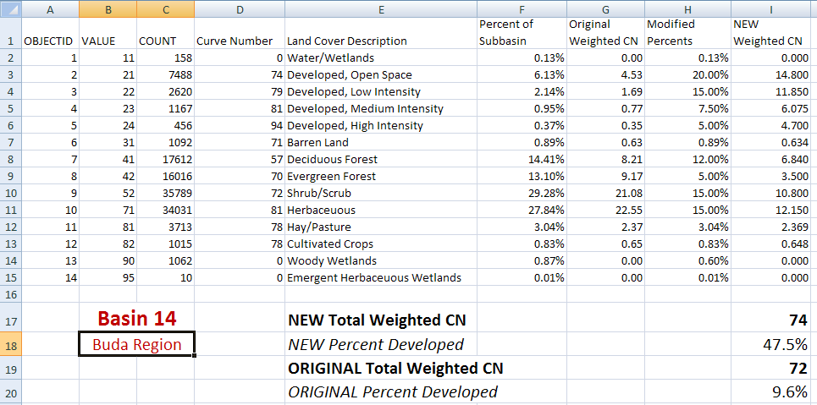
Basin 12 (South Austin)
Modified the percentage of the area with specific land uses
Found a new “urbanized” curve number

Slide 20
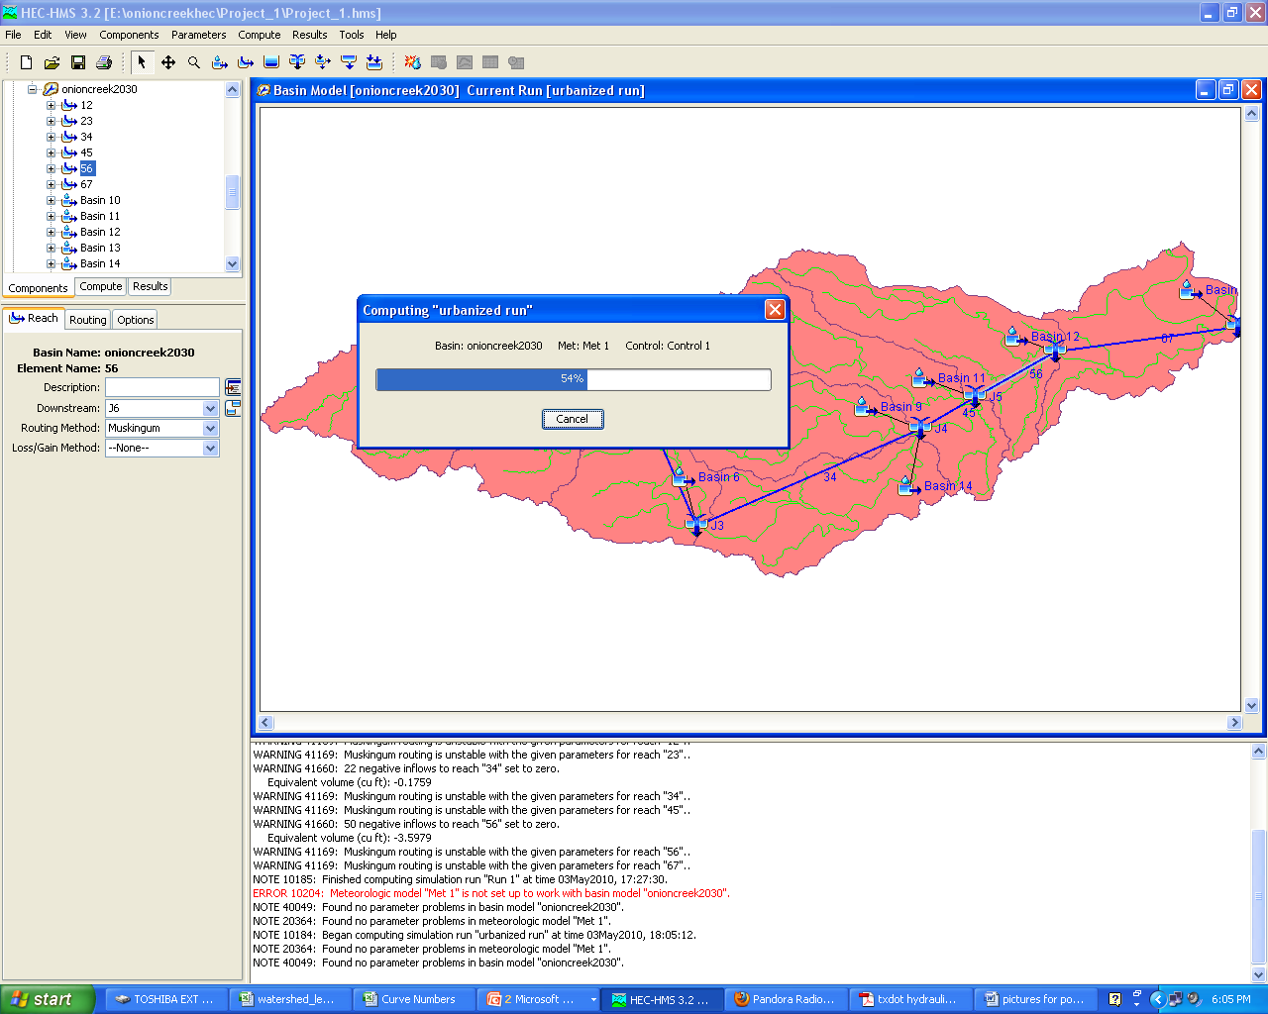
“Future” Run

Slide 21
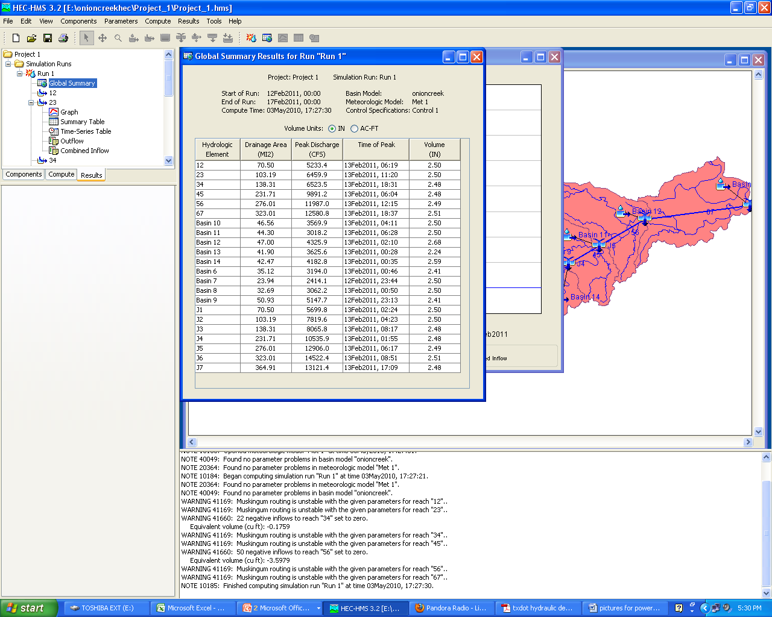
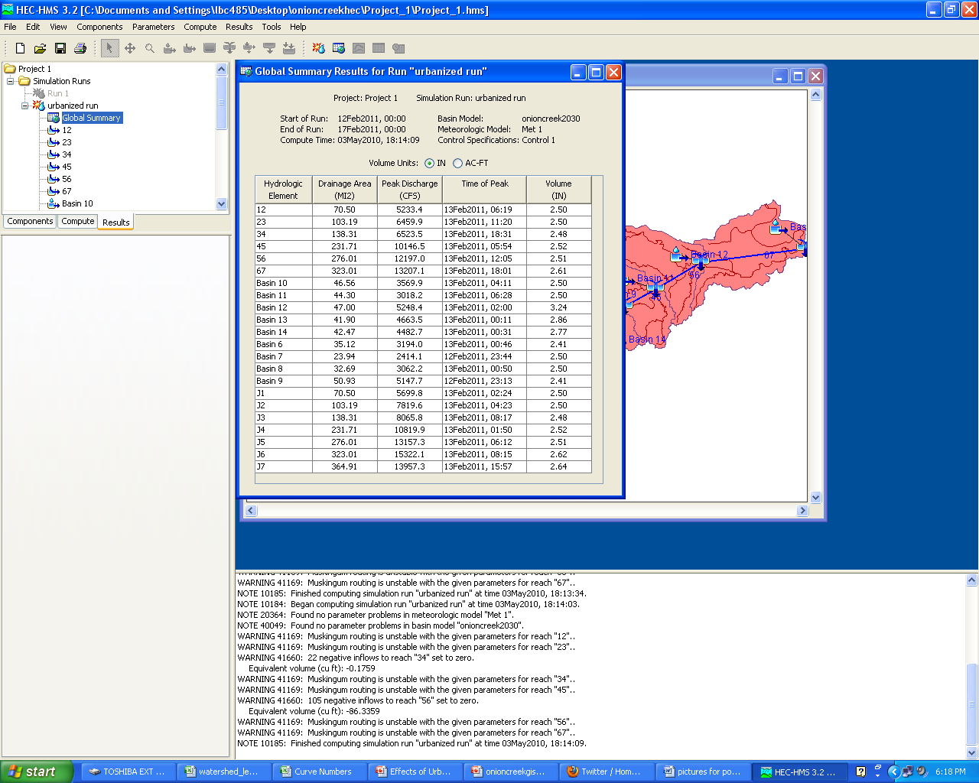
Comparison of Results

Slide 22
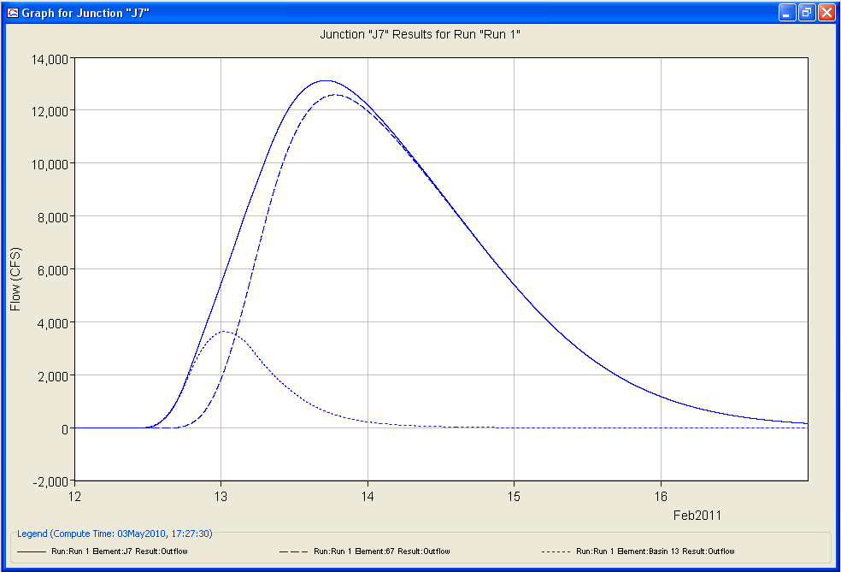
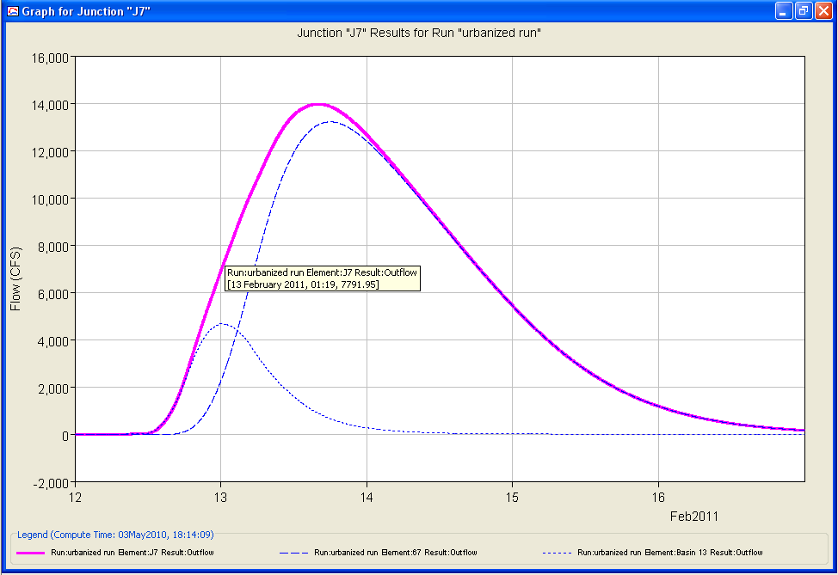
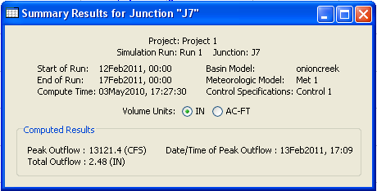
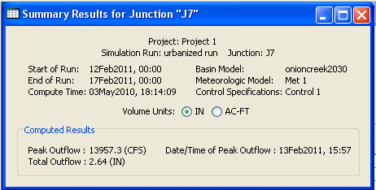
Junction 7 Hydrographs
Junction 7
Original
Urbanized

Slide 23
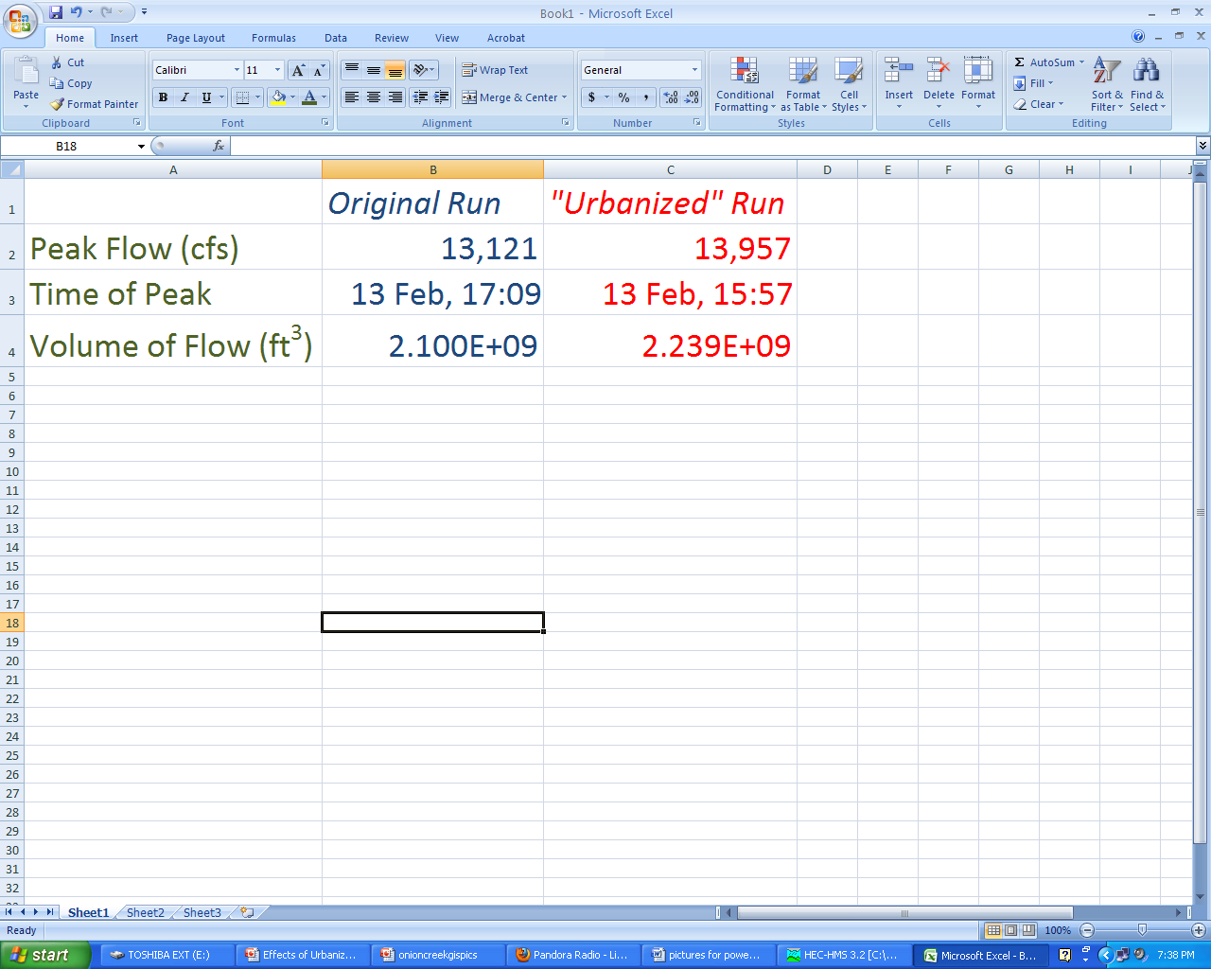
Quantitative agree with Qualitative?
Assumptions from Slide Two - Increased Impervious Cover and Improved Drainage Systems cause:
  Higher Peak Flows
  Shorter Lag Times
  Higher Total Runoff Volumes
YES
YES
YES

Slide 24
Conclusions
Quantitative results agreed with qualitative assumptions, but the effect was not as dramatic as I hoped
  Lag Time increased only by 1 hour 12 minutes
  Hardly a recognizable difference in hydrographs
To adequately route flows, coefficients should be back calculated
I wish I would have taken GIS in the fall.

Slide 25
Still to do…
Write report
Take GIS in the fall

Slide 26
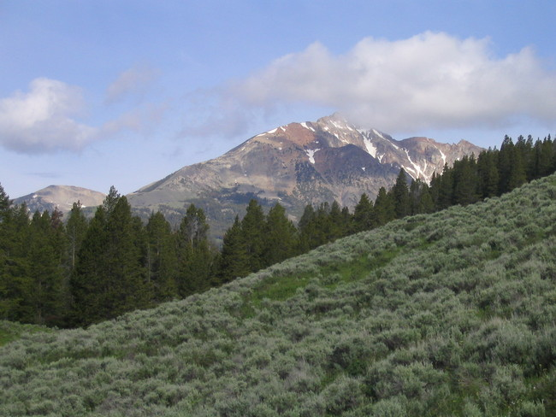
Questions?
Electric Peak – Yellowstone National Park
Never to be urbanized…

