Slide 1
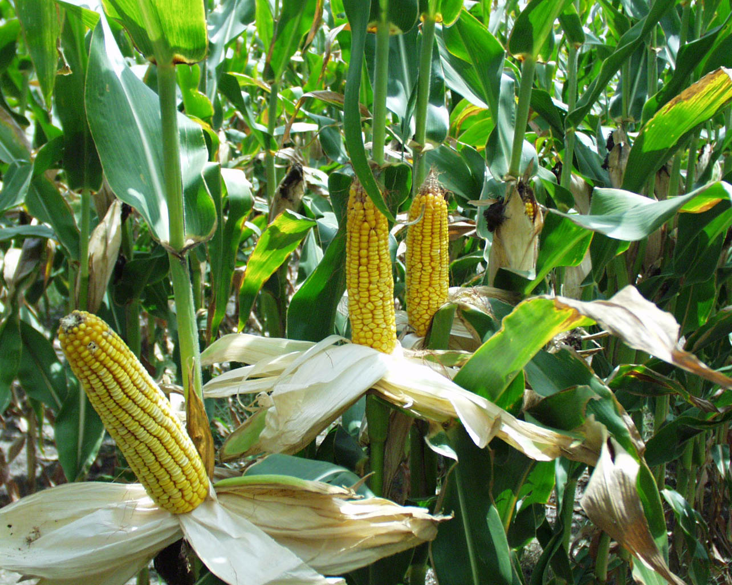
Evapotranspiration (ET) from Dedicated Energy Crops
Ashlynn Stillwell
CE394K.2: Surface Water Hydrology Spring 2010
5/4/10

Slide 2
Outline
Increasing biofuels production
Methods of calculating ET
Results for Mead Irrigated site
CO₂ from crops
Future work
Questions

Slide 3
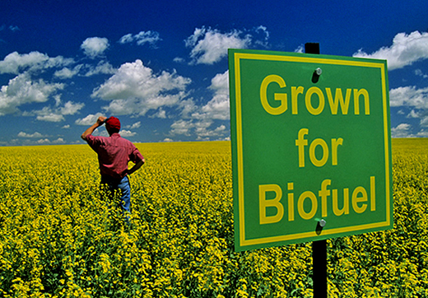
Increasing Biofuels Production
Energy Independence and Security Act (2007) mandates 36 Bgal/yr by 2022
General consensus that new land will be cultivated
Additional crops might lead to additional ET
[earthfirst.com]
[EISA, Schnoor et al., USDA]

Slide 4
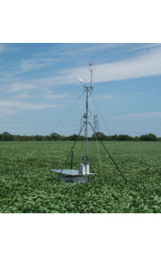
AmeriFlux Sites for Analysis
ARMS SGP Main
  Corn/soybeans rotation
  Lamont, OK
Fermi Agricultural
  Corn/soybeans rotation
  Winfield Township, IL
Mead Irrigated
  Continuous corn
  Mead, NE
Rosemount G19 Alternative
  Corn/soybeans rotation
  Rosemount, MN
[AmeriFlux]

Slide 5
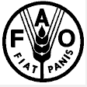
Methods of Calculating ET
Reference ET₀ (Penman-Monteith equation)
  ET₀ for well-watered grass
  K_{c} crop factors adjust to ET
FAO CROPWAT 8.0 software
Energy balance method
Scaling of latent heat flux (using eddy covariance instruments)

Slide 6


Penman-Monteith equation
Net radiation
Soil heat flux
Air temperature
Wind speed
Vapor pressure deficit
Slope of vapor pressure curve
Psychrometric constant
Pressure
Reference evapotranspiration ET₀
Crop factors K_{c}

Slide 7
ET Variation throughout Day

Slide 8
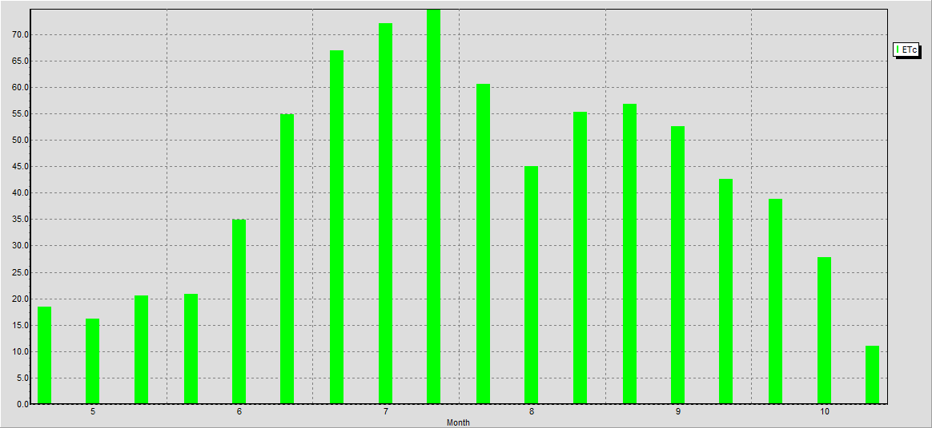
FAO CROPWAT 8.0 software
Input data
  Climate
  Precipitation
  Crop (some built-in)
  Soil (some built-in)
Output: Crop Water Requirements

Slide 9

Energy Balance / Scaling of Latent Heat
Energy balance method
Scaling of latent heat flux (when measured directly with eddy covariance instruments)
[Tanner]
[Hyun]

Slide 10
Comparison of ET Methods

Slide 11
Cumulative ET for Methods
ET Calculation Method | Cumulative ET (mm) | Percent Error
Reference ET₀ | 1,089 | 66%
Penman-Monteith | 707 | 8%
FAO CROPWAT software | 770 | 17%
Energy Balance (Tanner) | 824 | 26%
Scaling Latent Heat Flux | 656 | baseline
Indirect calculations overestimate ET compared to direct measurements

Slide 12
CO₂ from Crop Cultivation
Crop growing season
No statistical difference between pre- and post-growth CO₂

Slide 13
Conclusions
Direct measurement of latent heat flux provides lowest magnitude of ET
Penman-Monteith equation with K_{c} provides good approximation
Crops sequester CO₂, but other operations emit CO₂
(Not shown here; in paper)
  Highest ET at ARMS SGP Main site (Oklahoma)
  Comparable ET from corn vs. soybeans

Slide 14
Future Work
Write report
Beyond CE394K.2
  Satellite- and GIS-based methods of calculating ET
  Change from native vegetation to energy fuel crop

Slide 15
Questions?
Data Acknowledgments
Office of Biological and Environmental Research of the U.S. Department of Energy as part of the Atmospheric Radiation Measurement Program
AmeriFlux Network, Oak Ridge National Laboratory

