Slide 1
Hydraulic Modeling of the Floodplain in Sanderson, TX
Rachel Chisolm
CE 394K- Surface Water Hydrology
Dr. Maidment
5/6/10

Slide 2
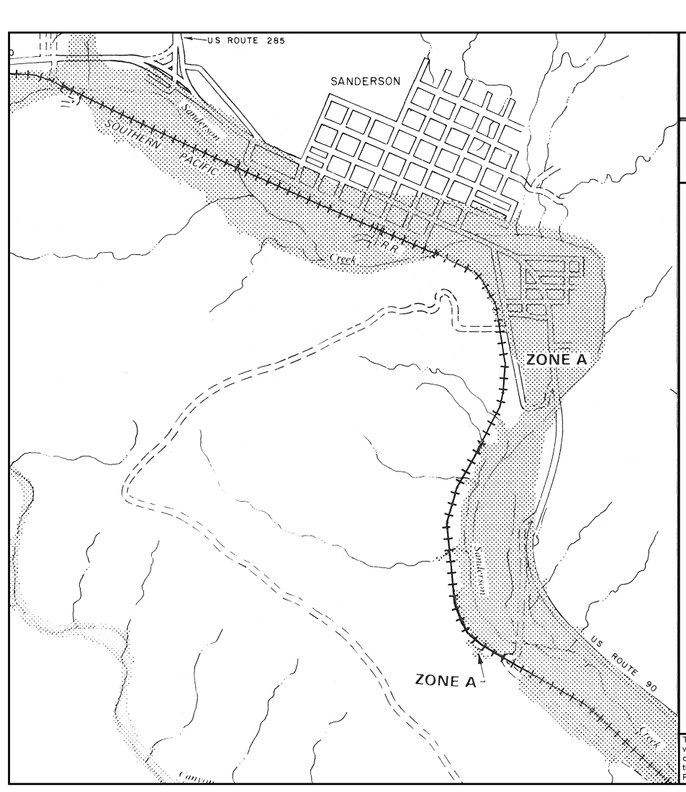
Background
Sanderson, TX susceptible to flash flooding
System of 11 flood control dams completed in 1980’s
Most recent FEMA flood map is from 1977
FEMA flood map for Sanderson, TX
source: FEMA’s Map Service Center available online at msc.fema.gov

Slide 3
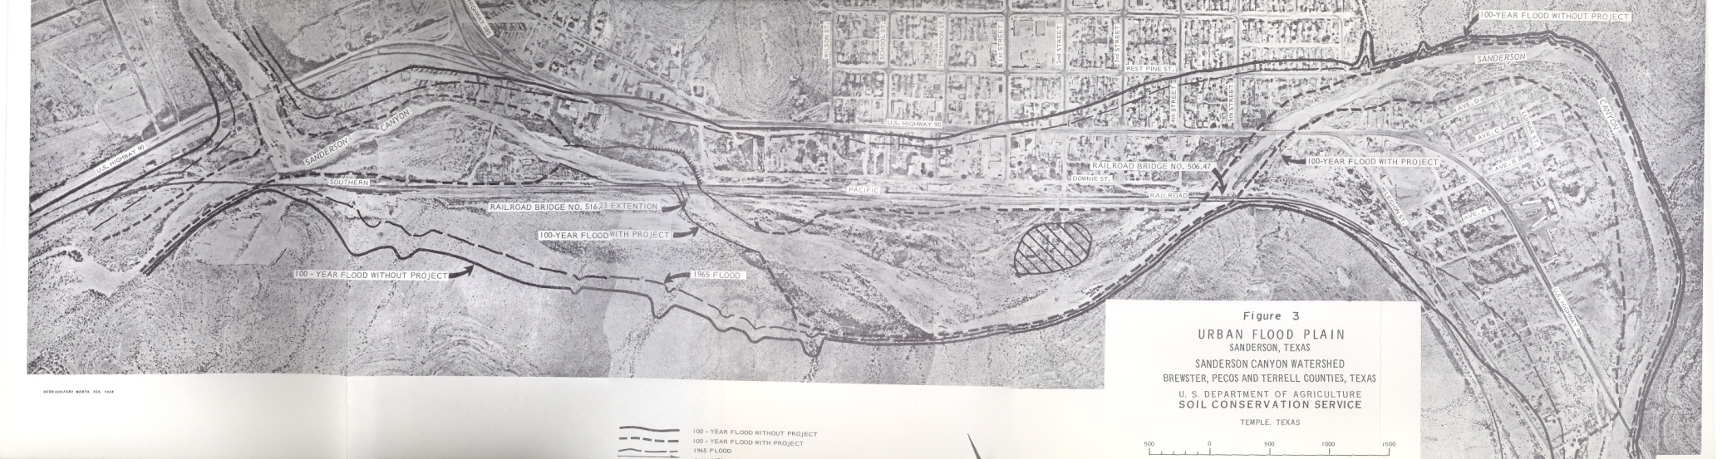
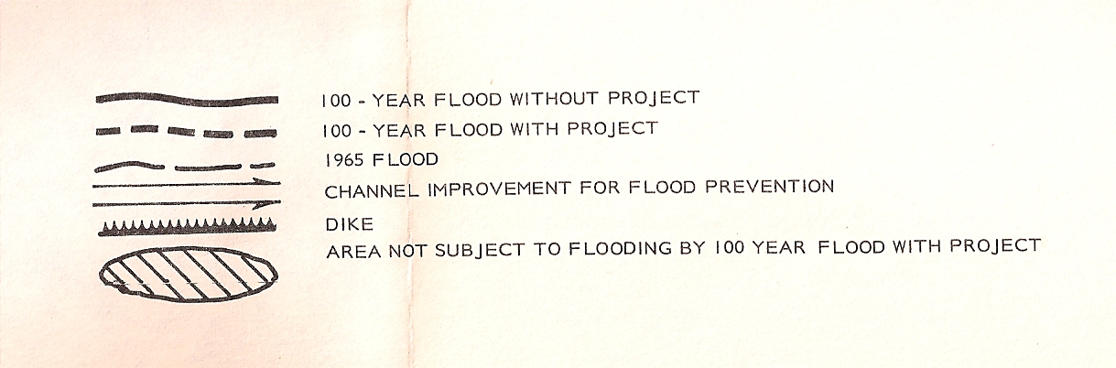
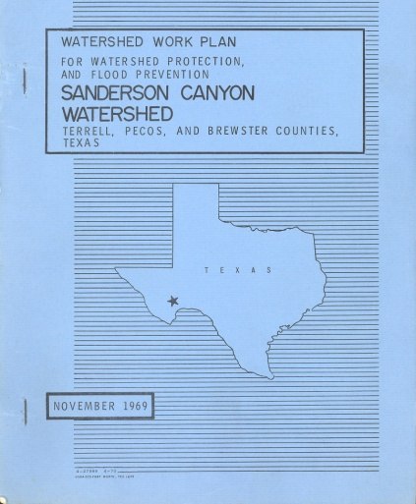
Projected Effect of the Dams
Legend
Source: Watershed Work Plan for Watershed Protection and Flood Prevention Sanderson Canyon Watershed, USDA’s Soil Conservation Service, November 1969
The assumption in the SCS report is that with the dams in place, the 100 year flood is contained in the channel.

Slide 4
The Modeling Process

Slide 5
Steps in Hydraulic Modeling
Preprocessing with HEC-geoRAS
  Stream centerlines
  Cutting cross-sections
Run steady-state model in HEC-RAS
Calibrate Manning’s n values
Run unsteady model in HEC-RAS
Show results in GIS ➔ map of floodplain

Slide 6
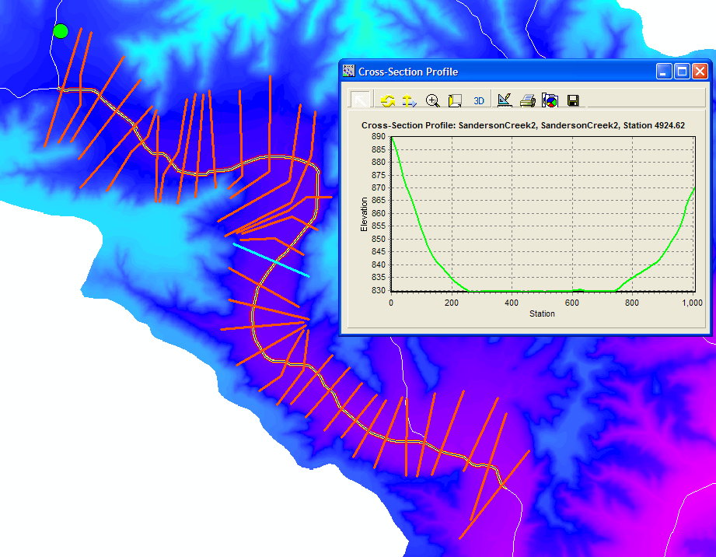
Preprocessing in HEC-geoRAS

Slide 7
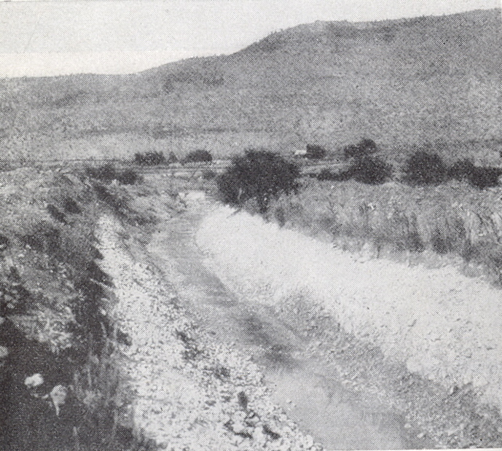
Manning’s n
Starting values:
  Channel- 0.03
  Floodplain- 0.05
Source: Chow, Ven Te, Open-Channel Hydraulics
Example of a channel with a Manning’s n value of 0.03

Slide 8
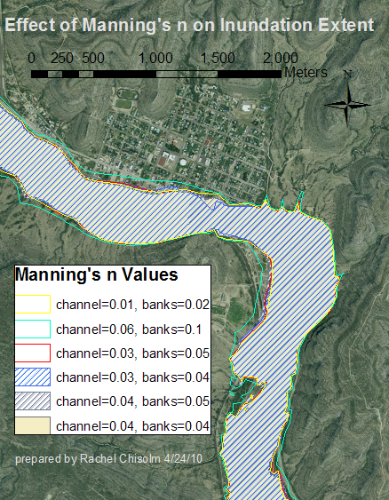
Calibration of Manning’s n
Disclaimer: Map is based on 10 m digital terrain model that is too coarse to define an accurate floodplain

Slide 9
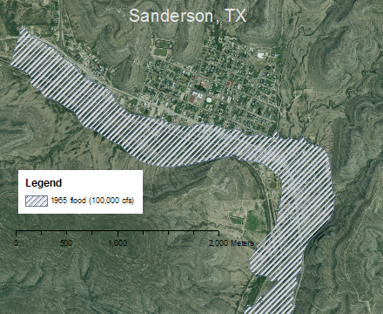
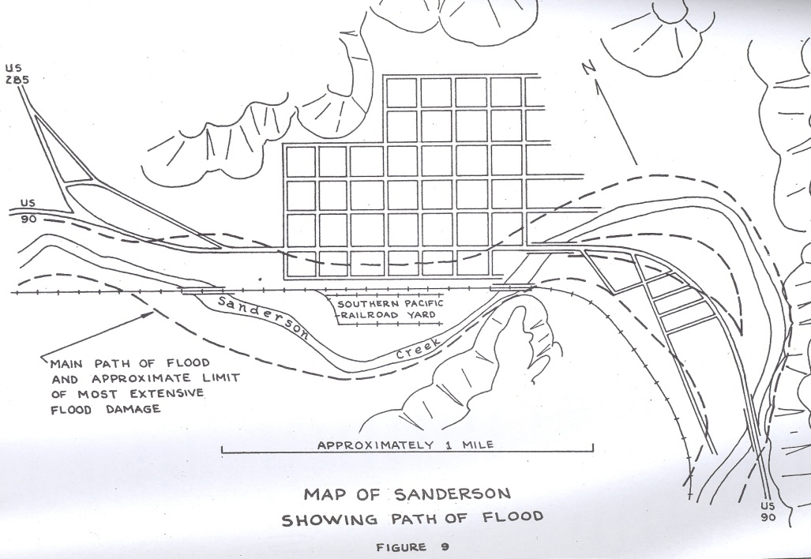
…compared to estimated 1965 Flood Extent
Source: Crawley, Richard Alvin. Flood Effects on Sanderson Creek Trans-Pecos Texas, June 11, 1965. MA Thesis , The University of Texas at Austin, January 1969
Disclaimer: Map is based on 10 m digital terrain model that is too coarse to define an accurate floodplain

Slide 10
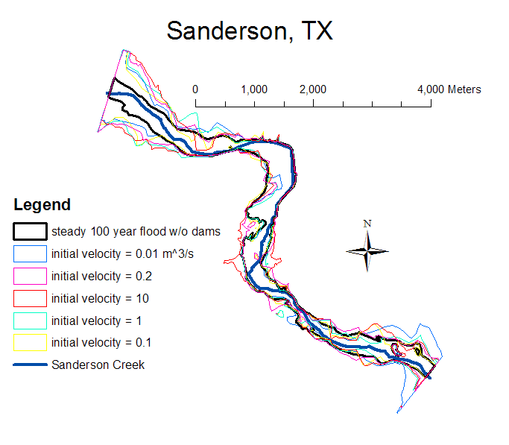
Unsteady Model
Disclaimer: Map is based on 10 m digital terrain model that is too coarse to define an accurate floodplain

Slide 11
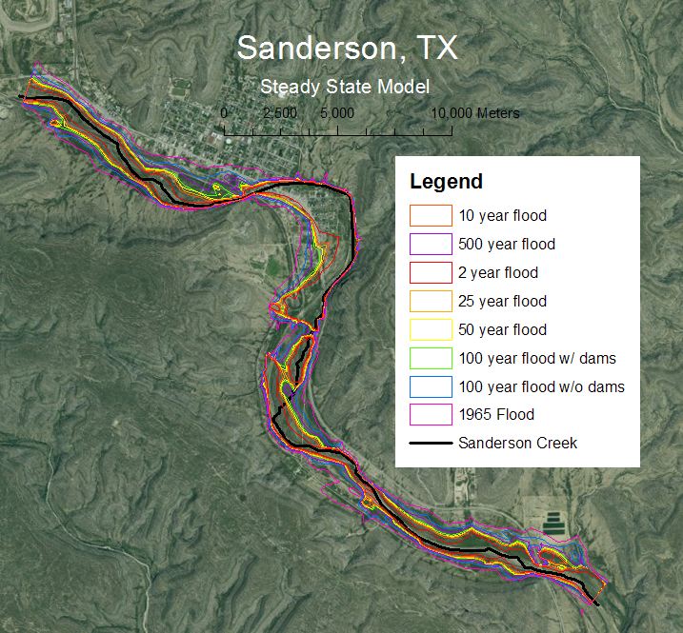
Results of Steady State Model
Disclaimer: Map is based on 10 m digital terrain model that is too coarse to define an accurate floodplain

Slide 12
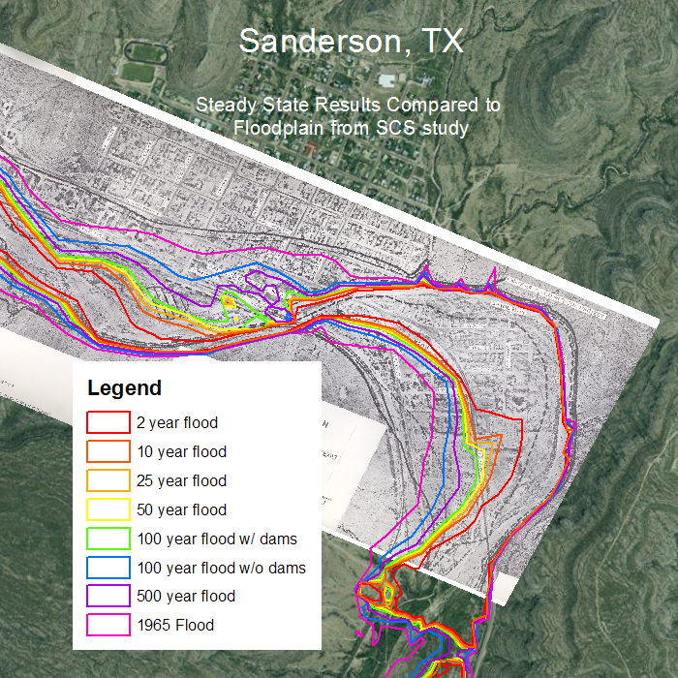
Results compared to SCS Report…
Disclaimer: Map is based on 10 m digital terrain model that is too coarse to define an accurate floodplain

Slide 13
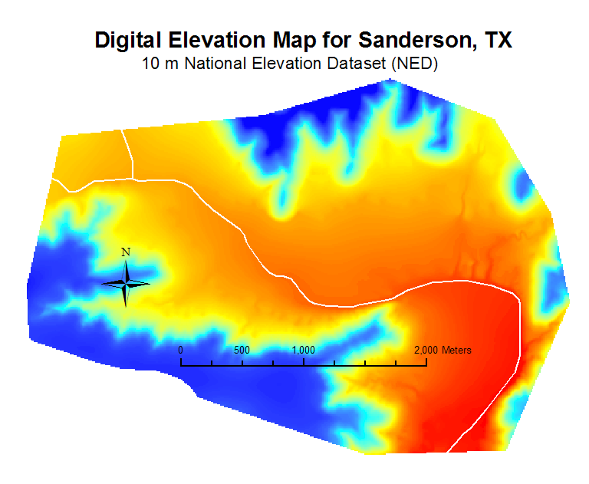
…the reason why

Slide 14
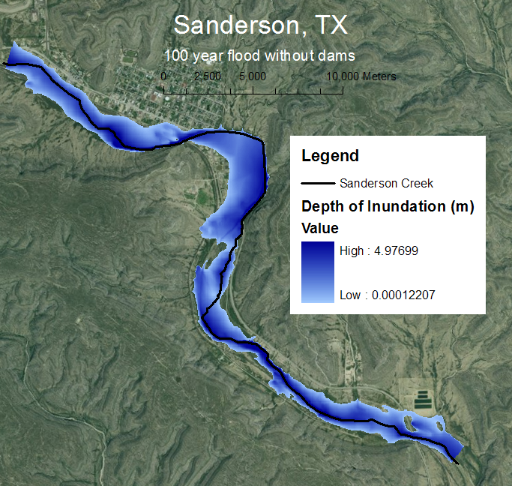
100 year flood without dams
Disclaimer: Map is based on 10 m digital terrain model that is too coarse to define an accurate floodplain

Slide 15
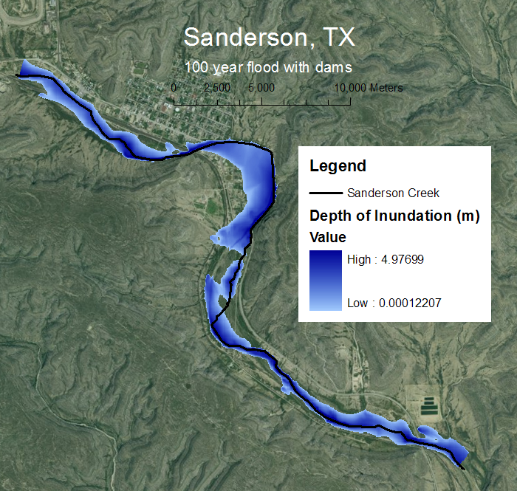
100 year flood with dams
Disclaimer: Map is based on 10 m digital terrain model that is too coarse to define an accurate floodplain

Slide 16
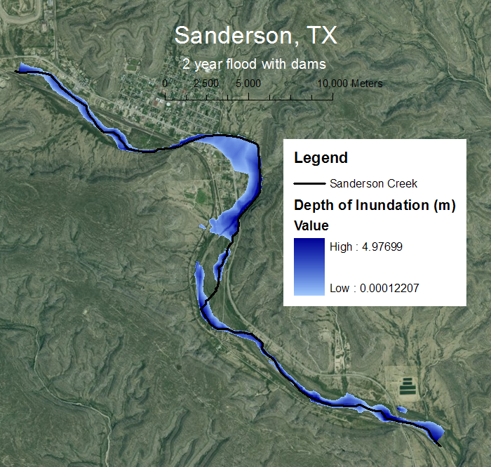
2 year flood with dams
Disclaimer: Map is based on 10 m digital terrain model that is too coarse to define an accurate floodplain

Slide 17
Conclusions
We need LIDAR data!!!
  Channel is not well defined with NED
  Streamlines delineated from NED do not match up with imagery and NHD flowlines
Differences in depth of inundation can be seen for floods of different return periods

Slide 18
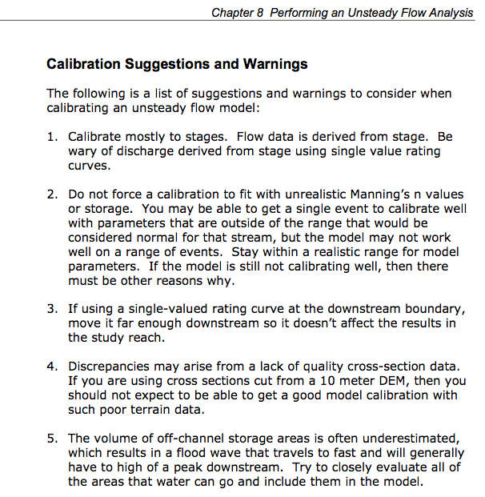
From HEC-RAS User’s Manual

Slide 19
Acknowledgements
Glenn Wright and others from AEcom
Darrel Seidel, Trent Street and others from the NRCS
Melinda Luna- TNRIS
Dr. Maidment
Laura Hurd, Cody Hudson, and Marcelo Somos

Slide 20
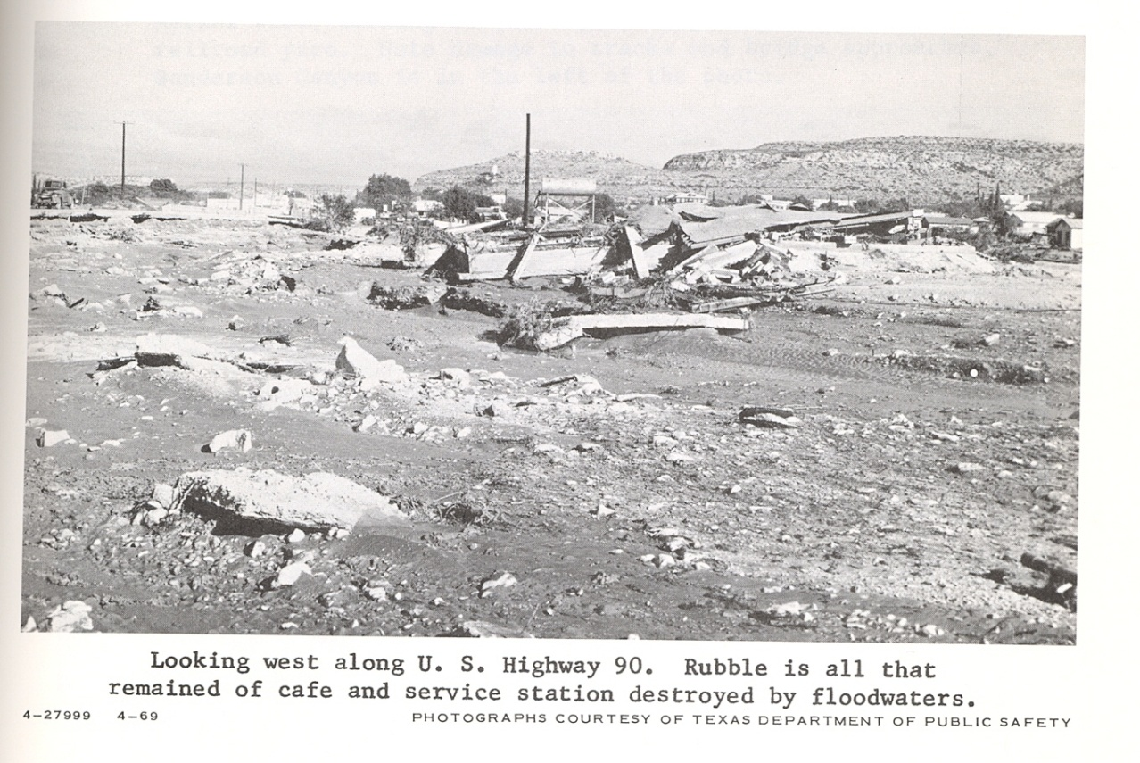
Questions
Source: Watershed Work Plan for Watershed Protection and Flood Prevention Sanderson Canyon Watershed, USDA’s Soil Conservation Service, November 1969
“It was like the last day on earth” -Edelmira Calzada, survivor of the 1965 flood

