Slide 1
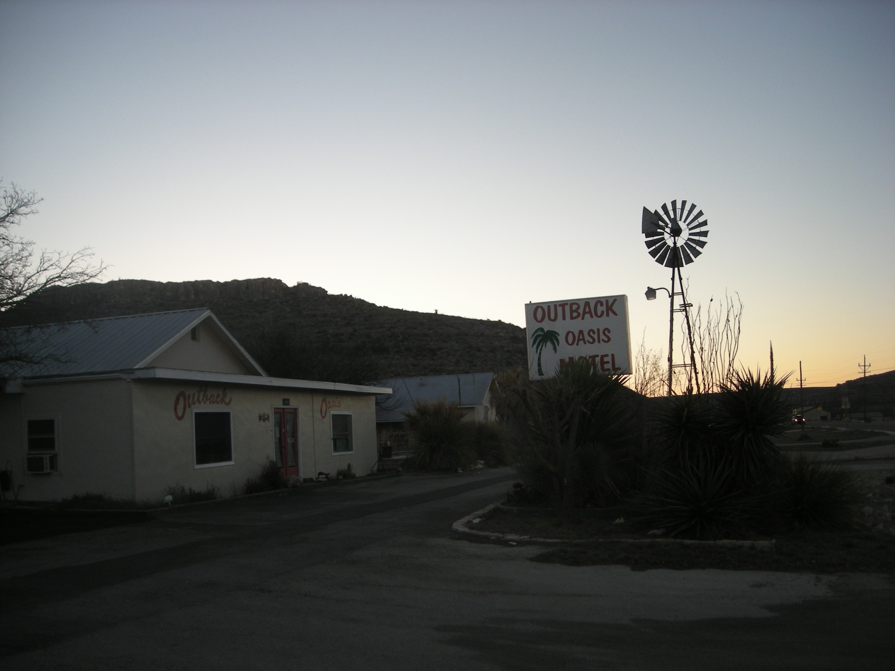
The Sanderson Project
Finding the S vs. Q relationship
By: Cody Hudson
Notes:
-Similar to HW7
-trying to find a relationship between storage and outflow so flow through the dam can be routed in HEC-HMS

Slide 2
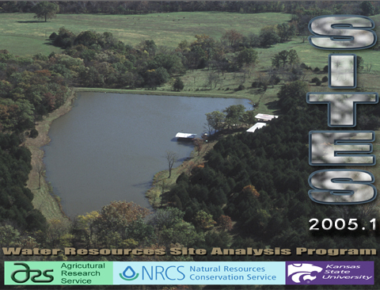
SITES Background
Water Resources “Site” Analysis Program
Developed for NRCS
Performs hydrologic and hydraulic analyses of water control structures
Calculates spillway stability

Slide 3
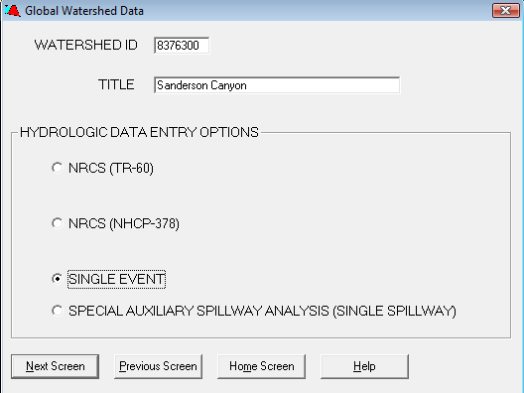

Single Event Analysis
Used to simulate design storm through existing structures
Calculates
  Inflow Hydrograph
  Outflow Hydrograph
  Spillway Stability
  Storage/Outflow
Notes:
-TR-60 does design of spillway elevation and material for large dams
-NHCP-378 does design of spillways for small dams less than 35 feet in height and with product of height (ft) and storage volume (acre-ft) less than 3,000

Slide 4
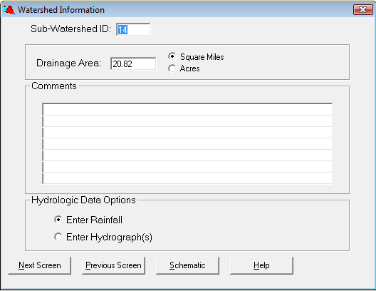
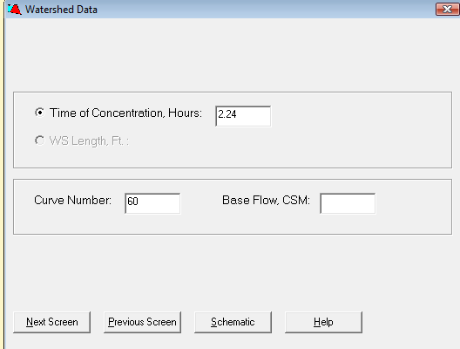
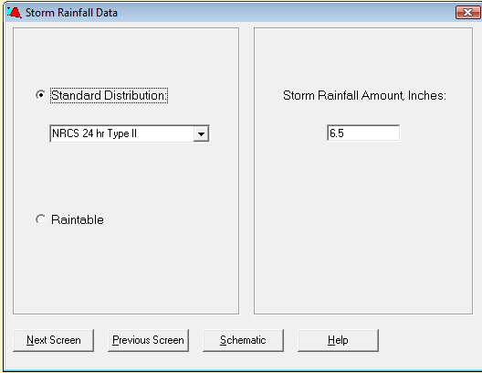
Hydrology (Inflow)
Enter Rainfall or Hydrograph
Calculate SCS Hydrograph based on
  Basin characteristics
  Rainfall amount
  Rainfall distribution
Notes:
-If you have a gage near the end of the basin you could use a hydrogaph
-Time of Concentration taken from previous NRCS study
-Curve number originally calculated in NRCS study but a different number was determined because of new research at Texas Tech (authors suggested taking calculated CN and subtracting 20 or using Antecedent Moisture Condition (AMC I)
-TR-55 gives storm rainfall and distribution for Eastern United States

Slide 5
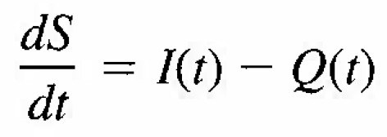
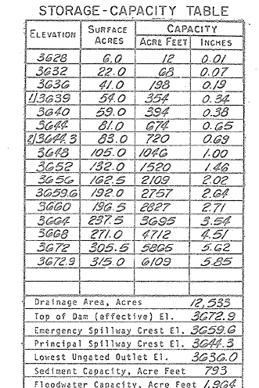
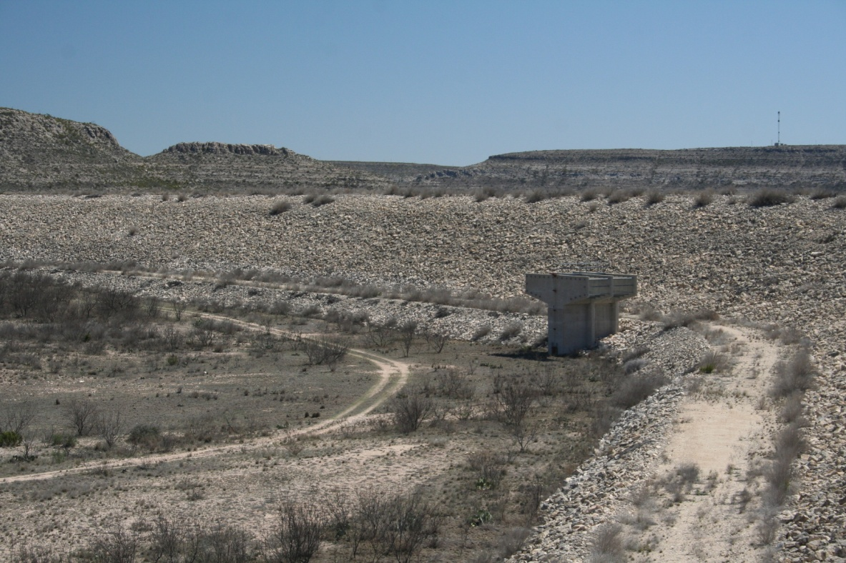
Elevation-Storage
dE(S)
E(S)=Elevation function of storage

Slide 6
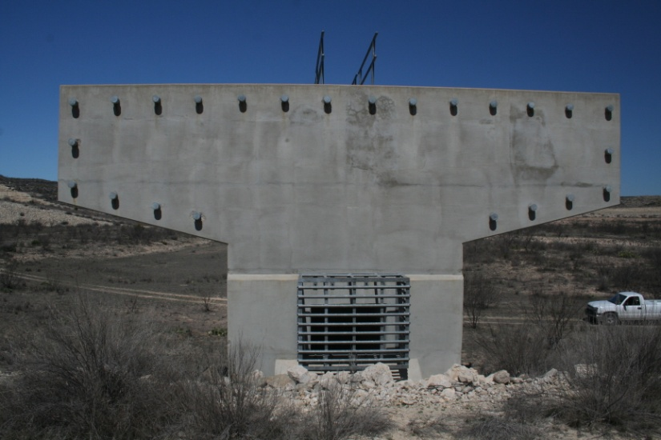
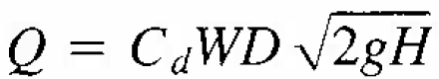
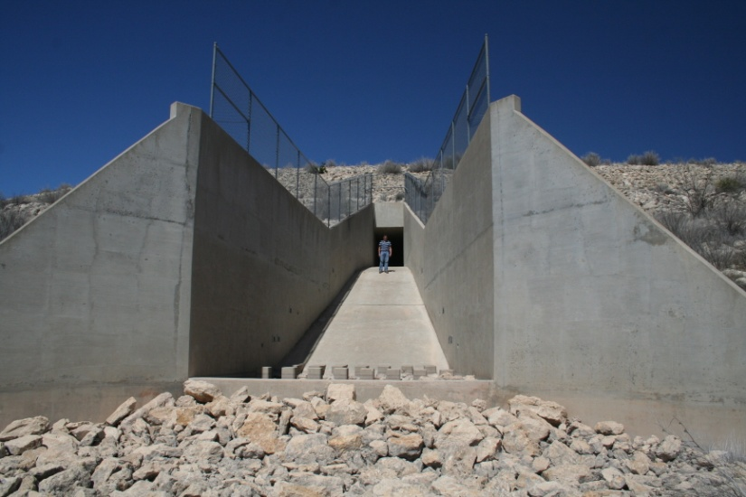
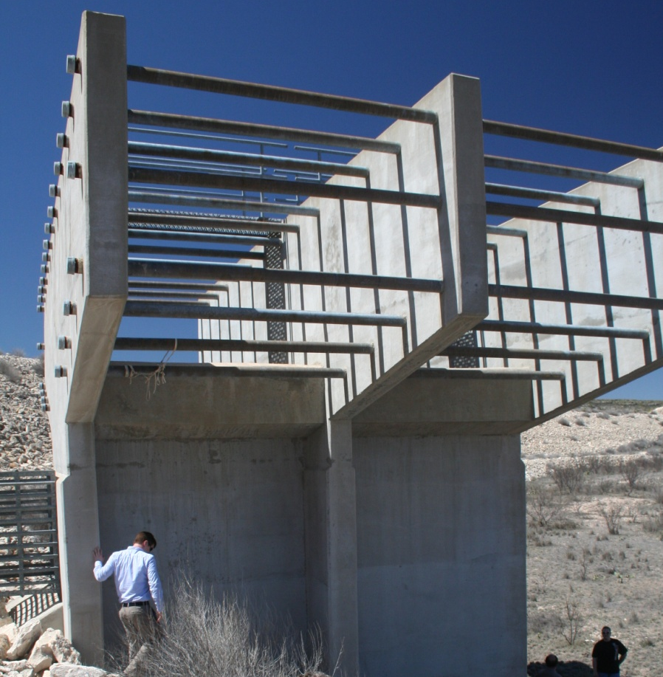
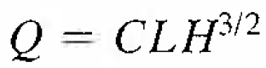
Hydraulics(Outflow)
Principal Spillway
  Orifice flow
  Weir flow
W
D
L

Slide 7
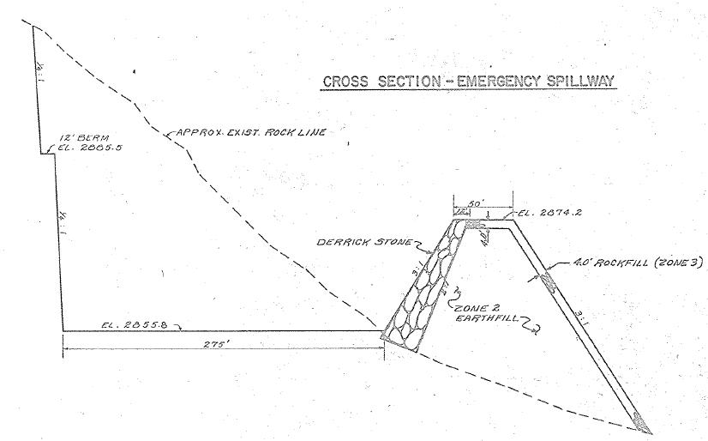
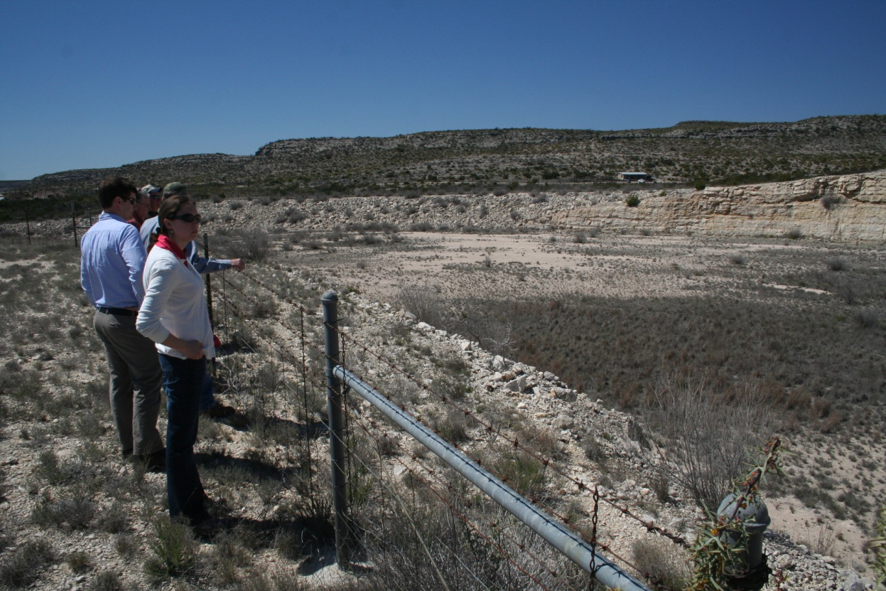
Hydraulics
(Outflow)
Auxiliary Spillway
  Open Channel Flow
  Width
  Side Slope
  Channel Slope
  Length
  Manning’s n
Notes:
-Area (A) and hydraulic radius (R) are functions of water depth (H)

Slide 8
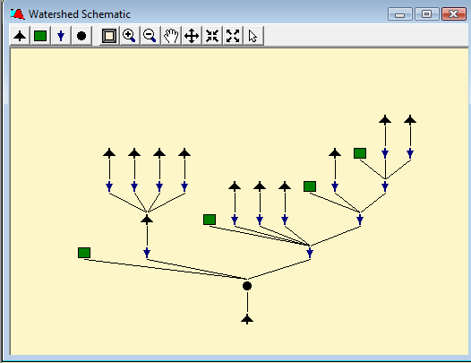
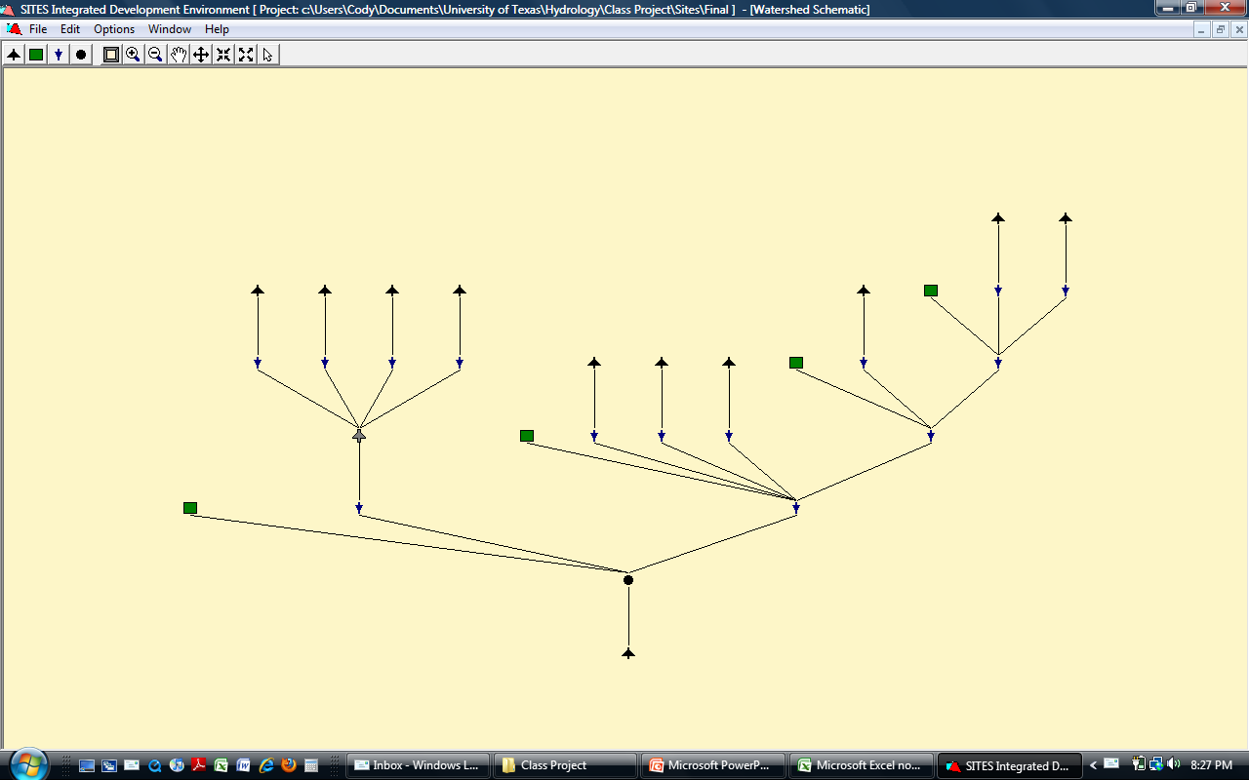
Watershed Schematic
Structure
Reach
Junction
Uncontrolled
Subwatershed
Notes:
-Graphical user interface similar to HEC-HMS
-Four different elements
-Reaches are used to perform river routing
-Structures have an associated subwatershed (Hydrology and Hydraulic Input screens)
-Uncontrolled subwatersheds (hydrology input screen only)
-Junction used to combine hydrographs

Slide 9
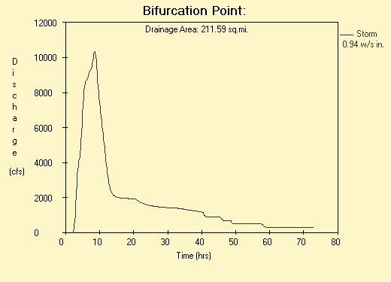
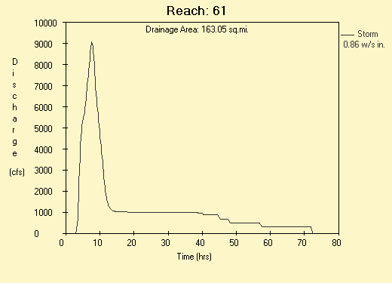
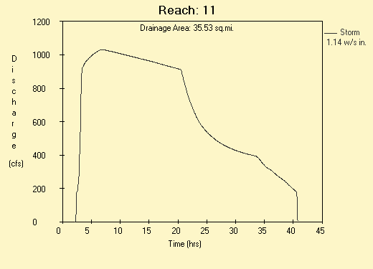
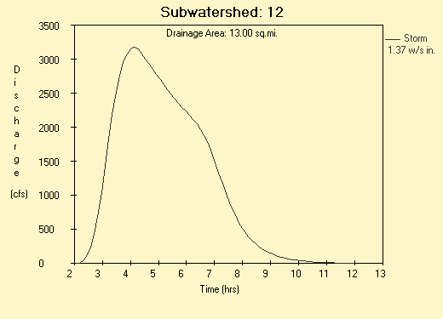
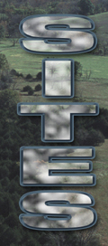
Sites Model
CN=60
6hr 100 year rainfall = 5.11 in
Peak Flow = 10,323 cfs @ 8.6 hr
Notes:
-6 hr rainfall taken from 1981 NRCS study
-CN=60 was selected based on SCS AMCI

Slide 10
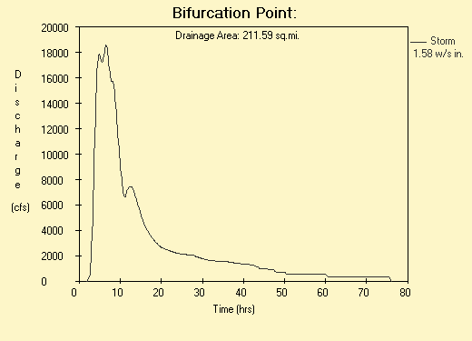
Sites Model
CN=74
6hr 100 year rainfall = 5.11 in
Peak Flow = 18590 cfs @ 6.5 hr

Slide 11
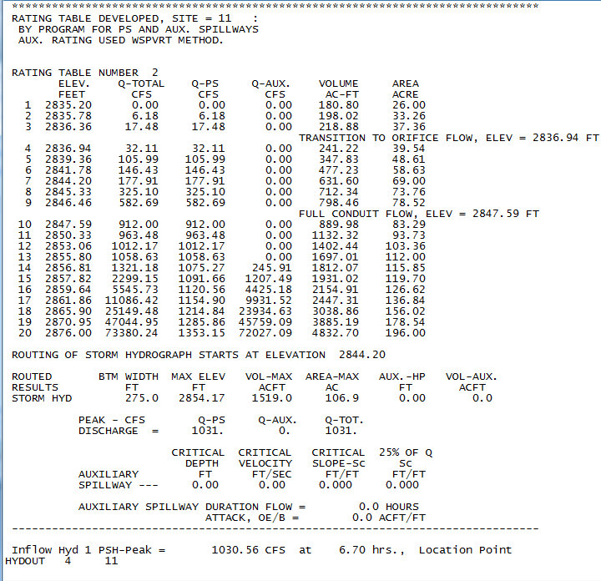
Site 11
Notes:
-after running model output text files for each structure are generated

Slide 12

Questions

