Slide 1
Terrain Processing of Sanderson, Texas
Laura Hurd

Slide 2
Overview
Terrain overview
Flood of 1965
Terrain Pre-Processing
Terrain Accuracy
Dams
Flooding

Slide 3
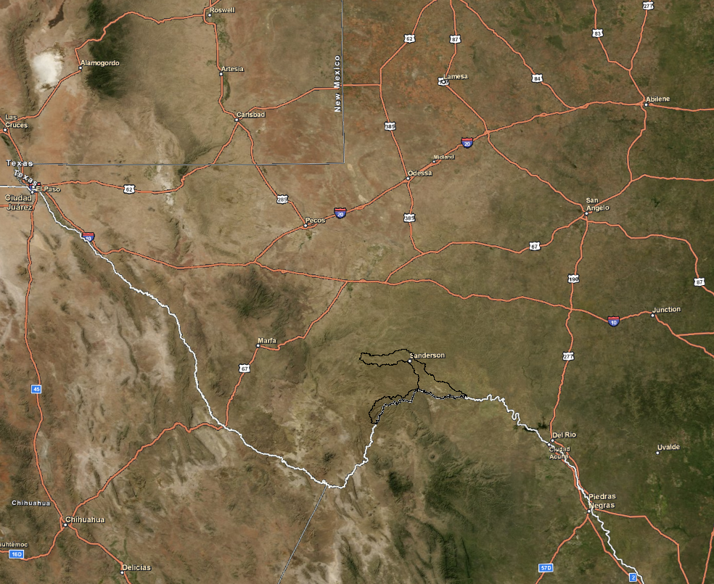
Terrain overview: Sanderson HUC 8-13040208

Slide 4
Terrain Overview: 2500ft drop over 30 miles= 1.7% Slope

Slide 5
Terrain overview: Zoom-in of Sanderson Terrain (ft)

Slide 6
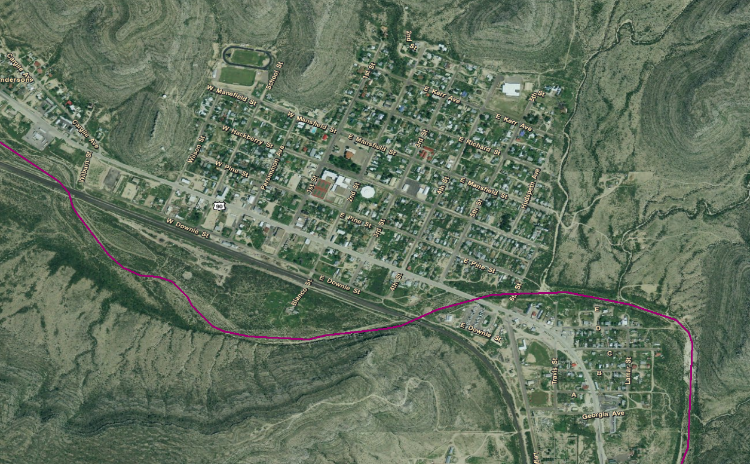
Flood of 1965 (100,000cfs)

Slide 7
Terrain Pre-Processing
NED data was 1/3 arcsecond (~10m) (http://seamless.usgs.gov)
projected the grid with NAD 1983 UTM Zone 13N
Used 100K NHDPlus flow-lines
Used Basic Dentritic Terrain Processing tool to get flow accumulation, catchments etc.
First Burned the NHD flowlines to get the AGREE-DEM

Slide 8
Terrain Accuracy
Compared DEM with geodetic benchmarks
benchmarks had A or B stability and an elevation datum of NAVD88
Average difference is 6.1ft between the benchmarks and DEM
Standard Deviation of the difference= 4.59ft
The accuracy prescribed by FEMA is 2.4ft
Ortho-imagery quads used to compare terrain with DEM
1:12,000 digital, mosaic 7.5 minute quads (http://datagateway.nrcs.usda.gov/)

Slide 9
Terrain Accuray: 1:12,000 digital Ortho-imagery quads, mosaic 7.5 minute quads (http://datagateway.nrcs.usda.gov/)

Slide 10
Dams: DEM (ft) with 11 dam sites

Slide 11
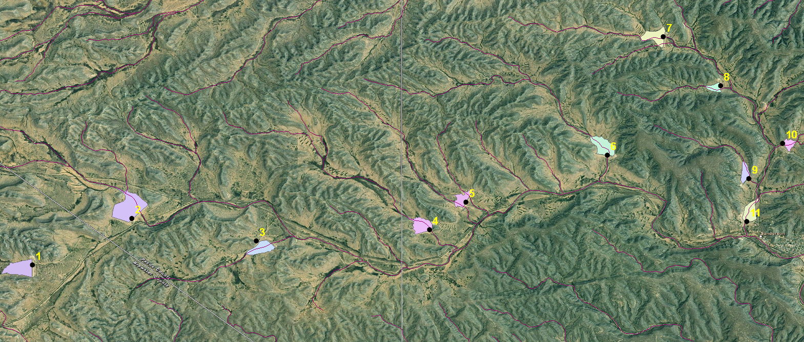
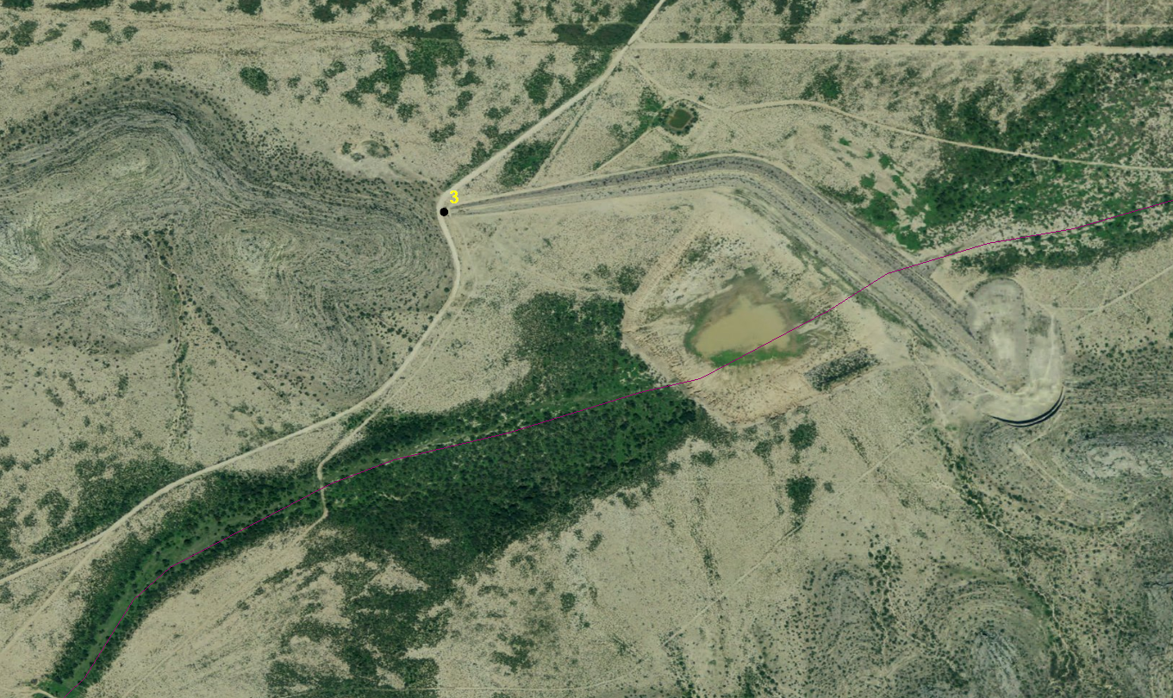
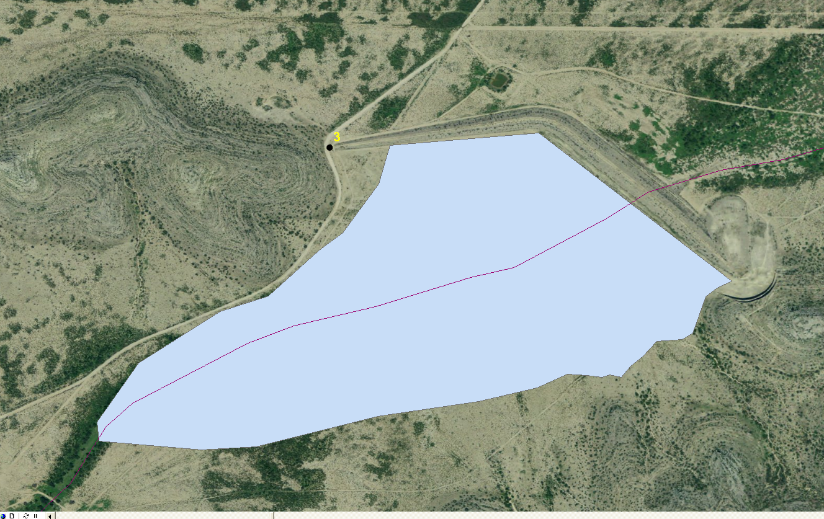
Dam capacity

Slide 12
Flooding: Water Surface elevation (meters) of 1965 Flood (100,000cfs)

Slide 13
Flooding: Depth(meters) of 1965 Flood (100,000cfs)

Slide 14
100 yr. flood without dams (72,268 cfs)
100 yr. flood with dams (16,224 cfs)
1965 Flood (100,000cfs)

Slide 15
Flooding: NHD vs. Delineated stream without burning

Slide 16
Flooding: Original DFIRM vs. Flow Produced in GIS

Slide 17
Conclusion
Terrain is not accurate enough for this study
Need more accurate LIDAR terrain data

