Slide 1
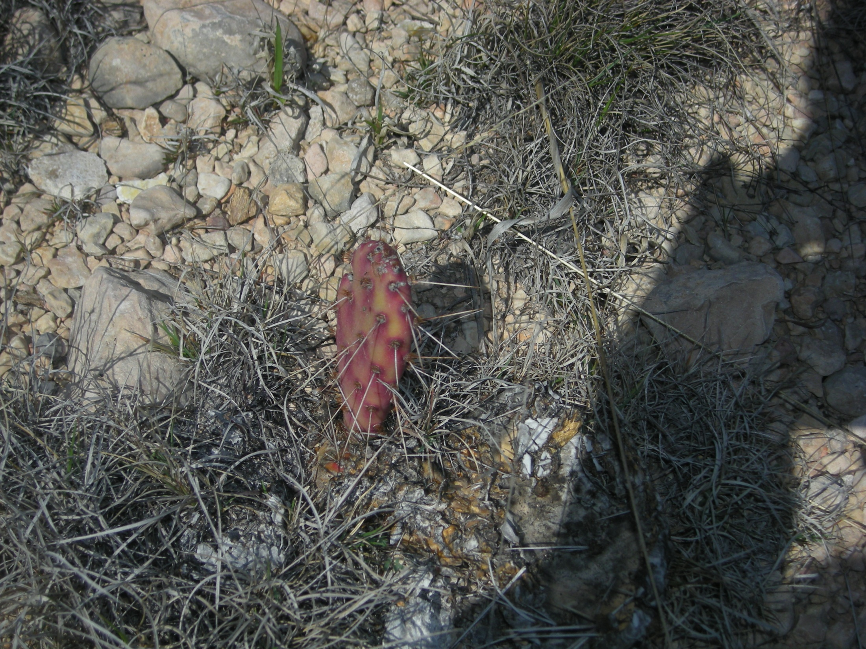
Sanderson Hec-HMS Hydrology model
Marcelo Somos

Slide 2
Introduction
On June 11, 1965, Sanderson was devastated by a flash flood
A wall of water roared down Sanderson Canyon into Sanderson destroying numerous homes and businesses
More than twenty people died in the flood

Slide 3
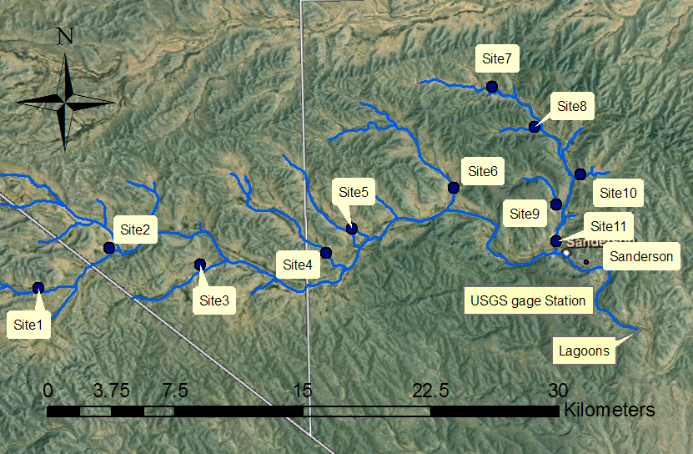
Cont.

Slide 4
Objectives
Determine a design storm for 24 hours and 6 hours duration and determine which of them gives the highest pick flow .
Calibrate the 100 years flood with the results of the USGS regression curve.
Estimate the 2, 10, 25, 50, 100 and 500 years flood including the dams in the simulation model.

Slide 5
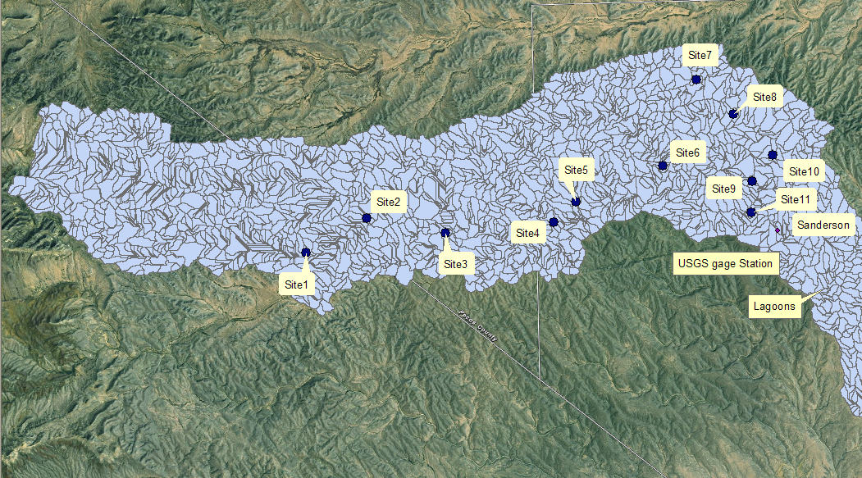
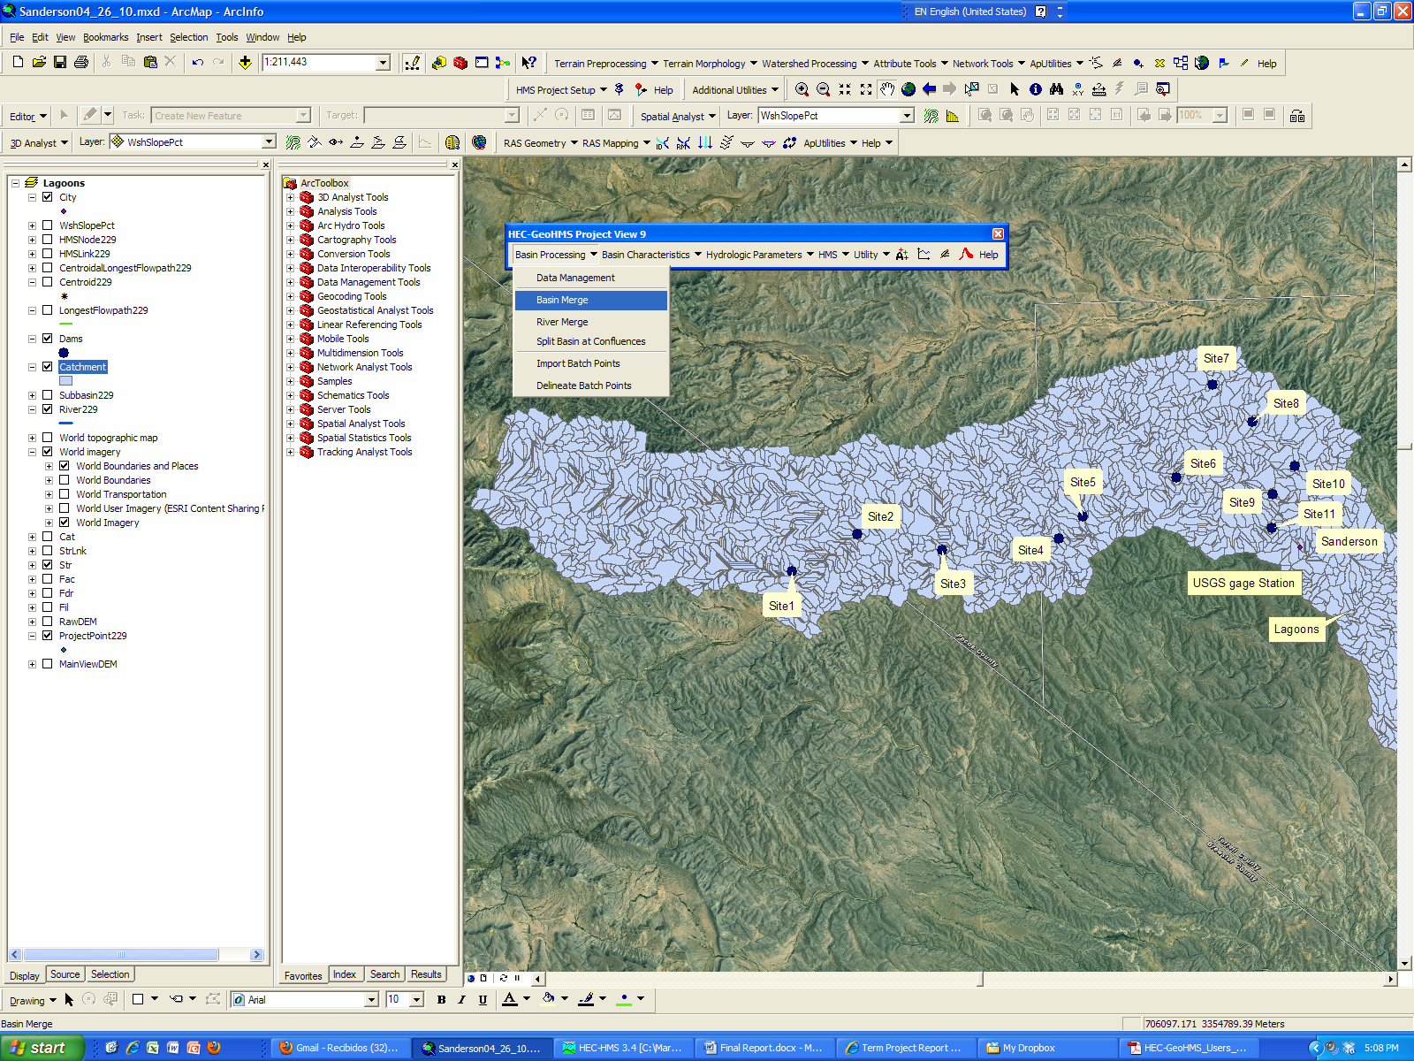
Methods: HEC-geoHMS
Basin processing

Slide 6
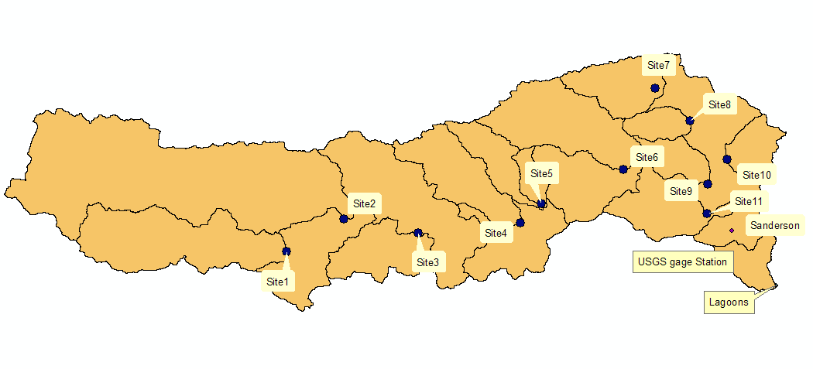
Cont.

Slide 7
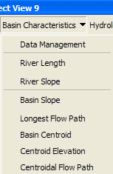
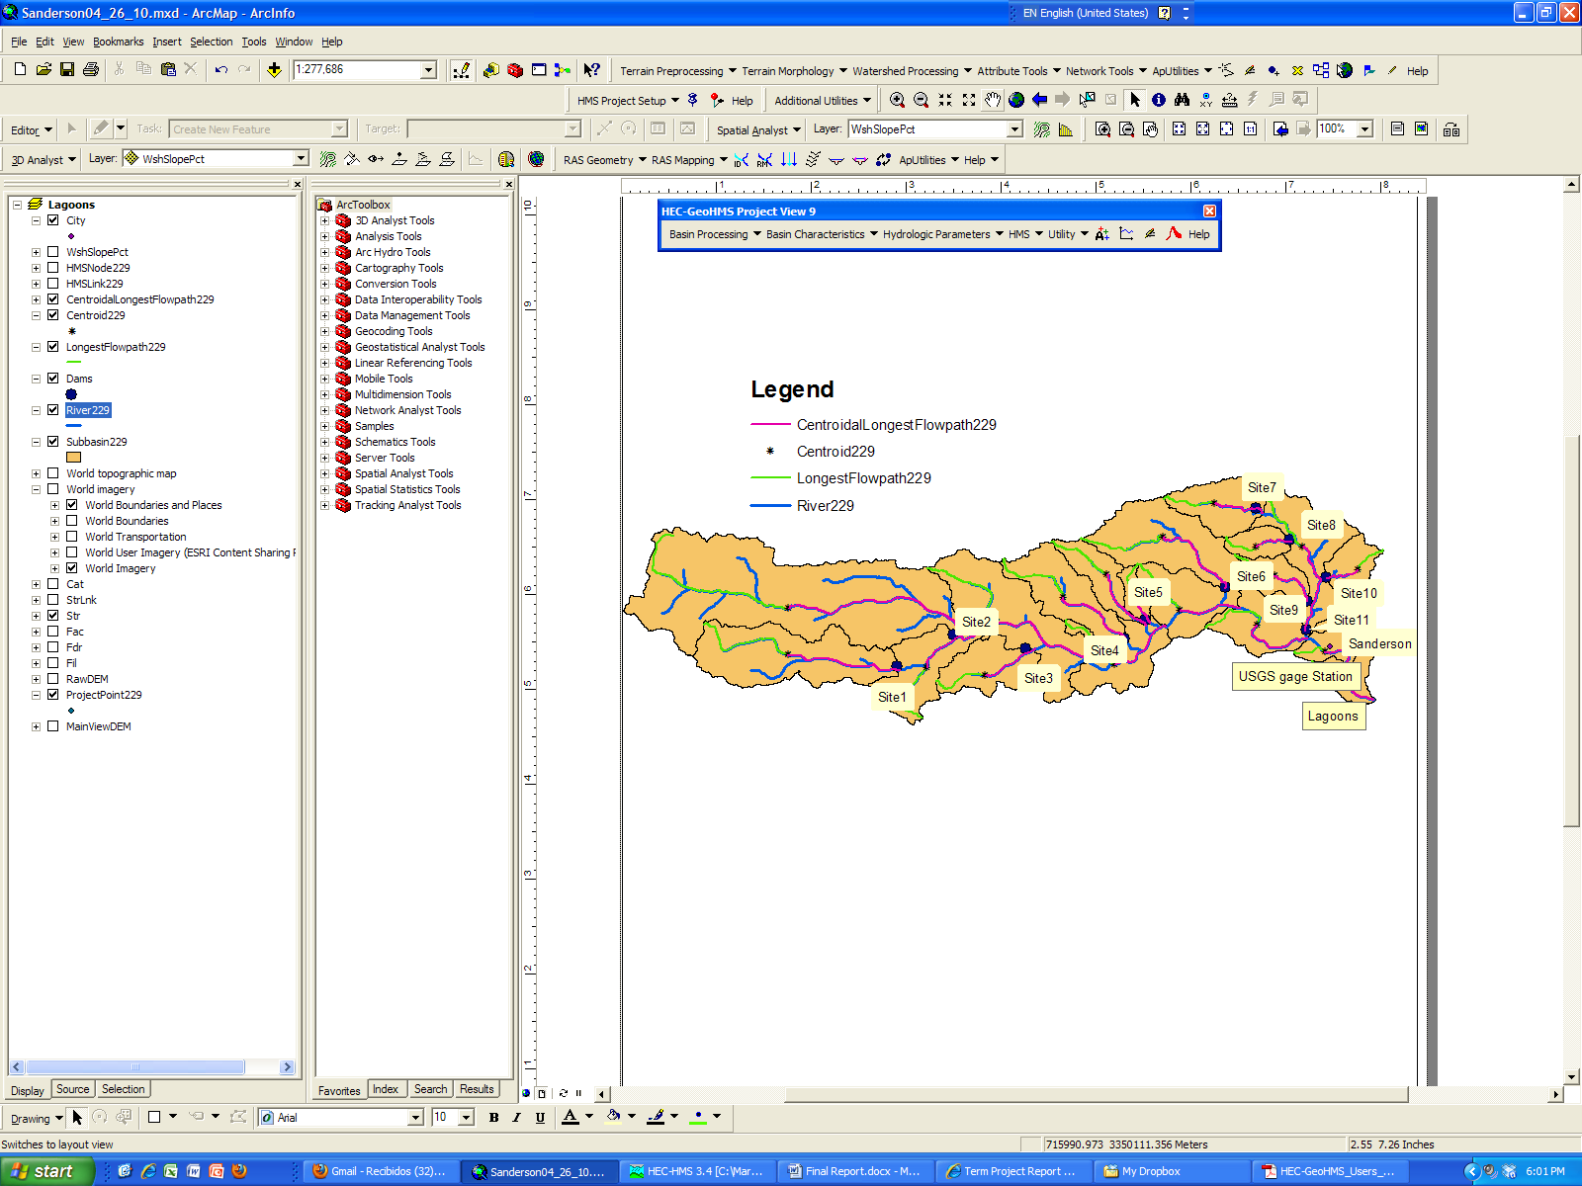
Cont.
Basin Characteristics

Slide 8
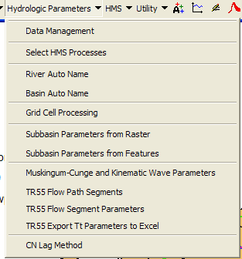
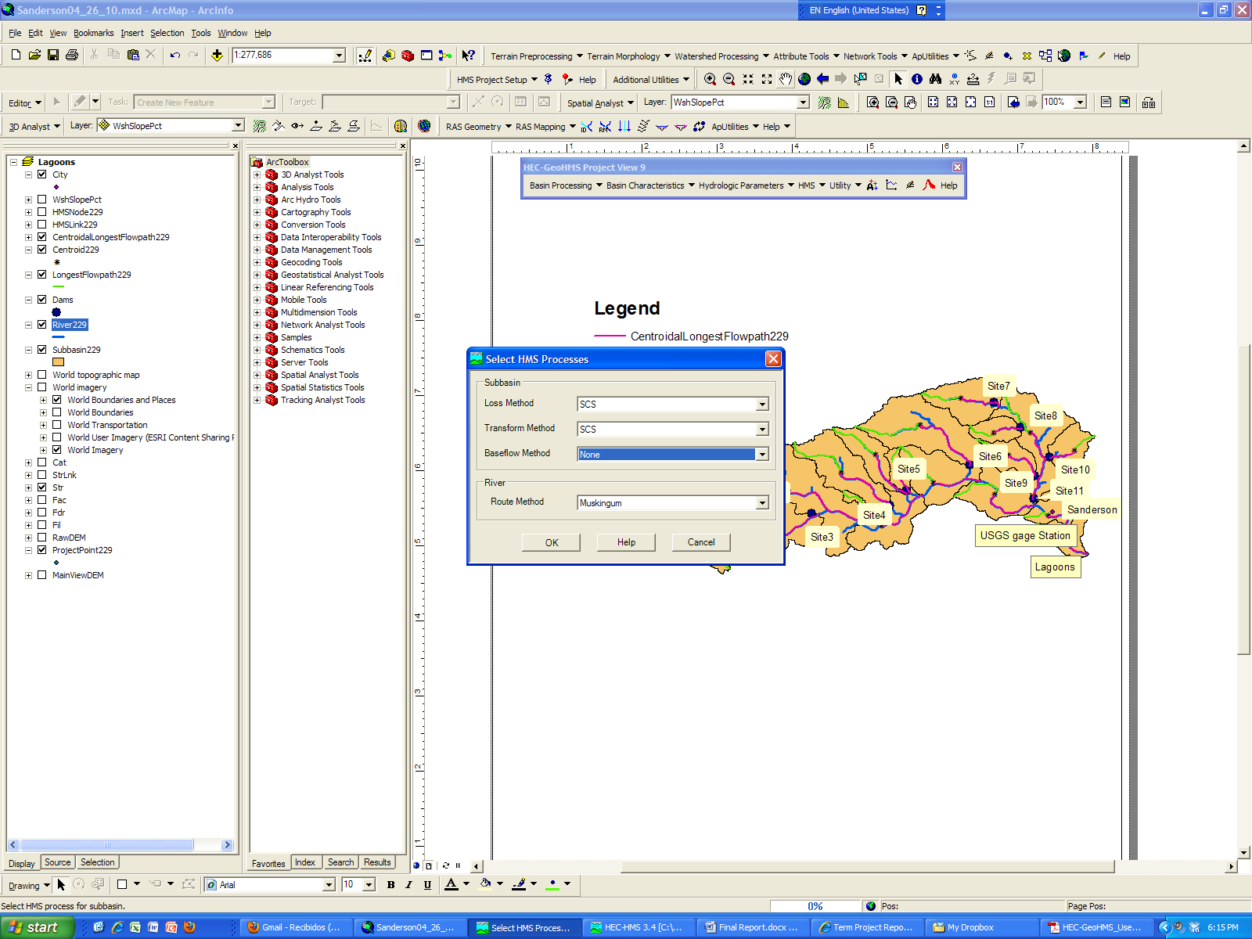
Hydrologic Parameters
Muskingum
x=0.2 natural channels
K=length/velocity (v=2.5 m/s)

Slide 9
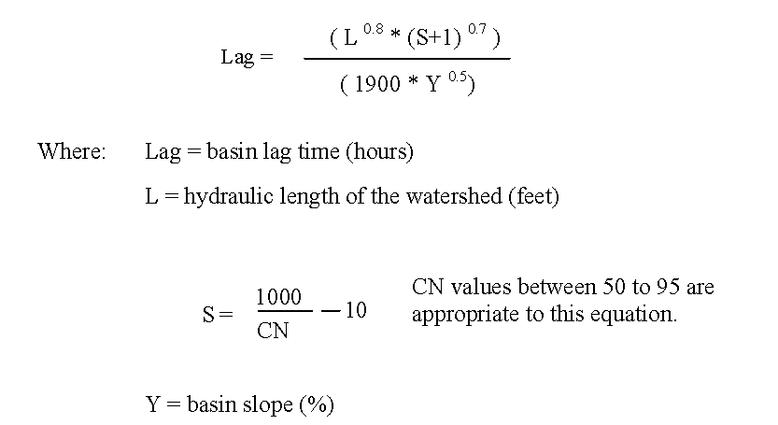
Cont.
CN Lag method

Slide 10
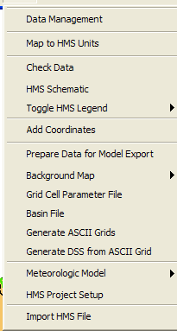
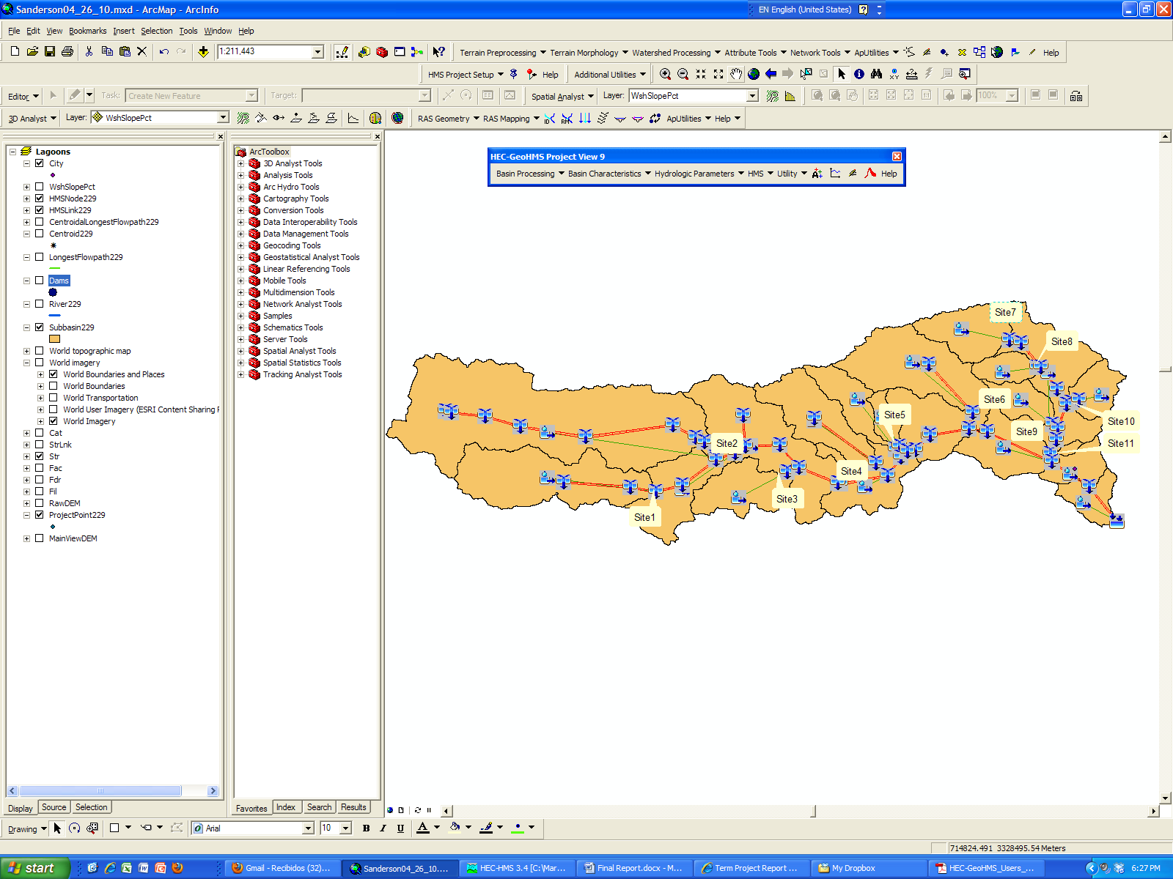
HEC-geoHMS to HEC-HMS

Slide 11
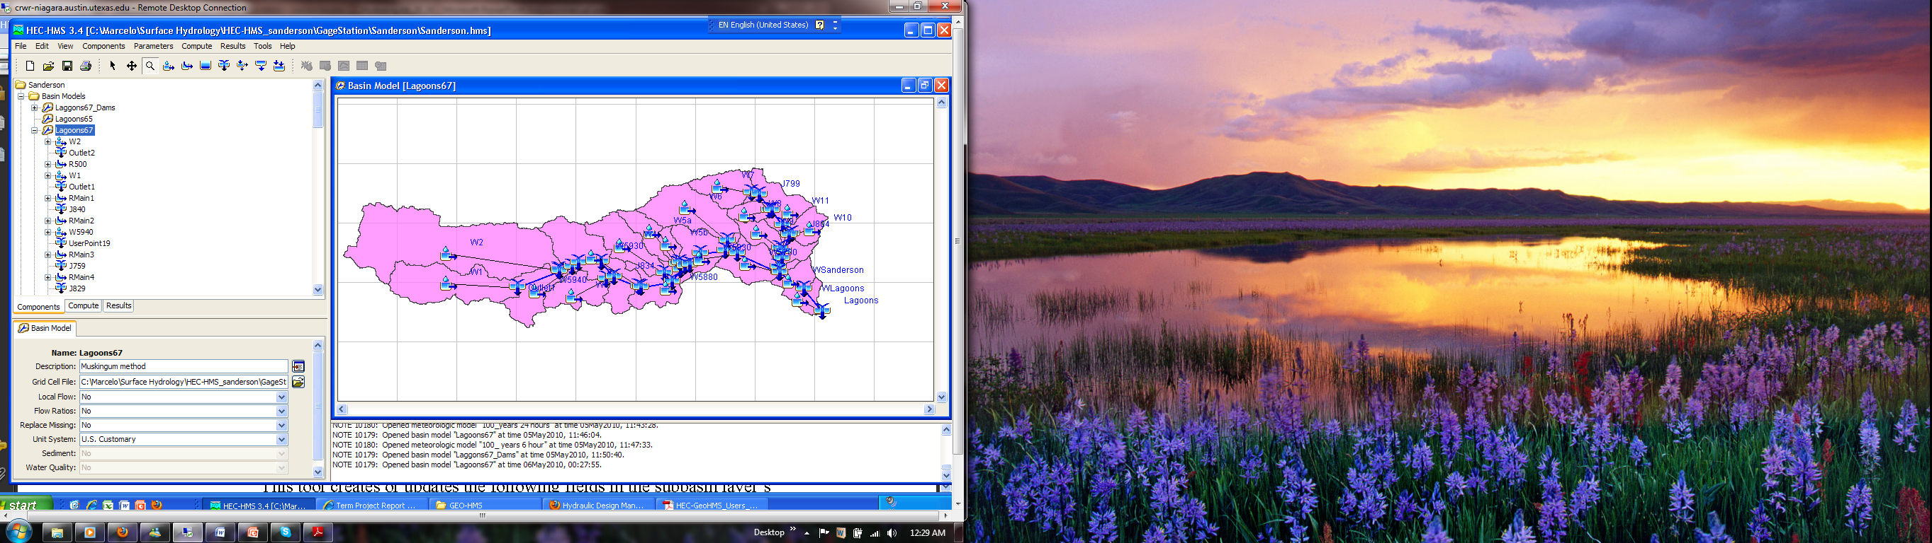
HMS

Slide 12
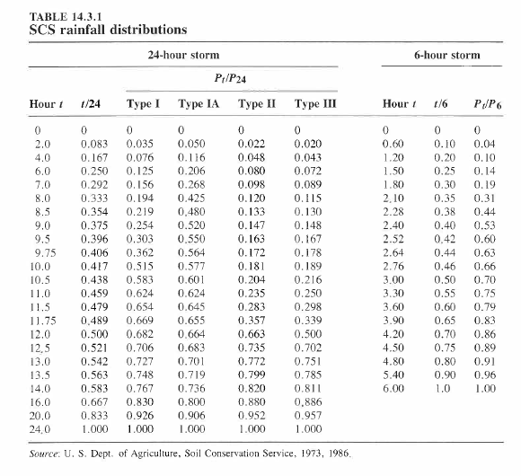
Design storm

Slide 13
Cont

Slide 14
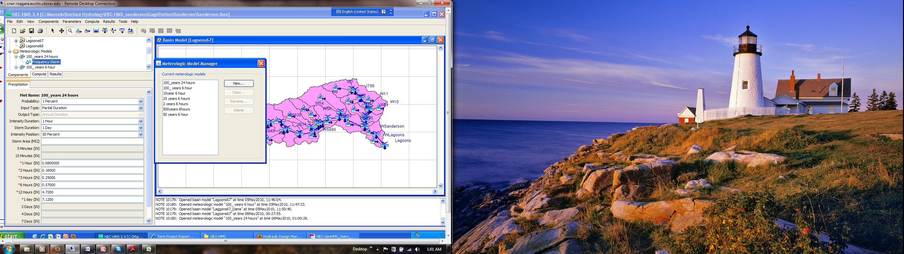
Cont.

Slide 15
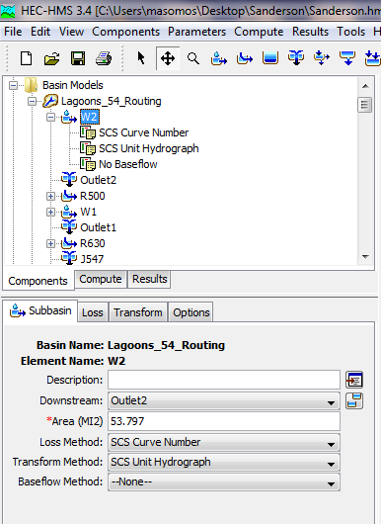
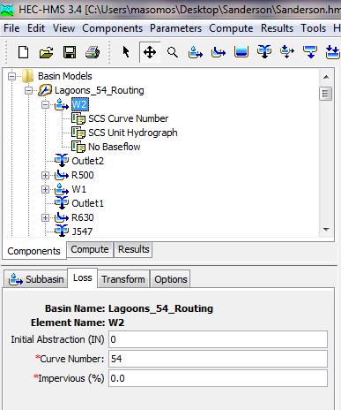
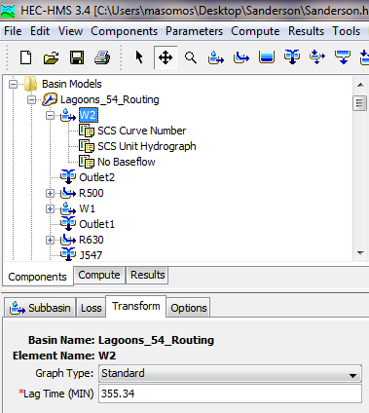
Watershed model and parameters

Slide 16
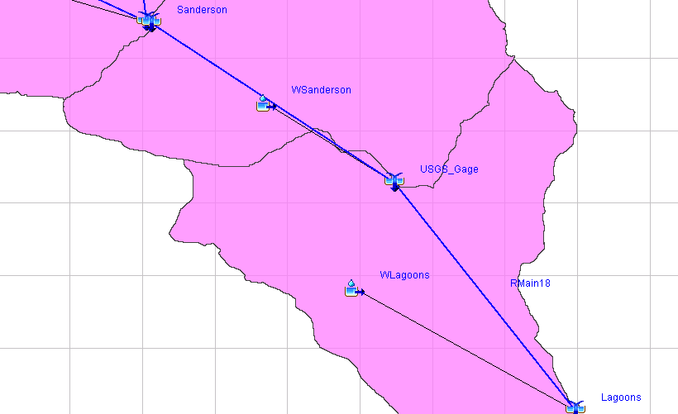
Run the model

Slide 17
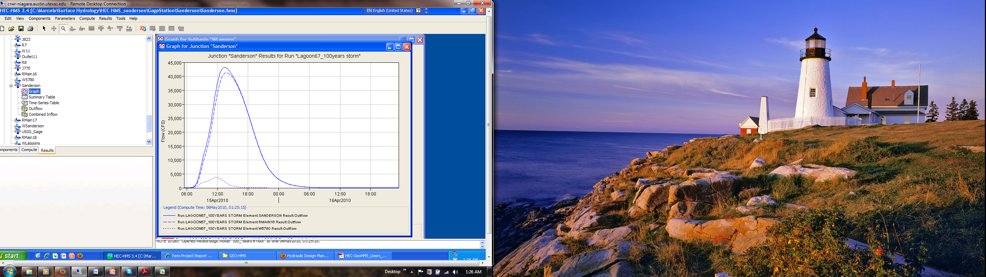
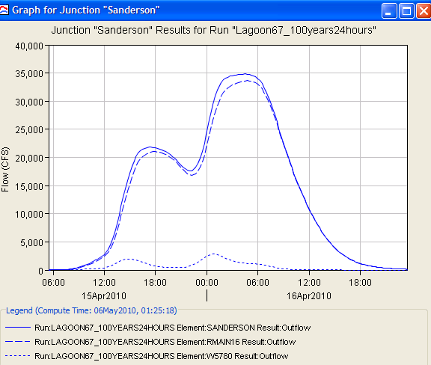
Cont.
At Sanderson junction:
6 hours rainfall 43214 CFS 24 hours rainfall 34818 CFS

Slide 18
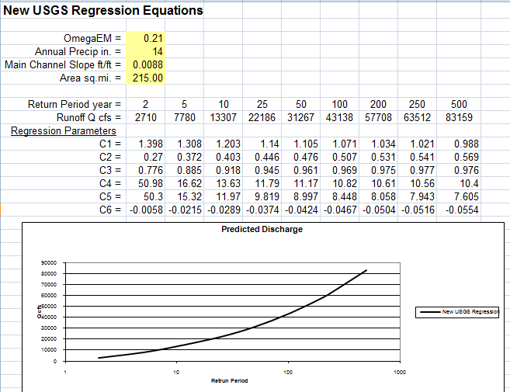
Calibration
CN= 67 ⇒43212 CFS
William H. Asquith, Ph.D., P.G.
Research Hydrologist
U.S. Geological Survey, Lubbock, Texas

Slide 19
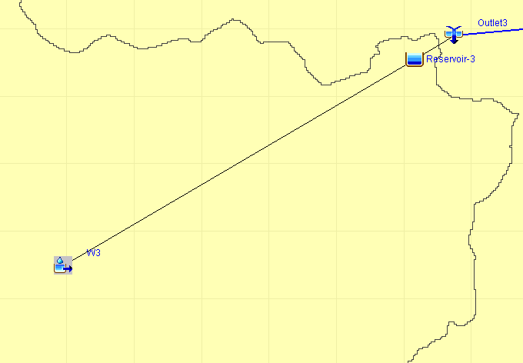

Dams
11 dams were included in the model

Slide 20
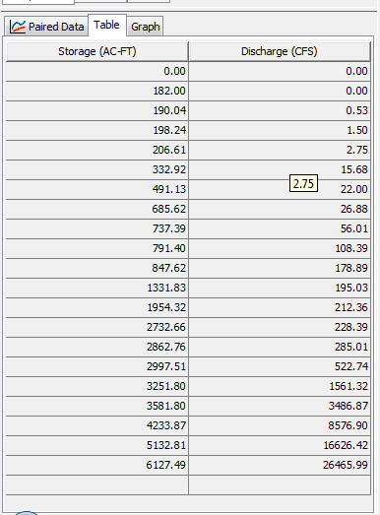
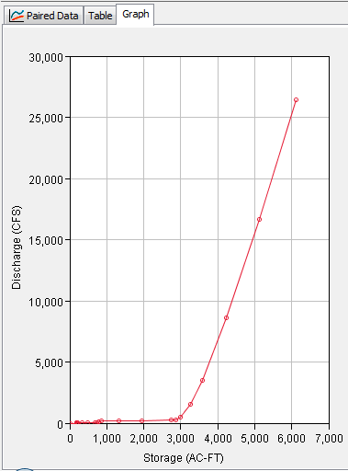
Dams storage flow curves

Slide 21
Cont.

Slide 22
Result

Slide 23
Conclusions
The 100 years design storm for a duration of 6 hours gives a higher peak outflow than a storm for a duration of 24 hours.
As a result of the calibration the CN used in the modelation has a value of 67.
The peak outflow for a design storm for 6 hours duration with return period of 2, 10, 25, 50, 100 and 500 is 2904, 8717, 11363, 13220, 16043 and 26730 CFS respectively.

Slide 24
Questions?

