Slide 1
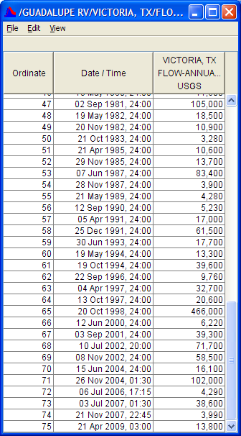
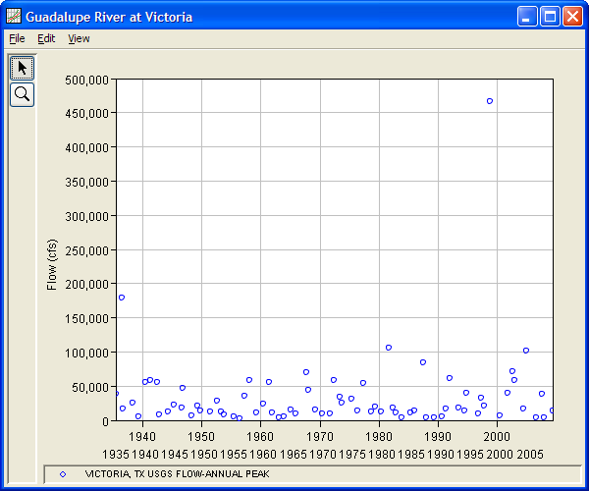
Flood Peak Data – Guadalupe River at Victoria, Texas, 1935-2009
Example 12.4.1 in book 1935-1979

Slide 2
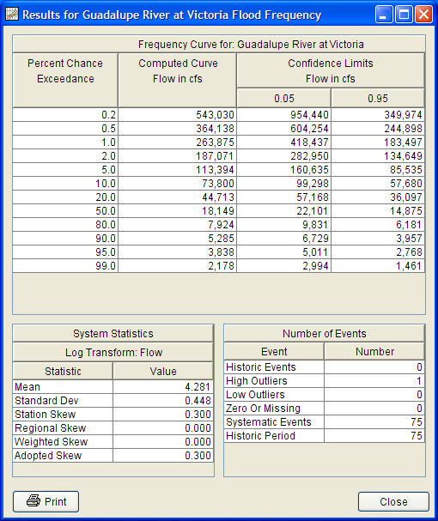
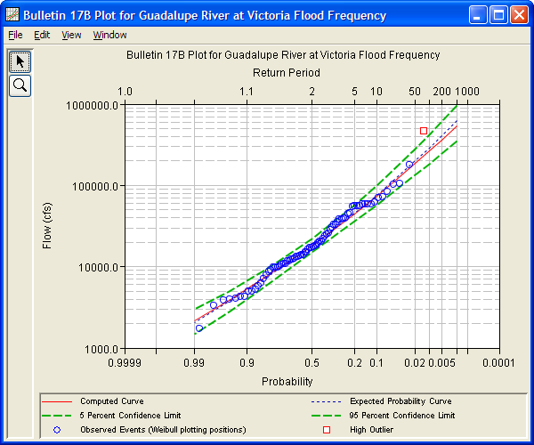
Flood Frequency Analysis – 1935 to 2009, n = 75 years of data

Slide 3
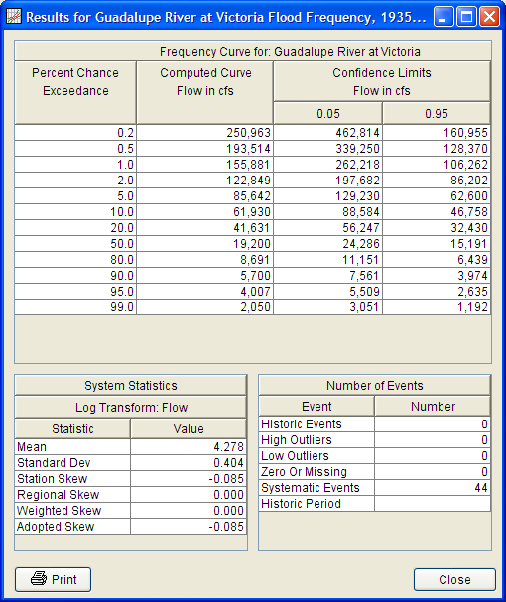
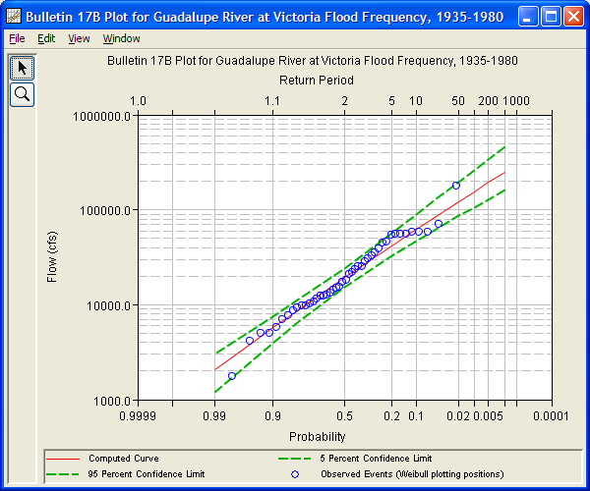
Flood Frequency Analysis, 1935-1979 n = 44 years of data

