Slide 1
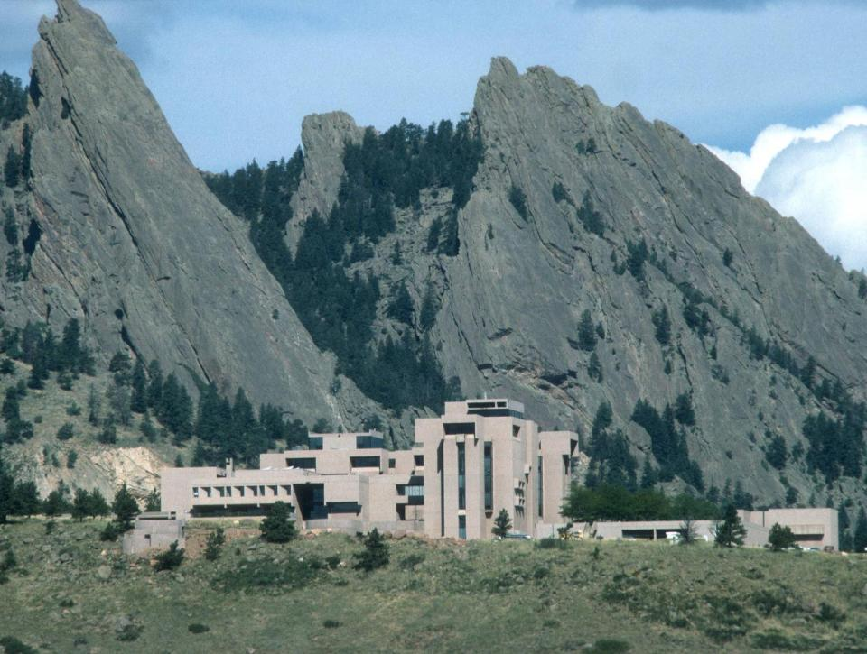
Water Resource Planning Options for Climate Change
David Yates and Kathleen Miller
NCAR – Boulder, CO
UT Austin 25 Feb 2010
“Science exists to serve human welfare. It’s wonderful to have the opportunity given us by society to do basic research, but in return, we have a very important moral responsibility to apply that research to benefiting humanity.” Dr. Walter Orr Roberts (NCAR founder)
Notes:
“I have a very strong feeling that science exists to serve human welfare. It’s wonderful to have the opportunity given us by society to do basic research, but in return, we have a very important moral responsibility to apply that research to benefiting humanity.”
Walter Orr Roberts

Slide 2
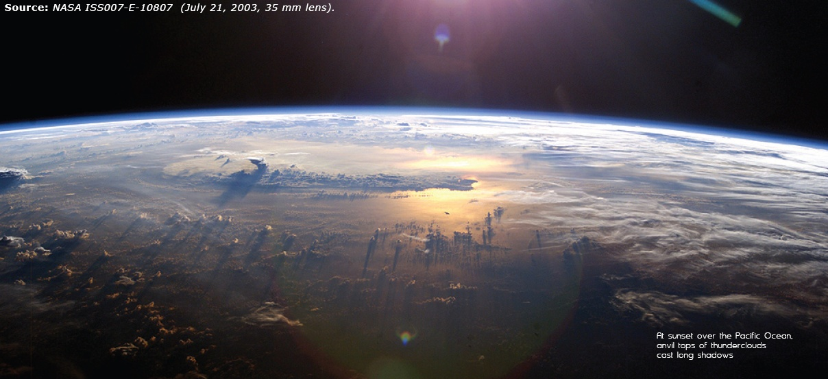
Notes:
Discussion About greenhouse gases and CO2
Preponderance of evidence..
The team first confirmed a theory that the slight increase in solar energy during the peak production of sunspots is absorbed by stratospheric ozone. The energy warms the air in the stratosphere over the tropics, where sunlight is most intense, while also stimulating the production of additional ozone there that absorbs even more solar energy. Since the stratosphere warms unevenly, with the most pronounced warming occurring at lower latitudes, stratospheric winds are altered and, through a chain of interconnected processes, end up strengthening tropical precipitation.
At the same time, the increased sunlight at solar maximum causes a slight warming of ocean surface waters across the subtropical Pacific, where Sun-blocking clouds are normally scarce. That small amount of extra heat leads to more evaporation, producing additional water vapor. In turn, the moisture is carried by trade winds to the normally rainy areas of the western tropical Pacific, fueling heavier rains and reinforcing the effects of the stratospheric mechanism.

Slide 3
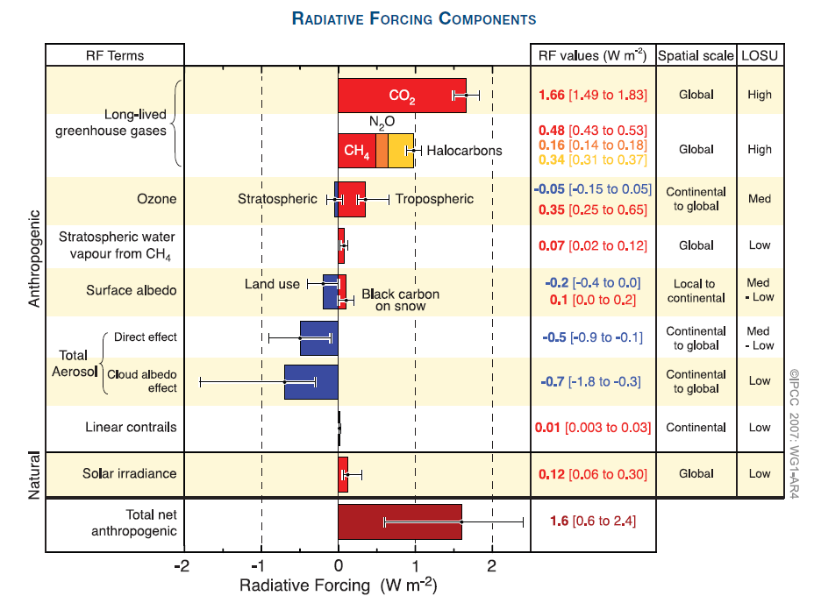
Notes:
Three Climate Change Hypotheses –
The human influence is minimal and natural variations dominate climate variations on all time scales;
While natural variations are important, the human influence is significant and involves a diverse range of first-order climate forcings (including, but not limited to the human input of CO2 );
Human influence is dominated by the emissions into the atmosphere of greenhouse gases, particularly carbon dioxide.

Slide 4
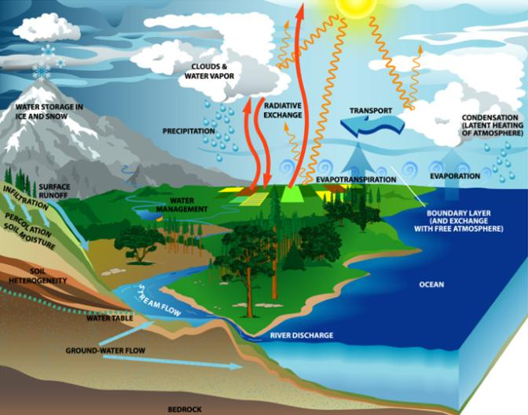
Warming accelerates the hydrologic cycle
Surface temperature Evaporation
Water holding capacity
Atmospheric moisture
Enhanced Greenhouse Rain intensity
Rain frequency ?
Floods & Droughts
Notes:
One of the things that we know FOR SURE is that warming will accelerate the hydrologic cycle. That means that as the Earth’s climate becomes warmer, there will inevitably be significant impacts on water resources. As the moisture content of the atmosphere increases – that causes a positive feedback which further enhances warming –water vapor is, itself, a powerful GHG.

Slide 5
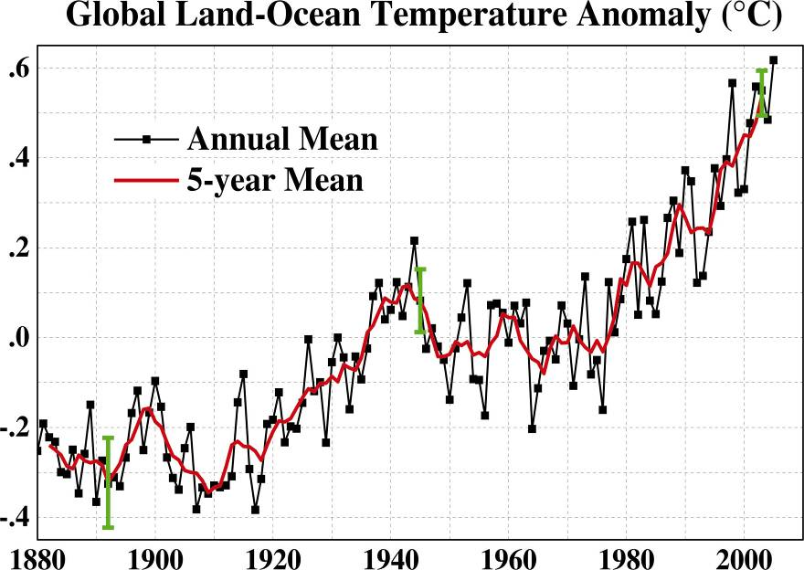
Global surface temperature since 1880
°C
Green bars show 95% confidence intervals
2005 was the hottest year on record; the 13 hottest all occurred since 1990, 23 out of the 24 hottest since 1980.
J. Hansen et al., PNAS 103: 14288-293 (26 Sept 2006)

Slide 6
Water Resource Impacts
Most likely:
  Global precipitation ↑~ 1- 2% per 1ºC
  Snow season shorter→ earlier peak flow
  Glacial wastage → summer flow ↑ near-term, but ↓ long-term
  Sea level rise → saltwater intrusion, coastal flooding
  Intense precipitation → water quality impacts

Slide 7
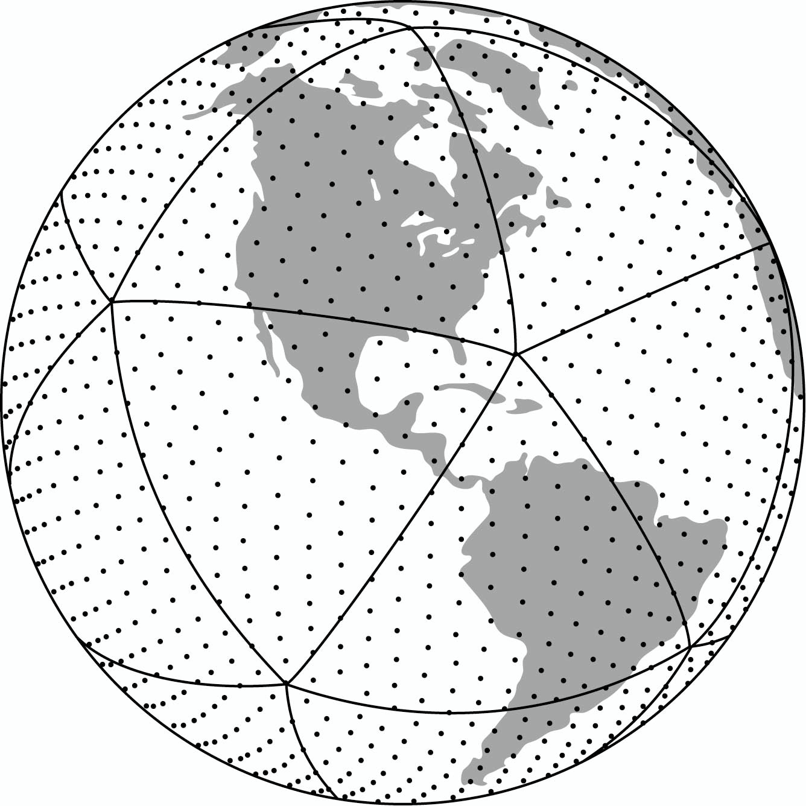
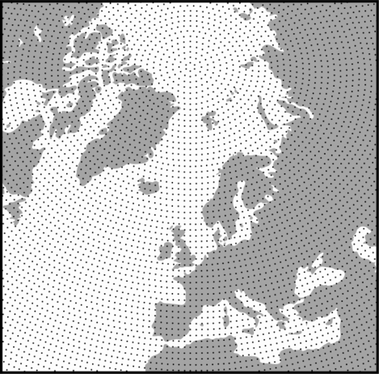
GCM’s – A Grid of Points over Earth
(Precipitation is the most difficult modeled variable)
Typical global climate model has 1-2 million calculation points

Slide 8
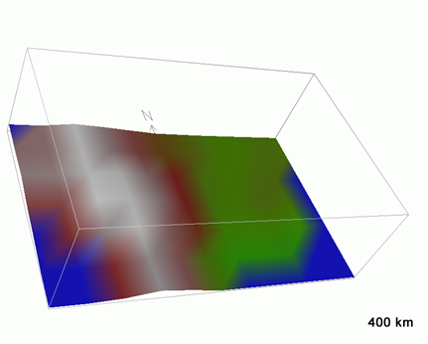
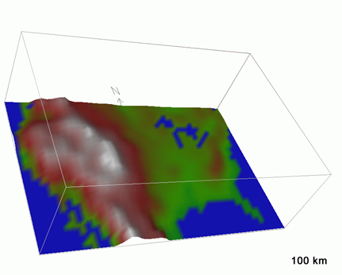
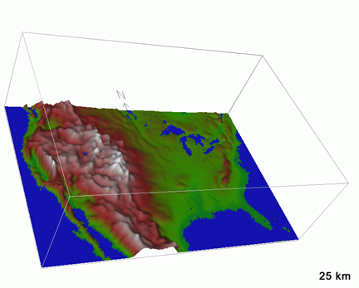
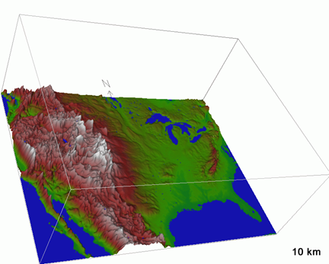
Climate Models circa early 1990s
Global coupled climate models in 2006
Global models in 5-10 yrs?
Regional models

Slide 9
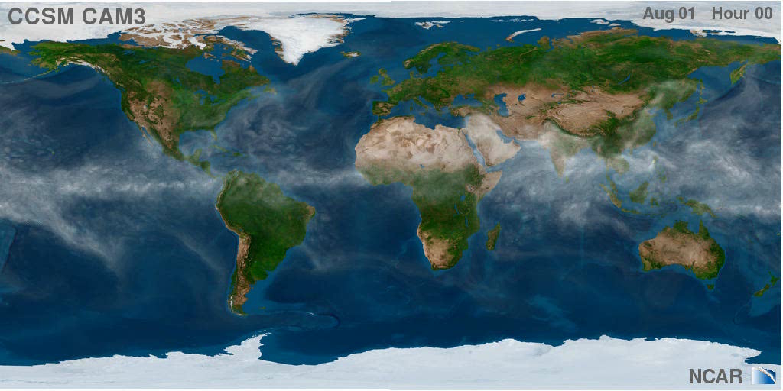

Slide 10
Adaptation – an ongoing process
 First steps can be taken now
  We know that:
  Global climate change may substantially change water supply and hazard characteristics
  It will create new uncertainties for water policy and planning.
  What can we do?
  Risk management approach to water resource policy and planning – Engage stakeholders
  Develop tools to incorporate climate change information

Slide 11
Need “Actionable Information”
David Behar, Water Utility Climate Alliance, “We need actionable
information to make changes or additions to capital investments..”,
San Francisco Public Utilities
Marc Wagee, Manager of Water Supply, Denver Water, “Surprisingly,
we haven’t dealt well with uncertainty.. Climate change is a wake-up
to this fact”

Slide 12
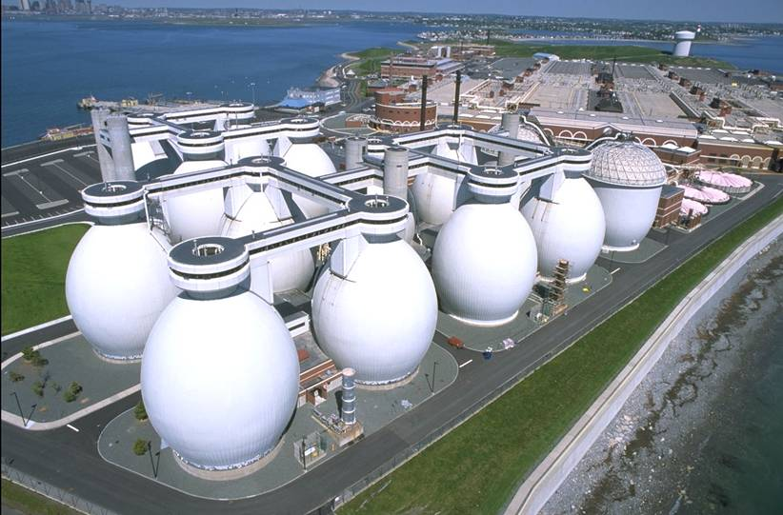
MWRA and the “Boston Harbor Cleanup”,

Slide 13

Study Approach
  Developing Decision Analysis tools that incorporate climate change information
  Risk-management approach to decision-making
  Worked with a set of water utility partners from the very start
Portland
MWRA
CO SPRINGS
IEUA
PALM BEACH COUNTY

Slide 14
Partnership Design and Decision Tools
Industry Research – AwwaRF
Utility Partners
Project Team
NCAR, consultants
Structured Process & Decision Tools
Climate Research – NCAR; Universities; Federal Agencies

Slide 15
Partnership Design and Decision Tools
Problem Structuring
  Problem Structuring
  Goals
Industry Research – AwwaRF
Colo
Springs
Utilities
Project Team
NCAR, MWH
WEAP, MODSIM
Climate Research – NCAR; NOAA, U. of Colo

Slide 16
Top Down Vs. Bottom Up
Emission and Climate Scenarios
Global Climate Models
Regionalization
Impacts
Vulnerabilities
Climate Adaptation Policy
Vulnerability
(physical/social)
climate variability and change
Adaptive Capacity
Reliability
Equity
Institutions
Economics
Technology
Infrastructure

Slide 17
Climate Change Assessments in Water Planning – Top Down
Jamie Anderson, Ca DWR, 2008

Slide 18
Bottom-Up Approach: Decision Analytic Approach to Climate Change
Problem Structuring
Deterministic Formulation
Uncertainty Analysis
Evaluation of Alternatives
Problem Structuring
Goals
Decision Model
Sensitivity Analysis
Probabilistic Representation
Future Projections
Robustness
MCDA
EV
Triple Bottom

Slide 19
Problem Structuring- Goals and Objectives
Problem Structuring
  Problem Structuring
  Goals
Inland Empire Utility Agency
  Focus on enhancing local supplies or rely on imports?
Colorado Springs Utilities
  Integrated Resource Plan… how to link to current safe yield analysis?
MWRA
  Safe Yield Analysis- What level of demand meets Quabbin storage targets under climate change
Palm Beach County
  IRP in the face of major changes (Lake Okeechobee, future demand, environ interests, sea level rise, climate change, etc.)

Slide 20
Deterministic Formulation
  Decision Model
  Sensitivity Analysis
Deterministic Formulation
This Approach is Model-based: “All are wrong, Some are Useful”
  Surprisingly, many water utility models are not “climate-enabled”
Develop approach that can address the questions at hand: “Keep it simple as possible, and no simpler”
Begin Climate Change Exploration
Notes:
We are going to present the WEAP model as a method for this analysis process. There are certainly other models,
But it just happens to be the one we are primarily, but not exclusively working with.
Weap provides the analytical engine for conducting supply-demand analysis.

Slide 21
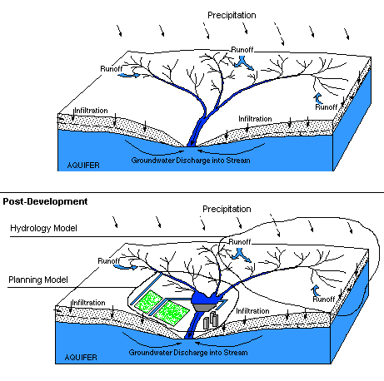
Need for An Integrating Model Framework
Deterministic Formulation
  Decision Model
  Sensitivity Analysis
Pre-development
Temp, rh, wind
Natural Watershed
Developed Watershed
Water imports

Slide 22
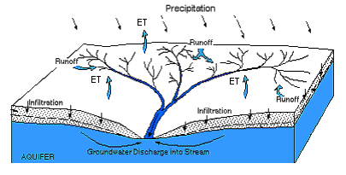
Hydrology Model
Deterministic Formulation
  Decision Model
  Sensitivity Analysis
Critical question: How does rainfall on a catchment translate into flow in a river?
Critical question: What pathways does water follow as it moves through a catchment? Runoff? Infiltration? ET? Seepage?
Critical question: How does movement along these pathways impact the magnitude, timing, duration and frequency of river flows?
Notes:
Physical hydrology models describe the water cycle of the watershed.. The “natural” processes…

Slide 23
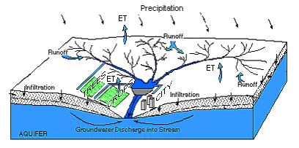
Planning Model
Deterministic Formulation
  Decision Model
  Sensitivity Analysis
Critical question: How operations be optimized to protect the services provided by the river?
Critical question: How should infrastructure (e.g. dams, diversion works, etc) be operated to achieve maximum benefit? How should water be allocated in shortage?
Critical question: How will allocation, operations and operating constraints change if new management strategies are introduced into the system?
Notes:
But in MANY places, humans have altered this natural, hydrologic cycle for beneficial use.
This use typically quite complex, in terms of its governance and regulation.
Water Planning: Water resource planning models ask the questions in the slide. Importantly,
Most water resource planning models do not directly use climate information, but use
Climate proxies, typically in the form of historical records of streamflow.

Slide 24
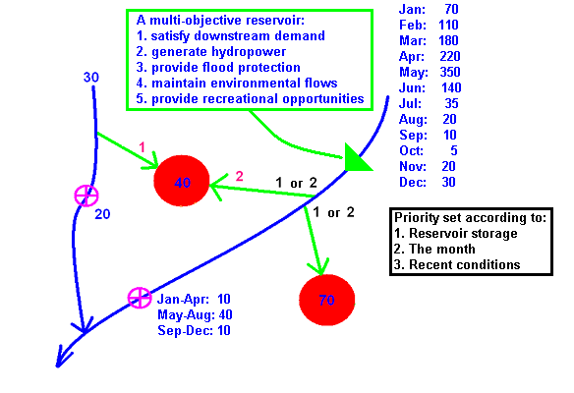
Water Management Can Get Complicated
Notes:
We need a collection of computer logic assembled in a manner that describes how water moves through this watershed.

Slide 25

Integrated Water Resource Management
Integrates hydrology and water planning model
GIS-based, graphical GUI interface.
Physical simulation of water demands and supplies.
User-created variables and modeling equations.
Scenario management capabilities.
Seamless watershed hydrology, water quality and financial modules
SEI-US.org, NCAR, Wat Res Fnd, USEPA
Yates et al. 2005, Water International, Pt. 1 and Pt. 2

Slide 26
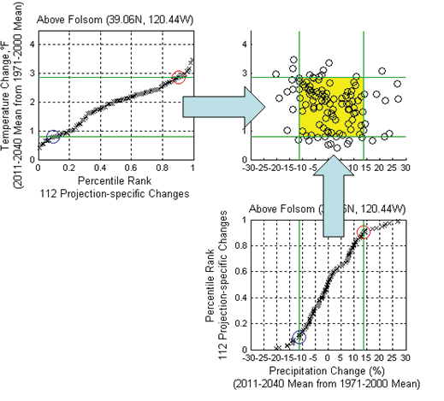
Evaluation of climate projection spread
Uncertainty Analysis
  Probabilistic Representation
  Future Projections

Slide 27
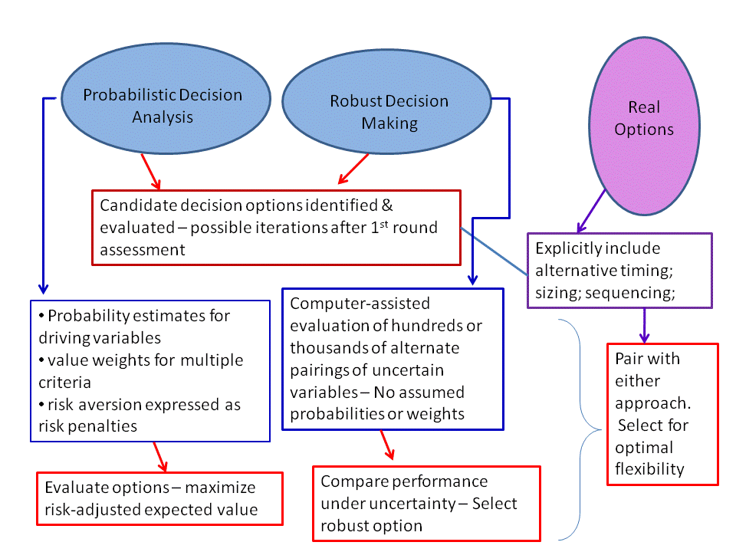
Evaluation of Alternatives
  Robustness
  MCDA
  EV
  Triple Bottom line

Slide 28
Case Studies
    Colorado Springs, CO
    Palm Beach County, FL
    Boston, MA
    Inland Empire of Southern CA
    Portland, OR
    Durham
    El Dorado Irr District
Portland
MWRA
EID
CO SPRINGS
IEUA
Durham
PALM BEACH COUNTY

Slide 29
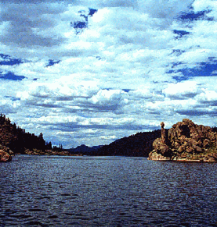
CSU’s Water System
75% of our water comes from reservoirs near the Continental Divide, over 200 miles away
25% of our water comes from Pikes Peak and the Arkansas River
Winter snows provide a continuous fresh water source for the citizens of Colorado Springs

Slide 30
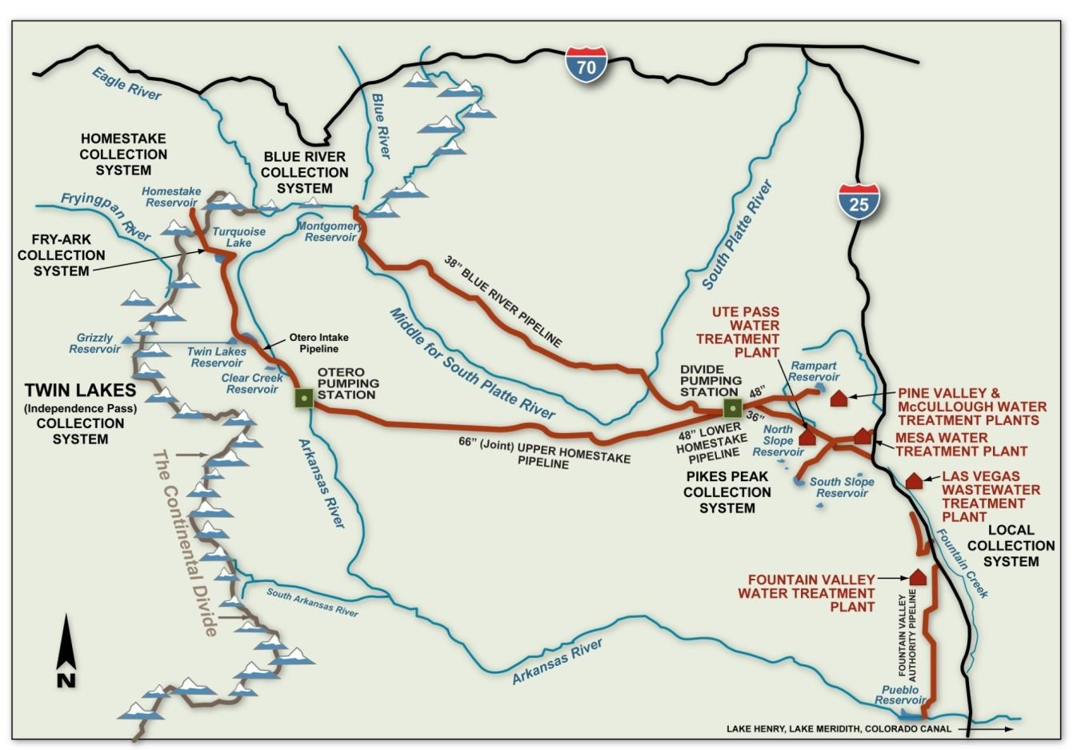
75% from West Slope
25% from East Side
Diversion Rights are Largely Controlled by Senior Rights on Colo River at Cameo and Shosone
30
Notes:
Not located near a major water source, so supplying our city with water has been a major challenge throughout our history. Pikes Peak system developed in first half of 20th century, Blue River System 1950’s, Homestake in 1960’s, and Fountain Valley Authority in 1970’s. Today we are living off the legacy of those who developed these systems.
As earlier generations have stepped up to meet this challenge, SDS is our legacy for this and future generations.
Have water rights to meet needs, SDS enables us to get it to Colorado Springs. Also will provide redundancy to delivery systems that were built many decades ago.
It is also important to our project partners – city of Fountain, Security and Pueblo West.
Pleased we’ve been able to collaborate with these other communities on this project.
30

Slide 31
Characterization of Watersheds and Sub-Watersheds
Deterministic Formulation
  Decision Model
  Sensitivity Analysis

Slide 32
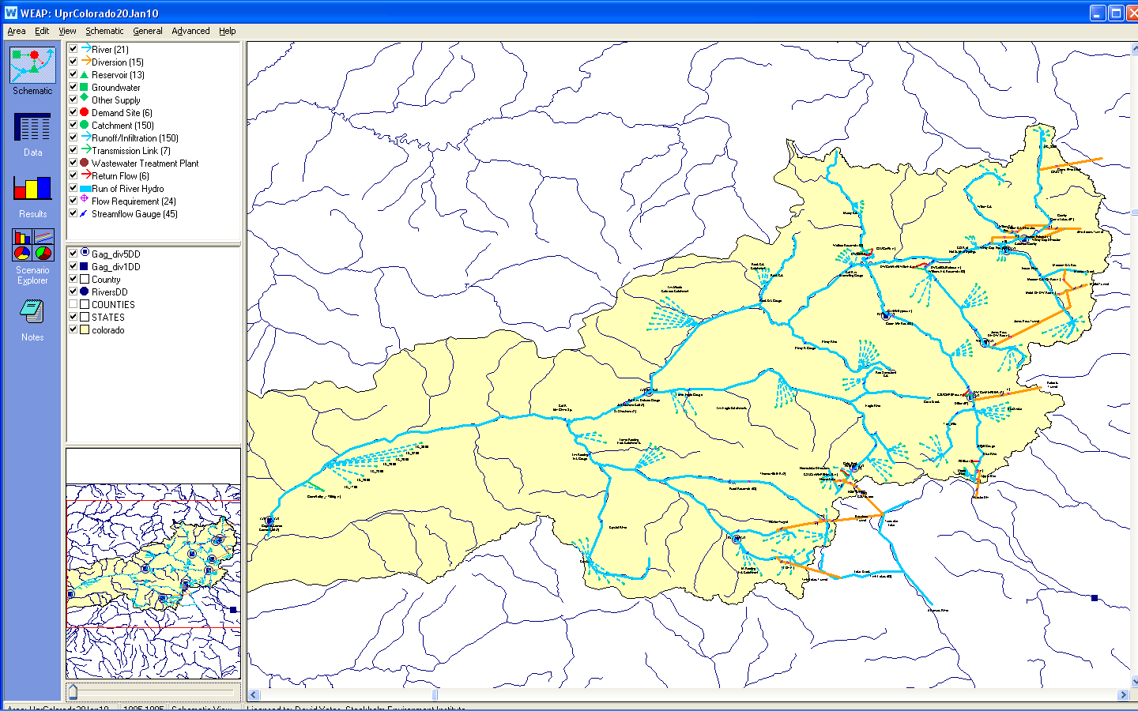
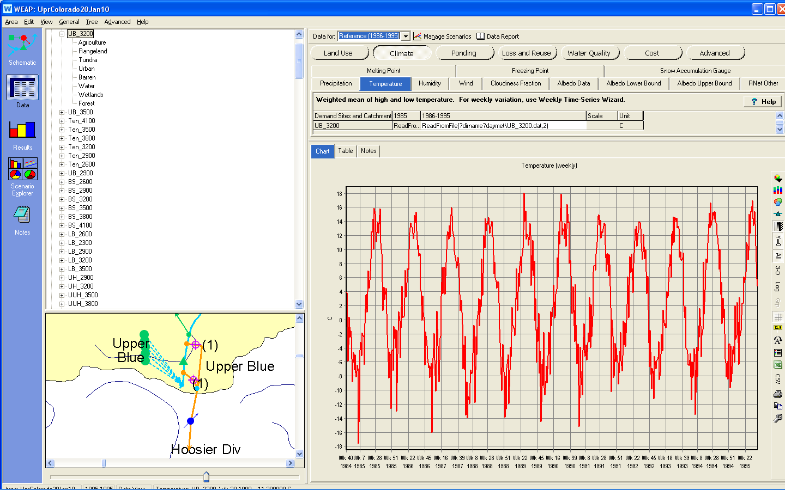
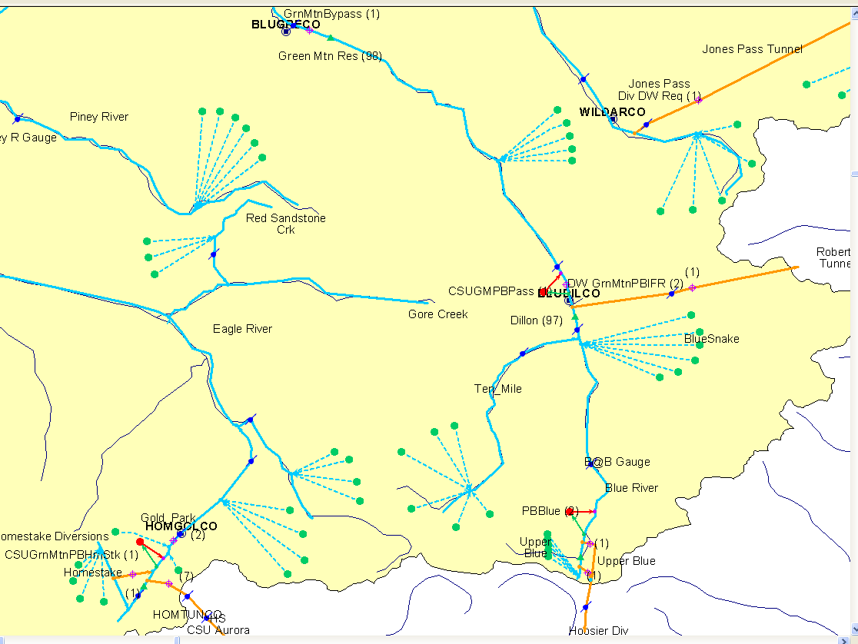
NCAR and CSU built a WEAP Application of West Slope Supply
Watersheds are defined according to Elevation Bands
with a unique climate forcing dataset.

Slide 33
The WEAP Application-Some Details
Rivers and Creek (11+)
  Blue, Ten Mile, Eagle, Homestake, Williams Fork, Fraser, Willow, Roaring Fork, Frying Pan, Muddy, Arkansas
Reservoirs (10)
  Granby/Grand, Dillon, Green Mountain, Homestake, Meadow Crk, Ruedi, Upper Blue, Williams Frk, Windy Gap, Wolford
Diversions and Rights (12)
  Grand River, CBT, Windy Gap, Willow Crk, Moffatt, Jones Pass, Roberts, Hoosier, Homestake, Boustead, Hunter, and Twin
Major Diversion Rights which Influence CSU
  Hoosier, Homestake, and Fry Ark. These are controlled by the Shoshone and Cameo Calls.
  Green Mountain Payback
  Representation of CBT and Denver Water’s “Rights”

Slide 34
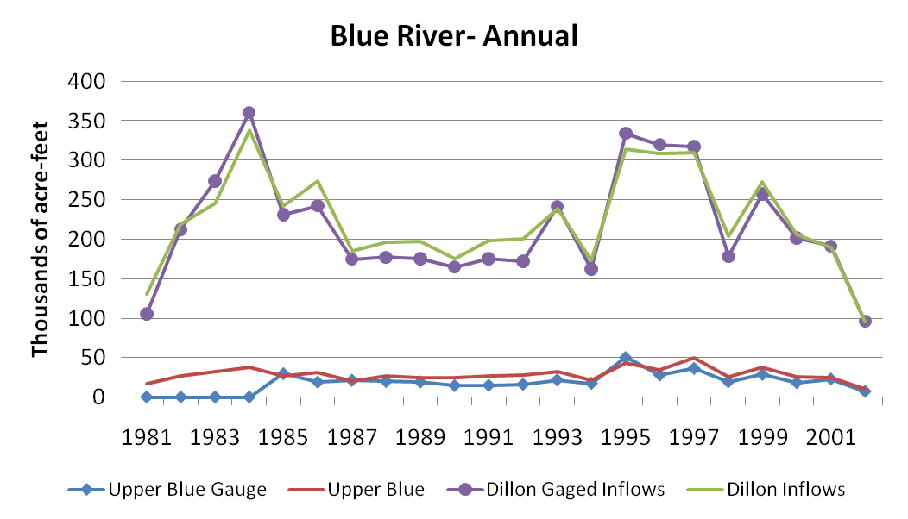
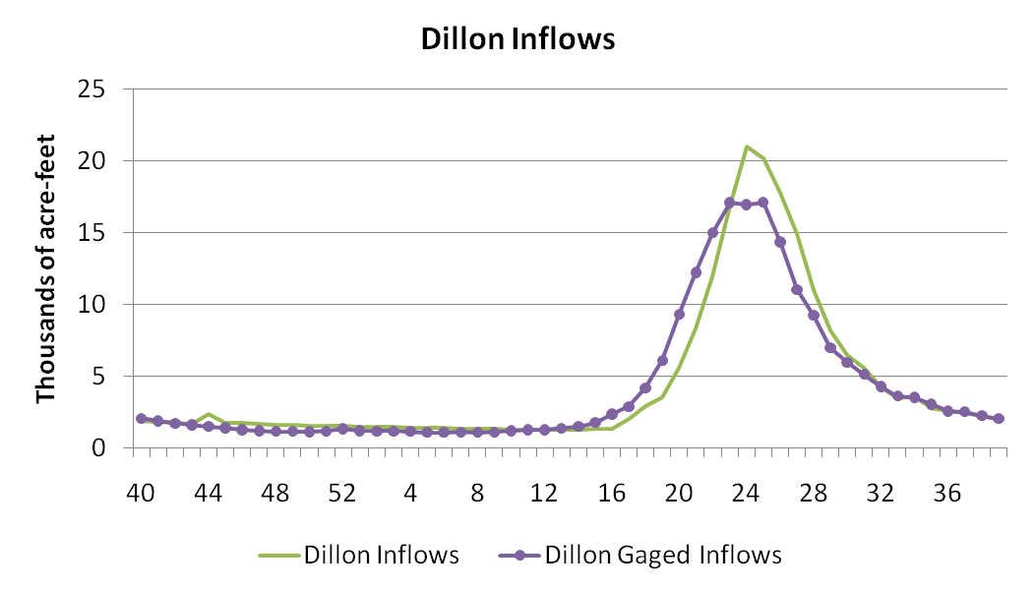
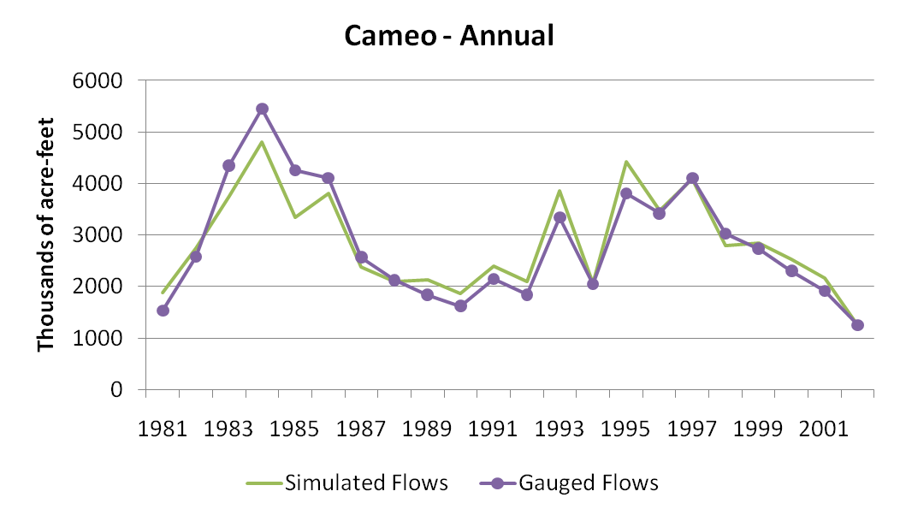
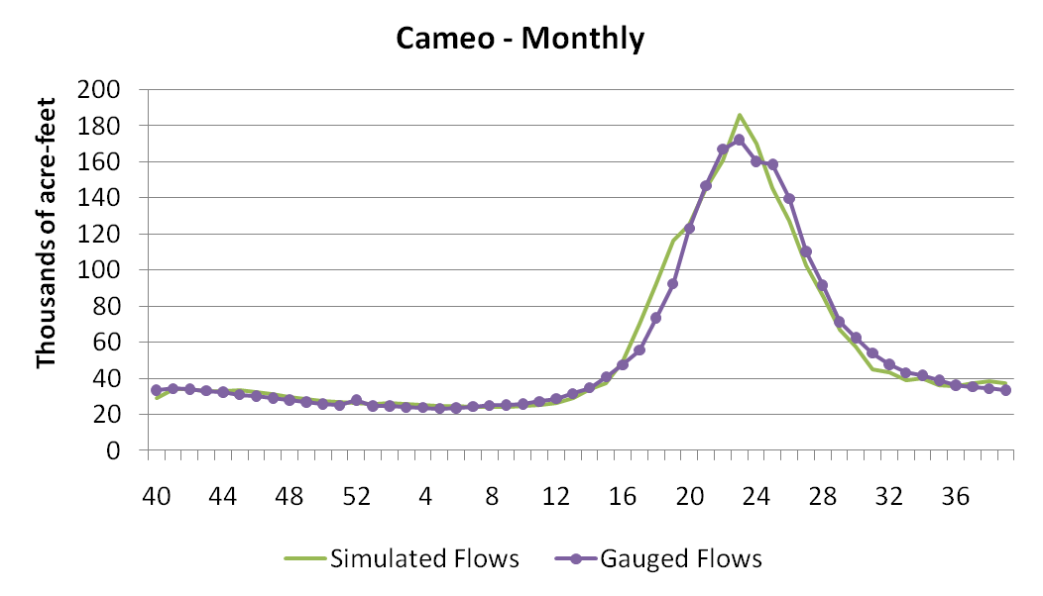
Calibration Objectives: Re-create observed flow, storage, and delivery for historic period
Streamflow
Cameo Weekly Avg flow
* Statistical evaluation will be available in Water Research Foundation Report

Slide 35
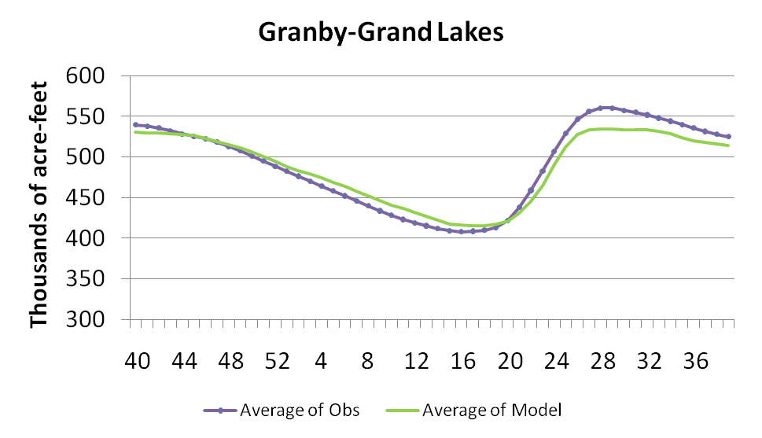
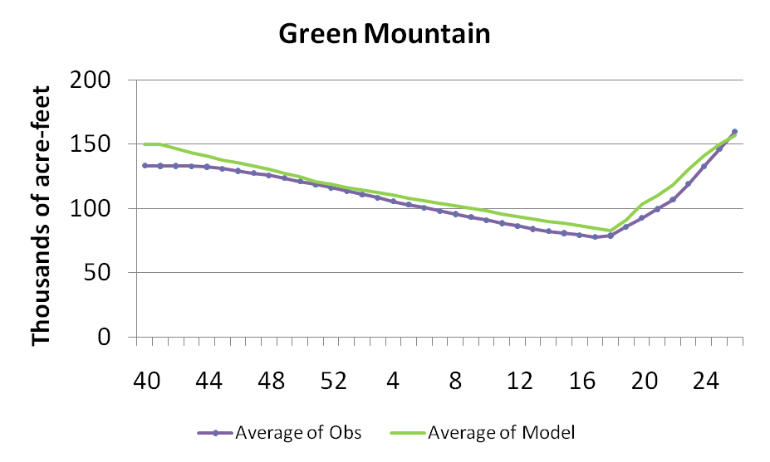
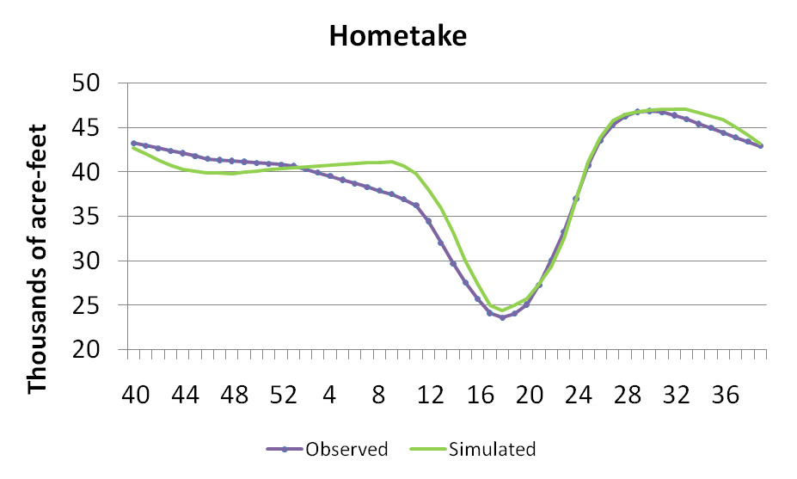
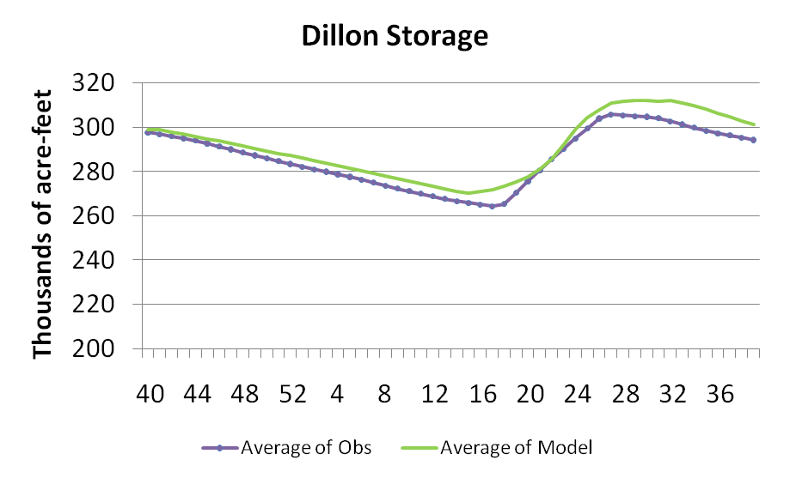
Monthly Average Storage
* Statistical evaluation will be available in Water Research Foundation Report

Slide 36
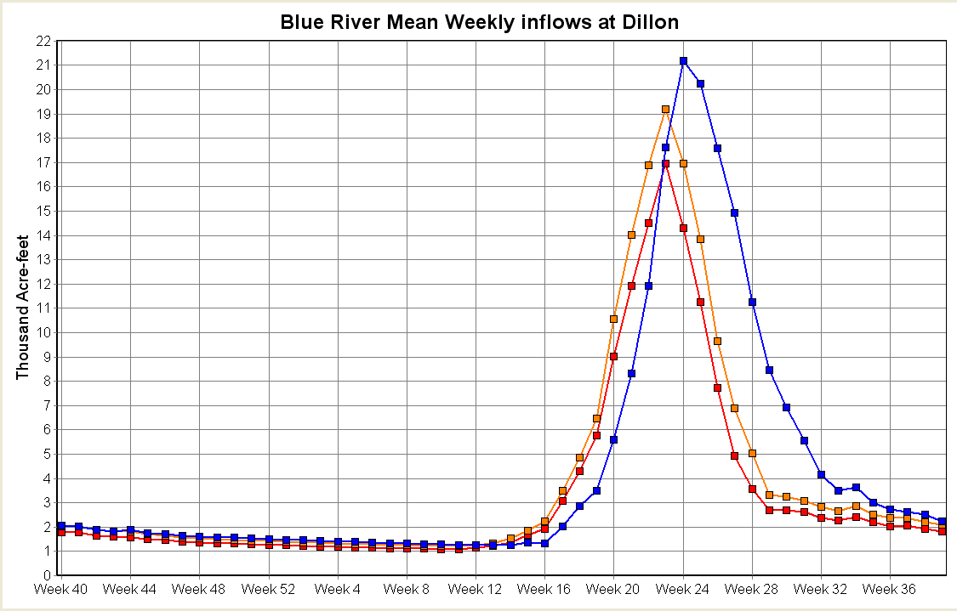
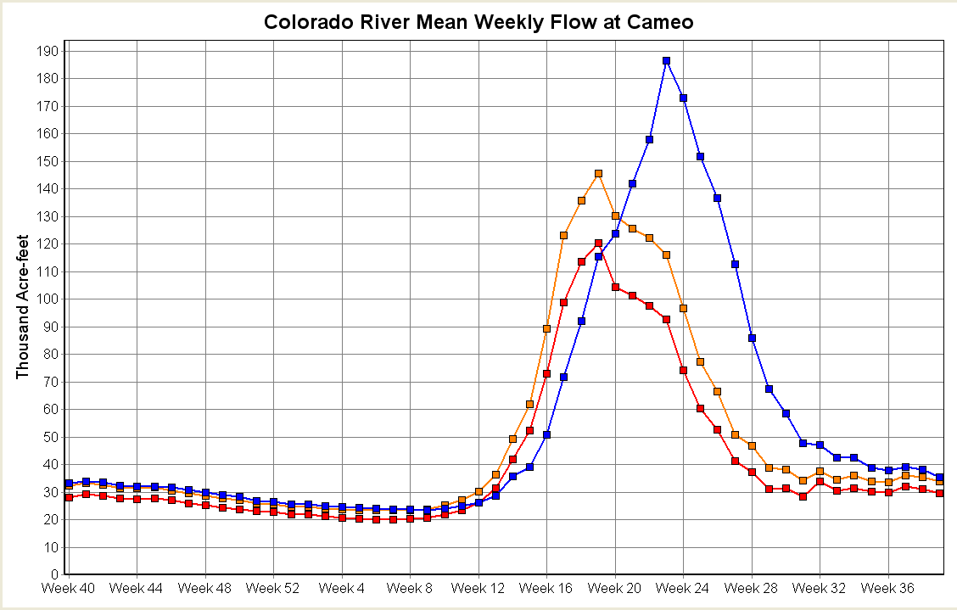
Only Simple Climate Sensitivity thus far
Add 2.8ºC to complete historic temperature- DT2.8
Add 2.8ºC and reduce precip. By 10% - DT2.8-10%
Blue River inflow to Dillon
Colorado at Cameo
*28-year monthly mean, (1000’s a-f)

Slide 37
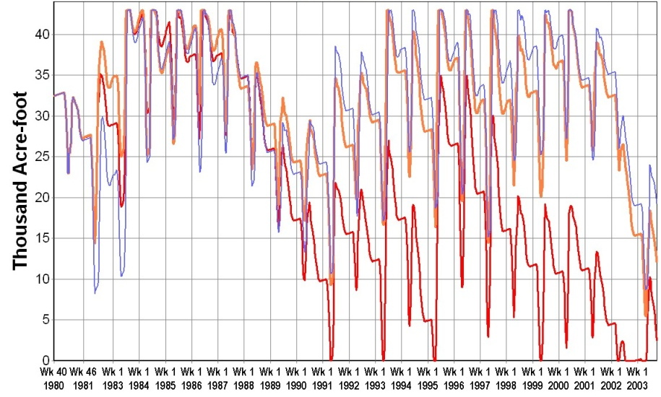
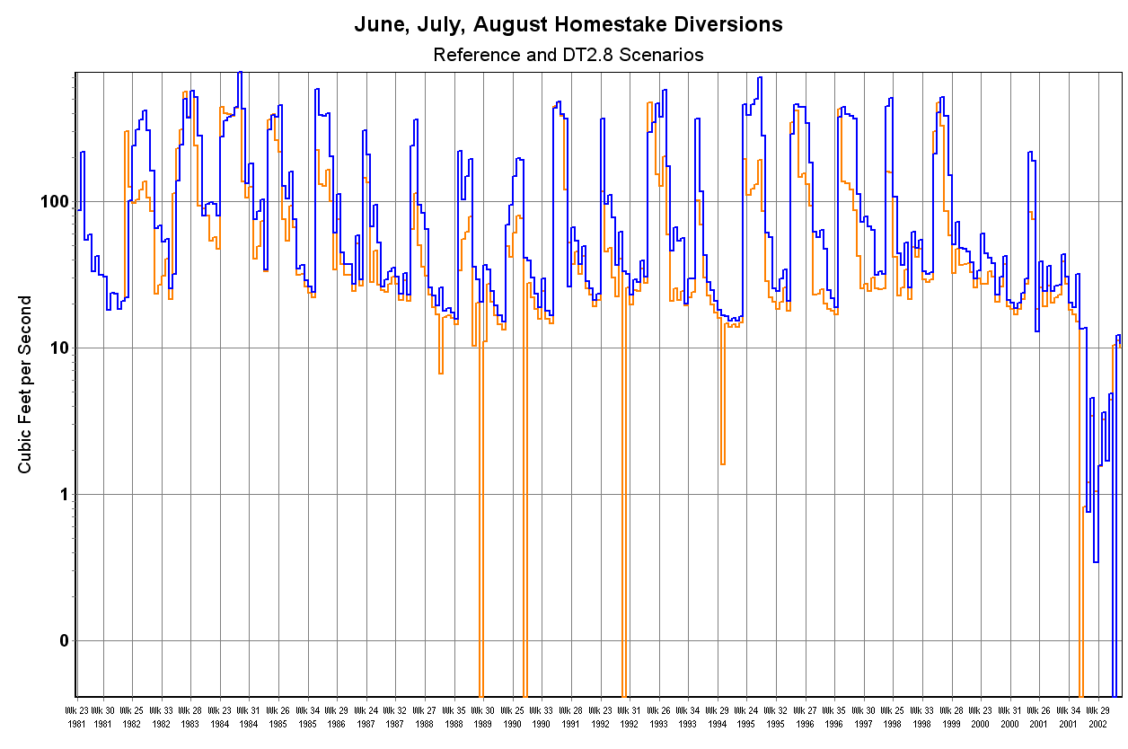
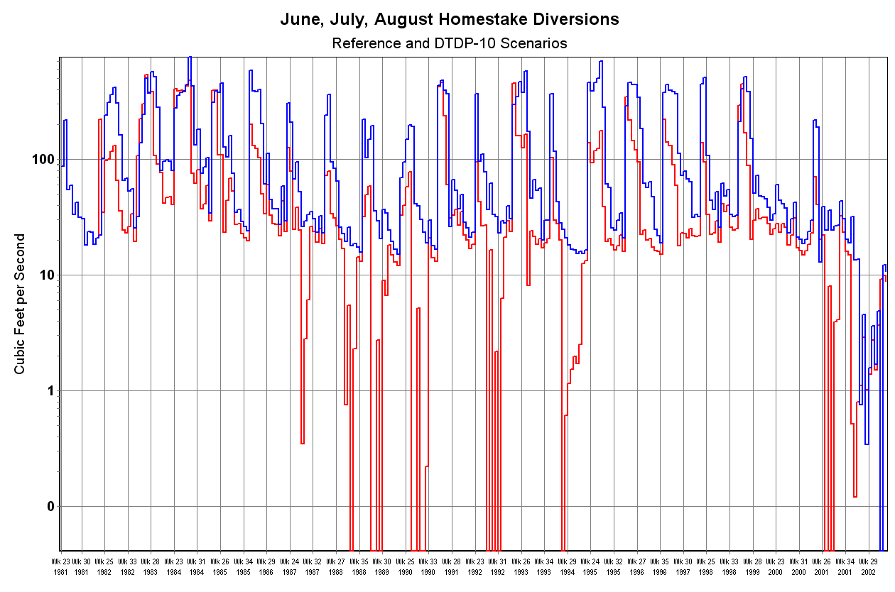
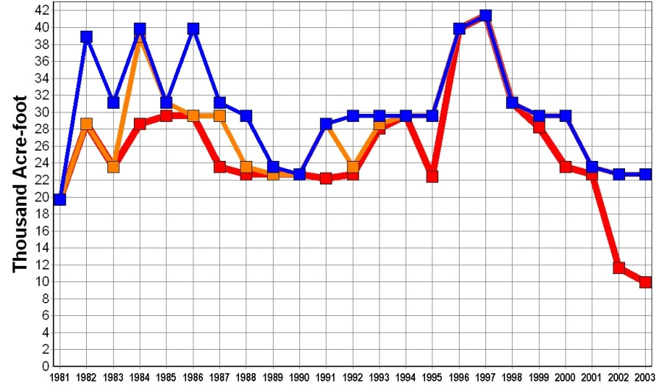
Storage, Delivery and Diversion: Homestake
Storage (weekly average, 1000’s a-f)
Delivery
Homestake Diversions (weeks)
June, July, August
DT2.8
June, July, August
DT2.8-10

Slide 38
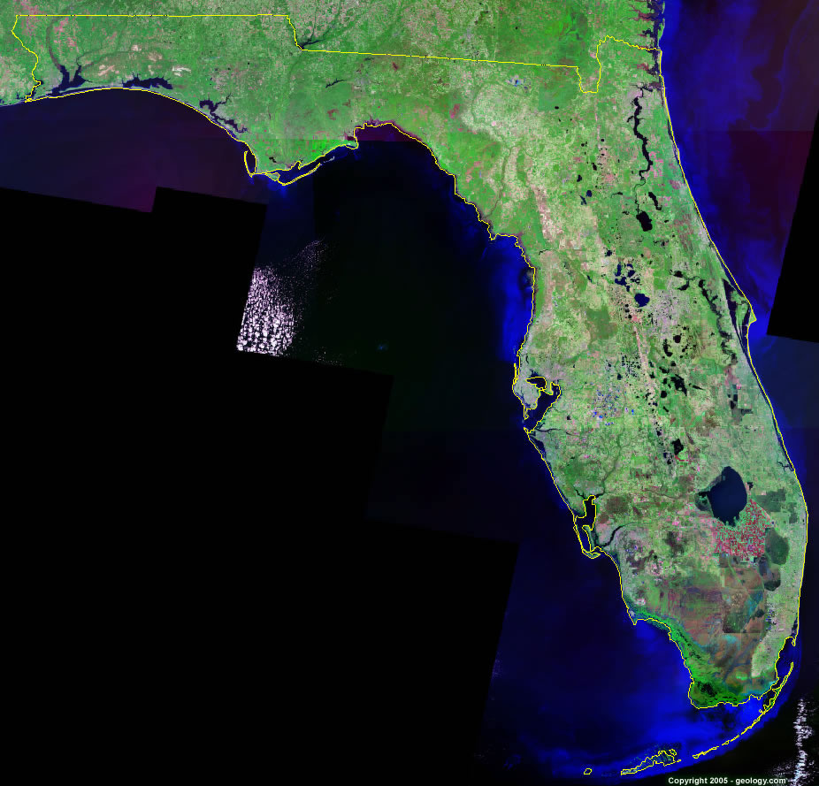
PBCWUD
Problem Structuring
  Problem Structuring
  Goals
Kissimmee
Headwaters-
Rapid Urbanization
Shallow Freshwater Lake- Reoperated for Flood Control
Largest Sugarcane region in Florida- some interest in ‘buying out’
Preservation of Wetland Habitat
Urbanizing Corridor
Inland Estuary- Freshwater flux to tide

Slide 39
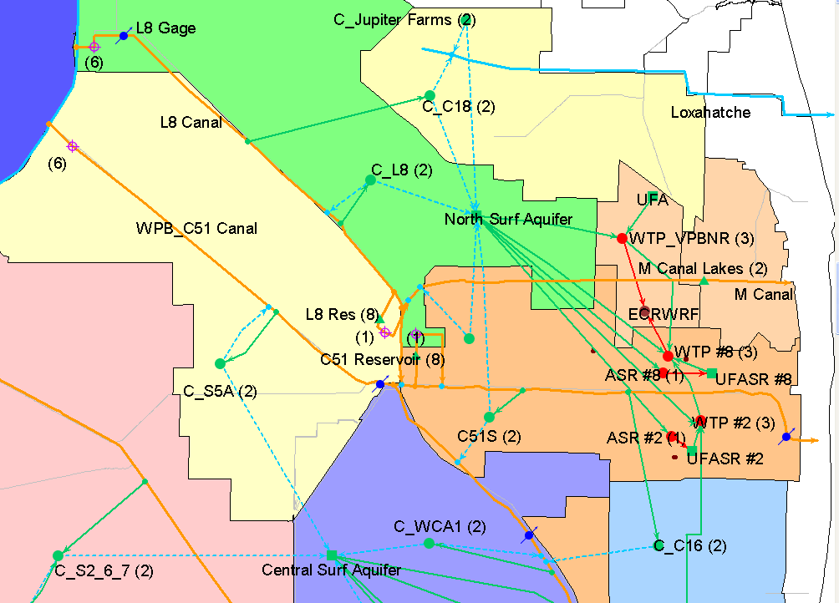
PBCWUD: Goal or Question:
Is there a “Robust” Capital Improvement Plan?
Problem
Structuring
Deterministic
Analysis
Uncertainty
Analysis
Evaluation of
Alternatives
iterations
20-Year CIP Projects:
ASR wells
Surface Storage
Water and WWTP Expansions
New RO Treatment Facility
Wellfield Expansions
New Deep Injection Wells

Slide 40
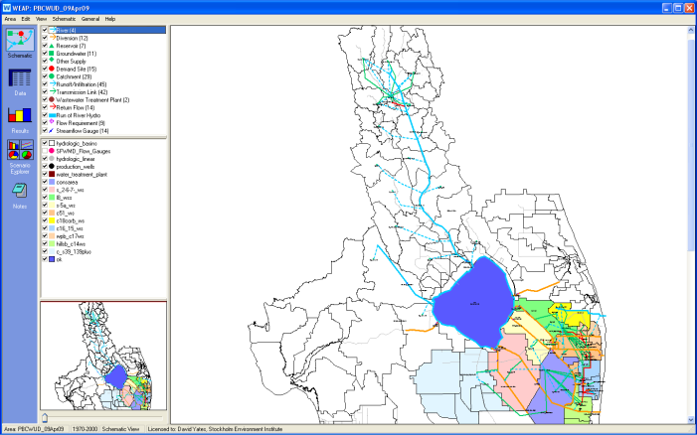
WEAP Supply-Demand Model
Rigorous Representation
Problem
Structuring
Deterministic
Analysis
Uncertainty
Analysis
Evaluation of
Alternatives
iterations

Slide 41
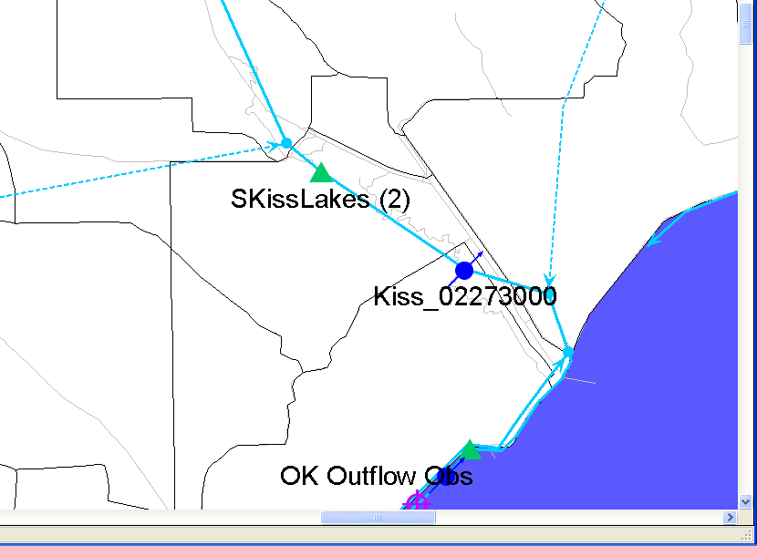
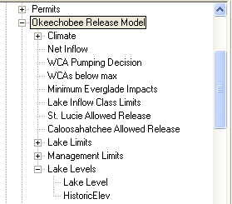
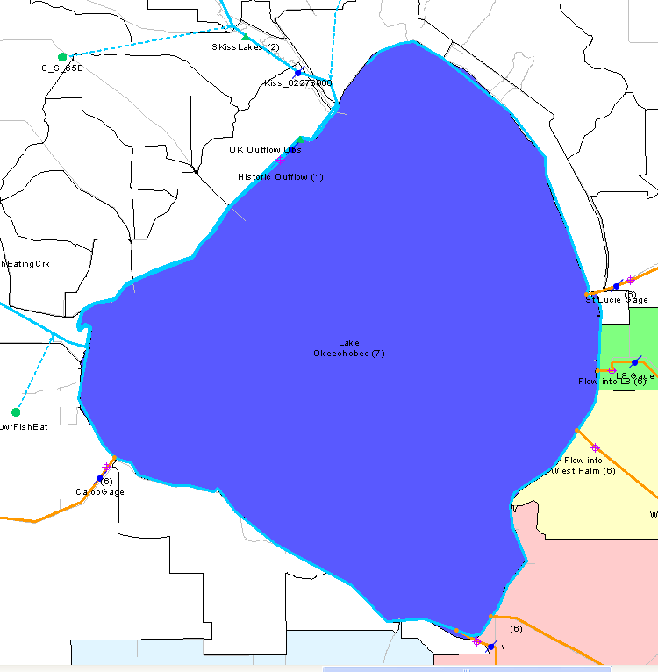
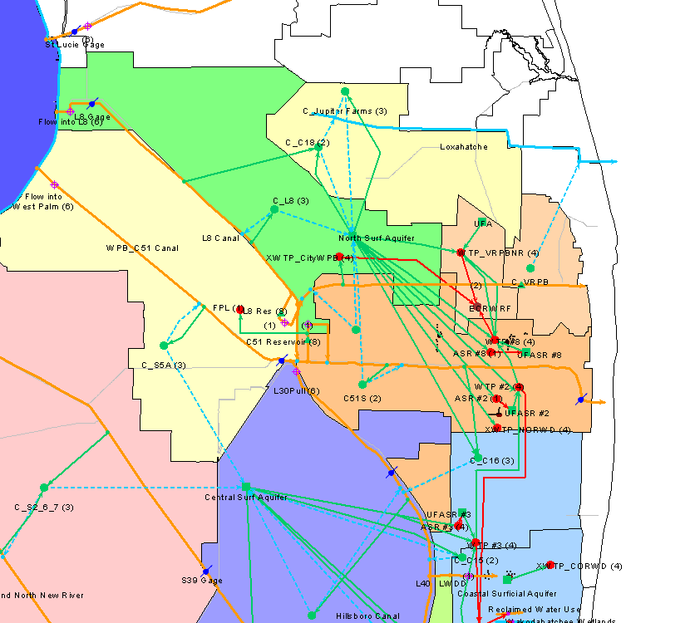
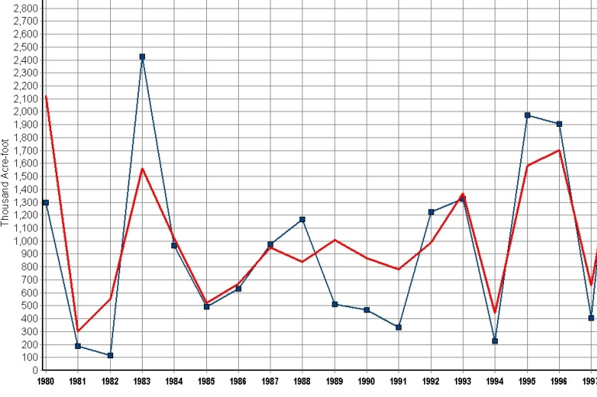
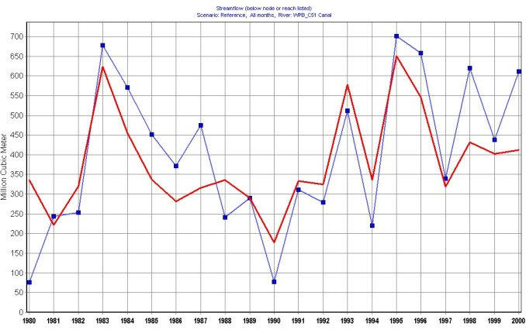
WEAP Model- Model of Supplies
Problem
Structuring
Deterministic
Analysis
Uncertainty
Analysis
Evaluation of
Alternatives
iterations
Lake Okeechobee
Storage
C-51 Outflow
Kissimmee Inflows
obs
simulated
obs
simulated
observed
simulated

Slide 42
Problem
Structuring
Deterministic
Analysis
Uncertainty
Analysis
Evaluation of
Alternatives
iterations
Population: An Uncertain Future in South Florida?
PBCWUD Total Demand in 2008 - ~80 MGD
Regional Demand in 2008 - ~ 225 MGD

Slide 43
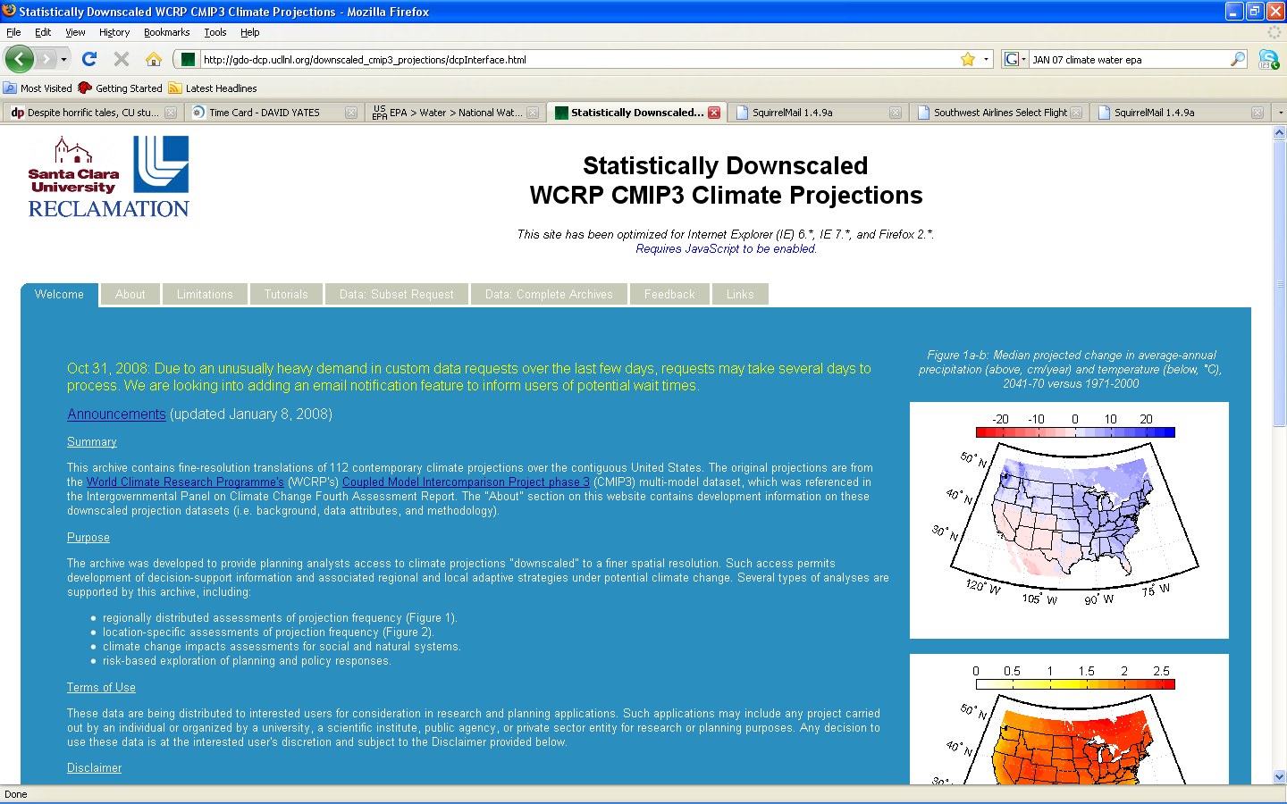
Problem
Structuring
Deterministic
Analysis
Uncertainty
Analysis
Evaluation of
Alternatives
iterations
Climate Scenarios- Spatial-Statistical Downscale

Slide 44
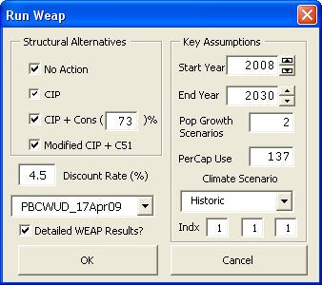
Problem
Structuring
Deterministic
Analysis
Uncertainty
Analysis
Evaluation of
Alternatives
iterations
Microsoft Excel,
MCDA Dashboard-
Explore Uncertainties
MCDA (Excel) used to set parameters
WEAP
Population Growth Scenario
Water Use Rate (gpcpd)
Climate (Historic or Model)
Regulation

Slide 45
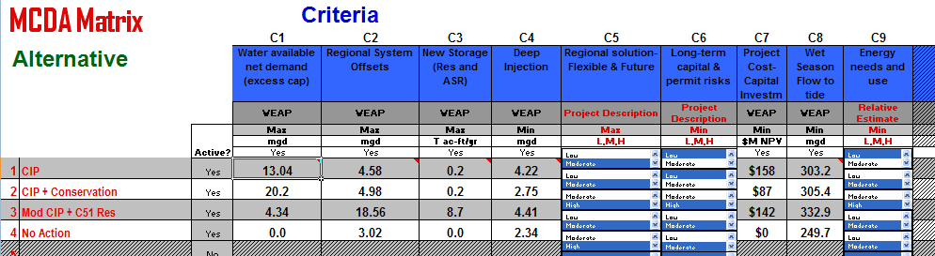
MCDA
Problem
Structuring
Deterministic
Analysis
Uncertainty
Analysis
Evaluation of
Alternatives
iterations
Stakeholder Weights Assigned to Each Criteria
Each Criteria is Evaluated for Each Alternative

Slide 46



HOW? Then Use Model to Evaluate Alternatives
Focusing in on an Alternative: Modified CIP + C51
WEAP Mathematical “Expression Builder” is used to mimic the
operations of C-51, e.g. Fill during high flows, release during low flows
C-51 Storage
inception
Dry Period

Slide 47

Example Results – C-51 Reservoir
Monthly Mean Discharge, 2023-2030 (Historic climate ‘repeats’)
Storage in wet period,
Decrease in discharge
Release in dry period,
Increase in Discharge
D²S² Helping Water Manager Plan for the Future

Slide 48

http://www.isse.ucar.edu/awwarf/
http://waterresearchfoundation.org/
http://sei-us.org
http://weap21.org
David Yates yates@ucar.edu
Kathleen Miller kathleen@ucar.edu

