Slide 1
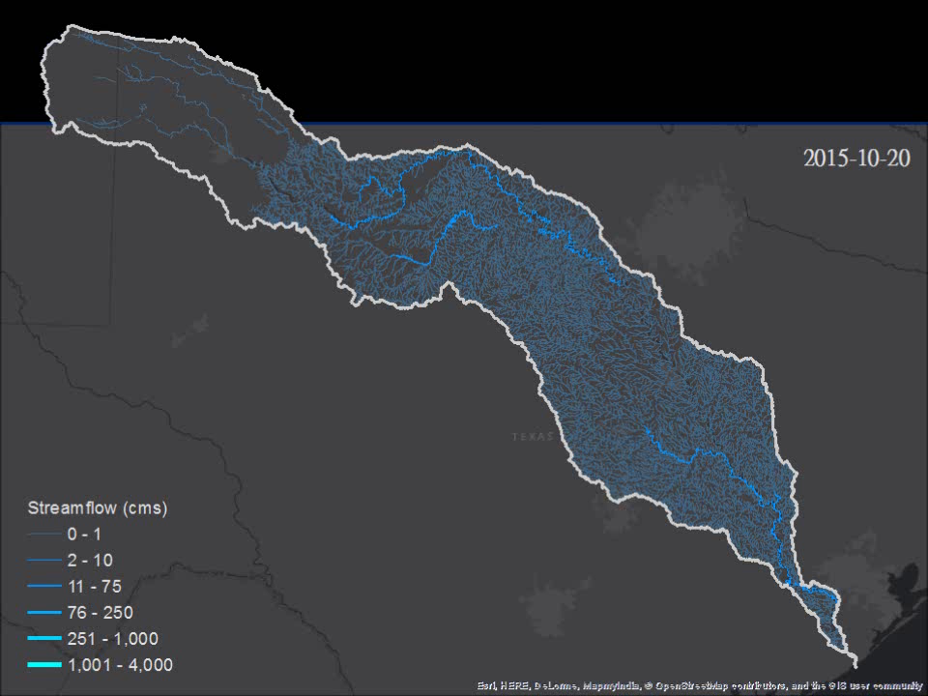
RAPID Simulation
Notes:
Brazos River pulses south of Lake Whitney in February, 2016:
http://waterdata.usgs.gov/tx/nwis/uv?cb_00060=on&format=gif_default&site_no=08093100&period=&begin_date=2016-02-01&end_date=2016-03-01

