Slide 1
A Common Information Model for Flood Response
David R. Maidment
Center for Research in Water Resources
University of Texas
Flash Flood Summit
National Water Center
Tuscaloosa, Alabama
11 September 2014
This version of this presentation has been edited from its original form

Slide 2
NWS Flash Flood Services Vision
Transform predictive flash flood services for any causative event by establishing an end-to-end nationally consistent framework that provides:
Seamlessly integrated observation and monitoring networks
High-resolution, hydrologically continuous (from flash flooding to flooding) national water model directly coupled with numerical weather prediction datasets and other forcings
Objective forecasting and characterization of the urgency, severity, and certainty of flood impacts at the street level
Actionable information, consistent communication and decision support services to transform society to become ready, responsive and resilient to flash flood and flood threats
Slide: Mary Mullusky, NWS (adapted)

Slide 3
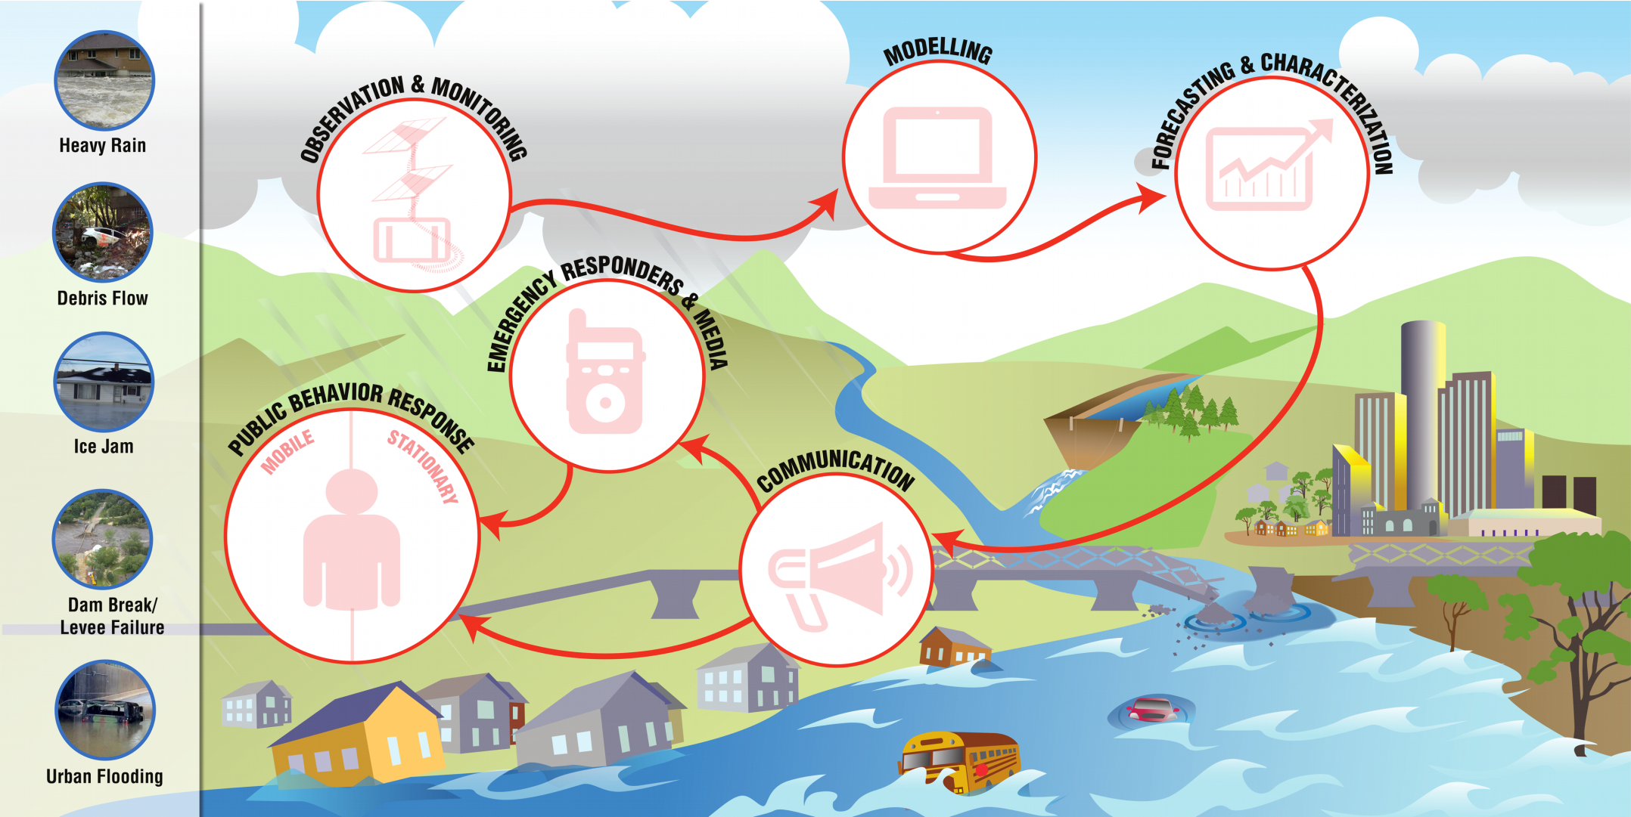
End-to-End Flash Flood Services
OBSERVATION & MONITORING
MODELING
FORECASTING & CHARACTERIZATION
COMMUNICATION
EMERGENCY RESPONSE & MEDIA
PUBLIC BEHAVIOR RESPONSE
Slide: Don Cline, NWS

Slide 4
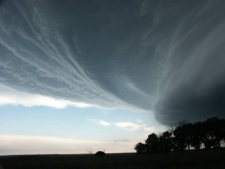
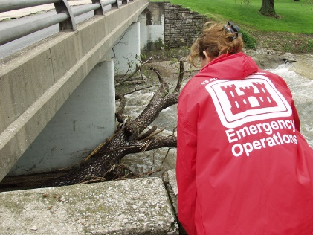

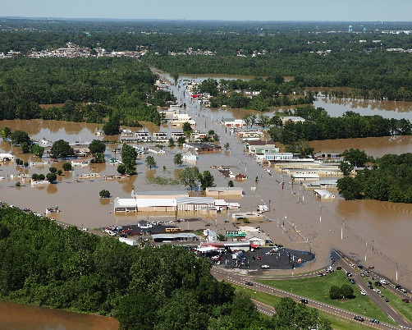


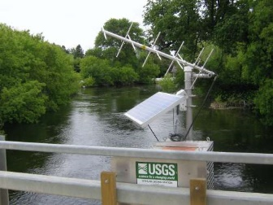

Linkages among federal agencies for flood response
Atmosphere
Stream
Street
Data

Slide 5
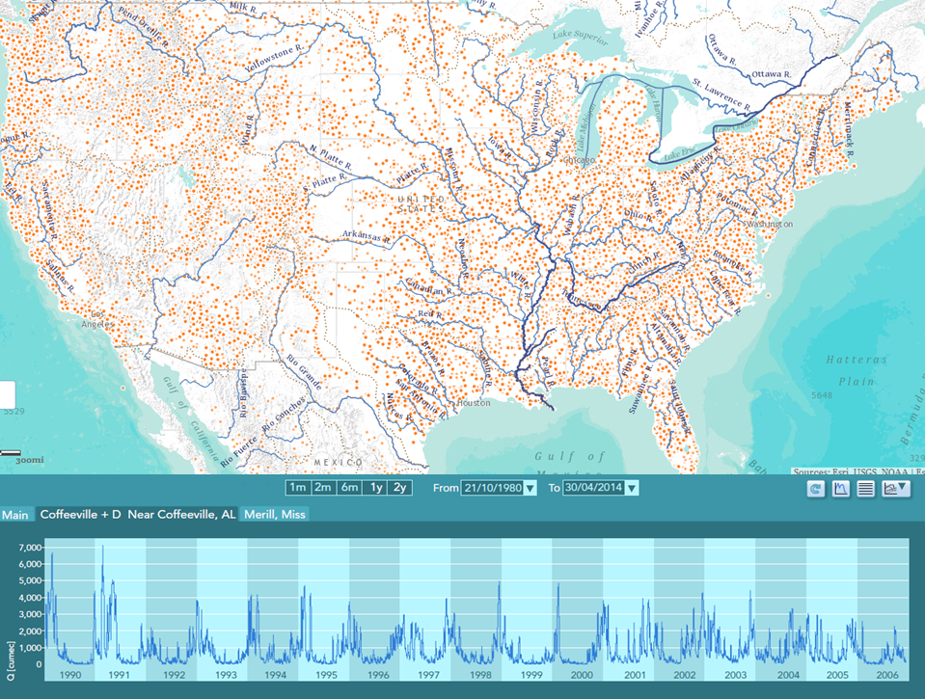
Contribution of the USGS
Temporal Data
Geospatial Data
National Water Information System Observational data available as water web services less than one hour from time of measurement
National Hydrography Dataset Plus
Base dataset for national stream reaches (~ 2 km), catchments (~ 3 km²), and water bodies
(jointly developed by USGS and EPA)

Slide 6
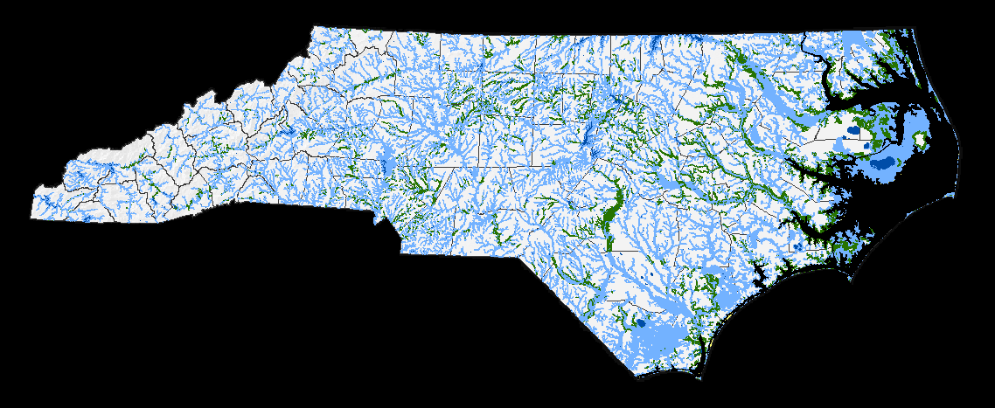
State of North Carolina
Special Flood Hazard Areas
Slide: John Dorman, NCFMP

Slide 7
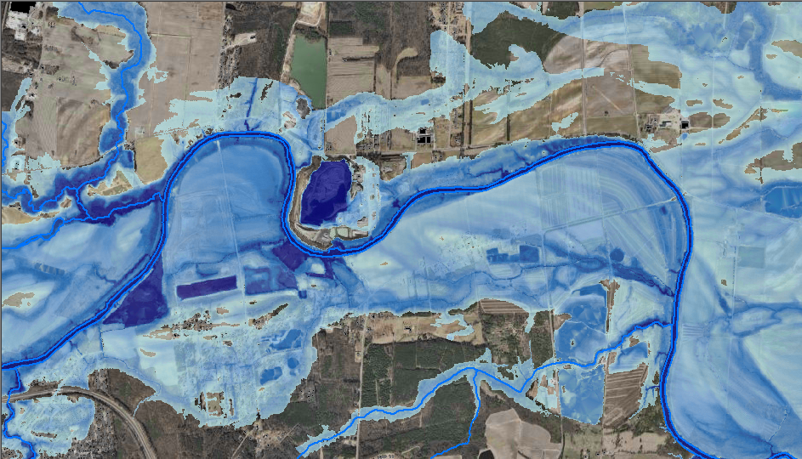

GENERATION - Flood Depth Grids
10-yr, 25-yr, 50-yr, 100-yr, 500-yr
FEMA RiskMap: Mapping Flood Depth
Slide: John Dorman, NCFMP

Slide 8
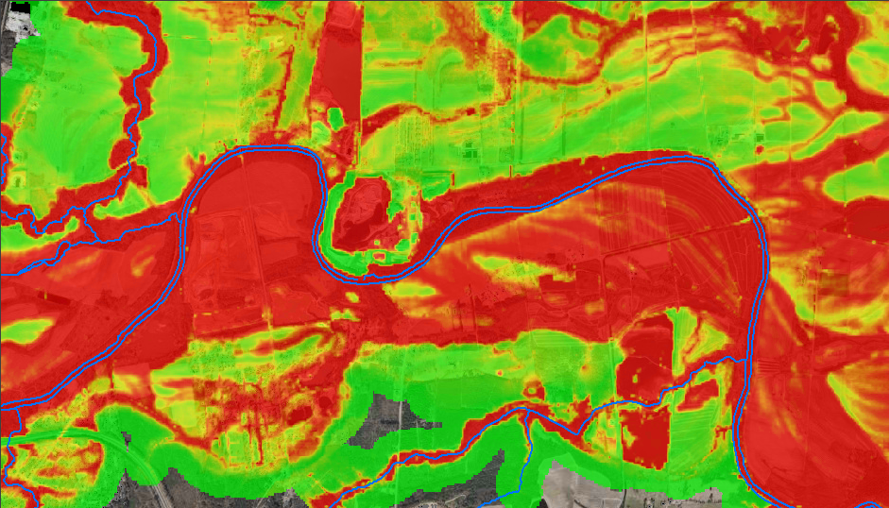

GENERATION - Probability Grids
10-yr, 25-yr, 50-yr, 100-yr, 500-yr
Mapping Flood Likelihood
Slide: John Dorman, NCFMP

Slide 9
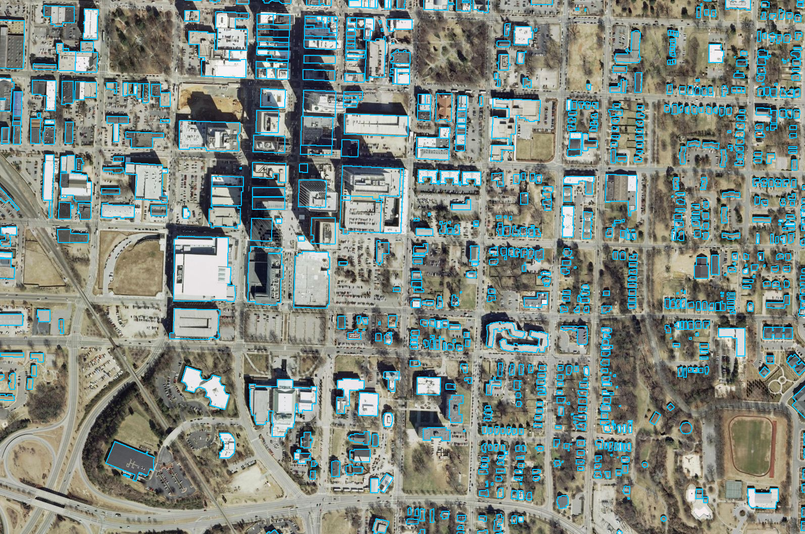
ACQUISITION / GENERATION - Building Footprints
Algorithm for building boundary generations
Approximately $0.30 / structure
Slide: John Dorman, NCFMP

Slide 10
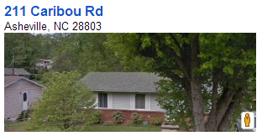
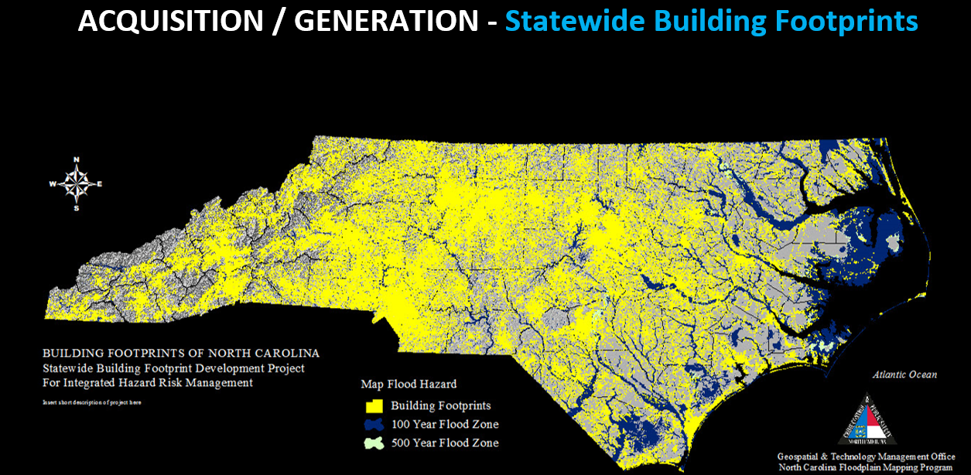
5 million building footprints in NC
An example for one home in the state
Image: John Dorman, NCFMP

Slide 11
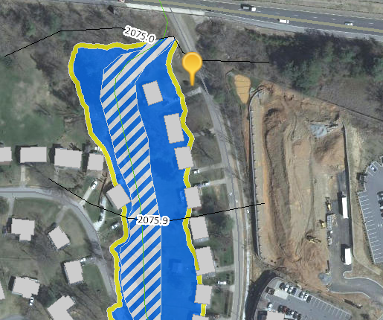
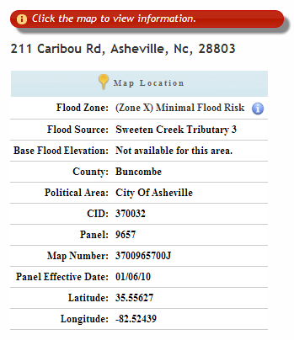
Flood Risk Information System (FRIS)
http://fris.nc.gov/fris/

Slide 12
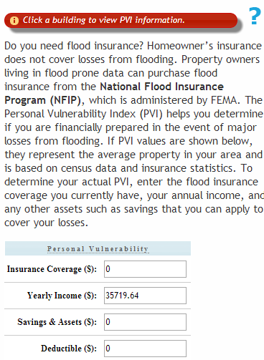
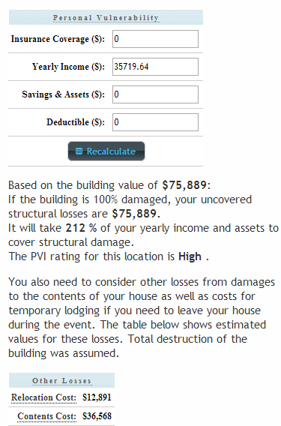
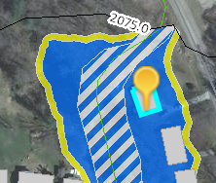
Personal Vulnerability Index

Slide 13
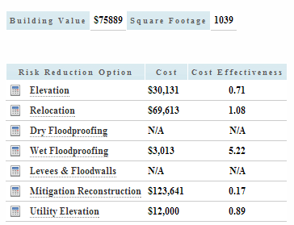
Cost Effectiveness of Mitigation

Slide 14
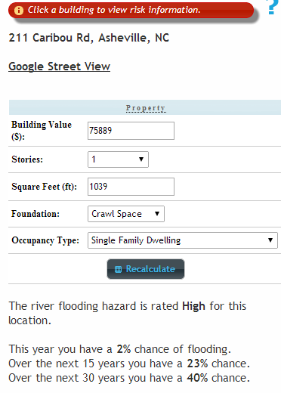
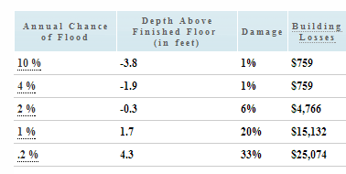
Annual Flood Damage

Slide 15
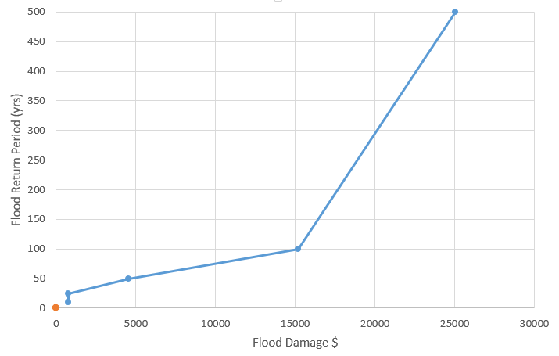

Flood Damage
Expected Annual Damage = $434
$161 (37%)
100 year
$99 (23%)
50 year
$174 (40%)

Slide 16
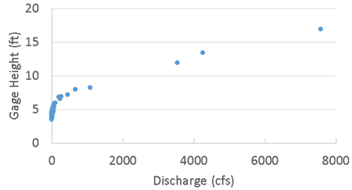
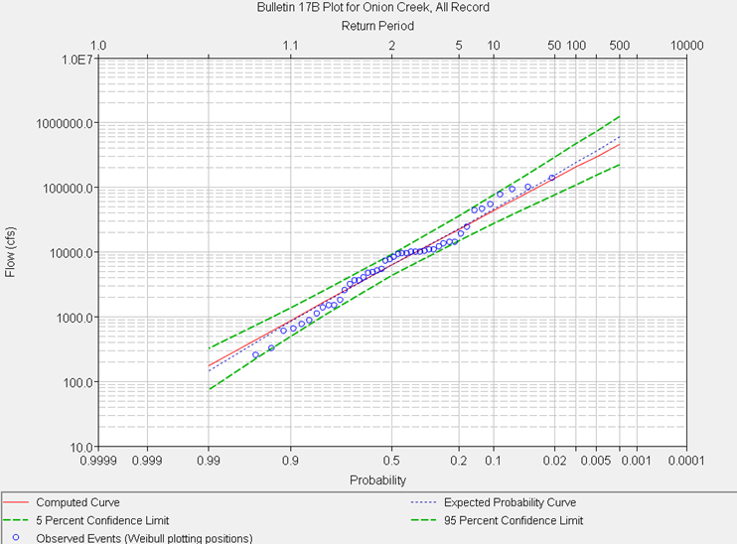
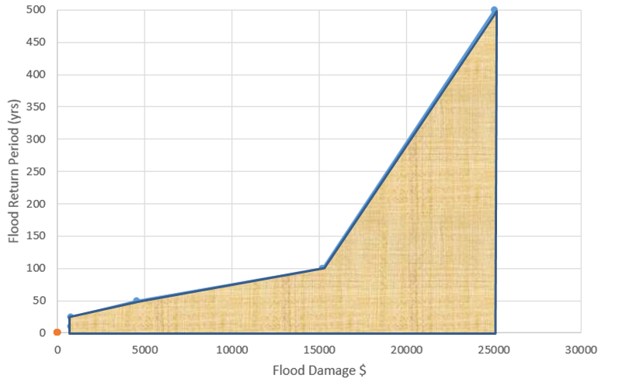
Hydroeconomic analysis for flood mitigation
(USACE Flood Planning, FEMA RiskMap)
Elevation
Rating curve
Elevation-Damage curve
Discharge
Damage
Flood
Frequency
curve
Expected
Annual
Damage
Probability

Slide 17
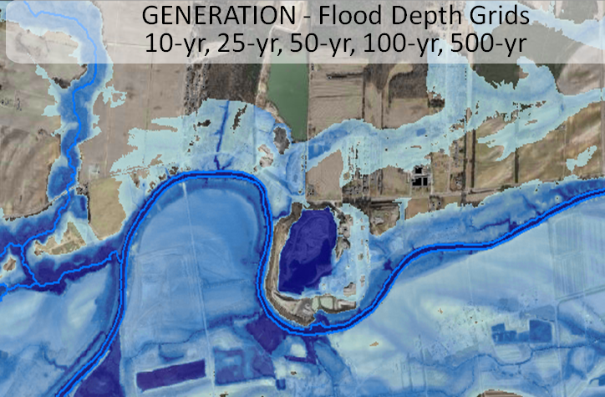
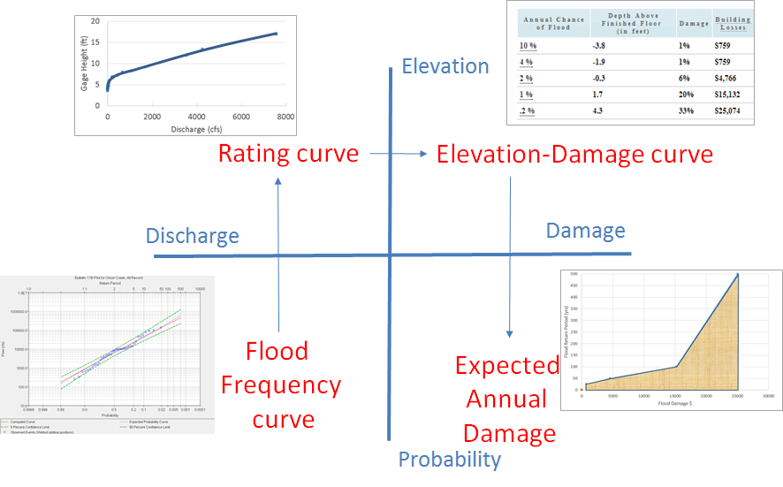
Role of flood mapping
Translate river hydraulics into flooding at homes

Slide 18
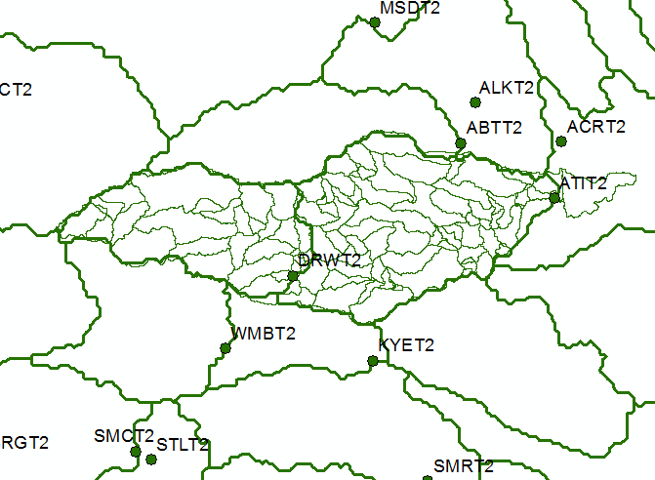
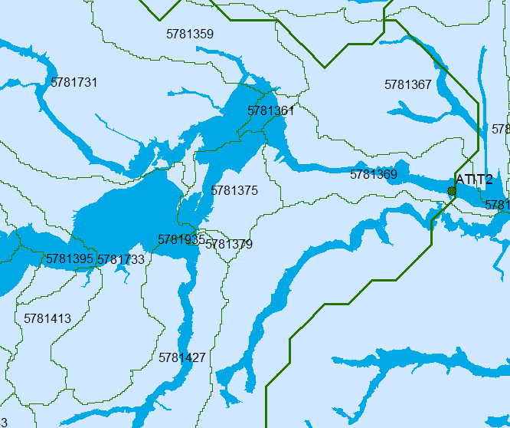
Linking NWS Flood Forecasts to FEMA Flood Hazard Map
NWS River Forecast Subbasins
National Flood Hazard Map
The FEMA National Flood Hazard Map is intersected with the NHDPlus Catchments to
form “NHDPlus Flood Warning Zones”. The downscaled NWS flow forecast for each zone
is used to assess flood risk. If flood risk is high, a warning is sent to all cell phones in this zone.

Slide 19
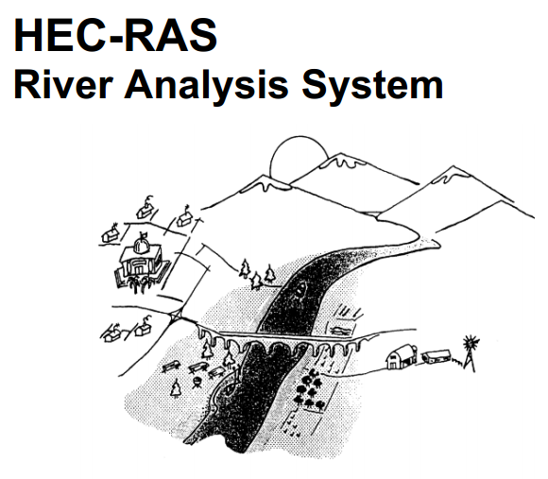
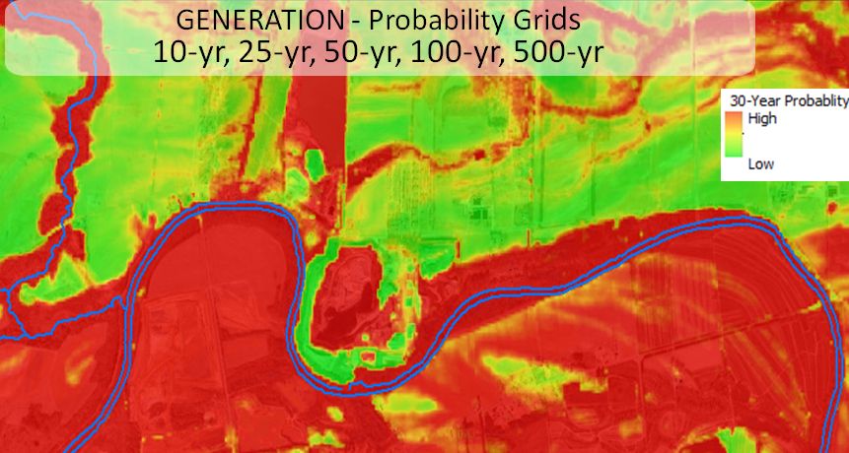
Flood Response Planning
(NWS and federal partners, Local Flood Emergency Responders)
Elevation
Discharge
Impact
Wide area
flood planning
Probability

Slide 20
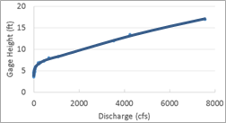
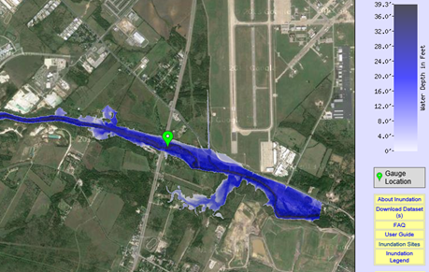
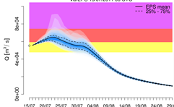
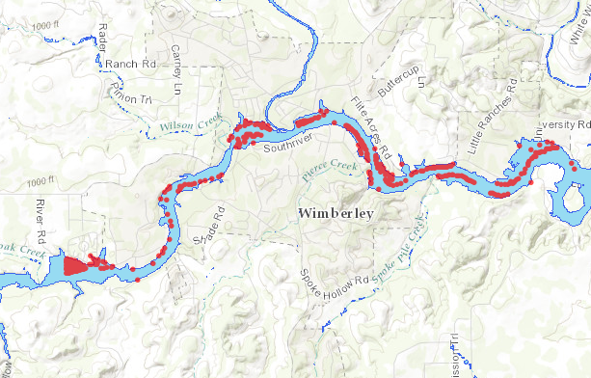
Flood Response Operations
(Local Emergency Responders)
Elevation
Rating curve for stream reach
Real-time flood map
Discharge
Impact
Flooded
Structures
NWS ensemble
streamflow forecast for stream reach
Probability

Slide 21









NFIE Goal: Connect National Scale Flood Modeling with Local emergency planning and response
How can near-real-time hydrologic simulations at high spatial resolution, covering the nation, be carried out using the NHDPlus or next generation hydro-fabric (e.g. data structure for hillslope, watershed scales)?
How can this lead to improved emergency response and community resilience?
How can an improved interoperability framework support the first two goals and lead to sustained innovation in the research to operations process?
Slide: Ed Clark, NWS

Slide 22
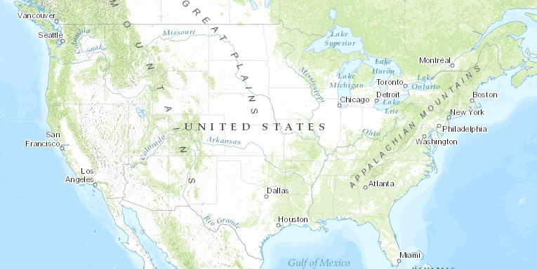
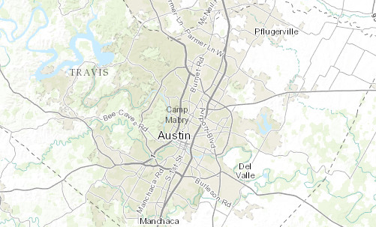
National Flood Interoperability Experiment:
Close the gap between national flood forecasting and local emergency response
Federal
Local
…improve information flow
…national forecasting at
stream reach scale

