Slide 1
NOAA National Weather Service Innovators Program Planning for 2016 Summer Institute National Water Center National Flood Interoperability Experiment Phase II: Building on the National Water Model (NWM)
David Maidment, Sagy Cohen, Sarah Praskievicz, Ibrahim Demir, Alfonso Mejia, with contributions from Jon Nelson and Albert Van Dijk
5 April 2016

Slide 2
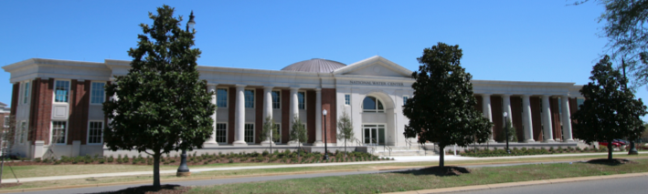
Summer Institute
Overview (one week)
Research Formulation (one week)
Research Development (four weeks)
Capstone Event (one week)

Slide 3
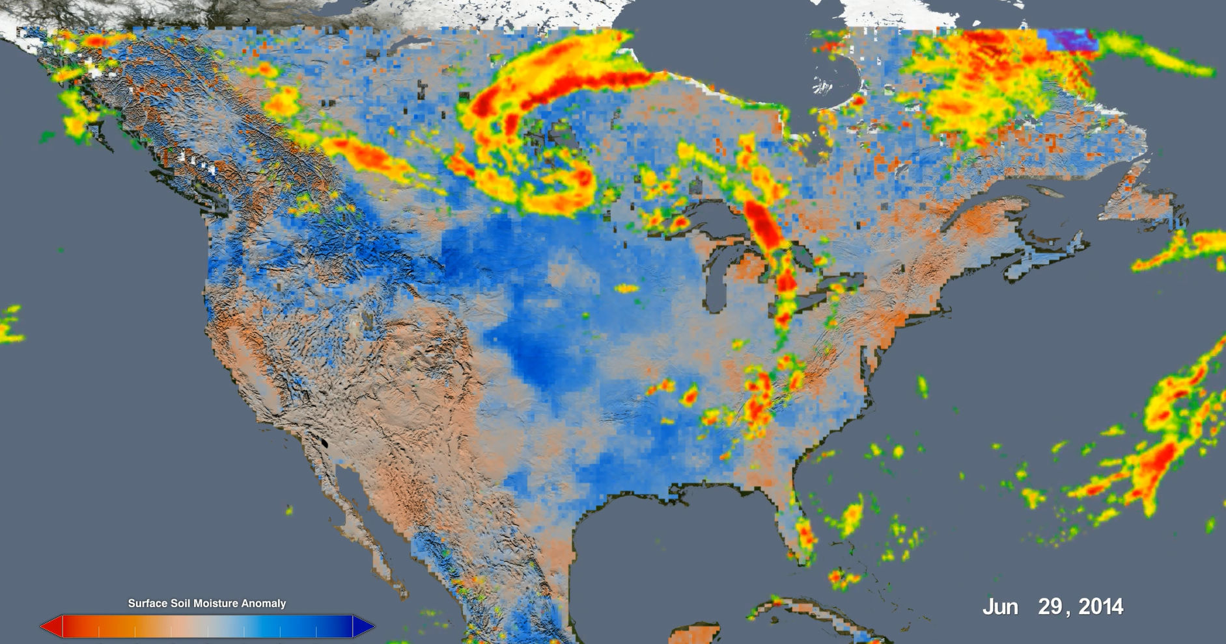
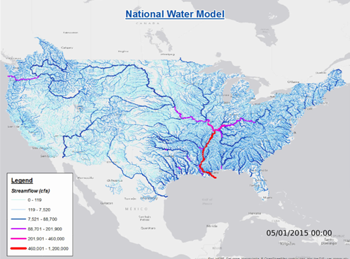
Modeling Soil Water Dynamics and Flow

Slide 4
Conceptual Framework
Operational
Under Development
NWM-Geo: National geospatial framework for hydrology
NWM-Response: Community Flood Response System
NWM-Hydro: National Water Model
NWM-River: River channel information and real-time flood inundation mapping
NWM-Services: Web services for flood information

Slide 5
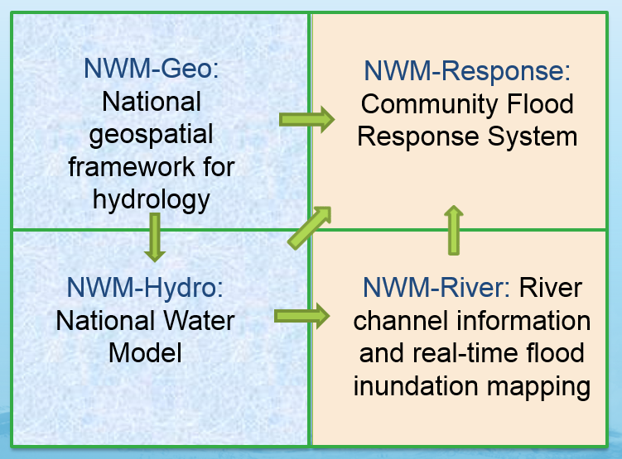
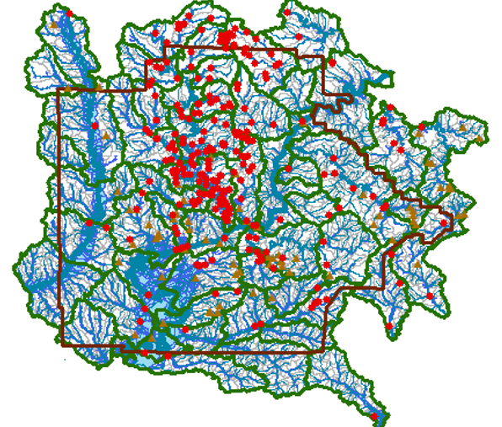
Summer Institute Overview – June 6-10 Theme – National Water Model for Tuscaloosa County
Day One (Monday evening reception) – Introduction to National Weather Service, National Water Center, National Water Model
Day Two (Tuesday) – Table top exercise for Flood Emergency Response in Tuscaloosa County
Day Three (Wednesday) – Geospatial framework for Tuscaloosa County
Day Four (Thursday) – Flow forecast for Tuscaloosa County
Day Five (Friday) – Inundation mapping for Tuscaloosa County

Slide 6
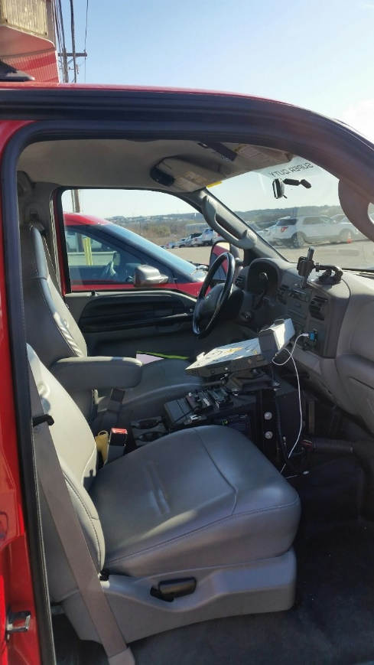
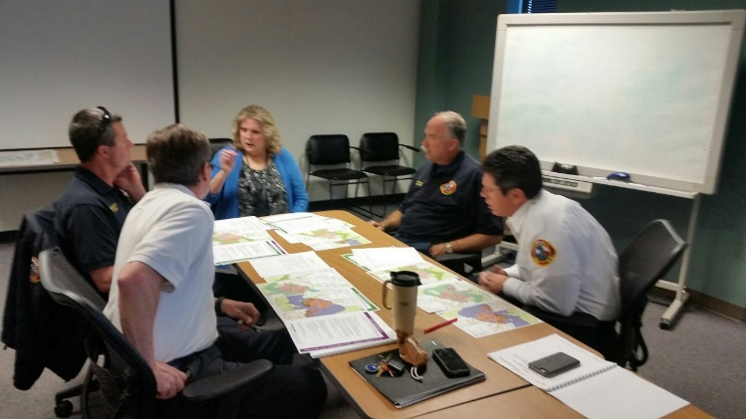
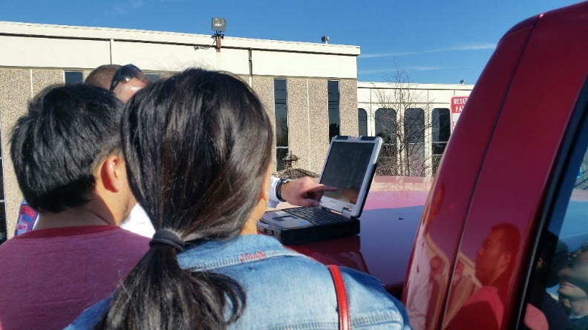
Day Two – Flood Emergency Response
Morning – Introduction to First Response Community in Tuscaloosa County
Afternoon – Table Top Exercise on Flood Emergency Response for Boxing Day Flood 2015
Coordinated by Harry Evans and Rob Robertson
Conducted in Situation Room at NWC

Slide 7
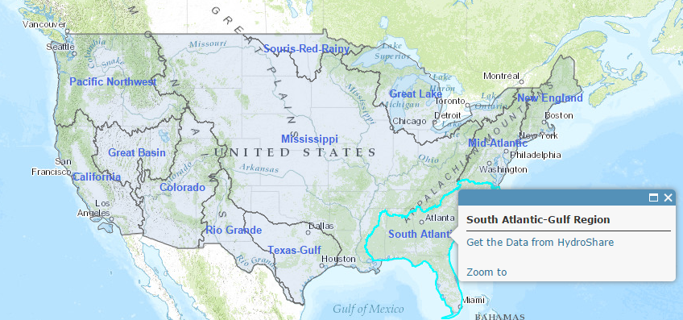
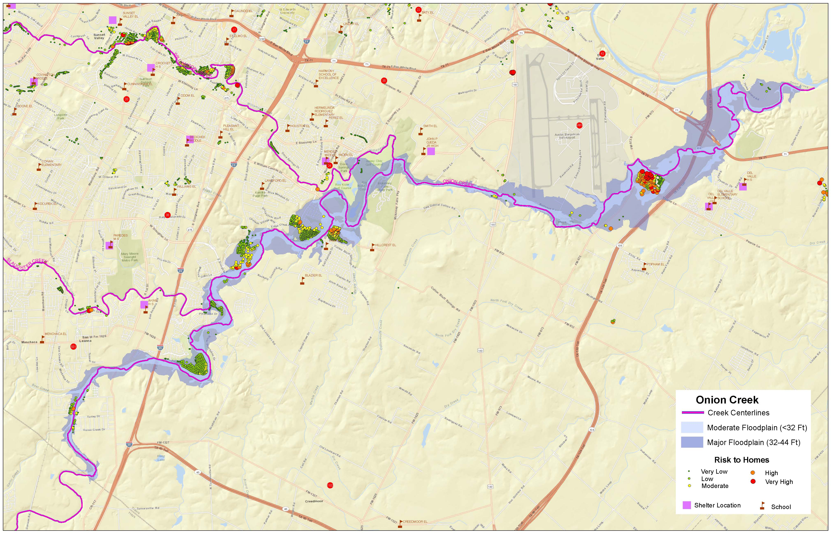
Day Three – Geospatial Framework
Morning – Introduction to NWM-Geo for nation
Afternoon – Building a NWM-Geo Base Map for Tuscaloosa County and adding local information to produce a Strategic Operations Map
NWM-Geo in HydroShare
Strategic Operations
Map for a River
NWM-Geo for
Tuscaloosa County

Slide 8
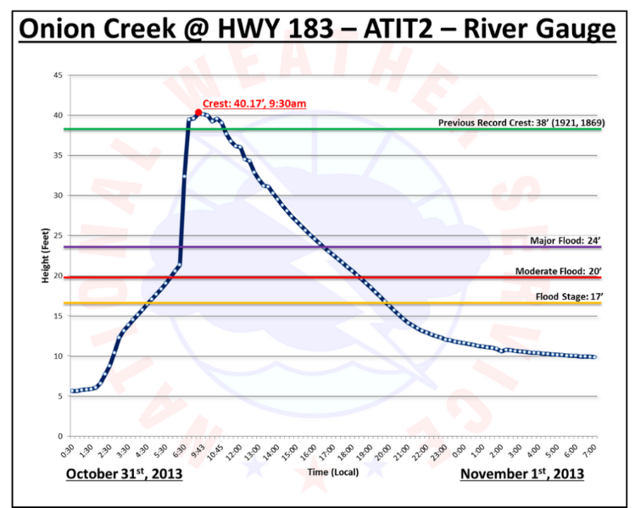
Day Four – Flow Forecast
Morning – Introduction to National Water Model at continental scale
Afternoon – Hydrographs and Flow maps for rivers in Tuscaloosa County
NWM-Hydro for
Tuscaloosa County

Slide 9
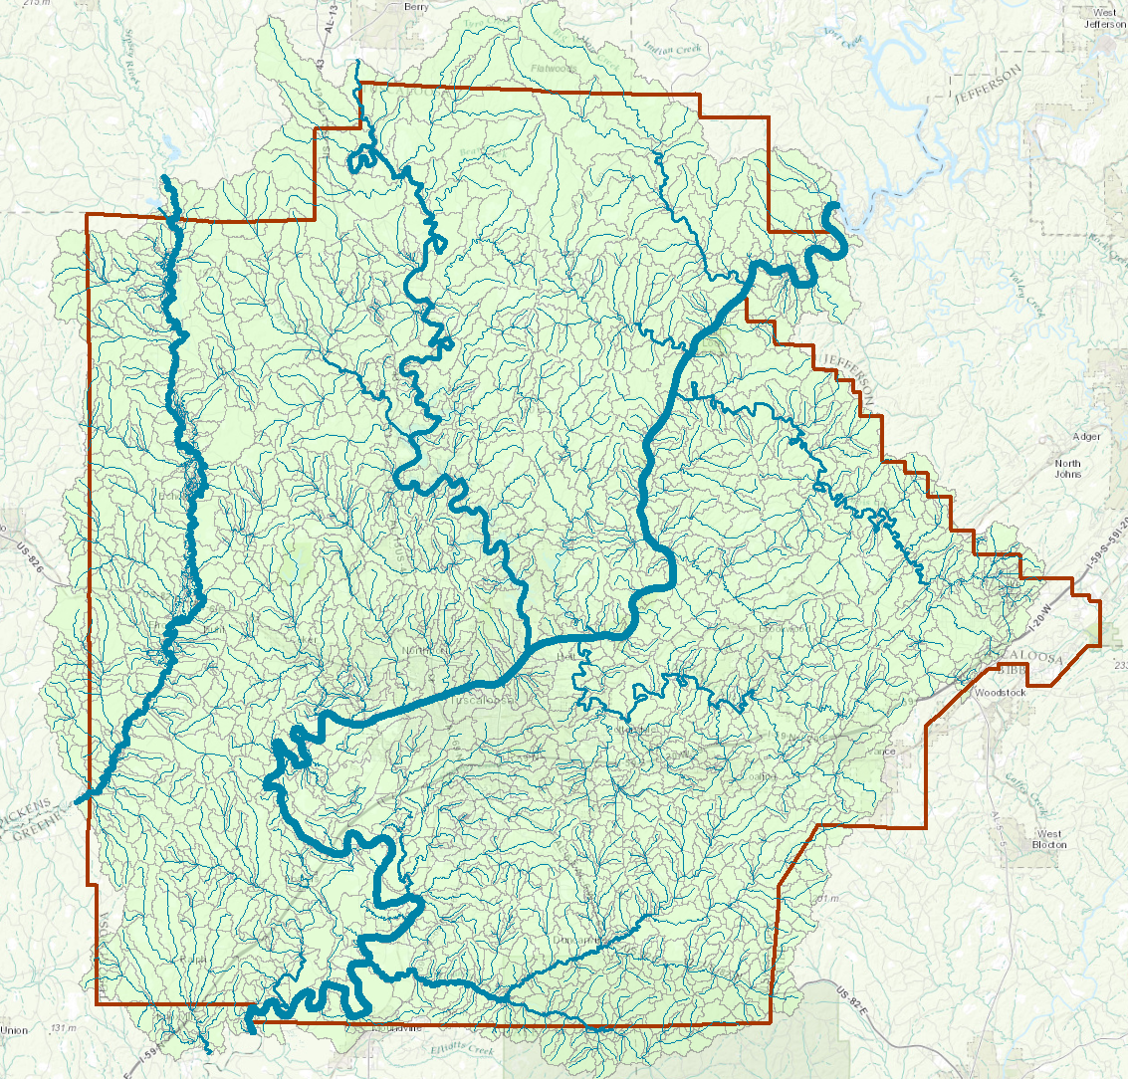
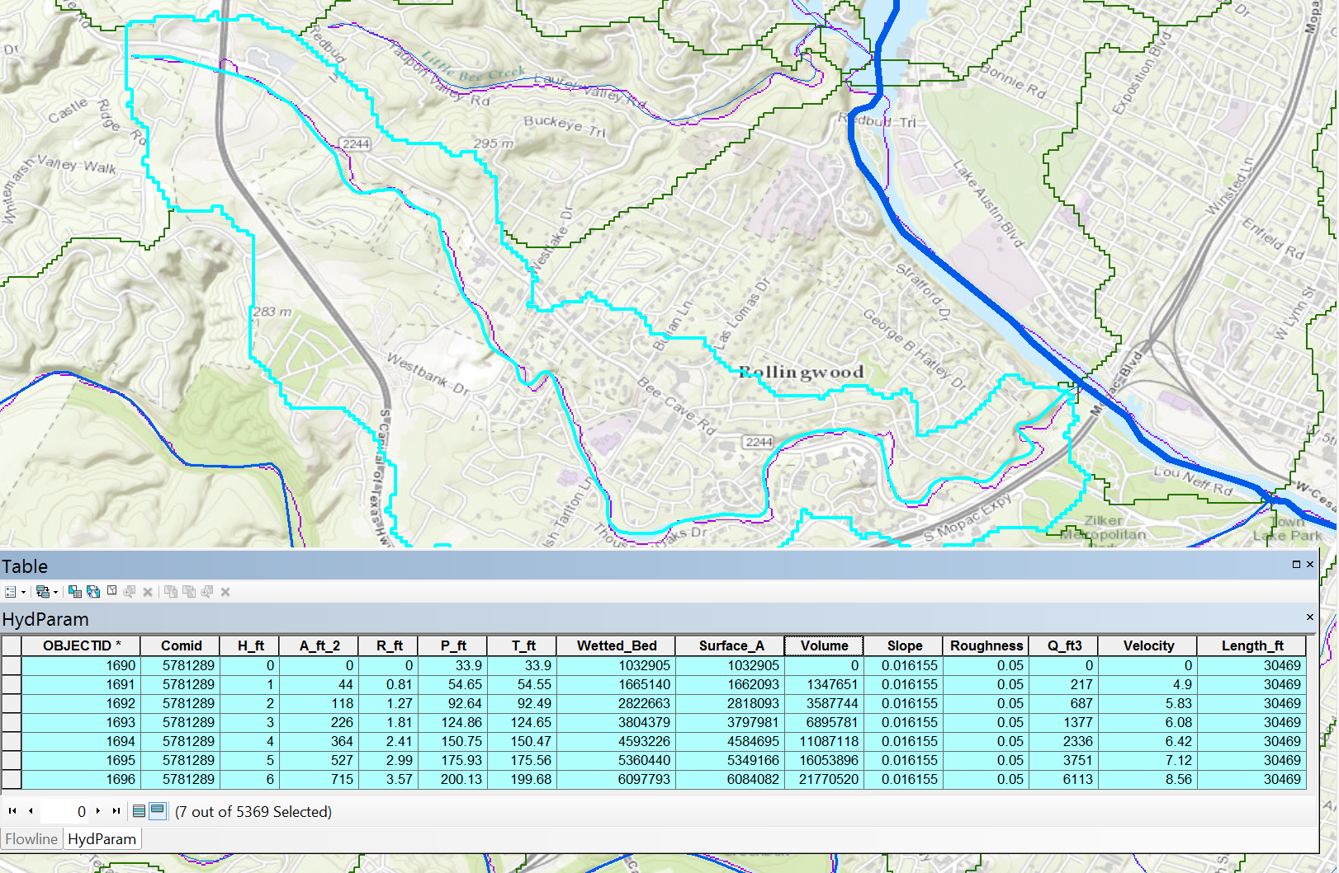
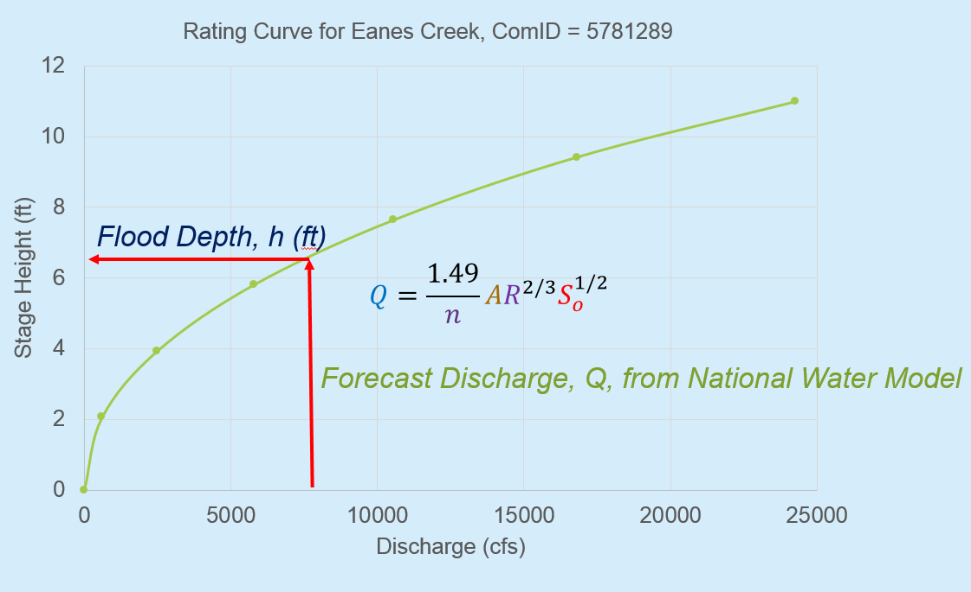
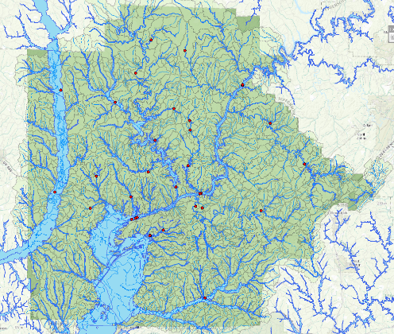
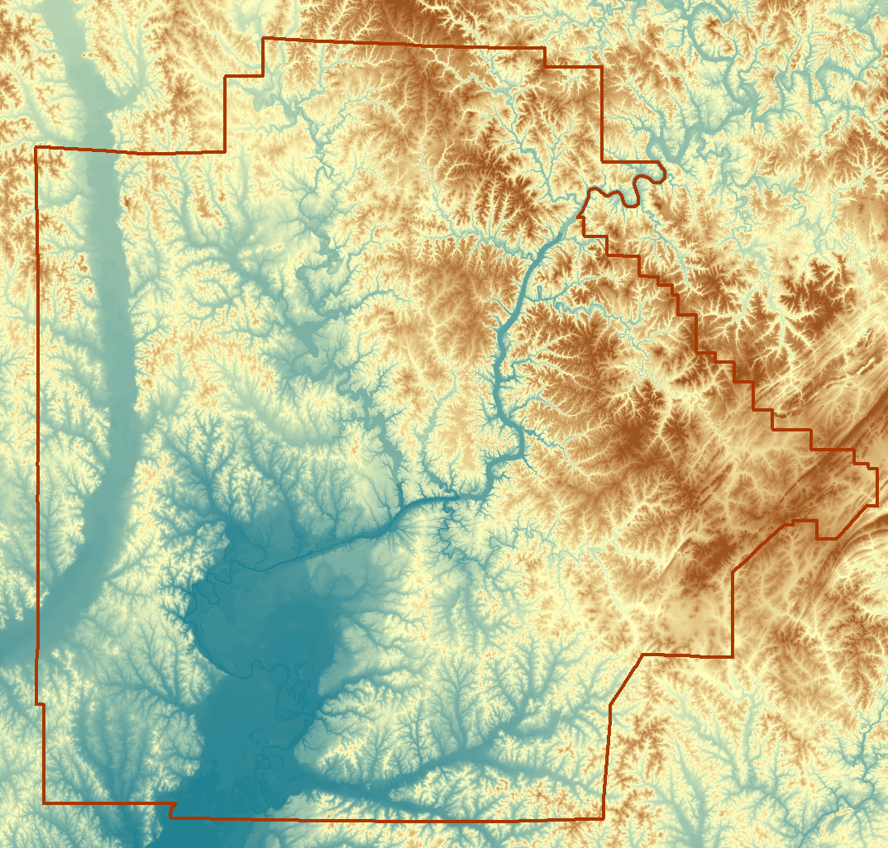
Day Five – Inundation Mapping
NHDPlus
Hydraulic Parameters
For each NHDPlus reach
Rating Curve for each
NHDPlus reach
National Elevation
Dataset
NWM Forecasts
Inundation Mapping for Tuscaloosa County

Slide 10
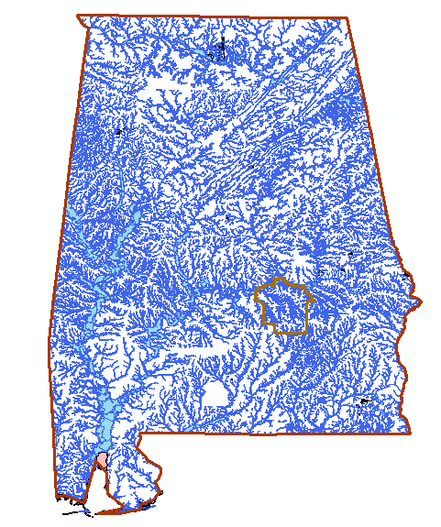
Theme 1: Flood Inundation Mapping
Is it feasible to scale up the Tuscaloosa County prototype to produce a real-time flood inundation map linked to the National Water Model for the State of Alabama?

Slide 11
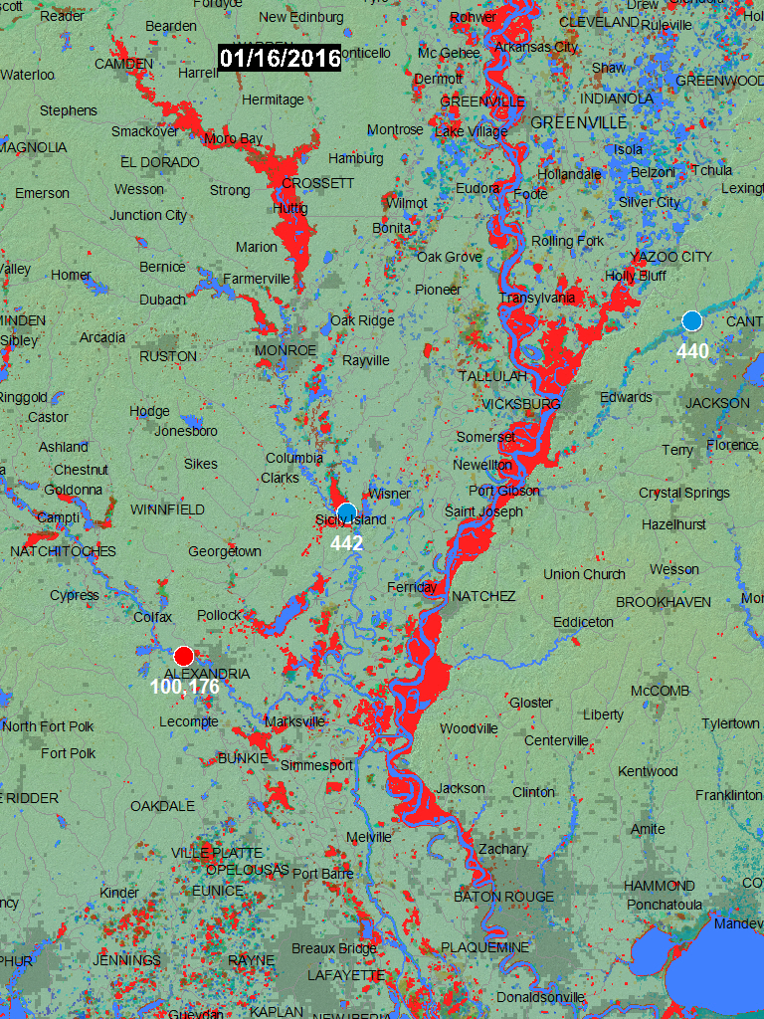
SRS Flood Mapping
Near-real-time mapping
Dartmouth Flood Observatory (DFO) map of January 6 2016 flooding in the Mississippi using MODIS imagery.

Slide 12
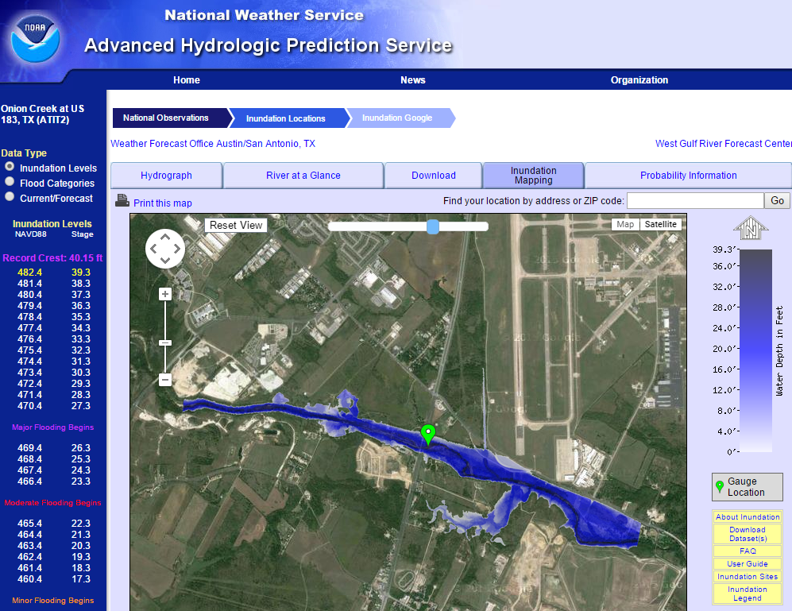
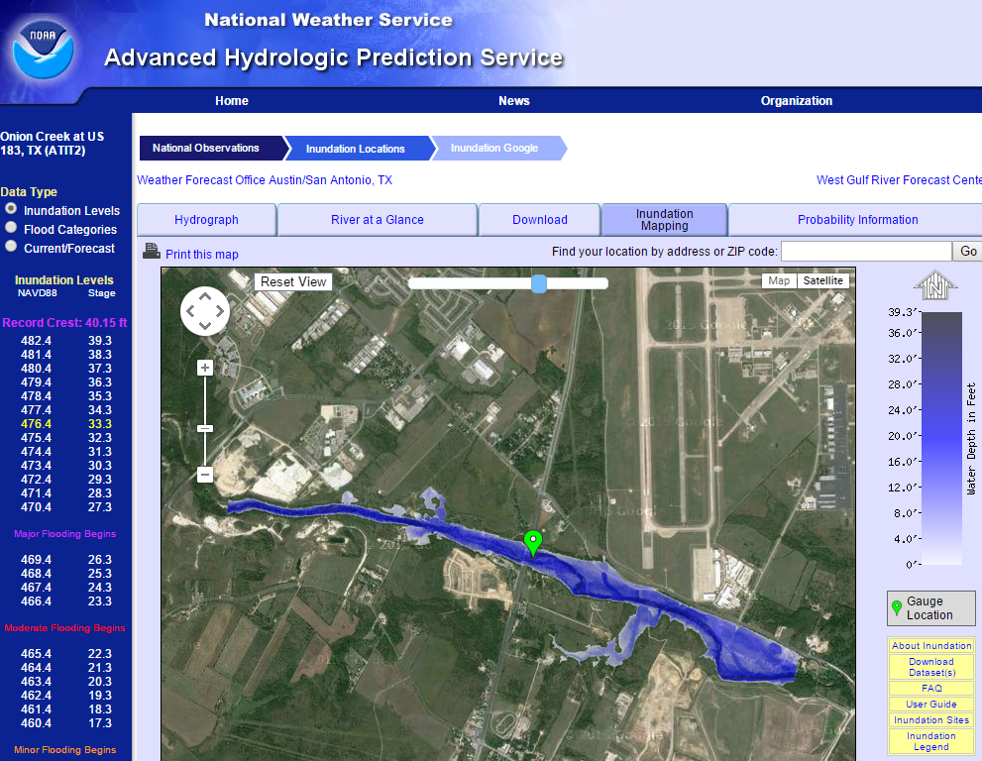
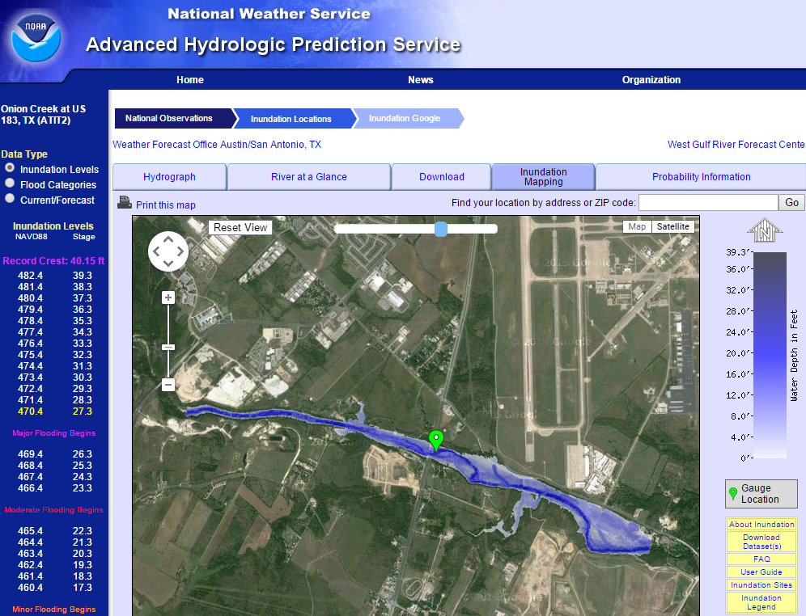
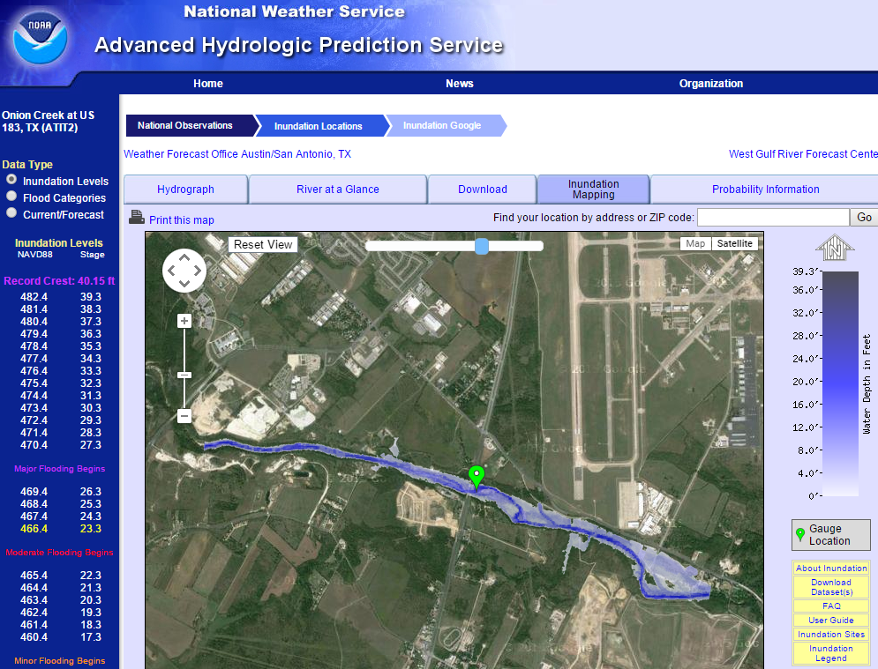
Real-Time Flood Inundation Mapping (USGS/NWS)
http://water.weather.gov/ahps2/inundation/inundation_google.php?gage=atit2

Slide 13
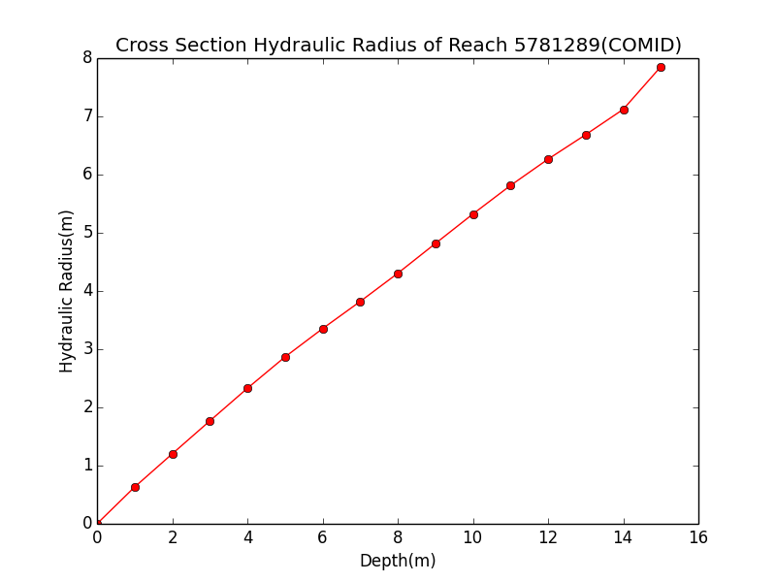
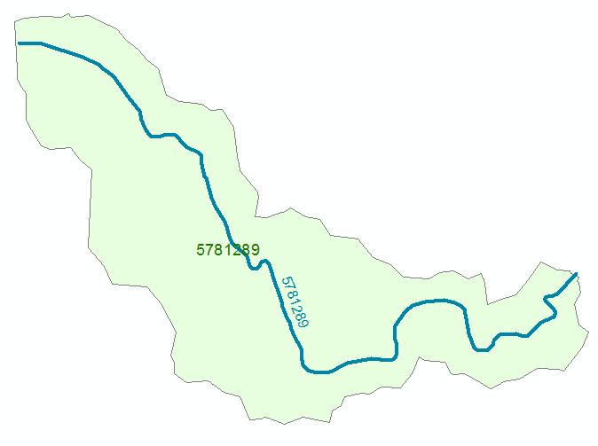
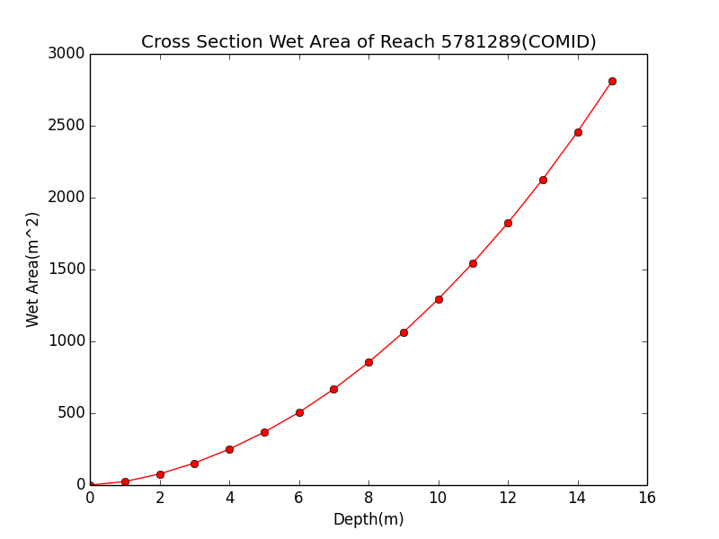
Discharge Computation
Hydraulic Radius, R
Flood Discharge, Q (cfs)
$$Q=\frac{1.49}{n}AR^{2/3}S_{o}^{1/2}$$
Flood Depth, h (ft)
Crossection Area, A
n = 0.035 Manning roughness of channel
S_{o} = 0.0163 Bed slope

Slide 14
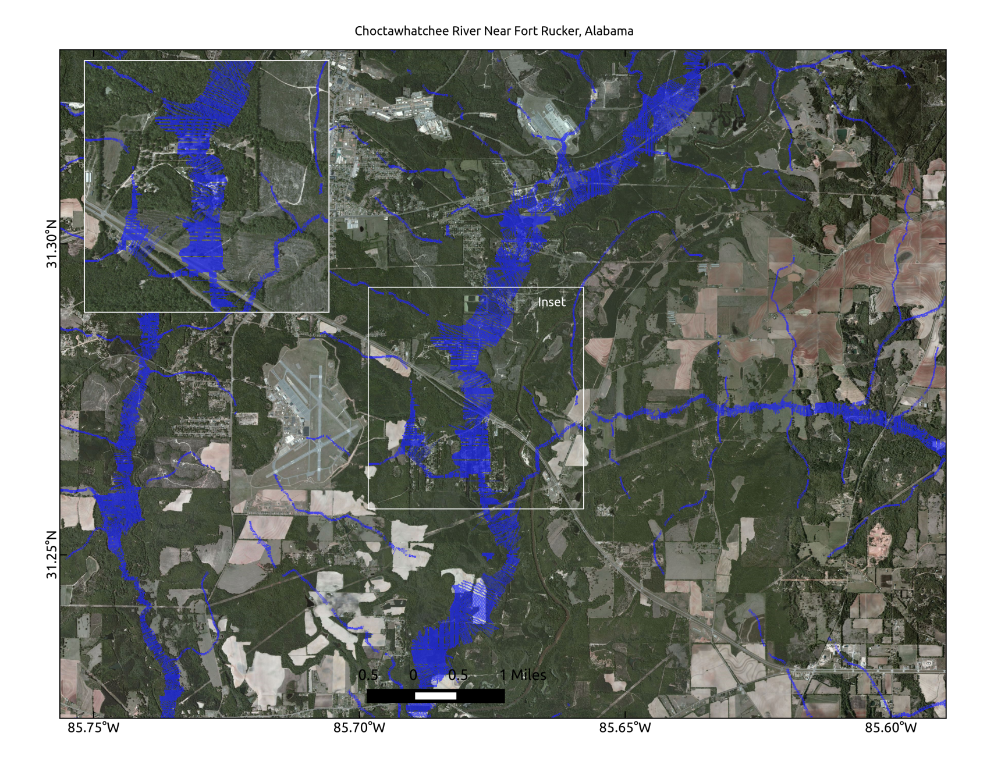
High-Resolution Flood-Inundation Modeling using AutoRoute (USACE)

Slide 15
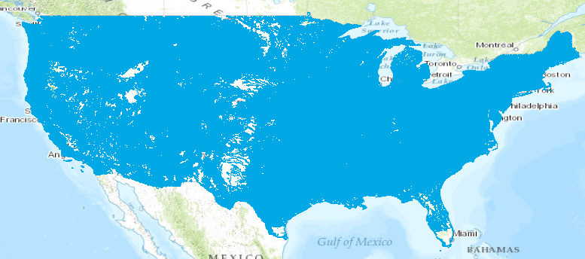
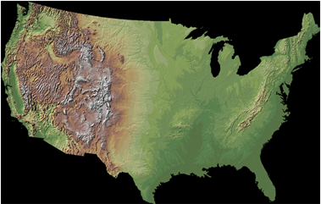
Experiment for 2016: Combine hydrography and elevation to define river channel geometry and flood inundation extent for 5 million km of stream reaches over continental US
Use the CyberGIS computing facility
at the University of Illinois at Urbana-Champaign

Slide 16
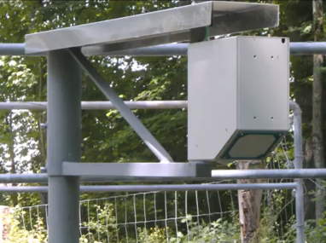
Theme 2: Densified Measurement and Modeling
Can acceptable discharge estimates be made by measuring water surface elevation and surface velocity continuously and using hydraulic modeling to produce the rating curve?

Slide 17
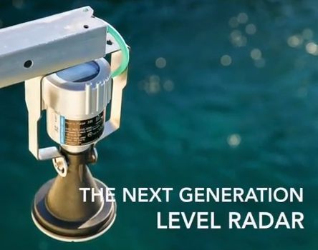
Radar Measurement Technologies
Measures surface velocity ($12,000)
Measures water level ($5000)
Densified forecasting requires densified measurement

Slide 18
Streamflow Observation and Modeling
1 gage:
USGS Stream gage sites (~ 8000) (Level and Flow)
Gold standard
Water Level and Surface Velocity
Silver
Water Level
Bronze
National Water Model Computation
(2.7 million)
:340 reaches
Densified Measurement Demonstration Site near Tuscaloosa

Slide 19
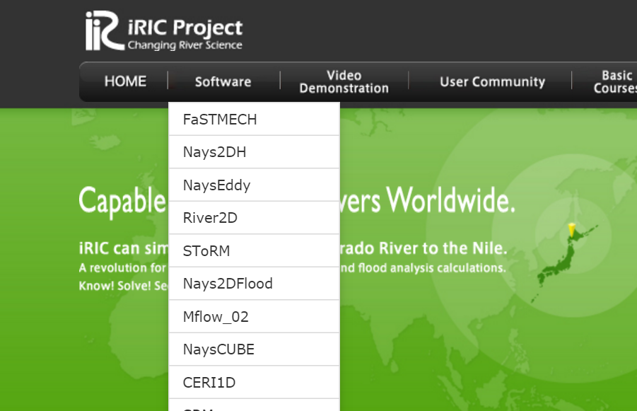
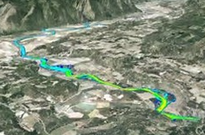
Detailed Hydraulic Modeling of Local River Reaches (Jonathan Nelson, USGS)
http://i-ric.org/en/index.html

Slide 20
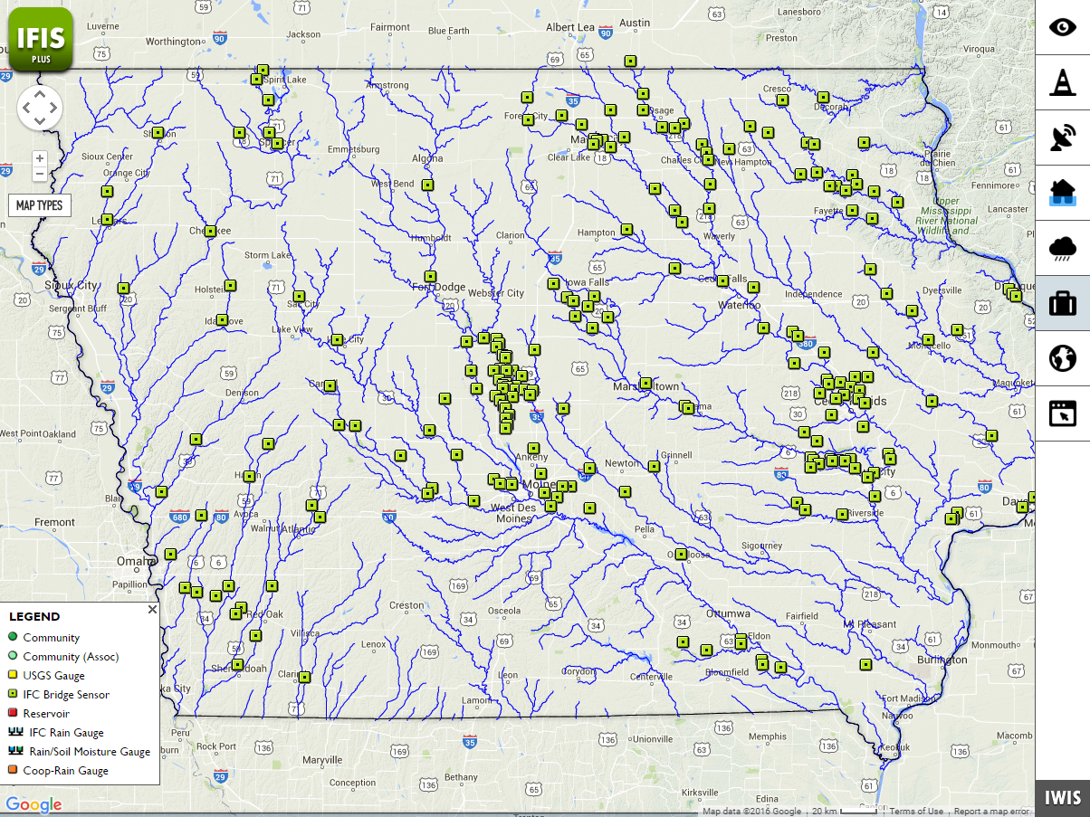
Theme 3: Data Assimilation and Forecast Error
What is the forecast error when the National Water Model is applied in Iowa?
Can data from the Iowa Flood Center observation network be combined with the NWM forecasts to produce an adjusted forecast with reduced error?

Slide 21
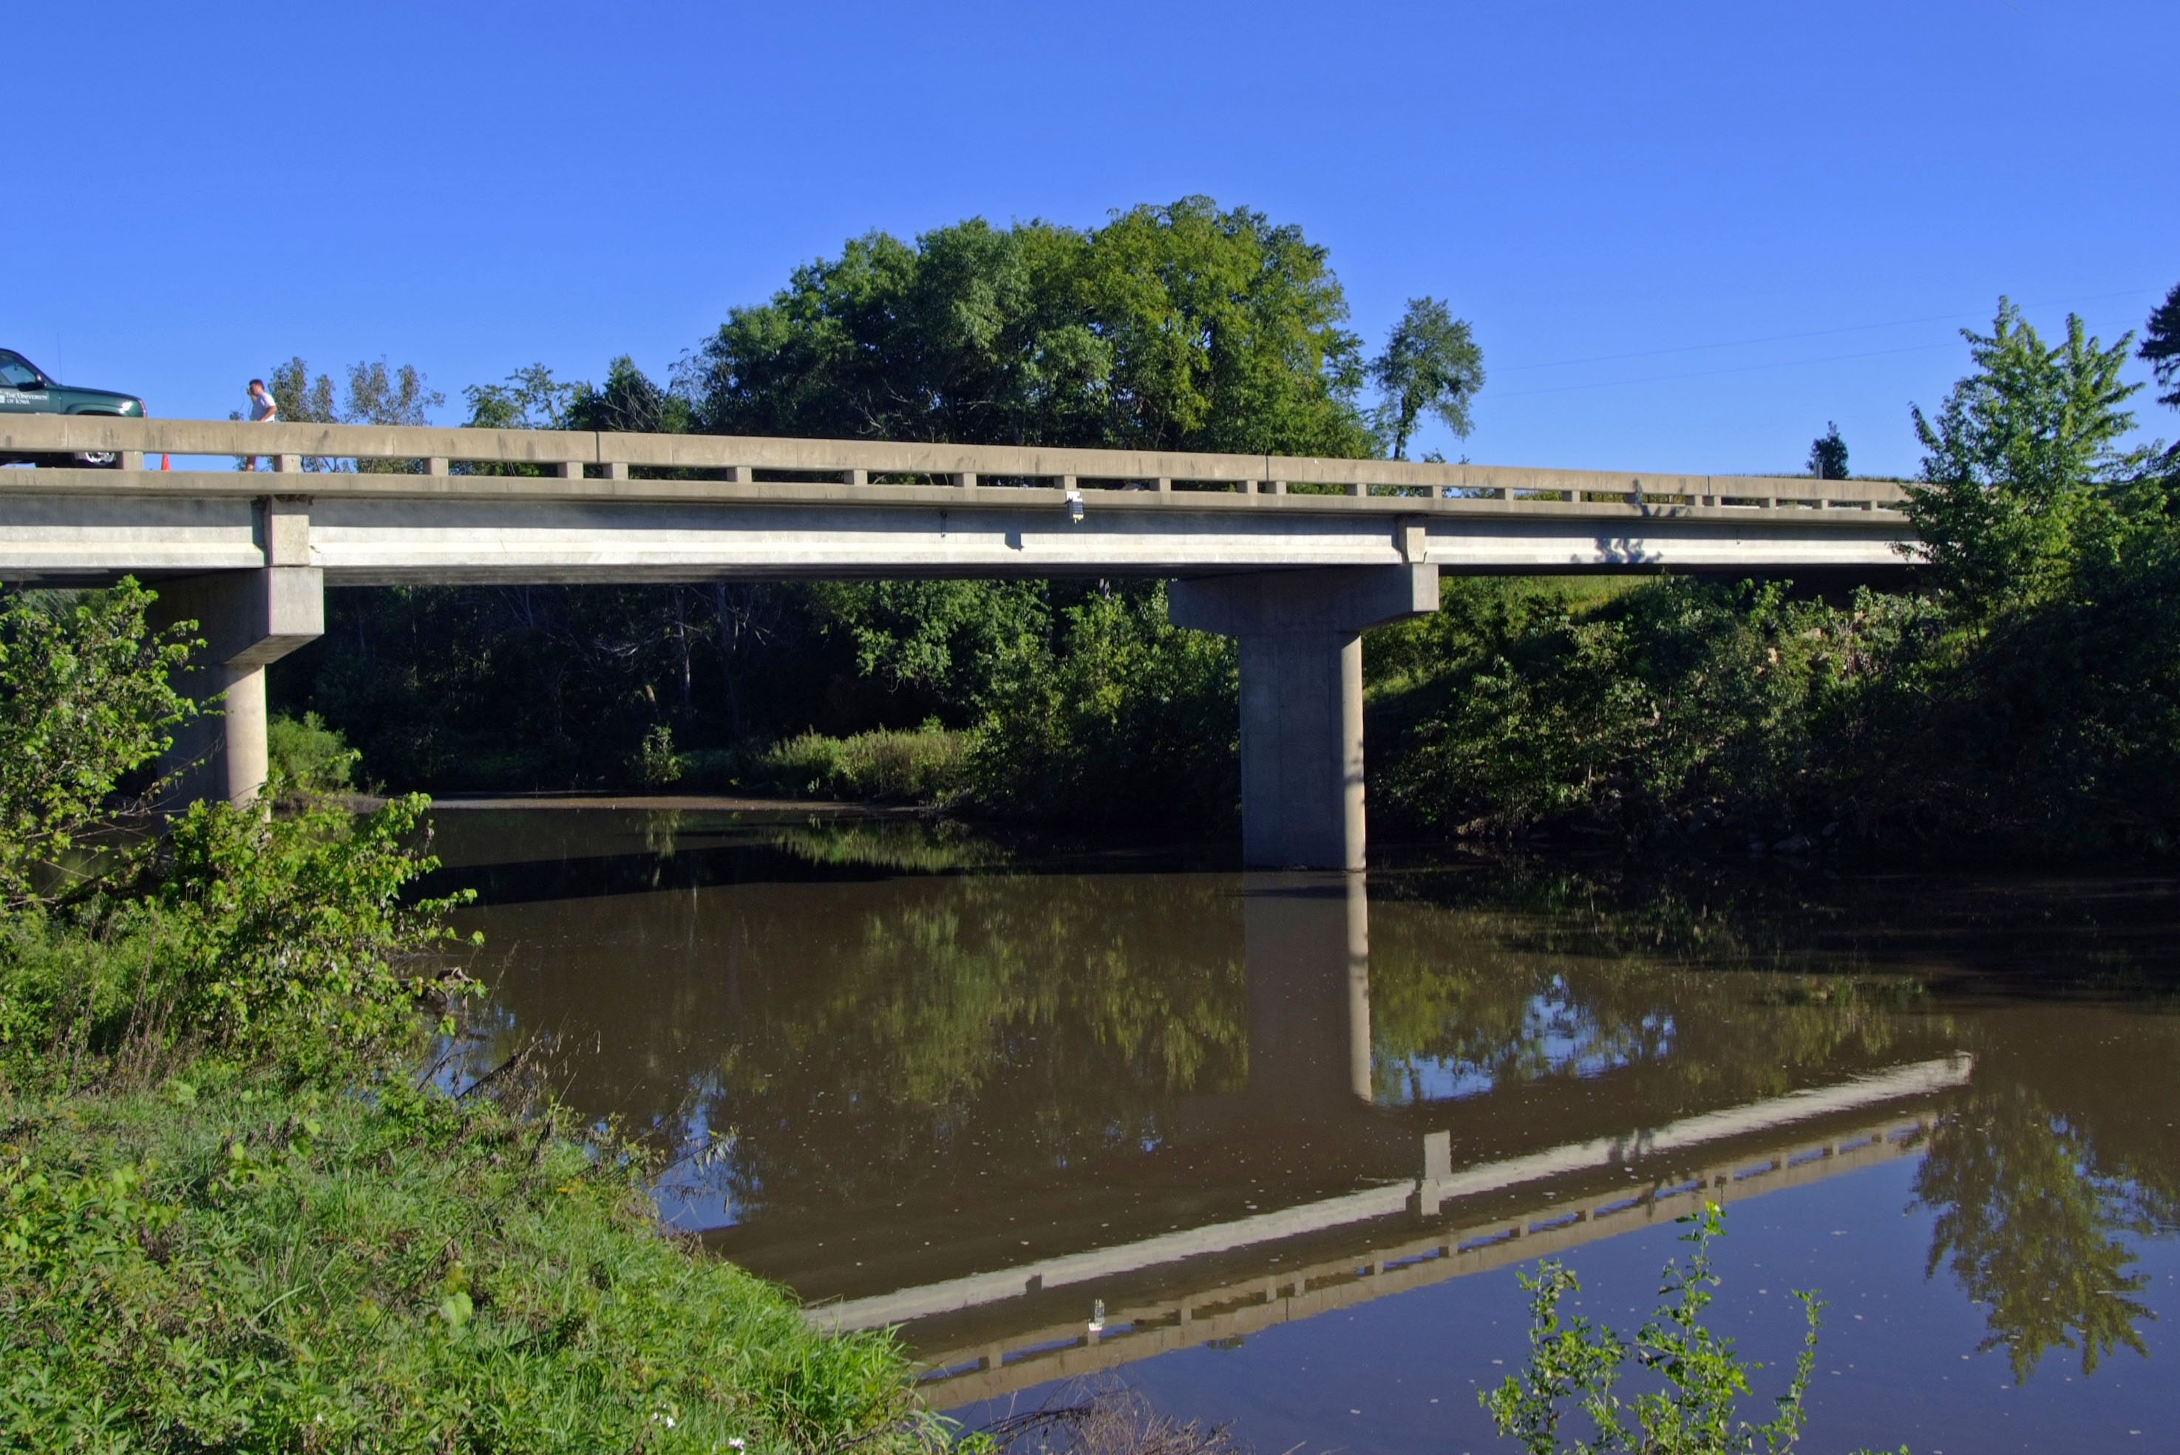
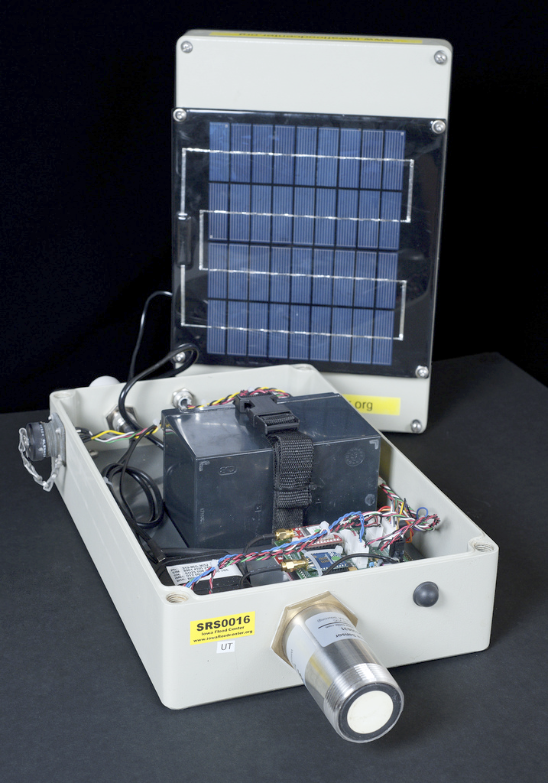
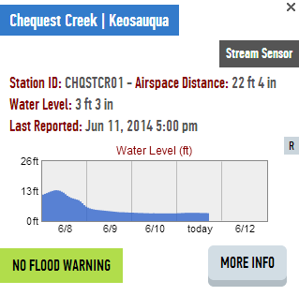
Iowa Flood Center STREAM SENSORS
Notes:
Point to make here is the need for physically based models given the dynamic and complex nature of rainfall.

Slide 22
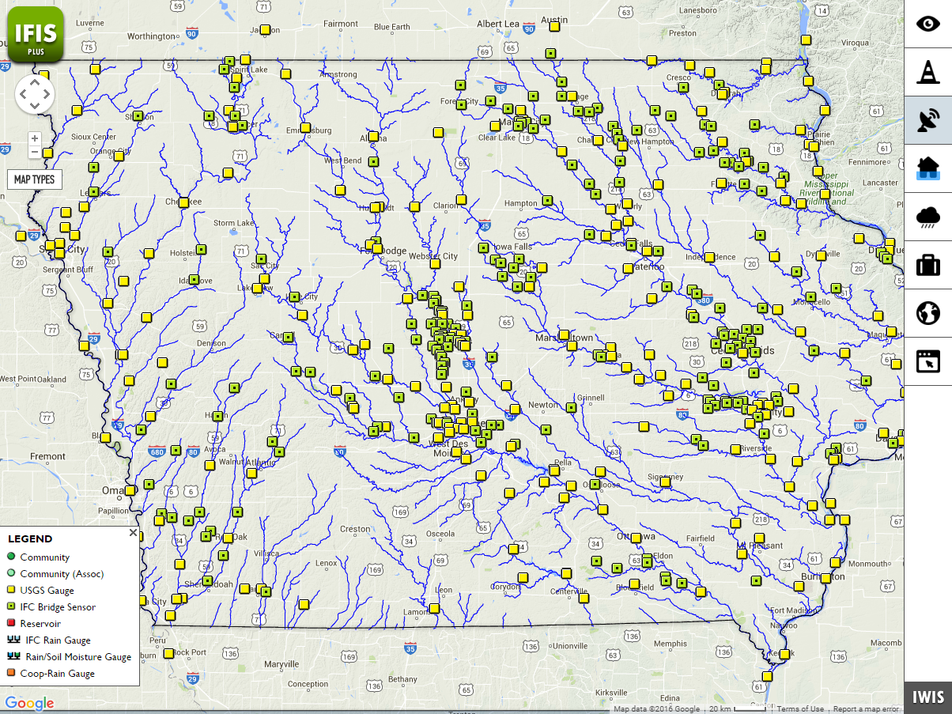
Iowa Flood Center River Stage Sensors
224 IFC Gauges
461 USGS + IFC Gauges
How can we determine forecast errors?
How much can it be reduced through densified measurement?
How can we use data assimilation to adjust the forecasts to the observations?
Effect of placement and # of stream sensors in a watershed
Effect of different input sources (e.g. rainfall) on forecast model

Slide 23
Theme 4: Flood Emergency Response
Can the flood response map templates produced for Travis county be adapted for application in Tuscaloosa county?
Can an app be developed for a hand-held device that would produce citizen warning of flood events?

Slide 24
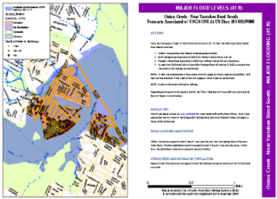
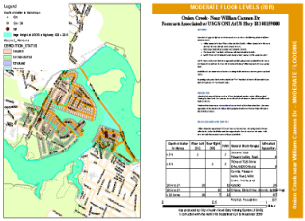
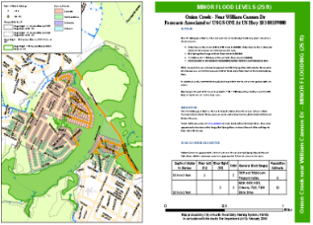
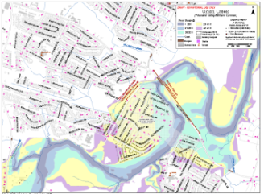
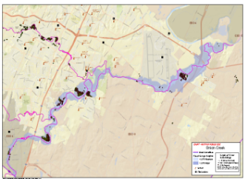
Community Flood Response Map Book
Pre-Planning Maps
Operational
Maps
Incident Command
Strategic
▪ High level of detail for high priority reaches
▪ Area command level
▪ Overview of affected area
Major
Flood Level
Moderate
Flood Level
Minor
Flood Level

Slide 25
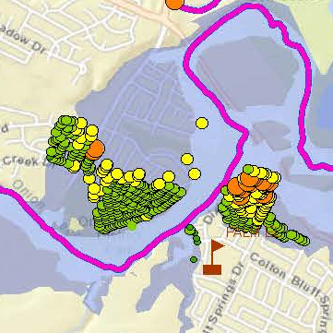
Strategic Overview Map
One area of risk

Slide 26
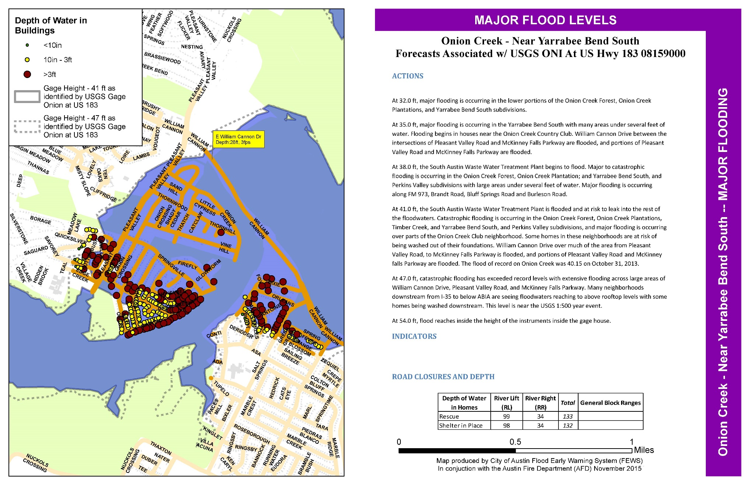
Pre-Planning Flood Map
Actions, Indicators, Road Closures and Depth

Slide 27
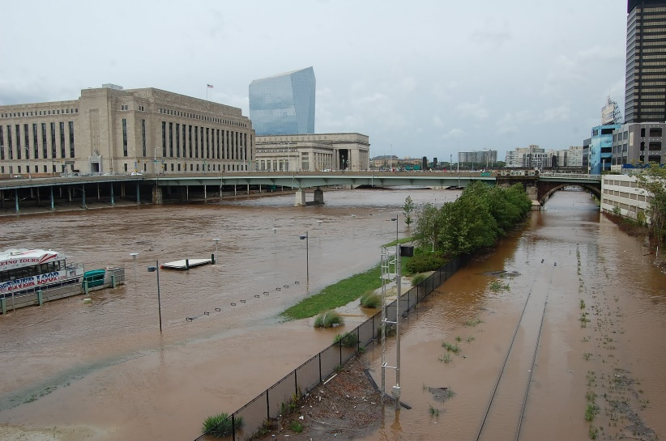
Theme 5: Case Studies
How does the National Water Model add additional useful information for the Delaware River Basin?
How can the National Water Model be applied in the City of Philadelphia?

Slide 28
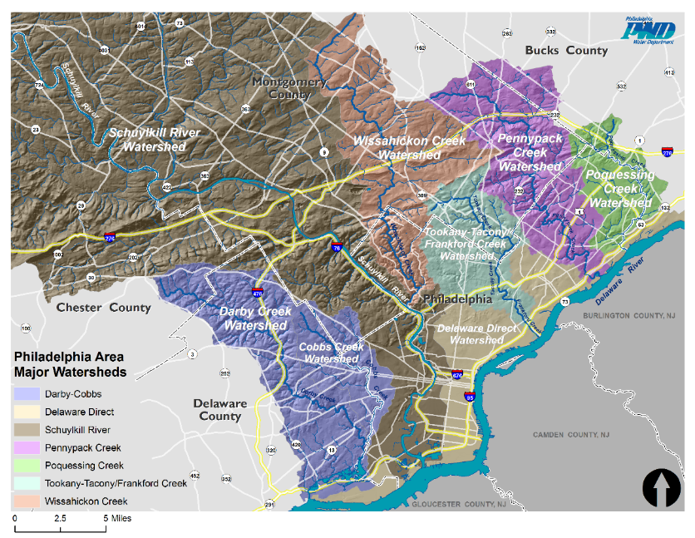
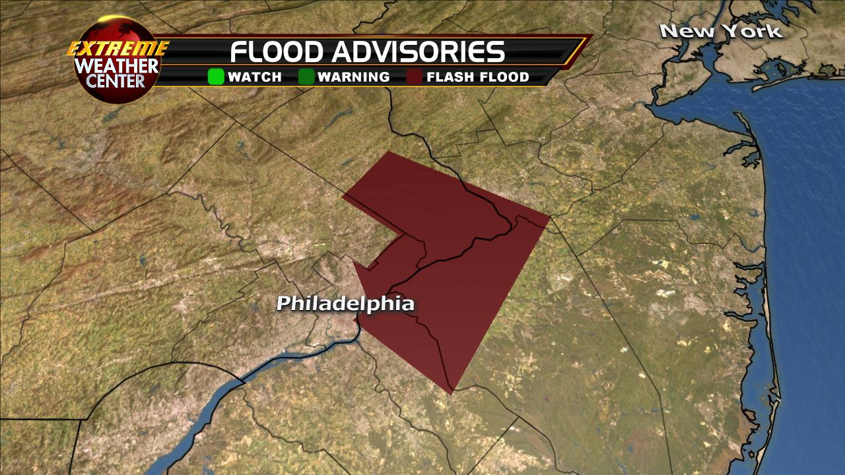
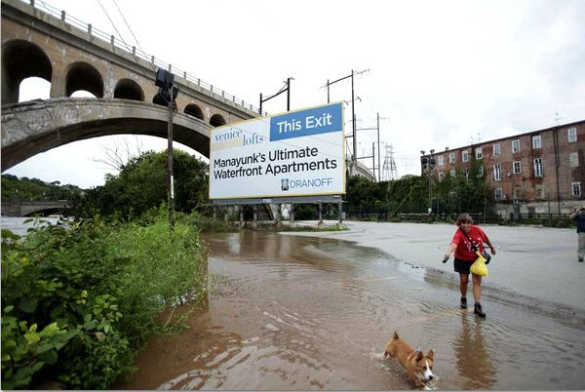
Flooding in Philadelphia
Notes:
SEPTA bridge flooding: http://blog.bicyclecoalition.org/2011/08/flood-clean-up-needs-volunteers.html
Flooding with dog: http://www.centercityrealestate.com/philadelphia-real-estate-blog/philadelphia-flooding-after-hurricane-irene/
Map: PWD

Slide 29
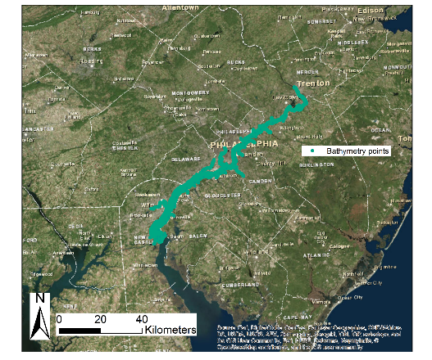
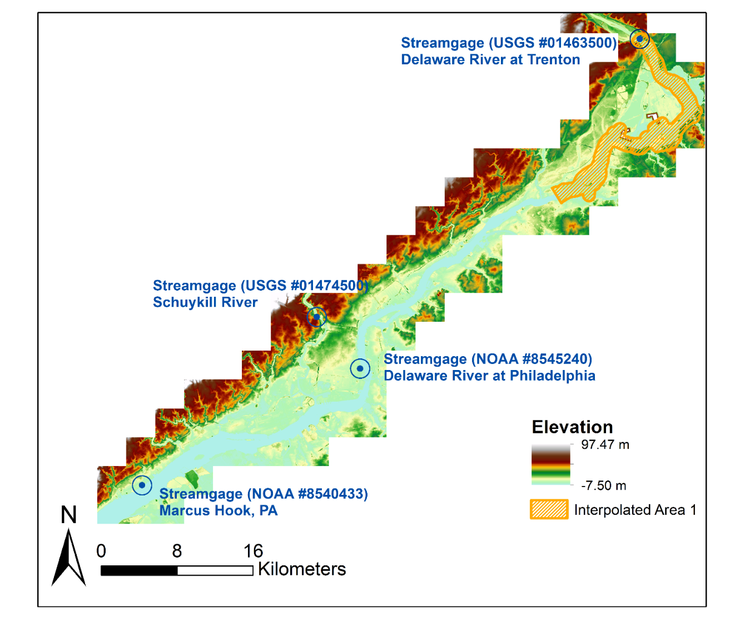
The Delaware River
Bathymetry + 1 meter DEM

Slide 30
Theme 6: Continental Water Balance
How can a Common Operating Picture of the continental scale water balance of the United States be visualized?
How can time series and water conditions maps be produced for a particular location or region?

Slide 31
Albert van Dijk
Professor Water Science and Management, The Australian National University.
Led development of a continental water balance monitoring system.
How can we visualize and interpret continental scale water balance modelling and results for Australia and the US?

Slide 32
Current wetness conditions
http://www.bom.gov.au/water/landscape/

Slide 33
Situational Awareness
Perspective
Situational
awareness
Foresight
PAST
PRESENT
FUTURE
YEARS
MONTHS
WEEKS
DAYS
DAYS
WEEKS
MONTHS
YEARS
Australian Water Resource Assessment Model
Flood
Forecasts
7-day
Streamflow
Forecasts
Seasonal
Streamflow
Forecasts
Notes:
Looking back to the future
Forecasting is the Bureau's DNA – weather and climate, and also flood for over 50 years
Seamless approach to water forecasting
From flood – and more recently to short-term – seasonal and long term

