Slide 1
Community Flood Response System for Hays County
David R. Maidment and Harry R. Evans
Center for Research in Water Resources
University of Texas at Austin
Discussion with Hays County Emergency Response officials
San Marcos TX, 26 Aug 2015
Acknowledgements: Tomas Rodriguez, City of Austin

Slide 2
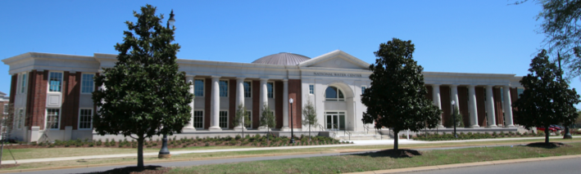
The Opportunity
New National Water Center established on the Tuscaloosa campus of University of Alabama by the National Weather Service and federal agency partners
Has a mission to assess hydrology in a new way at the continental scale for the United States

Slide 3
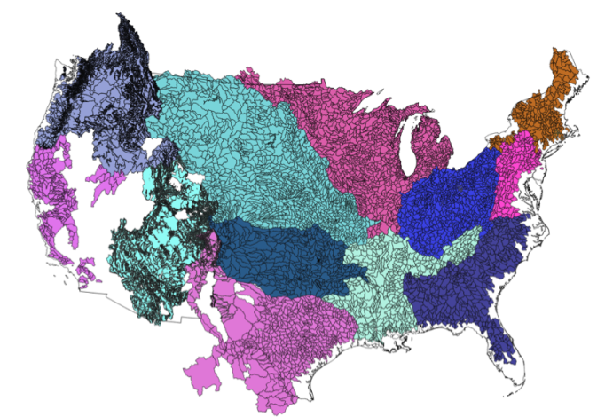
NWS River Forecast Centers (RFCs)
Prepare river and flood forecasts using models based on average basin characteristics
Provide forecast guidance to Weather Forecast Offices (WFOs)
Issue daily stage and streamflow forecasts, rainfall and drought data and information, and flash flood guidance
Work with water managers and other Federal Agencies
6000 sub-basins in continental US
3
Notes:
RFC Summary

Slide 4
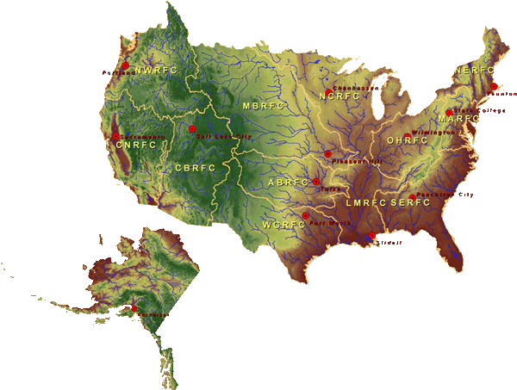
National Water Center
FY15 Centralized Water Forecasting
Centralized Data Archive – all RFC data
Modeling Evaluation Service
RFC and NWC modeling and forecasts
Modeling Testbed – new NWC capabilities
Centralized Water Forecasting Demonstration
Notes:
TRANSITION INTO METHODS
FY15 PROJECT HAS FOUR CORE COMPONENTS
RFC archive
Model evaluation service
Modeling testbed
Centralized modeling demonstration

Slide 5
Goal of the Experiment
Close the gap between National Flood Forecasting and Local Emergency Response
Demonstrate forecasting of flood impacts at “stream and street level”
National
Weather and Hydrology
National Weather Service and federal agencies
National Water Center
River Flooding and Emergency Response
Local, State and Regional Agencies
Citizens
Local

Slide 6
NFIE Conceptual Framework
NFIE-Geo: National geospatial framework for hydrology
NFIE-Response: Community Flood Response System
NFIE-Hydro: National high spatial resolution hydrologic forecasting
NFIE-River: River channel information and real-time flood inundation mapping
NFIE-Services: Web services for flood information

Slide 7
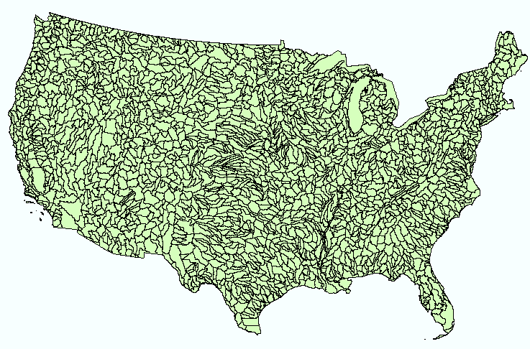
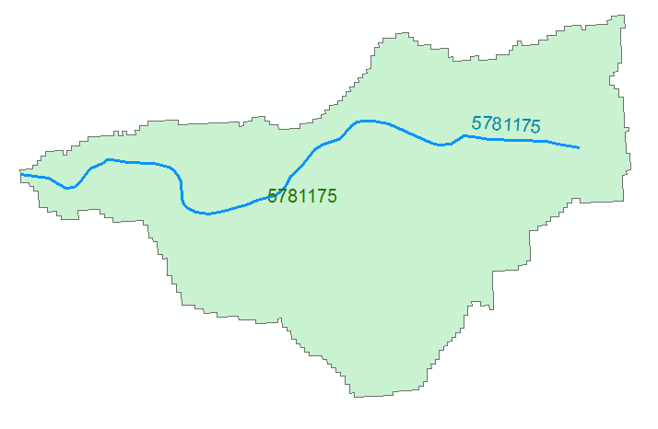
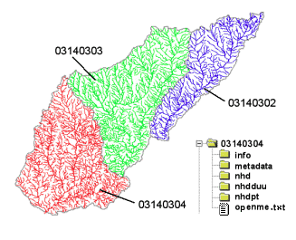
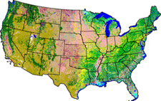
NHDPlus Version 2.1
Geospatial foundation for a national water data infrastructure
NHDPlus
2.7 million reach catchments in US
average area 3 km²
reach length 2 km
Uniquely labelled
National Elevation Dataset
Watershed Boundary Dataset
National Hydrography Dataset
National Land Cover Dataset

Slide 8
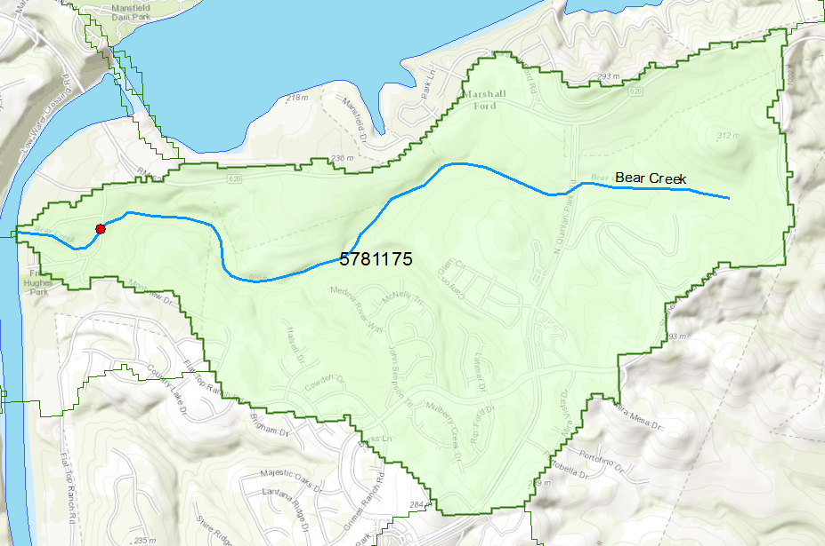
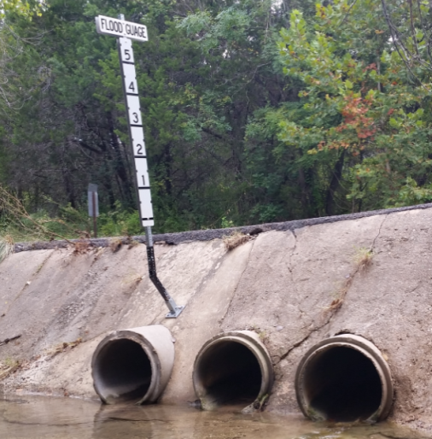
Flood Information for Fritz Hughes Park Rd
National Hydrography Dataset Plus
catchment for Bear Creek
(area = 5.71 km²)
Low water crossing at
3400 Fritz Hughes Park Rd

Slide 9
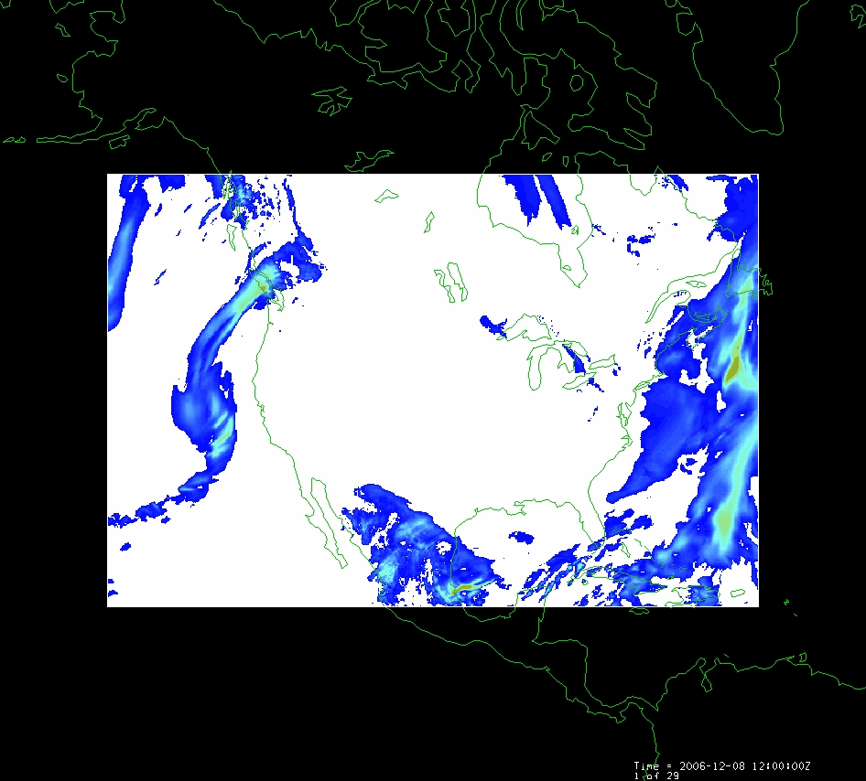
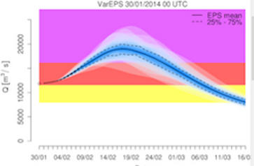
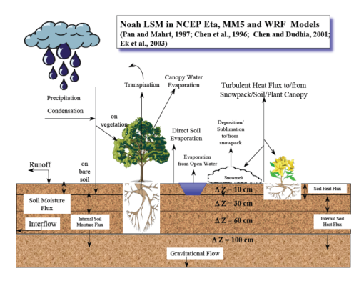
NFIE-Hydro Forecasting Model
Computed for the continental US in 10 minutes at Texas Advanced Computing Center
Weather model and forecasts (HRRR)
Probabilistic flood forecasts
Catchment-level forecasts
Weather
Precipitation
Streamflow
Runoff
Land-Atmosphere Model (NOAH-MP)
RAPID flow routing (for continental US)

Slide 10
Next Step: National Water Prediction Model Configurations
WRF-Hydro IOC Configurations – May 2016
Analysis & Assimilation
Short-Range
‘Flood Prediction’
Medium Range
‘Flow Prediction’
Long Range
‘Water Resources’
Cycling Frequency
Hourly
3-Hourly
Daily
~Daily (x16)
Forecast Duration
- 3 hrs
0-2 days
0-10 days
0-30 days
Spatial Discretization & Routing
1km/250m/NHDPlus Reach
1km/250m/NHDPlus Reach
1km/250m/NHDPlus Reach
1 km/catchment /NHDPlus Reach
Meteorological Forcing
MRMS blend/ HRRR-NAM bkgnd.
Downscaled HRRR /RAP/NAM blend
Short-range + Downscaled GFS
Downscaled & bias-corrected CFS

Slide 11
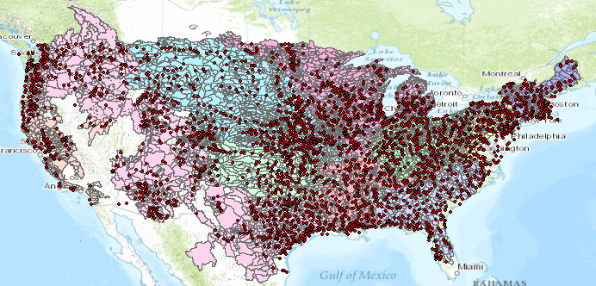
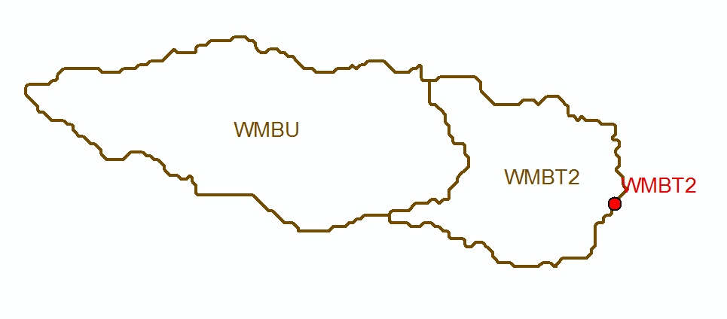
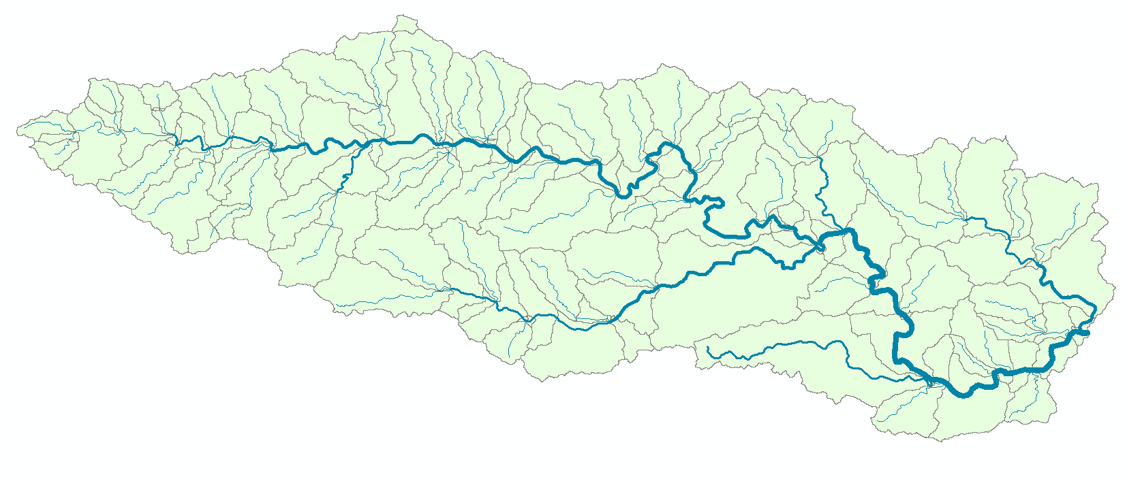
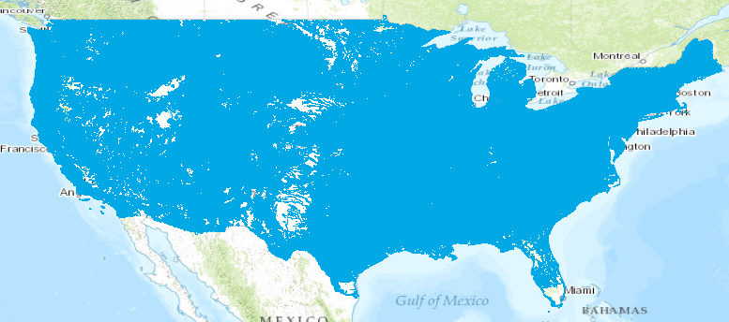
Current and NFIE Forecast Systems
Blanco River at Wimberley
Current: 6600 basins and 3600 forecast points
Two basins and one forecast point
Forecast Basin ~ 400 Square Miles
becomes
NFIE: 2.7 million stream reaches and catchments
Reach Catchment ~ 1 Square Mile
130 Catchments and Flowlines
uniquely labelled
A national flow network

Slide 12
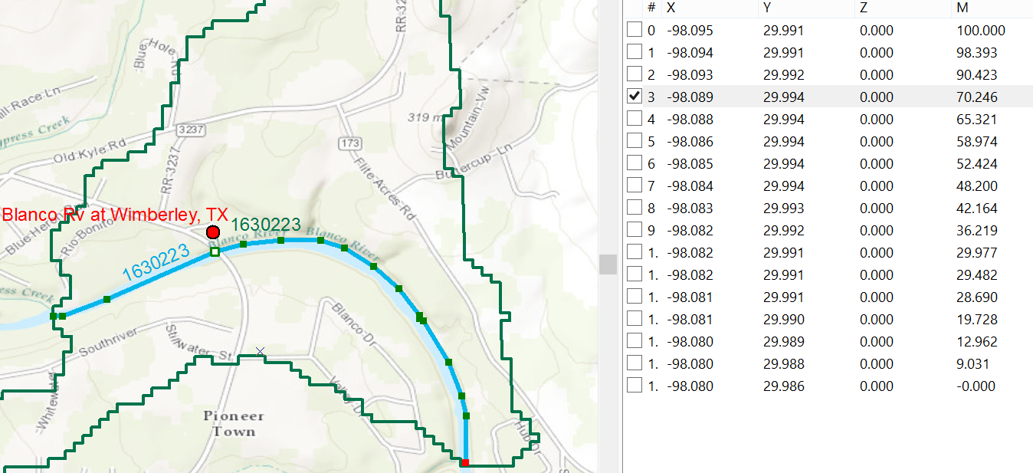
Linear Referencing on Flowlines
Using measures, the flow can be estimated at any point along the line
Stream Gage at RR 12 is at Measure 70.246
on Flowline 1630223
Long.
Lat.
Measure
Measure is the % distance upstream from most downstream point on line

Slide 13
Improvements in Flood Response Planning
Federal
GIS database and flood discharge forecasts
for 2.67 million stream reaches in
continental US from National Water Center
Conversion to water level forecasts and
inundation maps for 102,000 reaches in Texas
using 10m terrain data. Address points for flood
emergency response planning in each reach
State
Flood impact on transportation system
Flood response planning for stream reaches
and critical infrastructure. Inundation mapping
using LIDAR terrain data, if available.
Local
Flood response portal for citizens (ATXFlood)
Automated flood warnings from cell-phone
towers to phones in flood risk zones
Citizen

Slide 14
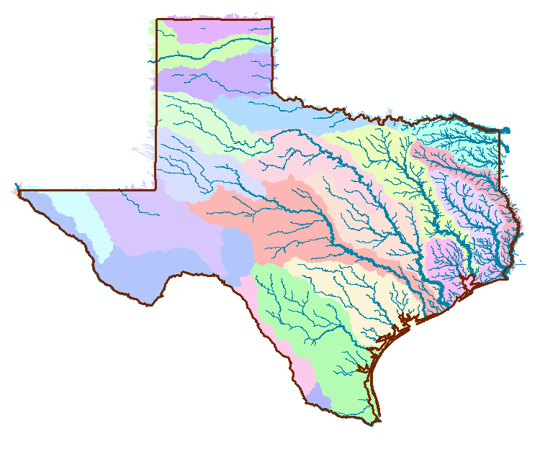
NFIE-Geo for Texas
NHDPlus reach catchment
Uniquely labeled across nation
102,000 NHDPlus reach catchments for Texas
Average area 7.1 km²
Average reach length 3 km

Slide 15
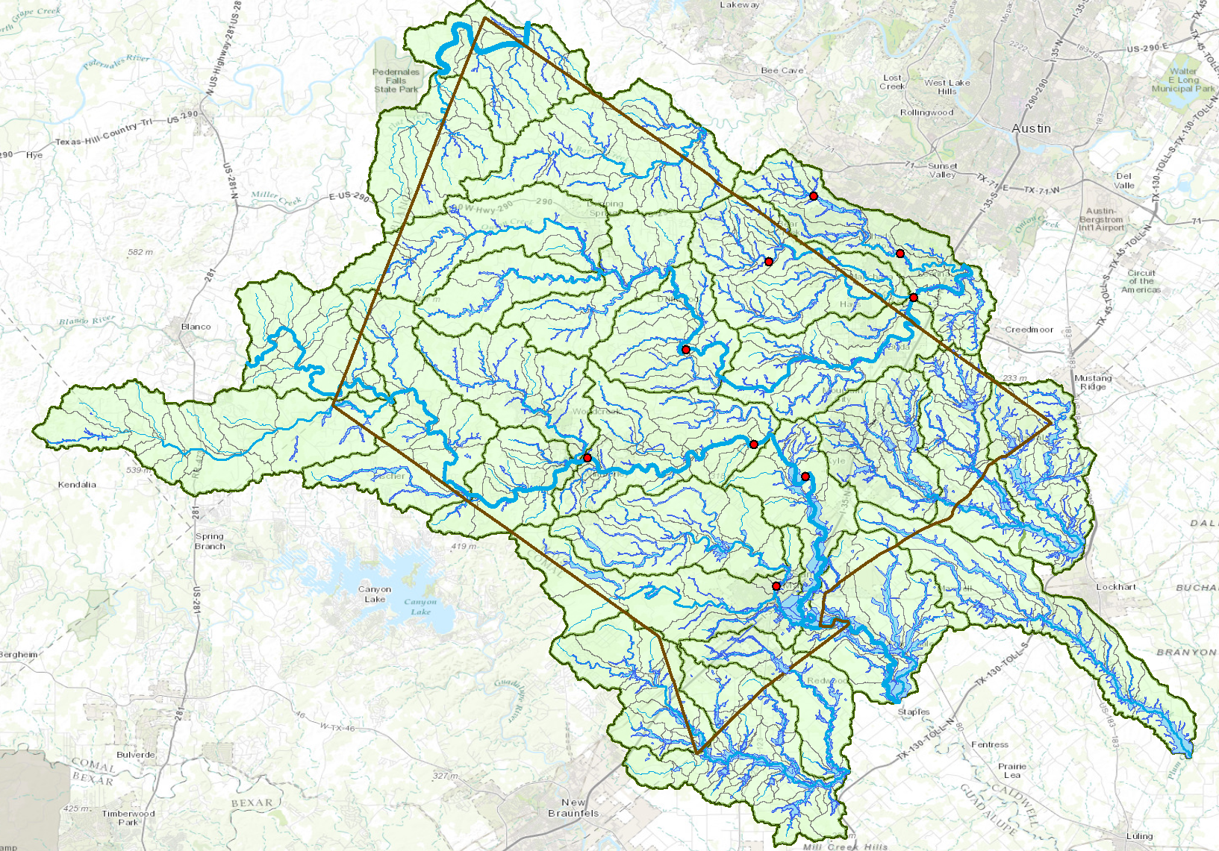
NFIE-Geo for Hays County
264 Forecast Reaches within County Boundary

Slide 16
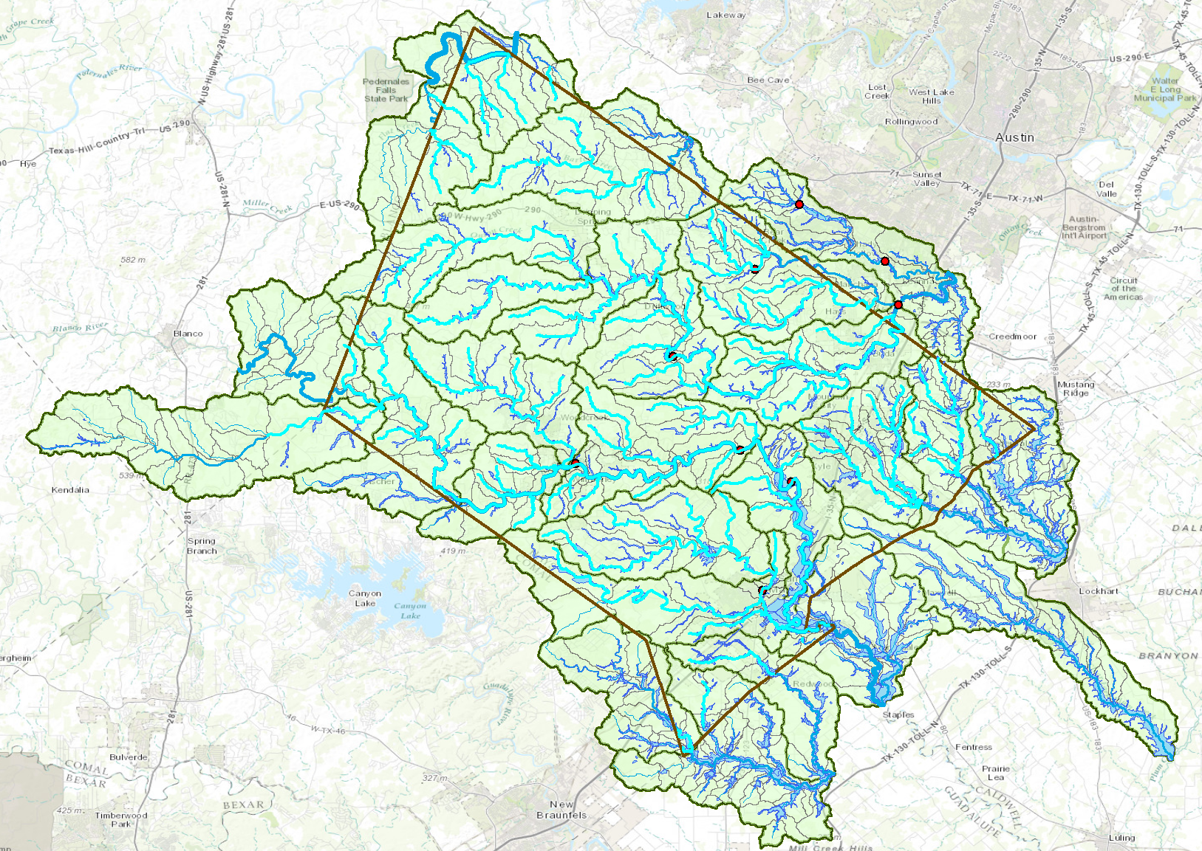
264 Forecast Reaches in Hays County

Slide 17
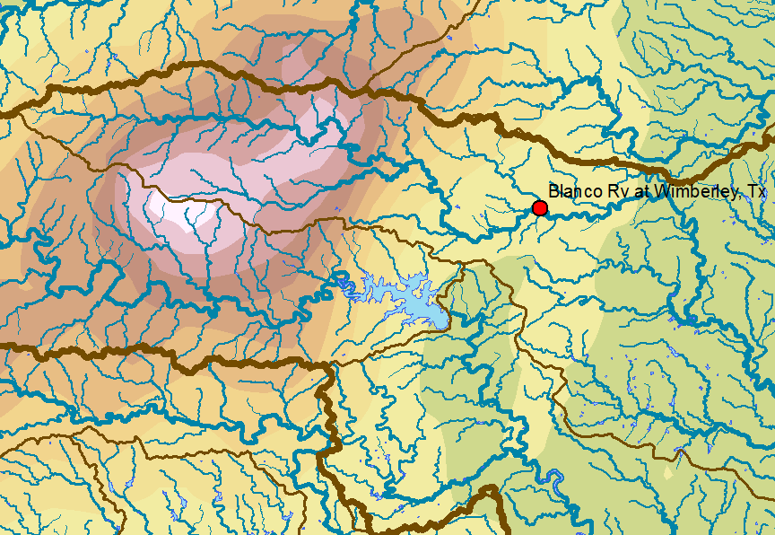
Memorial Day Weekend Precipitation
Total Precip.
(inches)

Slide 18
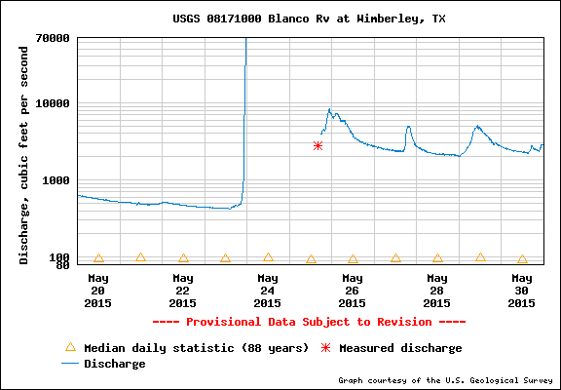
Flow in Blanco River at Wimberley
40 ft wall of water overwhelmed the gage

Slide 19
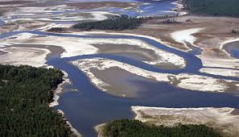
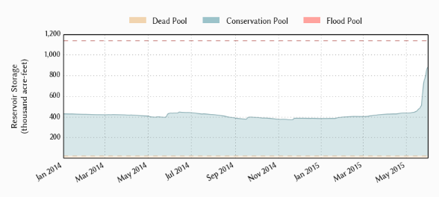
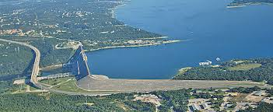
Drought to Deluge!
Lake Travis near Austin, Texas, has been in drought for the last four years
Reservoir storage doubled in 10 days
How can this happen?

Slide 20
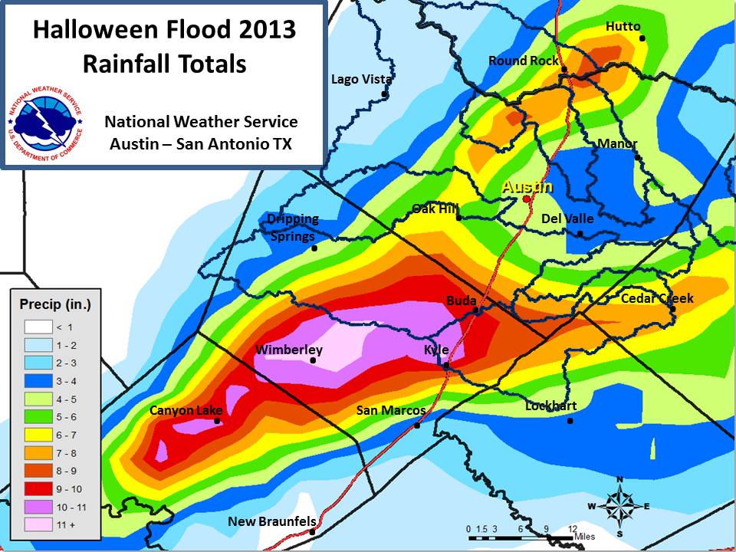

Slide 22
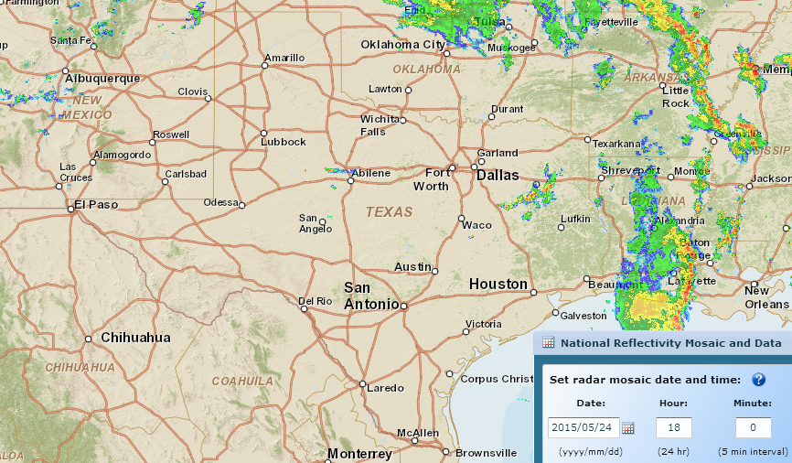
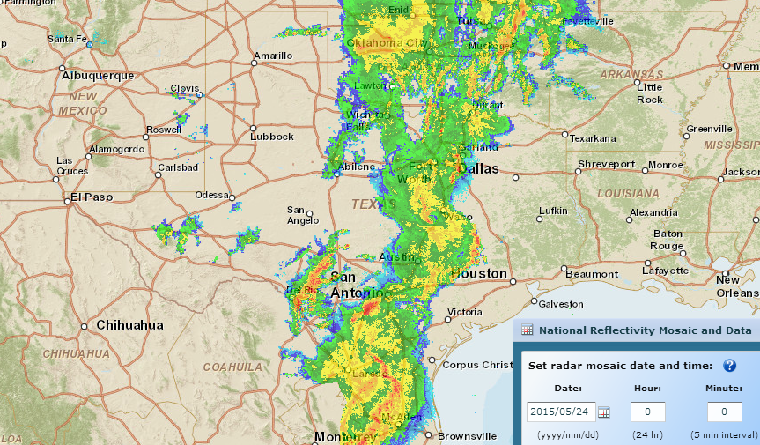
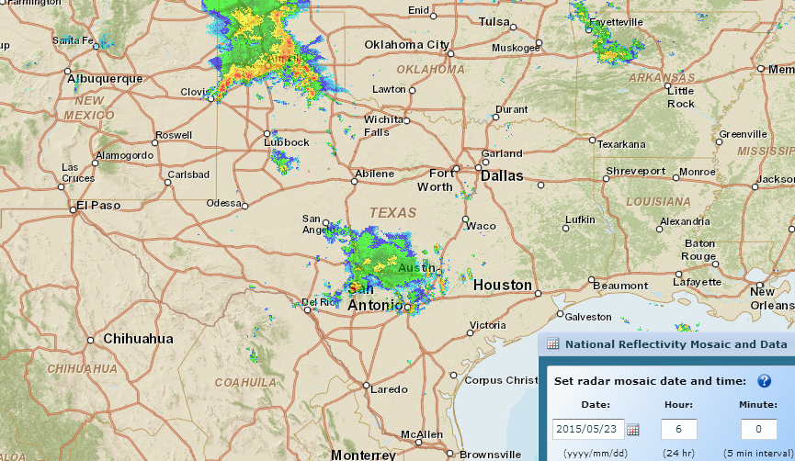
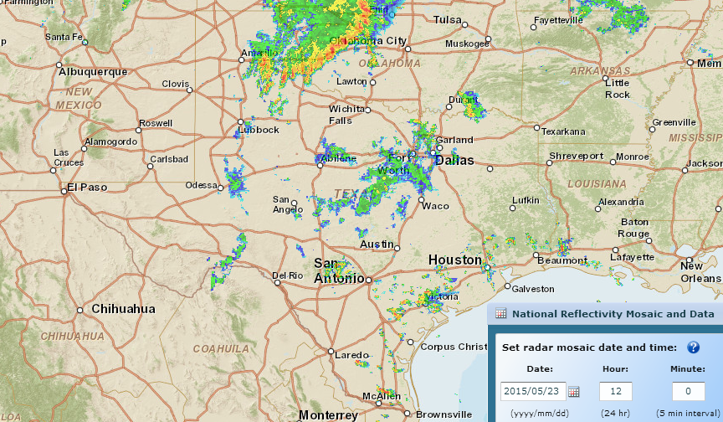
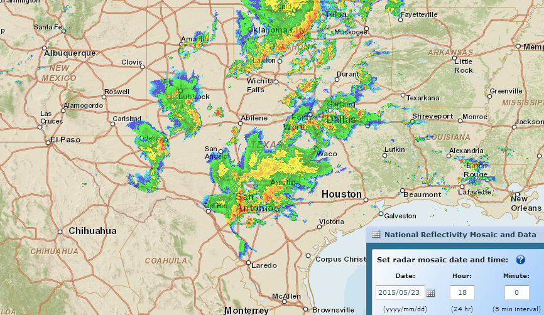
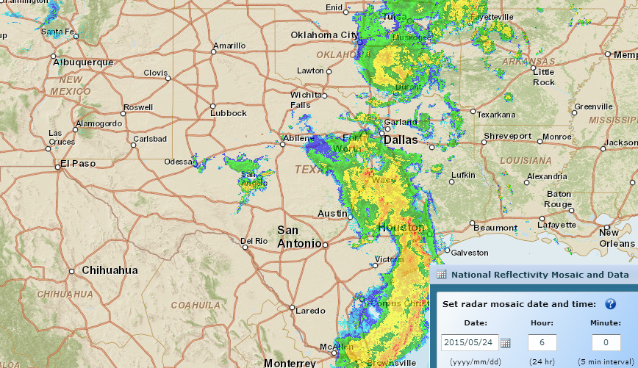
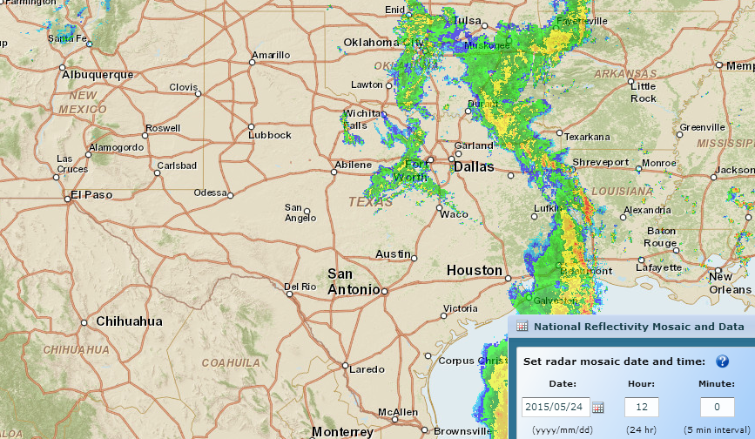
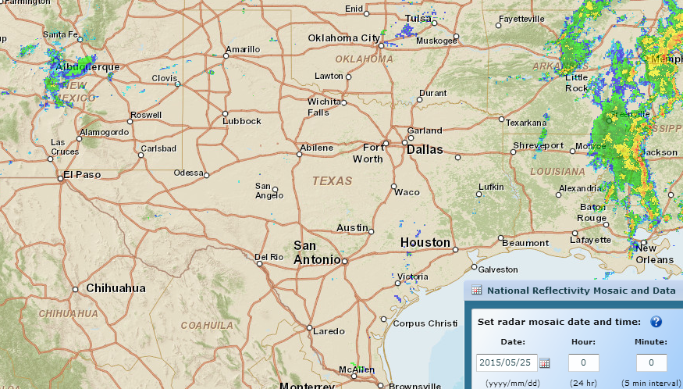
Storm Rainfall during Memorial Day Weekend
http://gis.ncdc.noaa.gov/map/viewer/#app=cdo&cfg=radar&theme=radar&display=nexrad
Where are the corresponding flood maps on the ground?
Sunday, May 24, Midnight
Sunday, May 24, 6 PM
Sunday, May 24, 6 AM
Saturday, May 23, 6 AM
Saturday, May 23, Midnight
Sunday, May 24, noon
Saturday, May 23, noon
Saturday, May 23, 6 PM

Slide 23
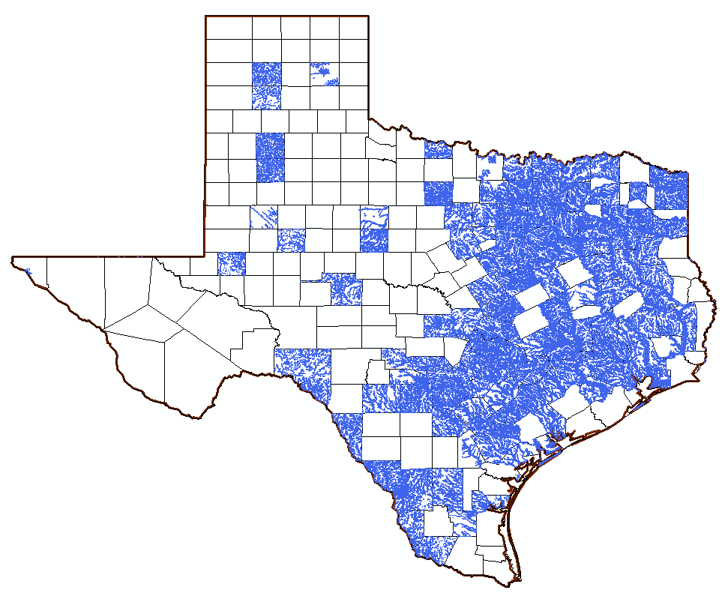
National Flood Hazard Layer in Texas (~ 120 counties)

Slide 24
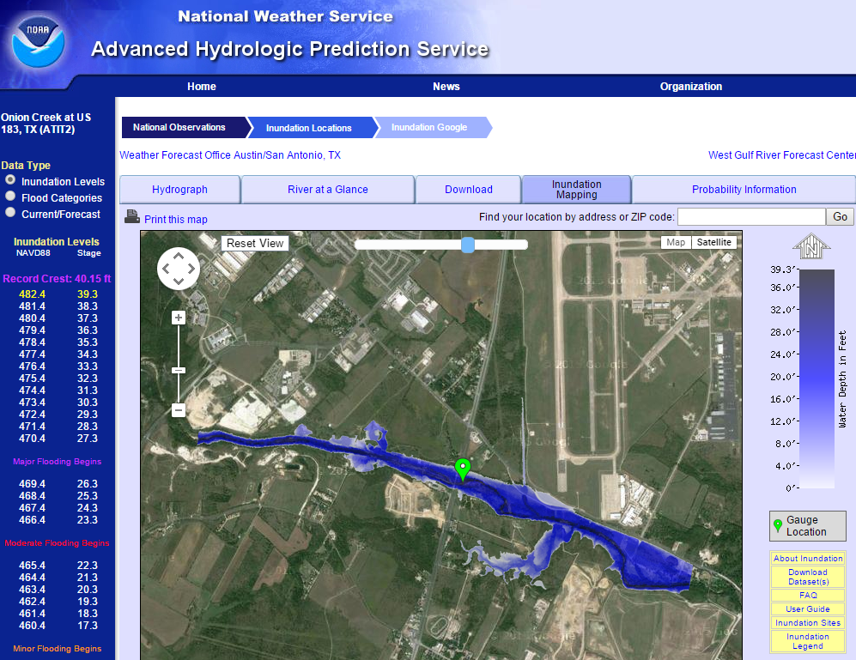
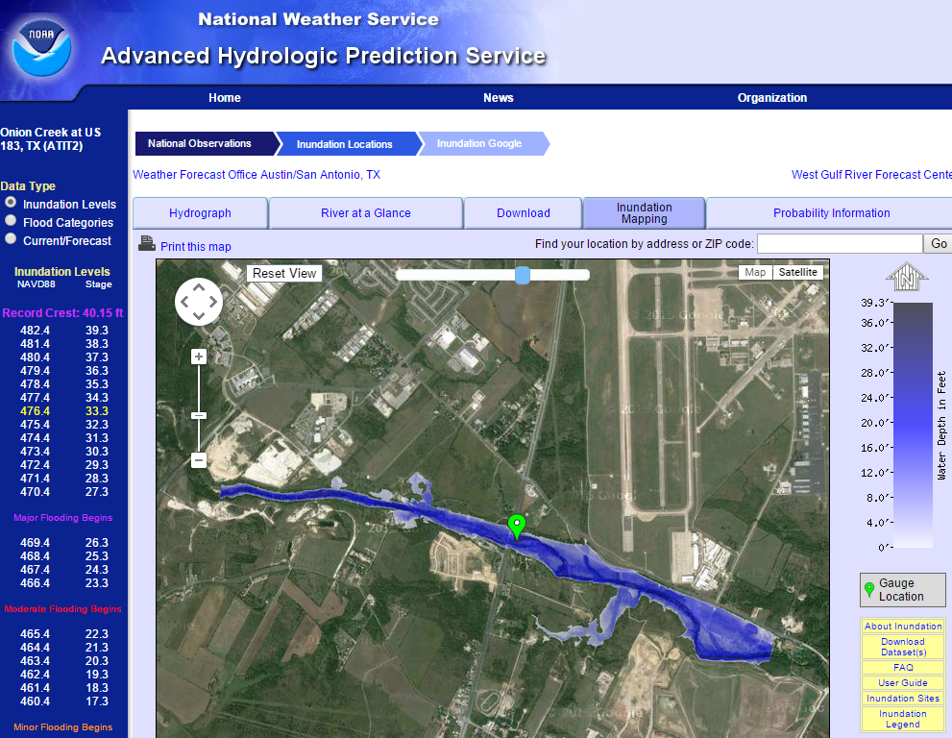
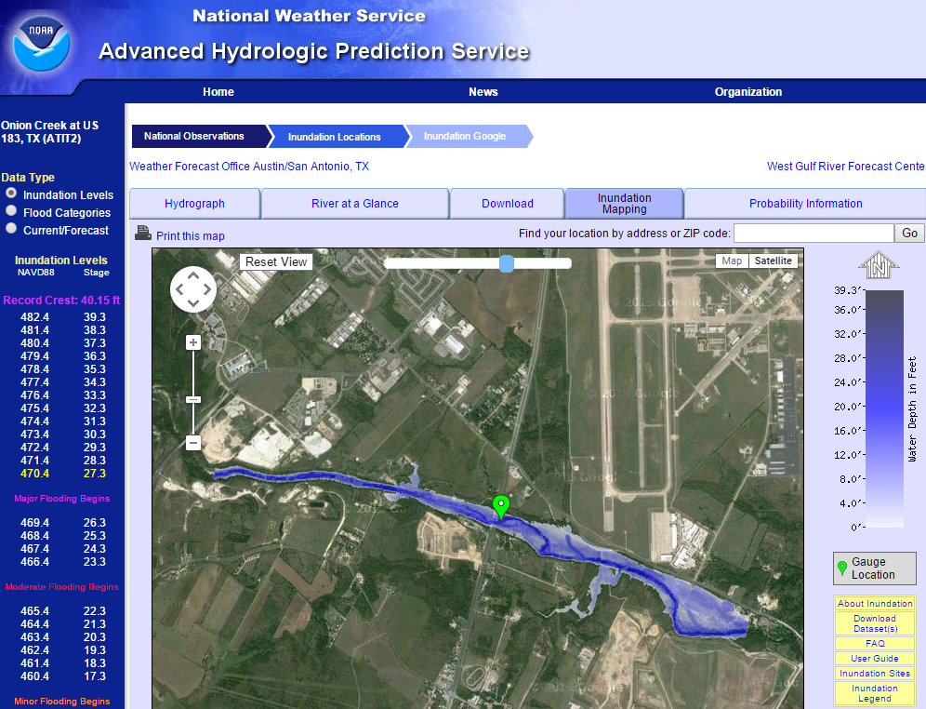
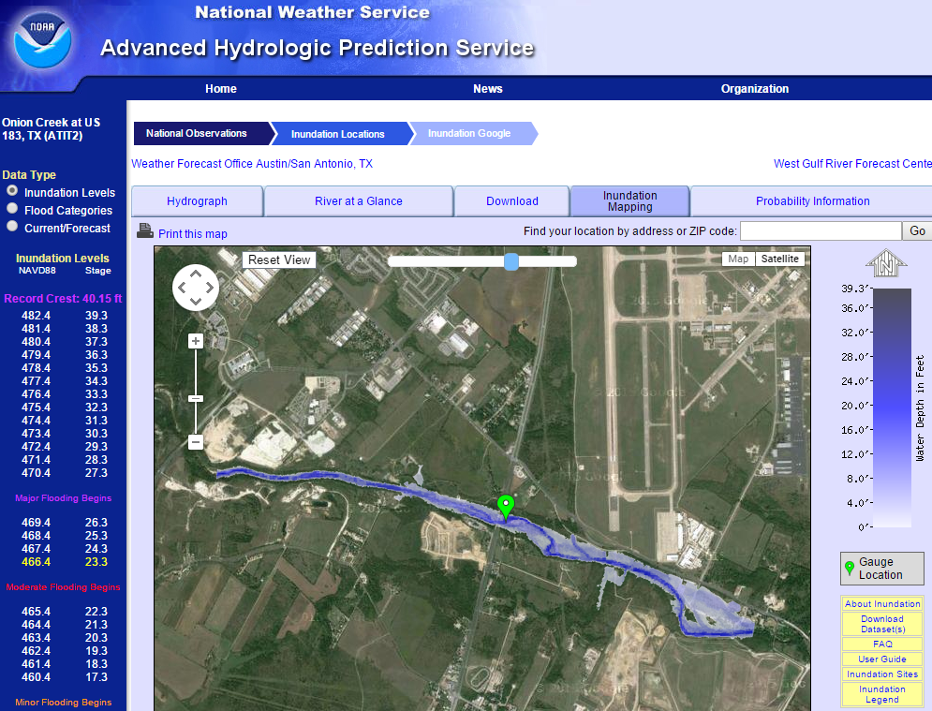
Real-Time Flood Inundation Mapping (USGS/NWS)
http://water.weather.gov/ahps2/inundation/inundation_google.php?gage=atit2

Slide 25
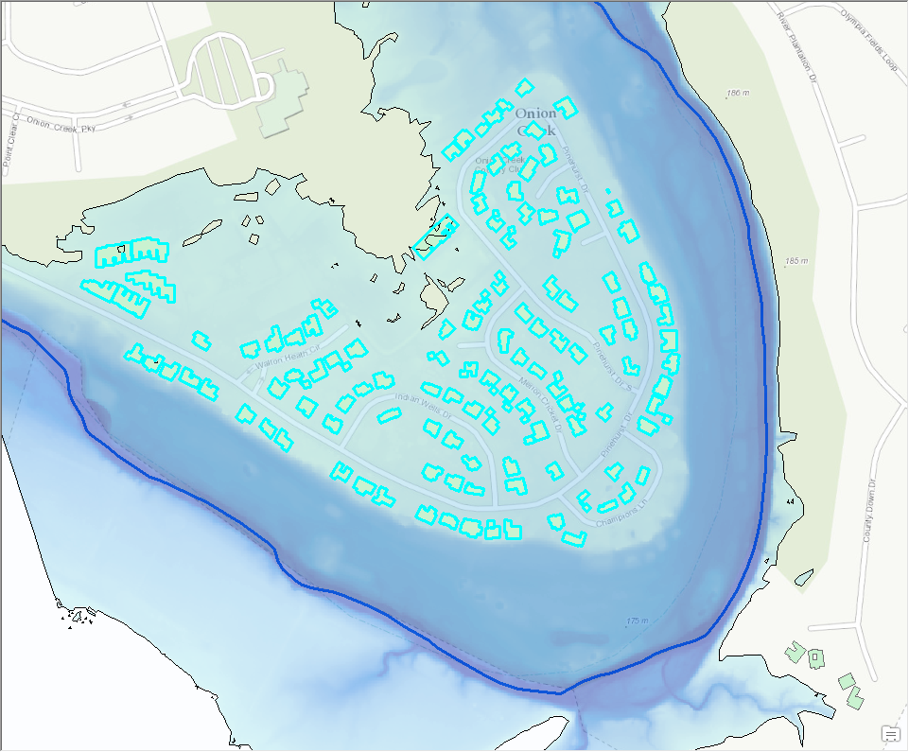
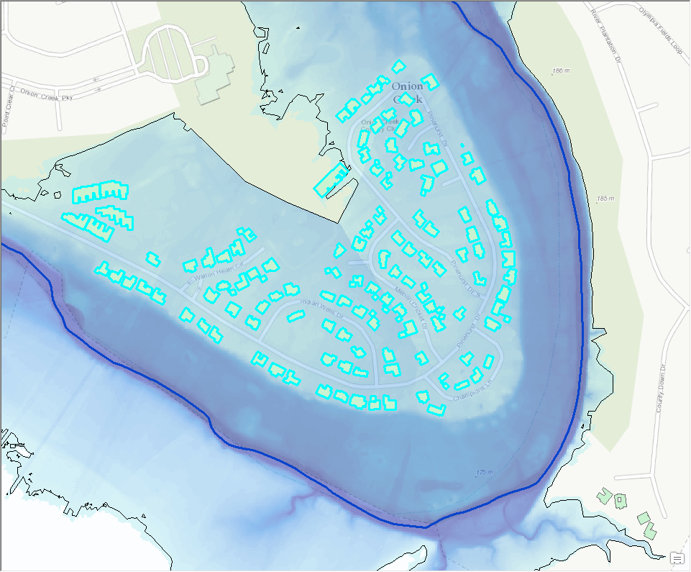
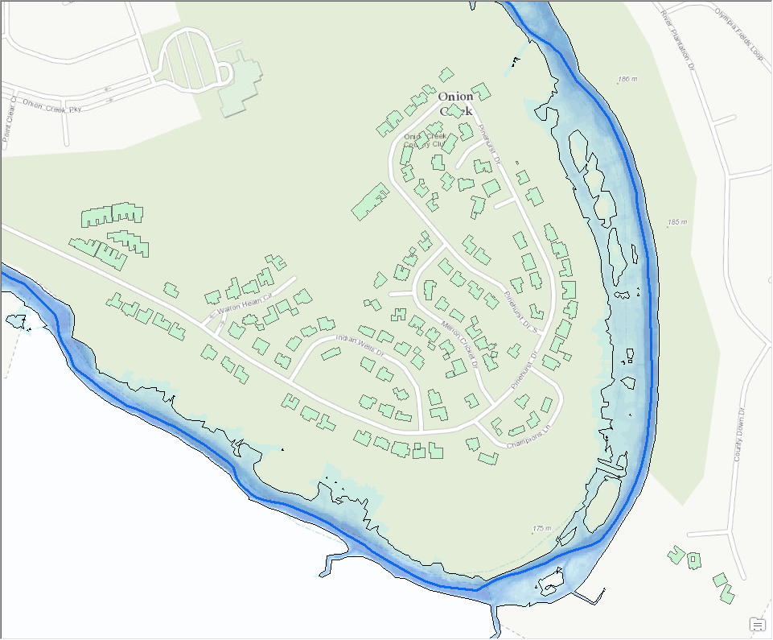
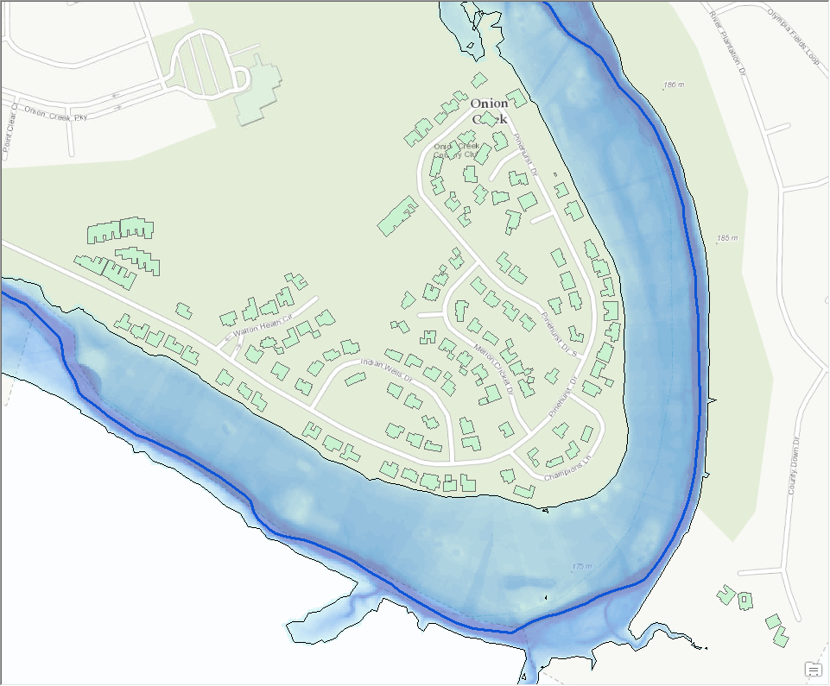
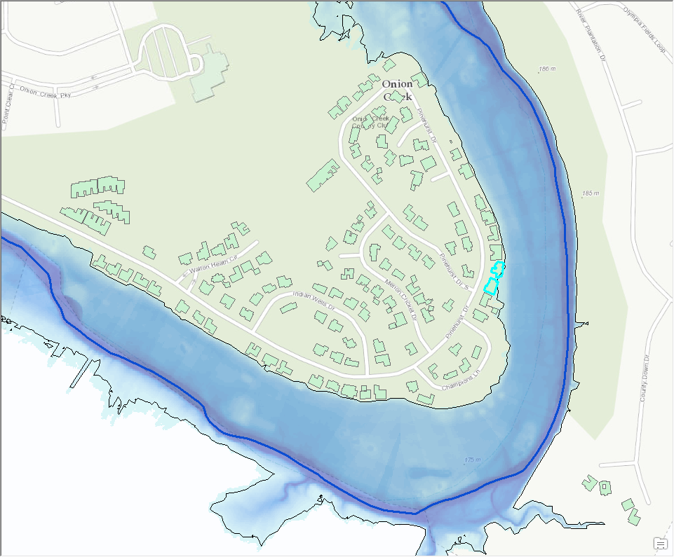
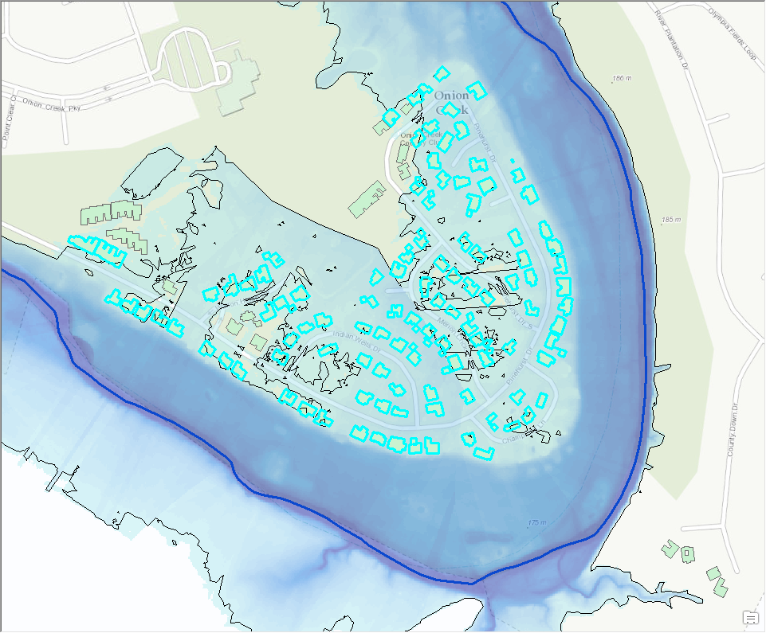
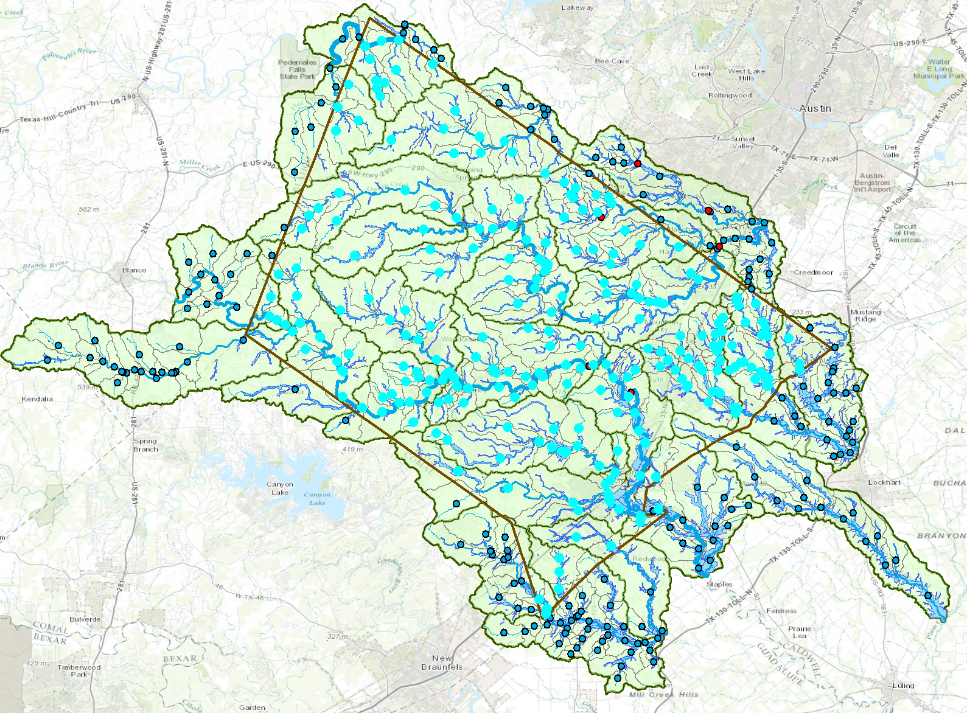
Elevation-indexed flood mapping
Center Points of Reaches
Hays County
Map sequence for each point

Slide 26
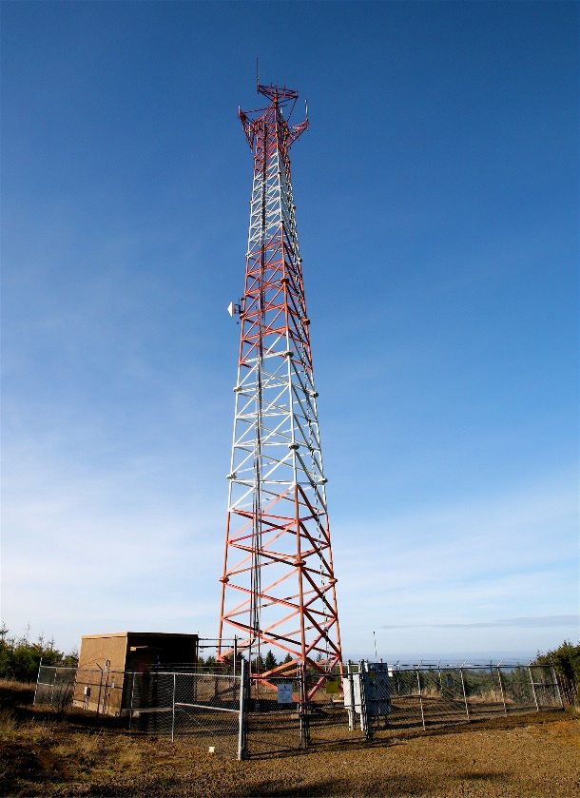
Flood warnings from cell-phone towers
Send warning
Detect phone in flood zone
Cell Phone Tower
Flood Risk Zone

Slide 27
National Flood Interoperability Experiment (NFIE) Conceptual Framework
NFIE-Geo: National geospatial framework for hydrology
NFIE-Response: Community Flood Response System
NFIE-Hydro: National high spatial resolution hydrologic forecasting
NFIE-River: River channel information and real-time flood inundation mapping
NFIE-Services: Web services for flood information

Slide 28
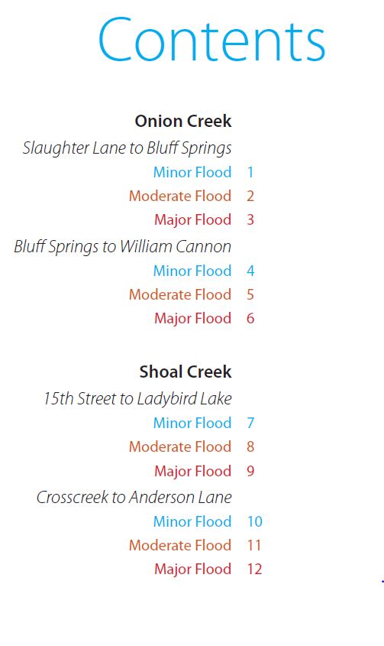
Community Flood Response Map Book
Source: Tomas Rodriguez, City of Austin

Slide 29
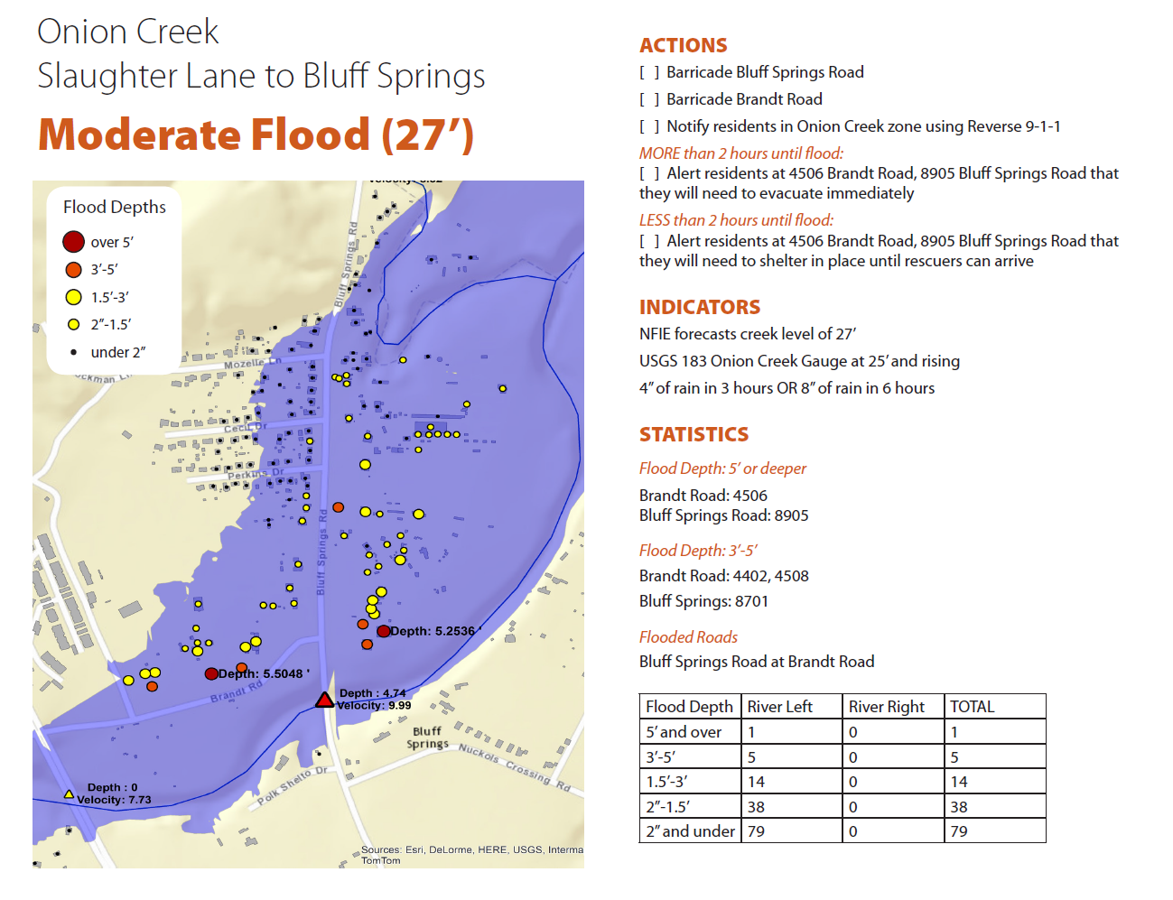

Slide 30
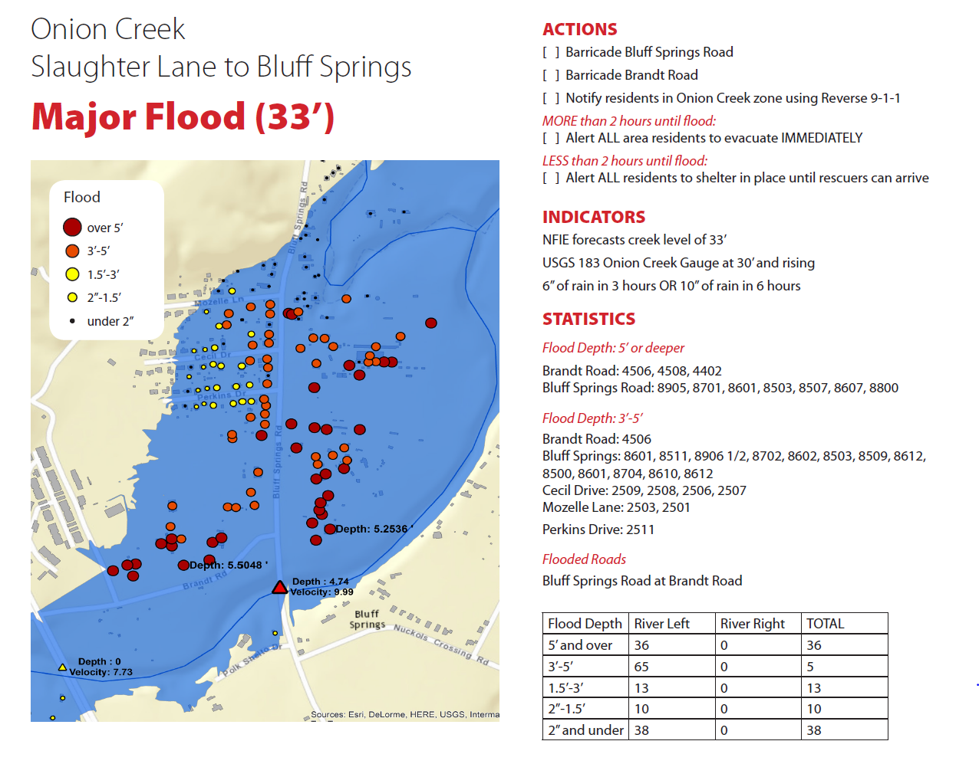

Slide 31
Situational Awareness For Everyone (SAFE)
Source: Jared Allen, NWS Austin-San Antonio Weather Forecast Office
Flood SAFE Viewer: http://arcg.is/1LPOHnE

Slide 32
SAFE Map for Blanco River near Wimberley, Tx
Source: Jared Allen, NWS Austin-San Antonio Weather Forecast Office
Blanco River Proof-of-concept Map: http://arcg.is/1GtObu3

Slide 33
Flood Emergency Response
Emergency Responders
Public
Incident Response
Warnings
Current and forecast storm rainfall
Creates Flood Response Maps
Current and forecast flood conditions
Impact on homes, critical infrastructure, and transportation routes
Public notification and warnings
Current and anticipated road closures
Real-time and forecast flood maps
Evacuation routes
Action
Wide Area Flood Plan
Public Education
Static flood maps
Number of flooded homes, critical infrastructure and transportation routes for different risk conditions
Pre-planning of flood response mobilization
Location based risk
Evacuation routes
Putting together a “go bag” for evacuation
Flood hazard prevention methods
Planning

Slide 34
Flood Response: 4 Critical Functions
Planning
Pre-planning
Public Education
Real-Time Flood Maps
Warnings
Action

Slide 35
Flood Response: 4 Critical Functions
Planning
Pre-planning
Public Education
Real-Time Flood Maps
Warnings
Action

Slide 36
Pre-Planning
Why: enhance disaster response
What: prepare for these types of floods:
Flash flood – short duration pulse; high risk, high mortality
Flat-water flood – chronic event; lower velocity, longer duration
Who: federal/state + local jurisdiction

Slide 37
Pre-Planning
Identify, map & prioritize high risk areas
Critical infrastructure
Key resources
Vulnerable population
First-responder access routes
Public evacuation routes

Slide 38
Pre-Planning Outputs
Flood response maps
Roads, bridges, address points, low-water crossings (where available)
First-responder access & public evacuation routes
Go / no-go decision support data
Blocked roads
Reflex time (to evacuate a risk area)

Slide 39
Flood Response: 4 Critical Functions
Planning
Pre-planning
Public Education
Real-Time Flood Maps
Warnings
Action

Slide 40
Public Education
Why: more public awareness & readiness results in more effective flood response
Plus much less costly than flood response!!!
What: professional materials & campaigns
Educate on go / no-go decision process
Warning message content (including disabilities, language barriers)
Ready, Set, Go (public guidelines for action)

Slide 41
Flood Response: 4 Critical Functions
Planning
Pre-planning
Public Education
Real-Time Flood Maps
Warnings
Action

Slide 42
Real-Time Flood Response Maps
Pushed to emergency managers, and to first responders on maps and mobile devices
Real time precipitation data
Expected rise and flood level
Address points affected
Low-water crossings
Threats to critical infrastructure & key resources
Utilities, communications, roads
Hospitals, schools, public safety, food & fuel

Slide 43
Flood Response: 4 Critical Functions
Planning
Pre-planning
Public Education
Real-Time Flood Maps
Warnings
Action

Slide 44
Public Warnings
Warnings must convey a credible threat, and be actionable
Explanatory enough to not be ignored
Go / no-go directions
Flood maps available to the public
Complement Integrated Public Alert and Warning System (IPAWS)
Must consider social media
Twitter, Facebook, Instagram, etc.
Cell phone alert in flood zone
News media: need consistent messaging
Monitor social media via hotspot mapping

