Slide 1
National Flood Interoperability Experiment (NFIE)
NFIE in a Nutshell
Prepared by David R. Maidment
Center for Research in Water Resources
University of Texas at Austin
4 February 2015

Slide 2
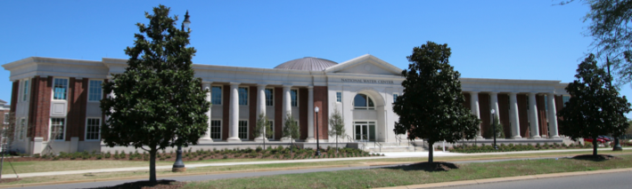
The Opportunity…
New National Water Center established on the Tuscaloosa campus of University of Alabama by the National Weather Service and federal agency partners
Has a mission to assess hydrology in a new way at the continental scale for the United States

Slide 3


Partnership with the academic community …
National Weather Service has joined with CUAHSI to conduct a one-year National Flood Interoperability Experiment (NFIE)
Includes a Summer Institute for students and faculty at the National Water Center, June 1 to July 17, 2015

Slide 4
Goal of the Experiment …
Close the gap between National Flood Forecasting and Local Emergency Response
Demonstrate forecasting of flood impacts at “stream and street level”
National
Weather and Hydrology
National Weather Service and federal agencies
National Water Center
River Flooding and Emergency Response
Local, State and Regional Agencies
Citizens
Local

Slide 5
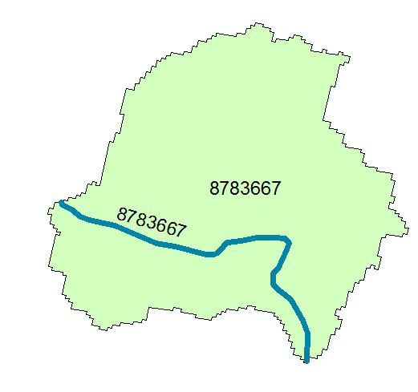
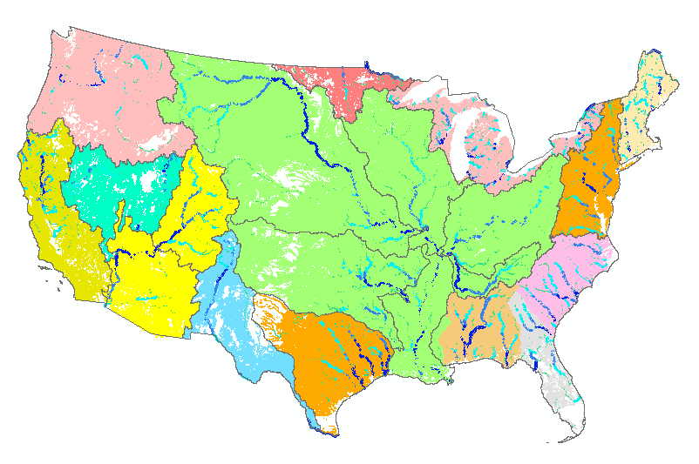
Assumptions…
High spatial resolution hydrologic modeling at continental scale
Built upon NFIE-Geo: A national geospatial framework for hydrology
  Continental landscape divided into 2.67 million local catchments, each containing a single stream reach
  Stream reaches connect to form a national stream network
2.67 million catchments
Average area 3 km²
Average reach length 2 km

Slide 6
NFIE Conceptual Framework…
NFIE-Geo: National geospatial framework for hydrology
NFIE-Response: Wide area planning for flood emergency response
NFIE-Hydro: National high spatial resolution hydrologic forecasting
NFIE-River: River channel information and real-time flood inundation mapping
NFIE-Services: Web services for flood information

Slide 7
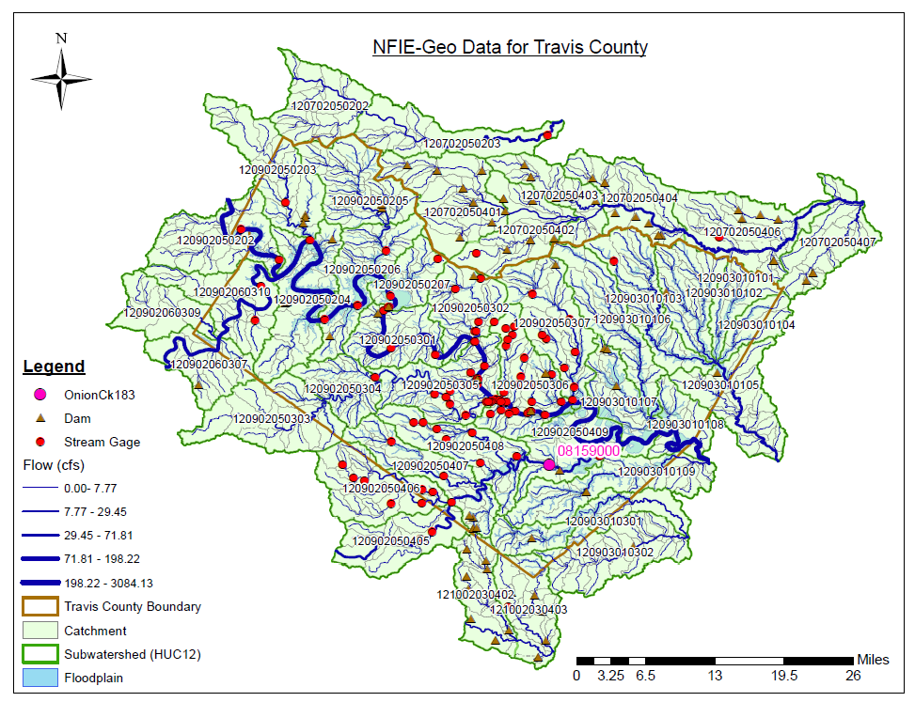
NFIE-Geo for a county….
County subset of national geospatial data layers
Map courtesy of Cyndi Castro
UT Austin
http://www.caee.utexas.edu/prof/maidment/CE397Flood/Assignment2/NFIEGeo.pdf

Slide 8
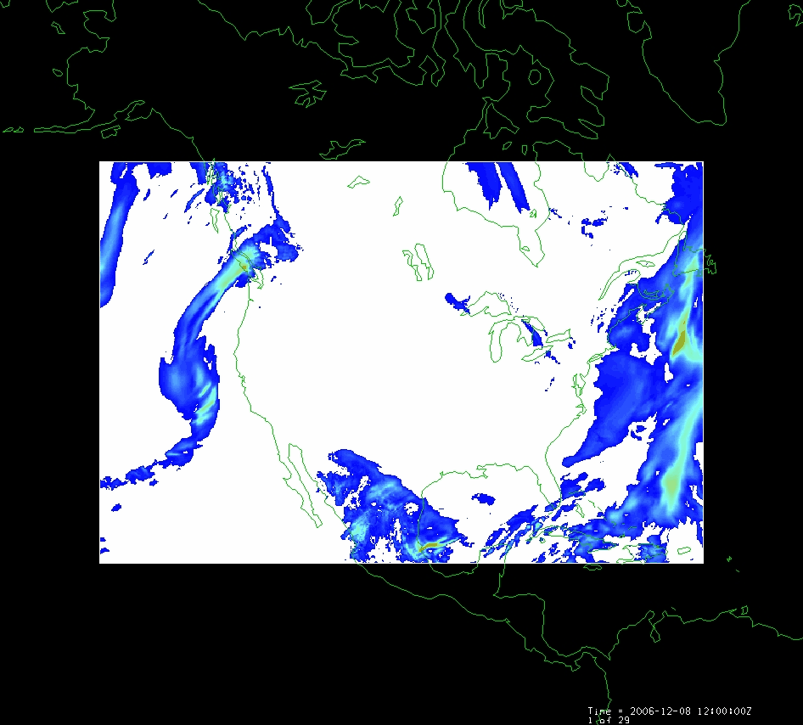
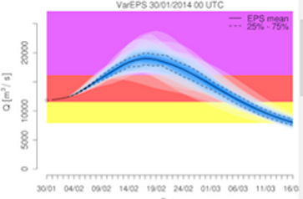
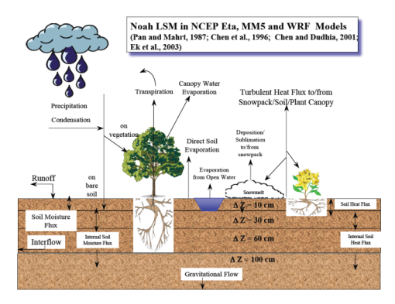
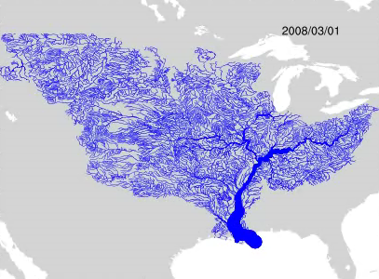
NFIE-Hydro Forecasting Model…
Weather model and forecasts
Probabilistic flood forecasts
Catchment-level forecasts
Weather
Precipitation
Streamflow
Runoff
Land-Atmosphere Model
Channel flow routing (for continental US)

Slide 9
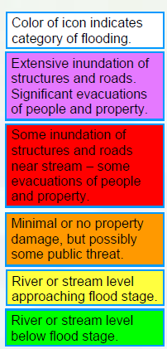
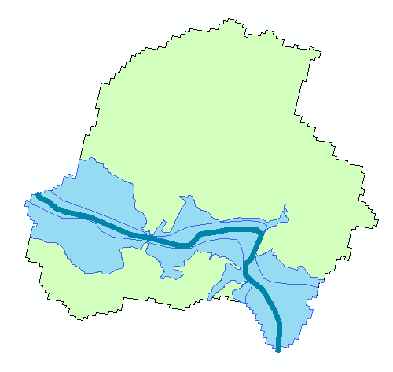
Flood risk zones…
Each catchment has a flood hazard zone defined from FEMA flood data
Probabilistic forecast from NFIE-Hydro defines flood risk
Color the zones according to risk

Slide 10
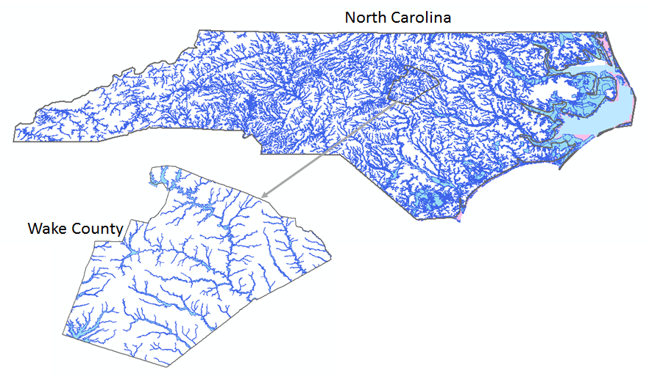
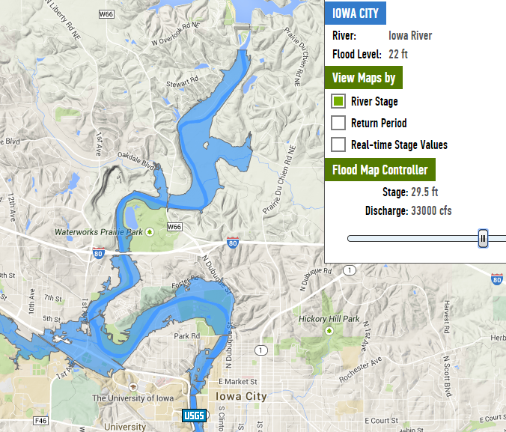

More comprehensive solution…
NFIE-River: Dynamic flood modeling, forecasting and inundation mapping in space and time
Requires LIDAR terrain data so can only be done for particular regions
North Carolina Floodplain Mapping Program
Iowa Flood Information System

Slide 11

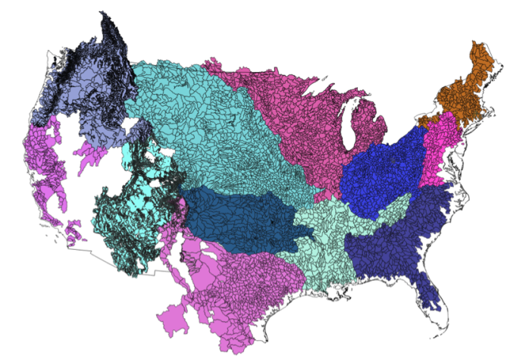
Transformative for the nation…
Forecasts produced by
  Current system – 3600 locations
  NFIE system – 2.67 million locations
New Information to help emergency managers save lives and keep people safe
700 times more
Current
Proposed

Slide 12


Flood Emergency Response…
NFIE-Response: Work with the first response community to define flood strategy and tactics
https://www.youtube.com/watch?v=ympaR6YUxiA&feature=youtube

Slide 13
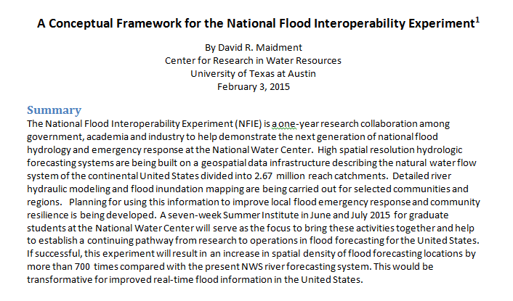
Conceptual Framework Paper…

