Slide 1






National Flood Interoperability Experiment (NFIE)
Briefing at White House Conference Center
Convened by Office of Science and Technology Policy
Executive Office of the President
David Maidment, University of Texas at Austin
Edward Clark, National Weather Service
October 3, 2014
Acknowledgements:
Peter Colohan, OSTP; Don Cline, NWS; Anne Castle, DoI, Nate Booth, USGS; David Arctur, Gonzalo Espinoza, Fernando Salas, Marcelo Somos, Ahmad Tavakoly, Tim Whiteaker, UT Austin; David Gochis, NCAR; Cedric David, JPL; Harry Evans, City of Austin; Steve Kopp, Elbert Leiva, Nawajish Noman, Jack Dangermond, ESRI; Michael Natschke, Matt Ables, Kisters; Kristin Tolle, Microsoft Research; Andy Ernest, University of Alabama; Barbara Minsker, University of Illinois; David Tarboton, Utah State University; Richard Hooper, CUAHSI.
Financial support provided by the National Science Foundation.

Slide 2
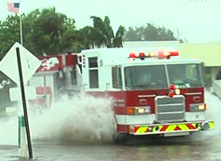



Goals
National Flood Interoperability Experiment
Close the gap between national flood forecasting
and local emergency response
  Impact at the street level
Create real-time flood information services
  Shared among organizations, geographies, people
Engage academic community through the National Water Center
  Innovation for transformative change

Slide 3
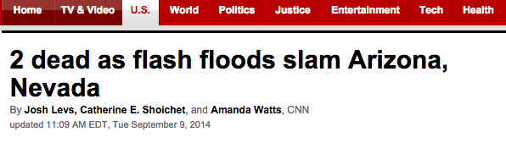
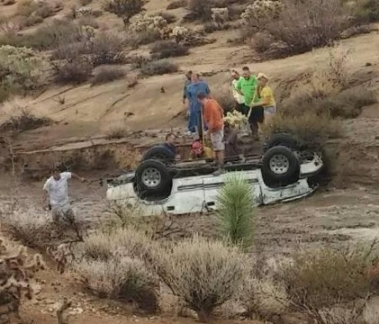
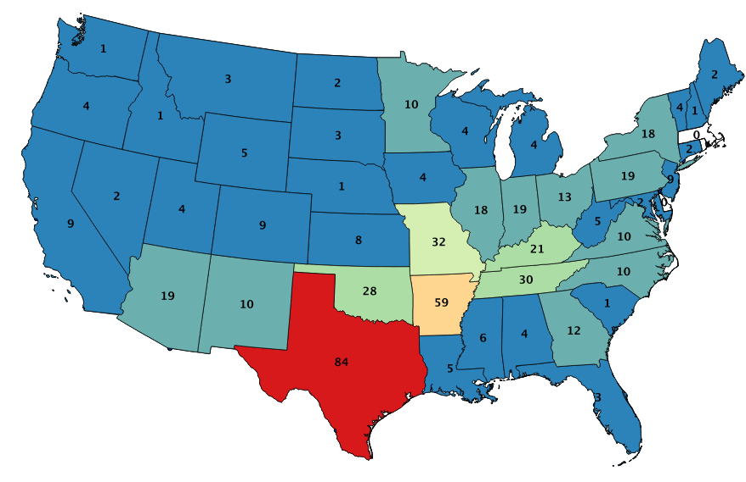
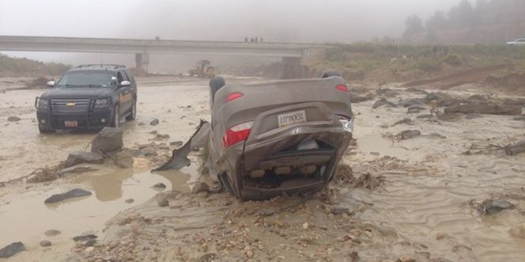
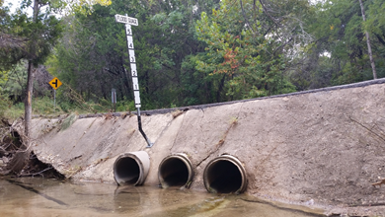
Why – People
On average, more people die annually from flooding than from
any other form of natural disaster
Low water crossing
Spatial Distribution of
Flood Fatalities 2007-2013
(source: NWS StormDat)

Slide 4
Why – Cost
More cost to federal government from flooding
than any other form of natural disaster

Slide 5
Perspective: 2500 Fatalities
# of Fatalities | Attribution
3000 | Teens killed annually in crashes caused by texting while driving¹
2977 | Victims of 9/11 terrorist attacks
2538 | Projected U.S. flood fatalities over next 30 years (2013-2043)
2344 | U.S. Military fatalities in Afghanistan 2001-2014 (Operation Enduring Freedom)²
1417 | Airline fatalities past 20 years (1993-2012)³
¹Safety.TRW.com
²www.icasualties.org/oef/
³National Transportation Safety Board (www.ntsb.gov/data/aviation_stats.html)
Notes:
U.S. Mortality 2010: 2,515,458
What is 2500?
2500 is 1/10% of national mortality per year – not very big in comparison
The number of customers visiting five average Starbucks stores each day.
The number of pizzas sold by Dominoes every 3 minutes
Bryant Denny Stadium capacity: 101,821
UA Freshman Class in 2013: 6478
U.S. Highway Fatalities in 2012 (passenger vehicles): 12,271 (NTSB)

Slide 6
Perspective: $300B
$Billion | Attribution
$502 | Estimated cost to build the U.S. Interstate Highway System, 1956-present (2014 $$)¹
$300 | Projected U.S. flood damages over next 30 years (2013-2043)
$209 | Cost of NASA’s Shuttle Program (39 years)²
$123 | U.S. aggregate losses from tornadoes, hail and straight-line winds (1990-2010)³
$27 | Cost of Federal wildfire suppression (Forest Service and DOI)(1985-2013)⁴
¹Federal Highway Administration
²National Aeronautics and Space Administration
³Lloyds of London ⁴National Interagency Fire Center
Notes:
Putting $300B into perspective
The current U.S. Gross Domestic Product is $17,311 Billion
The U.S. Pizza Industry sales in 2013 was $36.787B (http://www.pmq.com/December-2012/Pizza-Power-2013-State-of-the-Industry-Report/)
$300B would support 5.2 million 4-year college degrees at current costs of $14,300/yr for public institutions. This is about ¼ of the 21 million students expected to enter college in 2014. (Source: National Center for Education Statistics (http://nces.ed.gov/fastfacts/)
Median cost of a new home in 2013 was $270K – that’s 1 million homes for $270B. Average cost was $311K

Slide 7

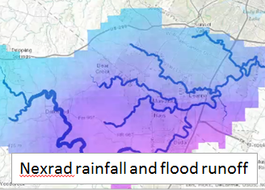
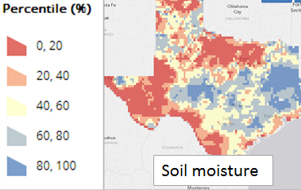
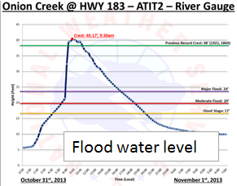
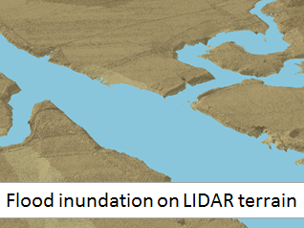
Why – Science
Synthesize the four examples of “high impact” earth observations
Weather and seasonal climate monitoring and prediction e.g. Ground-based Weather Radars
Dynamic land-surface monitoring and characterization e.g. Soil Observations
Water level and flow i.e. Stream Gage Network
These are very different kinds of data.
How to make them smoothly interoperable?
Elevation and geo-location – Airborne light Detection and ranging (LiDAR)

Slide 8
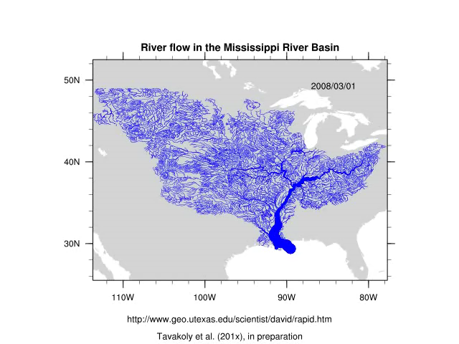
Why – Technology
Build a national high spatial resolution, near real-time river and stream model
River flow in the Mississippi River Basin
Use Weather Research and Forecasting Hydro model (WRF-Hydro)
(from NCAR)
Like this but for
whole continental US
Link to current
NWS River Forecasts
Build on NHDPlus
(from EPA and USGS)
using RAPID river model
Source: http://rapid-hub.org/

Slide 9
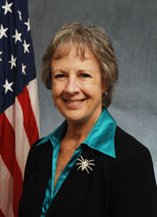

Why – Open Water Data Initiative
Create a shared network of open water data services
Open Water Data Initiative is a component of the Water Science and Technology Initiative
Essential for the development of:
  Modeling Frameworks
  Decision Support Systems
  Policy and practice to address societal challenges
ACWI Subcommittee on Spatial Water Data will lead this effort
National Flood Interoperability Experiment is a use-case within the OWDI planning and a demonstration of advanced modeling techniques
Anne Castle,
Assistant Secretary for Water
and Science, Department of Interior
Notes:
‘Data to Models” and how these activities including the OST&P efforts advance the nation’s capabilities to respond to water resources related questions and challenges.

Slide 10

National Water Data Center
Located on Tuscaloosa Campus of University of Alabama
Operated by National Weather Service to support IWRSS partners (NWS, USGS, Corps of Engineers, FEMA)

Slide 11
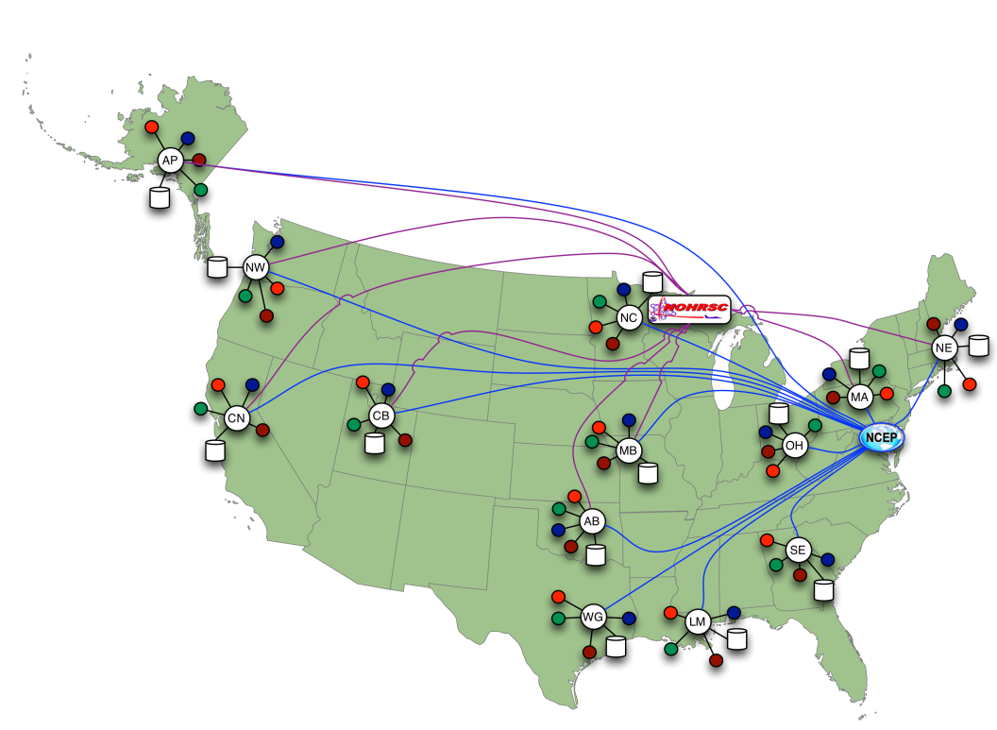
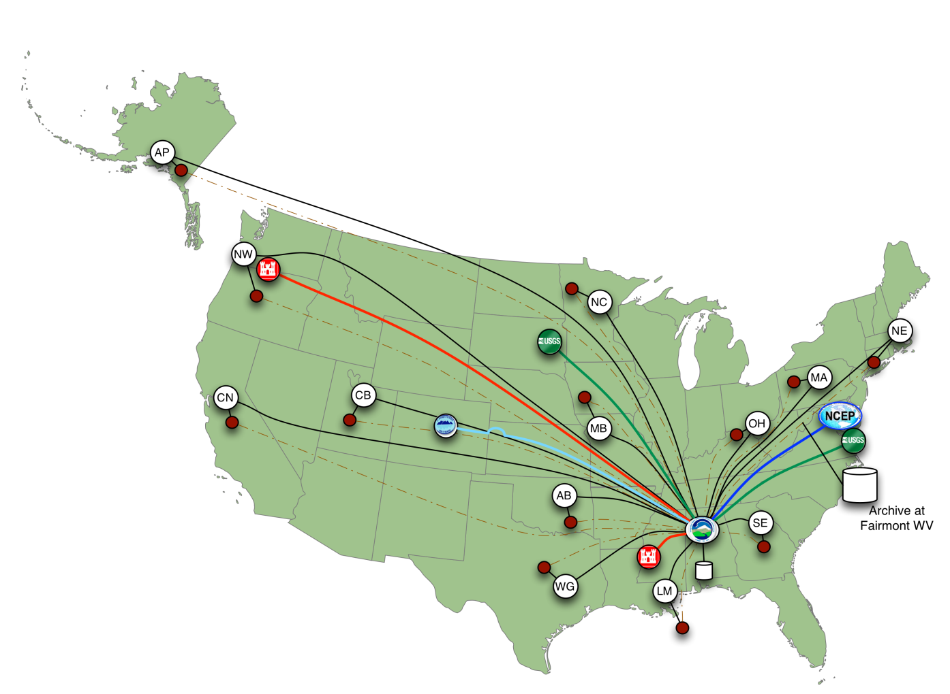
Initiative: Evolution of NWS Data Services
WITH National Water Center:
NWC centralizes data acquisition, processing, archival and service backup
Regional Offices acquire local data, especially anthropogenic, and QA/QC
NWC provides centralized forecast guidance for full spectrum of water parameters
TODAY:
Each regional office responsible for all data acquisition, QA/QC, modeling, post-processing, archival and service backup
Archive
State/Local Data
National External Data
Regional External Data
Geospatial Data
11

Slide 12
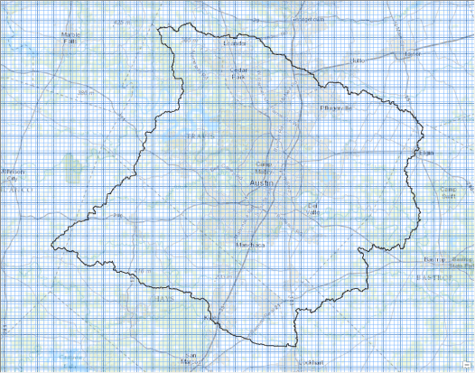
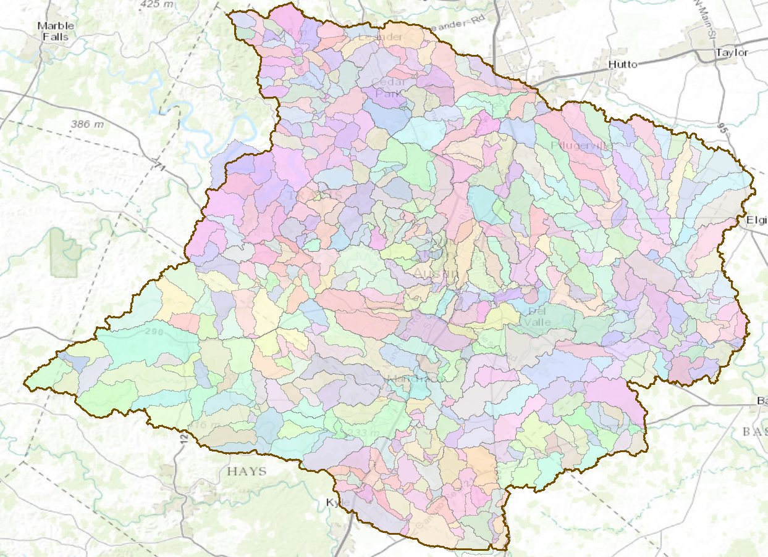





Research Questions
How can near-real-time hydrologic simulations at high spatial resolution, covering the nation, be carried out using the NHDPlus or a next generation hydro-fabric
How can this lead to improved emergency response and community resilience?
How can an improved interoperability framework support the first two goals and lead to sustained innovation in the research to operations process?
WRF-Hydro weather and
land-atmosphere simulation
RAPID modeling of flow in
stream reaches of NHDPlus

Slide 13
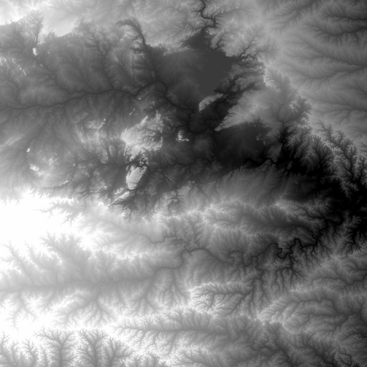
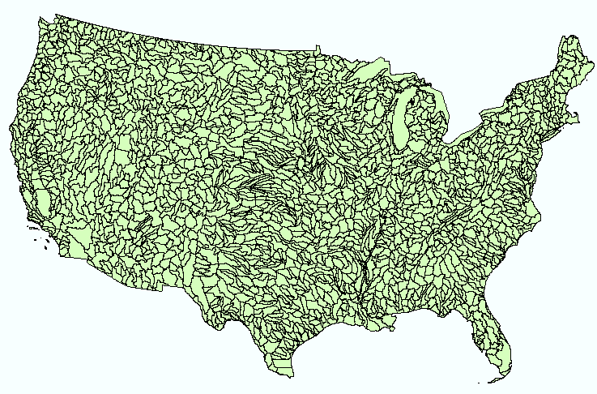
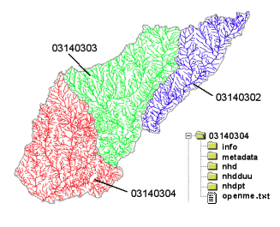
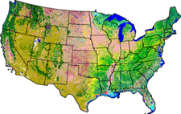
NHDPlus Version 2
Geospatial database for a national water data infrastructure
NHDPlus
(built 2004-2014)
National Elevation Dataset
Watershed Boundary Dataset
National Hydrography Dataset
National Land Cover Dataset
2.6 million catchments average area 3 km²,
reach length 2 km

Slide 14
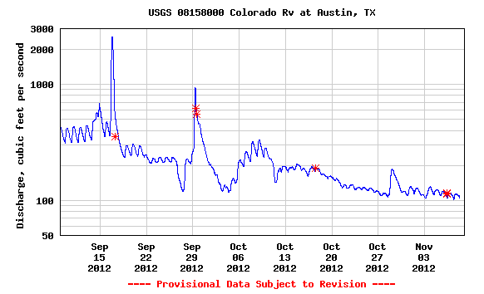

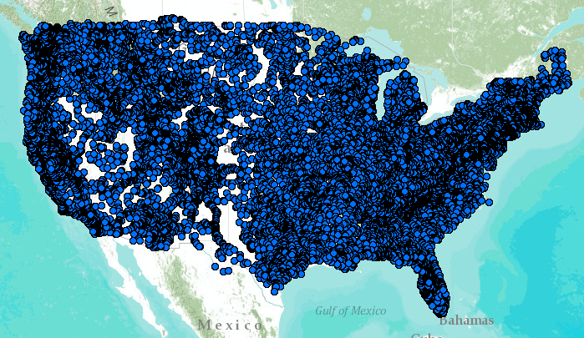
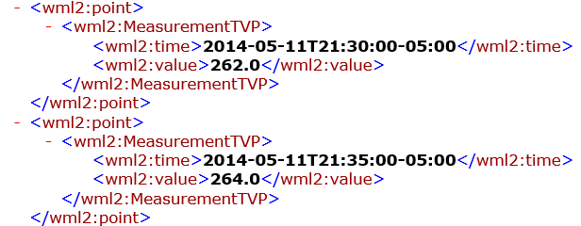
WaterML Web Services –
CUAHSI, USGS, OGC, WMO …..
Water time series data on the internet
24/7/365 service
For daily and real-time data
. . . Operational water web services system for the United States
http://waterservices.usgs.gov/nwis/iv/?format=waterml,2.0&sites=08158000&period=P1D&parameterCd=00060

Slide 15
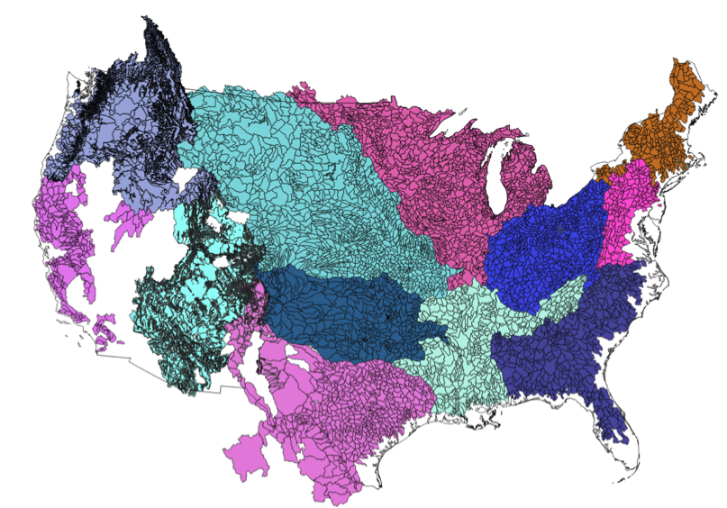
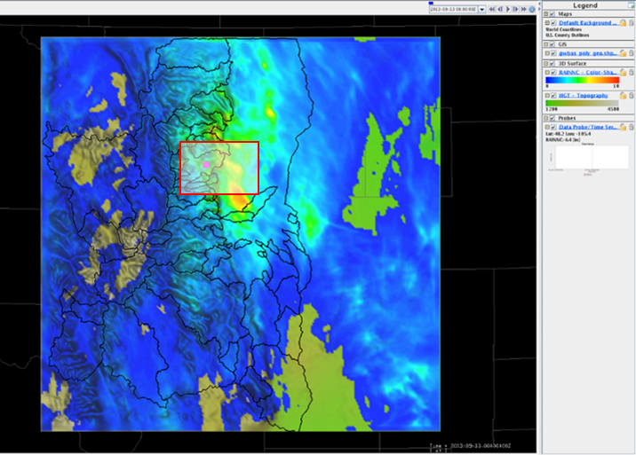
Demonstrate Experimental Design
NWS CHPS Modeling Units: 12 CONUS RFCs
Experimental WRF-Hydro ¹
PI-XML to WaterML2²
Data Services
¹Responsibility of NCAR
²pre-decisional

Slide 16
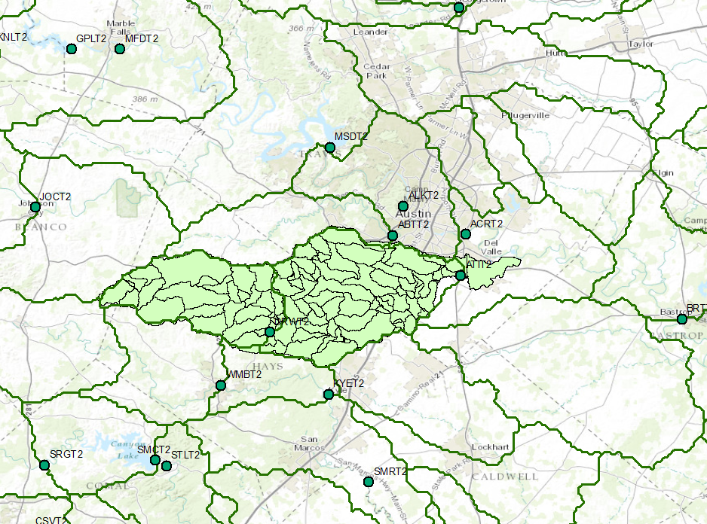
Dynamic Downscaling of NWS Forecasts
Daily updated NWS river subbasin forecasts recomputed on NHDPlus catchments
NHDPlus catchments
NWS River Forecast subbasins

Slide 17
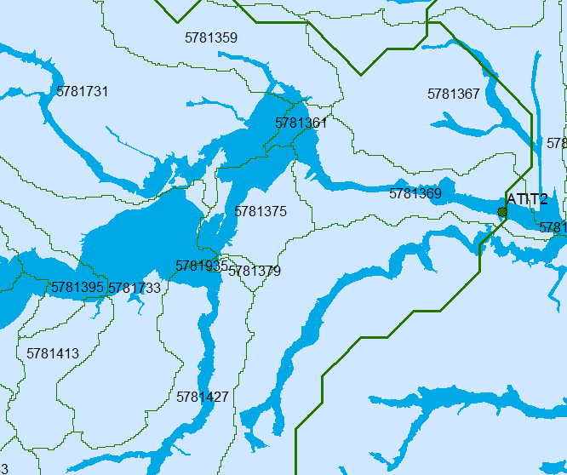
National Flood Hazard Layer
Define flood hazard zone within each NHDPlus catchment

Slide 18
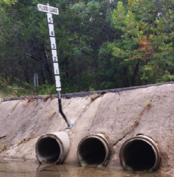
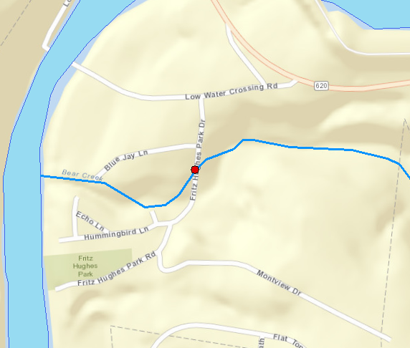
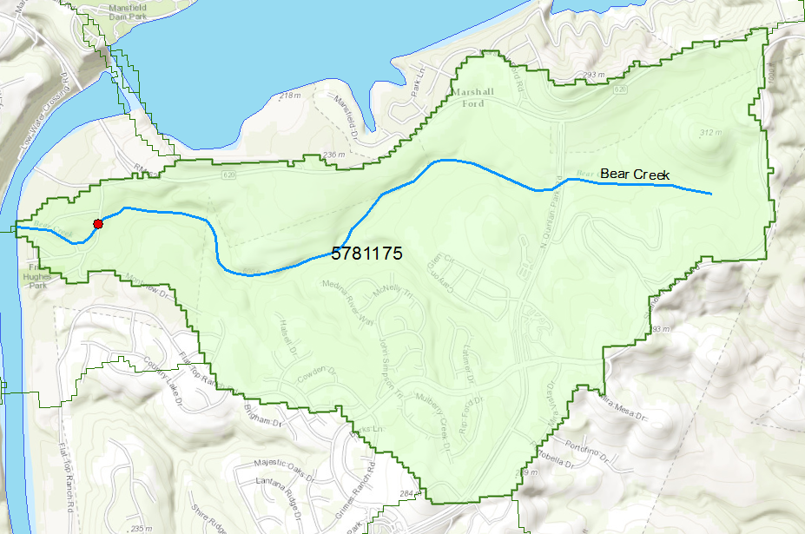

An Example
Better national flood information can have a local impact
An isolated community with only
one access road
A low water crossing that
floods readily
Creek
Road
End of Road
NHDPlus Catchment 5781175
“I appreciate anything that can be done to prevent another tragedy”
… Rhoda Mae Kerr, Chief, Austin Fire Department
First Vice President, International Association of Fire Chiefs

Slide 19





NFIE: Organizational Structure
Federal Sector
(Organized through IWRSS)
Academia
(Organized through CUAHSI)
Industry
(Organized through academic partners)
Proposed Activities:
Establish and support key data services (e.g. local channel inflow, precipitation, streamflow)
Provide subject matter experts on hydrology, hydrologic forecasting, and water resources management
Modernize infrastructure to demonstrate support of community standards
Proposed Activities:
Webinar series to build knowledge base
Recruit and coordinate the faculty and students for the Summer Institute
Case study for existing research projects
New innovations
Proposed Activities:
Expand existing GIS services
Develop new GIS tools supporting the community of practice and providing value added services to customer base

Slide 20
NFIE: Timeline
Summer Institute Capstone
Fall NFIE Meeting
Flash Flood Summit at the NWC
Spring NFIE Meeting
Summer Institute Kickoff
Hydro Domain Working Group
Summer Institute
Aug ‘14
Sep
Mid-Nov
Jan ’15
Mar
May
Jun
Aug ‘15
Summer Institute
Fall Semester
Spring Semester
NFIE
Assembly of Components
Synthesis
IWRSS Interoperability and Data Synchronization – Design Planning
Federal
Subcommittee on Spatial Water Data and Open Water Data Initiative

Slide 21
Contact
David Maidment, University of Texas at Austin
maidment@utexas.edu
Edward Clark, National Weather Service
Edward.clark@noaa.gov

