Slide 1
National Flood Interoperability Experiment for the Texas Emergency Response
David R. Maidment and Harry R. Evans
Center for Research in Water Resources
University of Texas at Austin
Texas Division of Emergency Management
Austin, TX| 30 October 2015
Acknowledgements: Ed Clark, Fernando Salas, Marcelo Somos Valenzuela, Andy Ernest
ESRI, Kisters, Microsoft Research

Slide 2
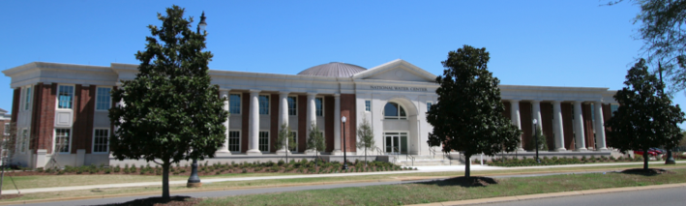
The Opportunity
New National Water Center established on the Tuscaloosa campus of University of Alabama by the National Weather Service and federal agency partners
Has a mission to assess hydrology in a new way at the continental scale for the United States

Slide 3
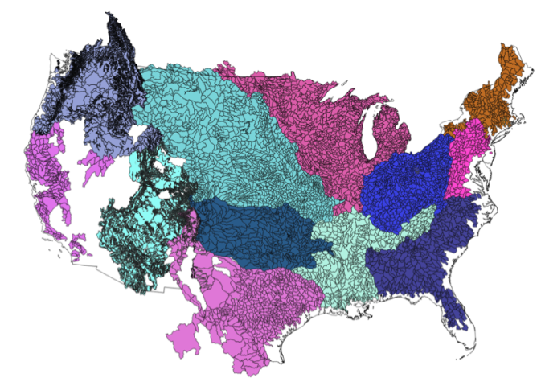
NWS River Forecast Centers (RFCs)
Prepare river and flood forecasts using models based on average basin characteristics
Provide forecast guidance to Weather Forecast Offices (WFOs)
Issue daily stage and streamflow forecasts, rainfall and drought data and information, and flash flood guidance
Work with water managers and other Federal Agencies
6600 sub-basins in continental US
3
Notes:
RFC Summary

Slide 4
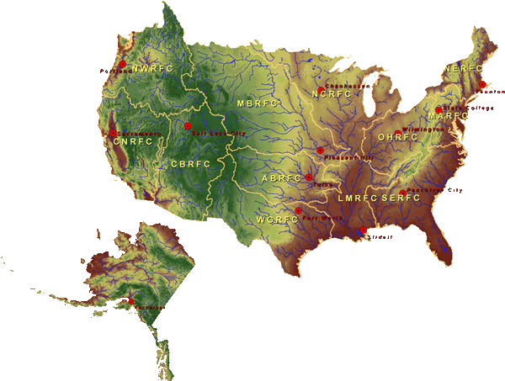
National Water Center
FY15 Centralized Water Forecasting
Centralized Data Archive – all RFC data
Modeling Evaluation Service
RFC and NWC modeling and forecasts
Modeling Testbed – new NWC capabilities
Centralized Water Forecasting Demonstration
Notes:
TRANSITION INTO METHODS
FY15 PROJECT HAS FOUR CORE COMPONENTS
RFC archive
Model evaluation service
Modeling testbed
Centralized modeling demonstration

Slide 5
Goal of the Experiment
Close the gap between National Flood Forecasting and Local Emergency Response
Demonstrate forecasting of flood impacts at “stream and street level”
National
Weather and Hydrology
National Weather Service and federal agencies
National Water Center
River Flooding and Emergency Response
Local, State and Regional Agencies
Citizens
Local

Slide 6
NFIE Conceptual Framework
NFIE-Geo: National geospatial framework for hydrology
NFIE-Response: Wide area planning for flood emergency response
NFIE-Hydro: National high spatial resolution hydrologic forecasting
NFIE-River: River channel information and real-time flood inundation mapping
NFIE-Services: Web services for flood information

Slide 7
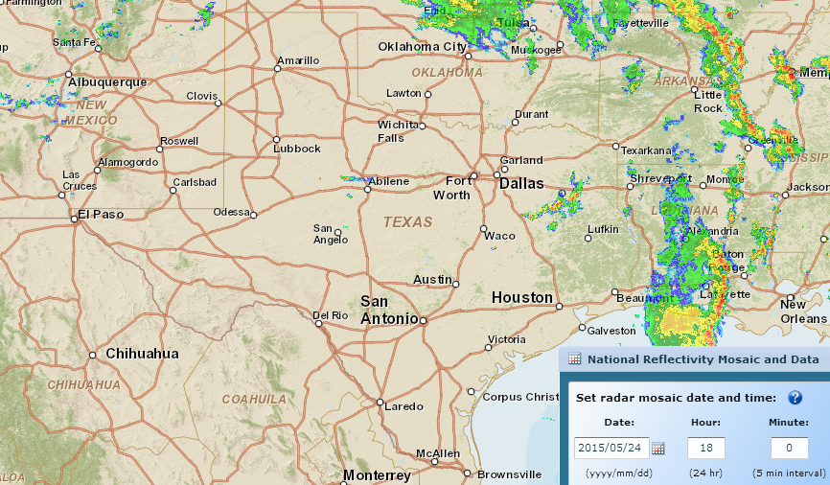
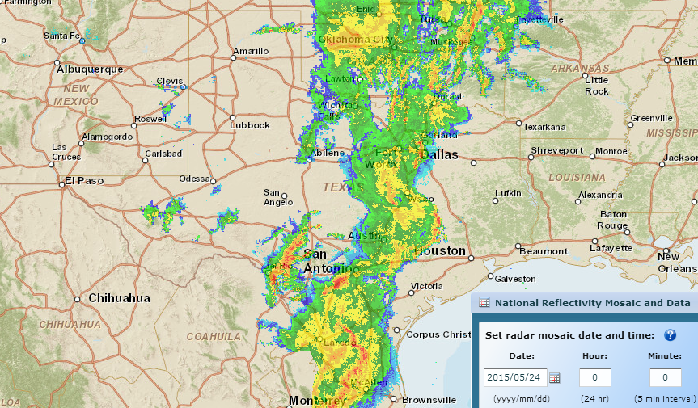
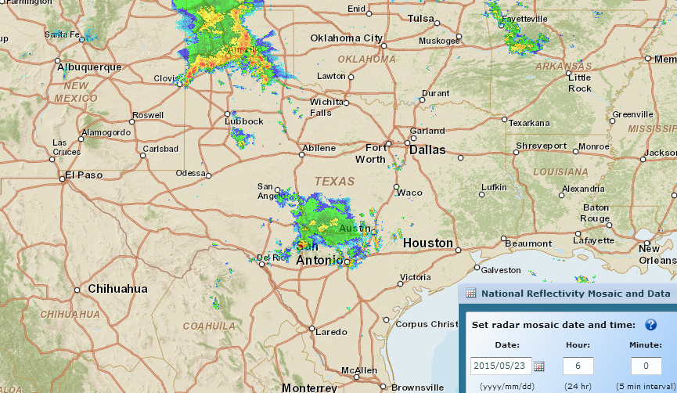
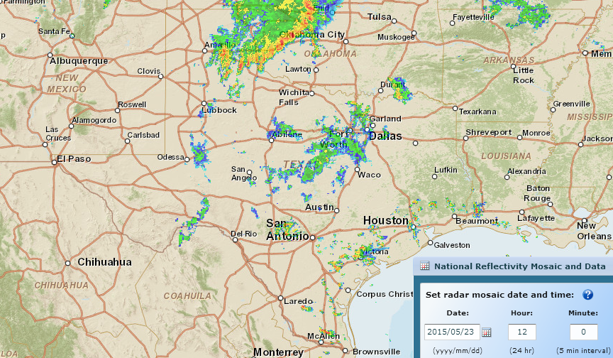
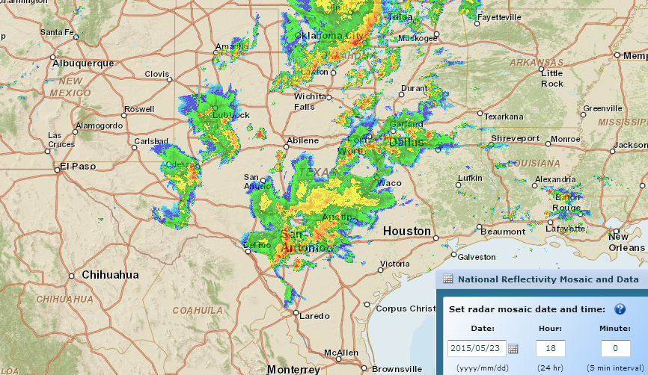
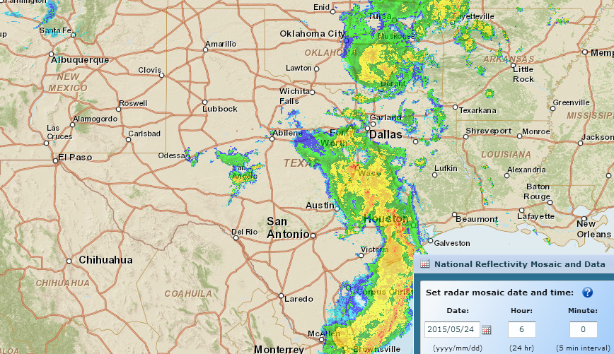
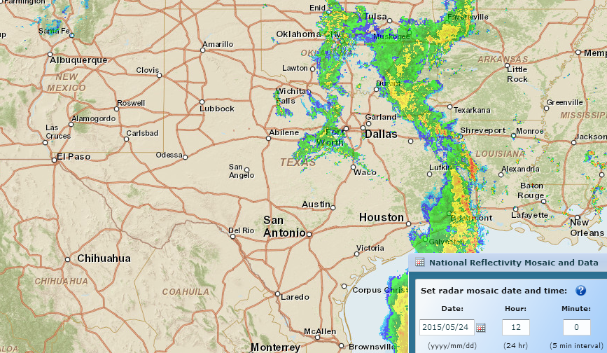
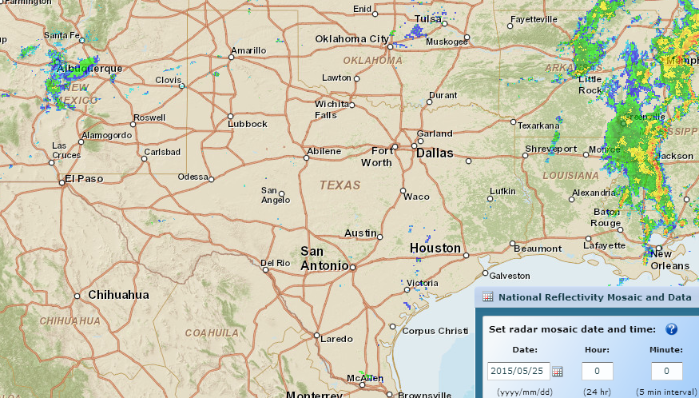
Storm Rainfall during Memorial Day Weekend
http://gis.ncdc.noaa.gov/map/viewer/#app=cdo&cfg=radar&theme=radar&display=nexrad
Where are the corresponding flood maps on the ground?
Sunday, May 24, Midnight
Sunday, May 24, 6 PM
Sunday, May 24, 6 AM
Saturday, May 23, 6 AM
Saturday, May 23, Midnight
Sunday, May 24, noon
Saturday, May 23, noon
Saturday, May 23, 6 PM

Slide 8
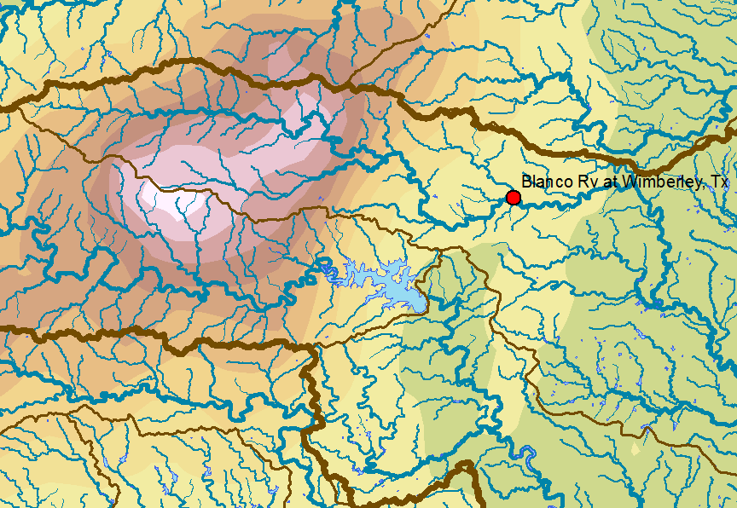
Memorial Day Weekend Precipitation
Total Precip.
(inches)

Slide 9
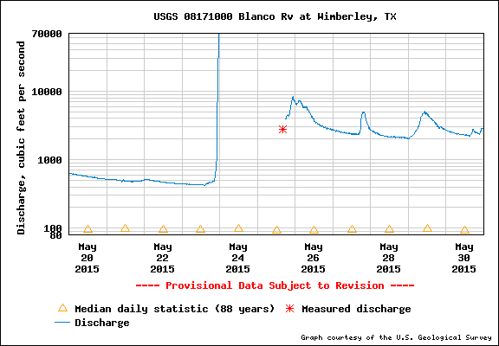
Flow in Blanco River at Wimberley
40 ft wall of water overwhelmed the gage

Slide 10
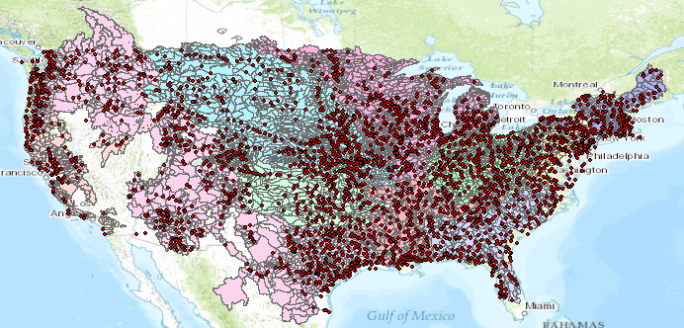
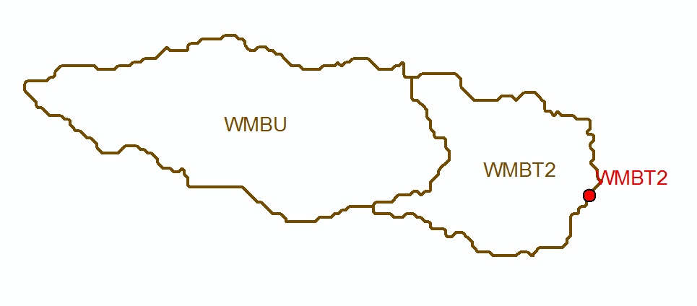
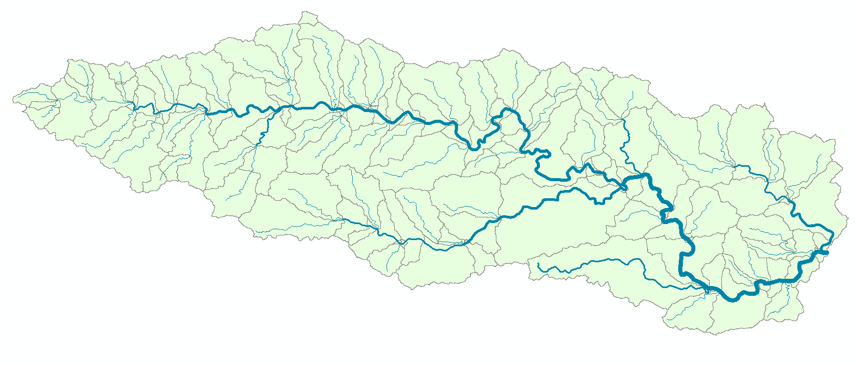
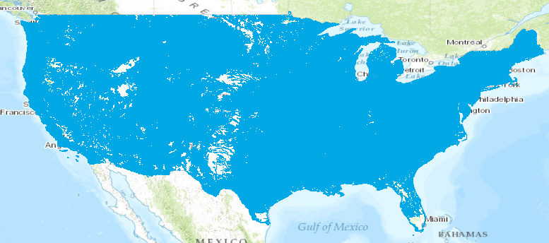
Current and New Forecast Systems
Blanco River at Wimberley
Current: 6600 basins and 3600 forecast points
Two basins and one forecast point
Basin ~ 400 Sq Mile
becomes
NFIE: 2.7 million stream reaches and catchments
Reach Catchment ~ 1 Sq Mile
130 Catchments and Flowlines
uniquely labelled
A national flow network

Slide 11
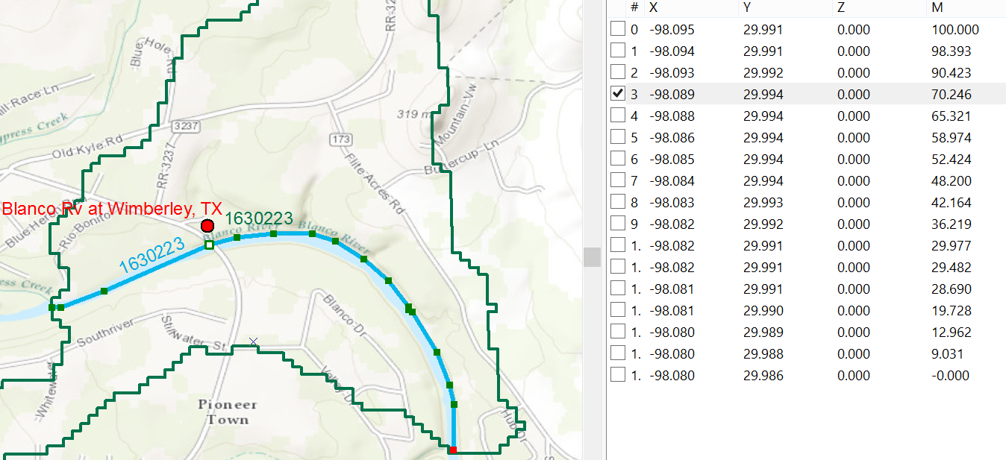
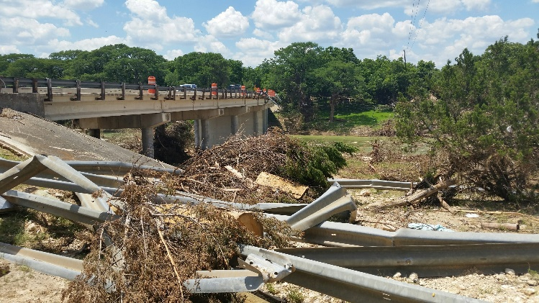
Linear Referencing on Flowlines
Using measures, the flow can be estimated at any point along the line
Bridge and Stream Gage at RR 12 is at Measure 70.246
on Flowline 1630223
Long.
Lat.
Measure
Measure is the % distance upstream from most downstream point on line

Slide 12
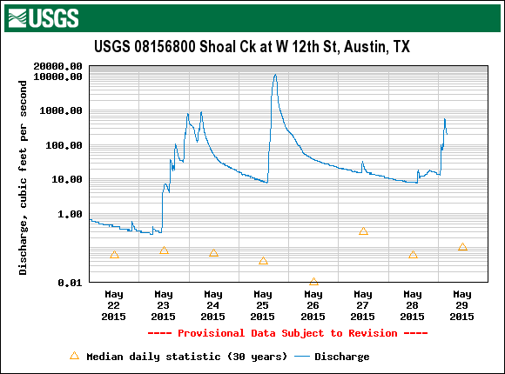
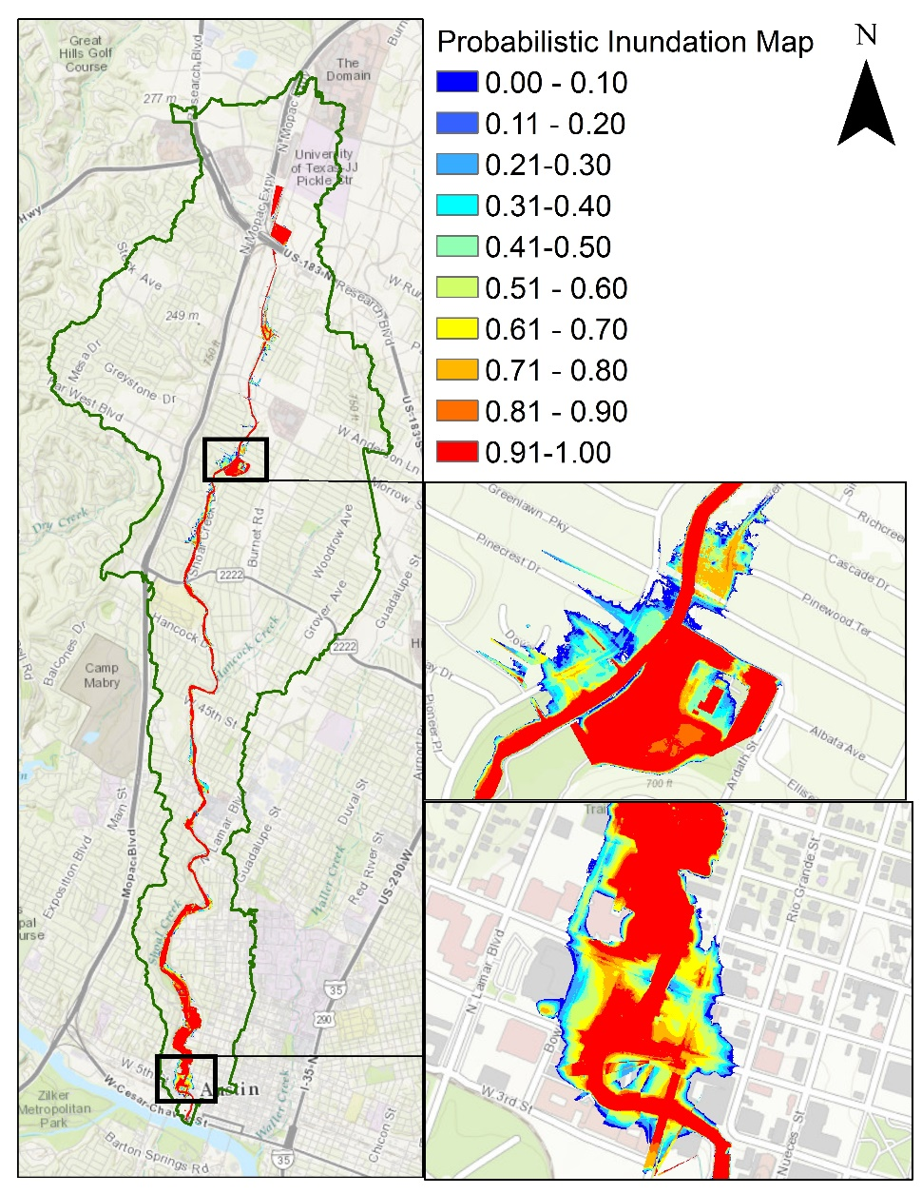
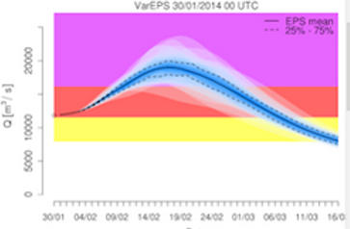
Probability of Flooding on Shoal Creek, Austin, TX
HEC-RAS model
Rating curves library
ECMWF-RAPID flow forecasts
Deterministic flood maps
Probabilistic flood maps
Ensemble of 50 flood forecasts

Slide 13
Progression of Memorial Day Flood

Slide 14
Multi-Year Strategic
Science and Services Plan
Total Water Prediction and National Water Center
FY 19-24
Major Integration
FY 18-23
Water Quality
Key Enhancement
FY 17-22
Dry Side: Drought and Post-Fire
Integrate enhanced NWM with key water quality data sets, models and tools to begin water quality prediction
Incorporate water quality data from federal and State partners into NWM
Link NWM output to NOAA ecological forecasting operations
New decision support services for predicting water quality issues such as Harmful Algal Blooms
New decision support services for emergencies such as chemical spills
NWC operations center expands to include water quality decision support services
Major Integration
FY 16-21
Coastal Total Water Level
Key Enhancement
Couple NWM with groundwater and transport models to predict low flows, drought and fire impacts
Add NWM processes that affect subsurface water movement and storage during dry conditions
Add NWM ability to track constituents (e.g. sediment, contaminants, nutrients) through stream network
New decision support services for water shortage situations and waterborne transport
NWC operations center expands to include drought and post-fire decision support services
FY 15-20
Flash Flood and Urban Hydrology
Core Capability
Couple NWM with marine models to predict combined storm surge, tide, and riverine effects
More complete picture of coastal storm impacts
Water prediction information linked to geospatial risk and vulnerability
New service delivery model implemented – increased stakeholder engagement and integrated information
NWC operations center opens and provides national decision support services and situational awareness
Centralized Water Forecasting
Enhance NWM with nested hyper- resolution zoom capability and urban hydrologic processes
Heightened focus on regions of interests (e.g. follow storms)
Street level flood inundation forecasts for selected urban demonstration areas
NWC increases guidance to NWS field offices to improve consistency and services for flash floods
National Water Model (NWM) operational May 2016
Water forecasts for 2.7 million stream reaches in U.S.
100 million people get a terrestrial water forecast for first time
National Water Center (NWC) begins providing daily situational awareness and guidance to NWS field offices
Slide Source: Dr Donald Cline, National Weather Service

Slide 15
Next Step: National Water Prediction Model Configurations
WRF-Hydro IOC Configurations – May 2016
Analysis & Assimilation
Short-Range
‘Flood Prediction’
Medium Range
‘Flow Prediction’
Long Range
‘Water Resources’
Cycling Frequency
Hourly
3-Hourly
Daily
~Daily (x16)
Forecast Duration
- 3 hrs
0-2 days
0-10 days
0-30 days
Spatial Discretization & Routing
1km/250m/NHDPlus Reach
1km/250m/NHDPlus Reach
1km/250m/NHDPlus Reach
1 km/catchment /NHDPlus Reach
Meteorological Forcing
MRMS blend/ HRRR-NAM bkgnd.
Downscaled HRRR /RAP/NAM blend
Short-range + Downscaled GFS
Downscaled & bias-corrected CFS

Slide 16
Improvements in Flood Response Planning
Federal
GIS database and flood discharge forecasts
for 2.67 million stream reaches in
continental US from National Water Center
Conversion to water level forecasts and
inundation maps for 102,000 reaches in Texas
using 10m terrain data. Address points for flood
emergency response planning in each reach
State
Flood impact on transportation system
Flood response planning for stream reaches
and critical infrastructure. Inundation mapping
using LIDAR terrain data, if available.
Local
Flood response portal for citizens (ATXFlood)
Automated flood warnings from cell-phone
towers to phones in flood risk zones
Citizen

Slide 17
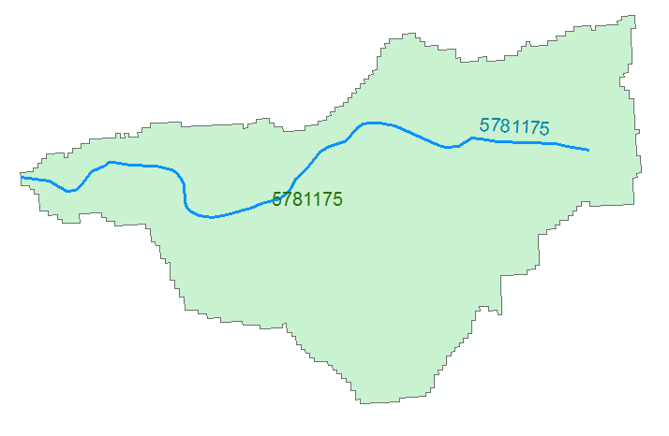
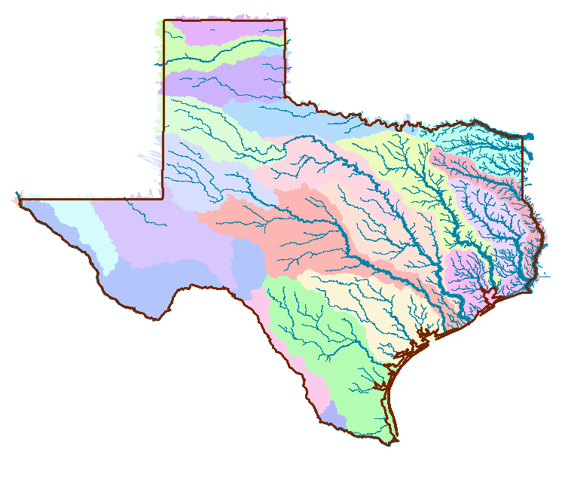
NFIE-Geo for Texas
NHDPlus reach catchment
Uniquely labeled across nation
102,000 NHDPlus reach catchments for Texas
Average area 7.1 km²
Average reach length 3 km

Slide 18
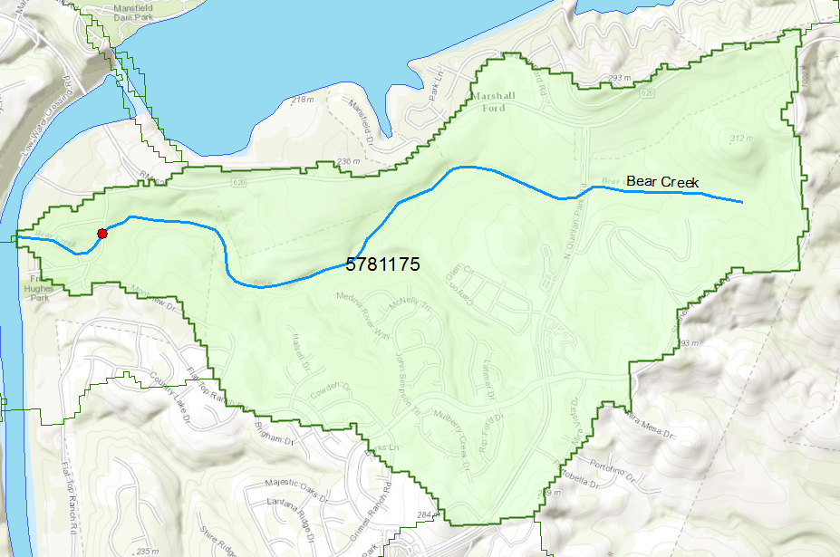
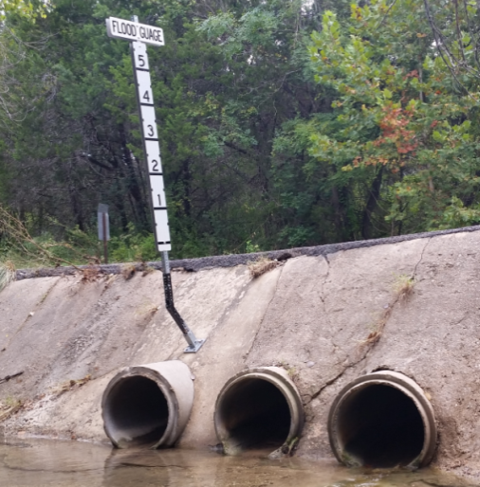
Flood Information for Fritz Hughes Park Rd
National Hydrography Dataset Plus
catchment for Bear Creek
(area = 5.71 km²)
Low water crossing at
3400 Fritz Hughes Park Rd

Slide 19
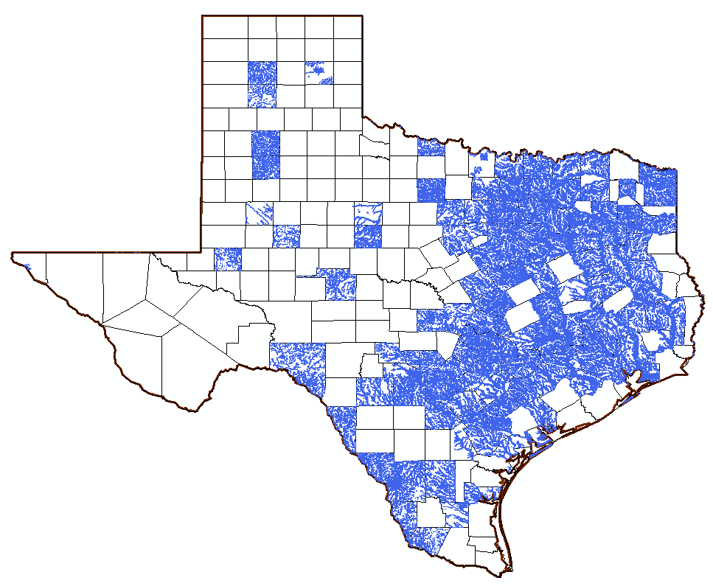
FEMA National Flood Hazard Layer in Texas (~ 120 counties)
Blanco County
Hidalgo County, Population 774,000
Cameron County Population 420,000

Slide 20
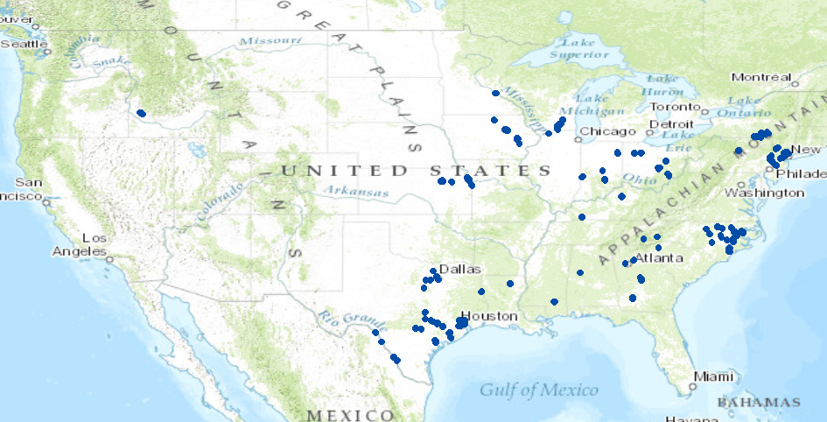
NWS Flood Inundation Maps for the US (130 in total)
33 maps in Texas (one quarter of total)

Slide 21
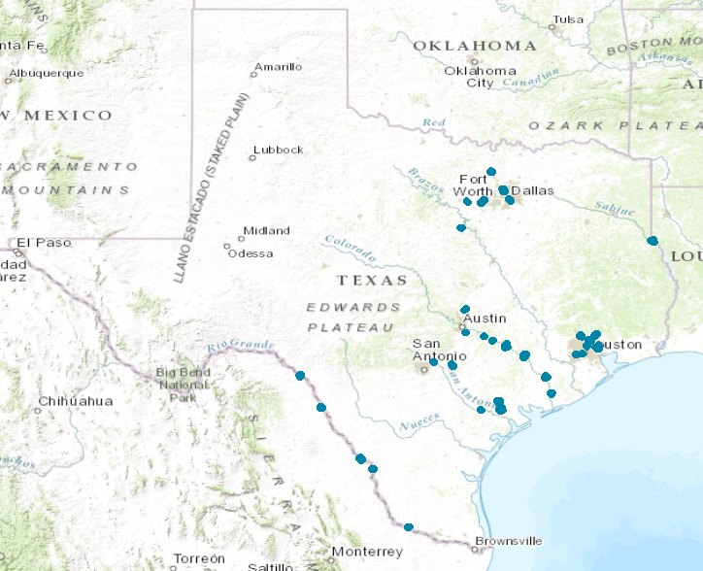
NWS Flood Inundation Maps in Texas
33 maps
12079 flood inundation extent polygons
1 ft or 0.5 ft intervals of elevation

Slide 22
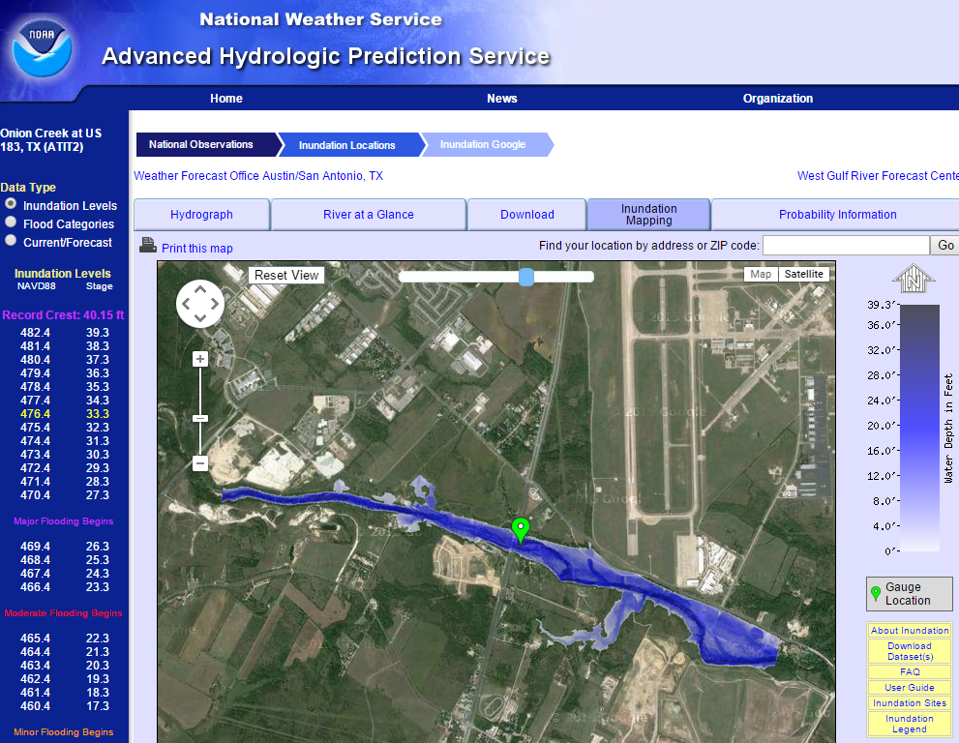
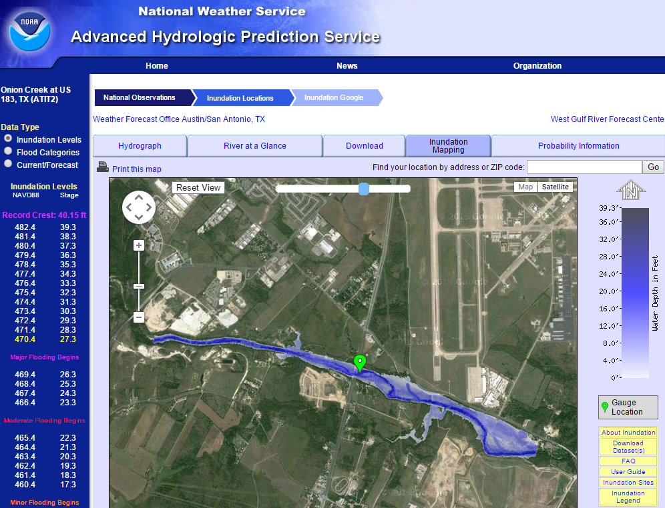
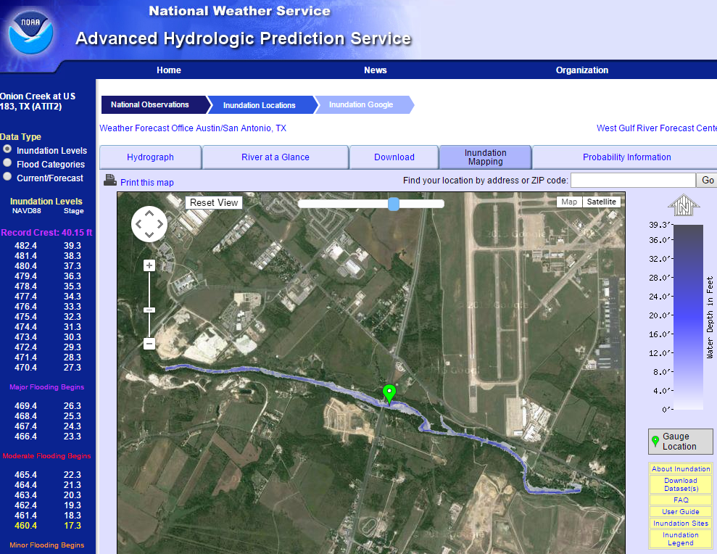
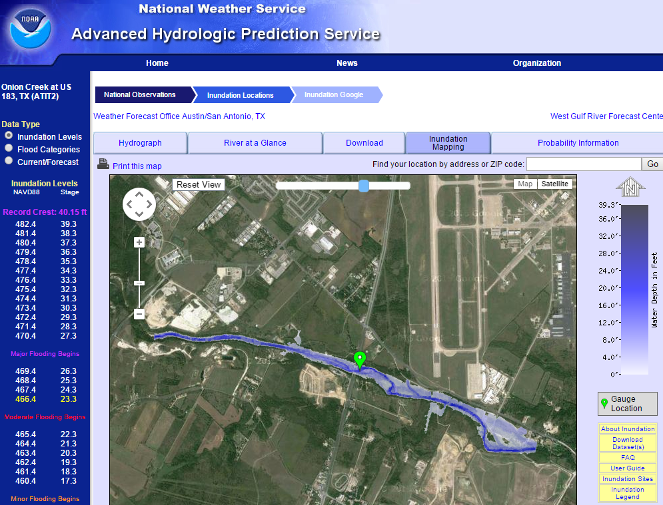
Real-Time Flood Inundation Mapping (NWS/AHPS)
http://water.weather.gov/ahps2/inundation/inundation_google.php?gage=atit2

Slide 23
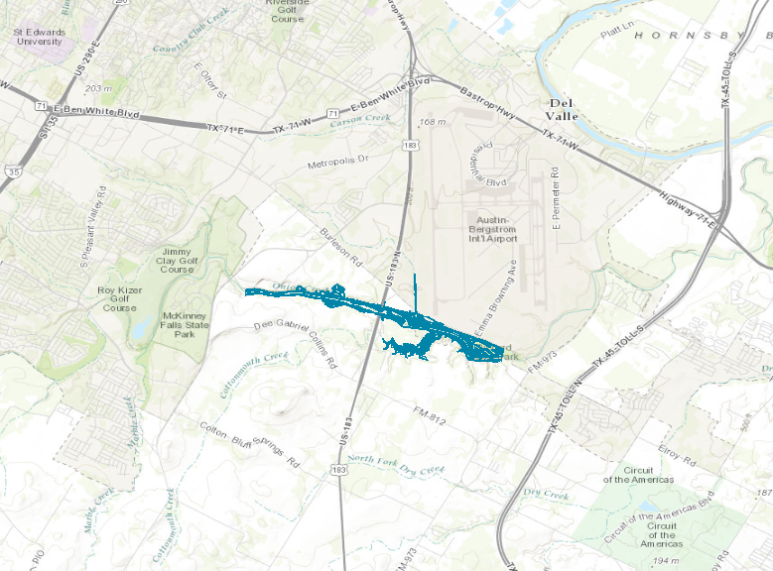
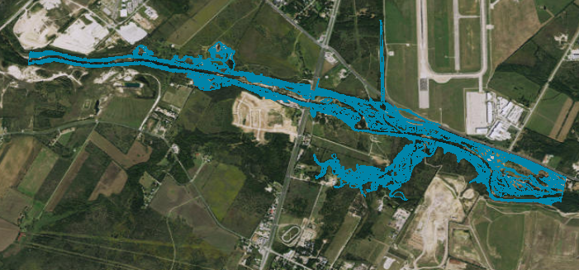
NWS Flood Inundation Map – Onion Creek at Highway 183 (ATIT2)

Slide 24
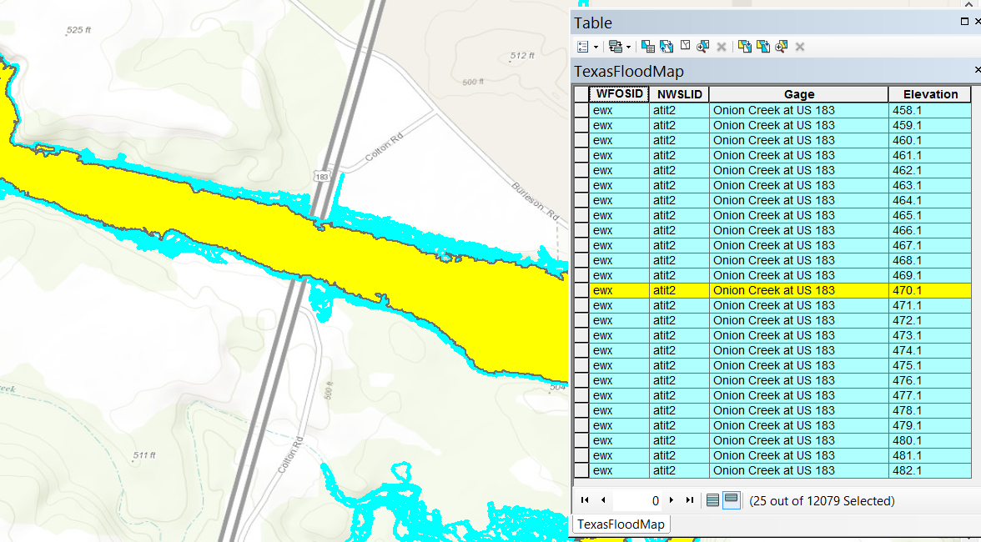
Flood Extent Map for each 1 ft of geodetic elevation (25 maps in all)

Slide 25
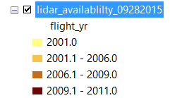
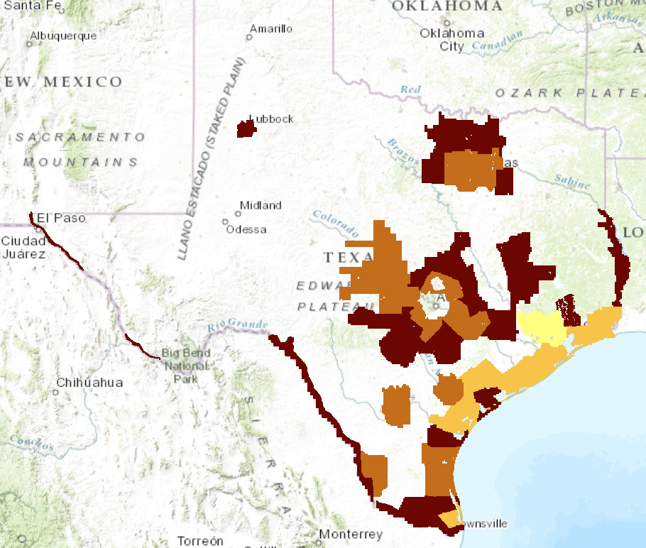
LIDAR Terrain Data Available from TNRIS

Slide 26
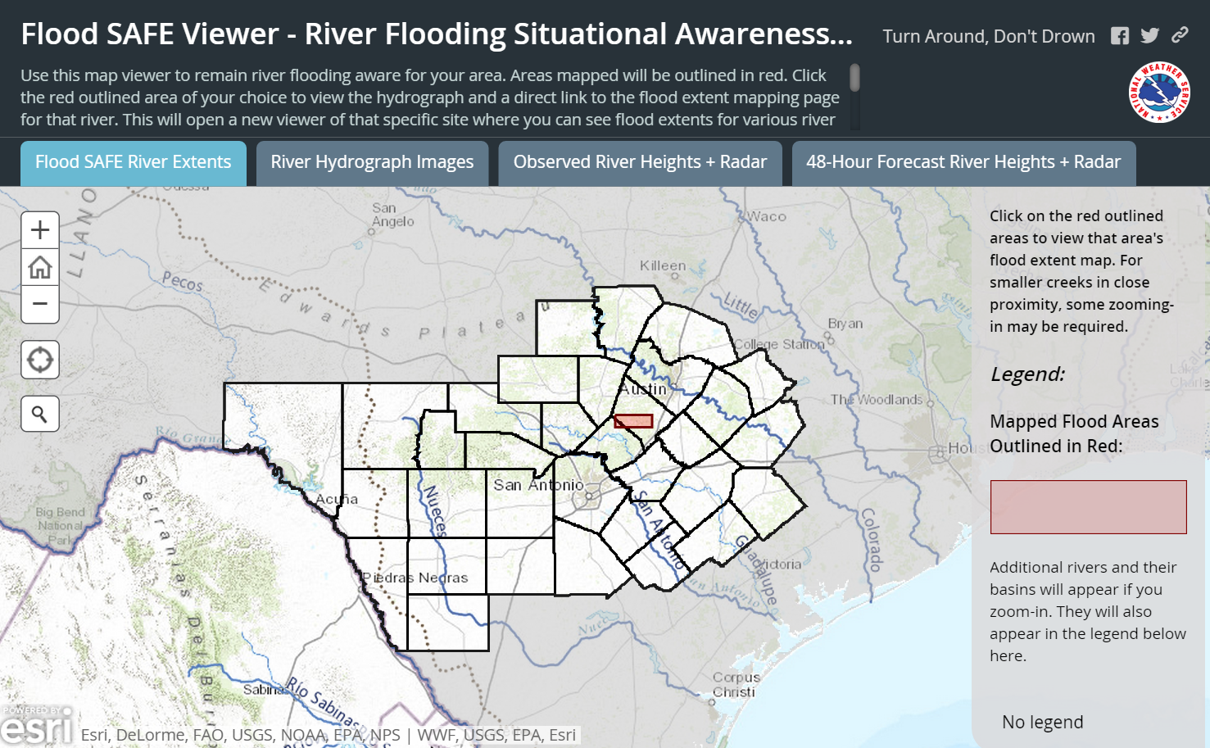
Situational Awareness For Everyone (SAFE)
Source: Jared Allen, NWS Austin-San Antonio Weather Forecast Office
Flood SAFE Viewer: http://arcg.is/1LPOHnE

Slide 27
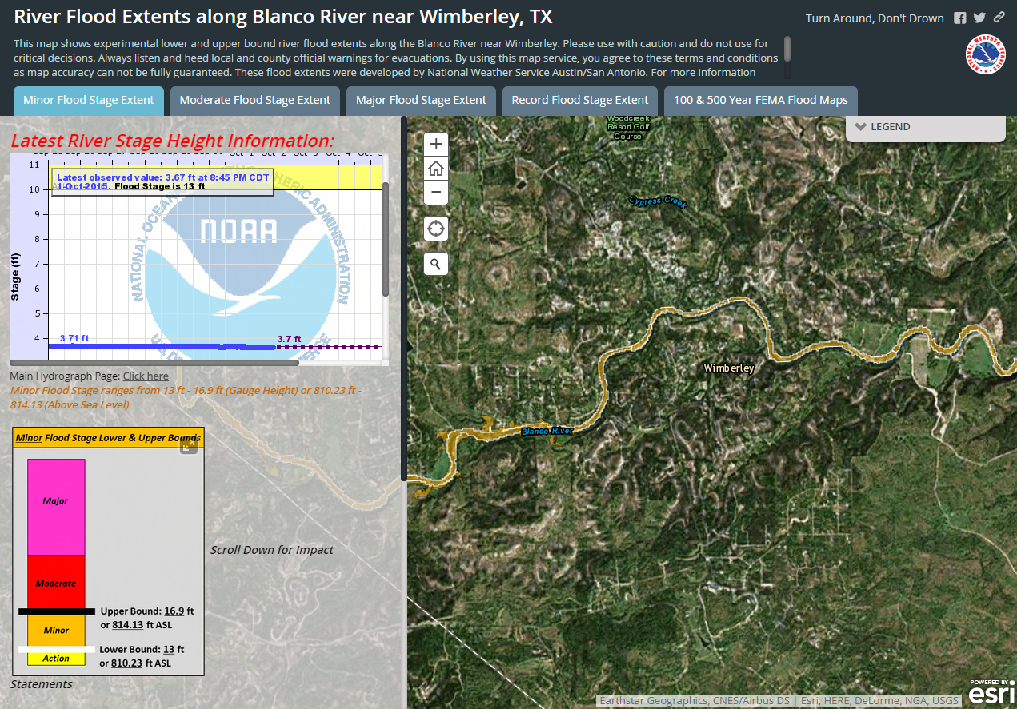
SAFE Map for Blanco River near Wimberley, Tx
Source: Jared Allen, NWS Austin-San Antonio Weather Forecast Office
Blanco River Proof-of-concept Map: http://arcg.is/1GtObu3

Slide 28
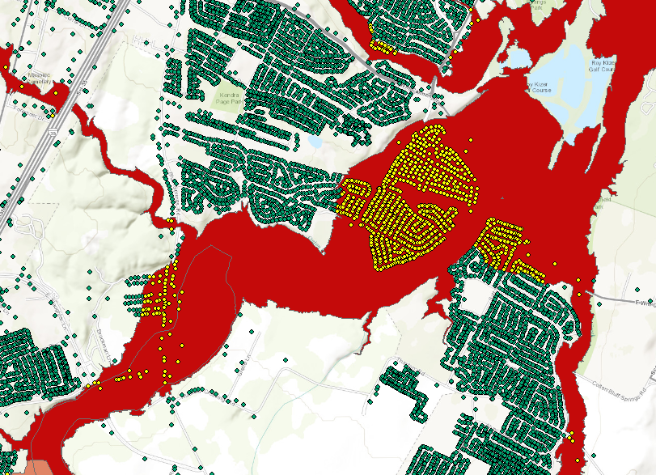
Address Points and the Floodplain

Slide 29
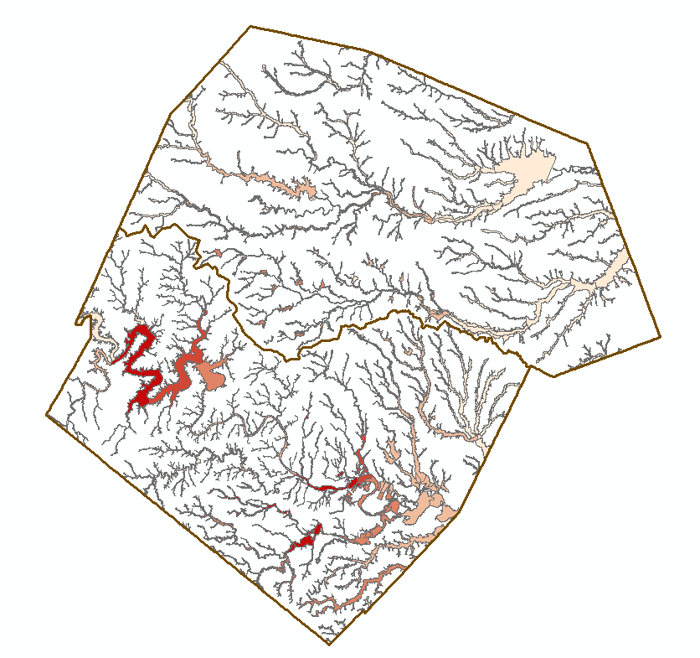
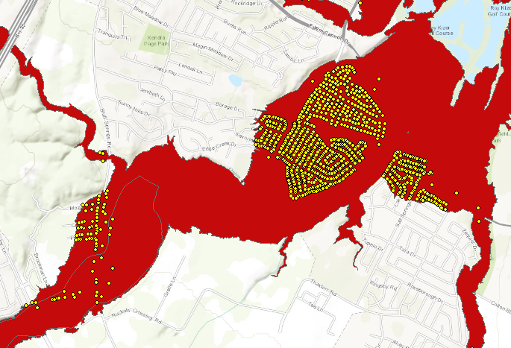
Address Points in the Floodplain
Address Points in Floodplain of Onion Creek
Floodpoints

Slide 30
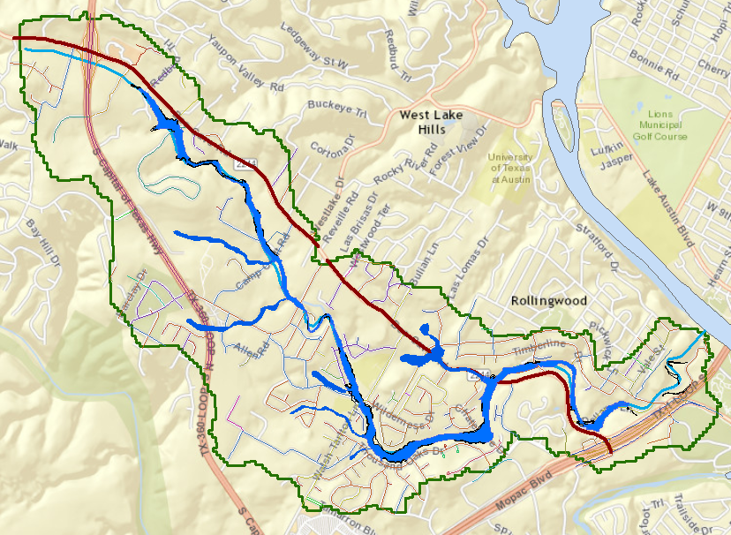
Dry Creek Transportation
Bee Cave Rd (FM 2244)
Identify streets with flood risk

Slide 31
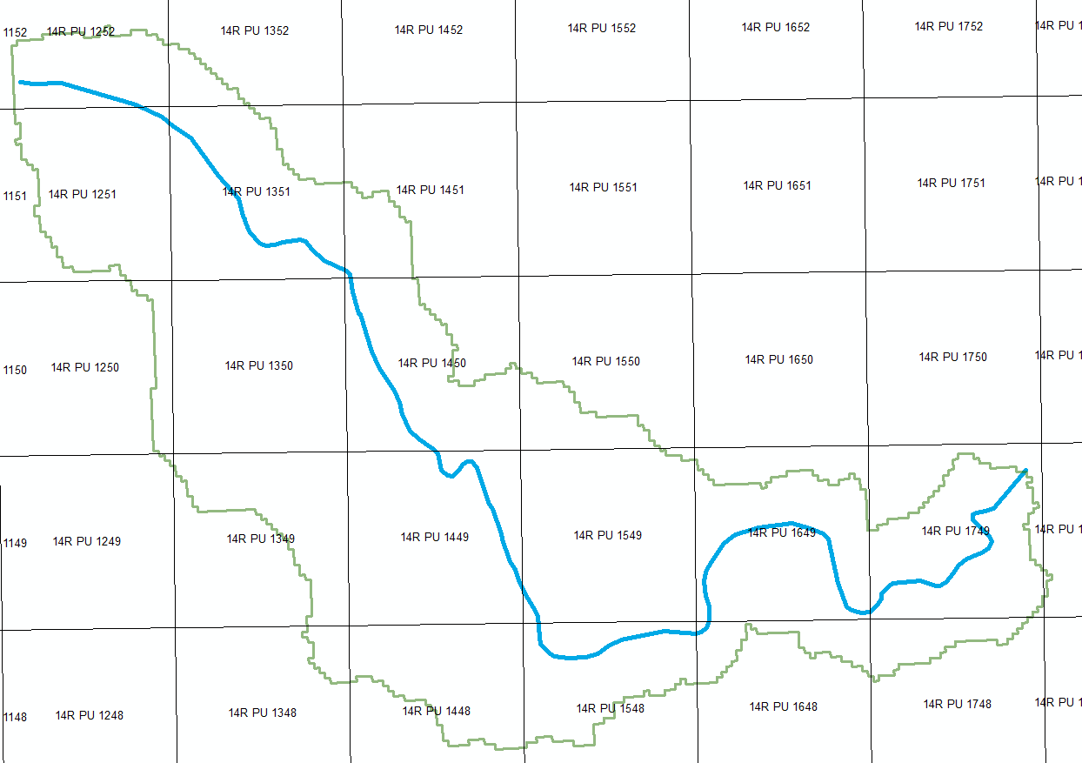
US National Grid Cells

Slide 32
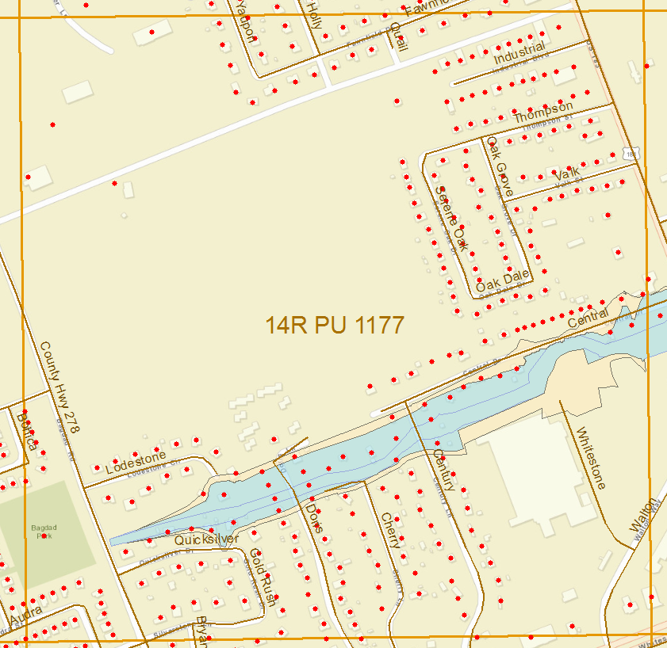
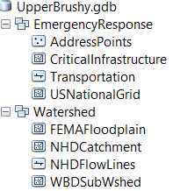
Address Points in a National Grid Cell

Slide 33
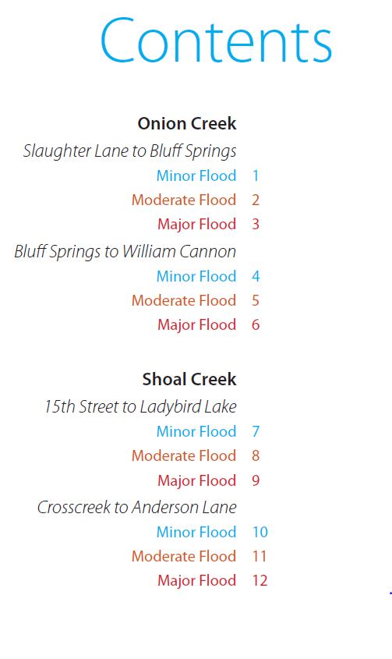
Community Flood Response Map Book
Source: Tomas Rodriguez, City of Austin

Slide 34
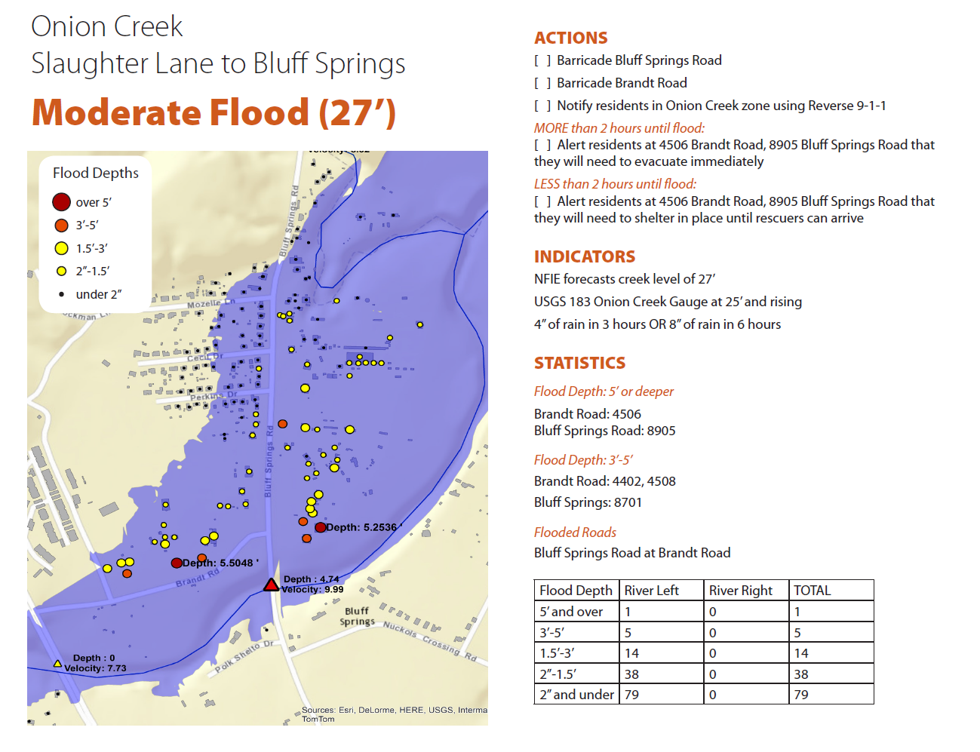

Slide 35
